Slide 1
Triassic Stratigraphy of the North Sea: A New Cross-border Chronostratigraphic Framework using Age Equivalent Units from the Tampen Spur Area, Norwegian North Sea
(Supplementary material)
Spyridon Saltapidas* Adrian Hartley, John Howell, Nick Schofield, Rachel Brackenridge, Douglas Watson
University of Aberdeen, Department of Geology and Geophysics, King’s College, AB24 3UE, UK

Slide 2
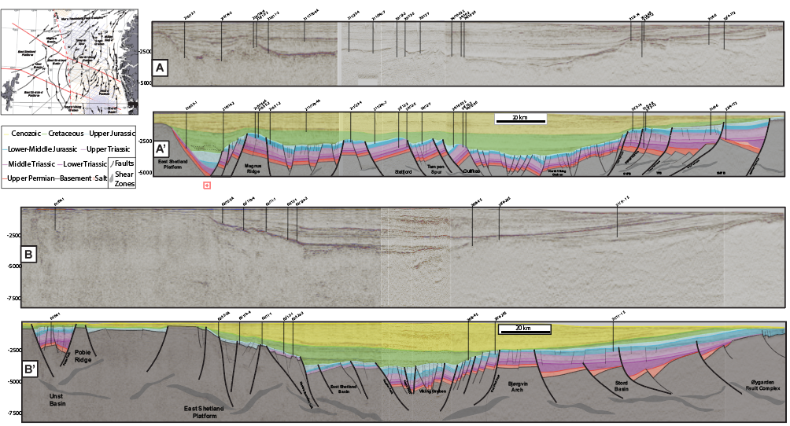
Triassic Basin overview

Slide 3
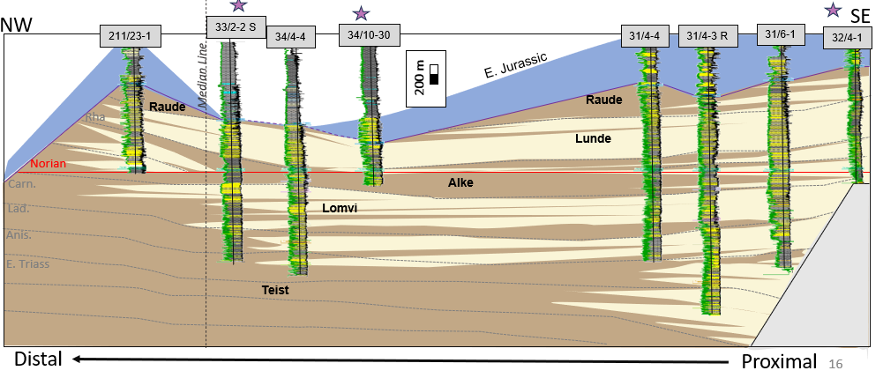
Depositional setting

Slide 4
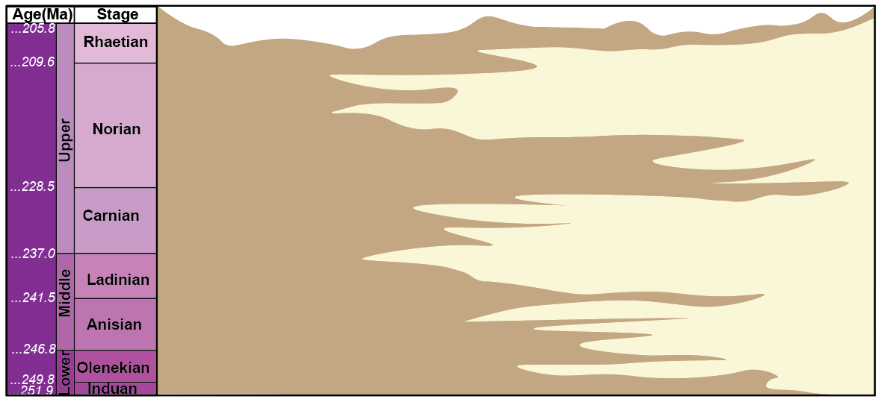
Wheeler Diagram
UK Sector
Norwegian Sector
Raude (Joshua)
Lunde (Josephine)
Alke (Jonathan)
Lomvi (Joanne)
Julius
Teist (Judy)
Smith Bank
Sediment route

