Slide 1
Vapor condensation in fractured porous media revealed by in-situ rapid neutron tomography and numerical modeling
Arash NEMATI,
Bratislav LUKIĆ, Alessandro TENGATTINI, Matthieu BRIFFAUT, Philippe SECHET
17/04/2024

Slide 3
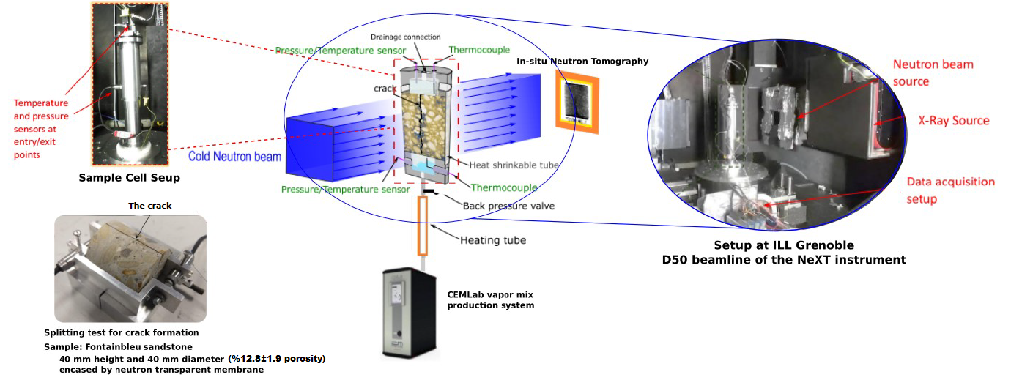
Experimental setup

Slide 4
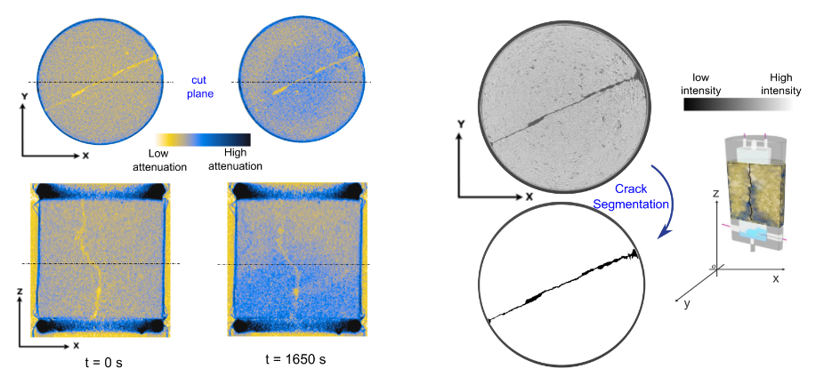
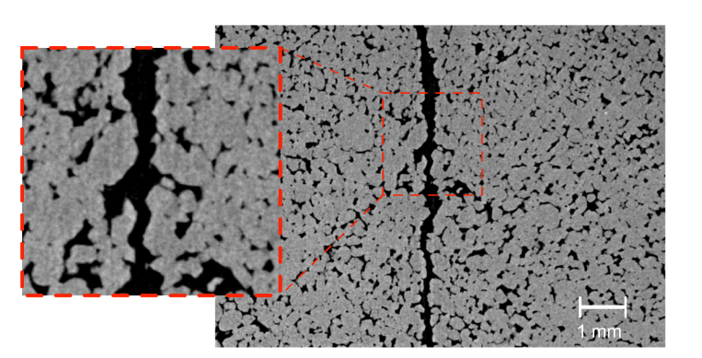
Imaging
Neutron Tomography
200 µm pixel size
Every 30-50 seconds
X-ray Tomography
30 µm pixel size
Before and after the injection
Synchrotron microtomography
6.5 µm pixel size
Before and after the injection

Slide 5
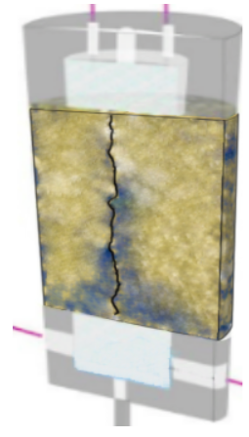
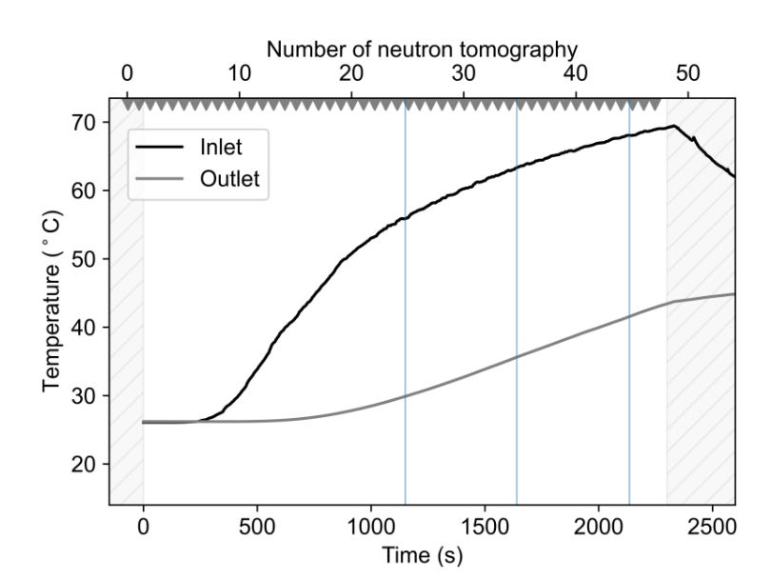
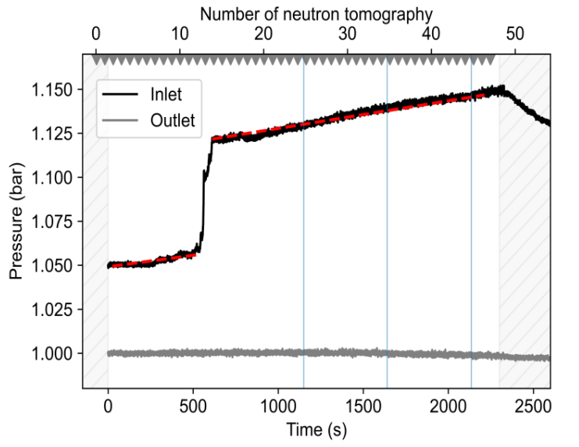
General trends
Outlet
Temperature and Pressure
No crack
With crack
Inlet Temperature
Inlet Pressure

Slide 6
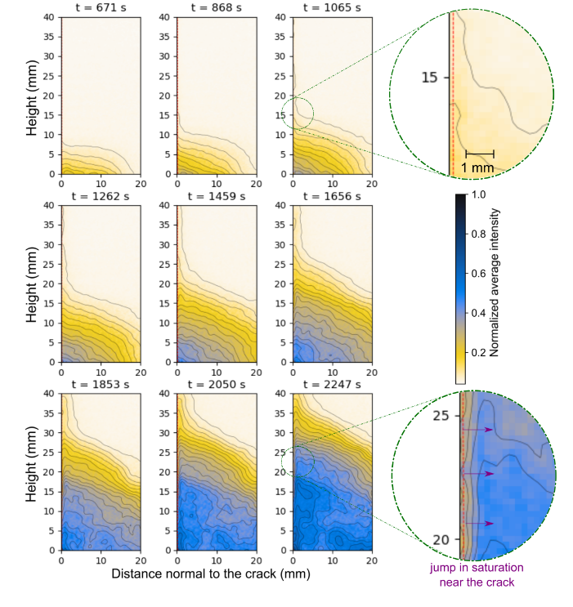
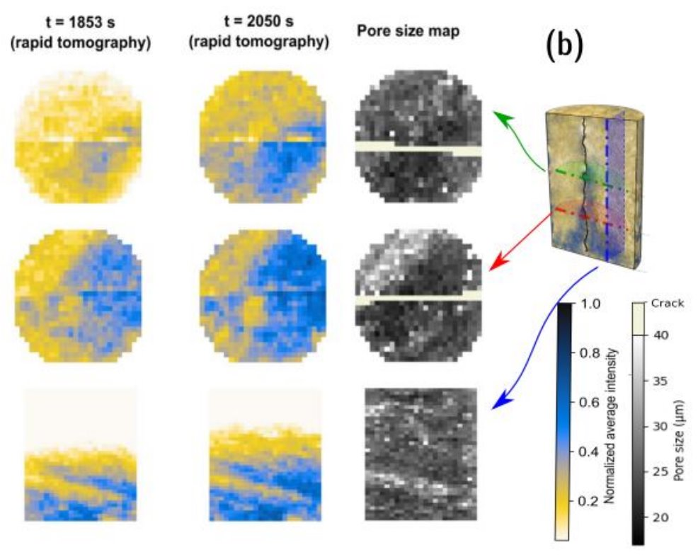
Crack vs Matrix
Crack thickness vs water content in the crack
Water content as a function of distance from the crack surface

Slide 7
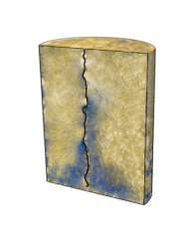
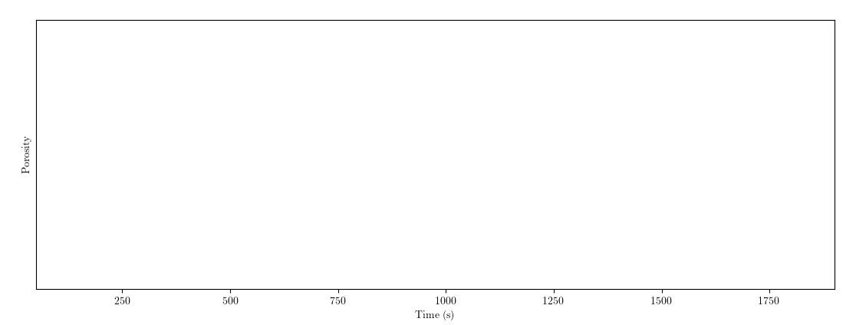
Effect of porosity

Slide 8
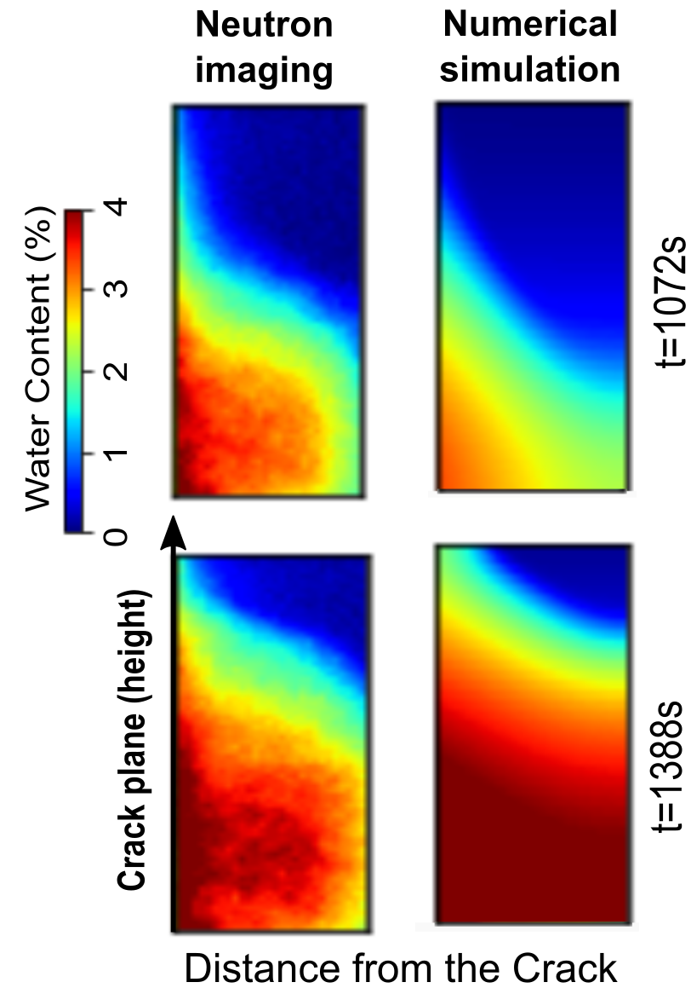
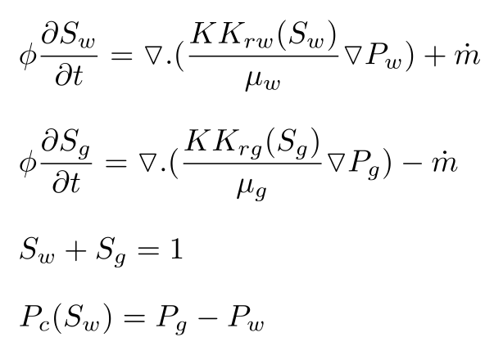
Numerical model
A numerical model, once calibrated and validated using experimental data, can offer valuable insights, considering the significant constraints inherent in experimental setups
The proposed model solves heat transfer coupled with two-phase flow equations and phase change mass transfer term.
Two-phase flow:
Heat and mass transfer:
A new solver is developed to solve these equations using the open-source solver of OpenFOAM in an iterative manner.
A numerical model, once calibrated and validated using experimental data, can offer valuable insights, considering the significant constraints inherent in experimental setups
The proposed model solves heat transfer coupled with two-phase flow equations and phase change mass transfer term.
Two-phase flow:
Heat and mass transfer:
A new solver is developed to solve these equations using the open-source solver of OpenFOAM in an iterative manner.
A numerical model, once calibrated and validated using experimental data, can offer valuable insights, considering the significant constraints inherent in experimental setups
The proposed model solves heat transfer coupled with two-phase flow equations and phase change mass transfer term.
Two-phase flow:
Heat and mass transfer:
A new solver is developed to solve these equations using the open-source solver of OpenFOAM in an iterative manner.
A numerical model, once calibrated and validated using experimental data, can offer valuable insights, considering the significant constraints inherent in experimental setups
The proposed model solves heat transfer coupled with two-phase flow equations and phase change mass transfer term.
Two-phase flow:
Heat and mass transfer:
A new solver is developed to solve these equations using the open-source solver of OpenFOAM in an iterative manner.

Slide 9
Thank you for your attention
Arash NEMATI,
arash.nemati@univ-grenoble-alpes.fr
----------------------------------------------------------------------------------------------------------------------------
Read more:
Nemati, A, et al. "Rapid In Situ Neutron Tomography and X-ray Imaging of Vapor Condensation in Fractured Sandstone." Transport in Porous Media 150.2 (2023): 327-357.
Nemati, Arash, et al. "Towards in-situ water quantification via neutron imaging: Insights from NeXT-Grenoble." Measurement Science and Technology (2024).

