Slide 1
Towards carbon dioxide imaging using Fabry-Pérot interferometer correlation spectroscopy
Moritz Sindram¹, Jonas Kuhn², Ralph Kleinschek¹, Christopher Fuchs³, Marvin Knapp¹, Benedikt Löw¹, Alexander Nies⁴, Tobias Schmitt¹, and André Butz¹
¹ Institute of Environmental Physics, Heidelberg University, Heidelberg, Germany (msindram@iup.uni-heidelberg.de) ² Department of Atmospheric and Oceanic Sciences, University of California, Los Angeles, CA, USA ³ Institute for Atmospheric and Climate Science, ETH Zurich, Zurich, Switzerland ⁴ Laboratoire de Physique et de Chimie de l`Environnement et de l`Espace, CNRS/University Orleans, Orleans, France

Slide 2
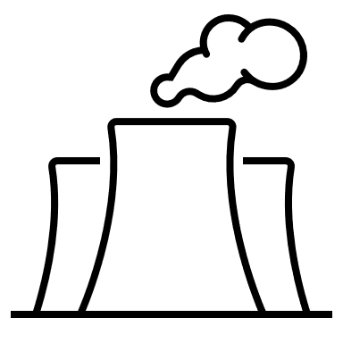
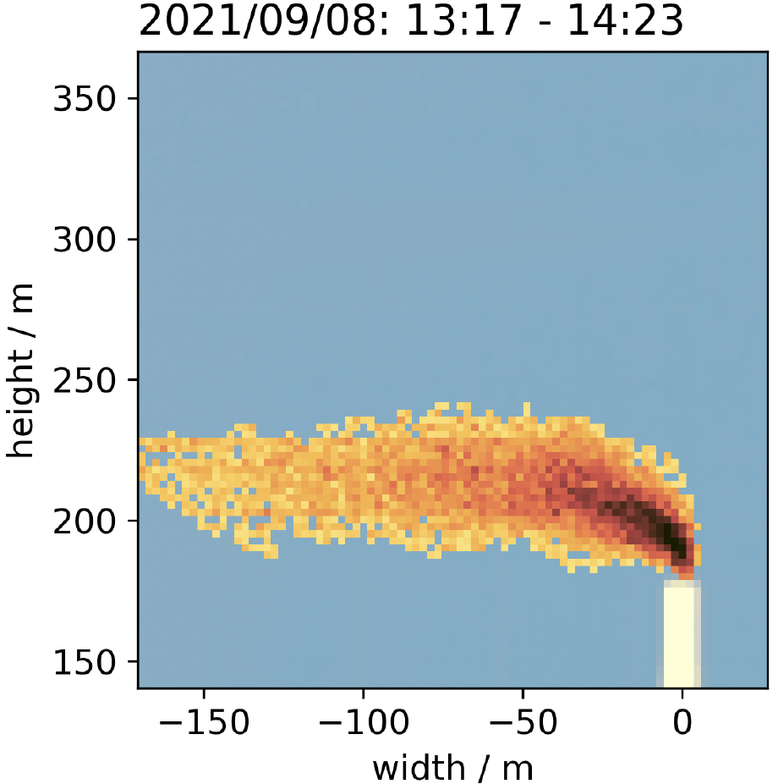
Ground-based carbon dioxide (CO₂) imaging
Close observational gap between in situ and satellite measurements
Imaging Fabry-Pérot interferometer (FPI) correlation spectroscopy was successfully applied to other trace gases (Fuchs et al., 2021; Nies et al., 2023).
Source attribution
Emission quantification
Emission quantification
Chemically passive tracer
SO₂ column density at Sabancaya (Peru)
CO₂ measurement at a power plant with a hyperspectral camera.
plume
plume
crater
stack
Knapp et al. (2023) [preprint]
SO₂
→ Potential improvement of instrument size and temporal resolution for CO₂ measurements.
msindram@iup.uni-heidelberg.de

Slide 3
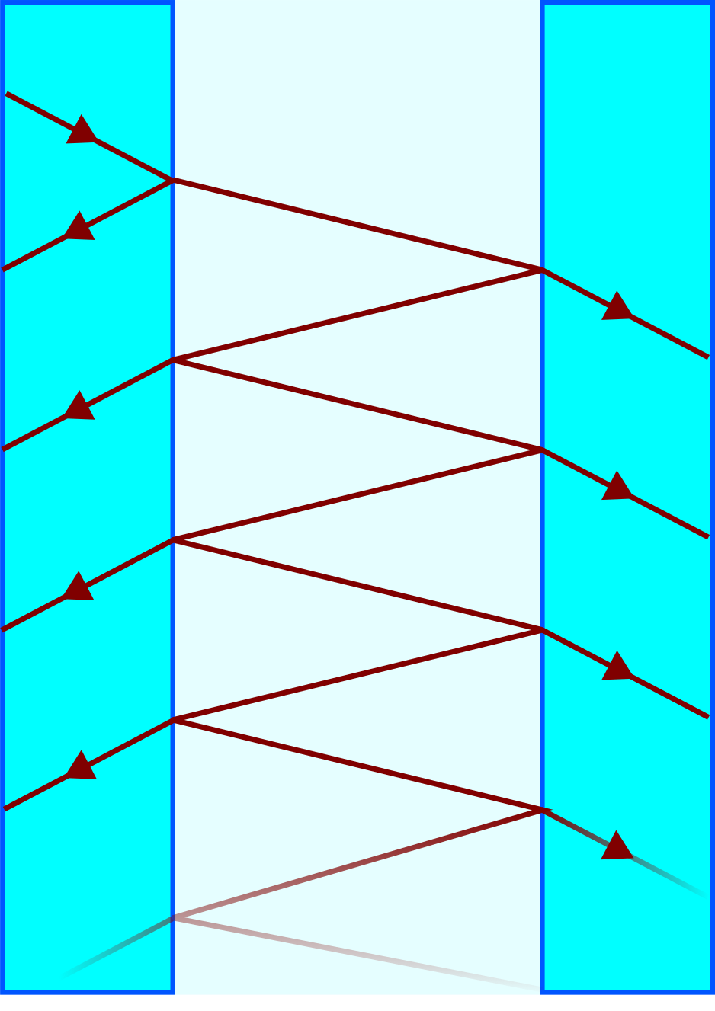
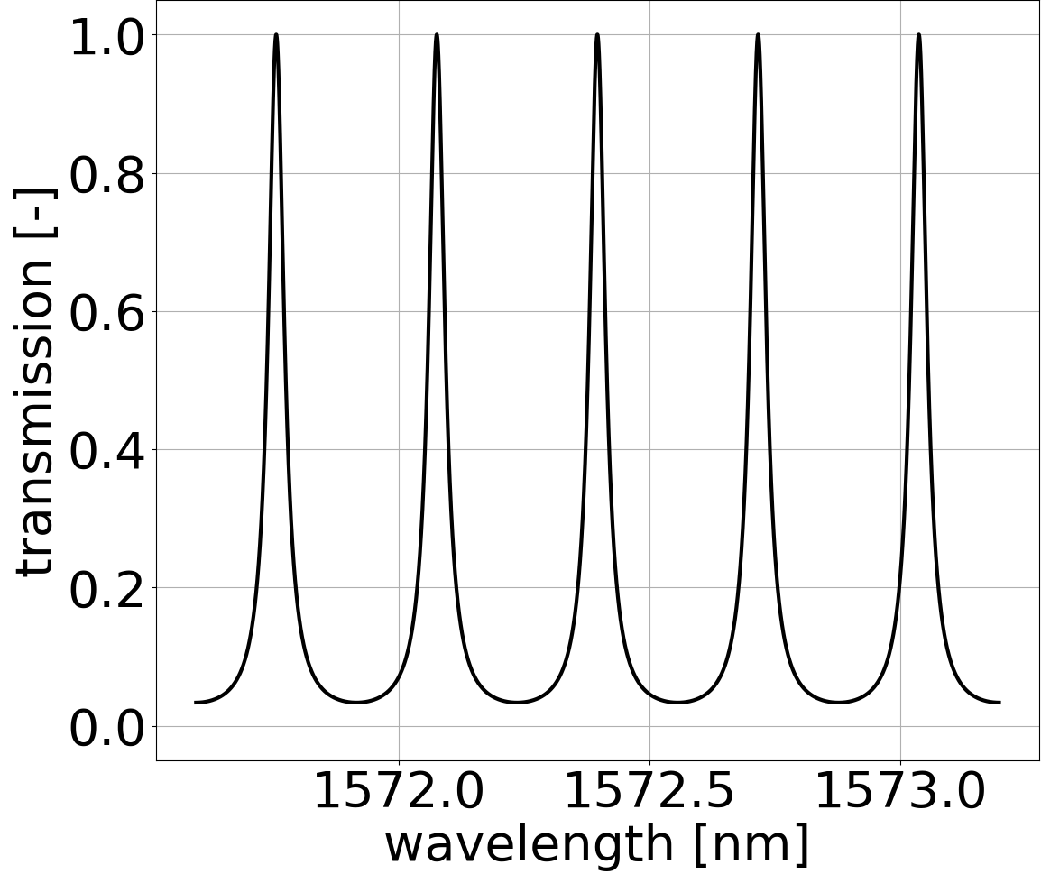
Fabry-Pérot interferometer (FPI)
FPI setup
Simulated transmission
Fittings for gas exchange
Separation spacers
Clear coated aperture
mirrors
Gas-filled
20 mm clear aperture
Matched to CO₂ absorption
Resolving power $≈$ 18,000
→ Periodic transmission maxima
msindram@iup.uni-heidelberg.de

Slide 4
Periodic CO₂ absorption at 1570nm
Atmospheric CO₂ transmission
msindram@iup.uni-heidelberg.de

Slide 5
Measurement principle
msindram@iup.uni-heidelberg.de

Slide 6
Measurement principle
→Match FPI transmission spectrum to CO₂ absorption at $1572nm$
msindram@iup.uni-heidelberg.de

Slide 7
CO₂ camera setup
Tuning Fabry-Pérot interferometer (FPI) in imaging setup → no spatial scanning required
msindram@iup.uni-heidelberg.de

Slide 8
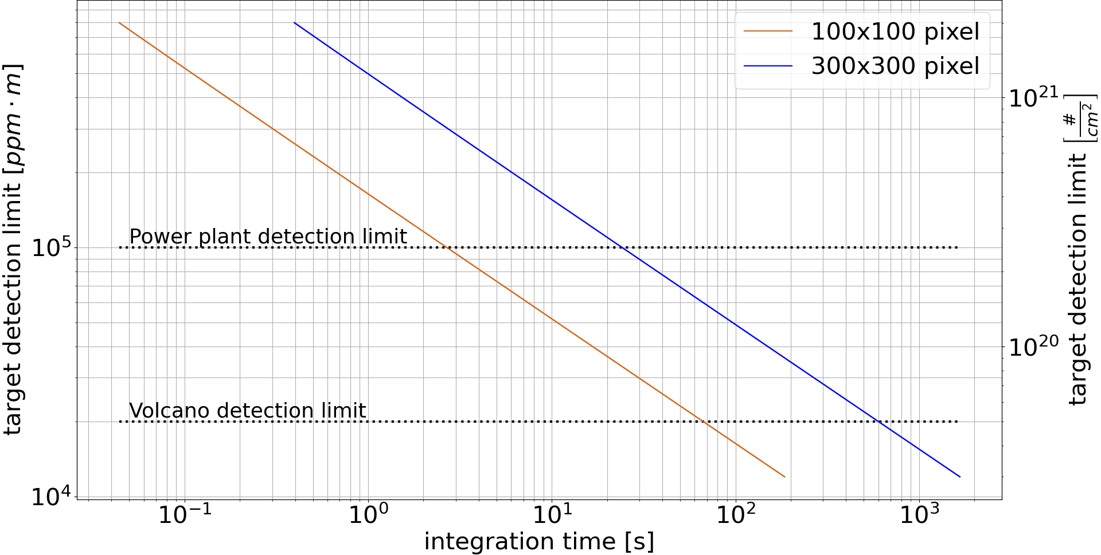
Performance simulation
Image of CO₂ emitted by power plant
→ Recorded with grating spectrometer → Integration time: 1h
25 s
10 min
plume
stack
→ Significantly faster than current instruments
Knapp et al. (2023) [preprint]
msindram@iup.uni-heidelberg.de

Slide 9
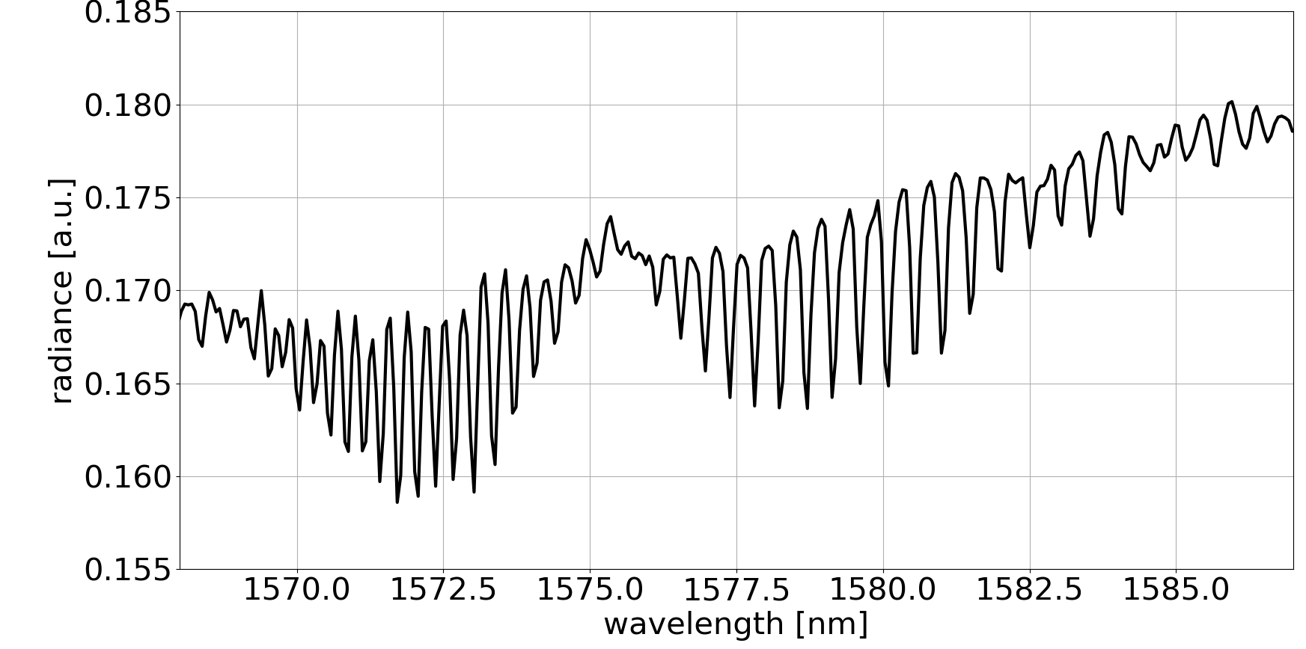
Prototype cuvette measurement
FPI ${CO}_{2}$ camera
${CO}_{2}$ filled cuvette
Light source
msindram@iup.uni-heidelberg.de

Slide 10
Prototype cuvette measurement
msindram@iup.uni-heidelberg.de

Slide 11
Towards Carbon Dioxide imaging using Fabry-Pérot interferometer correlation spectroscopy
Conclusion
Combination of high spectral resolution and imaging for CO₂ measurements
Simulations suggest significantly shorter integration times compared to existing instruments
Prototype proves CO₂ sensitivity
Outlook
Automate prototype
Proof-of-concept studies in the field
Contact
References
Moritz Sindram
msindram@iup.uni-heidelberg.de
Fuchs et al. (2021) https://doi.org/10.5194/amt-14-295-2021
Knapp et al. (2023) [preprint] https://doi.org/10.5194/egusphere-2023-1857
Nies et al. (2023) https://doi.org/10.3389/feart.2023.1063922
msindram@iup.uni-heidelberg.de

