Slide 1

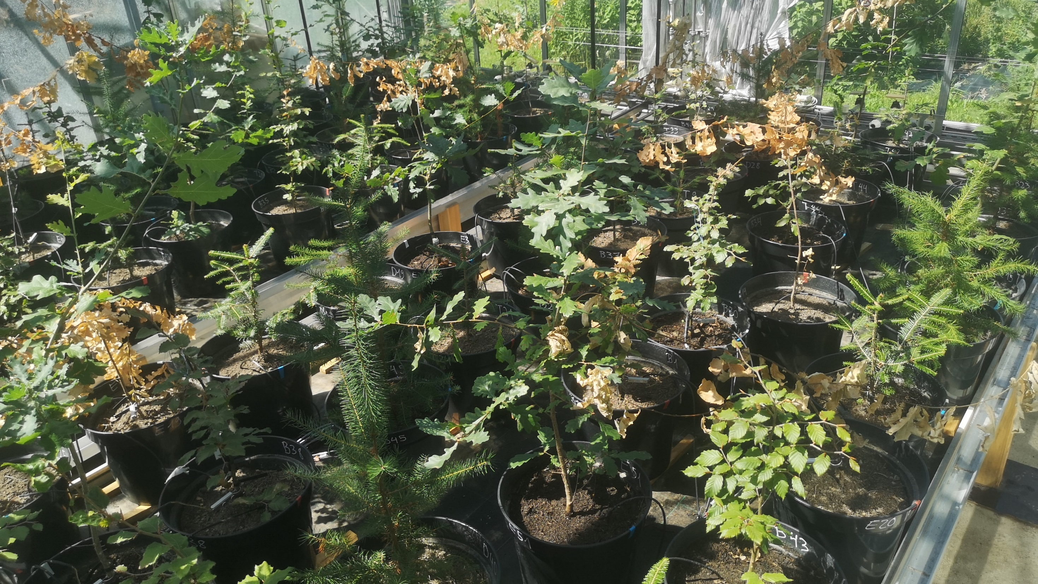




Optimizing Irrigation Strategies for Mitigating Drought Stress in Reforestation Areas:
Lessons from a Drought Stress Experiment
Leonie Hahn, Markus Schmidt, Carsten Lorz, Andreas Rothe,
Anja Rammig & Christian Zang
EGU24-5802 – 17th April 2024

Slide 2

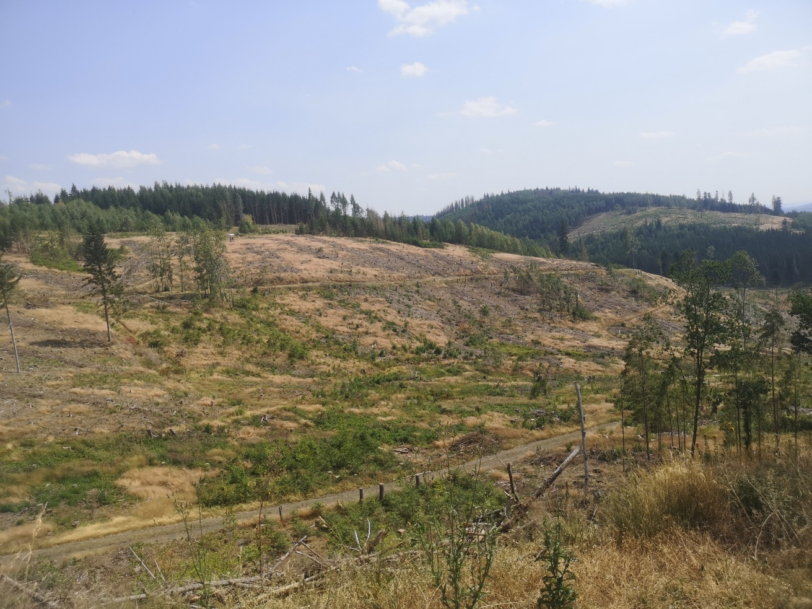


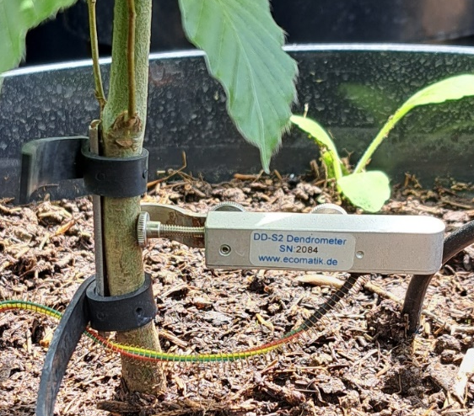
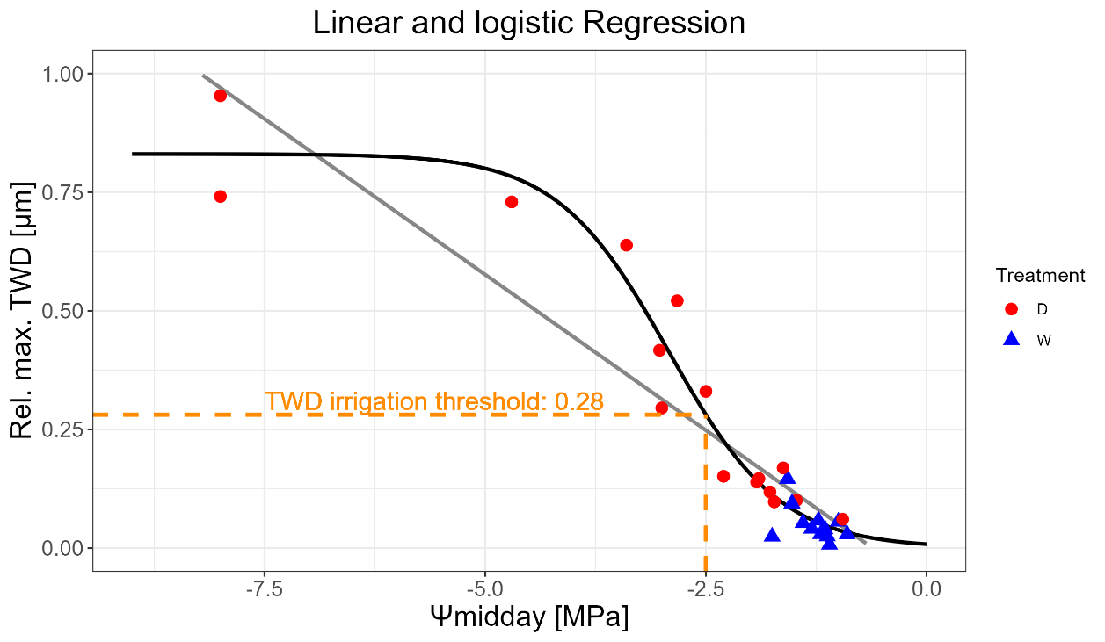
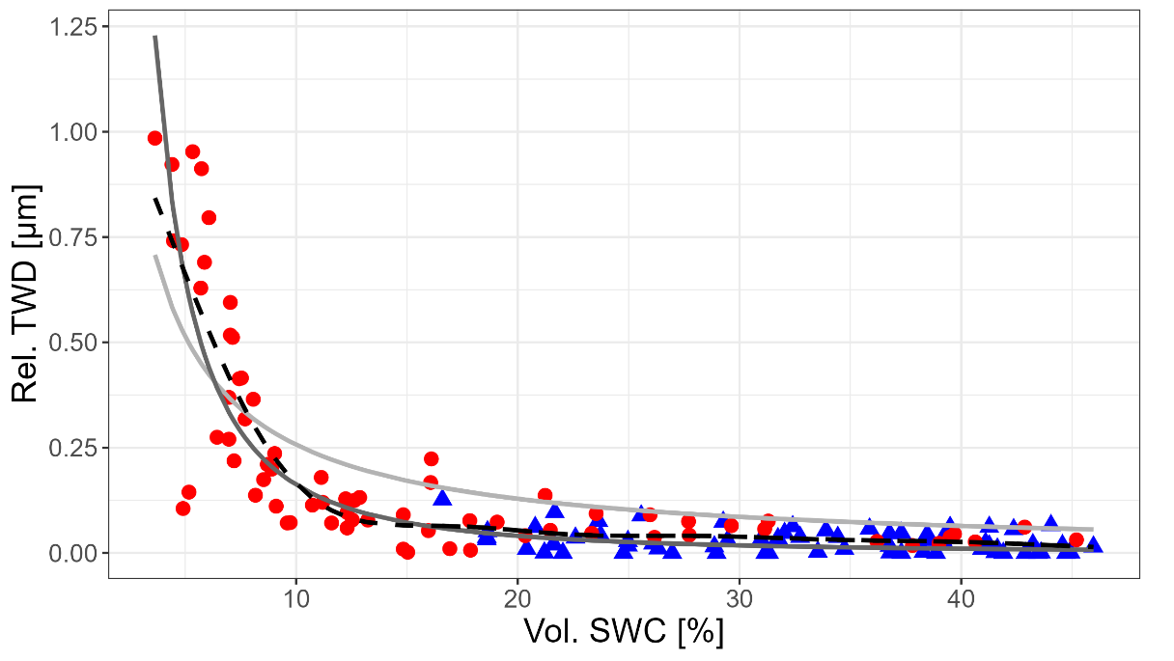
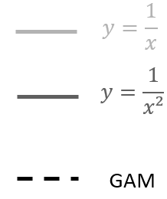
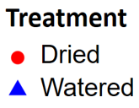
When do tree saplings need to be watered
to survive dry periods after planting?
Environmental
Measurements
Ecophysiological
Measurements
?
Determination of irrigation thresholds with logistic regression
Modeling irrigation thresholds
from environmental data
Logistic regression
Linear regression
Reduction of xylem conductivity by 10%

Slide 3
When do tree saplings need to be watered
to survive dry periods after planting?
Environmental
Measurements
Ecophysiological
Measurements
?
Determination of irrigation thresholds with logistic regression
Modeling irrigation thresholds
from environmental data
Logistic regression
Linear regression
Reduction of xylem conductivity by 10%

Slide 4
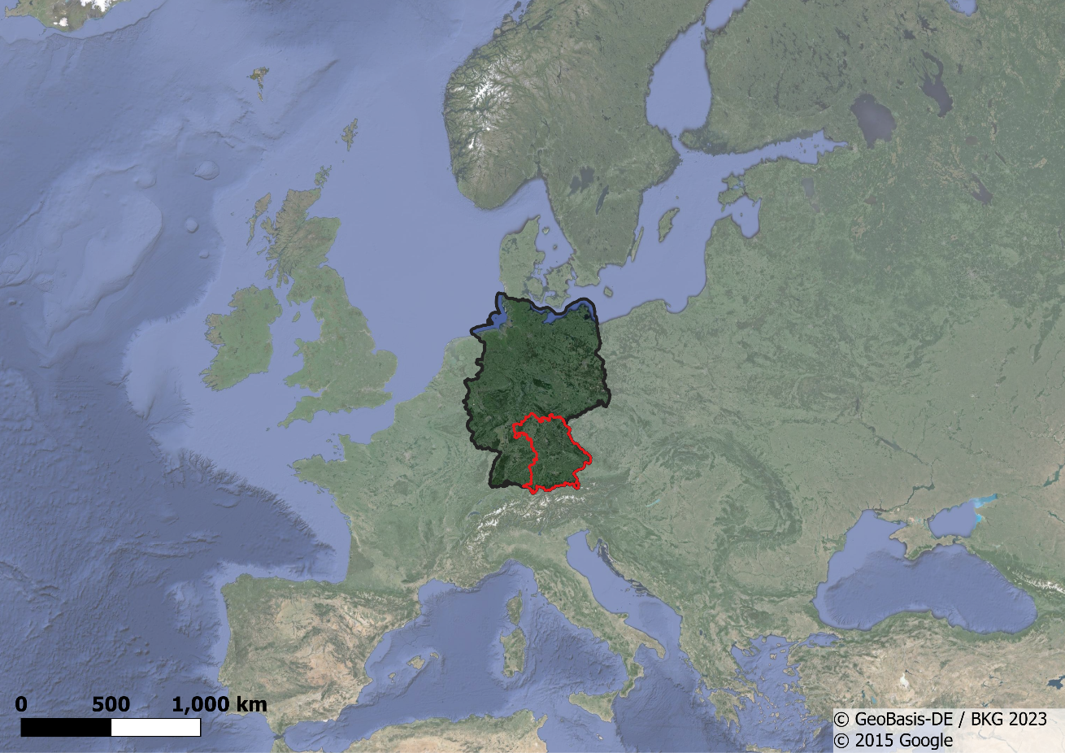
Background
Drought, bark beetle attacks and windthrow caused large damaged areas in Central Europe
Reforestation on calamity areas is proving difficult when drought persists, especially on unshaded and steep slopes
Irrigation included in the funding catalogue of the regional government of Bavaria (Germany) as a management measure due to the large failures in plantings in recent years

Slide 5


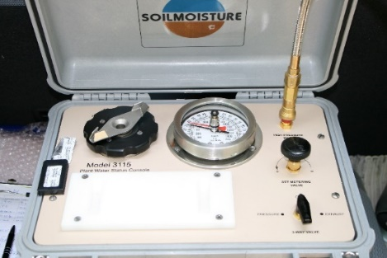

When do tree sapling need to be watered
to survive dry periods after planting?
Environmental measurements
Ecophysiological measurements
Rel. air humidity
?
Stem diameter changes
Air temperature
Photo: M. Schmidt
Plant water potential
Vol. soil water content

Slide 6

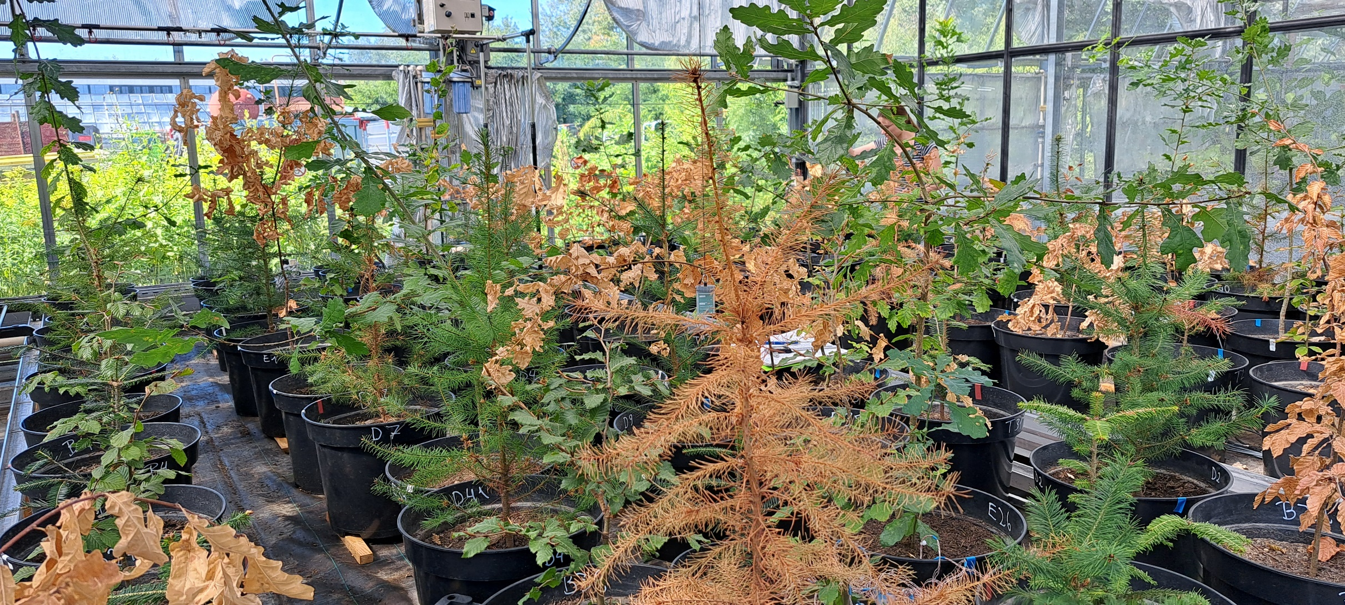
Experimental Setup
4 tree species:
Silver fir (Abies alba, 4 yrs.),
Douglas fir (Pseudotsuga menziesii „viridis“, 3 yrs.),
European beech (Fagus sylvatica, 2 yrs.),
Pedunculate oak (Quercus robur, 2-yrs.)
2 groups:
watered control (W) & dried (D),
arranged in alternating rows on 2 tables
10 trees per treatment & tree species
Schedule:
  Planting in the greenhouse: mid-March 2023
  Beginning of the drying out: end of June 2023
  End of experiment and tree harvest: mid-September 2023

Slide 7
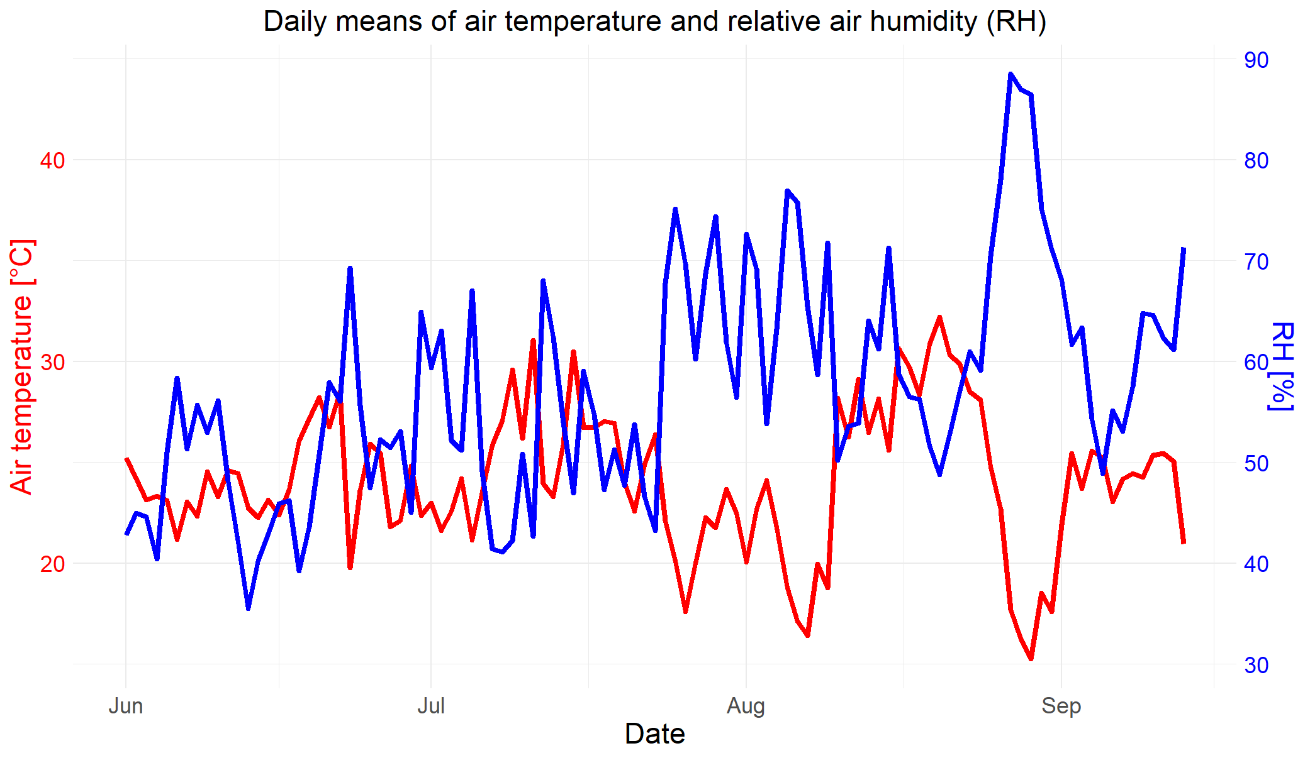
Climate in the greenhouse –
daily means of air temperature and rel. air humidity (RH)

Slide 8
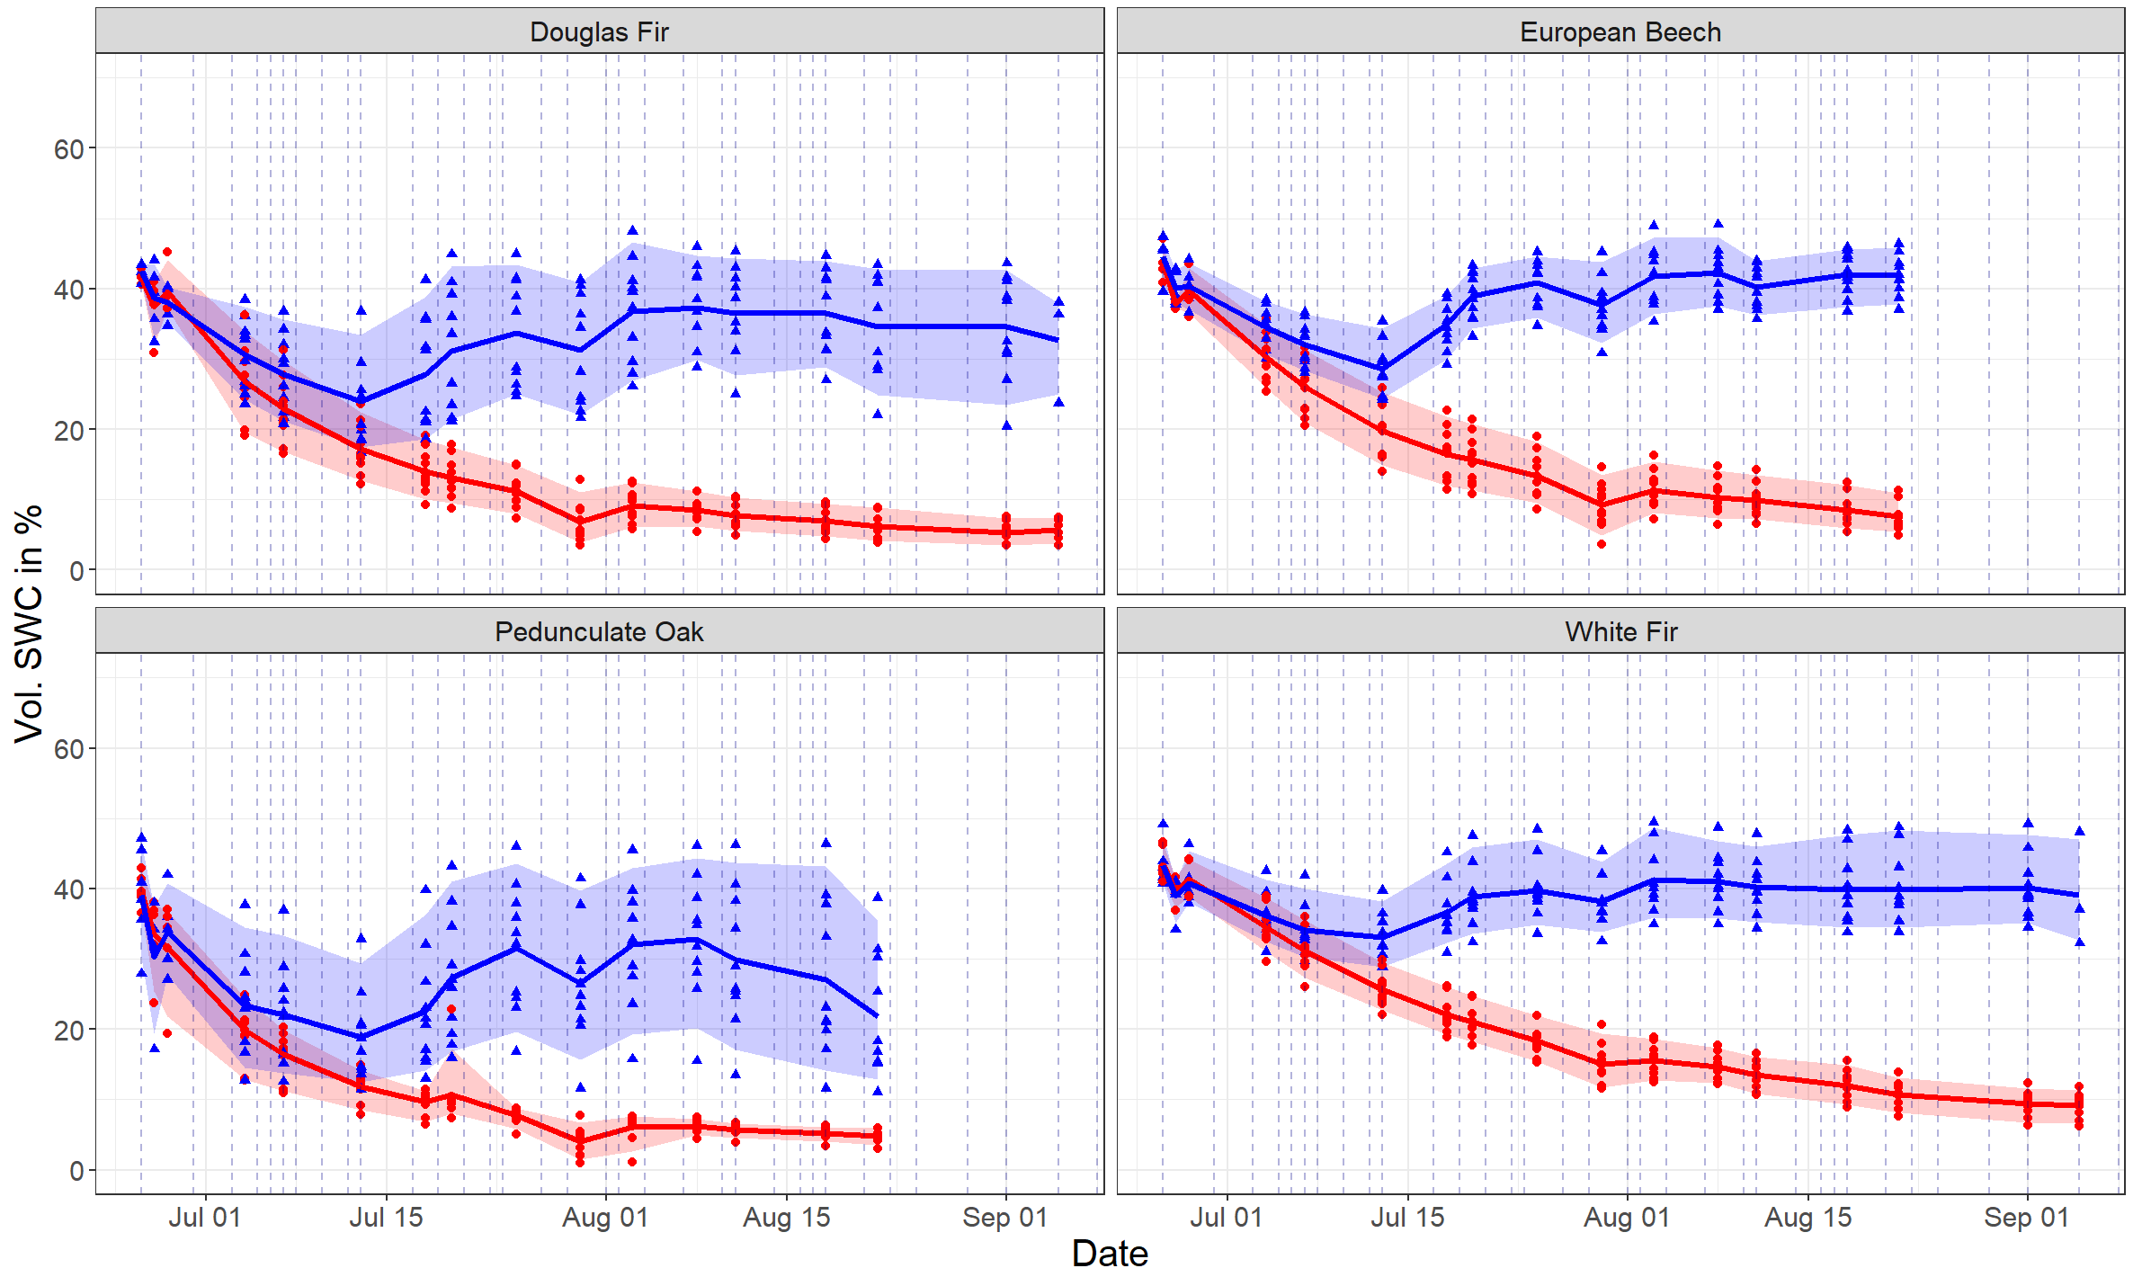
Volumetric soil water content (SWC)
Douglas fir (Pseudotsuga menziesii)
European beech (Fagus sylvatica)
Dried
Watered
95th percentil
mean
Pedunculate oak (Quercus robur)
Silver fir (Abies alba)
5th percentil
Watering dates

Slide 9
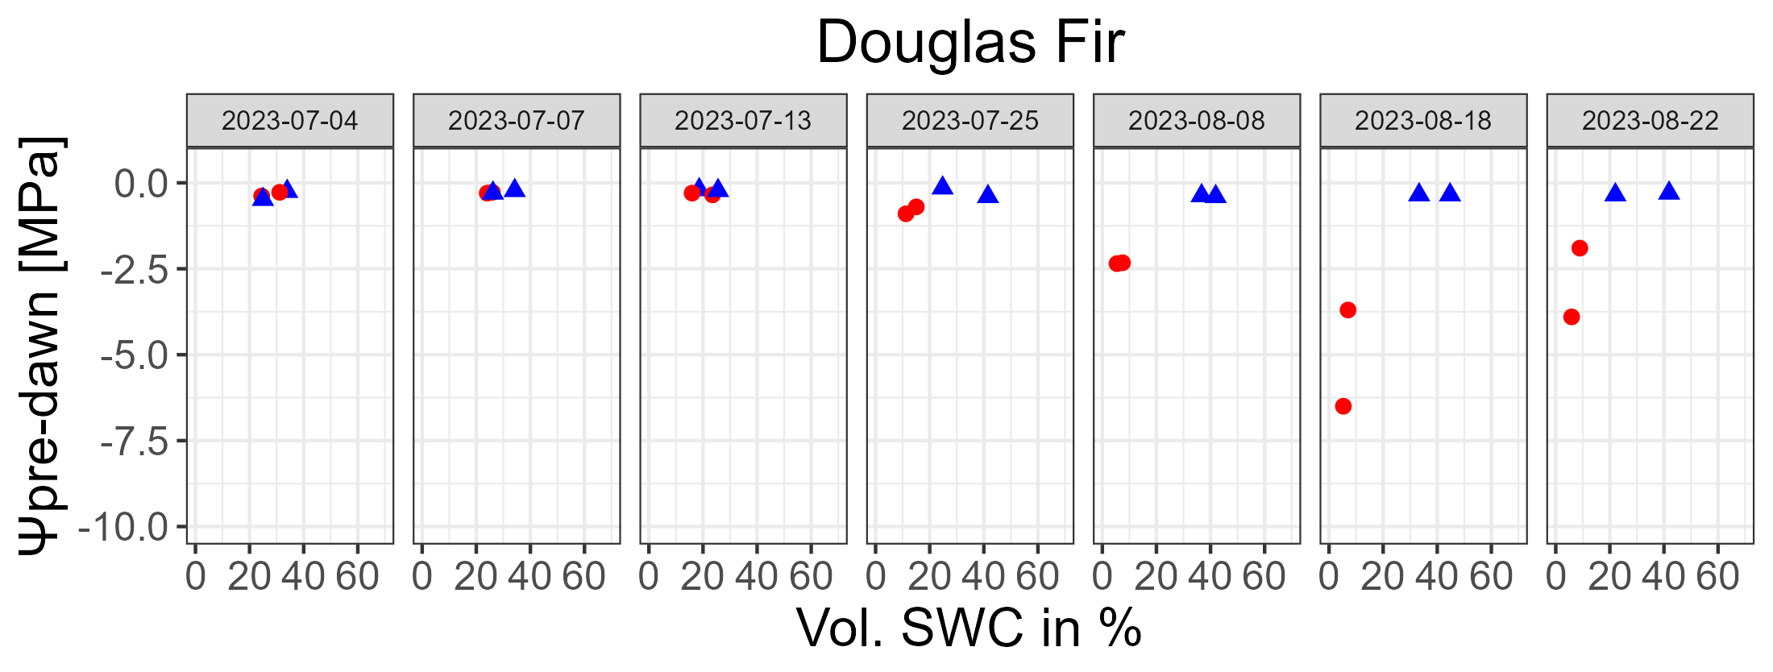
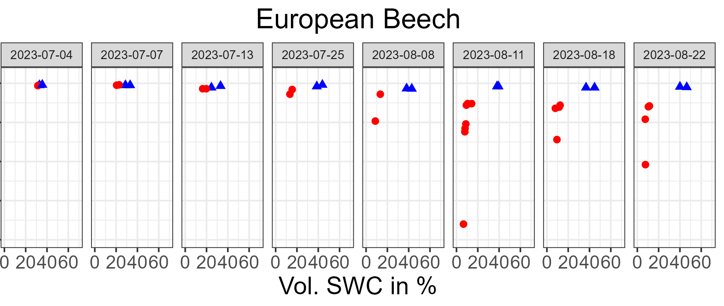
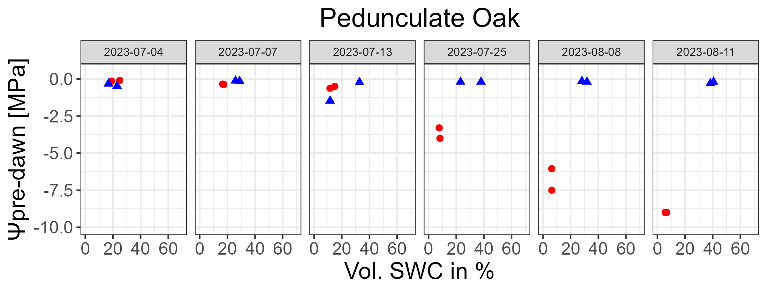
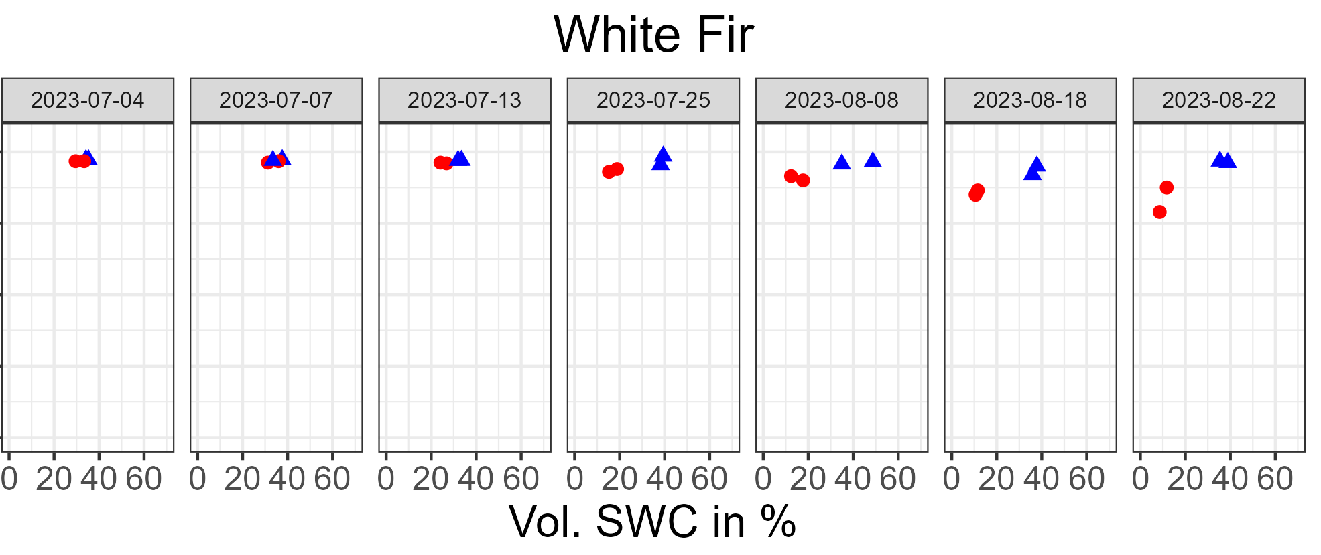


Pre-dawn water potential (Ψpre-dawn) vs.
vol. soil water content (SWC)
Douglas fir (Pseudotsuga menziesii)
European beech (Fagus sylvatica)
Vol. SWC [%]
Vol. SWC [%]
Pedunculate oak (Quercus robur)
Silver fir (Abies alba)
Vol. SWC [%]
Vol. SWC [%]
Dried
Watered
Notes:
Formen und Farben anpassen

Slide 10
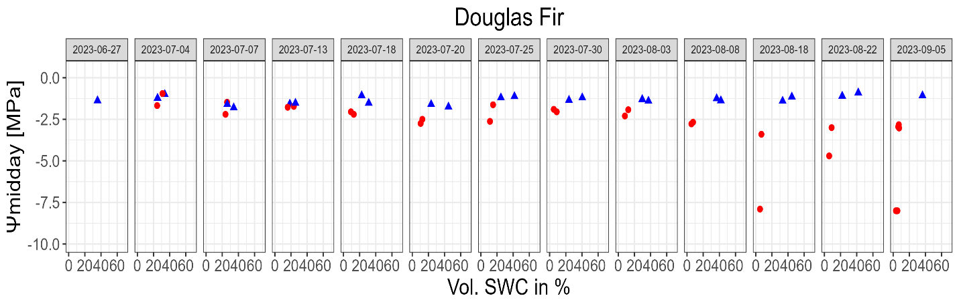
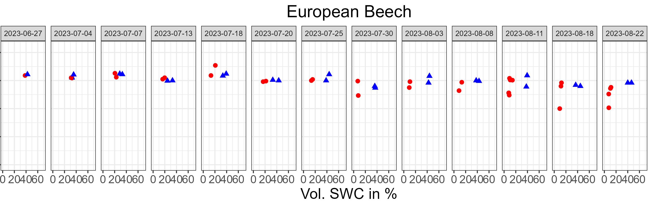
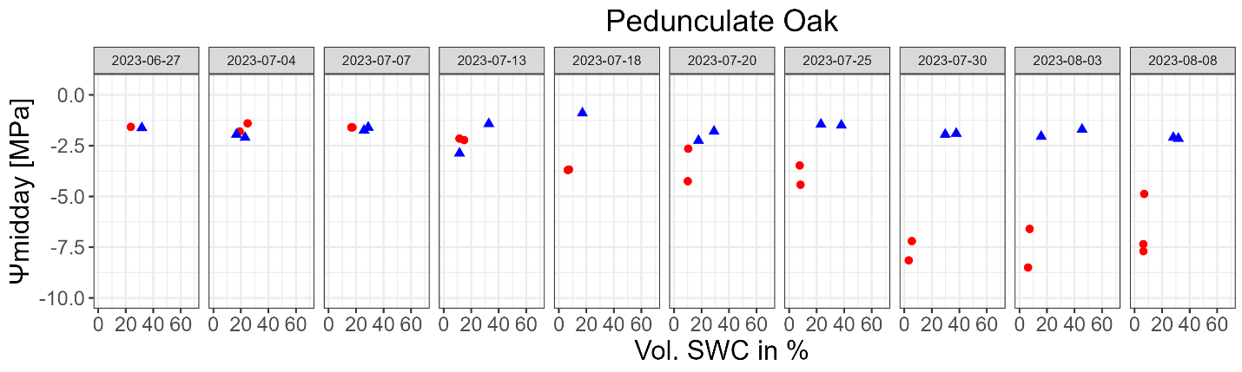
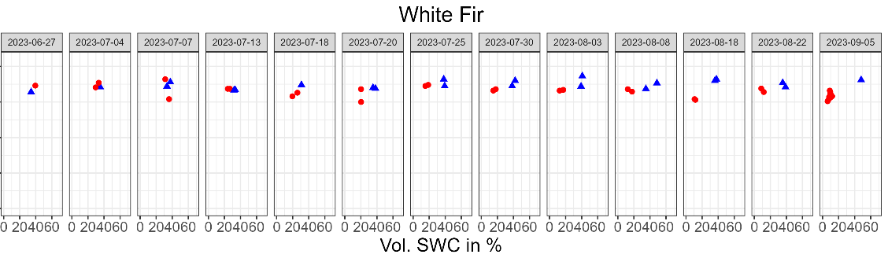
Midday water potential (Ψmidday) vs.
vol. soil water content (SWC)
Douglas fir (Pseudotsuga menziesii)
European beech (Fagus sylvatica)
Vol. SWC [%]
Vol. SWC [%]
Pedunculate oak (Quercus robur)
Silver fir (Abies alba)
Vol. SWC [%]
Vol. SWC [%]
Dried
Watered

Slide 11
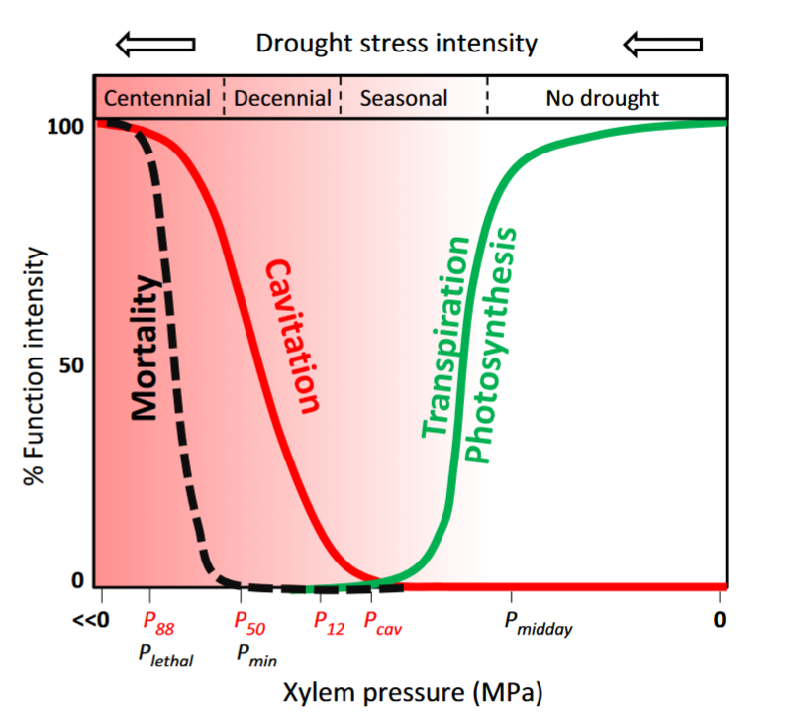
Decreasing xylem pressure leads to higher
mortality during drought
(Delzon & Cochard 2014)

Slide 12
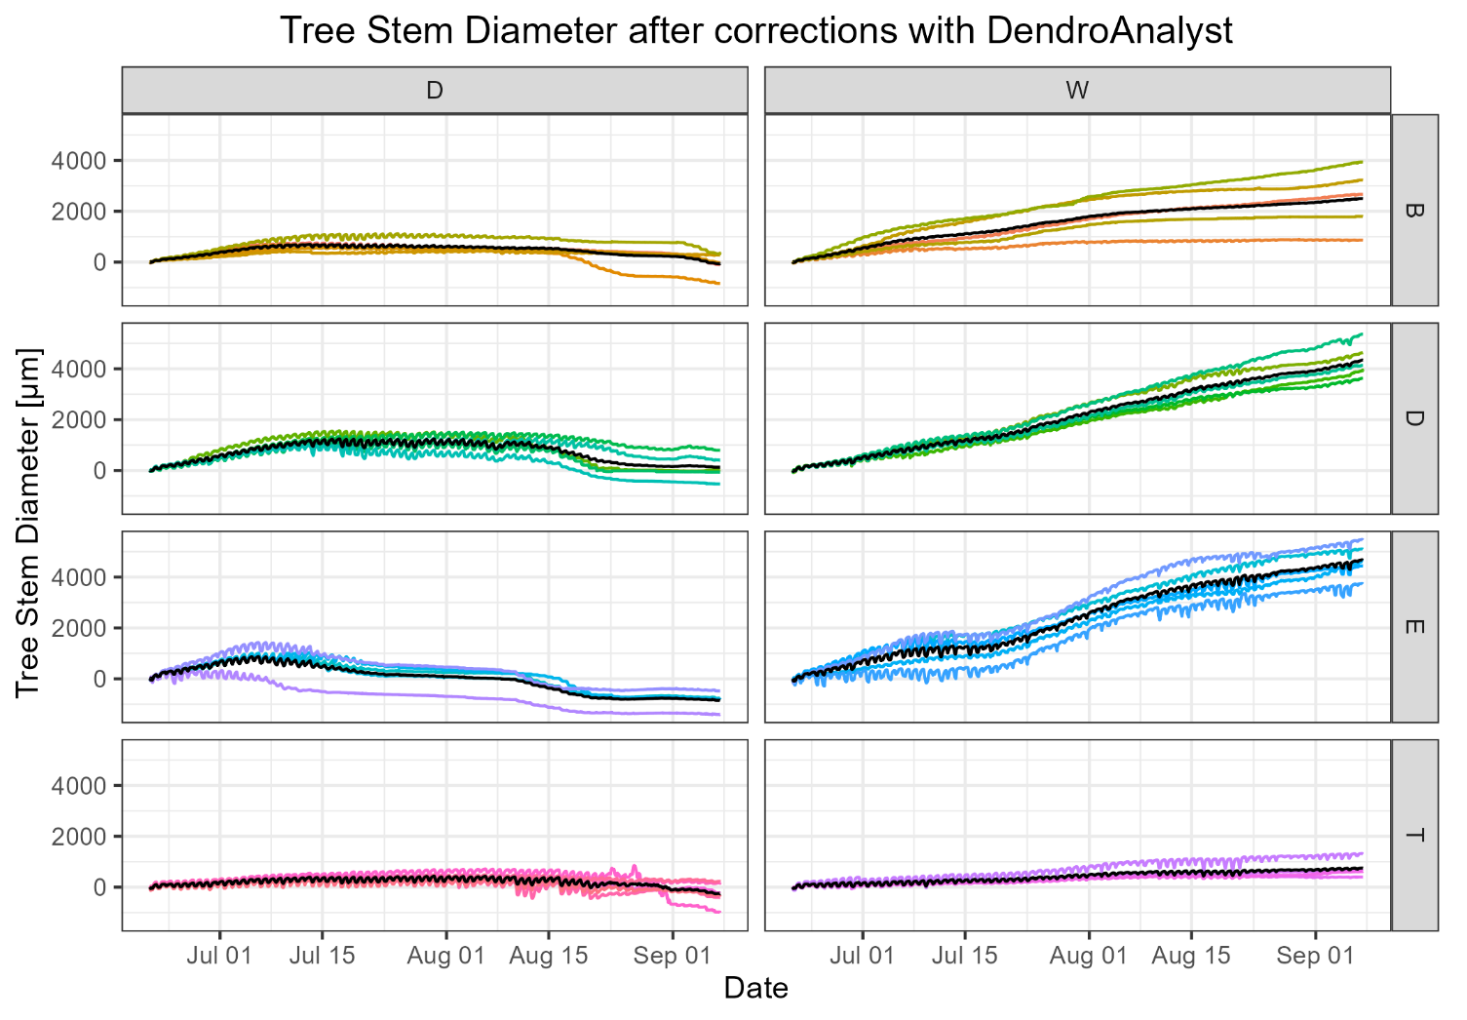
Tree stem diameters
Dried
Watered
European beech
Douglas fir
Mean tree
stem diameter
Pedun-culate oak
Silver fir

Slide 13
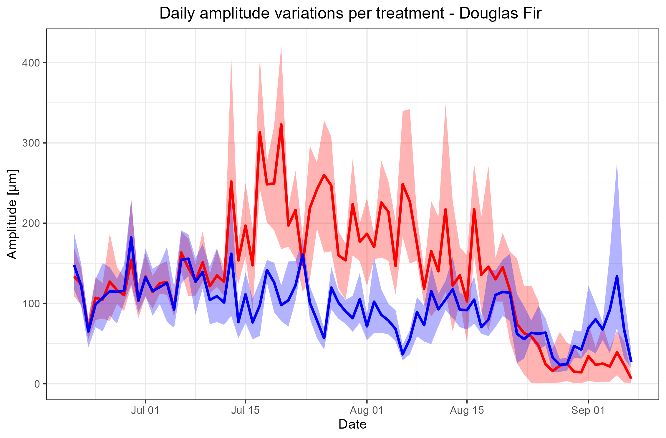
Daily amplitudes of tree stem diameter (TSD) changes
Douglas fir (Pseudotsuga menziesii)
Dried
Watered
daily max
Daily amplitudes of TSD changes in [µm]
daily mean
daily min
Date

Slide 14
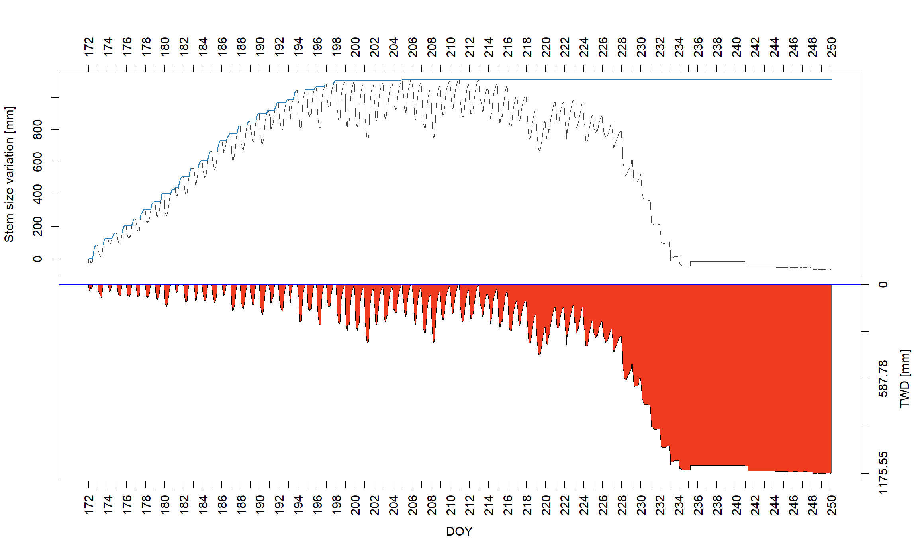
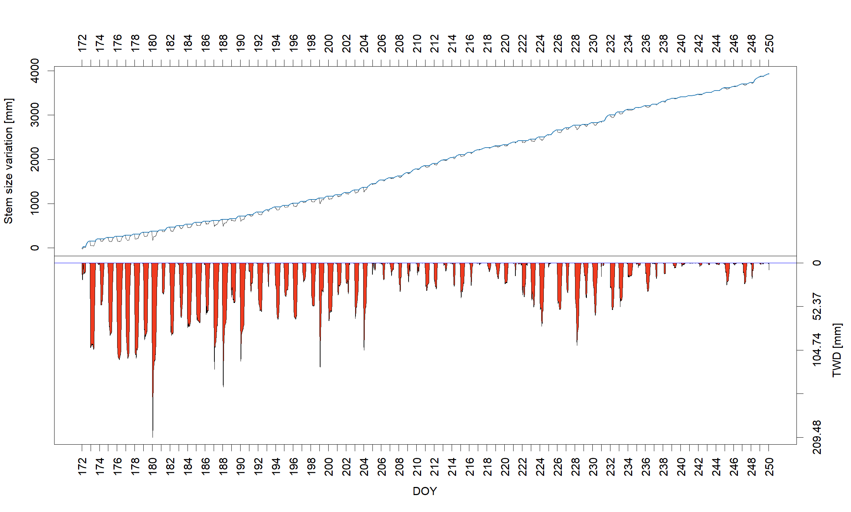
Tree stem size variations, GRO-curves and tree water deficit (TWD) from DendRoAnalyst (R) according to zero-growth approach (Aryal et al. 2020, Zweifel et al. 2005; 2006; 2016)
Douglas fir (Pseudotsuga menziesii)
Dried
Watered
GRO-curve (=irreversible stem expansion, when the current reading is higher
than previous maxima)
D7 D
D15 W
Stem size variation [µm]
Stem size variation [µm]
stem size variation
TWD (=reversible stem shrinkage and expansion, when the current reading is less than previous maxima)
TWD [µm]
TWD [µm]
Day of Year
Day of Year

Slide 15
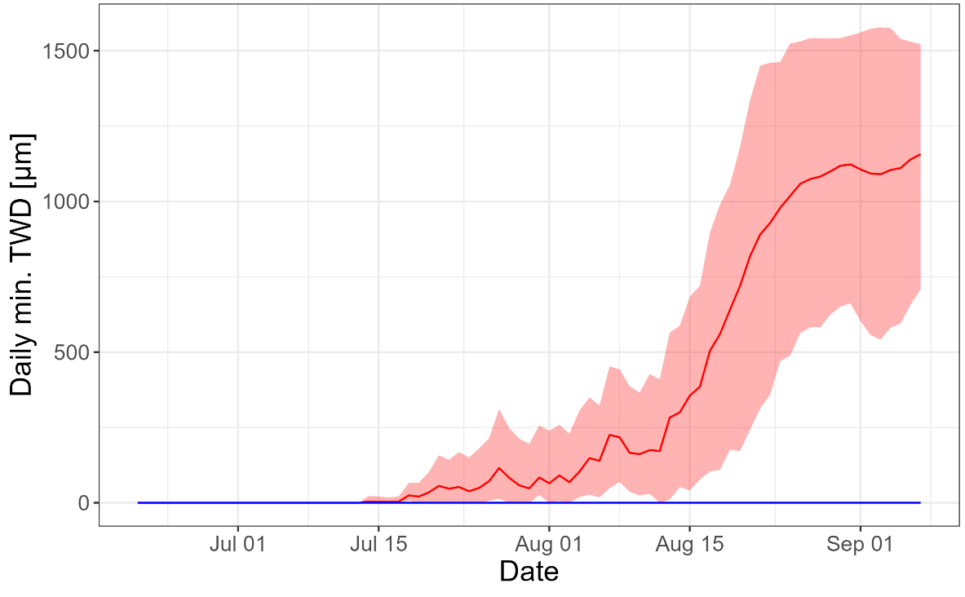
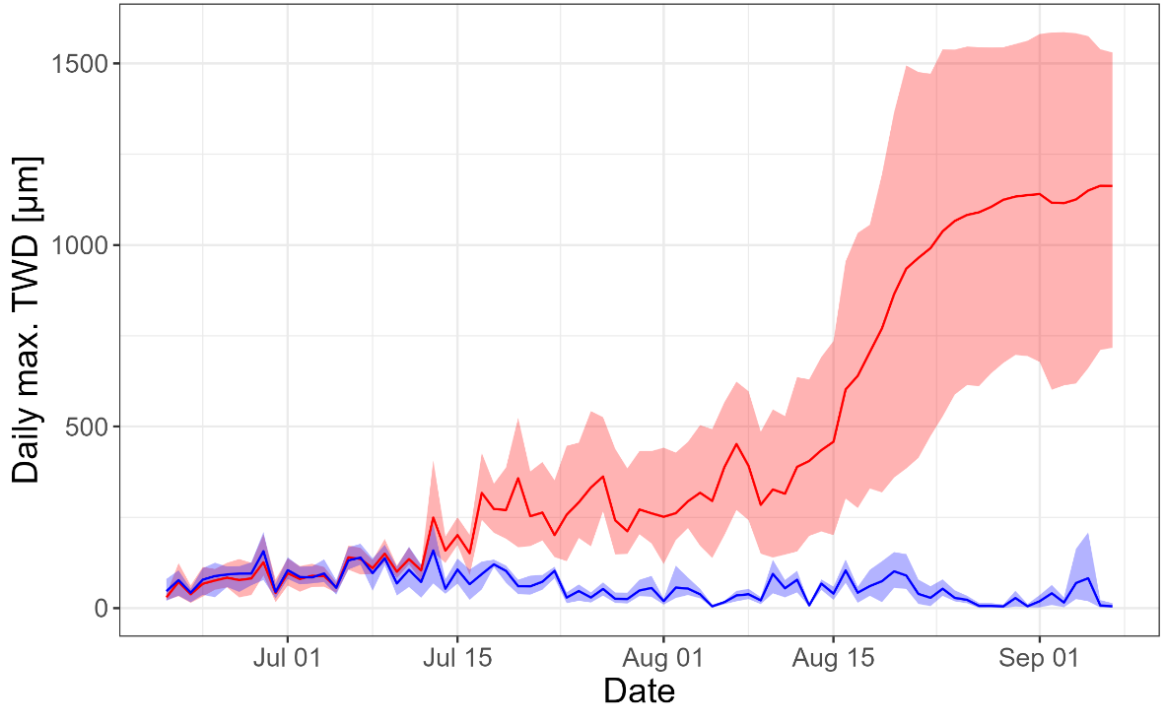
Tree water deficit (TWD) as an indicator for drought stress
Douglas fir (Pseudotsuga menziesii)
Minimum TWD
Maximum TWD
Dried
Watered
max
mean
max
Maximum TWD
Linked to diurnal drought stress dynamics
& short term fluctuations
Related to transpiration
Dependent on atmosph. water demand
and temp. (Salomón et al., 2022)
Minimum TWD
Reflects seasonal drought stress
Controlled by soil moisture (Salomón et al., 2022)
Notes:
Legende überarbeiten, Schriftgrößen anpassen

Slide 16
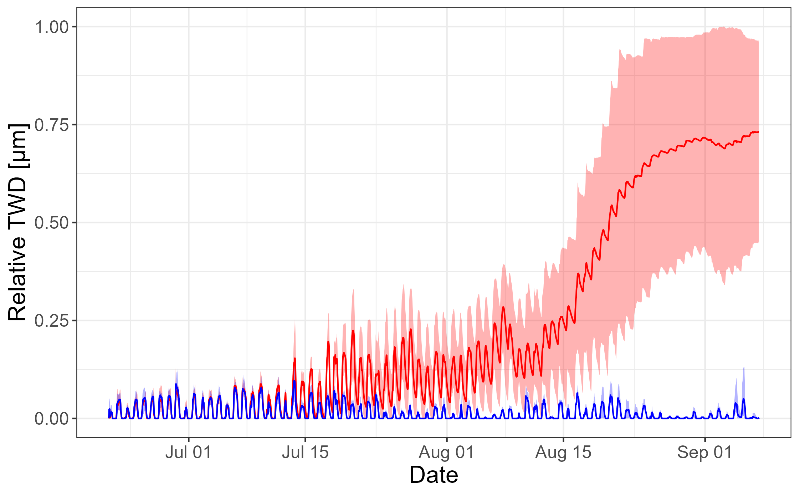
Relative tree water deficit (TWD)
Douglas fir (Pseudotsuga menziesii)
Dried
Watered
daily max
daily mean
daily min
Relative TWD = TWD_{actual} / TWD_{seasonal} _{maximum}
for Douglas fir: TWD_{seasonal} _{maximum} = 1586 µm

Slide 17
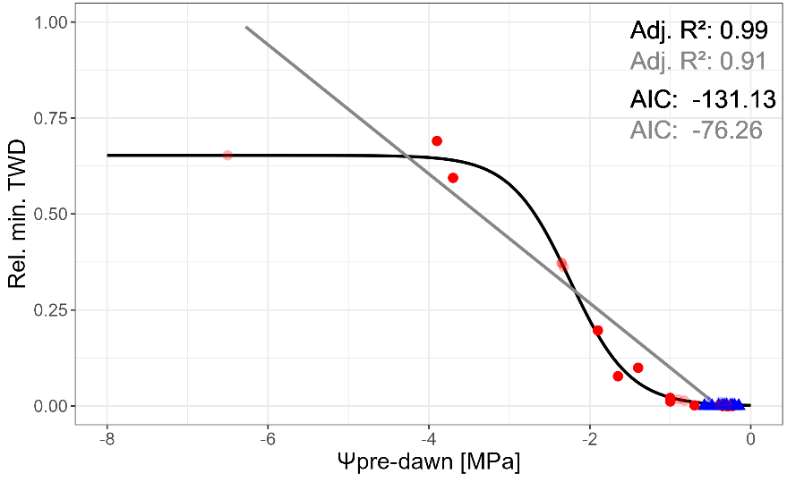
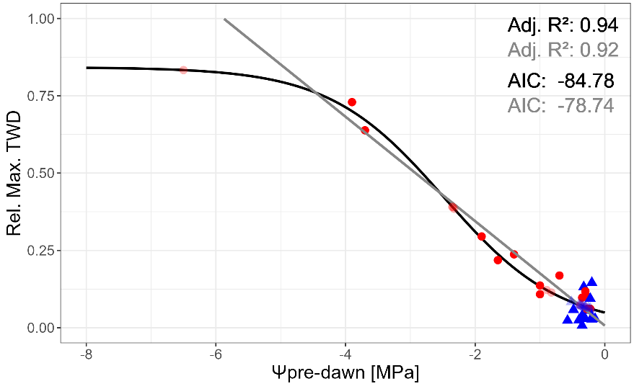
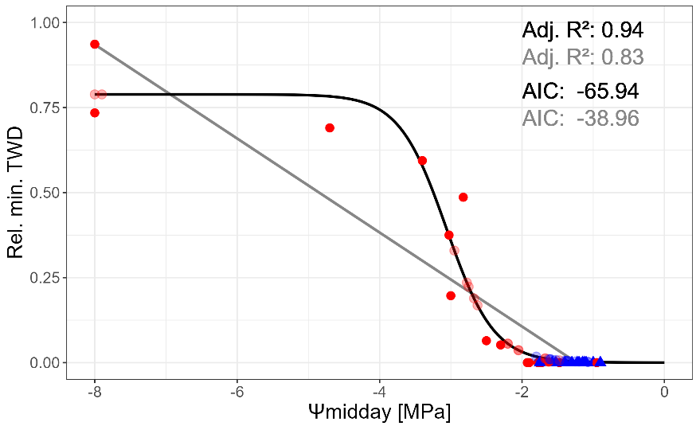
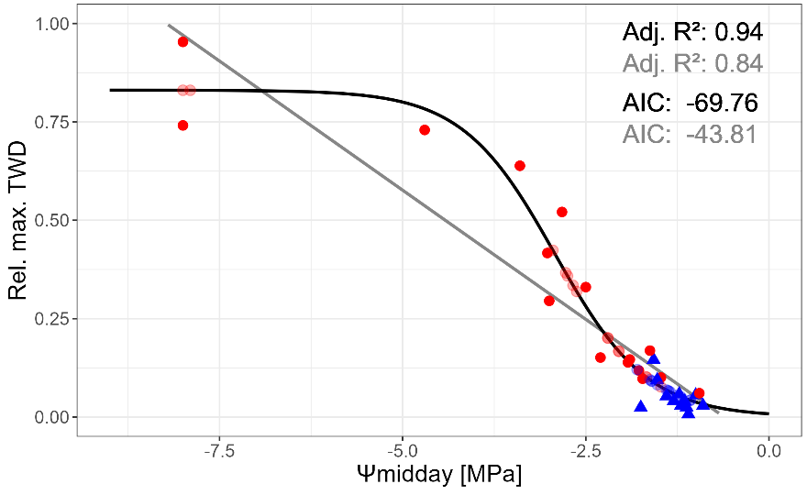
Prediction of tree water deficit (TWD) from water potential (Ψ)
with logistic regression (Dietrich et al. 2018)
Douglas fir (Pseudotsuga menziesii)
Rel. min TWD
Rel. max TWD
Logistic regression
Linear regression
Ψ_{pre-dawn}
Measured values
(TWD & Ψ measured)
Dried
Watered
Logistically predicted TWD values
(Ψ measured)
Ψ_{midday}
Dried
Watered
Notes:
WP Bewässerungsschwellenwerte anhand von hydraulischen Kurven einzeichnen?

Slide 18
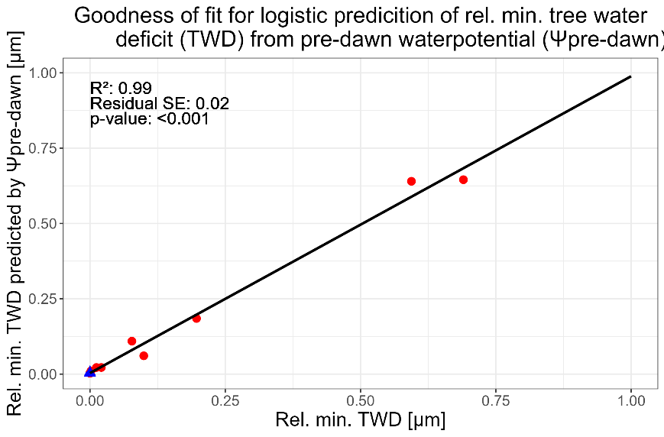
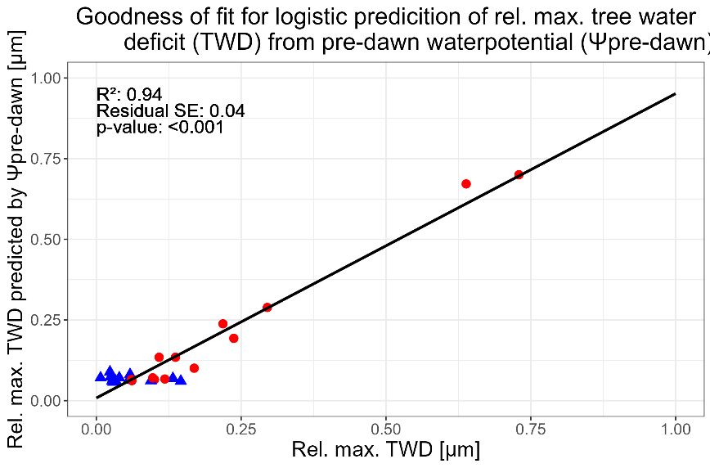
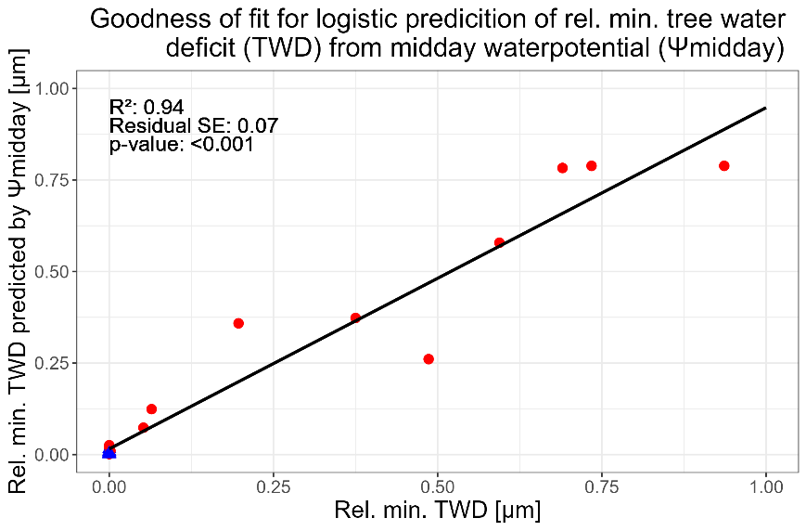
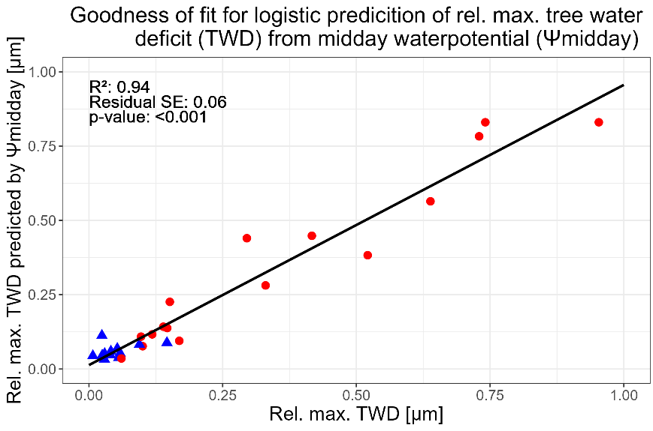
Goodness of fit for prediction of tree water deficit (TWD) from water potential (Ψ) with logistic regression
Douglas fir (Pseudotsuga menziesii)
Max TWD
Min. TWD
Max. TWD
Ψ_{pre-dawn}
Treatment
Dried
Watered
Ψ_{midday}

Slide 19
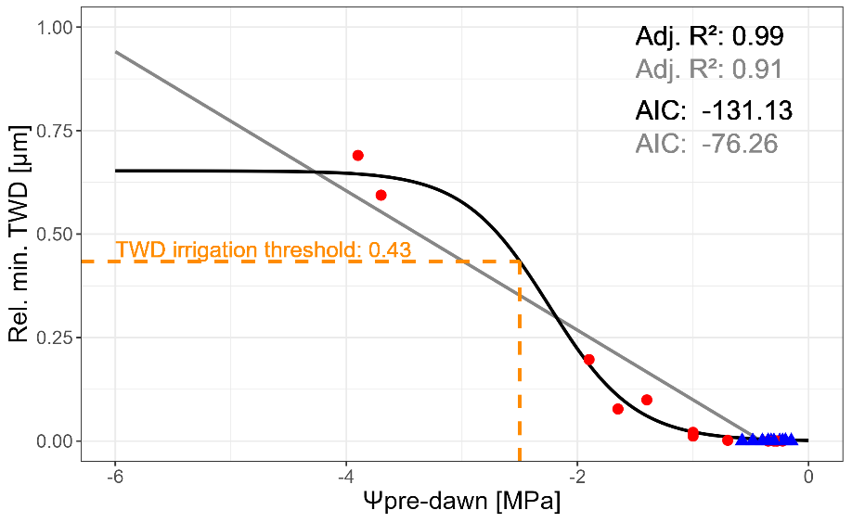
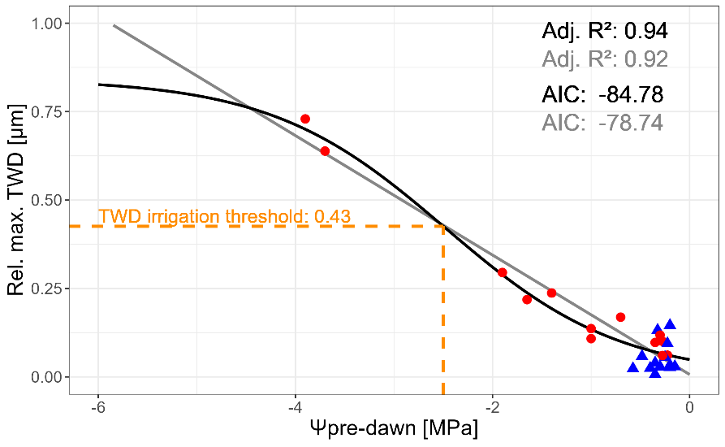
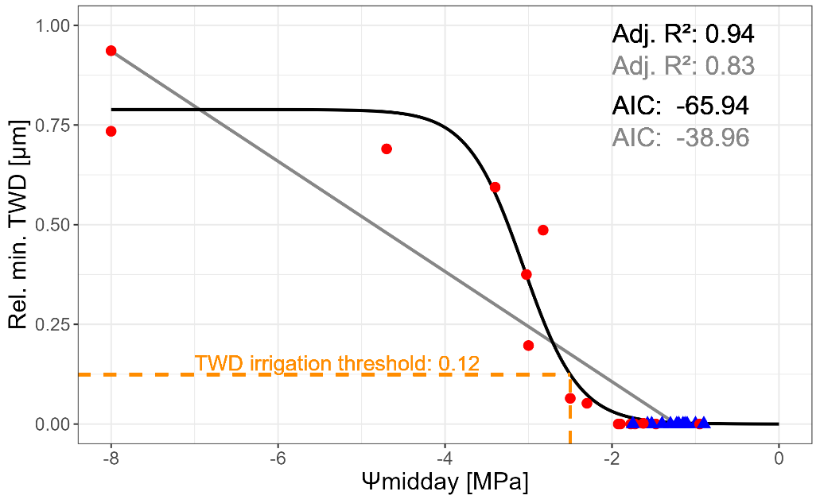
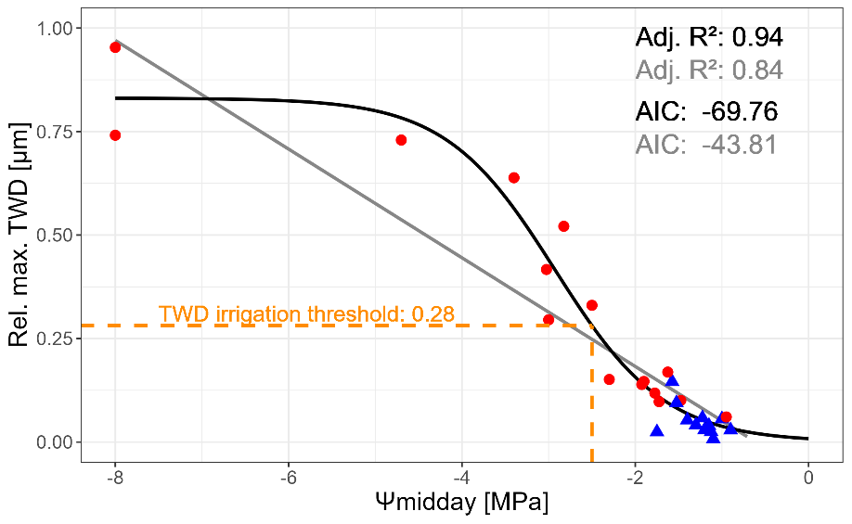
Determination of irrigation thresholds with logistic regression
Min. TWD
Douglas fir (Pseudotsuga menziesii)
Max. TWD
Logistic regression
Linear regression
Ψ_{pre-dawn}
Treatment
Dried
Watered
Irrigation threshold =
TWD, where Ψ is linked to a reduction
of xylem conductivity
by 10%
value for Douglas fir
(=-2.5 MPa) from compilation in Czajkowsi et al. 2009
Ψ_{midday}

Slide 20
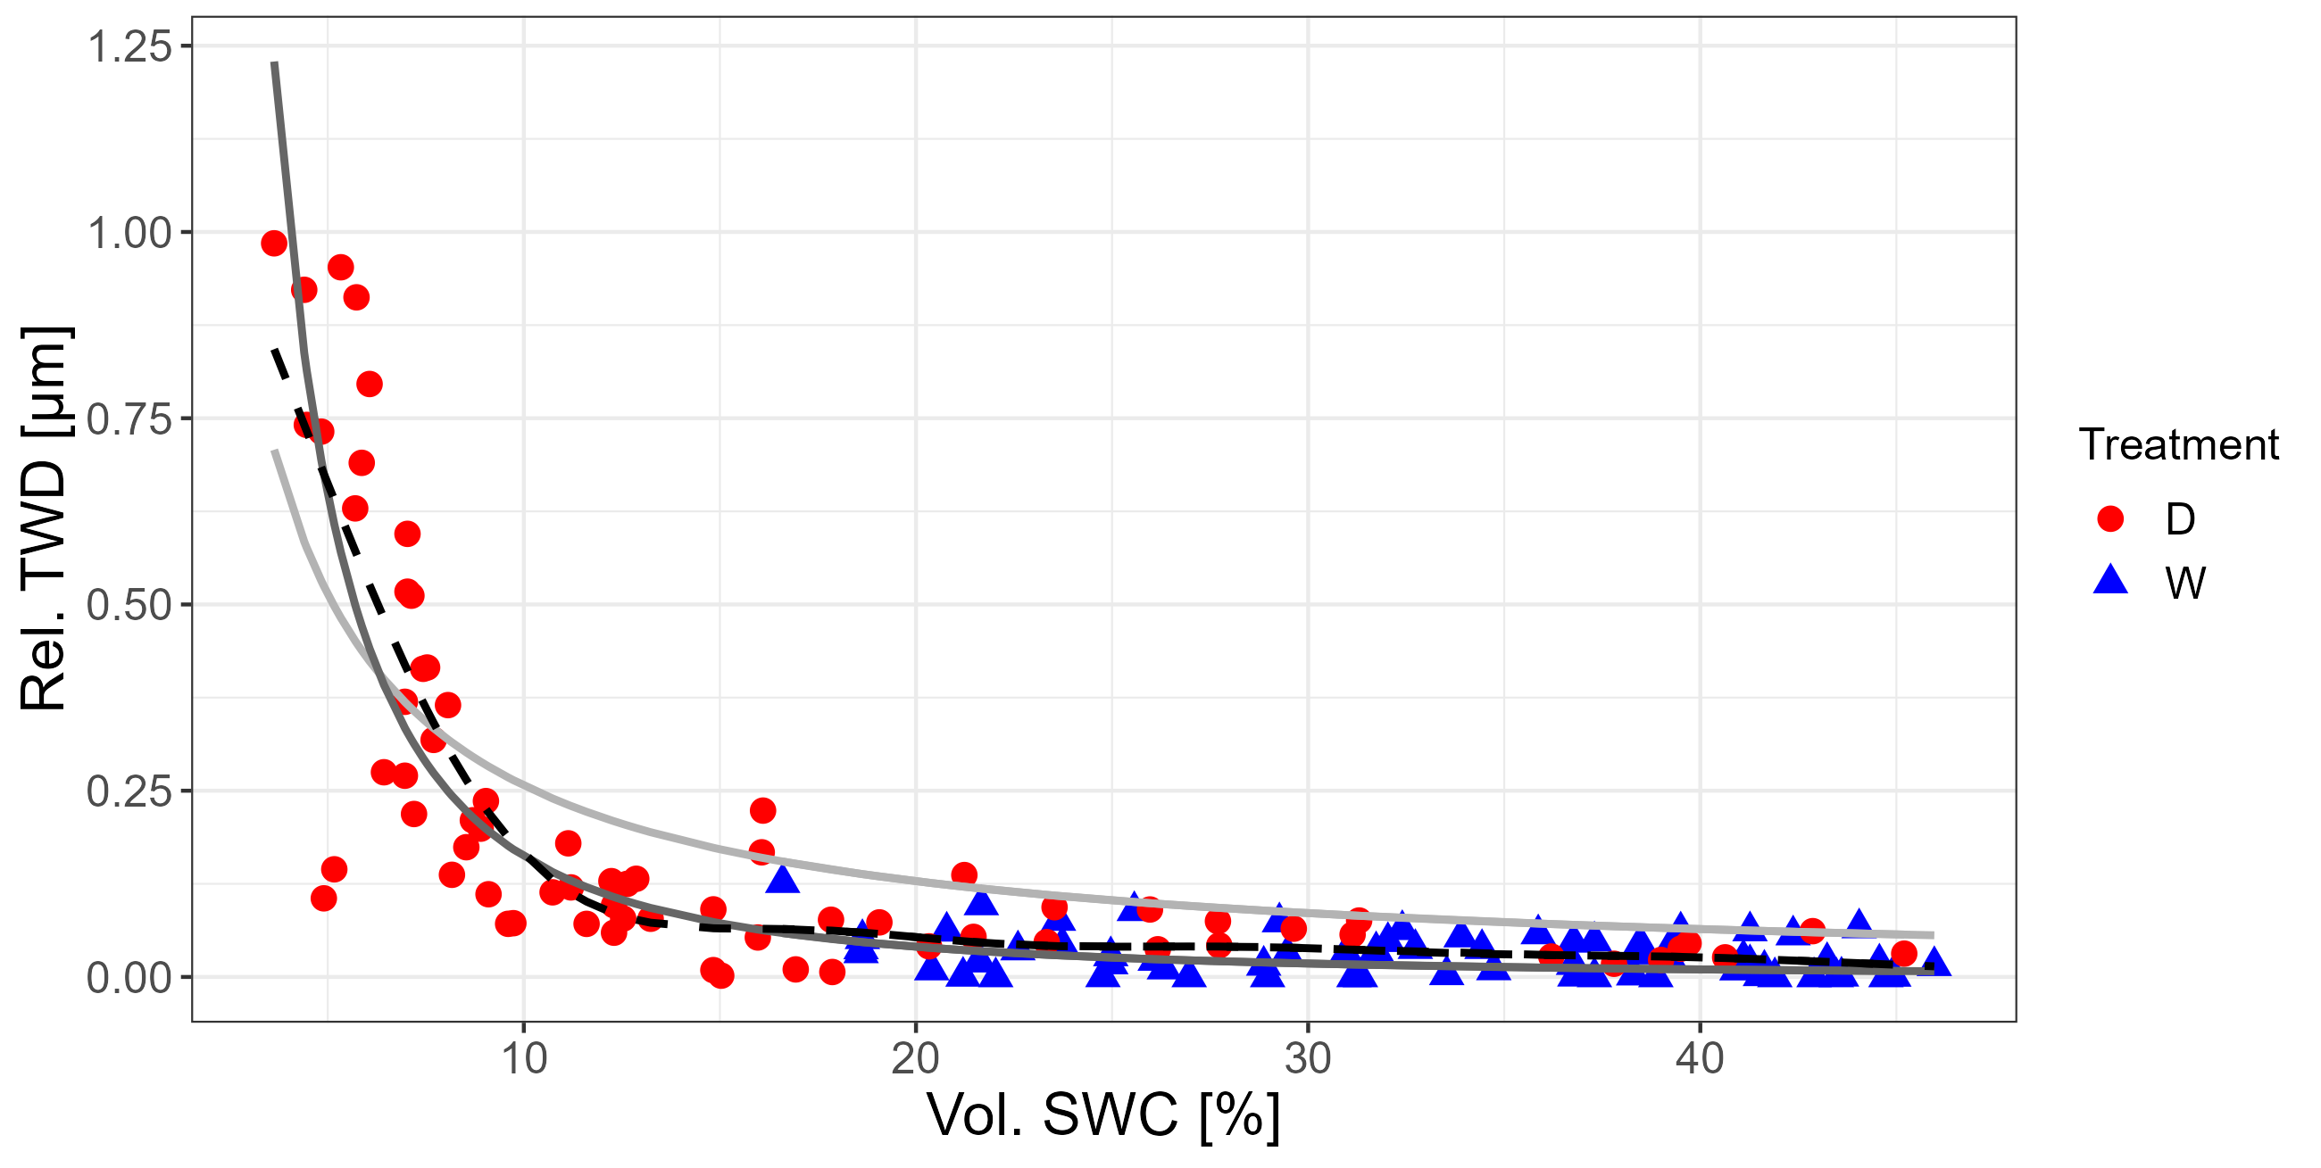
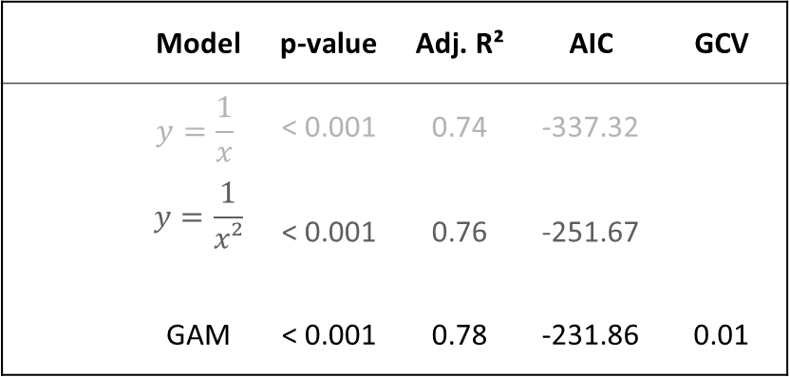
Modeling relative tree water deficit (TWD)
from vol. soil water content (SWC)
Douglas fir (Pseudotsuga menziesii)
 | Model | p-value | Adj. R² | AIC | GCV
 | $$y=\frac{1}{x}$$ | < 0.001 | 0.74 | -337.32
 | $$y=\frac{1}{x²}$$ | < 0.001 | 0.76 | -251.67
 | GAM | < 0.001 | 0.78 | -231.86 | 0.01
Treatment
Dried
Watered

Slide 21
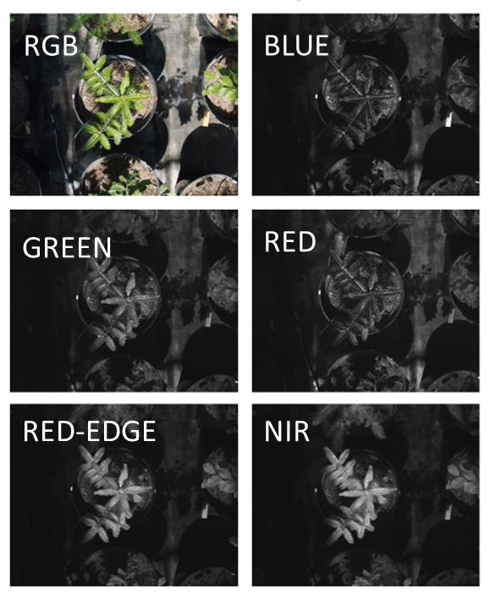
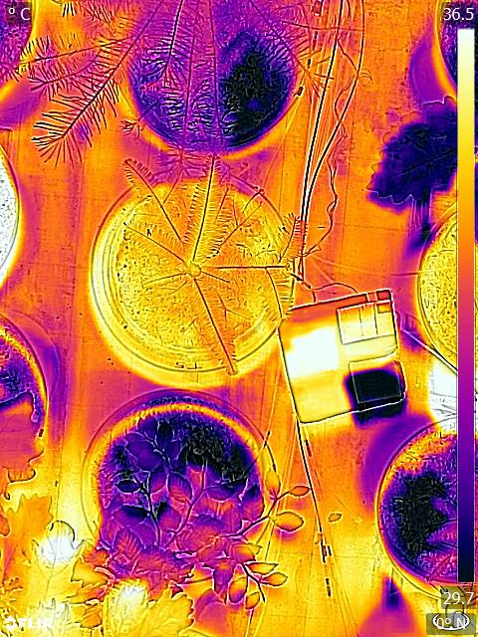
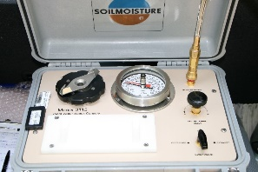
Outlook
When do tree saplings need to be watered
to survive dry periods after planting?
Ecophysiological measurements
Environmental measurements
Close-range
remote sensing
Multispectral drought stress/vegetation indices
Thermal drought
stress indices
?
Rel. air humidity
Stem diameter changes
Air temperature
Vol. soil water content
Photo: M. Schmidt
Plant water potential

Slide 22
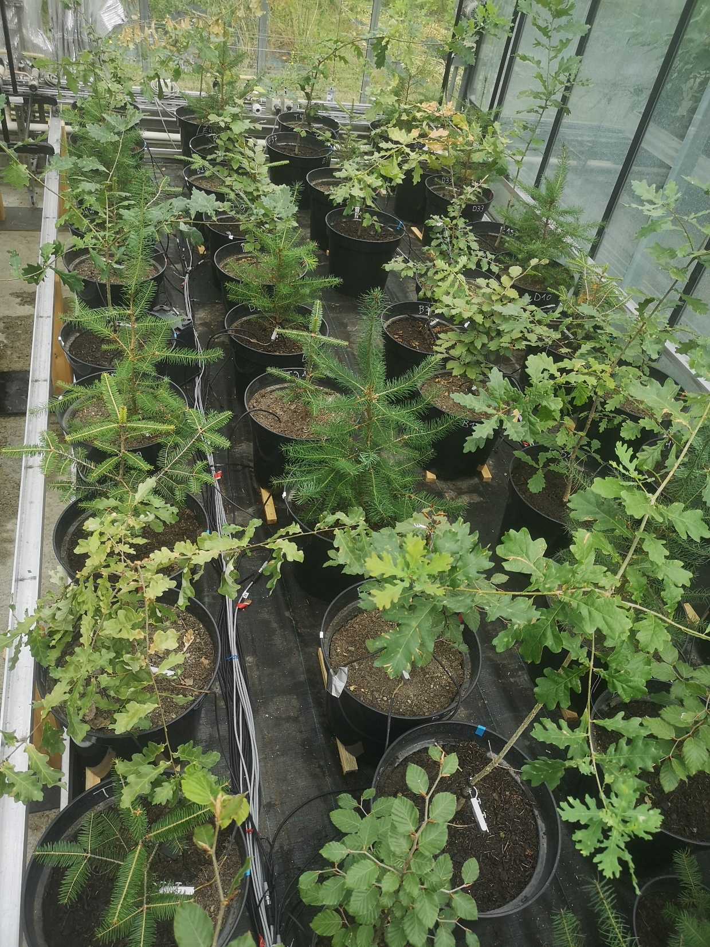
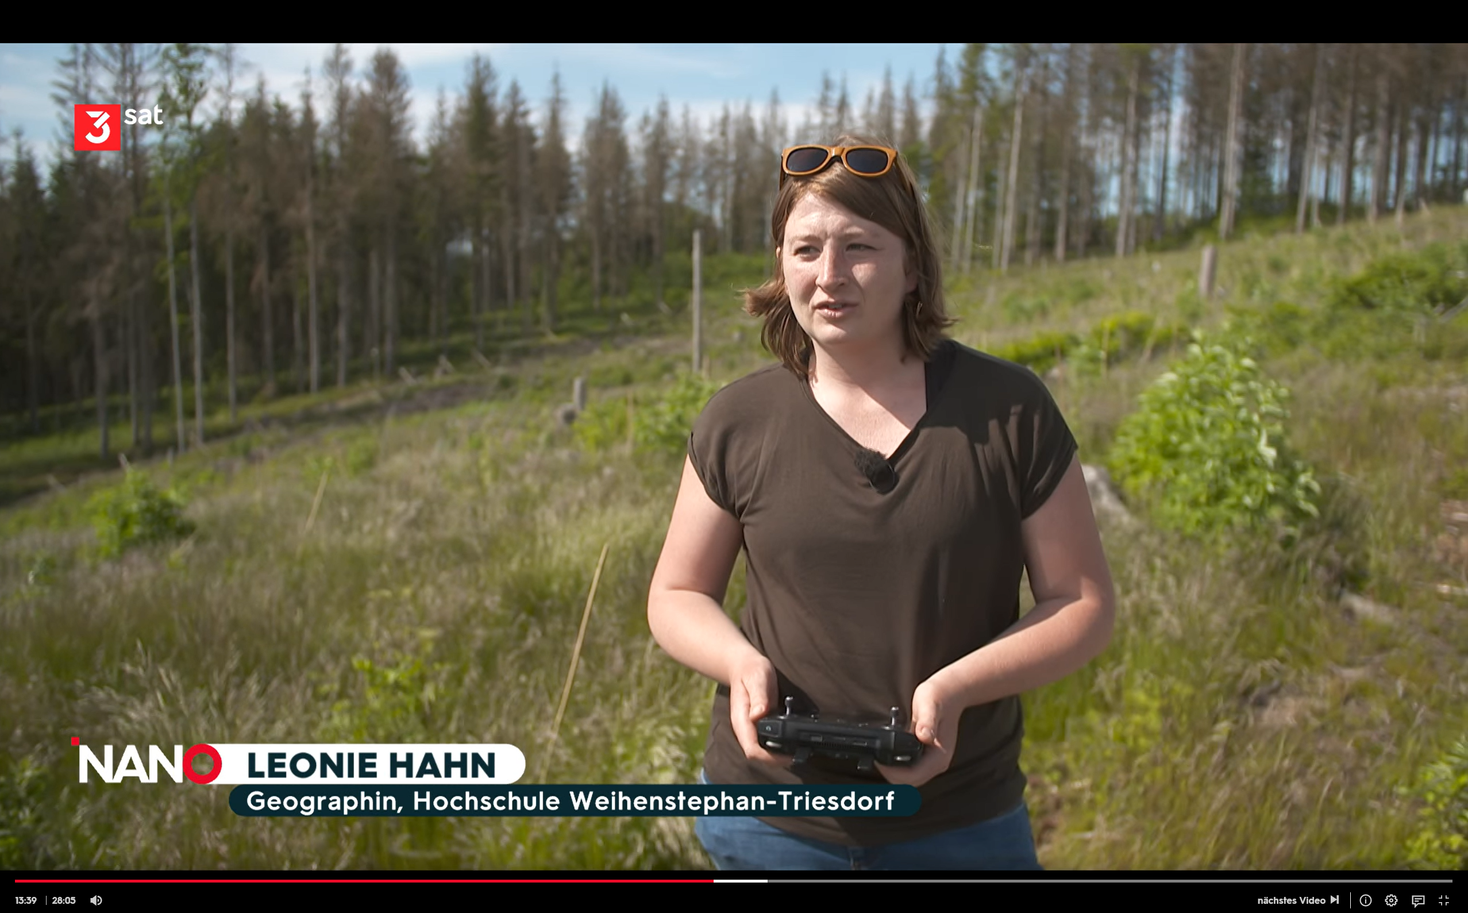
Further information
Project website:
https://www.hswt.de/en/research/research-profile/forschungsprojekte/projekt/1829-bewasserung-von-forstkulturen
TV report 3sat 21st August 2023:
https://www.3sat.de/wissen/nano/230821-sendung-wohin-fuehrt-der-wettlauf-zum-mond-nano-100.html
 leonie.hahn@hswt.de

