Slide 1
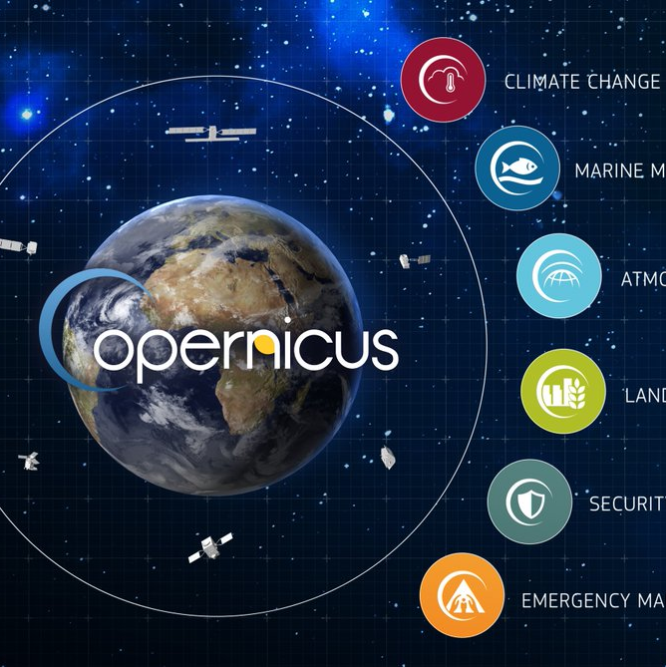

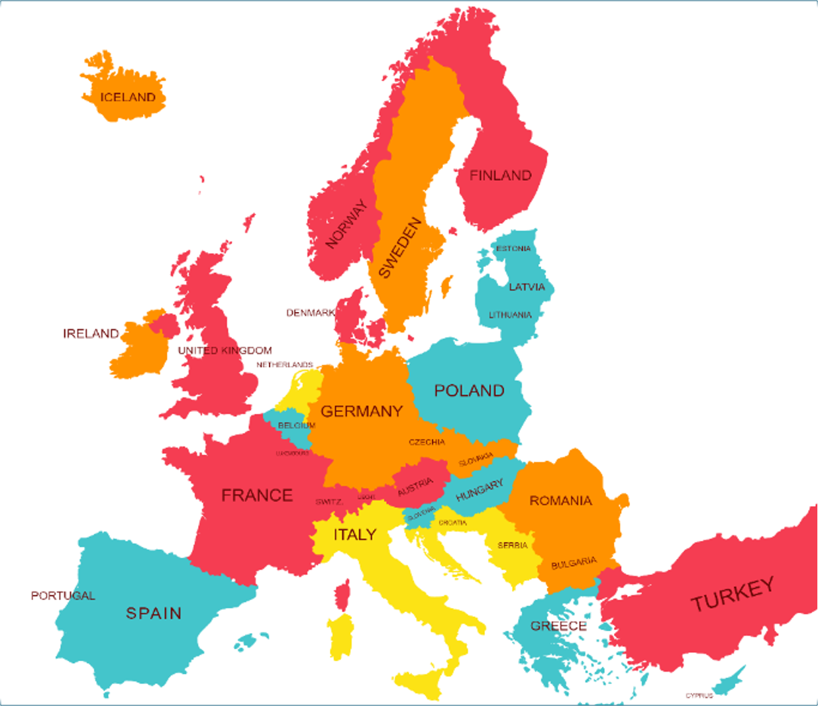

Targeted groups and user types
A case study on the User Learning Services C3S
Maria del Pozo

Slide 2

Case study : Copernicus Climate Change Program (C3S)
The C3S supports society by providing authoritative information about the past, present and future climate in Europe and the rest of the World.
Source: https://www.copernicus.eu/
Notes:
C3S is one of six thematic information services provided by Copernicus, the Earth Observation component of the European Union's space programme. Copernicus builds on existing research infrastructures and knowledge available in Europe and elsewhere. C3S relies on climate research carried out within the World Climate Research Programme (WCRP) and responds to user requirements defined by the Global Climate Observing System (GCOS). C3S provides an important resource to the Global Framework for Climate Services (GFCS).
C3S is implemented by the European Centre for Medium-Range Weather Forecasts (ECMWF) on behalf of the European Commission. ECMWF is an independent intergovernmental organisation serving its Member and Co-operating States and the broader community. The majority of C3S service elements are implemented by about 200 companies and organisations across Europe, which are selected based on competitive Invitations To Tender (ITTs).

Slide 3
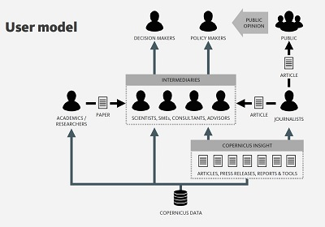
Case study : Copernicus Climate Change Program (C3S)
Climate services:
Producers
Intermediaries
End-users
+ Reach-out and Discerning identified by Copernicus
Source: https://www.copernicus.eu/

Slide 4



Case study: User Learning Services (ULS)
Learning services to process this data to derive information that helps you make the right decisions on climate adaptation and mitigation.
ULS service contract 2018-2021

Slide 5
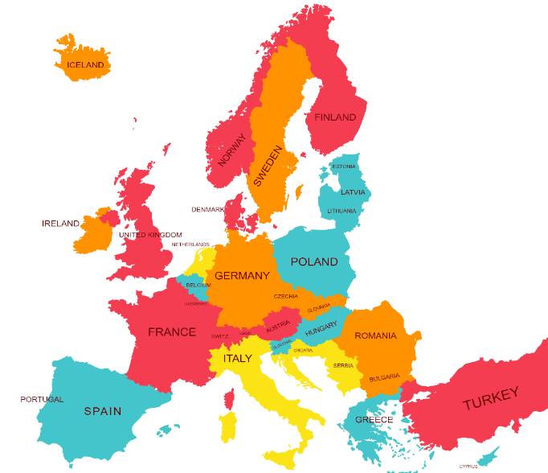
Case study: User Learning Services (ULS)
ULS service contract 2018-2021:
Online learning modules
21 Training events:
  11 complete online (COVID19)
  Local trainers

Slide 6
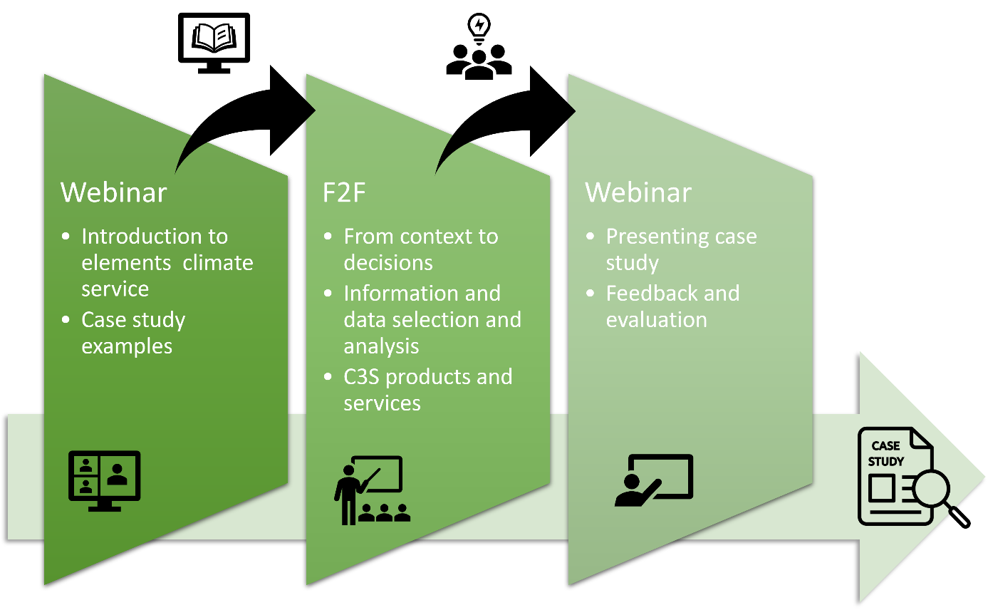
Case study: User Learning Services (ULS)

Slide 7
Research questions
What consensus exists among trainers regarding the identification of targeted audiences for the design of C3S User Learning capacity-building programs?
To identify and assess the level of agreement of
(1) targeted audiences and user types;
(2) related knowledge and skills;

Slide 8
Delphi method
Aim: searching and assessing consensus on complex debates
3 rounds of questionnaires:
  Round 1: targeted audiences and user types (n=27)
  Round 2: Knowledge and skills (n=24)
  Round 3: Assessment consensus (n=17)

Slide 9
What is consensus?
While a predefined threshold percentage is often not provided in many Delphi studies to quantify consensus (Barrios et al., 2021), the reported range for consensus varies widely, extending from 50% to 97%.
Recognized as accepted, the median consensus threshold stands at 75% agreement among participants (Diamond et al., 2014; Foth et al., 2016).

Slide 10
Targeted group: PRODUCER
 | Agreement | Average
Producers | 94% | 8.8
Producers group include scientists, consultants and experts that generate climate data by development and/or use of models, creating and refining information about the Earth's climate. Producers, who are often providers of climate services, might play a dual role as both generators and users of data, contributing to the development of models and offering tailored climate services to end-users in collaboration with intermediaries.

Slide 11
Targeted group: INTERMEDIARY
 | Agreement | Average
Intermediaries | 94% | 8.8
Intermediaries group refine climate data into useful information, ensuring accessible services that meet the specific needs of decision-makers while connecting producers with the user community. It's important to note that the user of an intermediary may not always be the end user; instead, it could be another intermediary in the value chain. This emphasizes the dynamic nature of the intermediary role in facilitating the flow of climate information through various stages of the value chain to ultimately meet the specific needs of decision-makers.

Slide 12
Targeted group: REACH-OUT
 | Agreement | Average
Intermediaries | 100 | 8.5
Reach-out group extends beyond mere dissemination and communication of climate information, encompassing the translation of complex scientific findings into accessible and educational materials for increasing awareness and understanding of climate-related issues of the general public or other professionals

Slide 13
Targeted group: ENABLERS
 | Agreement | Average
Intermediaries | 82% | 8.1
Enablers group shape and optimize business strategies and policies by making informed and strategic decisions that facilitate and enable business, secure funding, and formulate policies that allows the development and enhancement of climate services for all kind of users of climate information.

Slide 14
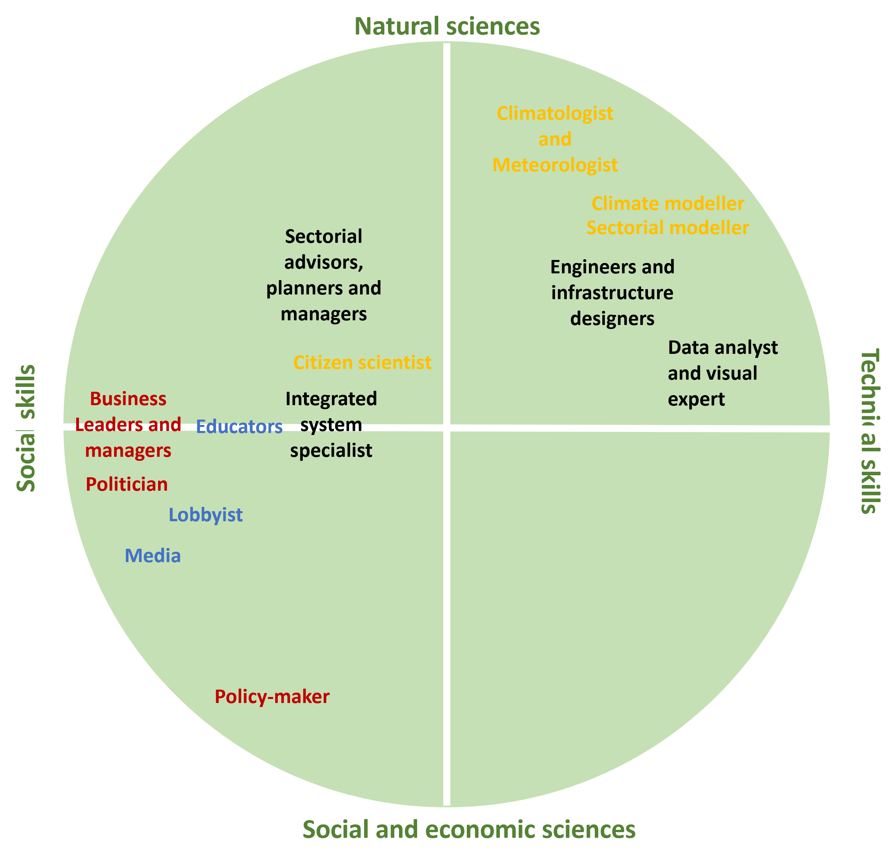
User types
  Enablers
  Out-reach
  Intermediaries
  Producers

Slide 15
Producers: users types agreements and confidence

Slide 16
Intermediaries: users types agreements and confidence

Slide 17
Reach-out: users types agreements and confidence

Slide 18
Enablers: users types agreements and confidence

Slide 19
Summary of results
General agreement above 8, except for integrated system analysis with a 7.67
General high agreement of 8,5 for user categories with no significant differences
User types have more difference among consensus but still higher rates
Higher levels of agreement also comes from lower levels of confidence (business managers, Lobbyists and Politian's), except for sectorial advisors, managers and planners

Slide 20
Other related publications
‘Conceptualizations and implementation of user engagement in Weather and climate services: A climate providers’ perspective by di Fant, V., del Pozo, M., Gulikers, J. and Paparrizos, S
Assessing design principles for climate services training courses: educational design principles assessment of six C3S Blended Training courses within the Copernicus Climate Change Service
A Learning Framework for Designing Climate Services Under Capacity Building (pre-print)

