Slide 1
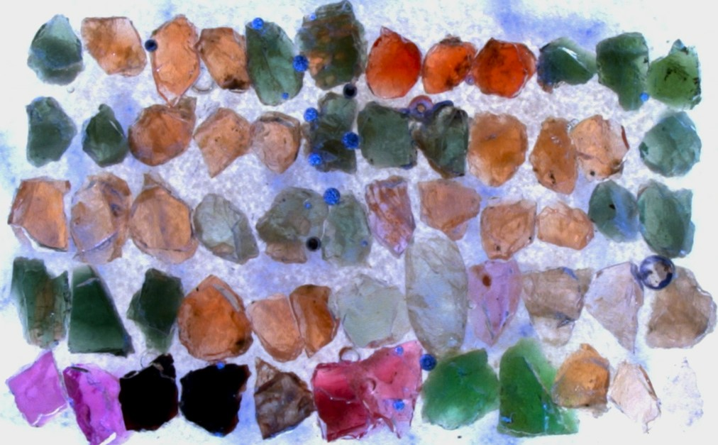
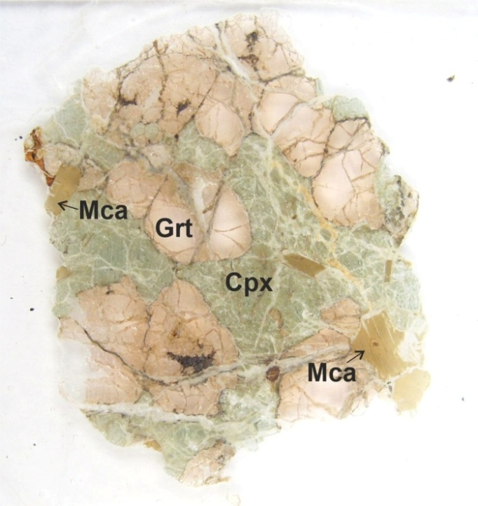
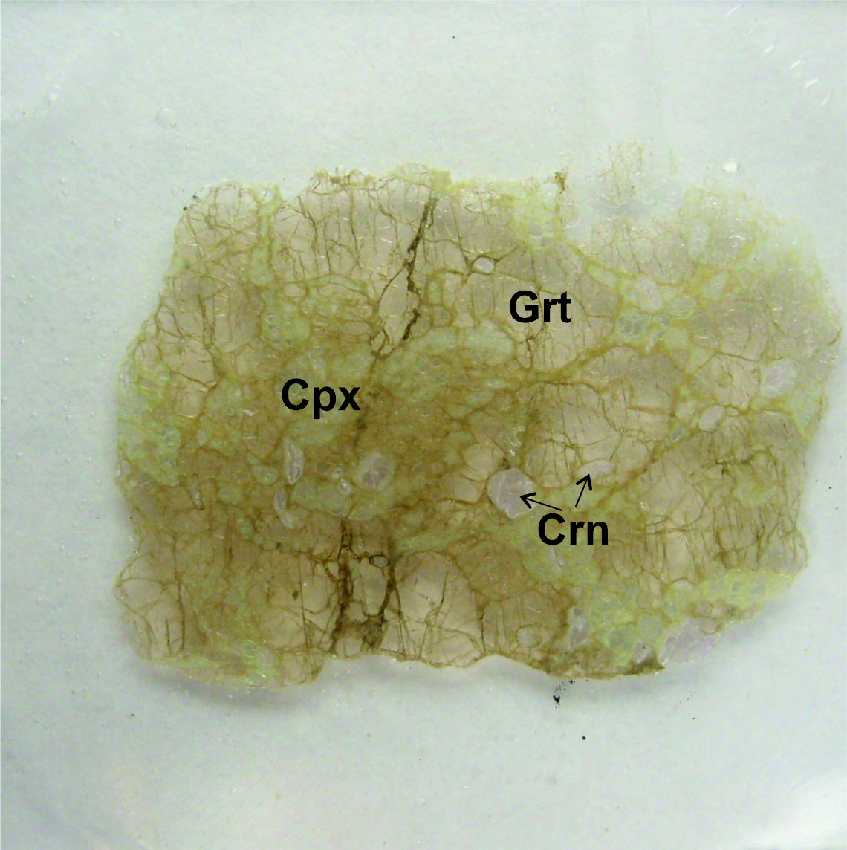
Petrology and geochemistry of a Cratonic mantle derived Eclogite Xenolith Suite from the Balmoral Kimberlite, Kimberley Region,
South Africa
Jiten Pattnaik^{1,2} and Fanus Viljoen²
¹Ben Gurion University of the Negev, Be'er Sheva, Israel (jitenkum@post.bgu.ac.il)
²University of Johannesburg, Johannesburg, South Africa

Slide 2
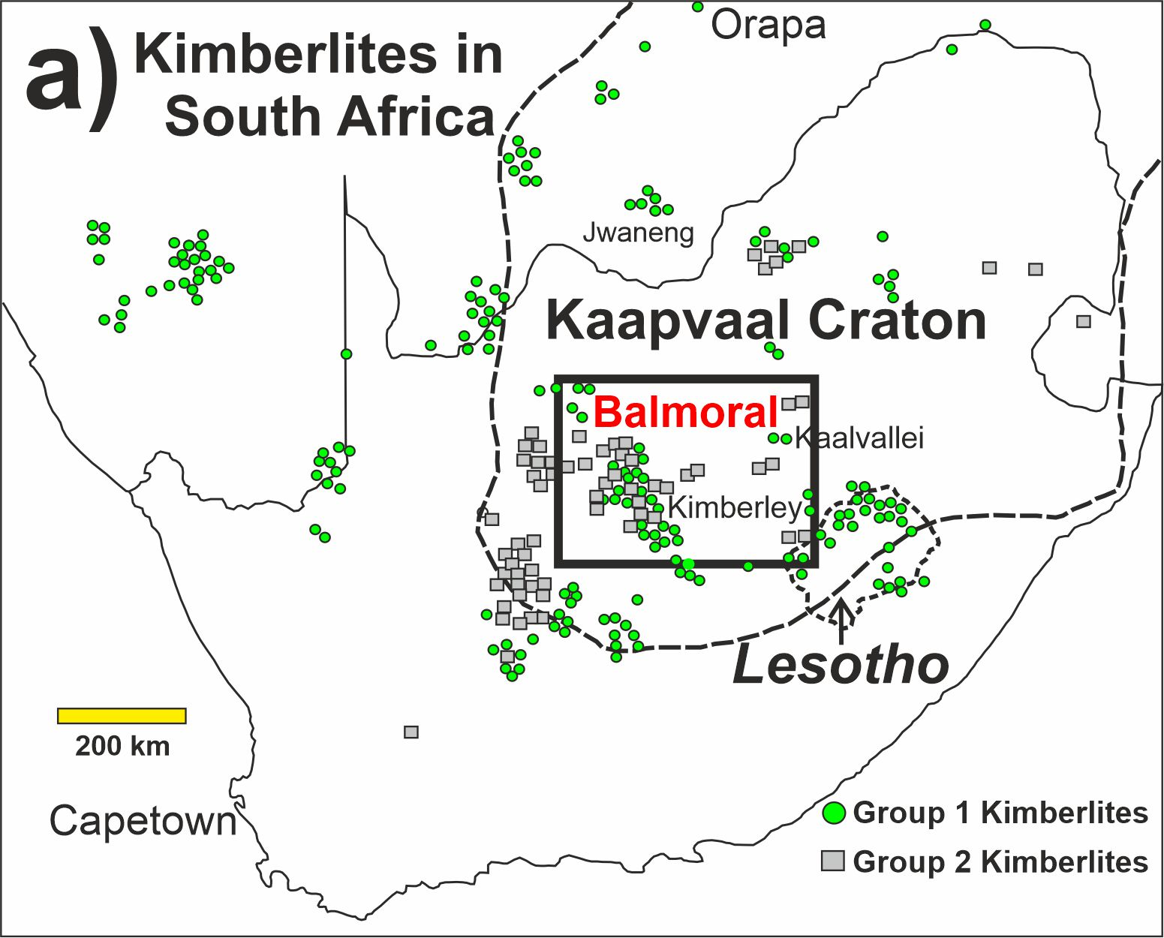
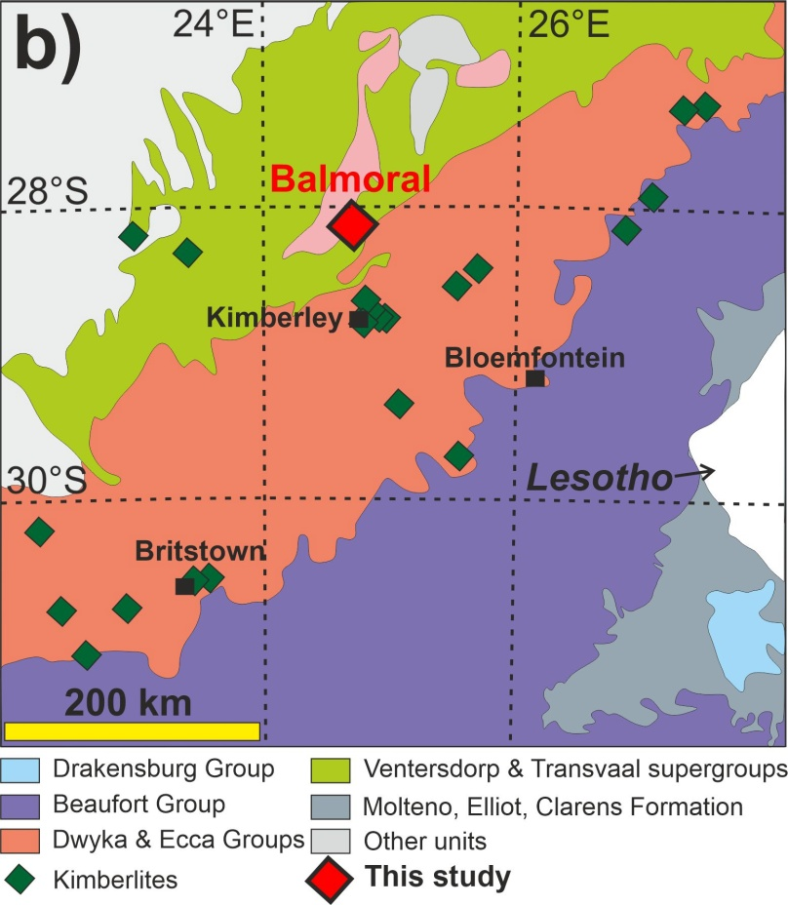
Kaapvaal craton – Balmoral eclogites

Slide 3
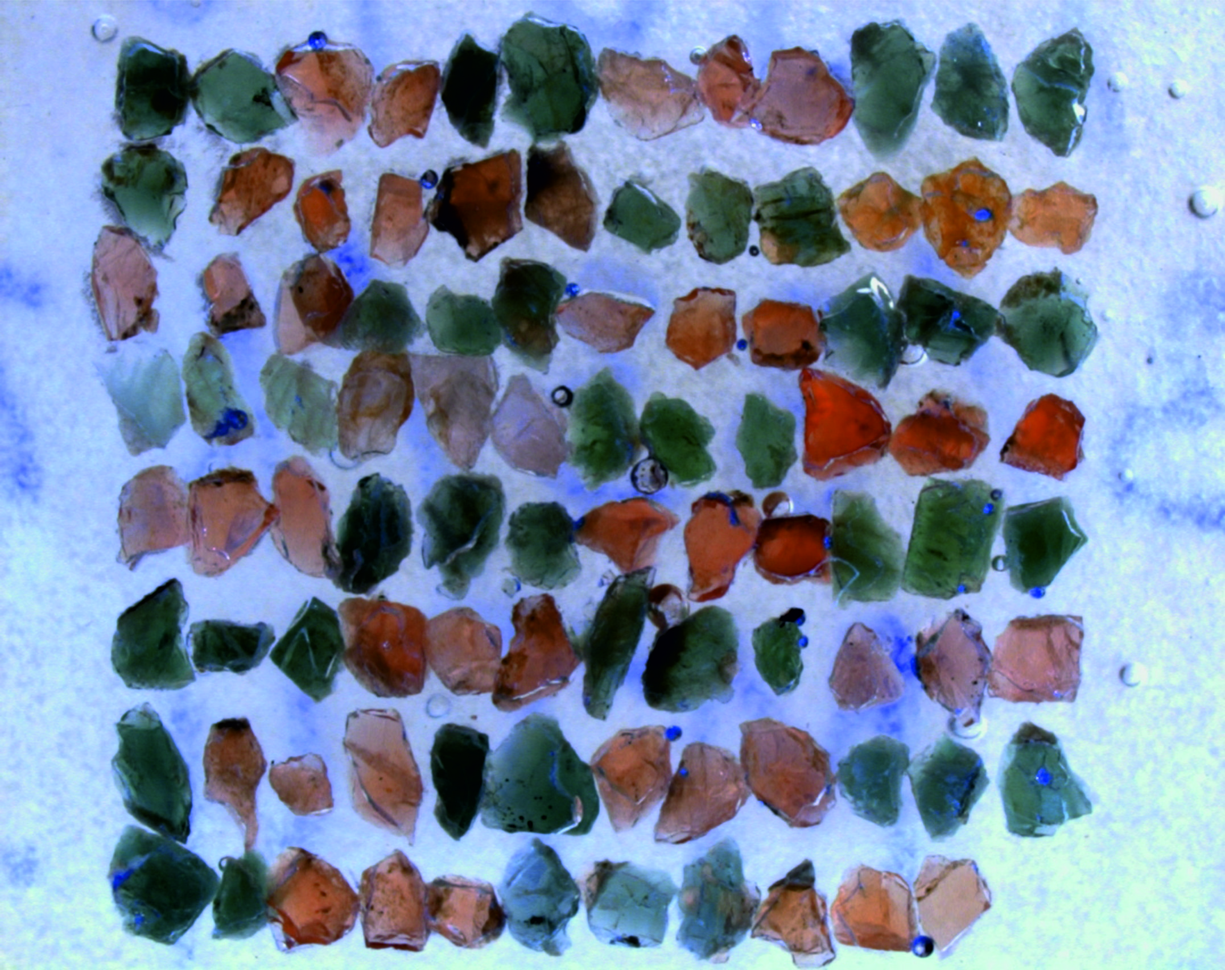
Samples
Mineral separates
(Garnet, clinopyroxene, corundum)
Corundum eclogites
Biminerallic eclogites
(High Ca and High Mg)

Slide 4
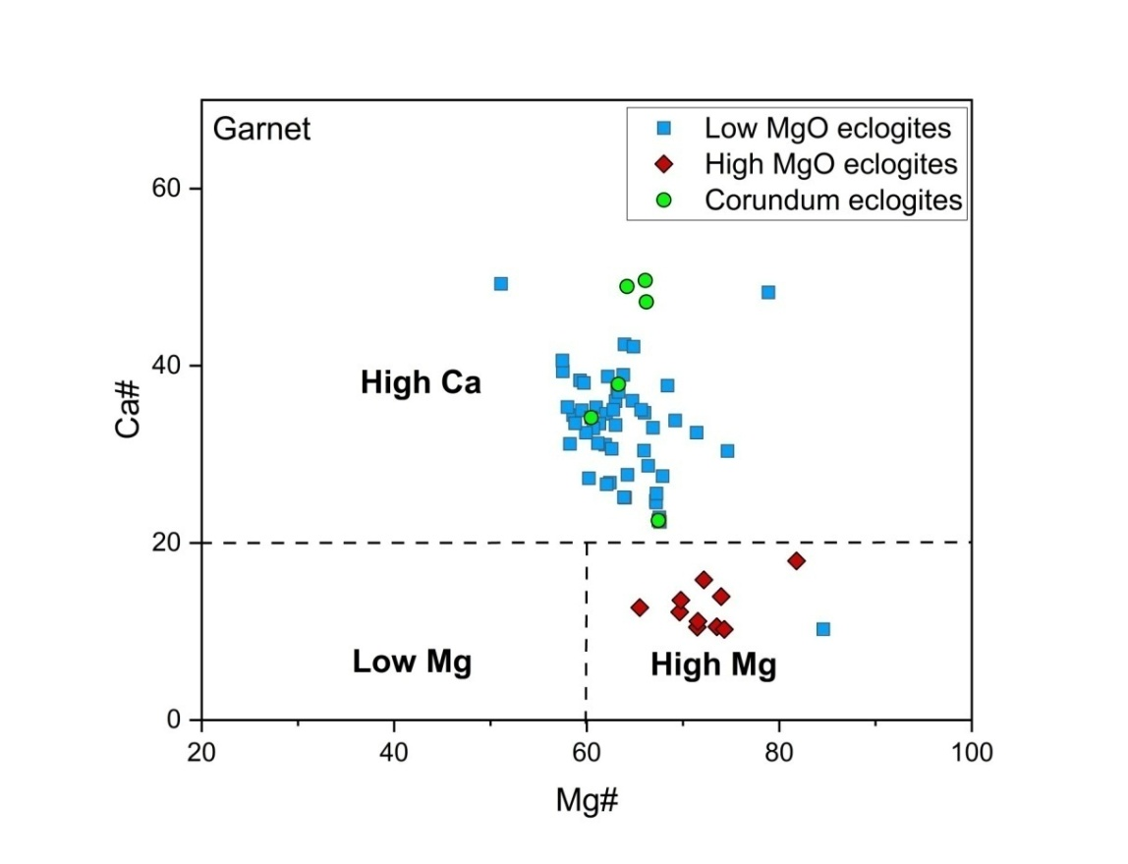
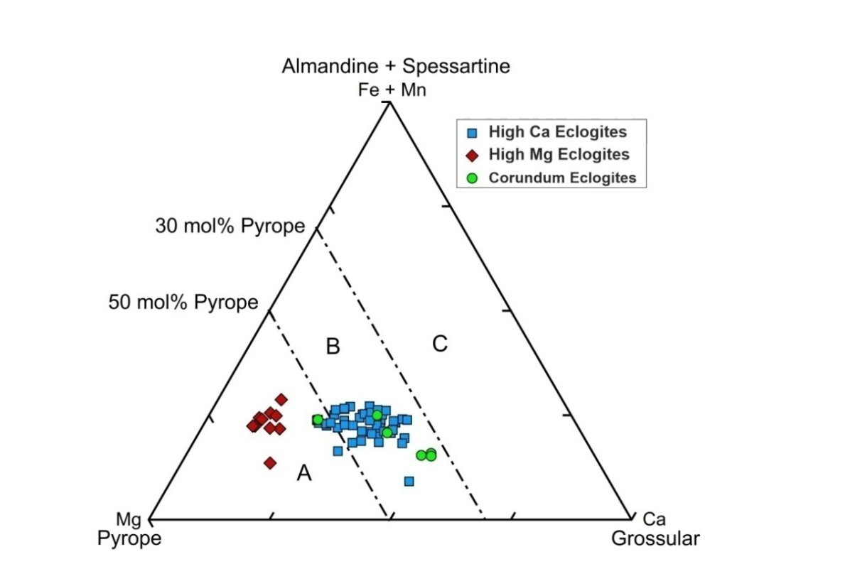
Classification - Garnets
High Ca and Corundum eclogites
fall in group B and C
High Mg eclogites
fall in group A

Slide 5
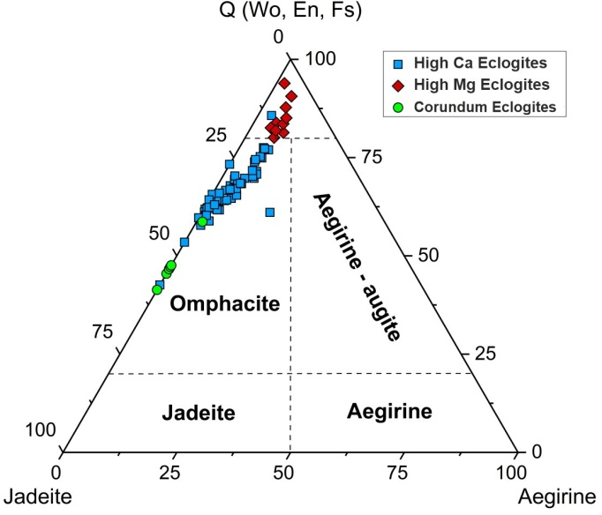
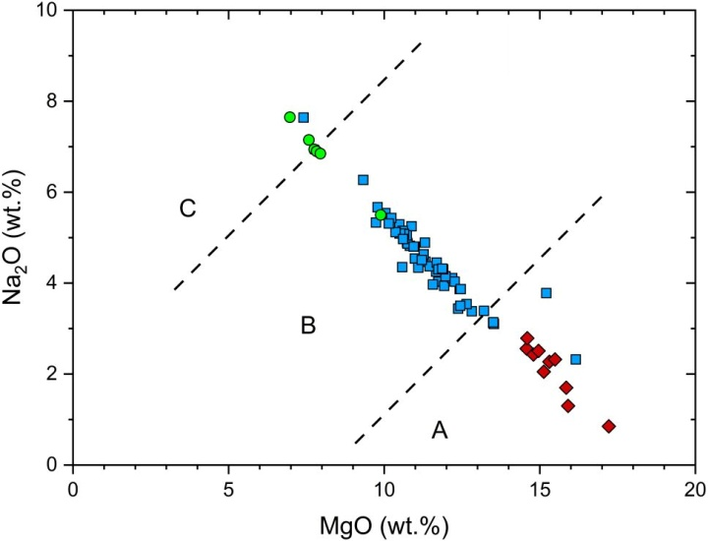
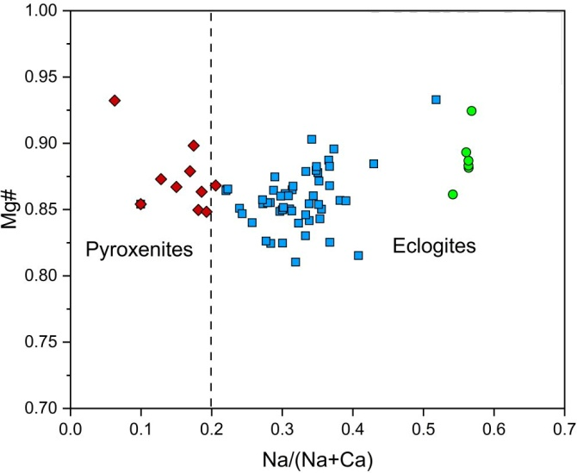
Classification - Pyroxenes
High Ca and Corundum eclogites
omphacitic in composition
fall in group B and C
High Mg eclogites
wollastonite to orthopyroxene component
fall in group A

Slide 6
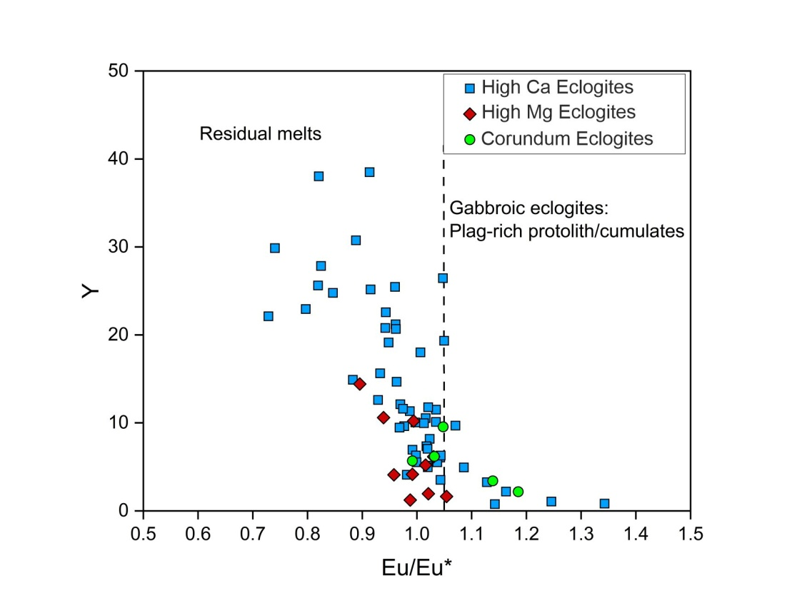
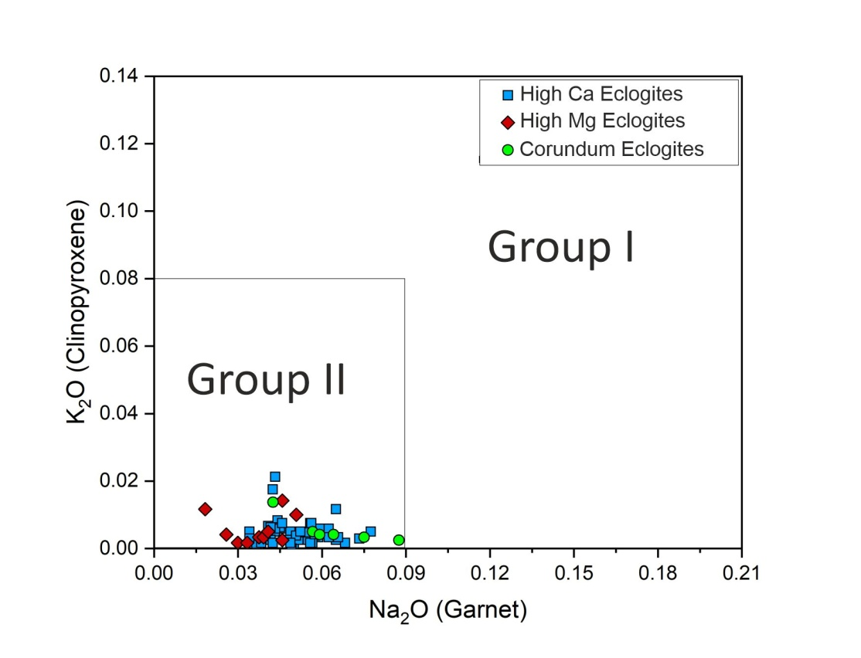
Protoliths
Basaltic protoliths (Eu/Eu* ≤ 1.05) interpreted as residual melts
All of them fall in group II

Slide 7
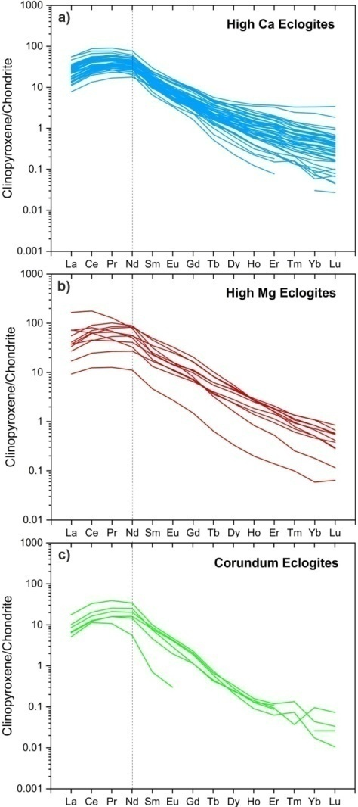
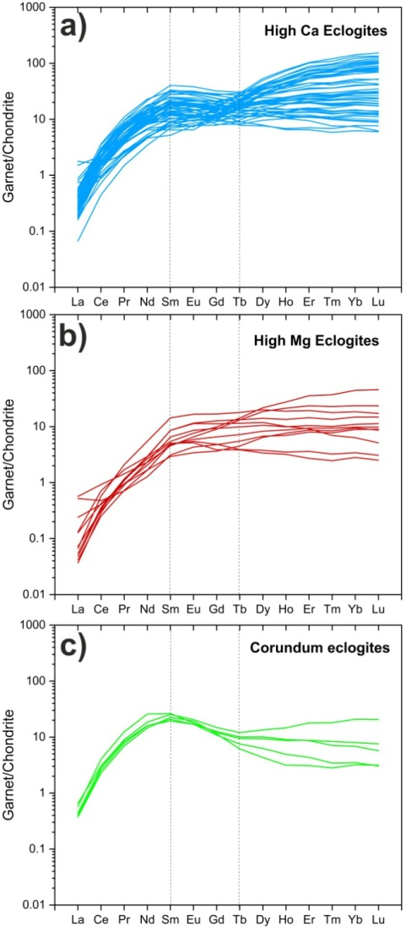
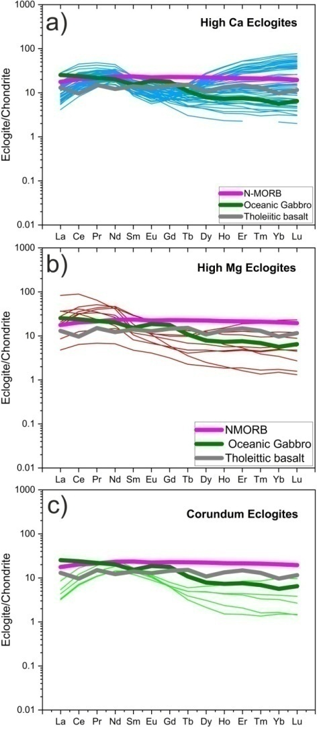
Trace element study
Presentation Outline
High Mg eclogites have a slight enrichment in the LREE_{N} pattern while High Ca eclogites have enrichment in HREE_{N} patterns. These REE_{N}
patterns are broadly comparable to those of oceanic gabbro and MORB.
Corundum bearing
eclogites are similar to oceanic gabbros in general

Slide 8
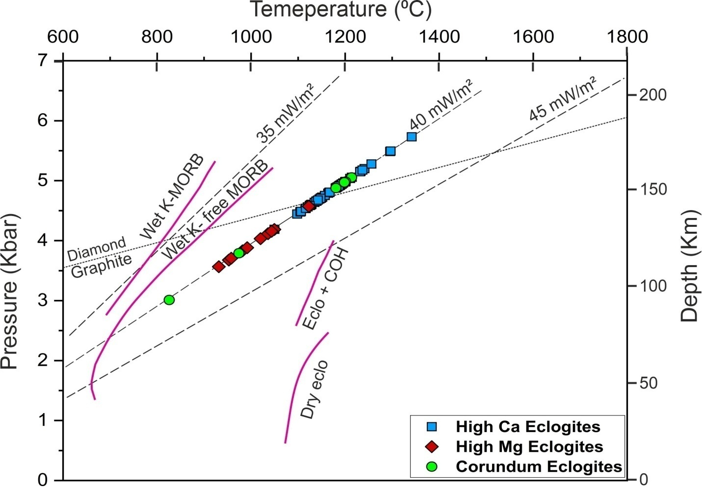
Thermobarometry
Presentation Outline
Equilibrated at a P-T range of 2.3 to 6.7 GPa (75–220 km) and 825 to 1341 °C which fall on cratonic geotherm of 40 mW/m²

Slide 9
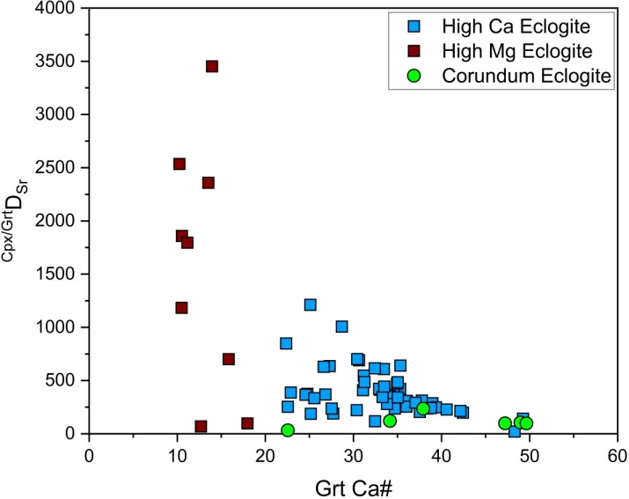
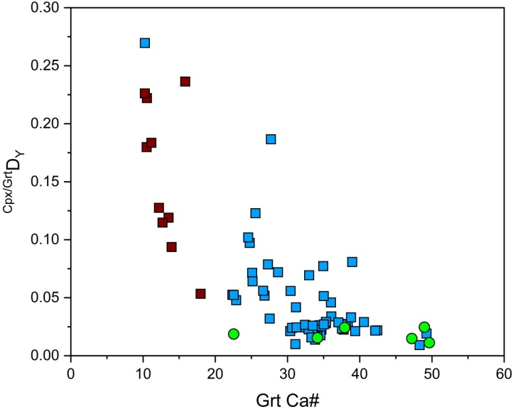
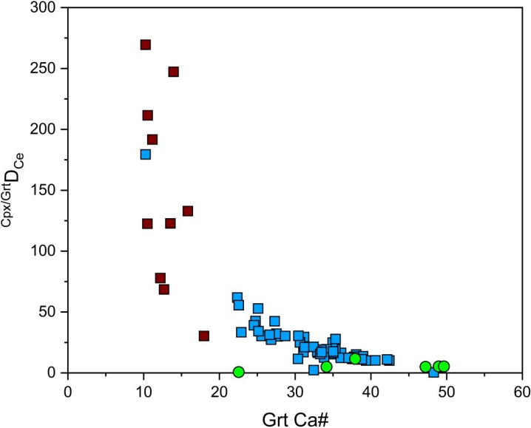
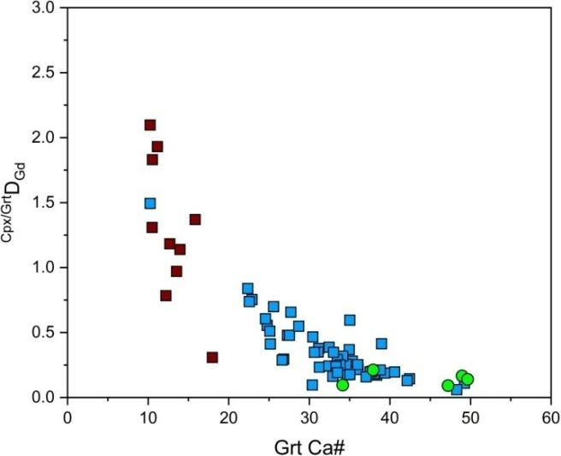
Trace element distribution between Cpx and Grt
Presentation Outline

Slide 10
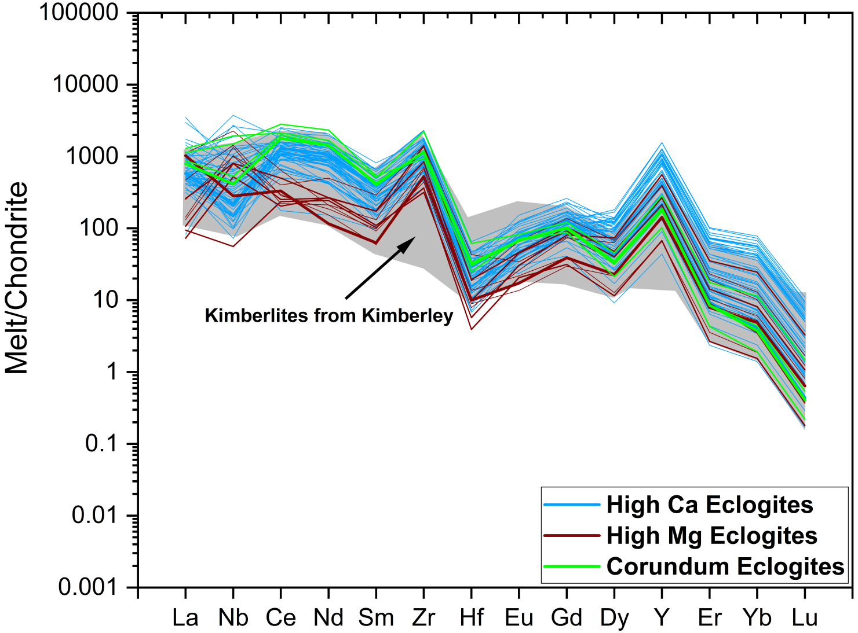
Hypothetical metasomatised melts
Presentation Outline
Metasomatic enrichment of carbonated silicate melts possibly related to proto-kimberlite activity prior to entrainment in the Kimberley kimberlites

