Slide 1
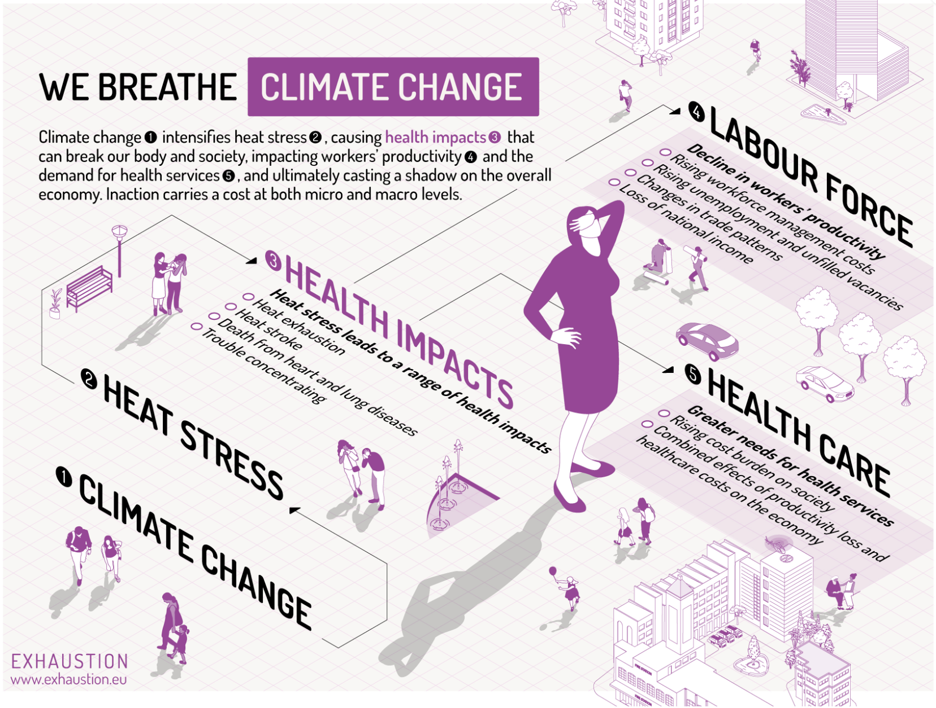
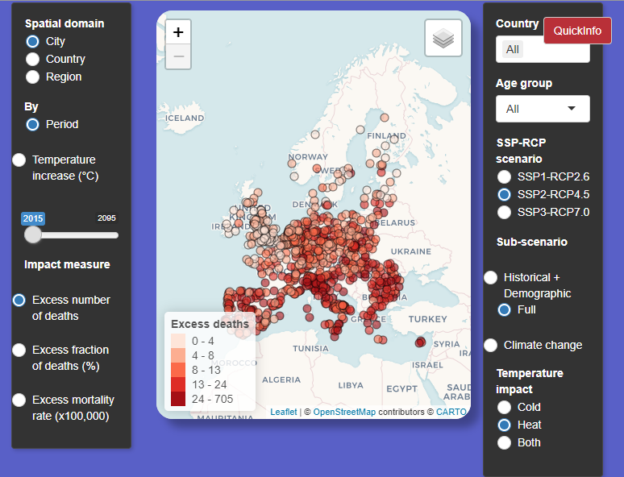
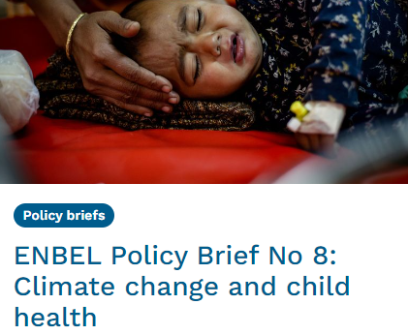
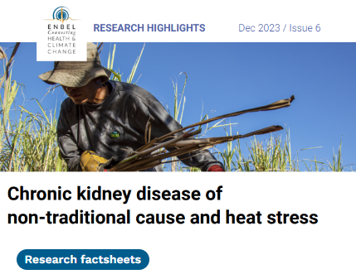
Communicating research findings on climate change and human health:
EXHAUSTION White paper (summary of main results)
Tool visualizing current and future temperature-related mortality in Europe (by SSPs)
Result visualizations from EXHAUSTION
ENBEL policy briefs (based on CC & health projects funded by the EU and Belmont Forum)
ENBEL research fact sheets (based on CC & health projects funded by the EU and Belmont Forum)
The CHANCE network on climate and health for Africa

