Slide 1
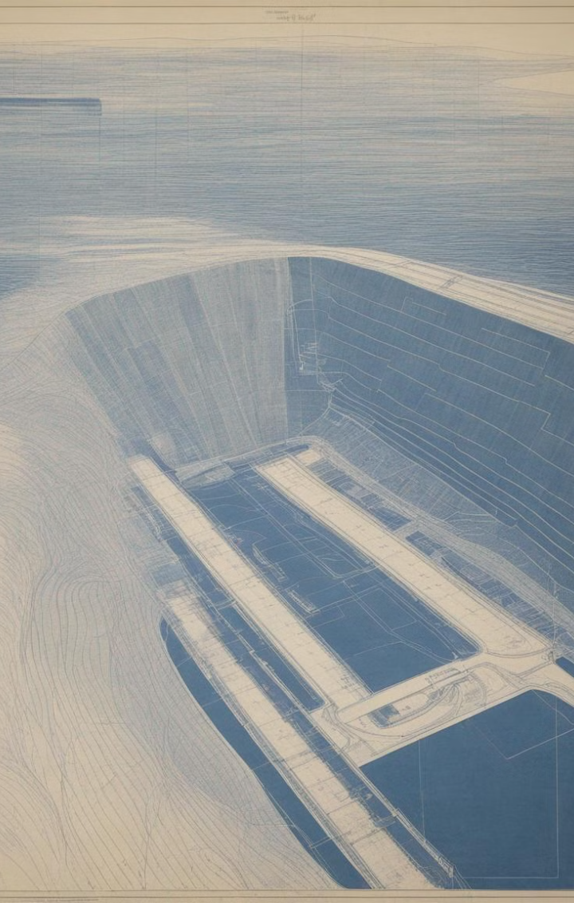
Hydropeaking Mitigation with Re-regulation Reservoirs
Ali Mchayk, Hannu Marttila, Björn Klöve, Ali Torabi Haghighi
University of Oulu; Faculty of Technology; Water, Energy, and Environmental Engineering Research Unit

Slide 2
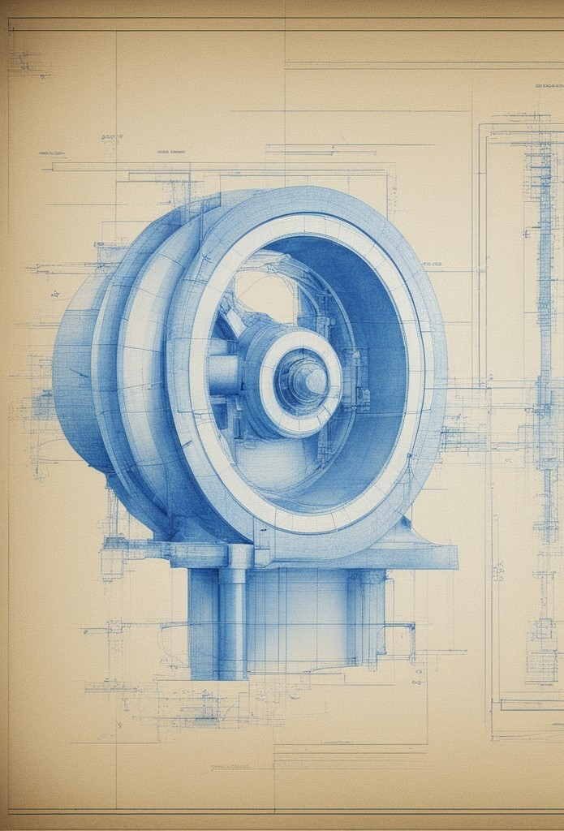
Hydropeaking Outline
1
Growing Trend
Hydropeaking will become more prominent, in a Net Zero Emissions scenario.
2
Parameters
Magnitude, frequency, timing, ramp rates, duration.
3
Impact
Ecology, sediment regime, thermal regime, riparian zones and floodplains.

Slide 3
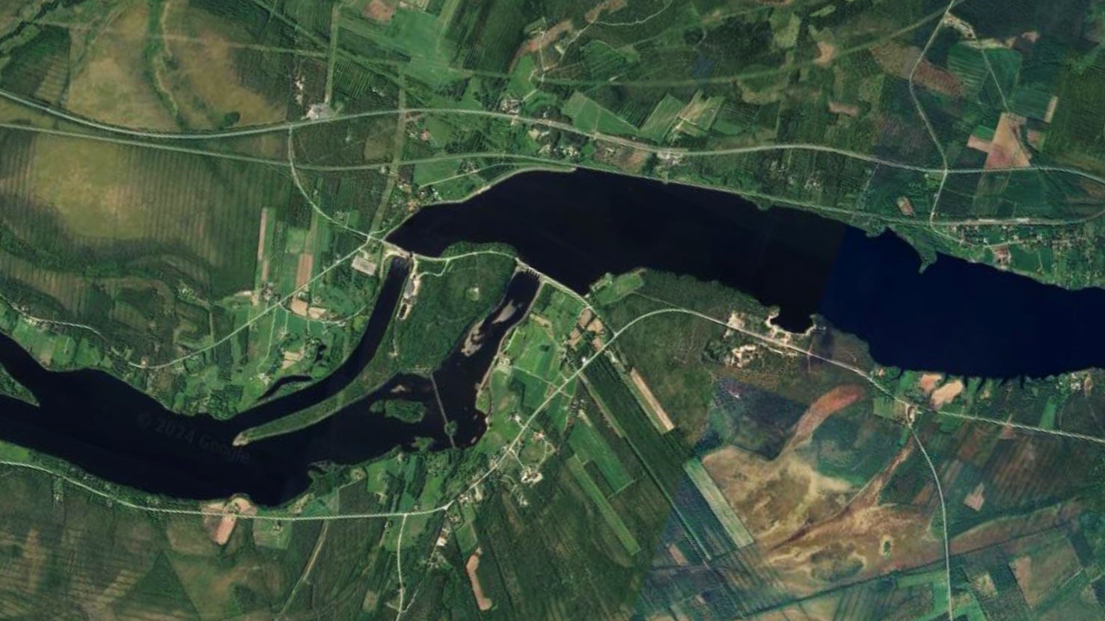

Slide 4
Un-regulated Upstream Flow
Natural flow regime represents the optimal flow regime, which is essential for maintaining the functional integrity of river ecosystems. Any deviation from the natural river flow is associated with a discrete environmental impact.

Slide 5
REGULATED DOWN STREAM FLOW
Hydropeaking results in noteworthy fluctuations in flow patterns, exerting adverse impact on river ecosystems. In comparison to seasonal or daily flow variations, the alterations induced by hydropeaking are more pronounced at temporal scales. Hydropeaking releases often exhibit higher magnitudes than natural flows, leading to significant modifications in water depth and velocity.

Slide 6
Re-Regulation Reservoir
A RRR stores a portion or the entirety of excess flow of a river regime and releases it back at an adequate rate to smooth out any sub-daily alterations in the regime. This could be achieved by storing the excess flow from the HPP during up-ramping events, to be released later during down-ramping events.

Slide 7
Re-regulated Downstream Flow
Altering the flow regime by human activities disturbs the established pattern of natural hydrological variation, exerting stress and degrading physical habitats in streams. This degradation leads to unfavorable impacts on the stream’s health, causing the river channel to function unnaturally and irregularly.

Slide 8
Re-Regulation Reservoir (RRR)
Reliability and Safety
1
Overflow and depletion prevention.
Peak and Minimum Flow
2
Augmenting flow extremities.
Ramping Rates
3
Up- & Down ramping rates thresholds.
Optimal Flow
4
Daily average flow when possible.
Optimal Ramping Rates
5
Ramping rate thresholds are satisfied.

Slide 9
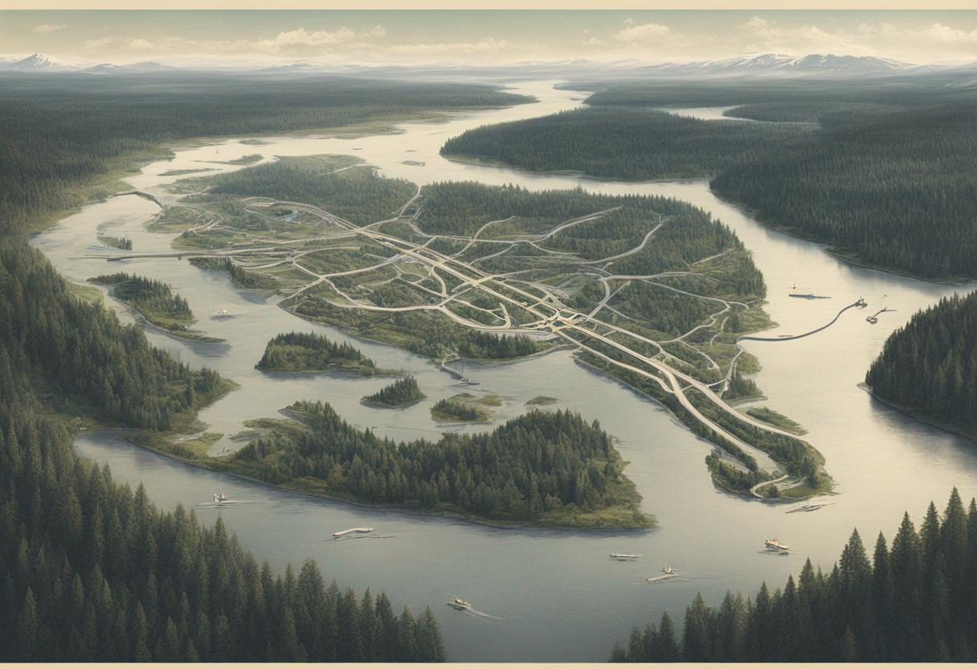

Slide 11
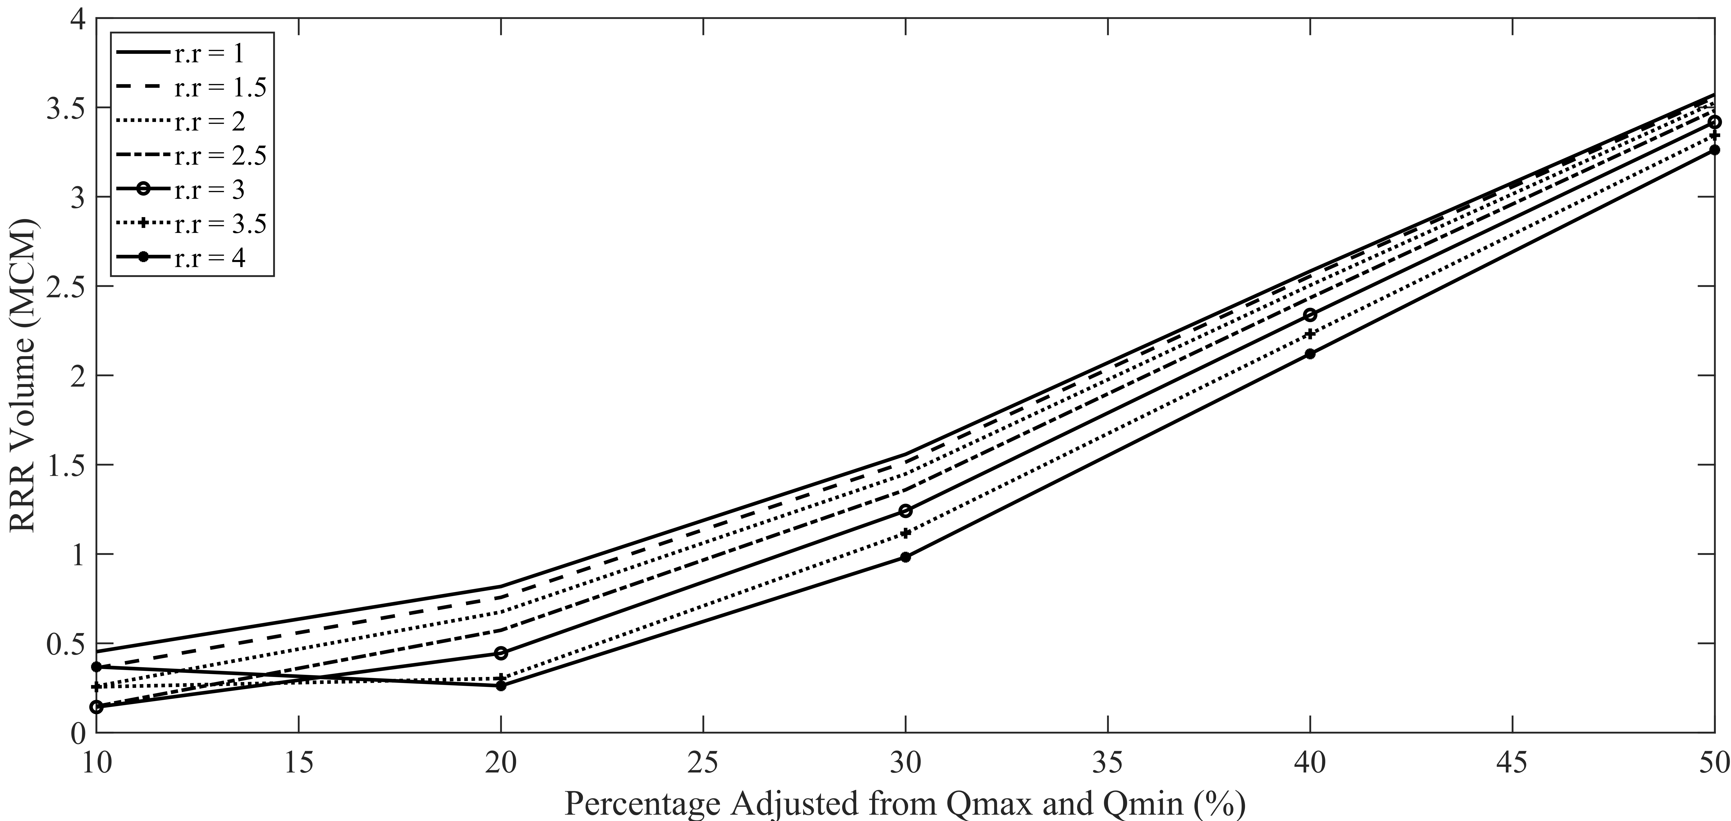
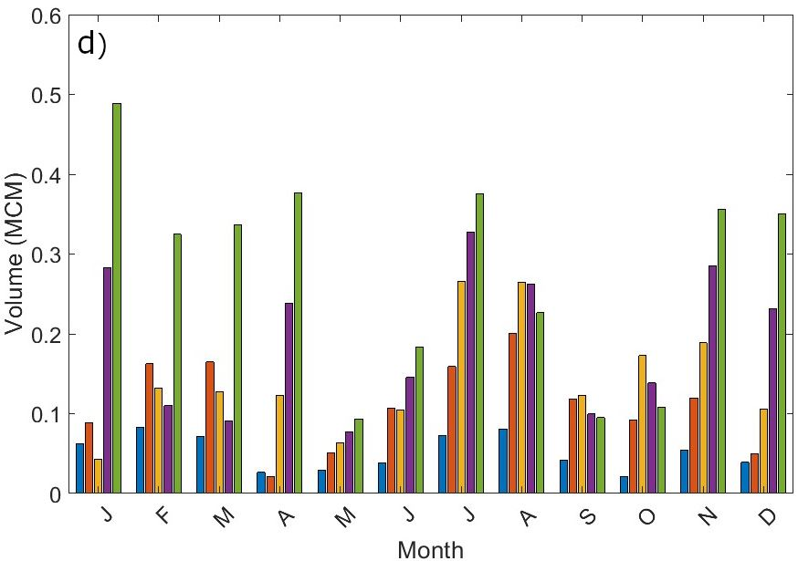
Careful consideration to the unique characteristics of a given river and its ecosystem when designing RRRs for hydropeaking mitigation is important for sustainable hydropower management without increasing the operational cost of power systems.

