Slide 1





Observing the Ammonia Daily Cycle over Agricultural Areas in Asia Using Combined Satellite Measurements
Iorga, A.^{1,2}, Harrison, J.J.^{1,2} and Moore, D.P.^{1,2}
¹ School of Physics and Astronomy, University of Leicester, UK, ²National Centre for Earth Observation, Leicester, UK

Slide 2

Agriculture and Air Quality
The Threat: Big Agriculture and Ecological Collapse
    The agricultural sector emits NH₃ into the atmosphere that contributes to environmental degradation (soil, water, air) and respiratory diseases
    Largest NH₃ hotspots: agricultural areas in South and East Asia
    NH₃ concentrations are expected to rise with average global temperatures due to climate change
The Challenge: Rapid Changes and Sparse Measurements
    NH₃ is difficult to monitor due to its short atmospheric life-time (a few hours)
    Ground observations are sparse and not many countries have networks that monitor NH₃ (particularly over Asia, Africa and South America)
The Solution: Combined Global Satellite Observations
    Combined satellite observations can give information on the evolution of NH₃ concentrations over large areas throughout a day where no ground observations are available

Slide 3
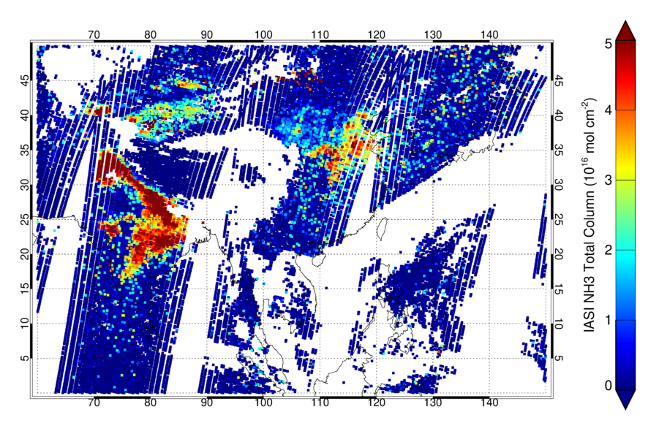
Preliminary results
We want to produce one OE-based NH₃ retrieval scheme for the IASI and CrIS instruments
Using the same retrieval setup and a-priori profiles would remove any possible biases
First attempts observing the NH₃ diurnal cycle over selected regions in the Indo-Gangetic Plain (IGP) for spring, autumn and winter
IASI and CrIS have higher signal-to-noise ratios than current geostationary satellites observing Asia
NH₃ total columns over South East Asia, 3rd April 2022, IASI day time observations.

Slide 4

Summary – Quick links
BACKGROUND
METHOD
RESULTS
Effects on the environment
Chemistry and spectroscopy
Challenges of retrieving NH₃
Satellite instruments
Retrieval scheme
Fast detection scheme
Satellite observations
Seasonal cycle
Daily cycles
CONCLUSIONS
ABOUT ME

Slide 5
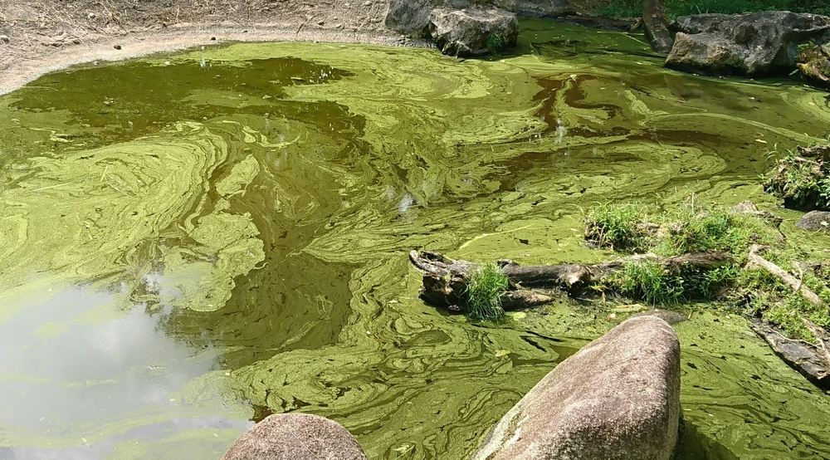

Ammonia (NH₃)
Most NH₃ (>70%) is produced from agriculture through the usage of N-based fertilisers and animal husbandry
Current budget highly uncertain ~50-130 TgN
Higher surface temperatures promote faster volatilisation rates of NH₃ from soils
Contributes to the acidification and eutrophication of soils and water bodies (1) through deposition leading to vegetation damage and biodiversity loss
Reacts with acids in the atmosphere to form PM_{2.5} leading to smog (2) and poor air quality
Harmful algae bloom causing “dead zones” in water bodies
1
NH₃-derived PM_{2.5} decreases visibility in cities near agricultural areas
2

Slide 6
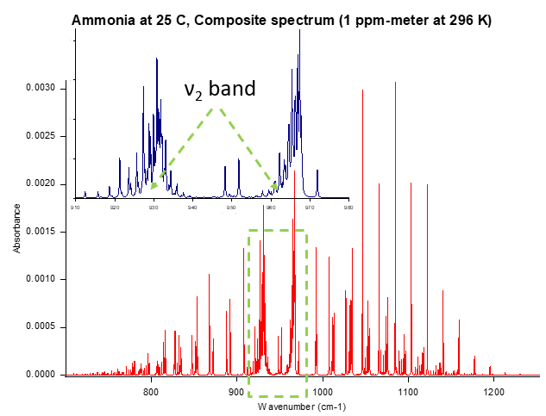
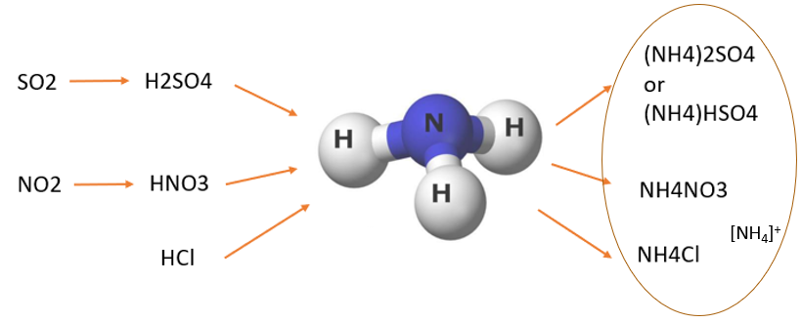
NH₃ Spectroscopy and Atmospheric Chemistry
NH₃ reacts with atmospheric acids to form aerosol (ammonium salt)
Strongest signal at Q–branch features ν₂ band

Slide 7

The Challenges of Retrieving Ammonia
Concentrations vary rapidly over space and time (highly reactive gas)
IR satellite measurements require high thermal contrast near the surface (most NH₃ is found ~ 0-2 km)
High thermal contrast results in a better NH₃ signal
More difficult to monitor ammonia at night

Slide 8

Satellite Instruments
IASI
Operated by EUMETSAT
MetOp –A, -B, -C satellites
Polar orbiting, nadir viewing
Local overpass 9:30 AM/PM
Swath 2200 km
12 km diameter footprint
50 x 50 km FOV (4 pixels, 2 x 2)
Spectral range 645 – 2760 cm⁻¹
Spectral resolution 0.5 cm⁻¹
CrIS
Operated by NOAA
Suomi-NPP, NOAA-20, NOAA-21 satellites
Polar orbiting, nadir viewing
Local overpass 1:30 AM/PM
Swath 2200 km
14 km diameter footprint
50 x 50 km FOV (9 pixels, 3 x 3)
Spectral range 650 – 2550 cm⁻¹
Spectral resolution 0.625 cm⁻¹

Slide 9

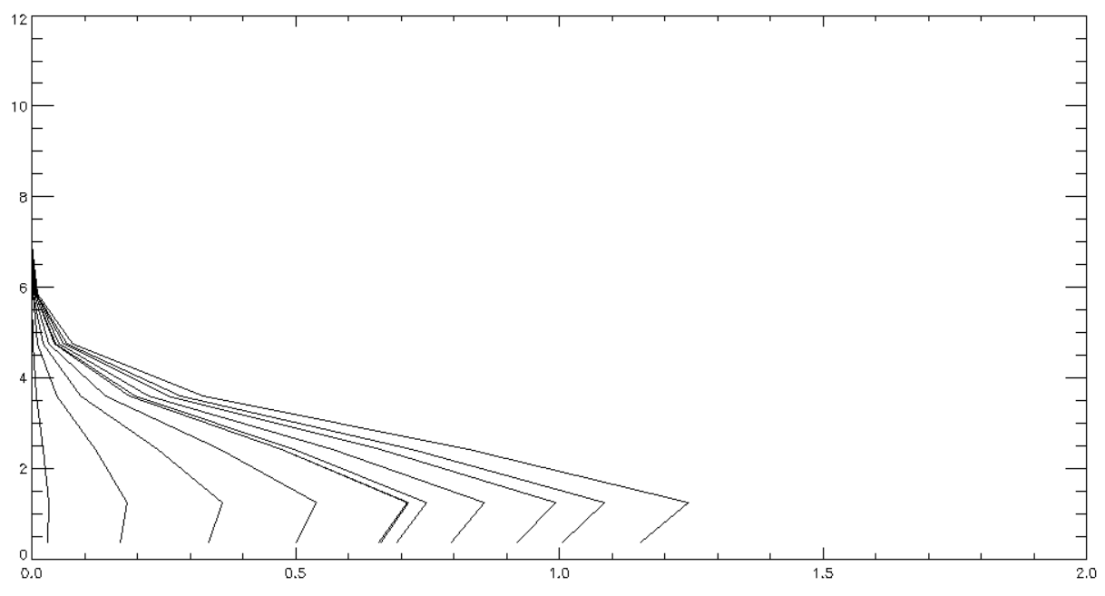
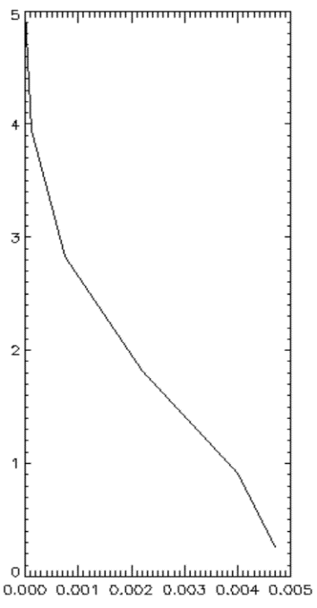
University of Leicester IASI Retrieval Scheme – (ULIRS)
NH₃ averaging kernel
Uses the Levenberg-Marquardt method -Optimal Estimation-based (OE)
NH₃ active in the IR range (920-940 cm⁻¹ and 960-980 cm⁻¹ Q-branches give the strongest signal)
Cloud free observations only
11 levels equidistant pressure grid
Produces averaging kernels
Uses the Reference Forward Model (RFM) – line-by-line radiative transfer model developed at the University of Oxford
NH₃, H₂O, CO₂, O₃, and temperature profile co-retrieved with N₂O, CFC-12 also in the microwindow
Uses 3 different NH₃ a-priori profiles depending on NH₃ pollution level (low, moderate, high) – Fast Detection Scheme
NH₃ a-priori
Altitude (km)
The CrIS Algorithm For Trace gases (CRAFT) is used as the retrieval scheme for the CrIS instrument. It is based on ULIRS and uses the same set of parameters, but currently is optimised for the high NH₃ case only.
Altitude (km)
Mixing ratio (ppmv)
Notes:
What other information to include? DOFS? Residuals? Fast Linear Retrieval Scheme – HRI?

Slide 10


Quick detection as input to ULIRS
NH₃ a-priori
S_{y} is the corresponding variance-covariance matrix:
$$S_{y}≡\frac{1}{N−1}\sum_{j=1}^{N}{\left(y_{j}−\overline{y}\right)}{\left(y_{j}−\overline{y}\right)}^{T}$$
K is calculated using the RFM and an assumed target gas profile
  Assumes a typical surface emissivity
  Assumes climatological pressure, temperature, humidity profiles
  Cloud-free scene
x scales the target gas profile, before conversion to a total column
J.C. Walker et al. (2012), J. Geophys. Res., 117, D00U16
A scaling factor x is retrieved using a one-step linear process
$x={\left(K^{T} {S_{y}}^{−1}K\right)}^{−1}K^{T}{{ S}_{y}}^{−1}\left( y−\overline{y} \right)$
K is the difference between a calculated IASI spectrum with target gas (for a fixed atmospheric profile), and one without
y is a measured IASI spectrum in the region of interest (cloud fraction 0-20 %)
y̅ is an averaged climatological background spectrum (cloud fraction 0-20 %) over the Asia region for each month in 2022:
$\overline{y}=\frac{1}{N}\sum_{j=1}^{N}{y_{j}}$
Notes:
What other information to include? DOFS? Residuals? Fast Linear Retrieval Scheme – HRI?

Slide 11
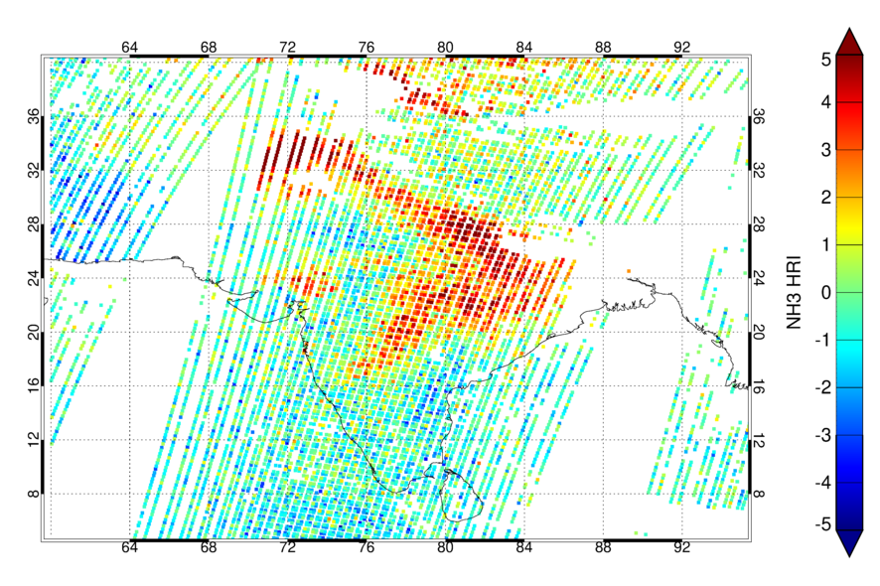
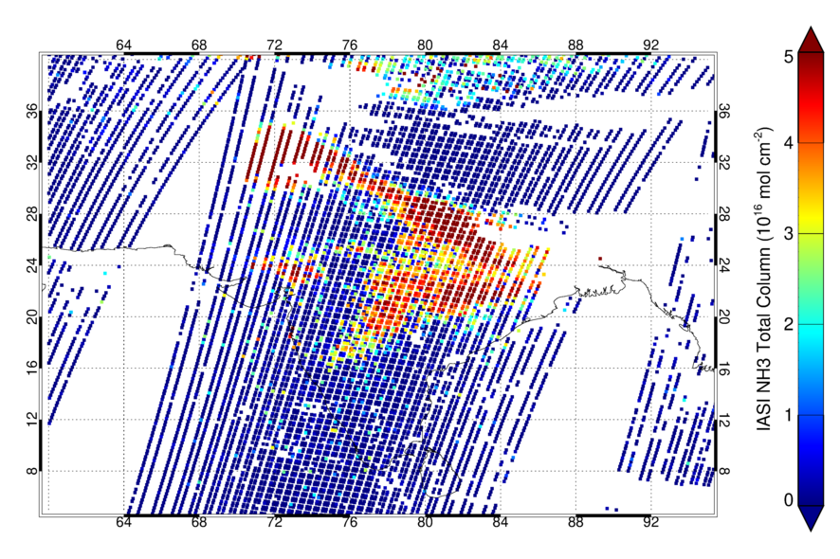
Fast Detection Scheme Day Time Observations
Fast detection 3rd April 2022
ULIRS 3rd April 2022
NH3 detection index
The Fast Detection Scheme (used by ULIRS) is used to determine 3 different NH₃ a-priori profiles depending on the pollution case.

Slide 12
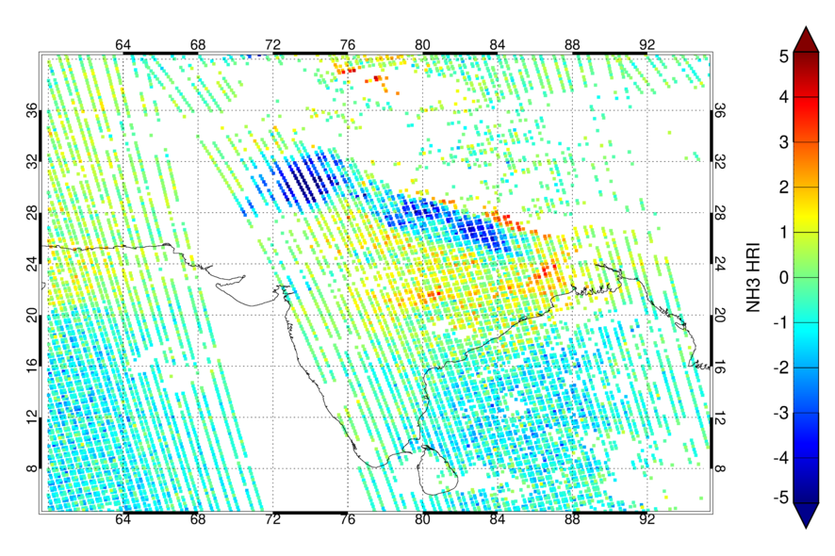
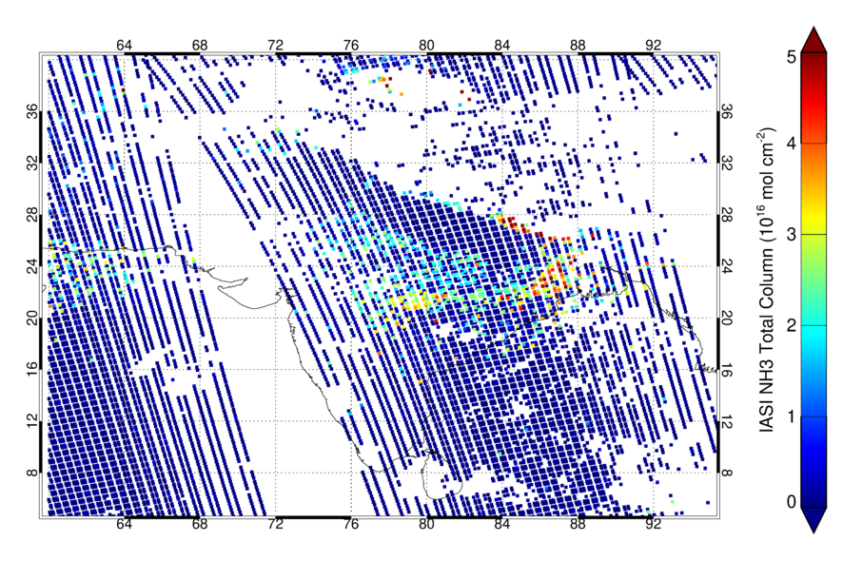
Fast Detection Scheme Night Time Observations
Fast detection 3rd April 2022
ULIRS 3rd April 2022
NH3 detection index
Negative thermal contrast (the surface temperature is lower than the temperature of the atmospheric layer where NH₃ peaks) can be observed in the fast detection for values smaller than -5
We are still trying to implement this correctly in the retrieval.

Slide 13
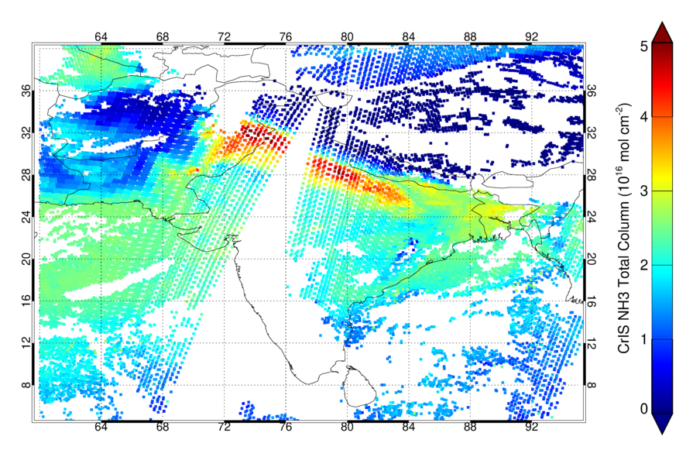
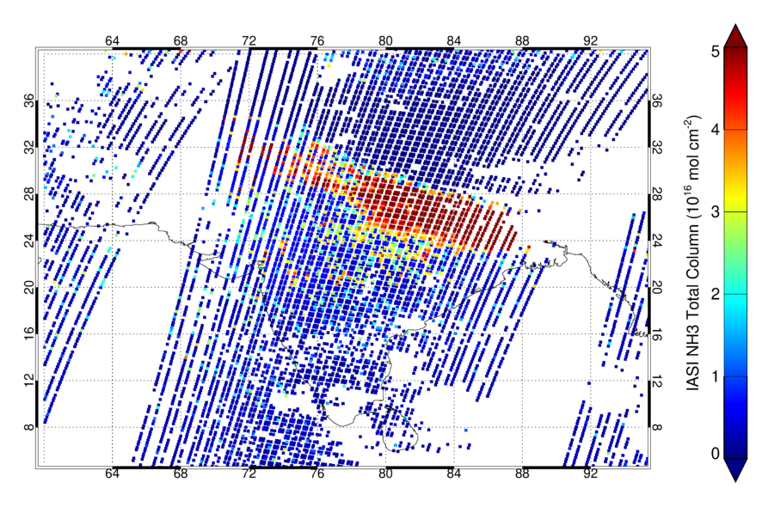
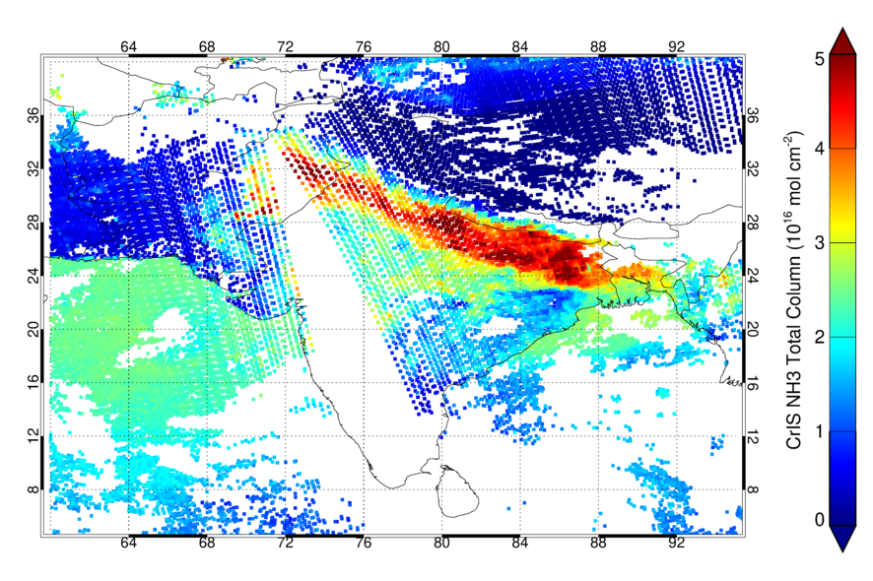
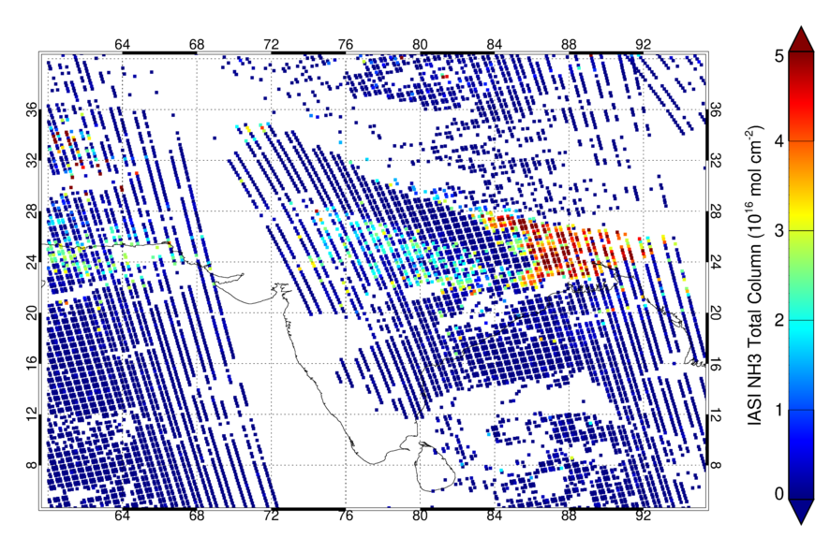
NH₃ Satellite Observations - Spring
CrIS night
Top left: CrIS night time (1:30)
Top right: IASI day time (9:30)
Bottom left: CrIS day time (13:30)
Bottom right: IASI day time (21:30)
Date: 8th April 2022
CrIS NH₃ night time total columns are higher than IASI night time over much of the Indo-Gangetic Plain. We are still investigating the IASI retrieval.
CrIS retrieval is only optimised over the Indo-Gangetic Plain.
IASI day
CrIS day
IASI night

Slide 14
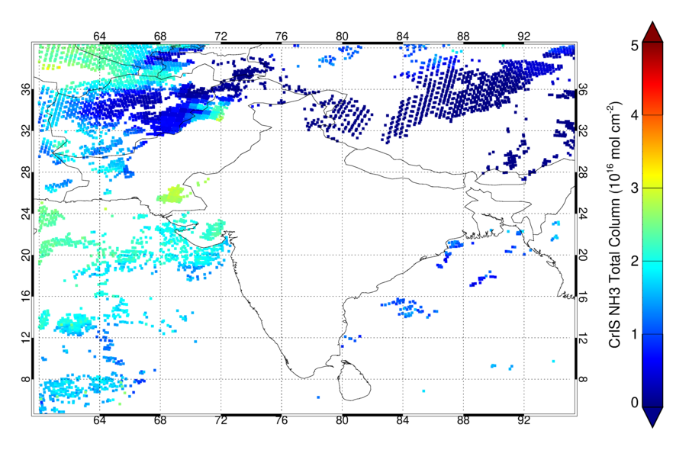
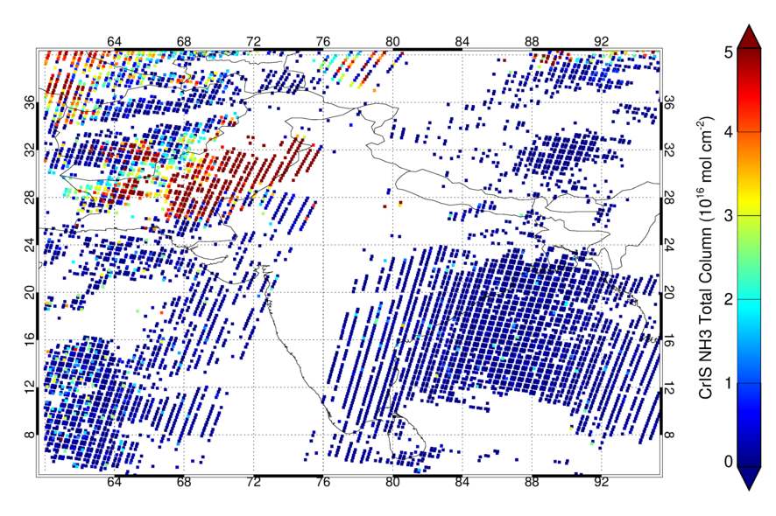
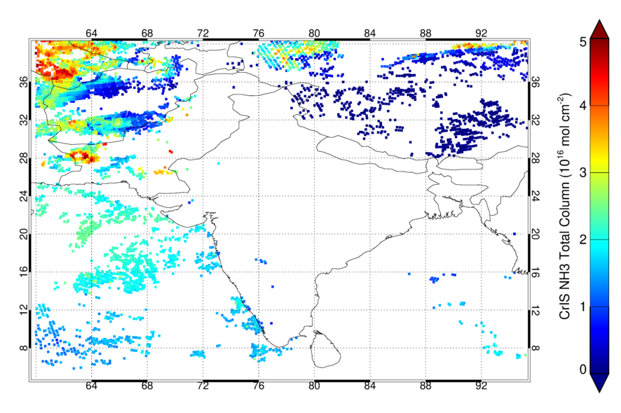
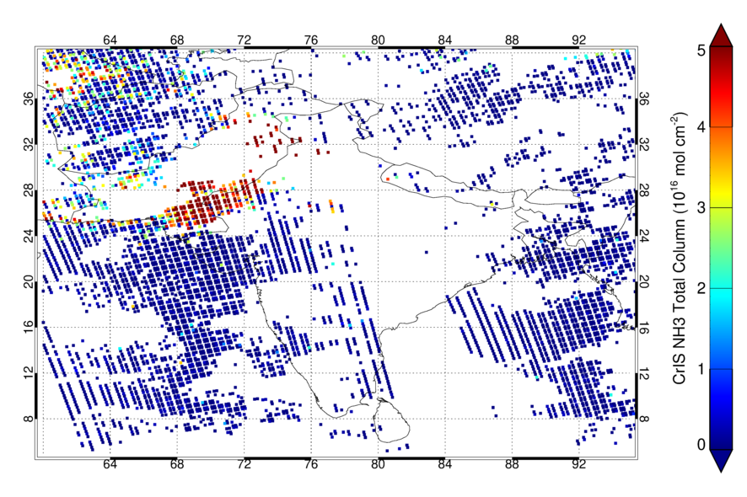
NH₃ Satellite Observations - Summer
Top left: CrIS night time (1:30)
Top right: IASI day time (9:30)
Bottom left: CrIS day time (13:30)
Bottom right: IASI day time (21:30)
Date: 30th July 2022
The monsoon season takes place between late June and early September in India.
This makes is more difficult to observe NH₃ during summer.
CrIS night
IASI day
CrIS day
IASI night

Slide 15
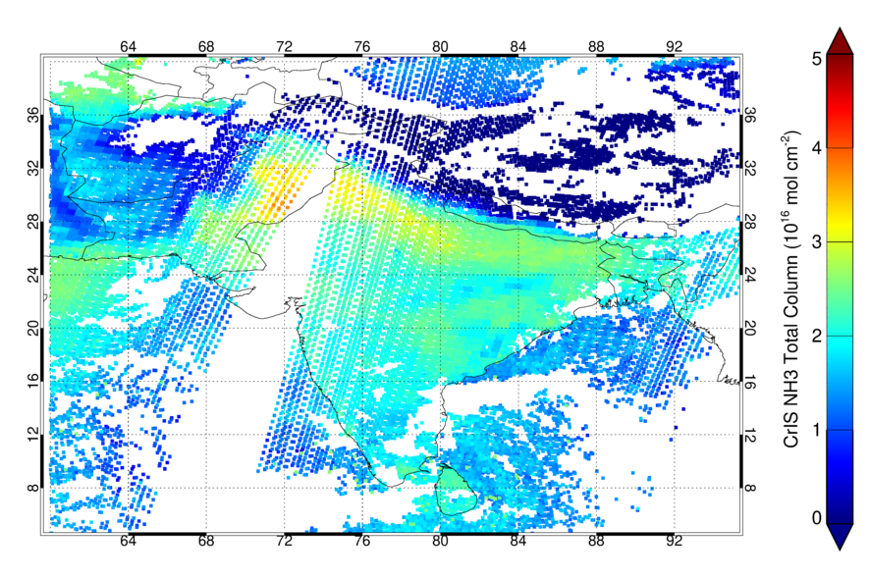
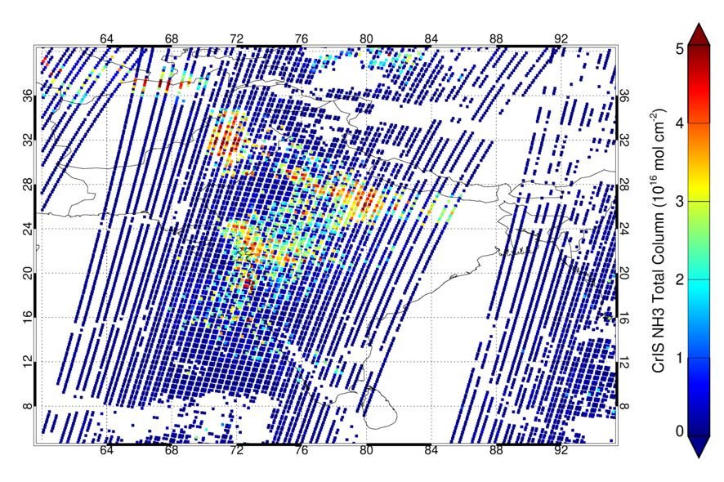
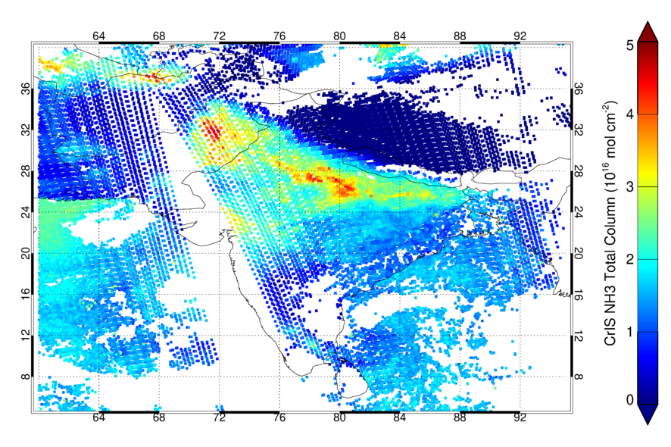
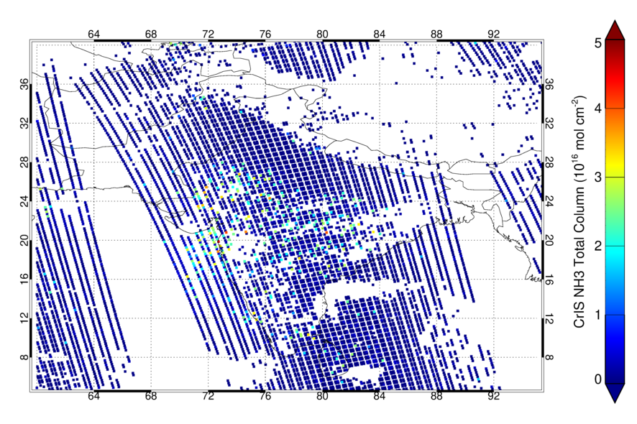
NH₃ Satellite Observations - Autumn
Top left: CrIS night time (1:30)
Top right: IASI day time (9:30)
Bottom left: CrIS day time (13:30)
Bottom right: IASI day time (21:30)
Date: 26th October 2022
CrIS NH₃ night time total columns are higher than IASI night time over much of the Indo-Gangetic Plain. We are still investigating the IASI retrieval.
NH₃ peaks during spring (main fertilisation period) followed by smaller increases in autumn (second fertilisation period).
CrIS night
IASI day
CrIS day
IASI night

Slide 16
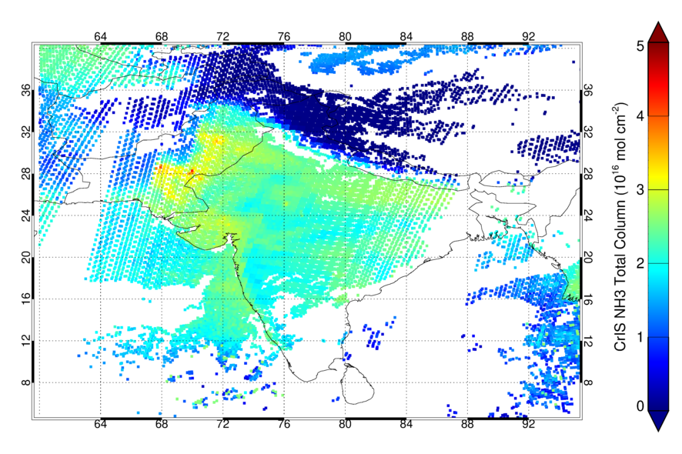
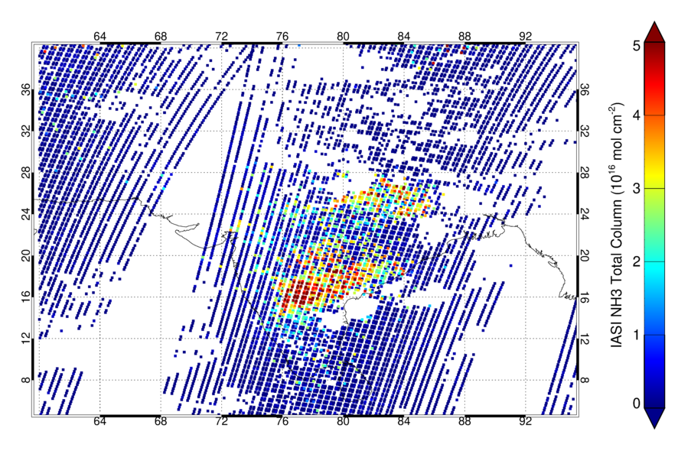
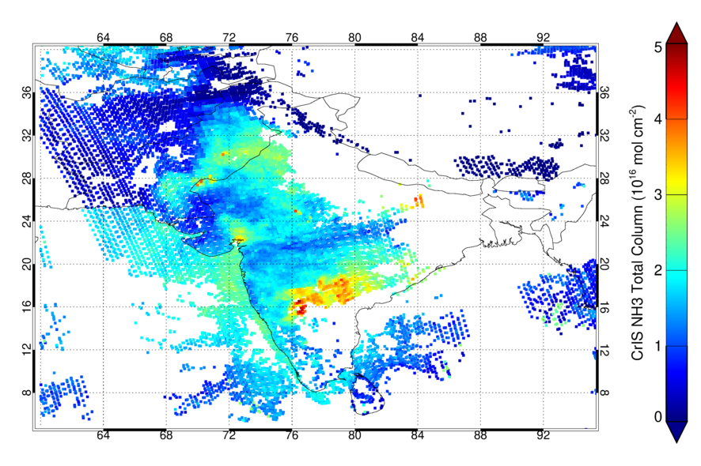
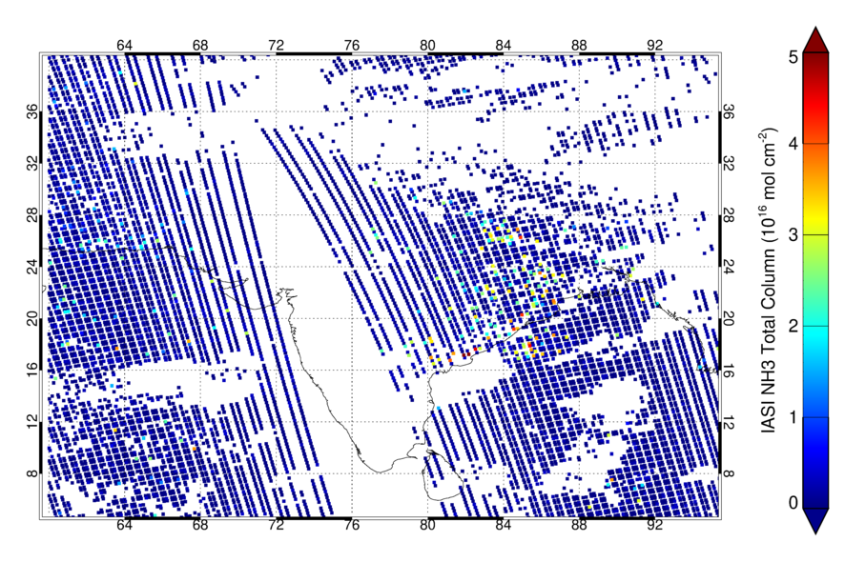
NH₃ Satellite Observations - Winter
Top left: CrIS night time (1:30)
Top right: IASI day time (9:30)
Bottom left: CrIS day time (13:30)
Bottom right: IASI day time (21:30)
Date: 26th January 2022
The NH₃ daily cycle is much weaker during winter, although small increases in the total column can still be observed during the day.
Generally lower thermal contrast is seen during the day.
CrIS night
IASI day
CrIS day
IASI night

Slide 17
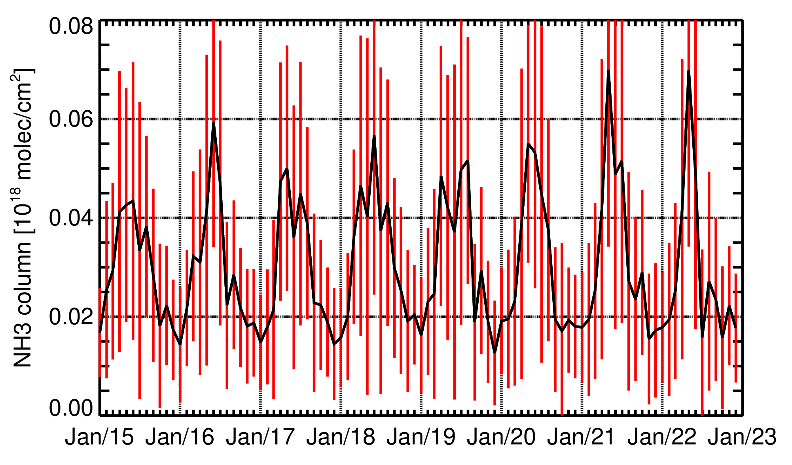
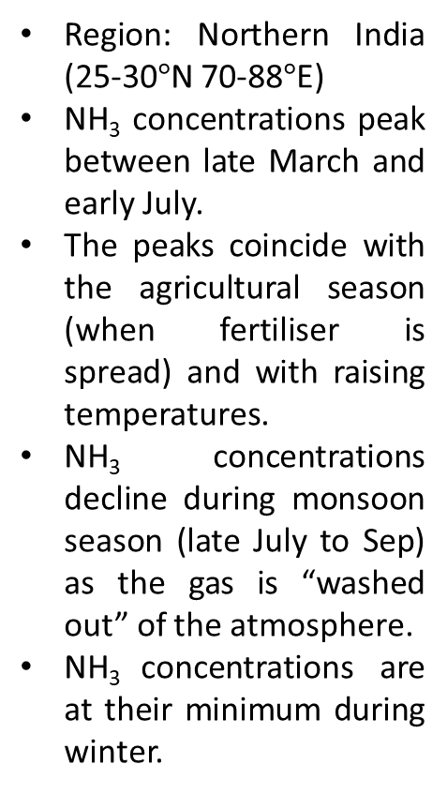
Ammonia Seasonal Cycle India 2015-2022
Region: Northern India (25-30$°$N 70-88$°$E)
NH₃ concentrations peak between late March and early July.
The peaks coincide with the agricultural season (when fertiliser is spread) and with raising temperatures.
NH₃ concentrations decline during monsoon season (late July to Sep) as the gas is “washed out” of the atmosphere.
NH₃ concentrations are at their minimum during winter.
Time series showing the NH₃ seasonal cycle over the Indo-Gangetic Plain between 2015 and 2022 using IASI day time observations.

Slide 18
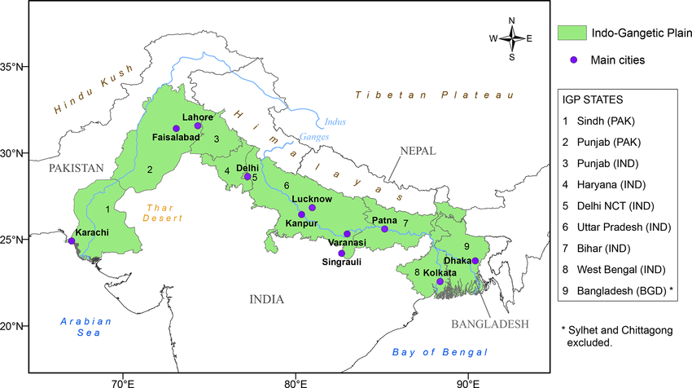
NH₃ Diurnal Cycle Study Areas - Indo-Gangetic Plain
The mean NH₃ total column was calculated inside the following grid box locations for each satellite overpass:
30-31N 73-74E (Punjab, Pakistan)
29-30N 76-77E (Haryana, India)
26-27N 81-82E (Uttar Pradesh, India)
The NH₃ daily cycle is over-plotted with the thermal contrast from ERA5 data, defined as the difference between the surface and the atmosphere at 900 hPa.
Study area
Geographical and administrative map of the Indo-Gangetic Plain (IGP), including Pakistan, India and Bangladesh.

Slide 19
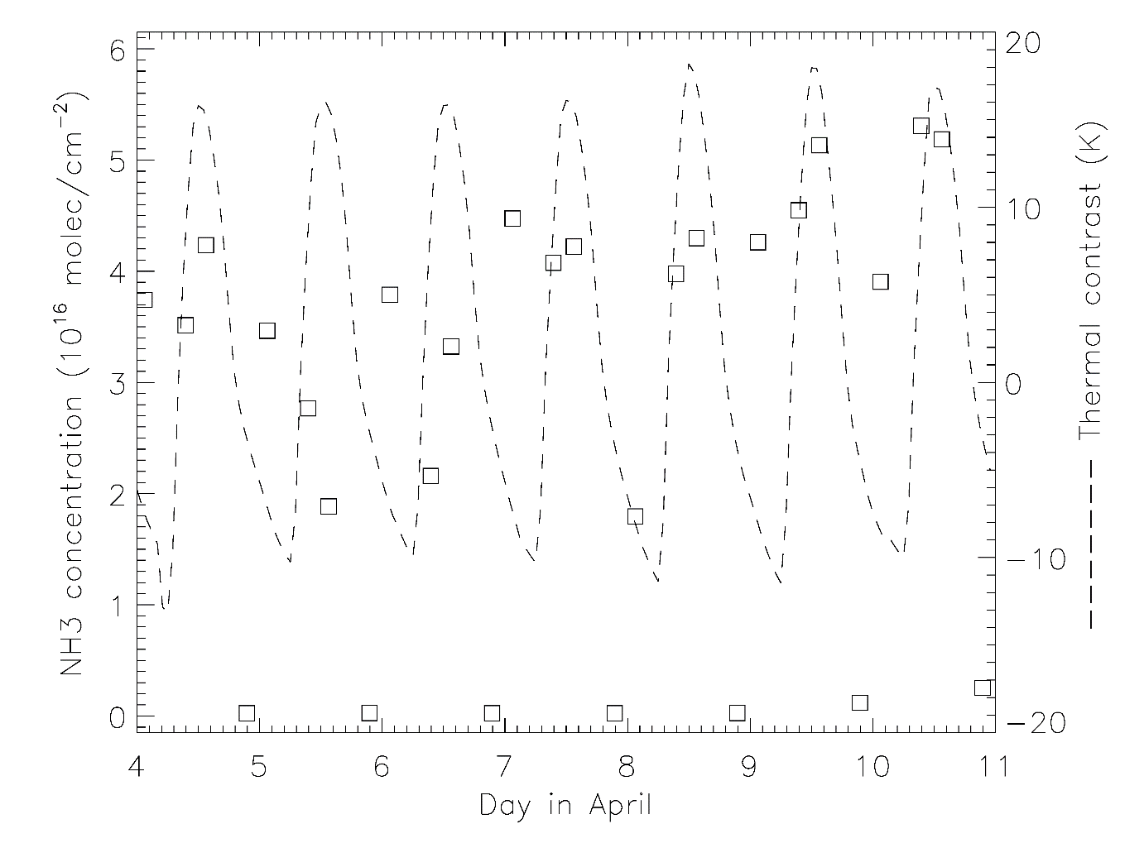
Punjab, Pakistan (30-31N 73-74E) - Spring
Legend
CrIS data
IASI data
- - - ERA5 TC

Slide 20
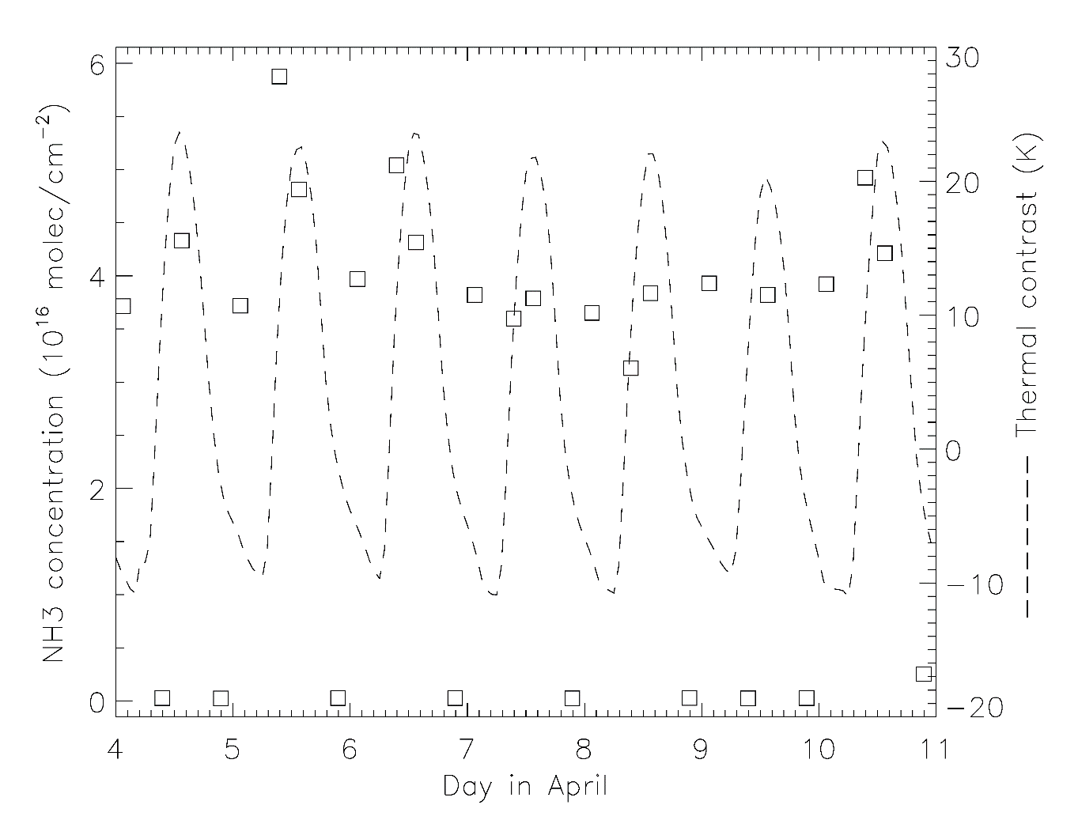
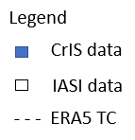
Haryana, India (29-30N 76-77E) - Spring

Slide 21
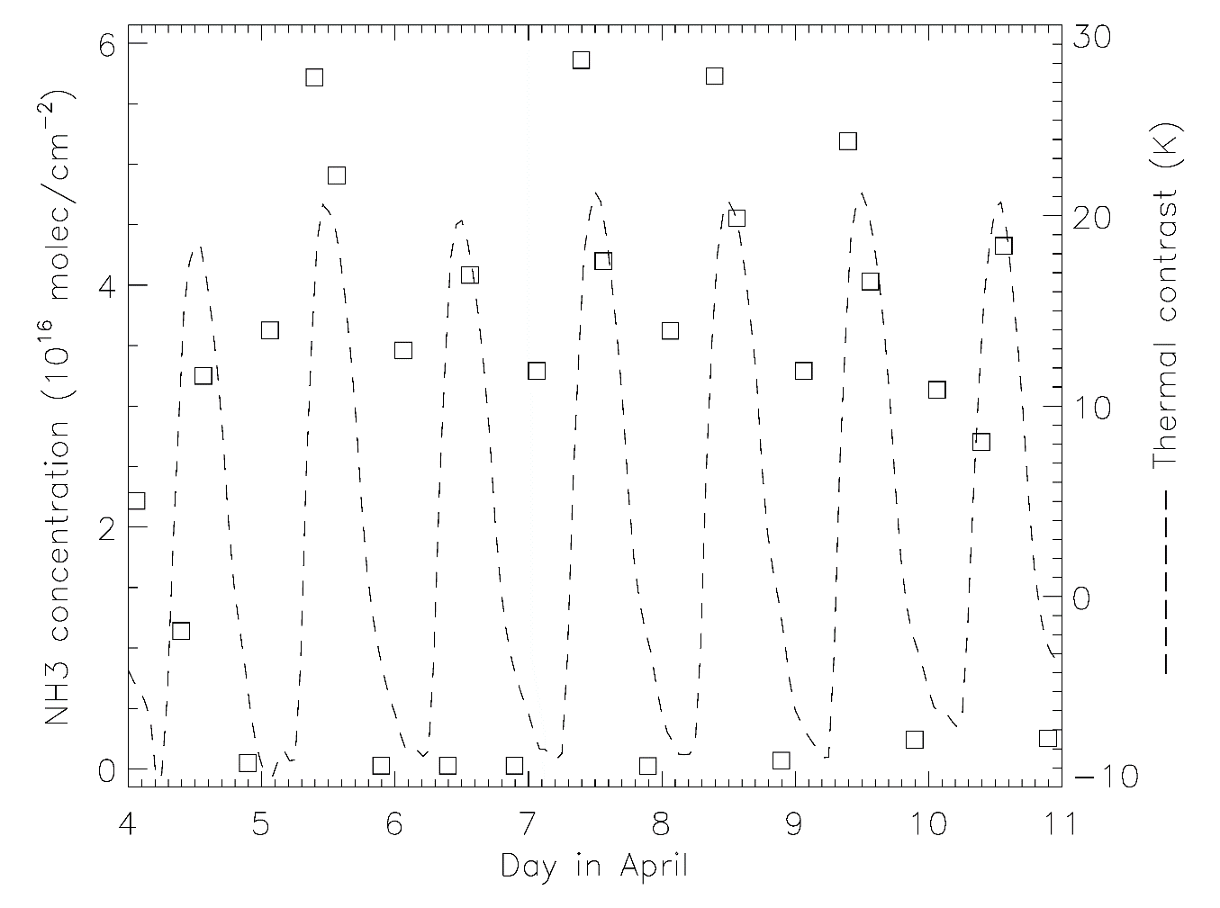
Uttar Pradesh, India (26-27N 81-82E) - Spring

Slide 22
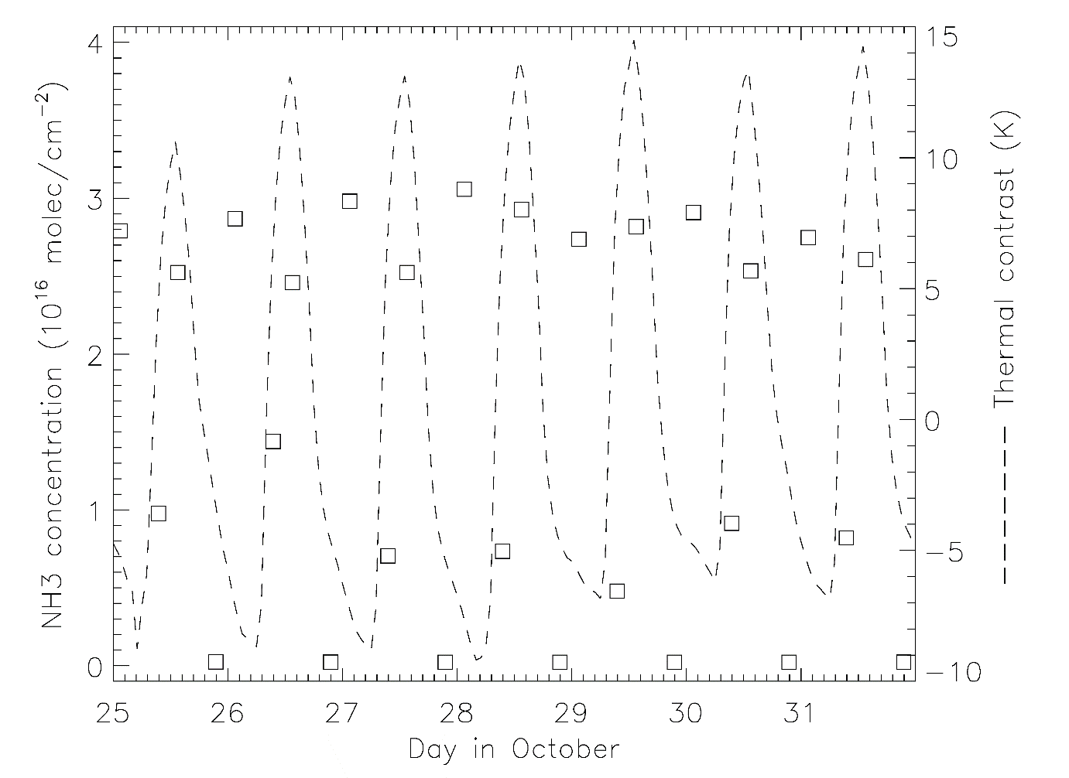
Punjab, Pakistan (30-31N 73-74E) - Autumn

Slide 23
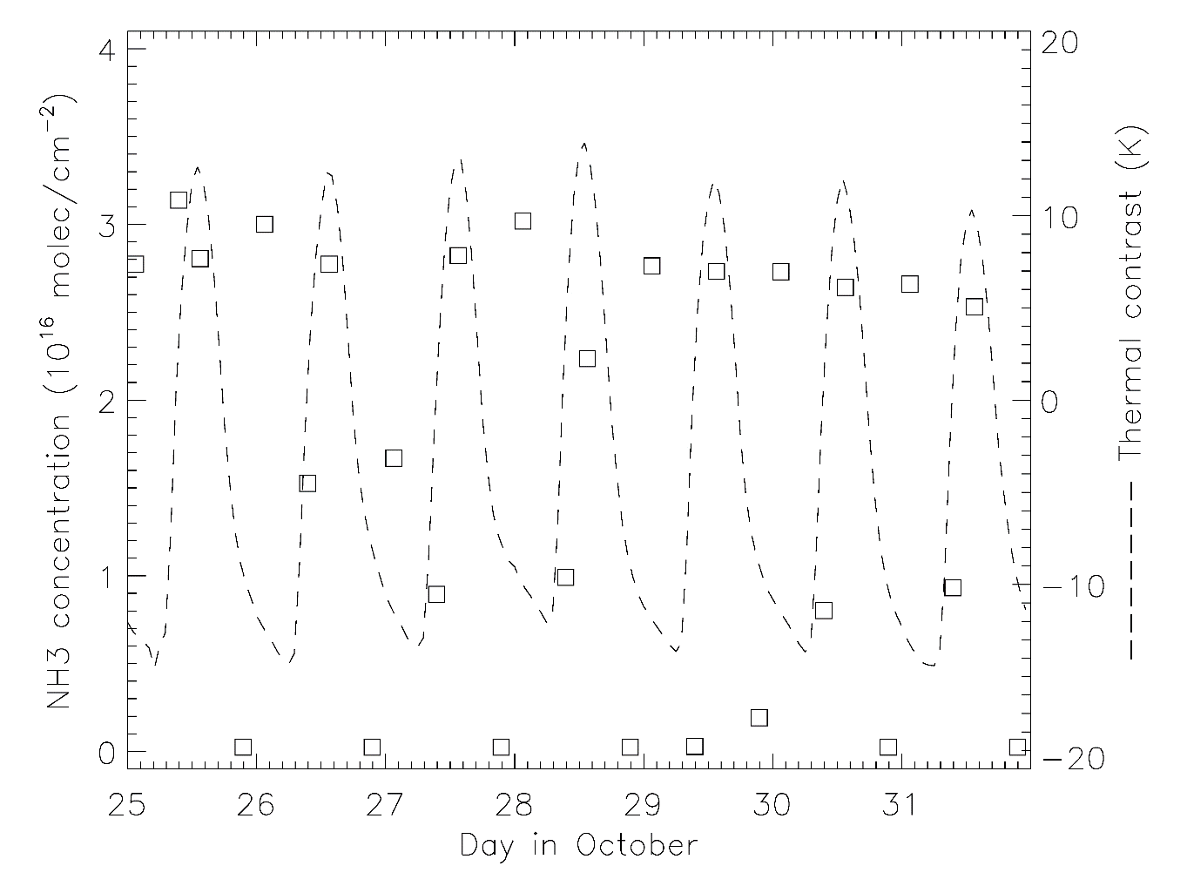
Haryana, India (29-30N 76-77E) - Autumn

Slide 24
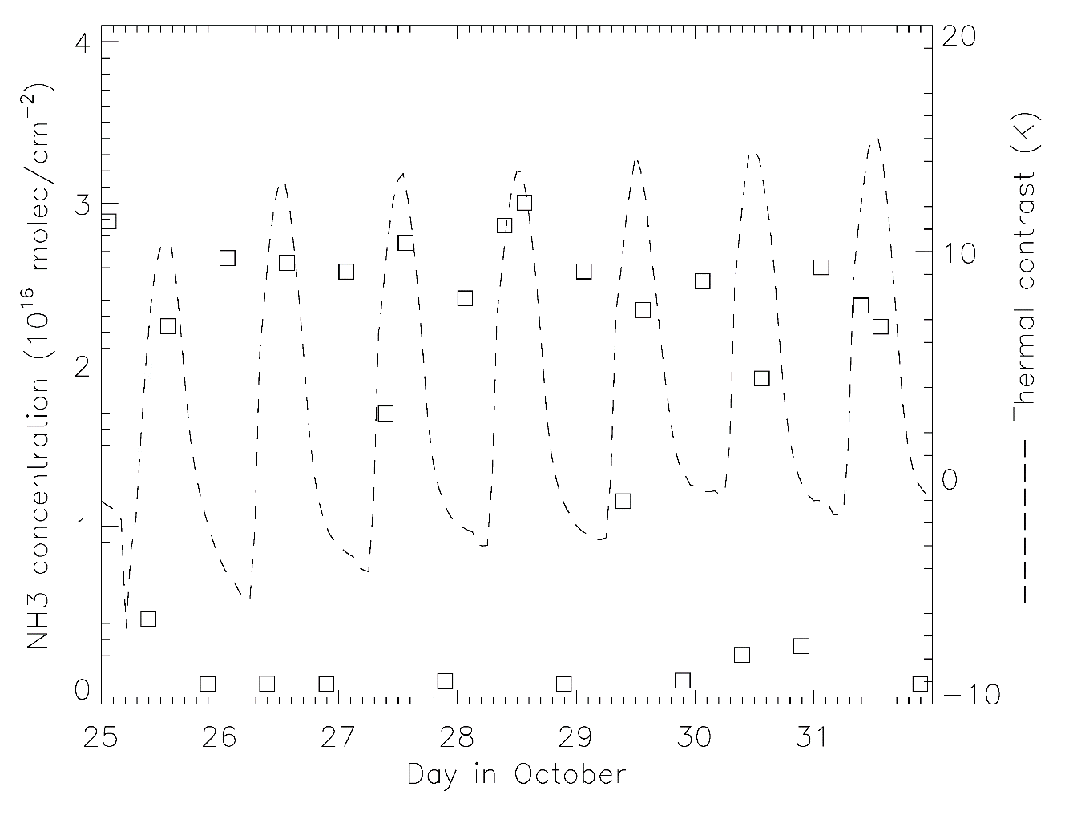
Uttar Pradesh, India (26-27N 81-82E ) - Autumn

Slide 25
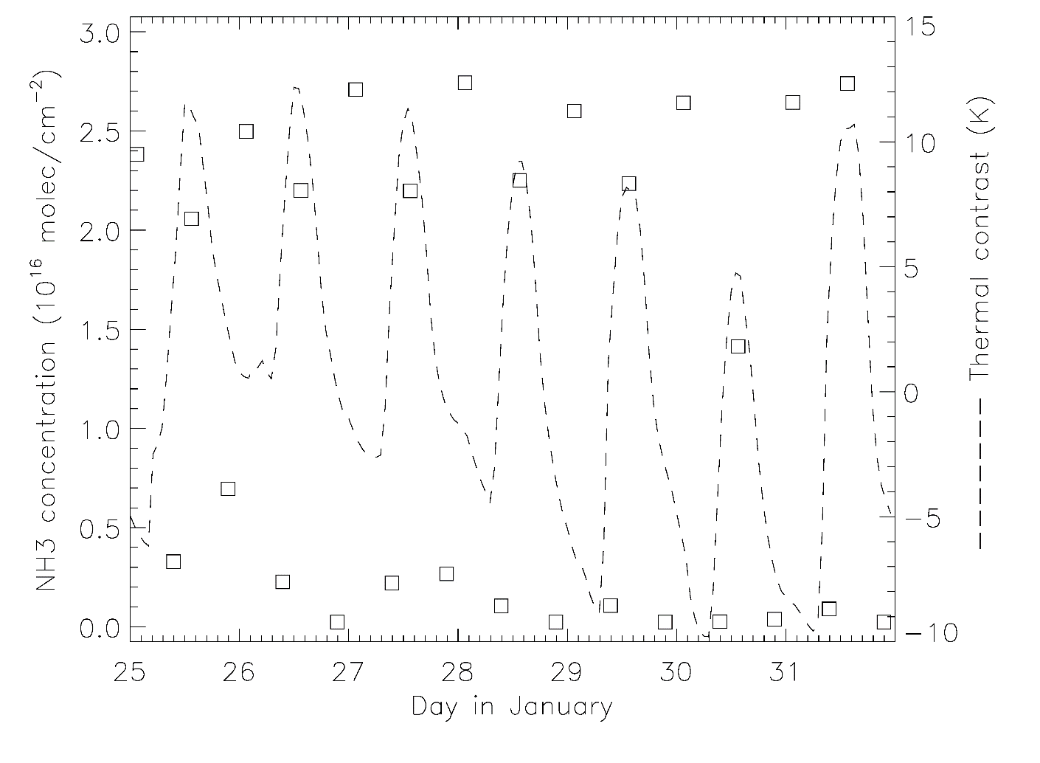
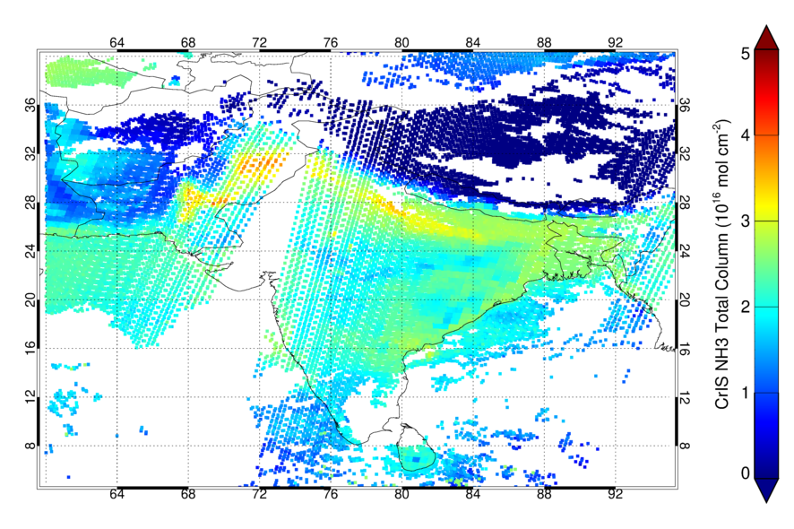
Punjab, Pakistan (30-31N 73-74E) - Winter

Slide 26
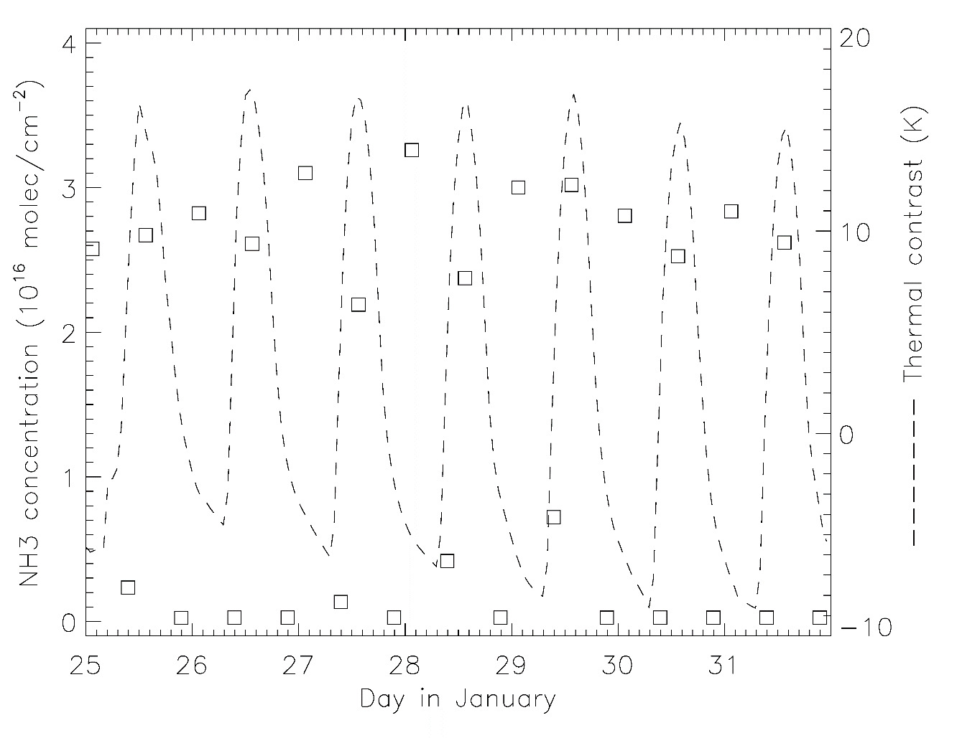
Haryana, India (29-30N 76-77E) - Winter

Slide 27
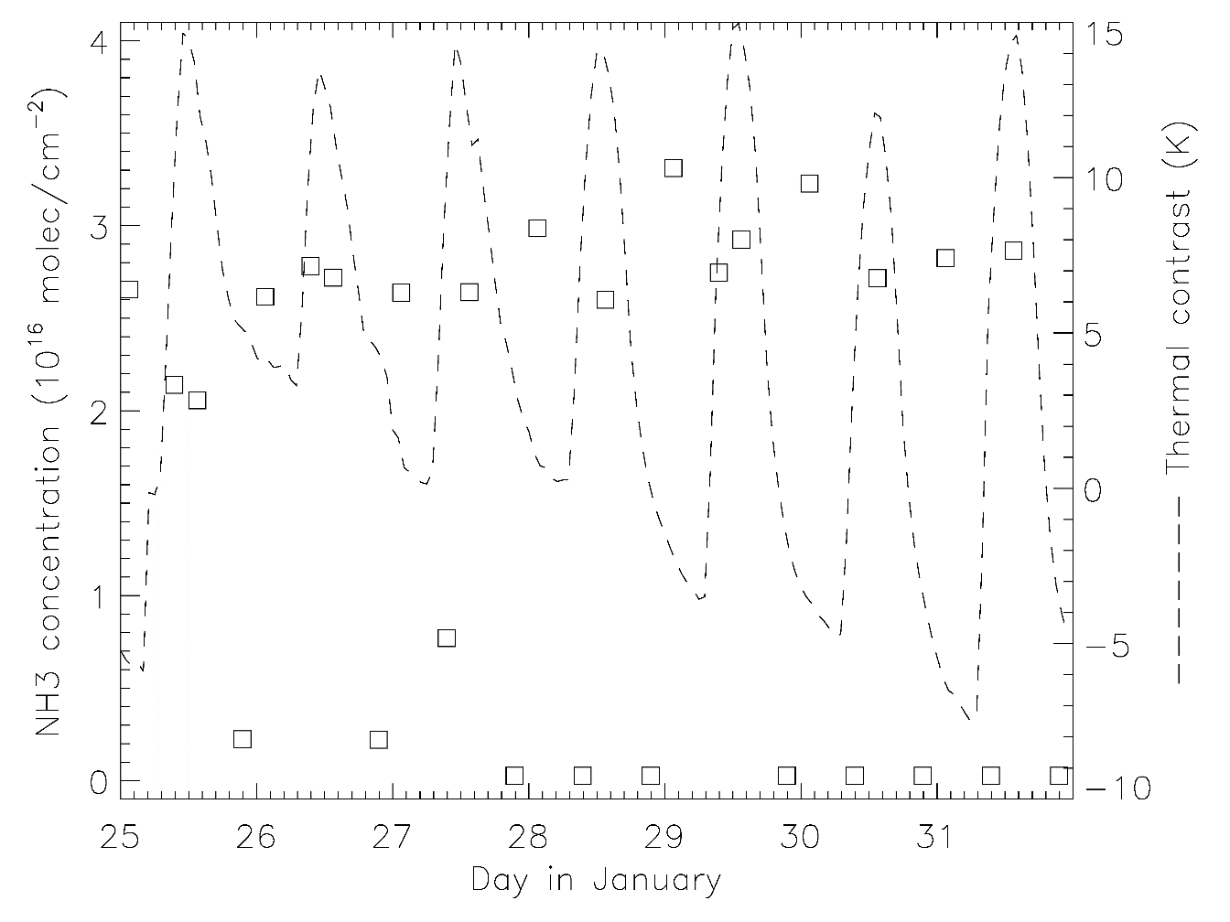
Uttar Pradesh, India (26-27N 81-82E ) - Winter

Slide 28


Conclusions
An OE-based retrieval scheme for NH₃ has been implemented for IASI and CrIS
A Fast Detection Scheme has been introduced for the IASI NH₃ product
The NH₃ seasonal and diurnal cycles have been studied over the IGP region
There are issues with small thermal contrasts suppressing IASI signals
Further work
Check consistency of IASI and CrIS night time observations
Implement Fast Detection Scheme into CRAFT
Extend study to include the North China Plain
Utilise new spectroscopic data in the retrieval
Compare satellite NH₃ measurements to modelled NH₃
Acknowledgements

Slide 29


About me
3rd year PhD Candidate
Monitoring Air Quality from Space: IASI and CrIS retrievals of Ammonia over SE Asia
Based at Space Park Leicester, University of Leicester, UK
Contact: ai184@leicester.ac.uk

