Slide 1
Landslide susceptibility modeling using data-driven weights-of-evidence based random forest and radial basis function network Xia Zhao E-mail: 19209071022@stu.xust.edu.cn Co-author: Wei Chen Xi’an University of Science and Technology China
Integrating Digital Technologies
and eXplainable AI (XAI) in Natural Hazard and Disaster Management

Slide 2
1
Introduction
CONTENTS
2
Study area
3
Materials and methods
4
Results
5
Conclusions

Slide 3
01
PART
Introduction

Slide 4
1.1 Topic basis and Research significance
Topic basis: Landslide disasters are the main type of disasters, accounting for about 75% of the total number of geological disasters.
Research significance: China is a country possessing vast mountainous areas, in which amounts of landslides spread. Consequently, landslide susceptibility assessment has widely attracted people’s attention in relevant domains.
As the final result of landslide susceptibility assessment, landslide susceptibility map is generally considered as a type of effective measure to mitigate the risk of landslide hazard, which owns significant value for governments in mountainous areas.

Slide 5
1.2 Full text summary
Abstract:
Xiaojin County, Sichuan Province, China was selected as the study area of this paper, and twelve conditioning factors were determined according to the literature review. The spatial correlation between landslide and conditioning factors is analyzed using the weights-of-evidence (WoE) model, and the landslide susceptibility in Xiaojin county is predicted. The landslide susceptibility in this region was mainly assessment by WoE based random forest (RF) model. The radial basis function network (RBFNetwork) model was also exploited to map landslide susceptibility with the identical datasets. Finally, the landslide susceptibility maps were produced, and the comprehensive performance of the three models was quantitatively evaluated and compared by the receiver operating characteristic (ROC) curves and area under curve (AUC) values. The results show that the three models are suitable for landslide susceptibility evaluation in the study area, and the evaluation effect of the WoE model is better than that of the RF and RBF network models. More concretely, the goodness-of-fit values of the WoE, RF and RBFNetwork models in the training dataset are 0.899, 0.880 and 0.866, respectively. In terms of prediction accuracy, AUC values are 0.892, 0.874 and 0.863 respectively. Additionally, mean decrease accuracy (MDA) and means decrease Gini (MDG) are used to quantify the importance of landslide conditioning factors. Elevation, soil, distance to roads and distance to rivers are considered as the most important conditioning factors in landslide susceptibility modeling. Consequently, the study achievements in this paper have reference significance on the development and exploitation of land resources in Xiaojin County.
Keywords:
Landslide Susceptibility Modeling; Weights-of-Evidence; Random Forest; Radial Basis Function Network; GIS.

Slide 6
02
PART
Study area

Slide 7
Study area

Slide 8
03
PART
Materials and methods

Slide 9
3.1 Preparation of training and validation datasets
Training
Validation
230(70%)
98(30%)
Landslide polygon
Grid landslide point (1)
Randomly select non landslide point (0)

Slide 10
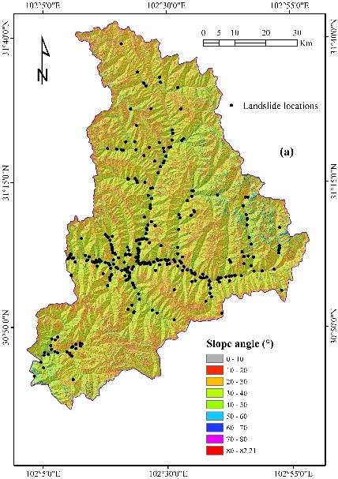
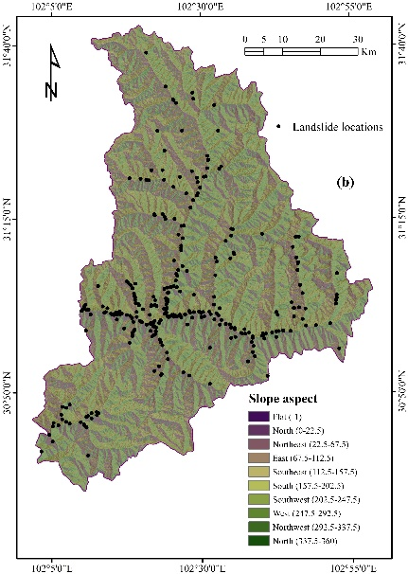
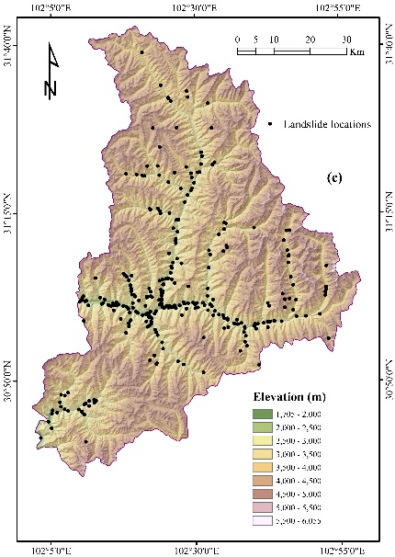
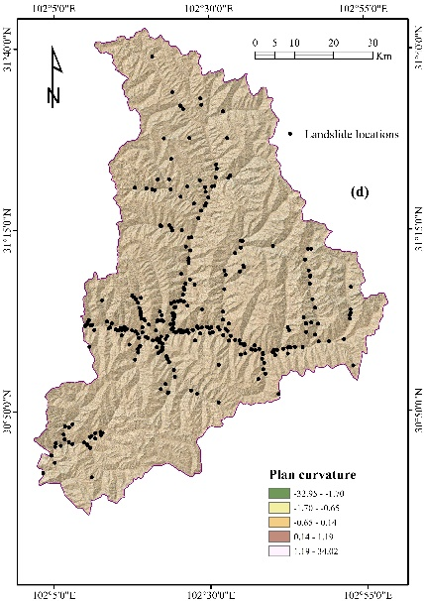
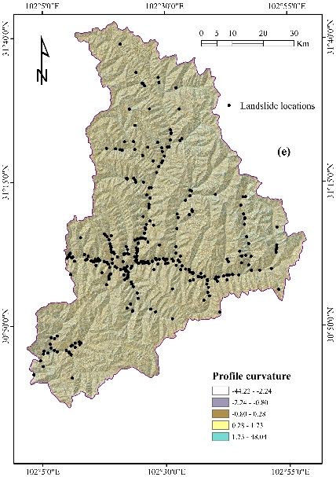
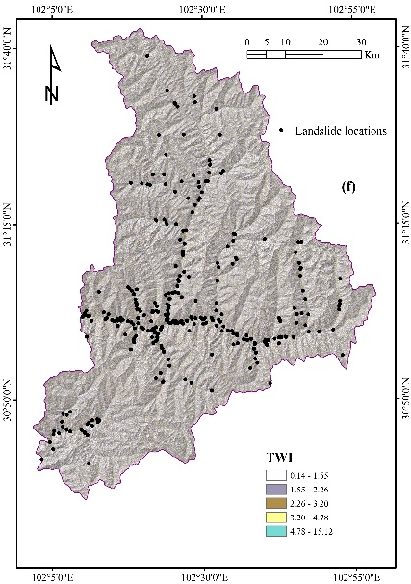
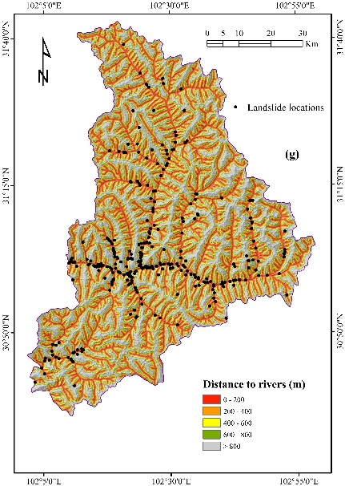
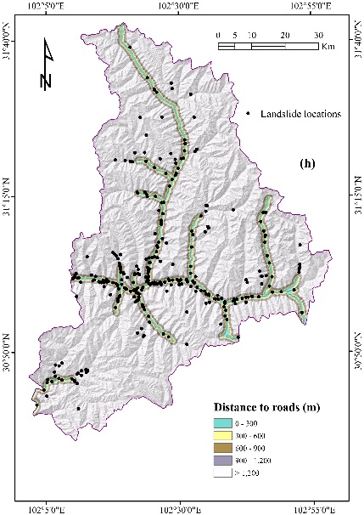
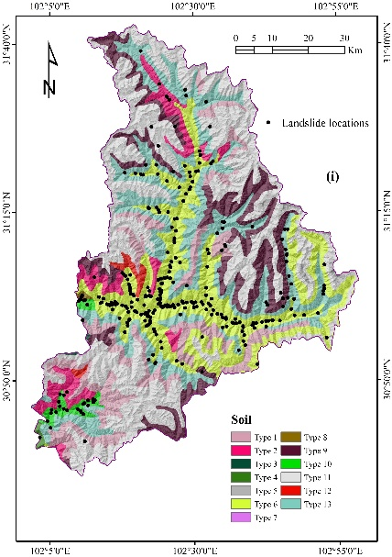
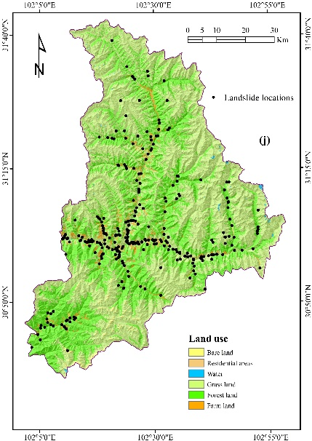
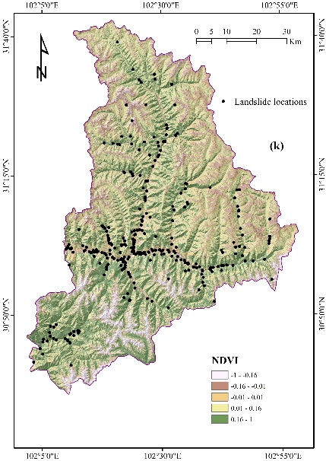
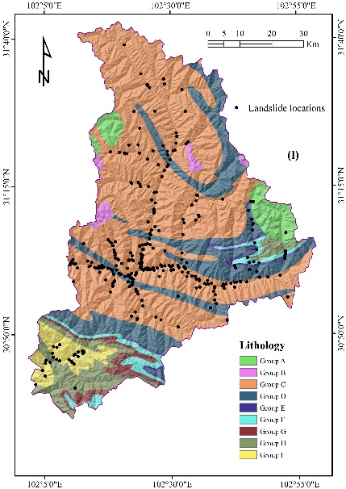
3.1 Preparation of training and validation datasets

Slide 11
3.2 Evaluation model
The weights-of-evidence (WoE) model is based on the classic Bayesian probability theory, In terms of landslide susceptibility mapping, the WoE model has been acknowledged as a prominent data-driven tool due to its excellent predictive capacity and computing efficiency.
The random Forest (RF) algorithm is a well-known procedure applied in classification and prediction, and RF is a combination of Decision trees and Bagging essentially. And in terms of the multiclass imbalance datasets, the prediction performance of RF is better than that of other classifiers.
The radial basis function network (RBFNetwork) algorithm used in this paper

Slide 12
04
PART
Results

Slide 13
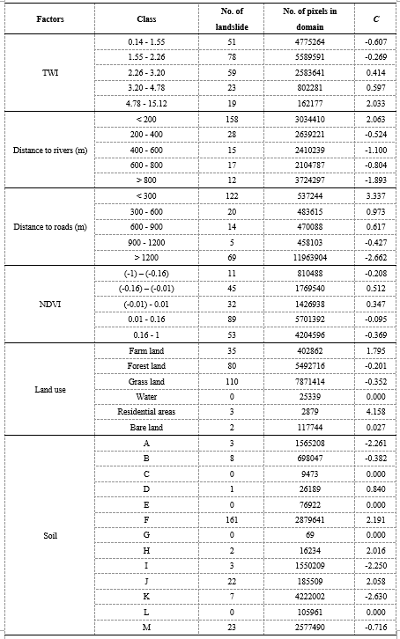
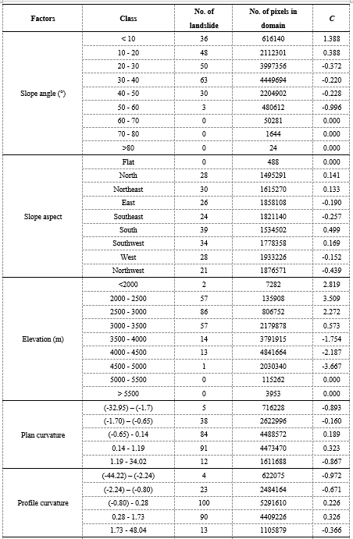
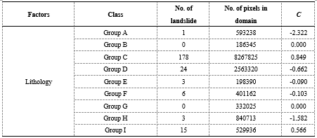
4.1 Correlation analysis
We use the WOE model to reveal the correlation between factors and landslide occurrence.

Slide 14
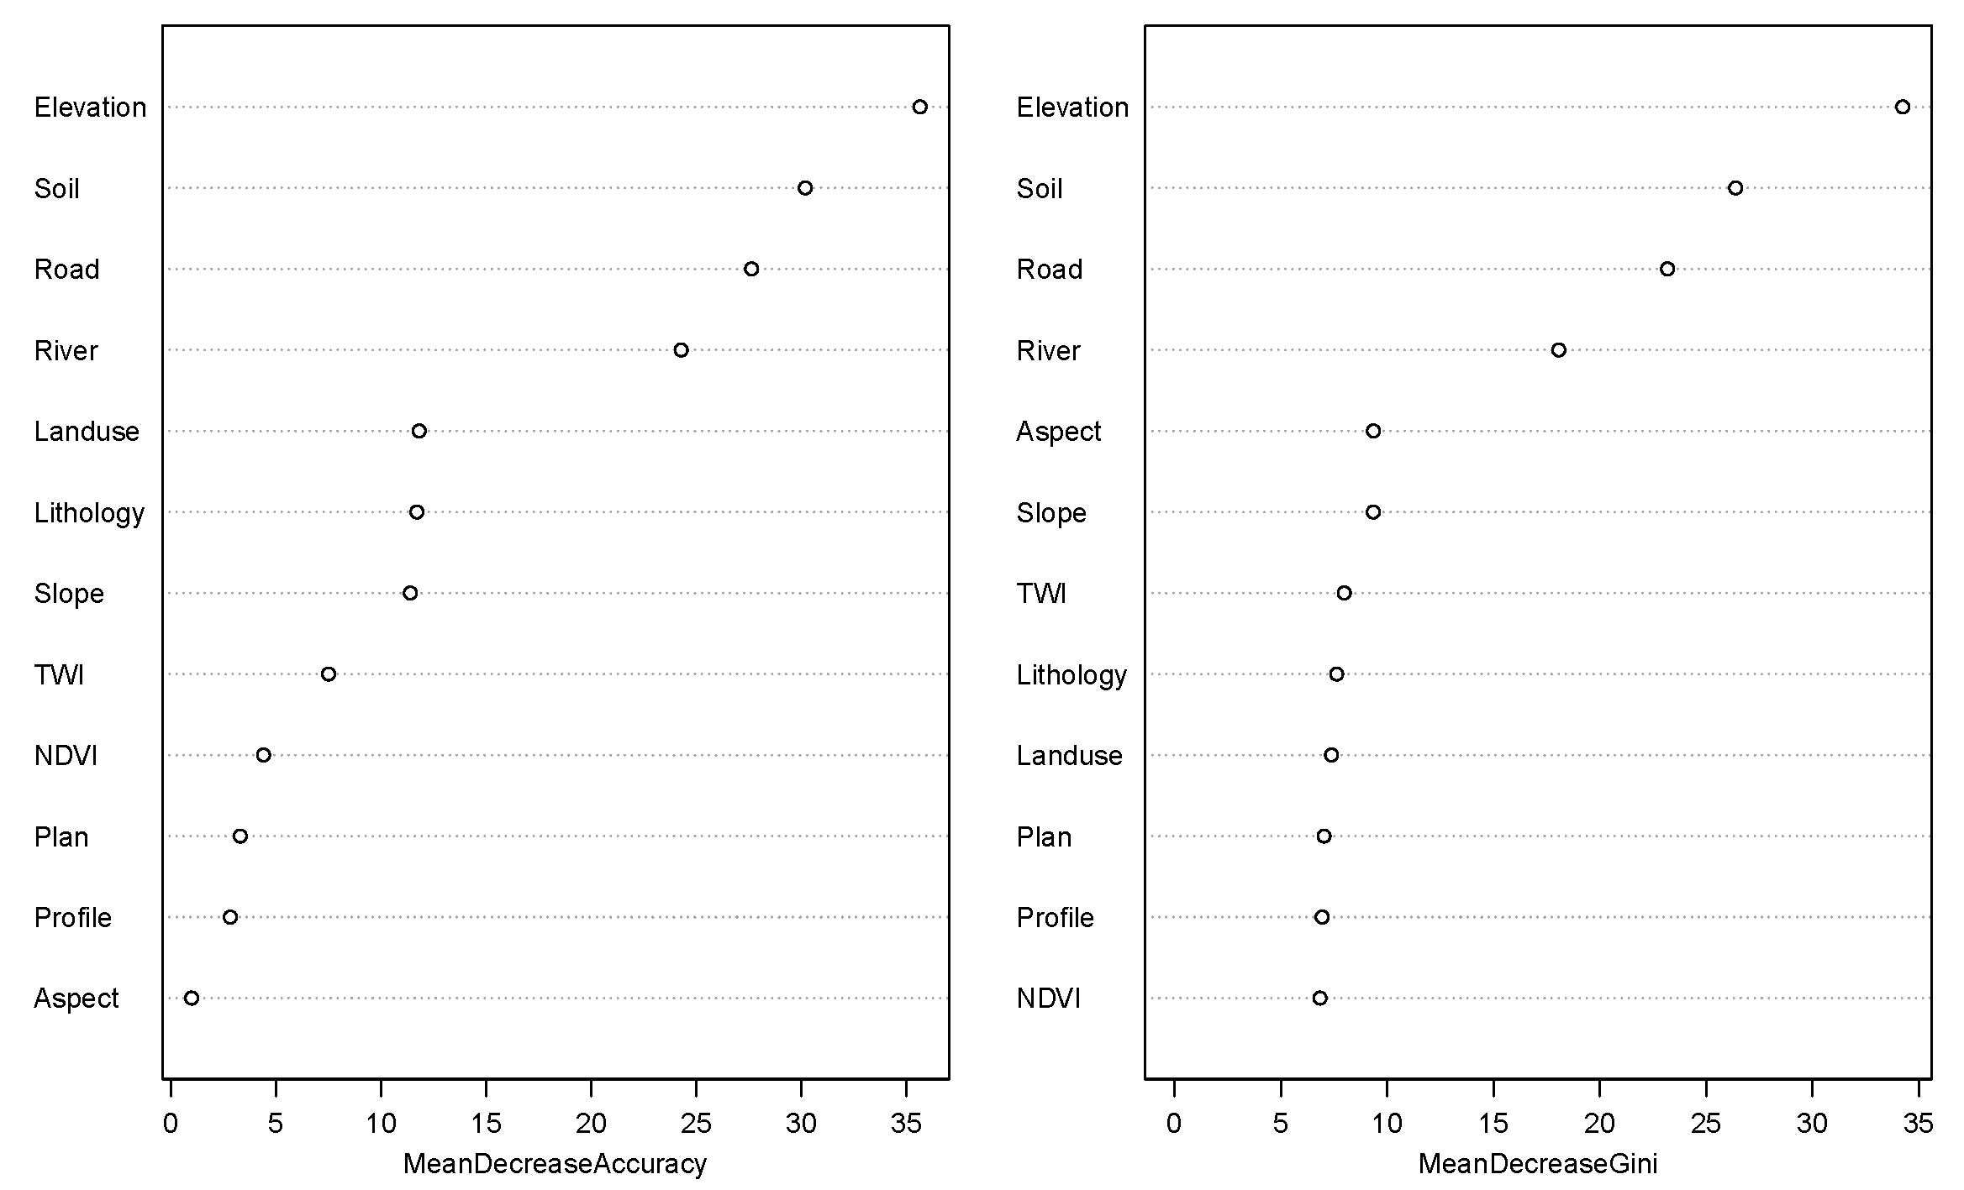
4.2 The Importance of Factors
The MDA and MDG were used to quantify the importance of each landslide conditioning factor.
The elevation, soil, distance to roads and distance to rivers are more important than the other eight conditioning factors.

Slide 15
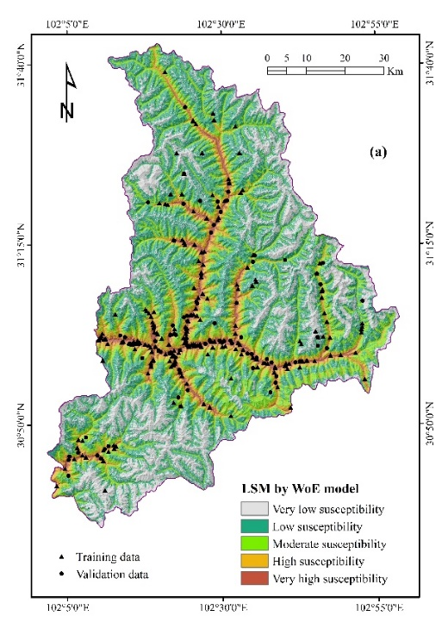
4.3 Generating landslide susceptibility maps
The landslide susceptibility map is drawn according to the landslide susceptibility index (LSI) of each pixel.
The LSI of the WoE model is determined according to the sum of the normalized weight contrast values (Wstwc) of each factor.

Slide 16
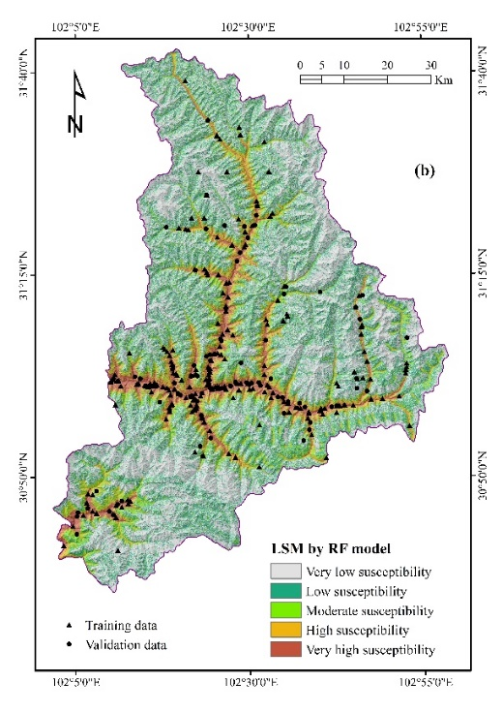
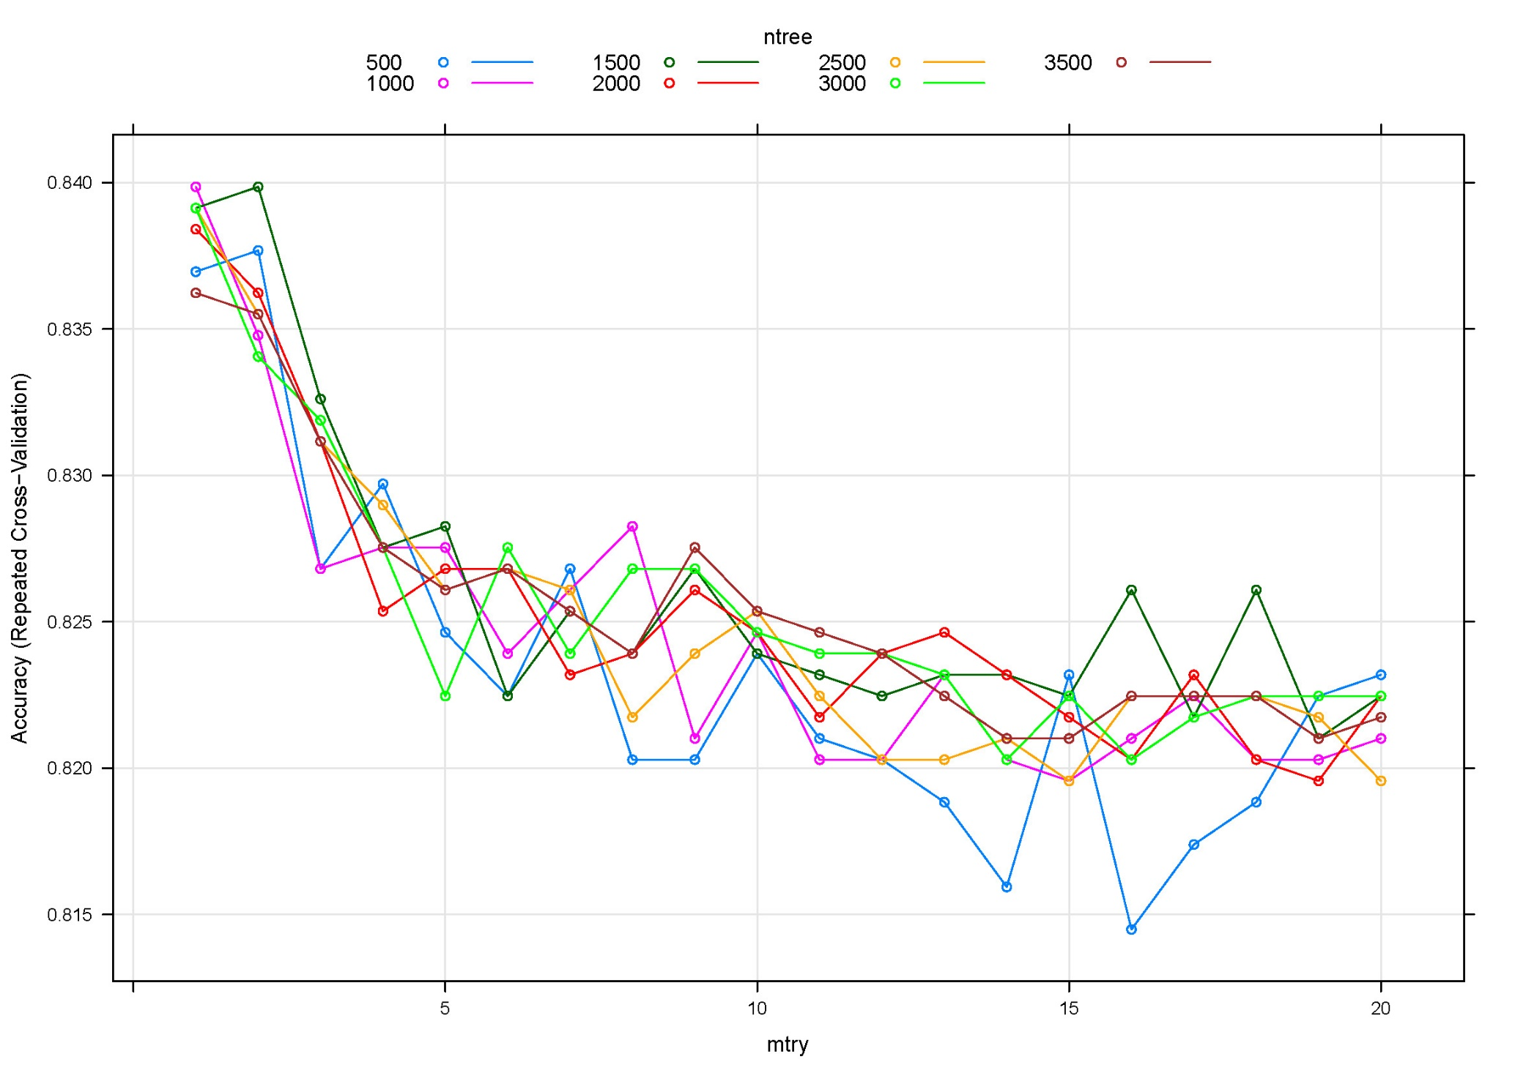
4.3 Generating landslide susceptibility maps
When establishing an RF model, optimize the optimal range of its two key parameters, namely the square root of the total number of image bands (mtry) and the number of trees (ntree).
The optimal parameters are
mtry = 1 and
ntree = 1000.

Slide 17
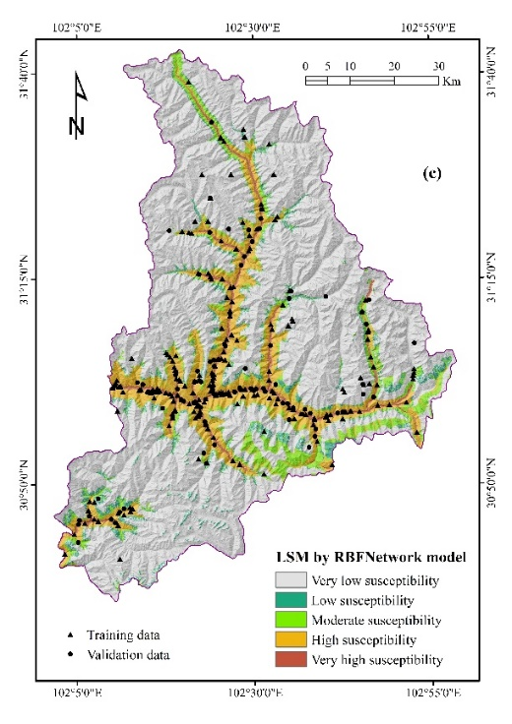
4.3 Generating landslide susceptibility maps
In addition to RF, the RBFNetwork model is another widely used classifier in various fields and is also used to generate landslide susceptibility maps. The input data of RBFNetwork model can be imported into a model through the input layer, and processed by radial basis function in the hidden layer .

Slide 18
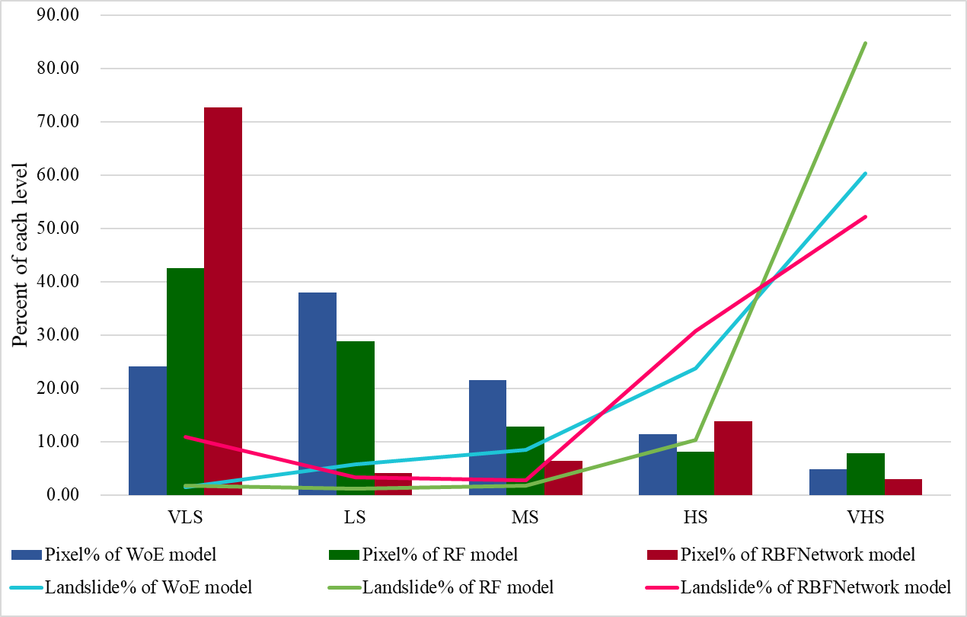
4.3 Generating landslide susceptibility maps

Slide 19
4.4 Model validation and comparison
ROC curves of the models using training dataset
ROC curves of the models using validation dataset

Slide 20
05
PART
Conclusions

Slide 21
Conclusions
The correlation between conditioning factors and landslide events was quantitatively analyzed using the WoE approach.
After testing, the best values of the two key parameters of RF model are mtry=1 and ntree=1000.
The relative importance of various conditioning factors was ranked based on MDA and MDG values, and the most important conditioning factors were elevation, soil, distance to roads and distance to rivers.
The landslide susceptibility maps based on WoE, RF and RBFNetwork models were produced using GIS tools.
The performance of the three models was evaluated and compared by AUC values.
Each landslide susceptibility maps five landslide susceptibility zones, which can help the local government make more reasonable landuse plans and schemes in the future.

Slide 22
THANKS!

