Slide 1
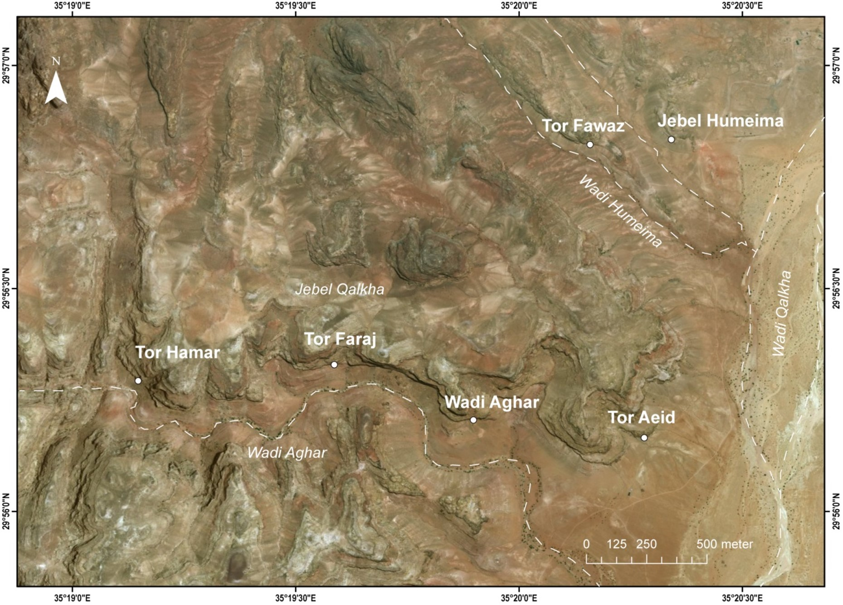



Geochemical characterization of Anatolian tephras from Late Middle and Early Upper Palaeolithic sites in the Jebel Qalkha area, southern Jordan
Locations
Shuang Zhang, Simon Blockley, Naima Harman, Christina Manning, Dustin White, Rhys Timms, Seiji Kadowaki
Shuang.Zhang@rhul.ac.uk

Slide 2
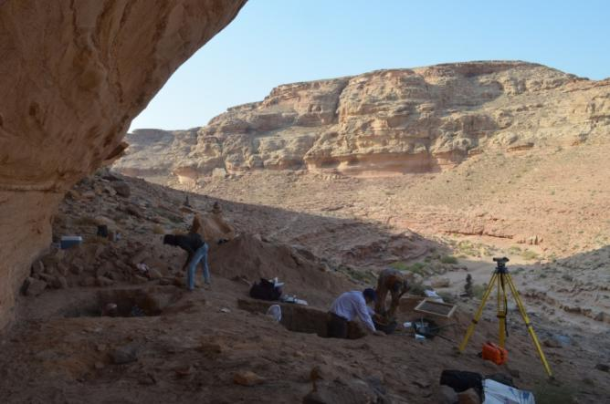
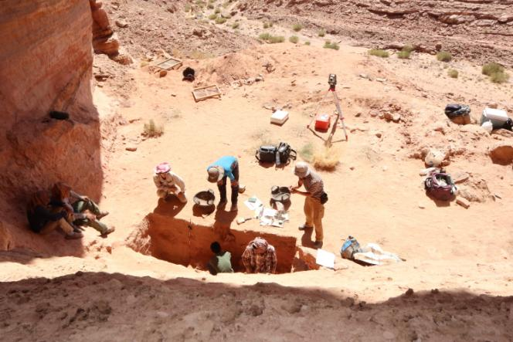

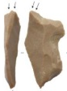
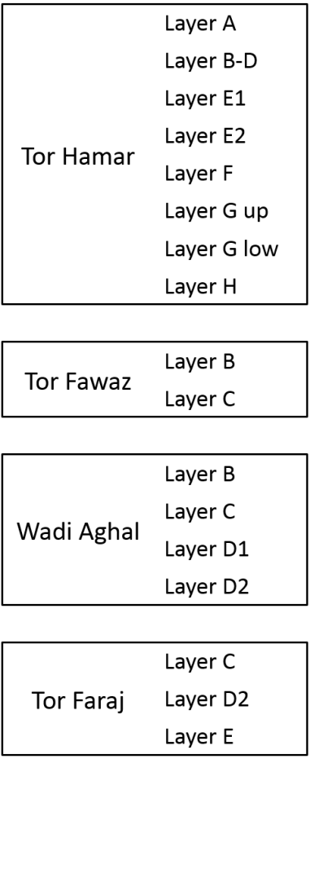





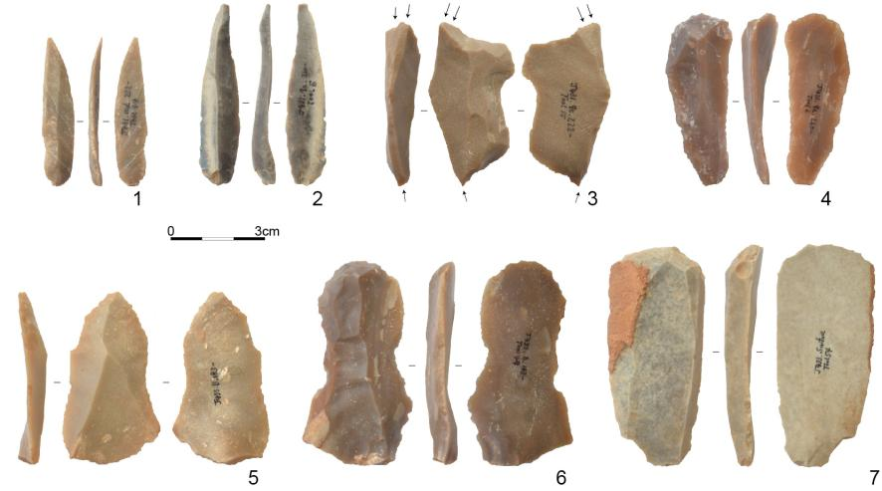



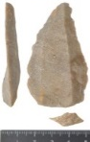

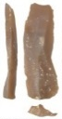
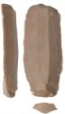
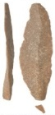

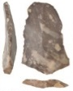


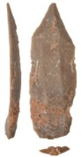
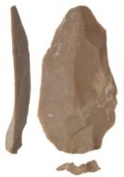
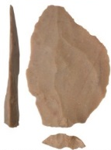

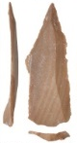
Re-investigation at 2 rock shelter sites, including the LMP, EUP, and Epipal
Tor Hamar
Tor Faraj
The Jebel Qalkha chronology based on OSL dates and radiocarbon dates
Epipaleolithic
Epi
Early Upper Paleolithic
EUP
Initial Upper Paleolithic
IUP
r
IUP
Late Middle Paleolithic
LMP

Slide 3
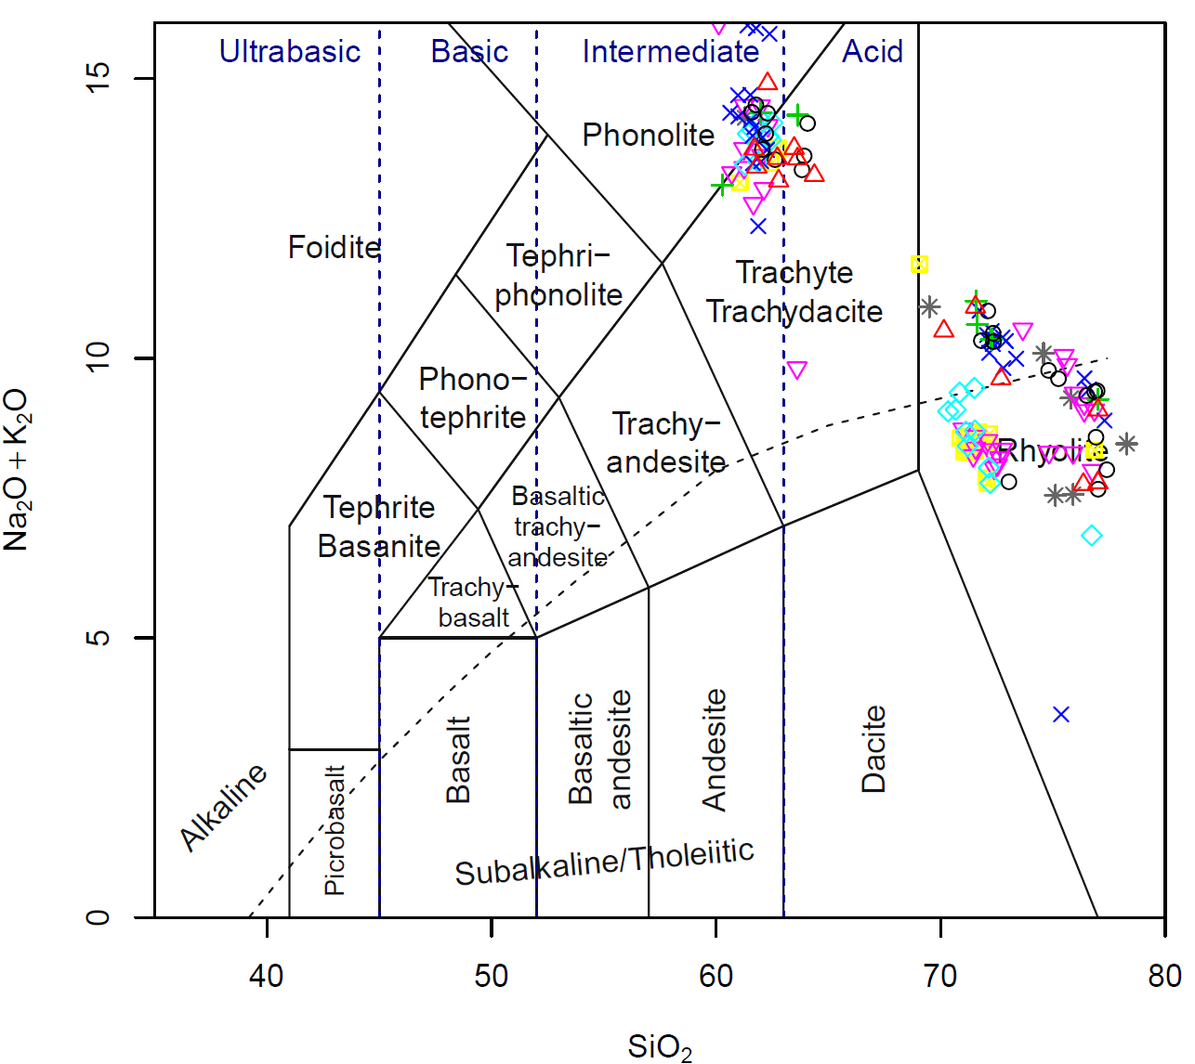
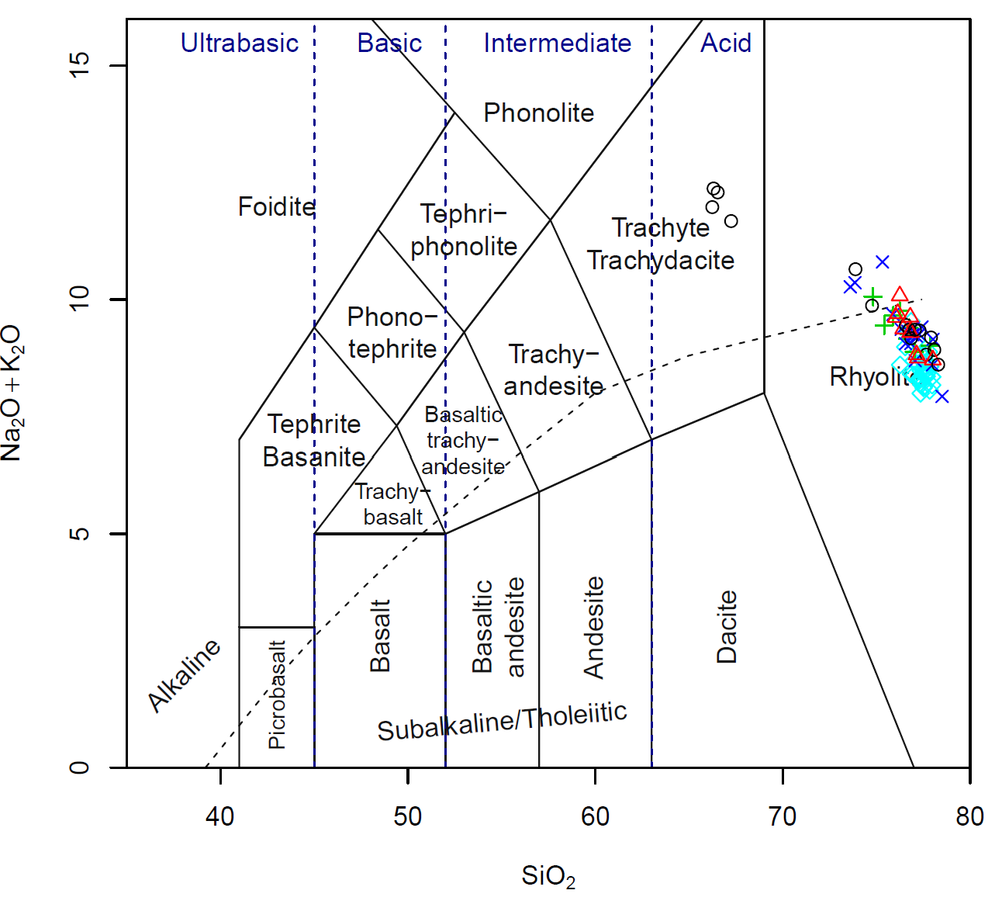
Tor Hamar
Tor Faraj

