Slide 1
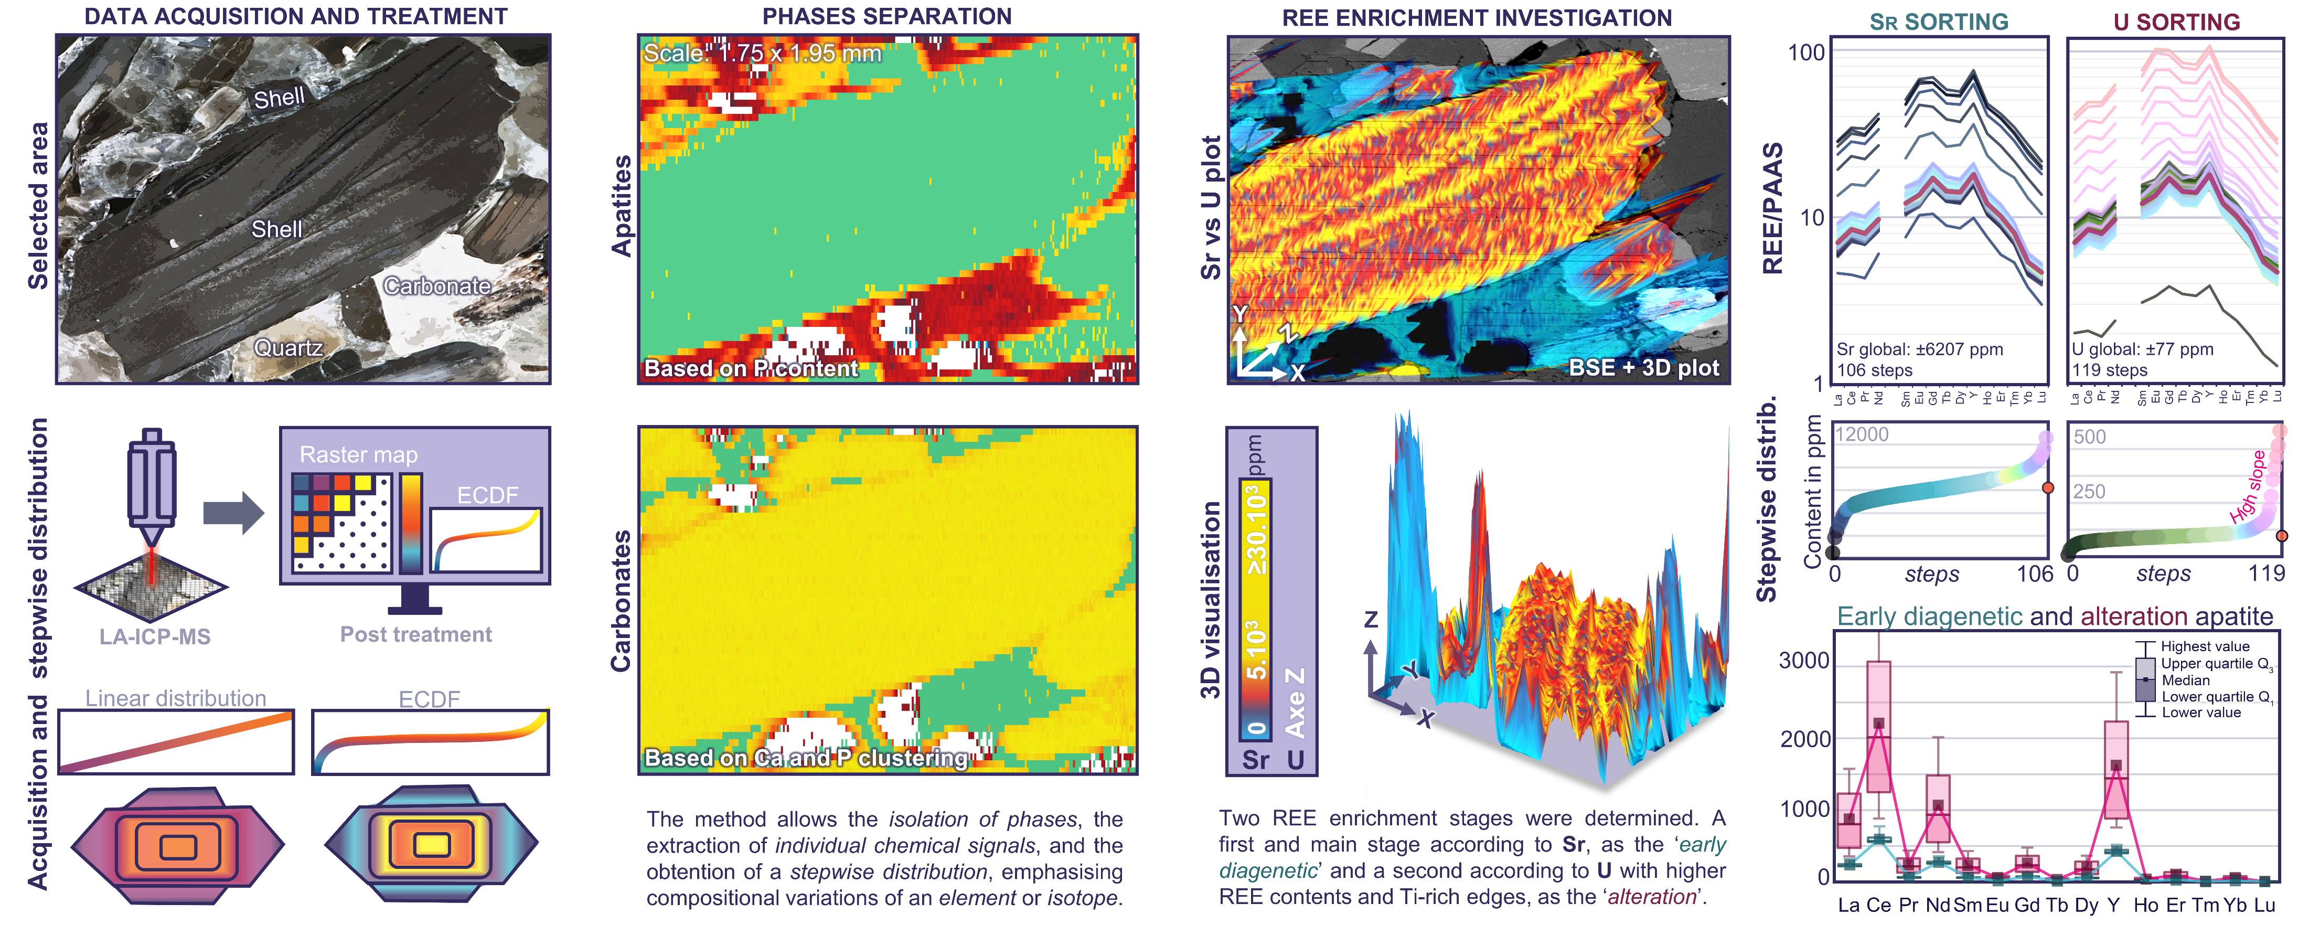
LA-ICP-MS imaging technique application on Estonian sedimentary phosphorites: Revealing REE enrichment stages and advanced ore characterisation

Slide 2
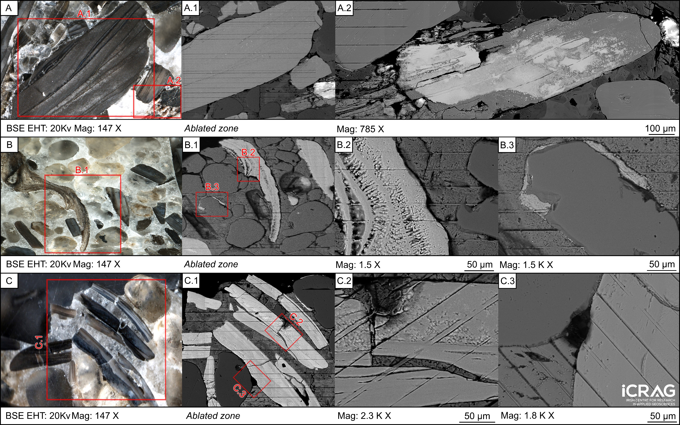
LA-ICP-MS imaging technique application on Estonian sedimentary phosphorites: Revealing REE enrichment stages and advanced ore characterisation

Slide 3
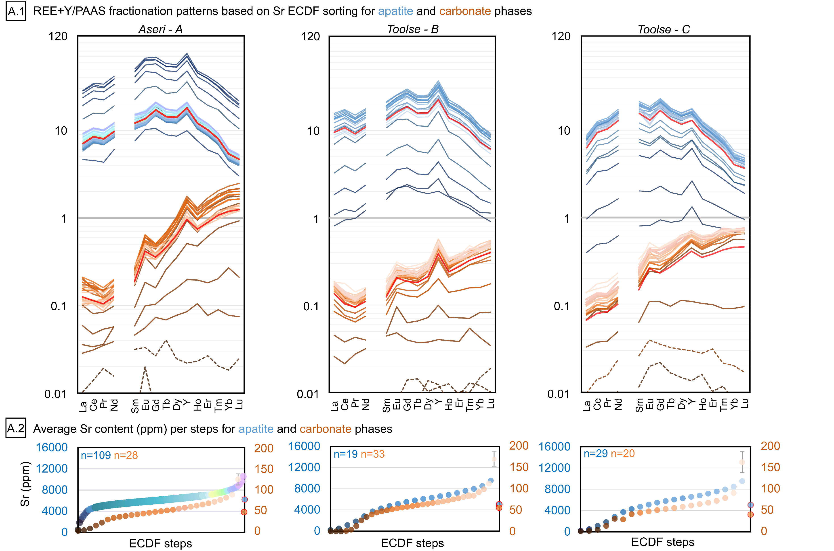
LA-ICP-MS imaging technique application on Estonian sedimentary phosphorites: Revealing REE enrichment stages and advanced ore characterisation

Slide 4
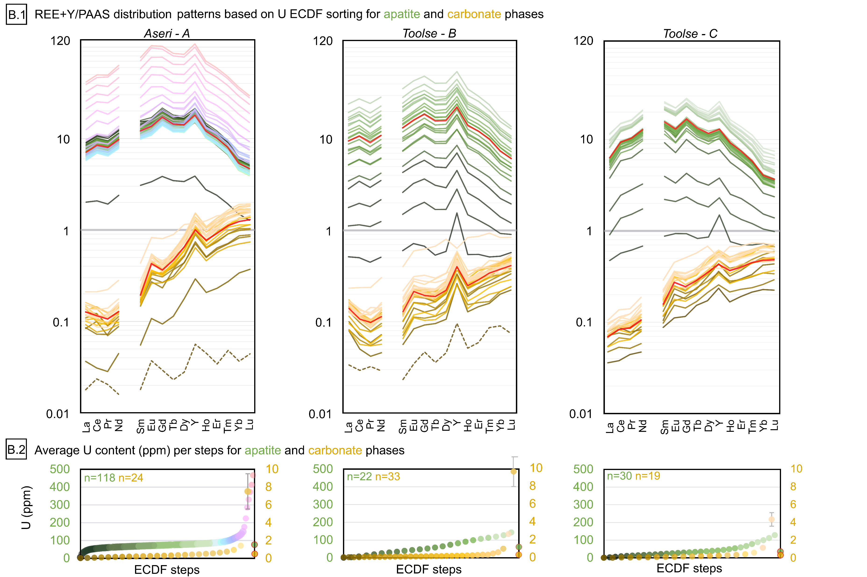
LA-ICP-MS imaging technique application on Estonian sedimentary phosphorites: Revealing REE enrichment stages and advanced ore characterisation

Slide 5
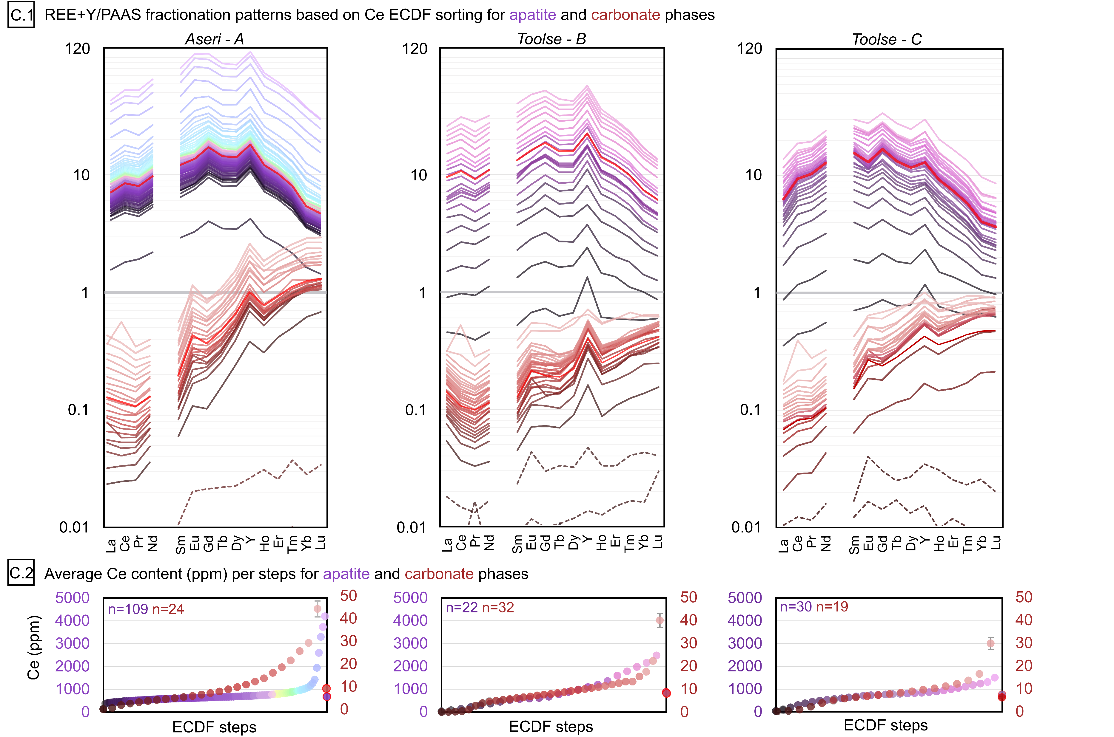
LA-ICP-MS imaging technique application on Estonian sedimentary phosphorites: Revealing REE enrichment stages and advanced ore characterisation

Slide 6
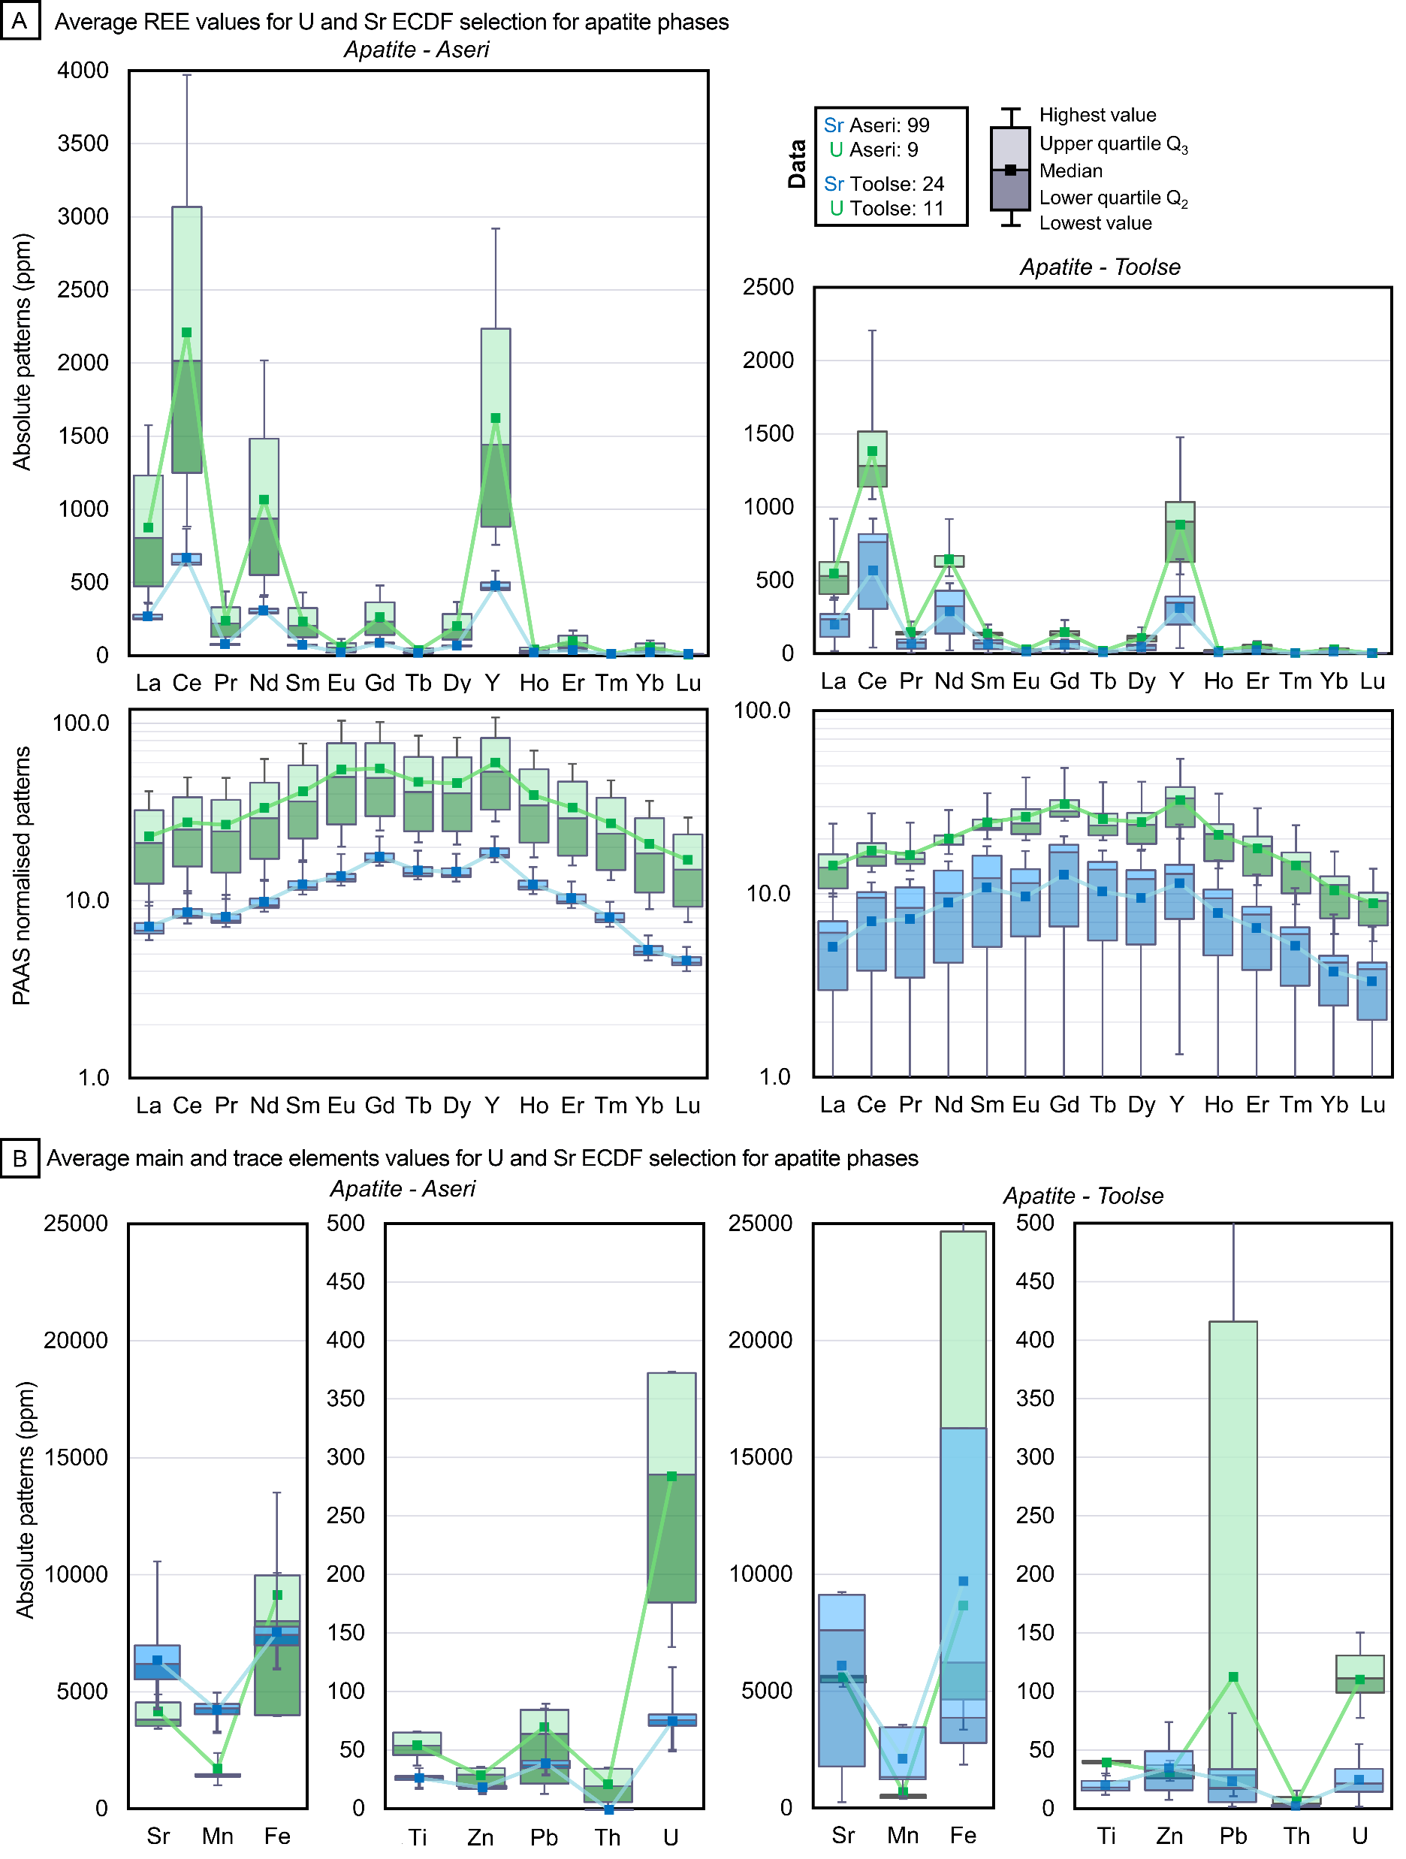
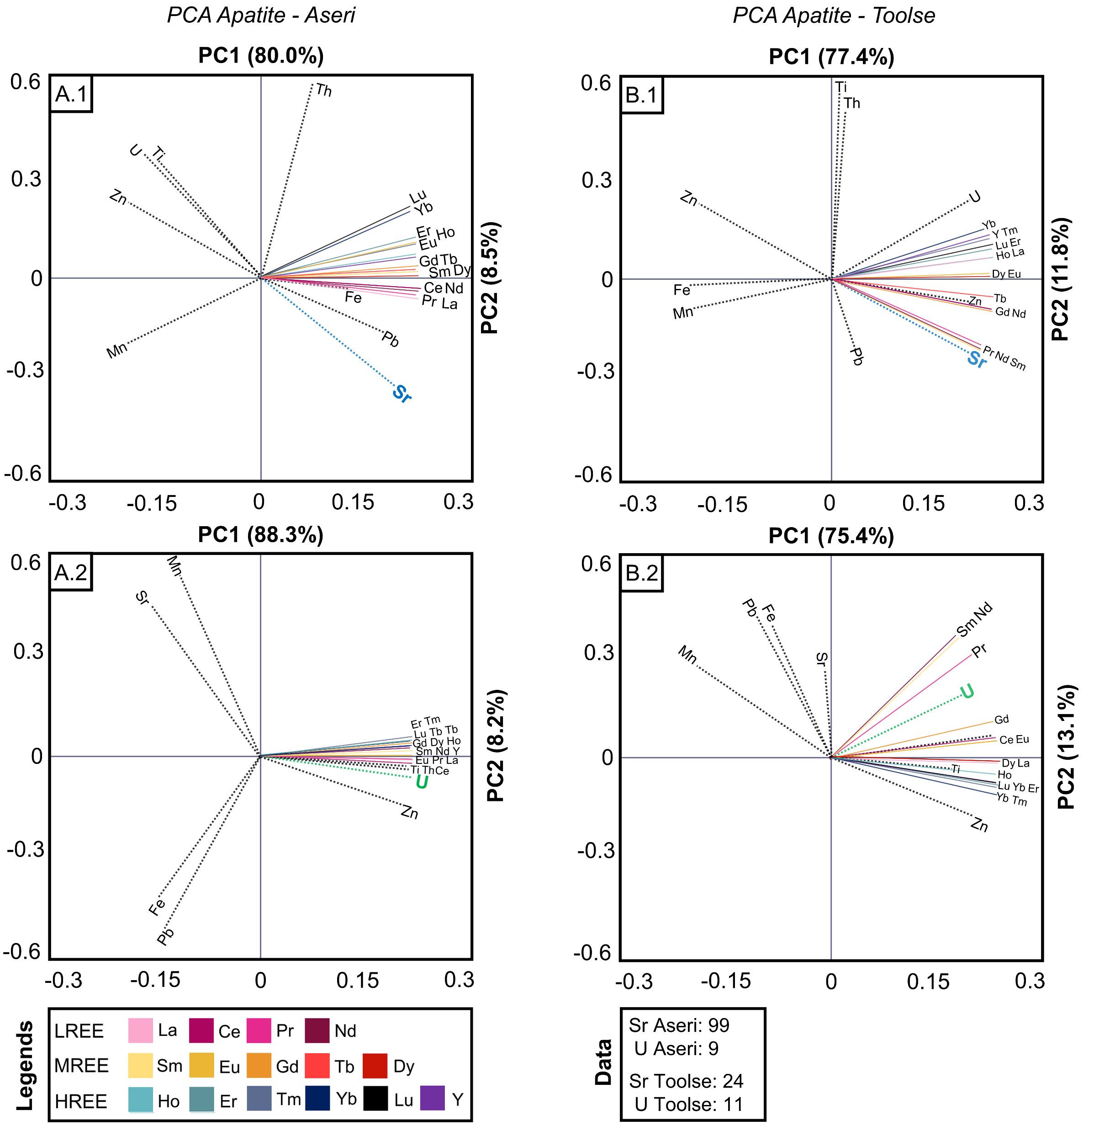
LA-ICP-MS imaging technique application on Estonian sedimentary phosphorites: Revealing REE enrichment stages and advanced ore characterisation

