Slide 1
EGU General Assembly 2024
Determination of the solubility, diffusion coefficient and hydrate stability of hydrogen sulfide in water and brine
Jiang Lei, Ph.D.
Institute of Deep-sea Science and Engineering,
Chinese Academy of Sciences
April 17, 2024

Slide 2
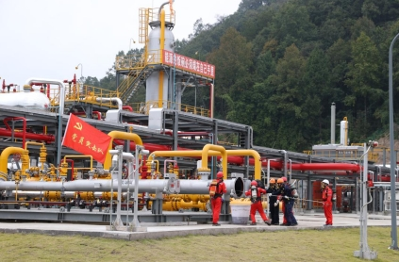
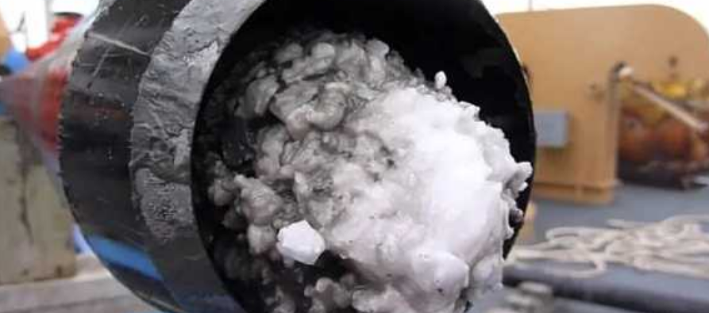
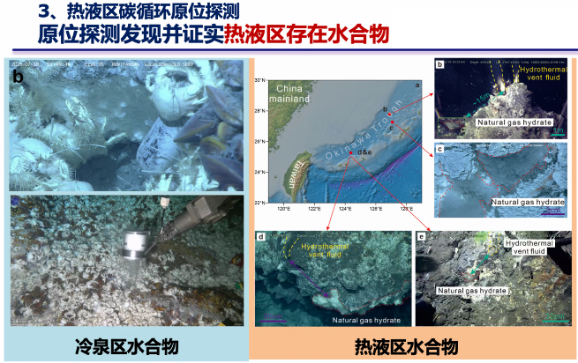
Background
cold-seeps
hydrothermal area
The high-sulfur natural gas fields are widely distributed in western China.
H₂S is prone to hydrate formation at low temperatures and high pressures, resulting in pipeline plugging, and subsequent pressure drop during natural gas production and transportation.
H₂S gas is often detected in deep-sea cold seeps and hydrothermal regions, exerting significant influences on mineralization and biological activities.

Slide 3
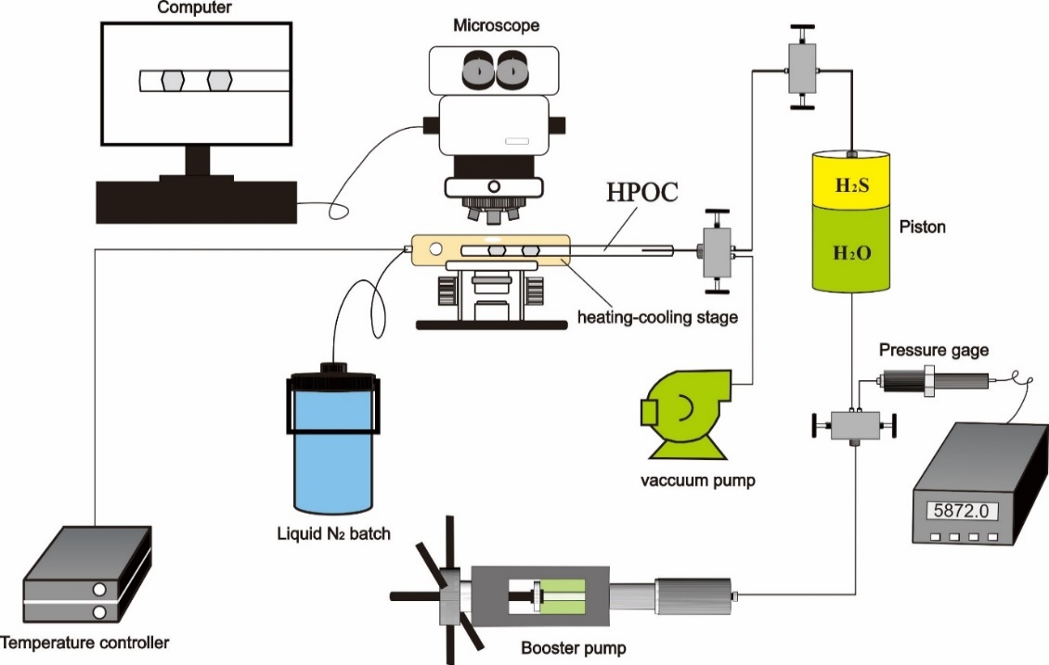
Experimental platform
Hydrate phase equilibrium conditions of gas-water system.
Growth dynamics of gas hydrate by measuring the consumption of gas over time.
Hydrate research
Experimental platform of high-pressure optical cell

Slide 4
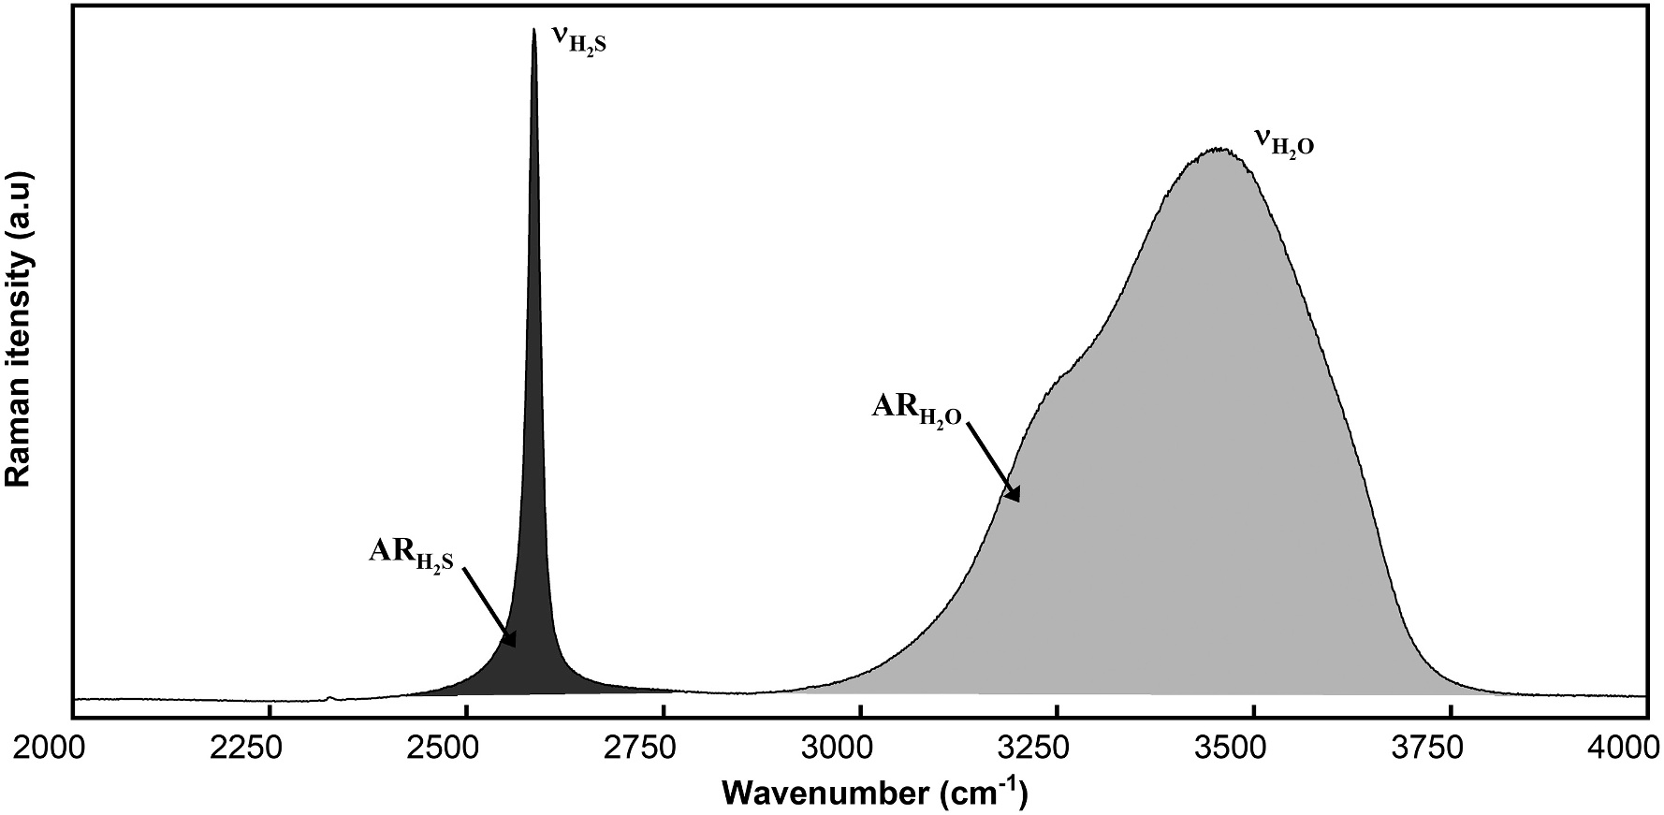

Experimental platform
Combined with laser Raman spectroscopy , HPOC can be used to measure the concentration and diffusion coefficient of gas in water across a wide range of temperatures and pressures
Principle
Thermocouple
273-603K
$${AR}_{H2S−H2O} ∝ β(C_{H2S}\text{/}C_{H2O}\text{)}$$
Mercury
10-120MPa
Pressurize
H₂S-H₂O
Heating-cooling stage

Slide 5
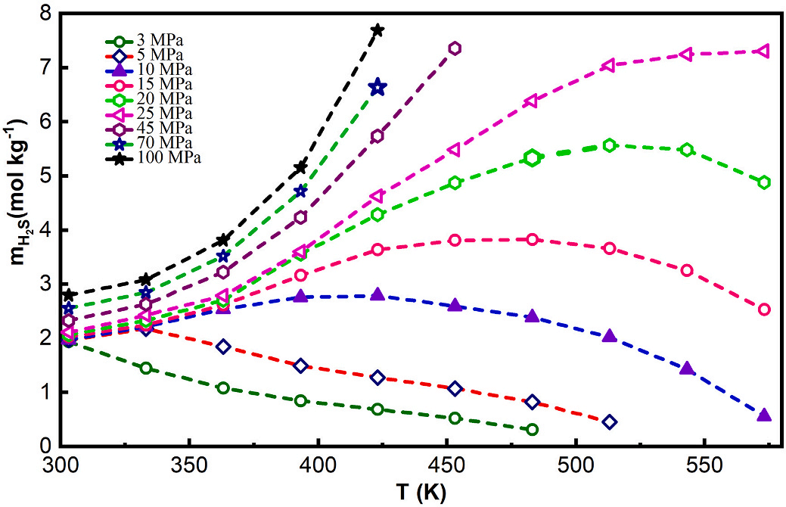
Solubility of H₂S in water
H₂S solubility decreases with increasing temperature when the pressure is below 3 MPa. However, when pressure above 5 MPa, solubility first increases and then decreases with increasing temperature. A similar solubility change trend has been observed for other gases, such as CO₂ and CH₄
H₂S solubility in water at various temperature and pressure
Jiang L*, Xin Y, Chou IM, Sun R. Raman spectroscopic measurements of H₂S solubility in pure water over a wide range of pressure and temperature and a refined thermodynamic model. Chem Geol. 2020;555:119816.

Slide 6
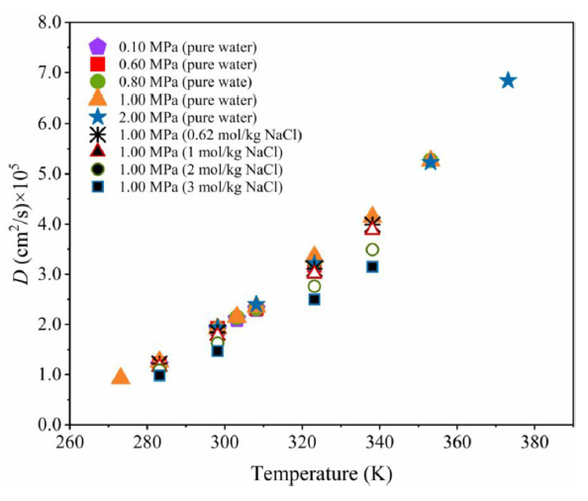
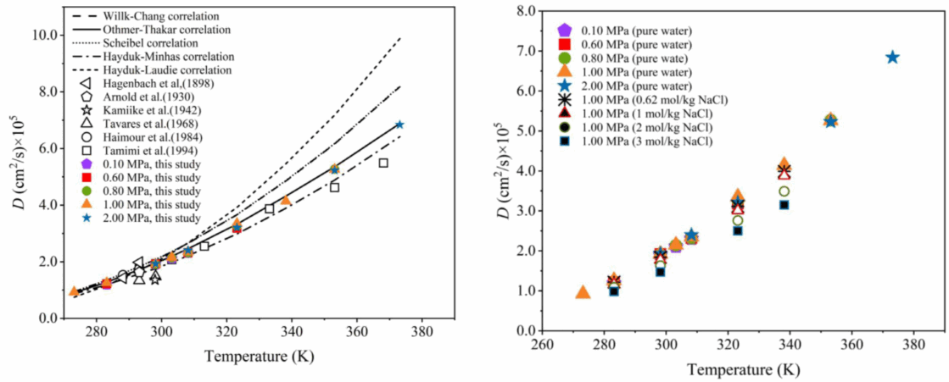
Diffusion coefficient of H₂S in water and brine
Compared with previous experiments
Diffusion coefficient of H₂S is mainly controlled by temperature, and is inhibited by salinity.
Match well at low temperatures but show wide deviations at high temperatures ( > 350 K)
Huang Y, Wu C, Chen Y, Chou IM, Jiang L*. Measurement of diffusion coefficients of hydrogen sulfide in water and brine using in-situ Raman spectroscopy. Fluid Phase Equilib. 2022;556:113381.

Slide 7
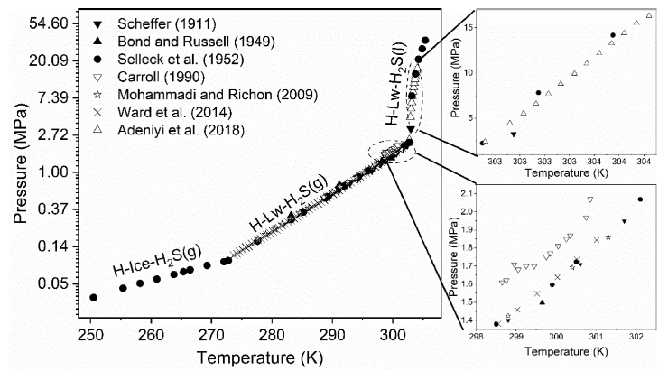
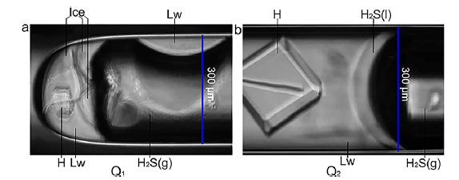
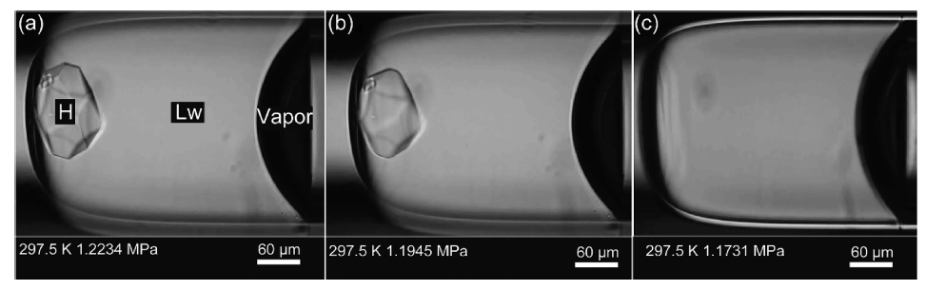
Stability of H₂S hydrate
1. Phase equilibrium conditions in water
H-Lw-H₂S(g)-H₂S(l)
We extended the experimental pressure to 66.128 MPa for the H−Lw−H₂S (l) phase boundary,
The upper quadruple point (Q₂) was located at 302.7 K and 2.2407 MPa and the lower quadruple point (Q1) was located at 272.4 K and 0.0986 MPa.
H-I-Lw-H₂S(g)
Sun J, Xin Y, Chou IM, Sun R, Jiang L*. Hydrate Stability in the H₂S–H₂O system—Visual Observations and Measurements in a High-Pressure Optical Cell and Thermodynamic Models. J Chem Eng Data. 2020;65:3884-92.

Slide 8

Stability of H₂S hydrate
1. Phase equilibrium conditions in electrolyte solutions
Np - experimental data
T0eq / Tsalt eq - H₂S hydrate dissociation temperature in pure water and salt solutions at the same pressure
The inhibitory effect of different electrolytes
LHV equilibrium curves shift more and more toward low temperatures and high pressures as the concentration of the electrolyte solutions increases.
The inhibitory effect of six electrolytes on H2S hydrate formation is in the order of MgCl2 > NH4Cl > NaCl > KCl > Na2SO4 = K2SO4.
Sun J, Sun R, Ming Chou I, Nguyen AV, Jiang L*. Experimental measurement and thermodynamic modeling of dissociation conditions of hydrogen sulfide hydrate in the presence of electrolyte solutions. Chem Eng J. 2022;431:133821.

Slide 9
Stability of H₂S hydrate
Why does electrolyte have an inhibitory effect on the stability of hydrates?
The electrolytes disturb the network of hydrogen bonds in water.
The more the water activity is affected, the stronger the inhibition effect of salt on hydrate equilibrium conditions will be

Slide 10
Stability of H₂S hydrate
2. Solubility of H₂S hydrate
The solubility of hydrogen sulfide (H₂S) hydrate, which determines the minimum concentration required for hydrate stability.
The solubility of H₂S hydrate in water was determined at temperatures ranging from 273.15 to 301.15 K with a 4 K increase and pressures ranging from the H–Lw–V three-phase equilibrium pressure for each temperature to 100 MPa.
Wu C, Chen J, Sun J, Chou IM, Mei S, Lin J, Jiang L*. Experimental determination and thermodynamic modeling of the hydrogen sulfide hydrate solubility in water. Chem Eng Sci. 2023:119474.

Slide 11

Sun J, Xin Y, Chou IM, Sun R, Jiang L*. Hydrate Stability in the H₂S–H₂O system—Visual Observations and Measurements in a High-Pressure Optical Cell and Thermodynamic Models. J Chem Eng Data. 2020;65:3884-92.
Sun J, Sun R, Ming Chou I, Nguyen AV, Jiang L*. Experimental measurement and thermodynamic modeling of dissociation conditions of hydrogen sulfide hydrate in the presence of electrolyte solutions. Chem Eng J. 2022;431:133821.
EGU General Assembly 2024
Thanks

