Slide 1
On the decadal changes of Atlantic-Pacific interactions and the effects of external forcing
Session: CL2.6
Soufiane Karmouche^{1,2} , Evgenia Galytska^{1,2}, Gerald A. Meehl³, Jakob Runge^{4,5}, Katja Weigel^{1,2} , and Veronika Eyring^{2,1}
¹ University of Bremen, Institute of Environmental Physics (IUP), Bremen, Germany ² Deutsches Zentrum für Luft- und Raumfahrt e.V. (DLR), Institute of Atmospheric Physics, Oberpfaffenhofen, Germany ³ National Center for Atmospheric Research (NCAR), Boulder, CO, USA ⁴ Deutsches Zentrum für Luft- und Raumfahrt (DLR), Institut für Datenwissenschaften, Jena, Germany ⁵ Technische Universität Berlin, Berlin, Germany

Slide 2
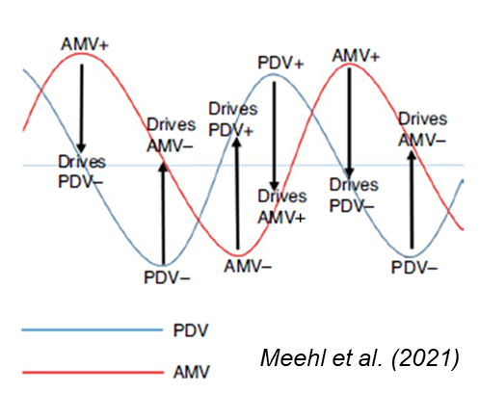
Motivation
Why Atlantic-Pacific interactions?
The Atlantic and Pacific are connected on seasonal-interannual to multidecadal timescales, affecting regional and global climate
Vary between Cold and Warm phases spanning (multiple) decades
i.e. Atlantic Multidecadal Variability (AMV) and Pacific Decadal Variability (PDV)

Slide 3
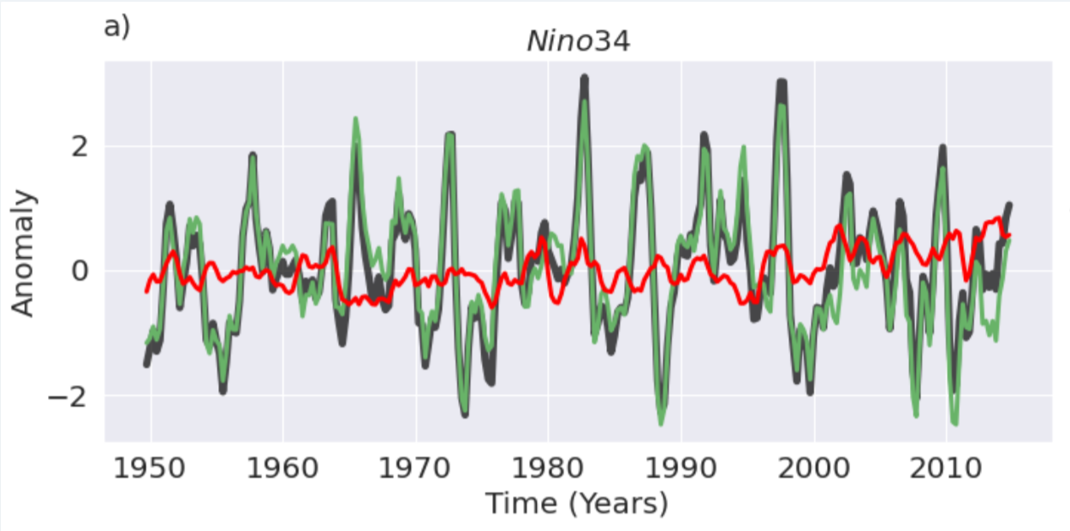
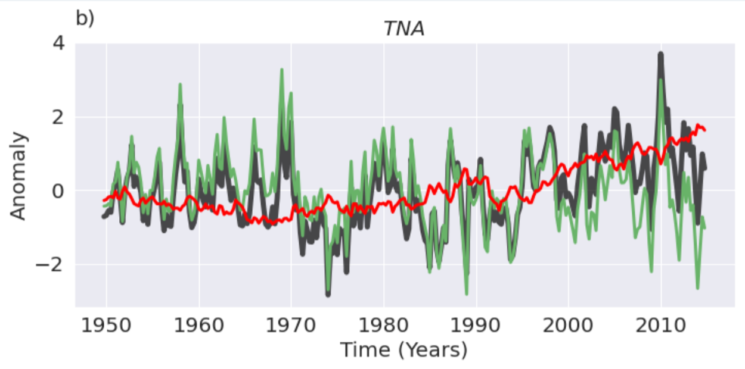
Separating internal variability from the externally forced components
CMIP6 Multi-ensemble mean (MEM) to estimate the externally forced signal
CMIP6 MEM: CESM2 (11), MIROC6 (50), UKESM1-0-LL (16)
Represents all natural + anthropogenic forcing signals
$$X = X_{MEM} +X_{internal } (X=SST,U,SLP)$$
Space- and time-varying estimate of external forcing
Karmouche et al. (2024)

Slide 4
Causal analysis of Atlantic-Pacific interactions
Results: 3. Long-term state of the two basins (PDV and AMV)

Slide 5
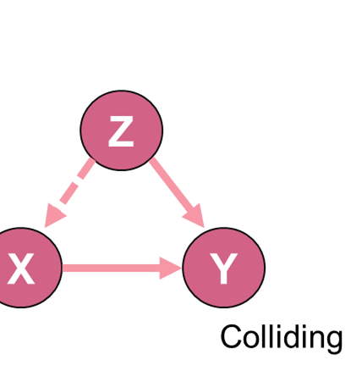
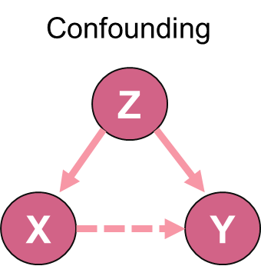
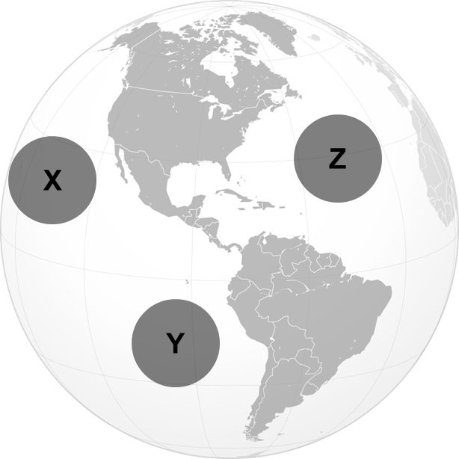
Causal Discovery
Correlation does not always explain a causal relationship
Might result in spurious connections due to:
Autocorrelation
X
Y
X
Z
Y
Mediation
Causality entails that 𝑋→𝑌 if and only if an intervention or manipulation in 𝑋 has an effect on 𝑌

Slide 6
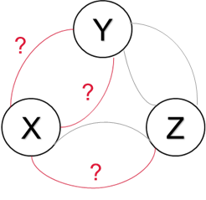
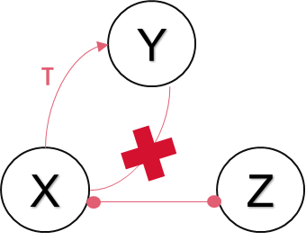
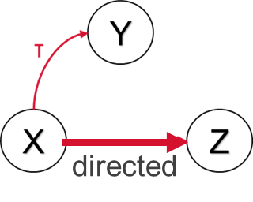
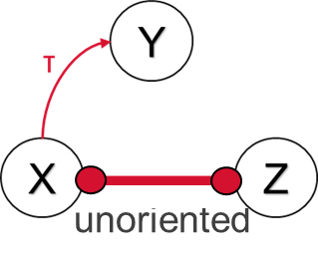
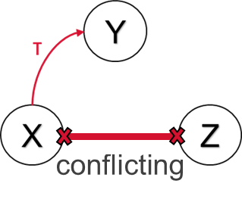
PCMCI+
Phase I. PC1 lagged phase
User specifies the maximum time lag τmax, and significance threshold αpc
Modified PC algorithm applied iteratively to estimate an initial set of lagged parents for each variable
Contains spurious connections due to autocorrelation and false positives
Phase II. Contemporaneous and lagged MCI phase
Refine the set of parents from Phase I through conditional independence tests for both lagged and contemporaneous pairs.
Graph including lagged and contemporaneous connections
Phase III. Contemporaneous Orientation phase
Orienting contemporaneous links
Developed by Runge (2020), implemented in TIGRAMITE package.
PC: Peter and Clark (inventors of the PC algorithm)
MCI: Momentary Conditional Independence
+: tailored for lag-zero links

Slide 7
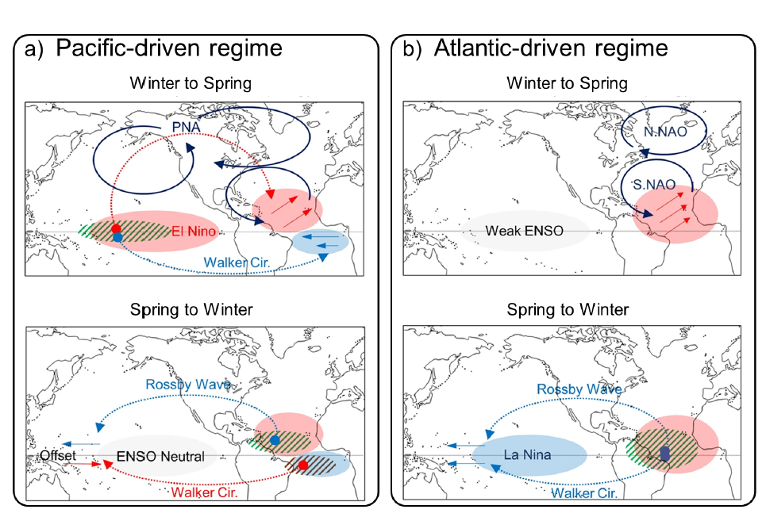
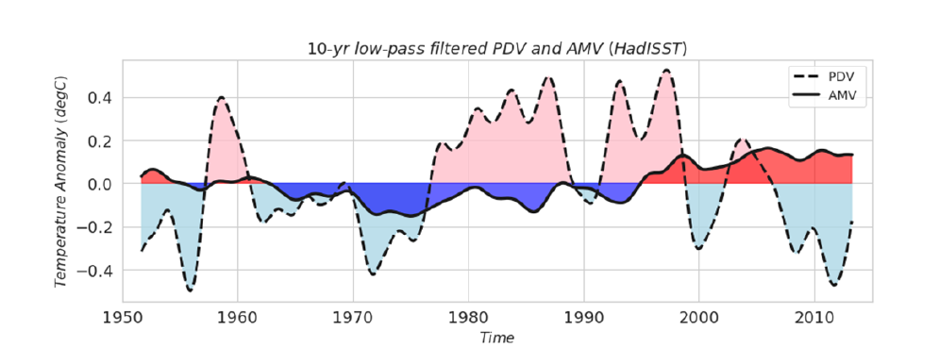
Background: Pacific-driven regime vs Atlantic-driven regime
Park et al. (2023)
TNA
Studies suggest that external forcing is responsible for the recent AMV changes (Klavans et al., 2022; He et al., 2023).
→ There is a need to separate the externally forced component from the internal variability.
1950–1983
1985–2014
Notes:
Diagram depicting the inter-basin interactions between the Pacific and Atlantic.
a) The formation of a tropical Atlantic mode throughout winter to late spring, and its impact on the tropical Pacific from late spring to the next winter in the Pacific-driven regime (e.g. 1950–1983). The red, blue, and gray shadings represent SSTA warming, cooling, and normal conditions, respectively. Dark blue solid arrows represent low-level atmospheric circulation associated with PNA and NAO. The dotted red and blue arrows represent atmospheric teleconnections that cause warming and cooling of the underlying SSTAs, respectively. The straight red and blue arrows represent unusual low-level winds.
The green and brown hatching lines indicate increased and decreased precipitation, respectively. b) is analogous to (a), but for the Atlantic-driven regime (e.g. 1985–2014). Figure adapted from Park et al. 2023.

Slide 8
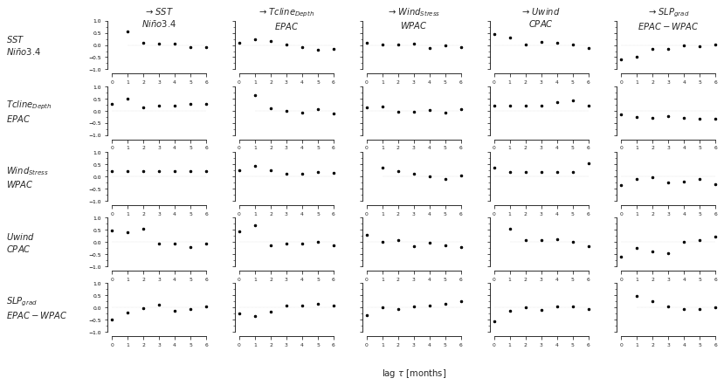
Zwischentitel mit Bild 8 Arial Regular 36 pt
Supplement - Proof of Concept: El Niño 1997-1998
Untertitel der Präsentation
Arial Regular 24 pt

Slide 9
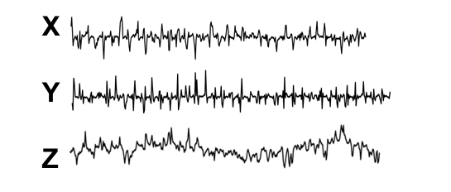
Supplement – PCMCI+
Phase I. Skeleton discovery phase.
Calculate cross correlation
X_{t}
Y_{t-1}
Y_{t-2}
Z_{t-τ}
O | N | D | J | F | M | A | M | J | J | A | S | O | N | D
O | N | D | J | F | M | A | M | J | J | A | S | O | N | D
corr(X_{t} , Y_{t-1} )
O | N | D | J | F | M | A | M | J | J | A | S | O | N | D
corr(X_{t}, Y_{t-2} )
…
…
O | N | D | J | F | M | A | M | J | J | A | S | O | N | D
corr(X_{t} , Z_{t-τ} )
Define a superset of potential lagged parental processes (without any conditioning)
P⁰ = {Y_{t-1}, Z_{t-2}, Y_{t-3}}

Slide 10
Supplement – PCMCI+
Phase I. Skeleton discovery phase.
Calculate partial correlation
Remove the linear influence of Z and test for the correlation between residuals corr (X_{t}, Y_{t-τ} | Z_{t} )
X _{t} and Y _{t-τ} are conditionally independent (only because of Z _{t})
X _{t} and Y _{t-τ} are conditionally dependent
P⁰ = {Y_{t-1}, Z_{t-2}, Y_{t-3}}
P¹ = {Y_{t-1}, Z_{t-2}}
corr(X_{t} , Y_{t-1 |} Y_{t-1} )
corr(X_{t} , Y_{t-1 |} Z_{t-2} )
corr(X_{t} , Y_{t-2 |} Y_{t-1})
Is this connection happening due to Y_{t-1}?
corr(X_{t} , Y_{t-τ |} Z_{t-2})
corr(X_{t} , Y_{t-τ |} Y_{t-1})
corr(X_{t} , Y_{t-3 |} Y_{t-1})
e.g. conditionally independent

Slide 11
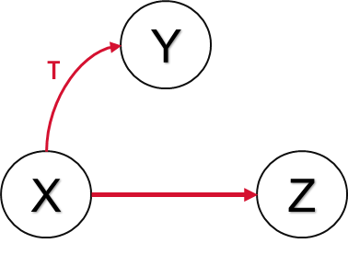
II. PCMCI+
Phase I. PC1 Lagged skeleton phase.
User specifies: max time delay (τmax) and significance level (αpc)
PC1 applied iteratively to estimate a set of lagged parents for each variable
Contains spurious connections due to autocorrelation and false positives
Phase II. Contemporaneous and lagged MCI skeleton phase.
Refine the set of parents from Phase I through MCI tests employing partial correlation
Graph including lagged and contemporaneous connections
Phase III. Contemporaneous Orientation phase.
Orienting contemporaneous links based on unshielded triples.
PC: (named after Peter and Clark)
MCI: Momentary Conditional Independence
+: tailored for lag-zero link estimation
Developed by Runge (2020), implemented in TIGRAMITE package.
High-dimensionality with high detection power
False positive control
Remove spurious dependencies
Causal network estimation

Slide 12
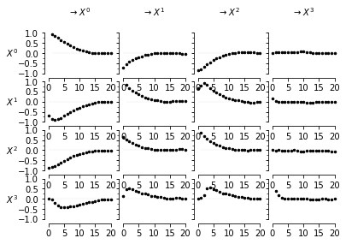
Supplement – PCMCI+
PCMCI assumptions :
Causal sufficiency : all common drivers (variables that affects two or more other variables ) are part of the study
Causal Markov property : any variable X is independent of the whole past conditional on the parents of X
Faithfulness : all conditional independencies arise from the causal graph
Stationarity (dependence stays the same in time)
Parameters of PCMCI :
Significance level of PC-step : different values are tested inside the PCMCI and automatically optimized
Significance level of PC-step : typically 5%, it controls the false positives.
Maximum time lag: defines how far we look back for time-lagged dependencies between the variables. It can be chosen following expert knowledge, or after plotting and analyzing the lagged correlations.
Example of estimated lagged correlations. In this case, a maximum time lag of 10 seems appropriate.

Slide 13
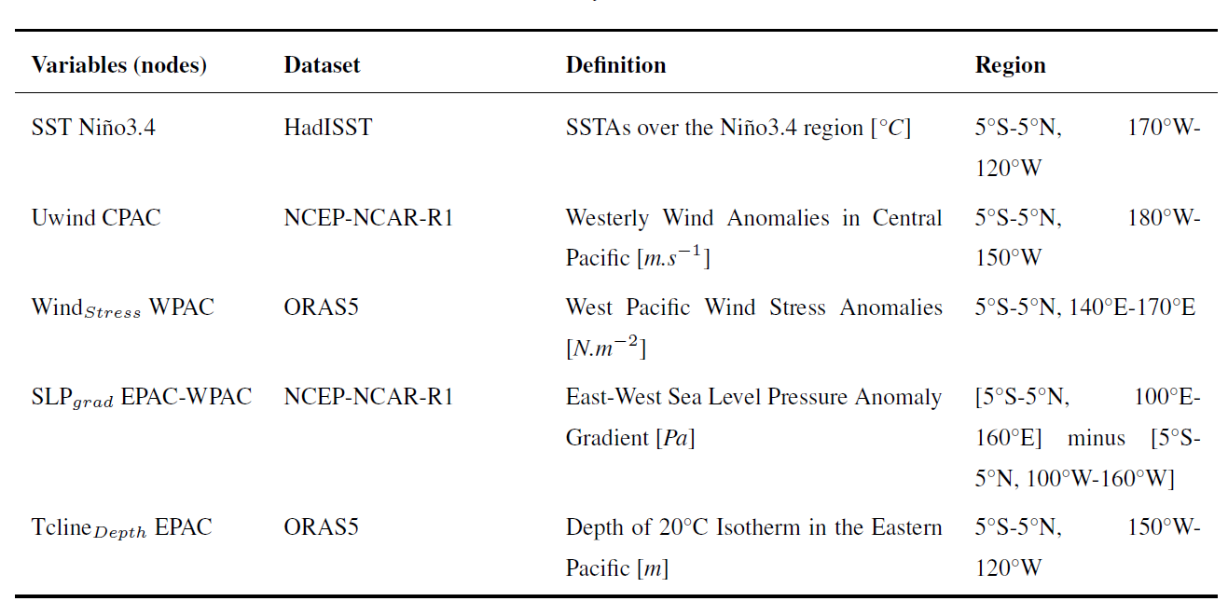
Zwischentitel mit Bild 8 Arial Regular 36 pt
Supplement - Proof of Concept: El Niño 1997-1998
Untertitel der Präsentation
Arial Regular 24 pt

Slide 14
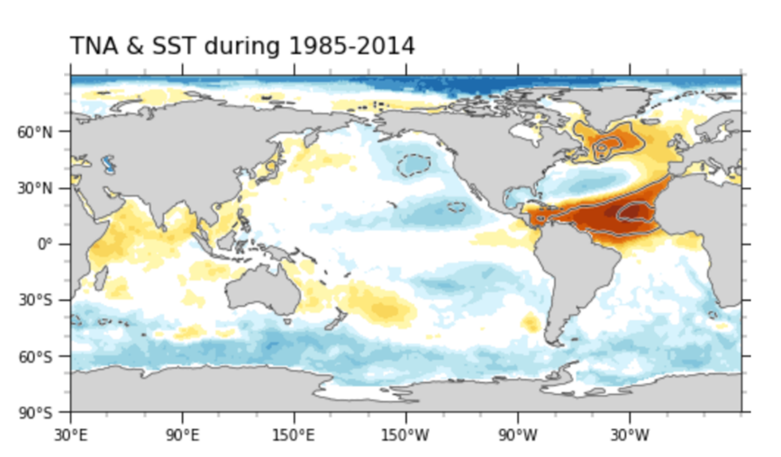
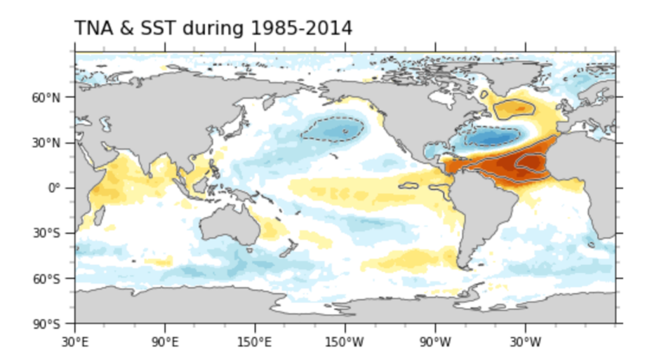
Causal analysis of Atlantic-Pacific interactions
Results: 1. Observed correlation maps
Karmouche et al. (2023b, in review)
Before subtracting MEM (mixed signal)
After subtracting MEM (mixed signal)
→ Externally forced signal contributed to the negative correlation of the TNA index with the eastern tropical and North Pacific SSTAs observed during the 1985-2014 Atlantic-driven regime.

Slide 15
Background: Pacific-driven regime vs Atlantic-driven regime
The impact of ENSO on tropical Atlantic:
Extratropical Rossby wave train (PNA-NAO)
Atmospheric bridge (PWC)
Tropospheric temperature mechanism (eastward Kelvin wave)
Net same-sign effect
Pronounced during 1950-1983
The impact of tropical Atlantic on ENSO:
The Rossby wave response (west of TNA)
The Kelvin wave response (east of TNA)
The wind–evaporation–SST–convection (WESC) feedback
Net opposite-sign effect
Pronounced during 1983-2014

Slide 16
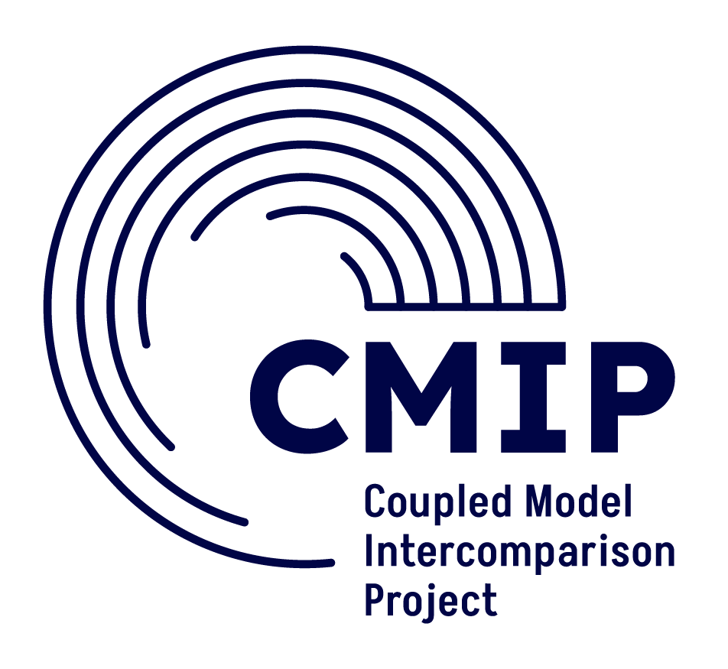
Abstract
Acknowledgments
Thank you for your attention
Discussion (Q&A)
Karmouche, et al. (2024, accepted). Changing effects of external forcing on Atlantic-Pacific interactions. EGUsphere, 2023, 1–36. https://doi.org/10.5194/egusphere-2023-1861

