Slide 1

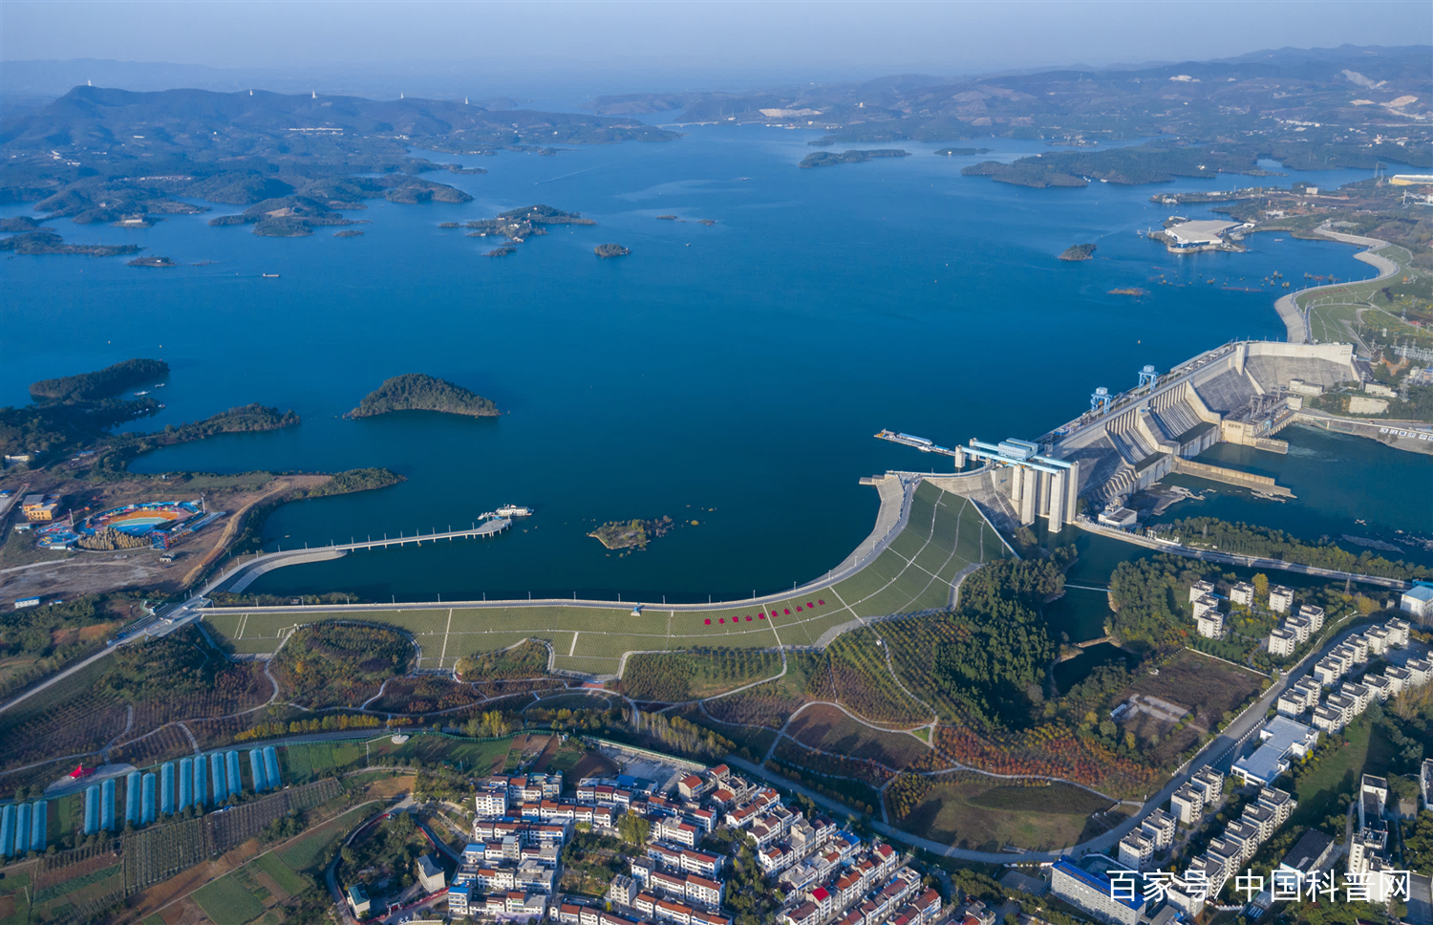
Prediction modelling framework comparative analysis of dissolved oxygen concentration variations using support vector regression coupled with multiple feature engineering and optimization methods: A case study in China
EGU24-7941 HS4.8
Guangxi University,
China
Xizhi Nong ^{a, b*}, Cheng Lai ª, Lihua Chen ª, Jiahua Wei ^{b}
ª State Key Laboratory of Featured Metal Materials and Life-cycle Safety for Composite Structures, School of Civil Engineering and Architecture, Guangxi University, Nanning 530004, China
^{b} State Key Laboratory of Hydroscience and Engineering, Tsinghua University, Beijing 100084, China.
E-mail: nongxizhi@gxu.edu.cn
Assistant professor, Western Outstanding Youth Talents granted by the Organization Department of Central Committee of the Communist Party of China

Slide 2


CONTENTS
EGU24-7941 HS4.8
Research background
Study area
Methodology
Results and discussion
Prospective

Slide 3
CONTENTS
EGU24-7941 HS4.8
Research background
Study area
Methodology
Results and discussion
Prospective

Slide 4
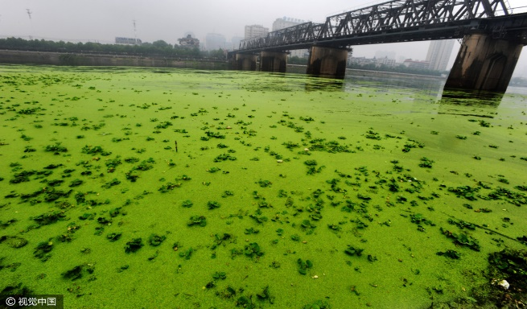
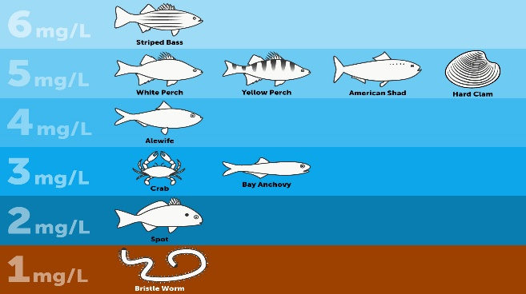


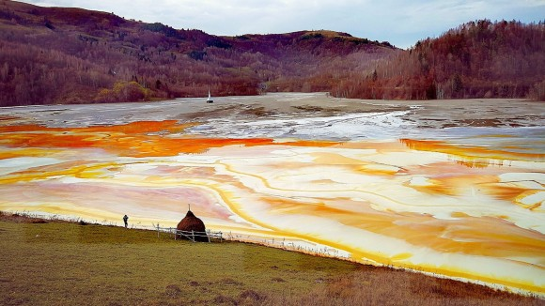
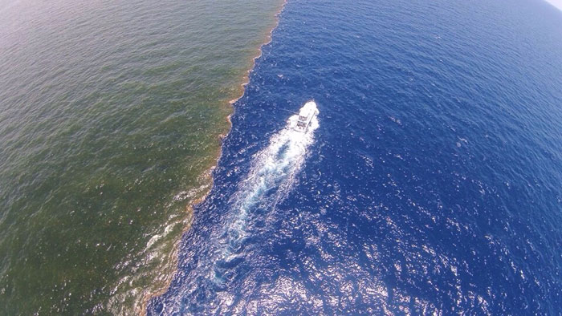
Research background: dissolved oxygen prediction
EGU24-7941 HS4.8
Dissolved oxygen (DO) is one of the most crucial indicators for assessing water quality and regulating aquatic life metabolism, low DO concentration may cause:
Harmful algal bloom
Fish mortality
Aquatic life deformity
Eutrophication
toxic metal release
from the sediment
Costal dead zone
Accurately predict the DO concentration retain a challenge

Slide 5
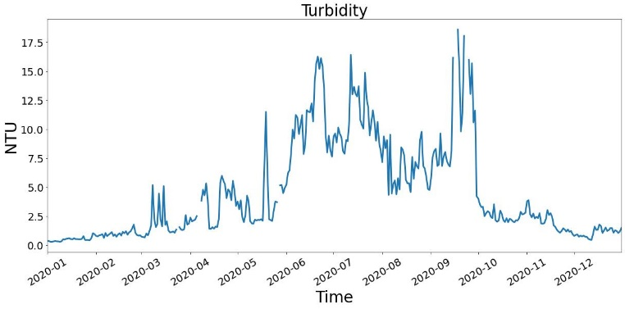
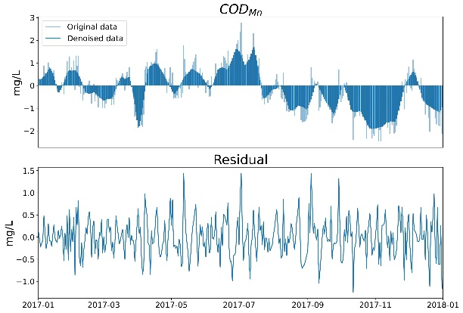
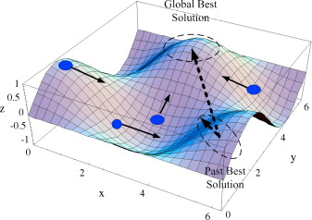
Research background: Data processing for data-driven models
EGU24-7941 HS4.8
Dirty data
Noisy data
(Data contains many outliers and missing values)
(Data contains many errors derive from instrument, man-made, etc.)
Data preprocess
Data denoising
Feature redundancy
Local optimum
Key parameters
(Also can be regard as key factors identification)
(Hyperparameters grasp the model in performance)
…
SVR
redundant
parameters
Feature selection
Model optimization
the non-stational and non-linear DO data require to comprehensively process
Most of studies focus on only one segment of the data processing
Notes:
溶解氧不平稳非线性的特点会影响模型的稳定性和准确性，因此需要对溶解氧数据进行处理，然而大部分研究仅关注于数据 处理的一部分

Slide 6
CONTENTS
EGU24-7941 HS4.8
Research background
Study area
Methodology
Results and discussion
Prospective

Slide 7
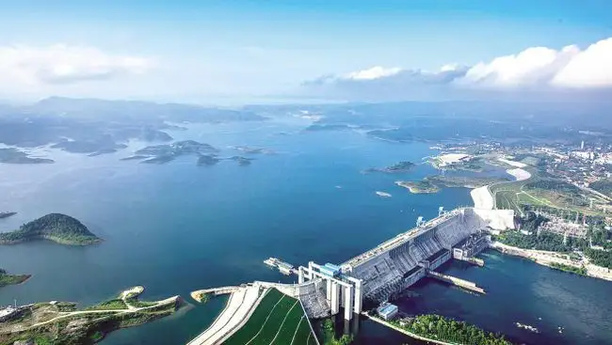
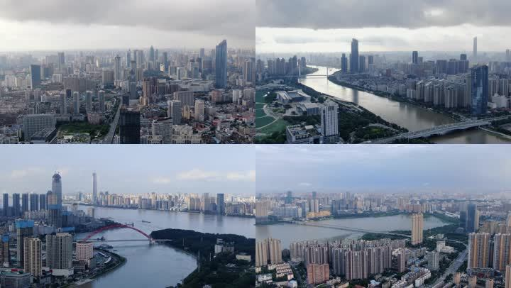
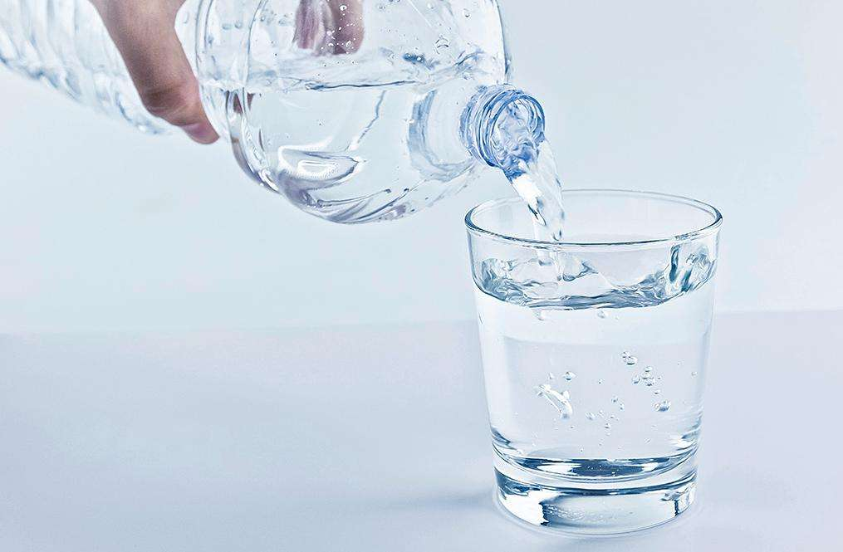

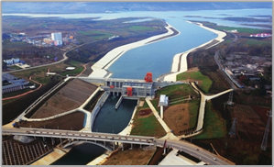

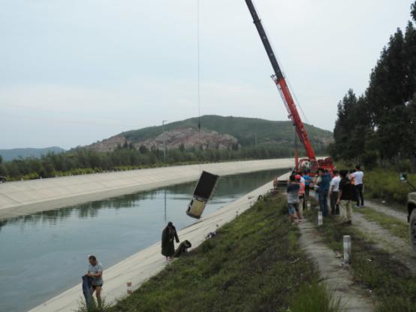
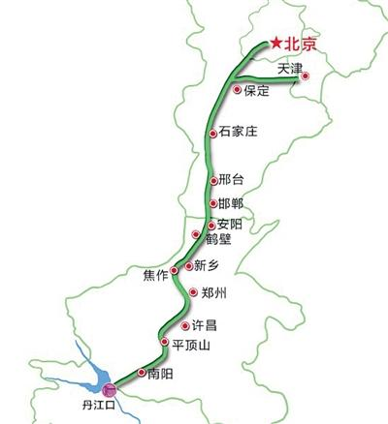
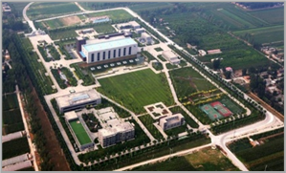
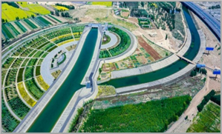
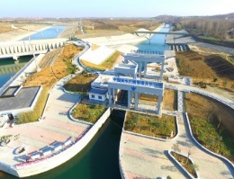
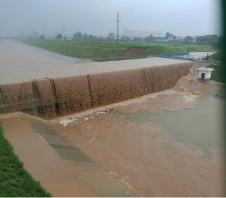
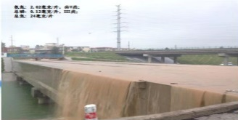
Study area： MRSNWDPC
EGU24-7941 HS4.8
The Middle route of the South-to-North Water Diversion Project of China (MRSNWDPC)
the current longest inter-basin water transfer project in the world, supplying 60 billion m³ of water and 5.9 billion m³ of ecological replenishment, directly benefiting 90 million people, with huge social and ecological benefit
Optimize the water resource allocation
Alleviating urban water stress
Safeguard of water safety
Water quality received wide attention due to the complex working conditions of this project since 2014
Large-scale and complex
water supply network
Strong interference from
many control construction
Hard to manage the diverse
and complex risk events

Slide 8
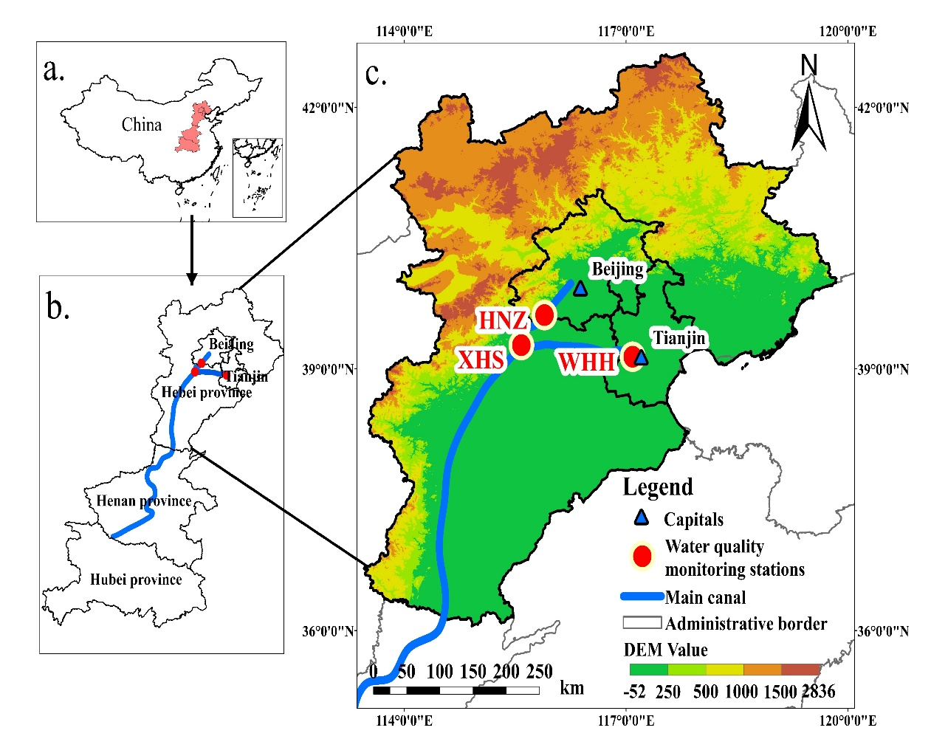
Study area: data collection
EGU24-7941 HS4.8
Study period
Data size
Stations
From 2017.01.01
To 2020.12.31
17, 532
daily observations
WHH
XHS
HNZ
Water quality indicators
Dissolved oxygen (DO) Permanganate index (COD_{Mn}) Ammonia nitrogen (NH₃⁻H) Chlorophyll-a (Chl-a) Water temperature (WT) | Turbidity (Turb) pH Conductivity (EC) Dissolved organic matter(DOM)
Meteorological indicators
Clear-sky photosynthetically active radiation(CS-PAR) |  | Wind speed (WS)
Hydrological indicators
Streamflow(FL)

Slide 9
CONTENTS
EGU24-7941 HS4.8
Research background
Study area
Methodology
Results and discussion
Prospective

Slide 10

Methodology
EGU24-7941 HS4.8
WHH
XHS
HNZ
GA
RS
PSO
SA
Wavelet analysis
Moving average
CEEMDAN
PCA
Random forest
Stepwise regression
LASSO
Spatio-temporal distribution
Raw data
Hyper-parameters optimization
Linear interpolation
Moving average
Feature selection
Data denoising
Data
Pre-processing

Slide 11
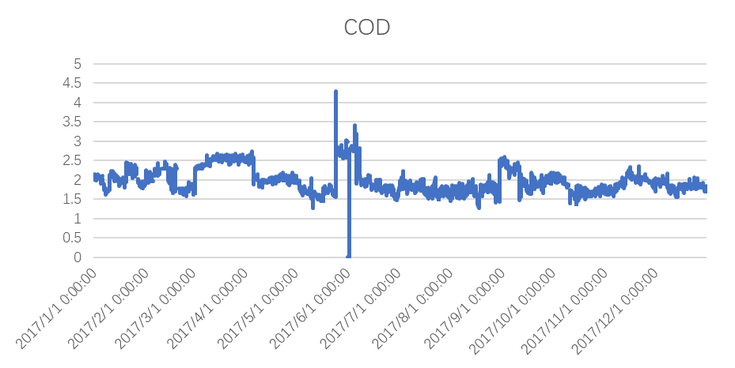

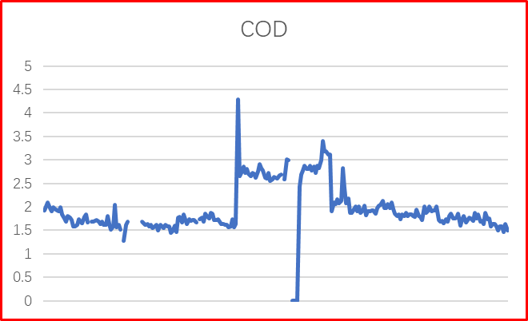
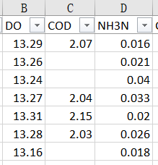
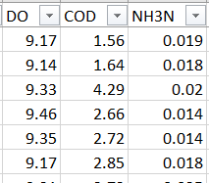
Methodology: Data pre-processing
EGU24-7941 HS4.8
The anomaly will increase the risk of model overfitting and degrade the model performance
Notes:
存在着缺失值和离群值作为数据处理的重点对象，一般采用填补、删除、定义和处理这么几种大类的方式，传统常用的如上所示，再本严重的数据处理中，我们选取了几个具有代表性的方法即线性插值和滑动平均值 （不用讲太多的时间）

Slide 12
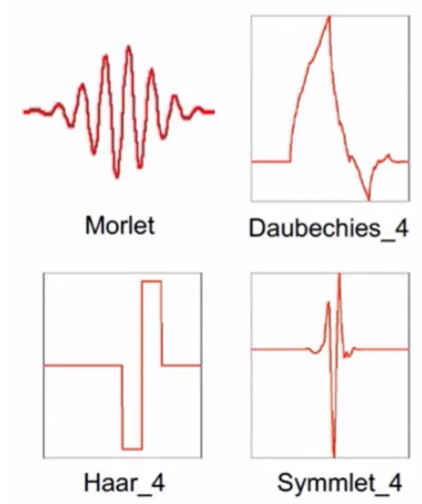

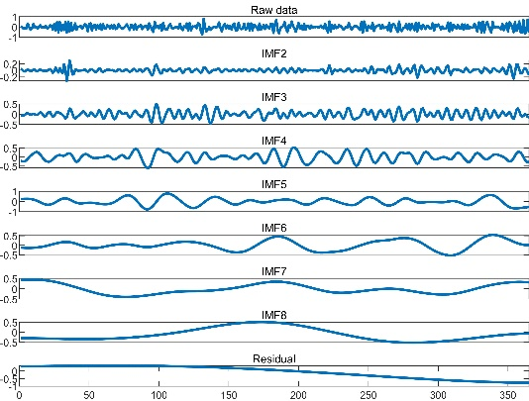
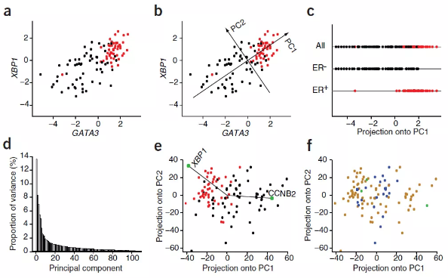
Methodology: Data de-noising
EGU24-7941 HS4.8
Data denoising is to remove noise of data, smooth model performance, and reduce errors in model prediction results
Wavelet analysis
Moving average
Scaling transform based on mother wavelet to approximate the original data
Sliding average calculates the average of a subset by selecting a fixed-length subset and advancing it item by item
Complete Ensemble Empirical Mode Decomposition with Adaptive Noise (CEEMDAN）
Principal component analysis (PCA)
PCA is the construction of a new, uncorrelated set of new variables by rotational change
Noise reduction by decomposing the original signal into multiple empirical modal components (IMFs) and residuals

Slide 13
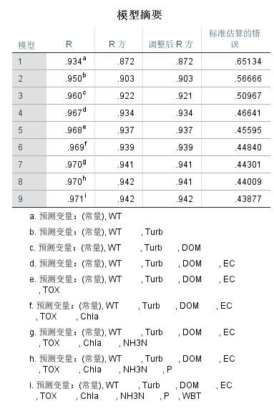
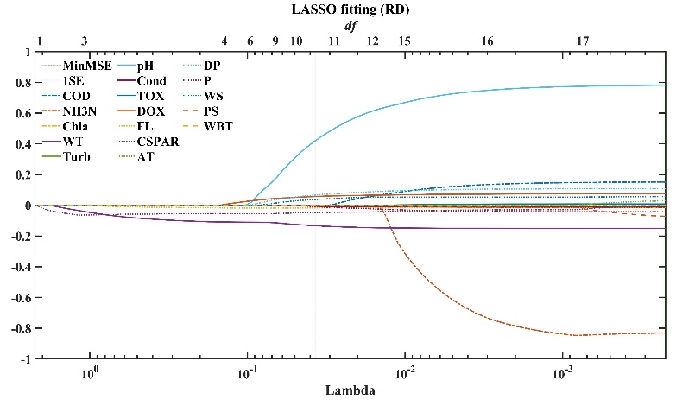
Methodology: Feature selection
EGU24-7941 HS4.8
Feature selection can eliminate redundant features, improve model training speed and identify key factors
Random forest
Stepwise linear regression
LASSO regression
input
Tree 1
Tree 2
Tree n
vote
result
Random forest generates tree models by randomly selecting a fixed-length subset of features in a sample, and finally the optimal tree model is obtained by a voting method
Stepwise regression screens the factors of the model by the importance between the independent and dependent variables, and increases the number of important independent variables in a stepwise manner
The LASSO regression compresses the coefficients in the linear model by adding the regularization term of the L1 paradigm to find the optimal sparse solution of the model

Slide 14
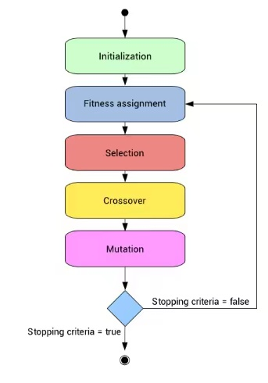
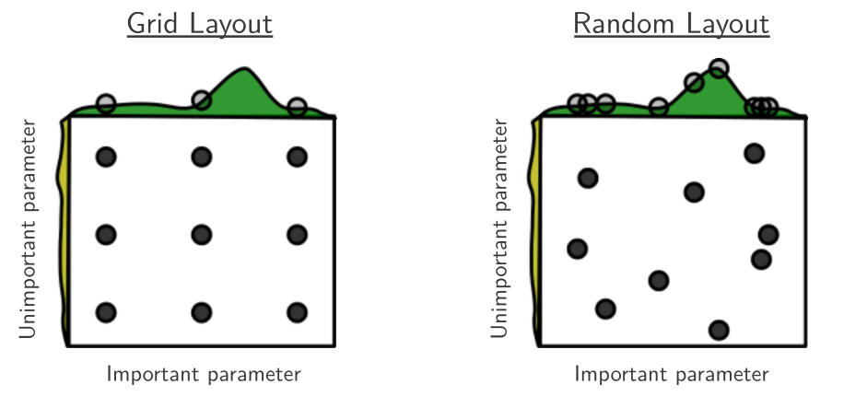
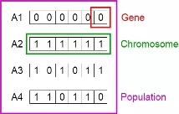
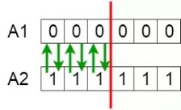
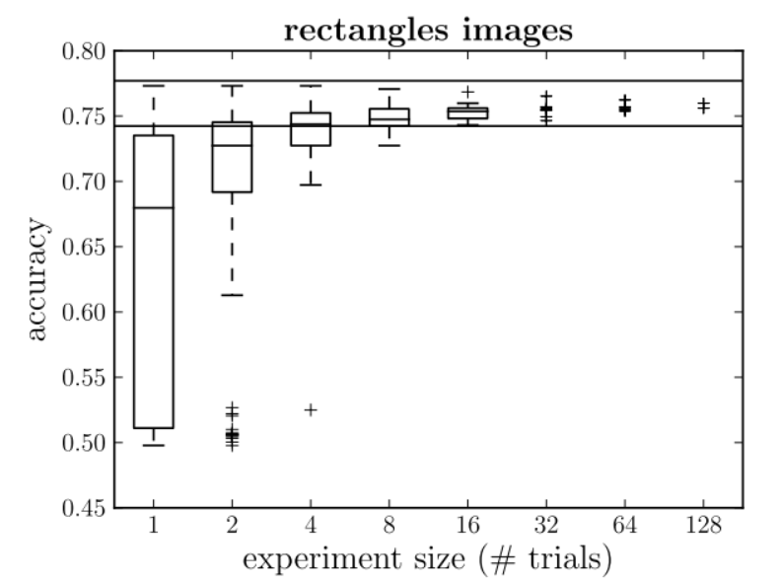
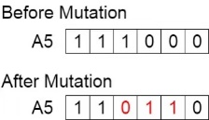




Methodology: Hyperparameters optimization
EGU24-7941 HS4.8
The optimization algorithm morph the hyperparameters setting into the optimal problems, increasing the performance by searching the best solution of hyperparameters
Genetic algorithm (GA)
Inspiring by the Darwin's natural selection principle, GA search the optimal value through the selection, crossover, and mutation
Random search (RS)
This algorithm randomly generates multiple, uniformly-sized hyperparameters array, and consistent train the model with the value of array to find the best solution
Particles optimization algorithm (PSO)
Inspiring by the foraging process of birds, PSO generates a great amount of moving particles to search the optimal solution
Simulated annealing algorithm (SA)
Inspired by the process of annealing and cooling material to achieve a state with minimal material .
$$y$$
Global optimum
$$y_{0}$$
Local optimum
$$x_{0}$$
$$x$$

Slide 15
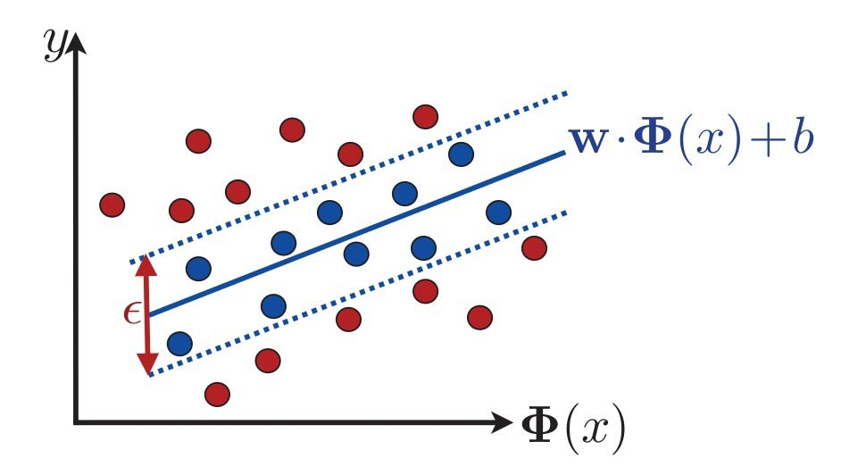
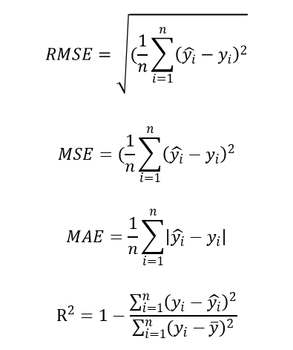

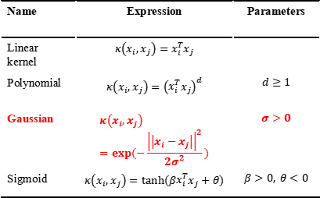
Methodology: SVR model construction
EGU24-7941 HS4.8
SVR model selection
Kernel function selection
Performance evaluation
Name | Expression | Parameters
Linear kernel | $$κ\left(x_{i},x_{j}\right)=x_{i}^{T}x_{j}$$
Polynomial | $$κ\left(x_{i},x_{j}\right)={\left(x_{i}^{T}x_{j}\right)}^{d}$$ | $$d≥1$$
Gaussian | $$κ\left(x_{i},x_{j}\right)=exp⁡(−\frac{{\left|\left|x_{i}−x_{j}\right|\right|}^{2}}{2σ^{2}})$$ | $$σ>0$$
Sigmoid | $$κ\left(x_{i},x_{j}\right)=tanh(βx_{i}^{T}x_{j}+θ)$$ | $$β>0, θ<0$$
Support vector regression (SVR)
SVR based on the distance between data point and hyperplane to calculate the model loss
$ε$-SVR was applied to construct the prediction model
Kernel function
Kernel function able to map the data from low dimension to high dimension
Gaussian kernel was used in this study
Performance evaluation
RMSE: root mean square error
MSE: mean square error
MAE: mean absolute error
R²: coefficient of determination

Slide 16
CONTENTS
EGU24-7941 HS4.8
Research background
Study area
Methodology
Results and discussion
Prospective

Slide 17
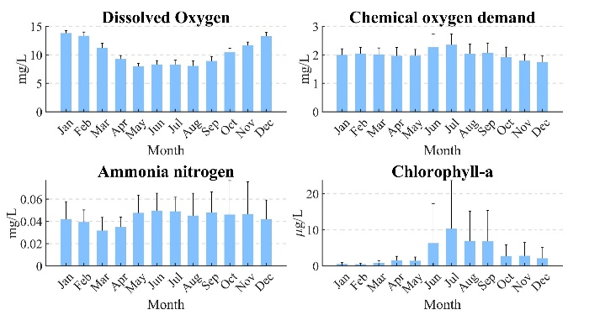
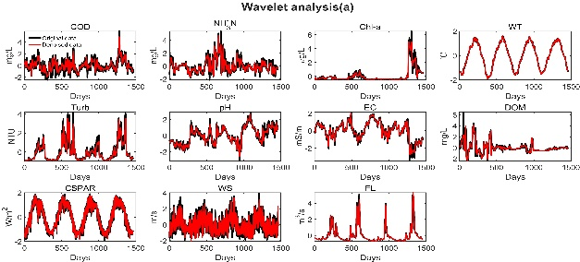
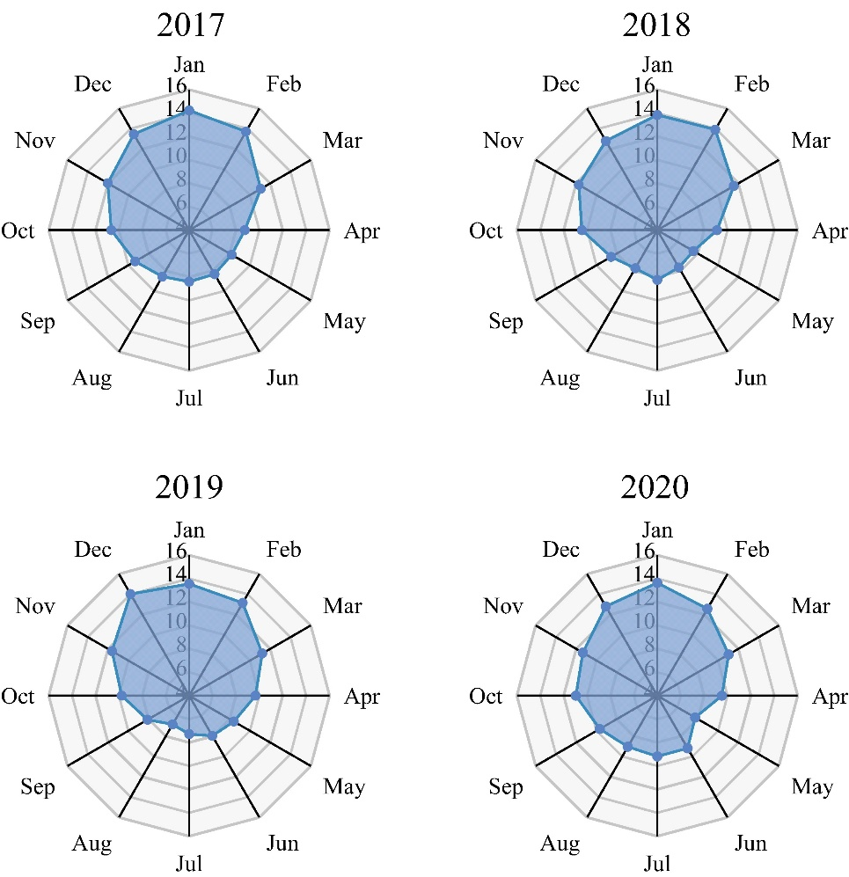
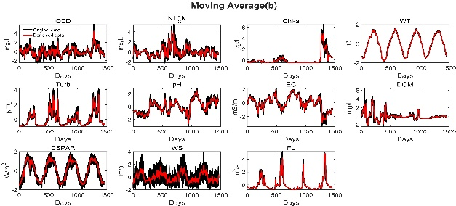
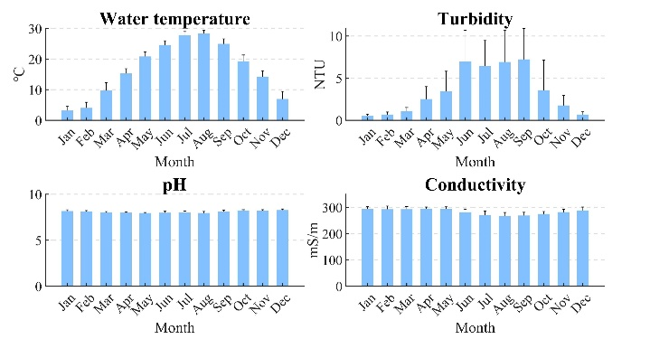
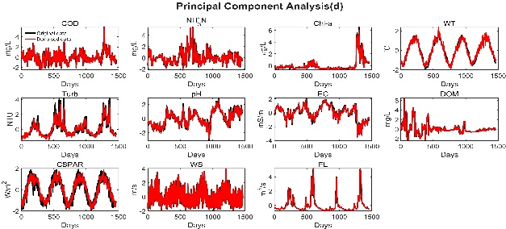
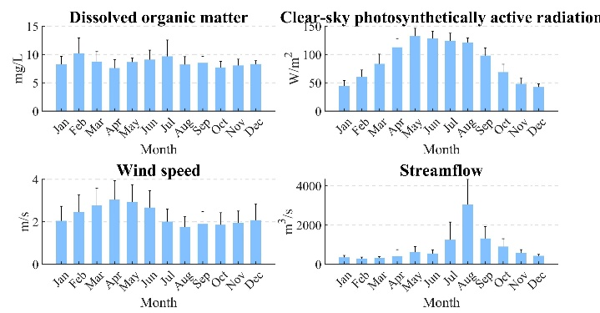
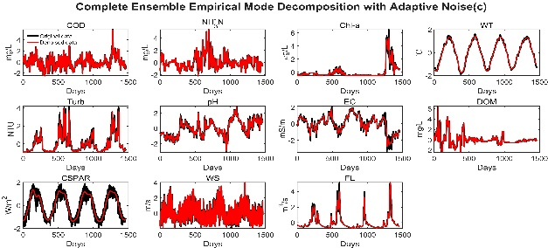
Results and discussion: Data preprocess and denoising
EGU24-7941 HS4.8
Data preprocess
Data denoising
Monthly analysis of DO
Wavelet analysis
Moving
average
PCA
CEEMDAN
DO concentration is high from October to February, and low in the rest of year
Temporal patterns

Slide 18
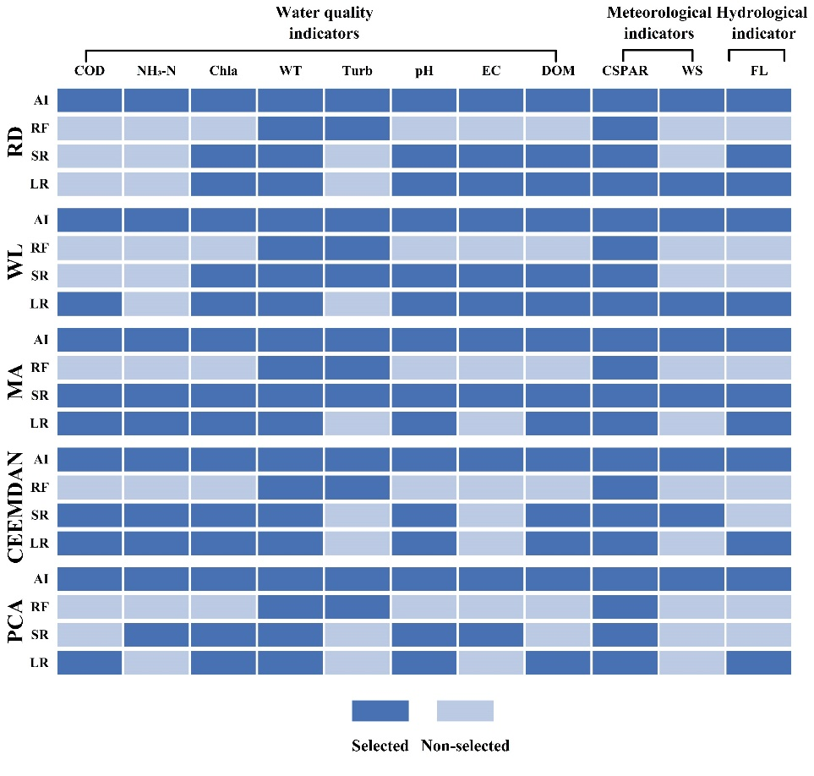
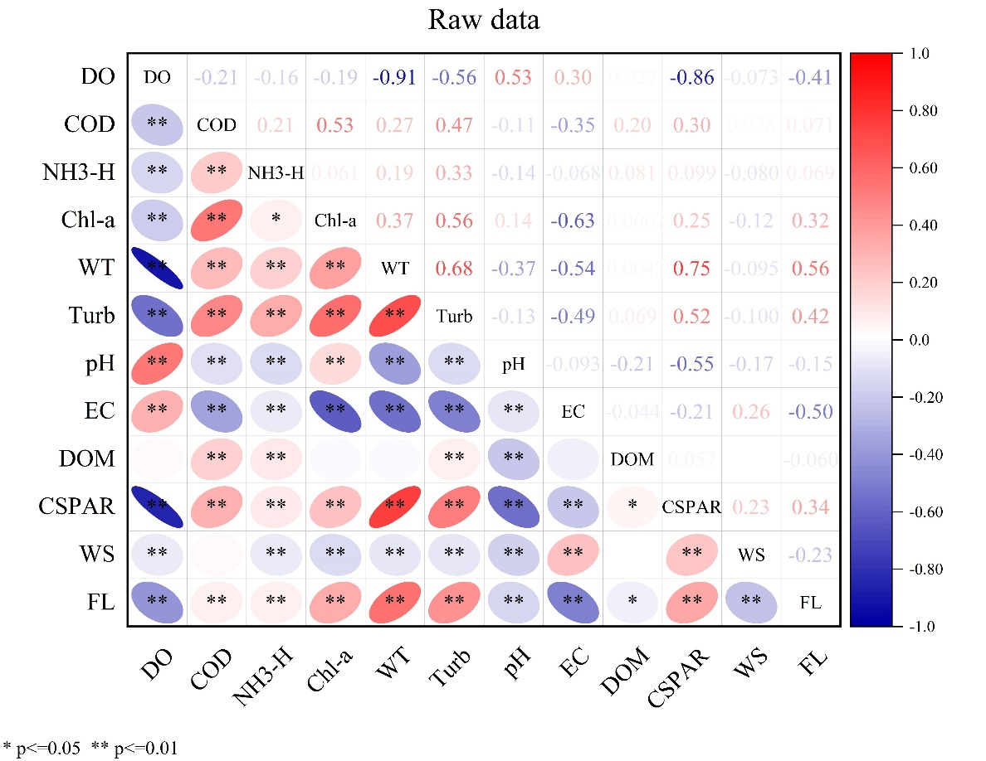
Results and discussion: Key features identification
EGU24-7941 HS4.8
in non-linear feature selection, WT and PAR were selected as predictors in every case
in linear feature selection, all the indicators significant in the 0.01 level, except for the DOM
the non-linear feature selection are able to capture the DOM’s impact on the DO
Non-linear feature selection
Linear feature selection
Notes:
这可能是由于降雨为该工程带来DOM输入，从而影响DO浓度

Slide 19
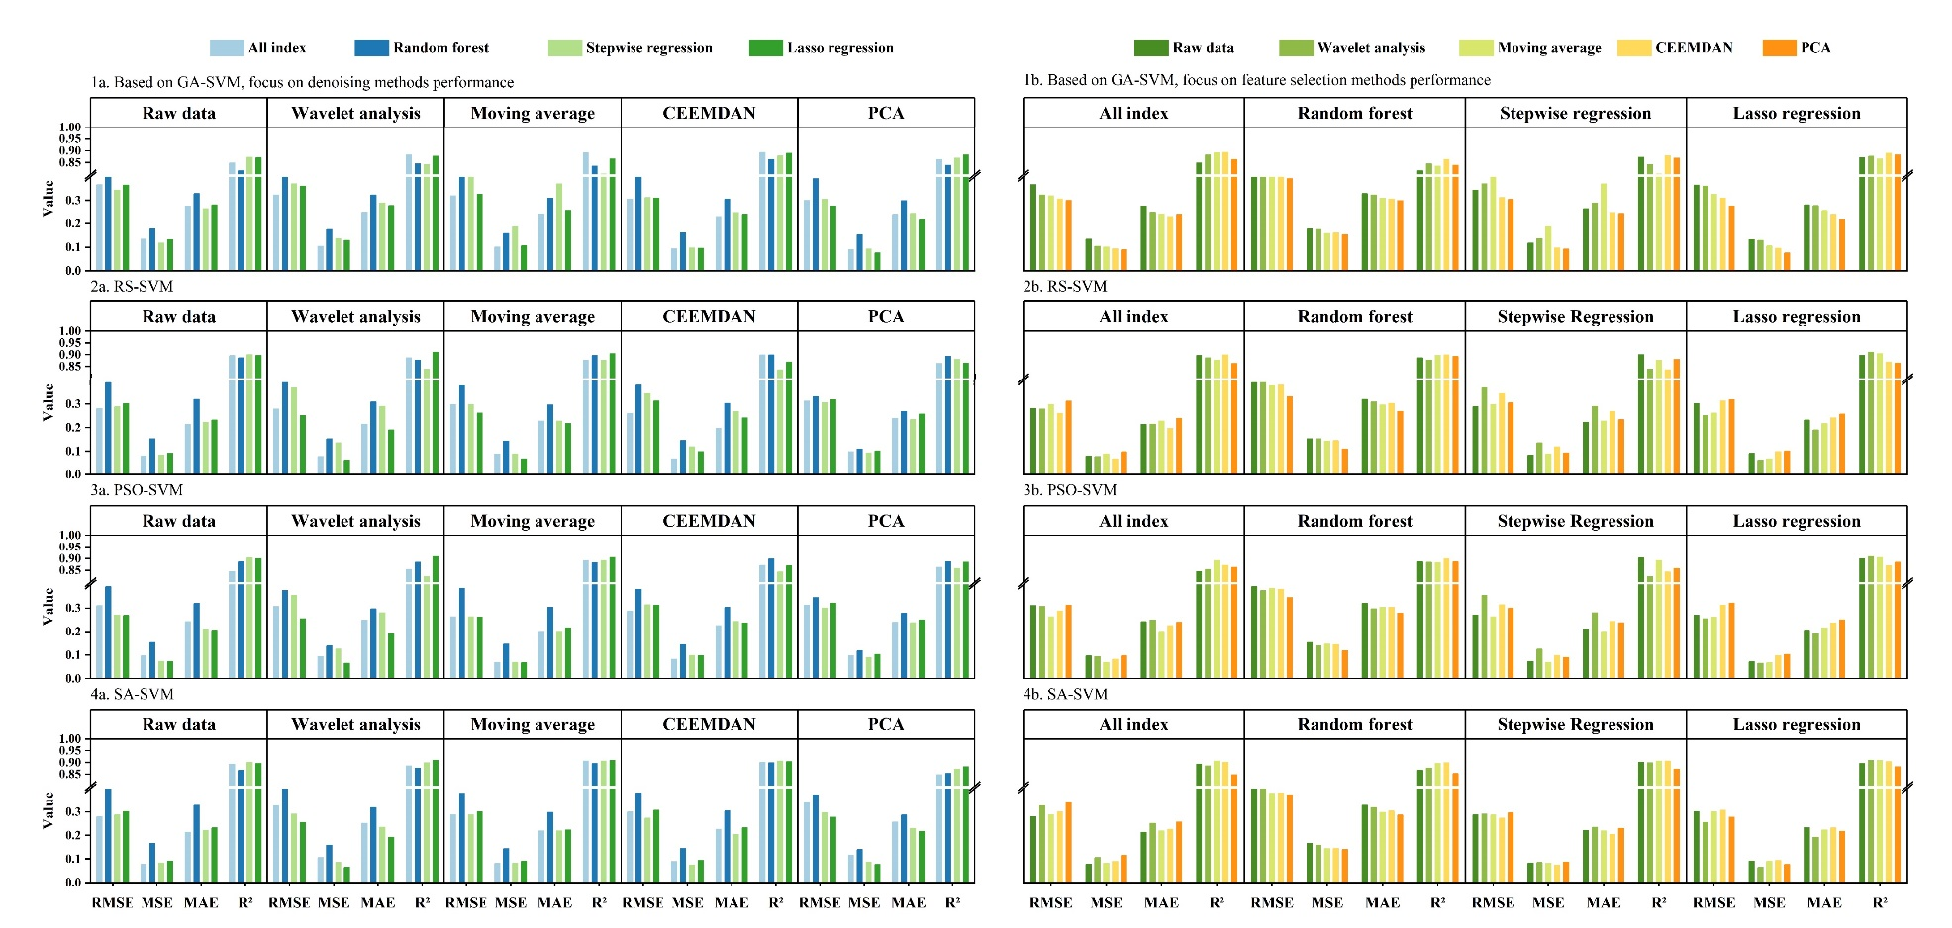

Results and discussion: Performance evaluation and analysis
EGU24-7941 HS4.8
Under multiple methods, performance evaluation indicators comparative analysis in WHH
The optimum model：WL—LR—RS—SVR (MSE = 0.063, R² = 0.911)；
The worst model：MA—RF—GA—SVR (MSE = 0.187, R² = 0.802)
WL —LR can obtain the satisfied performance in most of optimization algorithm, while RF receive poor performance
(a)
(b)
(c)

Slide 20


Results and discussion: Performance evaluation and analysis
EGU24-7941 HS4.8
Optimized SVR outperforms the MLR and standalone SVR in robustness and accuracy.
MLR obtains the best performance in some cases, which differs from the previous study.
When the PCA processed data, MLR existed model overfitting problems, so that cannot rely on MLR when this model faces new data
Standalone SVR presents a relatively low accuracy, which is inferior to the optimized SVR.
Time series prediction
Good-of-Fitting analysis

Slide 21

Results and discussion: Spatiotemporal distribution modeling
EGU24-7941 HS4.8
The prediction results of the WHH changed slightly in models, while XHS and HNZ stations showed dramatical fluctuations
XHS is superior to HNZ, but inferior to WHH, the best model in XHS is CEEMDAN—AI—RS—SVR (MSE=0.164, R²=0.884); the best model in HNZ is WL —RF —SA —SVR (MSE=0.189, R²=0.806）
A previous study has reported that the standard deviations of DO and streamflow are inverse to the predicted errors of the DO prediction for river bodies (Zhi et al., 2021),which is not consist with out study.
Notes:
可能优于该工程中具有大量的水工建筑物，导致溶解氧变化与自然河流不同。

Slide 22
CONTENTS
EGU24-7941 HS4.8
Research background
Study area
Methodology
Results and discussion
Prospective

Slide 23
Prospective
EGU24-7941 HS4.8
The drivers of DO not only include the well-known factors like Water temperature and hydrodynamics factors, but the different hydraulics construction, and physicochemical parameters may also impact the DO subtly.
For higher accuracy prediction, it is required to well process the data and model. Moreover, the results outputted by different process methods also need to make a comparison with other methods for avoiding the local optimal result.
Considering that this project will continue to operate for many years, dissolved oxygen variation under different climate sceneries and more accurate and reliable dissolved oxygen estimation methods are still required in the future.

Slide 24


Acknowledgments
This research was funded by
the Specific Research Project of Guangxi for Research Bases and Talents (No.AD22035185)
the Youth Science Foundation of Guangxi (No.2023GXNSFBA026296)
the National Natural Science Foundation of China (No.52309016)
the Western outstanding youth talents granted by the Organization Department of Central Committee of the Communist Party of China
Thanks for the review by the section convenor, Professor Kourosh Behzadian
EGU24-7941 HS4.8
Thanks for your attention

