Slide 1


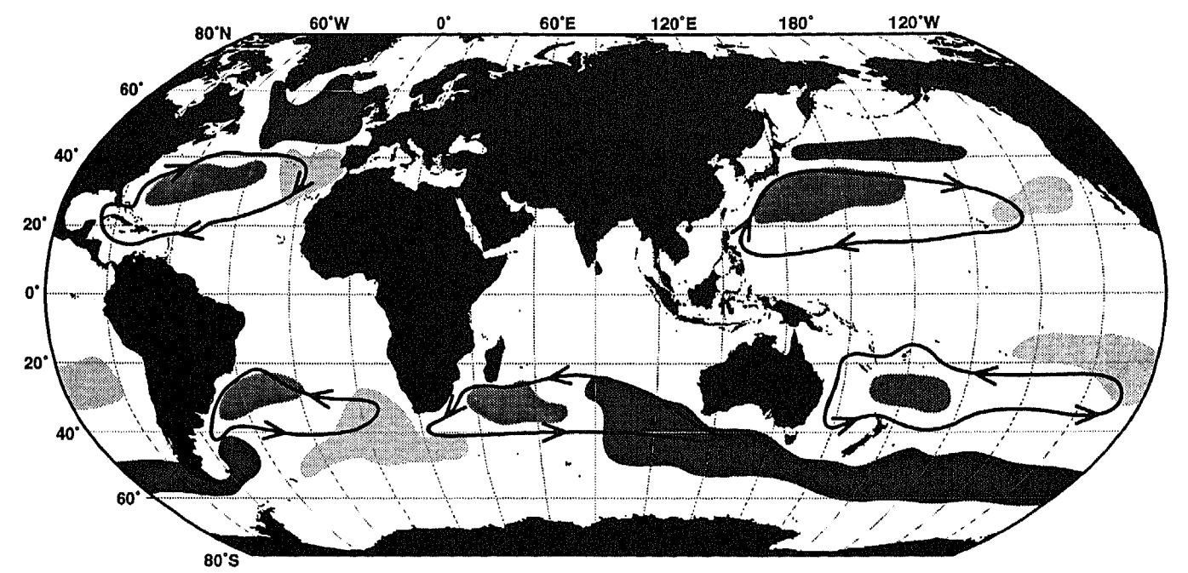
Surface forcing controls on the volume and heat content of subtropical and subpolar mode waters over the global ocean
Ciara Pimm (c.pimm@liverpool.ac.uk)¹, Ric Williams¹, Dani Jones^{2,3}, Andrew Meijers²
¹University of Liverpool, ²British Antarctic Survey, ³Cooperative Institute for Great Lakes Research, University of Michigan
Mode waters are globally important in the uptake and transport of heat and carbon.
Subtropical mode waters
Subpolar mode waters
Talley, L.D., 1999. Some aspects of ocean heat transport by the shallow, intermediate and deep overturning circulations. Geophysical Monograph-American Geophysical Union, 112, pp.1-22.
Notes:
We are looking at two different kinds of mode water, subtropical and subpolar. This talk mostly considers the North Atlantic and South Indian pools. But at the end North Pacific and Southeast Pacific are considered briefly.

Slide 2
Surface forcing controls on the volume and heat content of subtropical and subpolar mode waters over the global ocean
Ciara Pimm (c.pimm@liverpool.ac.uk)¹, Ric Williams¹, Dani Jones^{2,3}, Andrew Meijers²
¹University of Liverpool, ²British Antarctic Survey, ³Cooperative Institute for Great Lakes Research, University of Michigan
We aim to understand how external forcing affects different global mode waters.
Which forcings are most important in driving mode water volume?
Are local or farfield forcings more important on different timescales?
Talley, L.D., 1999. Some aspects of ocean heat transport by the shallow, intermediate and deep overturning circulations. Geophysical Monograph-American Geophysical Union, 112, pp.1-22.

Slide 3
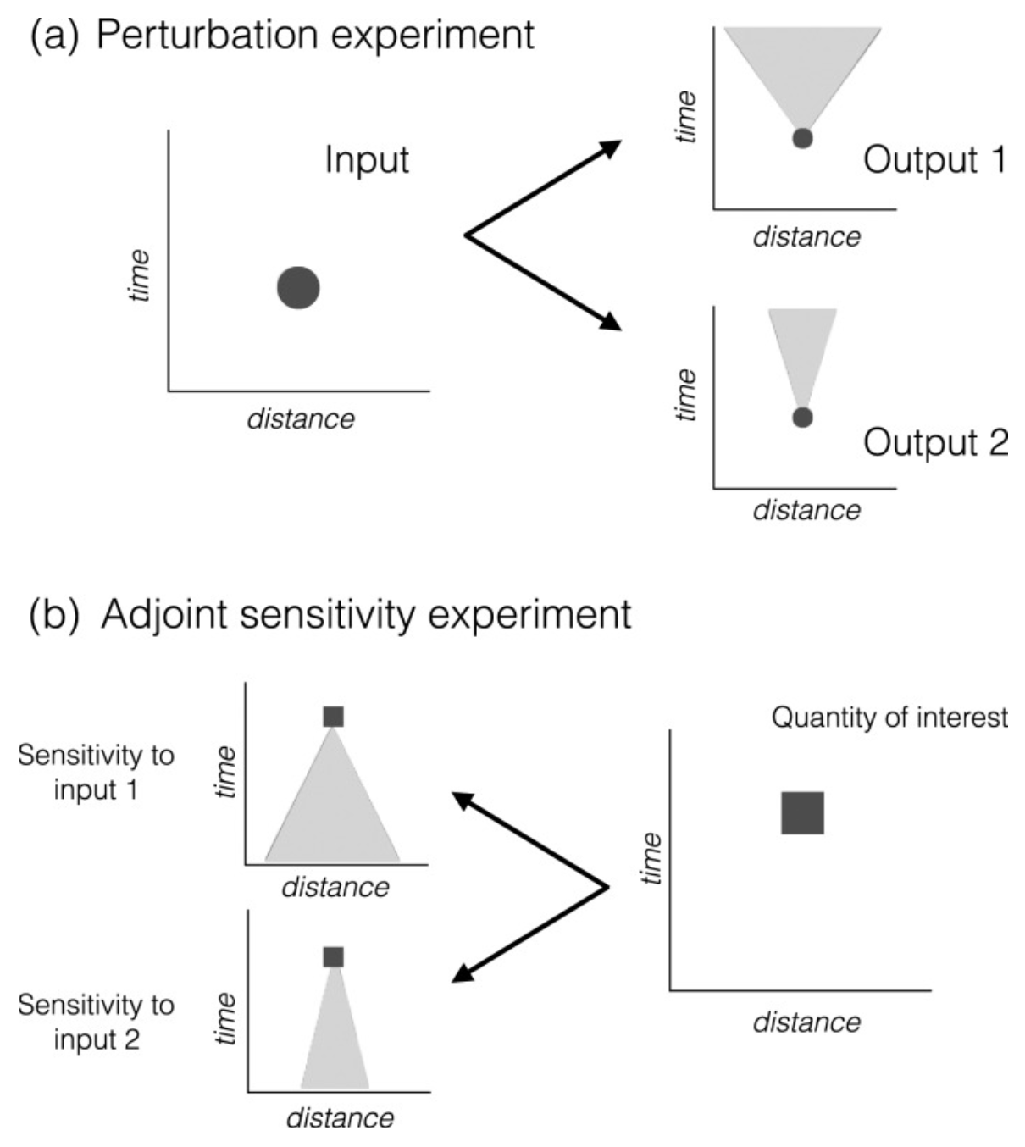
Surface forcing controls on the volume and heat content of subtropical and subpolar mode waters over the global ocean
Method
We conduct a set of adjoint sensitivity experiments in ECCOv4r4 to explore the impacts of external forcing on mode water volume.
A density-following adjoint feature is used to properly define the mode water pools.
Jones, D.C., Forget, G., Sinha, B., Josey, S.A., Boland, E.J., Meijers, A.J. and Shuckburgh, E., 2018. Local and remote influences on the heat content of the Labrador Sea: An adjoint sensitivity study. Journal of Geophysical Research: Oceans, 123(4), pp.2646-2667.
Notes:
This schematic explains one way to understand how an adjoint sensitivity experiment works. In a more standard forward perturbation experiment you pick one input (heat flux) and change it by a small amount, then you see how this change propagates throughout the model state with a difference from the control. In the adjoint sensitivity experiment you pick a quantity of interest/ objective function (mode water pool volume) and then linear partial differentials are calculated of the objective function to every independent variable at every position and time.

Slide 4
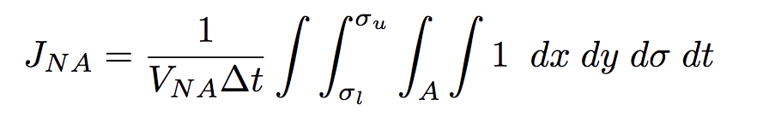
Surface forcing controls on the volume and heat content of subtropical and subpolar mode waters over the global ocean
North Atlantic subtropical mode water
Density surfaces: 26.3 – 26.7 kg/m³
Year: 2017
v
Winter mixed layer depth (m).
Annual-average potential temperature (°C) with neutral density contours (kg/m³, white), and 18° potential temperature contour (°C, red dashed).
Notes:
To set up an adjoint sensitivity experiment we define an objective function. The North Atlantic mode water is defined using winter mixed layer depth, the 18 degree potential temperature contour, and the bounding density surfaces 26.3 – 26.7. Combined in the integral equation for an objective function.

Slide 5
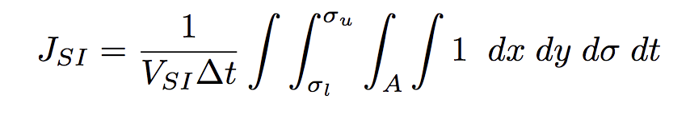
Surface forcing controls on the volume and heat content of subtropical and subpolar mode waters over the global ocean
South Indian subpolar mode water
Density surfaces: 26.8 – 27.0 kg/m³
Year: 2017
Winter mixed layer depth (m).
Annual-average potential vorticity (kg/m⁴) with neutral density contours (kg/m³, white), and 8° potential temperature contour (°C, red dashed).
Notes:
The South Indian mode water is defined using winter mixed layer depth, and the bounding density surfaces 26.8 – 27.0. Combined in the integral equation for an objective function.

Slide 6
Surface forcing controls on the volume and heat content of subtropical and subpolar mode waters over the global ocean
Defining Mode Water pools and bounding density surfaces
Considering annual-average potential temperature vs depth finds a pool of 18° subtropical mode water bounded by density surfaces 26.3 – 26.7 kg/m³.

Slide 7
Surface forcing controls on the volume and heat content of subtropical and subpolar mode waters over the global ocean
Defining Mode Water pools and bounding density surfaces
Considering annual-average potential vorticity vs depth finds a pool of subpolar mode water bounded by density surfaces 26.8 – 27.0 kg/m³.

Slide 8
Surface forcing controls on the volume and heat content of subtropical and subpolar mode waters over the global ocean
Objective Function
North Atlantic subtropical mode water
Density surfaces: 26.3 – 26.7 kg/m³
Year: 2017
Annual-average potential temperature (°C), with North Atlantic adjoint control volume (magenta) and South Indian adjoint control volume (green).

Slide 9
Surface forcing controls on the volume and heat content of subtropical and subpolar mode waters over the global ocean
Objective Function
South Indian subpolar mode water
Density surfaces: 26.8 – 27.0 kg/m³
Year: 2017
Annual-average potential temperature (°C), with North Atlantic adjoint control volume (magenta) and South Indian adjoint control volume (green).

Slide 10
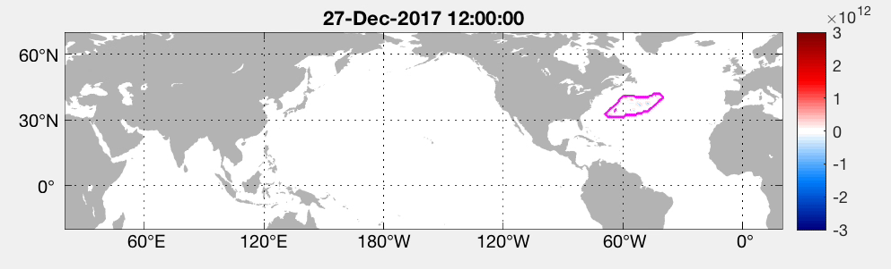
Surface forcing controls on the volume and heat content of subtropical and subpolar mode waters over the global ocean
Sensitivity of volume to net heat flux
North Atlantic subtropical mode water
Positive sensitivities X cooling => Increase in volume
Negative sensitivities X cooling => Decrease in volume
Notes:
When the North Atlantic adjoint sensitivity experiment is completed the outputs (or sensitivities) are analysed. Here we look at the sensitivity of the North Atlantic mode water pool volume to surface heat flux over time. Sensitivities imply a causal relationship between model variables, helping to explain underlying processes that affect volume. We look at heat flux first as it is known that heat flux is one of the most important factors affecting mode water pool formation.

Slide 11
How does surface forcing affect subtropical and subpolar mode waters over the global ocean?
Sensitivity of volume to net heat flux
North Atlantic subtropical mode water
Mode water volume is sensitive to local cooling, positive sensitivities.
It is also sensitive to farfield warming along the subtropical circulation, negative sensitivities.

Slide 12
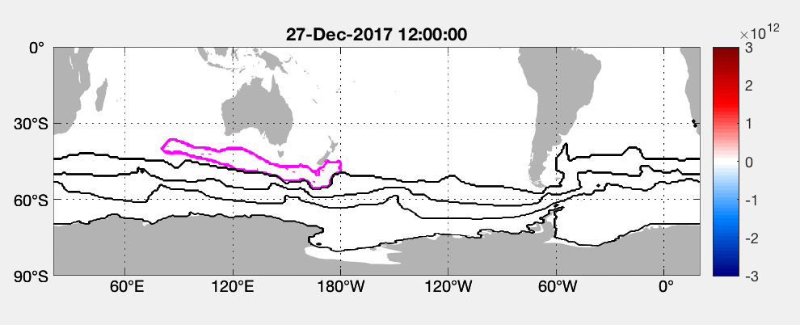
How does surface forcing affect subtropical and subpolar mode waters over the global ocean?
Sensitivity of volume to net heat flux
South Indian subpolar mode water
Positive sensitivities X cooling => Increase in volume
Negative sensitivities X cooling => Decrease in volume

Slide 13
Surface forcing controls on the volume and heat content of subtropical and subpolar mode waters over the global ocean
Sensitivity of volume to net heat flux
South Indian subpolar mode water
Mode water volume is sensitive to local, winter cooling for 3 years, positive sensitivities.
It is also sensitive to farfield warming along the Antarctic Circumpolar Current and the Indian Ocean, negative sensitivities.
Notes:
Here we look at the sensitivity of the South Indian mode water pool volume to surface heat flux over time. Sensitivities can show different pathways in which heat flux can affect mode water pool volume.

Slide 14
Surface forcing controls on the volume and heat content of subtropical and subpolar mode waters over the global ocean
Sensitivity of volume to net heat flux
North Atlantic subtropical mode water
South Indian subpolar mode water
Notes:
These are snapshots of different times in the winter and the summer for both regions, to help compare the two and see any similarities or differences.

Slide 15
Surface forcing controls on the volume and heat content of subtropical and subpolar mode waters over the global ocean
Results
North Atlantic subtropical mode water
South Indian subpolar mode water
Winter heat flux is initially the most important factor in driving mode water pool volume.
Eastward wind stress is important on longer timescales.
Notes:
Impacts are calculated by multiplying the adjoint sensitivities with the respective forcing anomaly. So now the different impacts can all be compared more easily as they are in the same units. Here four important factors are compared and heat flux and eastward wind stress are found to be the most important.

Slide 16
Surface forcing controls on the volume and heat content of subtropical and subpolar mode waters over the global ocean
Heat flux impacts on volume
North Atlantic subtropical mode water
South Indian subpolar mode water
Notes:
Here the impacts are split into local and nonlocal parts where local means in the area of the horizontal objective function, and nonlocal is anywhere that isn’t local. Local heat flux forcing is important initially, but then nonlocal forcing is more important on longer timescales.

Slide 17
Surface forcing controls on the volume and heat content of subtropical and subpolar mode waters over the global ocean
Heat flux impacts on volume
North Atlantic subtropical mode water
South Indian subpolar mode water
Preceding winter, local cooling drives an increase in mode water pool volume.
Notes:
Snapshots of heat flux impacts on volume, explaining some of the patterns.

Slide 18
Surface forcing controls on the volume and heat content of subtropical and subpolar mode waters over the global ocean
Sensitivity of volume to net heat flux
North Atlantic subtropical mode water
South Indian subpolar mode water
Warming along the subtropical circulation is important for the volume of the North Atlantic mode water pool.

Slide 19
Surface forcing controls on the volume and heat content of subtropical and subpolar mode waters over the global ocean
North Atlantic subtropical mode water
South Indian subpolar mode water
Upstream cooling along the ACC is important for the volume of the South Indian mode water pool.

Slide 20
Surface forcing controls on the volume and heat content of subtropical and subpolar mode waters over the global ocean
Heat flux impacts on volume
North Atlantic subtropical mode water
South Indian subpolar mode water
Notes:
Snapshots of heat flux impacts on a longer timescale.

Slide 21
Surface forcing controls on the volume and heat content of subtropical and subpolar mode waters over the global ocean
Forward Perturbation Experiments
North Atlantic subtropical mode water
South Indian subpolar mode water
Notes:
Forward perturbation experiments are completed to consider any nonlinearities and to help explain any complicated physical mechanisms. The heat flux is perturbated within the black contours and the response pf potential temperature is seen in a difference from the control. Potential temperature of perturbation experiment minus control experiment. Black contour perturbation region. Grey contour NA or SI adjoint region. Green contour control bounding density surfaces. Magenta contours perturbation bounding density surfaces. Note: Potential temperature of perturbation experiment minus control experiment. Black contour perturbation region. Grey contour NA or SI adjoint region. Green contour control bounding density surfaces. Magenta contours perturbation bounding density surfaces. Maybe only have one forward perturbation slide?

Slide 22
Surface forcing controls on the volume and heat content of subtropical and subpolar mode waters over the global ocean
Forward Perturbation Experiments
North Atlantic subtropical mode water
South Indian subpolar mode water
Note: Local cooling perturbations, Neutral density of perturbation experiment minus control experiment. Dotted lines are mixed layer depth, black control, red perturbation. Solid lines are bounding density surfaces, green control, magenta perturbation

Slide 23
Surface forcing controls on the volume and heat content of subtropical and subpolar mode waters over the global ocean
Conclusion
Preceding winter, local cooling provides a key control on mode water volume initially.
The mode water in the South Indian has a longer ocean memory to preceding winter cooling than in the North Atlantic.
So, inter-year heat flux forcing variability has more impact on the North Atlantic.
North Atlantic subtropical mode water
South Indian subpolar mode water

Slide 24
Surface forcing controls on the volume and heat content of subtropical and subpolar mode waters over the global ocean
Conclusion
Preceding winter, local cooling provides a key control on mode water volume initially.
The mode water in the South Indian has a longer ocean memory to preceding winter cooling than in the North Atlantic.
So, inter-year heat flux forcing variability has more impact on the North Atlantic.
Farfield eastward wind stress is also important on longer time scales.
North Atlantic subtropical mode water
South Indian subpolar mode water

Slide 25
Surface forcing controls on the volume and heat content of subtropical and subpolar mode waters over the global ocean
North Pacific subtropical mode water
Notes:
The North Pacific mode water is defined using winter mixed layer depth, and the bounding density surfaces 25.1 – 25.4. Combined in the integral equation for an objective function.

Slide 26
Surface forcing controls on the volume and heat content of subtropical and subpolar mode waters over the global ocean
Sensitivity of volume to net heat flux
North Pacific subtropical mode water
Notes:
North Pacific sensitivities are similar to North Atlantic with strong local positive sensitivities initially, then longer timescale negative sensitivities along the basin circulation.
Pos sens X cooling (pos anom) = increase in volume
Neg sens X cooling (pos anom) = decrease in volume

Slide 27
Surface forcing controls on the volume and heat content of subtropical and subpolar mode waters over the global ocean
Different impacts on volume
North Pacific subtropical mode water
Notes:
North Pacific impacts are found to have similar behaviour to the North Atlantic impacts.

Slide 28
Surface forcing controls on the volume and heat content of subtropical and subpolar mode waters over the global ocean
Different impacts on volume
North Pacific subtropical mode water
Notes:
North Pacific impacts are found to have similar behaviour to the North Atlantic impacts.

Slide 29
Surface forcing controls on the volume and heat content of subtropical and subpolar mode waters over the global ocean
South Pacific subpolar mode water
Notes:
The South Pacific mode water is defined using winter mixed layer depth, and the bounding density surfaces 26.9 – 27.1 Combined in the integral equation for an objective function.

Slide 30
Surface forcing controls on the volume and heat content of subtropical and subpolar mode waters over the global ocean
Sensitivity of volume to net heat flux
South Pacific subpolar mode water
Notes:
South Pacific sensitivities are similar to South Indian with strong local positive sensitivities initially, then longer timescale negative sensitivities along the ACC, even though these are much weaker.
Pos sens X cooling (pos anom) = increase in volume
Neg sens X cooling (pos anom) = decrease in volume

Slide 31
Surface forcing controls on the volume and heat content of subtropical and subpolar mode waters over the global ocean
Different impacts on volume
South Pacific subpolar mode water
Notes:
South Pacific impacts are found to have similar behaviour to the South Indian impacts.

Slide 32
Surface forcing controls on the volume and heat content of subtropical and subpolar mode waters over the global ocean
Different impacts on volume
South Pacific subpolar mode water
Notes:
South Pacific impacts are found to have similar behaviour to the South Indian impacts.

