Slide 1
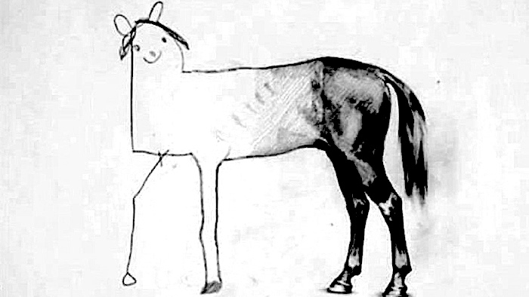



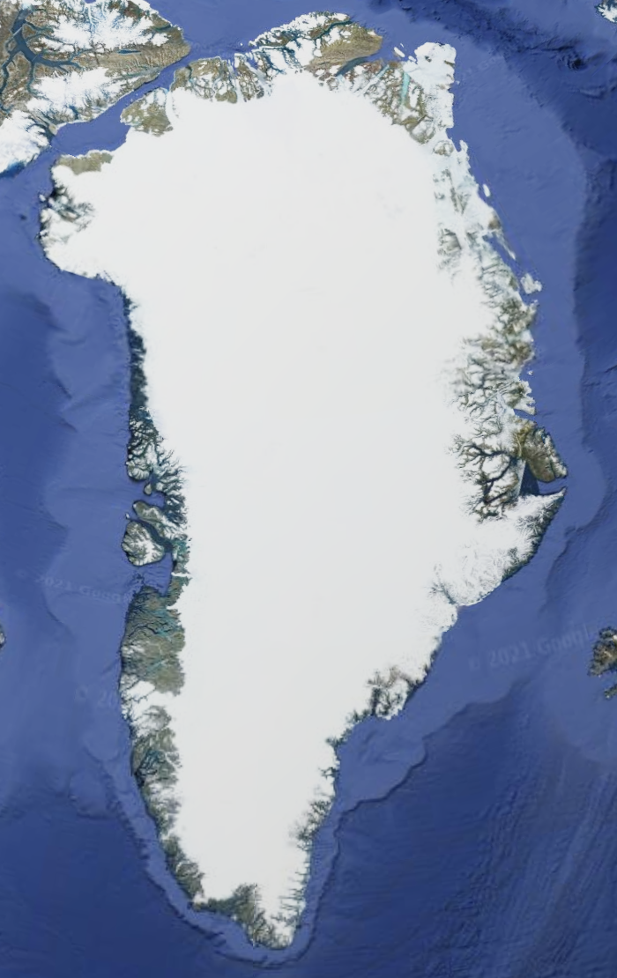
EGU 2024 – NP1.5
eridional
verturning
tlantic
irculation
A M O C Stability amid
Tipping Ice Sheets
From Conceptual to Intermediate Complexity Models
Sacha Sinet (s.a.m.sinet@uu.nl)
Anna S. von der Heydt, P. Ashwin, Henk A. Dijkstra

Slide 2







Interacting Tipping elements
Wunderling & al. (2024)
2

Slide 3

Interacting Tipping elements
A conceptual model
3

Slide 4
Interacting Tipping elements
A conceptual model
Freshwater
Freshwater
South box
Equatorial box
North box
Pyc. Depth
Depth box
Ⅰ. AMOC box model
Ⅱ. Parametrized Ice Sheet melt
Cimatoribus & al. (2014)
3
South box
Equatorial box
North box

Slide 5
Parametrized Ice Sheet Melt
Greenland ice content
Collapse!
4

Slide 6
Parametrized Ice Sheet Melt
Greenland ice content
WAIS ice content
No collapse!
Sinet & al (2023a)
5

Slide 7
Parametrized Ice Sheet Melt
Greenland ice content
WAIS ice content
Delay of initiation
WAIS tipping duration
No collapse!
5

Slide 8
Exploration!
6

Slide 9
Exploration!
No tipping!
6

Slide 10
Explanation?
Stable present-day AMOC
Tipping Point
Increasing WAIS Meltwater Flux
7

Slide 11
The no-overshoot region
No overshoot!
8

Slide 12


The no-overshoot region
AMOC Stability amid Tipping Ice Sheets:
the Crucial Role of Rate and Noise
Sinet & al (2023b), in rev.
Kill him.
Kill him now.
The Pycnocline Depth
Tipping without overshoot
Awkward!
Woof!
The Shift
Overshoot without tipping
Rate-induced Effects
8

Slide 13
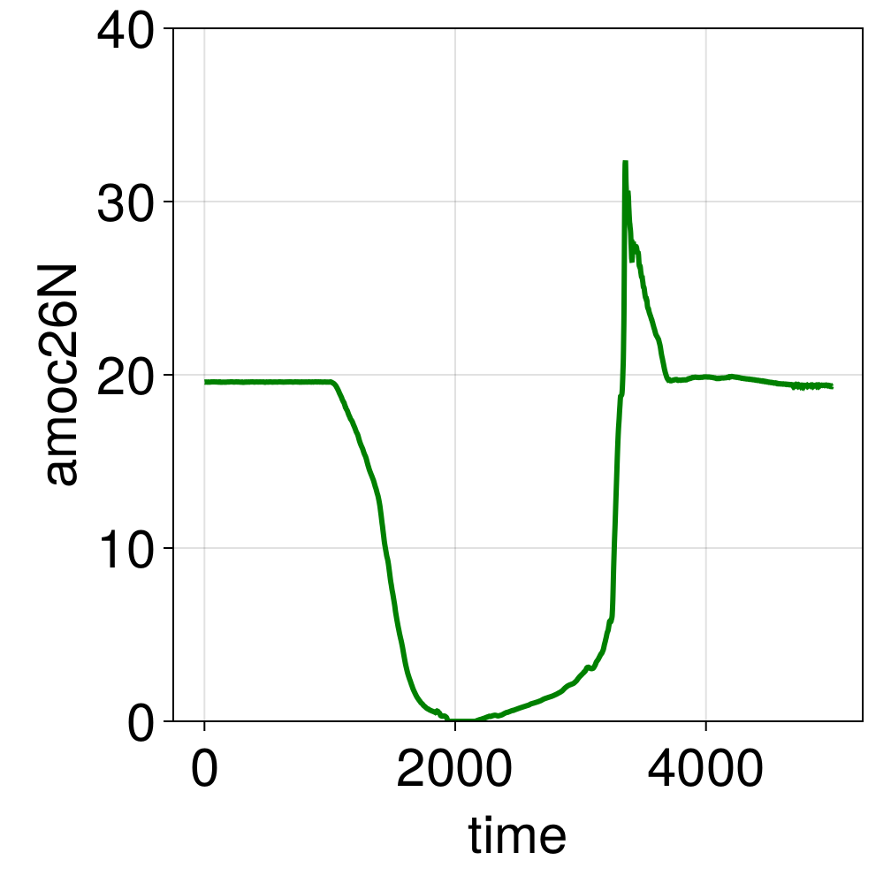
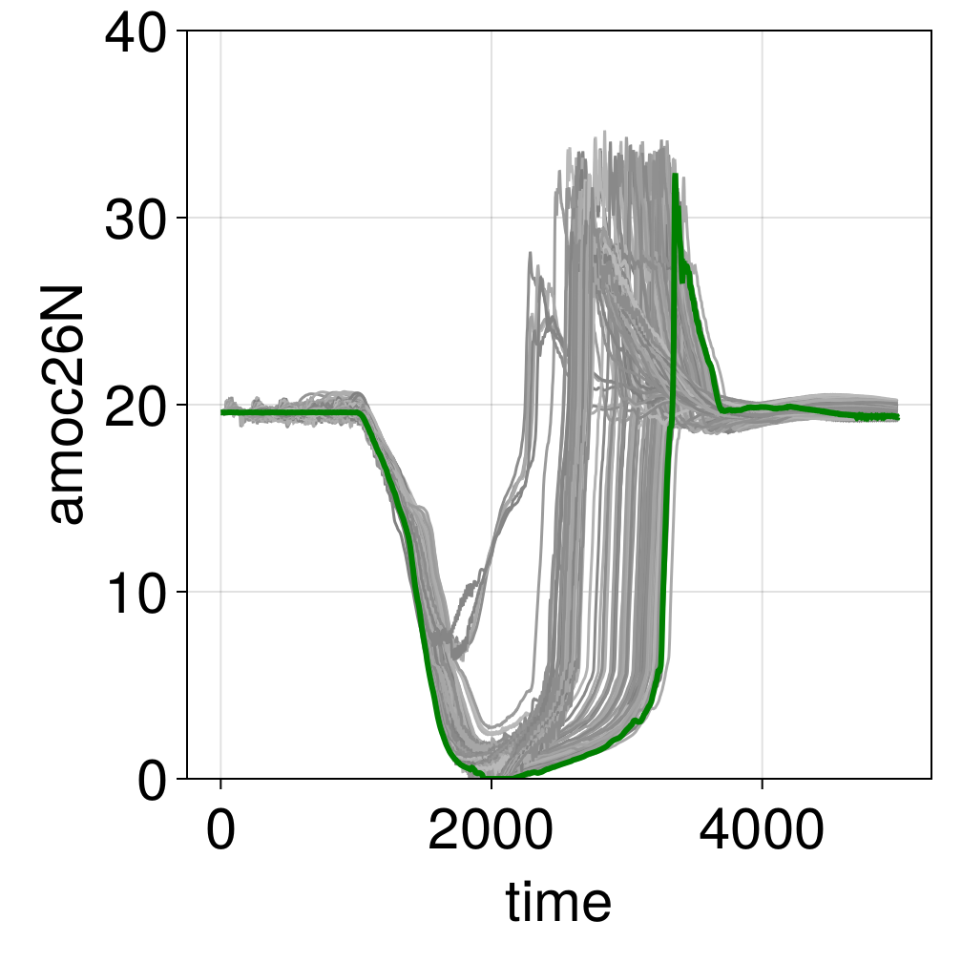
Let’s get serious
Same experiments in the EMIC
CLIMBER-X
Exciting!
GIS collapse
9

Slide 14
Let’s get serious
Same experiments in the EMIC
CLIMBER-X
Exciting!
Earlier recovery!
Weaver & al (2003)
9

Slide 15
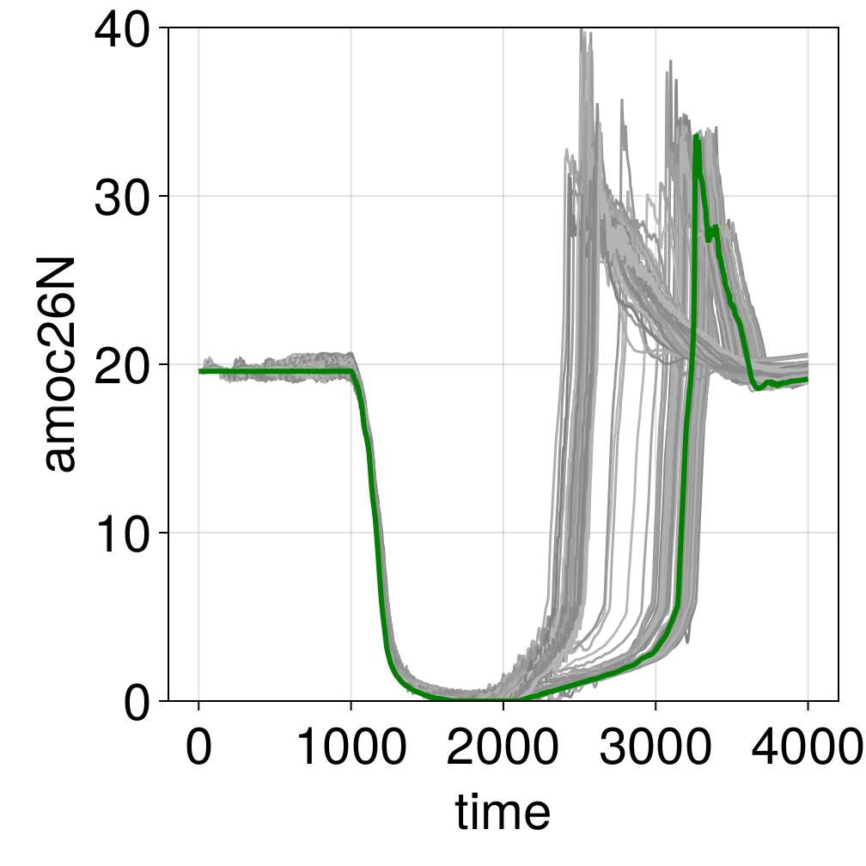
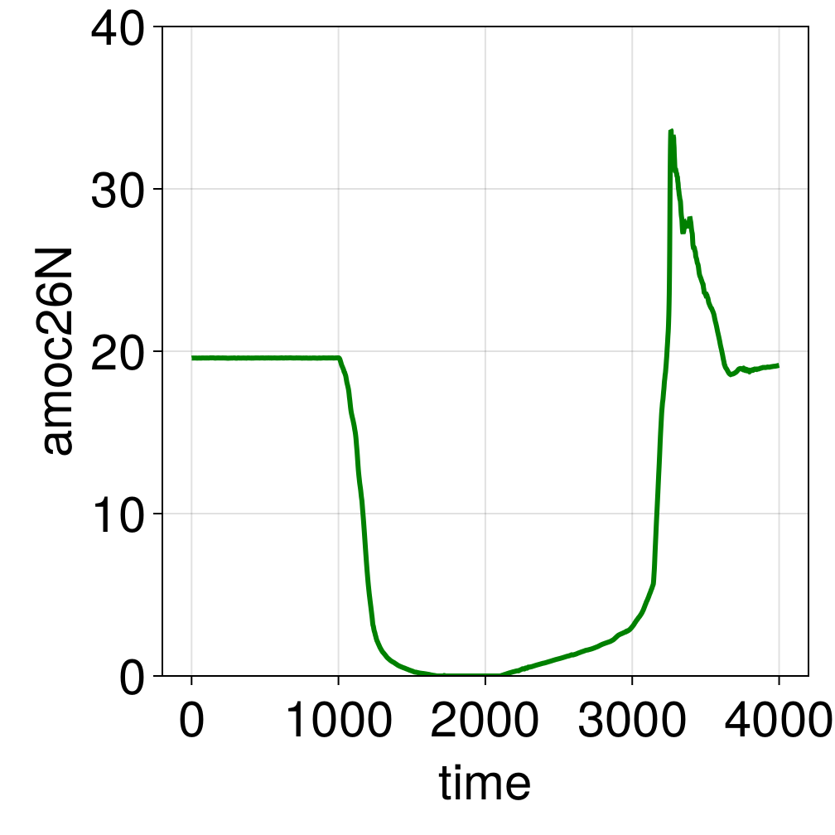
Let’s get more serious
Mmmmh…
GIS collapse
10

Slide 16
Let’s get more serious
10

Slide 17
Take Home
The End
Wunderling, N. et al. Climate tipping point interactions and cascades: a review. Earth System Dynamics 15, 41–74 (2024).
Sinet, S., von der Heydt, A. S. & Dijkstra, H. A. AMOC Stabilization Under the Interaction With Tipping Polar Ice Sheets. Geophysical Research Letters 50, e2022GL100305 (2023).
Cimatoribus, A. A., Drijfhout, S. S. & Dijkstra, H. A. Meridional overturning circulation: stability and ocean feedbacks in a box model. Clim Dyn 42, 311–328 (2014).
Sinet, S., Ashwin, P., von der Heydt, A. S. & Dijkstra, H. A. AMOC Stability Amid Tipping Ice Sheets: The Crucial Role of Rate and Noise. EGUsphere 1–22 (2023), in rev.
Weaver, A. J., Saenko, O. A., Clark, P. U. & Mitrovica, J. X. Meltwater Pulse 1A from Antarctica as a Trigger of the Bølling-Allerød Warm Interval. Science 299, 1709–1713 (2003).
West Antarctica collapse preserves the AMOC Stability
In many conceptual models
Presence of rate (and noise) makes prediction difficult
In an EMIC?
Needs more investigation
But consitent effect on AMOC recovery!
11

Slide 18
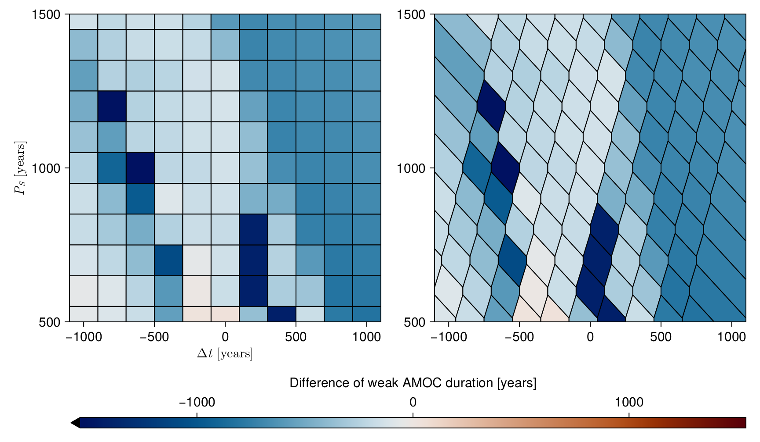
Supplementary figure 1
With respect to initiation delay
With respect to max. delay
12

Slide 19
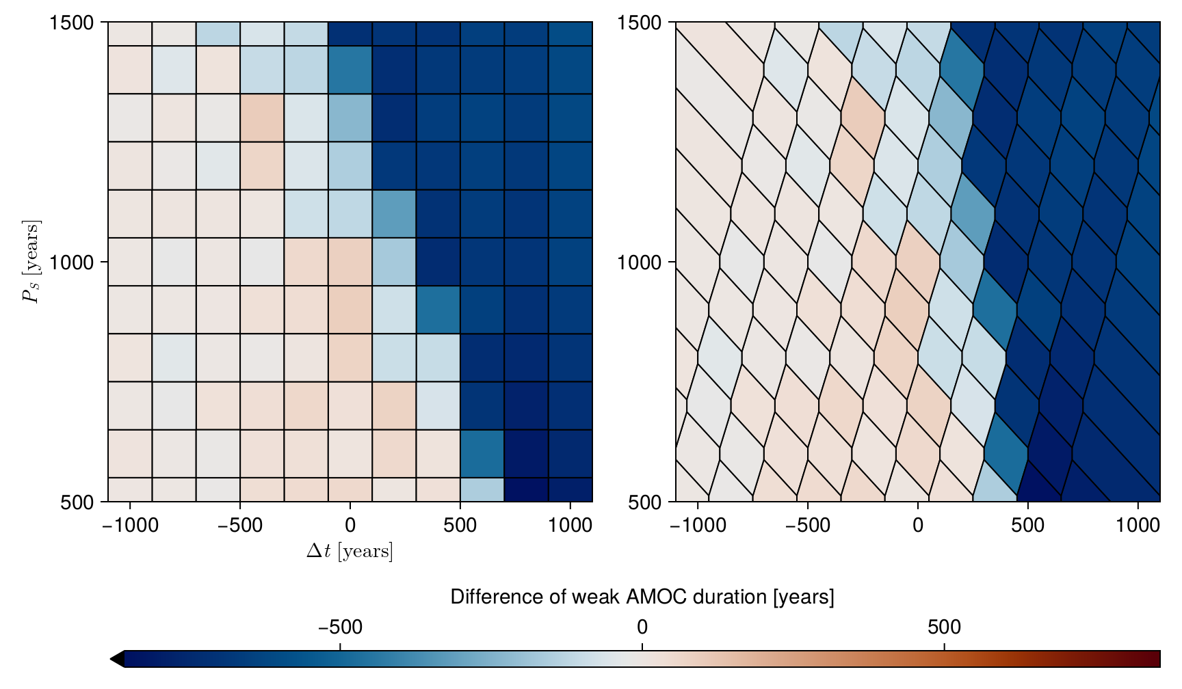
Supplementary figure 2
With respect to initiation delay
With respect to max. delay
13

