Slide 1
Sensitivity tests
Sensitivity test parameters
Significance of vertical diffusivity (Kv)- Summer and Spring seasons
Significance of water density – Summer and Spring seasons
Significance of Beaching- floating particles- Summer and Spring seasons
Significance of critical shear stress for resuspension- settling particles- Summer and Spring seasons
Seasonal variation of particle transport
Particle release:
Bordeaux release
Uniform release
Number of particles:500

Slide 2
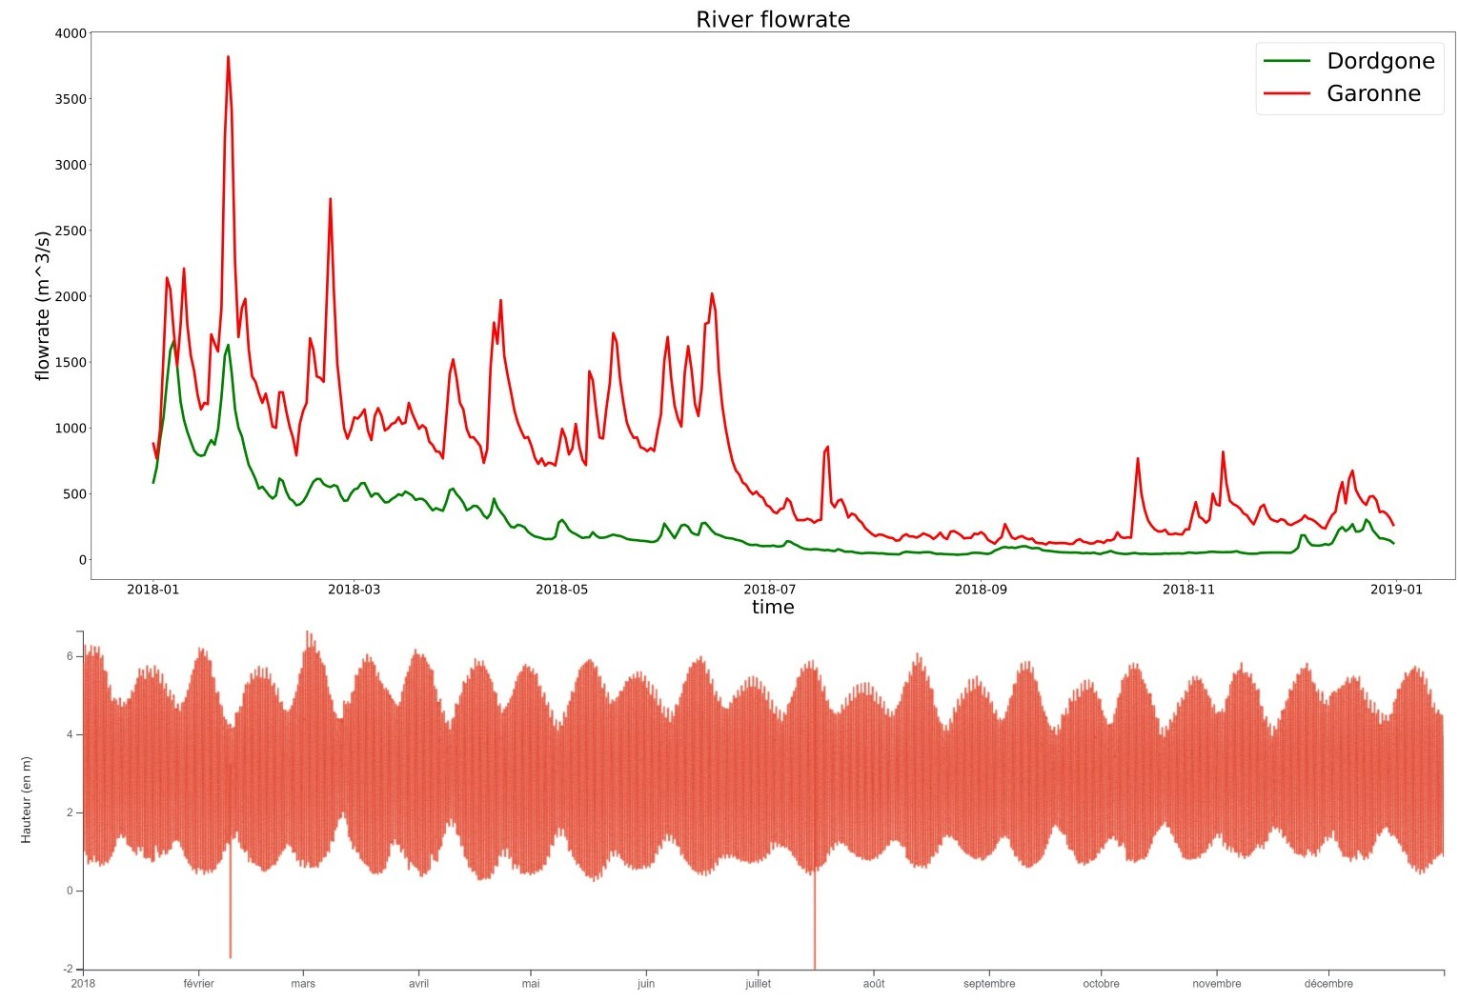
Study Period
Spring season
Summer season
Tidal range

Slide 3
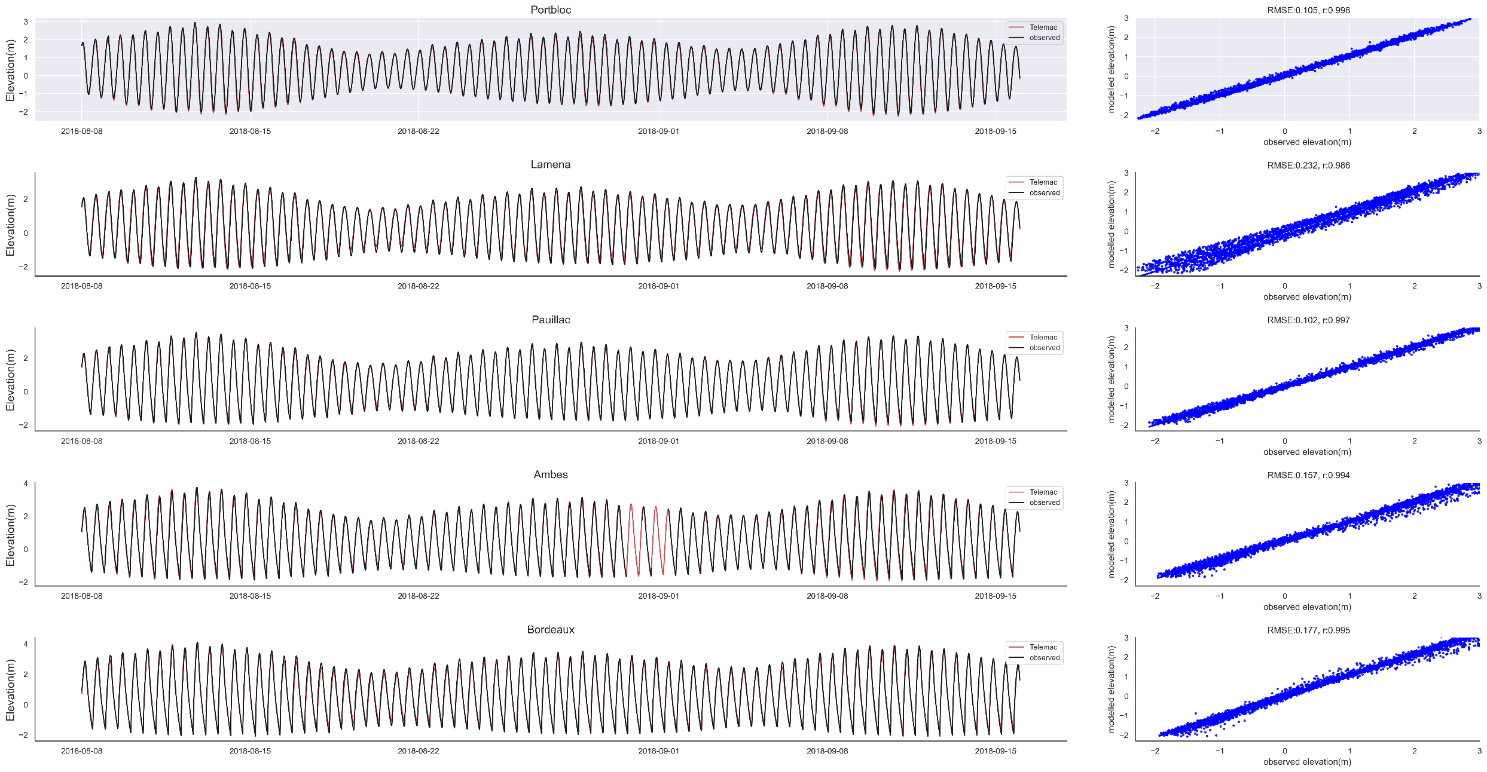
Hydrodynamic model validation –Summer 2018

Slide 4
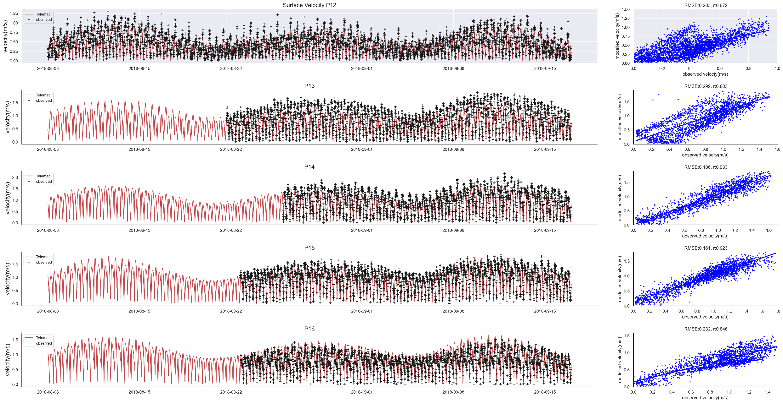
Hydrodynamic model validation –Summer 2018

Slide 5
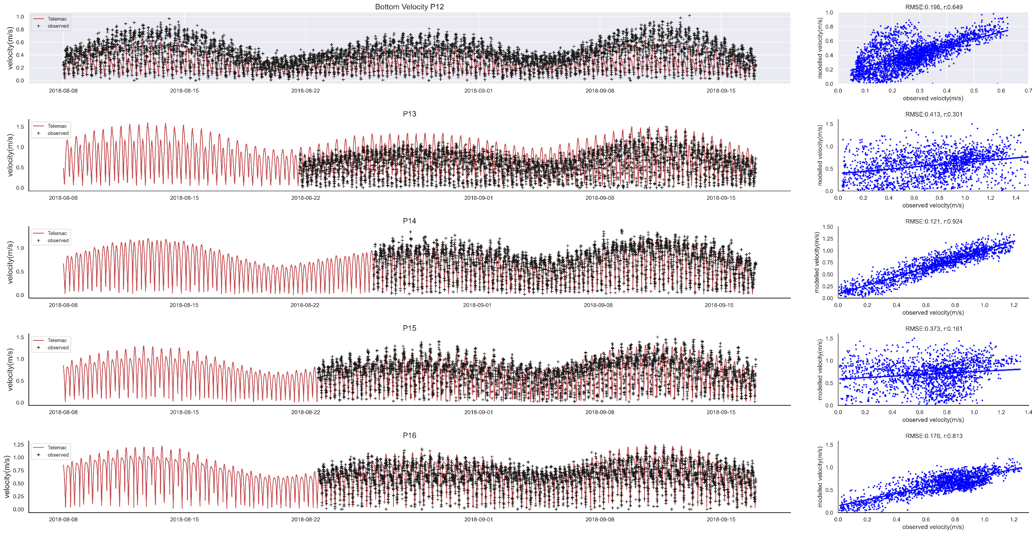
Hydrodynamic model validation –Summer 2018

Slide 6
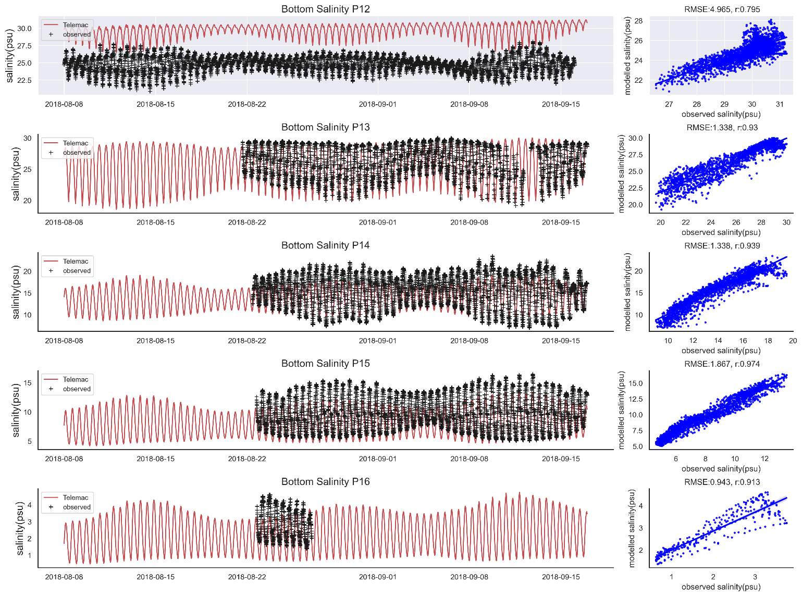
Hydrodynamic model validation –Summer 2018

Slide 7
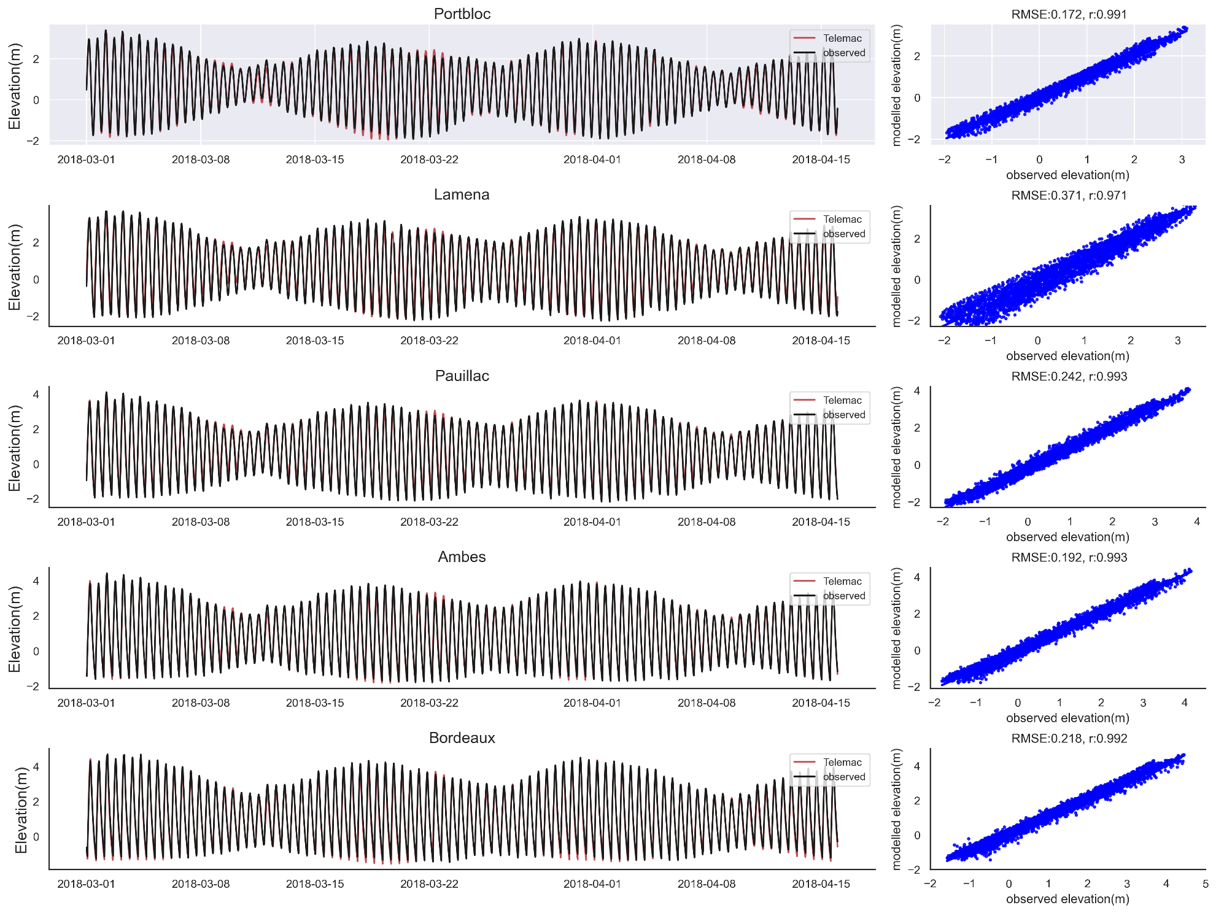
Hydrodynamic model validation –Spring 2018

Slide 8
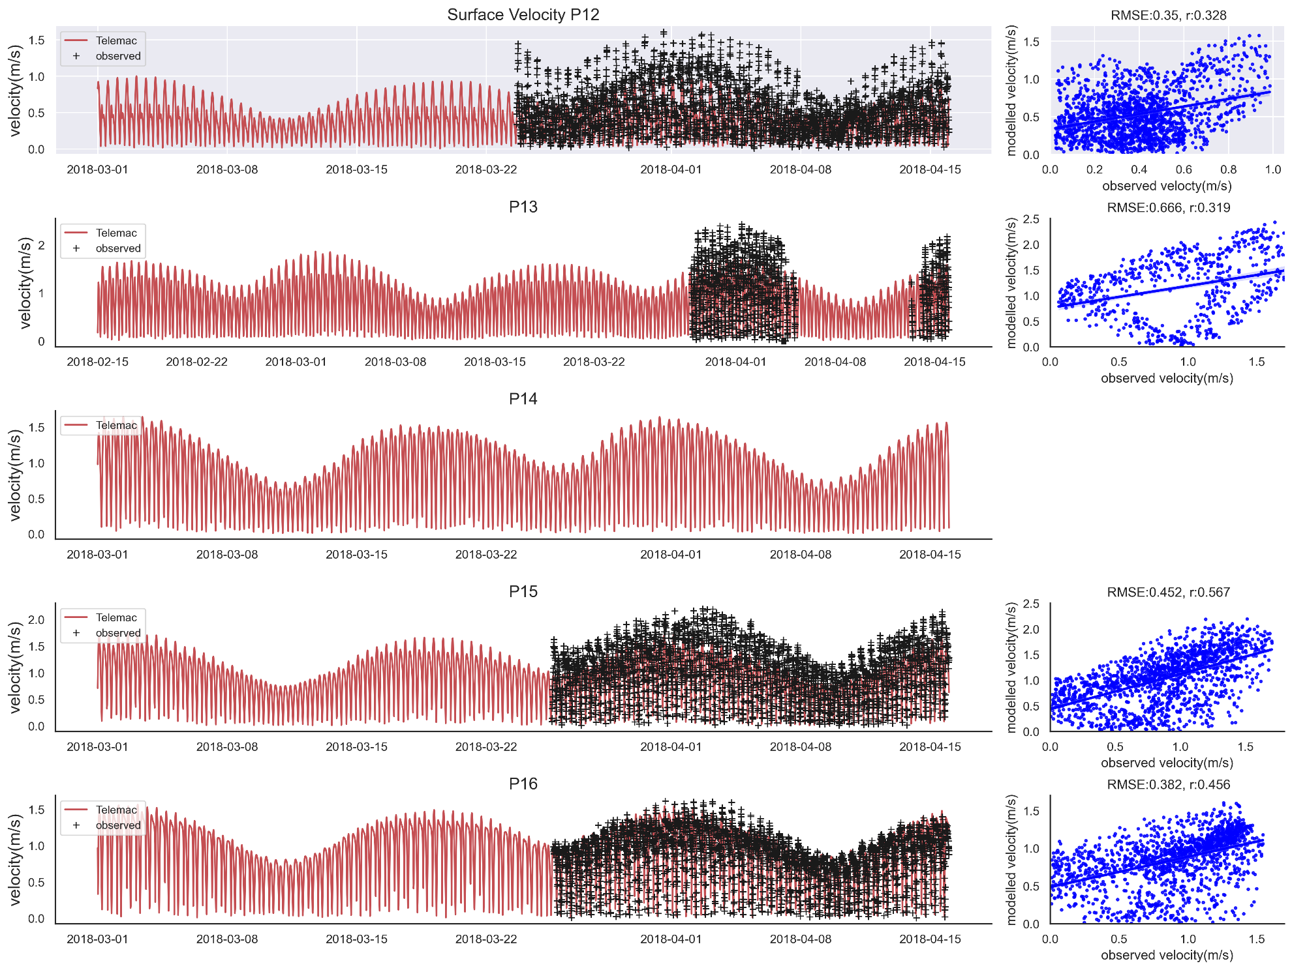
Hydrodynamic model validation –Spring 2018

Slide 9
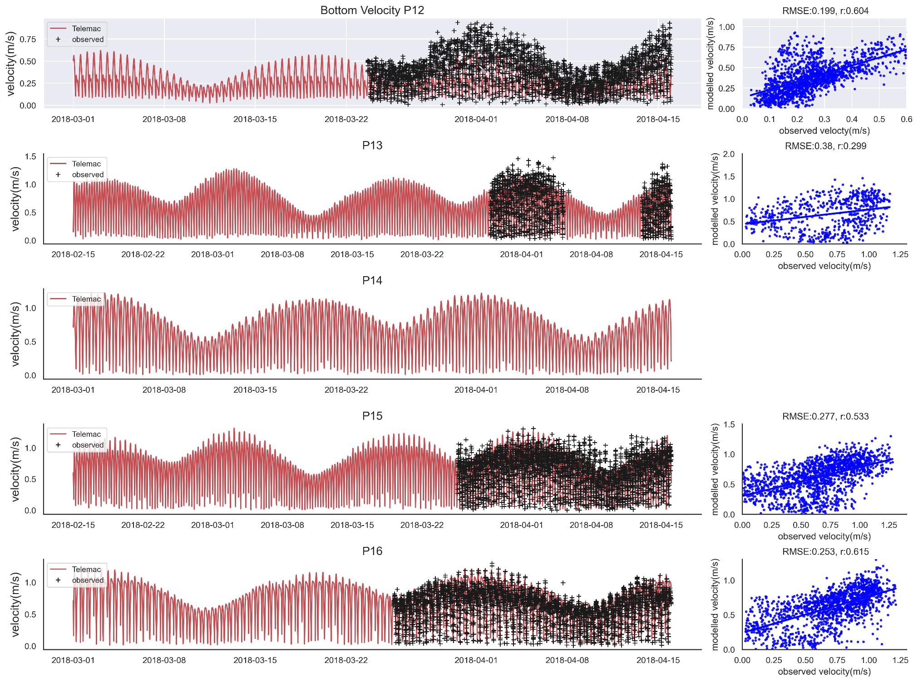
Hydrodynamic model validation –Spring 2018

Slide 10
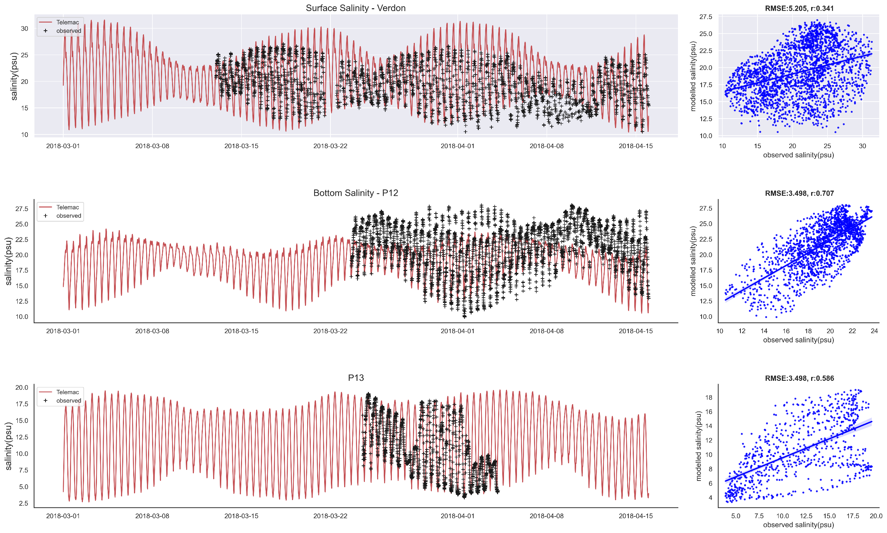
Hydrodynamic model validation –Spring 2018

Slide 11
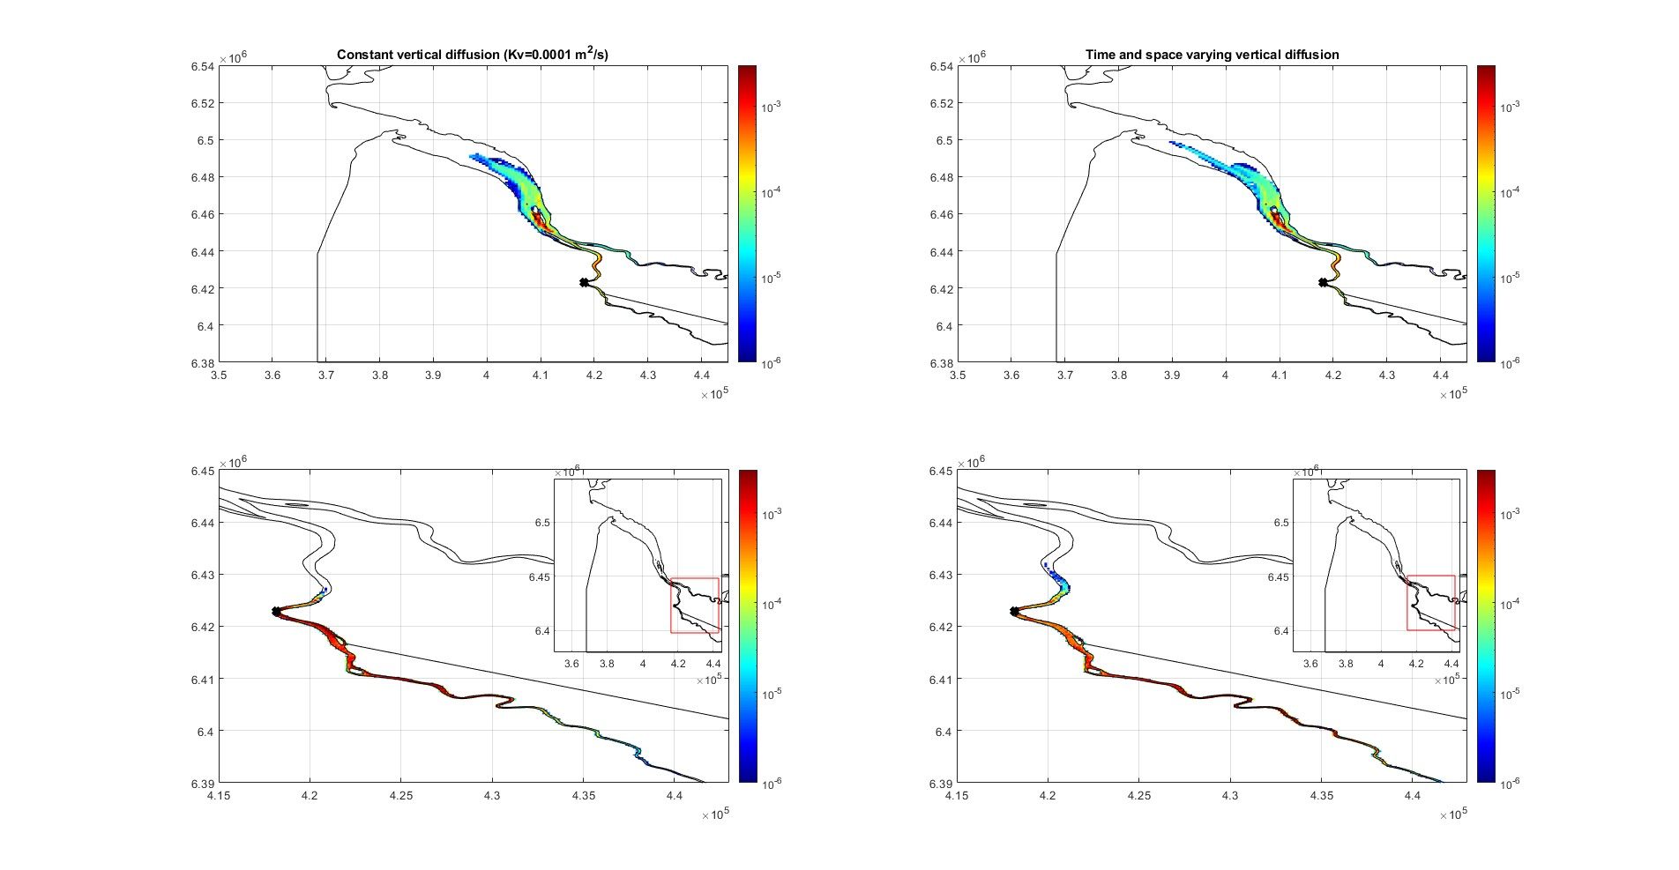
Sensitivity tests
Significance of Vertical eddy diffusivity (Kv)
Bordeaux release
Summer season
Rising particles
Settling particles

Slide 12
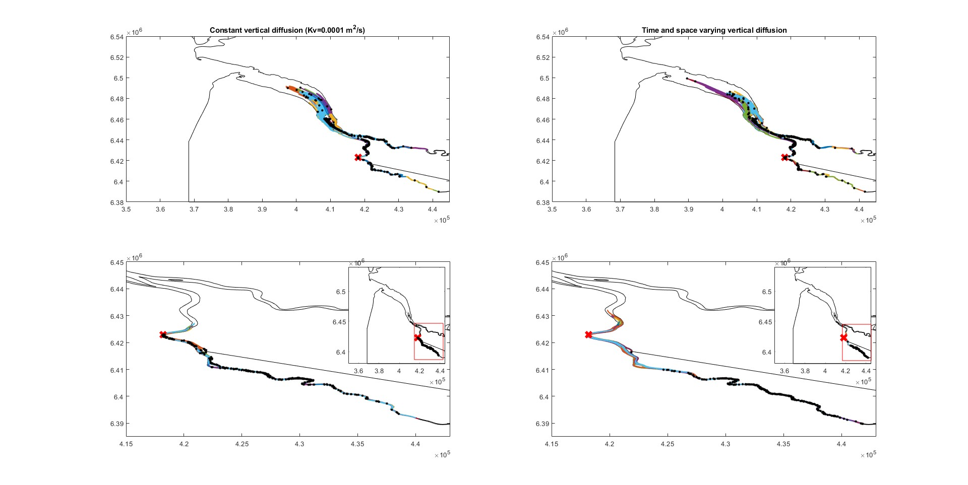
Sensitivity tests
Significance of Vertical eddy diffusivity (Kv)
Bordeaux release
Summer season
water | beached | settled
499 | 0 | 0
water | beached | settled
499 | 0 | 0
Rising particles
Settling particles
water | beached | settled
34 | 0 | 466
water | beached | settled
75 | 0 | 420

Slide 13
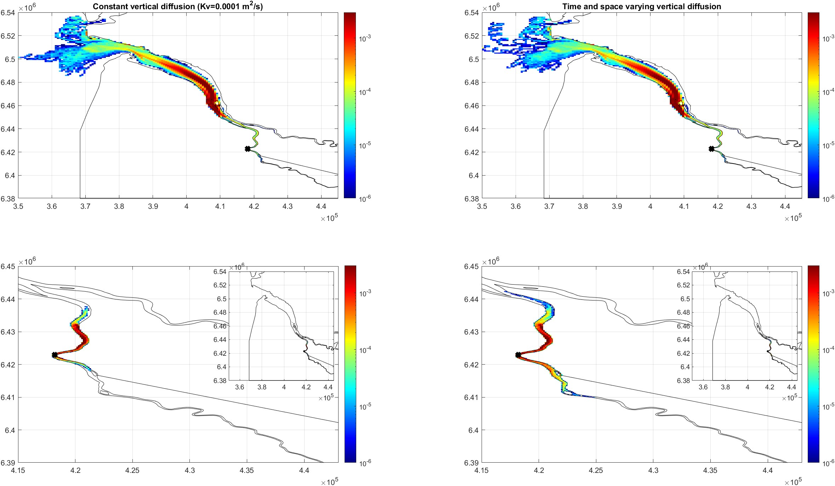
Sensitivity tests
Significance of Vertical eddy diffusivity (Kv)
Bordeaux release
Spring season
Rising particles
Settling particles

Slide 14
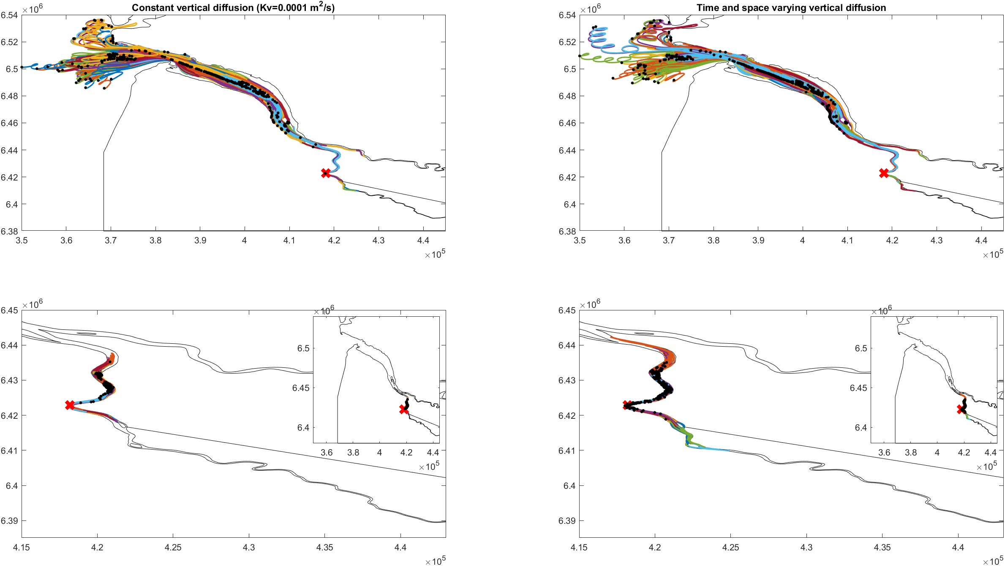
Sensitivity tests
Significance of Vertical eddy diffusivity (Kv)
Bordeaux release
Spring season
water | beached | settled
499 | 0 | 0
water | beached | settled
499 | 0 | 0
Rising particles
Settling particles
water | beached | settled
4 | 0 | 496
water | beached | settled
24 | 0 | 427

Slide 15
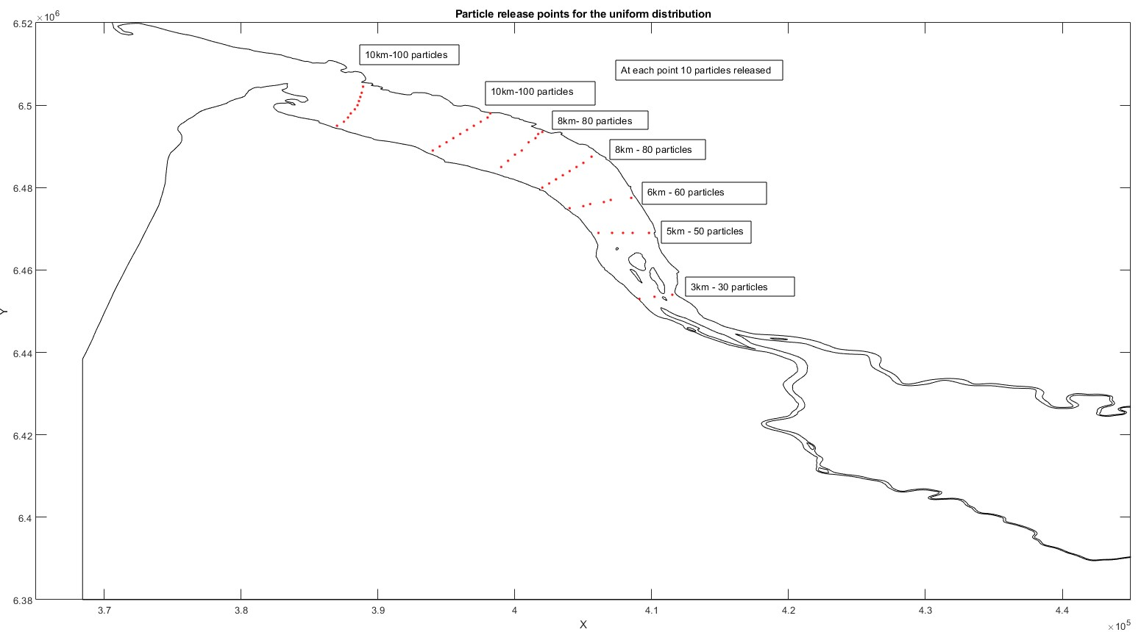

Slide 16
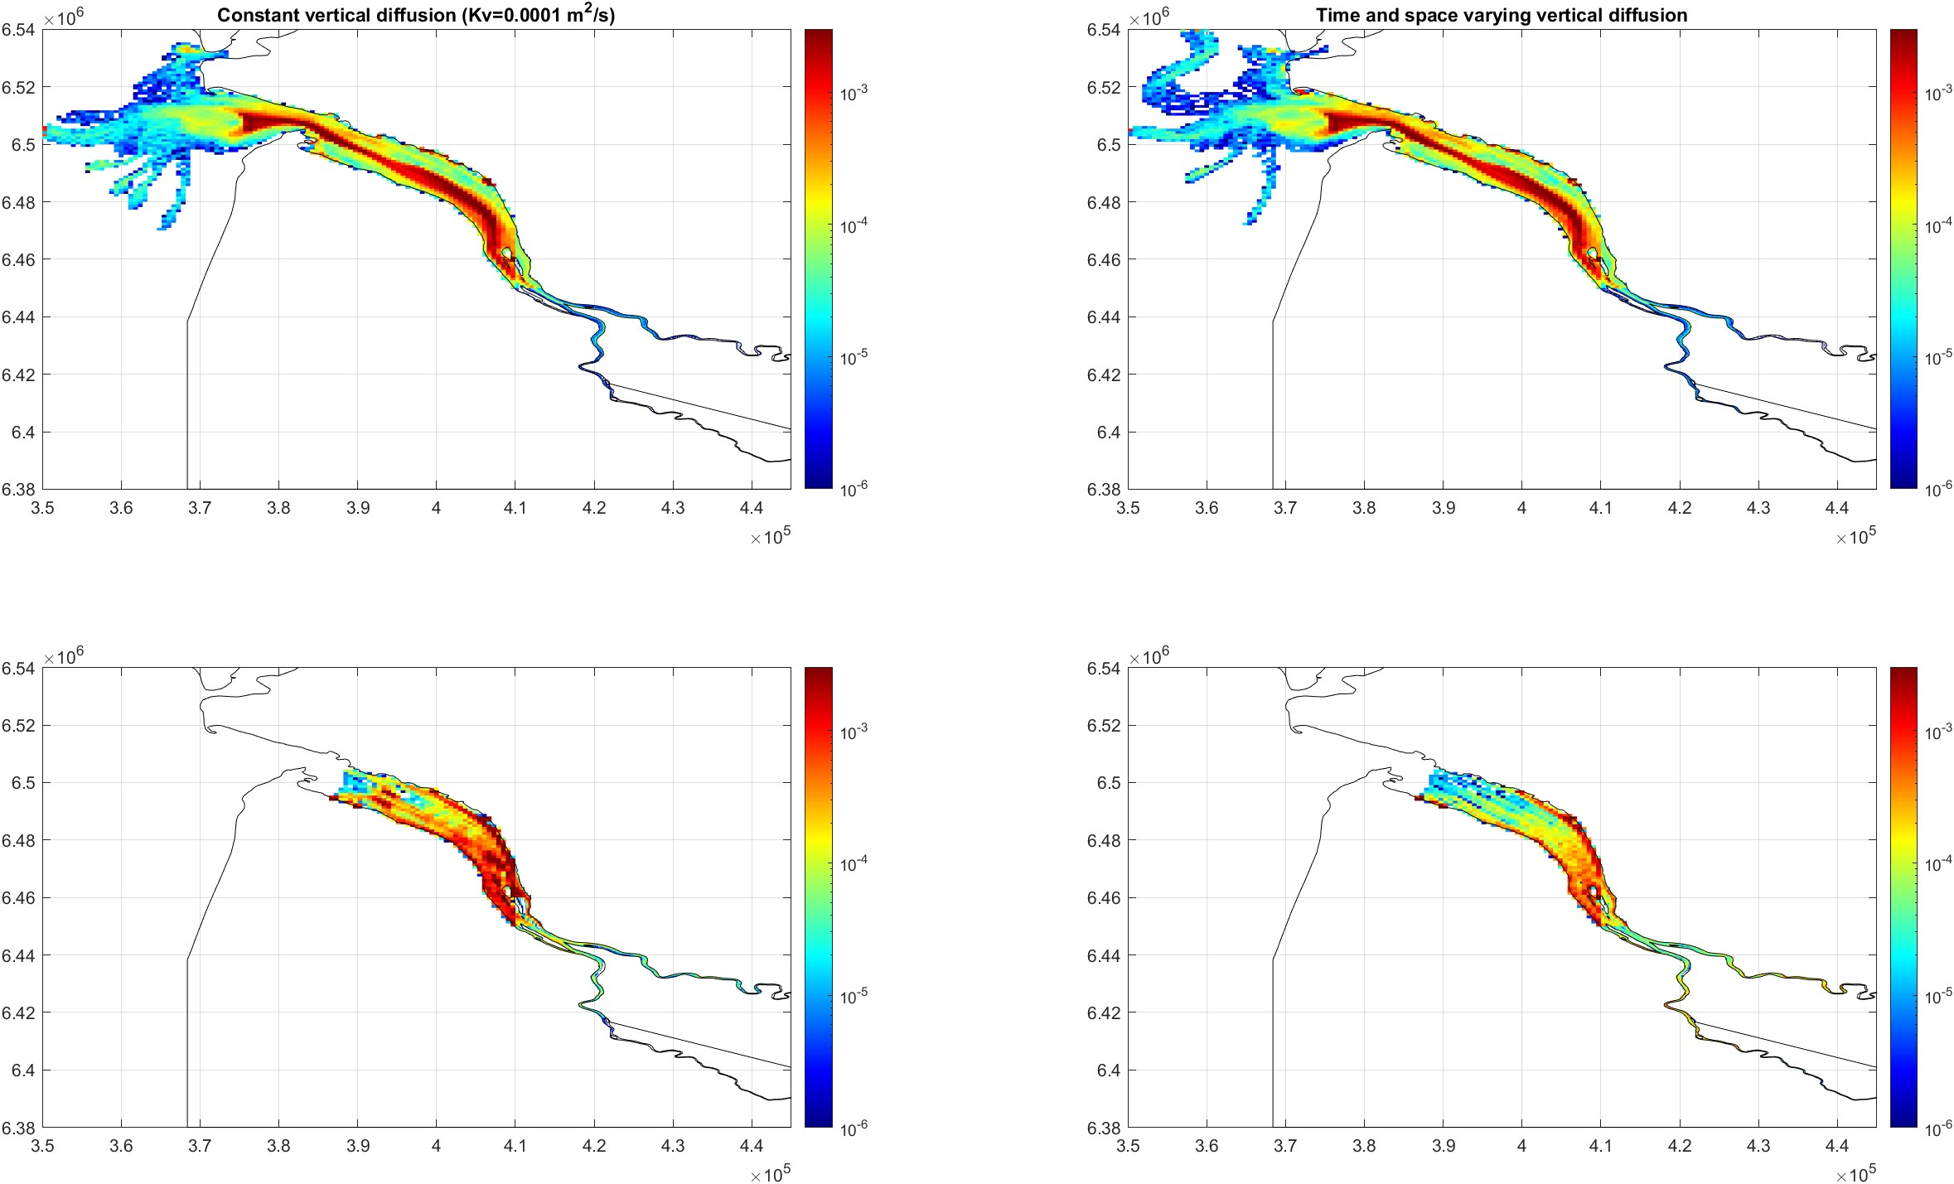
Sensitivity tests
Significance of Vertical eddy diffusivity (Kv)
Uniform release
Summer season
Rising particles
Settling particles

Slide 17
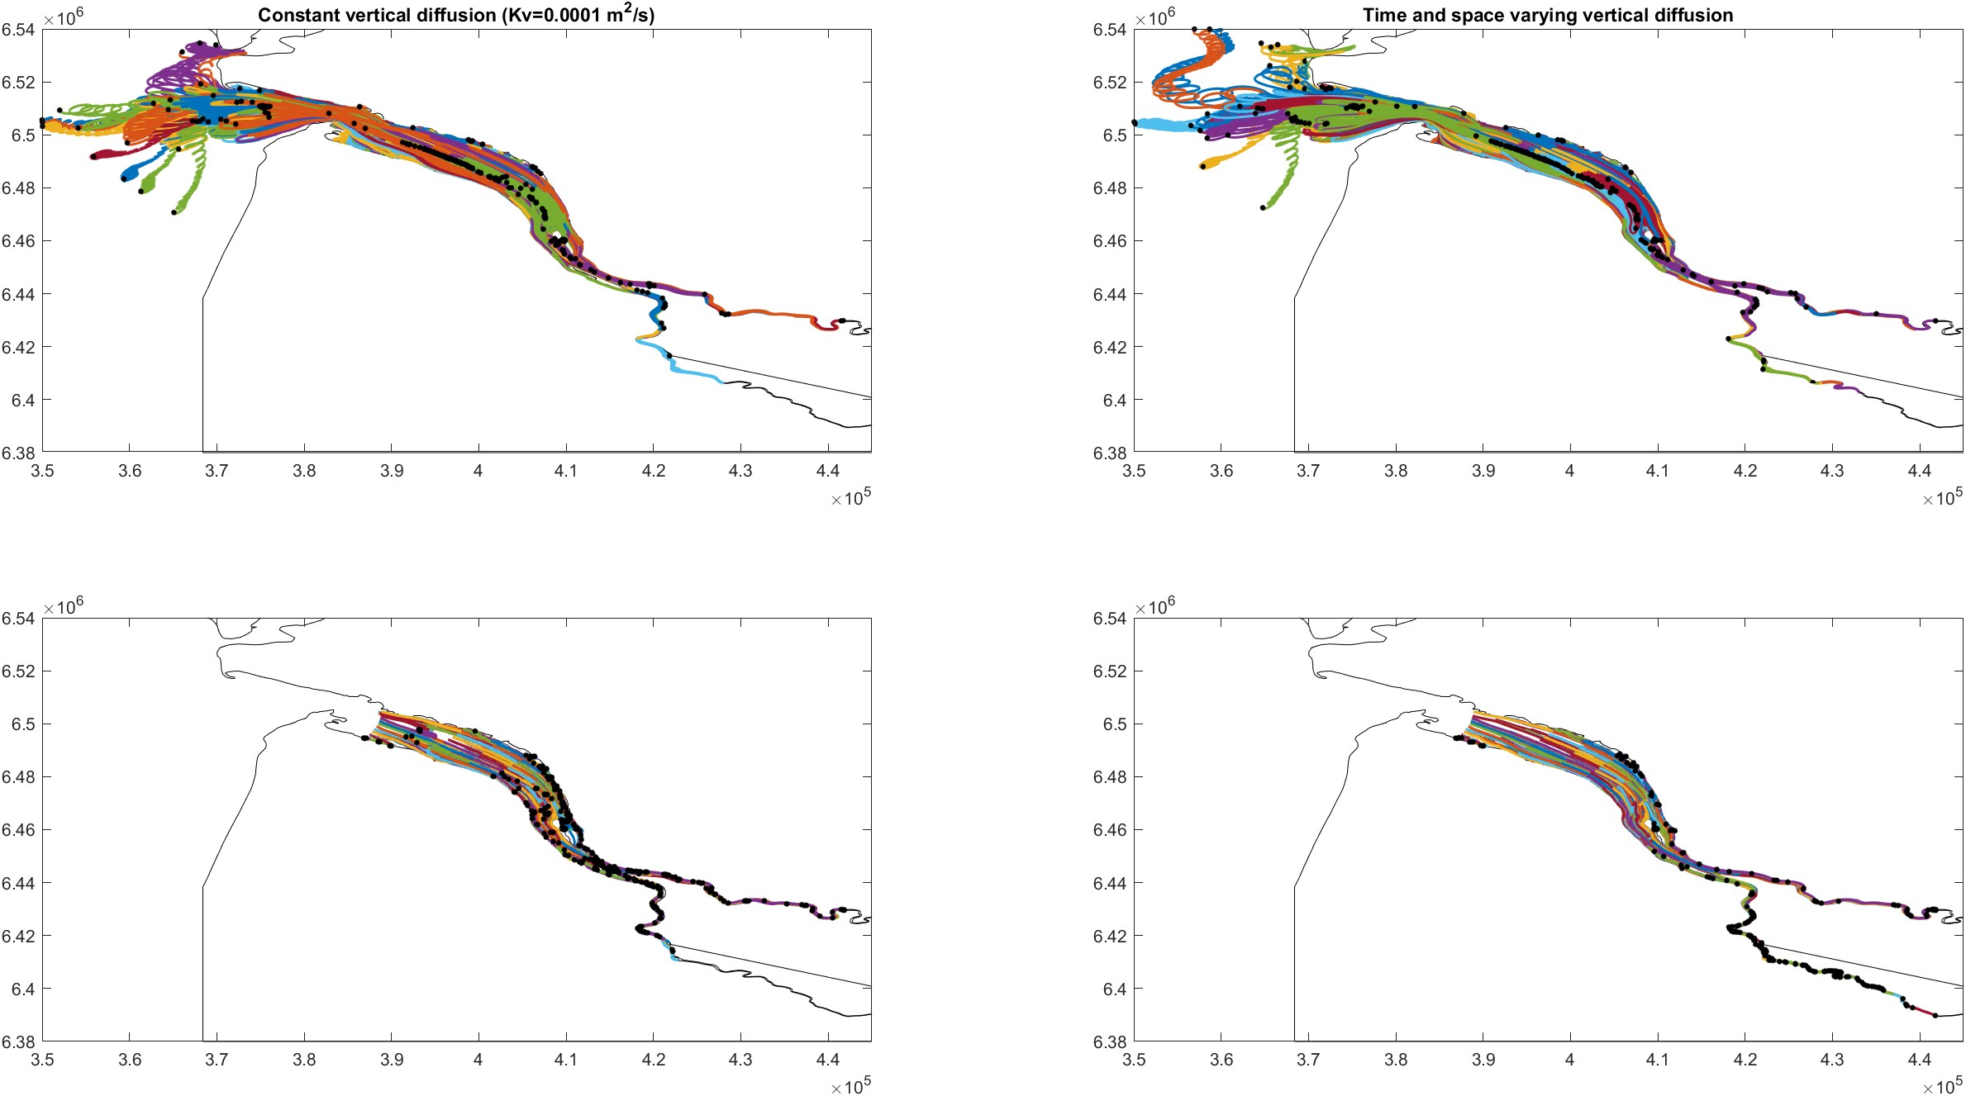
Sensitivity tests
Significance of Vertical eddy diffusivity (Kv)
Uniform release
Summer season
water | beached | settled
495 | 0 | 0
water | beached | settled
496 | 0 | 0
Rising particles
water | beached | settled
3 | 0 | 482
water | beached | settled
15 | 0 | 249
Settling particles

Slide 18
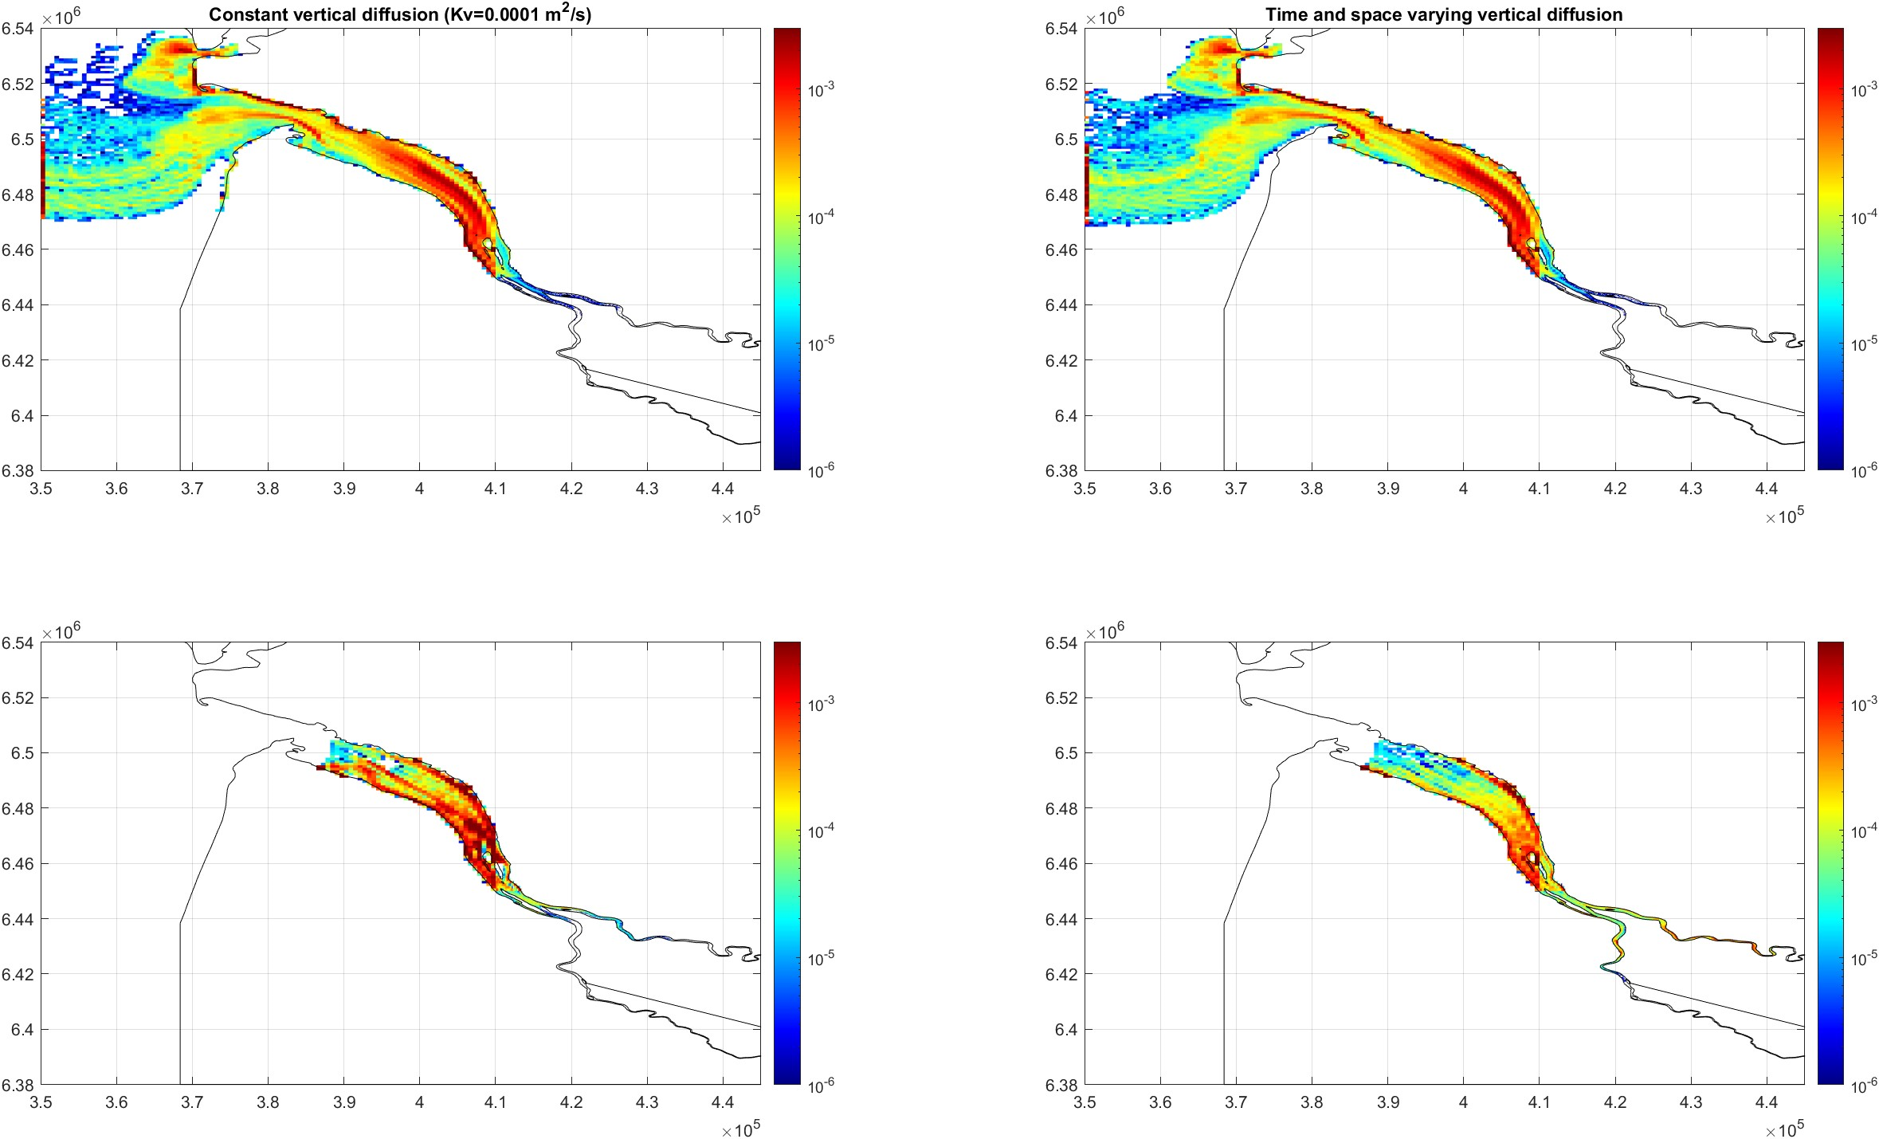
Sensitivity tests
Significance of Vertical eddy diffusivity (Kv)
Uniform release
Spring season
Rising particles
Settling particles

Slide 19
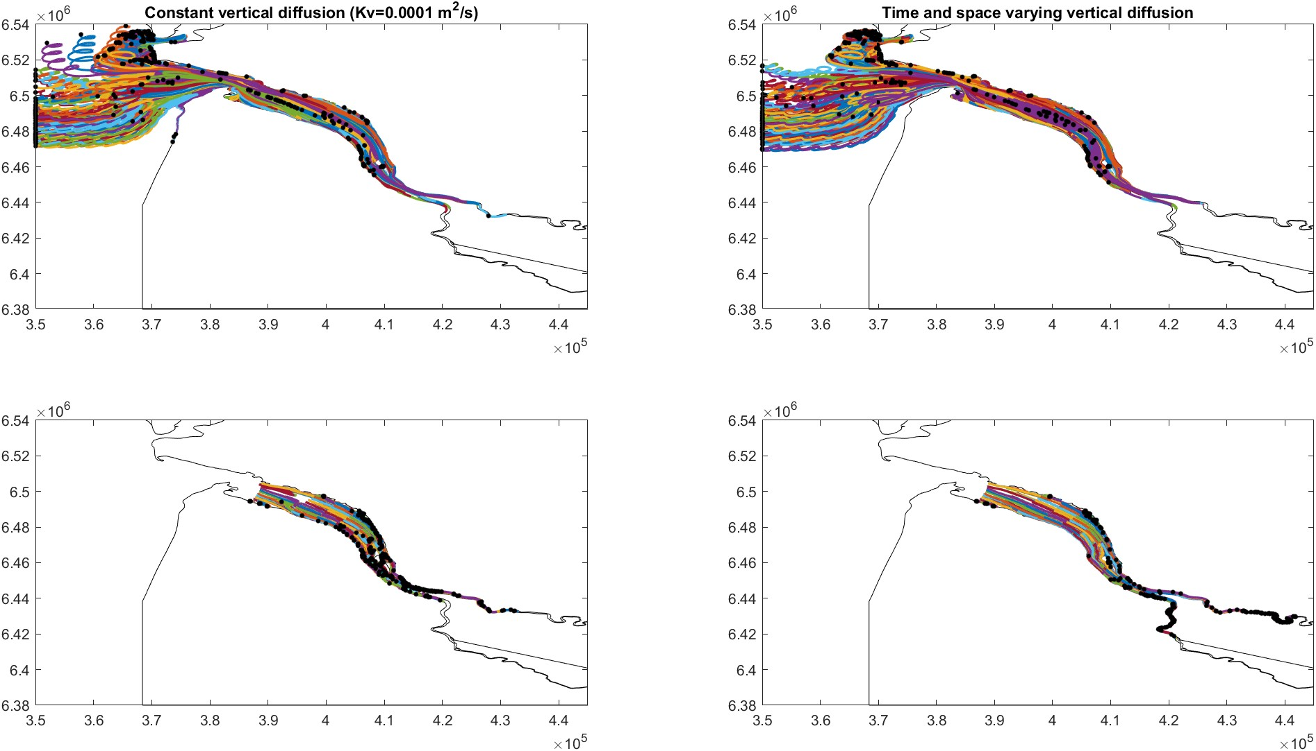
Sensitivity tests
Significance of Vertical eddy diffusivity (Kv)
Uniform release
Spring season
water | beached | settled
380 | 0 | 0
water | beached | settled
371 | 0 | 0
Rising particles
water | beached | settled
5 | 0 | 495
water | beached | settled
22 | 0 | 456
Settling particles

Slide 20
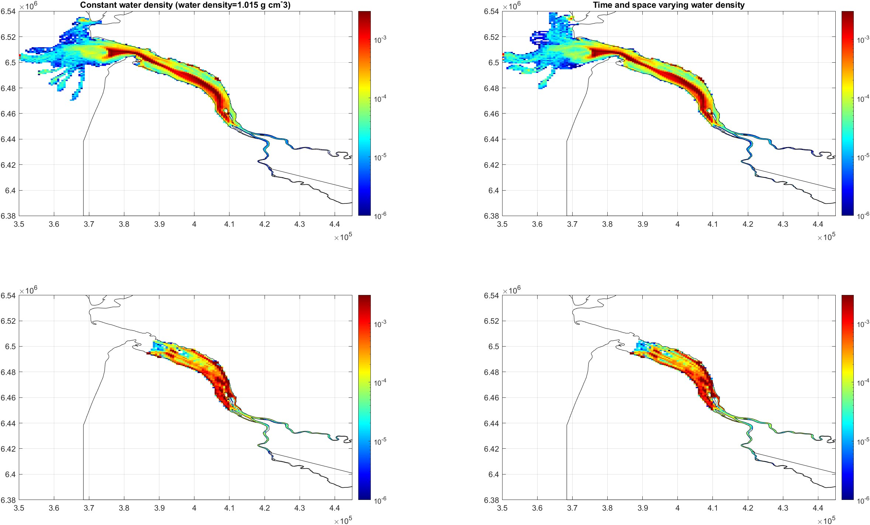
Sensitivity tests
Significance of water density
Uniform release
Summer season
Rising particles
Settling particles

Slide 21
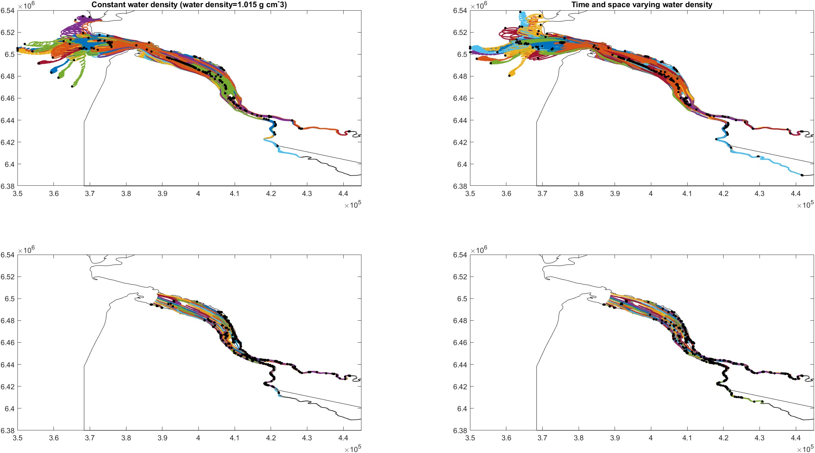
Sensitivity tests
Significance of water density
Uniform release
Summer season
water | beached | settled
495 | 0 | 0
water | beached | settled
490 | 0 | 0
Rising particles
water | beached | settled
3 | 0 | 482
water | beached | settled
0 | 0 | 473
Settling particles

Slide 22
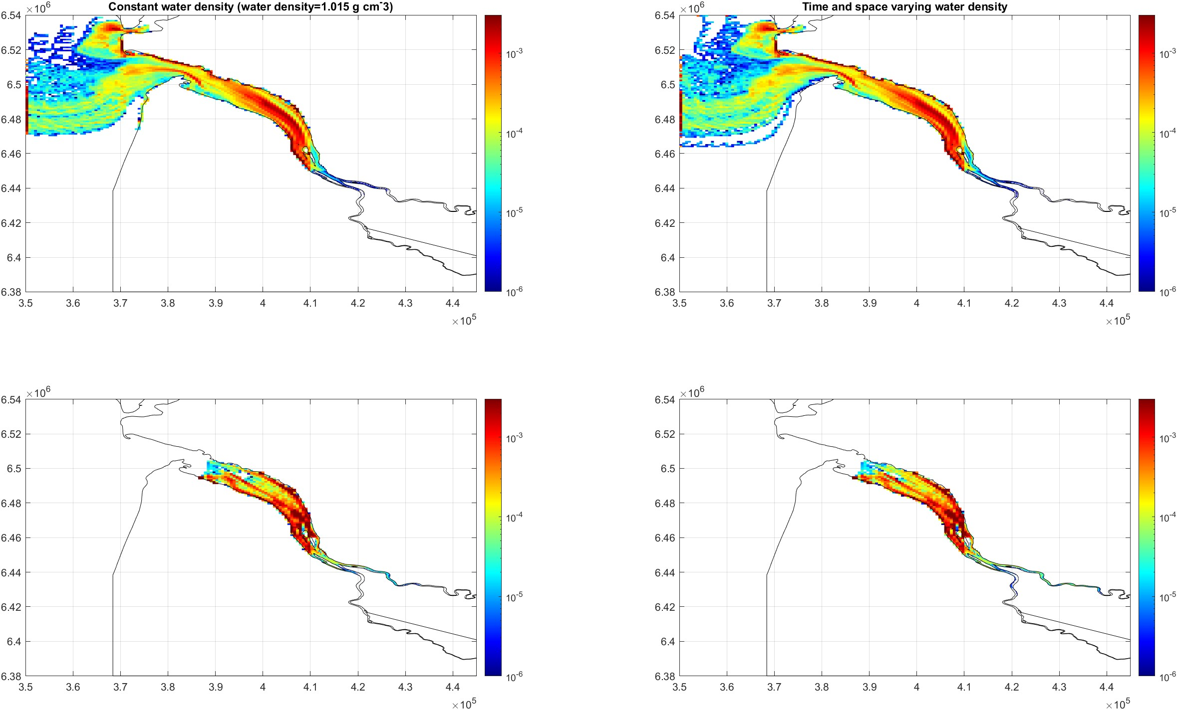
Sensitivity tests
Significance of water density
Uniform release
Spring season
Rising particles
Settling particles

Slide 23
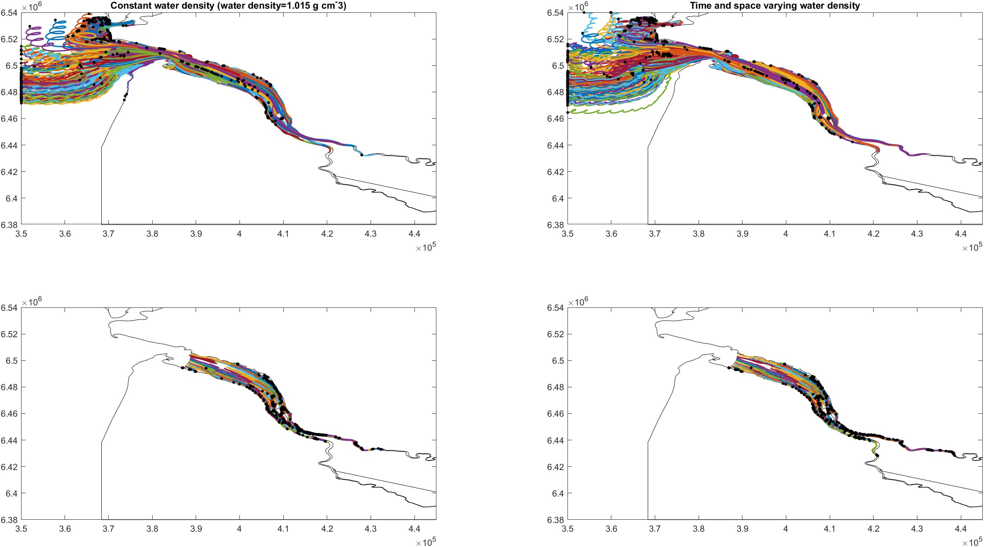
Sensitivity tests
Significance of water density
Uniform release
Spring season
water | beached | settled
380 | 0 | 0
water | beached | settled
364 | 0 | 0
Rising particles
water | beached | settled
5 | 0 | 495
water | beached | settled
1 | 0 | 495
Settling particles

Slide 24
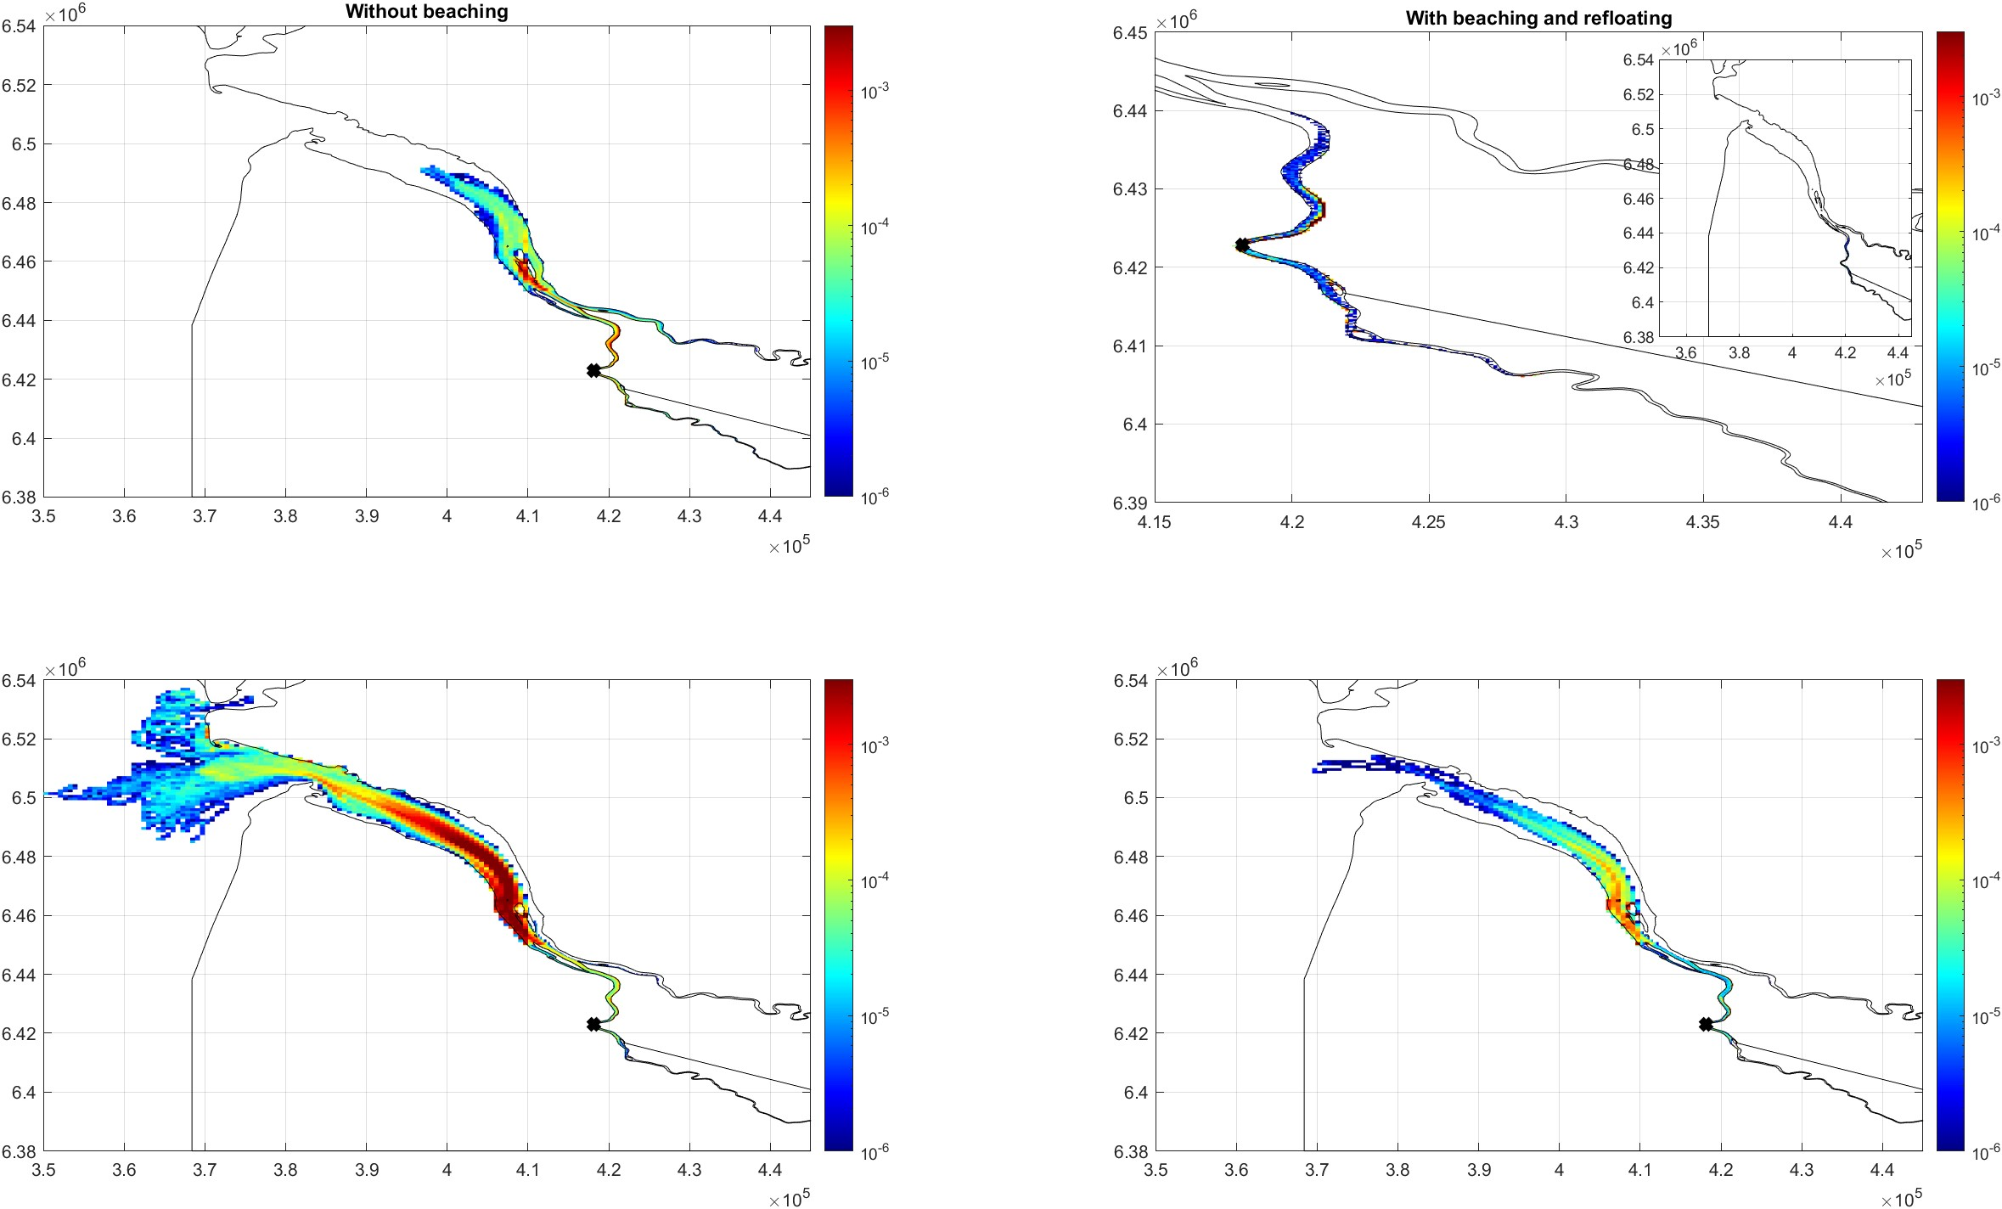
Sensitivity tests
Significance of Beaching-Floating particles
Bordeaux release
Summer season
Spring season

Slide 25
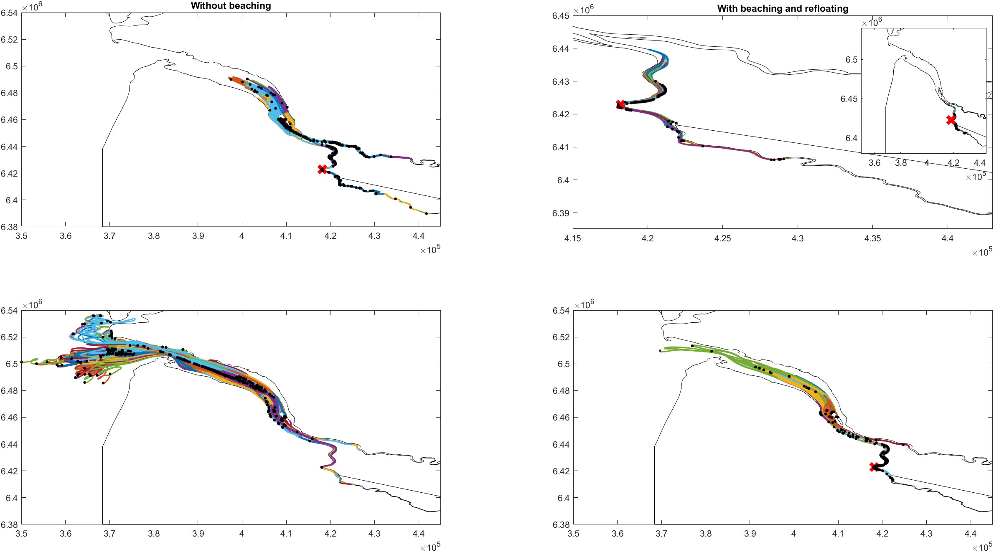
Sensitivity tests
Significance of Beaching-Floating particles
Bordeaux release
water | Beached | settled
499 | 0 | 0
Summer season
water | Beached | settled
0 | 500 | 0
water | Beached | settled
499 | 0 | 0
water | Beached | settled
20 | 480 | 0
Spring season

Slide 26
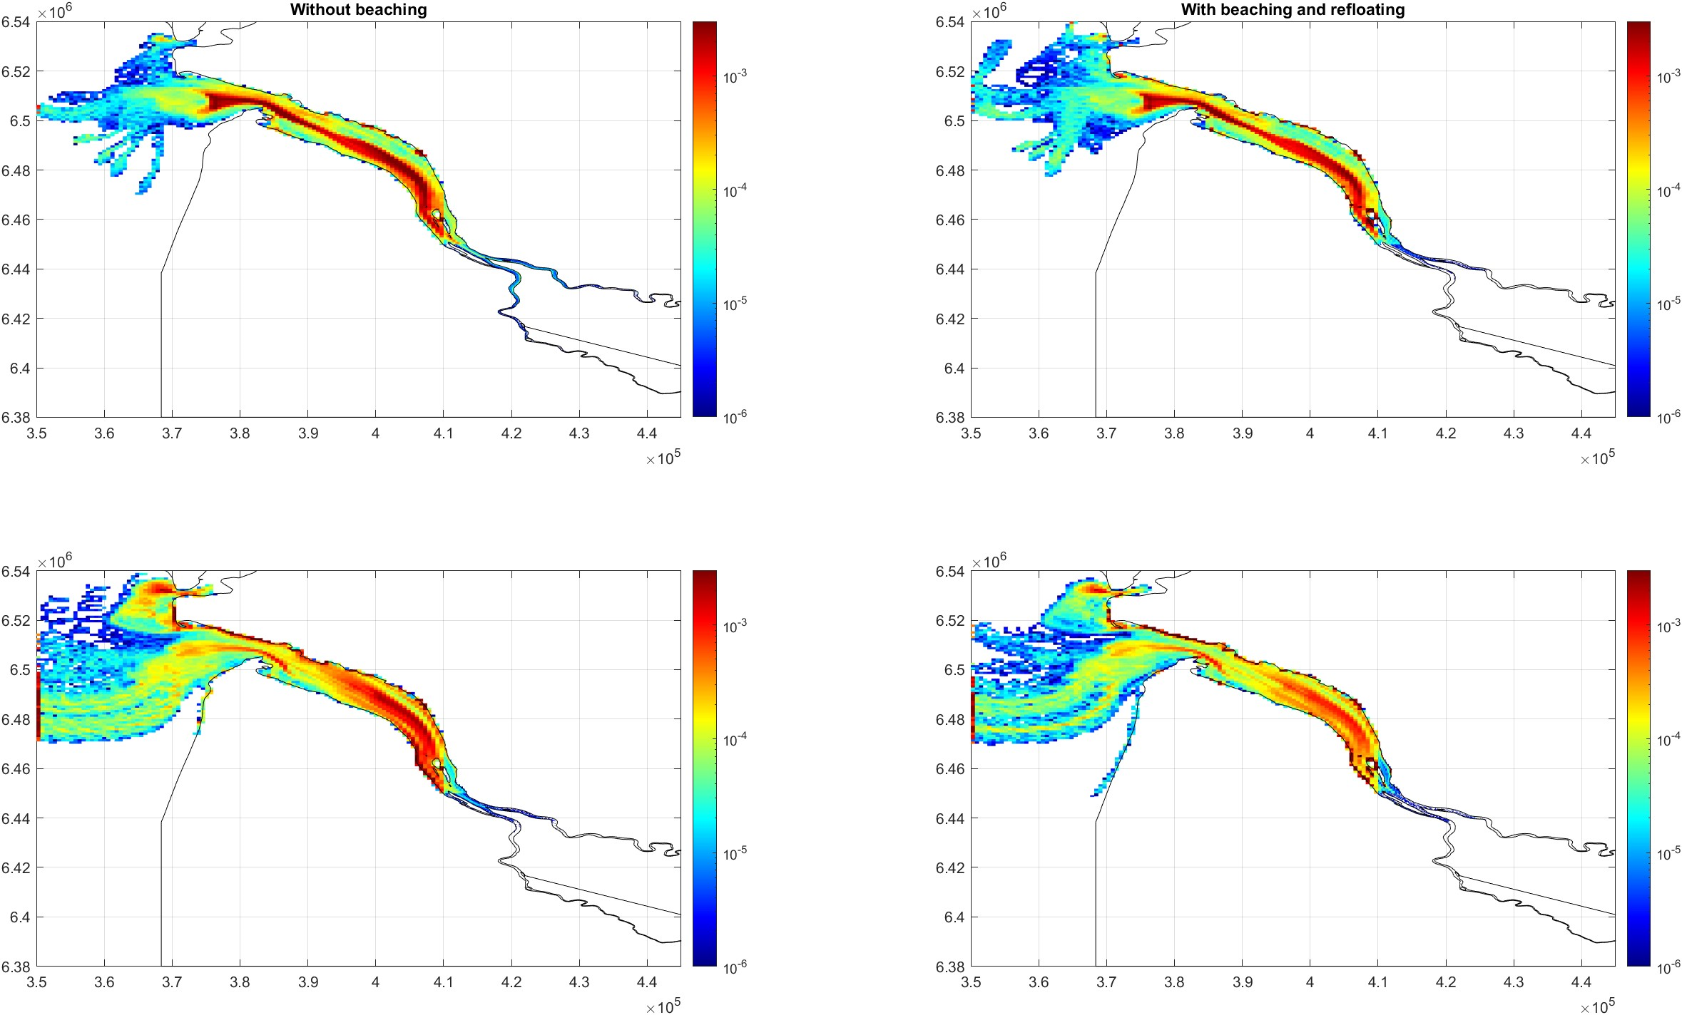
Sensitivity tests
Significance of Beaching-Floating particles
Uniform release
Summer season
Spring season

Slide 27
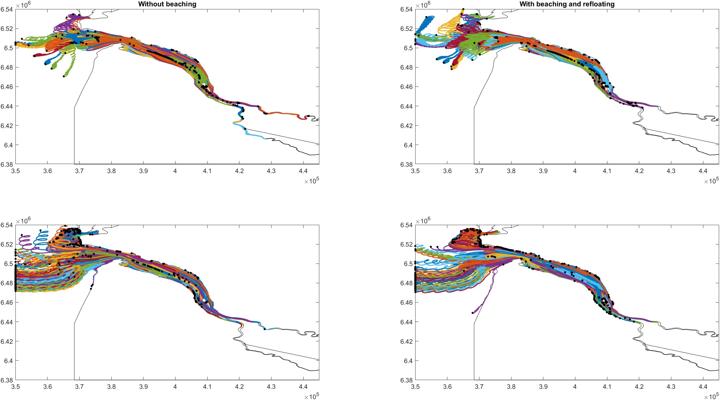
Sensitivity tests
Significance of Beaching-Floating particles
Uniform release
water | beached | settled
495 | 0 | 0
water | beached | settled
301 | 193 | 0
Summer season
water | beached | settled
380 | 0 | 0
water | beached | settled
93 | 312 | 0
Spring season

Slide 28
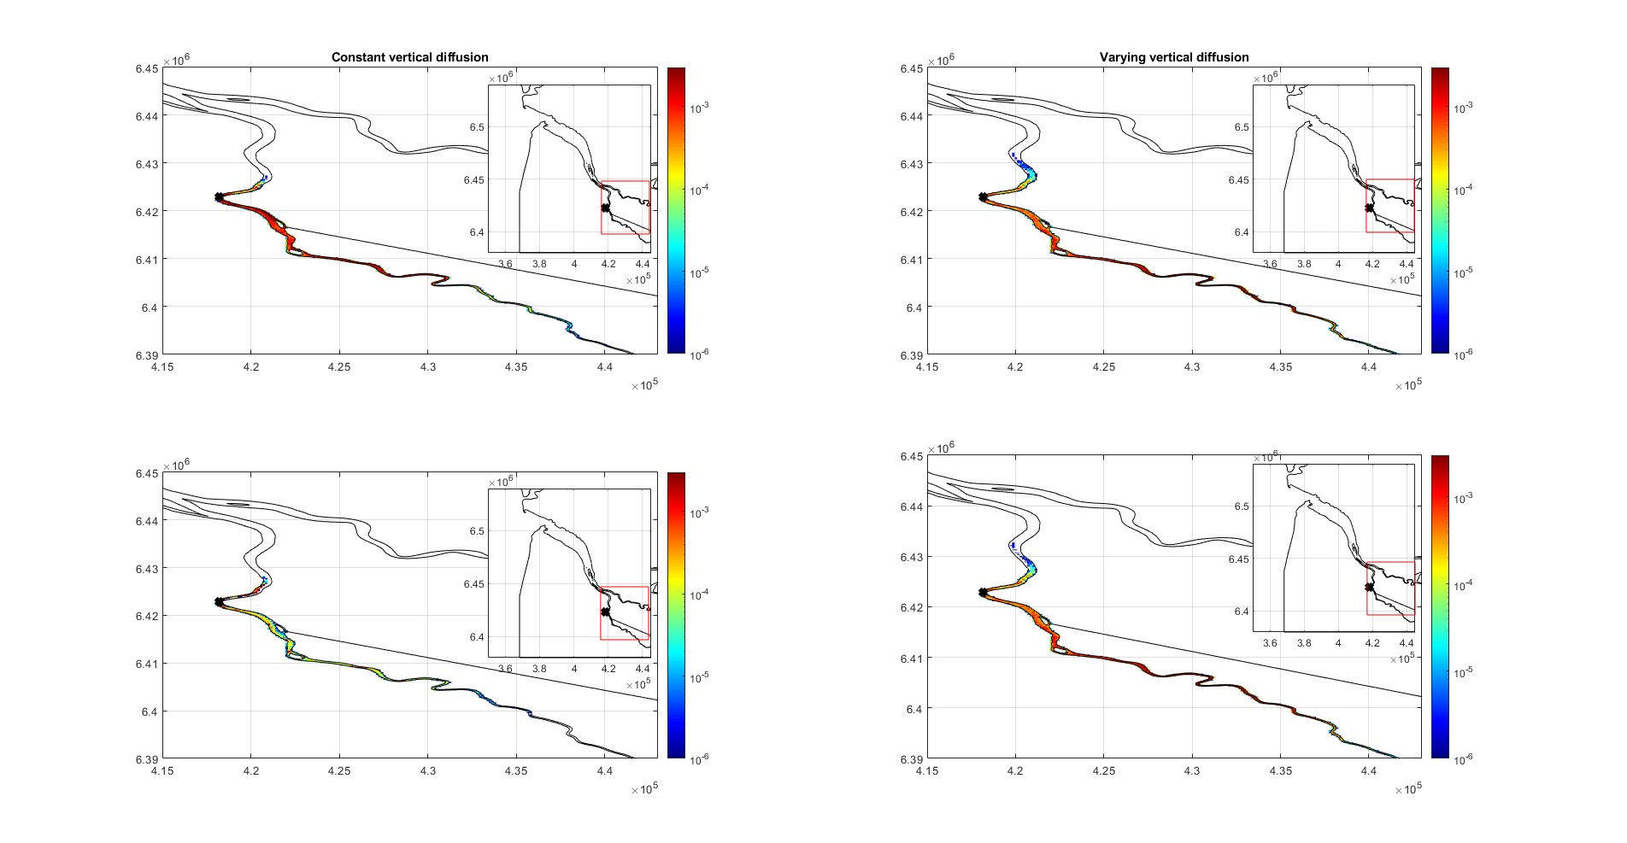
Sensitivity tests
Significance of Critical shear stress for resuspension (ꞇ_{cr})- settling particles
Bordeaux release
Summer season
Small ꞇ_{cr} (0.00133 N/m²)
High ꞇ_{cr} (0.18897 N/m²)

Slide 29
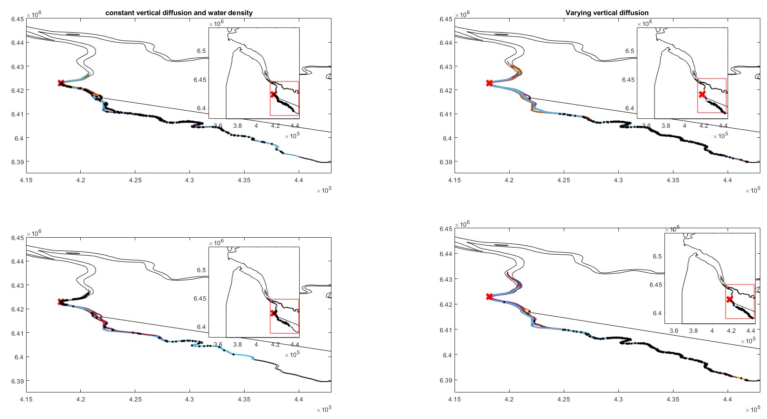
Sensitivity tests
Significance of Critical shear stress for resuspension (ꞇ_{cr})- settling particles
Bordeaux release
Summer season
Small ꞇ_{cr} (0.00133 N/m²)
High ꞇ_{cr} (0.18897 N/m²)

Slide 30
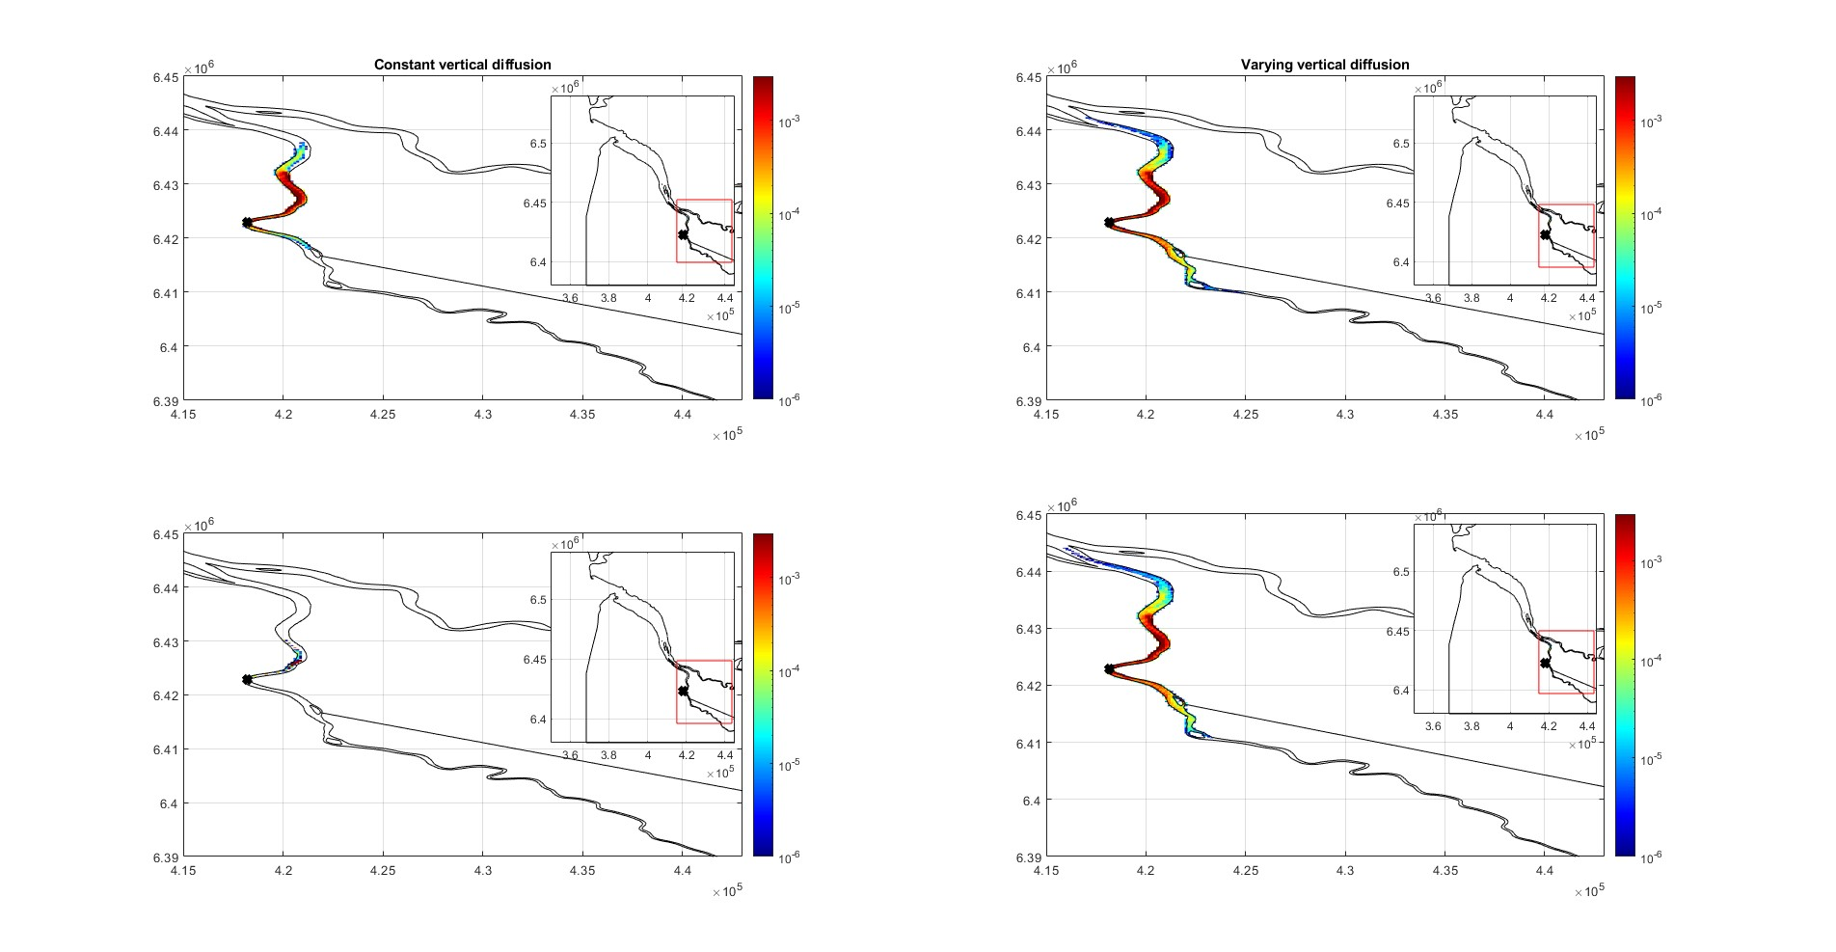
Sensitivity tests
Significance of Critical shear stress for resuspension (ꞇ_{cr}) - settling particles
Bordeaux release
Spring season
Small ꞇ_{cr} (0.00133 N/m²)
High ꞇ_{cr} (0.18897 N/m²)

Slide 31
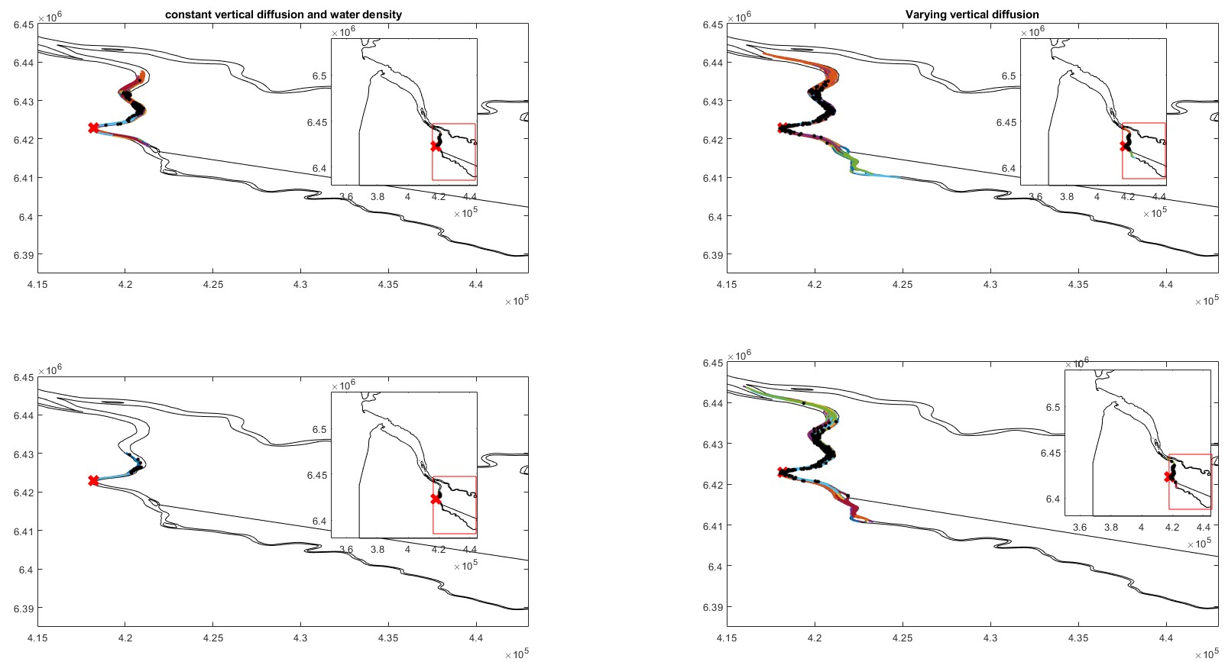
Sensitivity tests
Significance of Critical shear stress for resuspension (ꞇ_{cr}) - settling particles
Bordeaux release
Spring season
Small ꞇ_{cr} (0.00133 N/m²)
High ꞇ_{cr} (0.18897 N/m²)

Slide 32
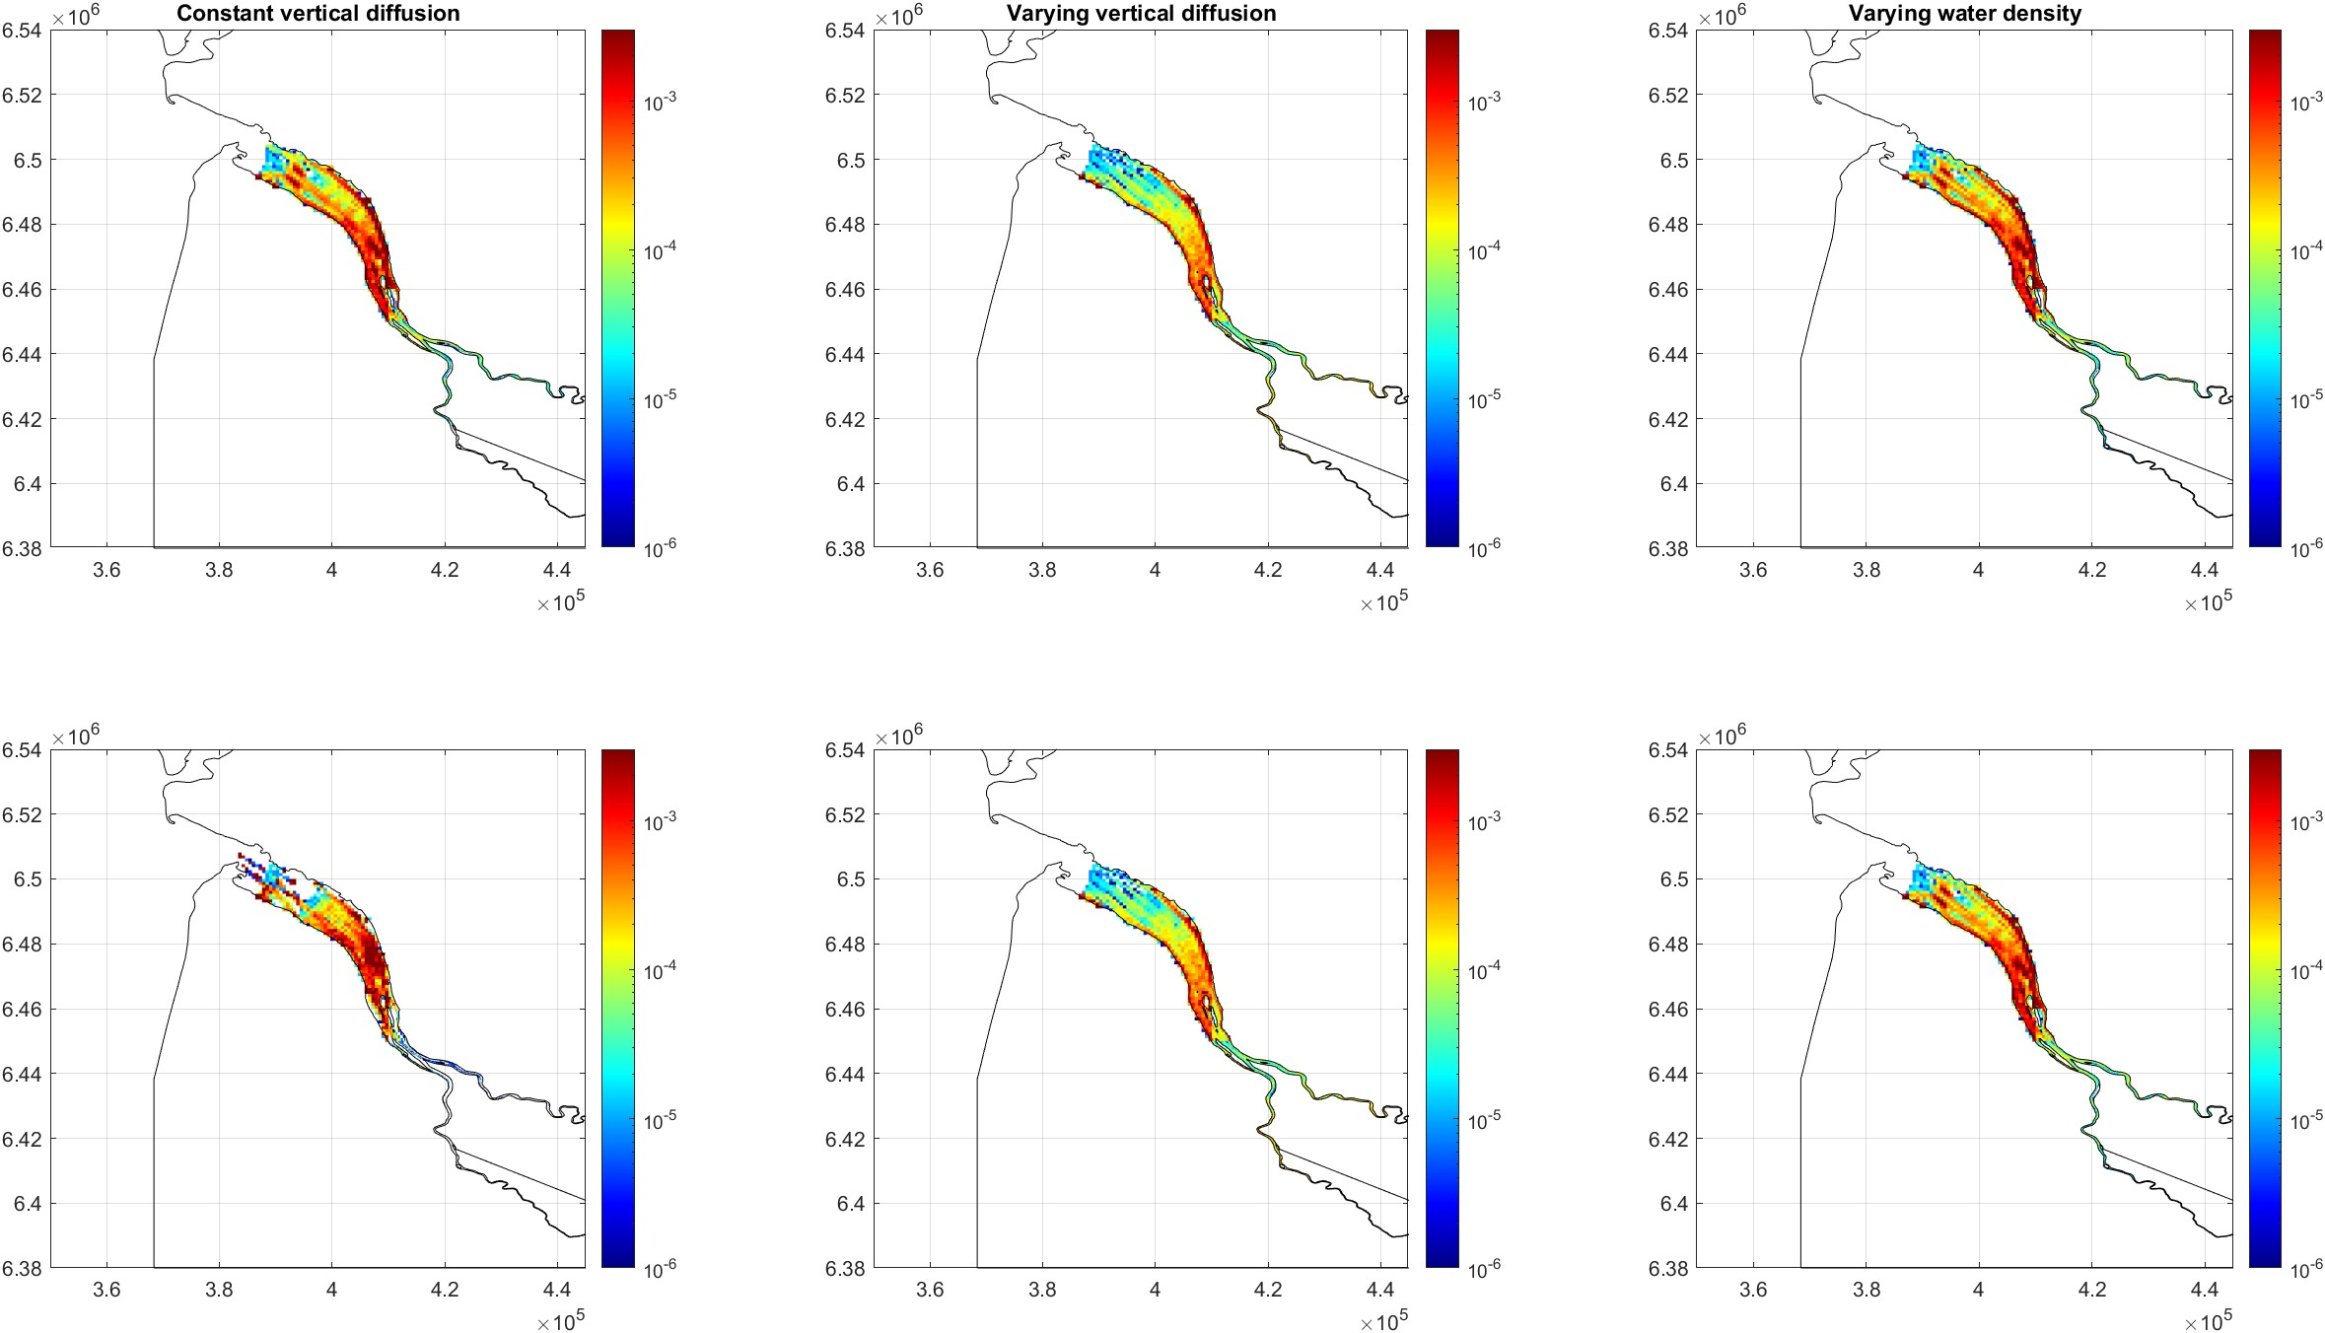
Sensitivity tests
Significance of Critical shear stress for resuspension (ꞇ_{cr}) - settling particles
Uniform release
Summer season
Small ꞇ_{cr} (0.00133 N/m²)
High ꞇ_{cr} (0.18897 N/m²)

Slide 33
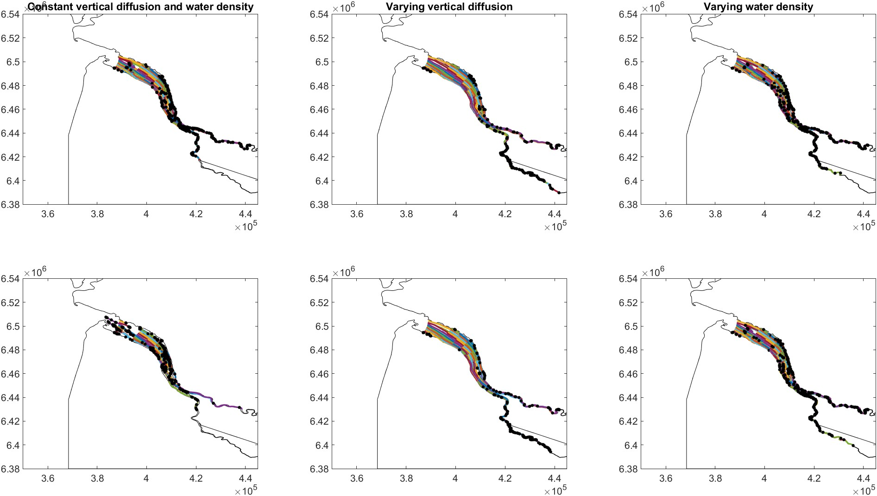
Sensitivity tests
Significance of Critical shear stress for resuspension (ꞇ_{cr}) - settling particles
Uniform release
Summer season
water | beached | settled
3 | 0 | 482
water | beached | settled
15 | 0 | 249
water | beached | settled
0 | 0 | 473
Small ꞇ_{cr} (0.00133 N/m²)
water | beached | settled
0 | 0 | 500
water | beached | settled
13 | 0 | 239
water | beached | settled
0 | 0 | 468
High ꞇ_{cr} (0.18897 N/m²)

Slide 34
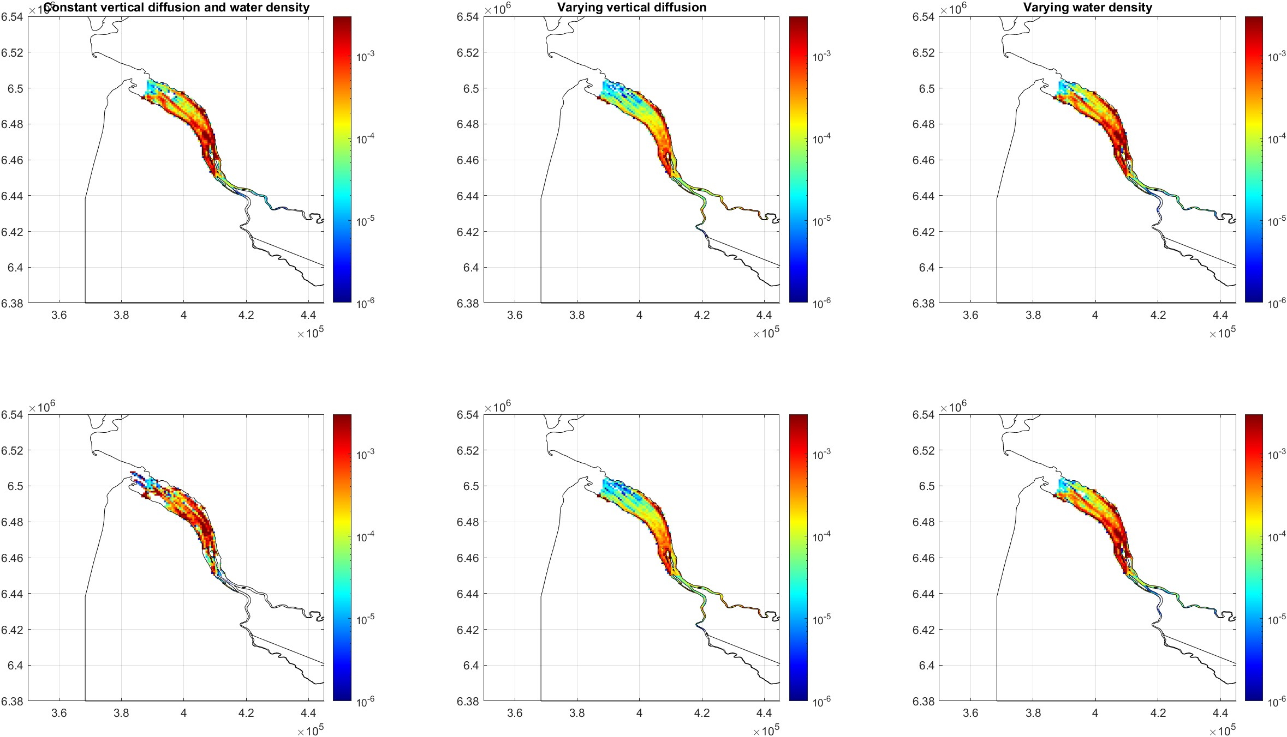
Sensitivity tests
Significance of Critical shear stress for resuspension (ꞇ_{cr}) - settling particles
Uniform release
Spring season
Small ꞇ_{cr} (0.00133 N/m²)
High ꞇ_{cr} (0.18897 N/m²)

Slide 35
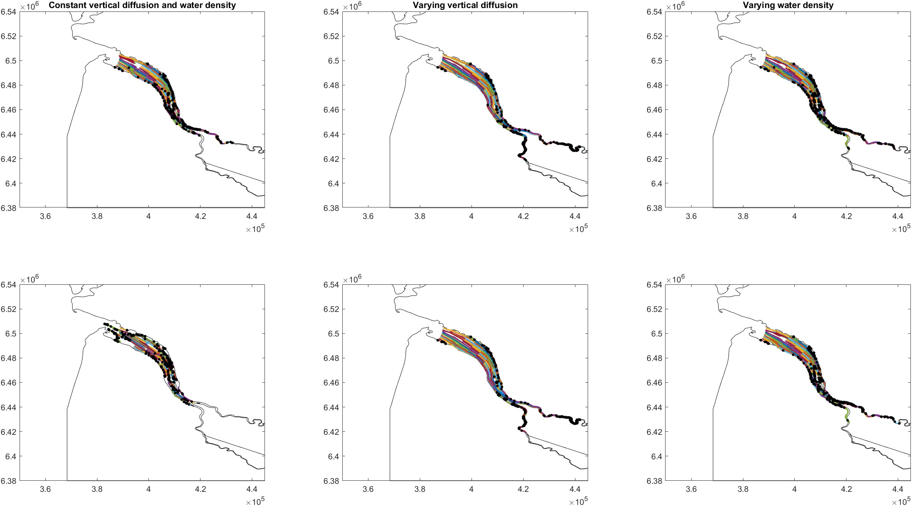
Sensitivity tests
Significance of Critical shear stress for resuspension (ꞇ_{cr}) - settling particles
Uniform release
Spring season
water | beached | settled
5 | 0 | 495
water | beached | settled
22 | 0 | 426
water | beached | settled
1 | 0 | 495
Small ꞇ_{cr} (0.00133 N/m²)
water | beached | settled
2 | 0 | 498
water | beached | settled
12 | 0 | 412
water | beached | settled
0 | 0 | 500
High ꞇ_{cr} (0.18897 N/m²)

Slide 36
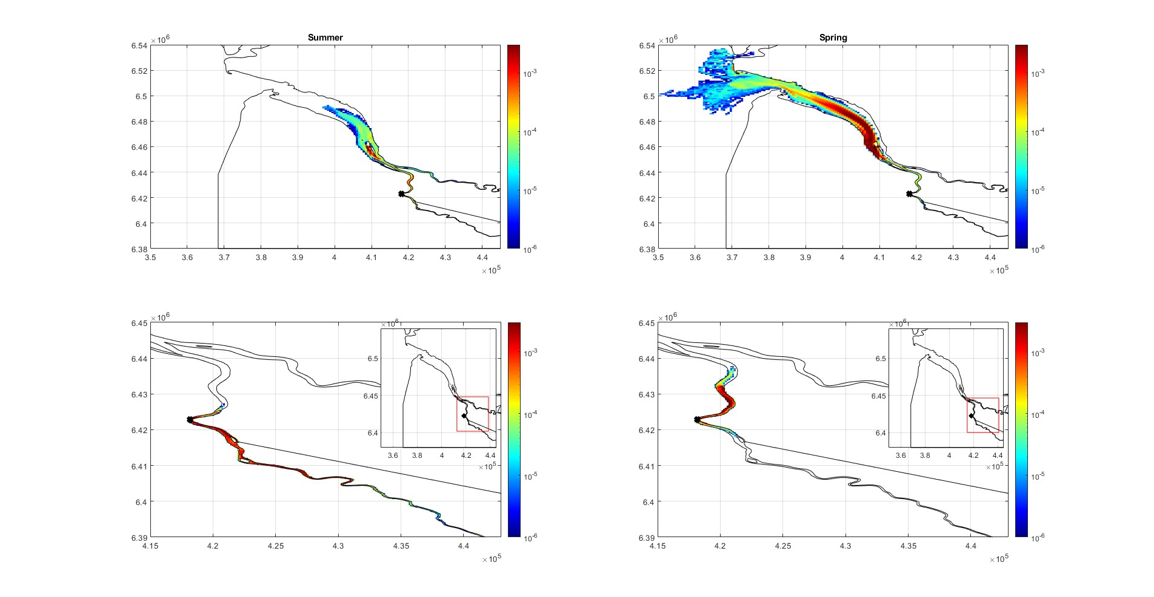
Seasonal variation of particles
Bordeaux release
Rising particles
Settling particles- small ꞇ_{cr}

Slide 37
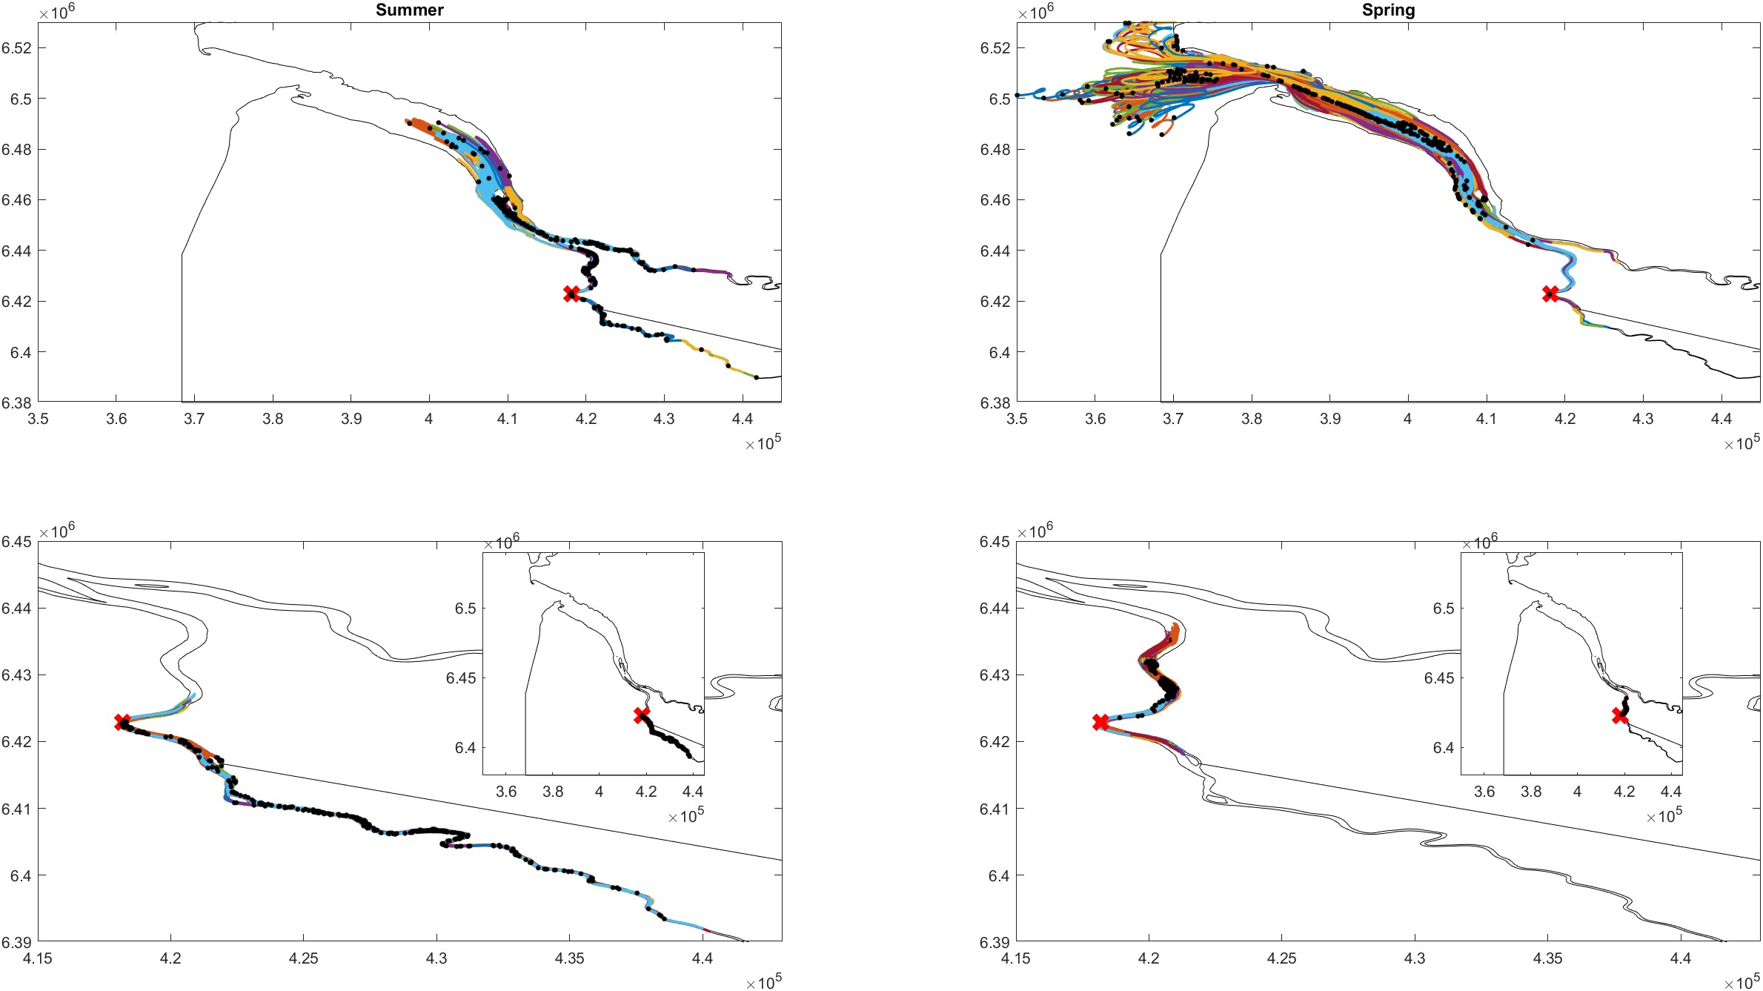
Seasonal variation of particles
Bordeaux release
Rising particles
Settling particles- small ꞇ_{cr}

Slide 38
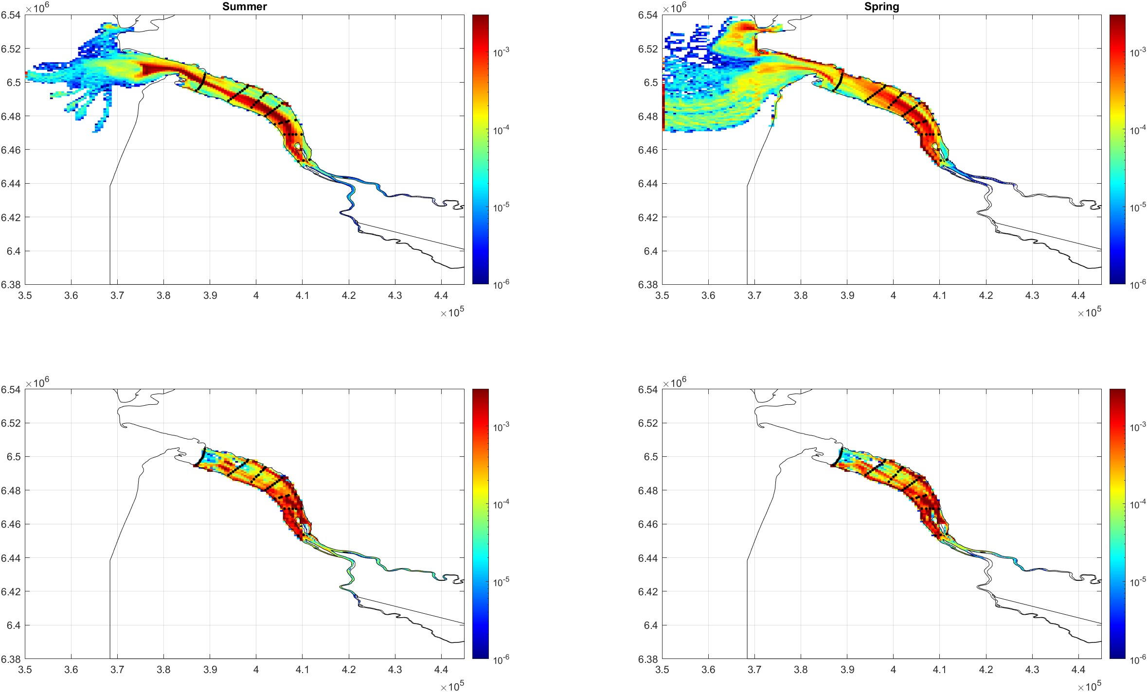
Seasonal variation of particles
Uniform release
Rising particles
Settling particles- small ꞇ_{cr}

Slide 39
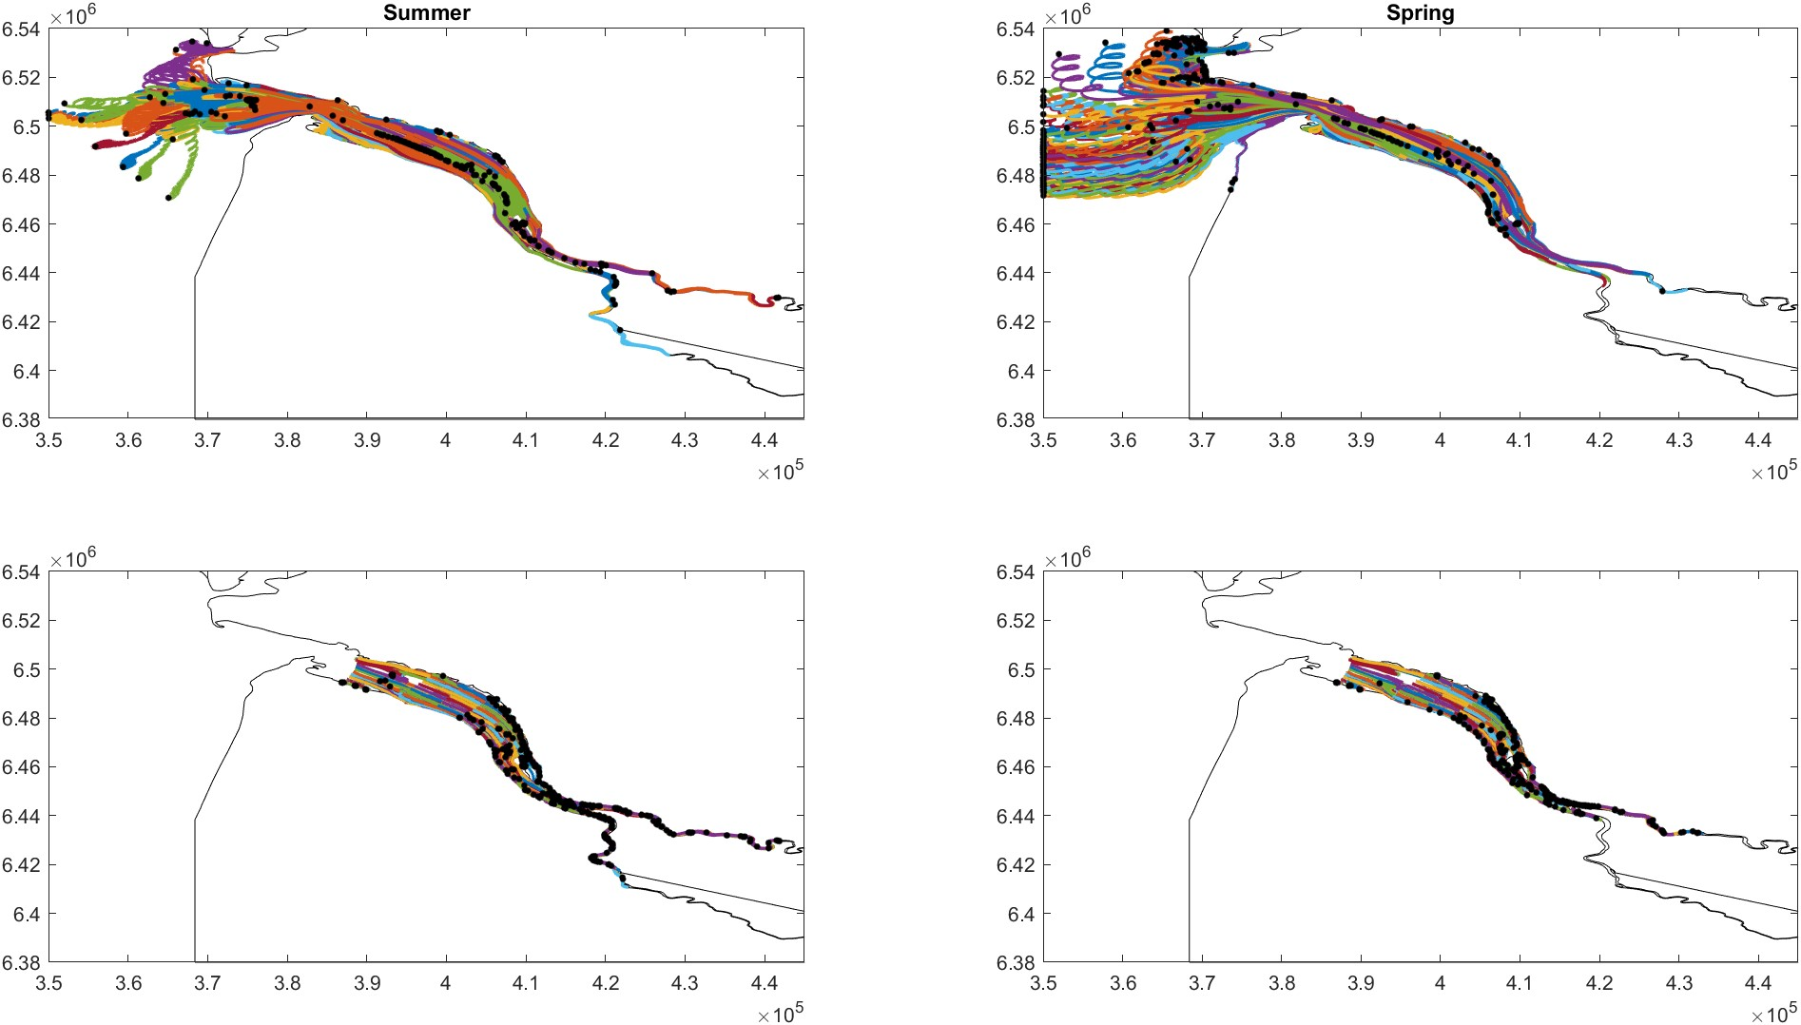
Seasonal variation of particles
Uniform release
Rising particles
Settling particles- small ꞇ_{cr}

