Slide 1
Clusters of Late Noachian- Early Hesperian large volcanic constructs across Arabia Terra and Xanthe Terra on Mars
Y. Y. Yoyo Chu*, J. R. Michalski, and A. A. G. Webb
Supplementary materials
*corresponding author

Slide 3
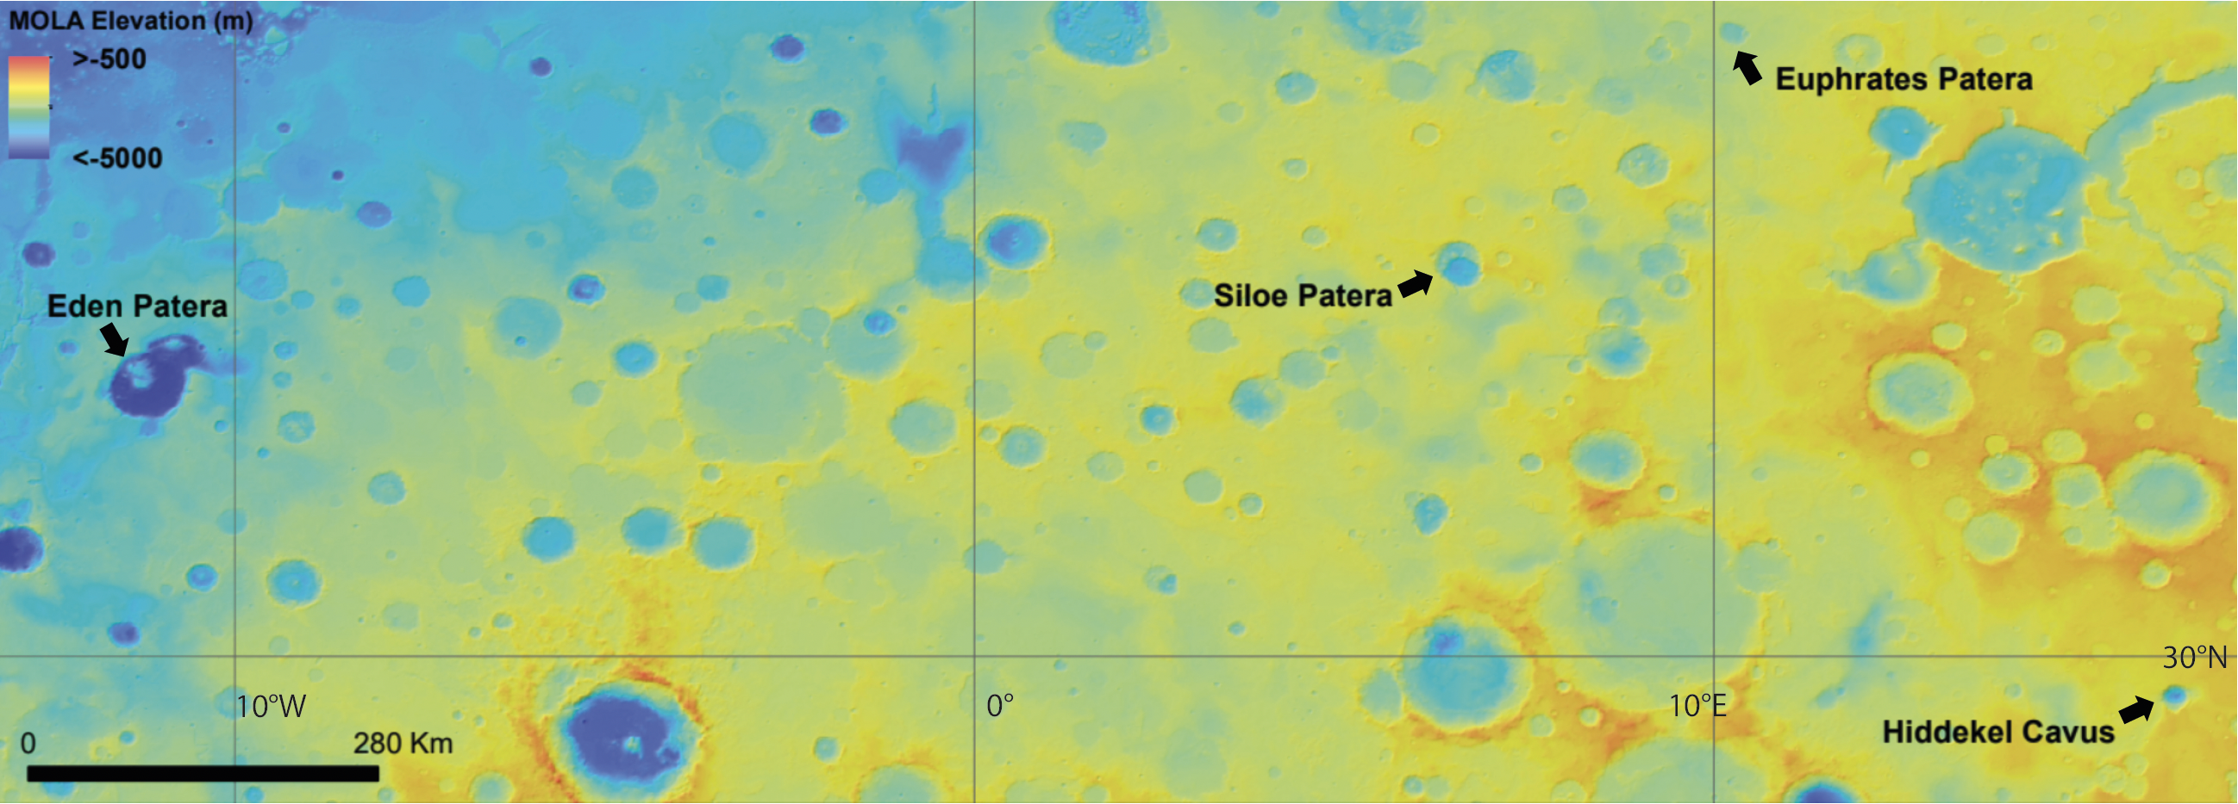
Distribution of ancient caldera complexes within Arabia Terra

Slide 4
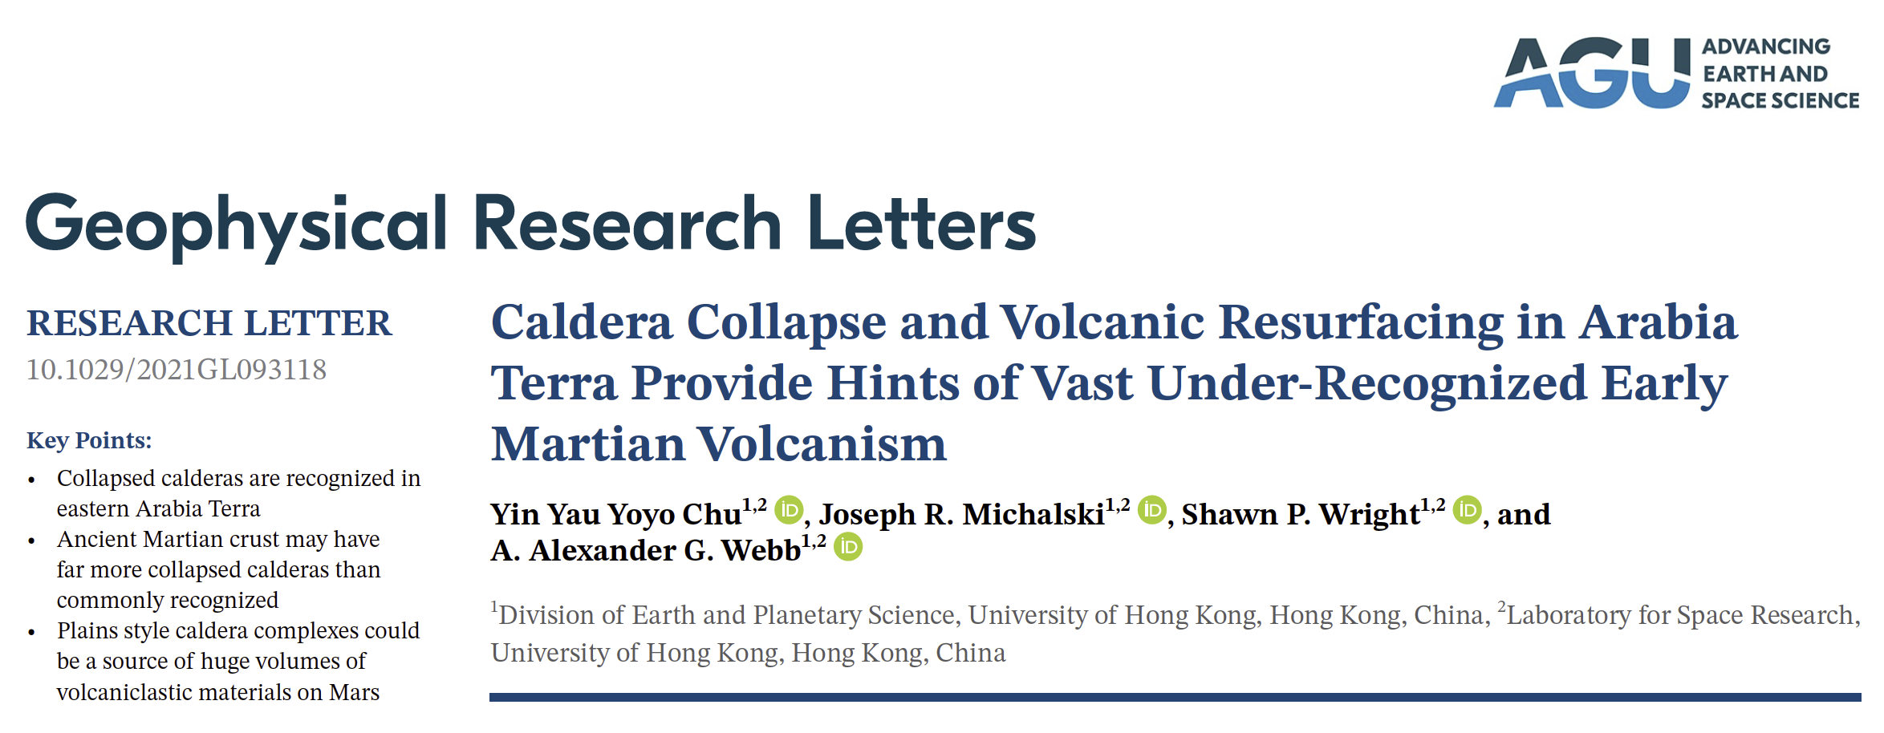
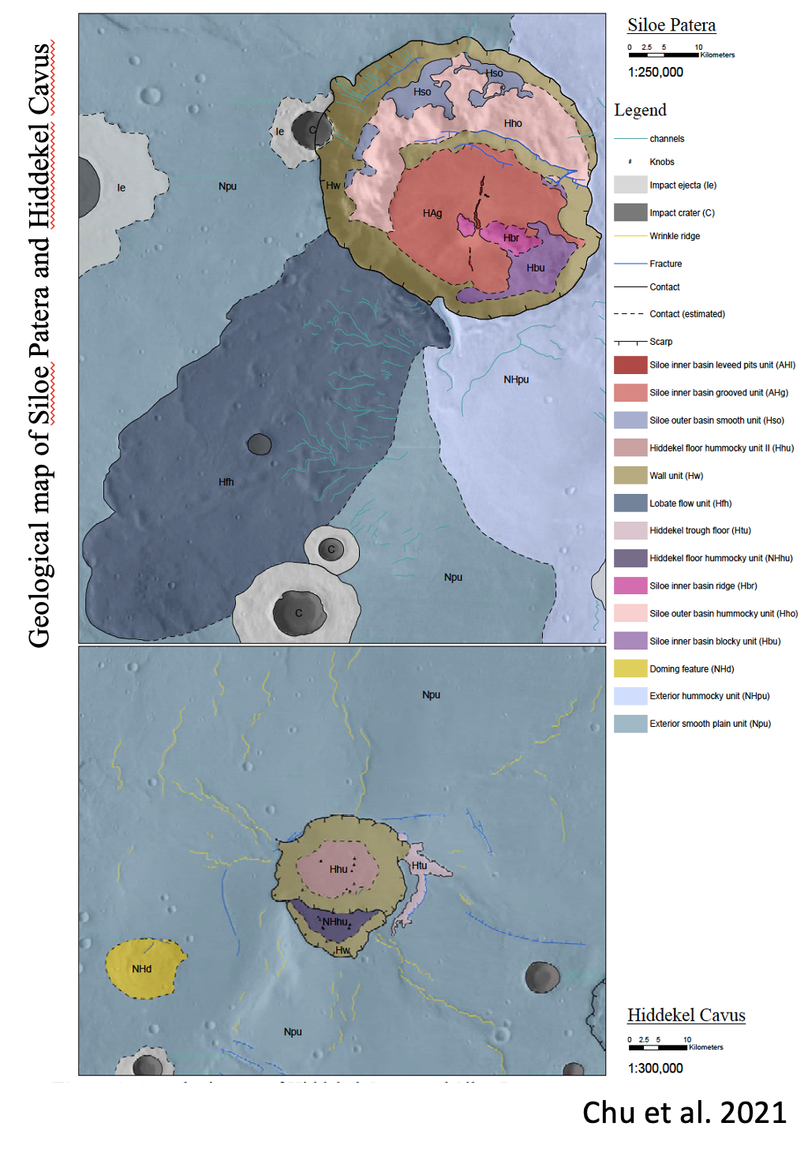
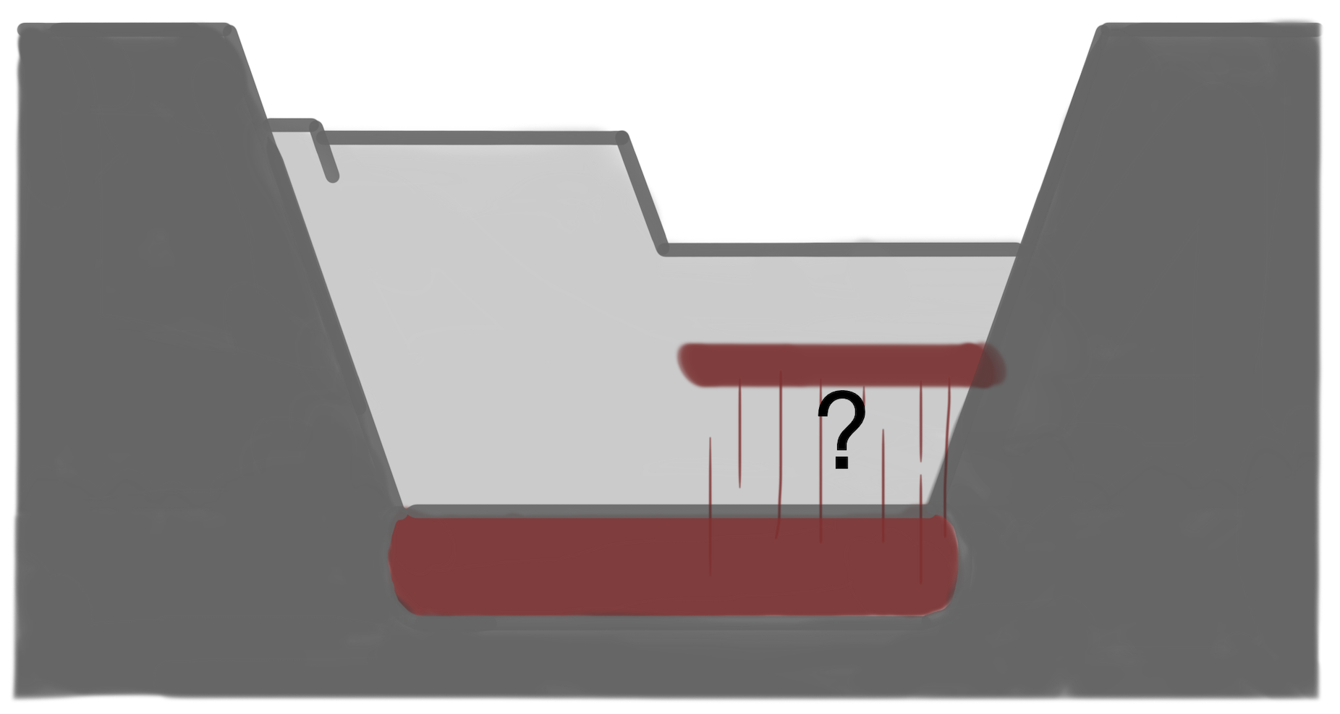
Siloe Patera
Consists of two overlapping craters
Both craters fairly circular
33x 40 km in size
Max elevation offset 1900 m
No external concentric faulting
Classic piston type calderas

Slide 5
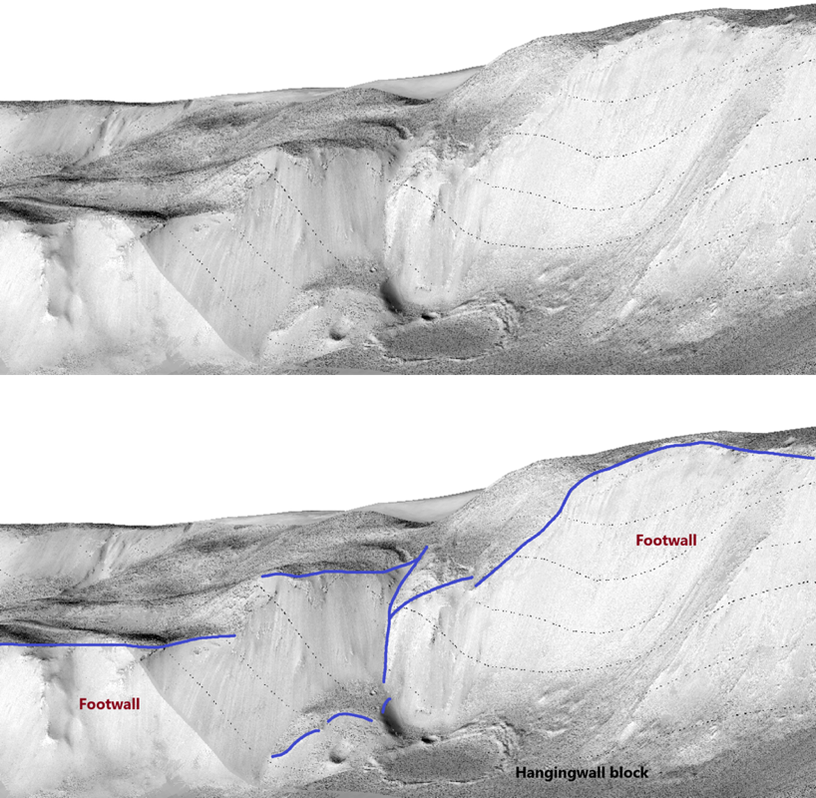
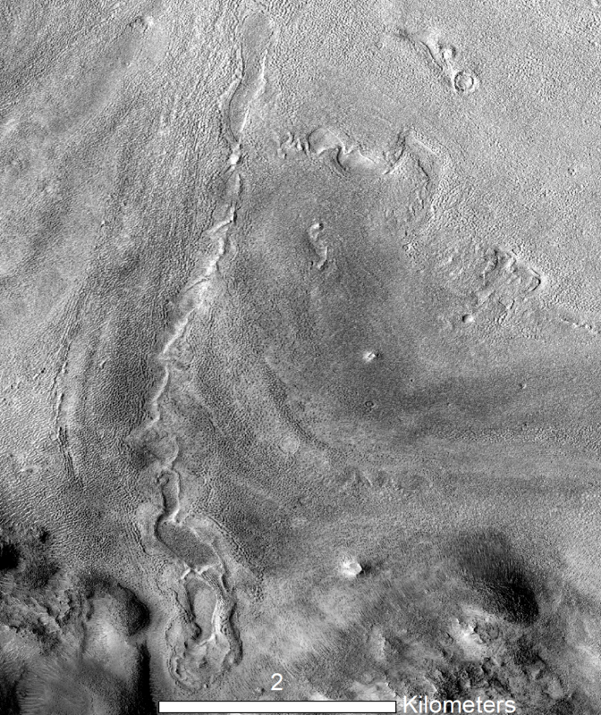
Fault-bounded relationship of the overlapping calderas
Flow deposit
Potential fissure-controlled volcanism
Young age of caldera floor <1Ga

Slide 6
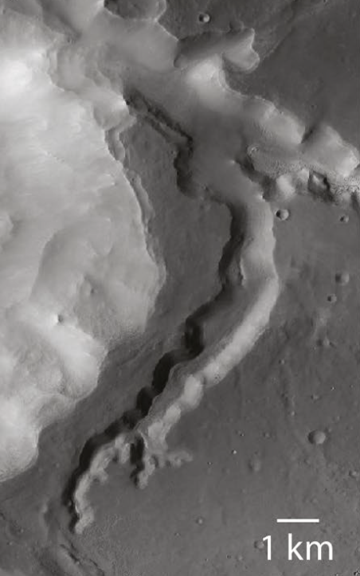
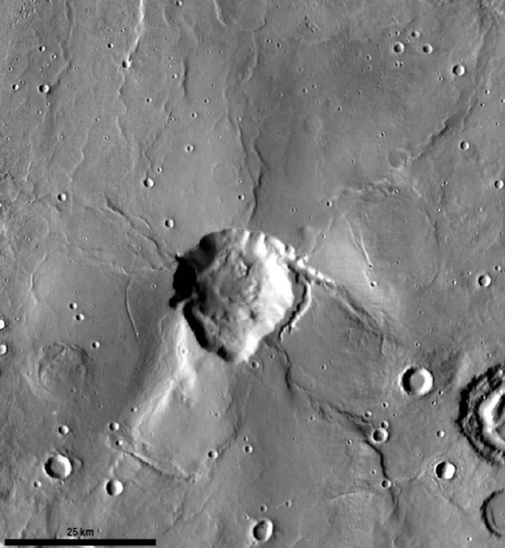
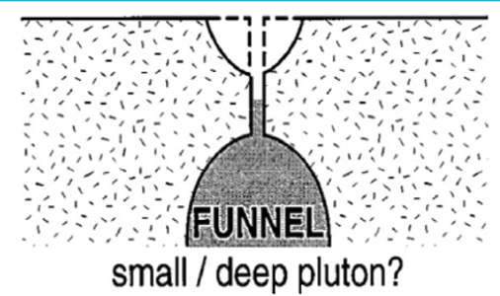
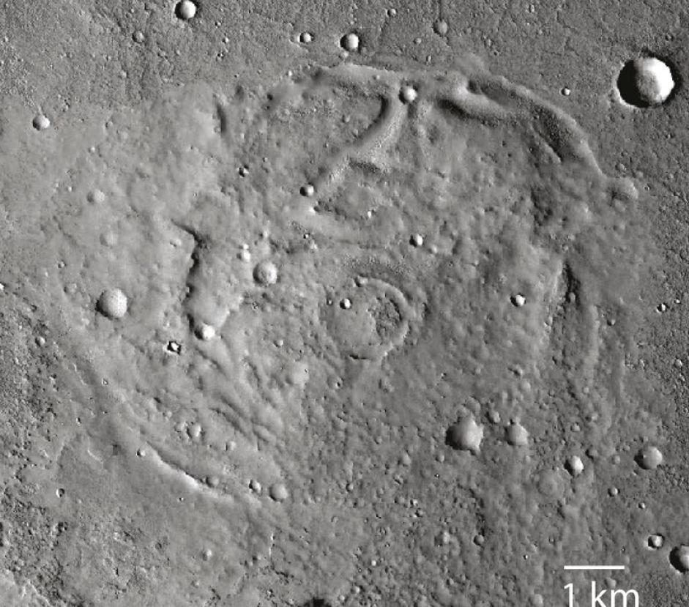
Hiddekel Cavus
Diameter - 20 km
Depth - 2.2 km
Extremely high depth to diameter ratio
Radiating wrinkle ridges
Dome feature (potential vent)
25 km

Slide 7
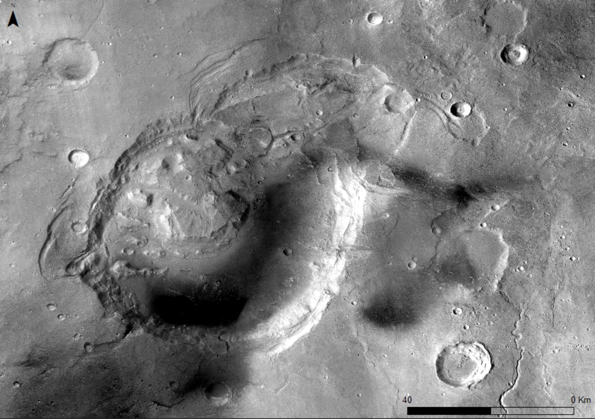
Eden Patera
Type locality of the plain-style caldera complexes
Clear evidence for structural collapse
Clear evidence for volcanic activities
60x80 km depression
total collapsed area of around 5000 km²
Max. elevation offset 1600 m
Potential piecemeal caldera

Slide 9
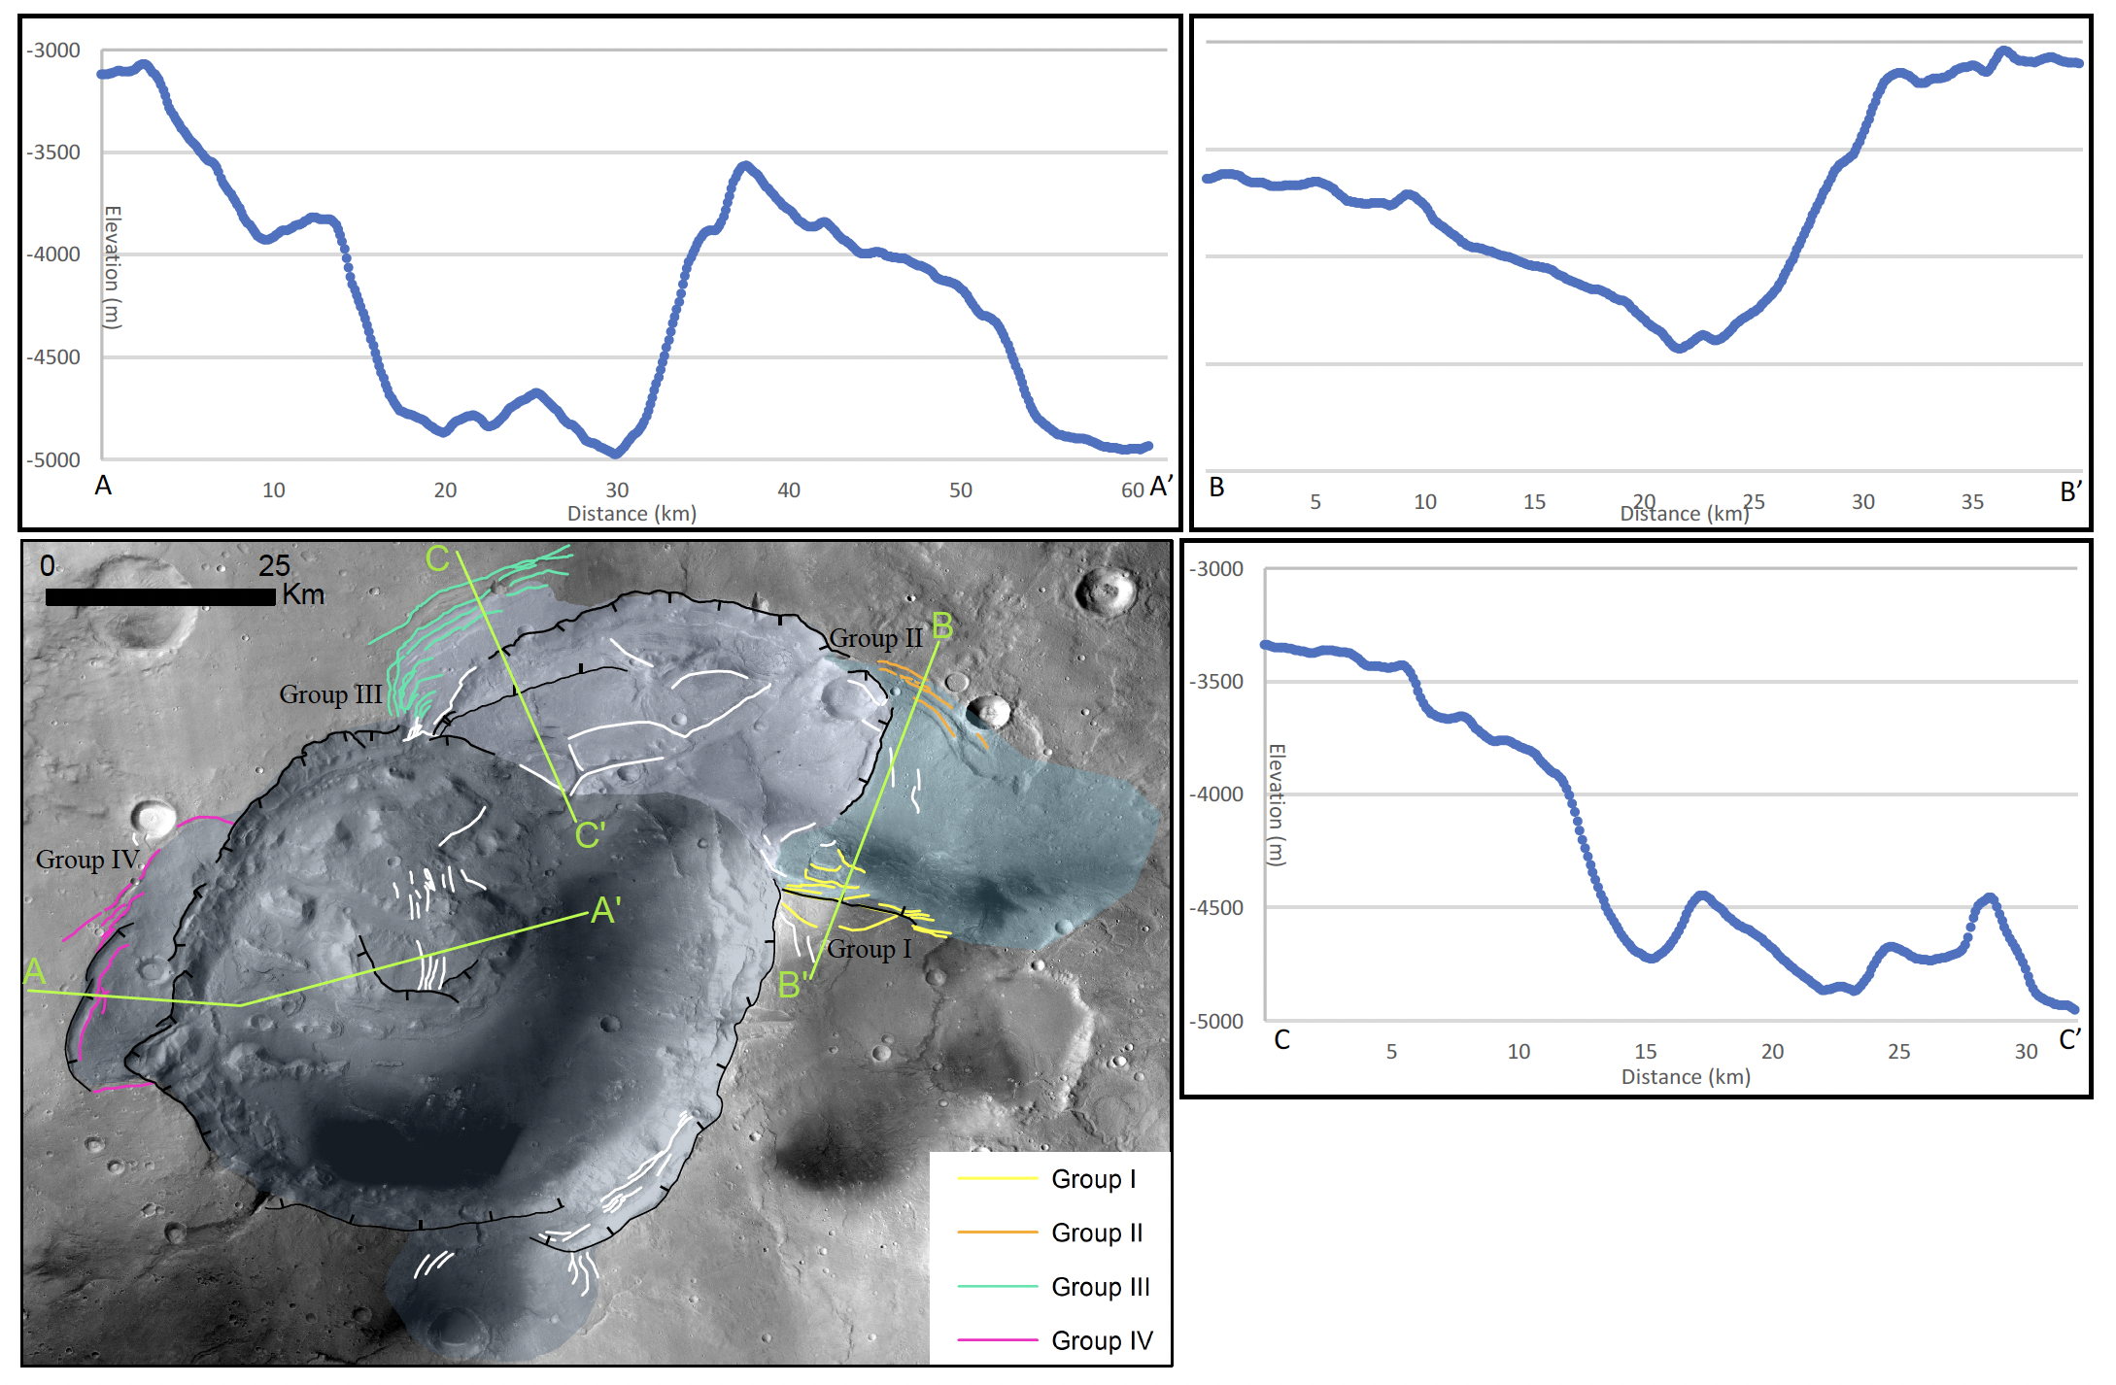
2
1
3
(0)
Multiple phases of caldera collapse at Eden Patera

Slide 10
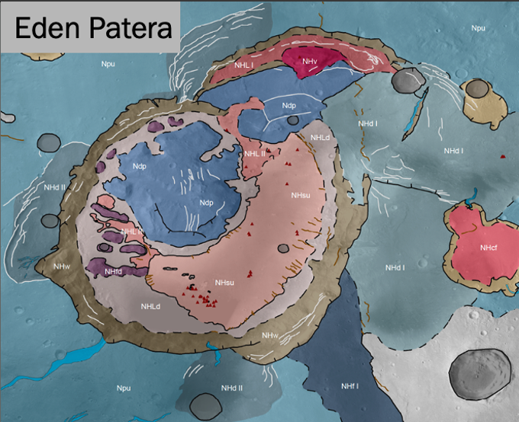
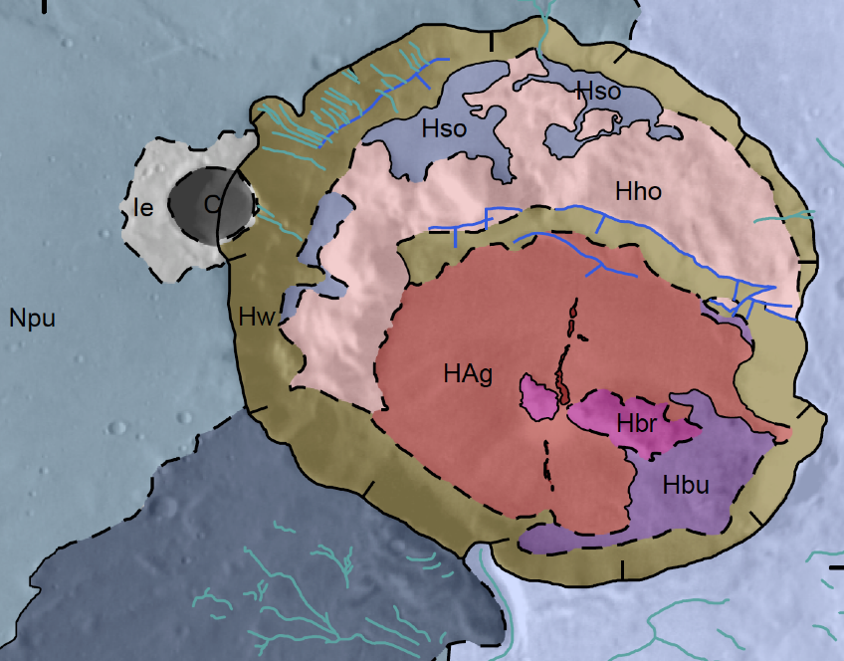
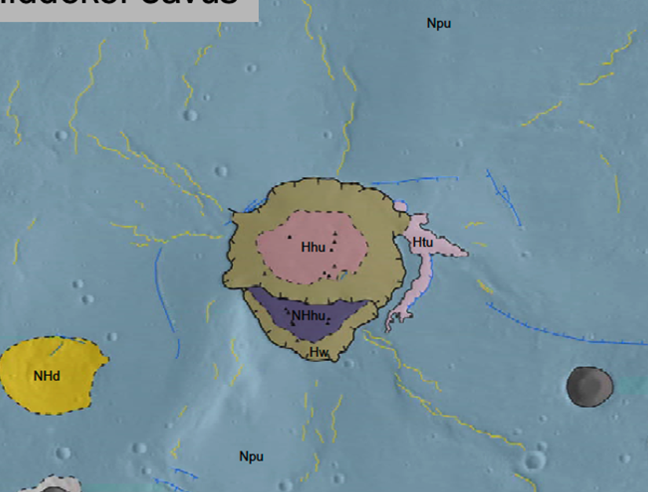
Eden Patera
Siloe Patera
Hiddekel Cavus
Crustal Collapse | Multiple phases of crustal collapse | Nested caldera structure | Catastrophic collapse forming the 2 km-deep cavus
Structural features | Remnant of fractured and tilted crustal materials | Relay ramp structure that connects the two depressions | Tiered bench tilted inwards
 | Arcuate grabens/faulting
Volcanic features | - Volcanic edifice - Lava lake features | - Possible young effusive eruption - Fine-grained infill materials | - Radiating wrinkle ridges - Limited evidence for local eruption - Redirected magma (?)
 | - Lobate flow deposit - Smooth floor unit
 | Friable deposits

Slide 11
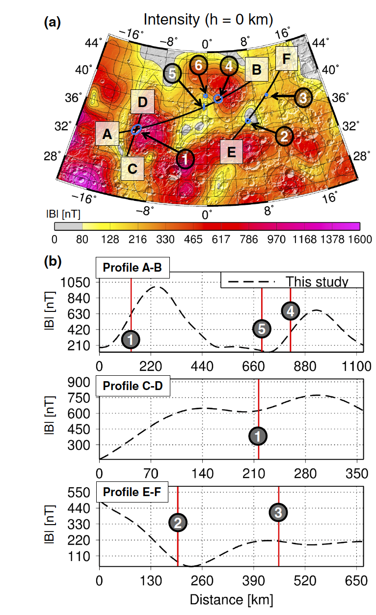
Palaeomagnetic anomalies
7
Magnetic anomalies at volcanic provinces
Local weak field associate with Siloe Patera (2)
Local demagnetisation?
Eden Patera (1) shows minor local weaker field
Minor trough to the SW of Hiddekel Cavus (7)
(Morschhauser, Lesur and Grott, 2014)

