Slide 1
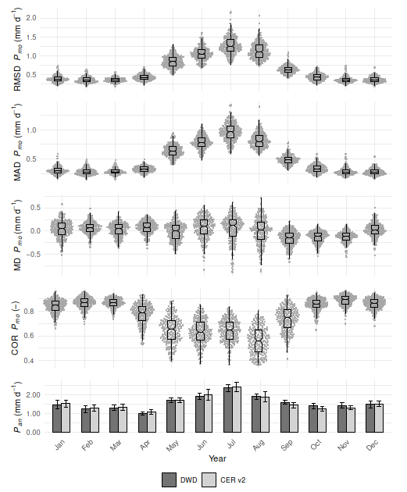
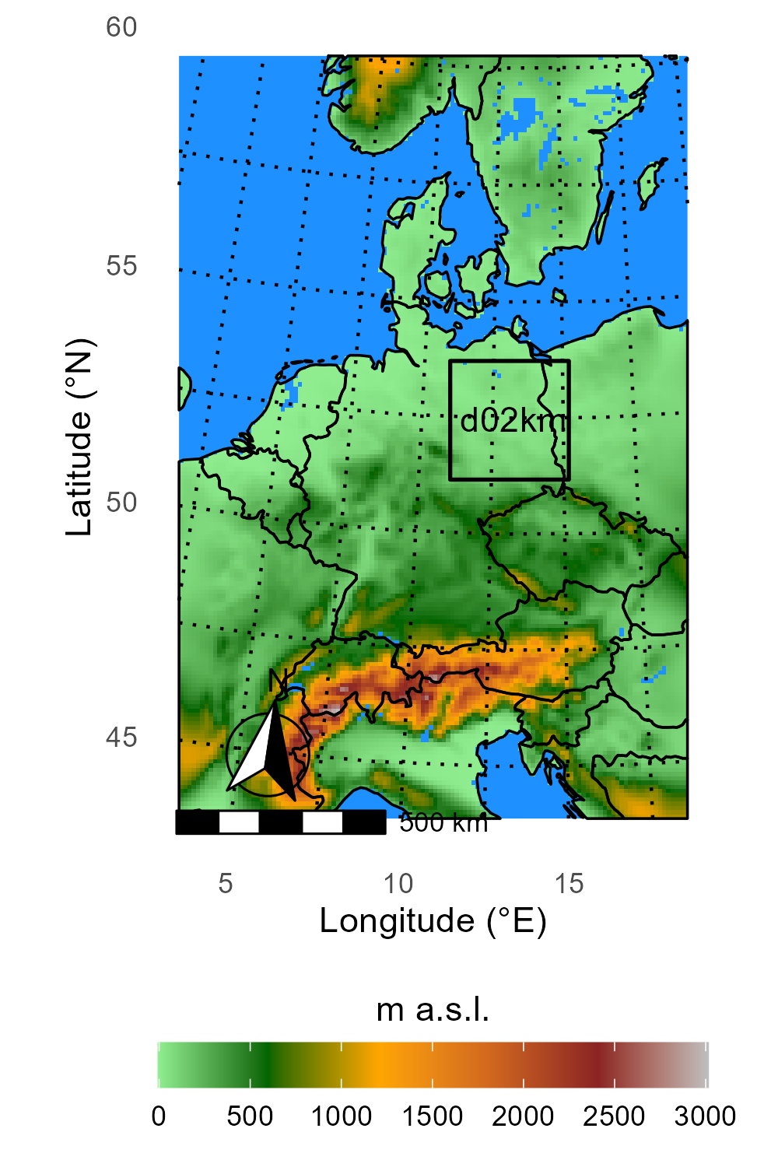
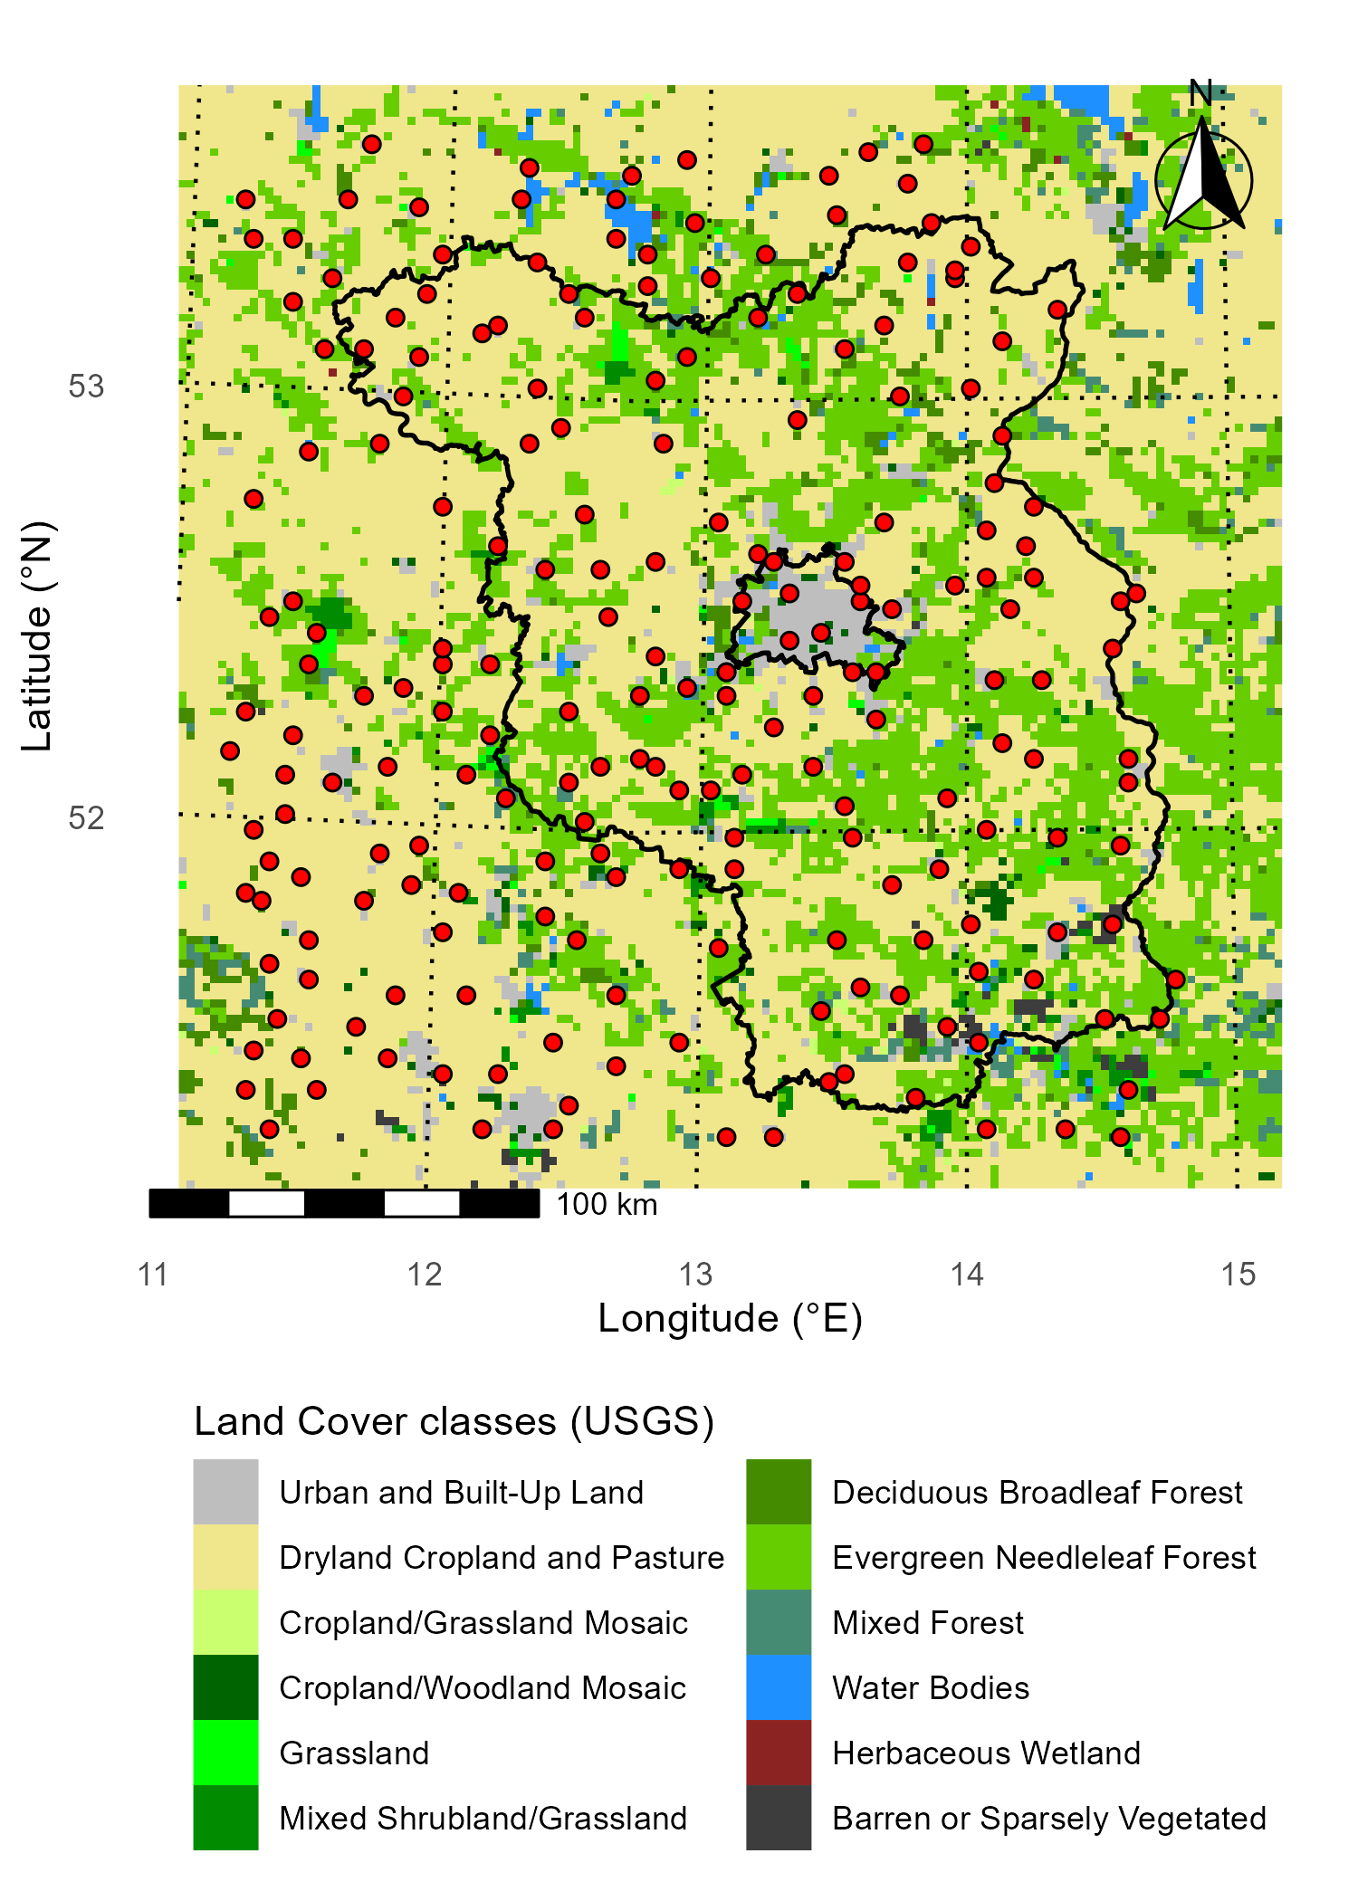
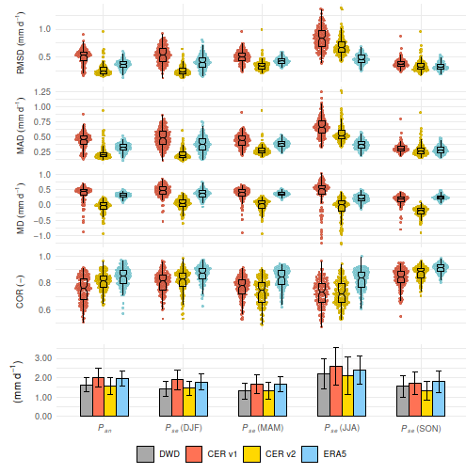
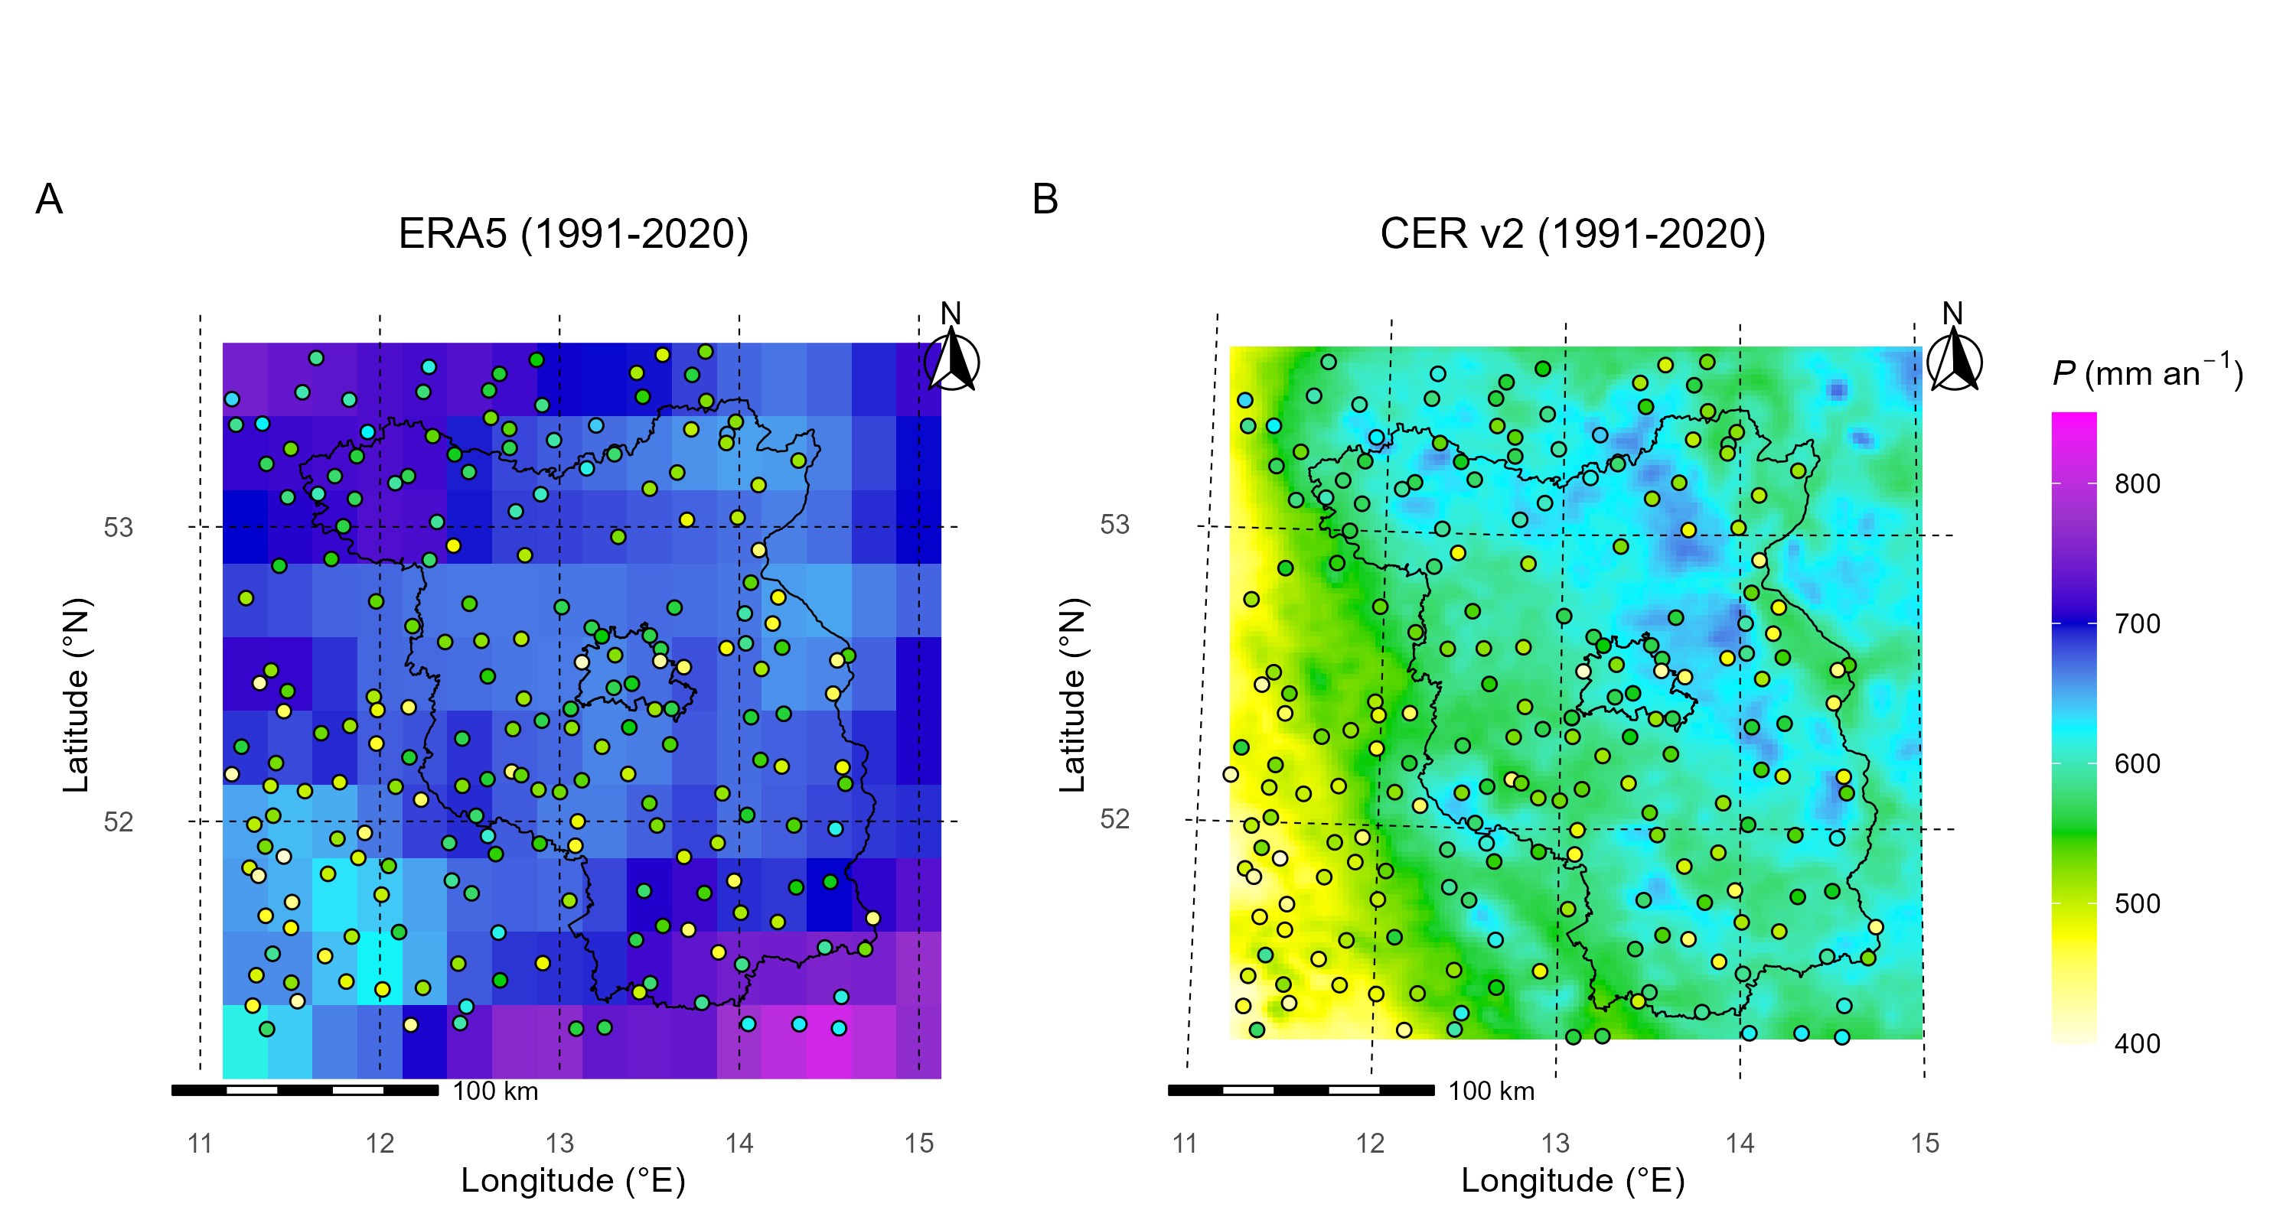
Introduction
The Central Europe Refined analysis version 2 (CER v2): Dynamical downscaling of ERA5 precipitation data for the metropolitan region Berlin-Brandenburg
Results
Increasing frequency and intensity of precipitation extremes in Central Europe (Zeder and Fischer, 2020)
Higher risk of damages due to flooding events and droughts in Berlin-Brandenburg (Germer et al., 2011)
Investigations of the water availability in the region using data driven models (Somogyvári et al., 2023)
Need for accurate high-resolution gridded hydrometeorological data
Table 3: Domain averages and standard deviations for the performance measures between the daily precipitation of the sensitivity experiments and DWD station data at 211 locations (2017). The first series of experiments comprises five different cumulus schemes (using the Thompson microphysics scheme), while in the second series of experiments tested five microphysics schemes (using the Kain-Fritsch cumulus scheme). Results for the CER v1 have been included for reference. The best performance of each testing phase is presented in bold.
Development and evaluation of a reanalysis-based regional atmospheric data set with:
a high temporal resolution, which enables observations of local short-term events.
a high spatial resolution that is not dependent on the density of the station network.
consistent, long time series for climatological investigations.
other relevant atmospheric variables such as evaporation, humidity, etc.
Name | MD | MAD | RMSD | COR | POD | FAR | FBI | PSS
Unit | mm d⁻¹ | mm d⁻¹ | mm d⁻¹ | - | - | - | - | -
CER v1 | 0.43 ± 0.27 | 1.96 ± 0.23 | 5.23 ± 1.05 | 0.68 ± 0.05 | 0.88 ± 0.04 | 0.28 ± 0.04 | 1.24 ± 0.09 | 0.5 ± 0.05
CU_G3D | 0.52 ± 0.3 | 1.75 ± 0.22 | 4.76 ± 1.05 | 0.73 ± 0.05 | 0.89 ± 0.05 | 0.25 ± 0.04 | 1.19 ± 0.1 | 0.57 ± 0.04
CU_KF | 0.1 ± 0.29 | 1.58 ± 0.22 | 4.32 ± 0.91 | 0.71 ± 0.06 | 0.8 ± 0.07 | 0.19 ± 0.04 | 1 ± 0.1 | 0.6 ± 0.05
CU_GF | 0.99 ± 0.29 | 2.02 ± 0.21 | 5.33 ± 0.91 | 0.74 ± 0.04 | 0.92 ± 0.03 | 0.26 ± 0.04 | 1.25 ± 0.09 | 0.57 ± 0.04
CU_KFCuP | 0.34 ± 0.26 | 1.63 ± 0.19 | 4.3 ± 0.84 | 0.72 ± 0.06 | 0.87 ± 0.04 | 0.24 ± 0.05 | 1.16 ± 0.09 | 0.57 ± 0.05
CU_mkF | 0.68 ± 0.29 | 1.86 ± 0.22 | 4.93 ± 1.01 | 0.74 ± 0.05 | 0.88 ± 0.05 | 0.24 ± 0.05 | 1.16 ± 0.1 | 0.59 ± 0.05
MP_TO | 0.1 ± 0.29 | 1.58 ± 0.22 | 4.32 ± 0.91 | 0.71 ± 0.06 | 0.8 ± 0.07 | 0.19 ± 0.04 | 1 ± 0.1 | 0.6 ± 0.05
MP_MO | 0.29 ± 0.29 | 1.65 ± 0.22 | 4.47 ± 0.96 | 0.71 ± 0.05 | 0.84 ± 0.06 | 0.23 ± 0.04 | 1.1 ± 0.1 | 0.57 ± 0.06
MP_MI | 0.38 ± 0.33 | 1.73 ± 0.23 | 4.73 ± 0.93 | 0.71 ± 0.06 | 0.83 ± 0.06 | 0.22 ± 0.04 | 1.07 ± 0.1 | 0.57 ± 0.05
MP_WDM6 | 0.15 ± 0.31 | 1.6 ± 0.22 | 4.36 ± 0.96 | 0.69 ± 0.07 | 0.74 ± 0.07 | 0.18 ± 0.04 | 0.91 ± 0.09 | 0.57 ± 0.07
MP_aTO | -0.04 ± 0.27 | 1.55 ± 0.22 | 4.36 ± 0.99 | 0.72 ± 0.06 | 0.75 ± 0.06 | 0.15 ± 0.04 | 0.89 ± 0.09 | 0.6 ± 0.06
Original CER (CER v1) dataset -> dynamical downscaling of ERA-Interim reanalysis
First use for investigations of surface near air temperature (Jänicke et al., 2017)
Inaccuracies in annual precipitation estimates
Only 18 years of data due to the discontinuation of ERA-Interim forcing data
Frederik Bart^{1*}, Benjamin Schmidt¹, Xun Wang¹,
Achim Holzmann¹, Fred Meier¹, Marco Otto¹, Dieter Scherer¹
→ Development of CER version 2 (CER v2) focusing on improving precipitation performance
Methodology
EGU General Assembly 2024, Vienna, Austria
An improved, regional, high-resolution atmospheric data set for the Berlin-Brandenburg region
Evaluation based on rain gauge data:
Higher performance than previous version (CER v1)
Substantial reduction in mean deviation
Low annual deviations
Highest performance during winter, spring and autumn
Figure 4: Performance measures for monthly precipitation rates (P_{mo}) between the CER v2 and station data over the course of the year. Points represent the corresponding results at each station over the entire 30-year period (1991-2020). The average P_{mo} and standard deviation across all stations for the CER v2 and station data is given at the bottom of the figure.
Figure 5: Performance measures based on the annual (P_{an}) and seasonal precipitation rate (P_{se}) between reanalysis-based data sets (CER v1, CER v2 and ERA5) and station data by the German weather service for 2001-2018. Individual dots represent results for 129 resampled grid cells that contain station data. The domain average P_{an} and P_{se} and standard deviations have been included at the bottom of the figure.
Figure 2: Extent and terrain height of the CER v2 10km domain. Water surfaces are shown as blue. Country and state borders are represented as black lines. The black square marks the position of the 2 km domain (d02km).
Simulation strategy
Daily re-initialization approach adopted from Maussion et al. (2011, 2014)
Figure 3: Land use categories in the 2 km domain of the CER v2 based on the CORINE Land Cover data set (CLC 2006) using the U.S. Geological Survey (USGS) classification. Red dots mark the locations of stations from the German Weather Service.
Conclusions & Outlook
Evaluation based on Performance measures:
Root Mean Squared Deviation (RMSD)
Mean Absolute Deviation (MAD)
Mean Deviation (MD)
Spearman correlation coefficient (COR)
Probability of Detection (POD)
False Alarm Ratio (FAR)
Frequency Bias Index (FBI)
Peirce Skill Score (PSS)
Station data
Daily raingauge data at 211 stations of the German Weather Service (DWD) for 1991-2020
Gridded data
ERA5 Reanalysis total precipitation data (ECMWF) (0.25° spatial resolution, hourly)
CER v1 precipitation data (2 km, hourly)
CER v2 precipitation data (2 km, hourly)
Highest accuracy using the Kain-Fritsch cumulus and Thompson microphysics scheme
Positive mean deviation found in ERA5 precipitation data for this region was reduced in the CER v2
Performance in terms of RMSD, MAD and MD was typically higher than for the CER v1
Lower performance than ERA5 during the summer months
Possible systematic deviations in measurement data should be considered (undercatch due to wind)
Outlook
Continuous expansion of the data set with the publication of further ERA5 reanalysis data
Evaluation of other atm. variables (temperature, wind, humidity, etc.)
Further evaluation of precipitation extremes based on daily/ subdaily conditions
Table 1: Model setup that was used for the sensitivity experiments for the selection of the physical parameterization scheme of the CER v2 (CU_G3D).
Figure 1: 30-year average of the annual precipitation based on ERA5 (A) and CER v2 data (B). Corresponding results at stations of the German Weather Service are included as dots.
Simulation period | 2017
Model version | WRF-ARW 4.3.3
Timesteps | 40 s
Map projection | Lambert conformal conic
Horizontal grid spacing | 10 km (121x 181 grid points)/ 2km (141 x141 grid points)
Vertical levels | 28 eta-levels
Forcing data | ERA5 (0.25° spatial resolution, hourly)
Initialization | Daily at 12:00 UTC
Run duration | 36 hr
Spin-up time | 12 hr
Longwave radiation | Rapid Radiative Transfer Model
Shortwave radiation | Dudhia shortwave scheme
Cumulus scheme | New Grell-Devenyi 3 scheme
Microphysics scheme | Modified Thompson scheme
Planetary boundary layer (PBL) | Bougeault–Lacarrere Scheme
Land surface model | Noah land surface model
Surface layer | Eta Similarity Scheme
Table 2: Overview of the cumulus and microphysics parameterization schemes tested in the sensitivity experiments, including the corresponding acronyms and references.
References
44 years of CER v2 data (1980-2023) available here:
¹ Chair of Climatology,
Technische Universität Berlin, Berlin, Germany
* Corresponding author:
frederik.bart@tu-berlin.de
Germer, S., Kaiser, K., Bens, O., Hüttl, R.F., 2011. Water Balance Changes and Responses of Ecosystems and Society in the Berlin-Brandenburg Region – a Review. DIE ERDE – Journal of the Geographical Society of Berlin 142, 65–95.
Jänicke, B., Meier, F., Fenner, D., Fehrenbach, U., Holtmann, A., Scherer, D., 2017. Urban–rural differences in near-surface air temperature as resolved by the Central Europe Refined analysis (CER): sensitivity to planetary boundary layer schemes and urban canopy models. International Journal of Climatology 37, 2063–2079. https://doi.org/10.1002/joc.4835
Maussion, F., Scherer, D., Finkelnburg, R., Richters, J., Yang, W., Yao, T., 2011. WRF simulation of a precipitation event over the Tibetan Plateau, China – an assessment using remote sensing and ground observations. Hydrol. Earth Syst. Sci. 15, 1795–1817. https://doi.org/10.5194/hess-15-1795-2011
Maussion, F., Scherer, D., Mölg, T., Collier, E., Curio, J., Finkelnburg, R., 2014. Precipitation Seasonality and Variability over the Tibetan Plateau as Resolved by the High Asia Reanalysis. Journal of Climate 27, 1910–1927. https://doi.org/10.1175/JCLI-D-13-00282.1
Somogyvári, M., Scherer, D., Bart, F., Fehrenbach U., Okujeni A., Krueger T., 2023. A hybrid data-driven approach to analyze the drivers of lake level dynamics (Manuscript submitted for publication). HESS.
Zeder, J., Fischer, E.M., 2020. Observed extreme precipitation trends and scaling in Central Europe. Weather and Climate Extremes 29, 100266. https://doi.org/10.1016/j.wace.2020.100266
Physics parametetrization scheme | Acronym
Grell 3D scheme | CU_G3D
Grell-Freitas scheme | CU_GF
Kain-Fritsch scheme | CU_KF
Kain-Fritsch-Cumulus Potential scheme | CU_KFCuP
Multi-scale Kain-Fritsch scheme | CU_mKF
Thompson scheme | MP_TO
Morrison double-moment scheme | MP_MO
Milbrandt-Yau double-moment scheme | MP_MI
WRF double moment 6-class scheme | MP_WDM6
Thompson aerosol-aware scheme | MP_aTO

