Slide 1
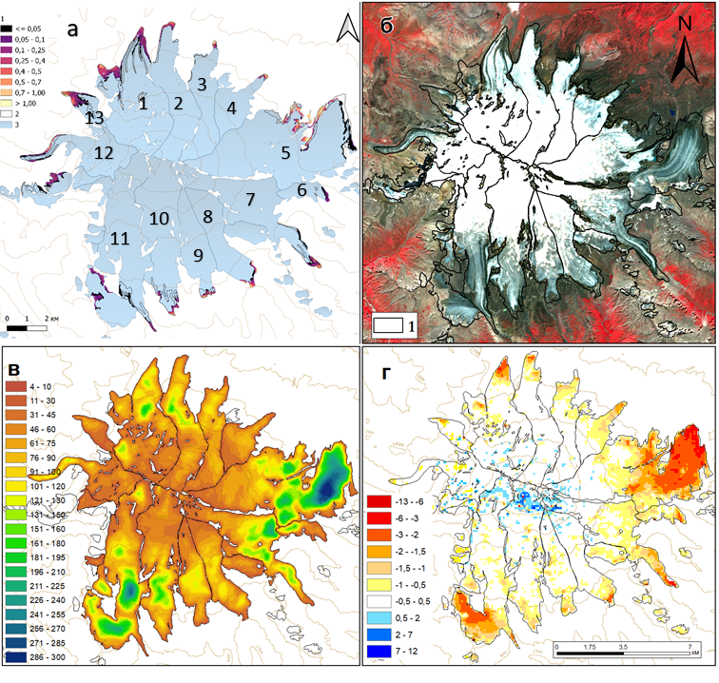
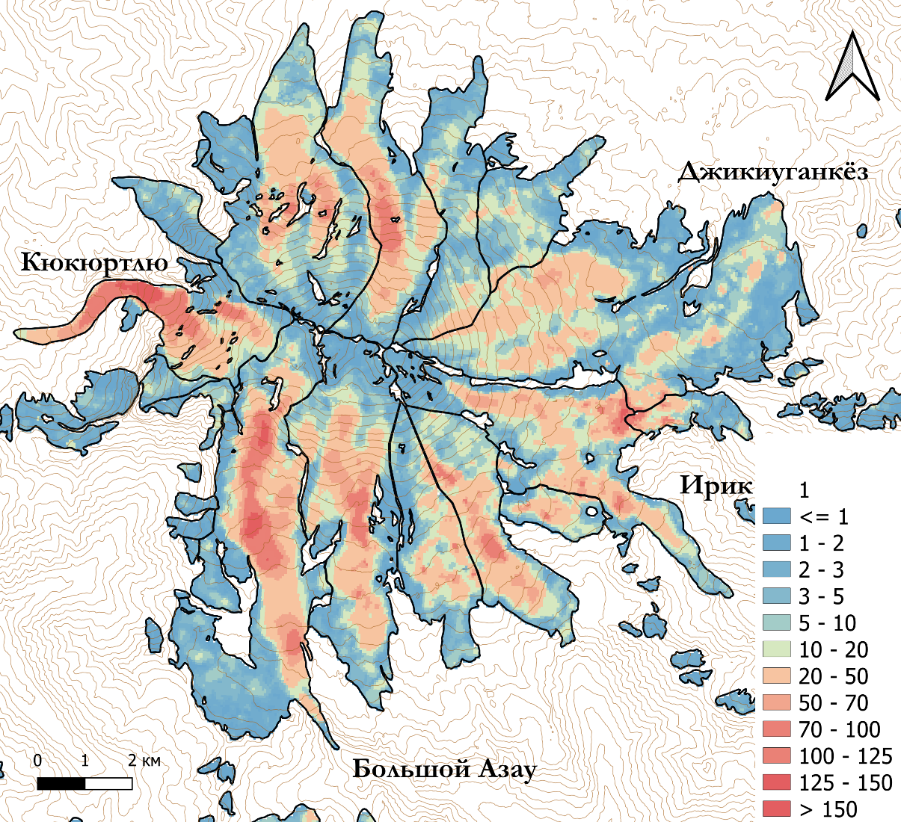
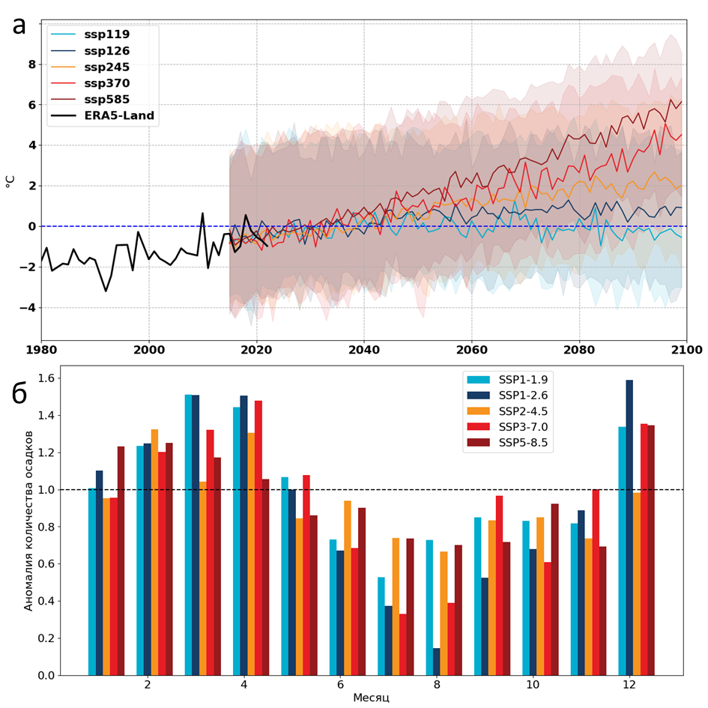
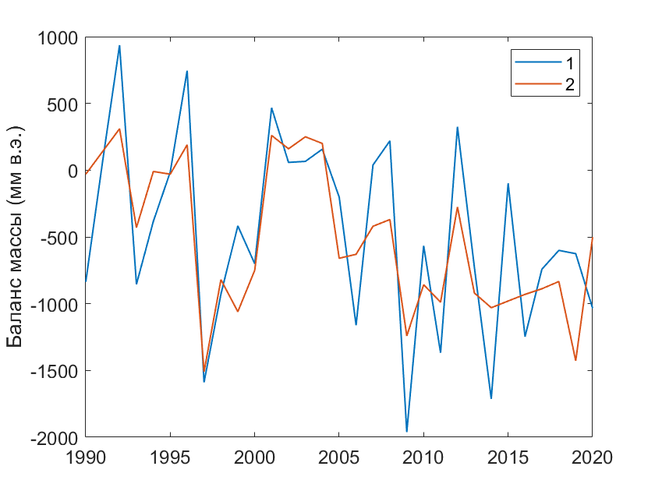
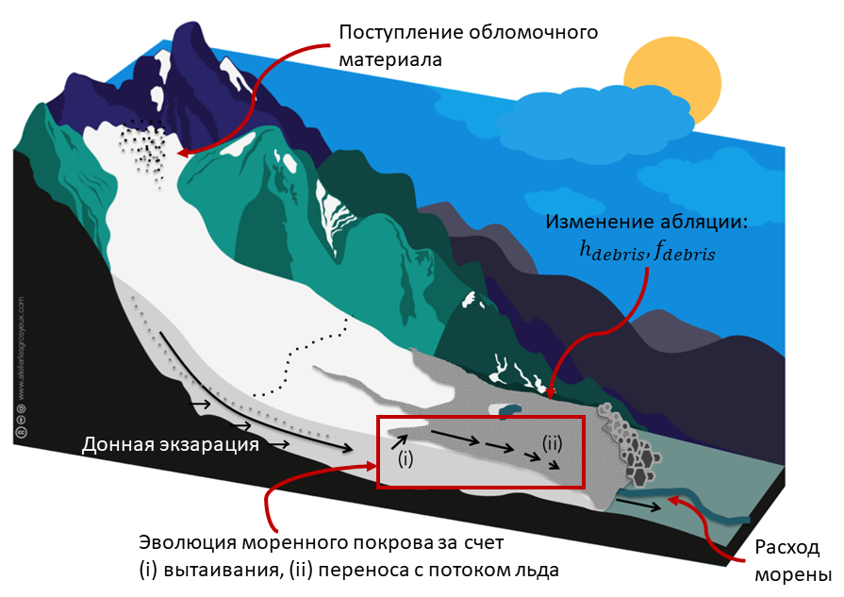
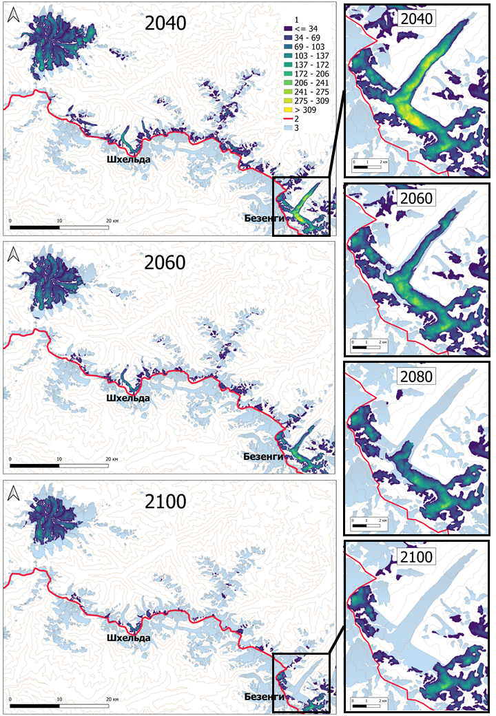
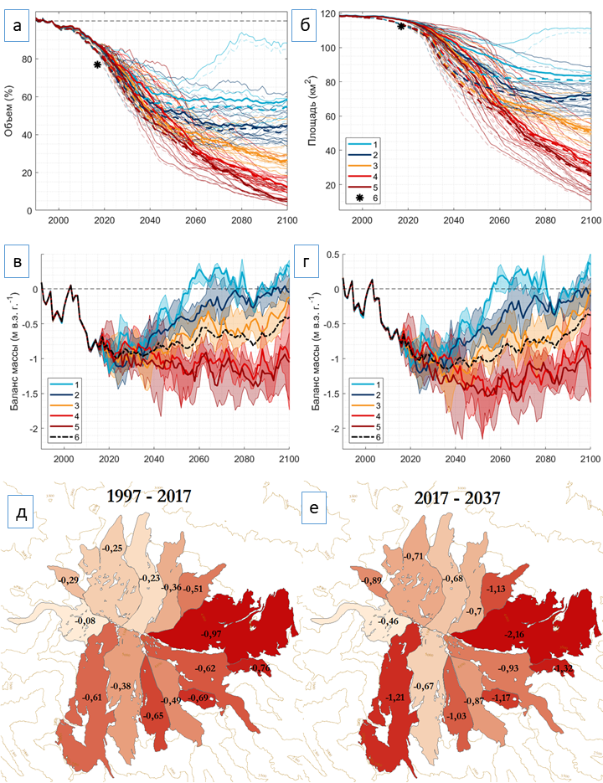
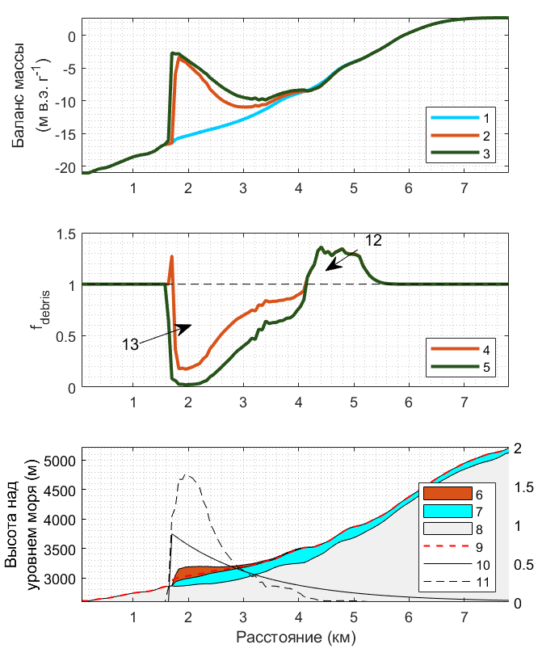
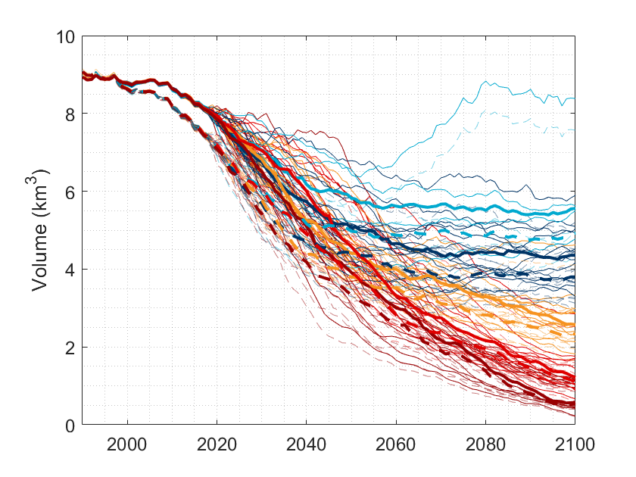
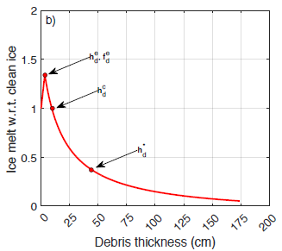
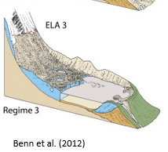
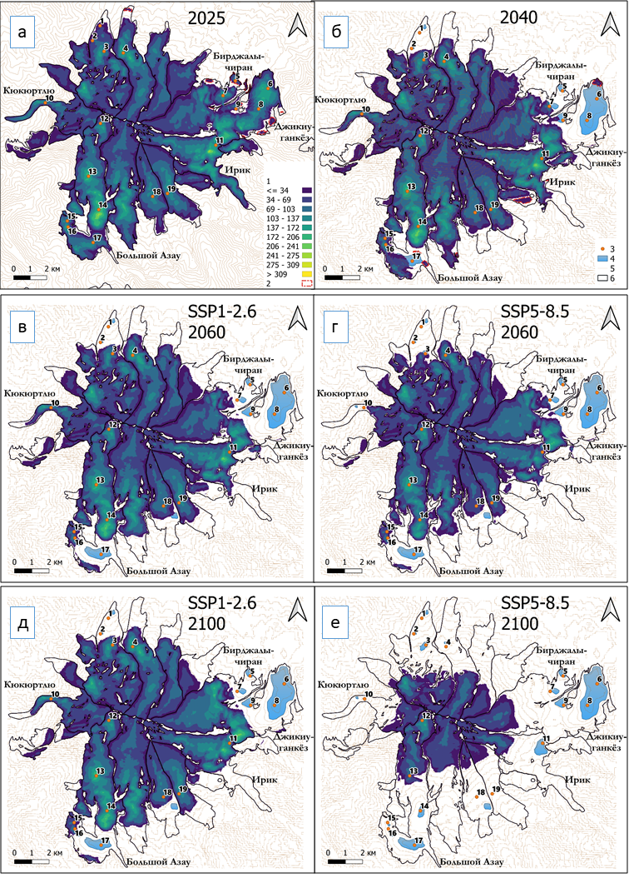
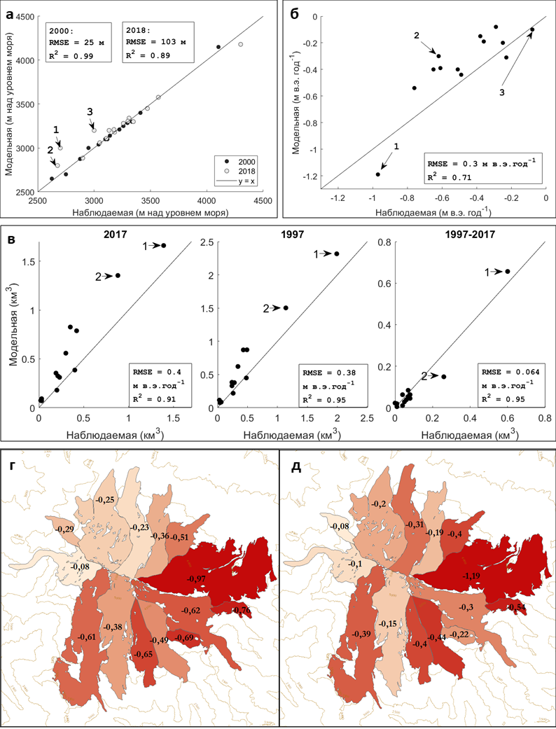
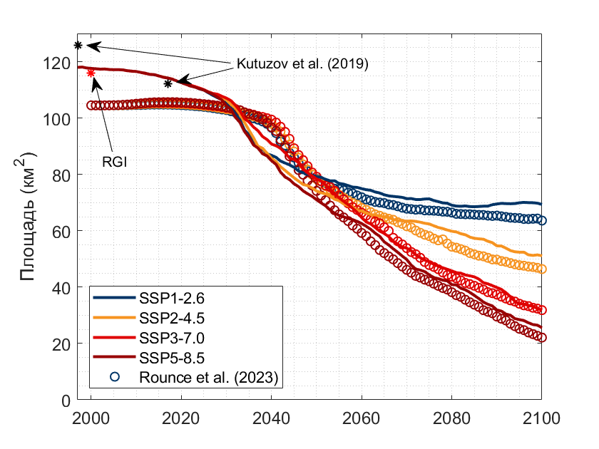
PROJECTIONS OF ELBRUS GLACIERS,
PROGLACIAL LAKES AND DEAD ICE AREAS.
Taisiya Postnikova, Oleg Rybak, Afanasy Gubanov, Harry Zekollari, Matthias Huss
Abstract
Mt Elbrus being the highest peak in Europe (5642 m a.s.l.) is an inactive volcano currently covered by nearly thirty glaciers. Glaciated area is 112.20 ± 0.58 km³ and 5.03 ± 0.85 km³ in volume as revealed by Kutuzov et al., (2019) for the year of 2017. Current and future deglaciation of the Caucasus in general and of the Elbrus glacial massif in particular can be the reason for various negative consequences for the local economy and environment. Therefore, relevant prognostic studies are of great value both for the academicians and for the policymakers.
In this research, we consider probable scenarios of Elbrus glacier change in the 21st century. We mostly focus at the phenomena accompanying degradation of glaciation, such as the formation of glacial lakes and areas of “dead” ice buried under the moraine, which is relevant for predicting Glacial Lake Outburst Floods (GLOFs). Future climate projections, based on SSP1-1.9, SSP1-2.6, SSP2-4.5, SSP3-7.0, SSP5-8.5 scenarios, were employed. Surface mass balance is calculated using temperature-index method (Huss and Hock, 2015). Glacier dynamics is emulated in 1-D global glacier model GloGEMflow (Zekollari et al., 2019) updated by incorporation of the module responsible for the description of debris cover evolution (Postnikova et al., 2023). Model adaptation for Elbrus involves the model transition from colluvial (e.g. slope erosion) to exarational (e.g. emergence of subglacial sediments) debris-cover sources, which aligns with the region's geological setting. These two modes of modelling the debris cover transformation in time are compared. While model validation reveals a slight underestimation of mass loss in the early 21st century, it accurately reproduces general mass loss patterns.
Under the warmest climate change scenarios, almost all of the remaining ice mass in the Central Caucasus will be concentrated on Elbrus. At the same time, Elbrus glaciers are anticipated to retreat above the 4000 m elevation by 2100. In case of moderate warming the position of glacier fronts may stabilize at an altitude of 3600-3700 m. According to our estimates, glacier retreat may lead to the formation of up to 17 new proglacial lakes. Under a moderate warming scenario (SSP1-2.6), up to 8 proglacial lakes may appear. The largest of them is expected to form at the terminus of the Djikaughenkioz ice plateau dammed by debris-covered dead ice in the 2030s-2040s assuming no sufficiently effective runoff channels are established.
This study was funded by the RSF grant number 23-27-00050.
Input
data
Ulluchiran
Karachaul
Ullukol
Mikelchiran
Djikiugankez
Irikchat
Irik
Terskol
Garabashi
Maliy Azau
Bolshoy Azau
Kyukyurtlyu
Bitugtyube
Debris
thickness (m)
Rounce et al.
2021
2023
Debris
flow
calibration
Ice velocity
(Millan et al 2022)
Ice
thickness
Elevation
Change 2000-2019
Hugonnet et al. 2021
Ice flow validatiom
Ice flow calibration
SMB calibration
Methods
Debris cover module (Anderson and Anderson, 2016; Verhaegen et al., 2020, Postnikova et al., 2023)
Climate
SMB Garabashi
Modelled
Measured
DEBRIS COVER
MODULE
Velocity
Climate
Input
data
Surf temp
SMB
Научная новизна
Calculate
SMB:
GloGEM (Huss&Hock, 2015)
corrected by debris cover geometry
Prec
Monthly anomalies compared to present
SMB
Glacier model
Ice
flow
Meltout
Advection
Output to
prefrontal
Update
glacier geometry
and ice thickness:
GloGEMflow
(Zekollari et al., 2019)
MODEL
Update debris cover area and thickness
On Elbrus we neglect slope erosion on the top since it is a conic glacierized volcano
Debris
flow
2006
CALIBRATION
2010
2012
2014
Glacier change, 21st century
Ablation change
Northern Caucasus
Elbrus
Nicholson et al. (2021),) ,
Anne Maussion,
Atelier les Gros yeux
Volume
SMB
Dashed lines =
no debris cover
transformation
Shkheldi
Bezengi
Bed erosion
without debris
Thick lines – median values for each SSP
Debris thickness controlled by velocity slowdown close to the front
Output
$h_{debris}^{∗}=44$ cm
$h_{debris}^{∗}=115$ cm
SMB
SMB
MODULE
Melt correction
$$f_{debris}$$
melt
reduction
PDD + refreezing +debris-cover effect
melt enhancement
$$M_{total}= M_{ice}∙\left(1−\frac{A_{debris}}{A}\right)+M_{debris}∙\frac{A_{debris}}{A}$$
$$M_{debris}=M_{ice}∙f_{debris}$$
For $h_{debris}=2 cm$ melt enhancement from Rounce et al 2021, ~1.4
$$f_{debris}= \left\{\begin{aligned}e^{\frac{−h_{debris}}{h_{debris}^{∗}}}, h_{debris}>2 cm, \\ \sim 1.4 , h_{debris}=2 cm, \\ linear in between \\ 1, h_{debris}=0 cm\end{aligned}\right.$$
SMB
Debris
area fraction
(10)
Debris thickness (11)
Verhaegen et al. (2023)
Proglacial lakes
+dead ice areas
Validation
Ice velocities
(Overdeepening locations were identified in
Lavrentiev et al. (2020))
Debris cover role in these lacation is the highest
Ice front elevation
Ice loss
1 – without debris transformation
2 – dead ice areas
3 – with debris transformation
Ice volume
Conclusions
.
(*)
(*)
Comparison to large-scale studies
(which don’t fit even RGI)
Area
($km^{2}$)
Comparison to Kutuzov et al. (2019)
(*) problems due to wrong RGI outlines for some glaciers
Notes:
In this study, we considered probable scenarios of changes in the glaciation of Elbrus in the 21st century, paying special attention to phenomena accompanying glaciation degradation, such as the formation of proglacial lakes and areas of "dead" ice buried beneath the debris cover, which is important for predicting floods and mudflows associated with glacial lake outbursts.
Future climate projections based on scenarios SSP1-1.9, SSP1-2.6, SSP2-4.5, SSP3-7.0, SSP5-8.5 were used.
Glaciation dynamics were modeled using the GloGEMflow model of ice flow along the flowline (Zekollari et al., 2019), updated by including a module responsible for the description of debris cover transformation in time (Postnikova et al., 2023) explicitly coupled to ice flow.
Adaptation of the model for Elbrus implies a transition from colluvial (e.g., slope erosion) to exarational (e.g., bed erosion and uplift to the surface) sources of debris cover, which corresponds to the geological peculiarities of the region.
According to our calculations, the mass reduction of Elbrus glaciers in 2020-2040 will be twice as fast as in 2000-2020, but after 2035-2040 glaciers may reach a stationary state or start losing mass more slowly.
Glaciers may reach equilibrium with climate before 2060 under the scenarios with the lowest temperature increase SSP1-1.9 and SSP1-2.6.
In this case, the position of glacier fronts is likely to stabilize at an altitude of about 3,600-3,700 m a.s.l.
The Elbrus glaciers retreat 200-300 m higher in 2060 in the SSP5-8.5 scenario compared to the SSP1-2.6 scenario.
By 2100, this difference increases to 500-1000 m (depending on exposure).
Beyond Elbrus, the glaciers of the North Caucasus will almost completely disappear in the SSP5-8.5 scenario.
Only small areas of ice above 4500 m will remain.
When modeling glaciers, taking into account the evolving debris cover, the retreat of some large glaciers is expected to slow down.
The debris cover on Elbrus glaciers such as Dzhikiugankyoz, Kyukyurtlyu, Bolshoi and Maly Azau contributes to the preservation of dead ice underneath.
However, on a regional scale, such a difference cannot play a major role.
Thus, the role of debris cover in slowing down glacier retreat is only temporary and local in nature. Nevertheless, taking into account the evolution of the moraine cover is important from the point of view of predicting the locations of stagnant ice buried under the debris, which can serve as a backwater for potentially dangerous glacial lakes in the absence of sufficiently effective runoff channels.
According to prognostic calculations, first of all, in the 2020s, several lakes are formed at the site of the Birjaly-Chiran glacier, probably underlain by buried ice, which is qualitatively consistent with observations (Dokukin et al., 2022).
The largest proglacial lakes at the site of the Bolshoi Azau Glacier and the Dzhikauganköz Plateau may be formed in recesses below 3500 m a.s.l. by 2040, regardless of the climate scenario. The largest lake on the Jikaugankeuz Plateau site is likely to be underlain by an extensive area of moraine-covered dead ice in the 2030s and 2040s, with dead ice that could reach 60 m thick. It is predicted that the thick Jikiuganköz glacial plateau may border a formed glacial lake around this period, and associated iceberg formation may accelerate glacier retreat.By the end of the century, in case of moderate warming, SSP1-2.6, up to eight lakes may be formed in place of retreating glaciers. At the same time, the formation of at least seventeen new lakes is possible on Elbrus, the location of which was identified earlier in (Lavrentiev et al., 2020). Information on the likely locations of lakes and areas of stagnant ice covered by debris is needed to implement effective early warning systems and develop appropriate mitigation measures to minimize potential impacts on downstream settlements and infrastructure.

