Slide 1
Fault interaction and strain partitioning deduced from deformed fluvial terraces of the Eastern North Qilian foreland, NE Tibetan Plateau
Xiu Hu^{1, 3, 4, 5}, Yiran Wang^{2, 3, 4}, Weitao Wang^{1, 5}, Michael E. Oskin⁴, Youli Li³, Peizhen Zhang^{1, 5}
¹School of Earth Sciences and Engineering, Sun Yat-Sen University, Zhuhai, China
²Earth Observatory of Singapore, Nanyang Technological University, Singapore
³College of Urban and Environmental Sciences, Peking University, Beijing, China
⁴Department of Earth and Planetary Sciences, University of California, Davis, USA
⁵Southern Marine Science and Engineering Guangdong Laboratory, Zhuhai, China
https://www.researchgate.net/publication/378414555_Fault_interaction_and_strain_partitioning_deduced_from_deformed_fluvial_terraces_of_the_Eastern_North_Qilian_foreland_NE_Tibetan_Plateau

Slide 2
Outline
Background
Terrace distribution
Discussion 1: Ages of terraces sequences
Discussion 2: Active tectonics and surface deformation
Discussion 3: Deducing the underlying structure
Discussion 4: Shortening rates and regional structure interpretation

Slide 3
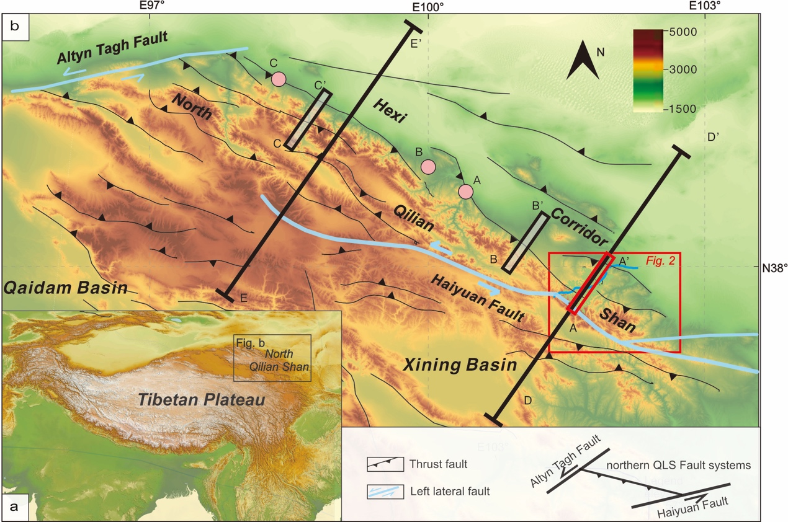
1.1 Question: the tectonic deformation pattern at the margin of Tibetan Plateau?
The distribution of the Crustal Shortening rate of ～5 mm/a？
Hinterland of western segment
1.4 mm/a
Wang et al., 2020
Hinterland of middle segment
2.6 mm/a
Zhong et al., 2020
How about the eastern segment?

Slide 4
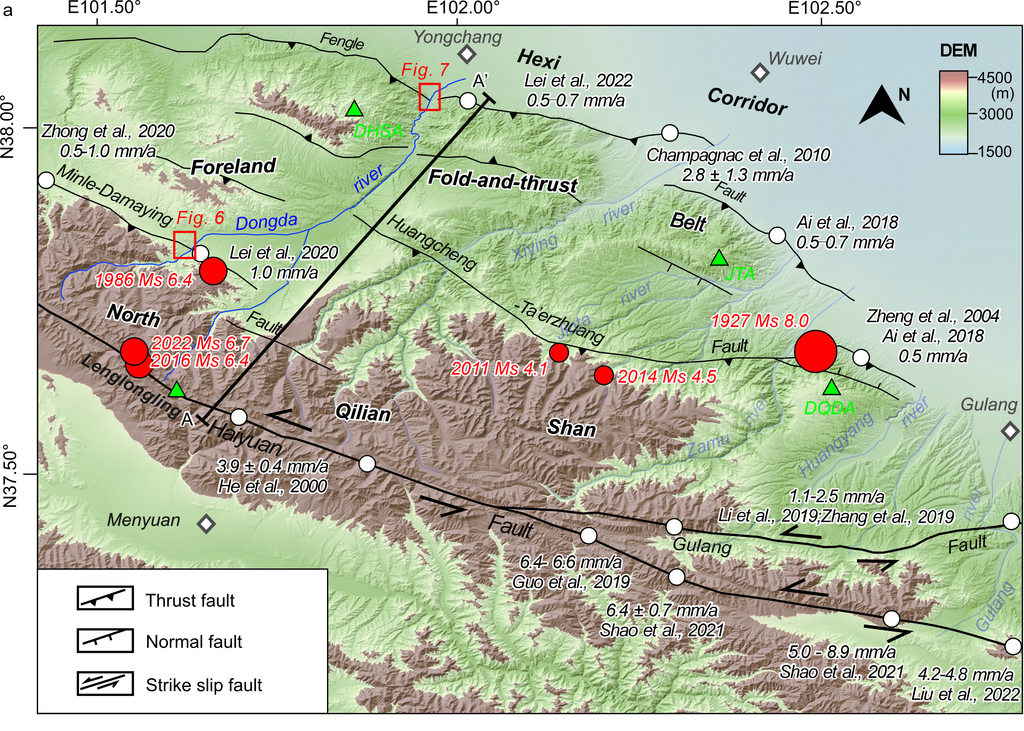
1.2 Regional studies
Active faults
Active folds
How these fold-and-thrust belts interact with each other?
Notes:
Fig. 2.jpg

Slide 5
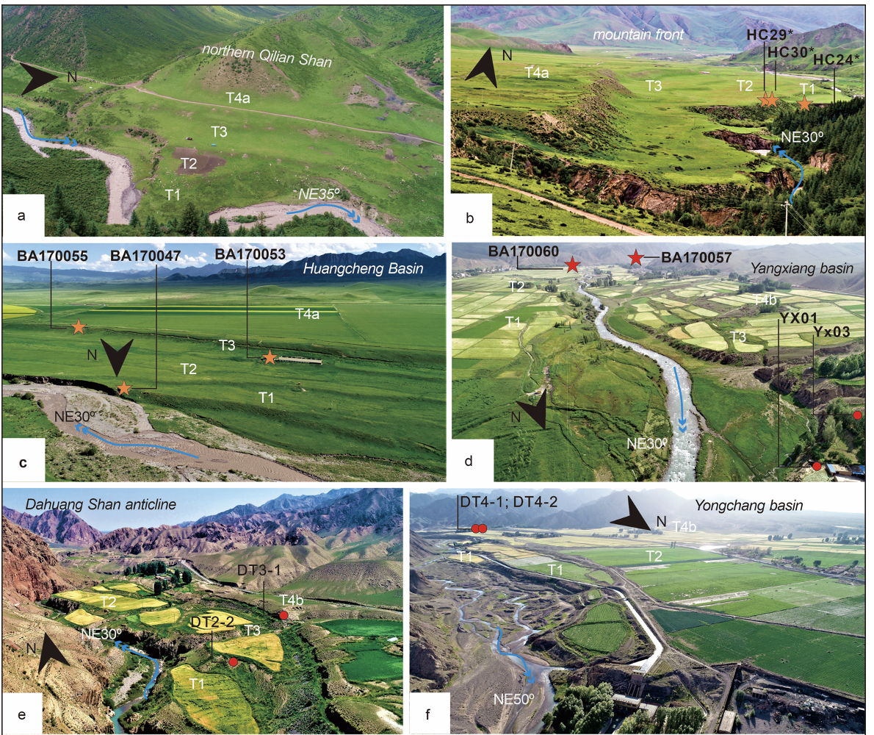
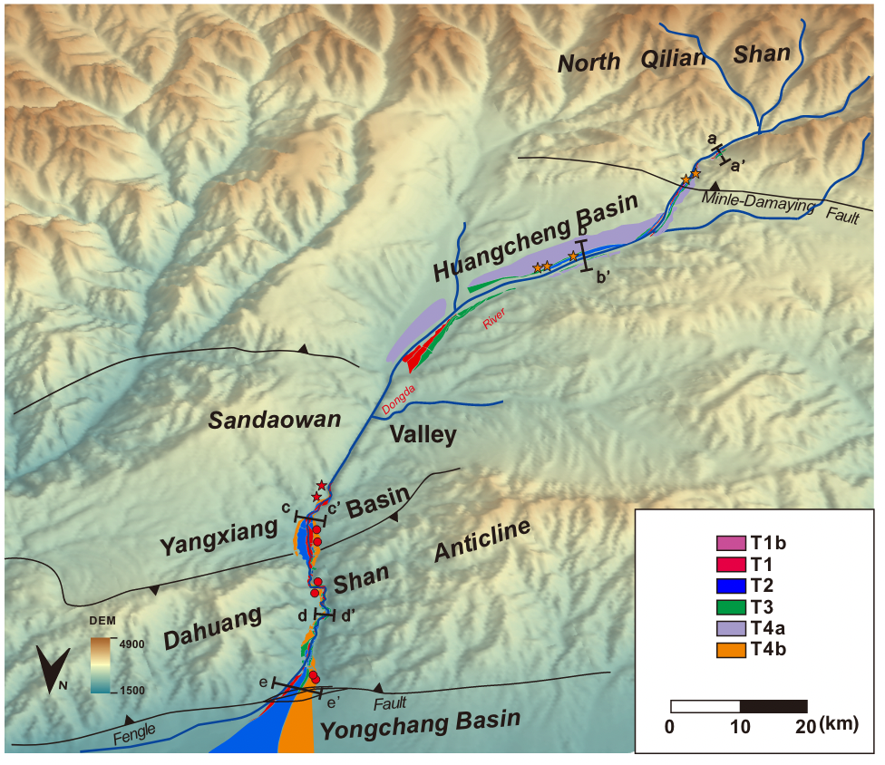
Terrace distribution
2.1 Four terraces tread were identified

Slide 6
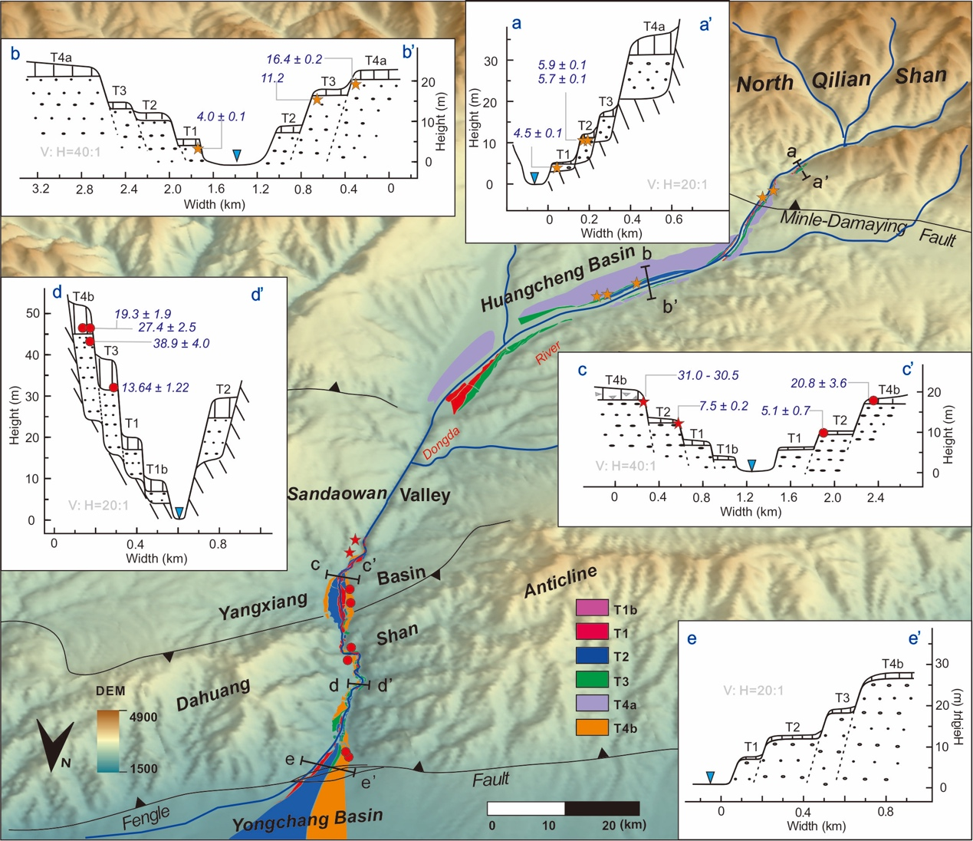
2.2 Terrace structures

Slide 7
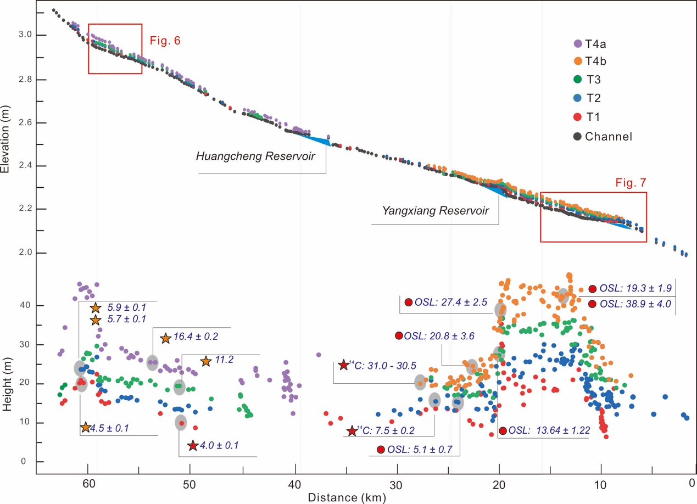
2.3 Longitude profile

Slide 8
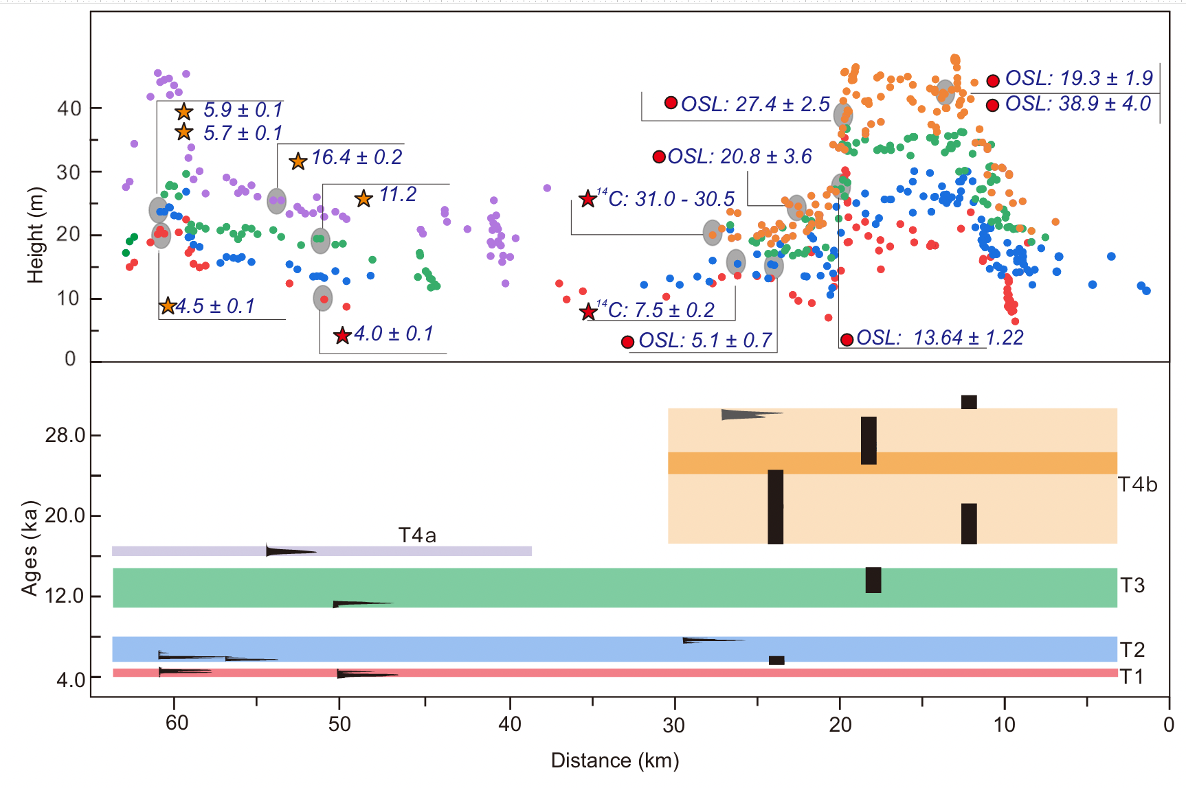
3.1 Ages of terrace sequences

Slide 9
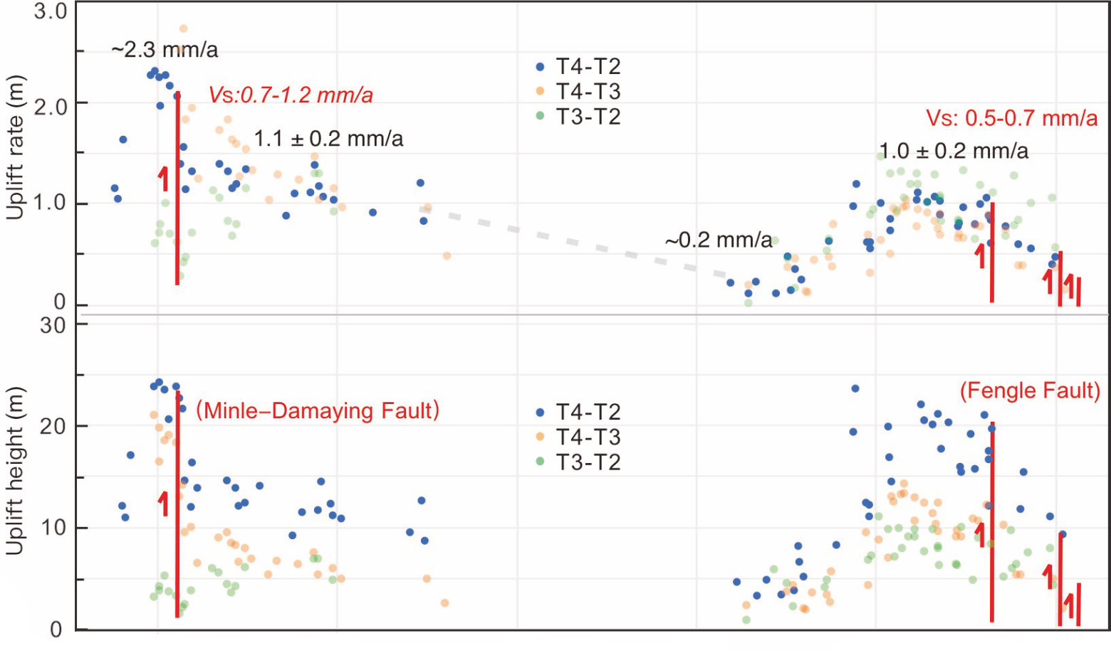
3.2.1 Active faults deduced from the deformed terraces
North Qilian Shan
Dahuang Shan
Huangcheng Basin
Yangxiang Basin

Slide 10
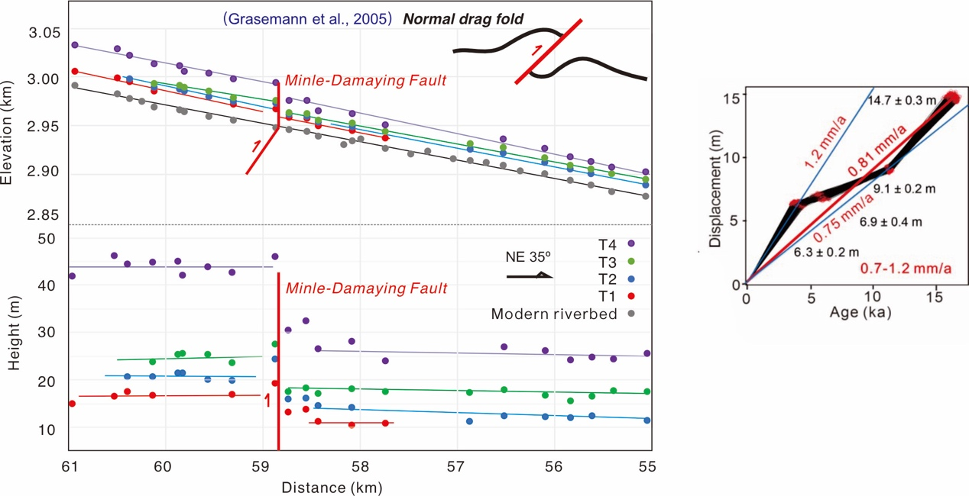
3.2.2 Minle-Damaying fault

Slide 11
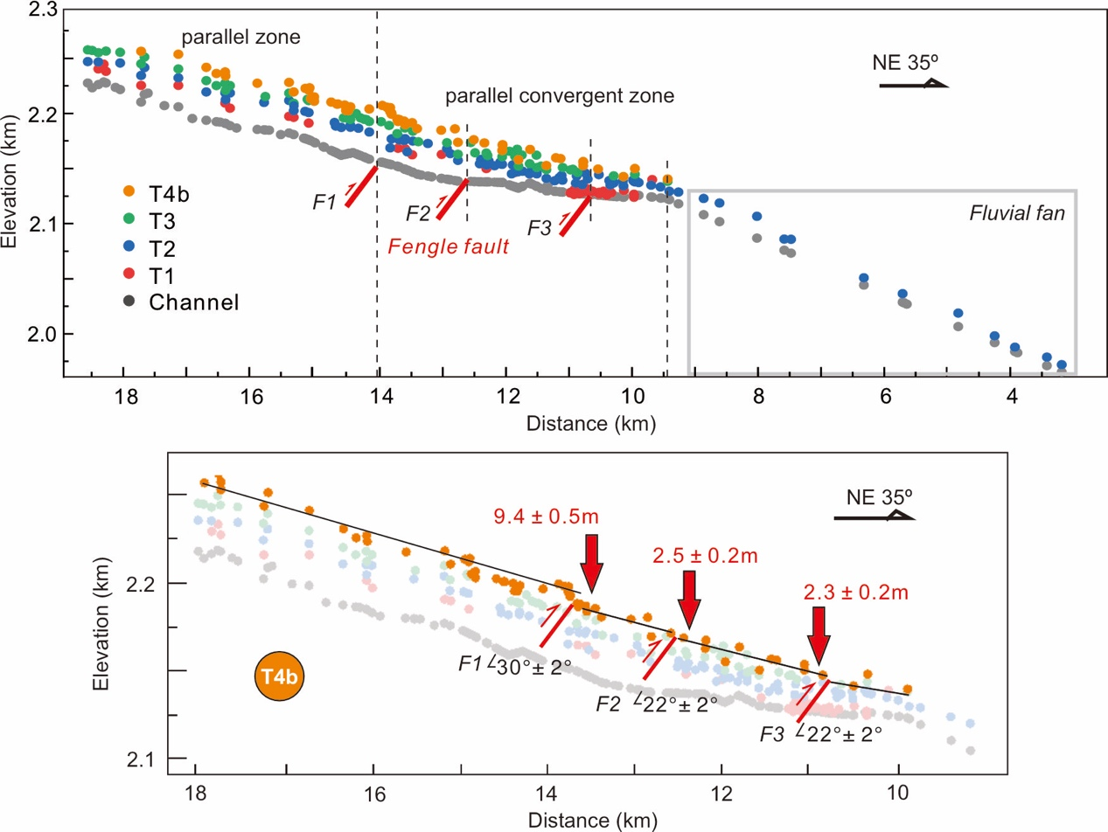
3.2.3 Fengle fault

Slide 12
3.2.4 fault related folding deformation
North Qilian Shan
Dahuang Shan
Huangcheng Basin
Yangxiang Basin

Slide 13
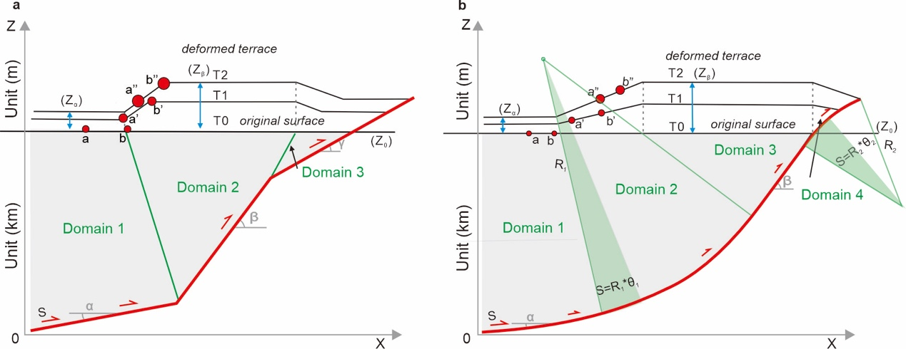
3.3 fault-related folding model
$$slope=\frac{Z_{b^{′}}−Z_{a′}}{X_{b^{′}}−X_{a′}}=\frac{Z_{b^{′′}}−Z_{a^{′′}}}{X_{b^{′′}}−X_{a^{′′}}}=\frac{sinβ−sinα}{cosβ}$$
$slope=\frac{Z_{b^{′}}−Z_{a′}}{X_{b^{′}}−X_{a′}}=\frac{Z_{b^{′′}}−Z_{a^{′′}}}{X_{b^{′′}}−X_{a^{′′}}}=\tan{(tθ)}$
(Suppe,1983)
(Erslev,1986)

Slide 14
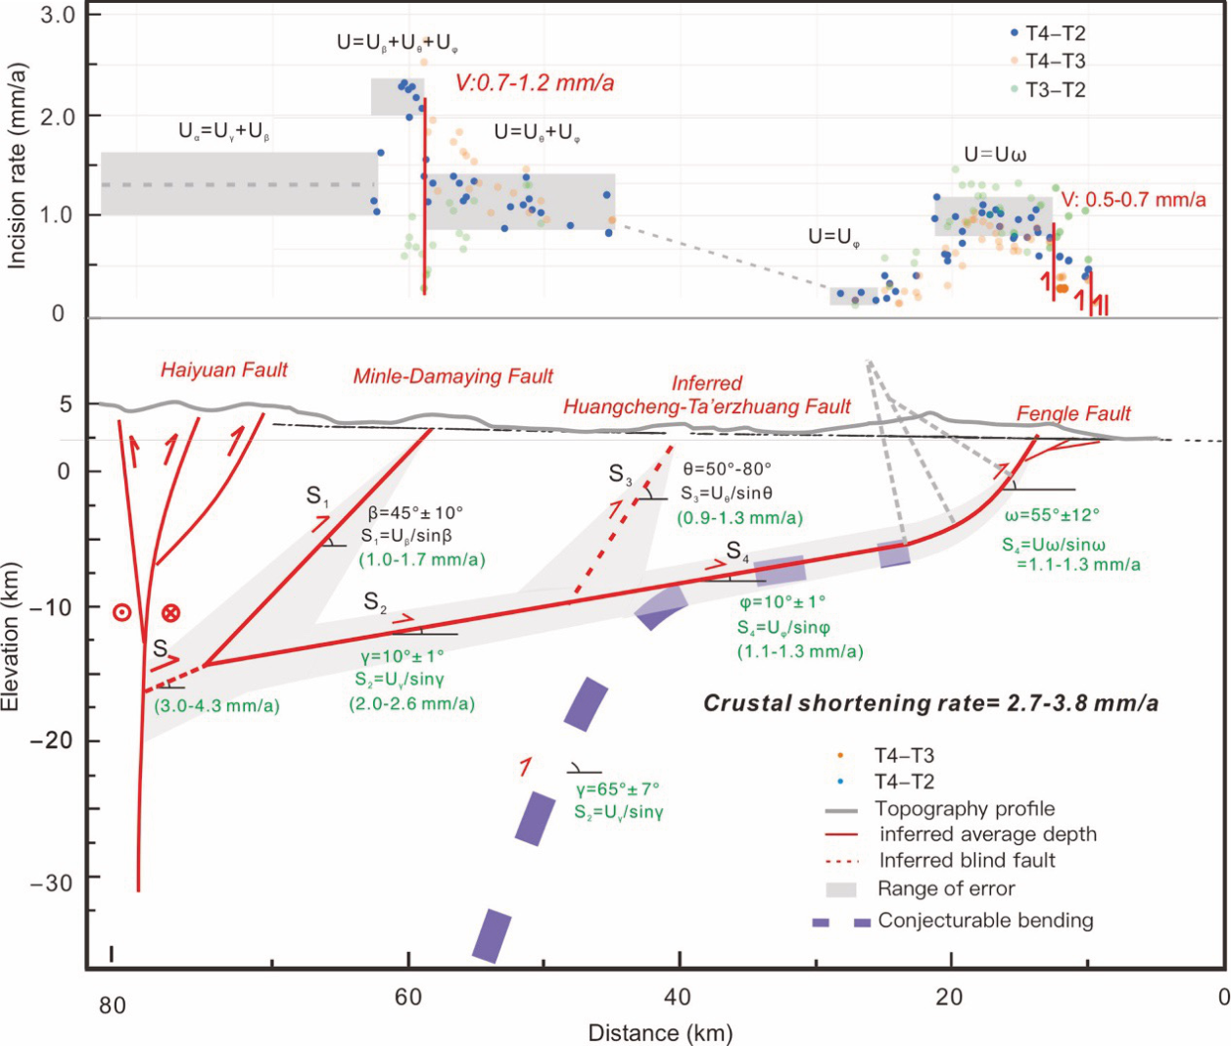
3.3 the underlying structure
the crustal shortening

Slide 15
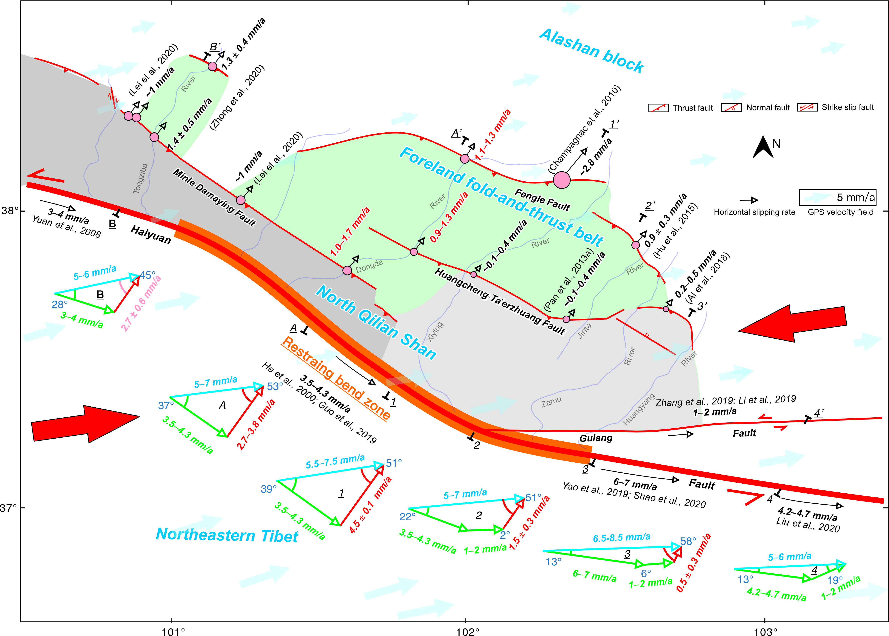
3.4 The regional tectonic deformation pattern

Slide 16
Thank you and that’s all！

