Slide 1
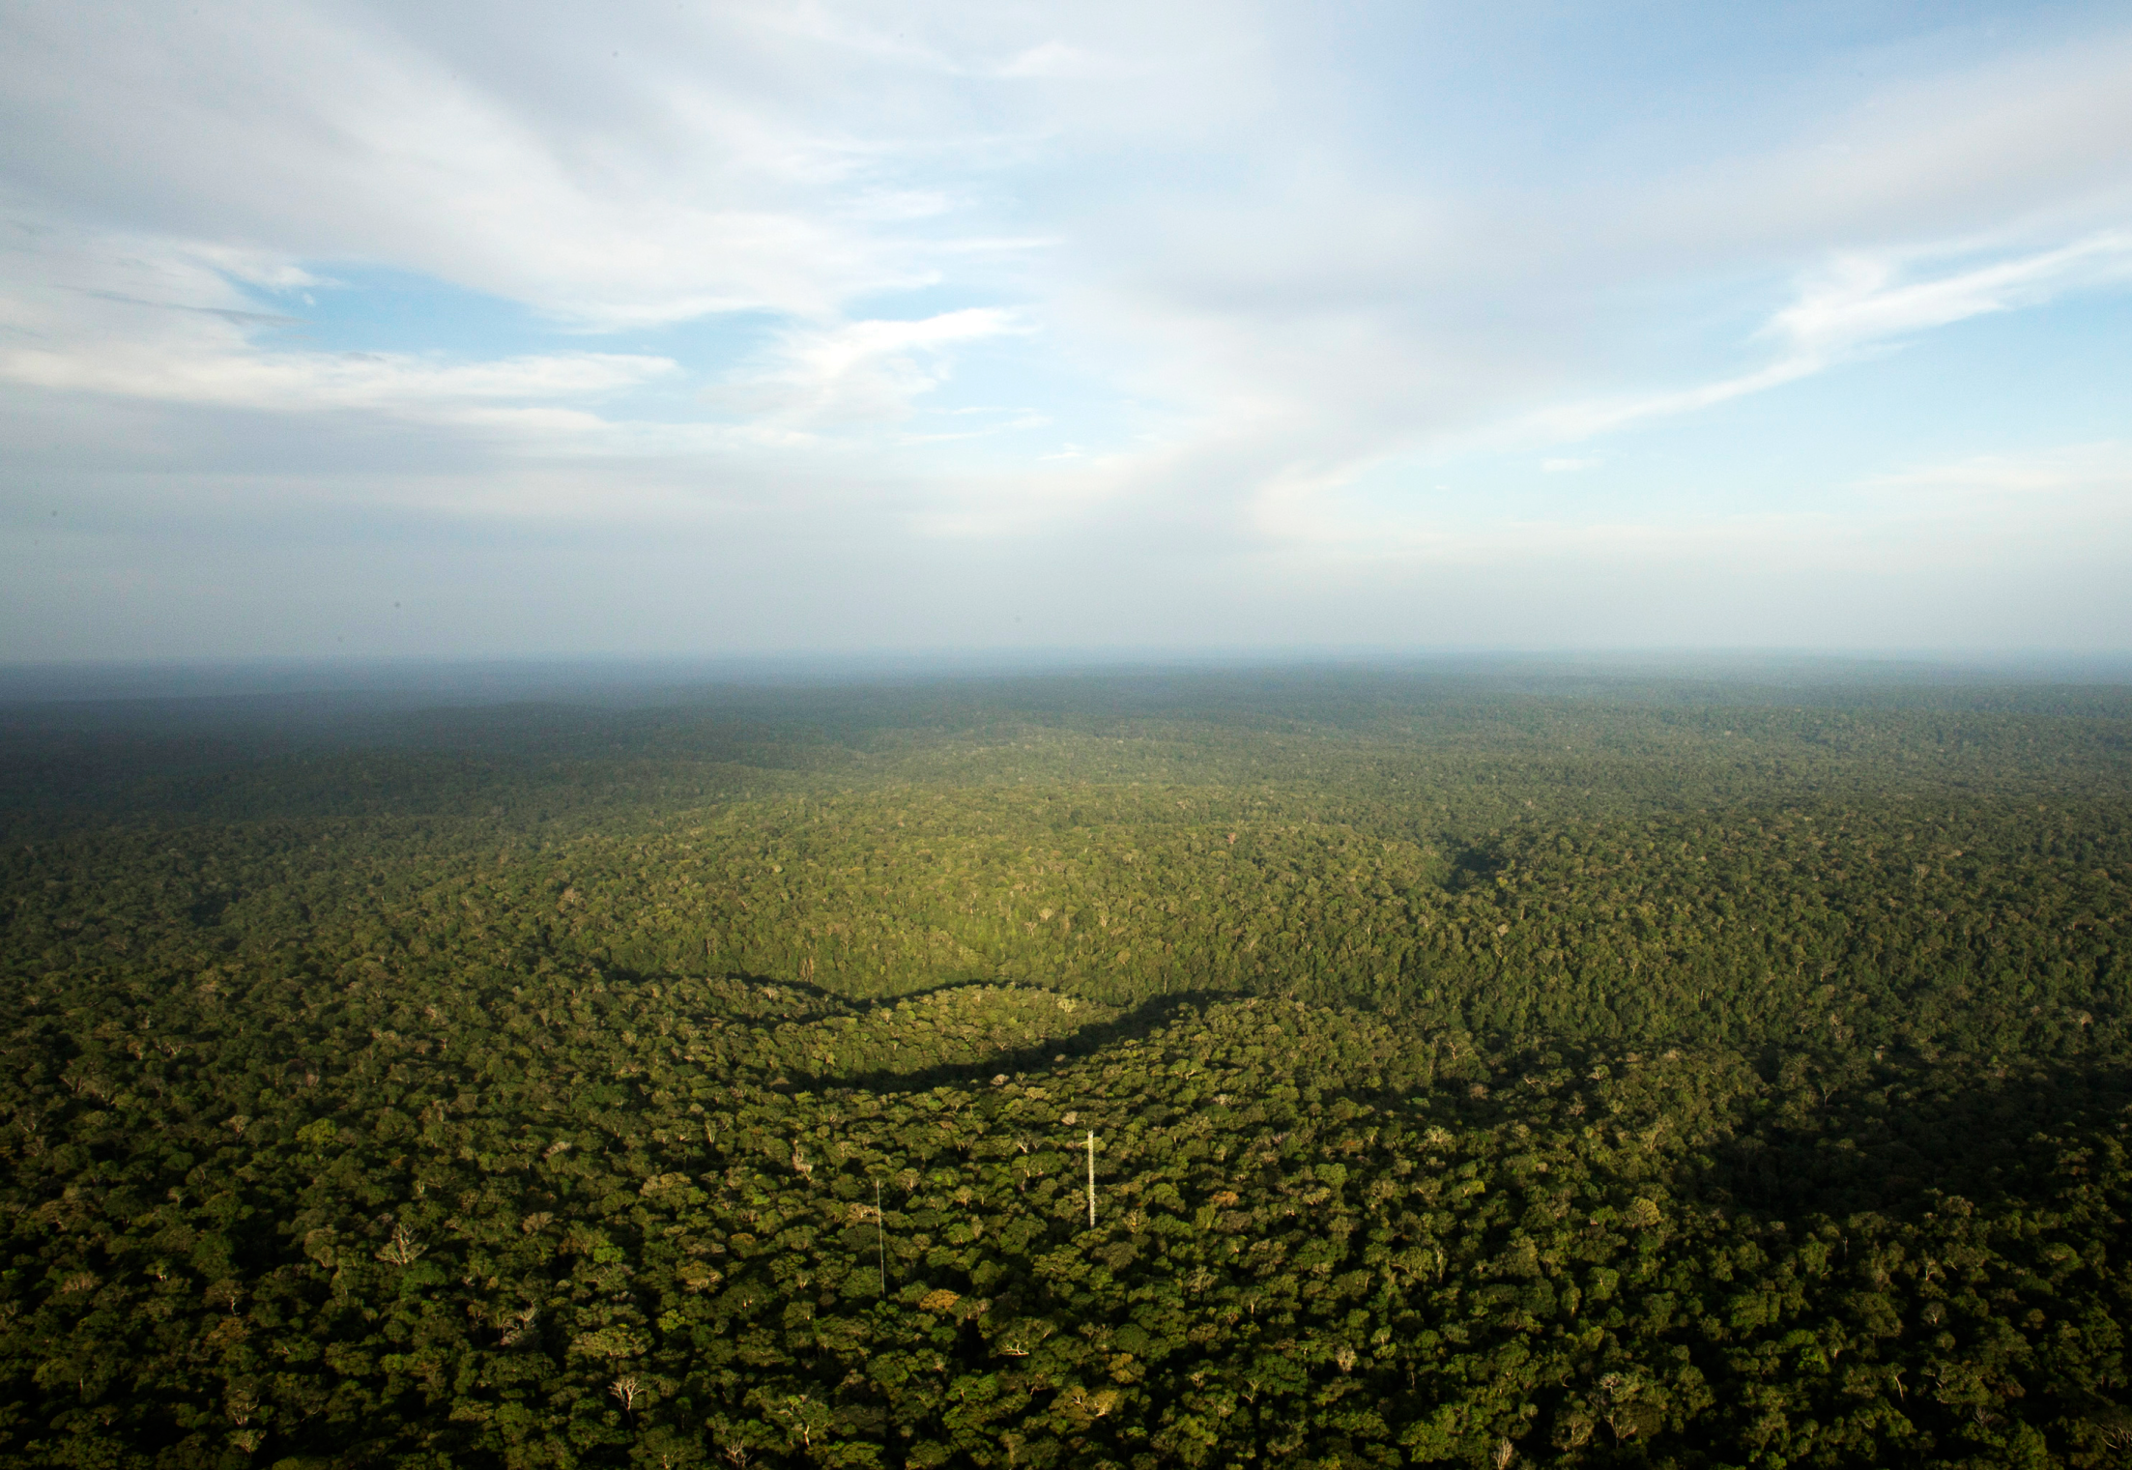



~ Supplemental materials ~
The isotopic composition of atmospheric water vapor during dry season in a central Amazon rainforest: Insights into local moisture recycling
Shujiro Komiya¹, Kazimierz Rozanski², Flávia Durgante³, Sam P. Jones¹, Robbert Moonen⁴, Getachew Adnew⁵, Santiago Botia⁶, Hella van Asperen¹, Cléo Quaresma Dias-Júnior⁷, Iván Mauricio Cely Toro⁷, Fumiyoshi Kondo⁸, Florian Wittmann³ and Susan Trumbore¹
¹Max Planck Institute for Biogeochemistry, Biogeochemical Processes Department, Jena, Germany
²Faculty of Physics and Applied Computer Science, AGH University of Science and Technology, Kraków, Poland
³Institute for Geography and Geoecology, Karlsruhe Institute of Technology (KIT), Karlsruhe, Germany
⁴Institute for Marine and Atmospheric Research Utrecht, Utrecht University, Utrecht, The Netherlands
⁵Nature, Forest and Biomass, Department of Geosciences and Natural Resource Management, Copenhagen University, Denmark
⁶Max Planck Institute for Biogeochemistry, Biogeochemical Signals Department, Jena, Germany
⁷Department of Physics, Federal Institute of Para (IFPA), Belem, PA, Brazil
⁸Japan Coast Guard Academy, Kure, Hiroshima, Japan
EGU 2024
April 18, 2024
Notes:
Hi I’m Shujiro Komya, a project scientist at Max Planck Institute for Biogeochemistry just like Sam Jones. First I would like to thank all collaborators here who contributed to this study.
Today I’m gonna present the results from the intensive joint field campaign in 2022 dry season at the ATTO site in Brazil, and the results are currently in prepared for a manuscript.
Now let’s move on the brief backgrounds.

Slide 2
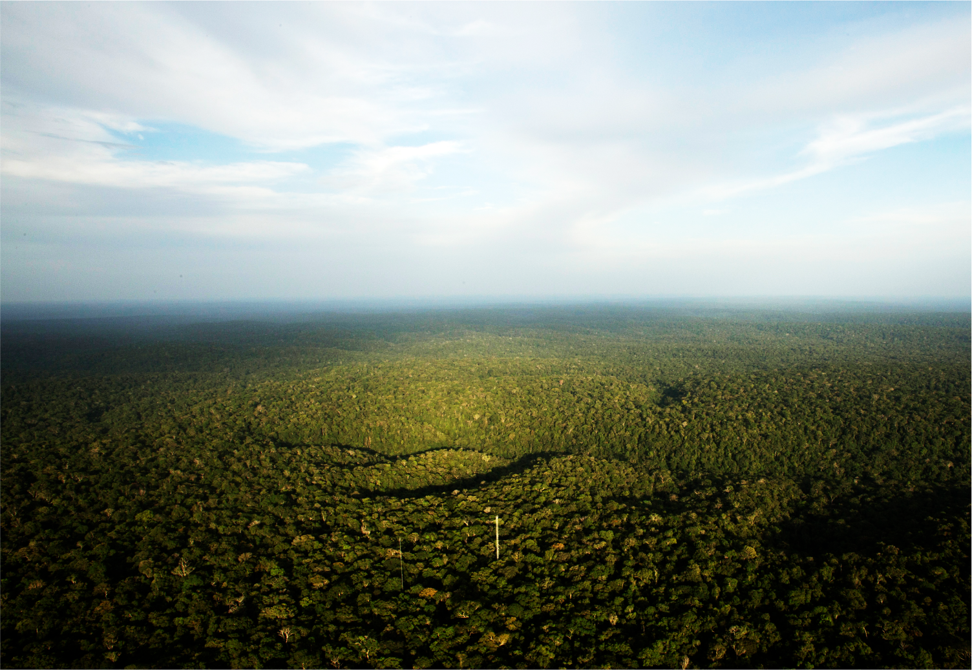
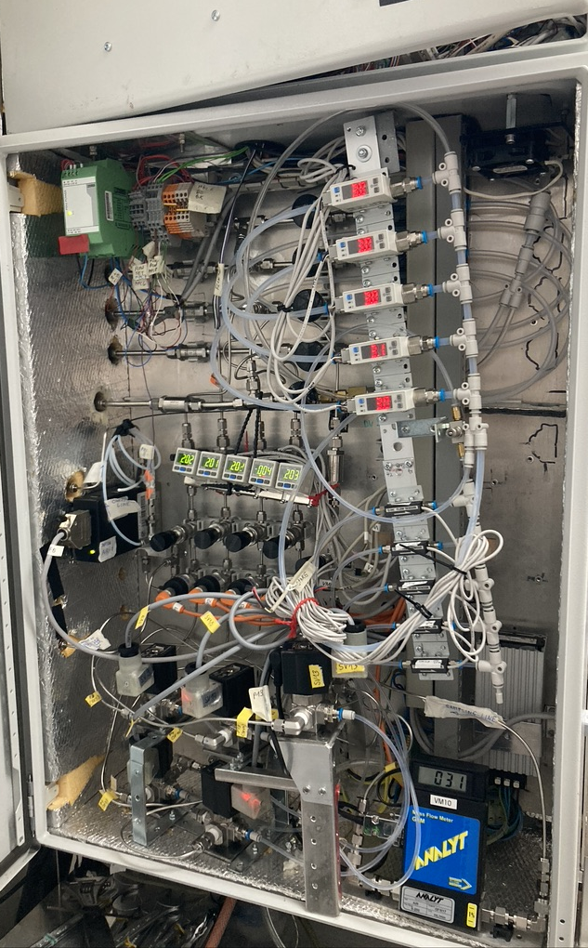
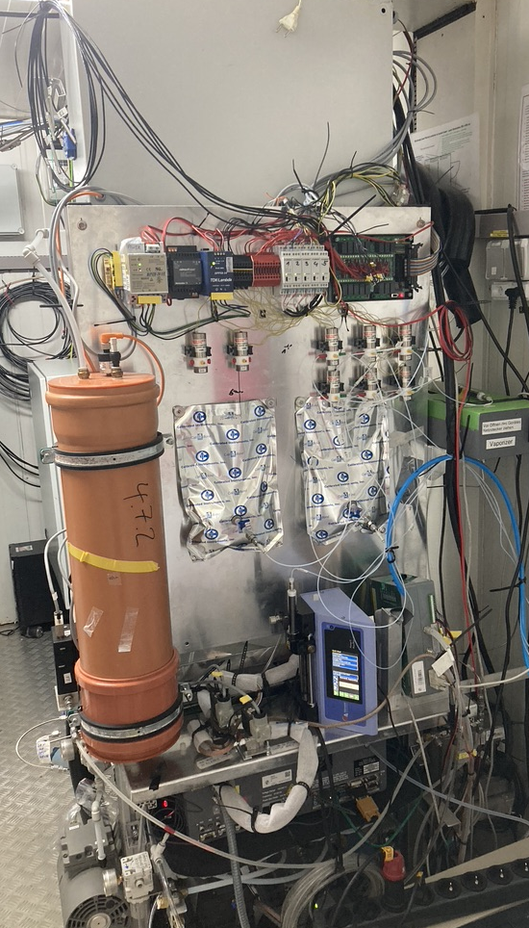
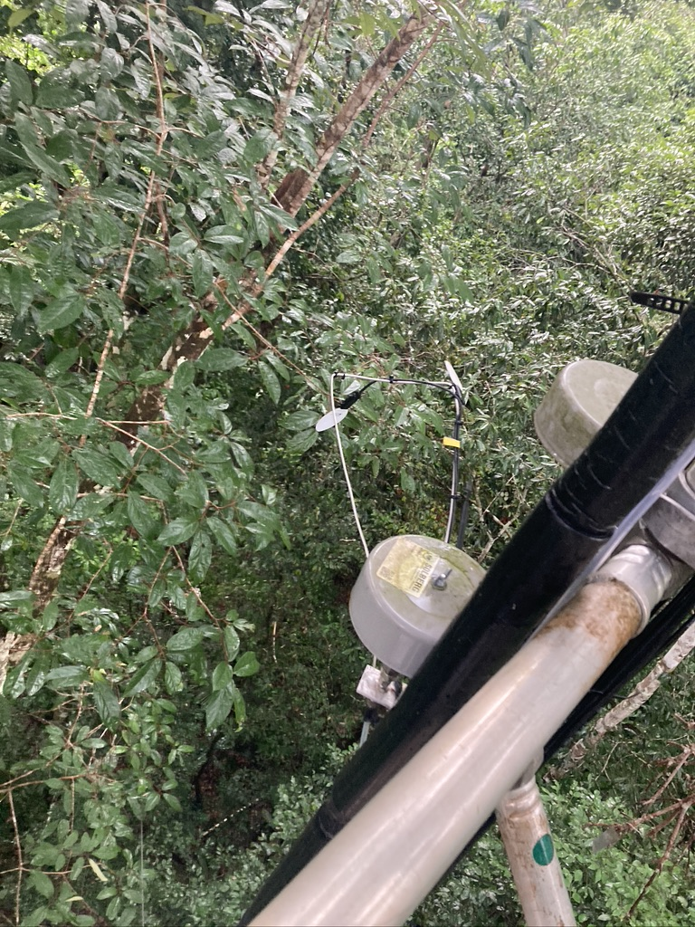
Material & Methods
2
Field campaign period: August 17 to September 5, 2022
80 m tower profile measurement system
Picarro’s L2140-i H₂O isotope analyzer
- H₂O isotopes (δ²H, δ¹⁸O , δ¹⁷O) at 79 m, 38 m, 24 m, and 4 m a.g.l.
Water sampling (δ²H, δ¹⁸O) on August 14-16, 2022 and May, 2018 to Dec., 2020
Leaf and soil water samples, jointly done with CloudRoot team (2022)
Rain, soil and ground water samples from May 2018 to Dec. 2020 by Flávia Durgante
EGU 2024
April 18, 2024

Slide 3
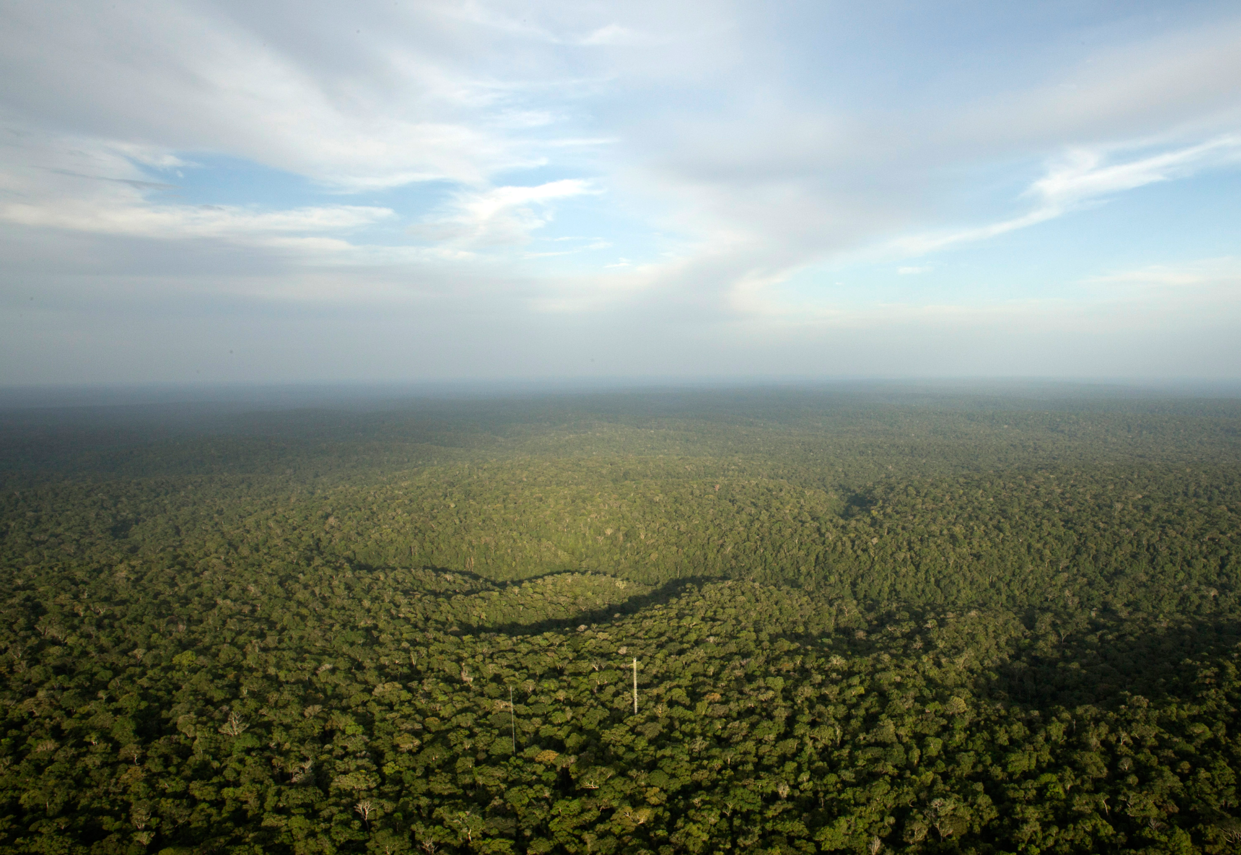
Acknowledgements
3
German-Brazilian project ATTO, supported by the German Federal Ministry of Education and Research (BMBF contracts 01LB1001A and FKR 01LK1602A) and the Brazilian Ministério da Ciência, Tecnologia e Inovação (MCTI/FINEP contract 01.11.01248.00), the Max Planck Society as well as the Amazon State University (UEA), FAPEAM, LBA/INPA, EU FP7 project ICOS-INWIRE (grant agreement n°313169), DLR, Fundacao Eliseu Alves and SDS/CEUC/RDS-Uatumã.
We wish to thank CloudRoot team, Freiland group (esp., Karl, Olaf, Tarek, Christian), Jost Lavric, Uwe Schultz and Thomas Seifert as well as the MPI-BGC Iso-lab (esp., Heike and Heiko), Mike (Michał Gałkowski), and all the people involved in the technical and logistical support of the ATTO project, in particular Viviana Horna, Reiner Ditz, Bruno Takeshi, Thomas Disper, Andrew Crozier, Hermes Braga Xavier and Sipko.
観測開始は来年に期待！
EGU 2024
April 18, 2024
Notes:
Also here I’d like to say thank you for my co-workers, and also helpers, especially for Thomas about ReddyProc’s implementation, and also for our group’s engineers, and all the supporters to help this research.

