Slide 1
Meeting Clean Air Targets could reduce the burden of Hypertension among Women of Reproductive age in India
Taruna Singh¹, Ekta Chaudhary² ,Sagnik Dey^{1,2}, Ambuj Roy³, Santu Ghosh⁴
¹School of Interdisciplinary Research, Indian Institute of Technology Delhi, India
²Centre for Atmospheric Sciences, Indian Institute of Technology Delhi, India
³Department of Cardiology, All India Institute of Medical Sciences Delhi, India
⁴St. John Medical College, Bangalore, India

Slide 2
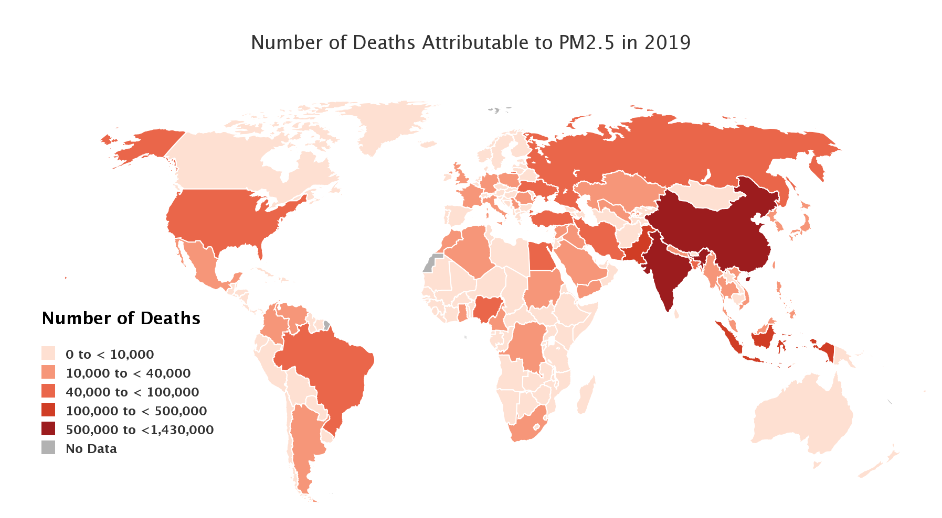
Air Pollution and Burden of Disease
Air pollution is the 4th leading risk factor (Singh et al., 2021)
Asian and African countries have the highest rates of death and DALYs attributable to PM_{2·5}
India's population is exposed to mean PM_{2·5} more than 40 μg/m³ annually (Curto et al., 2020)
Percentage of global deaths from specific causes attributable to total air pollution

Slide 3
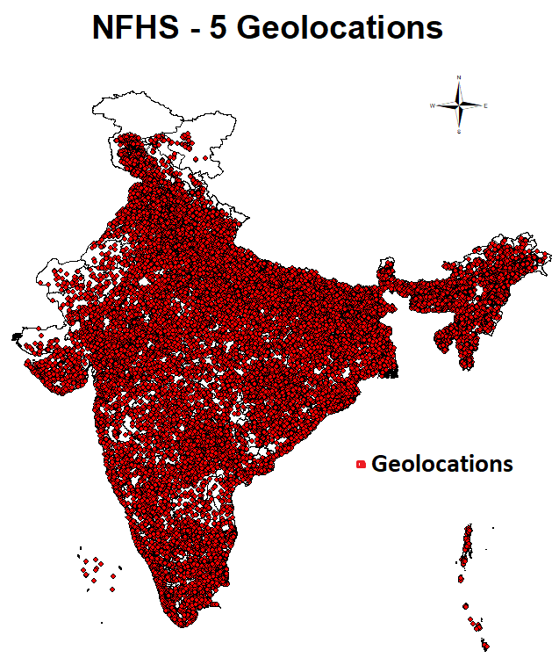
Objectives
NFHS Data Sampling Structure
To study the long-term association between PM_{2·5} and its species and hypertension among women and align it with the sustainable development goal SDG 3 which promotes good health and well-being.
To estimate the Health benefits of meeting Clean Air Targets based on indigenous exposure-response functions.
NFHS - 5 | Information
Population | Women (15 - 49 years age)
Sample size | 7,24,114
Information | 707 districts, 28 states and 8 union territories
PSU | 30,198
PM_{2.5} and its species concentration
Data & Methodology
A satellite-based exposure model was used to assess daily PM_{2.5} concentration (Dey et al., 2020)
Utilizing data from the National Family Health Survey-5 (NFHS-5) and satellite-driven PM_{2·5} exposure, we examined the links between hypertension and PM_{2·5} constituents.
Exposure data extracted for the geo-locations provided in the NFHS 5 data for the 2 years average

Slide 4
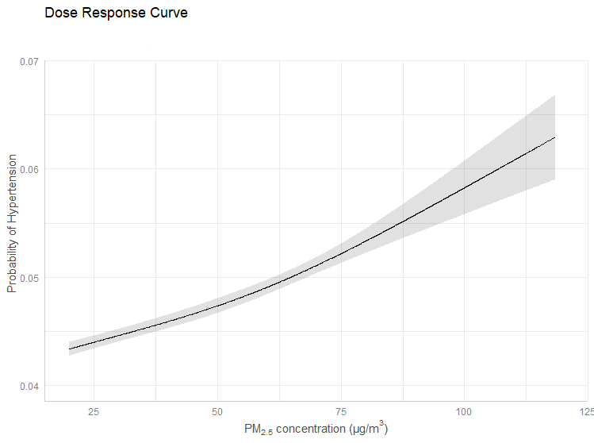
Statistical Analysis
Species | estimate | OR for increase of every IQR (95% CI)
Dust | 0.010 | 1.010 (1.009-1.011)
Black Carbon | 0.069 | 1.071 (1.062-1.081
Organic Carbon | 0.012 | 1.013(1.011-1.015)
Sulphate | 0.069 | 1.071 (1.062-1.081)
Logit(P(hypertension)) = β0 + β1 * PM_{2.5} + β2 *X2+ β3 * X3 + βn * Xn
β1, β2, β3: coefficients associated with respective variables
PM_{2.5}: represents the level of PM_{2.5} exposure
X2,X3: covariates
Results
With the increase in 10 µg/m³ PM_{2.5}, the risk of developing hypertension increased by an odds ratio of 1.052 (95% CI: 1.048-1.057)
Exposure-response curve developed between ambient PM_{2.5} and hypertension

Slide 5
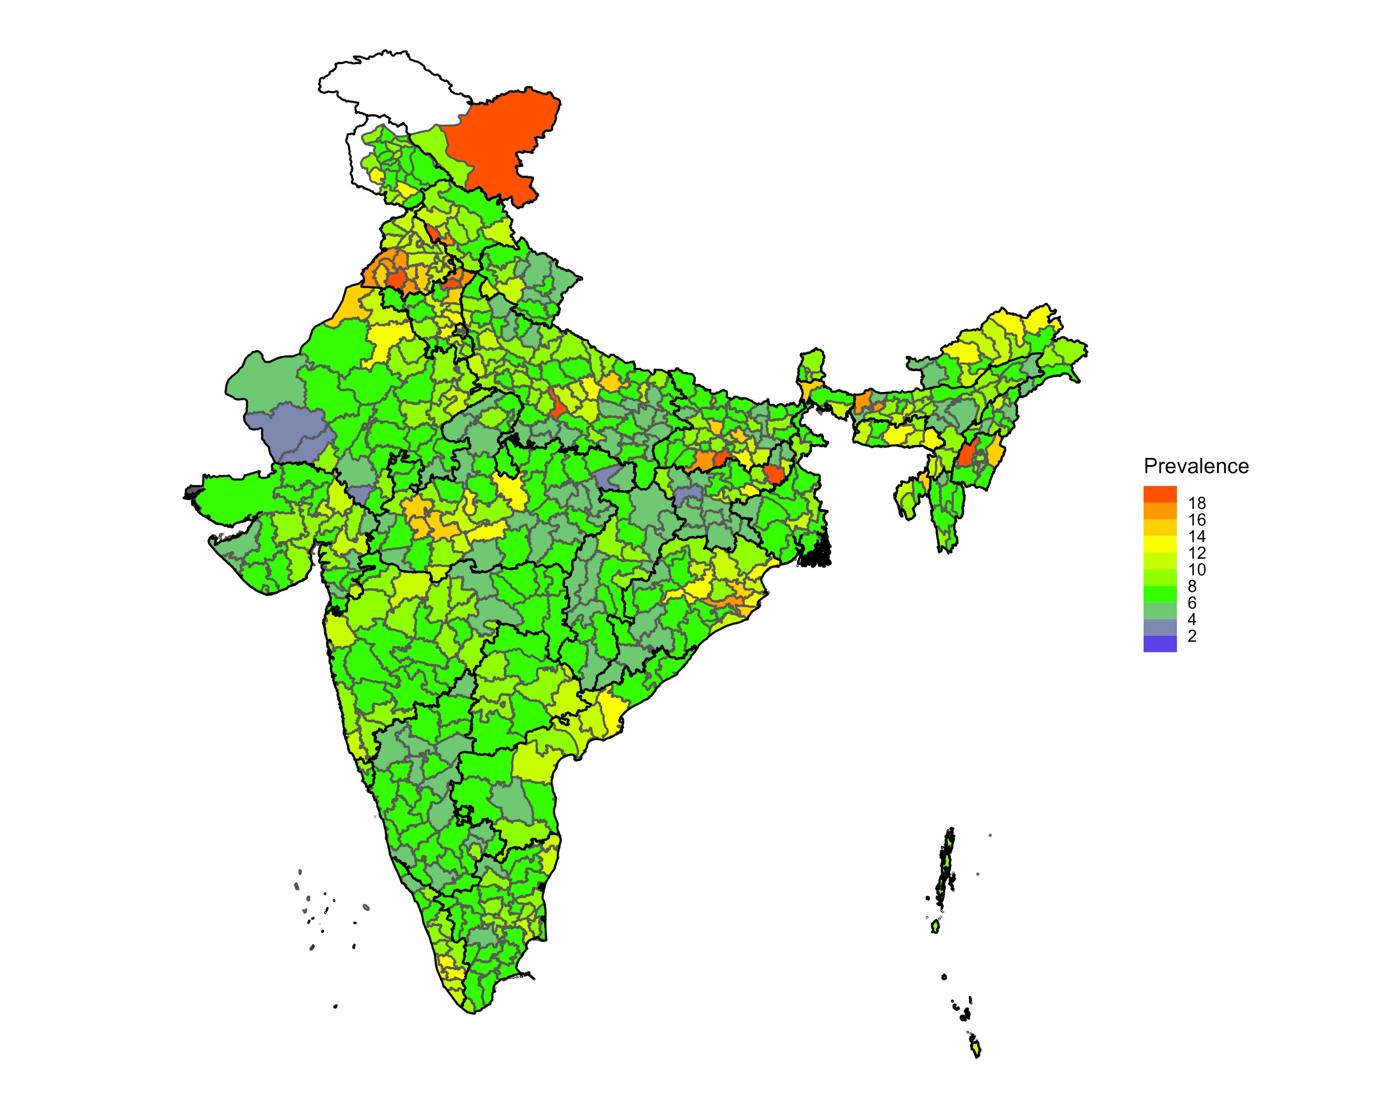
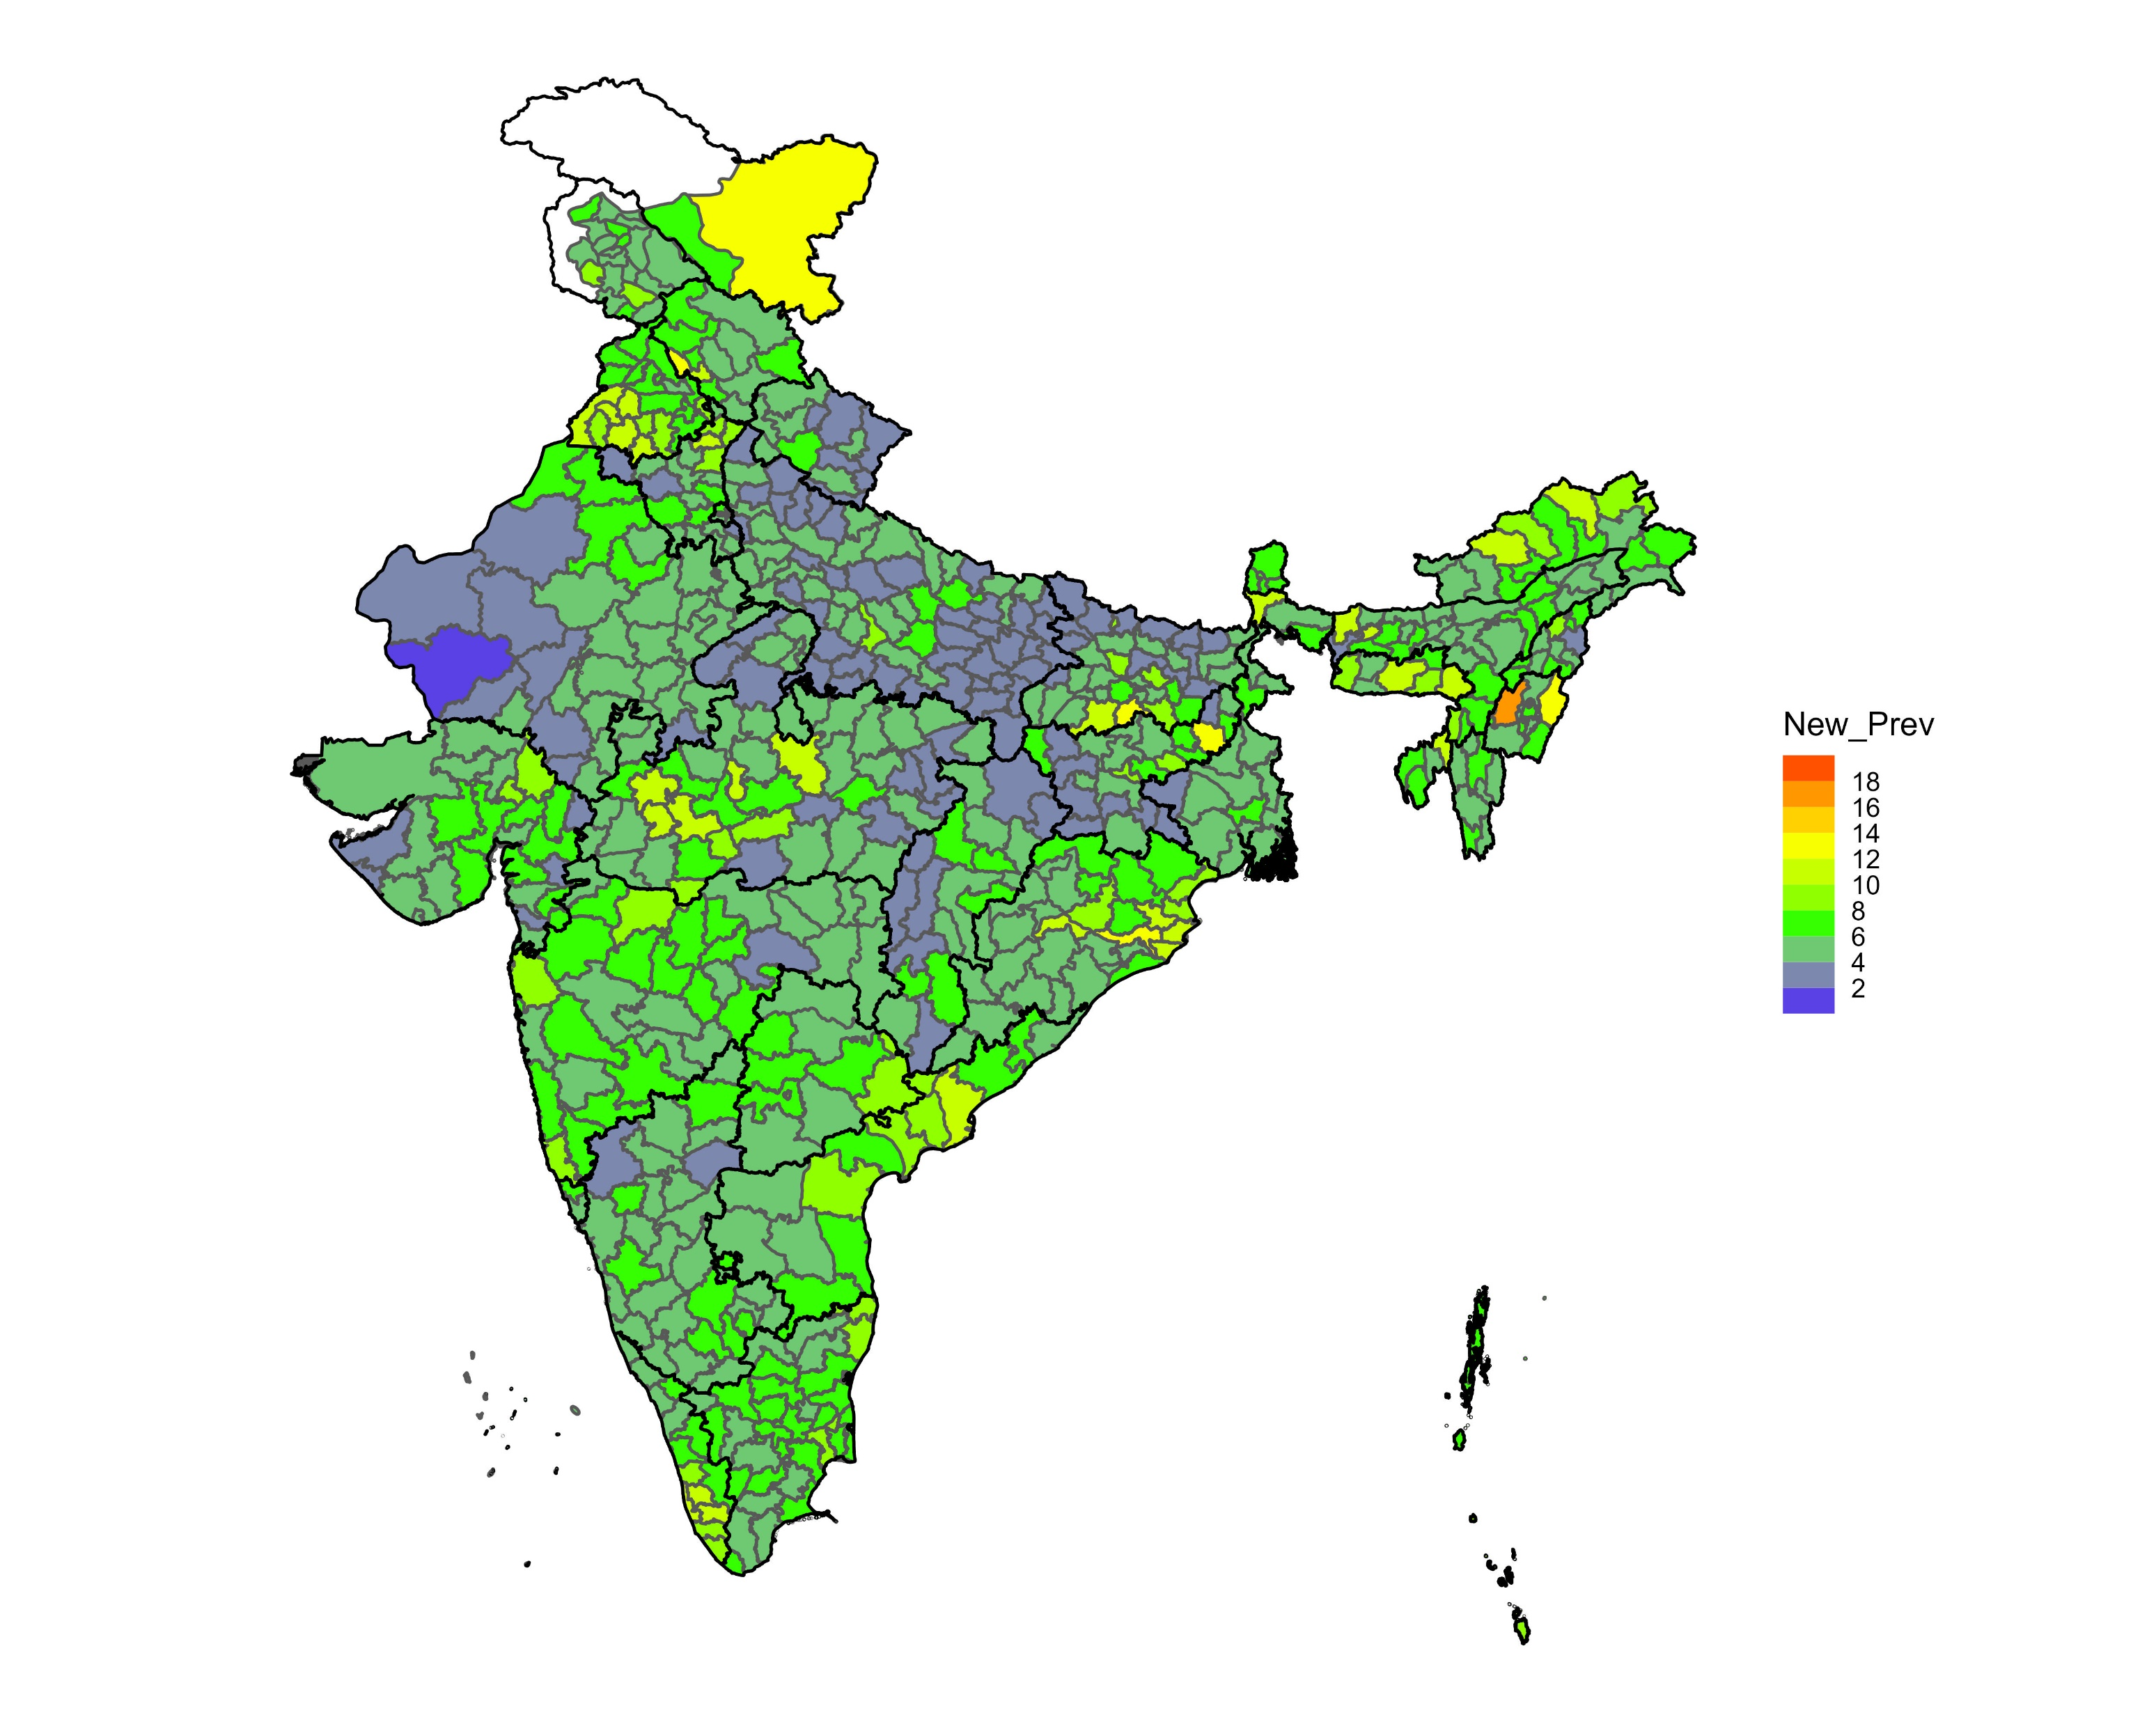
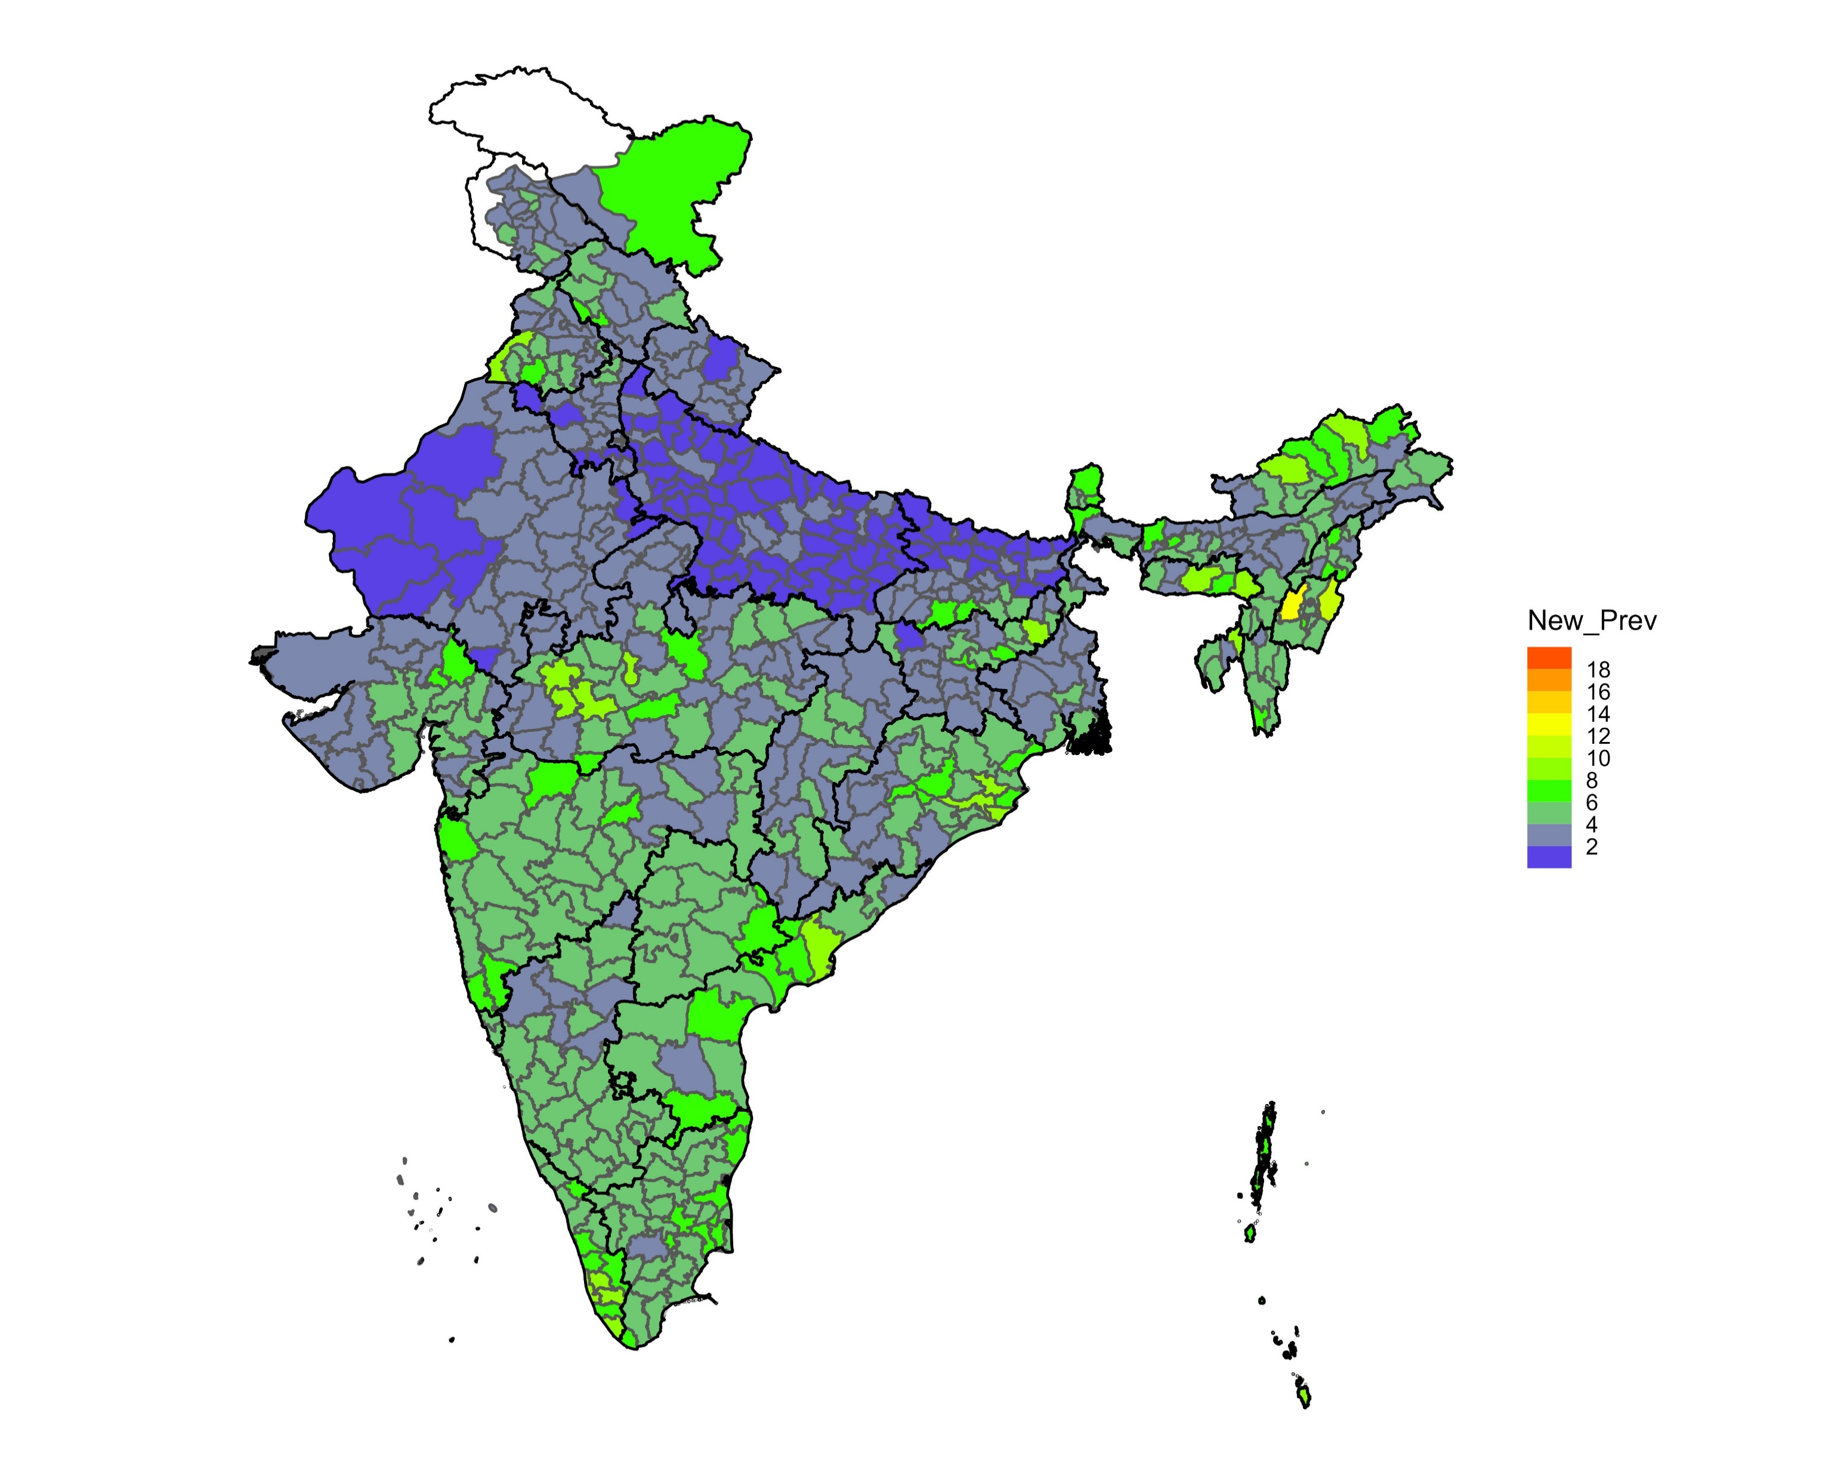
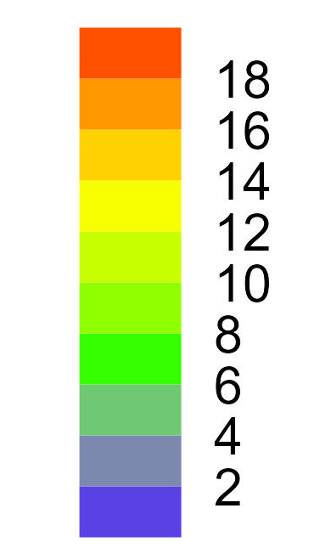
Health Benefits of Clean Air Targets
Benefit Calculation
Relative Risk (RR) = exp[log(OR) * Δ PM_{2.5}]
Attributable Fraction (AF) = (RR-1)/RR
Benefit (B) = AF * Prevalence
Policies implemented | Average hypertension prevalence (%)
(A) Overall Hypertension Prevalence | 8.23
(B) After NCAP | 5.81
(C) WHO | 4.02
Prevalence (%)
Hypertension Prevalence
Hypertension prevalence reduction if districts meet the target
Prevalence reduction if districts meet the WHO air quality guidelines

Slide 6
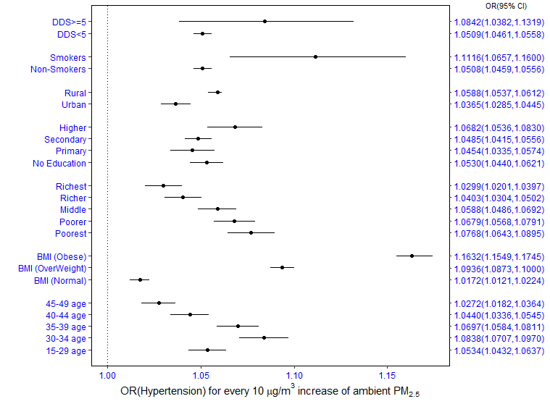
Assessing Individual Level Effect Modification
Effect was 11% more on smokers
Hypertension cases decreased when moving from poorest to richest
Individuals under the category of obese had a higher prevalence of hypertension

Slide 7
A 10 µg/m³ increase in PM_{2.5} was associated with a rise of 5.2% chances of hypertension in the individuals.
Evidence of effect modification by socio-economic conditions, suggests a more significant impact of PM_{2.5} on Hypertension belonging to the poorest wealth index.
District scale health benefits analysis suggested hypertension prevalence would be reduced to 2.42 % if each district met the NCAP target and 4.21% if each met the WHO target.
Conclusion

Slide 8
THANK YOU
Questions/suggestions
Taruna Singh
srz218423@iitd.ac.in
Indian Institute of Technology Delhi

