Slide 1


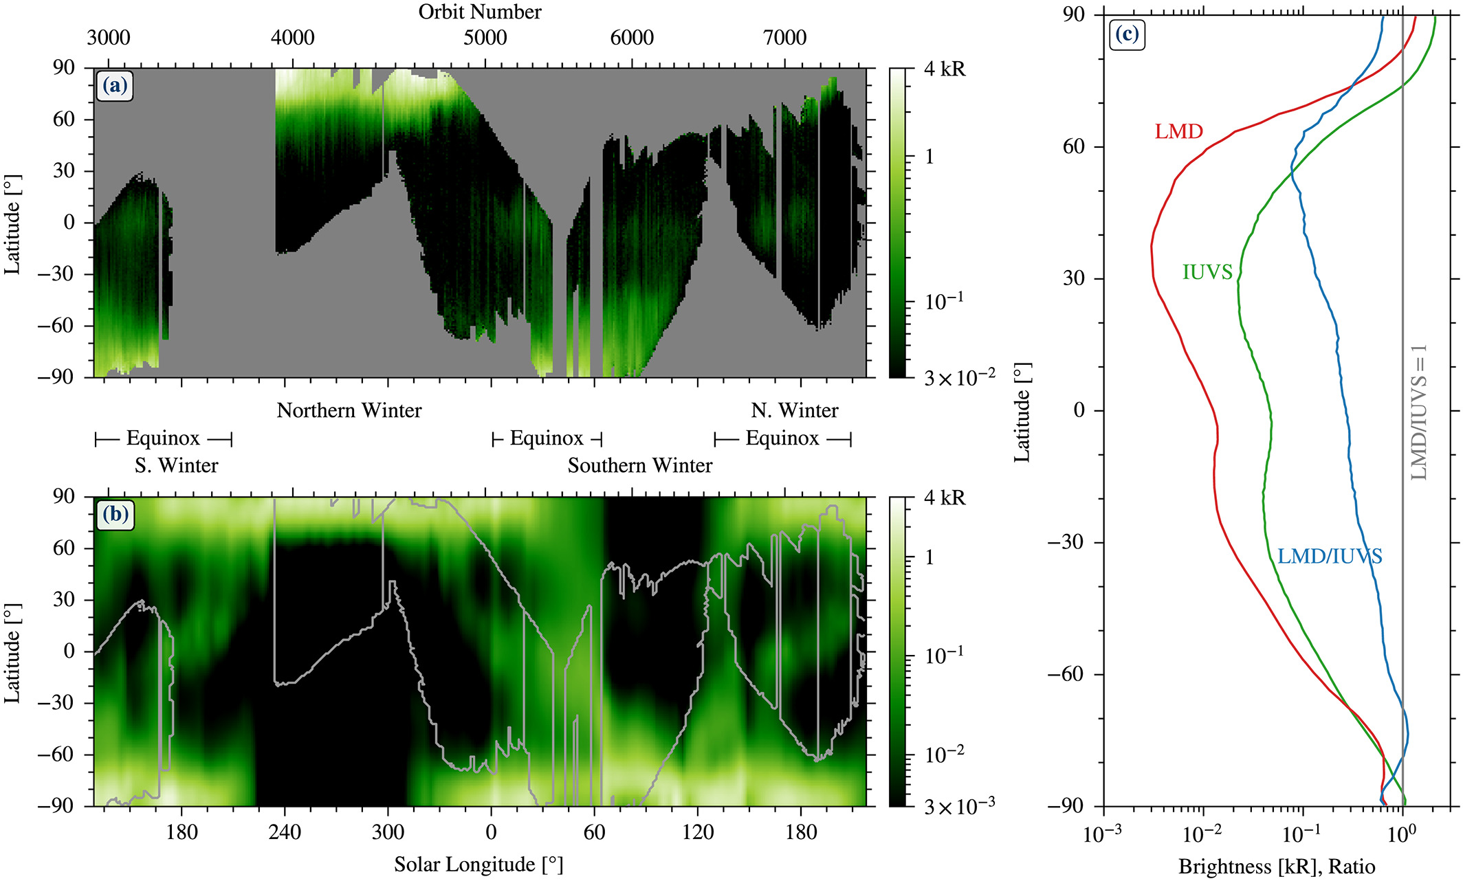
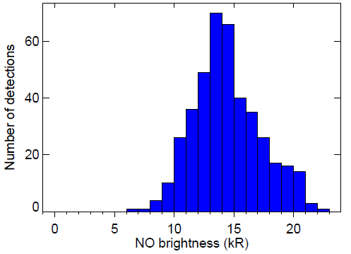
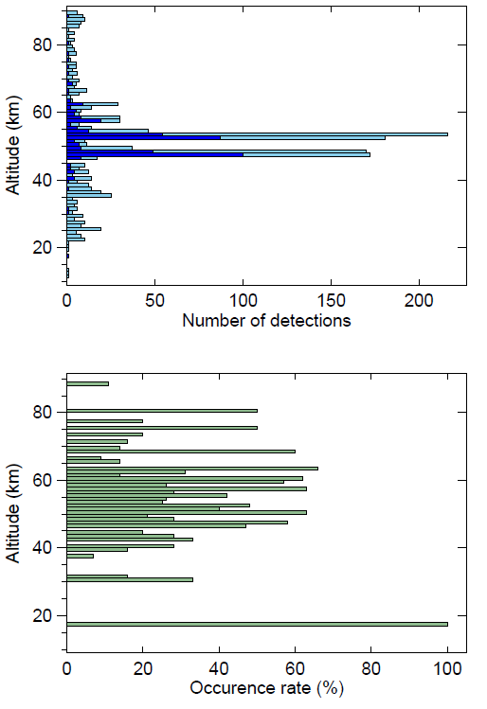
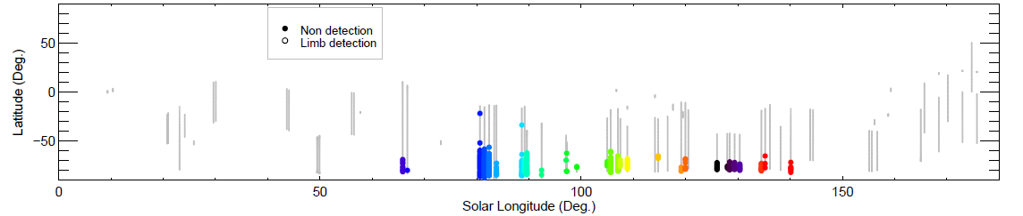
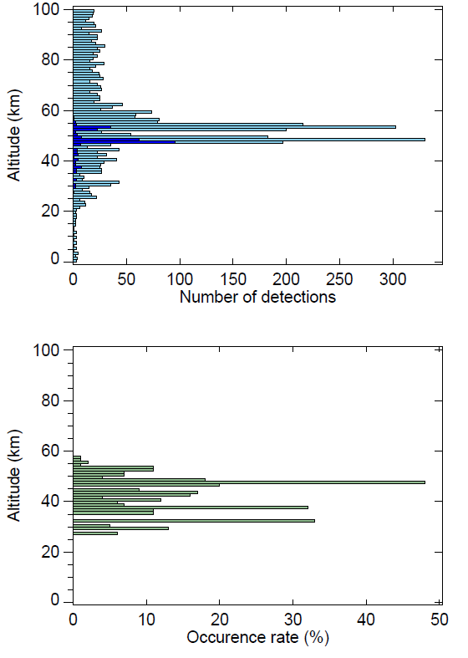
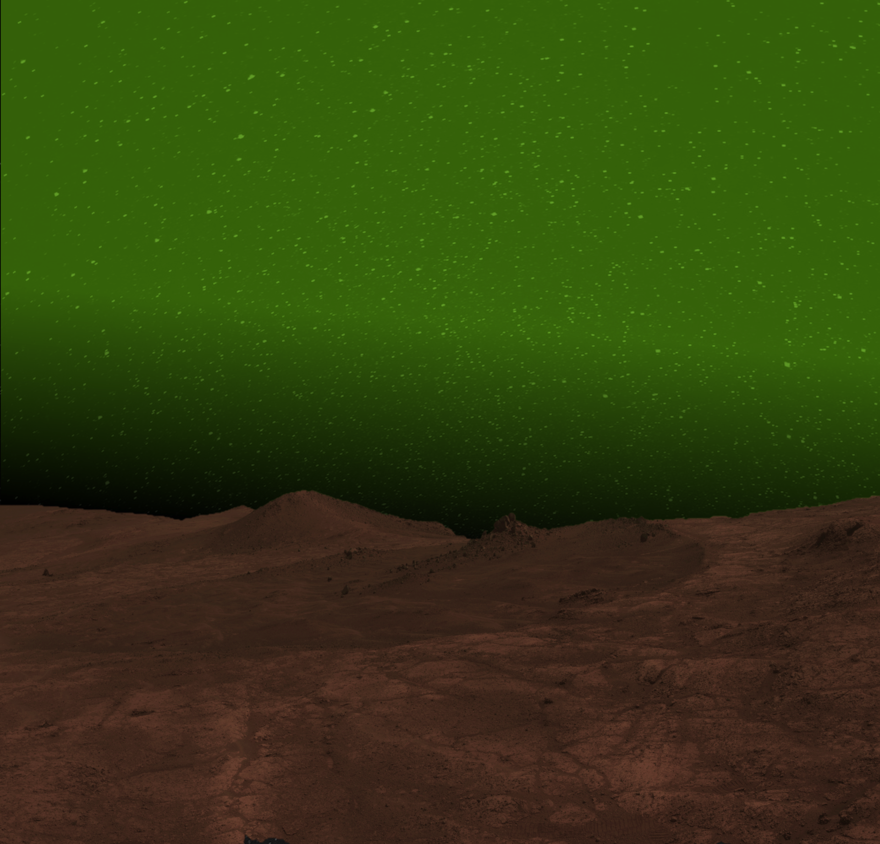
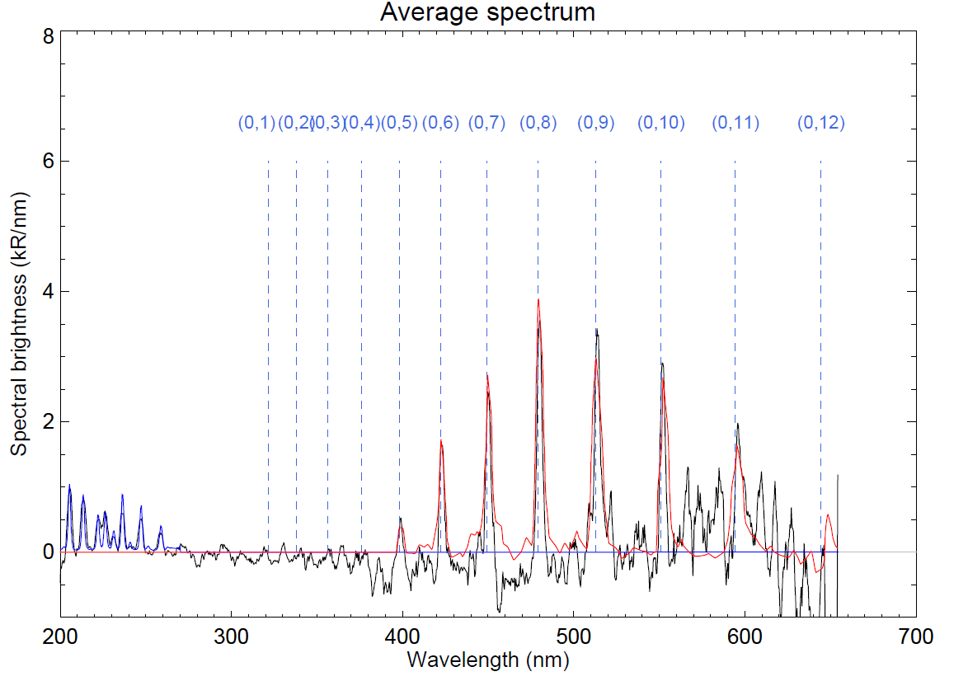
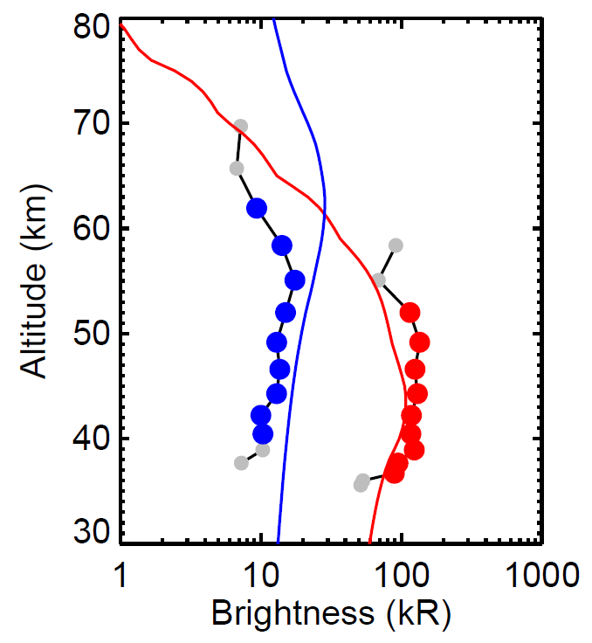
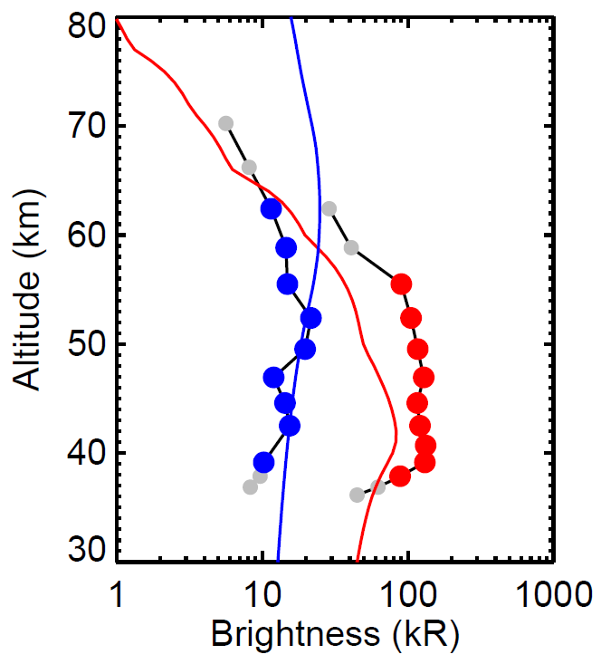
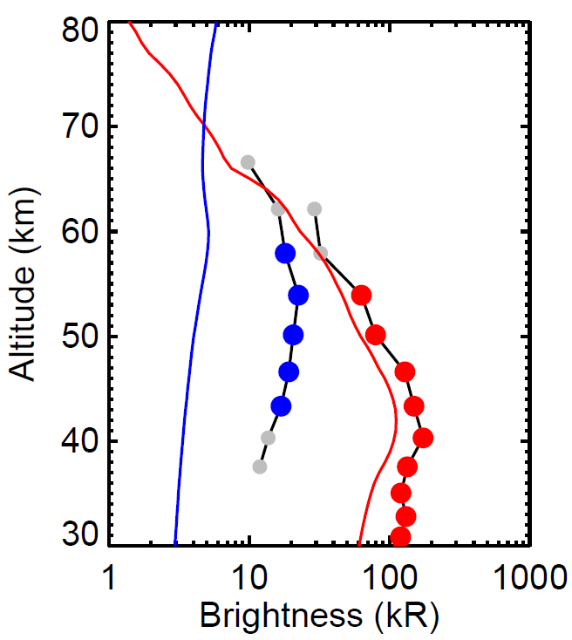
Probing the Mars upper atmosphere through simultaneous NOMAD/UVIS observations of the NO ultraviolet and O₂ visible nightglow
Lauriane Soret¹, J.-C. Gérard¹, F. González-Galindo², I. R. Thomas³, B. Ristic³, Y. Willame³, A. C. Vandaele³, B. Hubert¹
EGU2024
PS1.8
¹LPAP, STAR institute, Université de Liège, Belgium, ²Instituto de Astrofìsica de Andalucía - CSIC, Granada, Spain, ³Royal Belgian Institute for Space Aeronomy, Brussels, Belgium
1 – Introduction
So far, only the ultraviolet and infrared emissions have been investigated on the nightside of Mars (MEx and MAVEN). The middle ultraviolet spectrum is dominated by the v’=0 δ and γ bands of nitric oxide excited by radiative association of nitrogen and oxygen atoms. This NO UV nightglow is enhanced in winter at high latitudes in both hemispheres (Schneider et al., 2020). This seasonal brightening at high latitudes is the signature of the global transport of O and N atoms ascending from the sunlit summer polar regions that are carried downward by vertical winds and diffusion to the 40-60 km region of the dark winter hemisphere.
The NOMAD-UVIS instrument on board Trace Gas Orbiter (TGO) can, for the first time, simultaneously monitor the UV and visible domains in the Martian atmosphere. Gérard et al. (2023) have discovered the first visible nightglow: the (0,5) to (0,11) bands of the O₂ Herzberg II system between 400 and 650 nm. We present here a comprehensive statistical analysis of this nightglow based on a dedicated NOMAD-UVIS campaign of 37 orbits acquired between May and October 2023 in the southern hemisphere during the winter season.
3 – The NO nightglow
The NO ultraviolet nightglow has been extensively observed by Mars Express and MAVEN (Schneider et al., 2020). The brightness and location is well reproduced by the LMD MCD simulations but the altitude of the emission layer is overestimated (Milby et al., in prep).
NOMAD/UVIS detected 415 signatures of the NO nightglow near the southern winter pole. The mean intensity is 14 kR, that is 7.7 times lower than the O₂ visible nightglow. The emission layer is mainly located between 40 and 60 km, which is slightly higher than the O₂ nightglow.
Mean = 14 kR
MAVEN/IUVS
2 – The O₂ nightglow
The O₂ emission is generated by O + O + M → O₂* + M, with atomic oxygen carried by atmospheric circulation from the summer pole to the winter pole, where they recombine in an excited state, deexcite and produce the observed nightglow in the visible range.
The O₂ nightglow has been detected in 287 NOMAD/UVIS limb spectra, between Ls=65 and 140° and between 27 and 57 km of altitude. Almost a hundred detections have been made at 47 km. The mean intensity is 108 kR, which makes it bright enough to be visible to the naked eye for an astronaut.
LMD/MGCM
Figure 8: Map of the NO nightglow brightness.
Mean = 108 kR
Figure 6: The NO nightglow observed by MAVEN/IUVS (top, Schneider et al., 2020), simulated with MGCM (middle) and detected by NOMAD/UVIS (bottom) in the winter polar regions.
Figure 7: Distribution of the NO brightness, altitude and occurrence rate.
Figure 1: During the campaign, the O₂ nightglow has only been observed at high winter latitudes.
Figure 2: The nightglow is generally so bright that it would be visible to the naked eye.
4 – Simultaneous O₂ visible and NO UV limb observations
NOMAD/UVIS occasionally performs spectral acquisitions of both the NO UV and the O₂ visible emissions. Simultaneous limb brightness profiles can be generated. The NO layer tends to occur at higher altitude than the O₂. Mars PCM (v6) (González-Galindo et al., 2013) simulations have been performed for the same conditions as the observations. The model correctly reproduces the O₂ emission (altitude and brightness) but tends to overestimate the altitude of the NO layer.
Orbit 17797
Orbit 17822
Orbit 25650
19/11/2021
Lat = 80° S
Ls = 129°
SZA=112°
21/11/2021
Lat = 80° S
Ls = 130,
SZA=114°
23/08/2023
Lat = 77° S
Ls = 109°
SZA = 125°
Figure 3: The O₂ nightglow mainly occurs between 30 and 60 km.
Figure 4: Map of the O₂ nightglow brightness.
Figure 5: Artist view of the O₂ nightglow over the red planet (ESA press release).
Figure 9: Average NOMAD/UVIS spectrum of simultaneous O₂ and NO detections.
Figure 10: NOMAD/UVIS limb profiles (dots) and Mars PCM simulations (lines) of the NO (blue) and O₂ (red) nightglow. Grey dots represent upper limit brightness (non detection).
5 – Conclusions
NOMAD/UVIS simultaneously observes the O₂ visible and NO UV nightglow.
The O₂ nightglow is bright enough to be seen by the naked eye.
The NO layer is located ~10 km above the O₂ layer.
The O₂ nightglow is well reproduced (altitude and brightness) by the MPCM but the altitude of the NO layer is overestimated.
6 – Future work
A NOMAD/UVIS campaign dedicated the northern hemisphere is ongoing.
Brightness and altitude asymmetries will be studied.
O and N densities will be derived from the simultaneous limb profiles.
ACKNOWLEDGEMENTS
This project acknowledges funding by the Belgian Science Policy Office (BELSPO), with the financial and contractual coordination by the ESA Prodex Office (PEA 4000129686). B. H. is supported by the Belgian Fund for Scientific Research (FNRS).
REFERENCES
Gérard et al. (2023), Nat. Ast., doi: 10.1038/s41550-023-02104-8
González-Galindo et al. (2018), JGR Planets, doi: 10.1029/2018JE005556
Schneider et al. (2020), JGR Space Physics 125(8), e2019JA027318

