Slide 1
Vertical mixing of suspended sediment in big rivers using ADCP data and machine learning
Chris Tomsett¹, Julian Leyland¹, Steve Darby¹, Tom Gernon²,
Dan Parsons³, Thea Hincks², Josh Wolstenholme³
¹School of Geography & Environmental Science, University of Southampton
²School of Ocean and Earth Science, University of Southampton
³Geography and Environment, Loughborough University

Slide 2
The problem…
Sediment is an intrinsic component of river systems
Current monitoring provides snapshots of sediment concentrations
Many of these snapshots are temporally limited and do not provide insight into the vertical variation
…a solution?
ADCPs can be used to study sediment concentration through the water column
These typically use instrument and site-specific calibrations
ADCPs are frequently used for discharge monitoring, calibrating these could provide insights for sediment monitoring globally

Slide 3
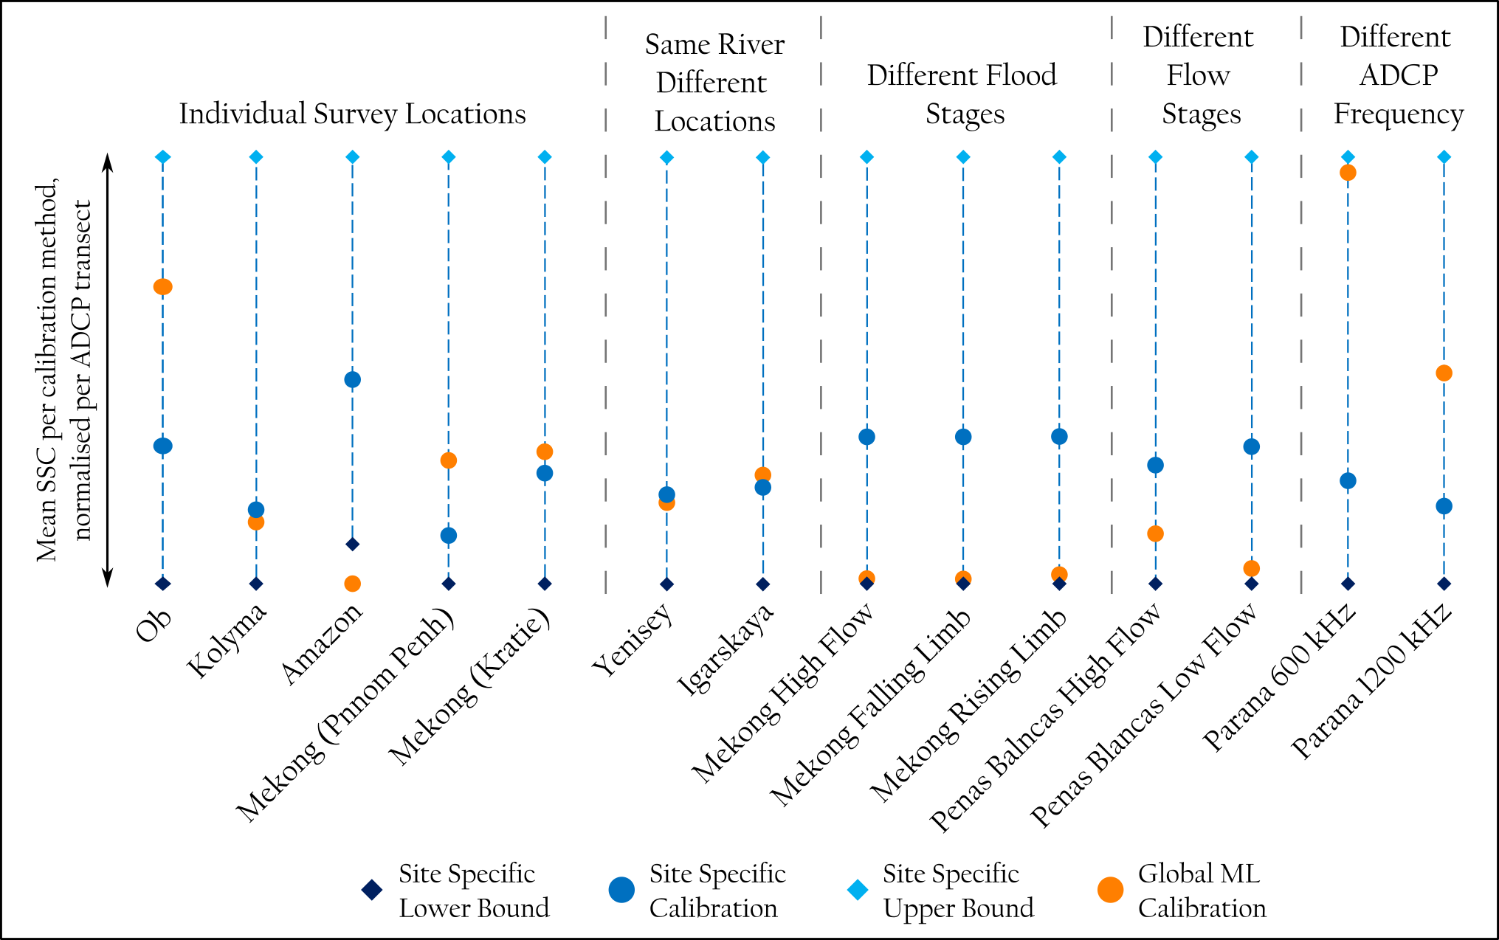
How effective is a global calibration?
13 of the 14 ADCP test-sites showed the global calibration fell within the range of site-specific calibrations
Globally predicted mean SSC values aligned well with site-specific mean SSC predictions
Wide range of scenarios tested against to provide evidence of scalability
Come and chat to find out more about how this was achieved…

Slide 4
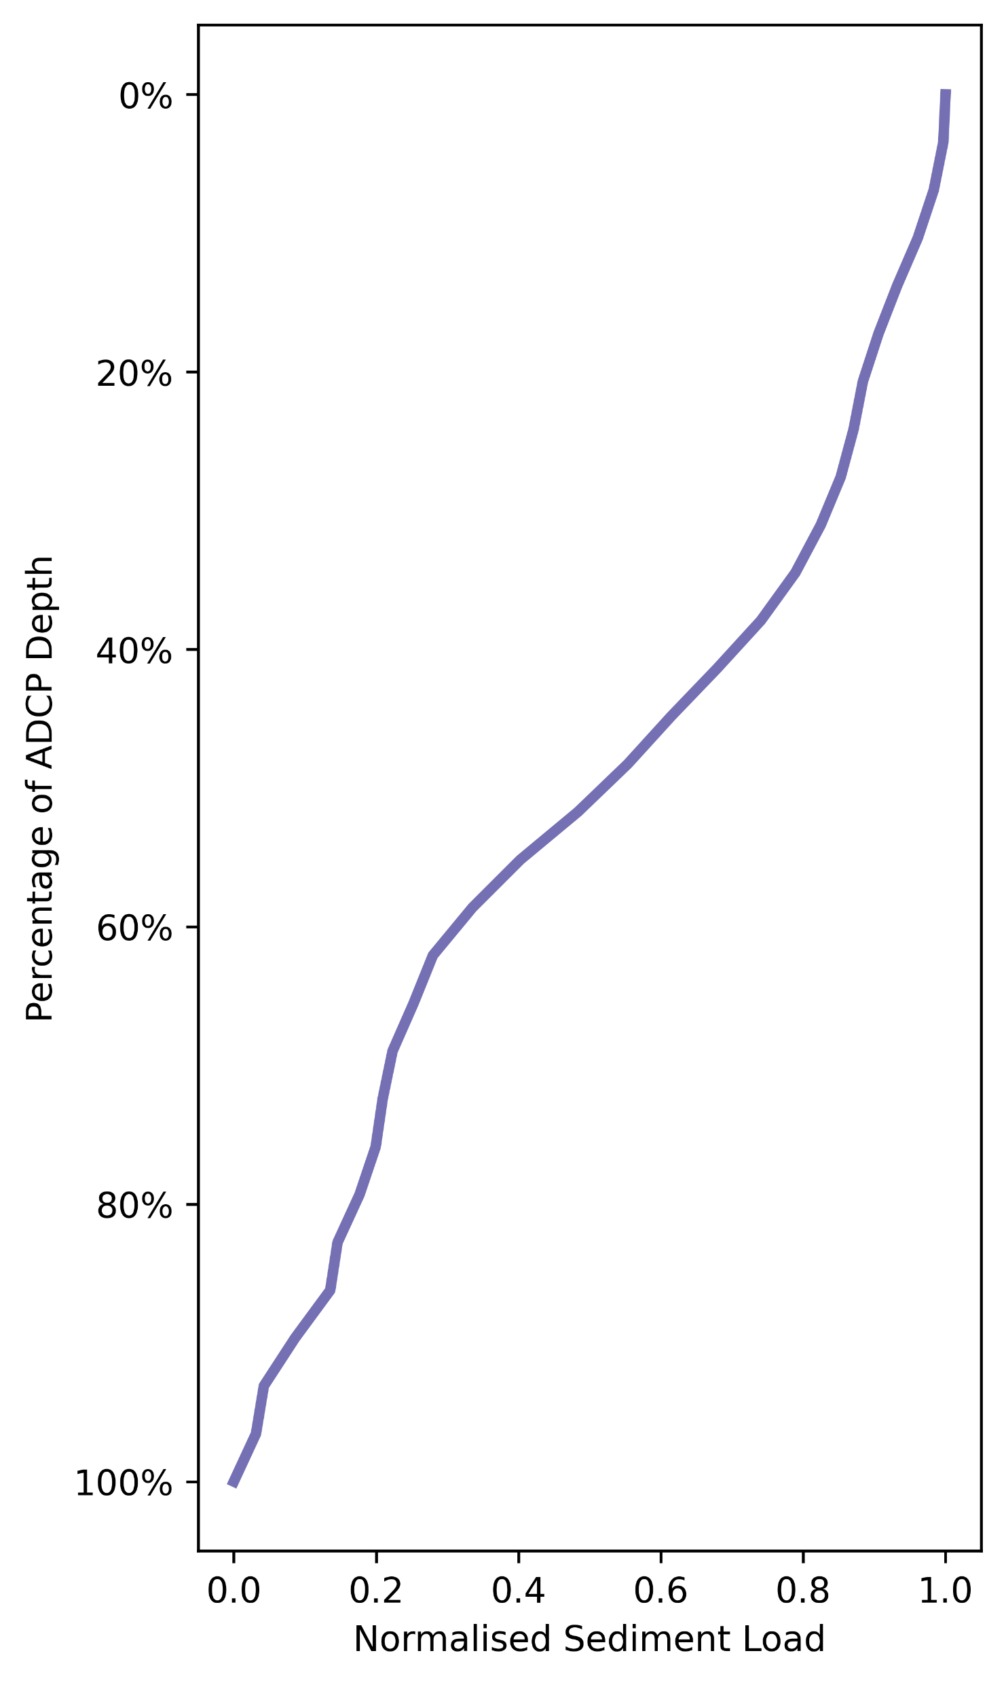
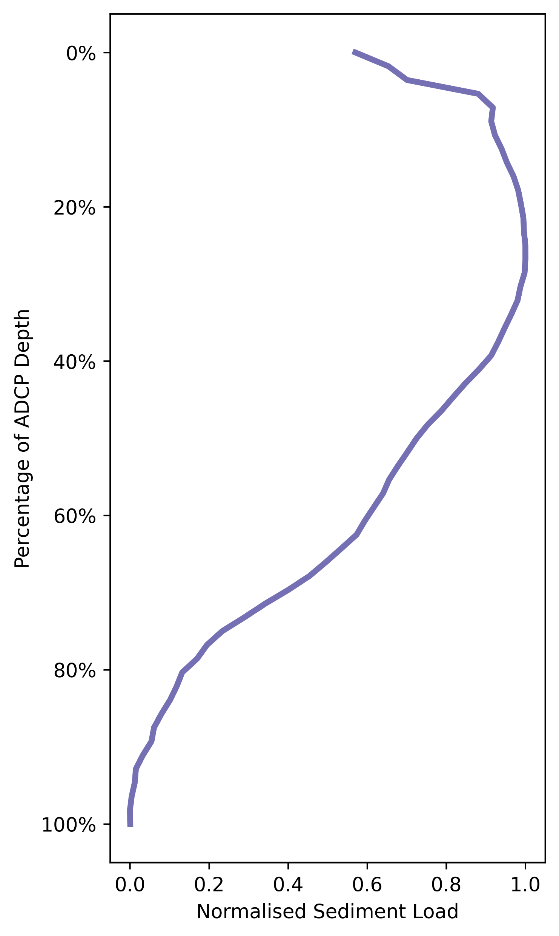
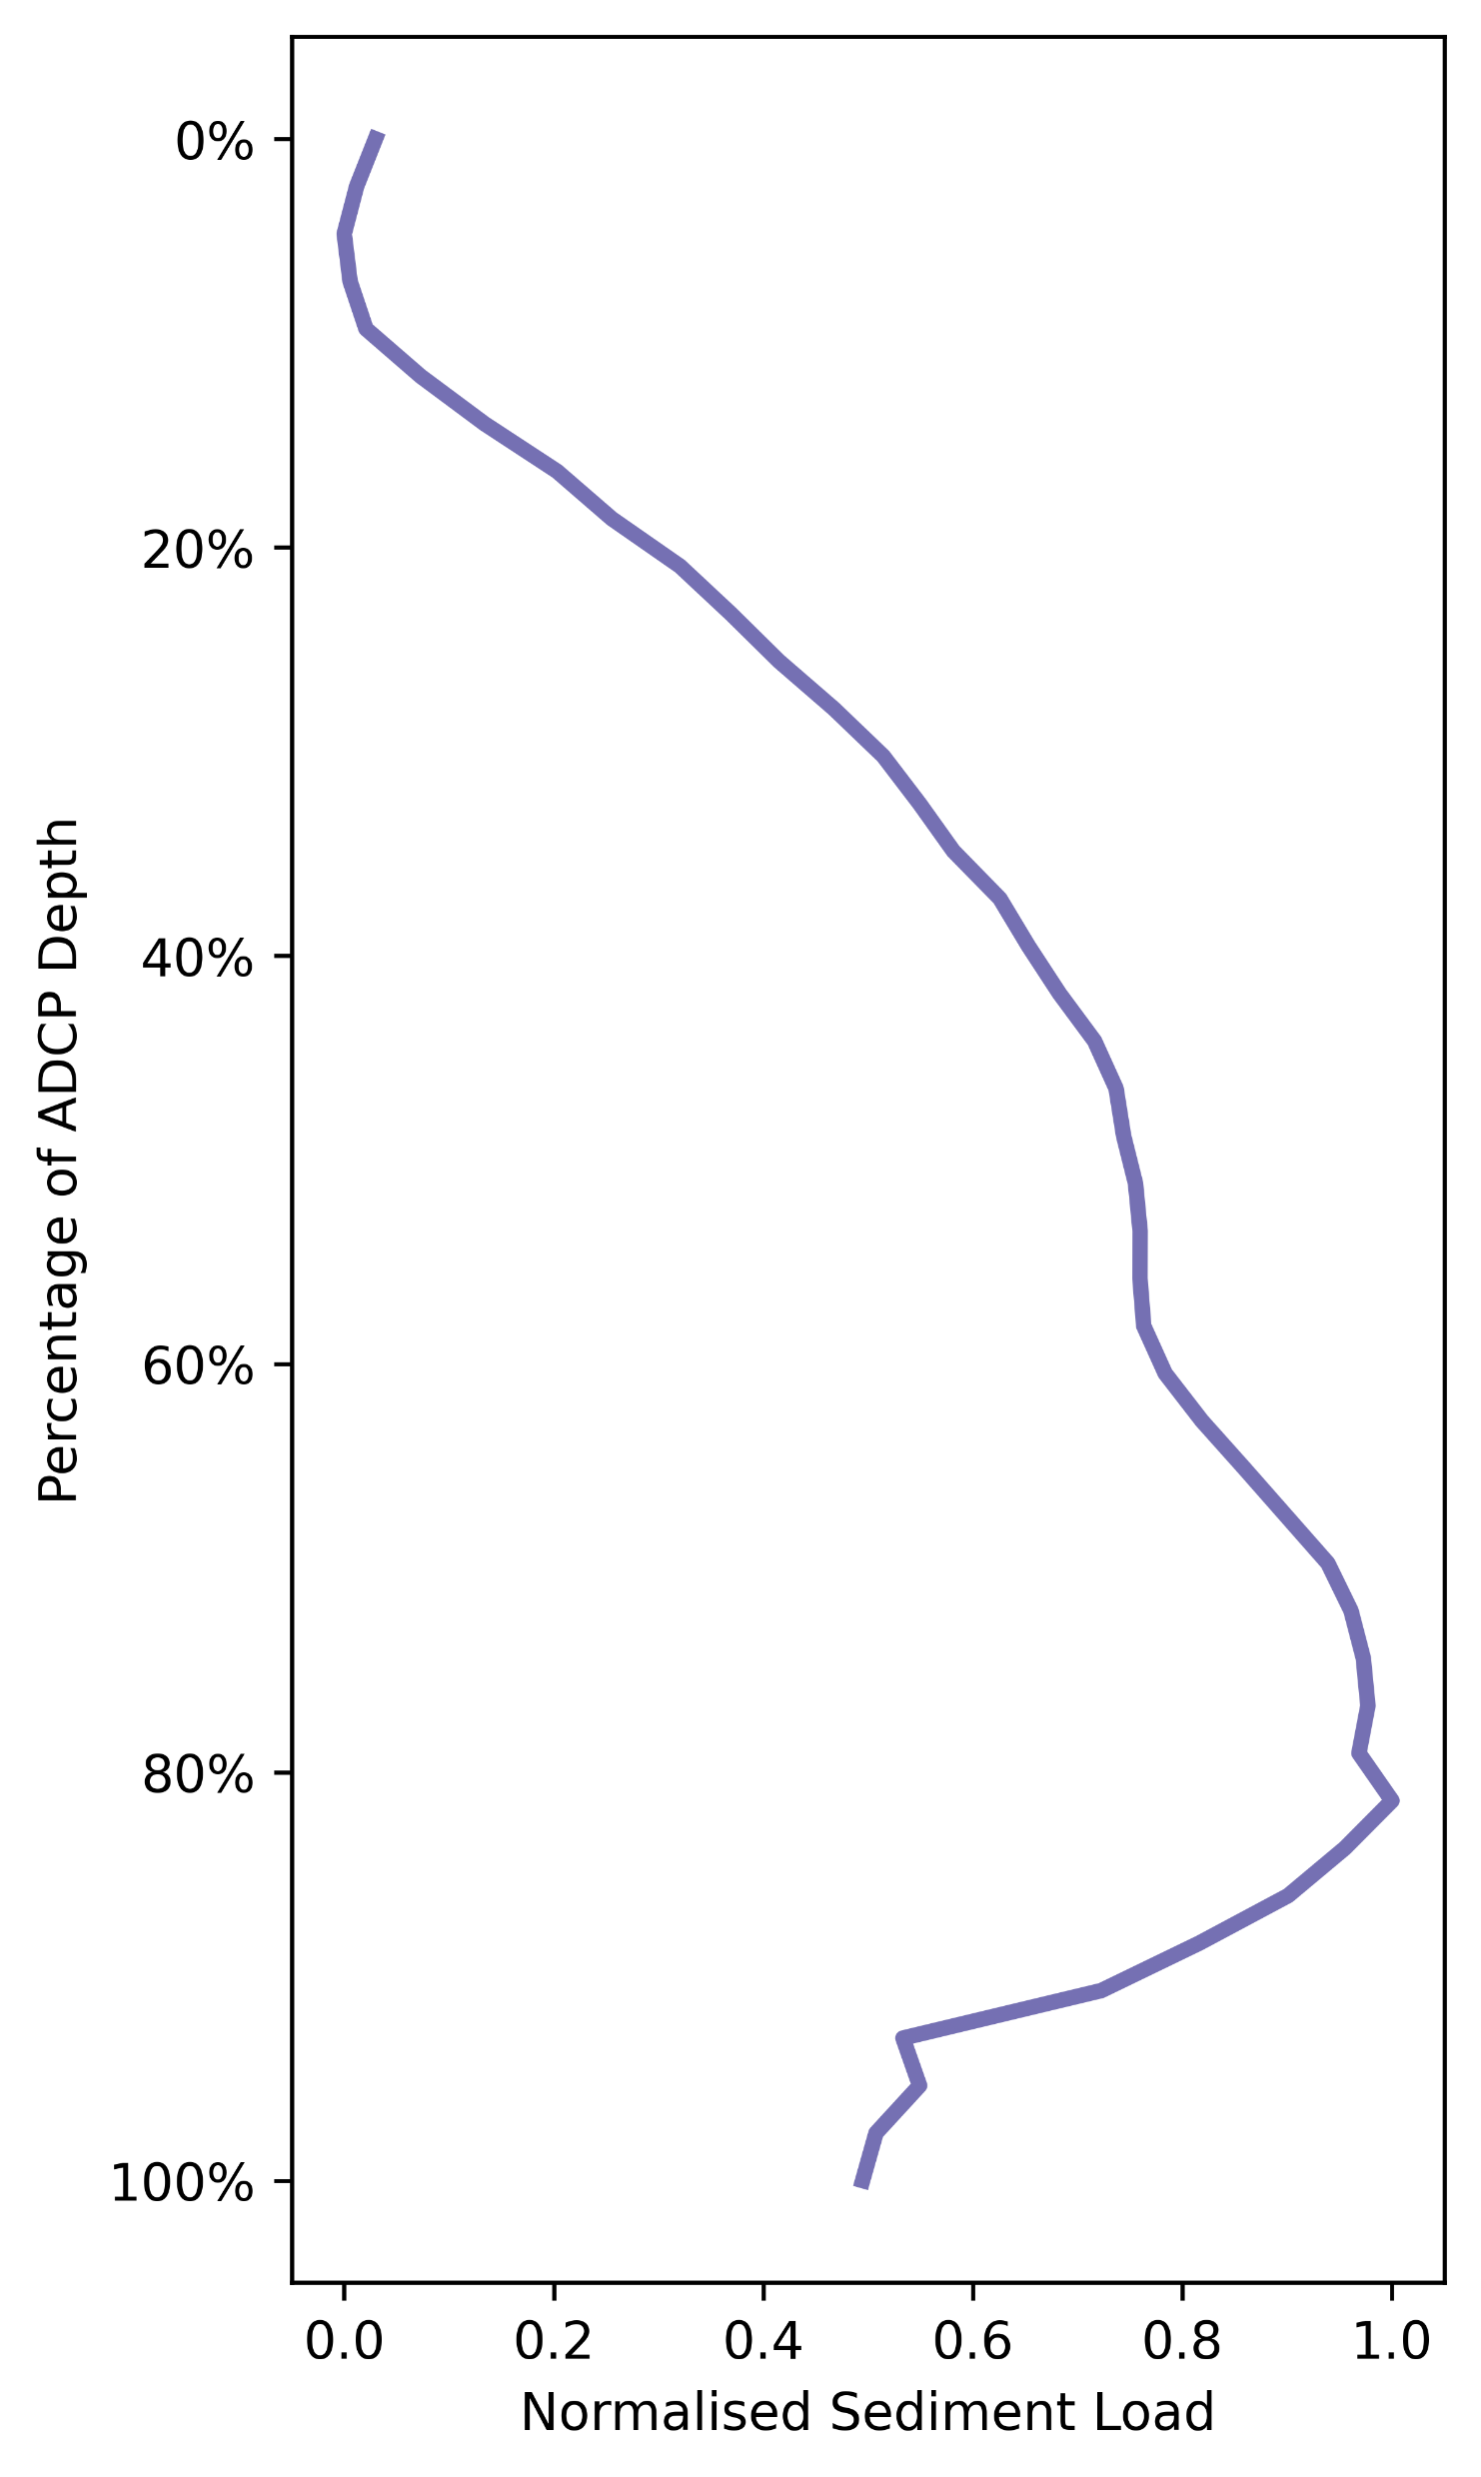
Vertical variability?
Mekong Flood Hydrograph
Rising Limb
Peak
Falling Limb
Vertical distribution of sediment is varying through time
Are assumptions made about sediment distribution for other research questions valid?
What are the processes driving these variations, and can we detect them?
Come and chat to find out more about how this was achieved…

Slide 6
Vertical mixing of suspended sediment in big rivers using ADCP data and machine learning
Click on a section header, a specific sub-section, or flick through sequentially.
Use the home button to return here.
Background
Model Development
Model Validation
Implications
Conclusions and Future Work
Sections
The importance of sediment
Data collation
Validation
workflow
Extracting vertical distribution
Conclusions
ADCPs for sediment monitoring
Calibration
workflow
Validation results:
Overview
Changing vertical distribution
Future work
Sub-sections
The Amazon
Backscatter and suspended sediment
Calibration results
Validation Results:
Breakdown
Can you help?
The Mekong
Individual Sites
Impact on
wider research
Research Questions
Different Locations
Flood Curve
Flow Stage
ADCP Frequency
References

Slide 7
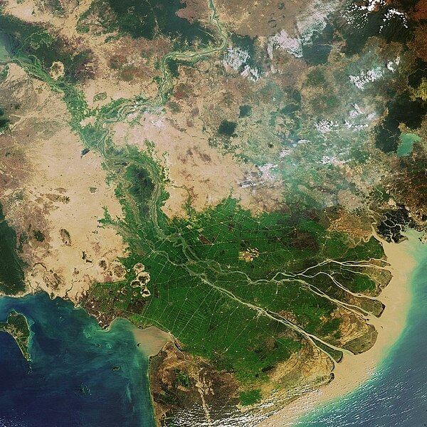
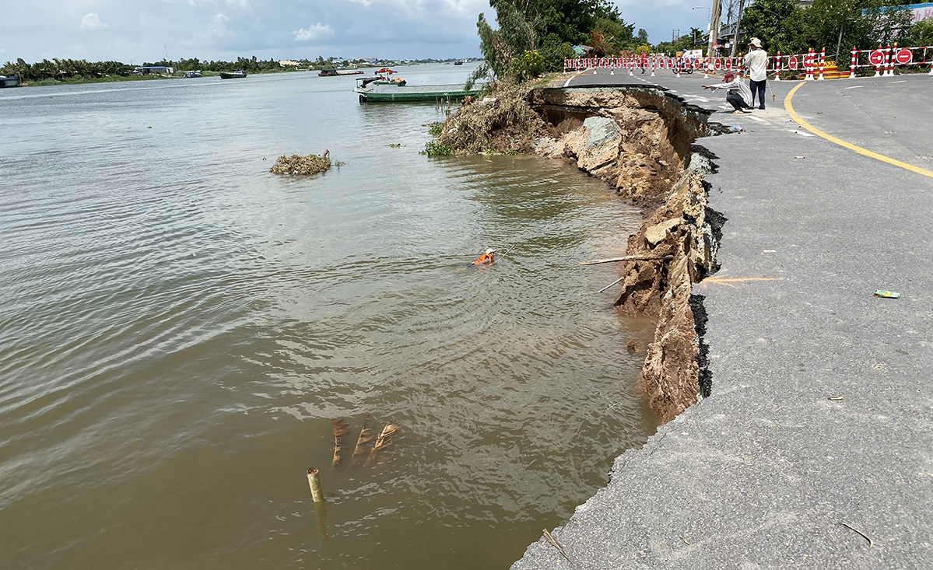
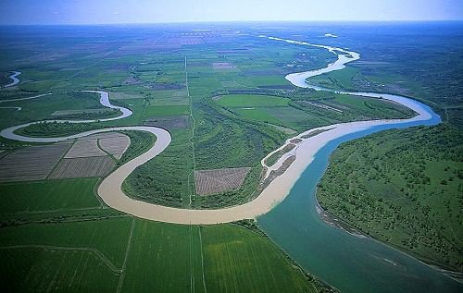
Background
The importance of sediment
Sediment is an intrinsic component of the fluvial system and is relied upon for maintaining deltas and supplying floodplain material, providing resilience during flooding and storms^{[1, 2]}
Understanding the processes which control sediment supply and how to monitor sediment transport is therefore of high importance
Current records from across the globe often offer snapshots of sediment concentrations, with few records globally showing long term trends in sediment supply^{[3, 4]}
What records are available often do not provide any detail on sediment variation through the water column, with implications for in-situ and remotely-sensed monitoring

Slide 8
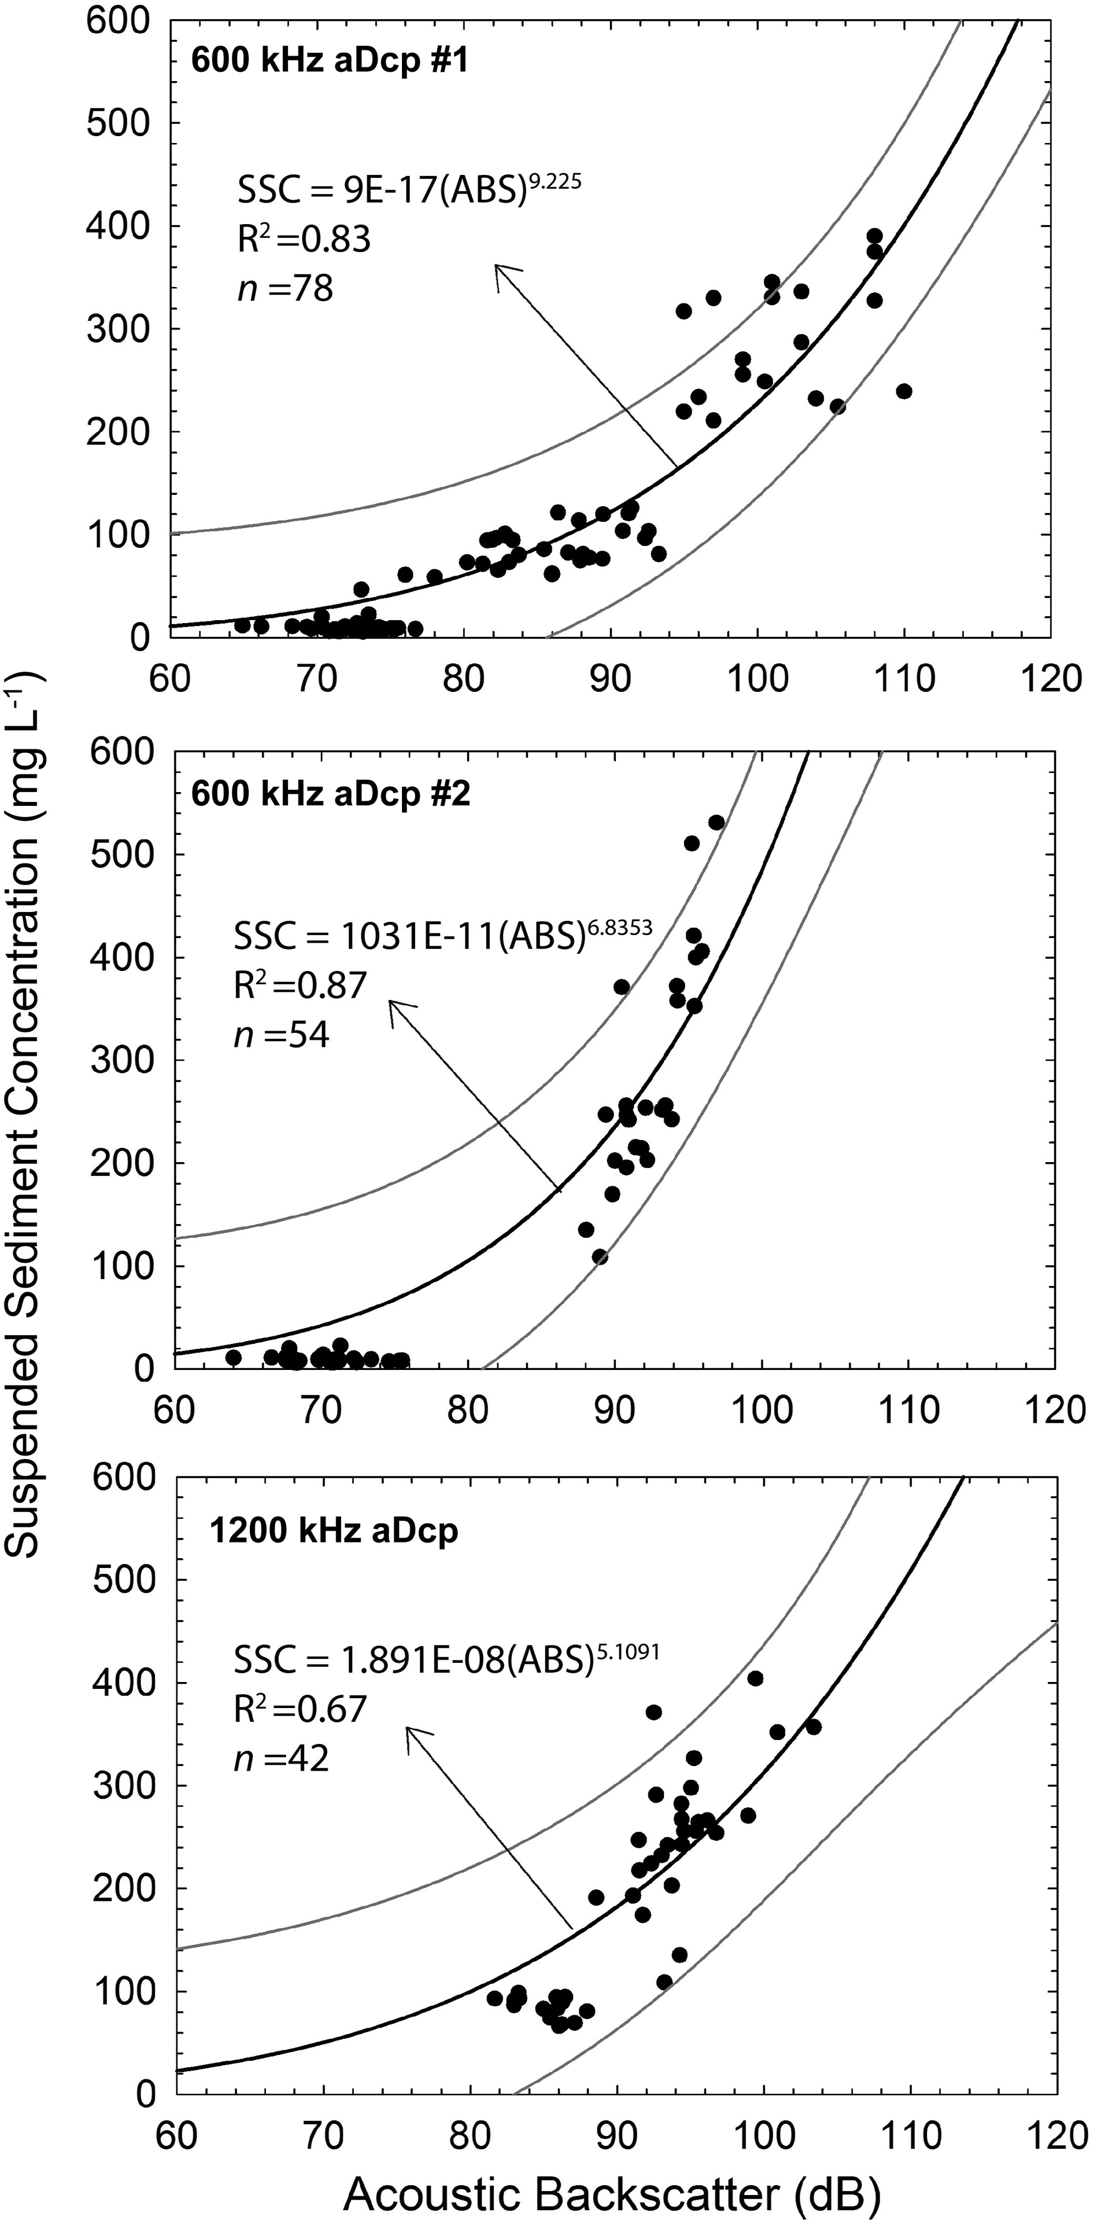
Background
ADCPs for sediment monitoring
The effectiveness of using ADCP data for sediment monitoring is well established^{[5-7]}
ADCPs typically require site and instrument specific calibrations to be effective at estimating sediment concentrations^{[e.g. 5-8]}
Different levels of acoustic calibration are present within the literature, from comparison to raw backscatter, acoustically corrected backscatter, and full unit calibration
These studies are limited in number, but the routine use of ADCPs for discharge measurements is more widespread
Unlocking the possibility of using this data for assessing sediment variability, if these machines calibrations can be predicted, is therefor of importance
Example derived calibration curves from Hackney et al. 2017^{[7]}

Slide 9
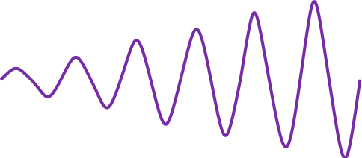
Background
How backscatter can indicate suspended sediment concentration
The relationship between backscatter and sediment concentration is based on the principal of the sonar equation $EL+S_{V}−S_{C}=R$ ^{[8]}
The properties of the sediment in the water column, both the number of particles and their size, affect the returned backscatter^{[5, 8]}
The interaction between ADCP frequency and particle size combinations differ as the scattering regime alters
The effect on backscatter of other factors such as instrument noise, organic matter, air bubbles etc. will also affect calibration accuracy
Increasing grainsize
Example site and instrument specific calibration
Increasing
frequency
Increasing backscatter = Increasing SSC

Slide 10
Background
Research questions
Can we quantify this phase space for unknown instruments?
How well does this perform at predicting SSC values across a variety of locations and conditions?
Increasing backscatter = Increasing SSC
Increasing grainsize
Example site and instrument specific calibration
What does this tell us about sediment variability within the water column and its drivers
Time? Location? Discharge?
Increasing
frequency

Slide 11
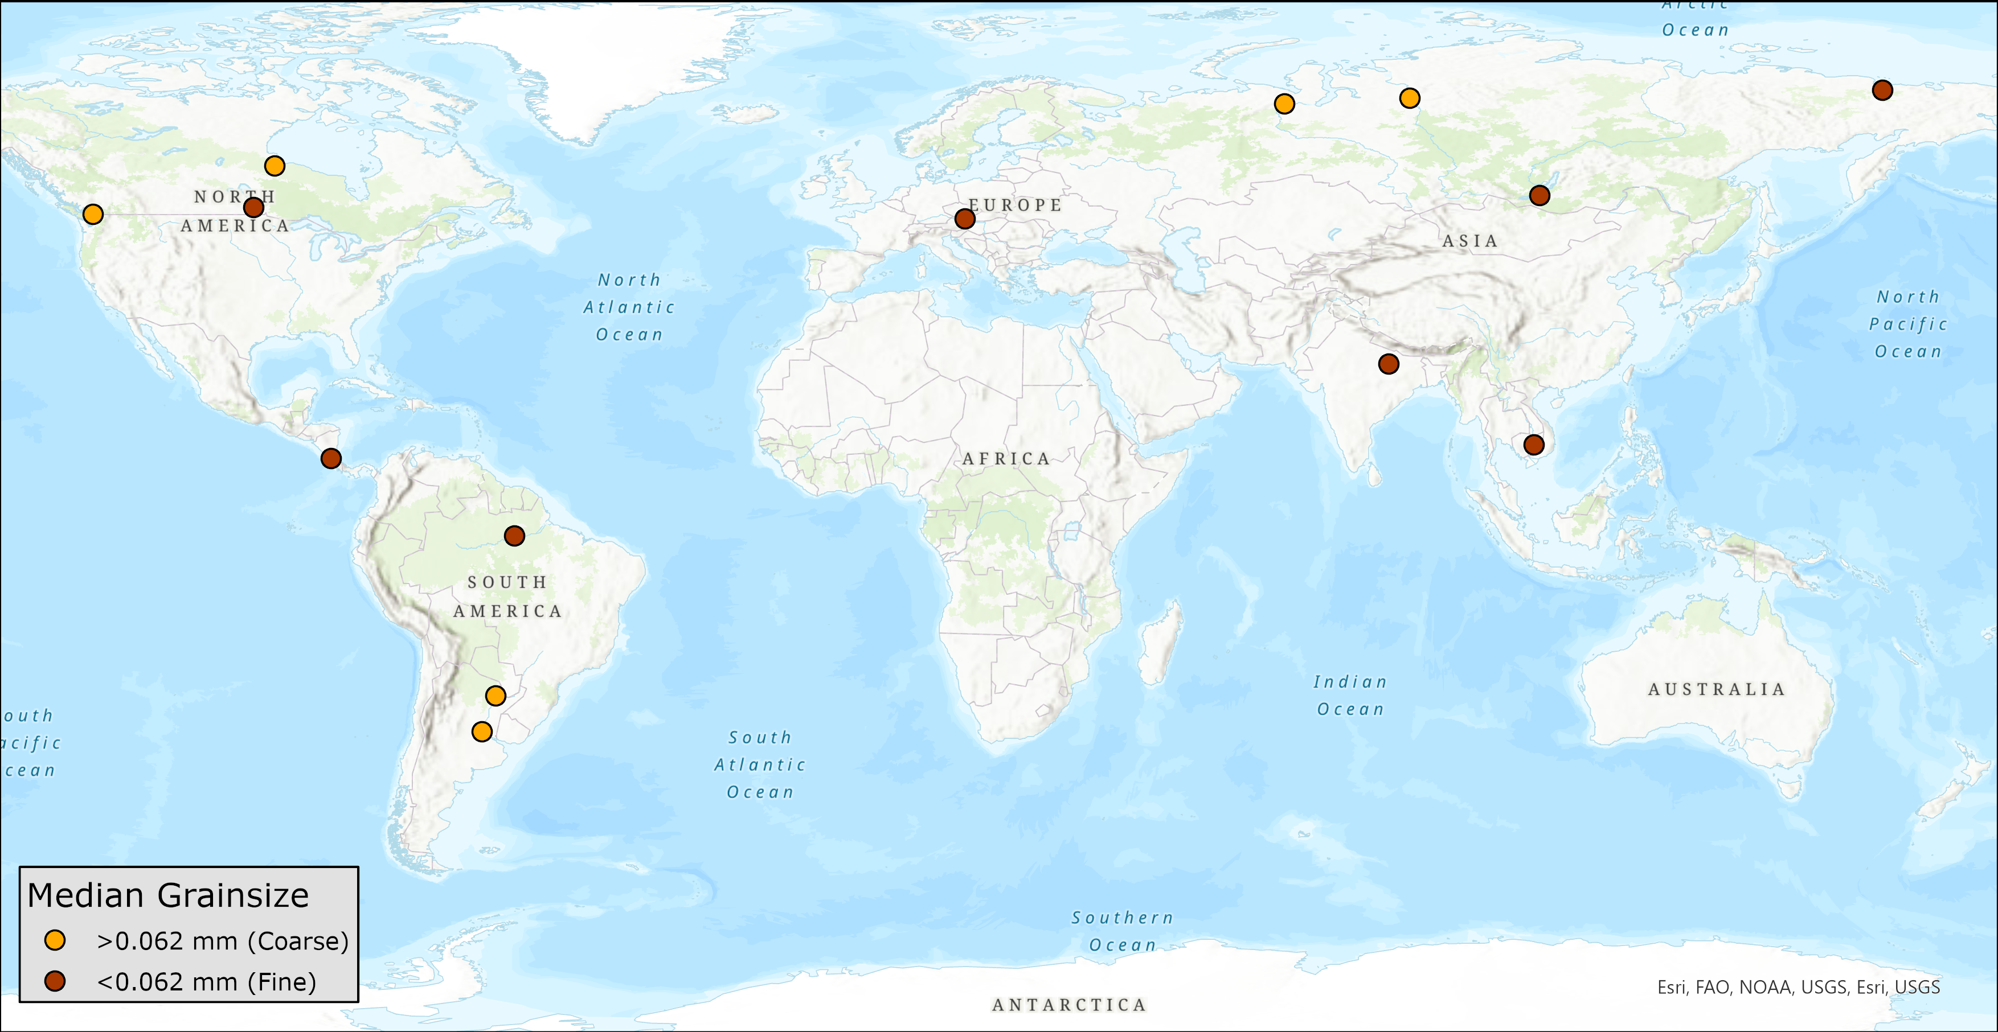
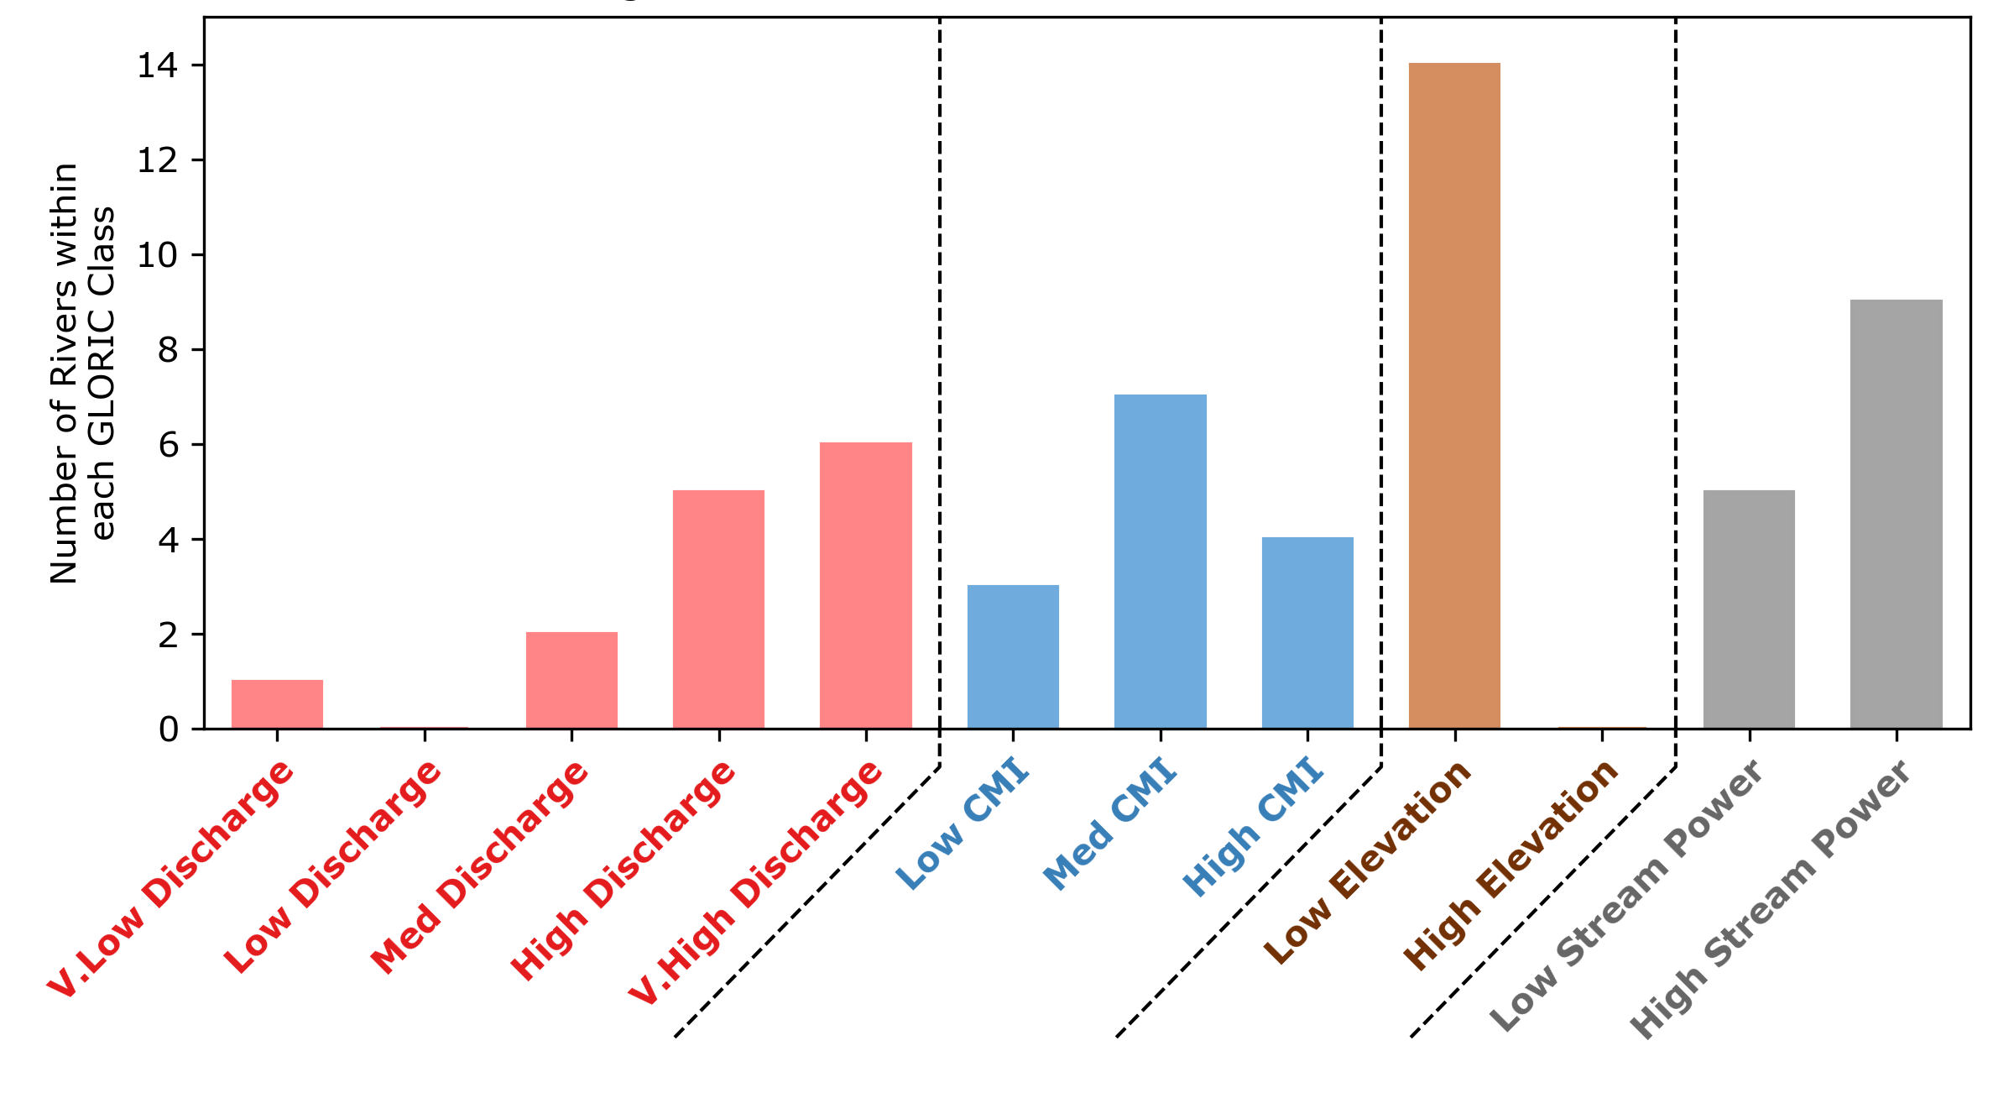
Model development and calibration
Data collation
Calibrations for multiple units were obtained from published research and online records (14 locations with 22 different ADCPs)
Samples came from a range of locations across the globe (top), with no data publicly available for African and Australian rivers
These sites included coarse (sand) and fine (silt) dominated rivers, and a range of ADCP frequencies (300, 600, 1000, 1200 kHz)
Comparisons with GloRiC data^{[9]} (bottom) showed these locations were within a diverse set of hydrological and climatological regimes, although only at low elevations

Slide 12
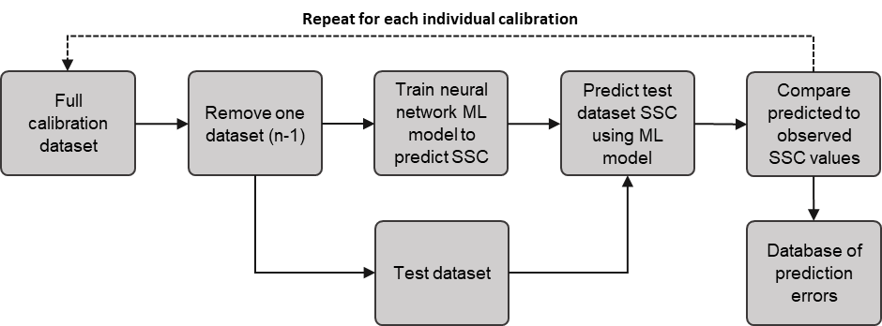
Model development and calibration
Calibration workflow
Backscatter (dB), frequency (kHz) and grainsize (Coarse/Fine) were used to train a neural network for estimating SSC
The network was trained on N-1 calibrations, with the dropped dataset acting as an ‘uncalibrated’ instrument for testing the model
The global calibration SSC predictions were then compared to the site-specific calibration SSC observations of the dropped dataset.
This was repeated for each dataset, aggregating all the errors to assess calibration accuracy across an effective range of ‘uncalibrated’ units

Slide 13
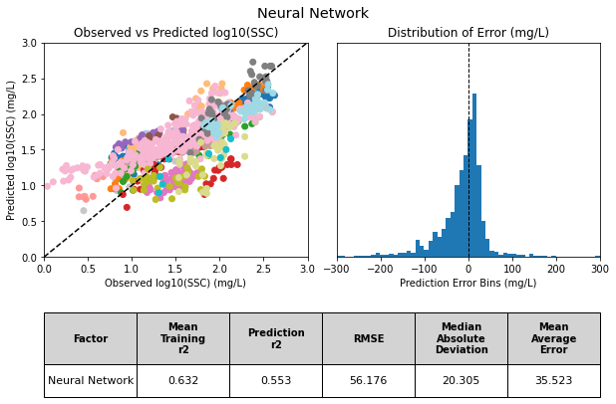
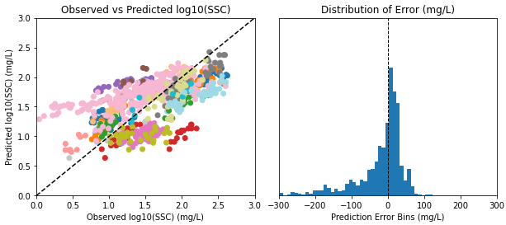
Model development and calibration
Calibration results
The calibration results (right) follow a 1:1 pattern with an r² of 0.553
The different methods of assessing variability suggest predicted SSC is within +/- 20 – 50 mg/L of the observed values
The developed model shows promising results for predicting SSC from uncalibrated ADCPs
The model tends to overpredict SSC, especially at low values
The model performed worse when using backscatter alone, with a greater spread of error around the 1:1 line
This highlights the necessity for including ADCP frequency and grainsize data

Slide 14
Model validation on ADCP transects
Validation workflow
Cross-section data linked to the calibration data used for the machine learning model were obtained where possible
The corresponding model trained on the remaining calibrations (see prior workflow) was applied to calculate mean SSC for each transect
For each site-specific calibration, the upper and lower confidence bounds were identified to create calibration curves using these limits
Site-specific calibration and these upper and lower limits were applied to the cross-section data for comparison
Global mean SSC estimate
Corresponding global calibration
Site-specific mean SSC estimate
Corresponding site-specific calibration
Raw cross-section from calibrated ADCP
Site-specific lower mean SSC estimate
Site-specific confidence bounds
Site-specific upper mean SSC estimate

Slide 15
Model validation on ADCP transects
Validation results: Overview
13 of the 14 ADCP test-sites showed the global calibration fell within the range of site-specific calibrations
Globally predicted mean SSC values aligned well with site-specific mean SSC predictions
Wide range of scenarios tested against to provide evidence of scalability

Slide 16
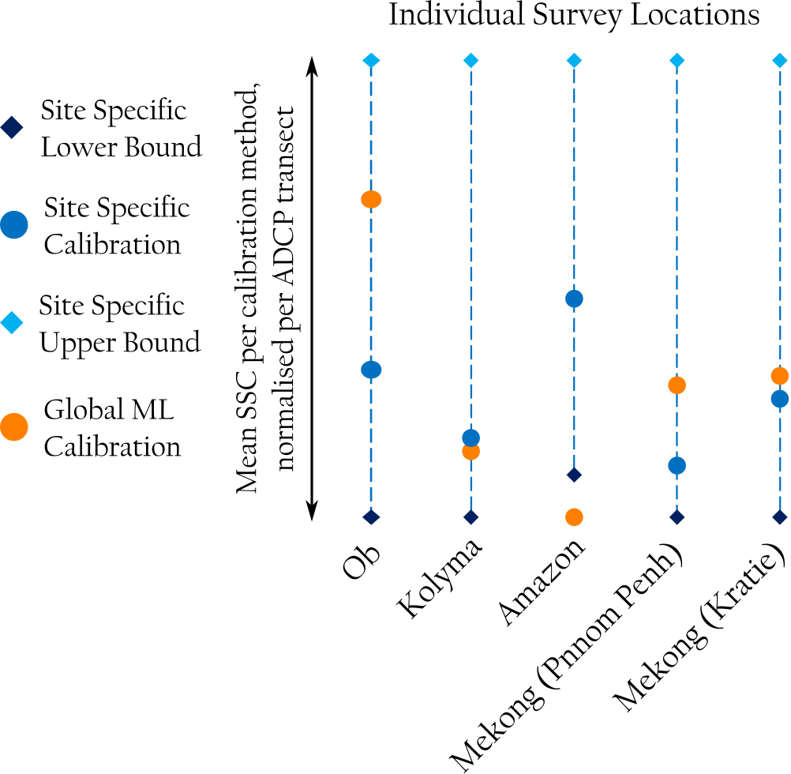
Model validation on ADCP transects
Validation results: Individual survey locations
The alignment between the global and site-specific calibrations was good overall
Both Mekong sites and the Kolyma had very good alignment between the global and site-specific calibrations
Only the Amazon was outside the confidence bounds of the site-specific calibration curve
This was the only identified site with a 300 kHz ADCP calibration
No other 300kHz dataset would have been used in training for this validation run, likely causing this under-response
Has implications for use on machines outside the training data range

Slide 17
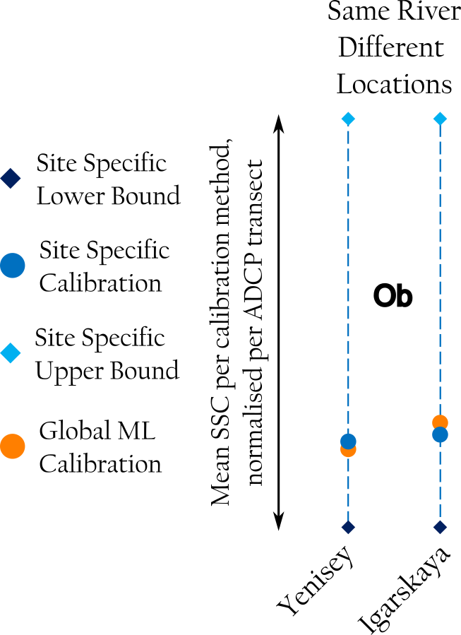
Model validation on ADCP transects
Validation results: Same river, different locations
Analysis of the same unit at two locations in a primary and secondary channel on the same river show similar results
These two channels had different hydrological (75000 vs 3300 m³s⁻¹) and sediment conditions (7800 vs 190 kgs⁻¹) to compare between
Across this range of data, the global model tracked the variation well, providing values close to the site-specific calibration

Slide 18
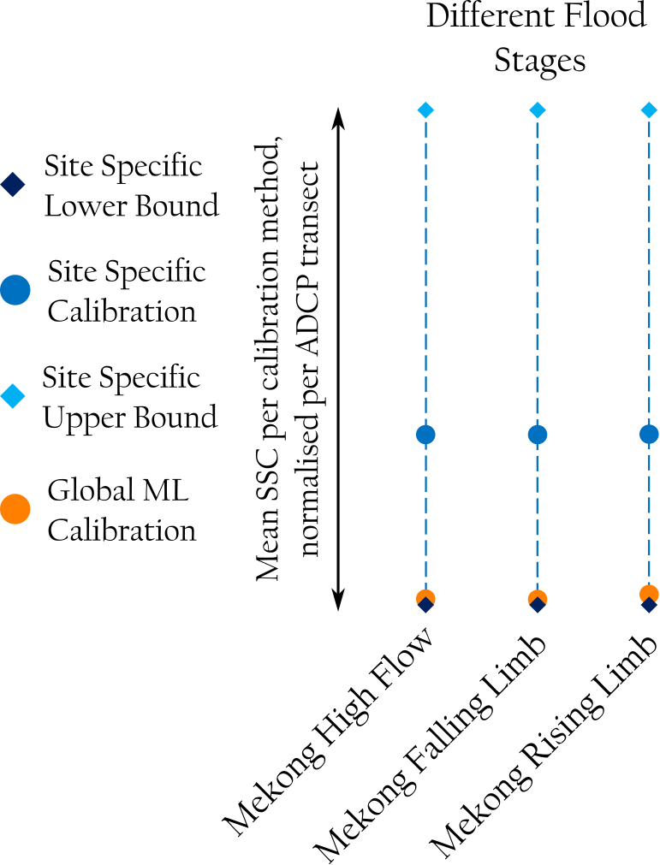
Model validation on ADCP transects
Validation results: Different flood stages
Analysis of the same unit across the various stages of a flood hydrograph (rising limb, peak, and falling limb) for the same locations
The alignment between global and site-specific calibrations is limited, with the global tending to align with the lower confidence limits
This is likely due to having the highest mean SSC values in the training data (>350 mg/L). Removing this data will lead to under-predictions from the global model
This suggests that for concentration values outside the trained range the global model is less effective, albeit still within the confidence limits of the site-specific values

Slide 19
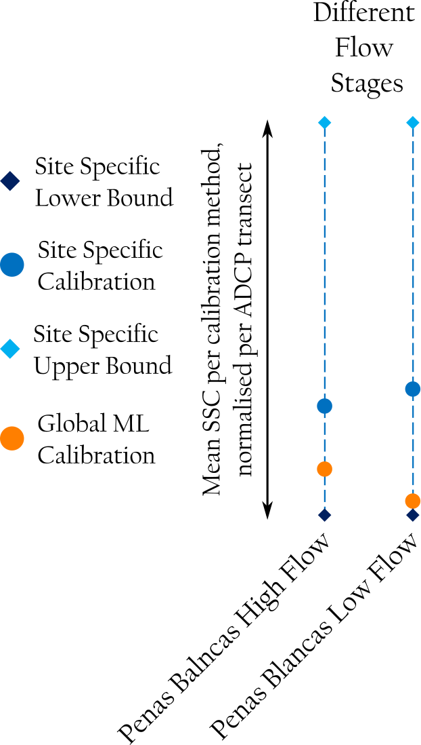
Model validation on ADCP transects
Validation results: Different flow stages
Analysis of the same unit across variations in flow conditions, categorised as high and low flow.
Although there is an underprediction in SSC for this location, this is less than for the Mekong across the flood stages.
The variation in alignment between the two methods implies that the effectiveness of a global calibration is flow condition dependent
This has implications for any assumptions made about the applicability of site-specific calibrations to the same location under different flows

Slide 20
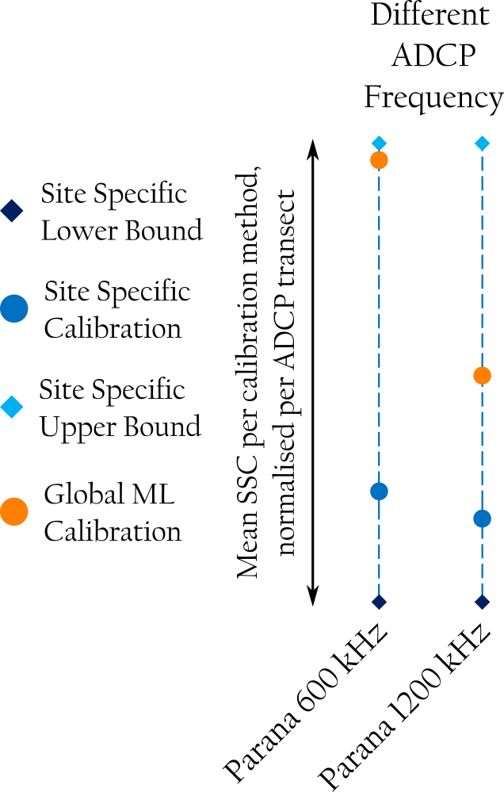
Model validation on ADCP transects
Validation results: Different ADCP frequency
Both the 600 kHz and 1200 kHz exhibit an overprediction in sediment concentration compared to site-specific calibrations
This may be due to the low SSC values reported in the calibration, matching with areas the global model overpredicted SSC for in the model development stage
However, they still lie within the confidence range from the site-specific calibration
This suggests that the model is accounting for variations in both backscatter values and ADCP frequency well

Slide 21
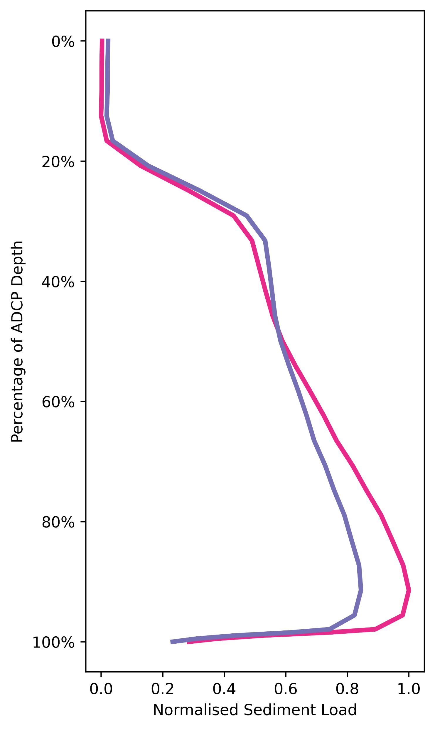
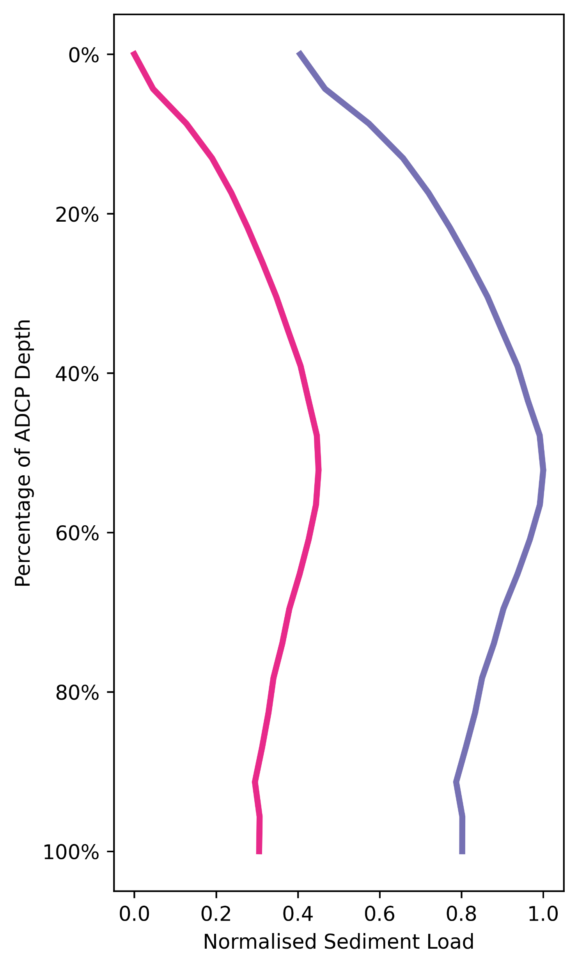
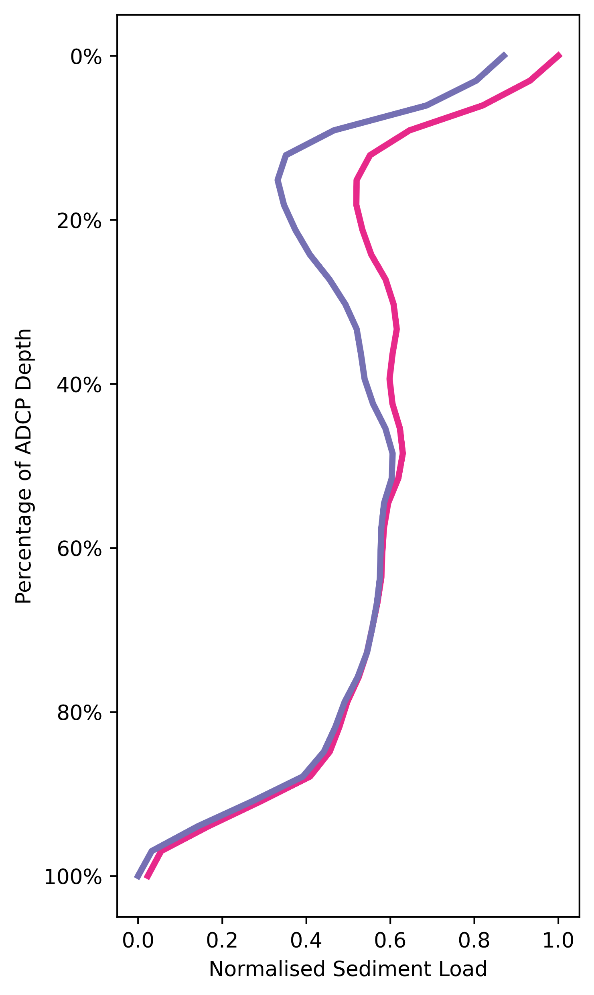
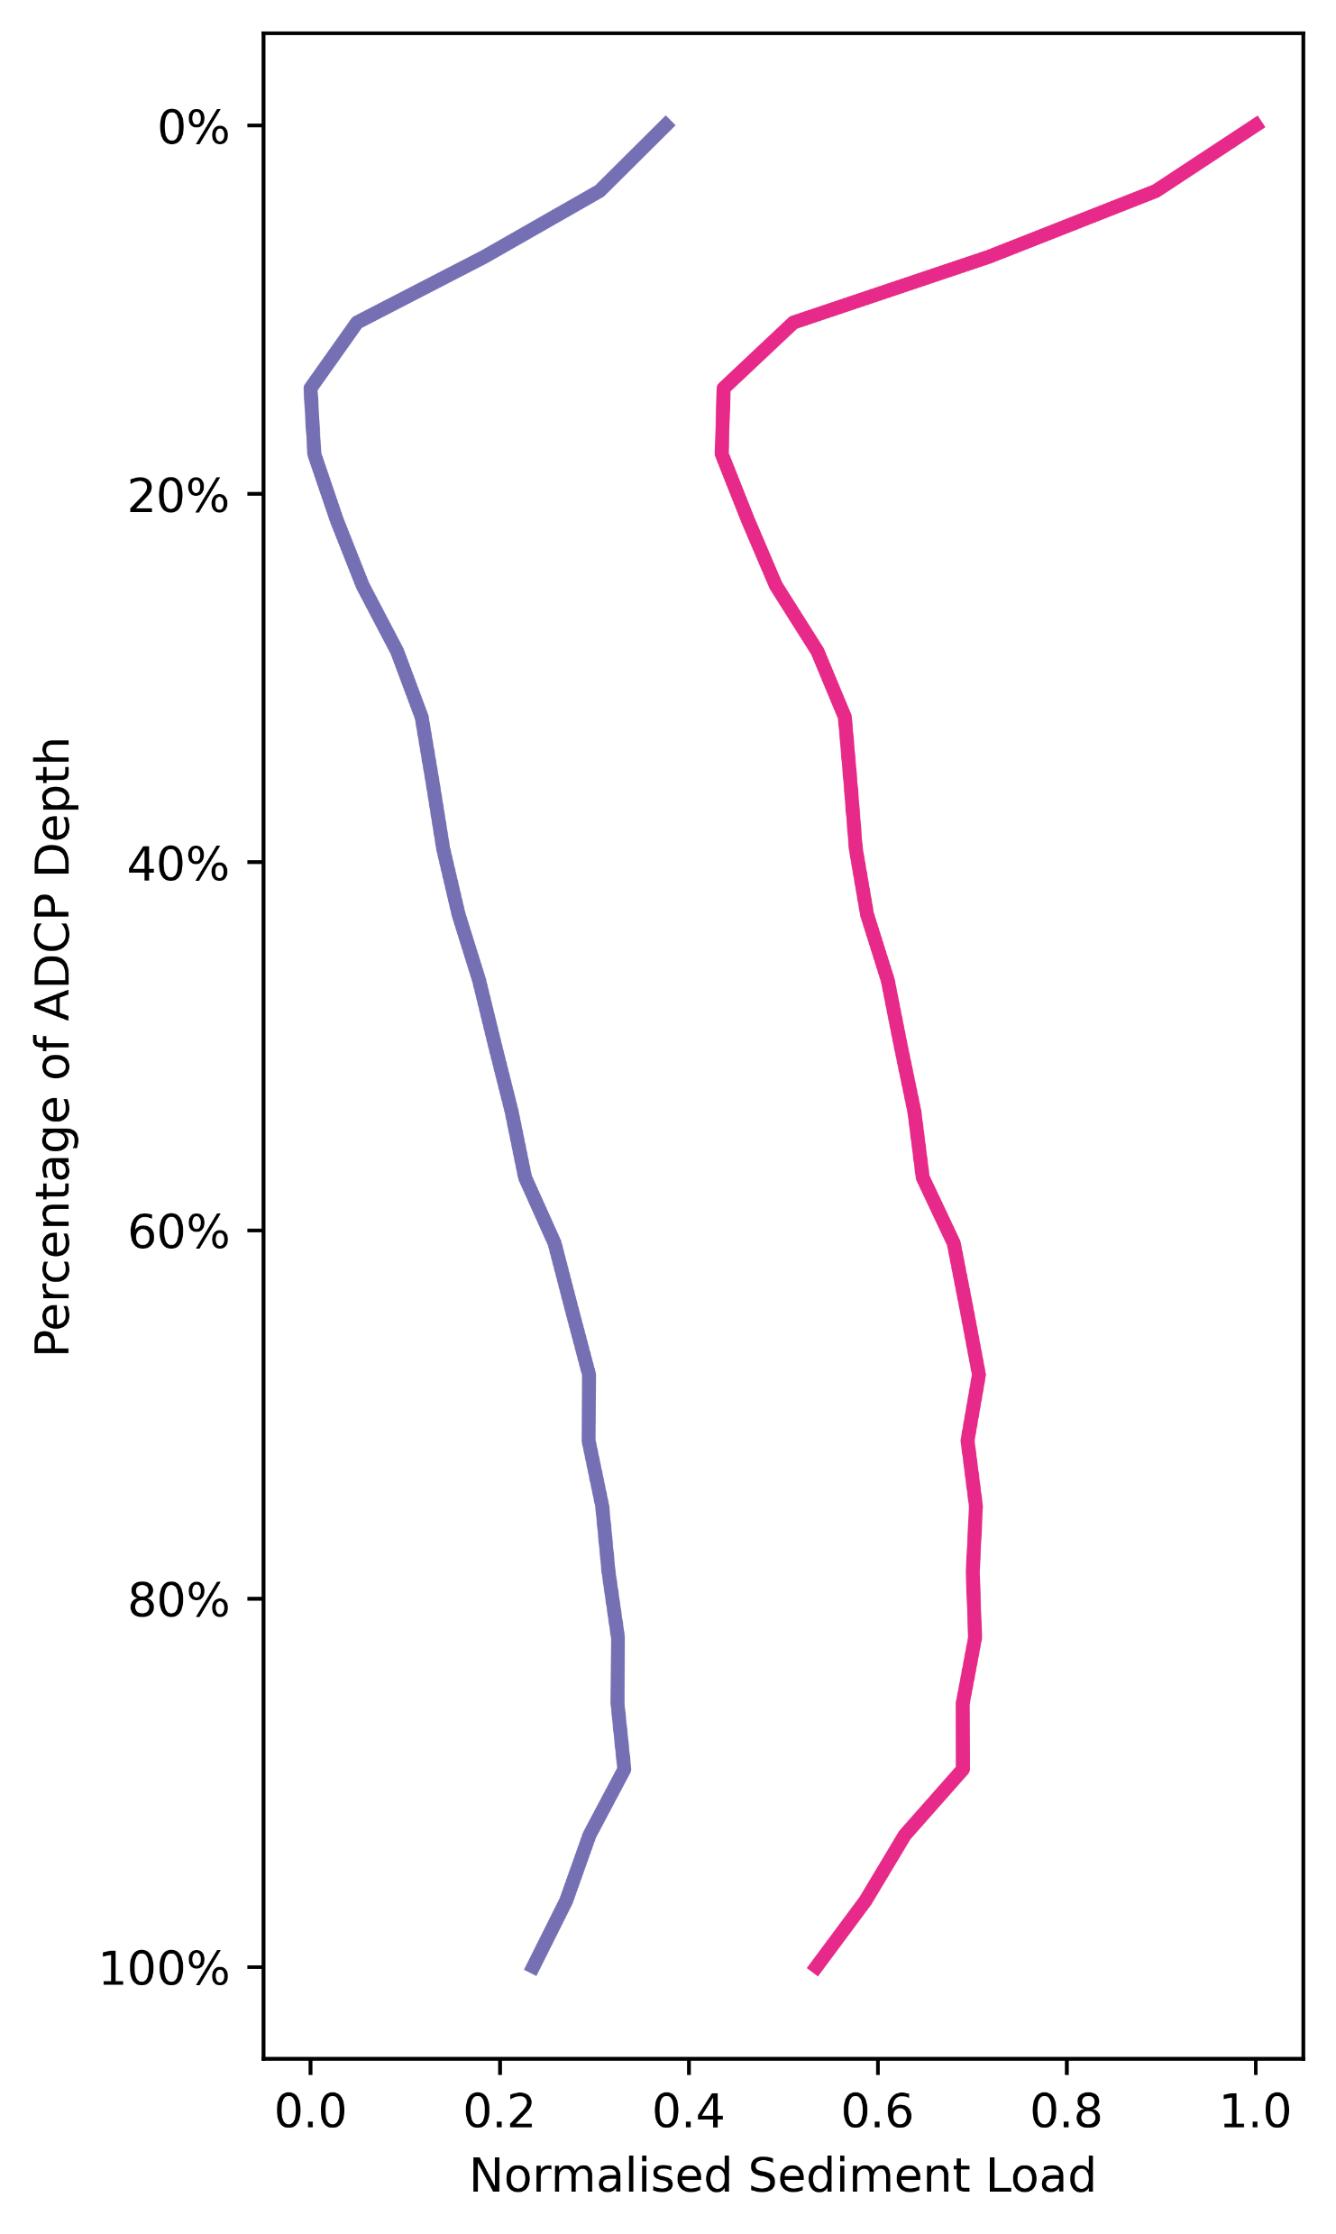
Implications
Vertical distribution extraction
Assessing global calibration effectiveness at identifying vertical variability
The normalised distributions of sediment load through the water column show good agreement (global in purple, s-s in pink)
Ratios of sediment in the top 20% (surface) to bottom 80% (subsurface) align well
This indicates that the global model could identify the vertical distribution from uncalibrated ADCPs
Ob
Amazon
Mekong Phnom Penh
Mekong Kratie
Surface
Subsurface
Global Ratio Site-Specific Ratio | 0.22 0.27 | Global Ratio Site-Specific Ratio | 0.73 0.75 | Global Ratio Site-Specific Ratio | 1.35 1.21 | Global Ratio Site-Specific Ratio | 1.07 0.95

Slide 22
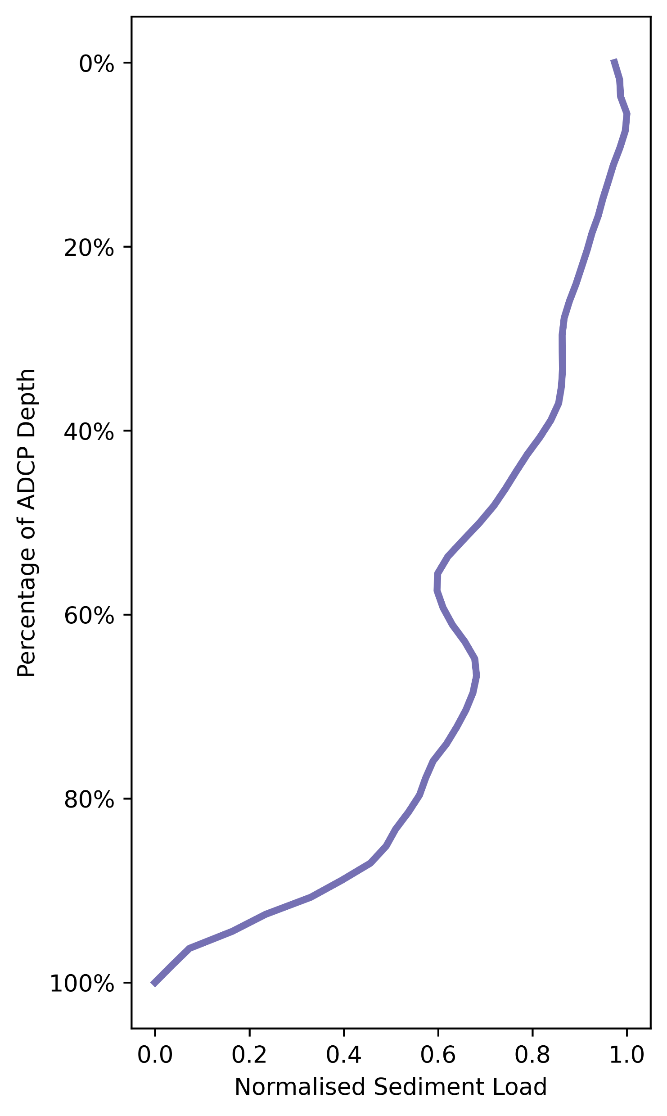
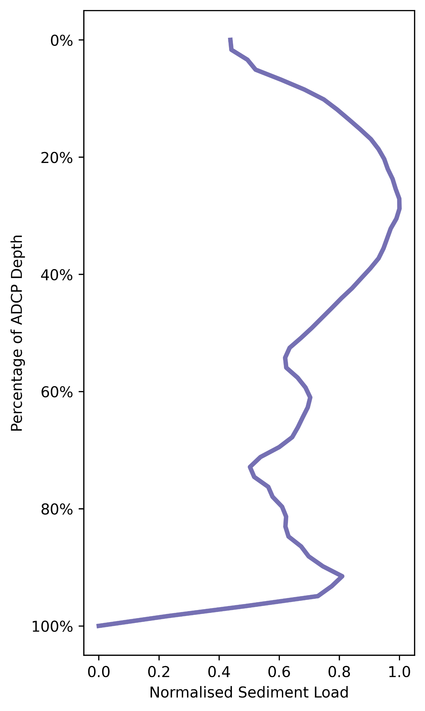
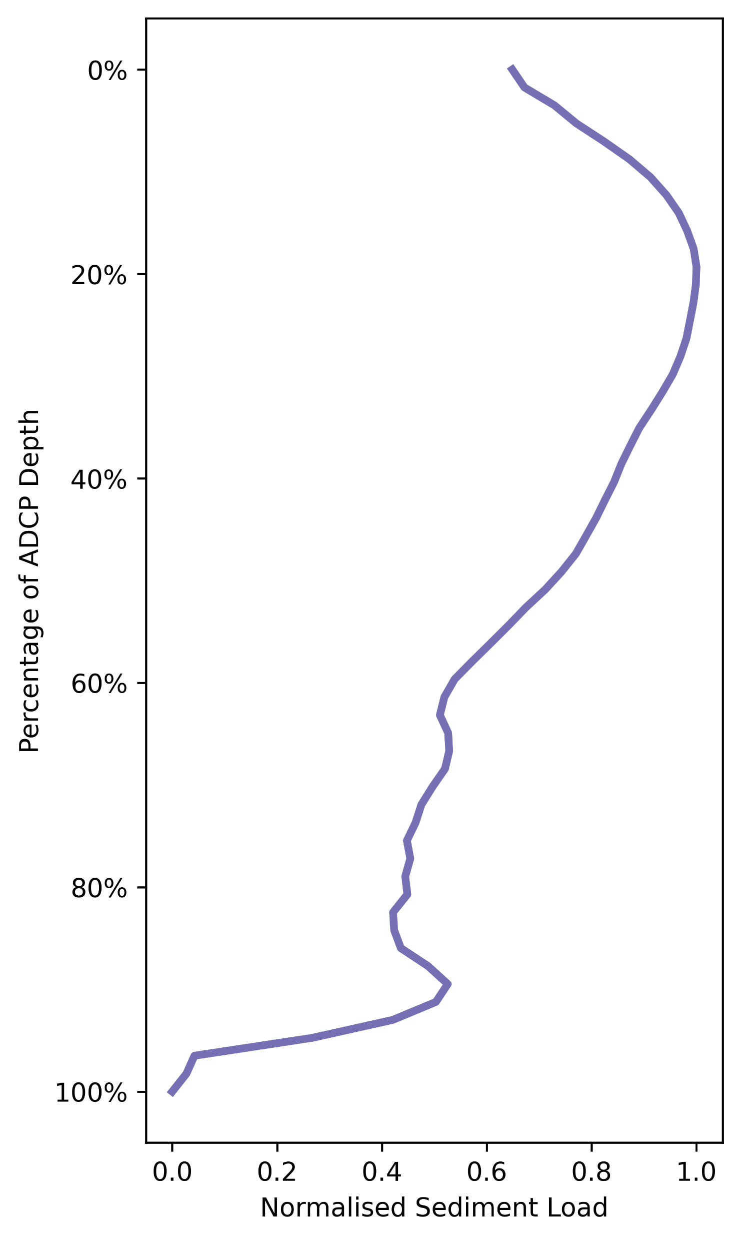
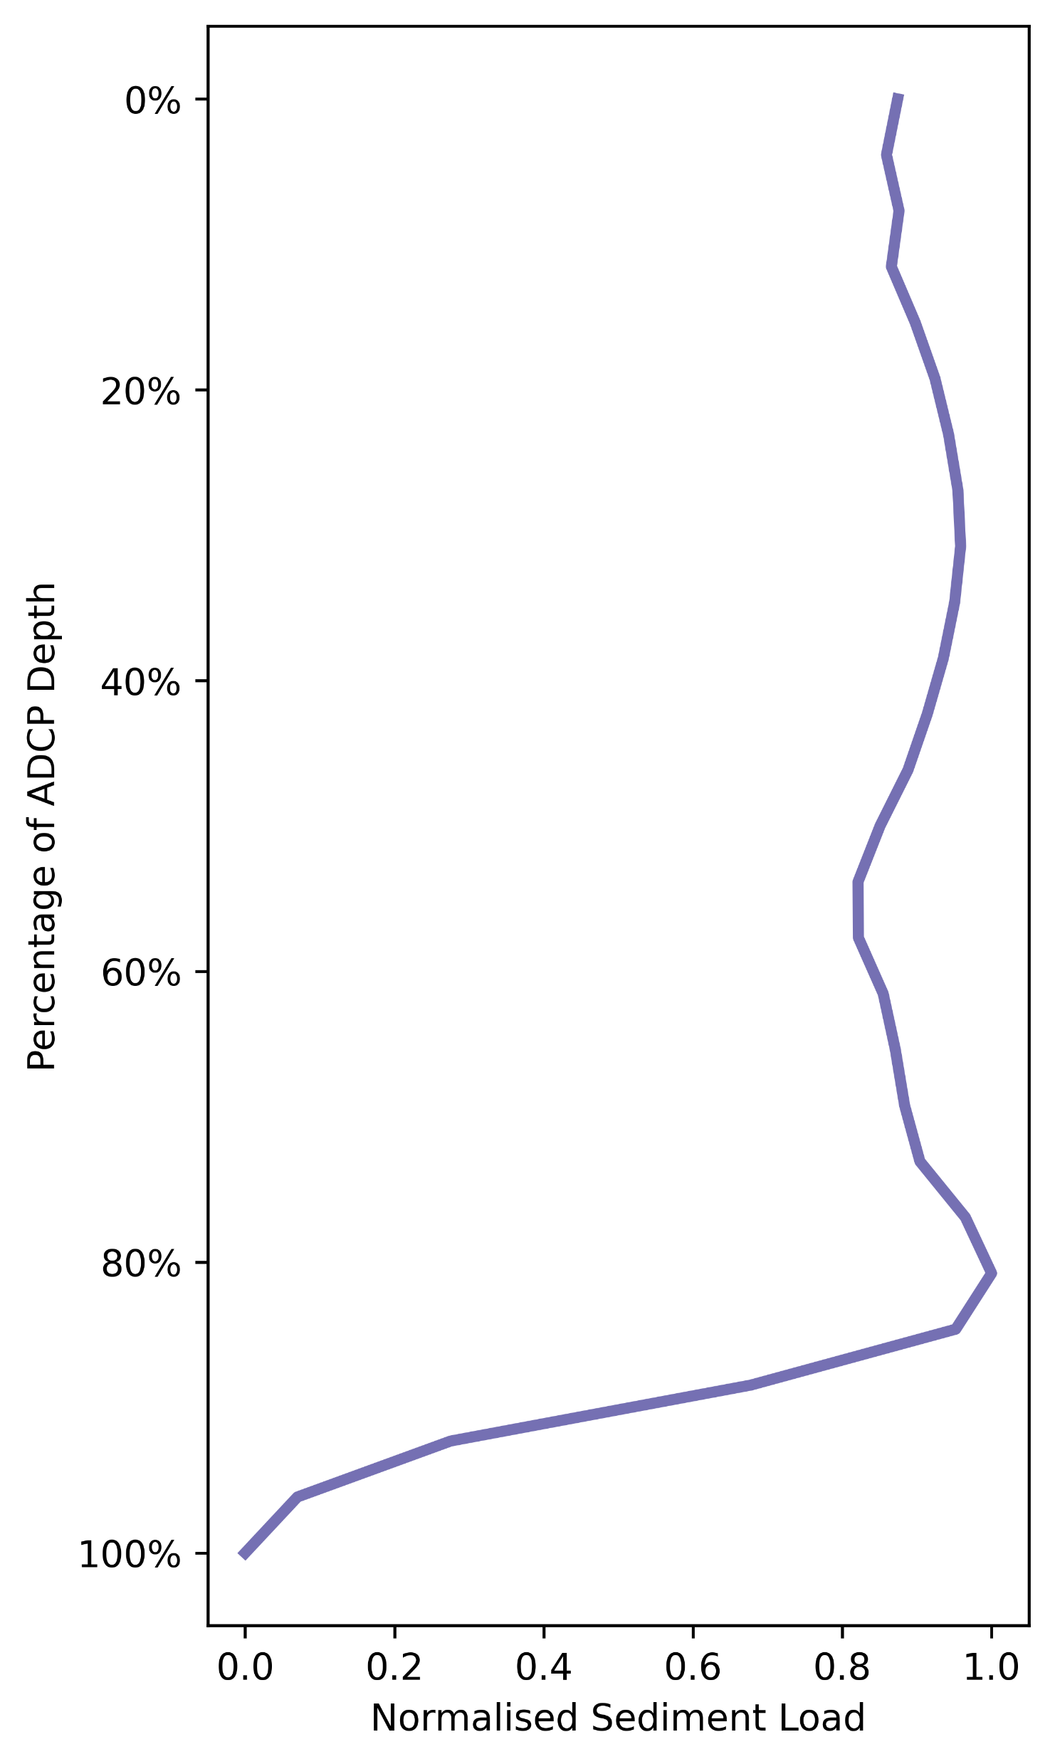
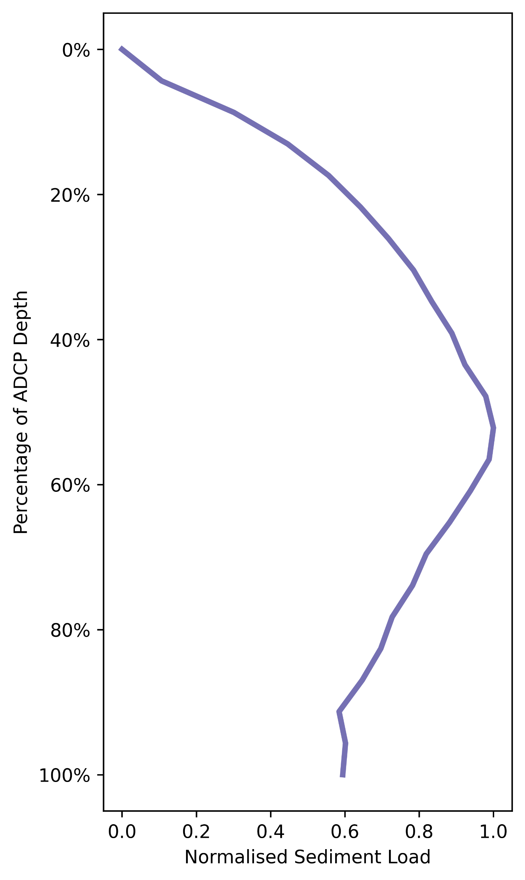
Implications
How does this variability change: The Amazon
Vertical distribution extracted from five different individual months of data for the Amazon river^{[4]} (not averaged over multiple years)
This highlights a changing profile of sediment concentration across the different months
This has implications for studies that assume static levels of mixing within the water column
Data is from a range of years, shown in month order
Amazon
April
May
June
July
November

Slide 23
Implications
How does this variability change: The Mekong
Vertical distribution extracted from individual transects over the rising limb, peak, and falling limb of the flood hydrograph^{[7]}
This highlights a changing profile of sediment concentration across these different flood stages
Most sediment transported at the top of the water column in the rising and peak flood stages
Conversely, at low flows a greater proportion of sediment is transported nearer to the bed
Mekong Flood Hydrograph
Rising Limb
Peak
Falling Limb

Slide 24
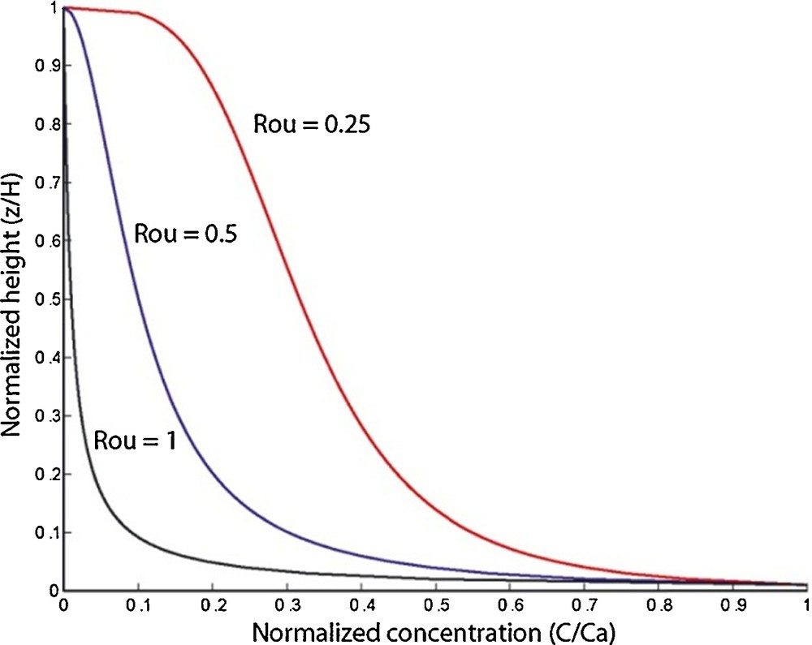
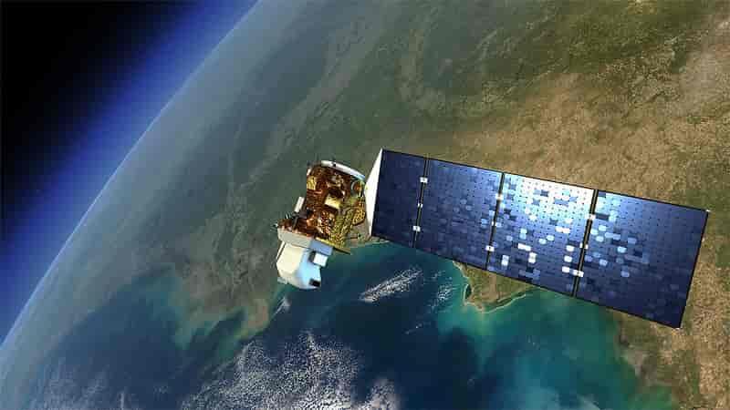
Implications
The impact on wider research
Many studies assume a homogenous sediment concentration profile within large rivers, and that this is stationary through time
Modelling studies which do not account for such variation may over or under-estimate the volumes of sediment being mobilised through the river system
Teles et al., 2016^{[11]}
Satellite-based remote sensing has begun to play a key role in monitoring sediment loads within the river network
If assumptions are made about the vertical mixing to extract depth integrated sediment concentrations, the accuracy of these may not be suitable and are likely to vary through time

Slide 25
Conclusions and future work
Conclusions
Sediment is a vital component of our river systems that requires detailed monitoring to further understand the processed governing sediment transport
ADCPs have proved effective at monitoring site-specific sediment loads, but few calibrations exist despite their widespread use for discharge monitoring
Using calibrations from the literature, a machine learning model has been developed to help overcome this, creating a predictive model based on backscatter, dominant grainsize class, and ADCP frequency
This has shown promising results both in comparison with the training data, and when comparing sediment concentration values between global and site-specific calibrations for example cross-sections
Consequently, it allows the identification of variations in vertical mixing between different rivers and through time, highlighting the importance of this research area

Slide 26
Conclusions and future work
Future work
Developing the calibration function to include more field calibration data.
Investigating the variation in sediment distribution through the water column across rivers globally, using both calibrated and uncalibrated units.
Exploring how sediment variation in the water column changes temporally, and what may be driving these changes

Slide 27
Conclusions and future work
Can you help?
The more calibration and test data available for this project the better
If you have ADCP data (with or without calibration), use the QR code to share with us
Include date, location, instrument frequency, and dominant grainsize (even if estimated)
Help us improve this research!

Slide 28
References
[1] Syvitski et al. 2009. doi.org/10.1038/ngeo629
[2] Chapman et al. 2016. doi.org/10.1007/s10584-016-1684-3
[3] USGS Water Data for USA
[4] HYBAM. https://hybam.obs-mip.fr/
[5] Latosinski et al. 2014. doi.org/10.1061/(ASCE)HY.1943-7900.0000859
[6] Venditti et al. 2016. doi.org/10.1002/2015WR017348
[7] Hackney et al. 2017. doi.org/10.1002/esp.4204
[8] Szupiany et al. 2019. doi.org/10.1002/esp.4572
[9] Ouellet Dallaire et al. 2019. doi.org/10.1088/1748-9326/aad8e9
[10] Teles et al. 2016. doi.org/10.1016/j.crte.2016.03.002

