Slide 1
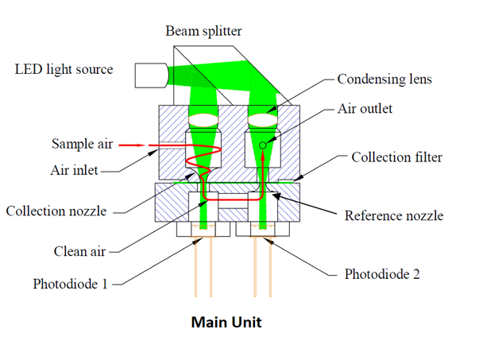
Status of Traceability in Black Carbon Measurements: Need of An Agreed Method
Arpit Malik^{1,2} and Shankar G. Aggarwal^{1,2}
¹CSIR-National Physical Laboratory, New Delhi, India, ²Academy of Scientific and Innovative Research (AcSIR) Ghaziabad, India
Emails: malikarpit5211@gmail.com, aggarwalsg@nplindia.org
Background
Literature Review
An Intercomparison of Two Commonly Used Photometers
Precise measurement of black carbon (BC) is crucial for regulatory compliance and identifying sources to mitigate health and climate effects.
Ground-based methods for measurement of BC in ambient air are broadly categorized into optical absorbance, evolved carbon, and laser-induced.
Block Diagram Categorizing Currently Available BC Measurement Methods
Among these, photometers based on the optical absorbance principle are widely used for continuous, long-term measurements due to their operational simplicity and ability to provide near real-time data.
There is inconsistency in critical measurement parameters involved such as standard wavelength, MAC value, and particulate matter size in which BC needs to be measured.
Furthermore, additional corrections are required to account for the multiple scattering and filter loading effects. Among these, the correction due to multiple scattering effect is the most significant.
Also, the independently derived MAC values of photometers at different sites are different from the manufacturer-recommended values.
Aethalometer (AE) is the most widely used photometer globally.
However, raw data of AE (M_{BC} (AE-raw) needs to be further corrected to account for the multiple scattering effect and change in MAC value from site to site.
Currently, there is a significant ambiguity in the correction factor (C_{o}) corresponding to the multiple scattering effects (C_{o} varying from 2.1 to 4.0; Singh et al., 2024) and MAC values of the Aethalometer.
Continuous soot monitoring system (COSMOS) has a low uncertainty limit (16%), does not require data corrections, and has a stable MAC value (Malik et al., 2022).
Singh et al. (2024) evaluated the MAC (AE) using C_{o}= 3.5 to correct the Aethalometer measurements at arctic and mid-latitudes. Therefore, the C_{o} value = 3.5 and MAC values derived in Singh et al. (2024) are used to derive M_{BC} (AE-corr) in the current study as well.
Ambient Air BC
(Mass Concentration)
Simulations (Reanalysis Data
of MERRA-2, CAMS)
Summary of Parameters, Specific Features, Uncertainty of Commercially Available Photometers
Instrument Name | Important Parameters |  |  | Special Feature (Advantage) | Reported Uncertainty Limits (±)
 | Wavelength (nm) | Recommended MAC (m²g⁻¹) | Detection Limit (ng m⁻³)
COSMOS (Continuous Soot Monitoring System) | 565 | 10 | 40 | Stabilized MAC value due to heated inlet | 12% (β_{abs}) 10% (MAC) Combined ⁓ 16%
Aethalometer (AE-31) | 370,470,520, 590,660,880, 950 | 39.5,31.1,28.1, 24.8,22.2,16.6, 15.4 | 100 | 7-wavelength operation and dual spot Mmeasurement | 36% (β_{abs}) 20% (MAC) Combined ⁓ 40%
MAAP (Multi Angle Absorption Photometer) | 670 | 6.6 | <50 | Optical scattering measured along absorption | 12% (β_{abs}) 25% (MAC) Combined ⁓ 28%
PSAP (Particle Soot Absorption Photometer) | 467,530,660 | NA | 100 | Compatible with Nephelometer to account for scaterring effect | Up to 50% in M_{BC}
Direct Measurement in Ambient Air
Evolved Carbon
(EC/OC Analyzer)
Laser-Induced
Incandescence
(SP2)
Optical Absorbance
(Aethalometer,
COSMOS)
1-hour averaged and 24-hour averaged M_{BC} (AE-raw) against simultaneous M_{BC} (COSMOS).
The initial large bias between raw data of Aethalometer (M_{BC} (AE-raw) = 1.92-1.98 times M_{BC} (COSMOS)) gets reduced significantly when the multiple correction factors and corrected value of MAC is used to correct Aethalometer data (M_{BC} (AE-corr) = 1.15-1.18 times M_{BC} (COSMOS)).
There is an imperative need to harmonize the correction factor due to multiple scattering.
It is crucial to derive the MAC values of photometers before long-term monitoring.
Further rigorous studies are required to recognize the most suitable and agreed-on method for continuous measurement of BC, and calibration protocols.
National-level regulatory bodies as well as national metrology institutes (NMIs), should come together to work towards standardizing the BC measurement method.
The light absorption of PM mass collected on the filter spot is measured in terms of absorption coefficient (β_{abs}) following the beer-lambert law.
The β_{abs} is then converted into BC mass concentration (M_{BC}) using a calibration constant (mass absorption cross-section, MAC) as per the following equation.
$$M_{BC}= \frac{ β_{abs}}{MAC}$$
Key Takeaways
Moreover, there is a lack of consensus on the traceable calibration procedures for commercially available optical absorbance-based photometers. Researchers utilizes different reference methods for calibration, including laser-induced incandescence (Malik et al., 2022), the evolved carbon (Li et al., 2023), and photoacoustic spectrometry (Malik and Aggarwal, 2021), each grounded in distinct measurement principles.
A schematic representing the working principle of a typical optical photometer.
References
1-hour averaged and 24-hour averaged M_{BC} (AE-corr) against simultaneous M_{BC} (COSMOS).
Li, W., Wang, Y., Yi, Z., Guo, B., Chen, W., Che, H., Zhang, X., 2023. Evaluation of MERRA-2 and CAMS reanalysis for black carbon aerosol in China. Environmental Pollution 123182.
Malik, A., Aggarwal, S.G., 2021. A Review on the Techniques Used and Status of Equivalent Black Carbon Measurement in Two Major Asian Countries. Asian Journal of Atmospheric Environment (AJAE) 15.
Malik, A., Aggarwal, S.G., Ohata, S., Mori, T., Kondo, Y., Sinha, P.R., Patel, P., Kumar, B., Singh, K., Soni, D., Koike, M., 2022. Measurement of Black Carbon in Delhi: Evidences of Regional Transport, Meteorology and Local Sources for Pollution Episodes. Aerosol Air Qual Res 22, 220128.
Singh, M., Kondo, Y., Ohata, S., Mori, T., Oshima, N., Hyvärinen, A., Backman, J., Asmi, E., Servomaa, H., Schnaiter, F.M. and Andrews, E., 2024. Mass absorption cross-section of black carbon for Aethalometer in the Arctic. Aerosol Science and Technology, pp.1-18.
Acknowledgements
A.M. is thankful to the Science and Engineering Research Board (DST-SERB) for providing travel funding under the International Travel Scheme (ITS) to attend this assembly. AM is also thankful to the University Grant Commission (UGC) for providing the fellowship under the UGC-SRF scheme (P90802) for this work. The Director, CSIR National Physical Laboratory is also acknowledged for facilitating the support.

