Slide 1
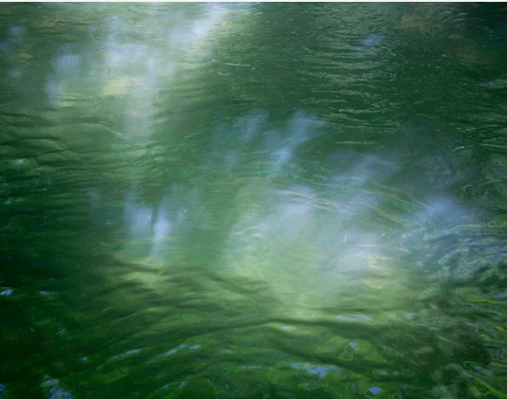







Patterns of green and blue water scarcities in agriculture
PICO presentation, EGU, 02.05.2025
Heindriken Dahlmann, Lauren Seaby Andersen, Sibyll Schaphoff and Dieter Gerten
Contact: heindriken.dahlmann@hu-berlin.de
Photo credits: Regina Hügli

Slide 2
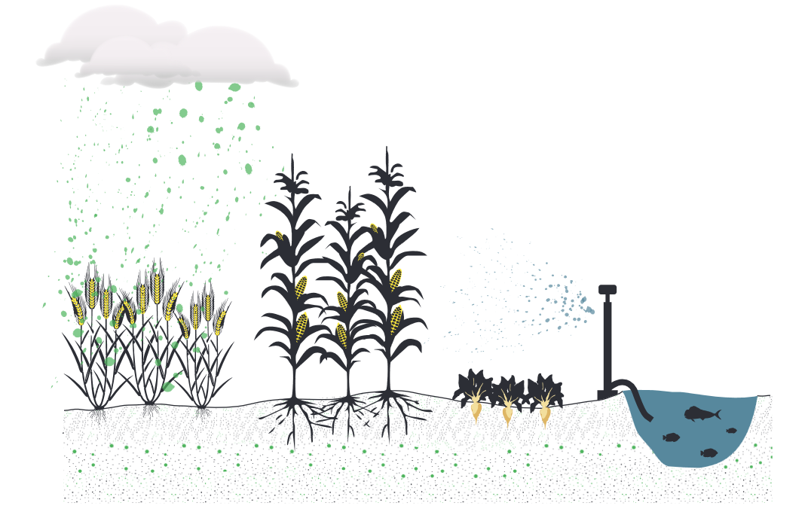
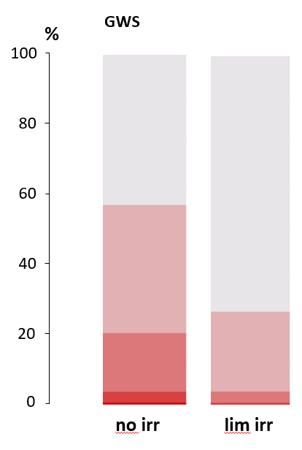
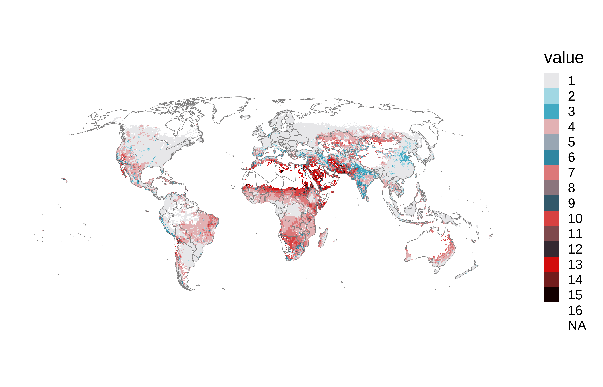
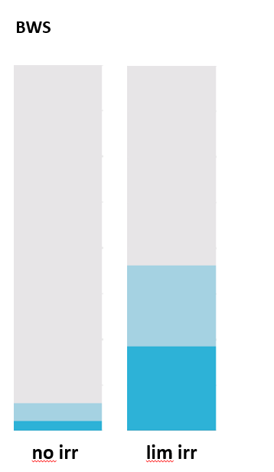

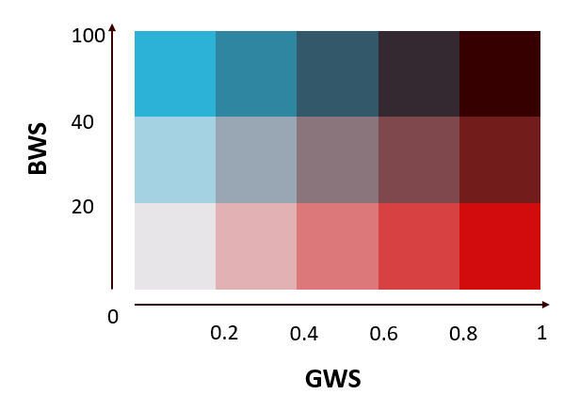
Patterns of green and blue water scarcities in agriculture (Heindriken Dahlmann^{1,2}, Lauren Seaby Andersen², Sibyll Schaphoff² and Dieter Gerten^{1,2}, in prep.)
¹ Integrative Research Institute on the Transformations of Human-Environment Systems (IRI THESys) & Geography Institute, Humboldt-Universität zu Berlin, Berlin, Germany
² Potsdam Institute for Climate Impact Research (PIK), Member of the Leibniz Association, Potsdam, Germany
Green water stress
→ Analysis of 12 rainfed and 12 irrigated crops
Water stresses modeled with the Dynamic Global Vegetation Model LPJmL
Interlinkages
Where are current hotspots of green and blue water stresses in agriculture and how are they interlinked?
Are there sufficient local blue water resources to buffer green water stress in a sustainable way?
Blue water stress
Green water stress
Blue water stress
% of agricultural area in cells with irrigation
Irrigation mitigates green water stress
This however increases blue water stress in many regions
30%
~
38%
~

Slide 3
Patterns of green and blue water scarcities in agriculture (Heindriken Dahlmann^{1,2}, Lauren Seaby Andersen², Sibyll Schaphoff² and Dieter Gerten^{1,2}, in prep.)
¹ Integrative Research Institute on the Transformations of Human-Environment Systems (IRI THESys) & Geography Institute, Humboldt-Universität zu Berlin, Berlin, Germany
² Potsdam Institute for Climate Impact Research (PIK), Member of the Leibniz Association, Potsdam, Germany
Green water stress
→ Analysis of 12 rainfed and 12 irrigated crops
Water stresses modeled with the Dynamic Global Vegetation Model LPJmL
Interlinkages
Where are current hotspots of green and blue water stresses in agriculture and how are they interlinked?
Are there sufficient local blue water resources to buffer green water stress in a sustainable way?
Blue water stress
Green water stress
Blue water stress
% of agricultural area in cells with irrigation
Irrigation mitigates green water stress
This however increases blue water stress in many regions
30%
~
38%
~

Slide 4
Patterns of green and blue water scarcities in agriculture (Heindriken Dahlmann^{1,2}, Lauren Seaby Andersen², Sibyll Schaphoff² and Dieter Gerten^{1,2}, in prep.)
¹ Integrative Research Institute on the Transformations of Human-Environment Systems (IRI THESys) & Geography Institute, Humboldt-Universität zu Berlin, Berlin, Germany
² Potsdam Institute for Climate Impact Research (PIK), Member of the Leibniz Association, Potsdam, Germany
Green water stress
→ Analysis of 12 rainfed and 12 irrigated crops
Water stresses modeled with the Dynamic Global Vegetation Model LPJmL
Interlinkages
Where are current hotspots of green and blue water stresses in agriculture and how are they interlinked?
Are there sufficient local blue water resources to buffer green water stress in a sustainable way?
Blue water stress
Green water stress
Blue water stress
% of agricultural area in cells with irrigation
Irrigation mitigates green water stress
This however increases blue water stress in many regions
30%
~
38%
~
No irrigation
Limited irrigation
No irrigation
Limited irrigation

Slide 5








Literature
Background
Interlinkages
Methodology
Summary
Blue water stress
Green water stress

Slide 6

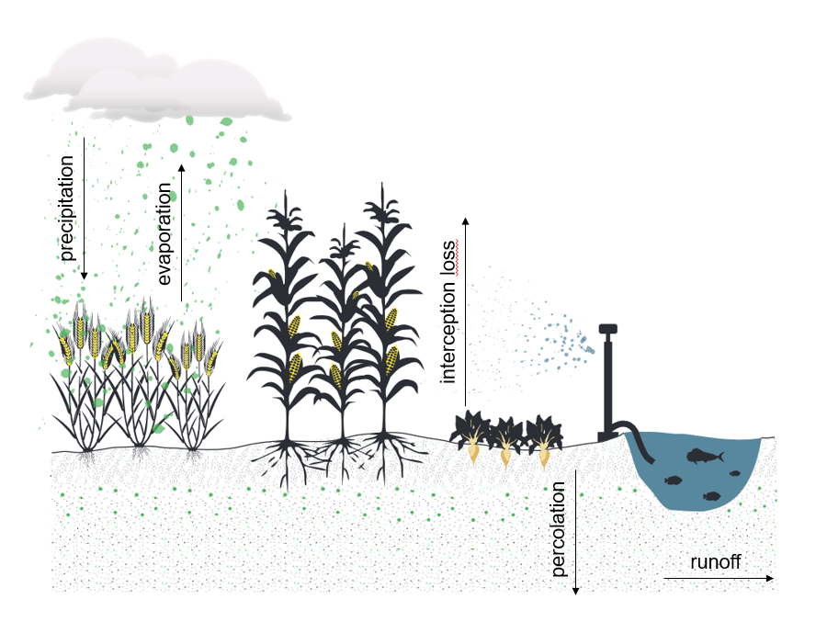

Background
Blue water resources (lakes, rivers, reservoirs, …) have been the focus of water scarcity analyses for a long time (Kummu et al., 2016; Mekonnen et al., 2016; Veldkamp et al., 2017)
Green water resources (soil moisture, precipitation, …) account for 85-90% of the water consumed by agriculture → major importance for food security (Rost et al., 2008; Rockström et al., 2009)
Discussions about the central role, potential limitation, and sustainable use of green water long absent, its availability was often taken for granted
Integrated scarcity assessments increase, but most of them simply overlay different individual scarcities

Slide 7
Background
an explicit consideration of the interlinkages between green and blue water stresses in a dynamic and process-based manner
Developing a green water stress index based on the plant-available soil moisture and atmospheric moisture deficit to map current green water stress hotspots
Mapping how irrigation is applied to mitigate green water stress
Analyzing the degree to which this irrigation increases blue water stress
Better understanding whether sufficient blue water resources are available to sustainably alleviate green water stress
What is needed?
What did we do?

Slide 8





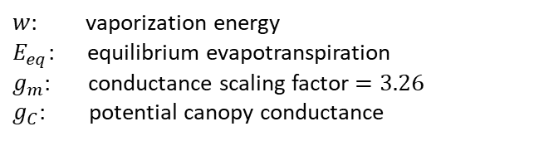


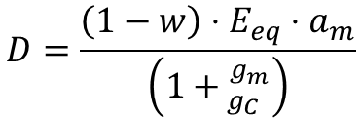

Methodology
Green water stress index
Blue water stress index
$$GWS=1 − \frac{S}{D}$$
$$BWS= \frac{WUdom+WUind+WUirr}{Q}$$
$WUdom$: domestic water use
${WU}_{ind}$: industrial water use
${WU}_{irr}$: irrigation water use
$Q$: discharge
Soil water supply
$$S=E_{max}⋅W_{r}$$
$E_{max}$: maximum transpiration rate $w_{r}$: relative soil moisture
Atmospheric demand
$$D=\frac{\left(1−w\right)⋅E_{eq}⋅a_{m}}{\left({1+ }_{g_{C}}^{g_{m}}\right)}$$
$w$: vaporization energy
$E_{eq}$: equilibrium evapotranspiration
$g_{m}$: conductance scaling factor $=3.26$
$g_{C}$: potential canopy conductance
: Priestly-Taylor coefficient = $1.391$

Slide 9
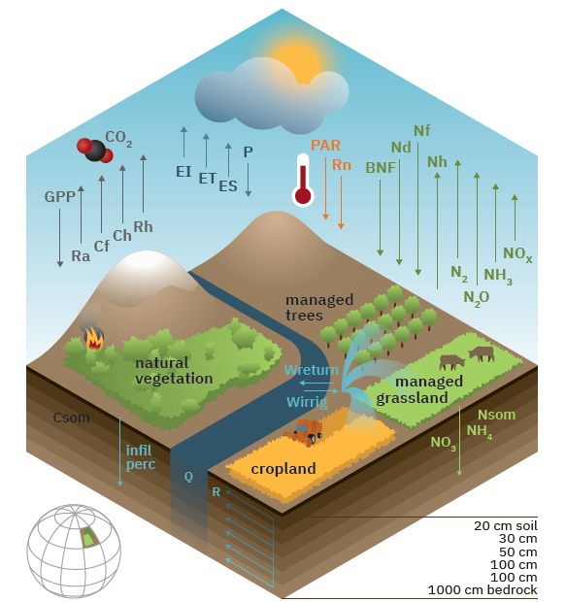




Methodology
LPJmL model
Computed on monthly basis & at grid cell level
Focuses on 12 CFTs (12 rainfed and 12 irrigated): temperate cereals, rice, maize, tropical cereals, pulses, temperate roots, tropical roots, sunflower, soybean, groundnut, rapeseed and sugar cane
Computed only for individual growing periods of the CFTs
In order to calculate GWS of all CFTs in a grid cell: GWS weighted and normalized
Source: https://www.pik-potsdam.de/en/institute/departments/activities/biosphere-water-modelling/lpjml

Slide 10
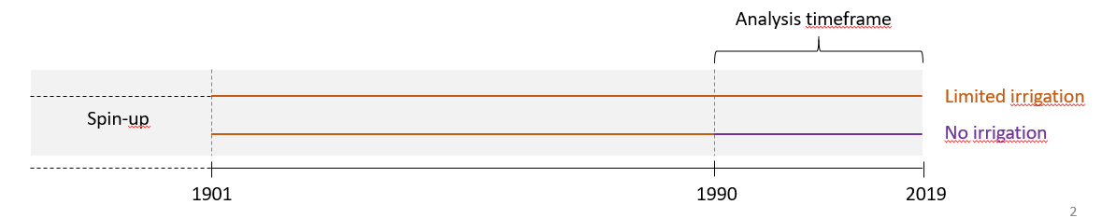
Methodology
Model runs
(1) No irrigation run
all agricultural area considered as rainfed
(2) Limited irrigation run
agriculture either rainfed or irrigated
considering water availability in cell and neighboring cells
Analysis timeframe
Limited irrigation
No irrigation

Slide 11

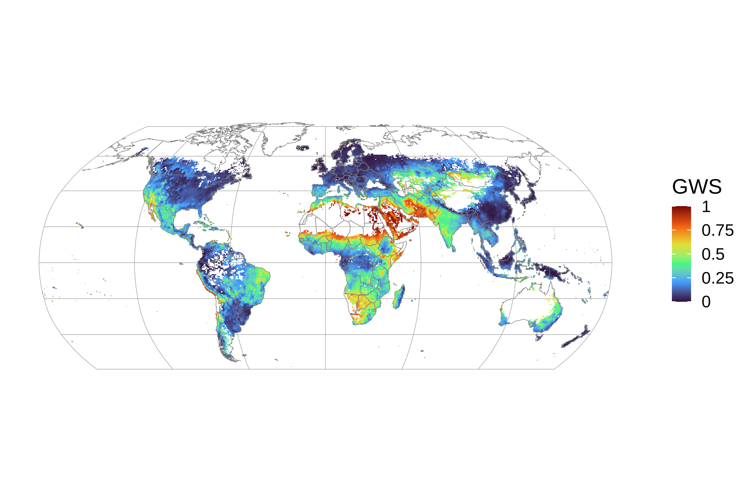


Preliminary results: Green water stress
Average green water stress 2015-2019 (no irrigation run)
Without irrigation around 450 Mha of agricultural area would experience green water stress (GWS > 0.2) globally. With irrigation, this number decreases to ca. 300 Mha.
→ average over all months and crops
High green water stress
No green water stress

Slide 12
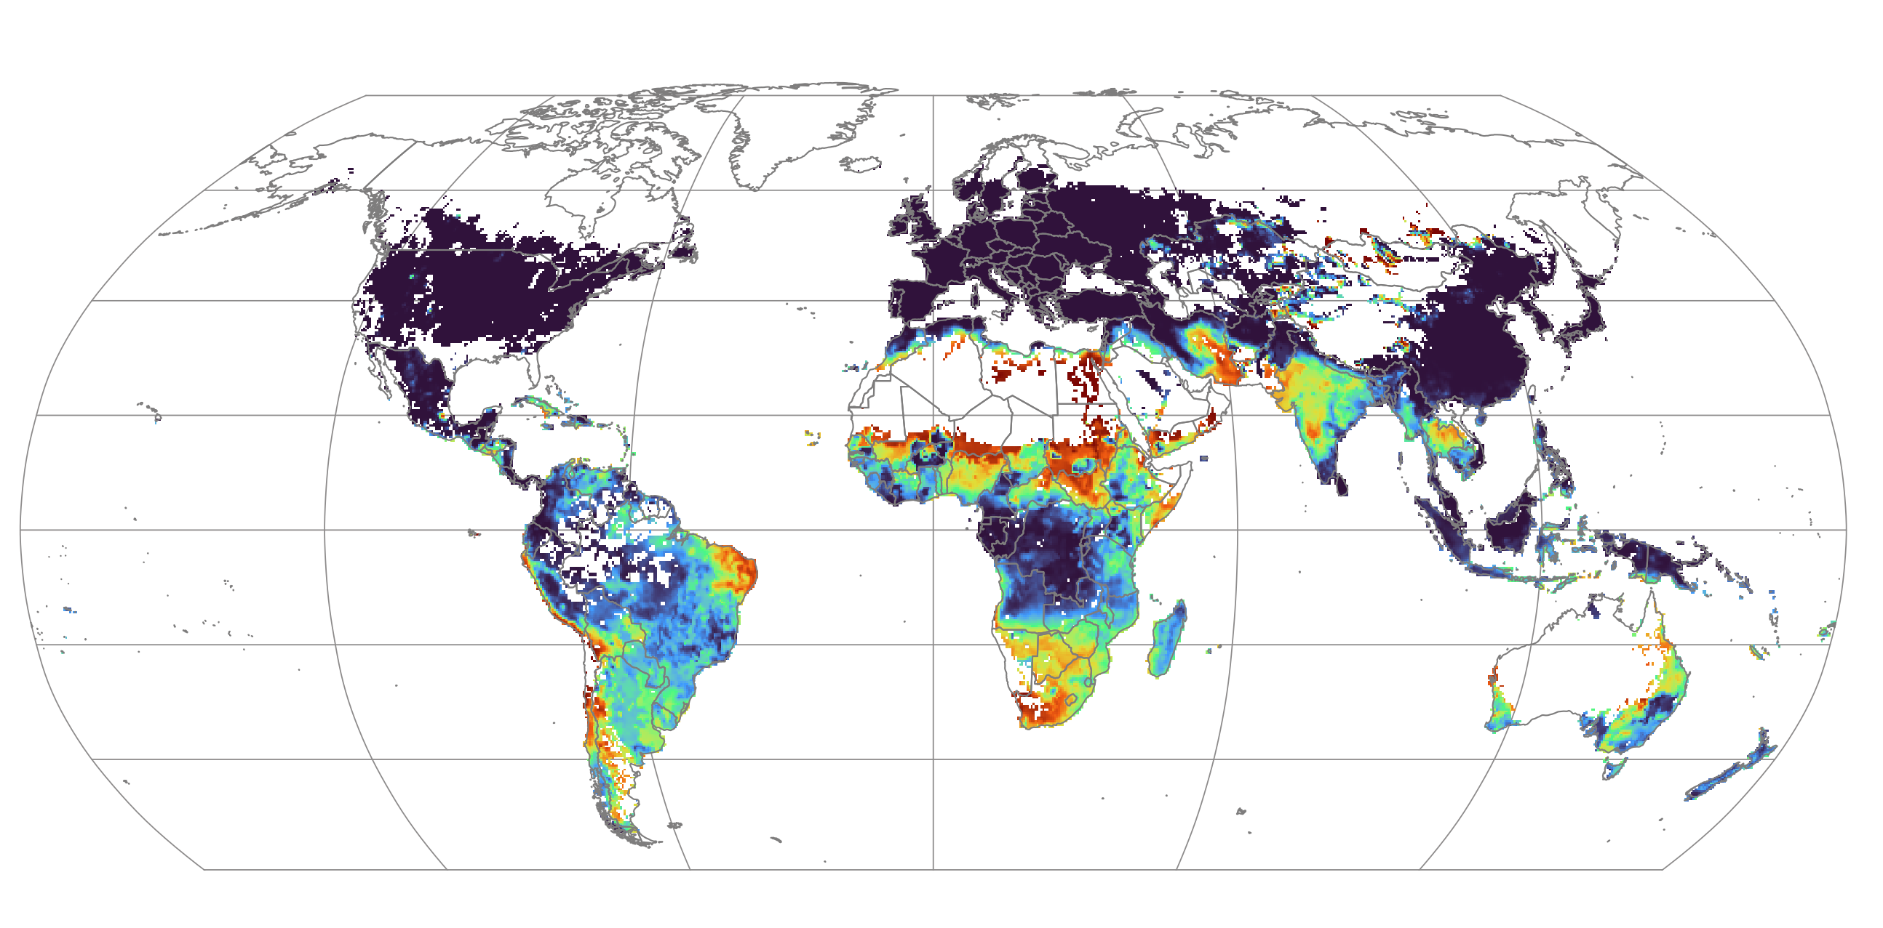
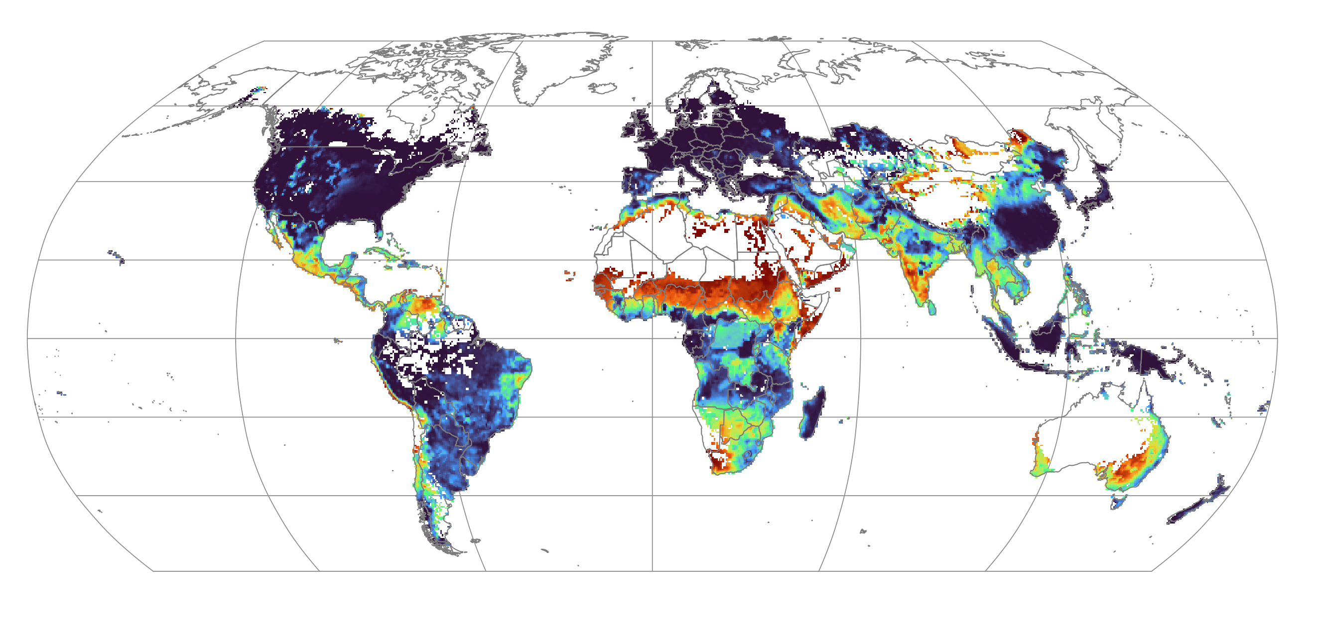

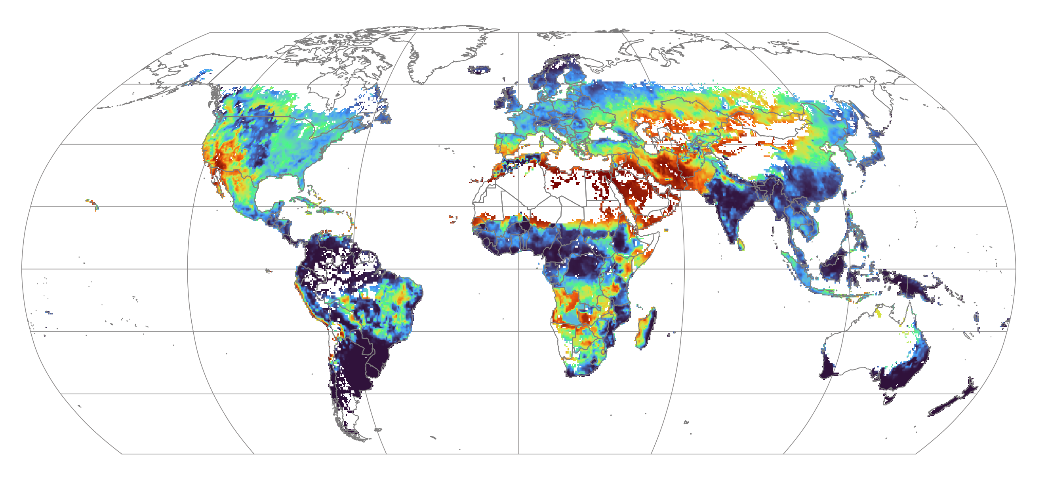
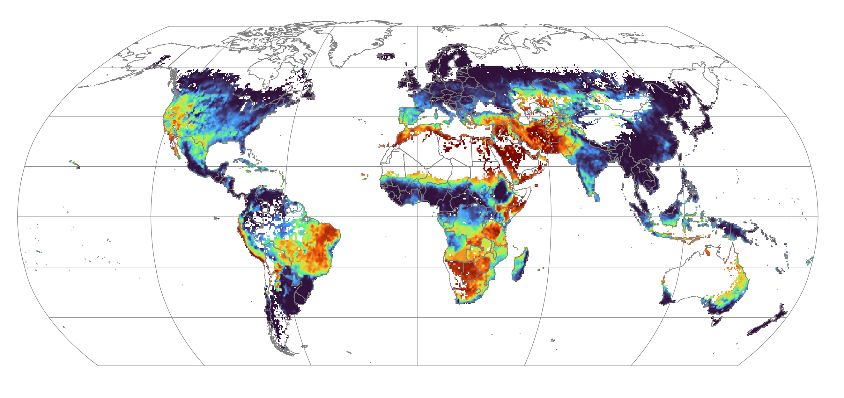
Preliminary results: Green water stress
Seasonal averages 2015-2019 (no irrigation run)
December, January, February
March, April, May
Green water stress during
drought year 2018
June, July, August
September, October, November

Slide 13
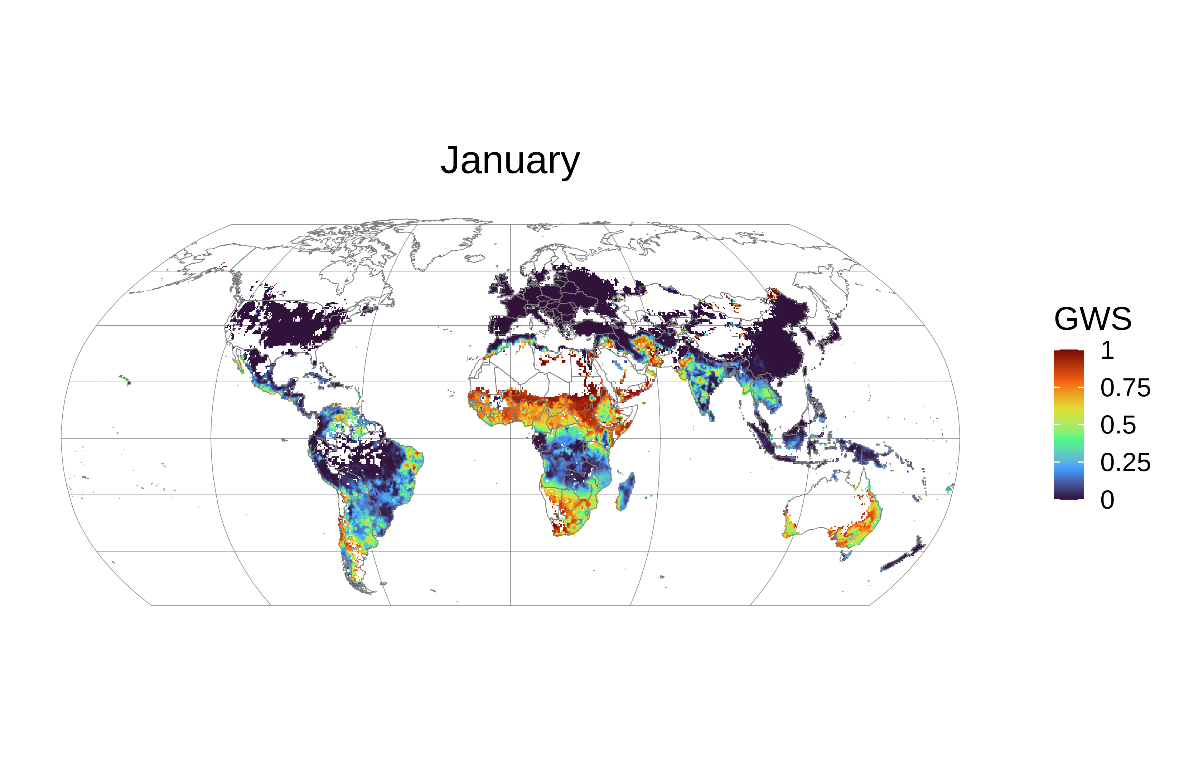
Preliminary results: Green water stress
Green water stress during 2018
→ Average over all crops, no irrigation run
High green water stress
No green water stress

Slide 14
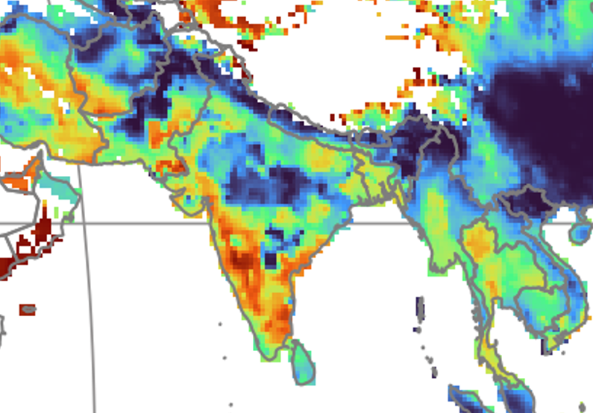
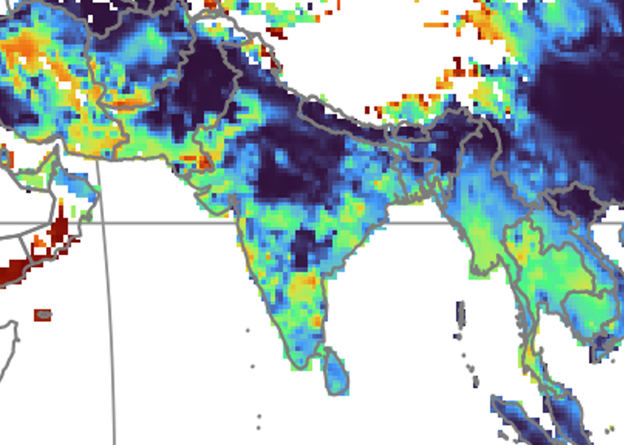
Preliminary results: Green water stress
Differences in green water stress comparing no irrigation and limited irrigation run
→ since most areas are rainfed, not many changes visible in the global maps
→ irrigated areas show large differences, because here irrigation buffers green water stress
e.g. India, average GWS in spring (2015-2019)
no irrigation run
limited irrigation run

Slide 15

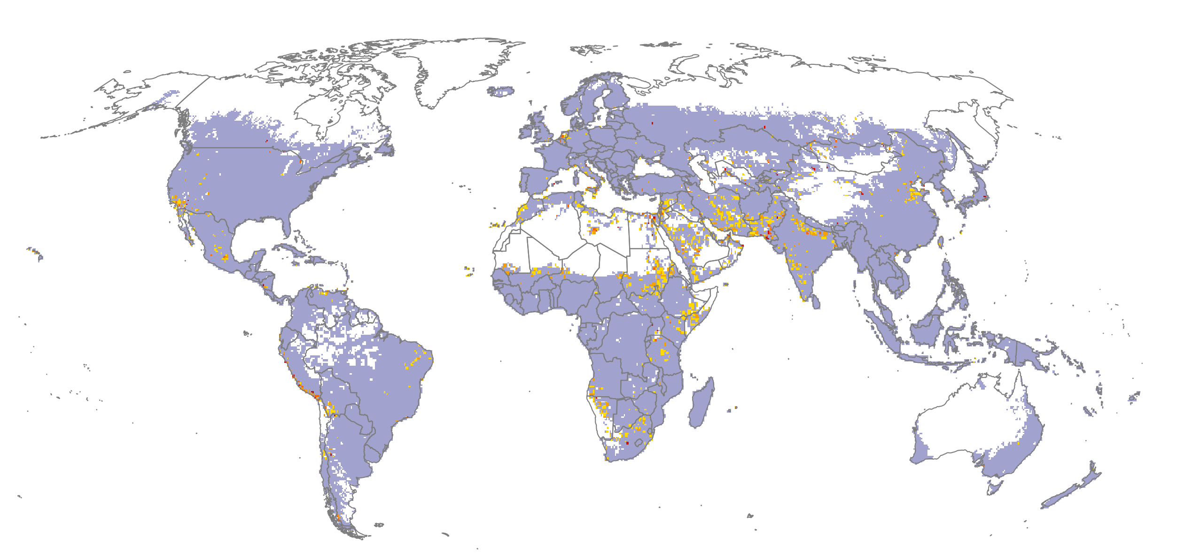
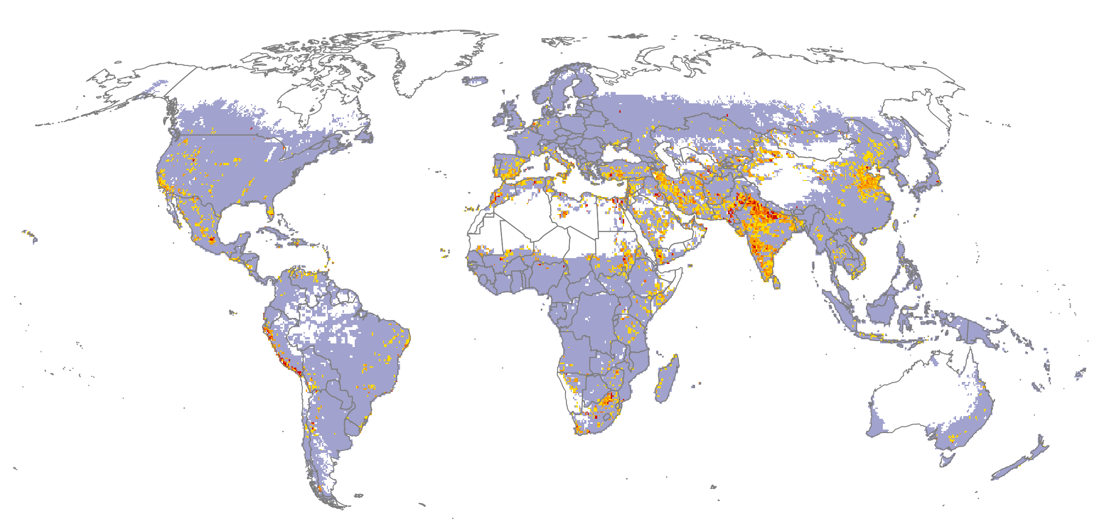
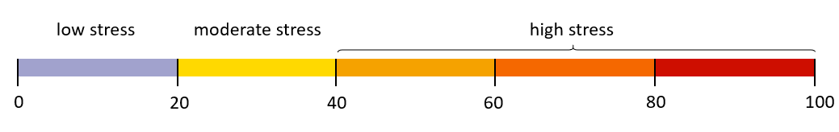
Preliminary results: Blue water stress
Average blue water stress 2015-2019
no irrigation run limited irrigation run

Slide 16




Preliminary results: Interlinkages between water stresses
Combined water stresses, average 2015-2019 (limited irrigation run)
no GWS, high BWS
high GWS, high BWS
high GWS, no BWS

Slide 17
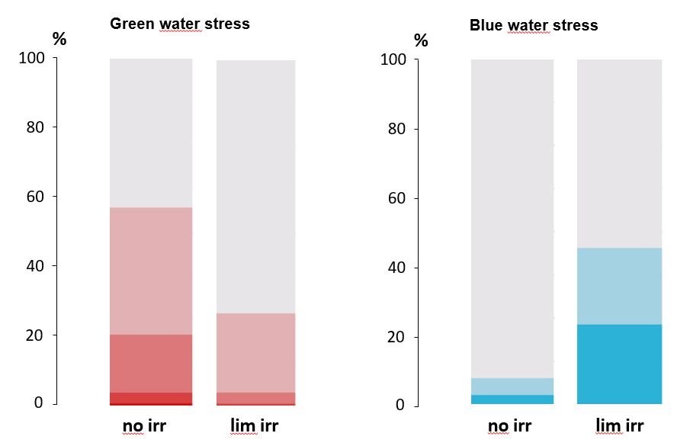
Preliminary results: Interlinkages between water stresses
Main regions experiencing green and blue water stress at the same time: MENA, Pakistan, Afghanistan, Somalia
Irrigation decreases green water stress in ca. 30% of the agricultural area in cells with irrigation
Due to this, areas with moderate blue water stress increase by ca. 17% and with high blue water stress by ca. 20%
no
irrigation run
limited irrigation run
no
irrigation run
limited irrigation run

Slide 18
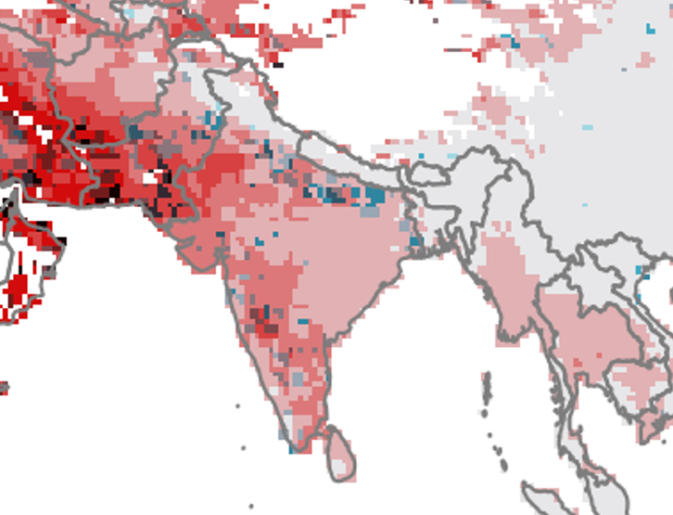
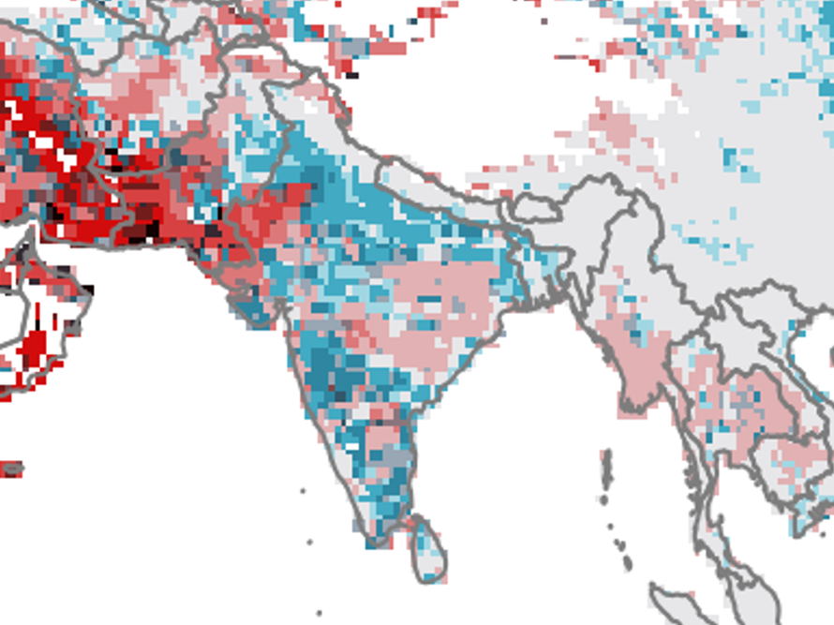
Preliminary results: Interlinkages between water stresses
Differences in water stress interlinkages comparing no irrigation and limited irrigation run
→ Irrigation is mainly driving increases in blue water stress
e.g. India, combining green and blue water stress (2015-2019)
no irrigation run
limited irrigation run

Slide 19
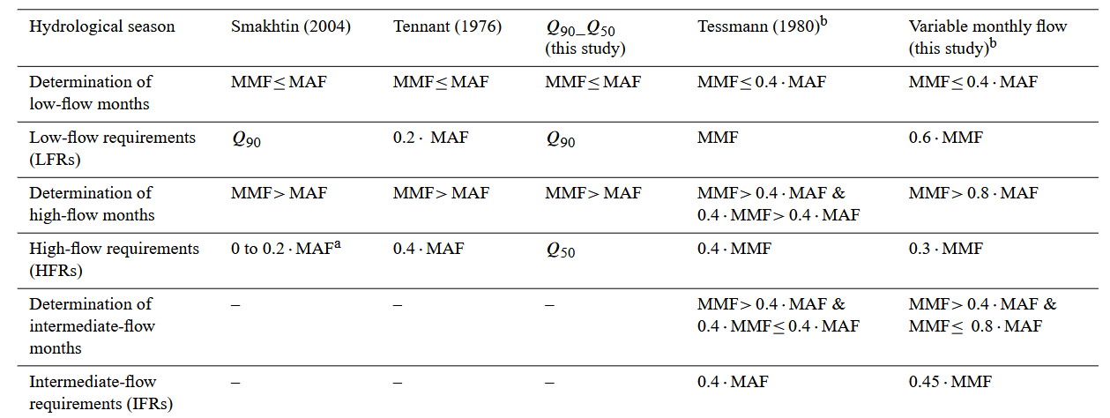
Preliminary results: Interlinkages between water stresses
Are there sufficient local blue water resources to buffer green water stress in a sustainable way?
Here, sustainability refers to considering environmental flow requirements (using the Variable Monthly Flow method)
Preliminary results:
Due to irrigation, ~ 340 km³/yr⁻¹ water added from non-sustainable water resources
Considering environmental flow requirements, this number rises up to ~ 500 km³/yr⁻¹
Challenges and limitations
Groundwater use (currently not included)
Telecoupled water flows (global perspective)
Environmental flow requirements
Pastor et al., 2014

Slide 20


Summary
Green water stress index
→ Analysis of 12 rainfed and 12 irrigated crops
Water stresses modeled with the Dynamic Global Vegetation Model LPJmL
Green water stress
$$GWS=1 − \frac{S}{D}$$
Blue water stress index
Interlinkages
Where are current hotspots of green and blue water stresses in agriculture and how are they interlinked?
Are there sufficient local blue water resources to buffer green water stress in a sustainable way?
$$BWS= \frac{WUdom+WUind+WUirr}{Q}$$
Blue water stress
Green water stress
Blue water stress
% of agricultural area in cells with irrigation
Blue water stress has increased due to the mitigation of green water stress
Water volume used from non-sustainable water resources: ~ 500 km³yr⁻¹
30%
~
38%
~
No irrigation
Limited irrigation
No irrigation
Limited irrigation

Slide 21

Literature
References for this presentation
Kummu, M., J. H. A. Guillaume, H. De Moel, S. Eisner, M. Flörke, M. Porkka, S. Siebert, T. I. E. Veldkamp, und P. J. Ward. „The World’s Road to Water Scarcity: Shortage and Stress in the 20th Century and Pathways towards Sustainability“. Scientific Reports 6, Nr. 1 (9. Dezember 2016): 38495. https://doi.org/10.1038/srep38495.
Mekonnen, Mesfin M., und Arjen Y. Hoekstra. „Four Billion People Facing Severe Water Scarcity“. Science Advances 2, Nr. 2 (5. Februar 2016): e1500323. https://doi.org/10.1126/sciadv.1500323.
Pastor, A. V., Ludwig, F., Biemans, H., Hoff, H., and Kabat, P.: Accounting for environmental flow requirements in global water assessments, Hydrol. Earth Syst. Sci., 18, 5041–5059 (2014), https://doi.org/10.5194/hess-18-5041-2014.
Rockström, Johan, Malin Falkenmark, Louise Karlberg, Holger Hoff, Stefanie Rost, und Dieter Gerten. „Future Water Availability for Global Food Production: The Potential of Green Water for Increasing Resilience to Global Change“. Water Resources Research 45, Nr. 7 (Juli 2009): 2007WR006767. https://doi.org/10.1029/2007WR006767.
Rost, Stefanie, Dieter Gerten, Alberte Bondeau, Wolfgang Lucht, Janine Rohwer, und Sibyll Schaphoff. „Agricultural Green and Blue Water Consumption and Its Influence on the Global Water System“. Water Resources Research 44, Nr. 9 (September 2008): 2007WR006331. https://doi.org/10.1029/2007WR006331.
Veldkamp, T.I.E., Y. Wada, J.C.J.H. Aerts, P. Döll, S. N. Gosling, J. Liu, Y. Masaki, u. a. „Water Scarcity Hotspots Travel Downstream Due to Human Interventions in the 20th and 21st Century“. Nature Communications 8, Nr. 1 (15. Juni 2017): 15697. https://doi.org/10.1038/ncomms15697.

Slide 22
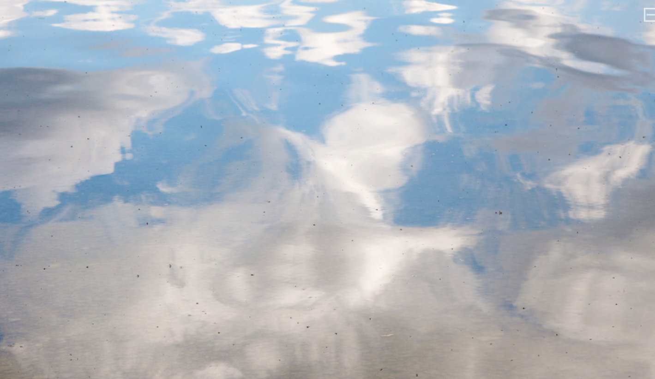


If you have comments, questions, ideas – please reach out!
Heindriken Dahlmann
heindriken.dahlmann@hu-berlin.de
PhD researcher at the IRI THESys, Humboldt-Universität zu Berlin Guest researcher at the Potsdam-Institut for Climate Impact Research
Link to the abstract
Photo credits: Regina Hügli

