Slide 1



Sediment pathways to small rivers in loamy agricultural region and where to find them
Emilie PEIFFER, Adrien MICHEZ & Aurore DEGRÉ
University of Liège, TERRA Teaching and Research Centre, Gembloux Agro-Bio Tech, Belgium
Notes:
Thank you for the introduction!

Slide 2
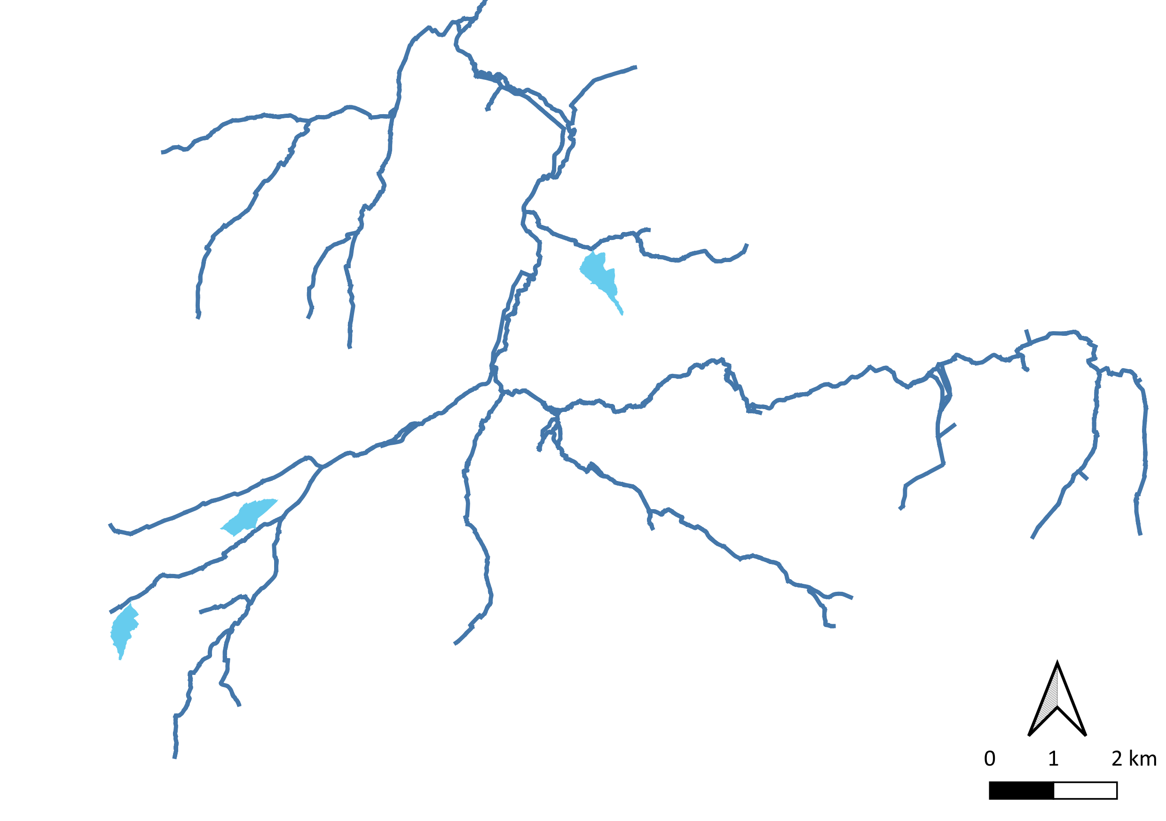








Finding pathways to small rivers
River (> 1 km²)
<
Catchment (> 0.2 km²)

Slide 4
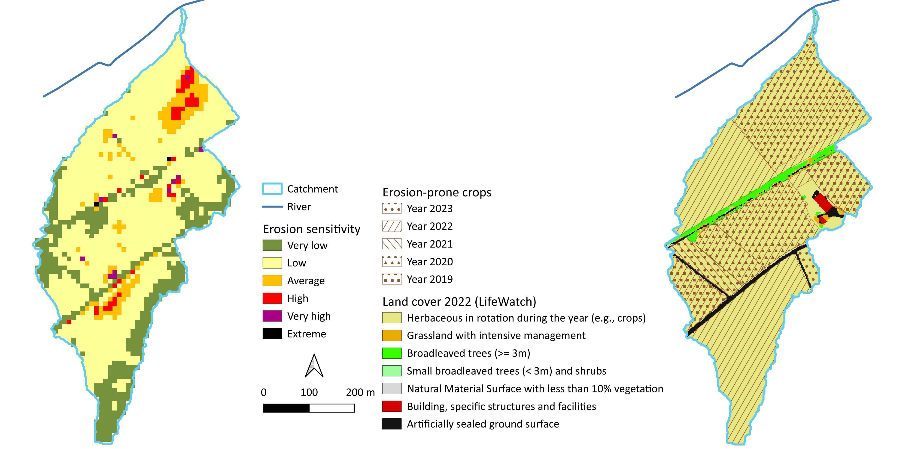

Sediment productive catchment
Rain erosivity
Soil erodibility
Slope length and steepness
Agricultural history

Slide 5
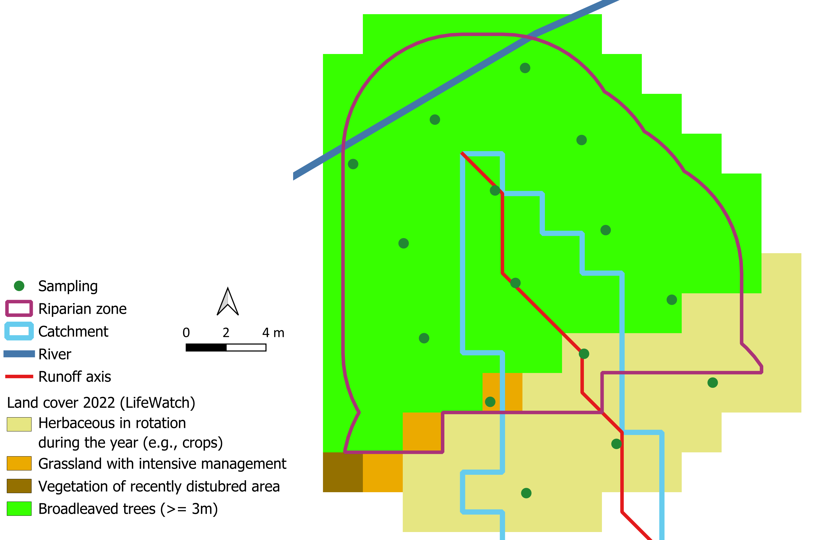
Sediment control : the riparian zone ?
Geometric configuration
Land cover
River type
…
Analysis :
  Soil texture
  Organic carbon
  Phosphorus

Slide 6



PICO4.9
Notes:
Thank you for the introduction!

Slide 7
Sediment pathways to small rivers in loamy agricultural region and where to find them
Emilie PEIFFER, Adrien MICHEZ & Aurore DEGRÉ
University of Liège, TERRA Teaching and Research Centre, Gembloux Agro-Bio Tech, Belgium
PICO
Introduction
Objectives
Study area
Catchment
Riparian zone
Sediment
Perspectives

Slide 8
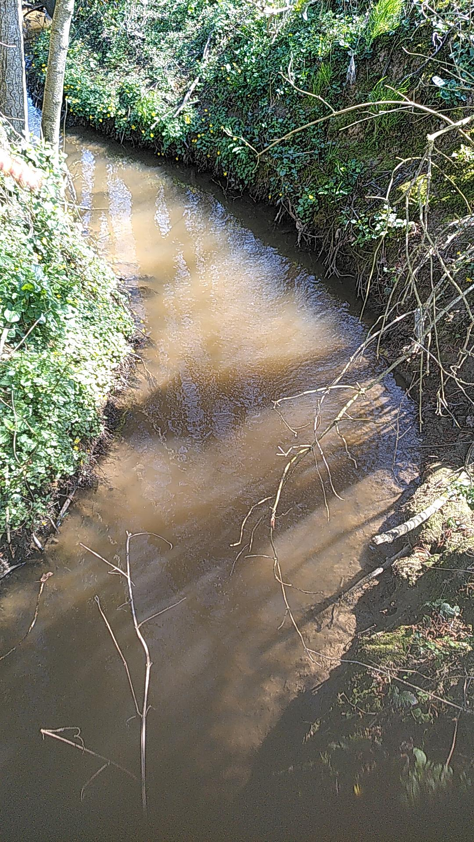
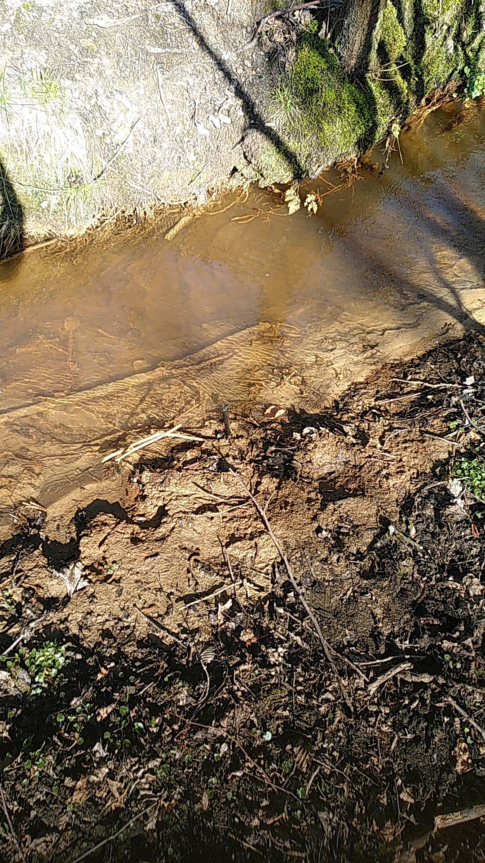
Sediment impact on river health
Catchment
Riparian zone
Perspectives
Sediment
Introduction
Study area
Objectives
Contamination
  Heavy metals
  Eutrophication
River morphology
Habitat
  Clogging
Turbidity

Slide 9
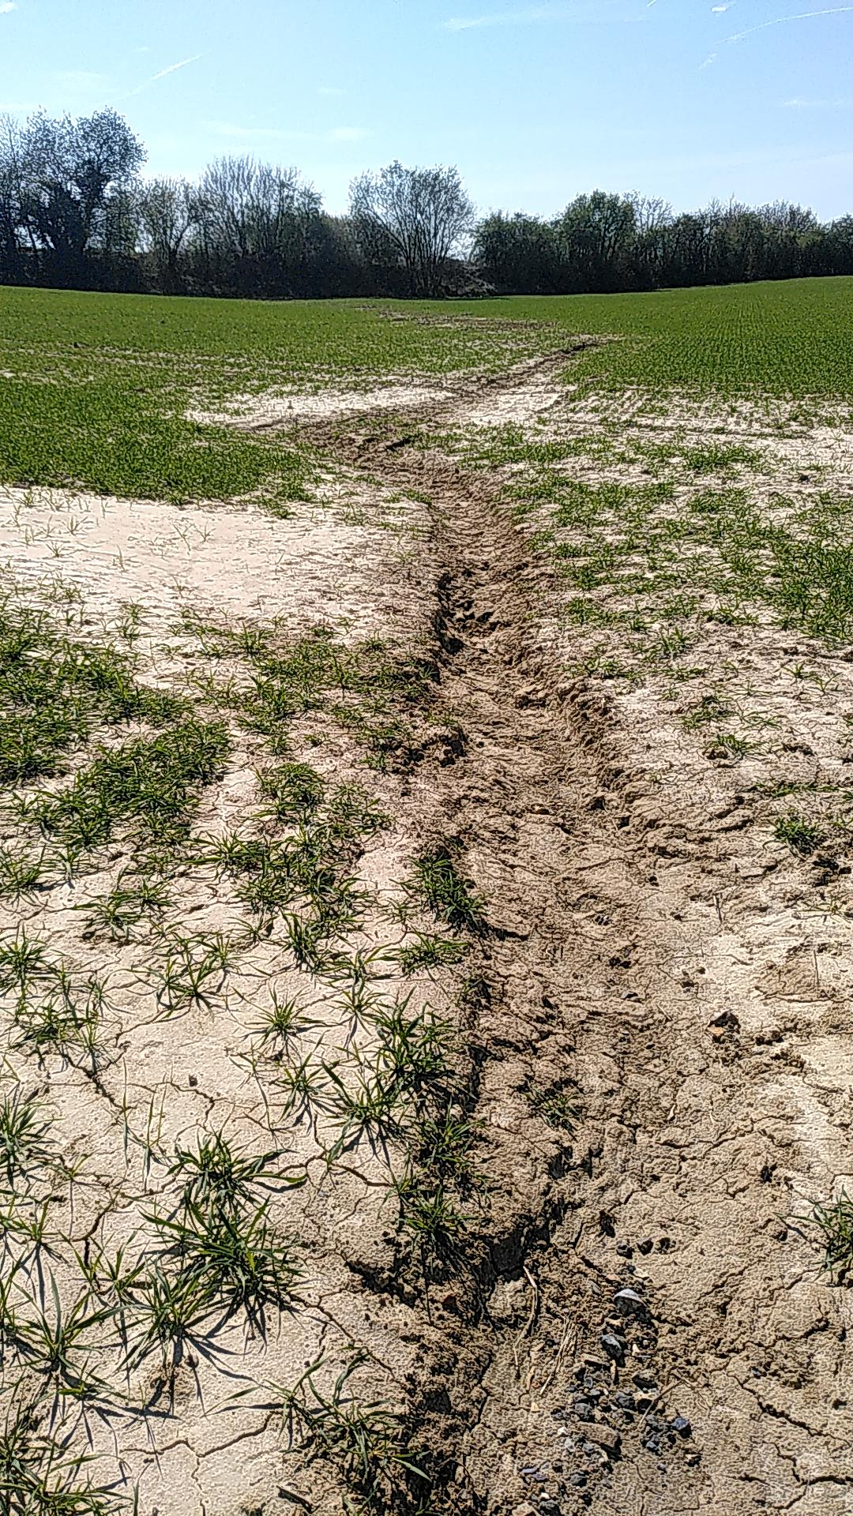
Sediment origin
Catchment
Riparian zone
Perspectives
Sediment
Introduction
Study area
Objectives
Bank erosion
Catchment erosion
Factors of soil erosion by water
  Climate: intense rainfalls
  Soil properties: soil texture, organic matter
  Landscape topography: slope steepness, curvature and uniformity
  Land-use: inappropriate agricultural practices

Slide 10
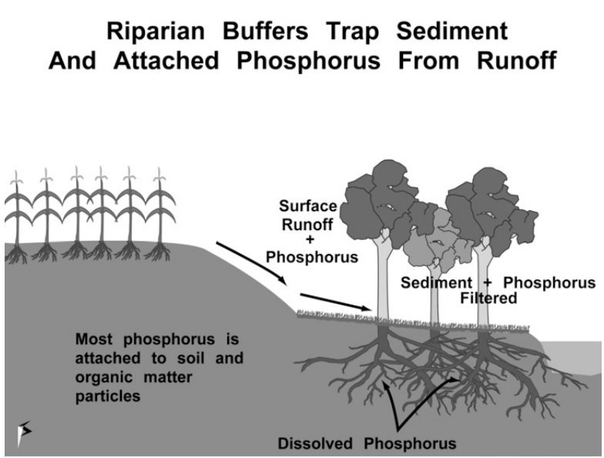
Sediment control solution ?
Catchment
Riparian zone
Perspectives
Sediment
Introduction
Study area
Objectives
Riparian zone : vegetation associated with semi-permanent rivers
It has a strong control on the aquatic ecosystem of small rivers :
Shade
Temperature
Bank stability
…
Schultz & al., 2009

Slide 11


Related legislation
Catchment
Riparian zone
Perspectives
Sediment
Introduction
Study area
Objectives
Water Framework Directive:
  Good water quality and quantity to support human and wildlife needs
  River Basin Management Plans
  Division of the river network into “surface water bodies”
    Artificial
    Heavily modified
    Natural
Common Agricultural Policy:
  GAEC 4: Buffer strips along watercourses
  Wallonia: 6 m
  Anonymous agricultural land parcels

Slide 12
Objectives
Catchment
Riparian zone
Perspectives
Sediment
Introduction
Study area
Objectives
  Identify where and how riparian vegetation should be used to mitigate sediment transfer and deposition.
  Locate small agricultural catchments prone to sediment transfer to the river
  Understand how riparian zones can prevent sediment transfer from the land to the river.

Slide 13
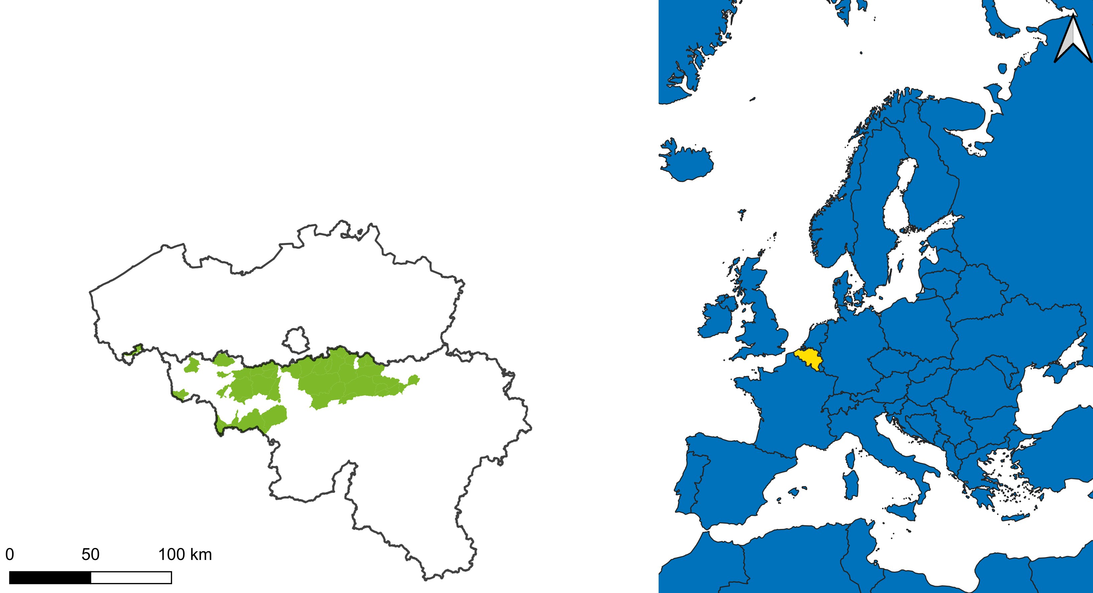
Zone of interest : Loess region (Wallonia)
Catchment
Riparian zone
Perspectives
Sediment
Introduction
Study area
Objectives
3 941 km²
Loamy soil
About 65% of the surface: agriculture
Natural surface water bodies
Notes:
Rajouter carte de l’Europe avec la Belgique/Wallonie en avant ?
+ Rajouter Meuse et Sambre sur carte verte ?

Slide 14
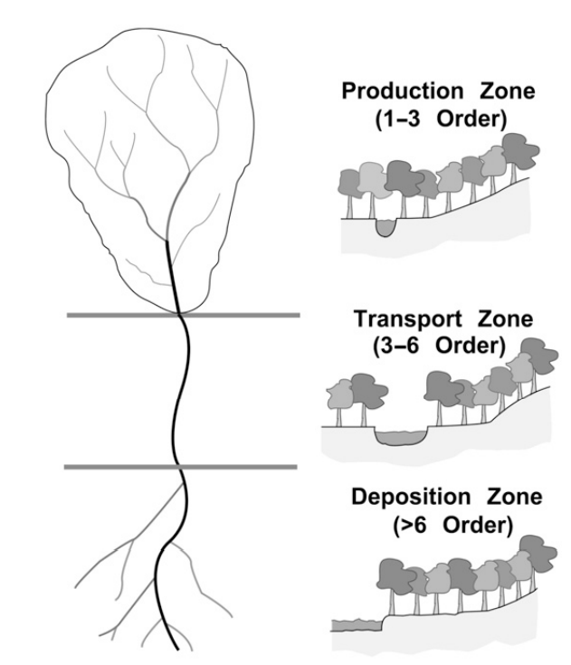
Landscape position
Catchment
Riparian zone
Perspectives
Sediment
Introduction
Study area
Objectives
Schultz, R. c. et al. Riparian and Upland Buffer Practices. in North American Agroforestry: An Integrated Science and Practice 163–218 (John Wiley & Sons, Ltd, 2009). doi:10.2134/2009.northamericanagroforestry.2ed.c8.

Slide 15
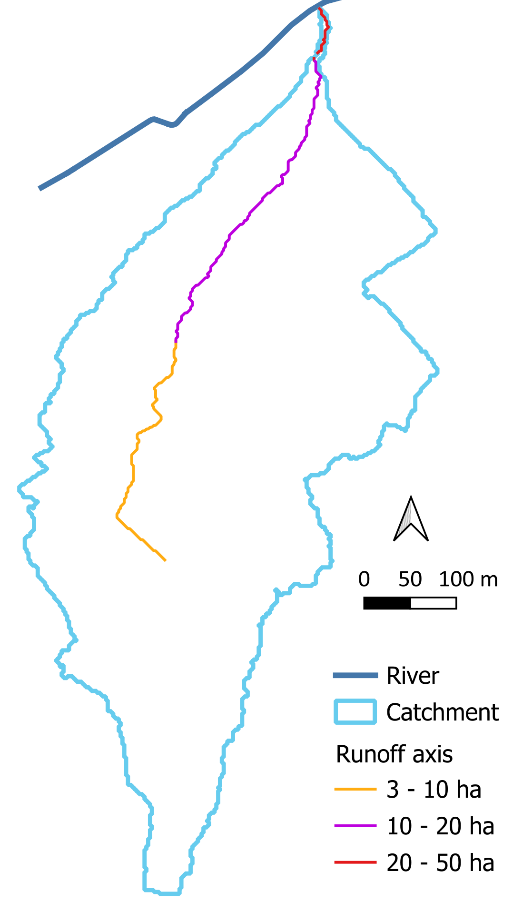
Catchment delineation
Catchment
Riparian zone
Perspectives
Sediment
Introduction
Study area
Objectives
At least 0.2 km²
With an outlet in a river
Based on :
Flow accumulation: LIDAXES [2 m]
River: Walloon hydrographic network [2.5 m]
Notes:
Refaire carte

Slide 16
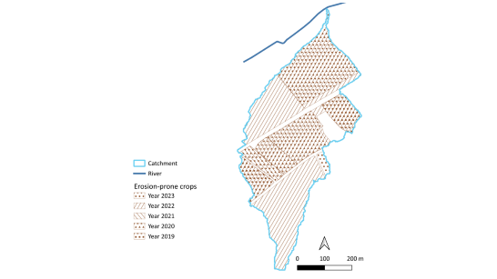
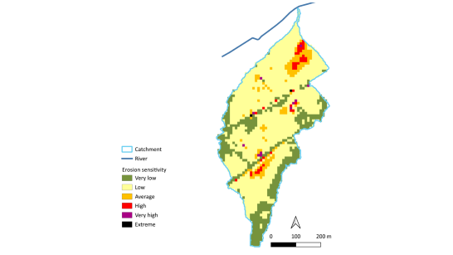
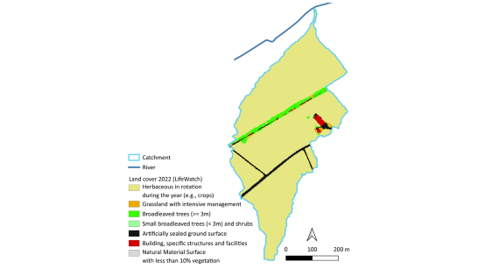
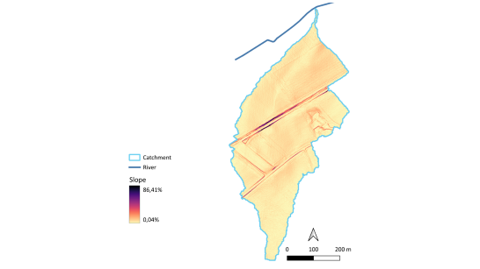
Catchment parameters
Catchment
Riparian zone
Perspectives
Sediment
Introduction
Study area
Objectives
Erosion sensitivity [10 m] Rain erosivity Soil erodibility Slope length and steepness |  | Erosion-prone crops based on agricultural history (2015 to 2023) [2.5 m]
Slope attributes [0.5 m] Number of changes Curvature Steepness Length |  | Land cover from 2022 [2 m]
Notes:
Refaire carte

Slide 17
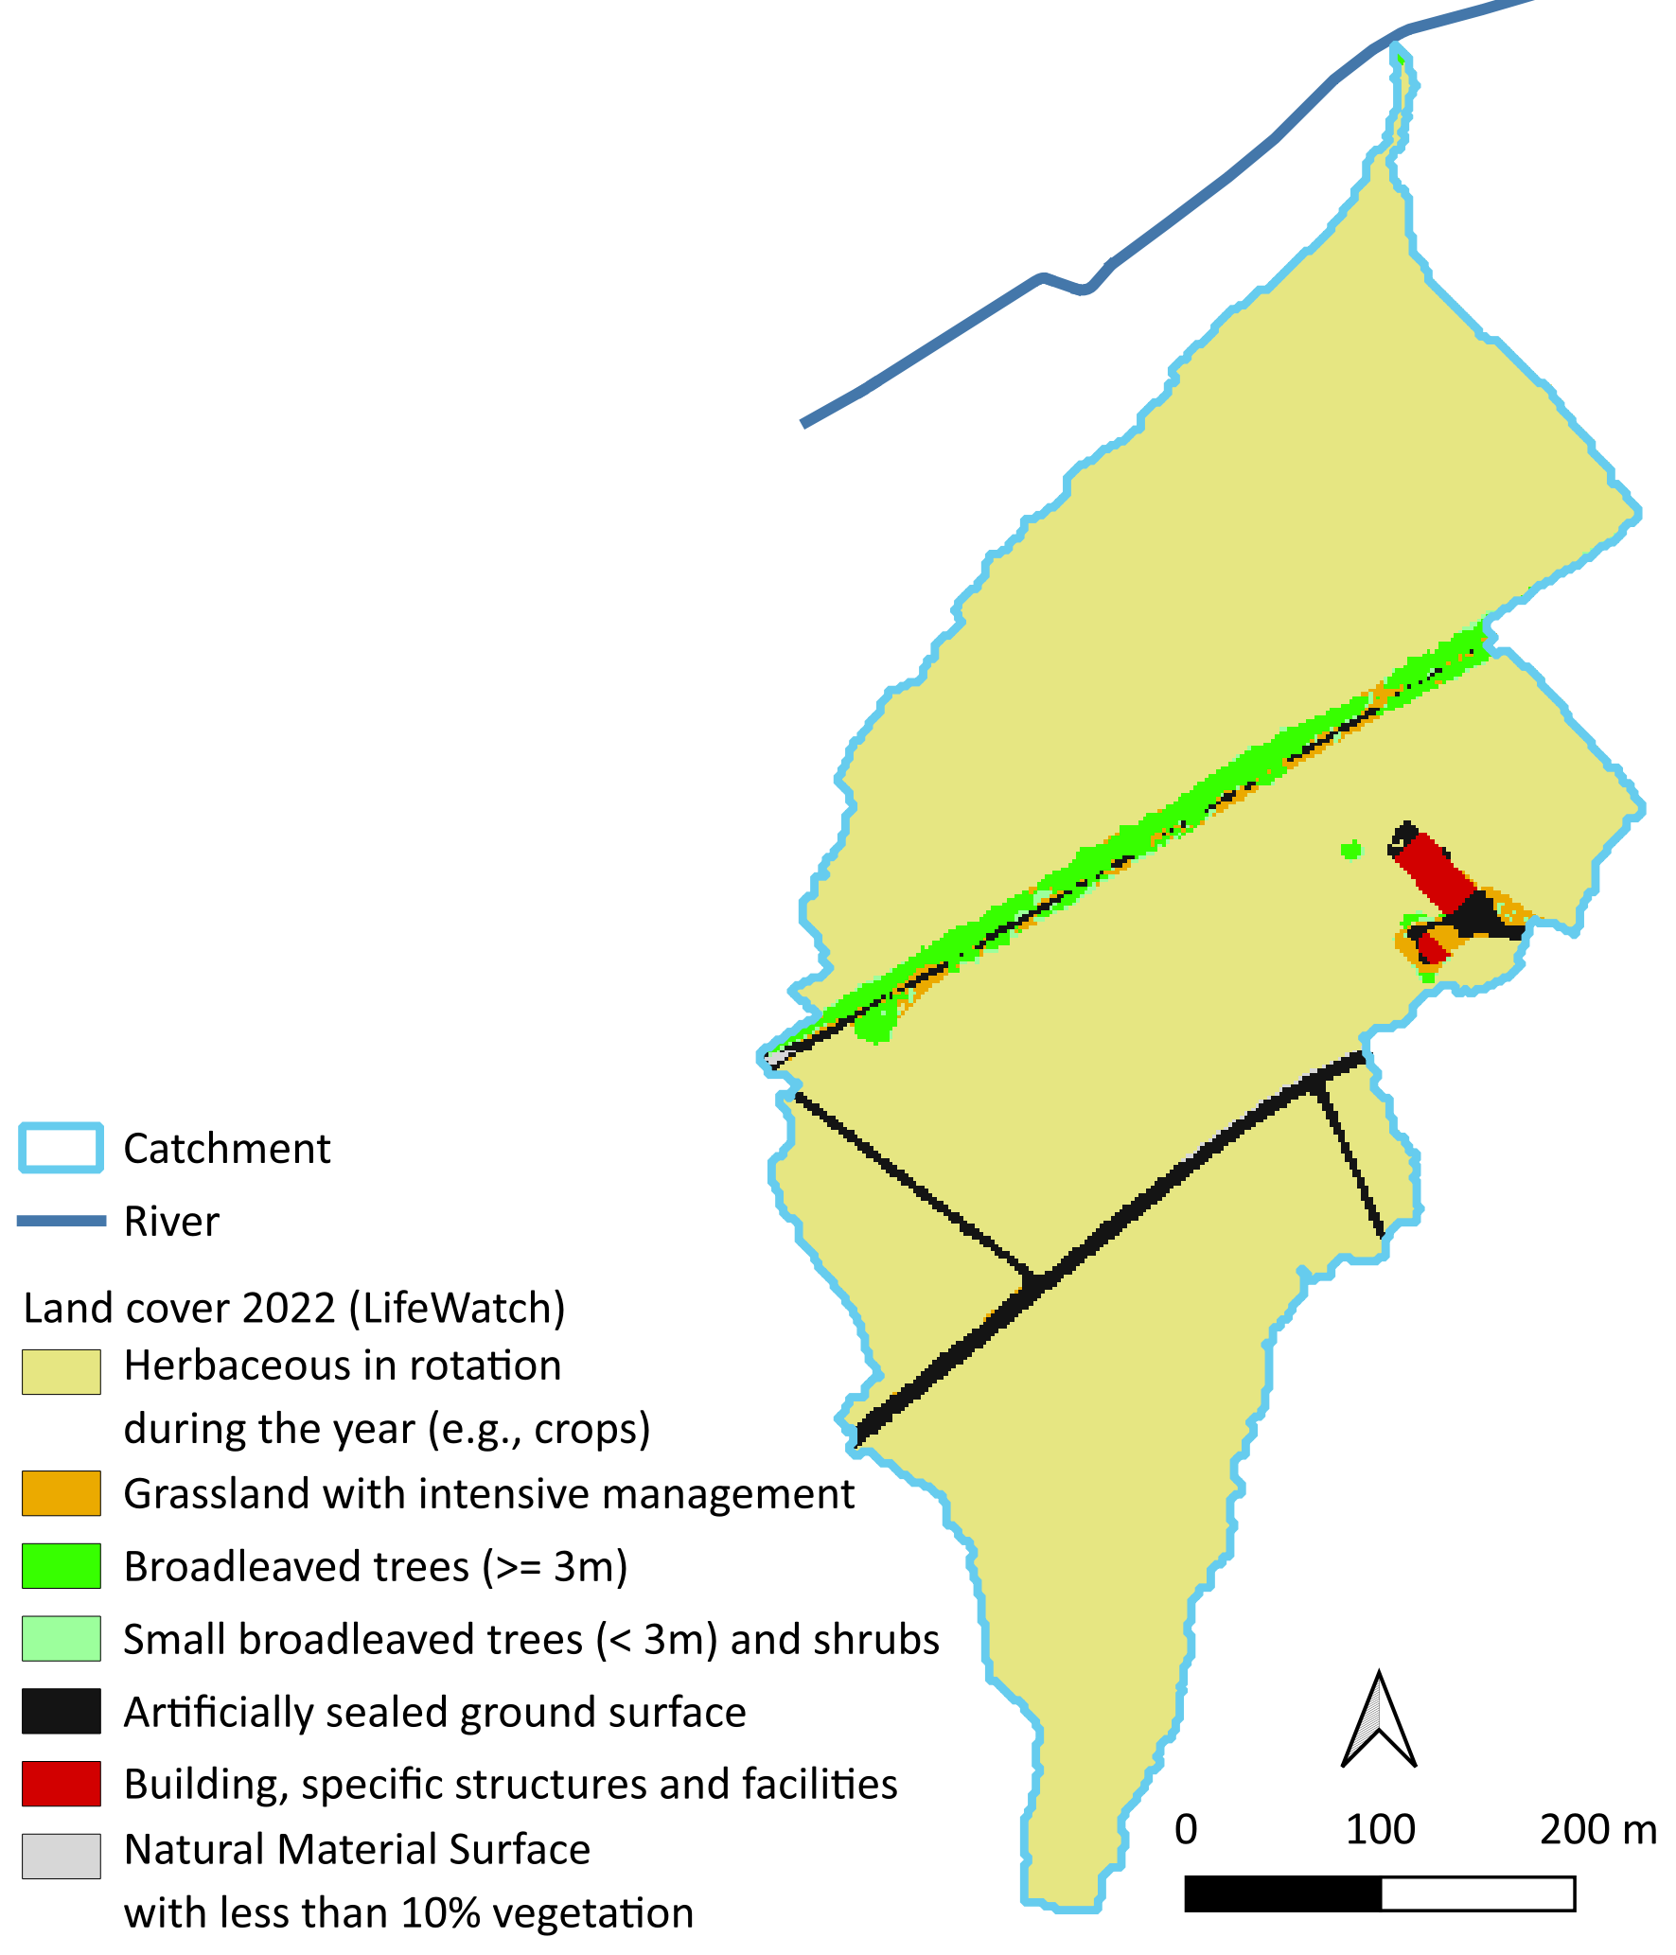
Notes:
Refaire carte

Slide 18
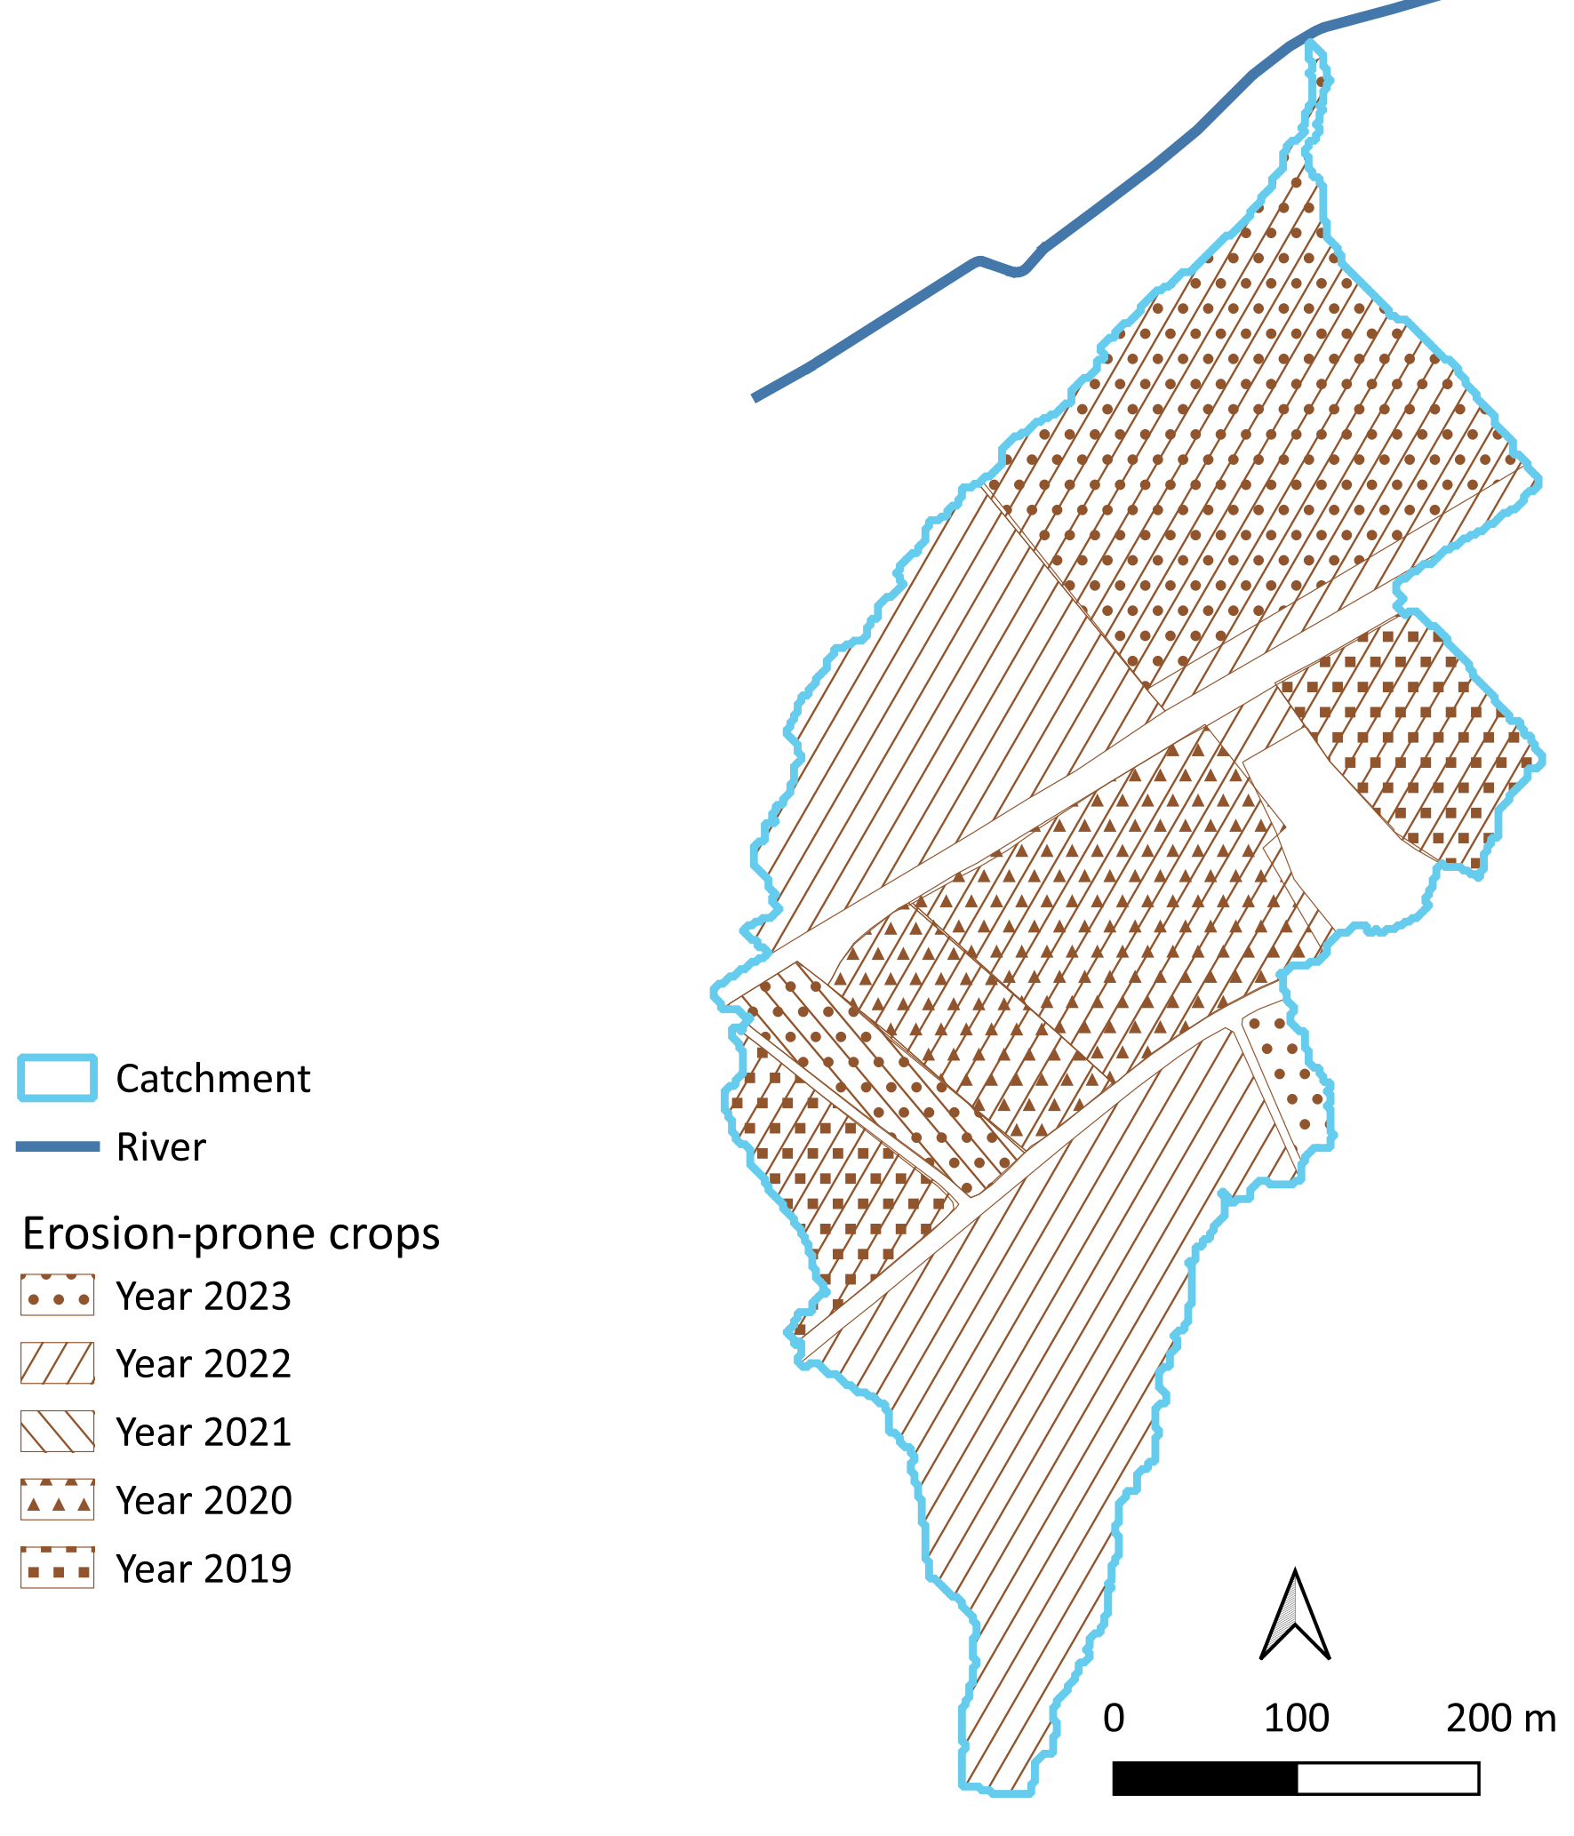
Notes:
Refaire carte

Slide 19
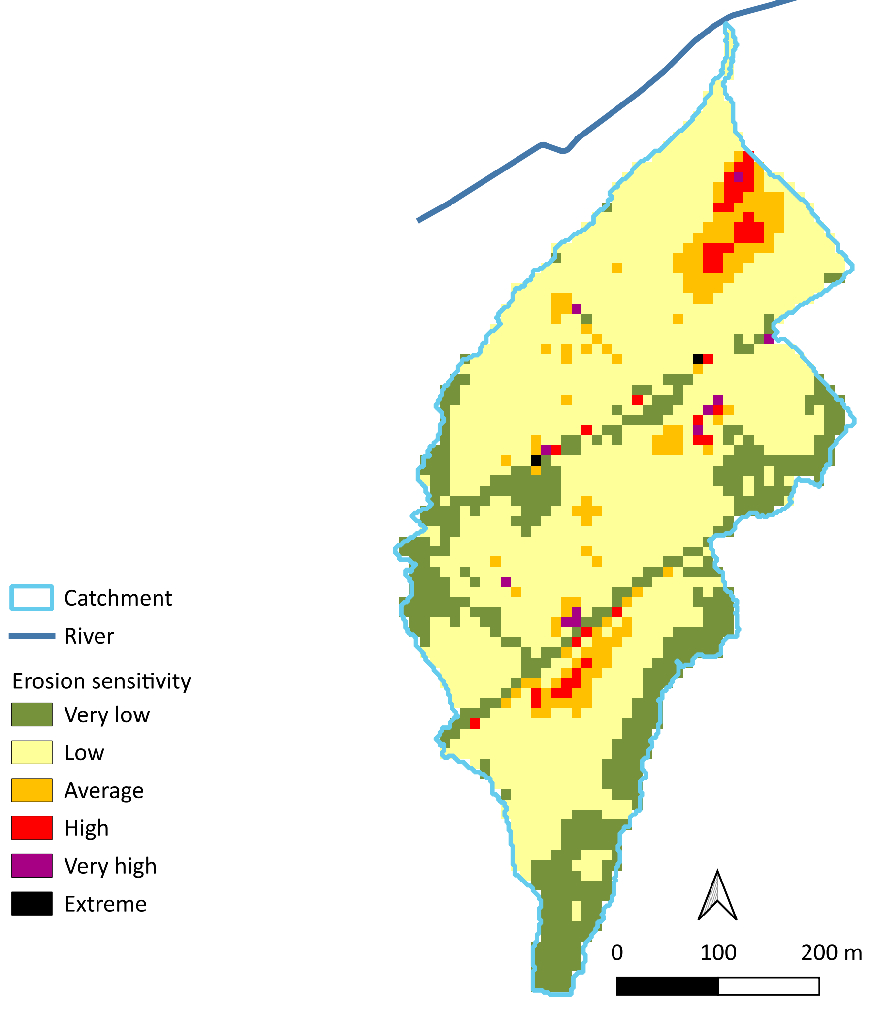
Notes:
Refaire carte

Slide 20
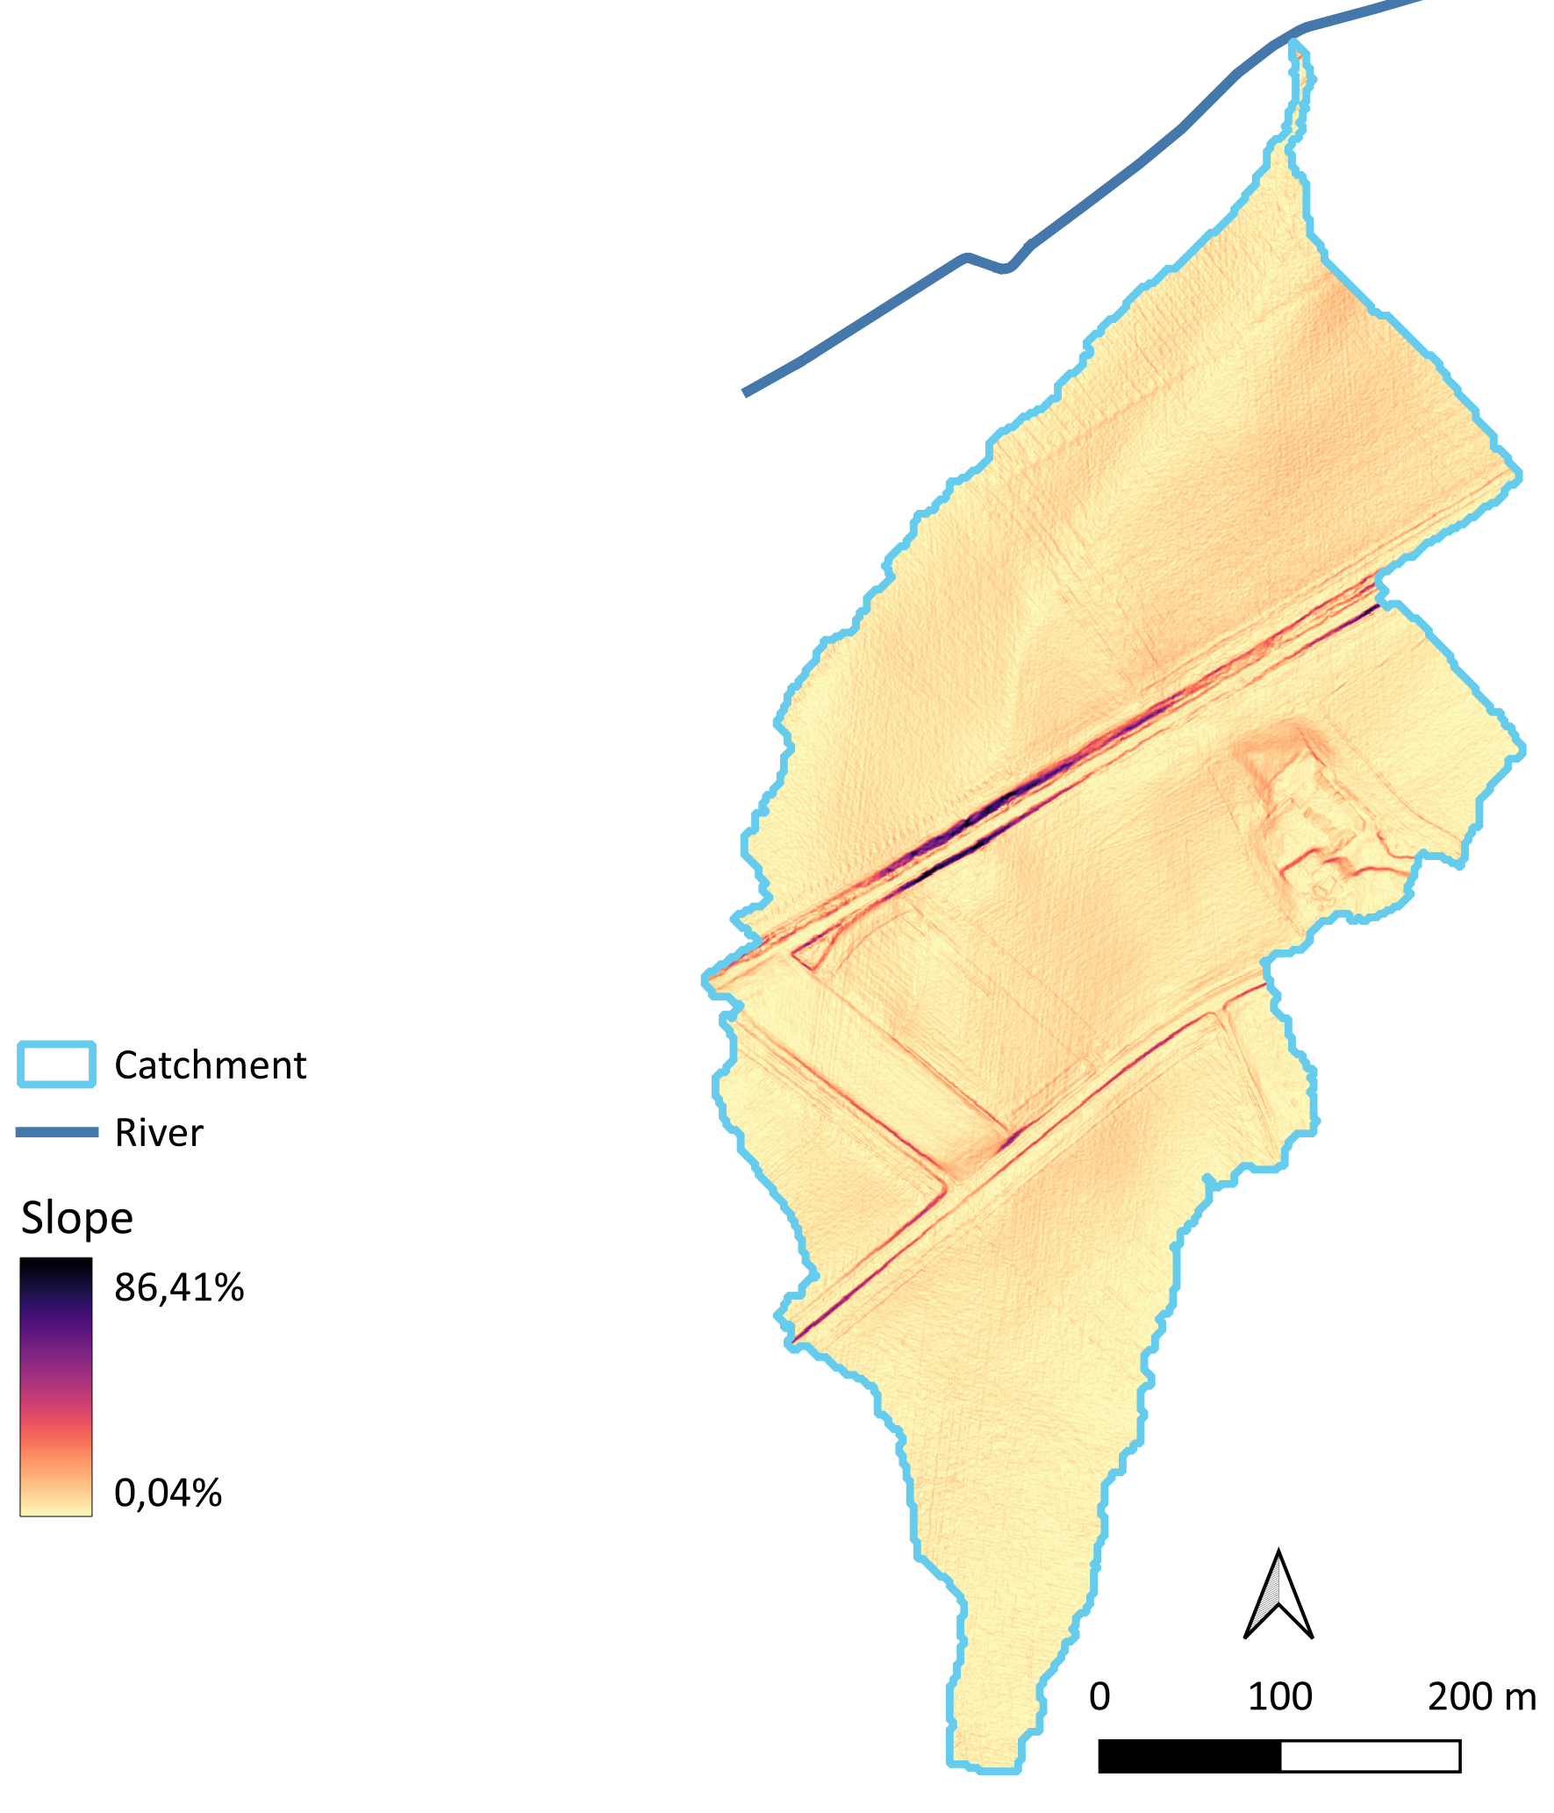
Notes:
Refaire carte

Slide 21



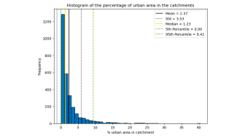
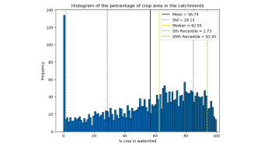
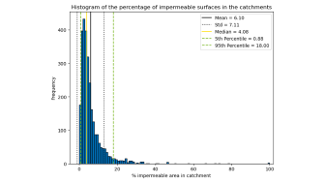
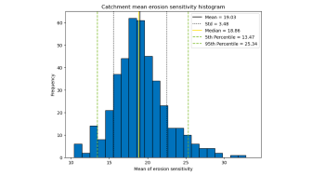
Catchment selection
Catchment
Riparian zone
Perspectives
Sediment
Introduction
Study area
Objectives
Histogram analysis of the 2865 catchments
Land cover:
  Majority of crops (> 55 %)
  Low urban (< 2.5 %)
  Low impermeable surfaces (< 5 %)
  = 1263 catchments
Without drainage systems
  = 411 catchments
High erosion sensitivity
  = 138 catchments

Slide 22
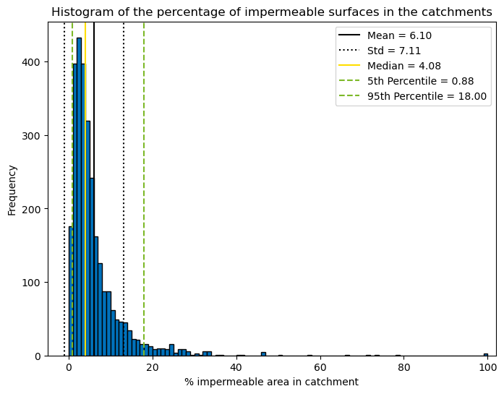

Slide 23
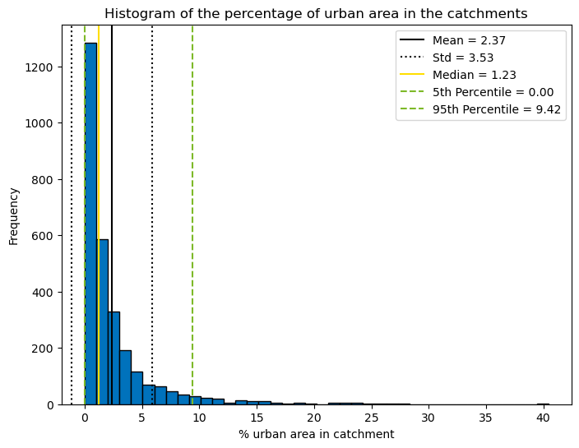

Slide 24
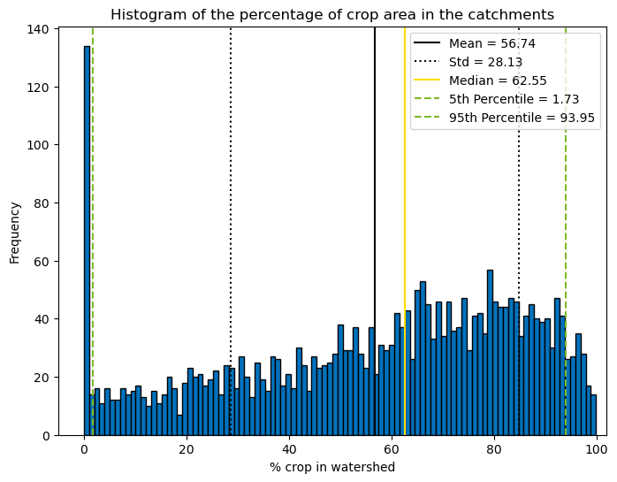

Slide 25
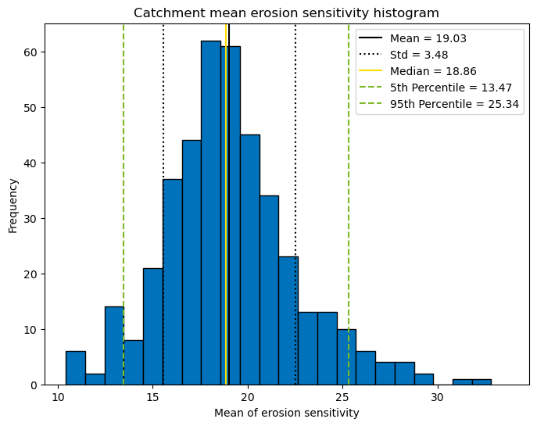

Slide 26
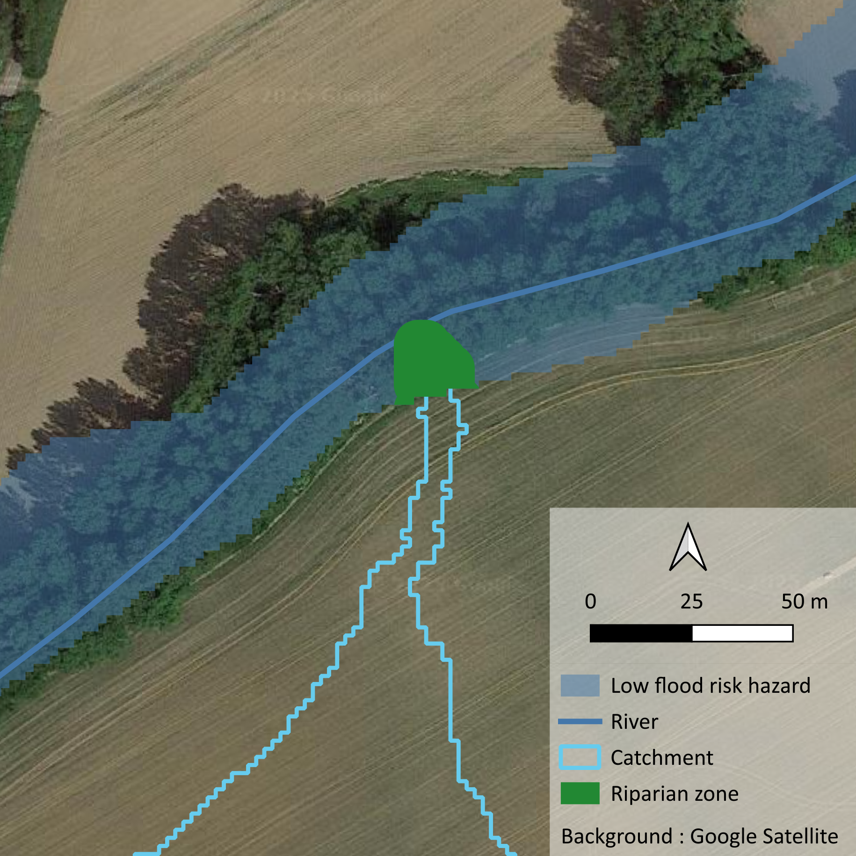
Riparian zone delineation
Catchment
Riparian zone
Perspectives
Sediment
Introduction
Study area
Objectives
Intersection between:
Catchment
Low risk flood hazard [2 m]
Notes:
Refaire carte

Slide 27
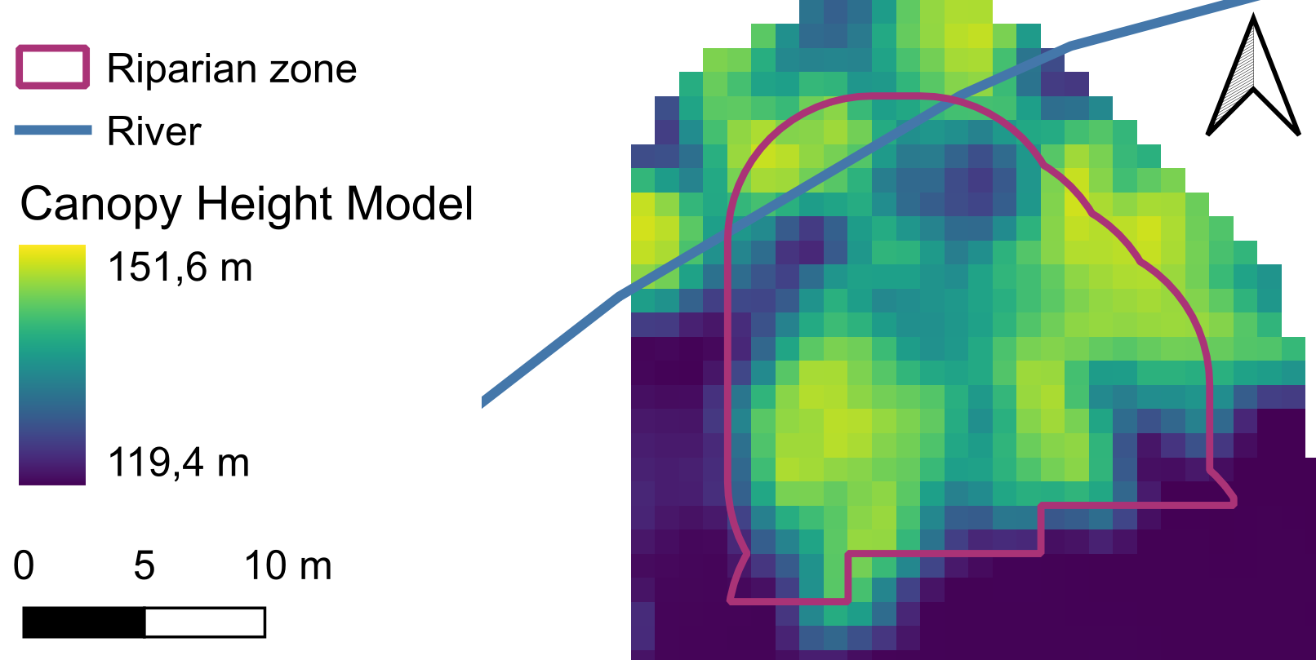
Riparian zone parameters
Catchment
Riparian zone
Perspectives
Sediment
Introduction
Study area
Objectives
Landscape features
Soil type
Slope steepness
Slope curvature
Land cover
Riparian vegetation | Outlet
Width | Height above nearest drainage
Height | Angle to the river
Composition / Diversity | Size of the downward river
Continuity | …

Slide 28



Riparian zone selection
Catchment
Riparian zone
Perspectives
Sediment
Introduction
Study area
Objectives
Clustering analysis: based on vegetated land cover
  No urban surfaces (0 %) & low impermeable surfaces (< 2%) = 66 catchments
  3 groups :
  Crops Forest Grassland
Selection of 9 catchments:
3 catchments per group
Visual assessment of satellite imagery from 1971 to 2023
Notes:
Refaire carte

Slide 29


Sediment analysis
Catchment
Riparian zone
Perspectives
Sediment
Introduction
Study area
Objectives
Difference of regional DEM
! Errors > Signal ?
2021-2022 2013-2014
Soil samples:
Organic matter : Springer Klee method
Soil texture : Robinson pipette method
Phosphorus :
  Water-dissolved
  AA-EDTA
Notes:
Icone empilement MNT (2 losanges ou 2 cartes topo)
Icone chimie

Slide 30

Sediment sampling strategy
Catchment
Riparian zone
Perspectives
Sediment
Introduction
Study area
Objectives
Along runoff (X) (max 7 points)
At 5m on each side (O)
2 X within the permanent vegetation cover
1 X outside the riparian zone
Other Xs within the riparian zone
Notes:
Refaire carte

Slide 31


Perspectives
Catchment
Riparian zone
Perspectives
Sediment
Introduction
Study area
Objectives
Train a model : Y = α. X + β
Y : sediment deposition results
X : GIS data
Recommendations for riparian zone management
Where should it be improved ?
How ?
Read me !
Contact me !
Notes:
Refaire carte

