Slide 1

Use of Convection Permitting climate models for maize yield projection over Italy
B. Monteleone, V. Nyabuti Ong’era, M. Mathew, L. T. Massano, G. Fosser
and CORDEX-FPS-CONV community
EGU General Assembly, Vienna, $2^{nd}$ May 2025

Slide 2
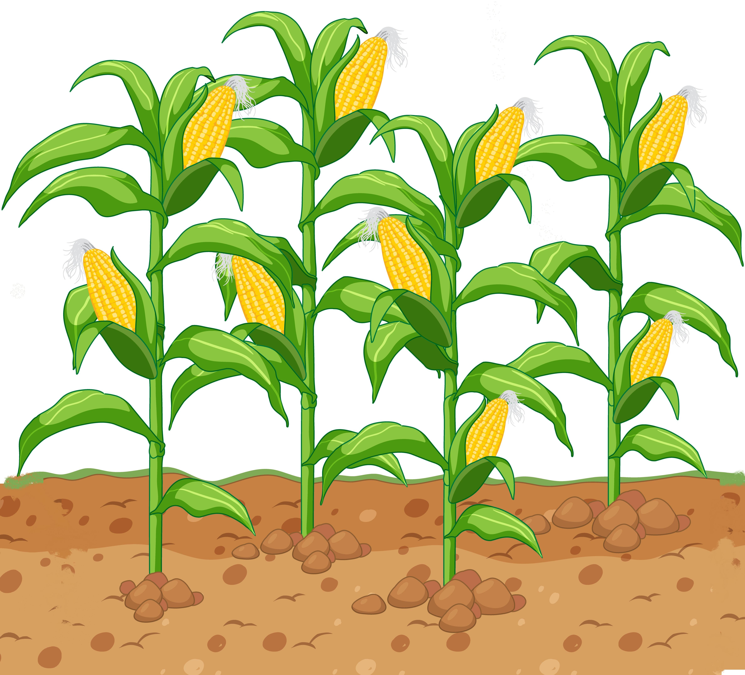
Aim of the study
Performance assessment of km-scale Convection Permitting Models (CPMs) when used inside a crop model in reproducing observed maize yield over Italy
Evaluation of the impact of climate change on maize yield at the end of the century (2090-2099, RCP 8.5)

Slide 3
Method
Use of the APSIM crop model
APSIM initialization
Soil information
Crop management
Assessment of CPMs performance
Yield projection
Initialized APSIM
Weather from 8 CPMs
Simulated yield versus observed (Istat, 2006-2023, province scale)
Initialized APSIM
Weather from reanalysis (ERA5-Land)
Weather from 8 CPMs (evaluation experiment)
Yield from CPMs versus yield from ERA5-Land
Historical (1996-2005)
Future (2090-2099, RCP 8.5)
Yield losses (historical vs future)

Slide 4
APSIM initialization
Simulated yield vs observed
Province scale (average of the grid cells)
Exclusion of grid cells above 600m a.s.l
Yearly temporal resolution
p<0.001

Slide 5
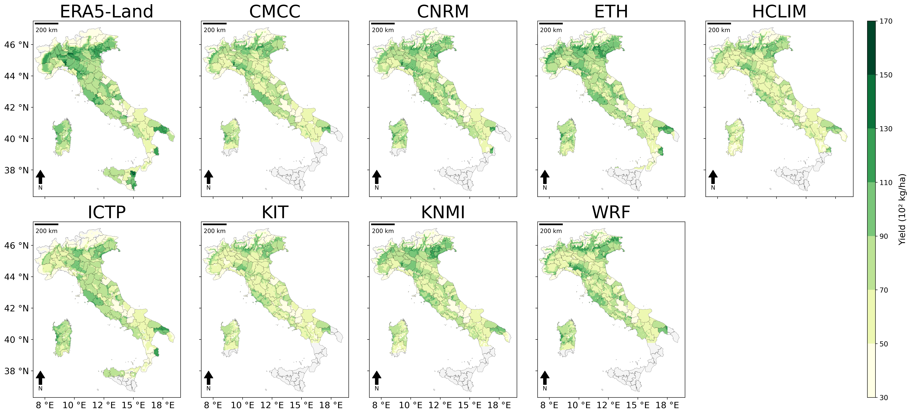
Assessment of CPMs performance
Yield underestimation with respect to ERA5-Land
(2000-2009)

Slide 6
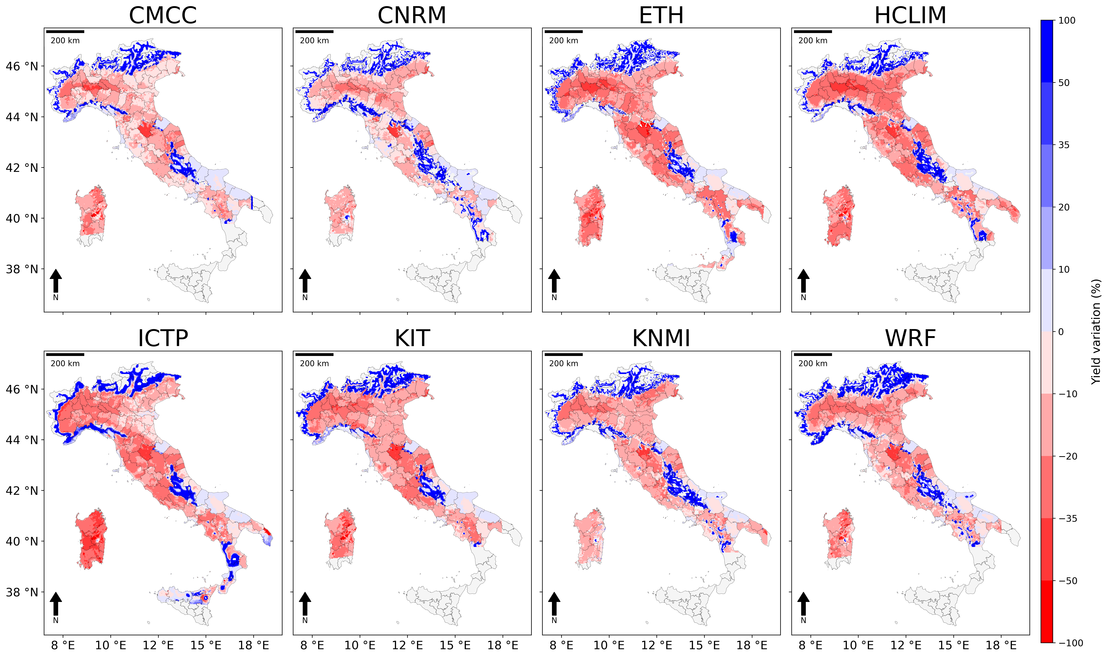
Future yield losses
Severe yield losses over the entire country
Yield losses from -9.7% (CMCC) and -20% (HCLIM) – average over the whole country
Yield losses due to temperature increase (shortening of the growing cycle)

Slide 7
Remarks and next steps
Remarks
Yield underestimation when CPMs are used to drive APSIM
Next steps
Estimate maize yield in 2040-2049 under RCP 8.5
Decrease of maize yield over Italy at the end of the century
Relevant yield losses (between -10 and -30 kg²/ha) in the Po Valley
Estimate future maize yield (mid and end century under RCP 8.5) introducing additional irrigation to satisfy crop water needs
Yield increase in montainous areas

Slide 8


Thank you for your attention
Corresponding author: laura.massano@iusspavia.it
Laura Massano
Abstract Info

Slide 11
The concept of crop model
A system of equations that reproduces the plant growth process
Daily Weather data
Precipitation
Maximum temperature
Soil information
Soil texture
Soil initial conditions (water content, nitrogen content, etc)
Crop management practices
Sowing date
Fertilizers
Minimum temperature
Solar radiation
Sowing density
Irrigation
Use of the APSIM crop model

Slide 12
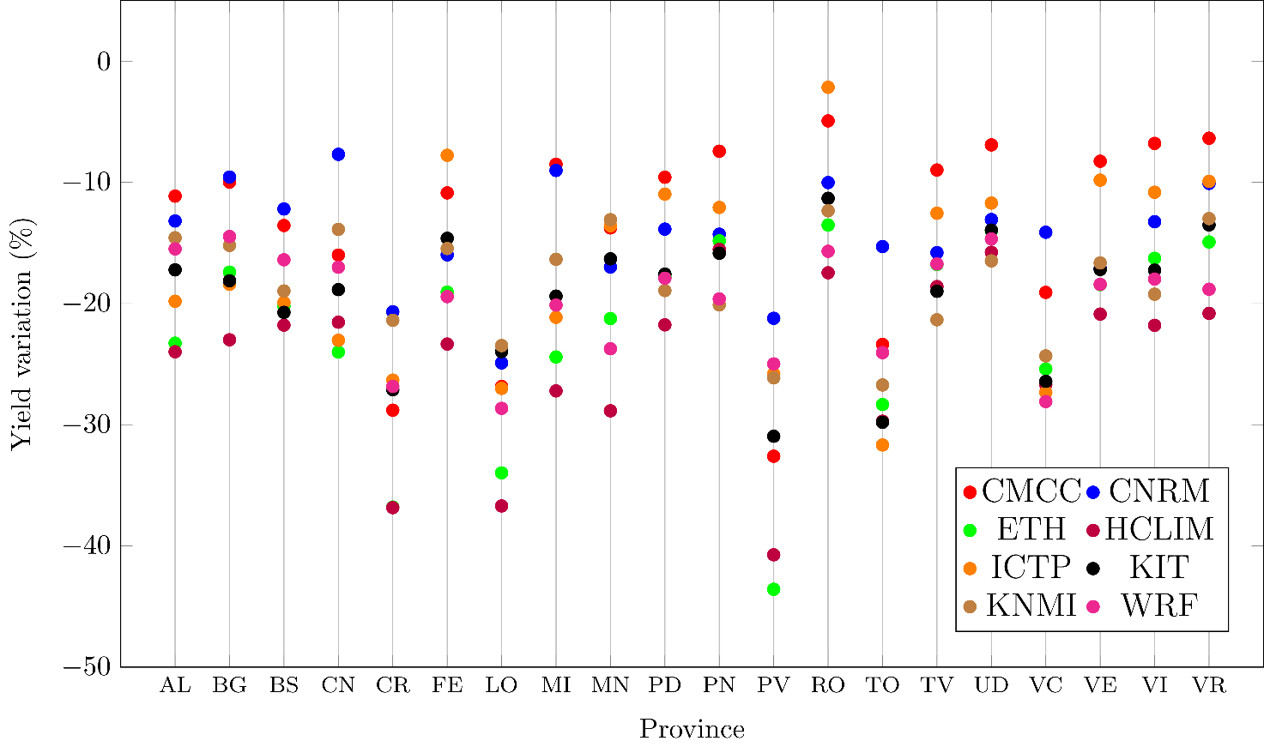
Yield losses in the top 20 provinces
Losses for each of the top 20 maize growing provinces according to the eight CPMs
All provinces are in the Po plain

Slide 13
Yield losses by CPM (% of grid cells)

