Slide 1

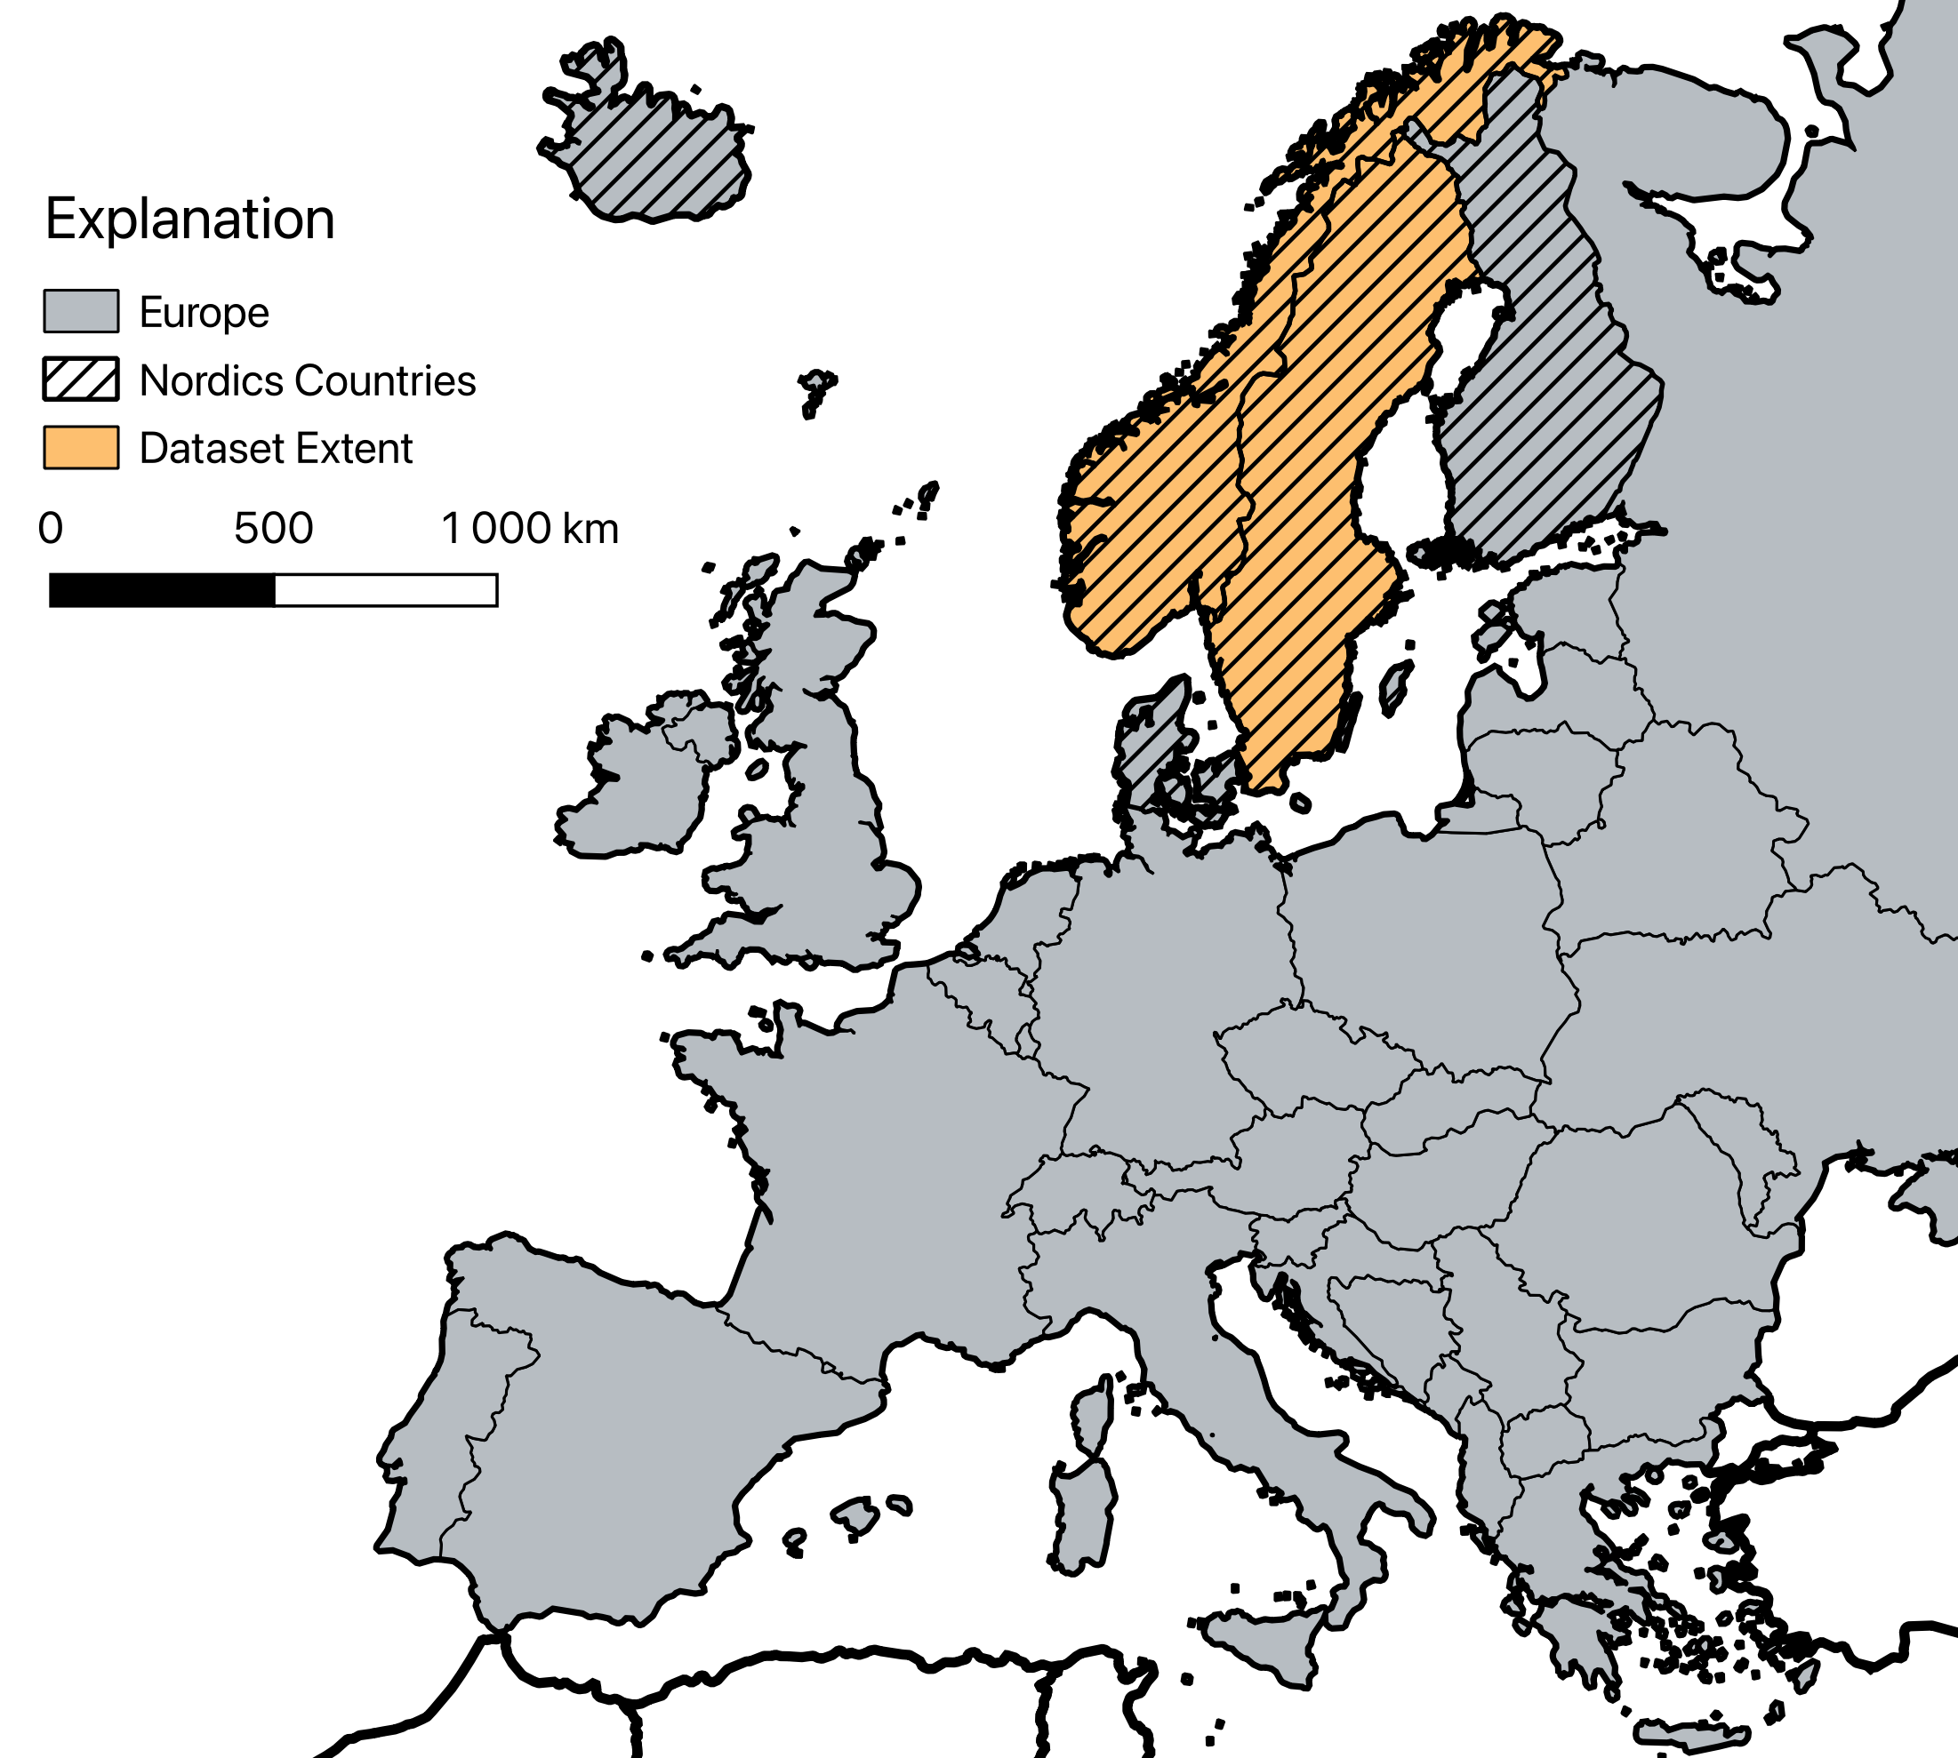
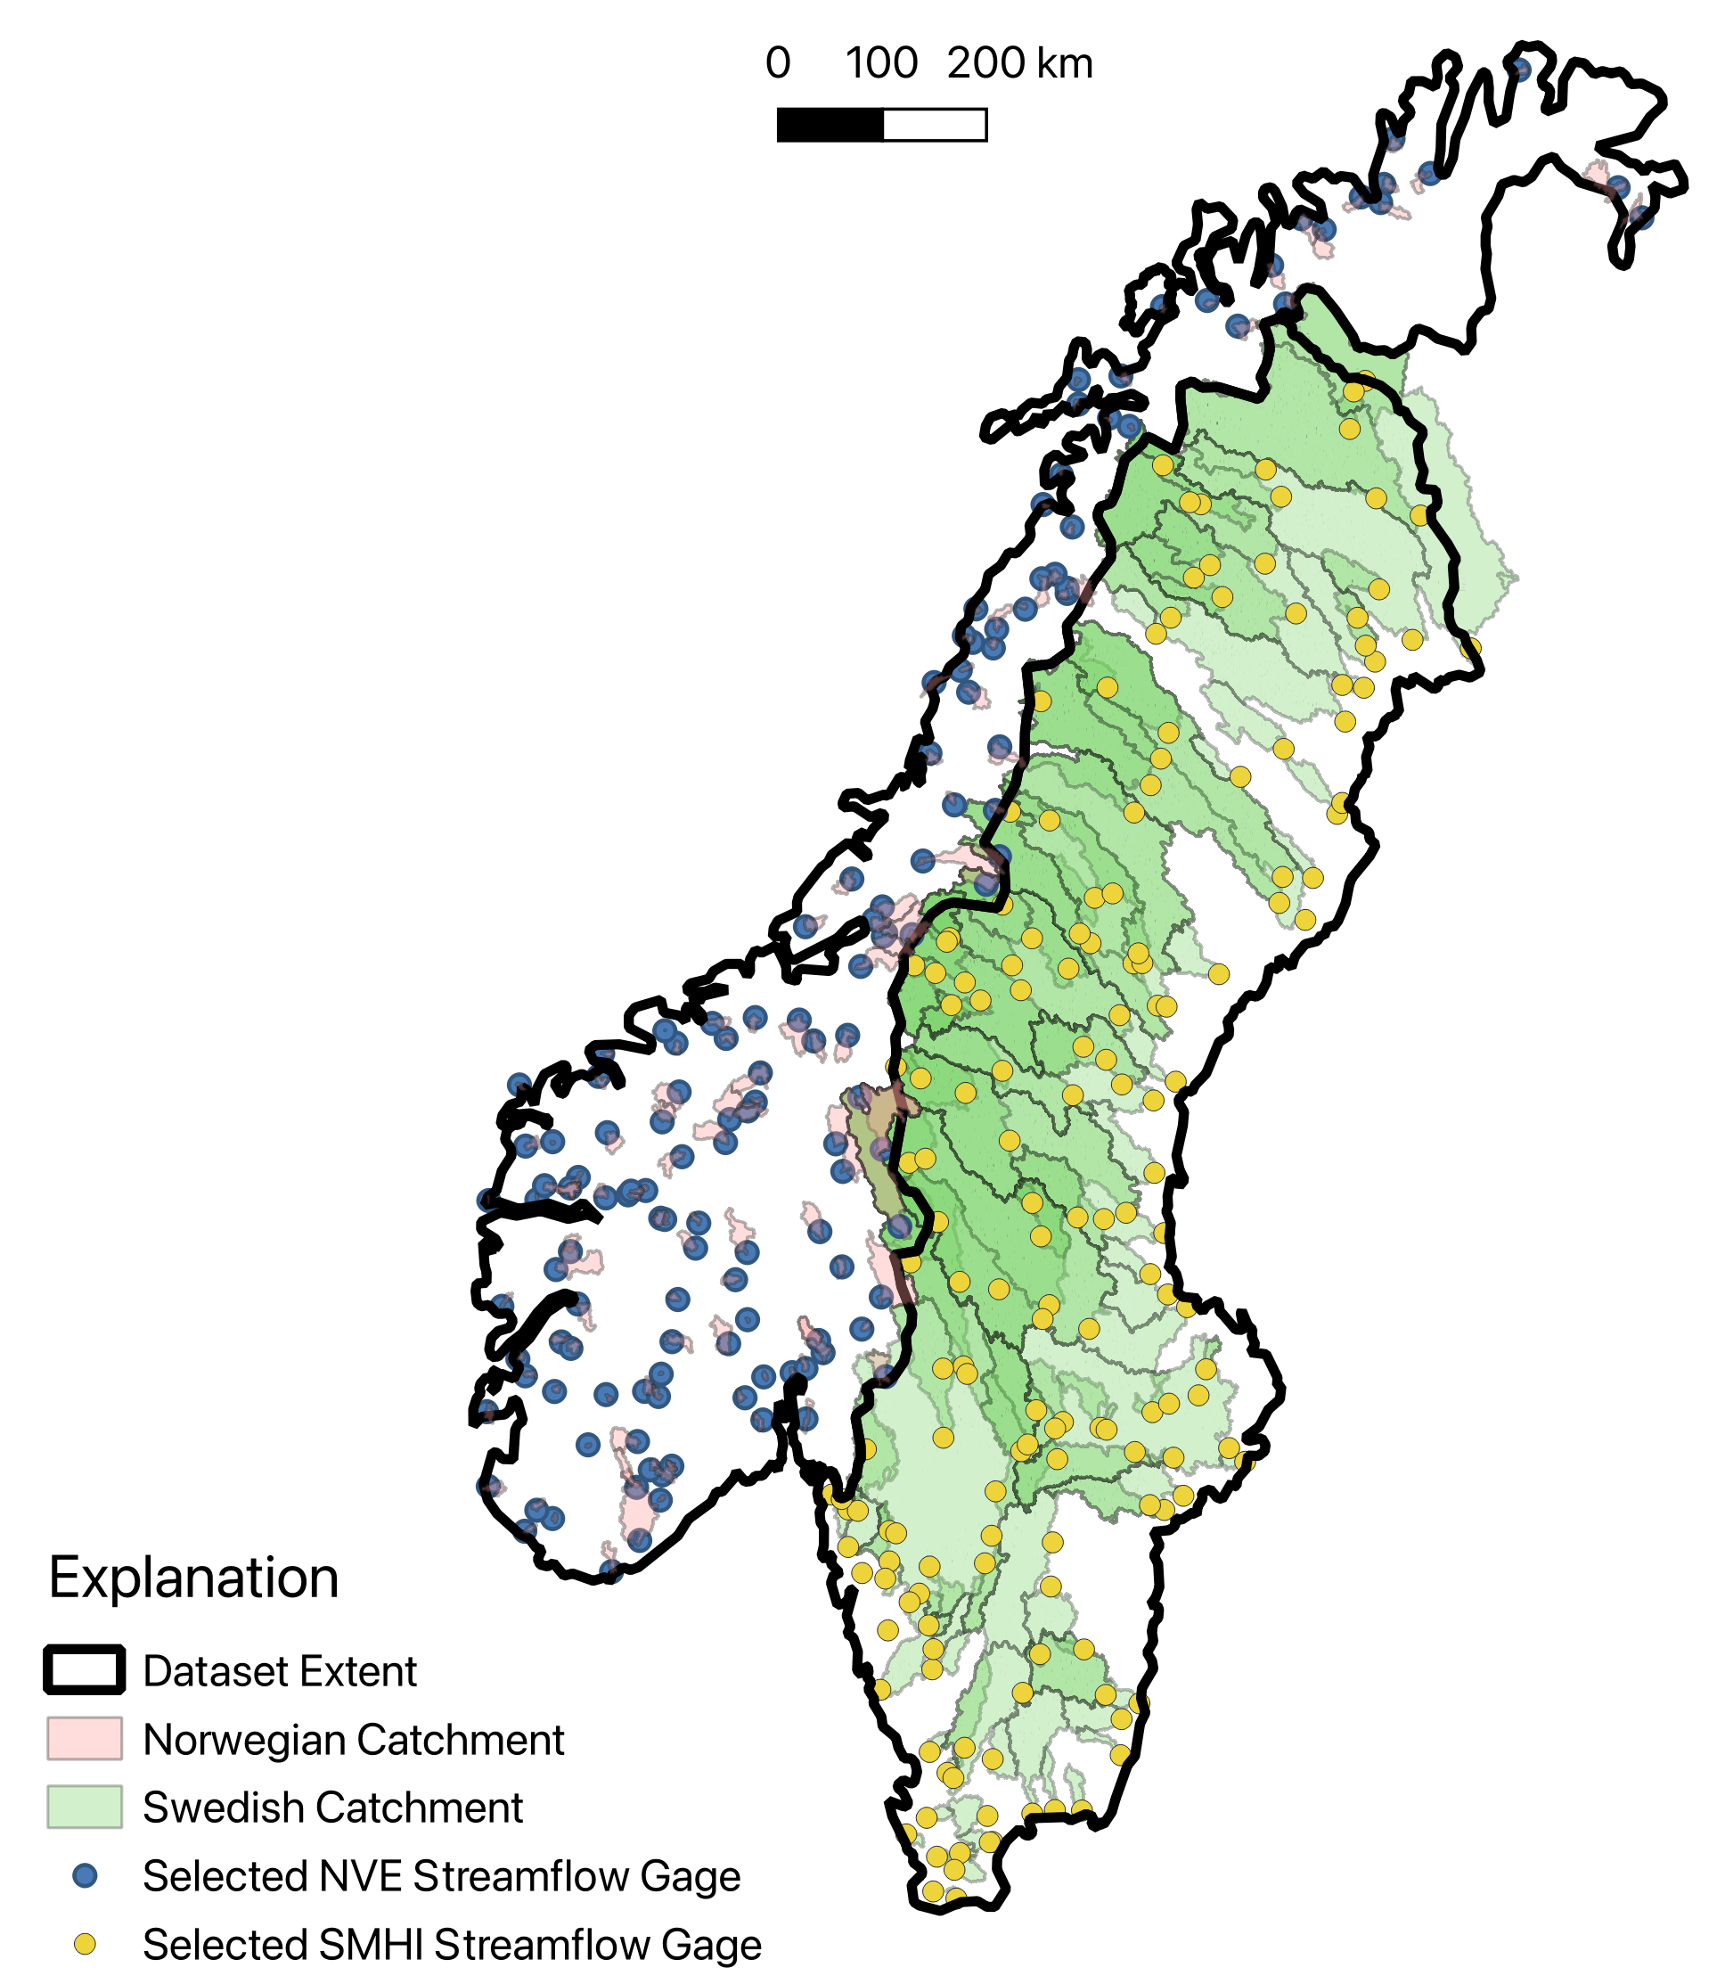
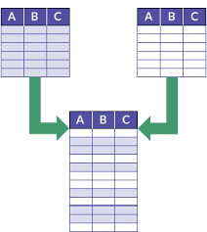



CAMELS-Nordic dataset 1980-2022
CAMELS-Nordic dataset 1980-2022
Motivation
To support and advance hydrological modeling and climate research efforts in Norway and the Nordic countries.
137 Norwegian Catchments
Temporal resolution: Daily
Spatial resolution: 1 km
166
Swedish Catchments
Creating a coherent dataset that is updateable with python tools.
Identifying current data gaps and deficiencies.

Slide 2
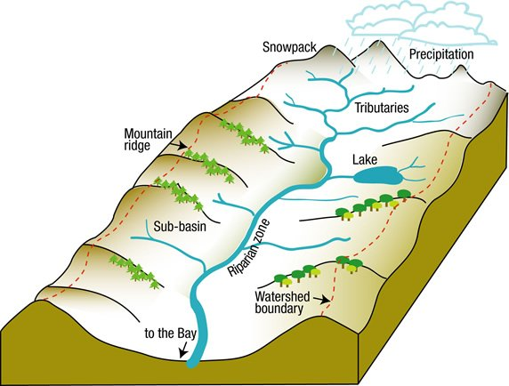
Catchment
Attributes and
MEteorology for
Large-sample
Studies
Climate Indices
Mean daily precipitation
Seasonality and timing of precipitation
Fraction of precipitation falling as snow
Hydrological Signatures
Mean daily streamflow
(seasonal)
Runoff ratio
Low and high flows​
Days without streamflow​
Catchment Properties
Catchment area [km2]
Mean elevation [m a.s.l.]
Mean slope [m a.s.l.]
Soil types
(Clay [%], Sand [%] , etc.)
Landcover types
(Forest [%], Urban [%] , etc.)
Credit: The Watershed Project

Slide 3
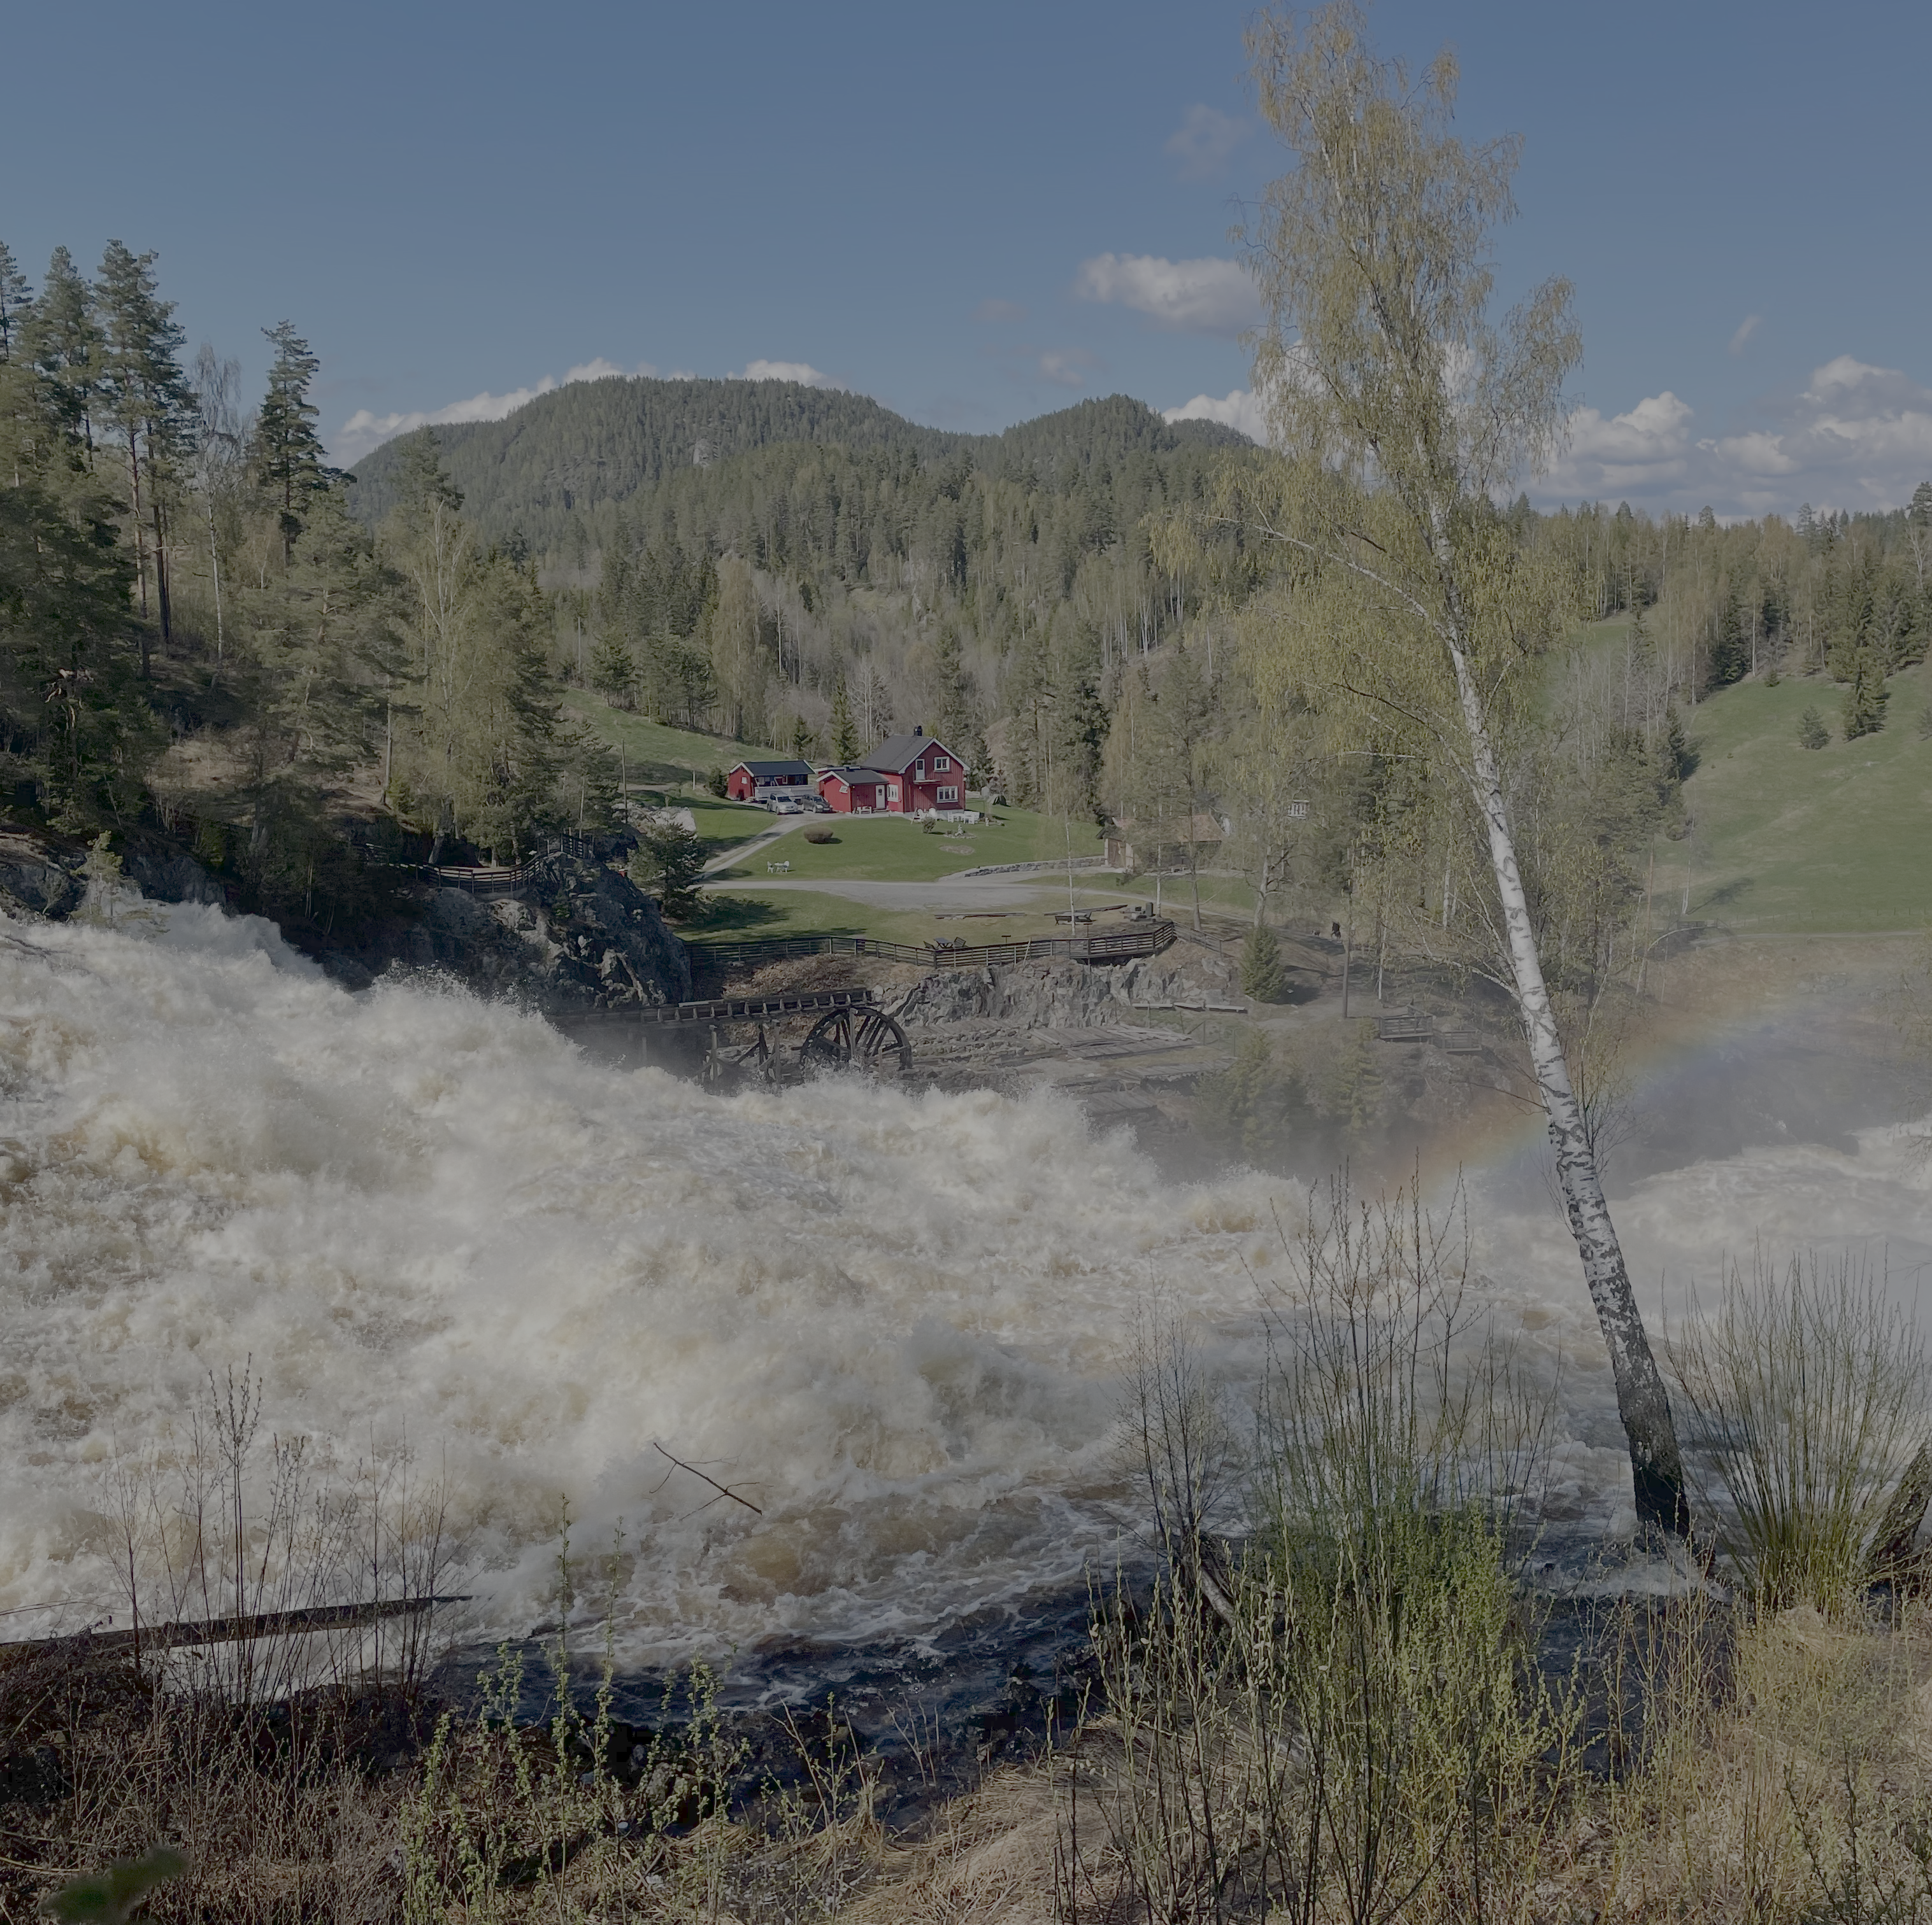

Development of CAMELS-Nordic, a large-scale hydrometeorological and catchment properties dataset for Norway and Sweden
Authors:
Kristen J. Valseth, Kent-Andre Mardal, Olga Silantyeva, Gaute Lappegard, & Lars Magnus Valnes

Slide 4
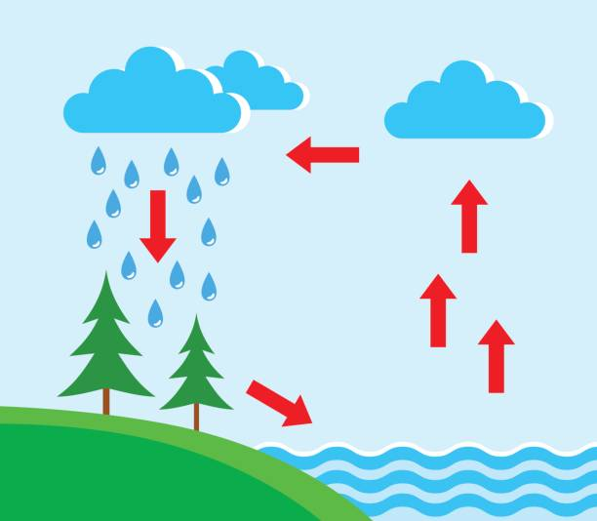

What are CAMELS datasets?
Catchment Attributes and MEteorology for Large-sample Studies
Synthesizes diverse sets of data into a coherent dataset that is comparable at the catchment scale.
Summarizes meteorological forcing and discharge daily time series.
Characterizes catchment land cover, soil, and geology.

Slide 5
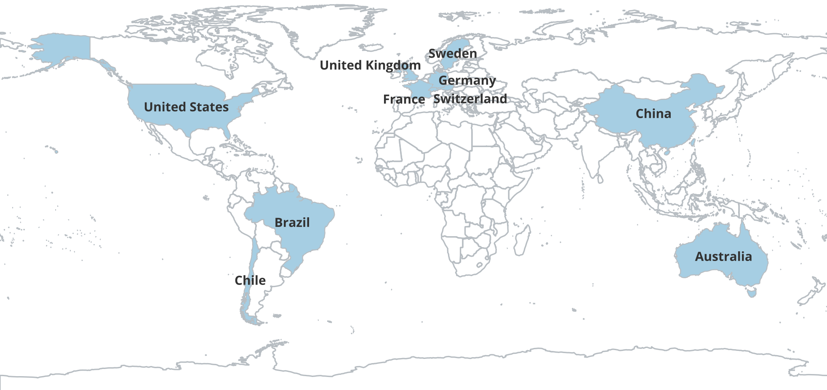
CAMELS datasets around the world.

Slide 6
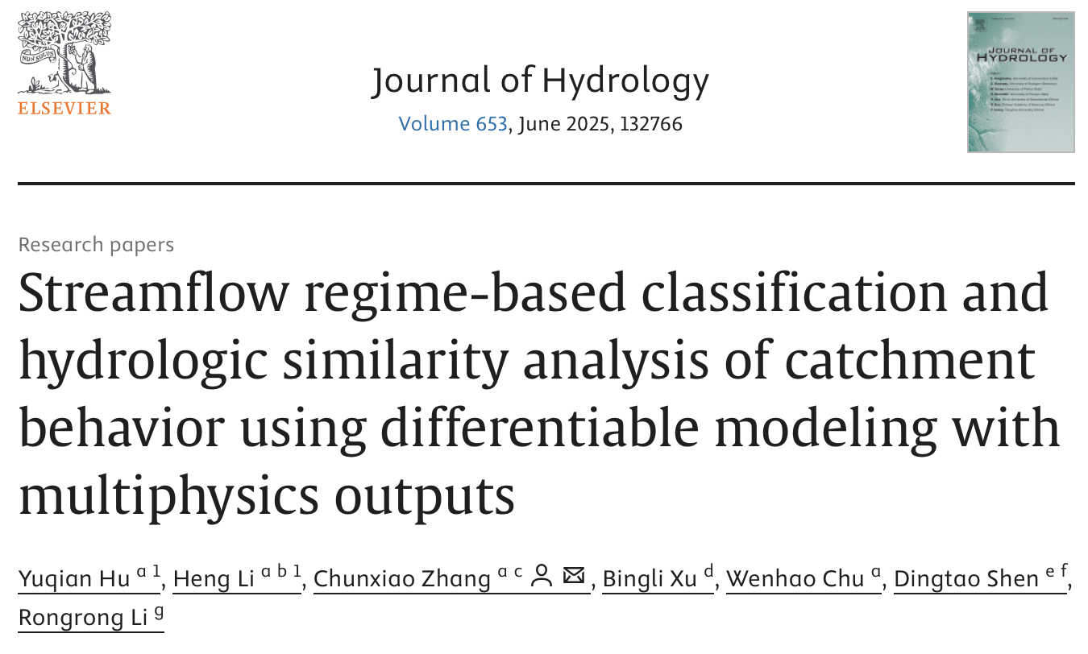
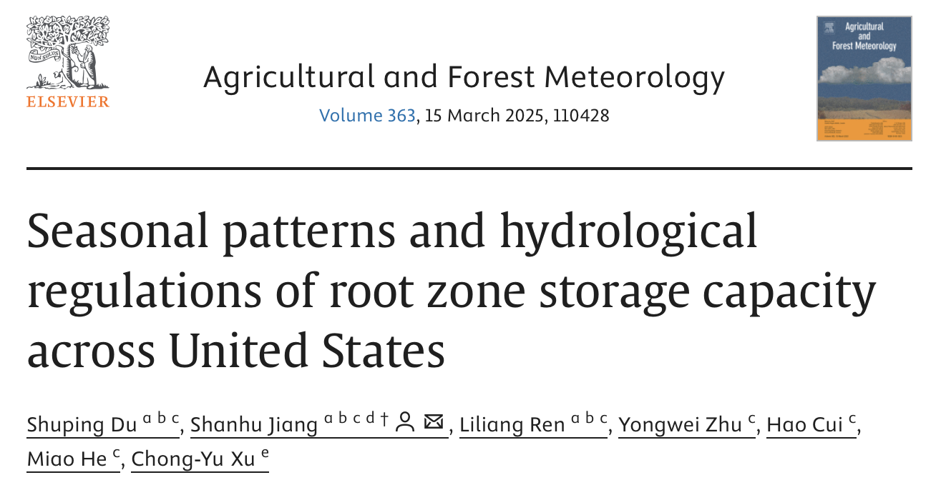

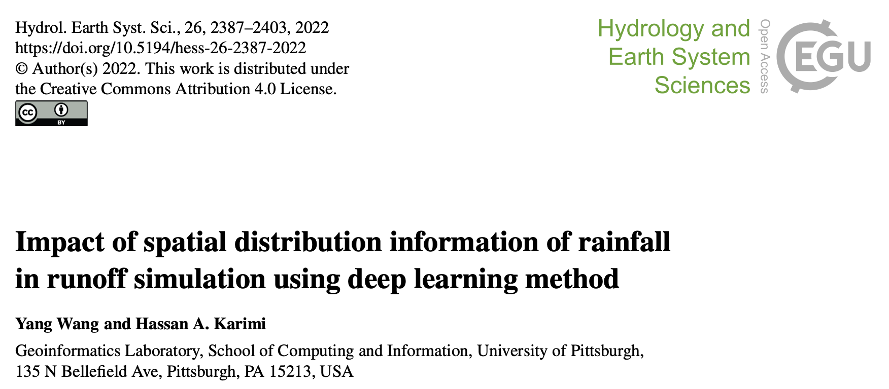

Studies using CAMELS datasets.

Slide 7
Motivation for creating CAMELS-Nordic.
To support and advance hydrological modeling and climate research efforts in Norway and the Nordic countries.
Creating not only a coherent dataset but one that is updateable with python tools.
Identifying current data gaps and deficiencies.

Slide 8
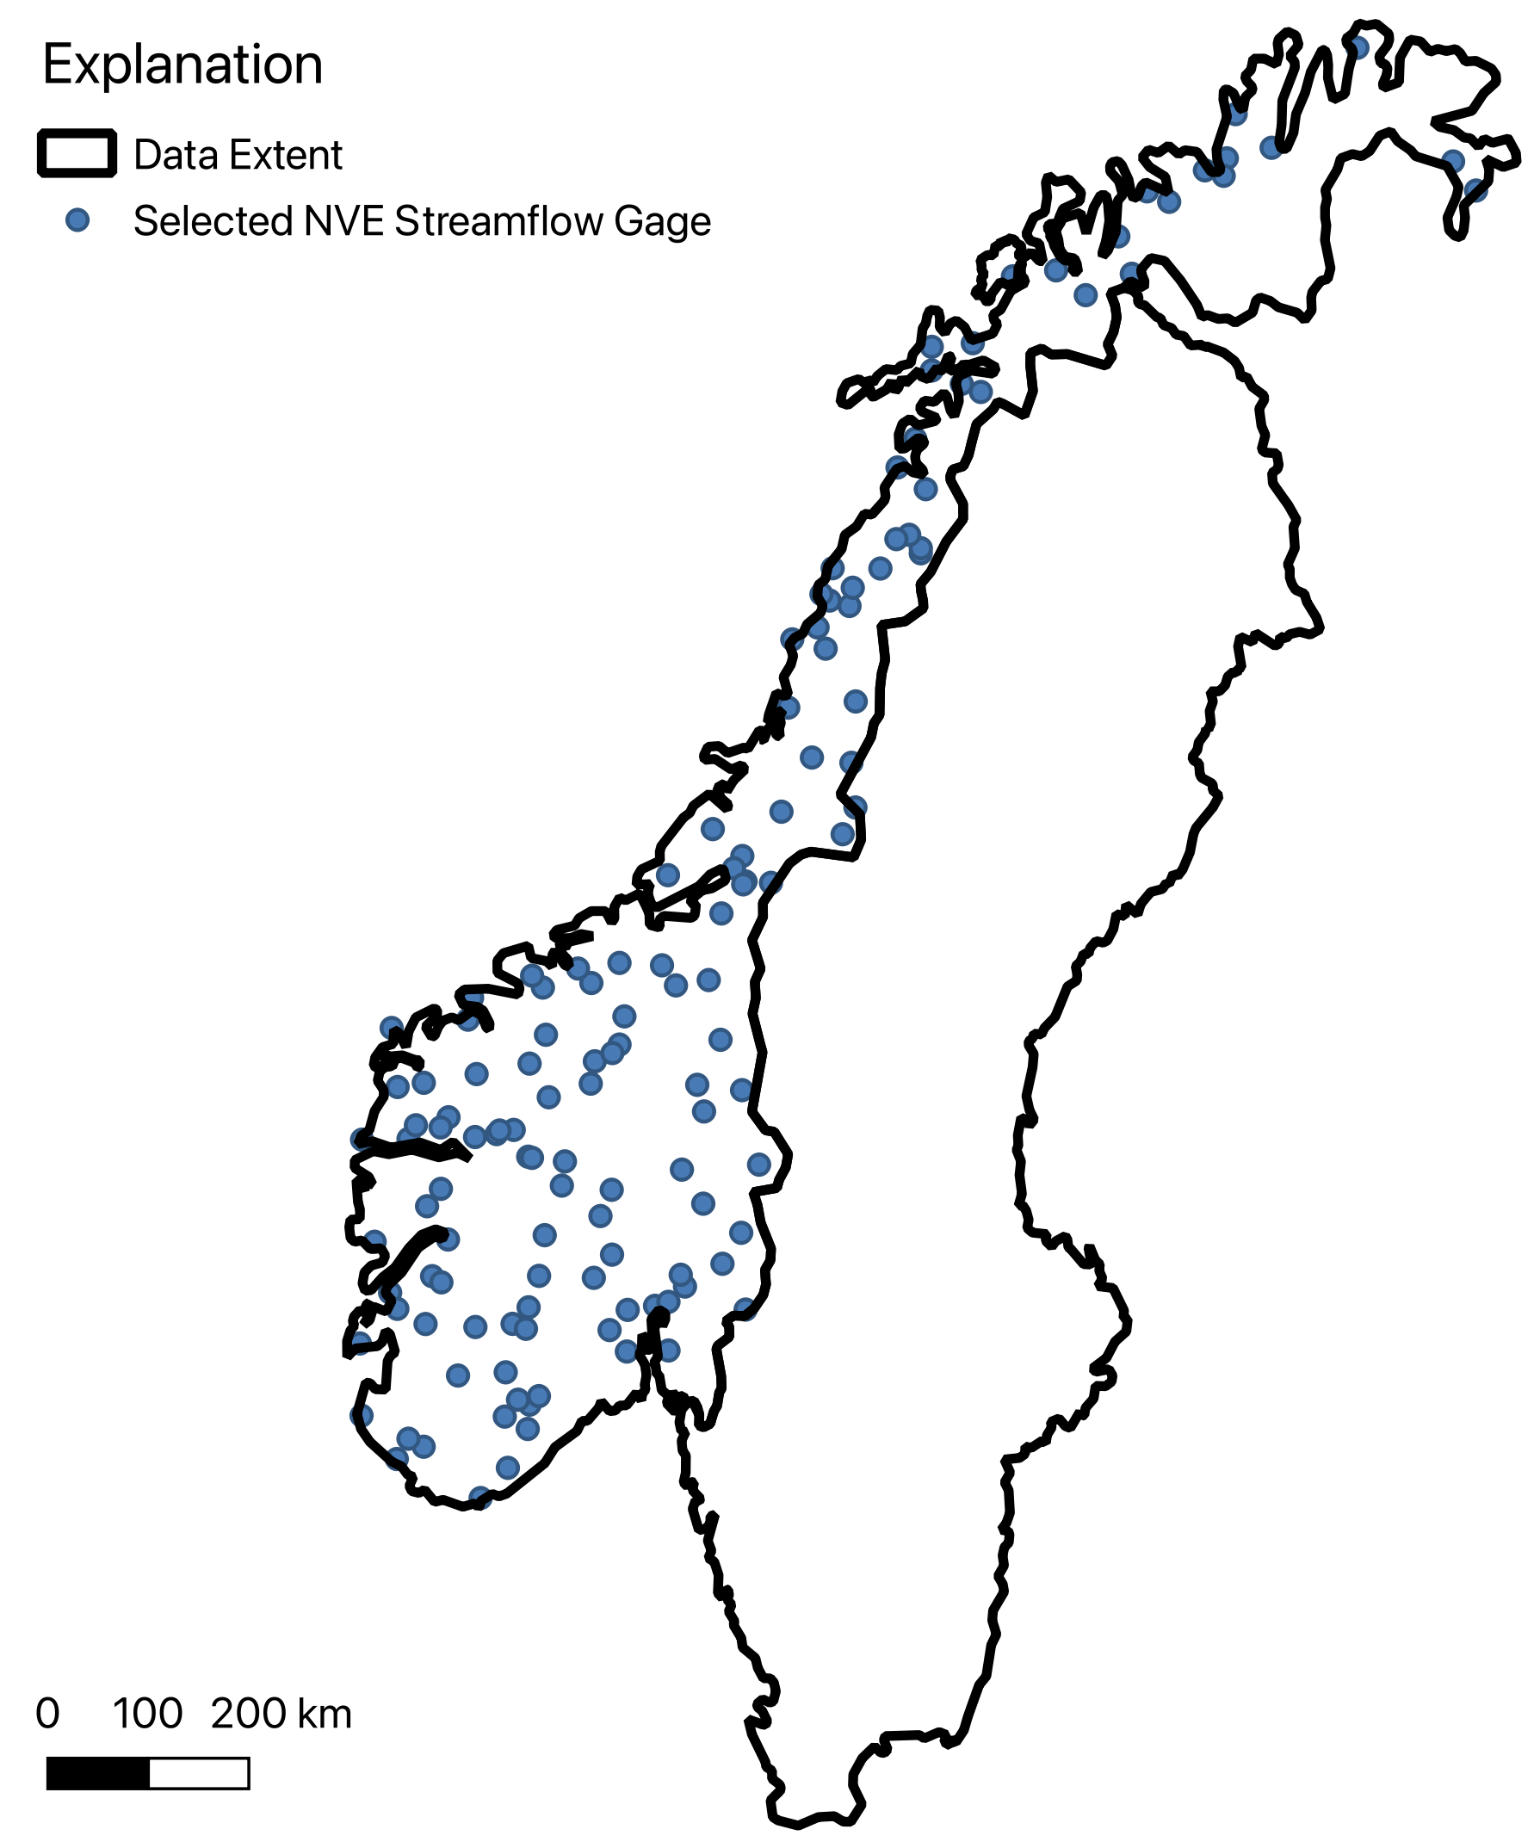
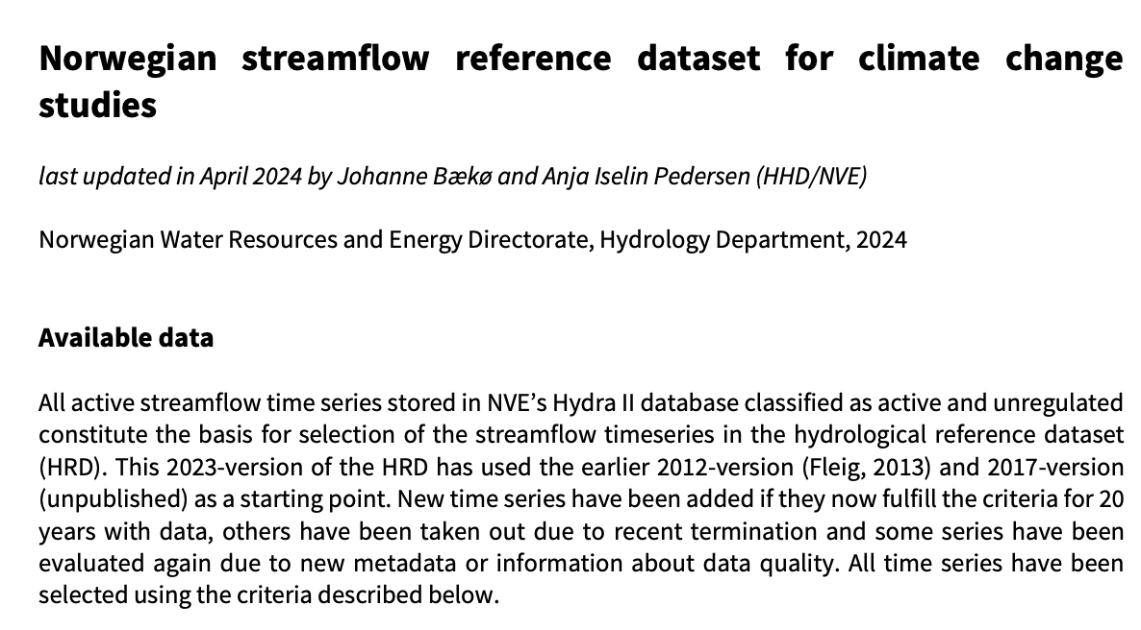
Selection of streamflow gages in Norway.

Slide 9
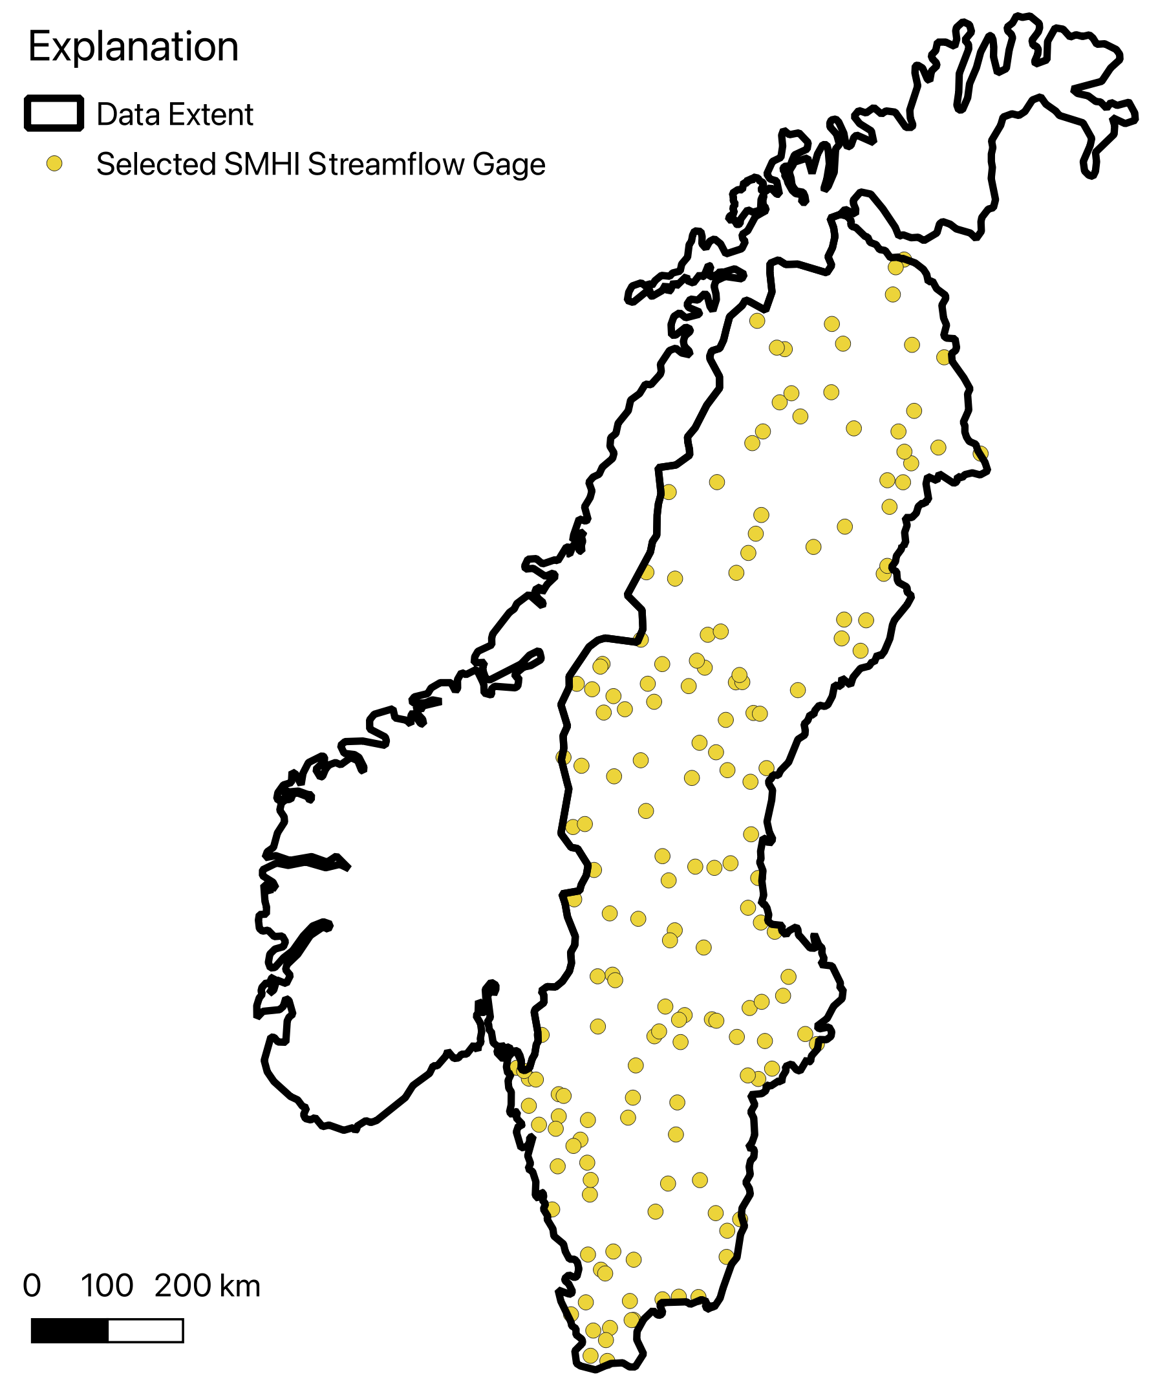
Selection of streamflow gages in Sweden.
All stations with complete daily record 1980-2022 available on the Swedish Meteorological and Hydrological Institute Open Data Portal.

Slide 10
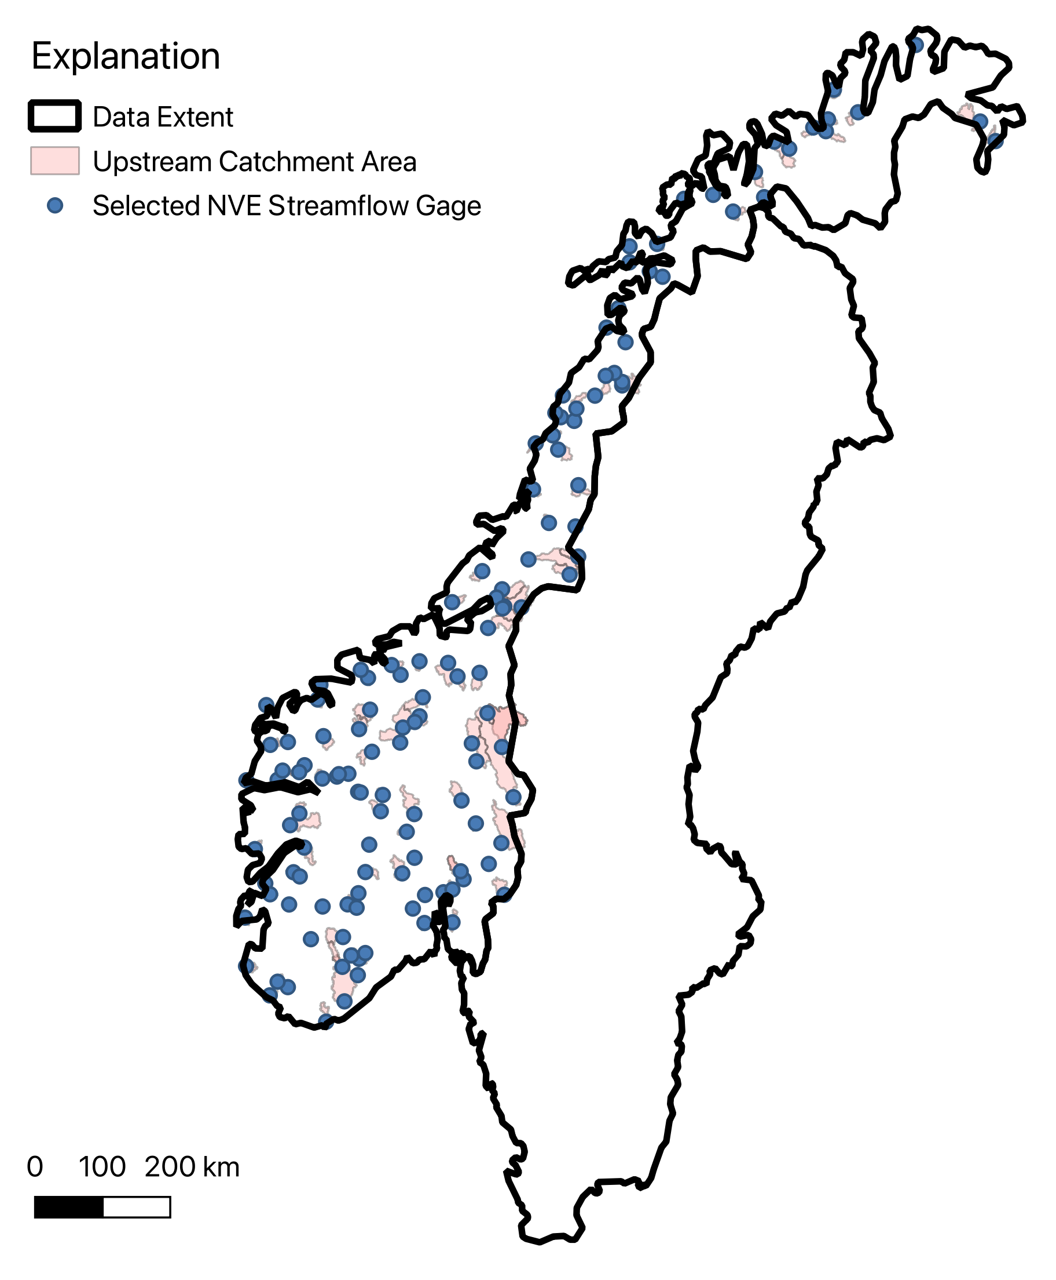
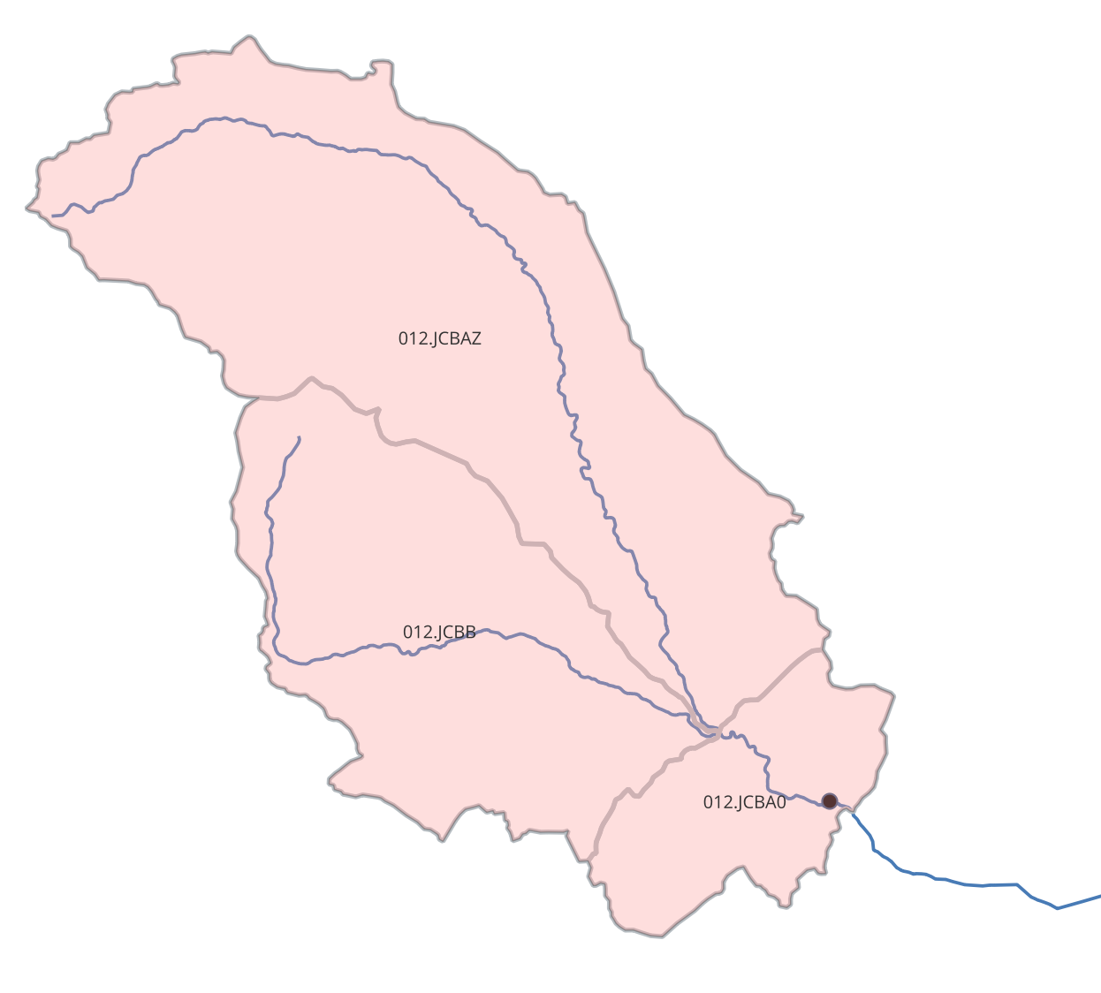
Selection of Norwegian catchments.

Slide 11
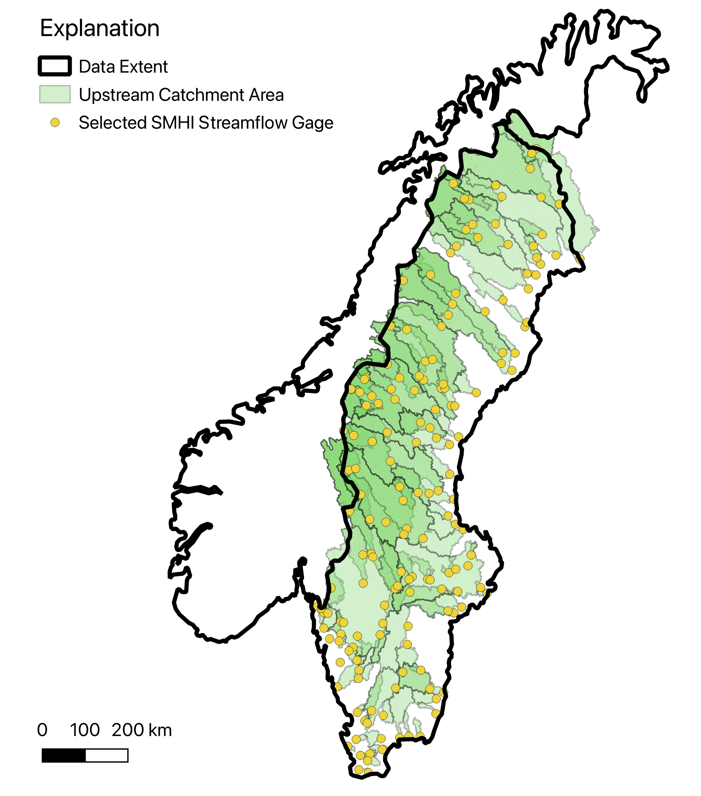
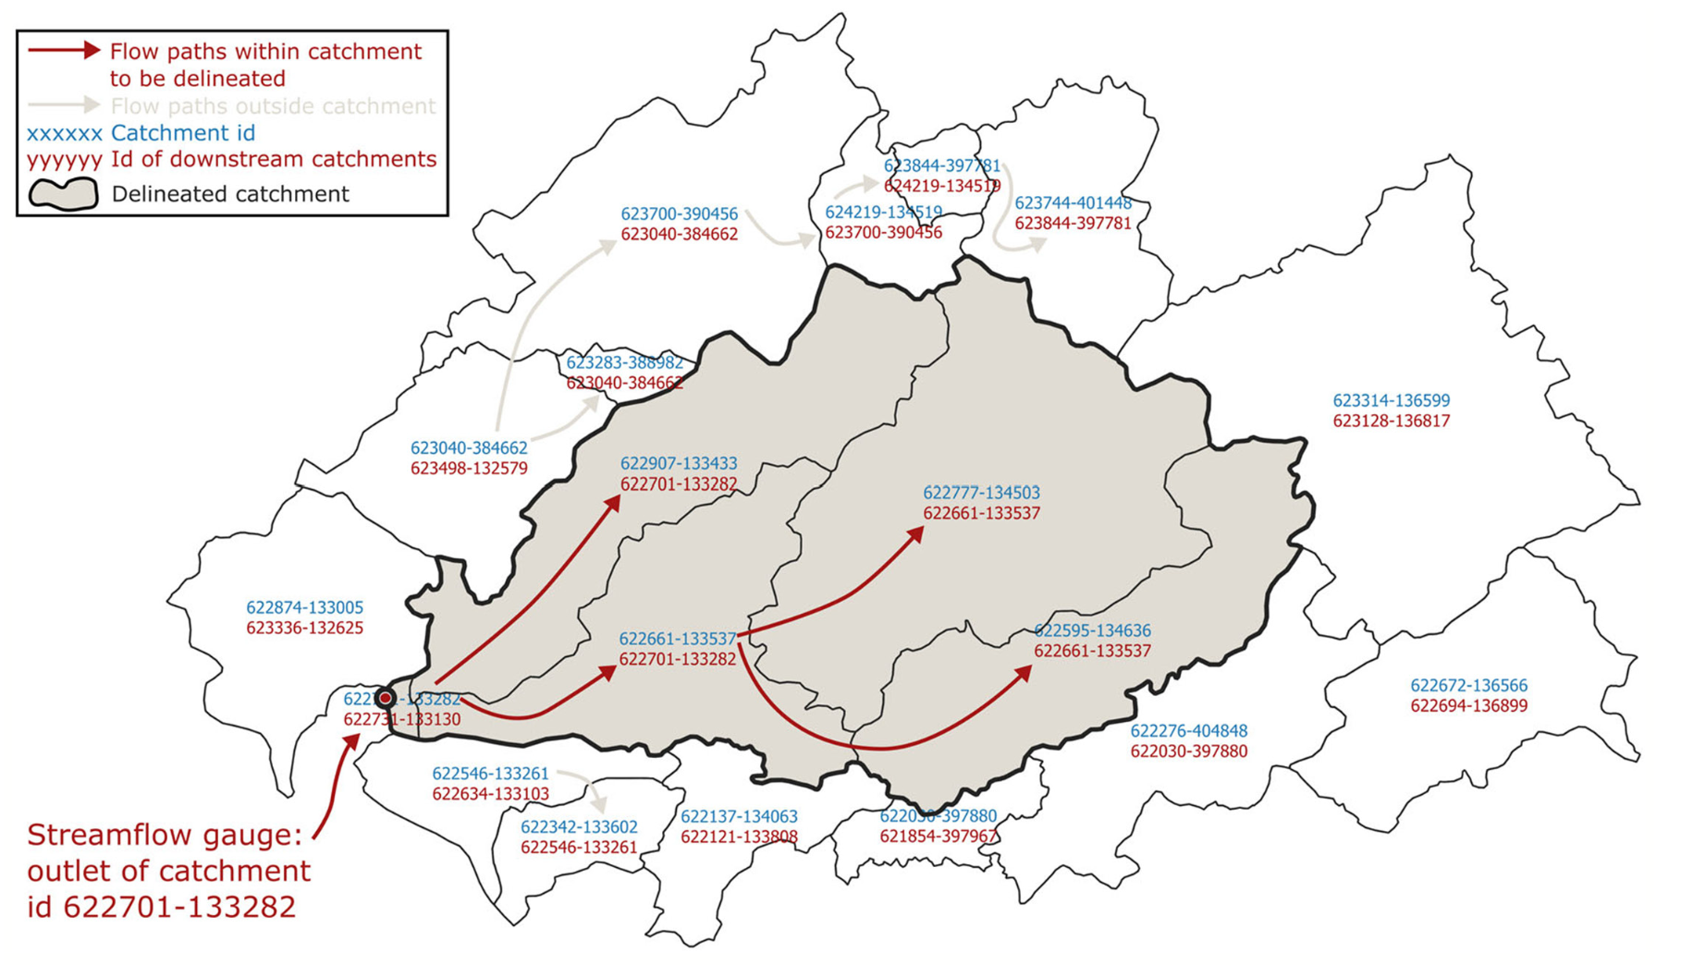
Selection of Swedish catchments.
C. Teutschbein. Camels-SE: Long-term hydroclimatic observations (1961–2020) across
catchments in sweden as a resource for modelling, education, and collaboration. Geoscience Data Journal, 11(4):655–668, 2024. doi: https://doi.org/10.1002/gdj3.239.

Slide 12
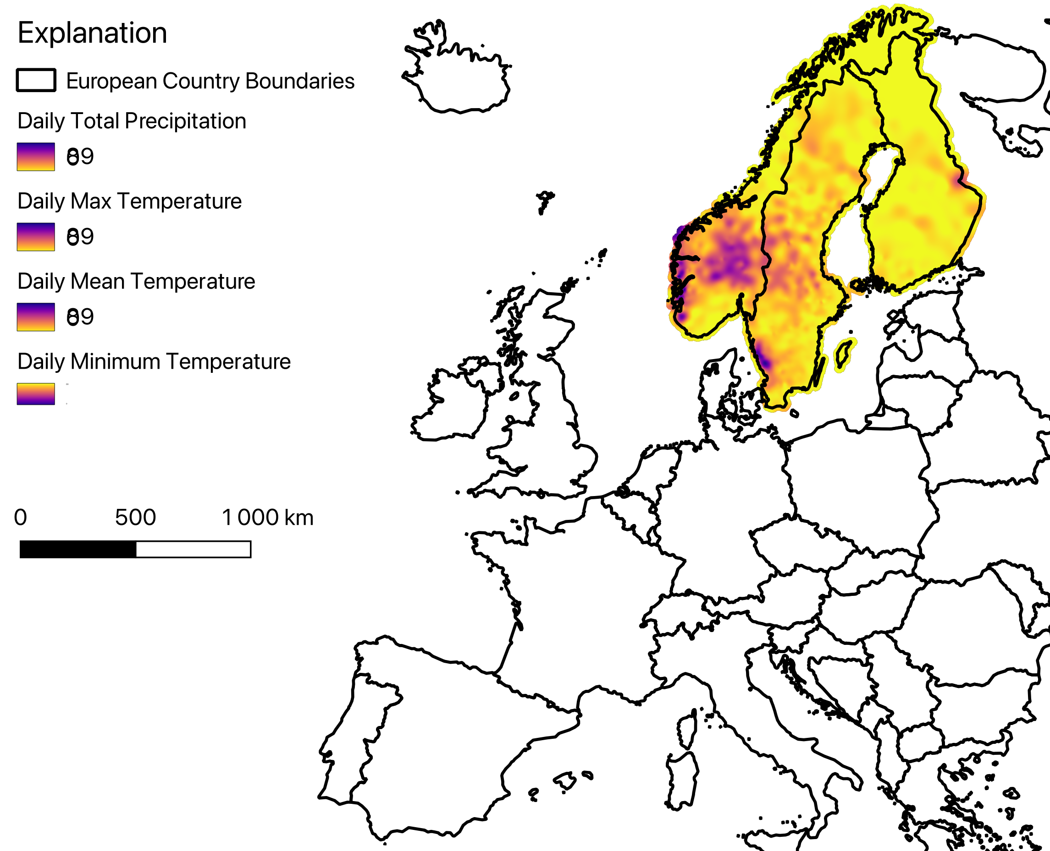
Datasets include in CAMELS-Nordic.
Nordic Gridded Climate Dataset
E-OBS daily gridded meteorological data
Corine Landcover Dataset 2018
NGU Løsmasser
SGU Jordarter

Slide 13
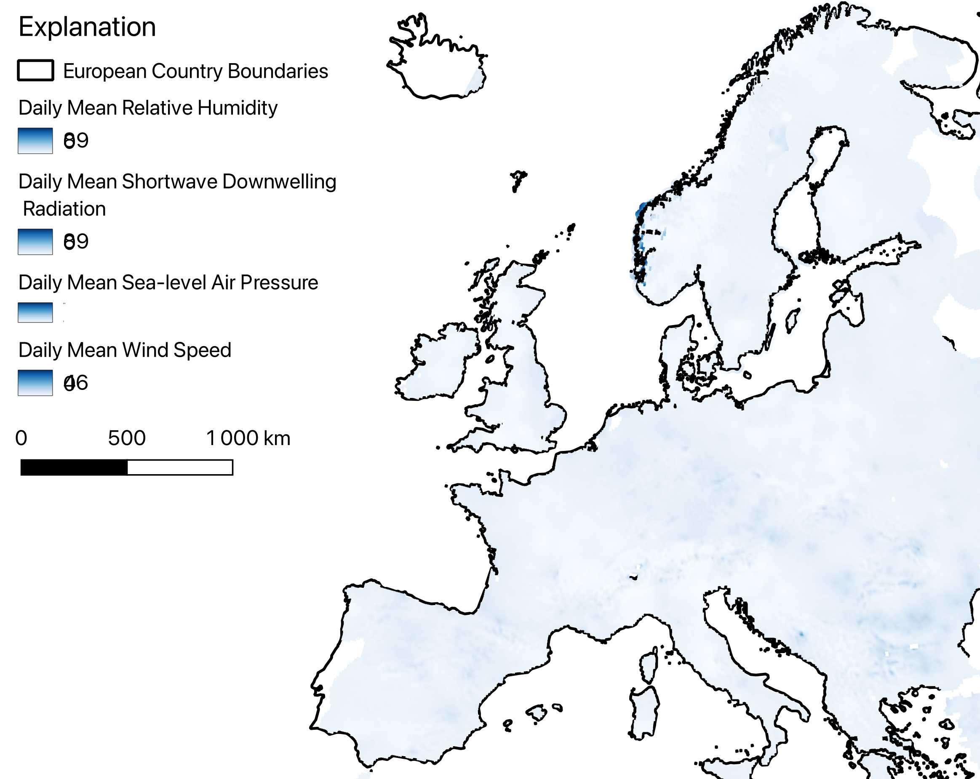
Datasets include in CAMELS-Nordic.
Nordic Gridded Climate Dataset
E-OBS daily gridded meteorological data
Corine Landcover Dataset 2018
NGU Løsmasser
SGU Jordarter

Slide 14
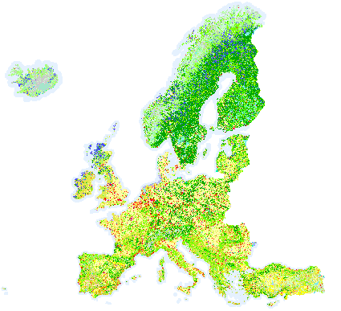
Datasets include in CAMELS-Nordic.
Nordic Gridded Climate Dataset
E-OBS daily gridded meteorological data
Corine Landcover Dataset 2018
NGU Løsmasser
SGU Jordarter

Slide 15
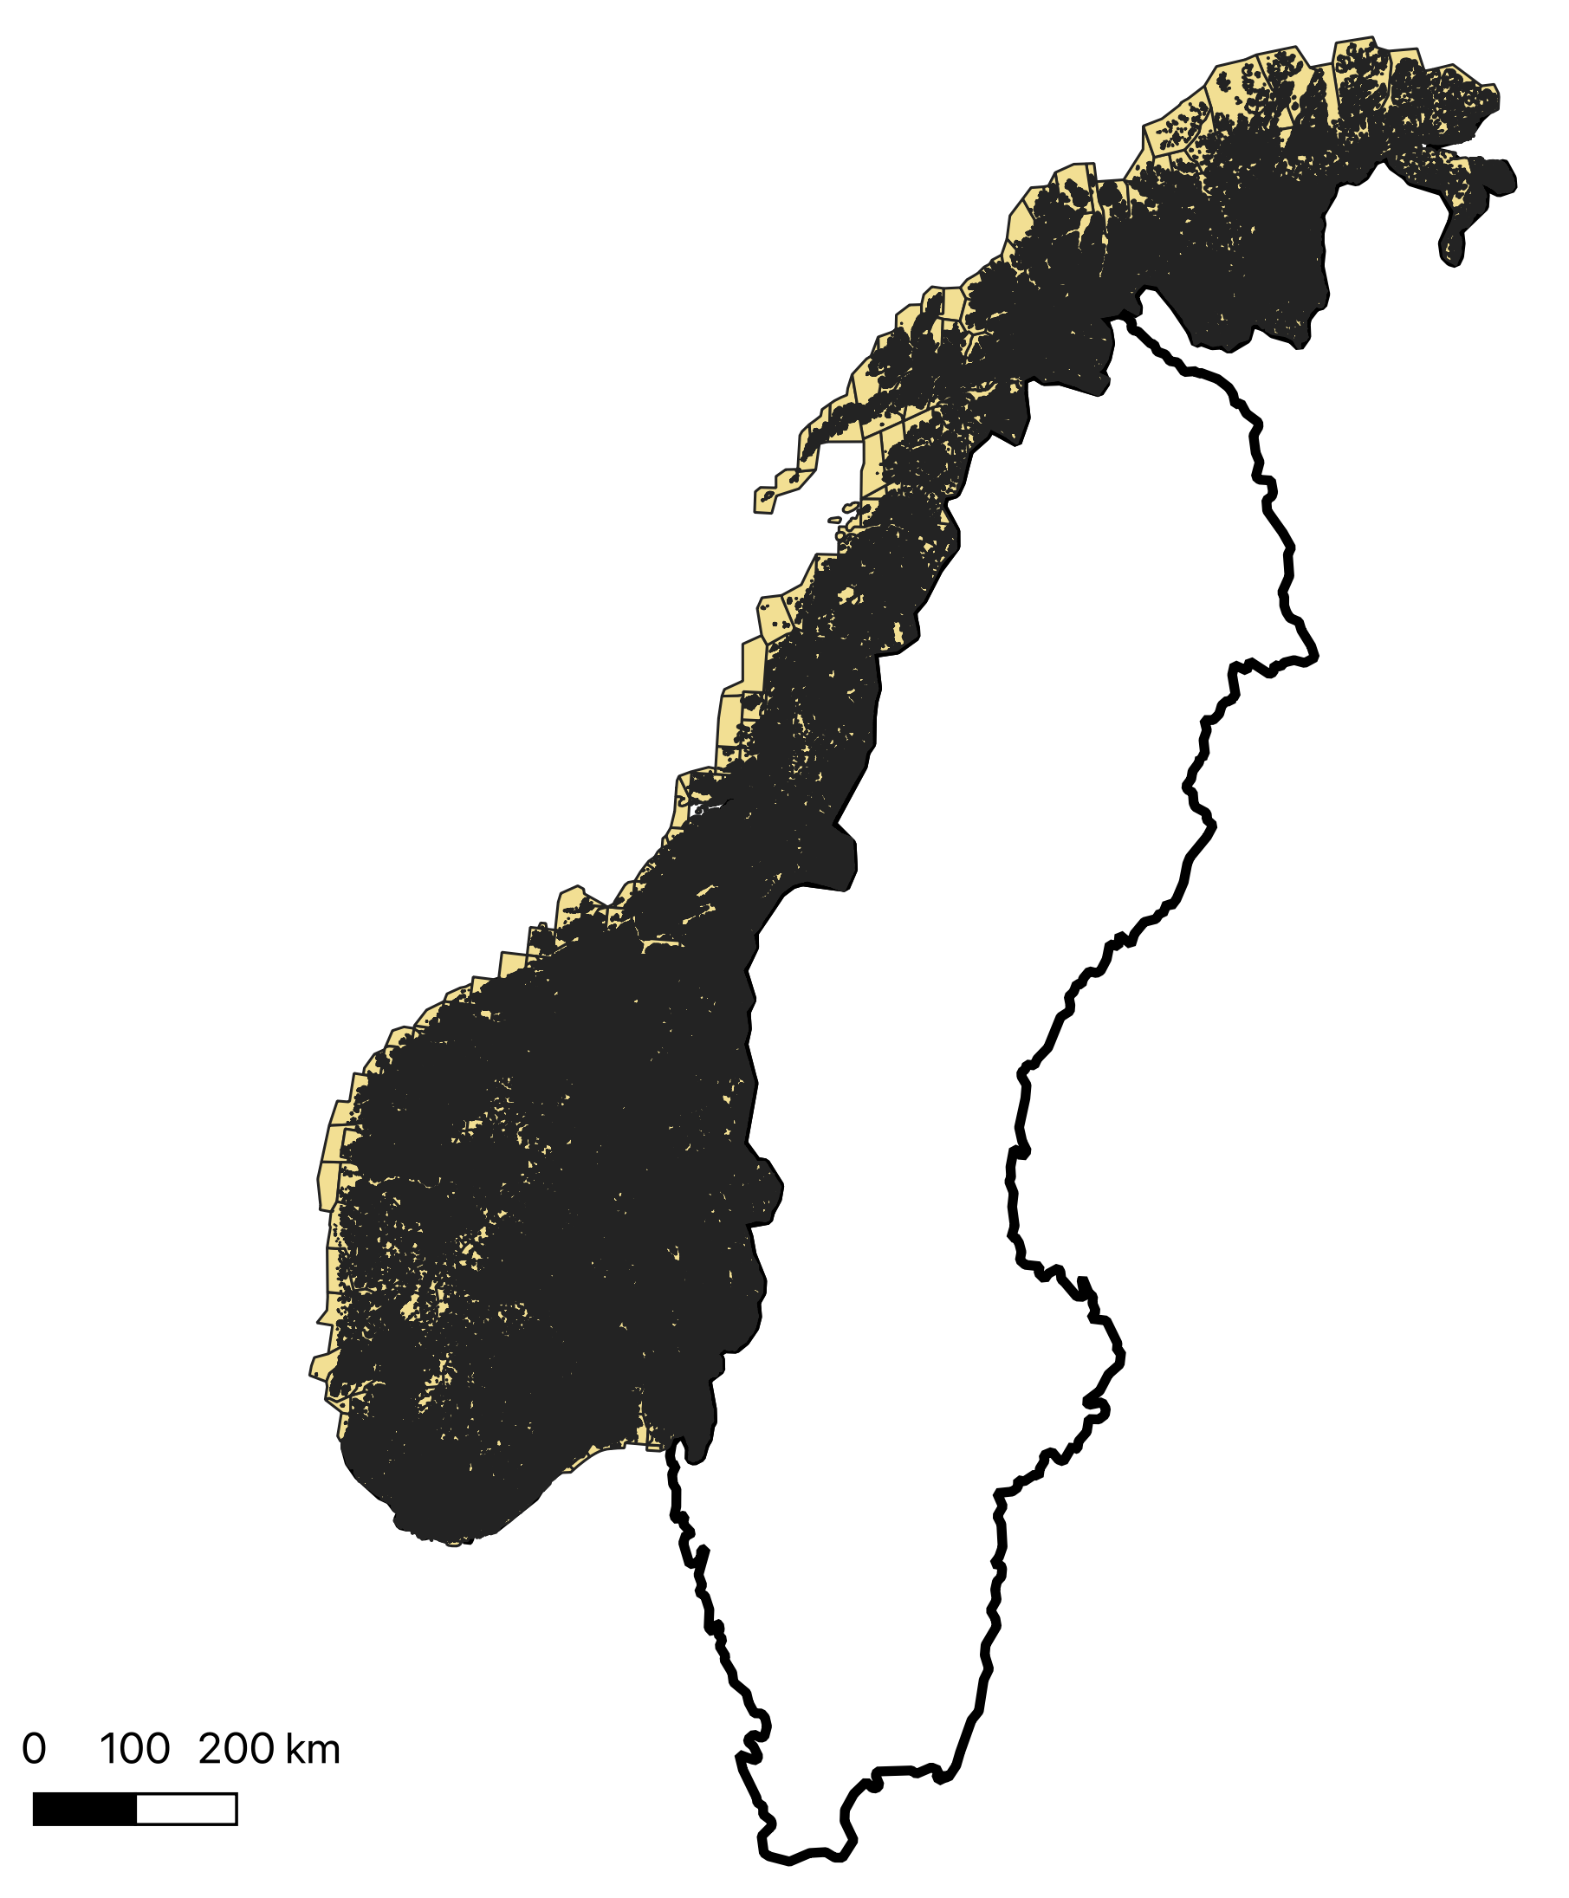
Datasets include in CAMELS-Nordic.
Nordic Gridded Climate Dataset
E-OBS daily gridded meteorological data
Corine Landcover Dataset 2018
NGU Løsmasser
SGU Jordarter

Slide 16
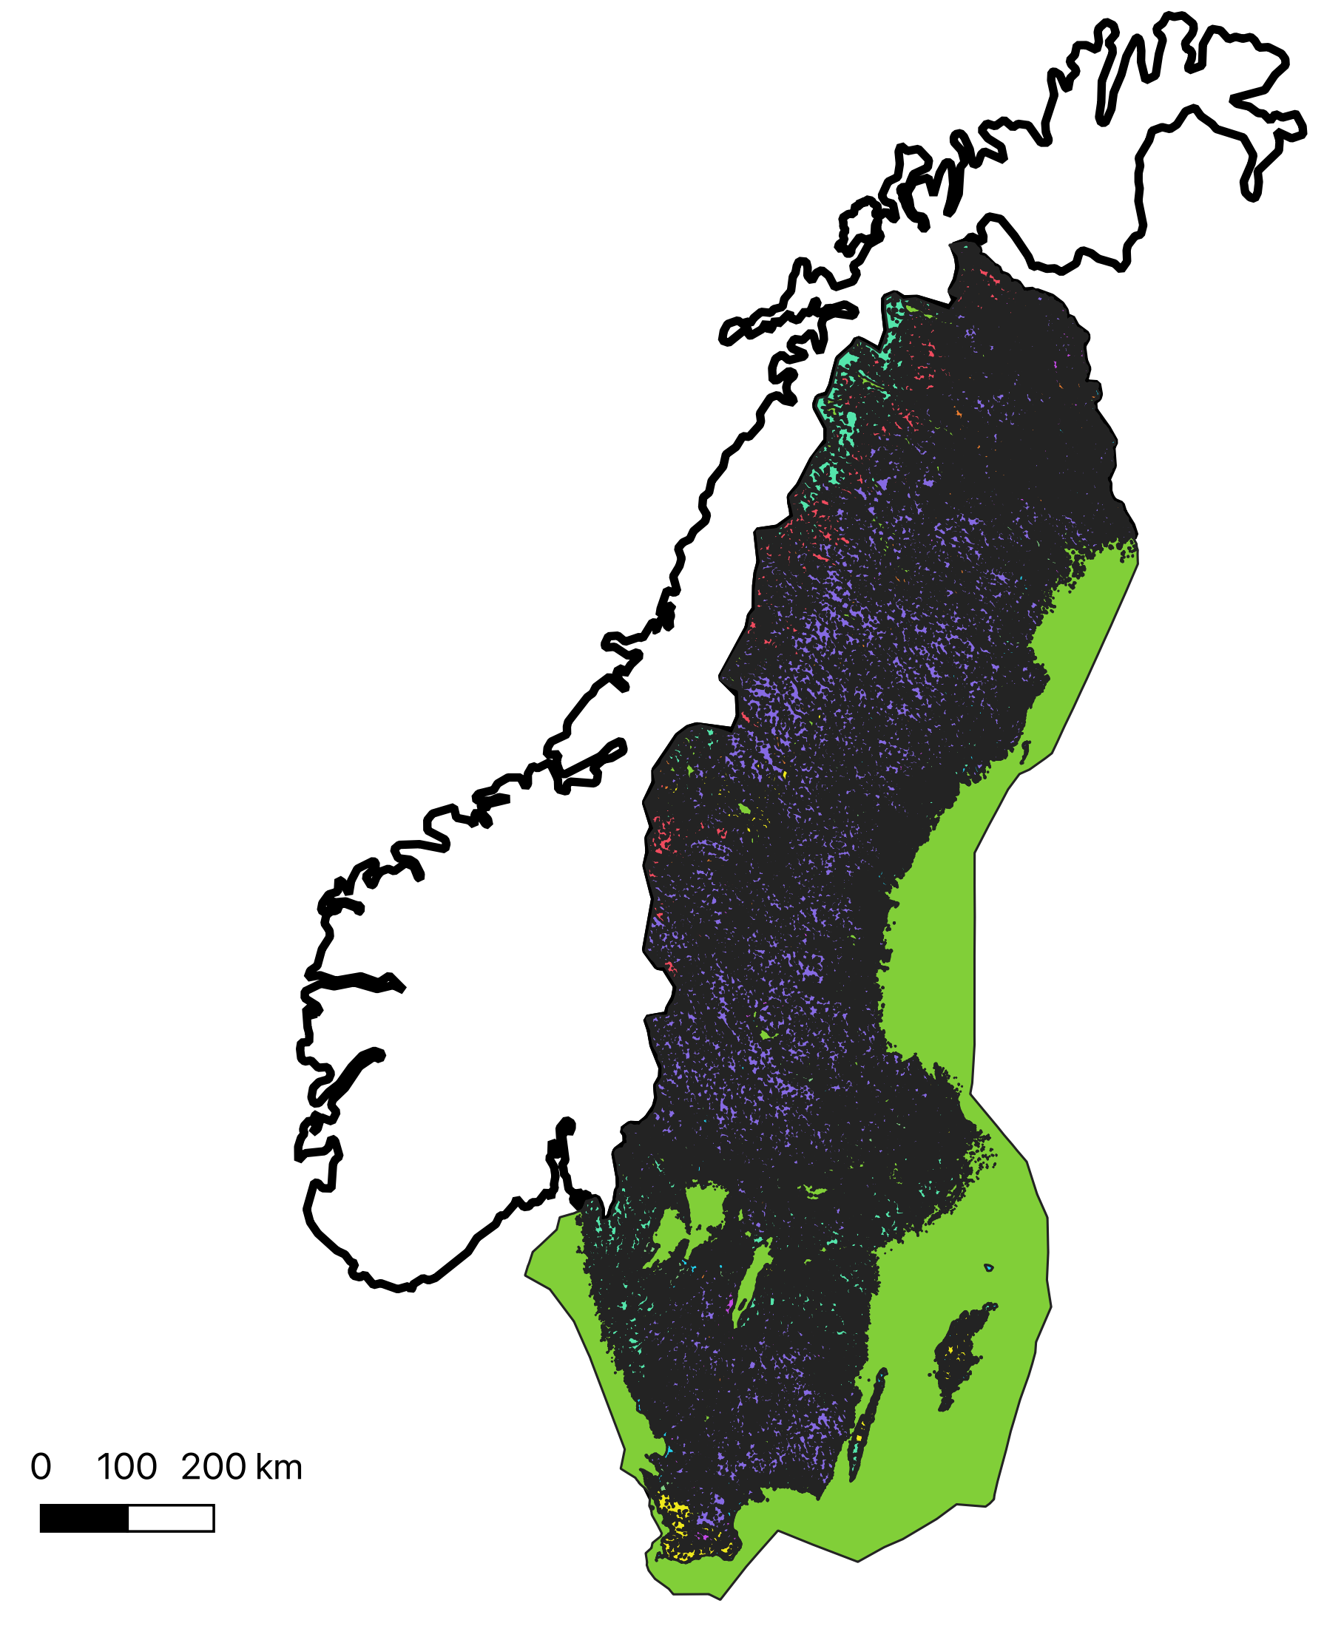
Datasets include in CAMELS-Nordic.
Nordic Gridded Climate Dataset
E-OBS daily gridded meteorological data
Corine Landcover Dataset 2018
NGU Løsmasser
SGU Jordarter

Slide 17
Calculated catchment attributes
Climate Indices
Hydrological Signatures
Mean daily precipitation
Seasonality and timing of precipitation
Fraction of precipitation falling as snow
Mean daily streamflow
(seasonal)
Runoff ratio
Low and high flows​
Days without streamflow​
Catchment Properties
Catchment area [km2]
Mean elevation [m a.s.l.]
Mean slope [m a.s.l.]
Soil types
(Clay [%], Sand [%] , etc.)
Landcover types
(Forest [%], Urban [%] , etc.)
Credit: The Watershed Project

Slide 18
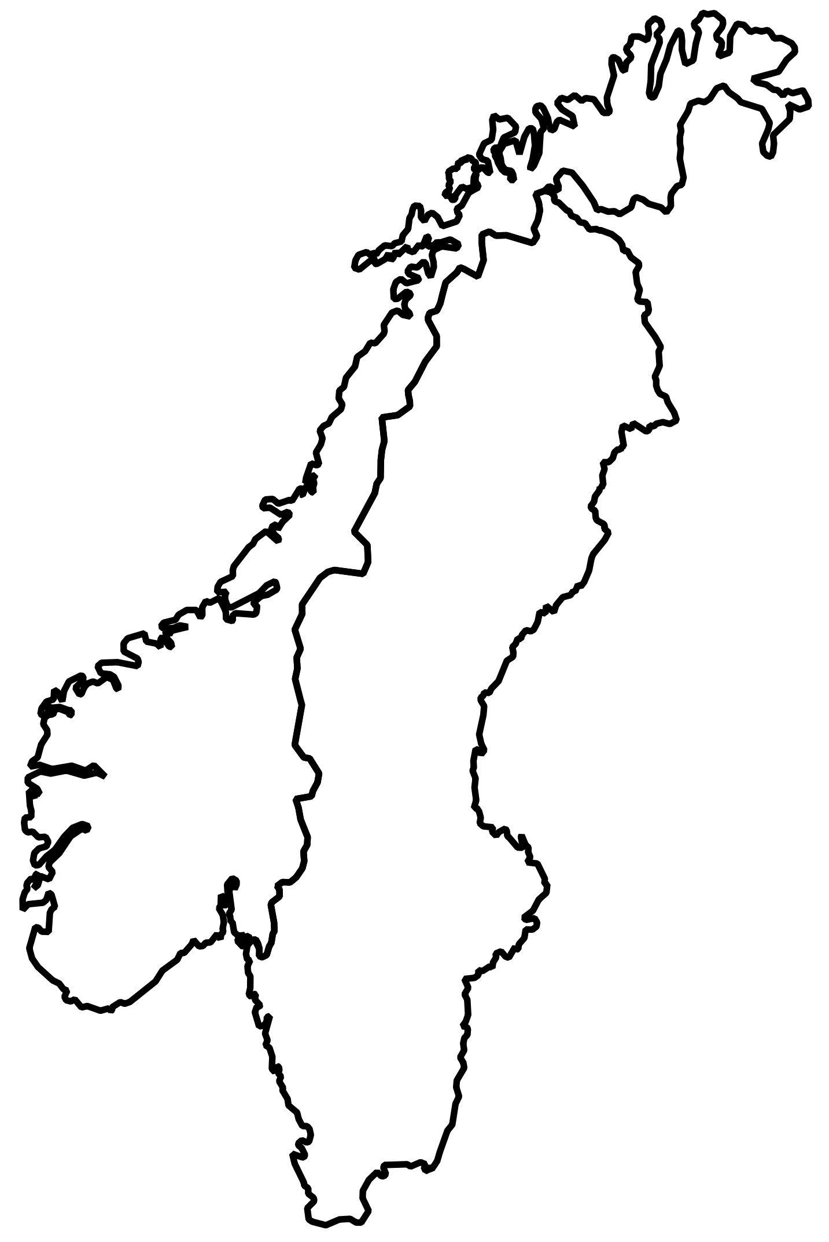
Data gaps and deficiencies.
Norway
Soil properties
Wind direction
Sweden
Soil properties
Wind direction
Glaciers
Snow Water Equivalent
Identification of streamflow gages with limit human impact

Slide 19

In summary, the CAMELS-Nordic dataset provides an opportunity to advance science and research in the Nordics.
Thank you!
Notes:
This template is for a conclusion slide. Use the headline (no more than two lines) to state your most important conclusion. Begin the headline with In summary or In conclusion to ensure that the audience knows they have come to the presentation’s end. Support that headline with an image and parallel points.
This slide should be your last slide. Audiences lose patience when they believe that they have come to the end, but other slides follow.
Notice that the word Questions appears at the bottom of this slide. That strategy is much more effective than burning a slide with just the word Questions. This slide allows the audience to look at the most important slide of the presentation during the question period. See The Craft of Scientific Presentations, 2nd ed., pages 182-183.

