Slide 1
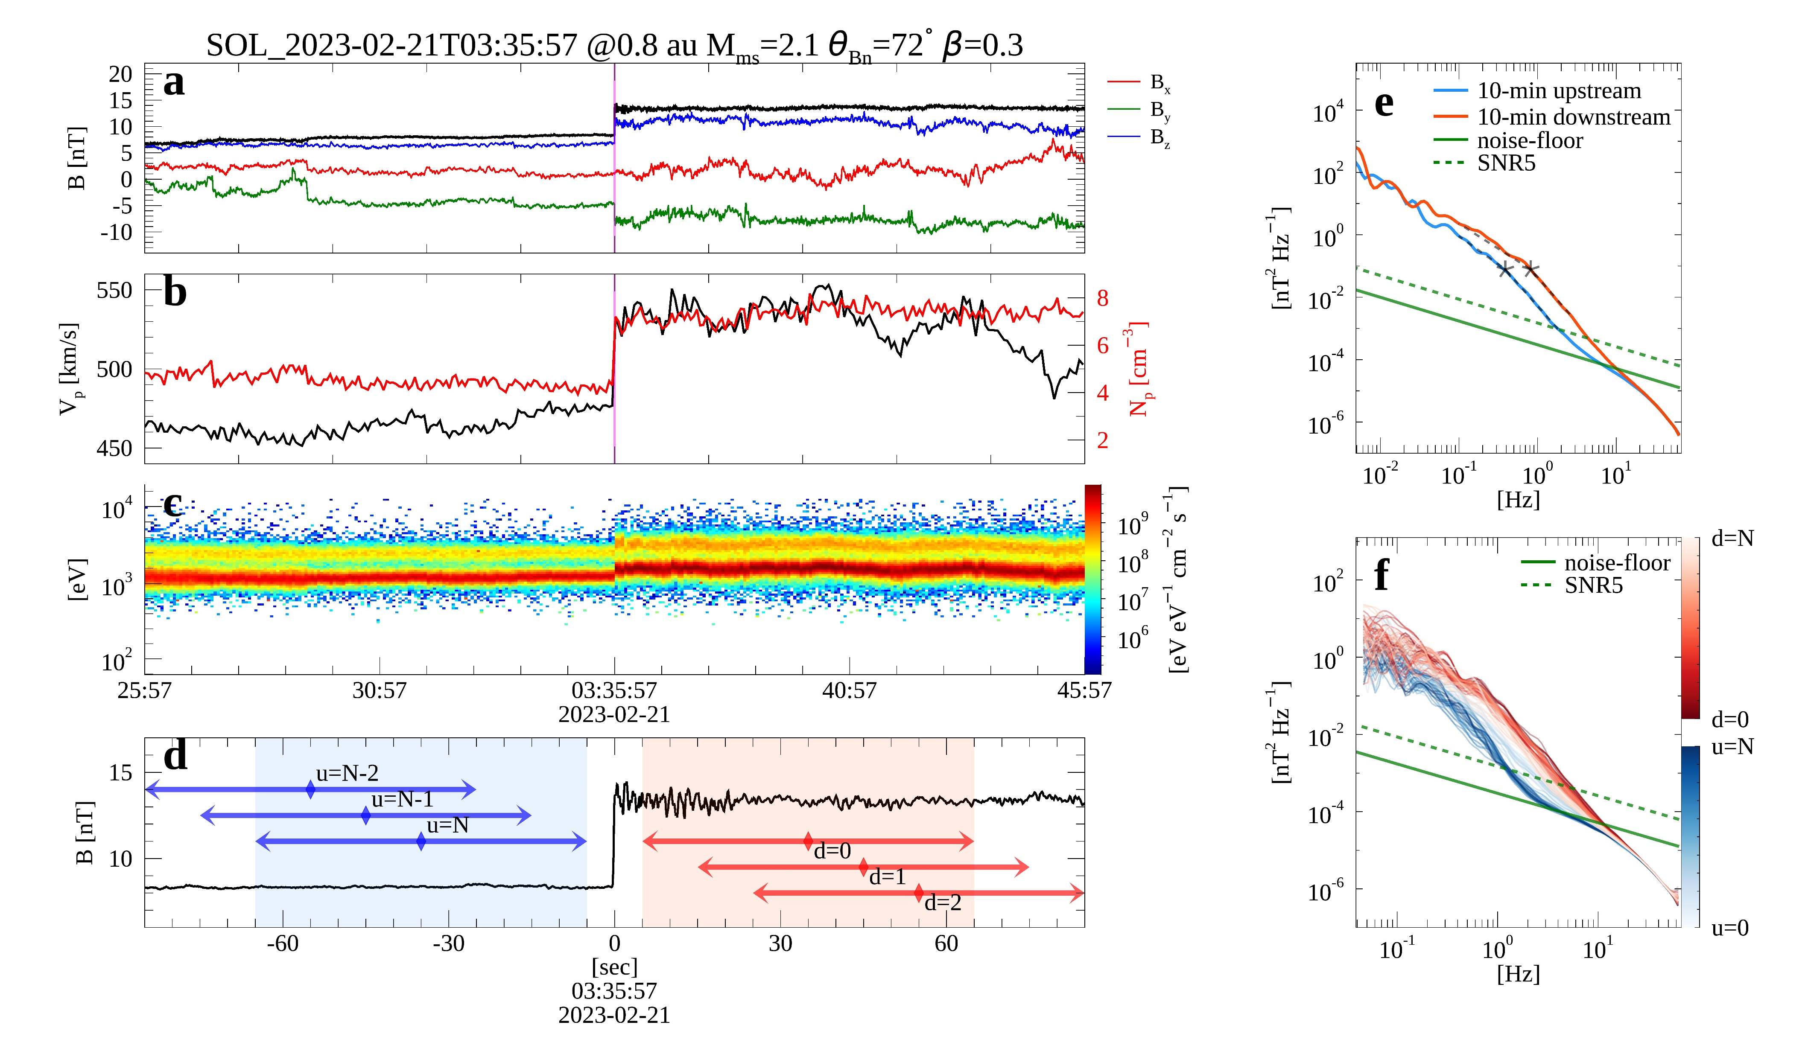
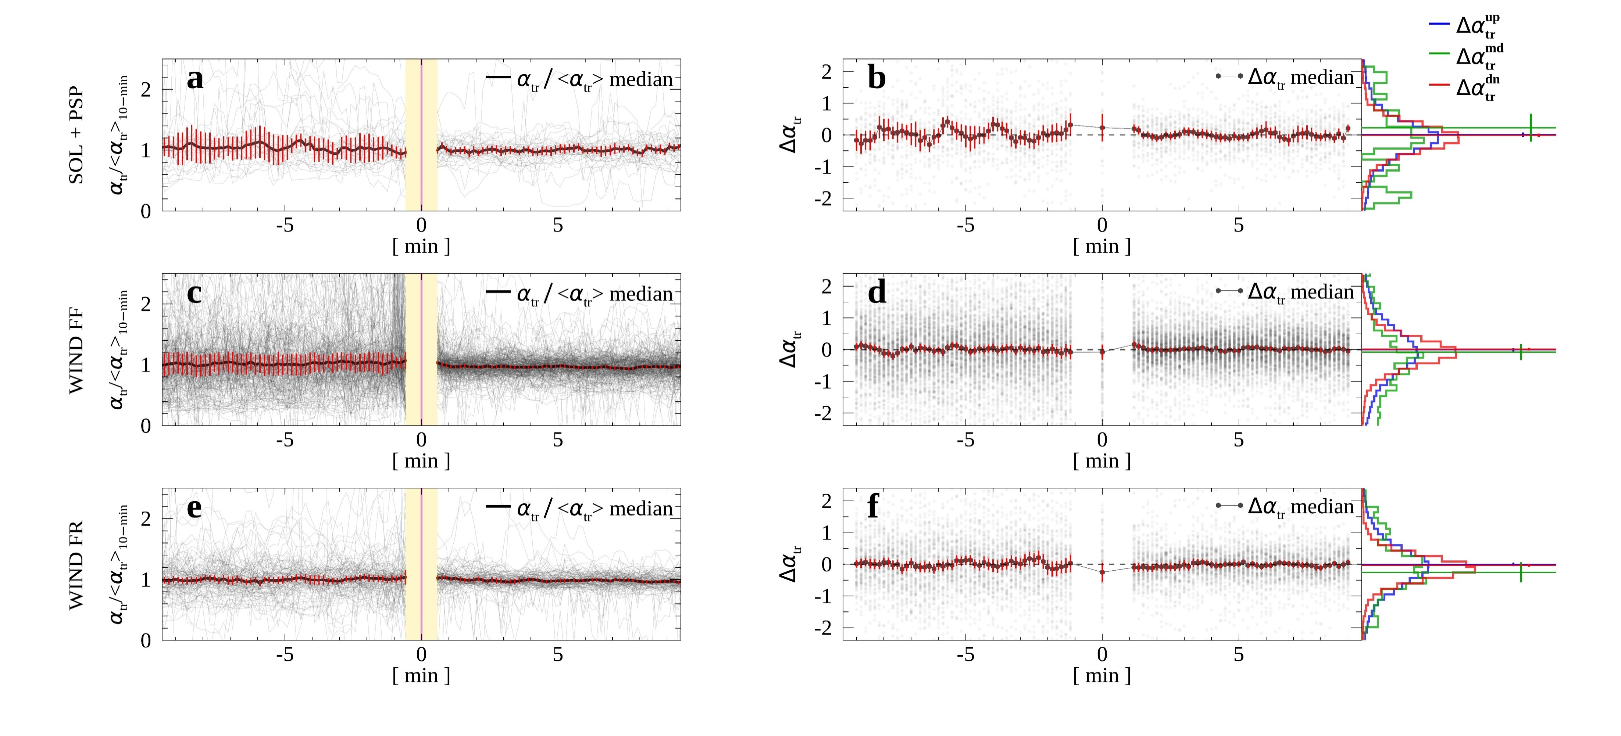
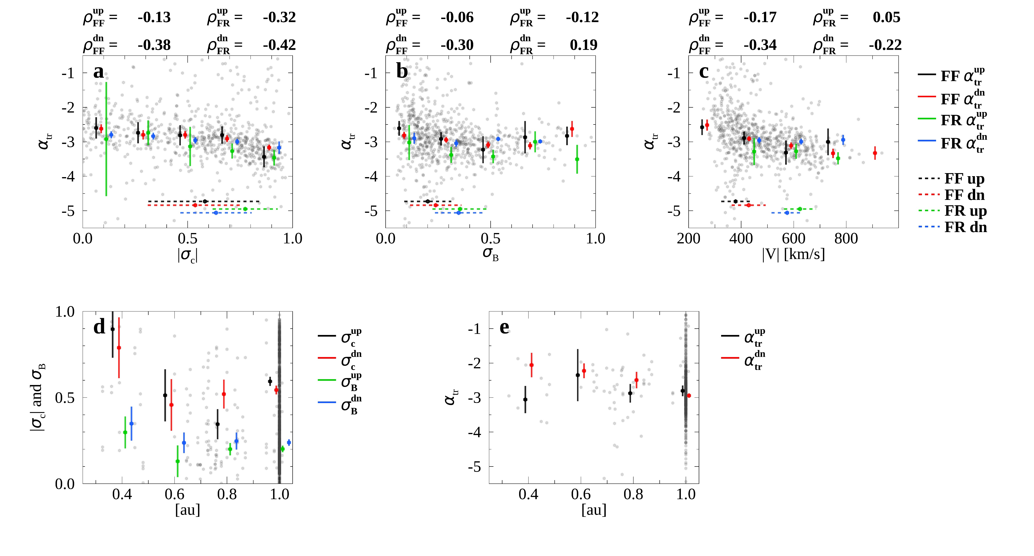
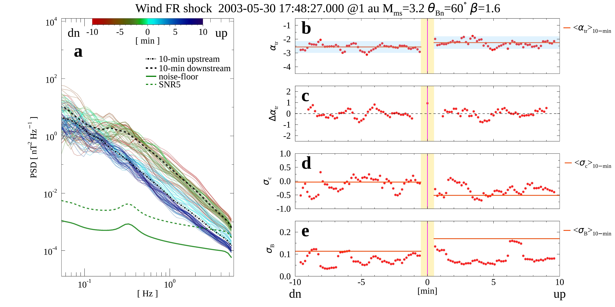
Evolution of Turbulent Energy Dissipation at Quasi-perpendicular Fast Interplanetary Shocks: The thickness of shock transition region
X4.160
${\text{Byeongseon} \text{Park}}^{1}$, ${\text{Alexander} \text{Pit}\text{ň}\text{a}}^{1}$, ${\text{Jana}\text{ Š}\text{afr}\text{á}\text{nkov}\text{á}}^{1}$, and ${\text{Zden}\text{ě}\text{k} \text{N}\text{ě}\text{me}\text{č}\text{ek}}^{1}$
${}^{1}$Charles University, Faculty of Mathematics and Physics, Prague, Czech Republic
Context
Shape of magnetic field spectra across interplanetary (IP) shock (1 au) seems invariant
Spectral breaks are found in ion cyclotron resonance scale both up- and downstream
Statistically conserving magnetic field spectral properties and energy dissipating mechanisms
Consistent flattening of $α_{tr}$ across fast reverse (FR) shock is observed
Aims
How thin shock is?
Transition times scale of the magnetic field fluctuation dissipation near IP shock
Systematic difference between FF and FR shocks
Dependence of shock properties on heliocentric distance
Data and Method
Plasma and magnetic field data from Wind, Solar Orbiter (SOL), and Parker Solar Probe (PSP)
Quasi-perpendicular IP shocks
Continuous wavelet transform (CWT) for magnetic field spectra and $α_{tr}$ estimation
Calculation of parameters within sliding (10-sec) computation window (1-min)
$φ_{u}$ ($u=0, 1, …, N$)
$φ_{d}$ ($d=0, 1, …, N$)
$φ=α_{tr}$, ${∆α}_{tr}$, $σ_{c}$, $σ_{B}$
$∆α_{tr}^{up}=α_{tr, u+7}−α_{tr, u}$
Figure 3. Example of the plasma quantities evolution via IP shock measured by Solar Orbiter. (a) magnetic field, (b) bulk speed and density, (c) proton energy flux. (d) shows example computation intervals. Magnetic field spectra of up- and downstream estimated in 10-min interval are shown in (e) and spectra estimated within the sliding windows are shown in (f).
Figure 1. Example of the plasma quantities evolution via IP shock measured by Solar Orbiter. (a) magnetic field, (b) bulk speed and density, (c) proton energy flux. (d) shows example computation intervals. Magnetic field spectra of up- and downstream estimated in 10-min interval are shown in (e) and spectra estimated within the sliding windows are shown in (f).
Discussion
The dissipation of magnetic field solely depends on the plasma conditions, not by shock itself
Helicity barrier to explain the effect of $σ_{c}$ on $α_{tr}$
Fluctuations propagate in the opposite direction in FF and FR upstream
Caveat: Less number of data points from SOL and PS with the exclusion of quasi-parallel shocks
Summary
Immediate formation of $α_{tr}$ within 5 s (the closest window from shock) regardless of the shock type
$σ_{c}$ is a predominant parameter regulating $α_{tr}$ over $σ_{B}$and V
$α_{tr}$ formation is simply governed by the Alfvenic nature regardless of the existence of shock
Role of shock as thin-boundary distinguishing two different plasmas
Figure 4. $α_{tr}$ dependence on |$σ_{c}$| (a), $σ_{B}$ (b), and |$V$| (c). |$σ_{c}$| and $σ_{B}$ as a function of distance is shown in (d) while $α_{tr}$ in (e)
Acknowledgement.
The present work is supported by the Czech Science Foundation under contract 23-06401S and the Charles University Grant Agency under contract 280423. The authors thank all PSP, SOL, and Wind teams for the magnetic field and plasma data.
References.
Park, B. et al. 2023, The Astrophysical Journal Letters, 954, L51.
Torrence, C., & Compo, G. P. 1998, Bulletin of the American Meteorological Society, 79, 61.
Figure 2. Example of the evolution of estimated parameters $φ$via a FR shock measured by Wind. (a) $α_{tr}$, (b) ${∆α}_{tr}$, (c) $σ_{c}$, and (d) $σ_{B}$. Yellow-shaded regions are excluded from analysis in order to avoid potential instabilities.

