Slide 1






Session HS5.2.3

Slide 2
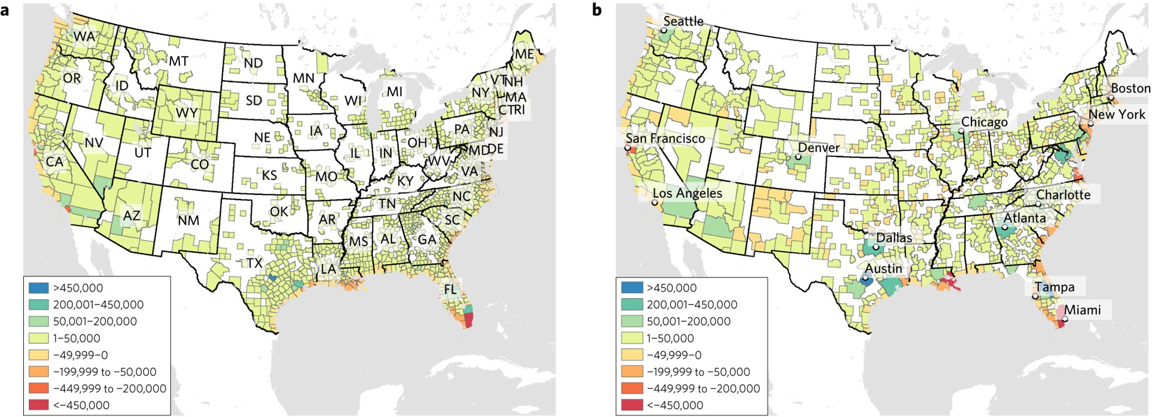



Session HS5.2.3
How 13 million global farming households respond to coastal flooding and salt intrusion under sea level rise? DYNAMO-M
Kushagra Pandey, Jens de Bruijn, Hans de Moel, Wouter Botzen, Jeroen Aerts
Let’s stay here,
What else to do
Let’s migrate
Estimated SLR net migrants (in-migrants minus out-migrants) for counties and core based statistical areas under the 1.8 m scenario and no adaptation. a, US counties. b, Core based statistical areas.(Hauer, M. , 2017, Nature Clim Change)
We should adapt
Pandey K. et al, 2024, NHESS

Slide 3
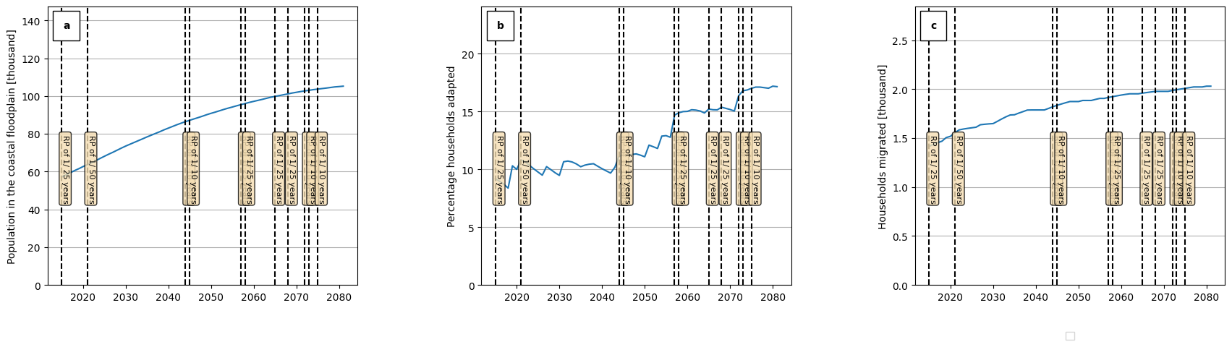
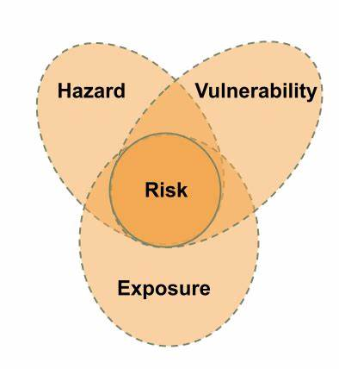
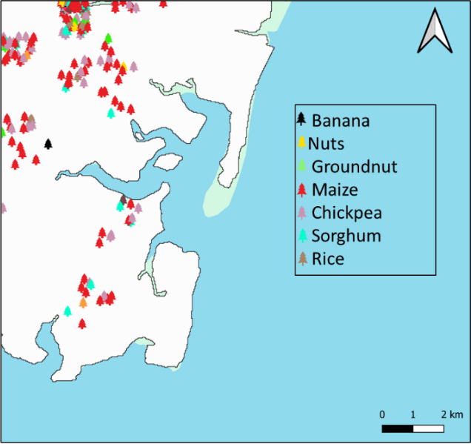
DYNAMO-M
Model Initialization
Survey
Future scenarios
sea level rise
socio-economics
Policies
risk
agents
Mozambique Argentina
Socio-economics
agent economics and costs
Temporal dynamics
Exposure, GDP, hazard
Impact
houses and farms
Pandey K. et. al., 2024
Results
Decision module
Discounted Expected Utility
Human behavior

Slide 4
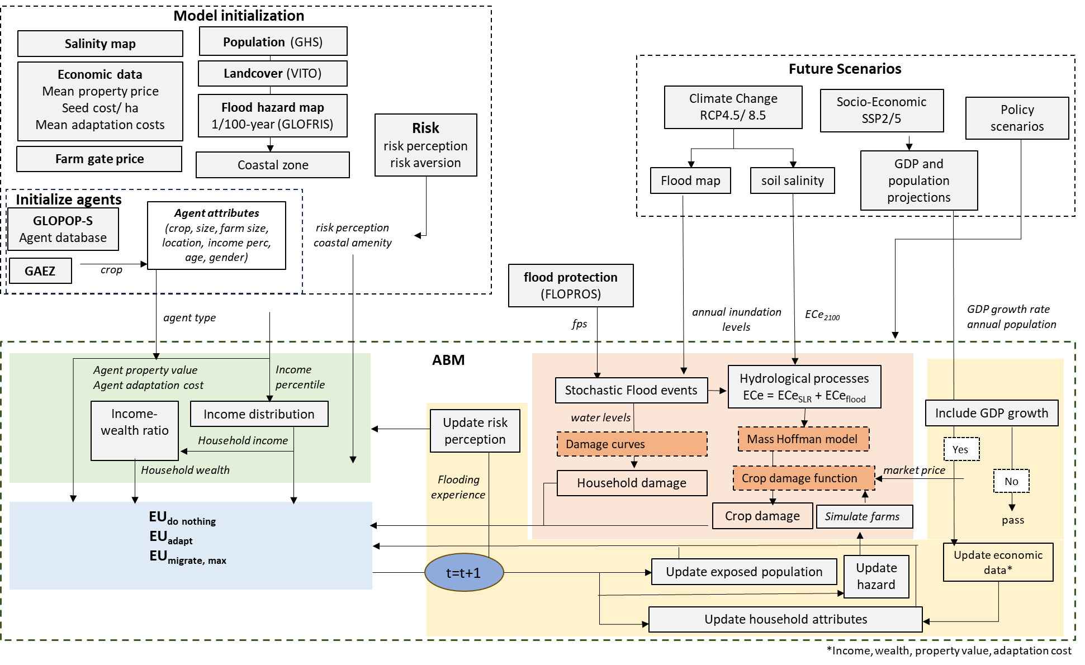

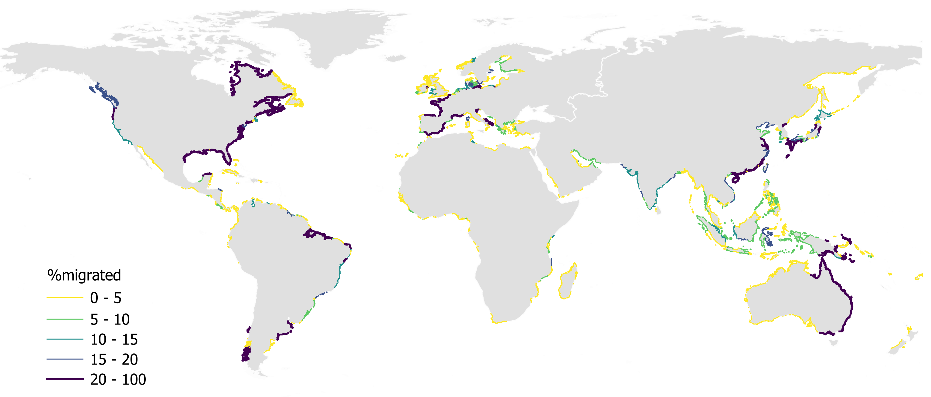





www.coastmove.org
More at PICO spot 4, PICO4.10
Model description
Global results
Scan me for abstract
@Kushagrapandey.bsky.social
Pandey, K., Botzen, W. J. W., de Bruijn, J. A., de Moel, H., and Aerts, J. C. J. H.: Global scale effects of salt intrusion and sea level rise on coastal migration and adaptation(in prep)

Slide 5


DYNAMO-M
www.coastmove.org
Model Initialization
Risk agents
Survey
Future scenarios
sea level rise
socio-economics
policies
Mozambique Argentina
Socio-economics
agent economics and costs
Temporal dynamics
Exposure, GDP, hazard
Impact
houses and farms
Results
Decision module
Discounted Expected Utility
Human behavior

Slide 6

Model initialization
Salinity map
Population (GHS)
Economic data
Mean property price
Seed cost/ ha
Mean adaptation costs
Landcover (VITO)
Flood hazard map
1/100-year (GLOFRIS)
Risk
risk perception
risk aversion
Farm gate price
Coastal zone
Future scenarios
sea level rise
socio-economics
policies
Initialize agents
GLOPOP-S
Agent database
Agent attributes
(crop, size, farm size, location, income perc,
age, gender)
risk perception
coastal amenity
GAEZ
crop
agent type
Income
percentile
Socio-economics
agent economics and costs
Temporal dynamics
Exposure, GDP, hazard
Impact
houses and farms
Results
Model
Decision module
Discounted Expected Utility
Human behavior

Slide 7
Future Scenarios
Climate Change
RCP4.5/ 8.5
Socio-Economics
SSP2/5
Survey
Model Initialization
Risk agents
GDP and population projections
soil salinity
Policy scenarios
Flood map
ECe₂₀₈₀
GDP growth rate
annual population
Adaptation aid
Damage coverage
annual inundation levels
Socio-economics
agent economics and costs
Temporal dynamics
Exposure, GDP, hazard
Impact
houses and farms
Results
Decision module
Discounted Expected Utility
Human behavior

Slide 8
Future scenarios
sea level rise
socio-economics
Policies
Model Initialization
Risk agents
flood protection (FLOPROS)
annual inundation levels
ECe₂₁₀₀
GDP growth rate
annual population
fps
Socio-economics
agent economics and costs
Hydrological processes
ECe = ECe_{SLR} + ECe_{flood}
Stochastic Flood events
Update risk perception
water levels
Include GDP growth
Damage curves
Mass Hoffman model
Yes
Flooding experience
Household damage
Crop damage function
market price
No
Decision module
Discounted Expected Utility
Human behavior
Crop damage
Simulate farms
pass
t=t+1
Update hazard
Update economic data*
Update exposed population
Update household attributes

Slide 9
www.coastmove.org
Model Initialization
Risk agents
Future scenarios
sea level rise
socio-economics
policies
risk perception
coastal amenity
Socio-economics
agent economics and costs
Temporal dynamics
Exposure, GDP, hazard
Impact
houses and farms
Results
Household economics
EU_{do nothing}
Eu_{adapt( 3ways)}
EU_{migrate, max}
*click to view equations

Slide 10
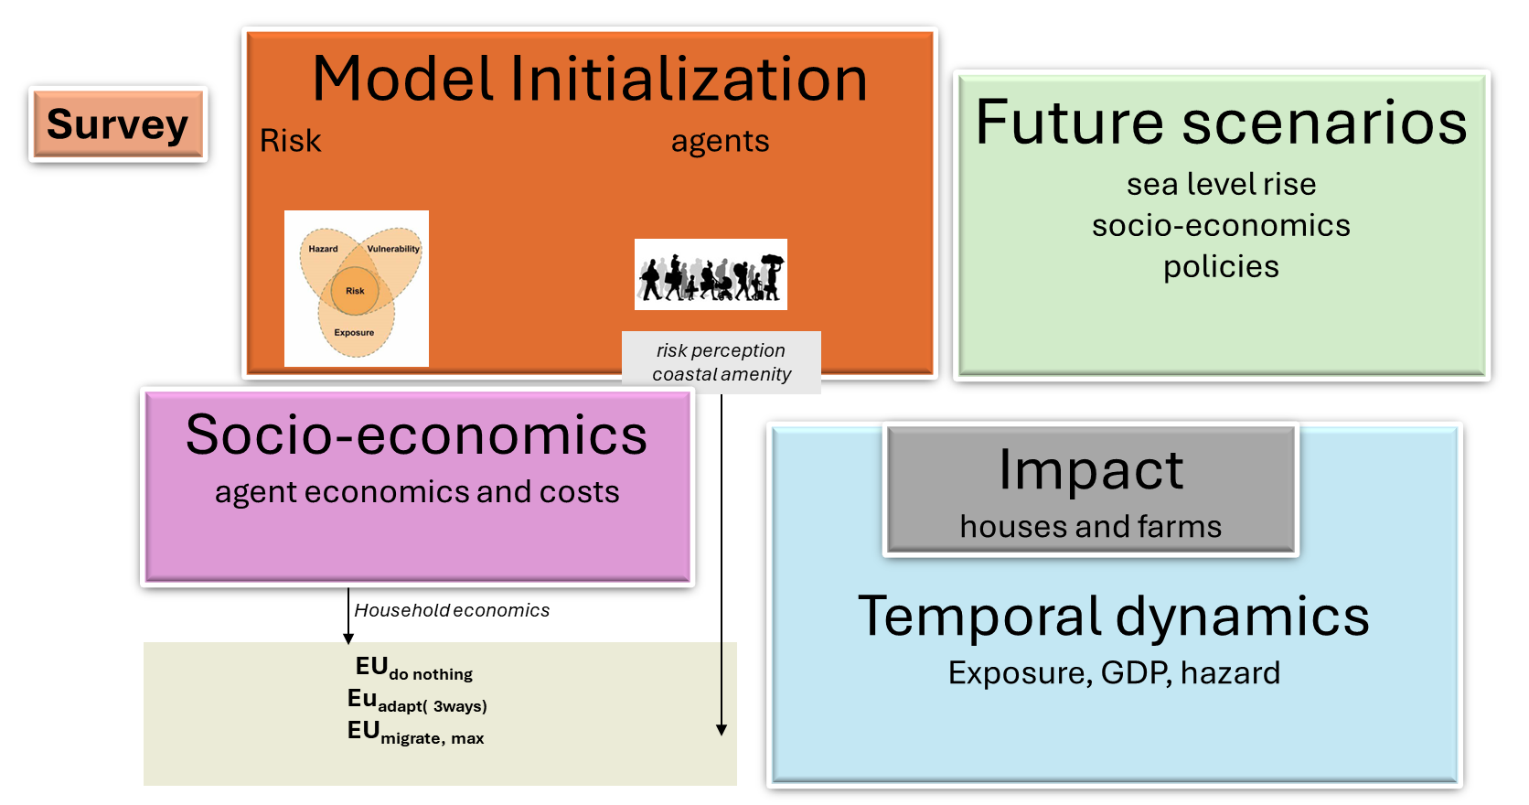

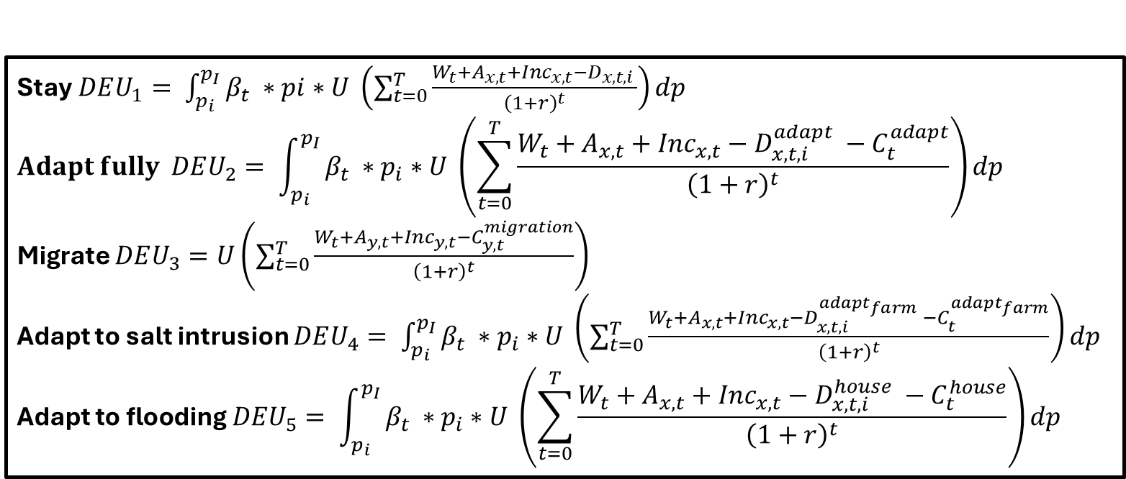
www.coastmove.org
Stay$DEU_{1}= \int_{p_{i}}^{p_{I}}{β_{t} ∗pi∗U \left(\sum_{t=0}^{T}{\frac{W_{t}+A_{x,t}+{Inc}_{x,t}−D_{x,t,i} }{{\left(1+r\right)}^{t}}}\right)dp }$
$$Adapt fully DEU_{2}= \int_{p_{i}}^{p_{I}}{β_{t} ∗p_{i}∗U \left(\sum_{t=0}^{T}{\frac{W_{t}+A_{x,t}+{Inc}_{x,t}−D_{x,t,i}^{adapt} −C_{t}^{adapt}}{{\left(1+r\right)}^{t}}}\right)dp }$$
Migrate $DEU_{3}=U\left(\sum_{t=0}^{T}{\frac{W_{t}+A_{y,t}+{Inc}_{y,t}−C_{y,t}^{migration}}{{\left(1+r\right)}^{t}}}\right)$
Adapt to salt intrusion $DEU_{4}= \int_{p_{i}}^{p_{I}}{β_{t} ∗p_{i}∗U \left(\sum_{t=0}^{T}{\frac{W_{t}+A_{x,t}+{Inc}_{x,t}−D_{x,t,i}^{adapt_{farm}} −C_{t}^{adapt_{farm}}}{{\left(1+r\right)}^{t}}}\right)dp }$ $$\text{Adapt} \text{to} \text{flooding} DEU_{5}= \int_{p_{i}}^{p_{I}}{β_{t} ∗p_{i}∗U \left(\sum_{t=0}^{T}{\frac{W_{t}+A_{x,t}+{Inc}_{x,t}−D_{x,t,i}^{house} −C_{t}^{house}}{{\left(1+r\right)}^{t}}}\right)dp }$$

Slide 11
www.coastmove.org
Model Initialization
Risk agents
Future scenarios
sea level rise
socio-economics
policies
agent type
Agent property value
Agent adaptation cost
Income
percentile
Temporal dynamics
Exposure, GDP, hazard
Impact
houses and farms
Income-wealth ratio
Income distribution
Household income
Results
Household economics
Decision module
Discounted Expected Utility
Human behavior

Slide 12
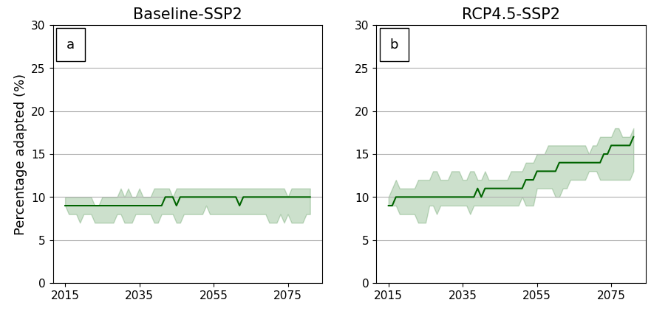
www.coastmove.org
Table1: Calibration parameters
Table2: Survey results from Argentina and Mozambique
Parameter | Min Value | Max Value | Step
Max risk perception | 1 | 3 | 1
Poverty line | 0.3 | 0.5 | 0.05
Loan duration(years) | 10 | 31 | 2
Adaptation cost ratio | 1 | 4 | 0.5
Asset type | Parameter | Argentina | Mozambique
 | Total respondents | 800 | 828
 | Farm owners | 139 | 413
Residential | Adapted with elevating houses(%) | 64.02 | 79.41
 | Will adapt in next 5 years(%) | 73.38 | 87.16
 | Will not adapt/cannot afford (%) | 26.62 | 12.84
Farms | Adapted with crop switch(%) | 30.93 | 11.13
 | Will adapt by crop switch in next 5 years(%) | 40.28 | 32.20
 | Will not adapt/cannot afford(%) | 59.72 | 67.80
Combined | Adapted both house and farm(%) | 20.86 | 9.20
 | Will adapt to both in next 5 years(%) | 30.93 | 28.81
Table3: Combined adaptation, MOZ

Slide 13
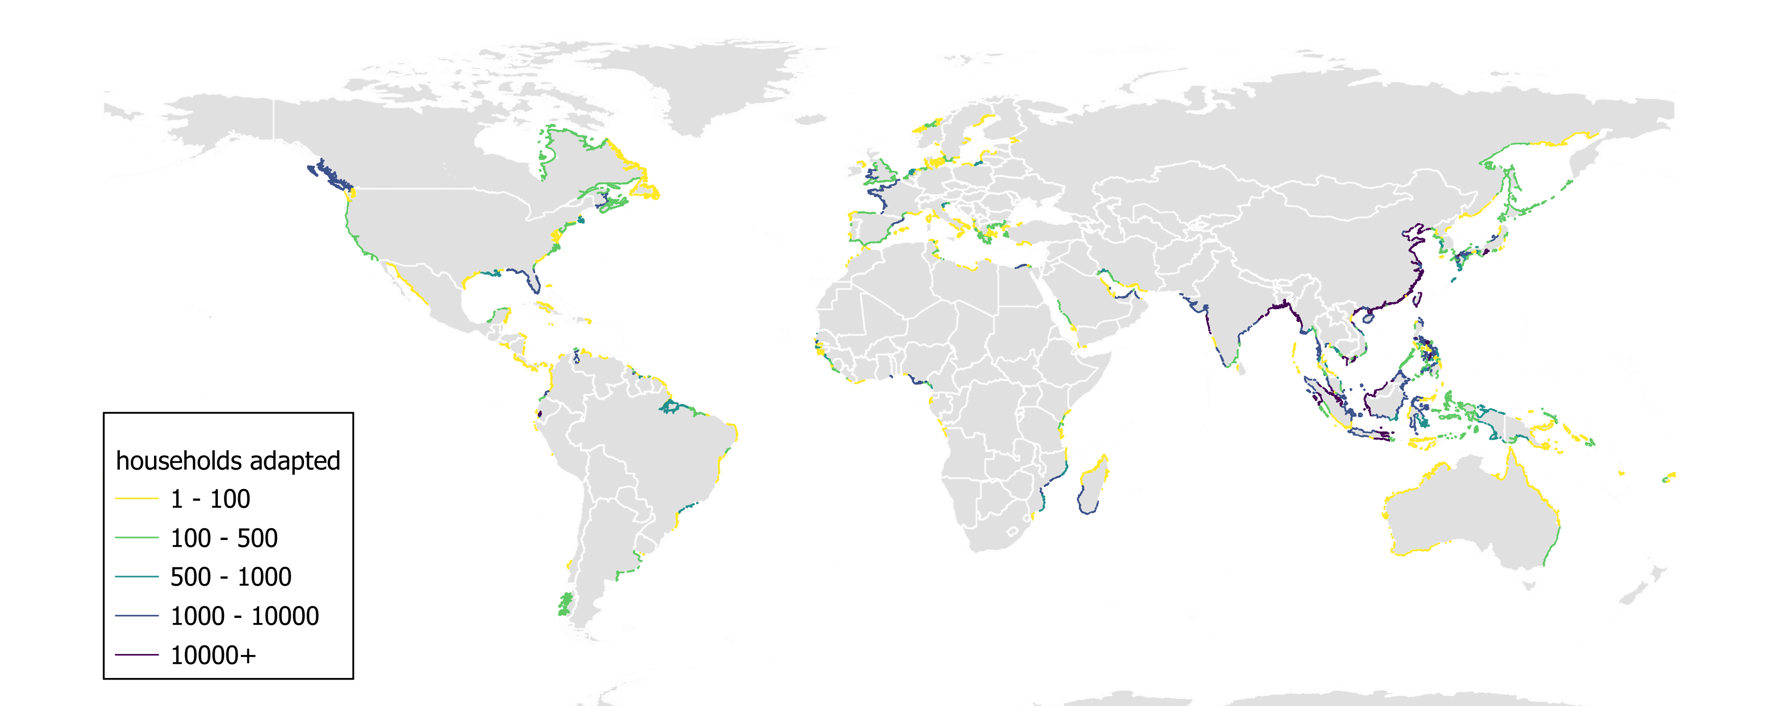
Results
www.coastmove.org
Adaptation
Migration
Single run
More…
Click on a region to see results

Slide 14
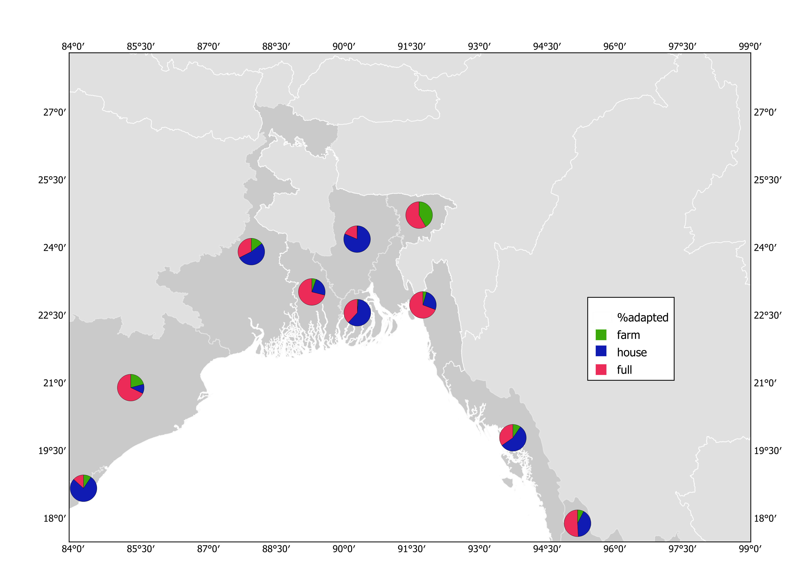
Results
www.coastmove.org
Nepal
Bangladesh
India

Slide 15
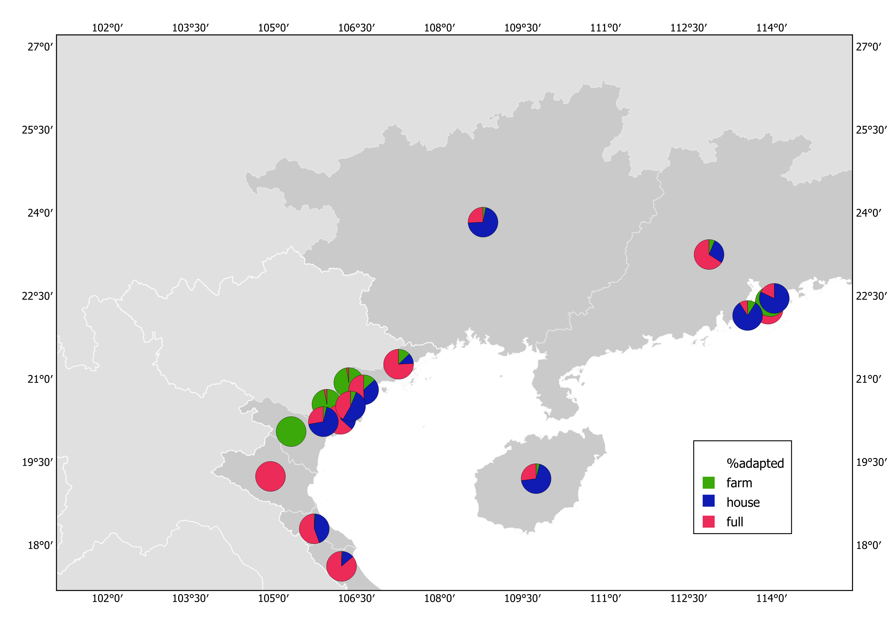
Results
www.coastmove.org
China
Laos
Thailand
Vietnam

Slide 16
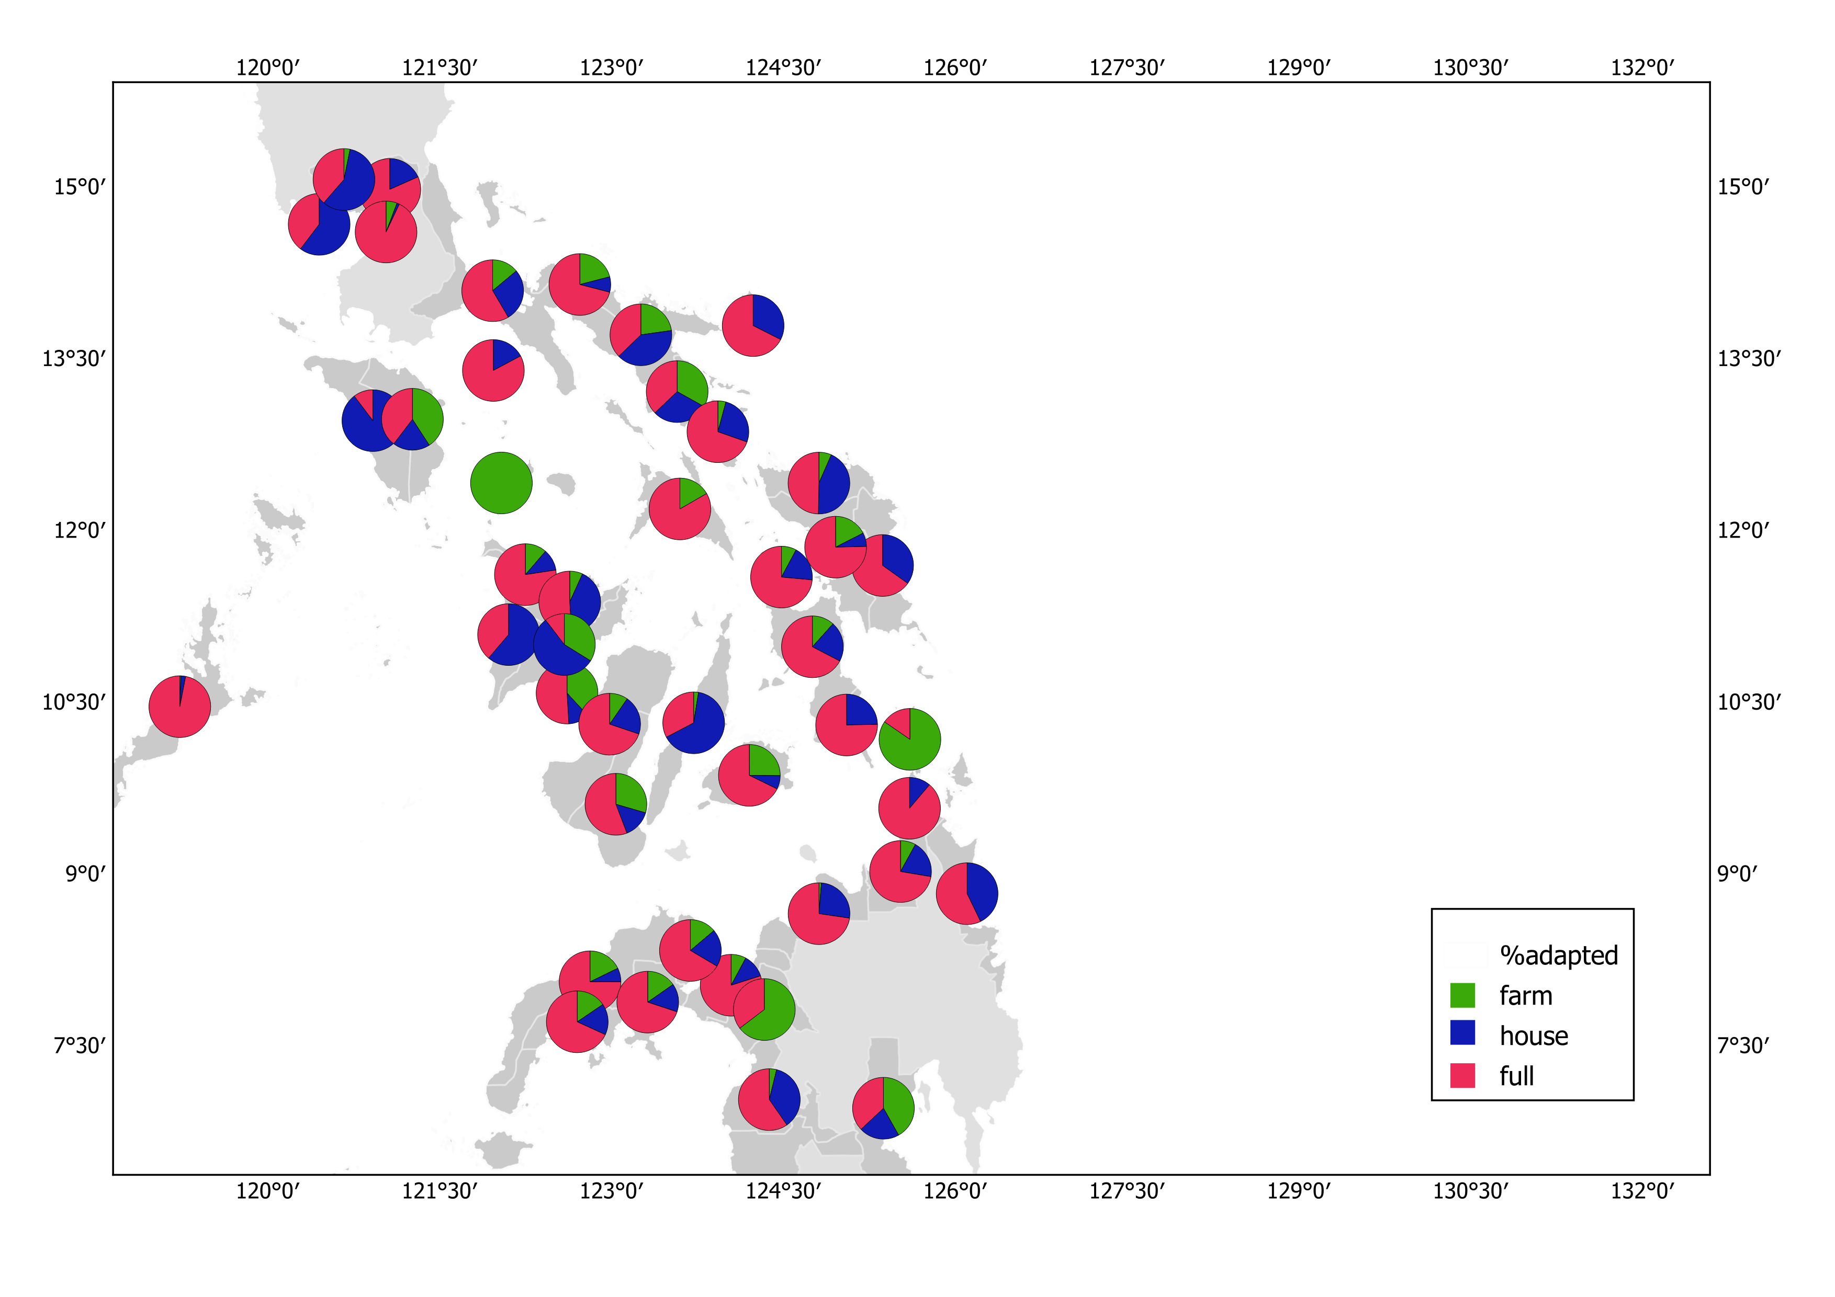
Results
www.coastmove.org
Philippines

Slide 17
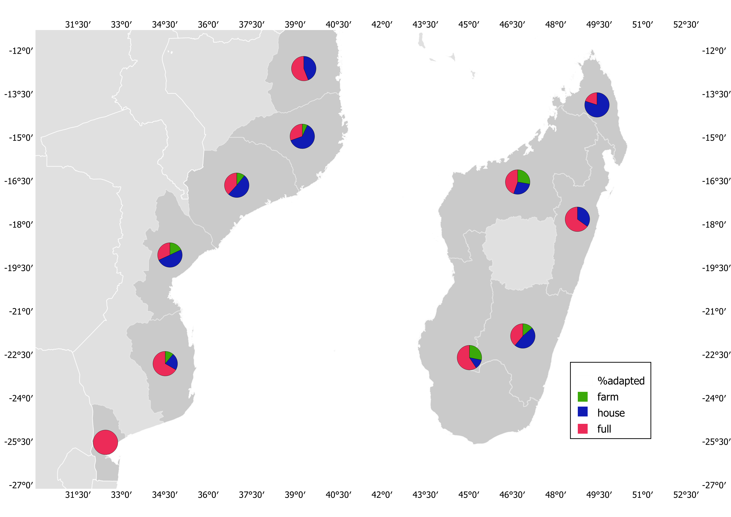
Results
www.coastmove.org
Mozambique
Madagascar

Slide 18
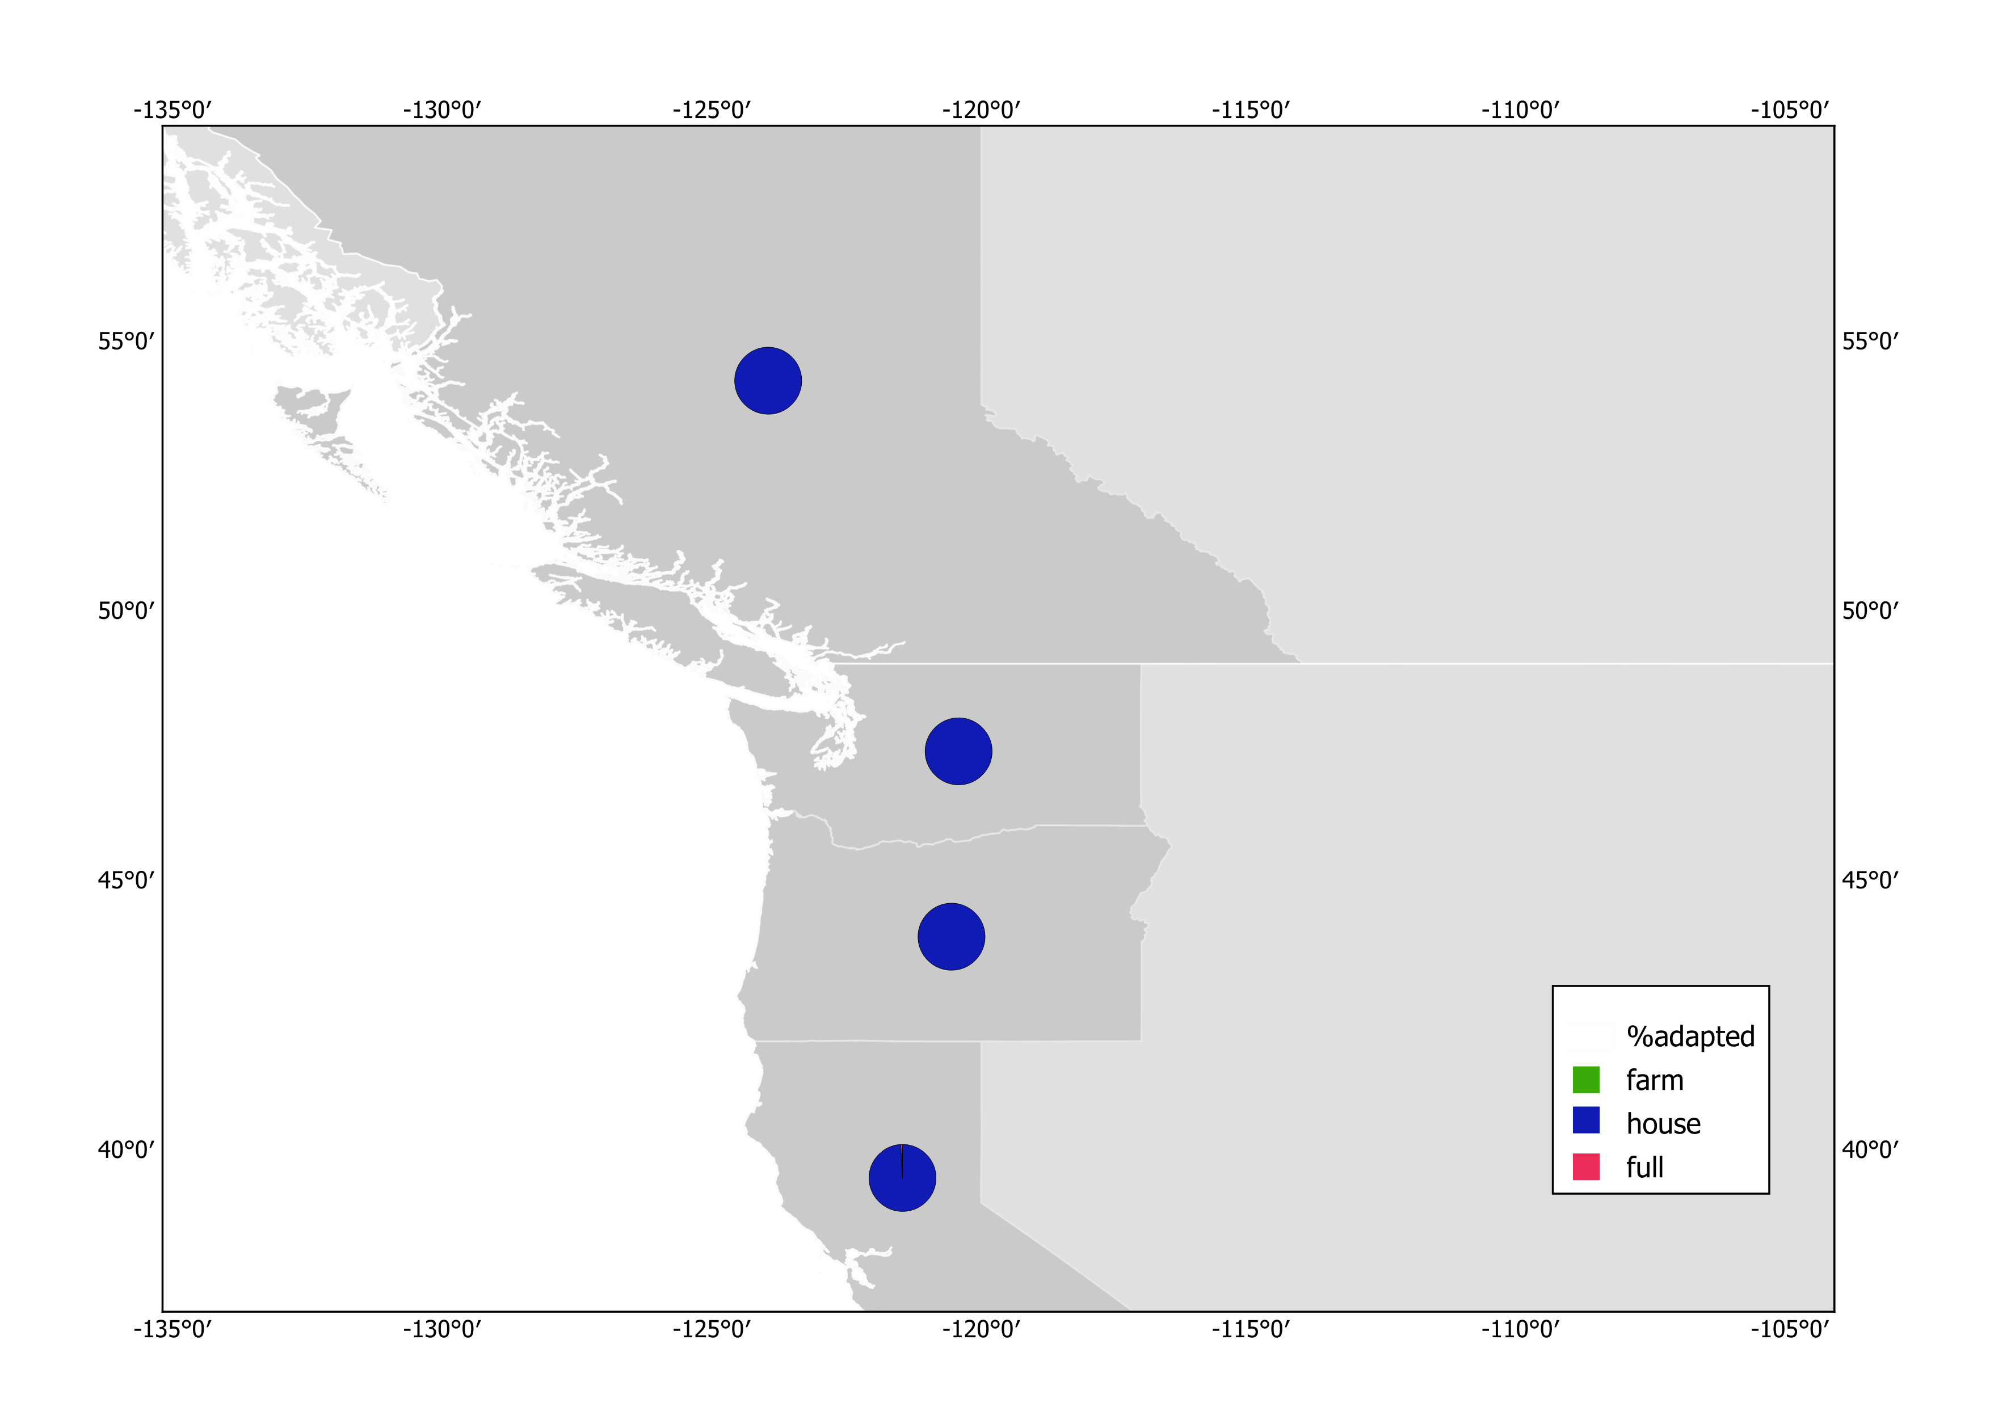
Results
www.coastmove.org
Canada
USA

Slide 19
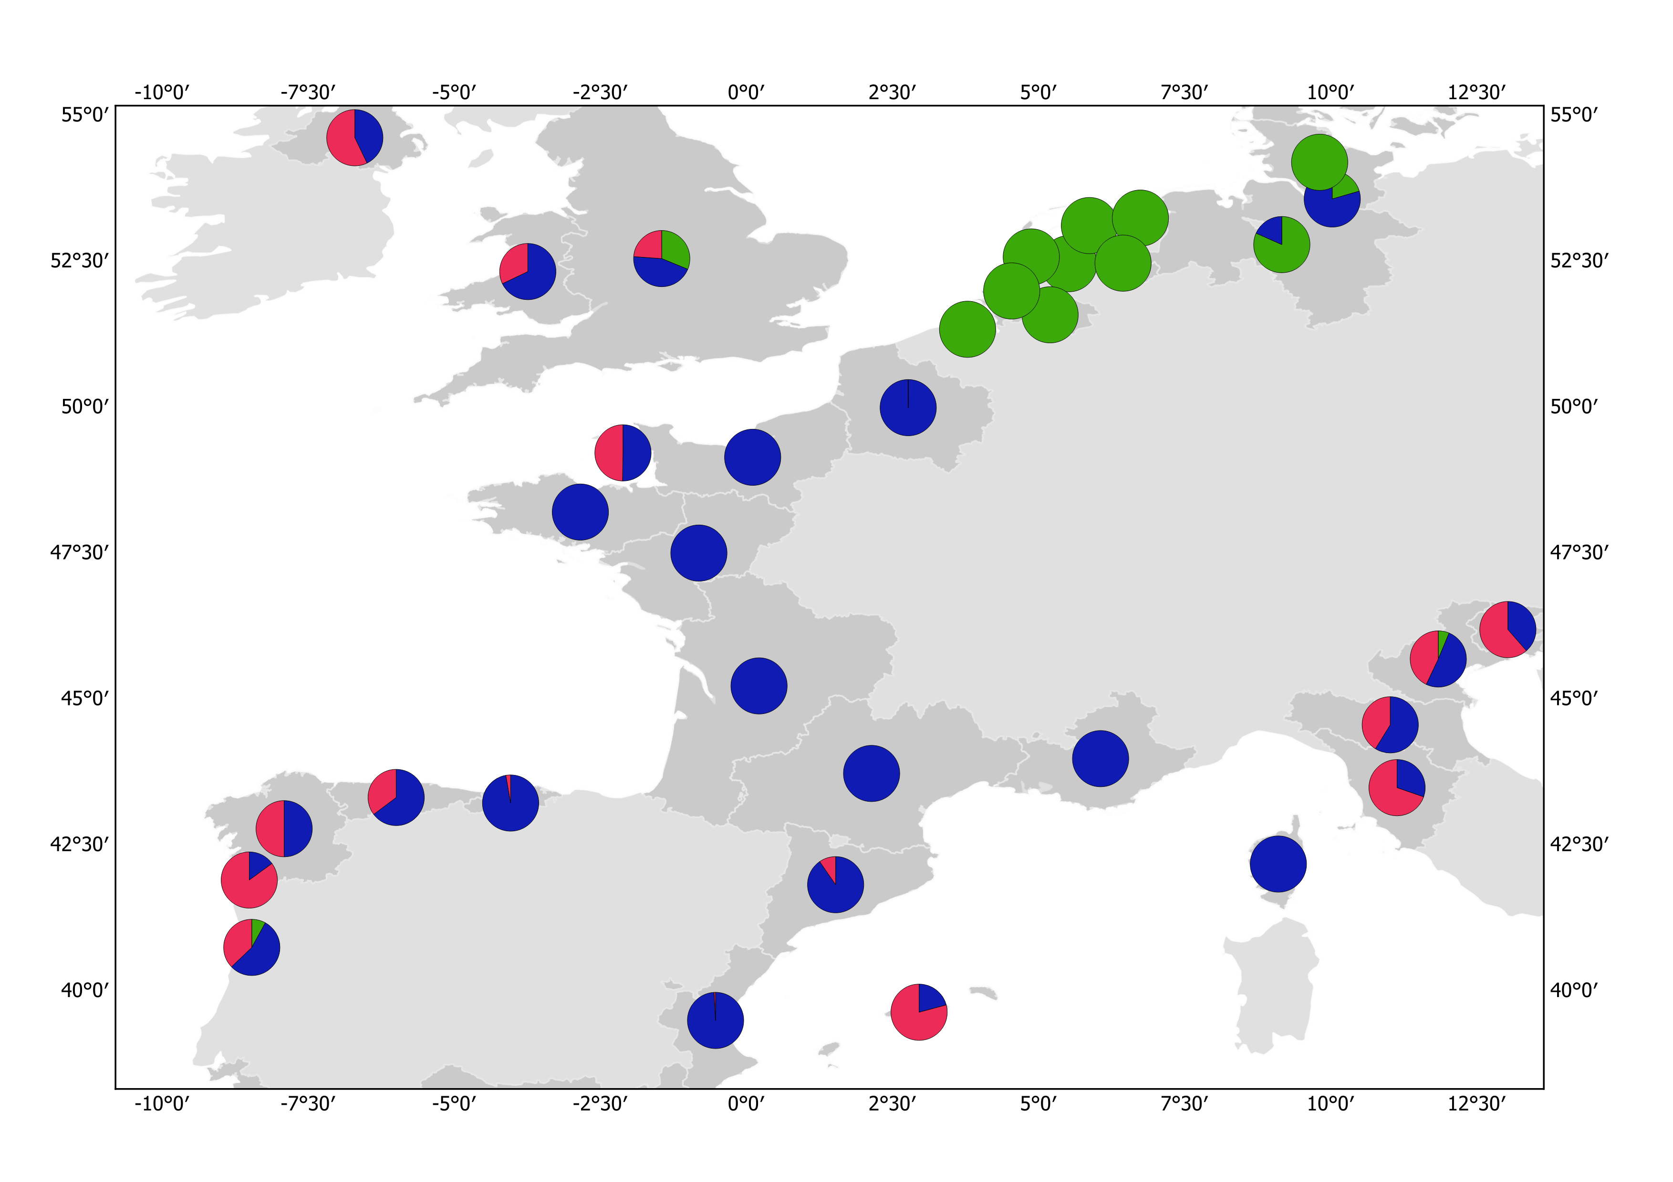
Results
www.coastmove.org

Slide 20
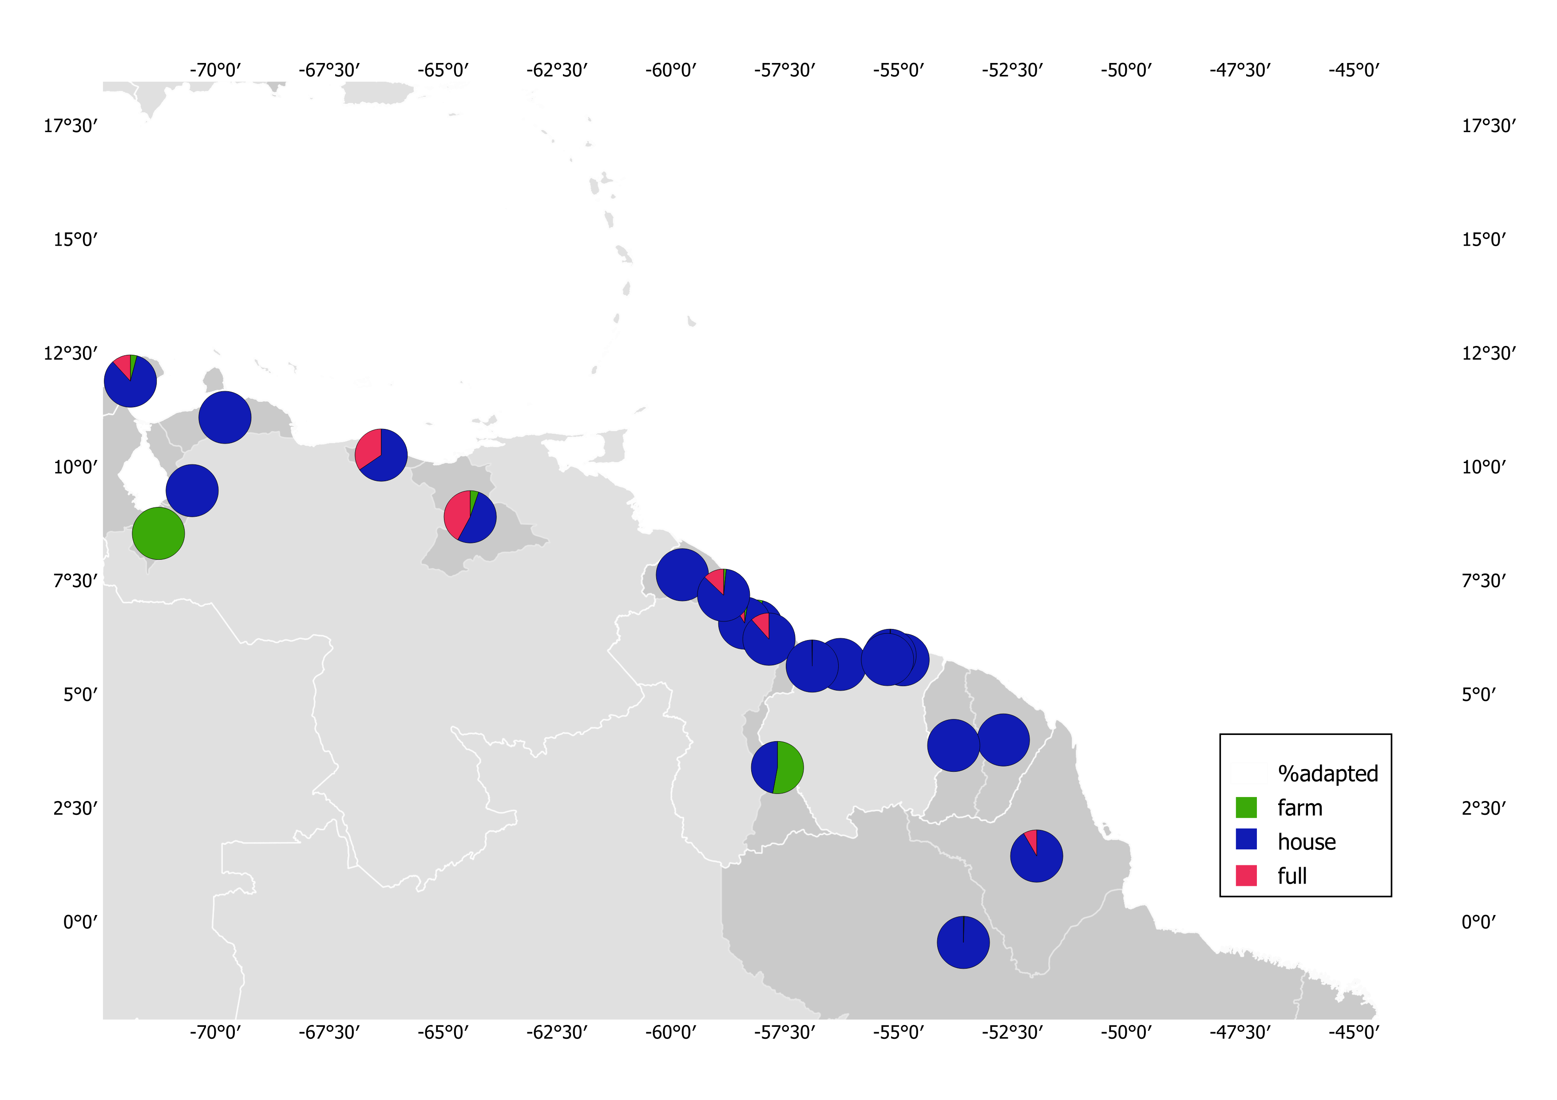
Results
www.coastmove.org
Venezuela
Brazil

Slide 21
Results
www.coastmove.org
Adaptation
Migration
Single run
More…
Percentage of household migrated from coastal zones relative to the average population during the model period(2015-2080)

Slide 22
Results
www.coastmove.org
Adaptation
Migration
Single run
More…
a: Population exposed to the risk of flooding and salt intrusion in the floodplain, b: percentage of households adapted, c: households migrated. This simulation is made for the coastal province of Sofala under RCP4.5-SSP2 and full behaviour setting.

Slide 23
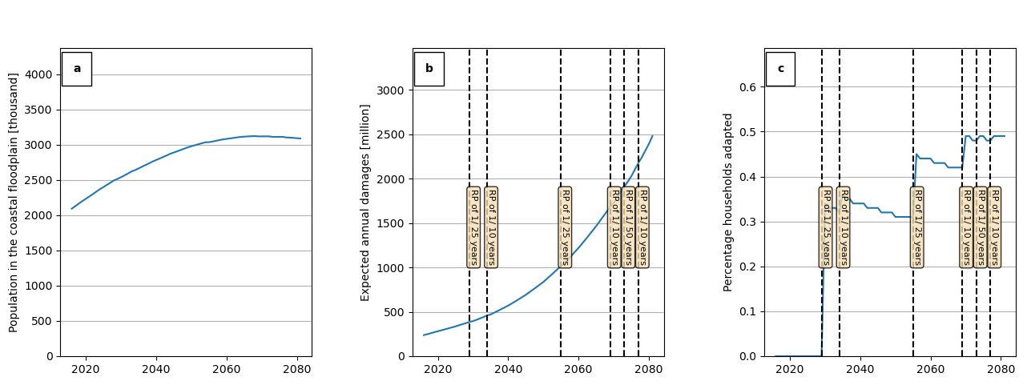
Results
www.coastmove.org
Adaptation
Migration
Single run
More…
a: Population exposed to the risk of flooding and salt intrusion in the floodplain in BGD, b: EAD, c: percentage of households adapted, This simulation is made for the coastal province of Sofala under RCP4.5-SSP2 and full behaviour setting.

Slide 24
Future work
www.coastmove.org
Adaptation
Integrate insurance agents with Dynamic Integrated Flood and Insurance(DIFI) Model (Tesselaar, M. et. al., 2020)
Incorporate change of profession for farmers
Account spatial heterogeneity of adaptation types
Nature based solutions
Migration
Single run
More…

