Slide 1
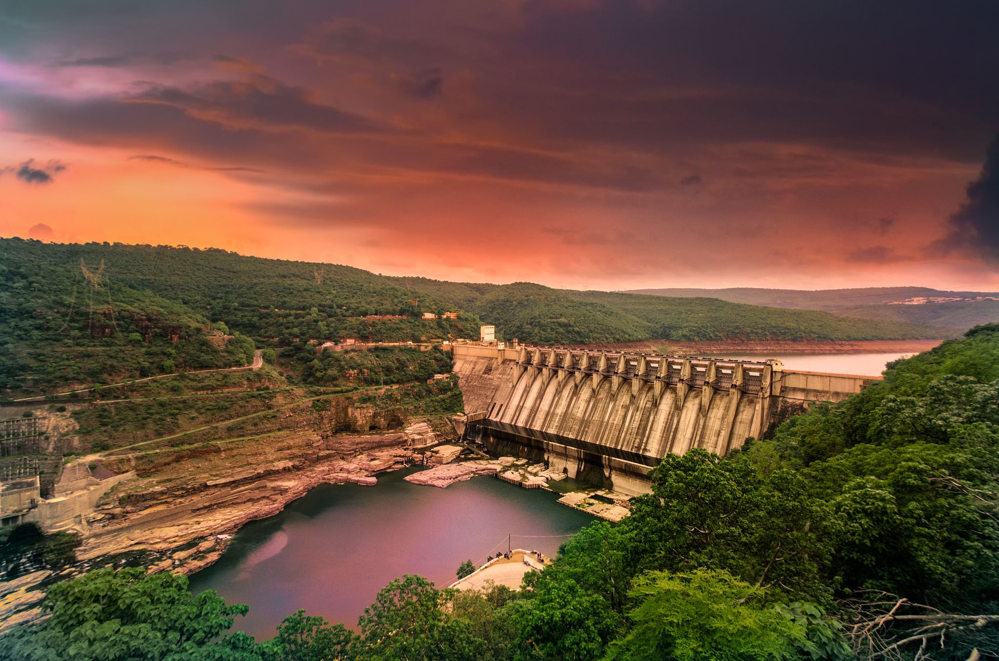

Seepage Dynamics in Homogeneous Earthen and Rockfill Dams: Insights from Experimental Modeling Under Transient Conditions.
Presented by: Subodh Shrivastava, Admn. No. 21DR0190
Under the guidance of
Prof. Srinivas Pasupuleti
Prof. Vishwas N Khatri
Dept. of Civil Engineering
Indian Institute of Technology (Indian School of Mines), Dhanbad

Slide 2
INTRODUCTION
Dams are important engineering structure that provide water storage, flood control, hydroelectric power and irrigation.
Managing the movement of water (see page) through the dam structure and its foundation, which is crucial for design and maintenance.
Seepage analysis is essential to ensure the stability and safety of dams.
This involves examining the hydraulic properties of the materials, the geometry of the dam and the surrounding environment.
Numerical and analytical models have been extensively used to predict seepage patterns.

Slide 3
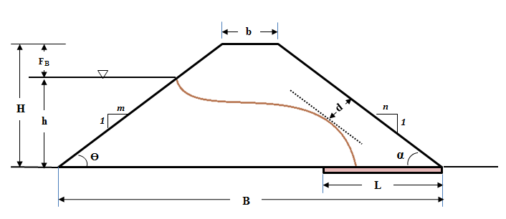
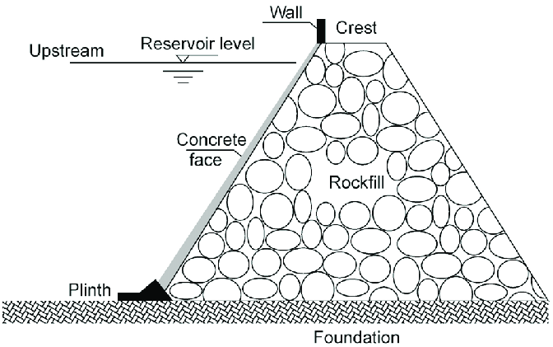
TYPES OF DAM-
There are various types of dam among which Earthfill and Rockfill dams are prominent for their ability to utilize natural materials and making them strong and adaptable to different environments.
1. Earthfill dam-
2. Rockfill dam-

Slide 4
LITRATURE REVIEW
Author & year | Title | Major findings
Amr R. Refaiy et al. 2021 | Modeling the effect of downstream drain geometry on seepage through earth dams | Increasing the length of the drain improves safety by increasing seepage discharge. A drain shifts the phreatic line away from the downstream slope, reducing erosion and preventing piping failure. The drain effectively removes seeping water and decreases pore water pressure within the dam, enhancing safety.
Sushant kumar et. al. 2022 | Modeling the effect of central impervious core and downstream filter geometry on seepage through earth dams | By increasing Dam height, Length of the horizontal filter, Downstream slope, Longitudinal slope seepage discharge increases. By decreasing Upstream slope, Thickness of the clay core, Viscosity of the fluid, Length of the earth dam seepage discharge increases.

Slide 5
Author & year | Title | Major findings
Doaa A. El Molla 2019 | Seepage through homogeneous earth dams provided with a vertical sheet pile and formed on impervious foundation | These finding significant role of sheet piles in controlling seepage through earth dams. The effect of tailwater depth on total seepage discharge is not significant
DJEHICHE Abdelkader et.al 2014 | THE SEEPAGE THROUGHTHE EARTH DAMS WITH A VERTICAL DRAIN : AN EXPERIMENTAL STUDY | The experimental models developed allow for the design of the most effective drain positions in earth dams. The models can determine the quantity of discharge for a given head of water in earth dams with pervious foundations under steady seepage conditions.

Slide 6
Research gap
There are many literatures available on numerical and analytical model based on seepage analysis in earthen and rockfill dam model but only few studies has been performed on experimental model of earthen and rockfill dam.
Within few literatures available for experimental model of earthen and rockfill dam, most of the studies has been conducted on steady state condition but only few experiments has been performed on transient state condition (Drawdown condition).

Slide 7
METHODOLOGY
Numerical model
Experimental model
Numerical modeling
Define geometry
Define material properties
Model setup in flume
Filling of materials
Adjusting Upstream water head
Note the piezometers reading
Define fluid such as U/S head
Define size of finite element grid/mesh
Solve the analysis
find the discharge for each upstream head.
Repeat the process for different time interval
Compare result

Slide 8
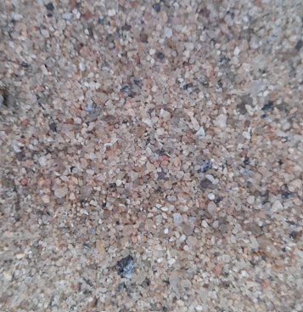
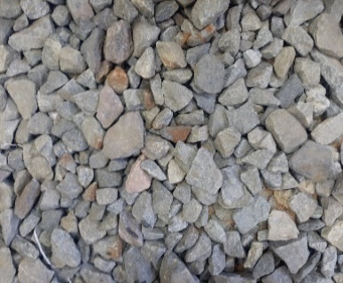
MATERIAL PROPERTIES
Properties | Values
 | Sand | Gravel
Colour | Greyish brown | Gray
Specific gravity, G | 2.6 | 2.67
Unit weight (kN/m³) | 19 | 22
Effective Size, D₁₀ (mm) | 0.2 | 15
D₃₀ (mm) | 0.36 | 18
D₆₀ (mm) | 0.55 | 25
Uniformity of Sand, C_{u} | 2.75 | 1.66
Coefficient of curvature, C_{c} | 1.18 | 0.864
Cohesion (kPa) | 1 | 2
Friction angle (°) (𝜙) | 35 | 44
Hydraulic conductivity(m/sec) | 0.007 | 0.1
Unified Soil Classification Symbol | SP | GP

Slide 9
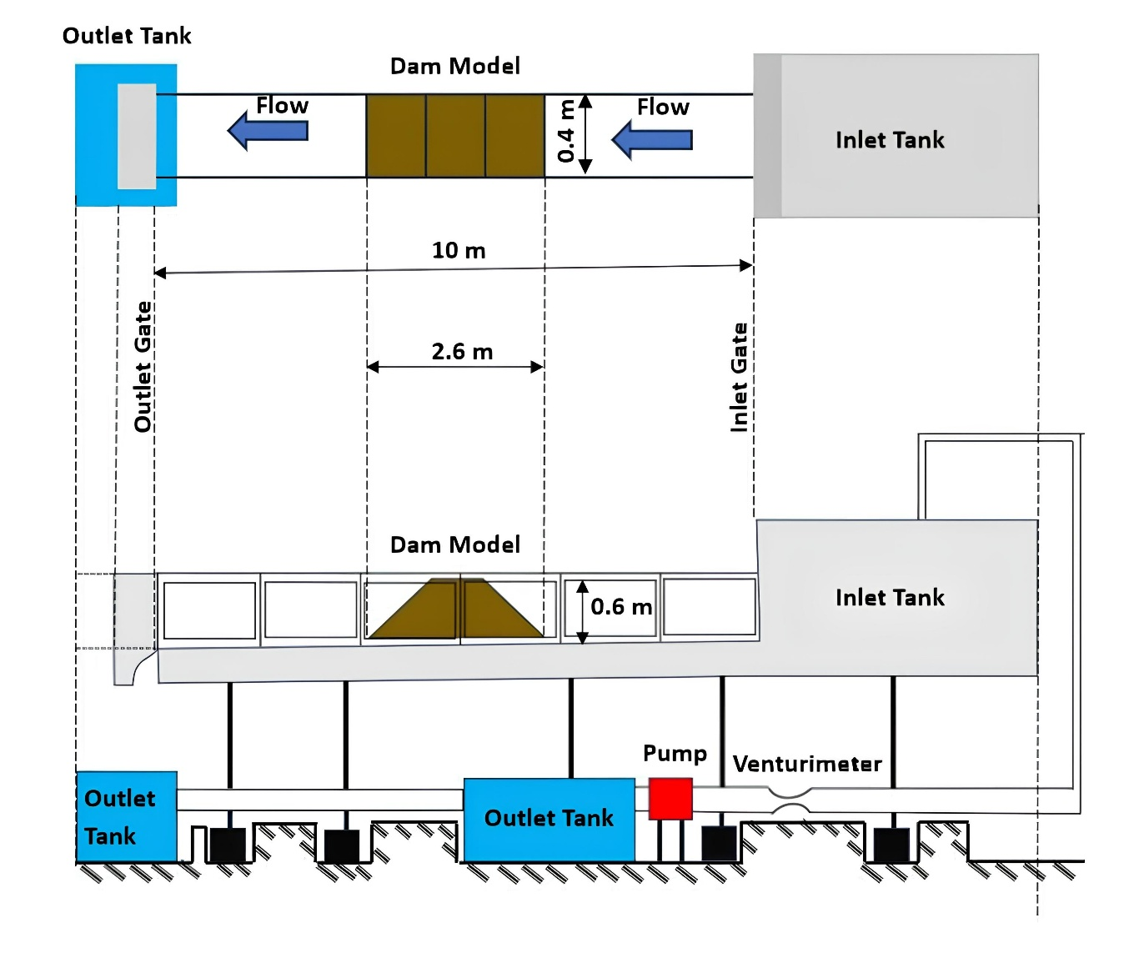
Flume and Dam Dimensions

Slide 10
EXPERIMENTAL MODEL CROSS SECTION
Piezometers
X-X’
1:1.5 (downstream slope)
Flow
60 cm
260 cm
60 cm
1:2 (upstream slope)
X
260 cm
Z-Z’
Z
Z’
X’
40 cm
40 cm

Slide 11
Earthen dam
PIEZOMETER NO. | TIME (min.) | 0 (H=42) | 5 (H=38.5) | 15 (H=35) | 25 (H=33) | 35 (H=31) | 95 (H=23.5)
1 |  | 37 | 34 | 31 | 28 | 26.5 | 19
2 |  | 37 | 34 | 31 | 28 | 26.5 | 19
3 |  | 37 | 34 | 31 | 28 | 23.5 | 15
4 |  | 30 | 28.8 | 25 | 22.6 | 20.8 | 12.5
5 |  | 26 | 25.3 | 21.6 | 19.5 | 17.8 | 10.2
6 |  | 24 | 24.5 | 21 | 18.8 | 17.2 | 9.8
7 |  | 16 | 17.9 | 15 | 13.5 | 12 | 6
8 |  | 10.2 | 13.6 | 11.5 | 10.4 | 9.2 | 4.2
9 |  | 8.2 | 12.5 | 10.8 | 9.8 | 9 | 4
10 |  | 5 | 10.2 | 8.3 | 7.6 | 6.8 | 2
11 |  | 0.5 | 5.5 | 4 | 4 | 3.4 | 0
12 |  | 0 | 0 | 0 | 0 | 0 | 0

Slide 12
Rockfill dam
Distance from Upstream (cm) | Time (min.) | 0 | 5 | 10 | 20 | 40 | 60 | 120
90 |  | 45 | 44 | 40 | 37 | 35 | 33 | 20
100 |  | 45 | 43 | 39 | 35 | 32 | 32 | 18
105 |  | 45 | 43 | 38 | 33 | 32 | 32 | 13
110 |  | 43 | 42 | 36 | 32 | 31 | 30 | 12
120 |  | 41 | 39 | 35 | 29 | 28 | 26 | 11
130 |  | 38 | 37 | 34 | 26 | 24 | 25 | 8
140 |  | 34 | 32 | 30 | 24 | 23 | 23 | 7
150 |  | 32 | 30 | 27 | 23 | 22 | 22 | 6
160 |  | 31 | 29 | 25 | 21 | 21 | 21 | 4
170 |  | 30 | 28 | 23 | 20 | 20 | 20 | 3
180 |  | 28 | 27 | 22 | 18 | 18 | 18 | 3
190 |  | 26 | 25 | 21 | 17 | 17 | 17 | 2
210 |  | 22 | 21 | 21 | 17 | 16 | 15 | 2
220 |  | 20 | 19 | 19 | 17 | 16 | 15 | 2

Slide 13
Change in Piezometric Head along dam cross section.
Earthen dam
Rockfill dam

Slide 14
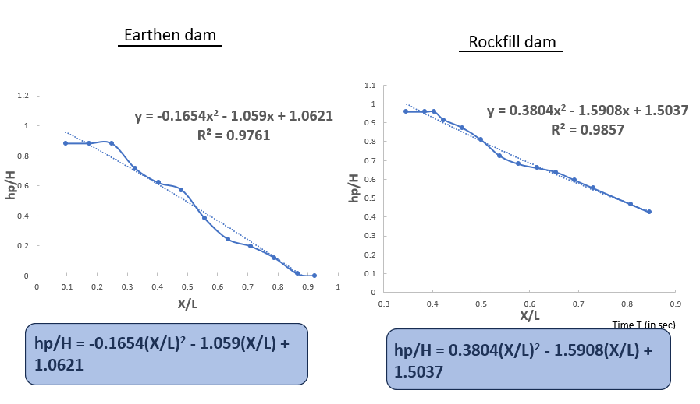

Slide 15
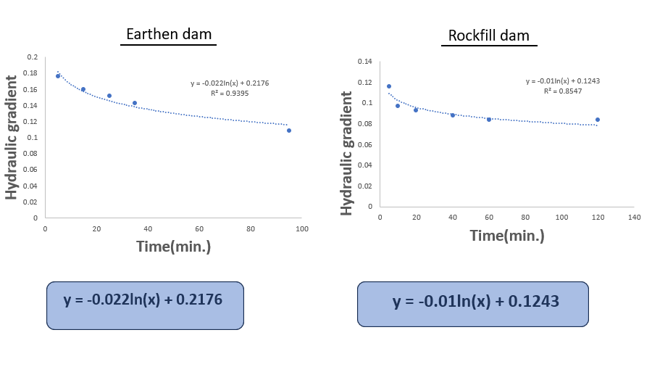

Slide 16
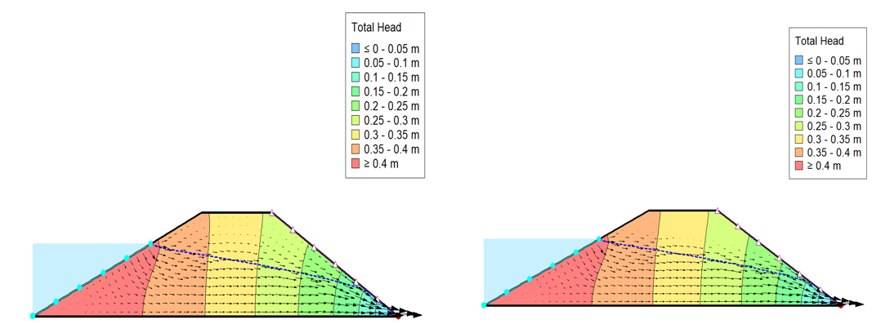
Total Water Head
Earthen dam
Rockfill dam
The figure shows the total head distribution in embankment dam models made of sand and gravel under steady-state seepage. Color contours indicate head levels, with red zones (≥ 0.4 m) near the upstream face showing high head, and blue zones (≤ 0.05 m) near the downstream toe indicating low head. Flow lines (dashed arrows) follow the seepage path from upstream to downstream, intersecting equipotential lines (solid) at right angles, consistent with flow net theory. The closer spacing of equipotential lines near the upstream face reflects a steeper hydraulic gradient. While both materials exhibit similar seepage patterns, the slight differences in contour distribution highlight the impact of permeability on head dissipation.

Slide 17
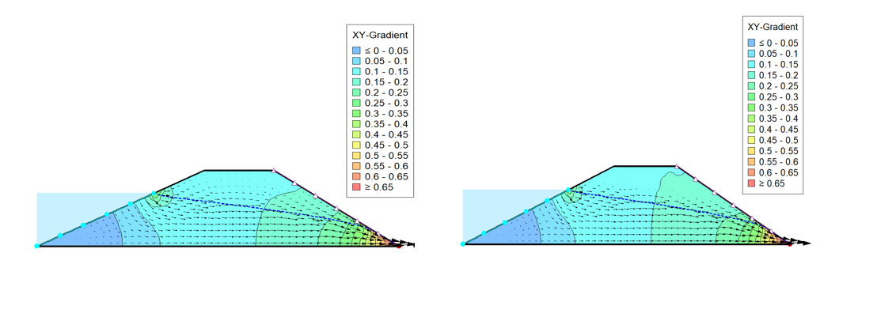
Hydraulic gradient analysis
Earthen dam
Rockfill dam
The numerical seepage analysis of embankment dams reveals key differences in hydraulic behaviour between sand and gravel materials. Coloured zones represent hydraulic gradient ranges, with red indicating high gradients and intense seepage, and blue showing low gradients. Flow lines (dashed arrows) trace water movement from upstream to downstream, while equipotential lines (solid contours) connect points of equal total head, intersecting flow lines perpendicularly. In the sand model, steeper gradients and sharper colour transitions near the downstream face reflect confined, high-velocity seepage due to lower permeability. Conversely, the gravel model shows smoother flow paths, wider-spaced equipotential lines, and more gradual head loss, indicating better drainage and lower erosion risk. These results emphasize how material permeability shapes seepage behaviour, with gravel offering safer, more stable dam performance

Slide 18
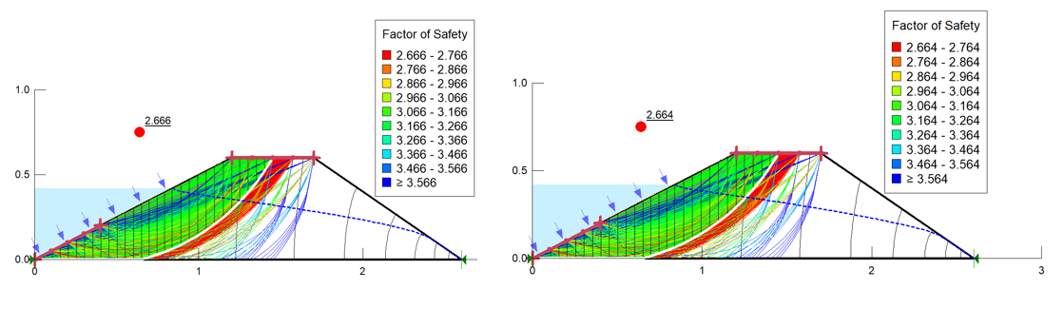
Factor of safety
Earthen dam
Rockfill dam
The figure presents the results of a slope stability analysis for two embankment dam models, one using sand material and the other gravel, conducted using the limit equilibrium method in GeoStudio. The Factor of Safety (FOS) values are depicted through color-coded contours along various potential slip surfaces, with each color zone representing a specific FOS range as outlined in the legend. Red zones indicate the most critical areas with the lowest FOS, suggesting potential failure surfaces, while blue and purple zones represent more stable regions with higher safety factors. The critical slip surface, marked by a thick colored curve and a red point, shows an FOS of 2.666 for the sand model and 2.664 for the gravel model. The blue dashed lines denote the phreatic surface (water table), and arrows indicate the direction of seepage flow through the embankment.

Slide 19
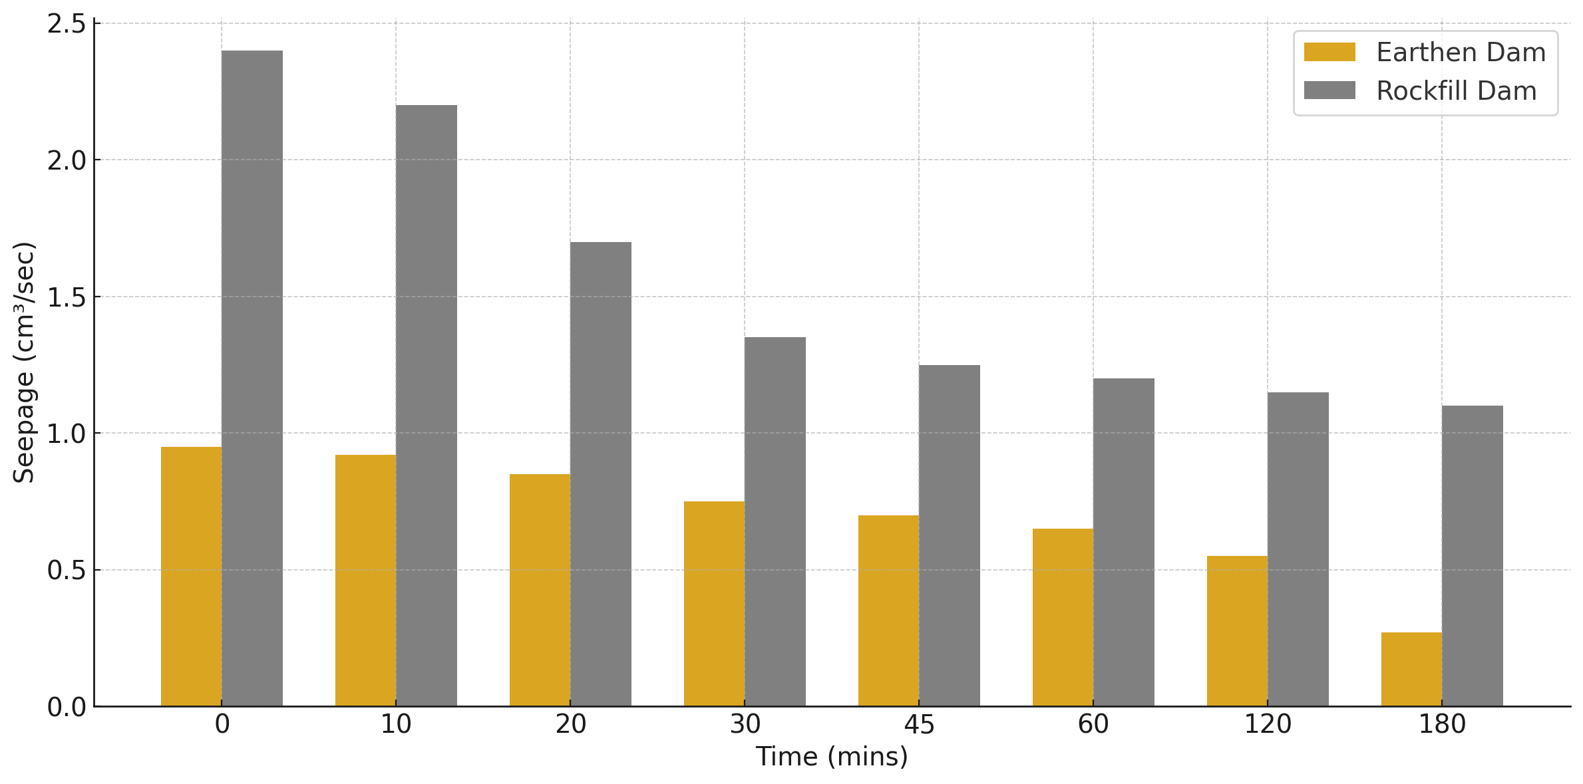

Slide 20
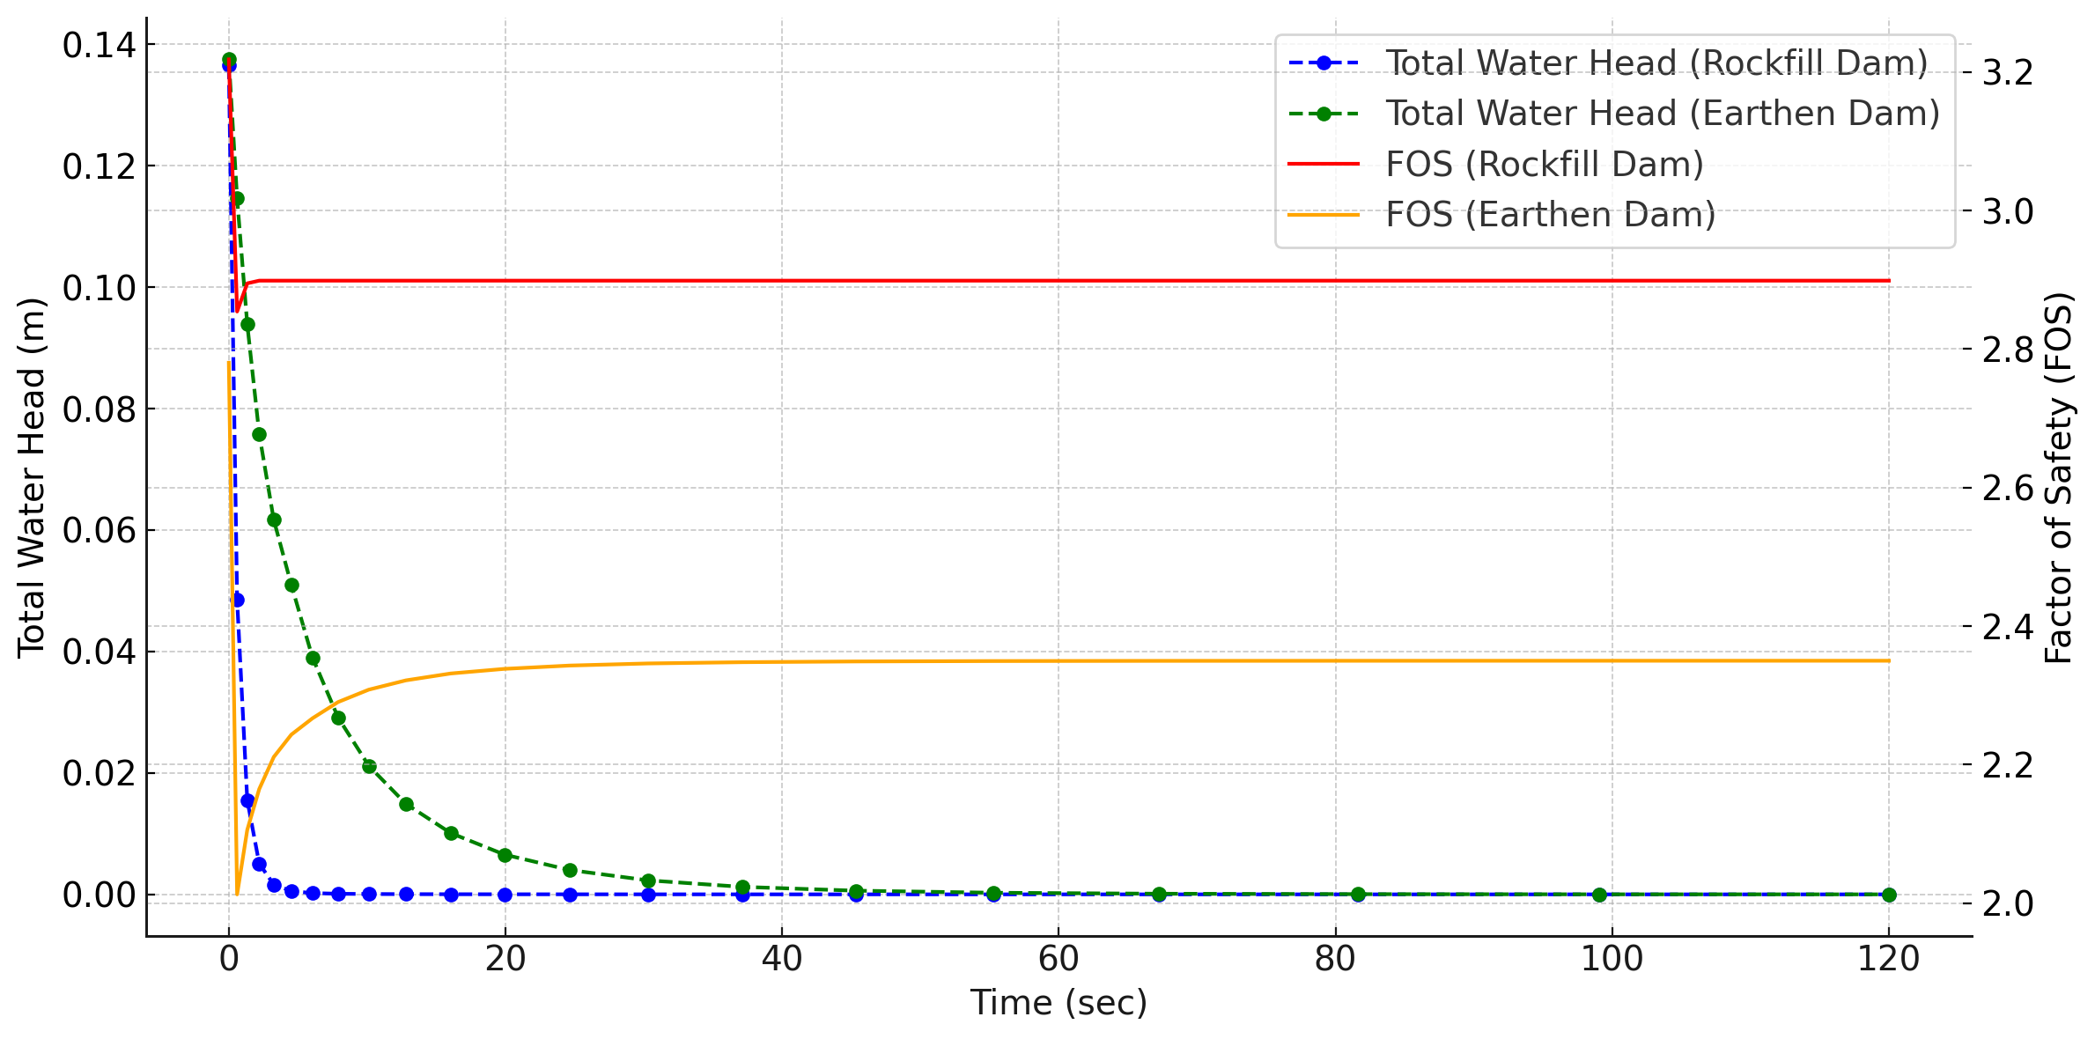

Slide 21
Key Findings
Seepage Reduction:
The Earthen Dam shows a greater reduction in seepage over time (~71.6% decrease) compared to the Rockfill Dam (~54.2% decrease), meaning the earthen dam reduced seepage ~17% more effectively.
Total Water Head Drop:
Both dams exhibit a significant drop in total water head (~99.3–99.4%), but the Rockfill Dam shows a slightly faster reduction, indicating quicker pore pressure dissipation.
Factor of Safety (FOS):
The Rockfill Dam maintains a higher and more stable FOS, decreasing only ~9.97% (from 3.22 to 2.90), while the Earthen Dam drops by ~15.45% (from 2.78 to 2.35), meaning the Rockfill Dam ends up ~23% safer.

Slide 22
Conclusion
Overall, the Rockfill Dam exhibits superior long-term stability with consistently higher Factor of Safety and faster pore pressure dissipation, while the Earthen Dam offers more effective early-time seepage reduction making each dam type advantageous under different performance priorities.

Slide 23


