Slide 1
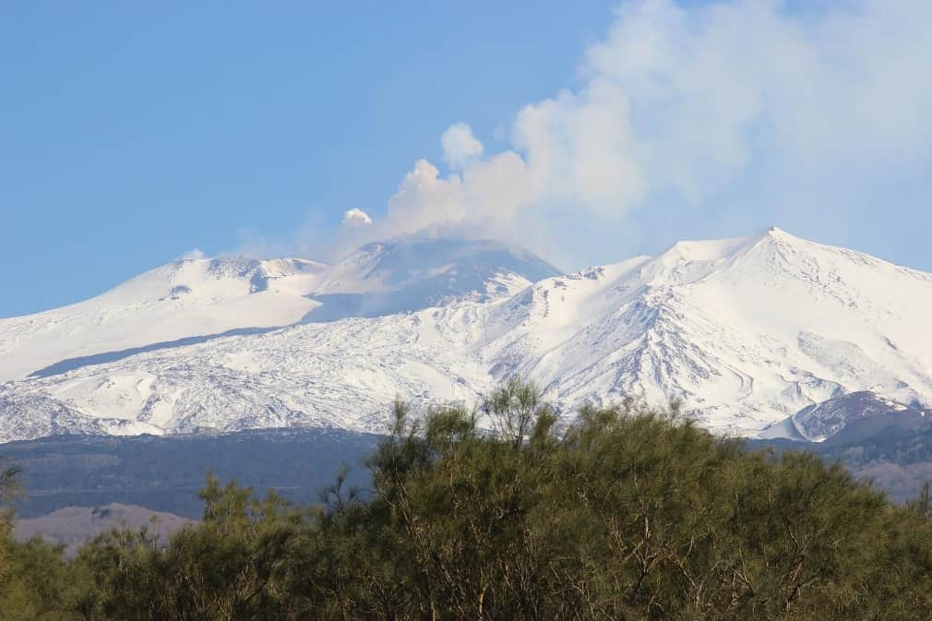
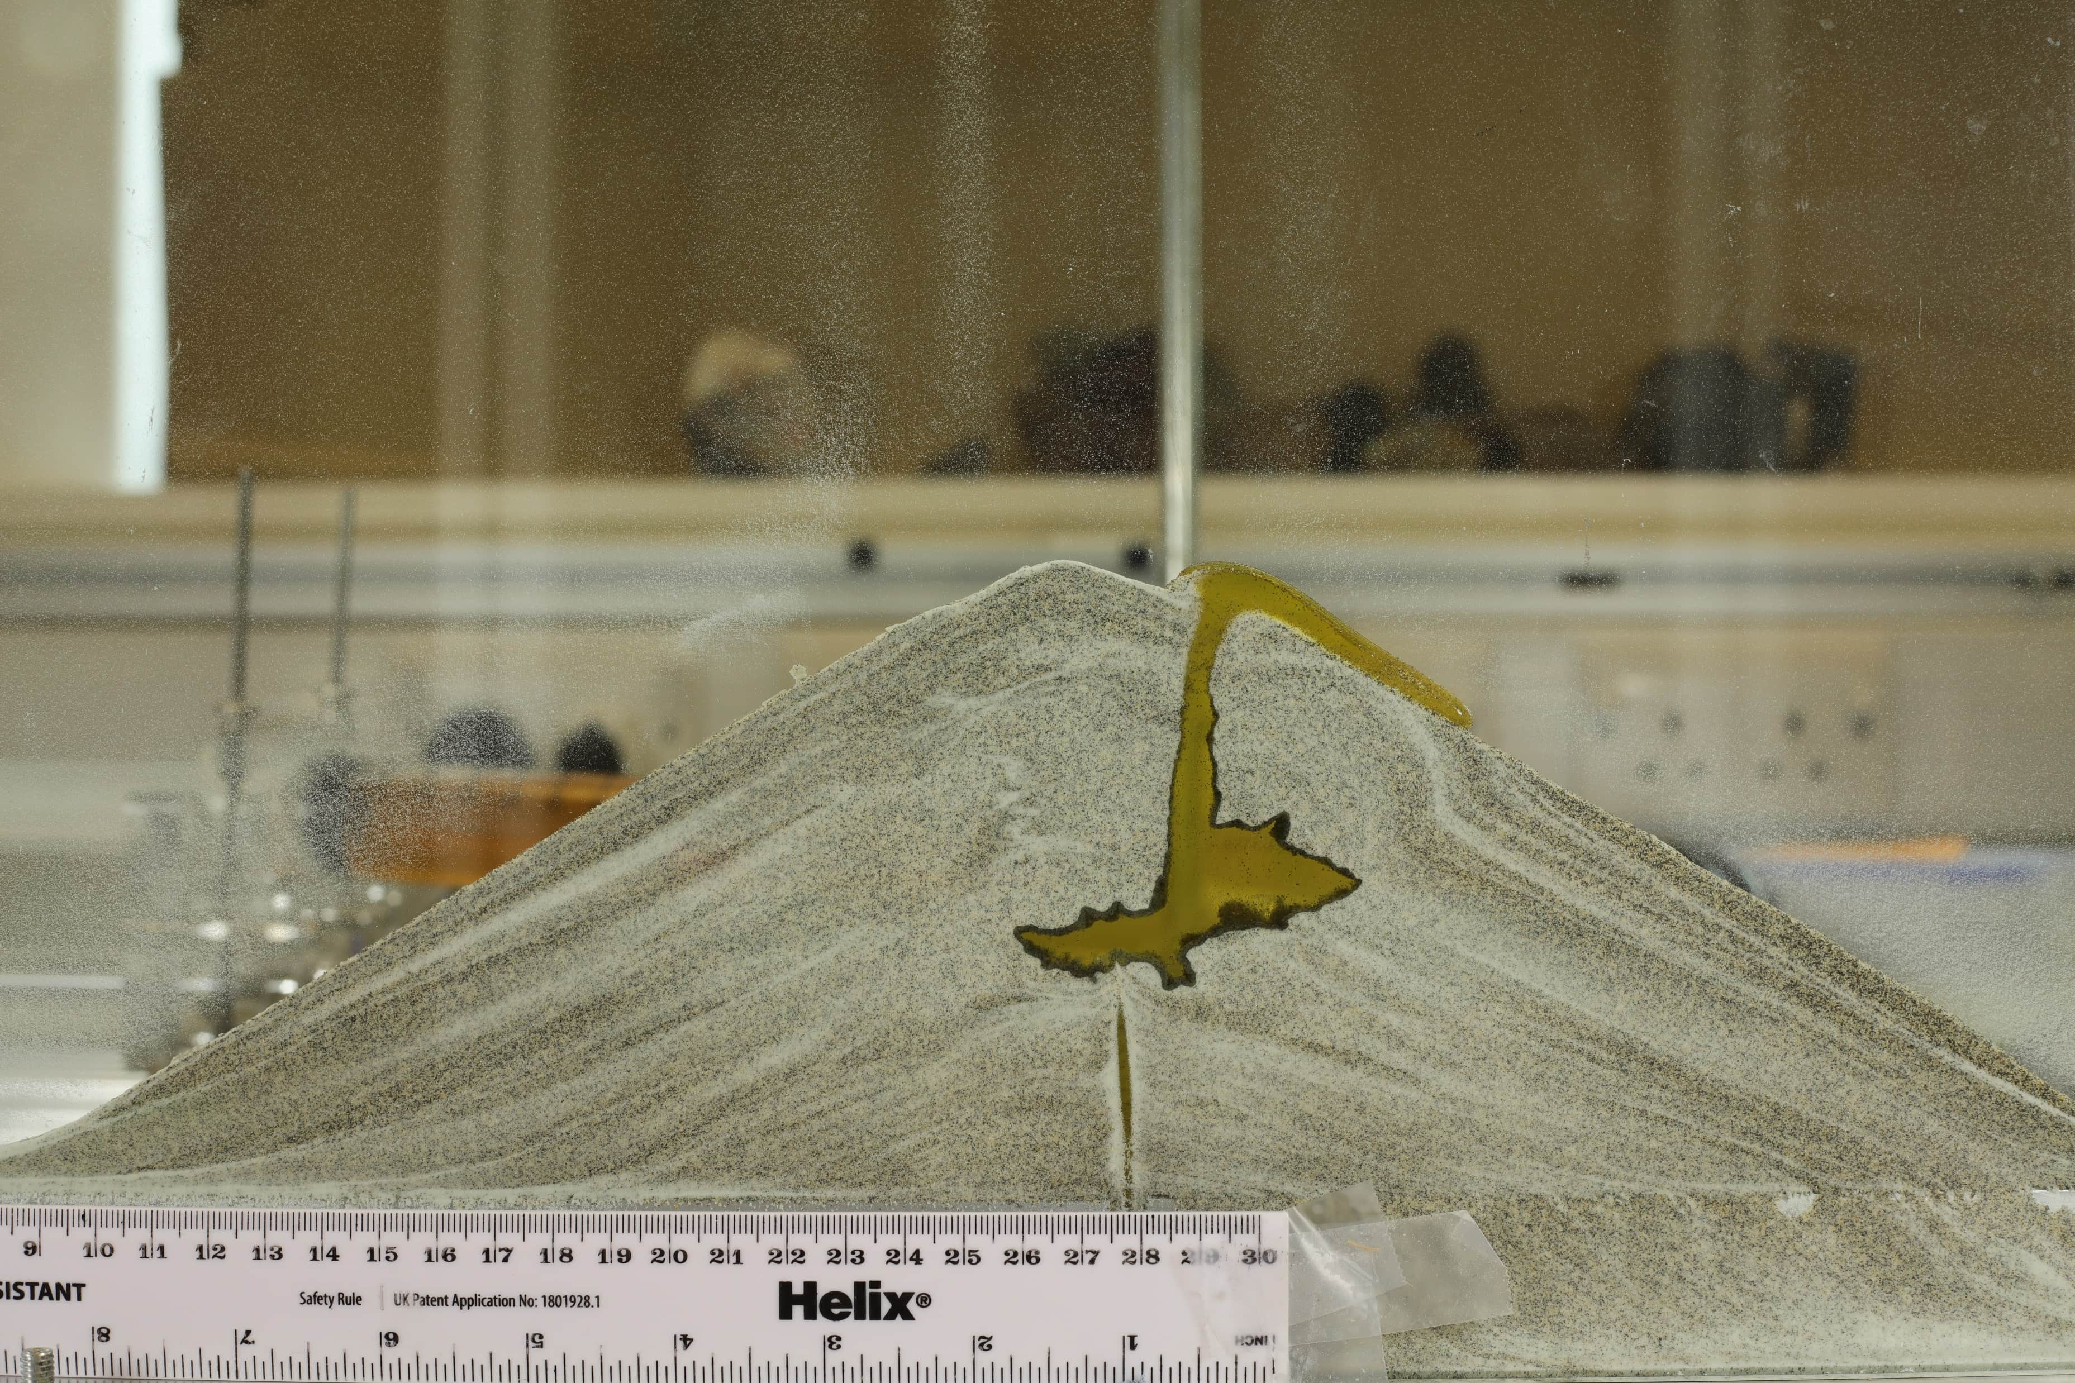
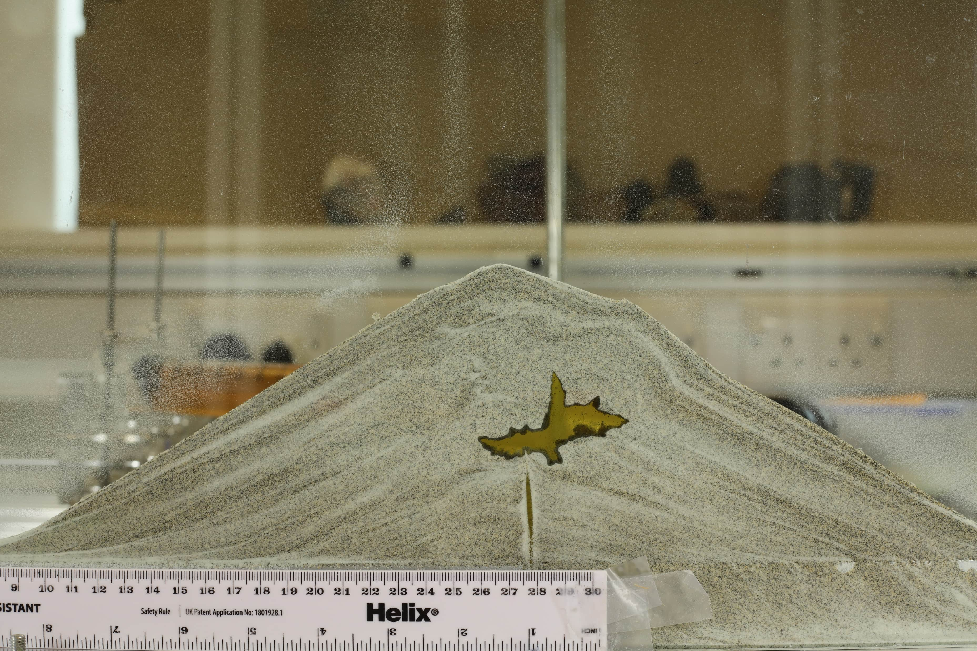
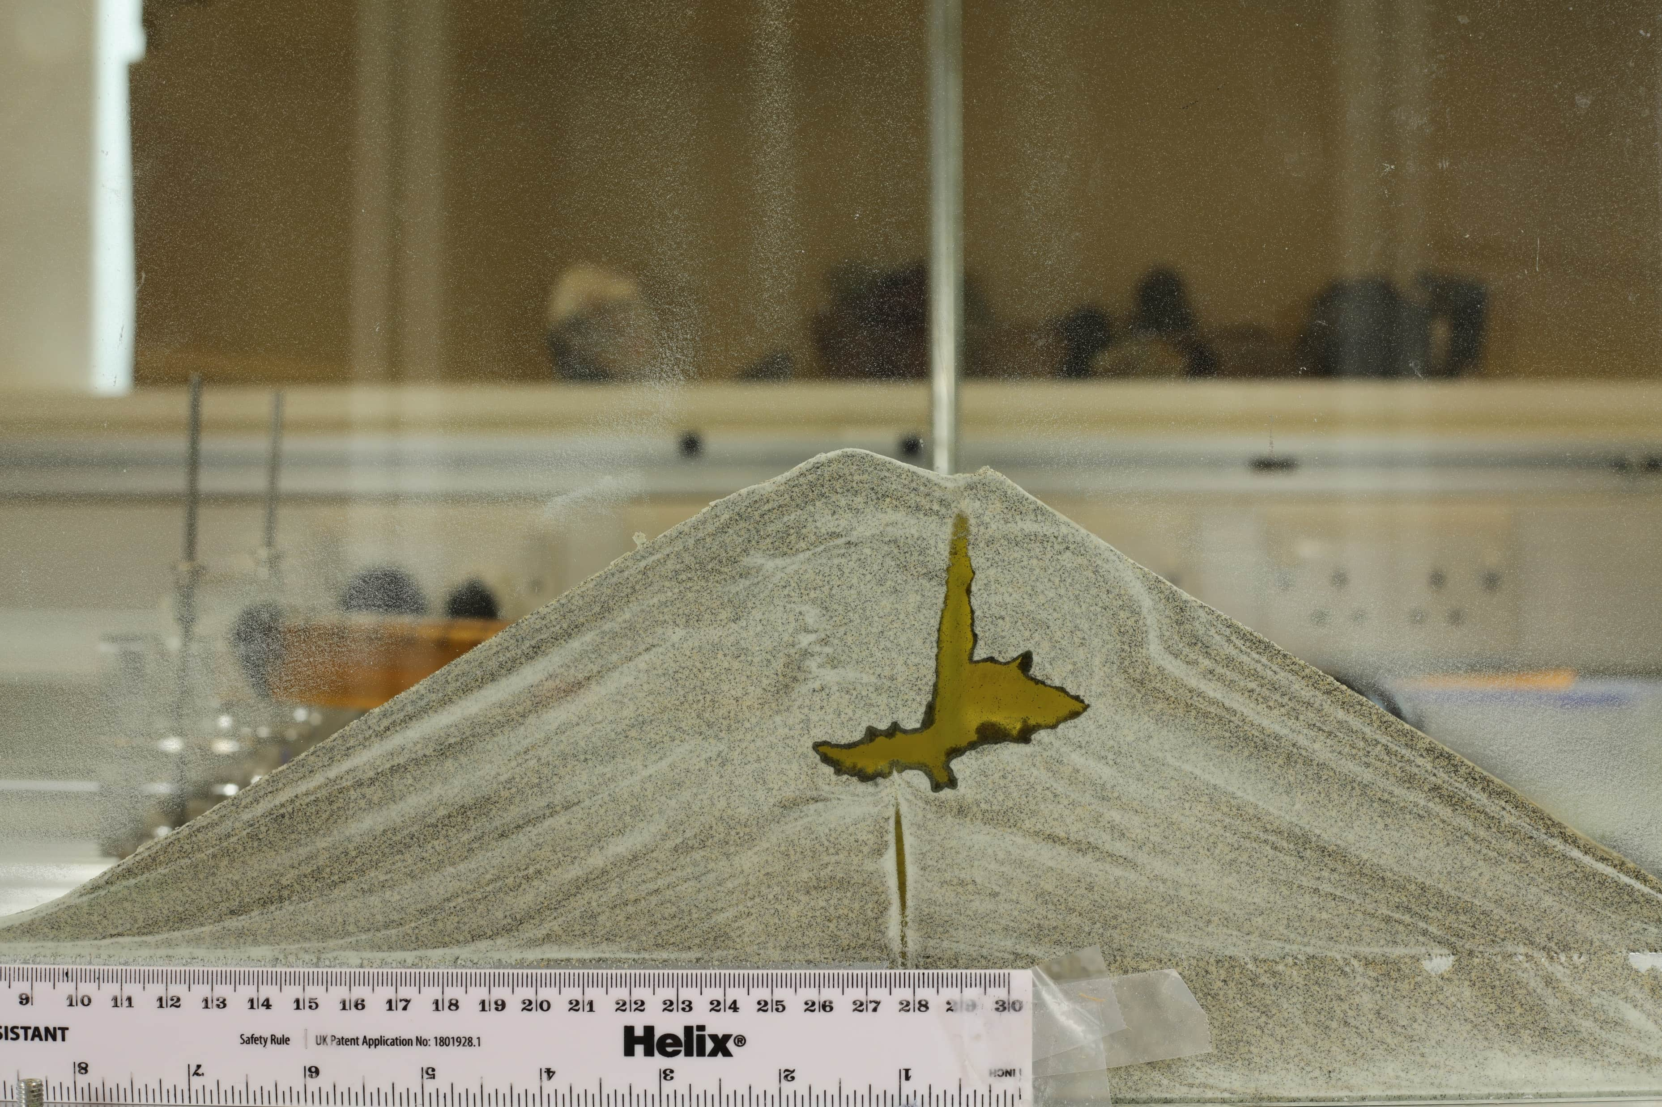
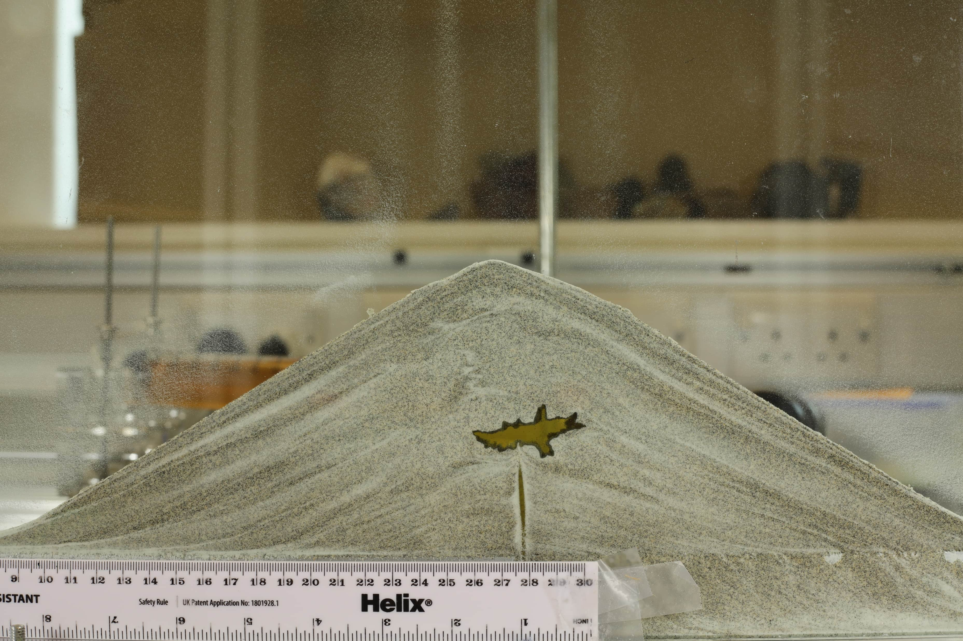
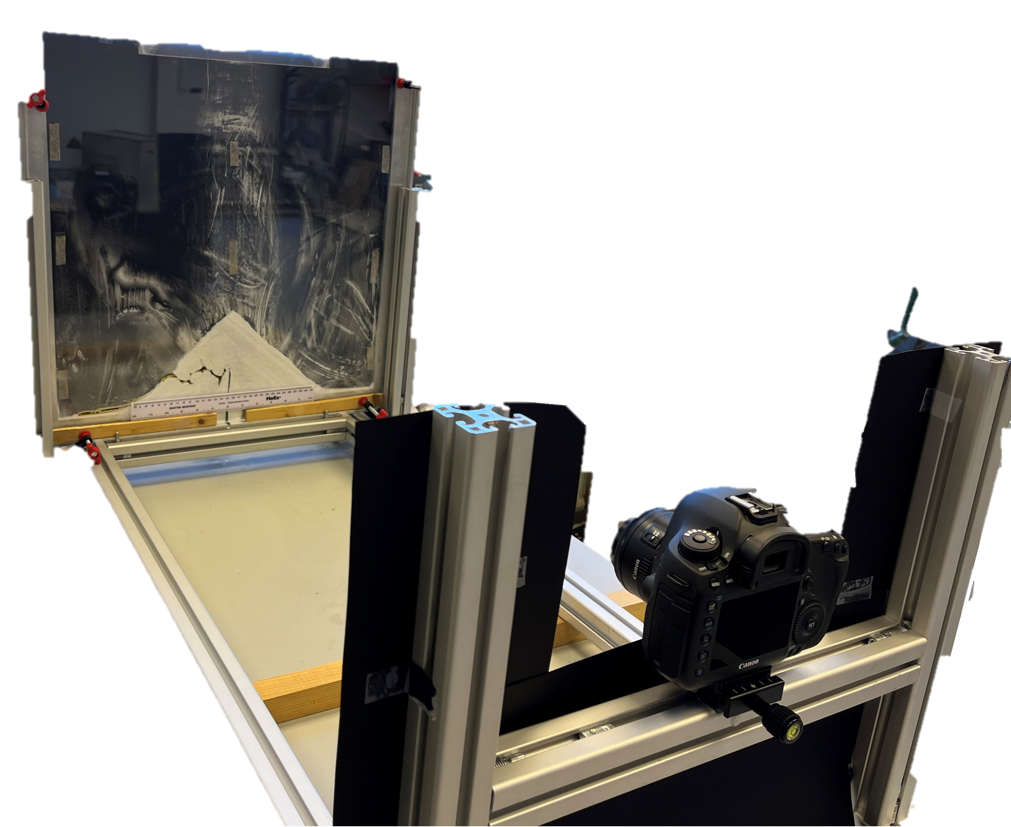
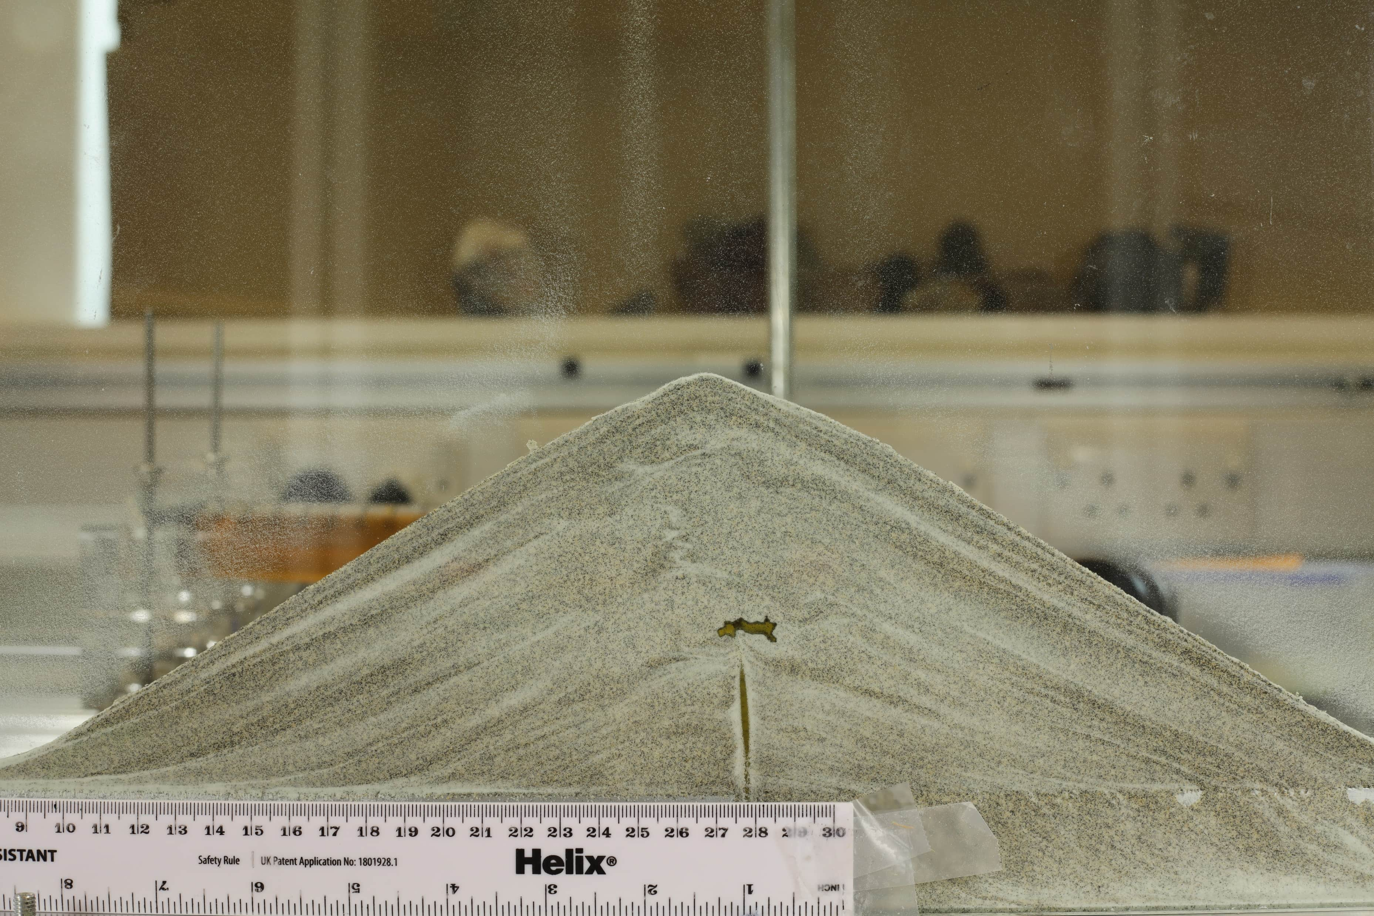
Analogue Modelling of Intrusion Dynamics in Relation to Internal and Surface Deformation
Andrew Mitchell¹, Steve Lane¹, Jennie Gilbert¹, Hugh Tuffen¹, Mike James¹
1. Lancaster University, Lancaster Environment Centre, UK
Granular cone
Liquid intrusion
Digital camera
50 cm
This project has received funding from the European Union‘s Horizon 2020 research and innovation programme under grant agreement No 858092.
Abstract QR code

Slide 2
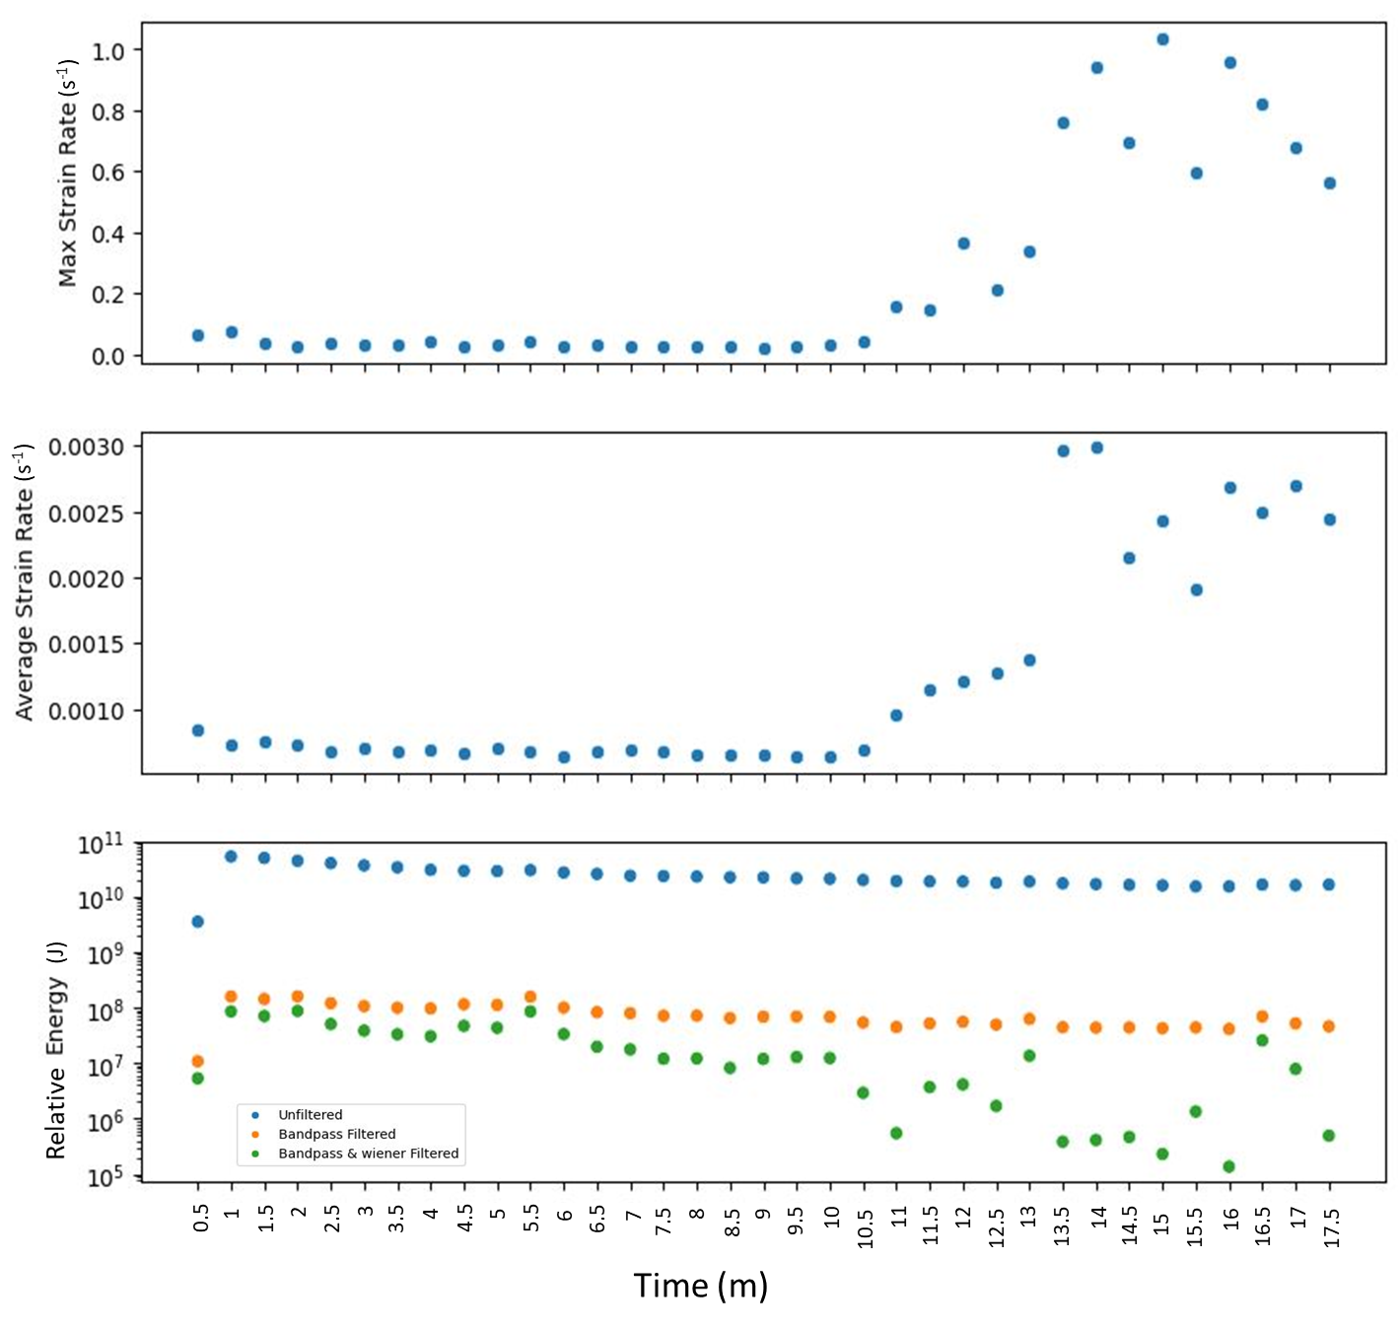
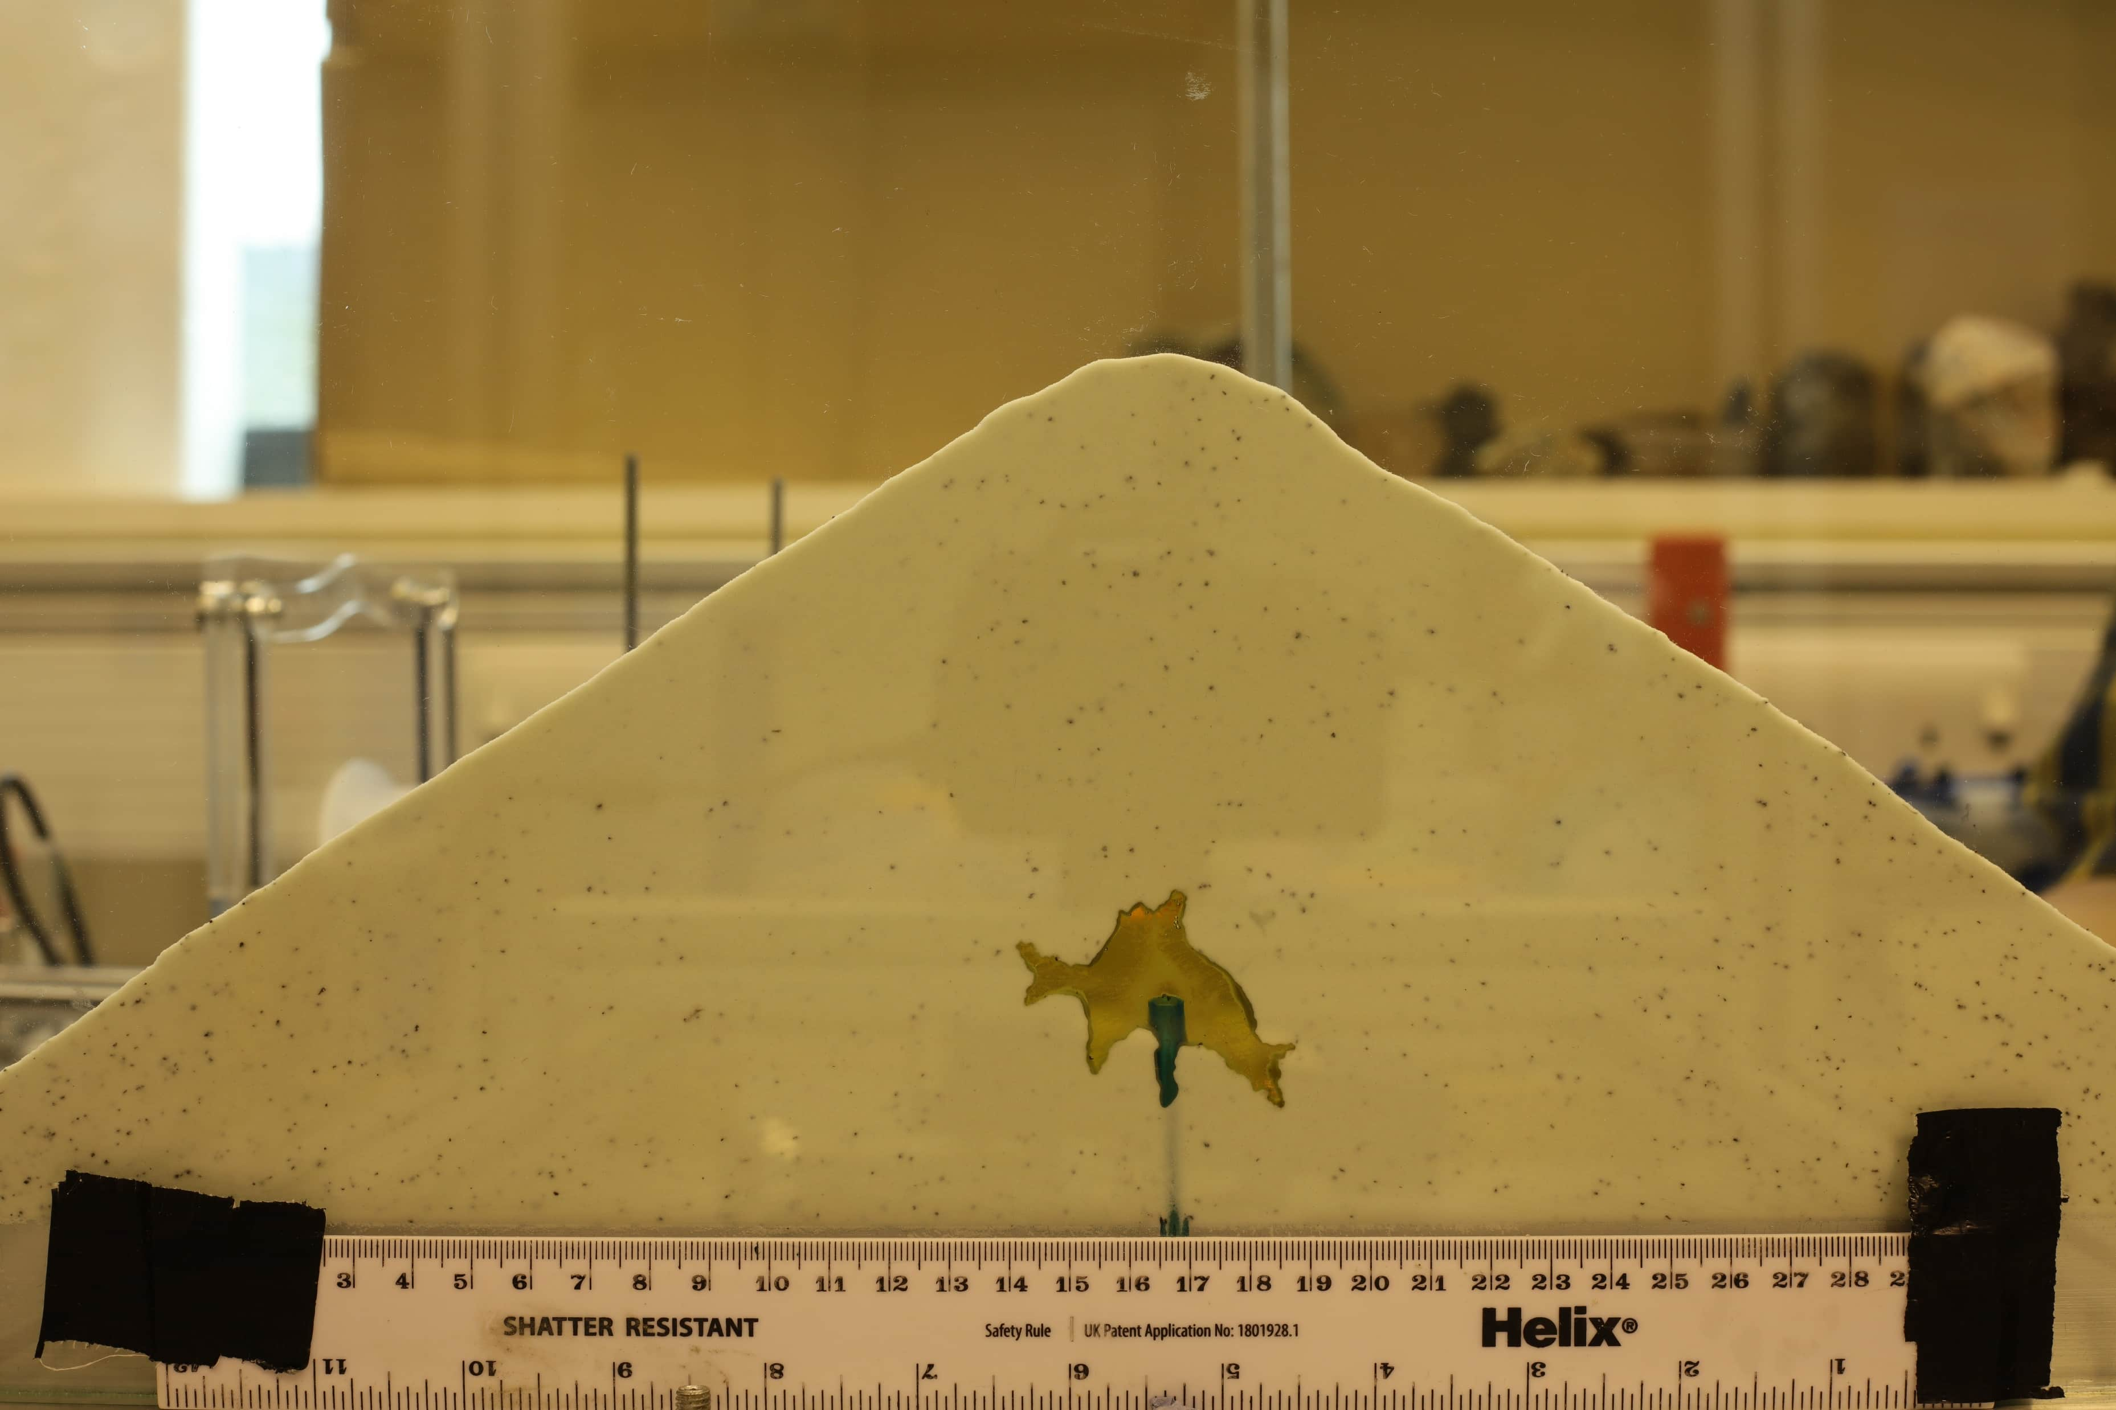
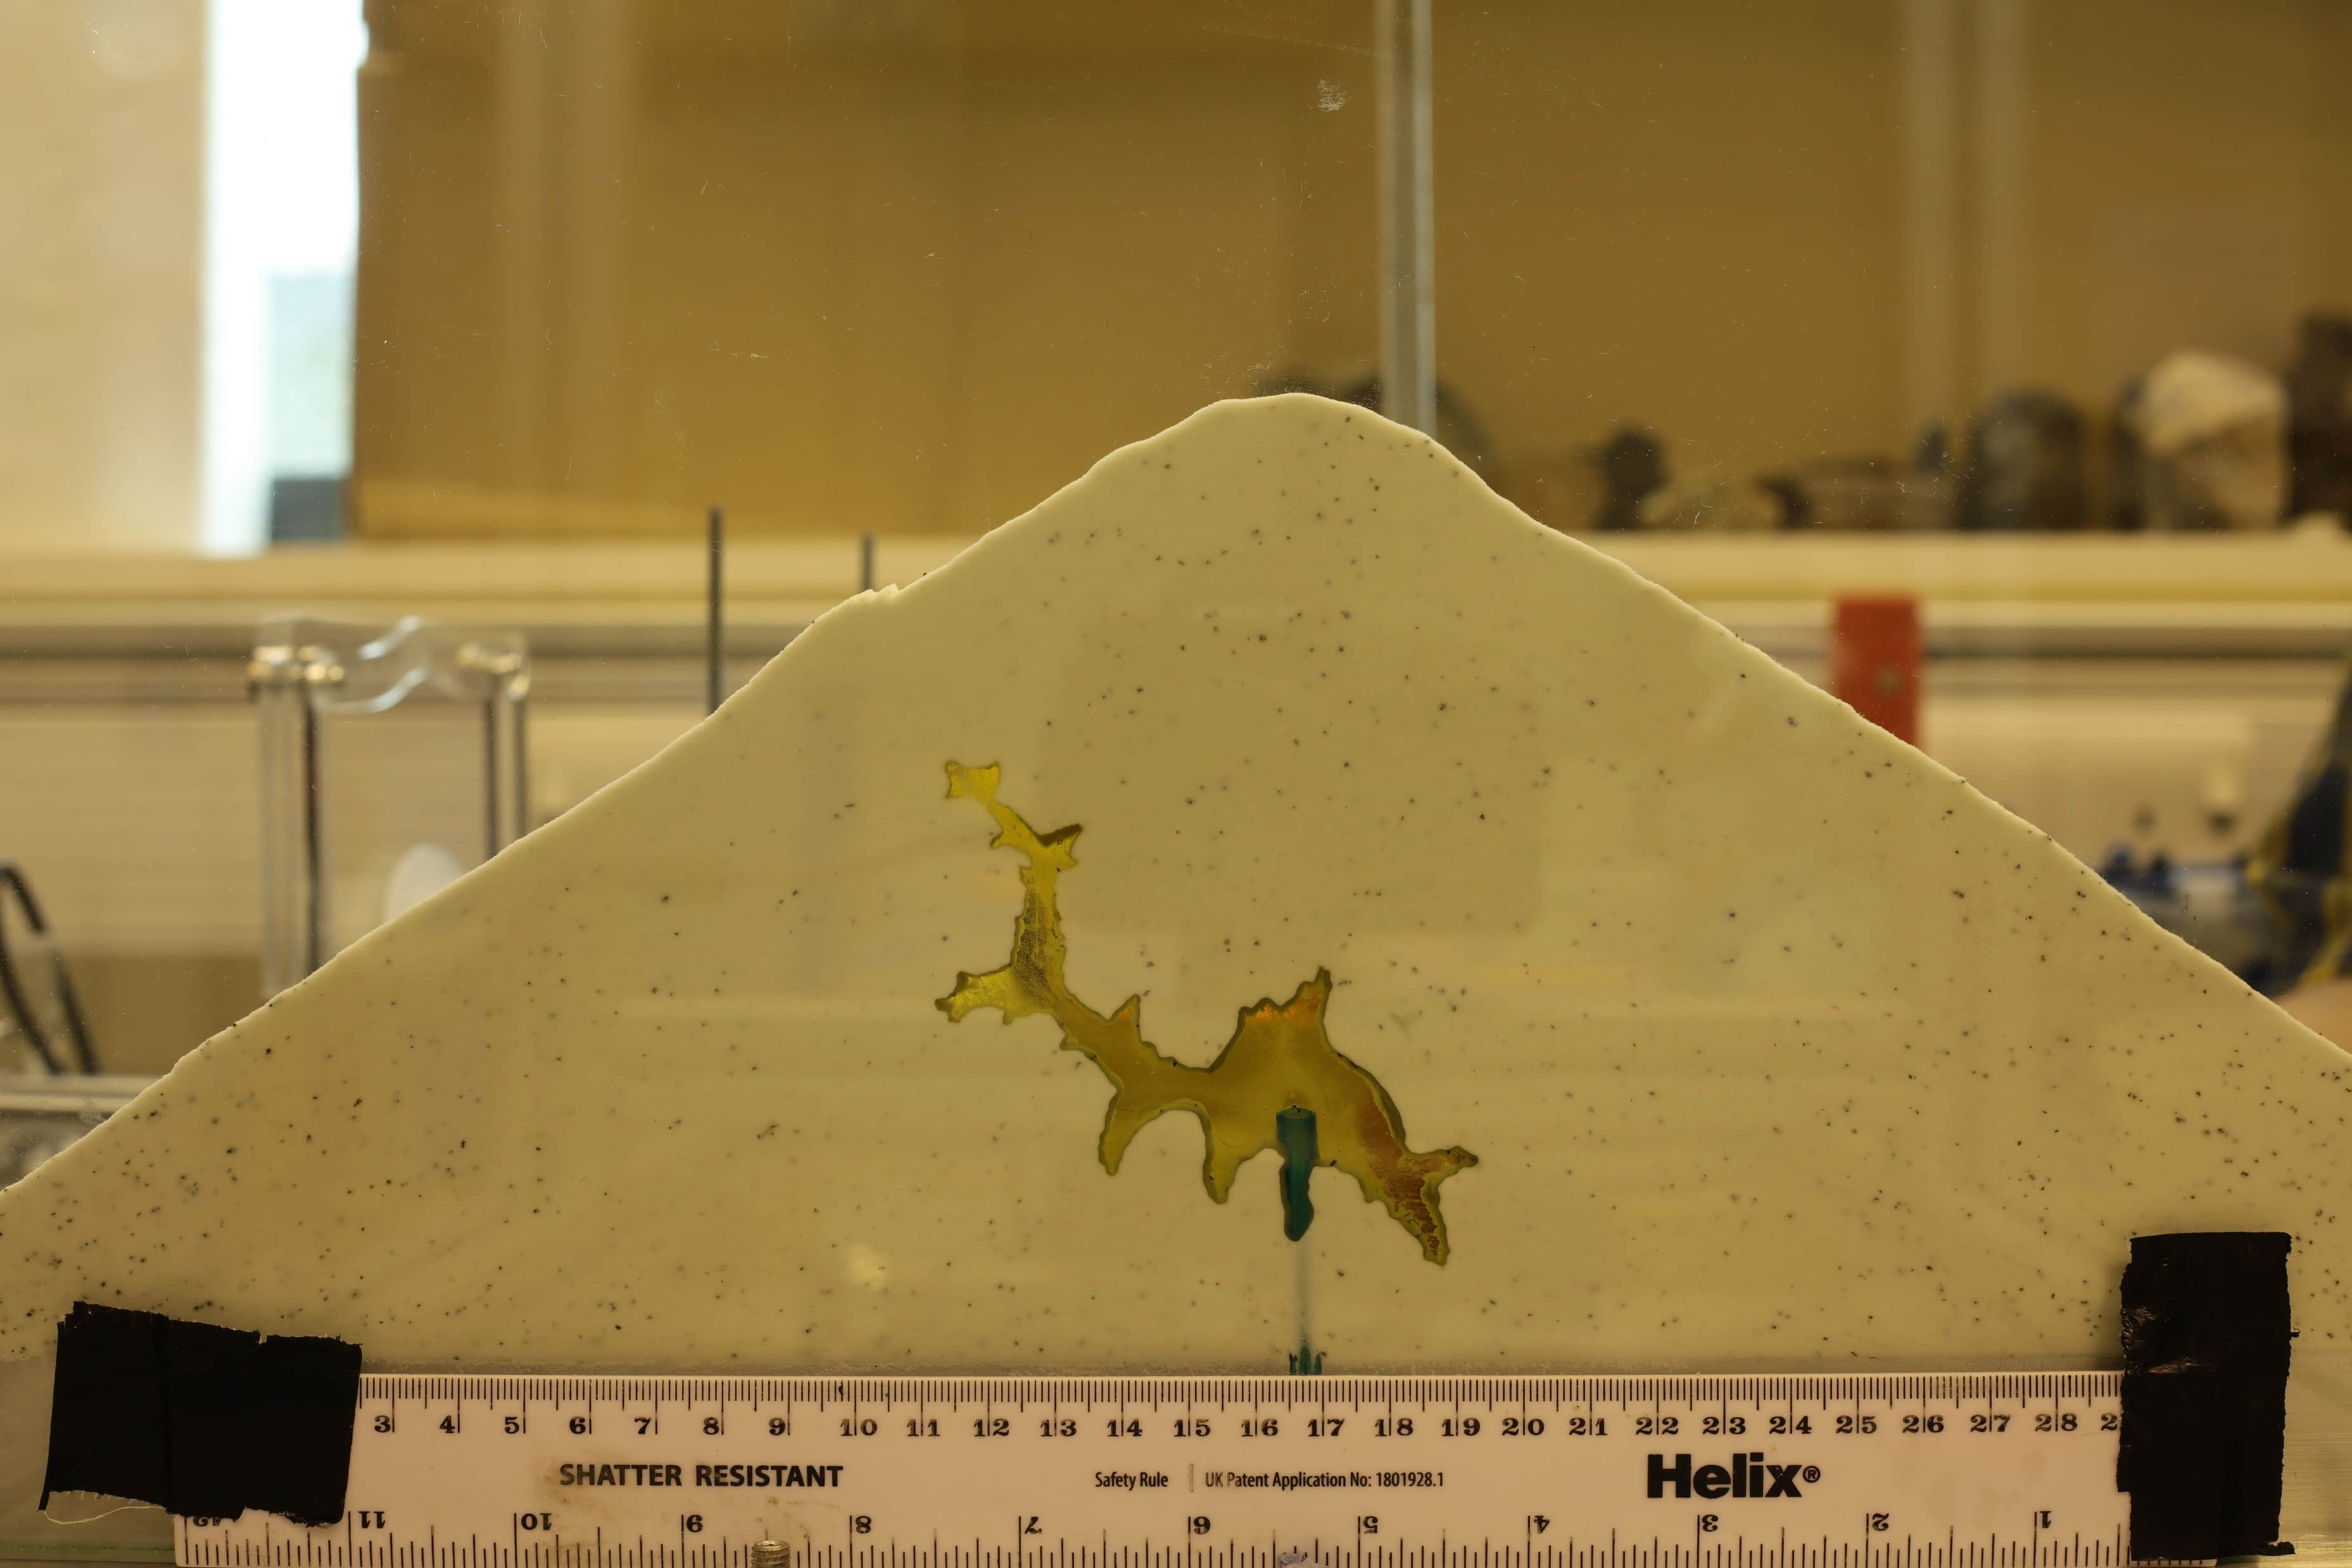
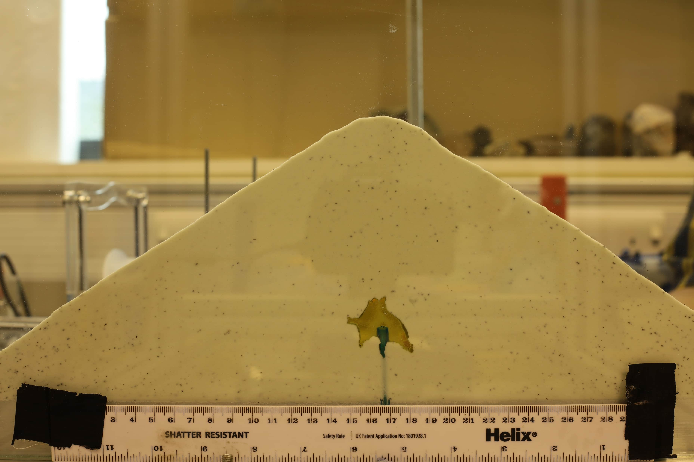
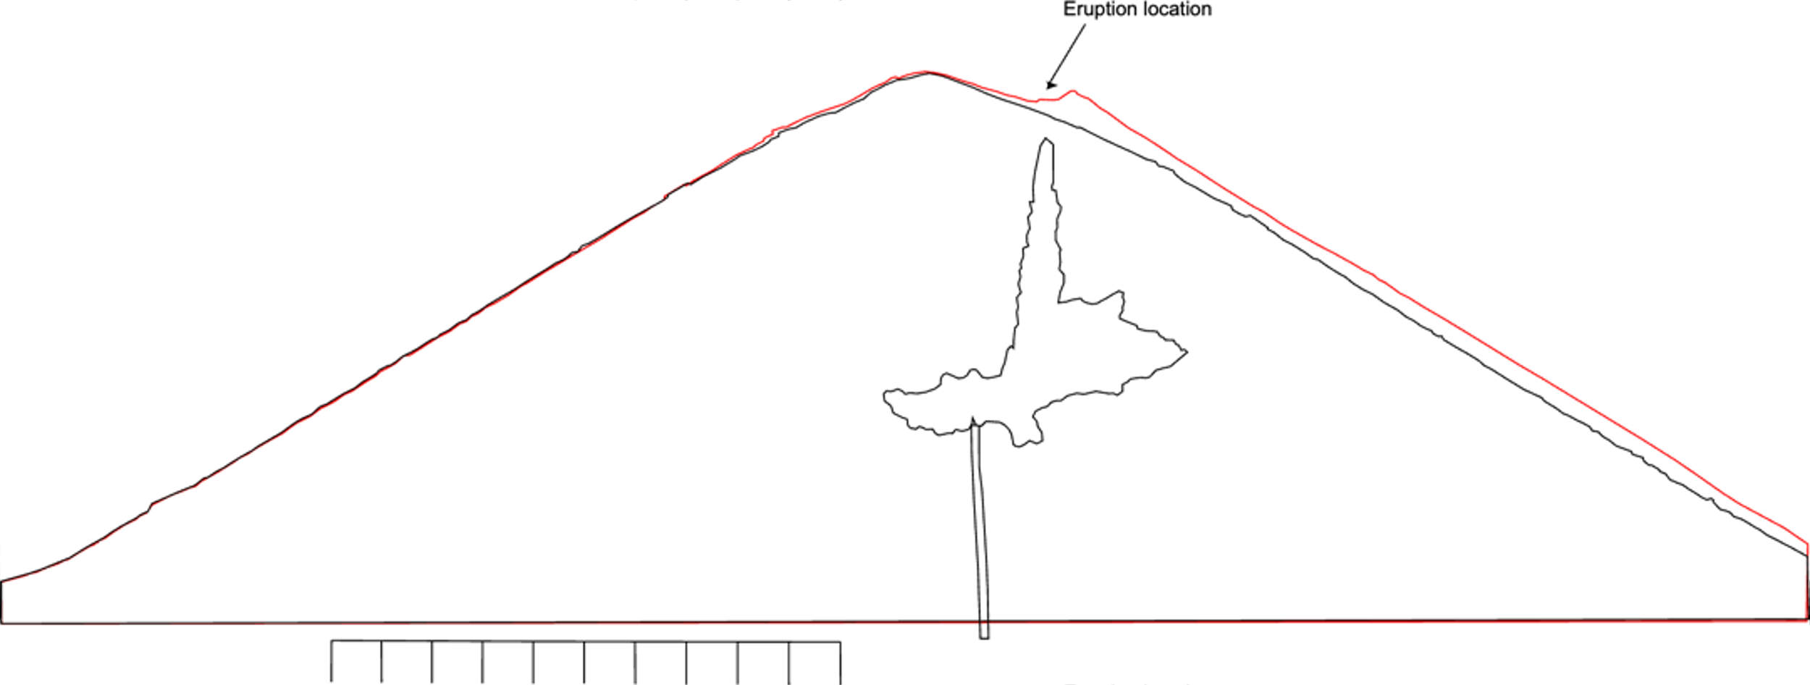
Key findings – internal compaction to localised surface uplift
Eruption location
PIV results highlight the transition from broad symmetrical subsurface deformation accommodated by compaction to localised surface uplift.
Liquid extrusion location occurs along the edge of the deformation region.
Some experiments highlight a correlation between strain rate and acoustic noise in relation to liquid propagating through the granular material.
Constant pressure vs constant volume intrusions create different deformation responses within the analogue models.
This project has received funding from the European Union‘s Horizon 2020 research and innovation programme under grant agreement No 858092.
Abstract QR code

Slide 3
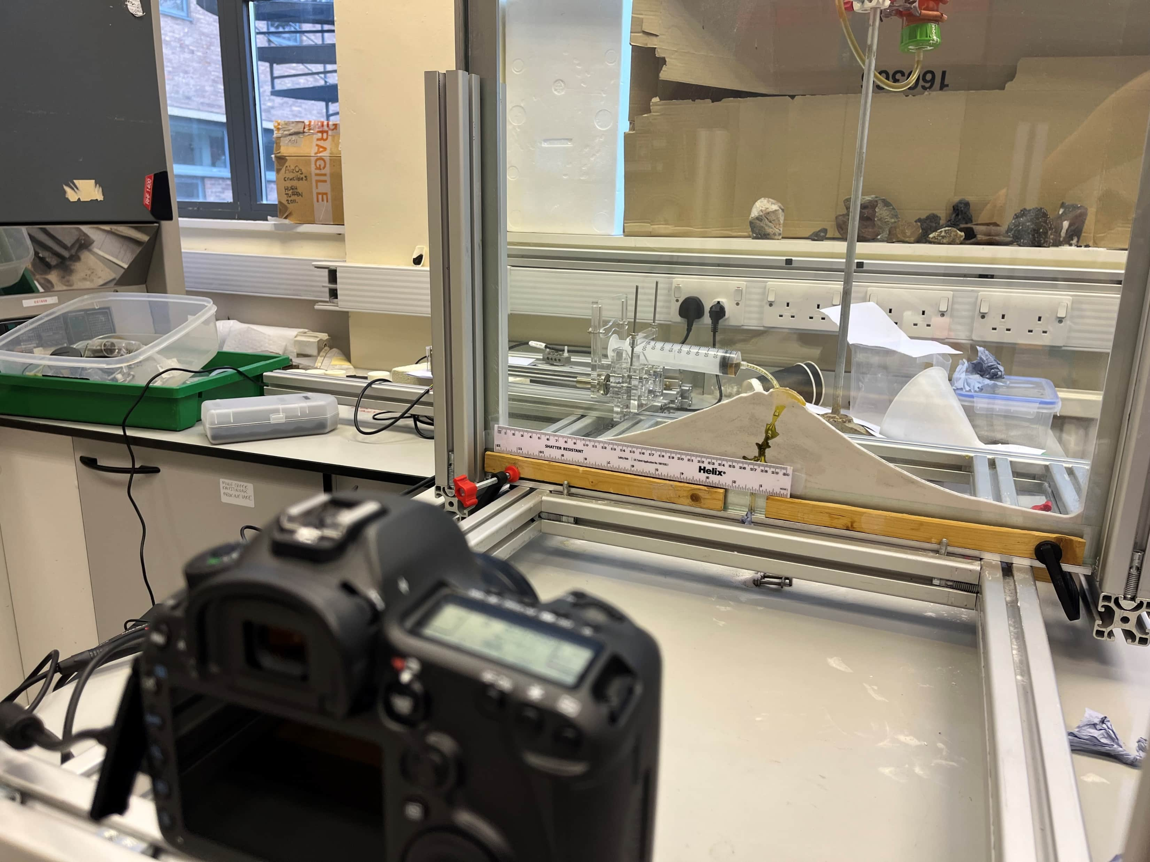
Experimental setup and rationale
Digital camera set to take images to produce a frame-by-frame analysis of the particle displacements.
Granular material is poured in between two glass panels to create the cone-shaped analogue edifice.
Aims and objectives:
To improve the understanding of near-surface intrusions that contribute to ground deformation on volcanoes.
Volcano deformation is a sign of volcanic unrest, therefore highlighting the importance for understanding these deformation processes prior to an eruption.
To create a quasi-2D analogue model to enable the visual tracking of the liquid intrusion into the granular material, whilst also monitoring surface displacement patterns.
To highlight intrusion dynamics and track the liquid propagation to the surface.
This project has received funding from the European Union‘s Horizon 2020 research and innovation programme under grant agreement No 858092.
Abstract QR code

Slide 4
Scaling and material selection
Golden syrup is used as the magma analogue as it is a near-Newtonian fluid, that is cheap and readily available.
Granular material is used as the volcano edifice analogue for studying near surface processes. Combinations of sand, ballotini, and polyethylene powder are used to analyse the effects of material cohesion.
Analogue models must be geometrically, kinematically and dynamically scaled to nature to enable connections and comparisons between laboratory results and nature. In this study the focus is on near-surface deformation processes, which makes low cohesion granular material the most suitable to represent near-surface brittle deformation.
Stress ratio equation: $π\text{σ}=\frac{\text{σ}m}{\text{σ}n}=\frac{ρm hm gm}{ρn hn gn}$ where P is density, h is height, g is gravity, m is model, n is nature. Using the equation and the middle values from the table below, the stress ratio of the model to nature would = 0.0001, which infers that the model is 10⁻⁴ times the stress in the natural system.
Parameter | Nature | Model | Scaling | Comments
Height (m) | 10 – 1000 m | 0.05 – 0.25 m | 5 x 10⁻³ to 2.5 x 10⁻⁴ | 1 cm in the model represents 4 to 200 m in nature
Density (kg/m³) | 2200 - 2800 | 1200 - 1600 | 0.5 – 0.7 | Typical values for sand (granular material) representing weak volcanic material
Cohesion (C) | 10⁴ -10⁶ Pa | 10 – 200 Pa | 10⁴ -10² | Much weaker than volcanic rocks, but allows realistic failure and deformation at scaled-down stresses
Stress (σ) |  |  | ~1.1 x 10⁻⁴ | Model stresses are ~ 0.01% of natural stresses
This project has received funding from the European Union‘s Horizon 2020 research and innovation programme under grant agreement No 858092.
Abstract QR code

Slide 5
Methodology – image optimisation
Camera settings were tested to optimise the image quality for the analogue experiments.
Changing the aperture (opening of the camera lens) was shown to have a large impact on the image quality.
Aperture F/1.8
Aperture F/8
Aperture F/22
Optical aberrations
Diffraction
This project has received funding from the European Union‘s Horizon 2020 research and innovation programme under grant agreement No 858092.
Abstract QR code

Slide 6
Raw image – visual analysis
This project has received funding from the European Union‘s Horizon 2020 research and innovation programme under grant agreement No 858092.
Abstract QR code

Slide 7
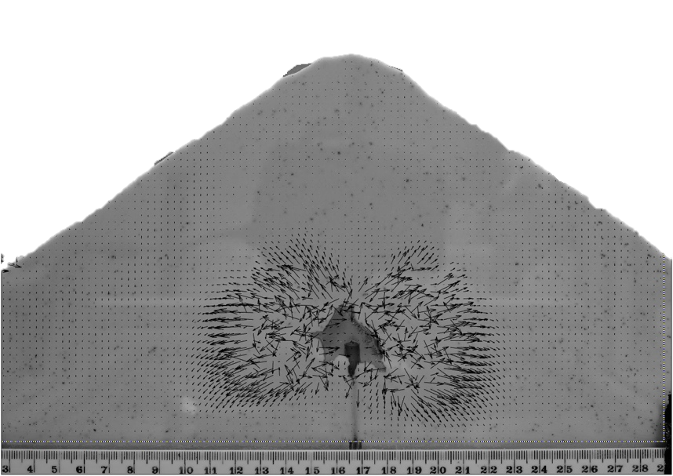
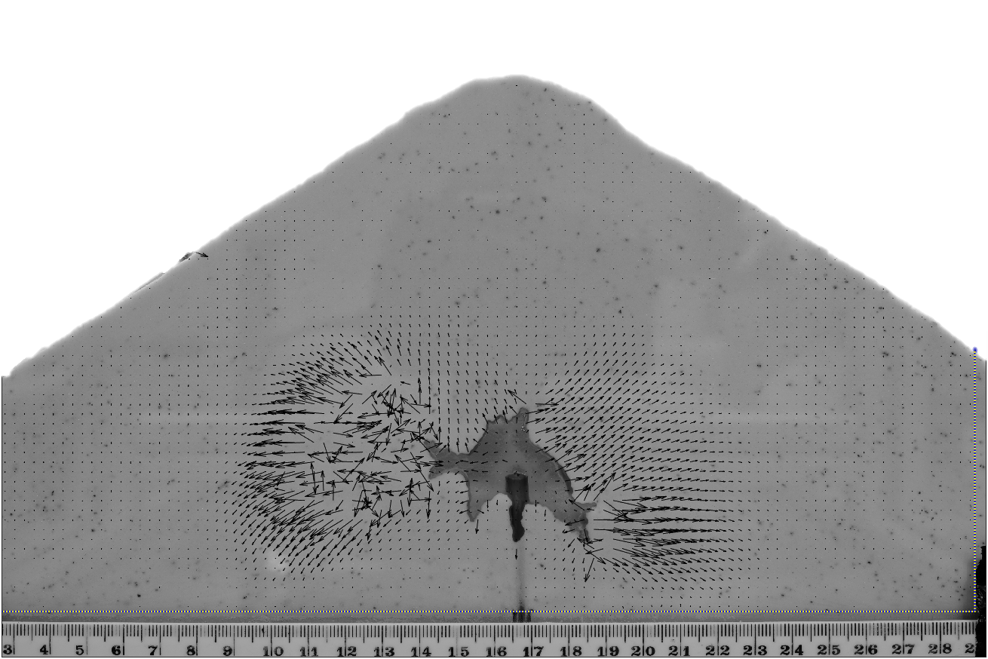
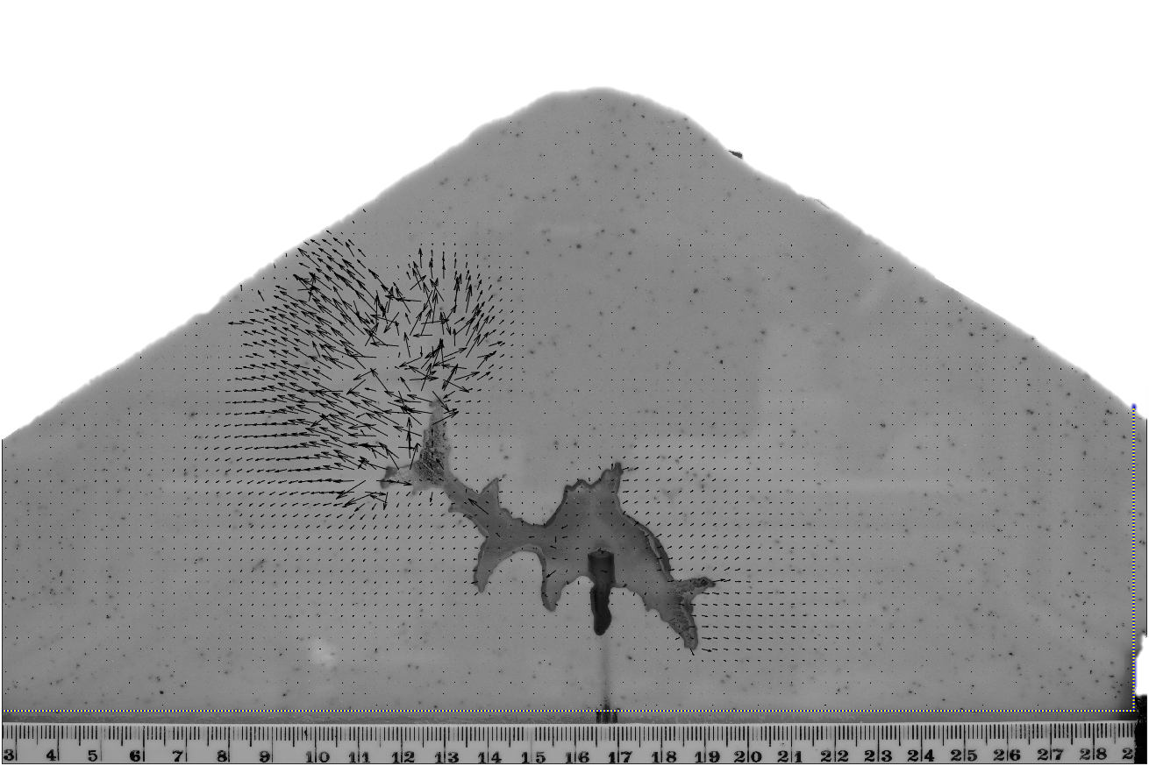
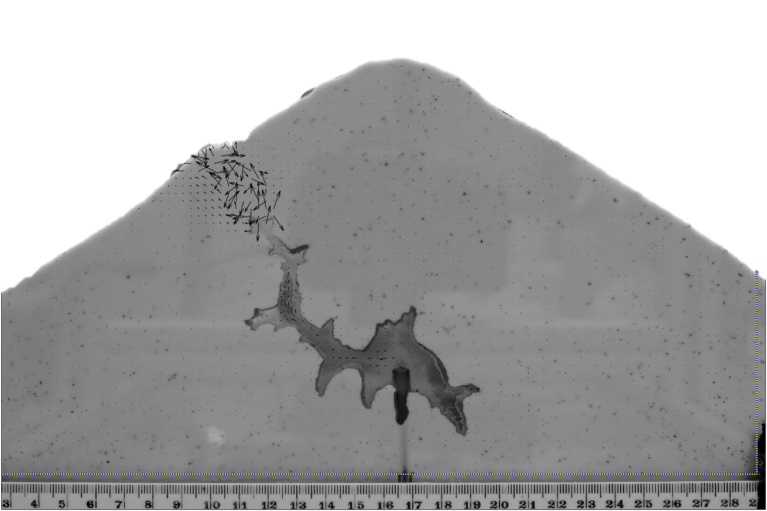
PIV analysis vector displacement
T = 5 seconds
T = 10 seconds
T = 40 seconds
T = 25 seconds
This project has received funding from the European Union‘s Horizon 2020 research and innovation programme under grant agreement No 858092.
Abstract QR code

Slide 8
PIV analysis – Velocity magnitude
T = 5 seconds
T = 10 seconds
T = 25 seconds
T = 40 seconds
This project has received funding from the European Union‘s Horizon 2020 research and innovation programme under grant agreement No 858092.
Abstract QR code

Slide 9
Liquid extrusion location – consistently along the edge of the deforming region
This project has received funding from the European Union‘s Horizon 2020 research and innovation programme under grant agreement No 858092.
Abstract QR code
Eruption location
Uplifted region at the end of the experiment
1 cm
Uplifted region at the end of the experiment
Liquid intrusion
1cm
Liquid intrusion
Uplifted region at the end of the experiment
Uplifted region at the end of the experiment
1 cm
Percolation
Liquid intrusion
Liquid intrusion
Percolation

Slide 10
Surface displacement and extrusion location
The surface of the edifice model is displayed at different stages of the experiment as the model intrusion progresses towards the surface. Surface uplift shows a steady rate of increase along the upper left slope, whereas the central regions show a greater increase in uplift in the final few frames.
The golden syrup breaches the surface along the edge of the deformation section.
Extrusion location
Frame 1
Frame 13
This project has received funding from the European Union‘s Horizon 2020 research and innovation programme under grant agreement No 858092.
Abstract QR code

Slide 11
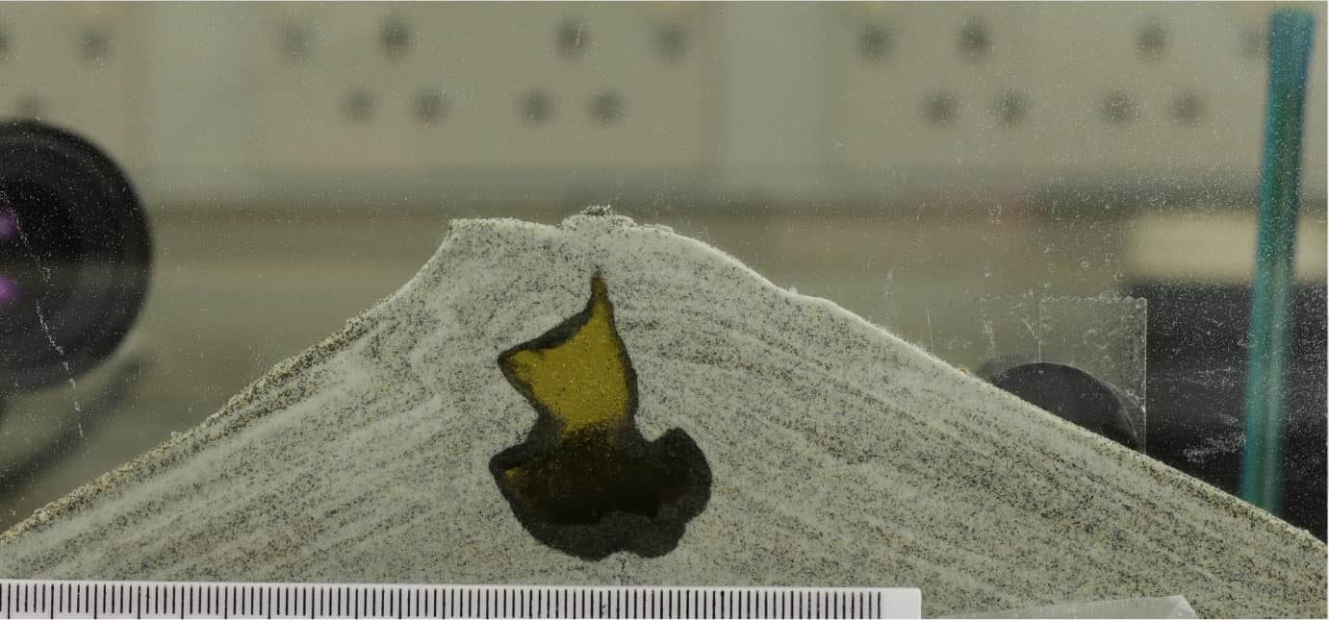
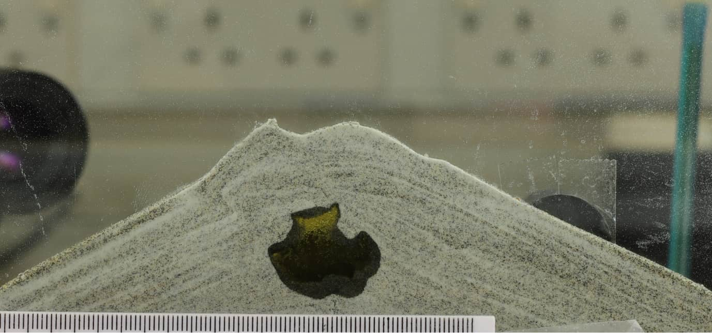
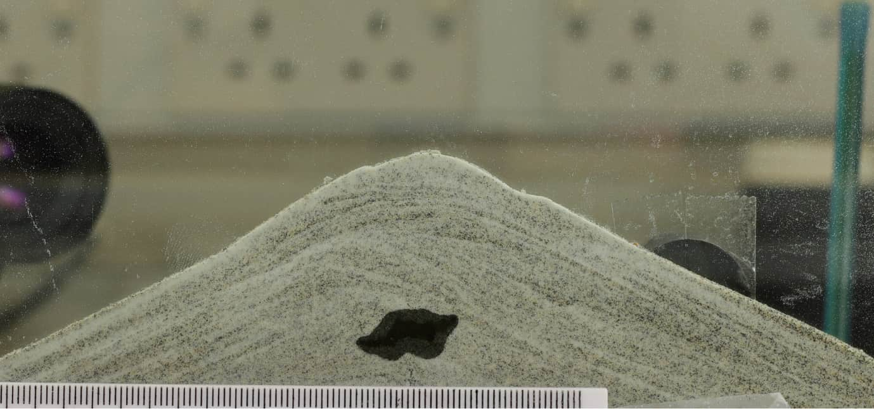
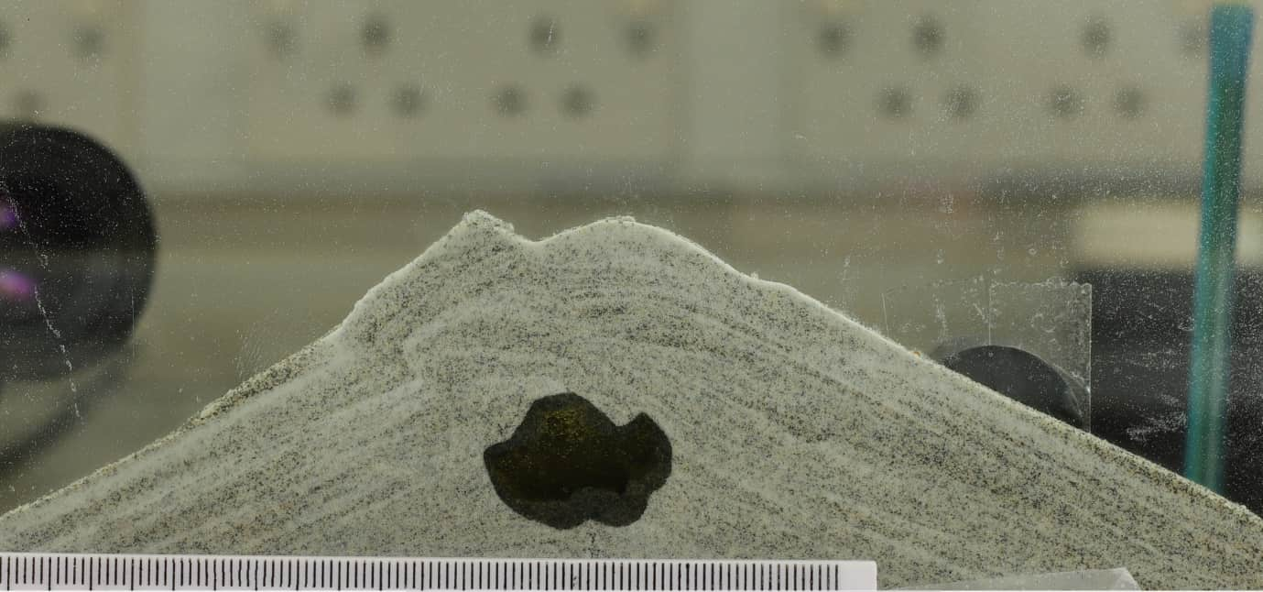
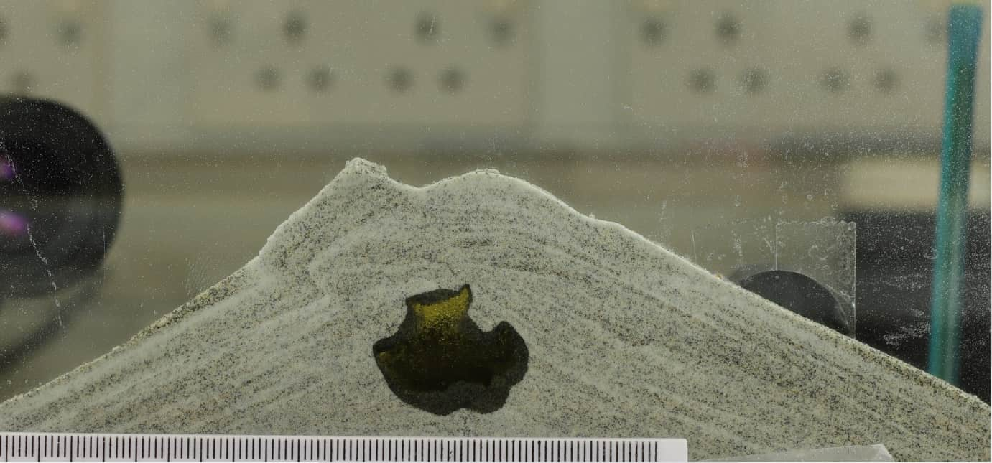
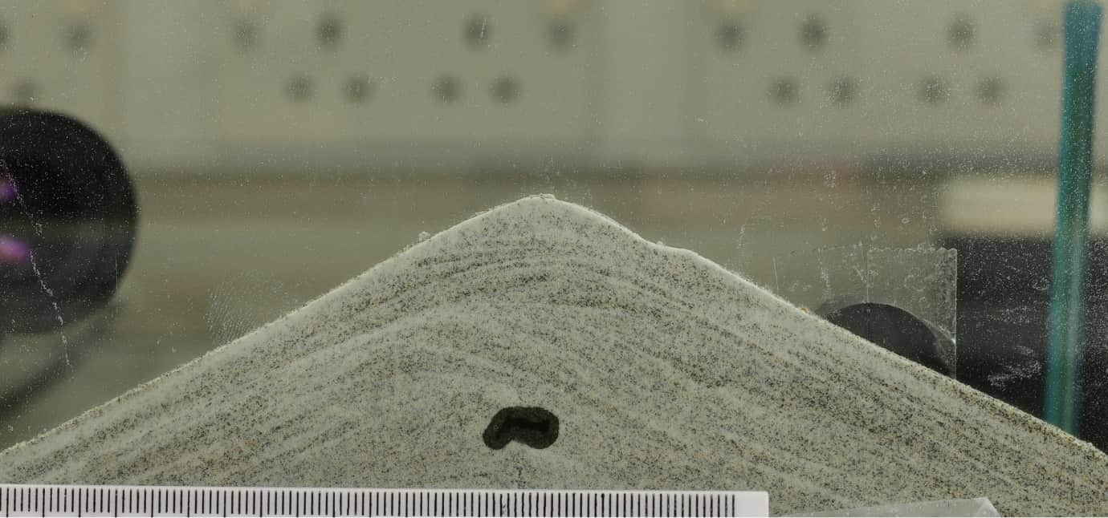
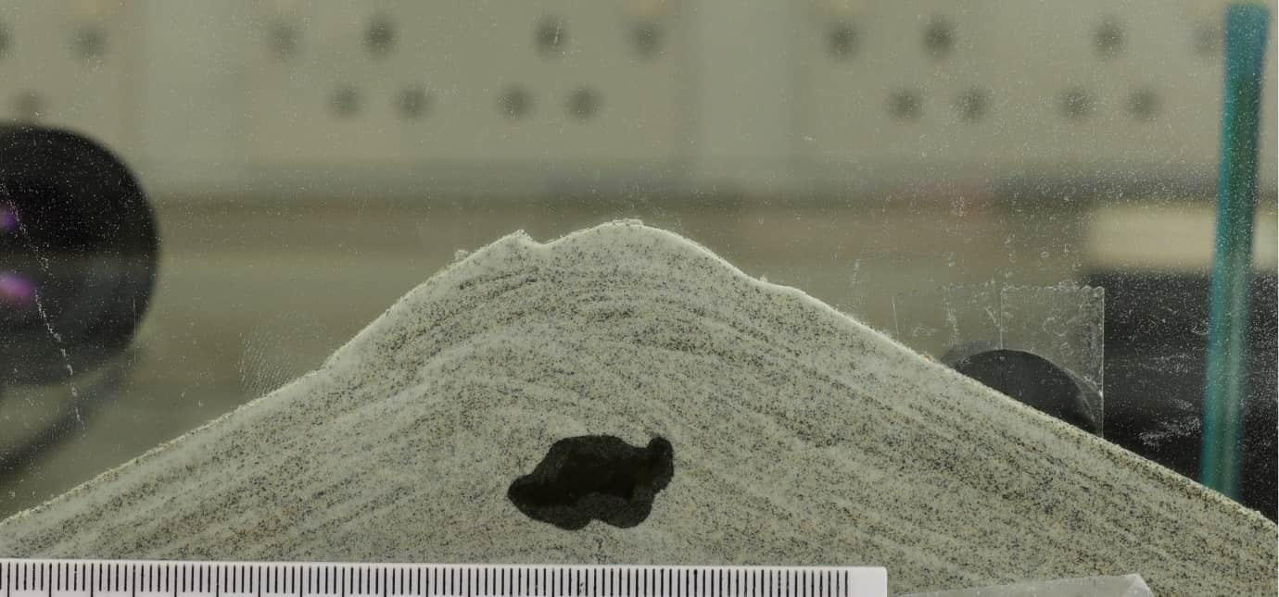
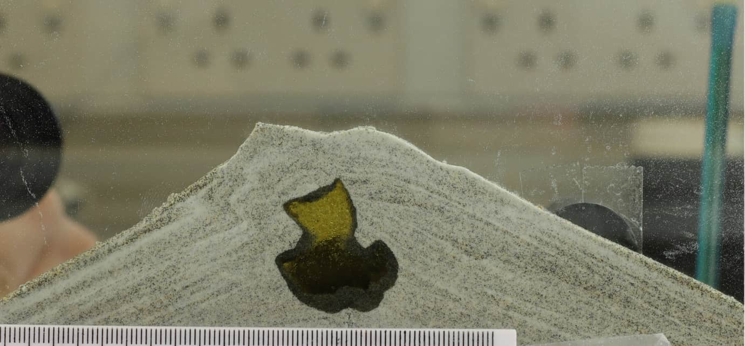
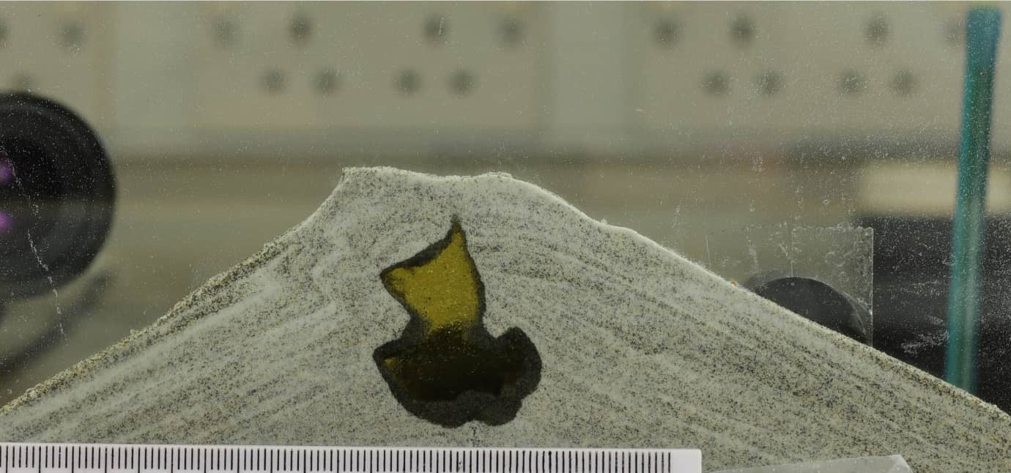
Intrusion growth patterns
The granular material is forced upwards and rotated outwards due to the growth of the golden syrup (analogue intrusion). The displacement of this material creates a pathway of least resistance for the golden syrup to breach the surface.
This project has received funding from the European Union‘s Horizon 2020 research and innovation programme under grant agreement No 858092.
Abstract QR code

Slide 12
PIV displacement vectors, strain rate, and acoustic data
This project has received funding from the European Union‘s Horizon 2020 research and innovation programme under grant agreement No 858092.
Abstract QR code
Analysis of the acoustic data from contact microphones, alongside strain rate data from PIV. Initial results have highlighted a relationship between increased strain rate, and decreased acoustic energy, whilst occurring at the transition from internal compaction to surface uplift.
In PIV, strain rate is calculated by the strength of velocity gradient in the direction of the local velocity.

Slide 13
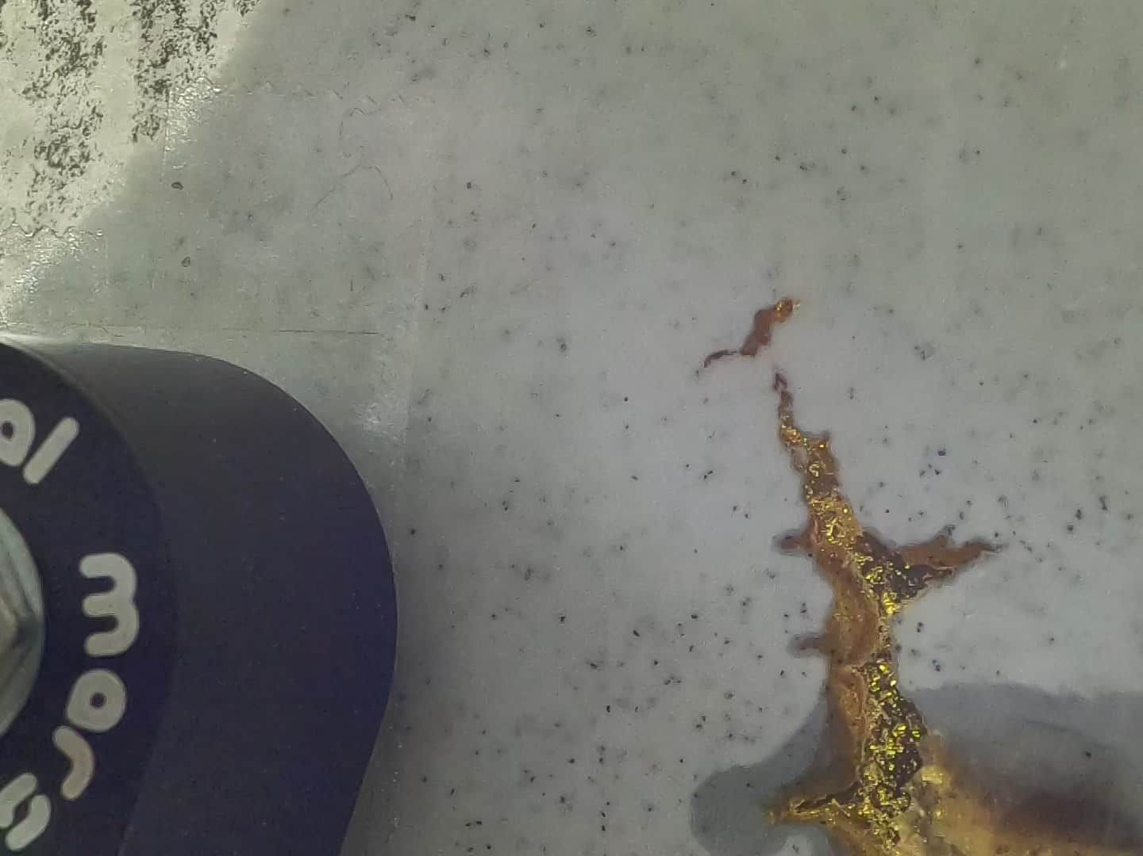
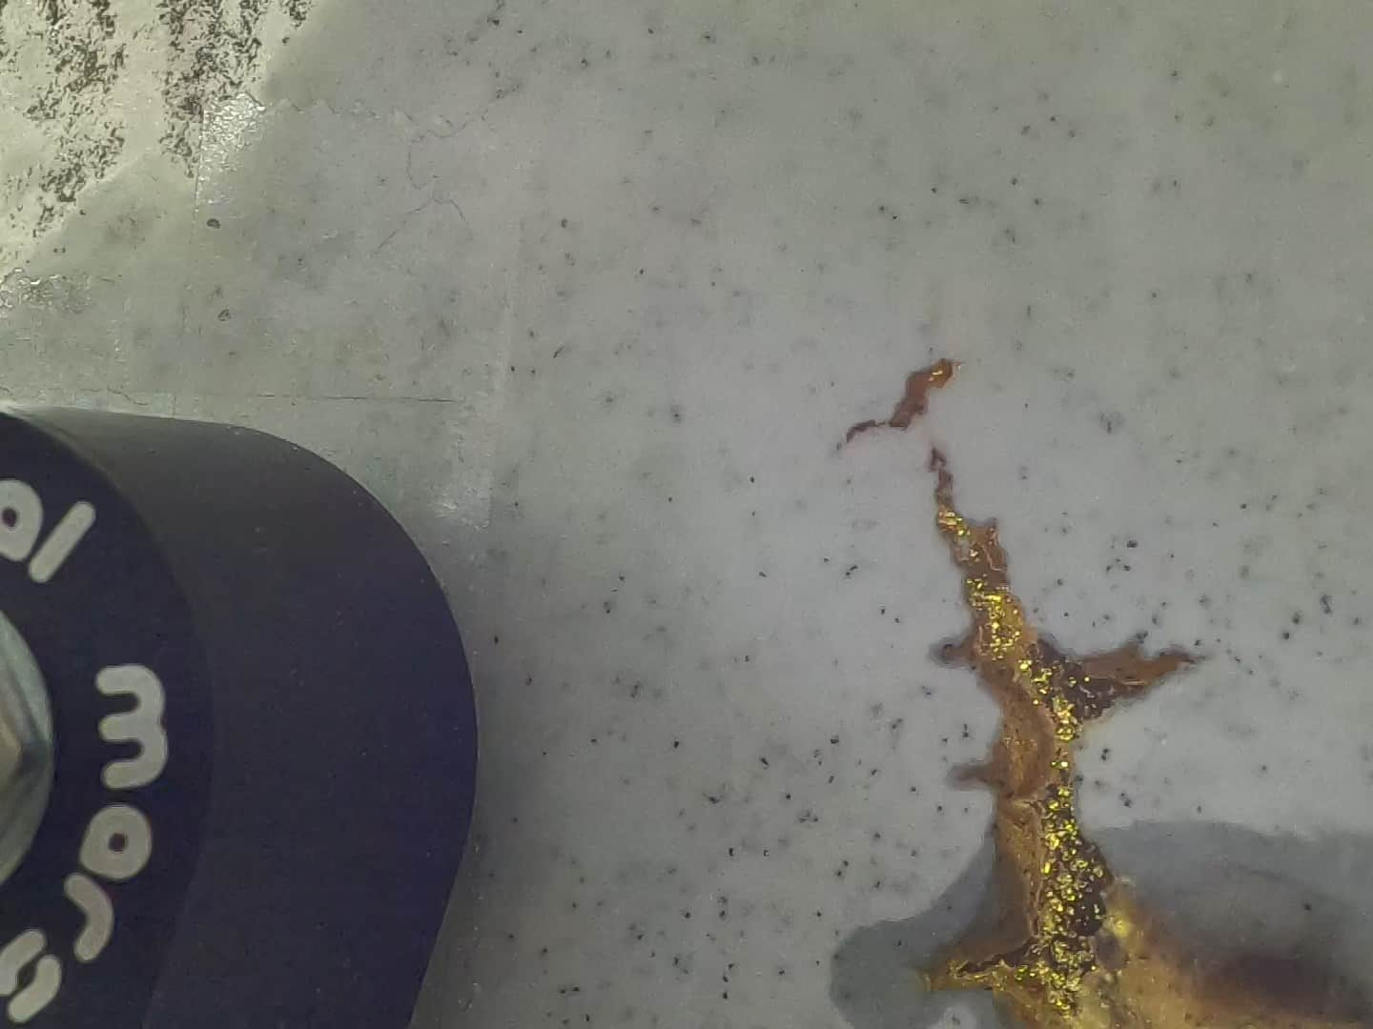
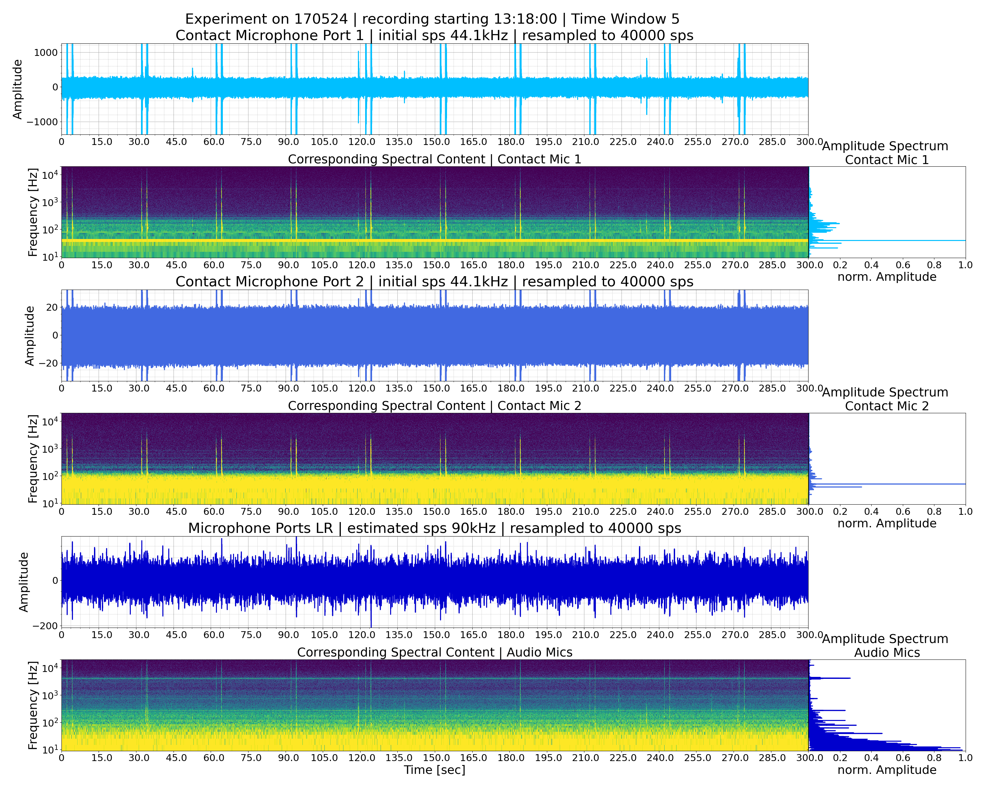
Contact microphone and GoPro capturing flank collapse
This project has received funding from the European Union‘s Horizon 2020 research and innovation programme under grant agreement No 858092.
Abstract QR code

Slide 14
Conclusions and future work
Internal compaction to surface uplift transition occurs alongside increased strain rate and decreased acoustic energy.
Liquid extrusion location consistently occurs along the edge of the deforming section.
Compaction and fracturing dictate deformation and propagation pathways by dynamically modifying internal resistance and guiding subsequent fluid migration along newly formed low-resistance zones.
Constant pressure injections reflect gradual, incremental, and more gravity-influenced deformation dynamics, while constant volume injections exhibit faster, pressure-driven propagation with immediate and clear structural deformation responses.
Future work: Pressure measurements of the intruding liquid will be compared to the deformation response to understand their connection.
A greater range of injection rates will be explored to ascertain the impact on subsurface and surface deformation rates and patterns.
This project has received funding from the European Union‘s Horizon 2020 research and innovation programme under grant agreement No 858092.
Abstract QR code

