Slide 1
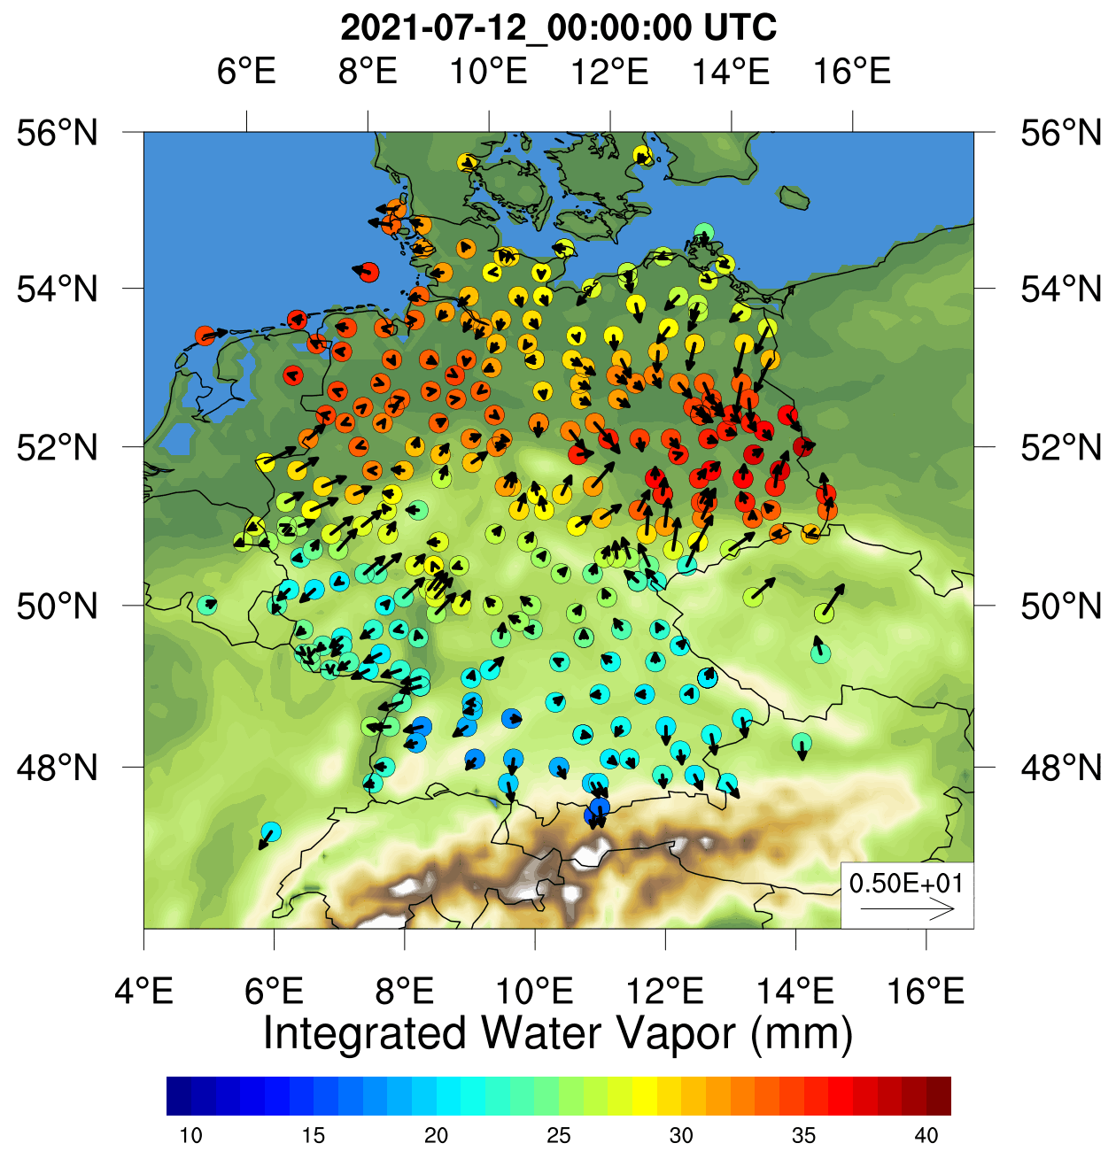
Simulation of Tropospheric Gradients and
Integrated Water Vapor
Time period: Ahr River Flood, Germany
Simulations from Weather Research and Forecasting Model (Skamarock et al., 2008)
Simulation time period – June and July 2021
Assimilation cycle interval – Six hourly
GFZ data from ~300 station network in Germany

