Slide 1
SUPPLEMENTARY SLIDES
Copernicus data and services uptake with EO4EU platform: an AI-augmented ecosystem for Earth Observation data accessibility and exploitation
May 2, 2025
Speaker: Federico Fornari
Contributors: Federico Fornari, Vasileios Baousis, Mohanad Albughdadi, Marica Antonacci,
Tolga Kaprol, Claudio Pisa, Charalampos Andreou, Kakia Panagidi, Stathes Hadjiefthymiades

Slide 2
EO4EU System Architecture at a Glance
EO4EU applications
Dashboards
API
Data processing workflows
XR
EO4EU processing infrastructure
Fusion
Semantic annotation
Compression
Knowledge management
Orchestration Language
EO sources
Copernicus: CAMS-CDS-CLMS, CMEMS
ADAM: Sentinel Satellite Missions, Copernicus Data space
Other services & use cases: Istat.it, INSPIRE, CMCC, ECMWF, NOAA

Slide 3
Overview of the Multi-site infrastructure for the development of EO4EU platform
With the underlying infrastructure serving as the backbone, the best data processing platform should enable users to effectively analyse, visualise, model and deploy data-driven solutions.

Slide 4
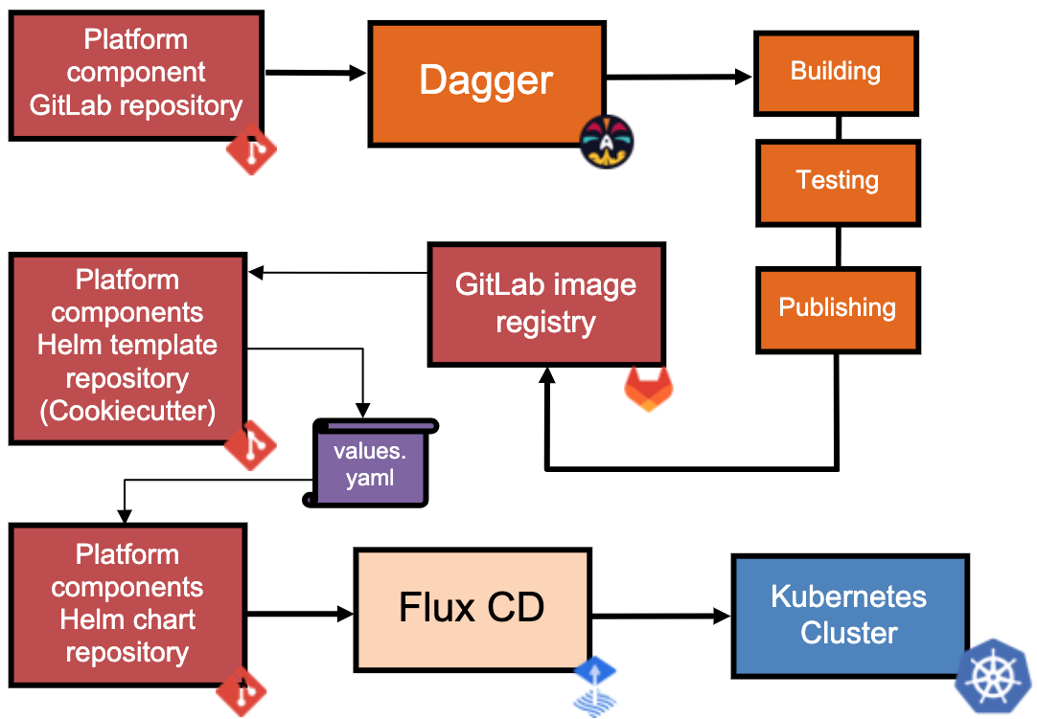
EO4EU CI/CD Architecture
GitLab: Centralized code versioning
and collaboration
Dagger: Automates builds/tests,
ensuring consistency across environments
Cookiecutter: Standardizes
Kubernetes Helm chart management
Flux CD: Monitors and synchronizes
app state in Kubernetes clusters

Slide 5
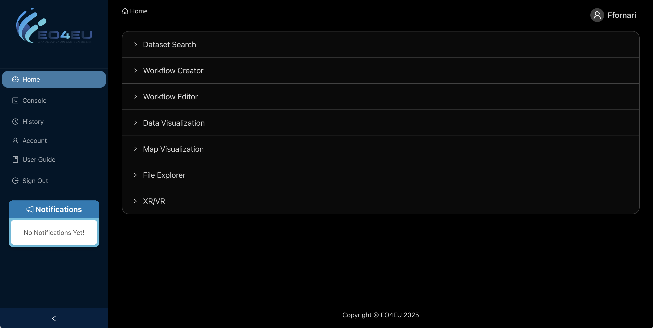
Access to the platform: https://dashboard.apps.eo4eu.eu/

Slide 6
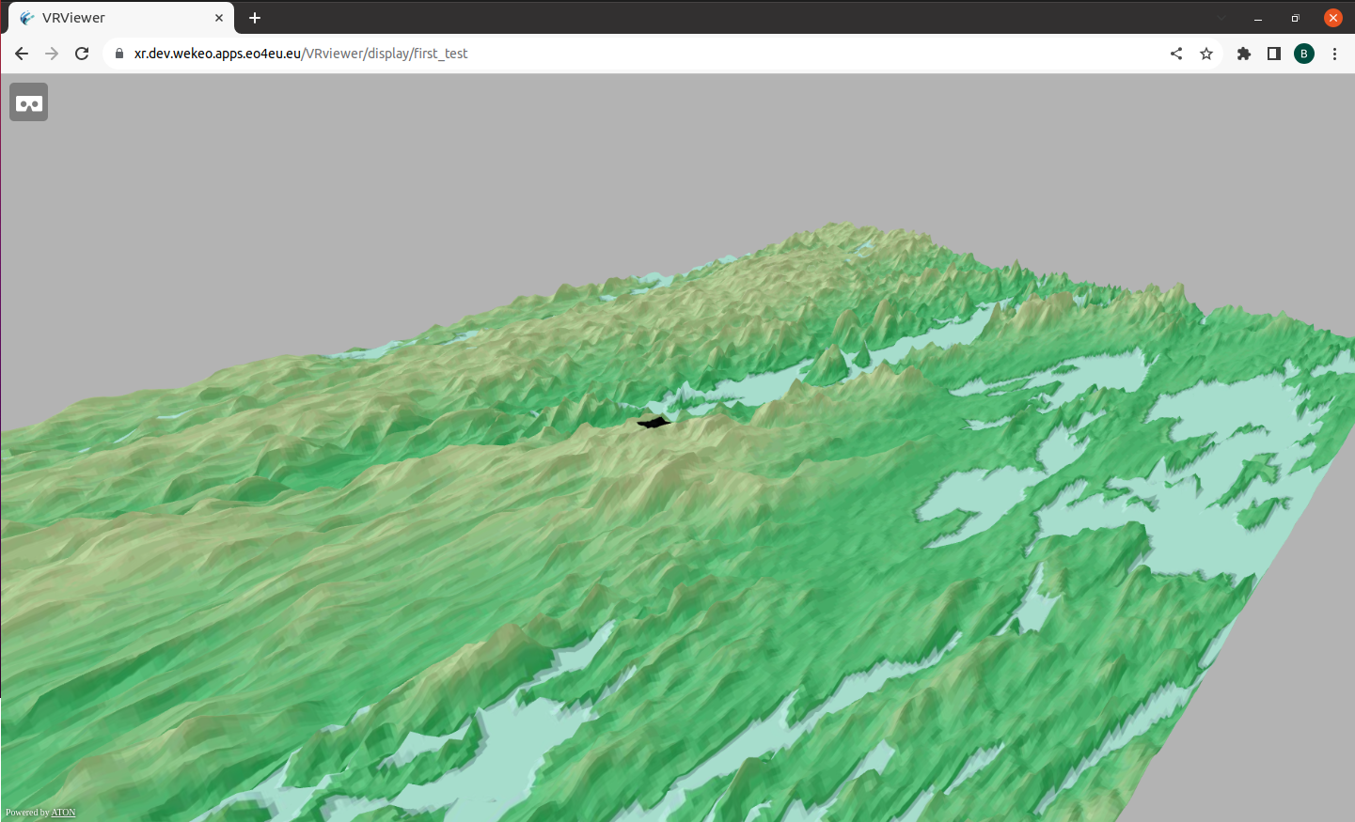
Workflow
Prepare the EO data
Download the data from S3 bucket
Reproject the data to EPSG:4326
Prepare the 3D model
Get the Digital Elevation Model
Get the texture for the context
Create a 3D model integrating the EO data, the context data and the DEM
Export and Display
Export the 3D model to GLTF
Create 3D tiles from the exported model
Display on a Webpage
https://xr.apps.eo4eu.eu/VRviewer

Slide 7
Stakeholders and Beneficiaries
Researchers and Academia: Supports research institutions
with more accessible EO data
Policy-Makers:
Supports evidence-based policy-making and climate action
EO data providers:
Promotes further usage of EO data through value added tools
Private sector:
Encourages innovation through more accessible EO data for non-technical users
Citizens and scientists:
Enables new actions to reduce
and monitor the impact of
climate change
Standards Development Organisations: Contributes to the revision of standards related to EO data

