Slide 1




Identification of catchments with similar hydro-meteorological conditions during rainfall-runoff events: An event-based clustering approach for 378 catchments in the contiguous United States
EGU25-10711
PICO spot A.7
28/04/2025
Adriane Hövel¹, Christine Stumpp¹, Michael Stockinger¹, Ross Woods², and Yanchen Zheng²
¹BOKU University, Institute of Soil Physics and Rural Water Management, Department of Landscape, Water and Infrastructure, Muthgasse 18, 1190 Vienna, Austria
²School of Civil, Aerospace and Design Engineering, University of Bristol, Bristol, BS8 1TR, UK
Grant number: P34666

Slide 2
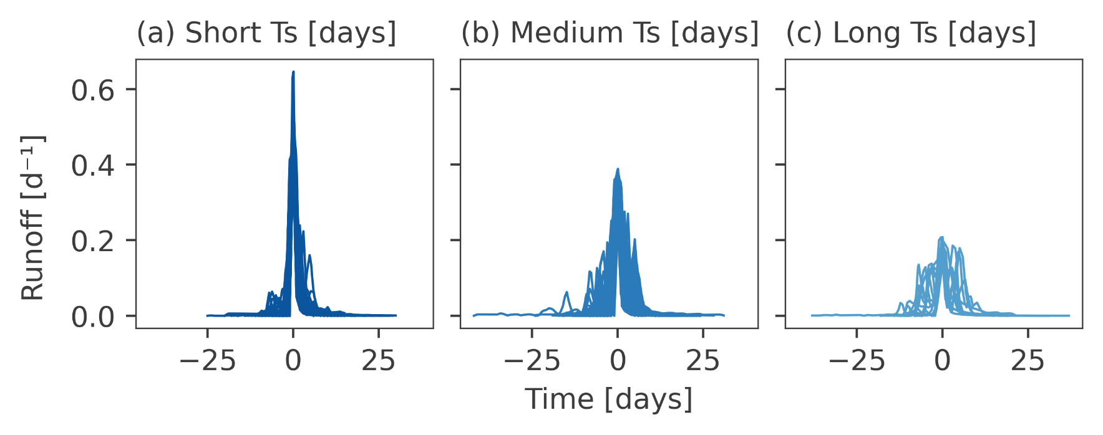
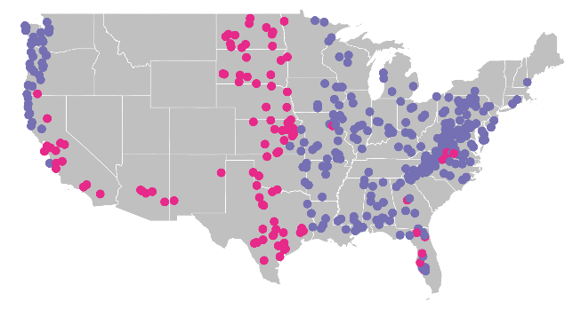
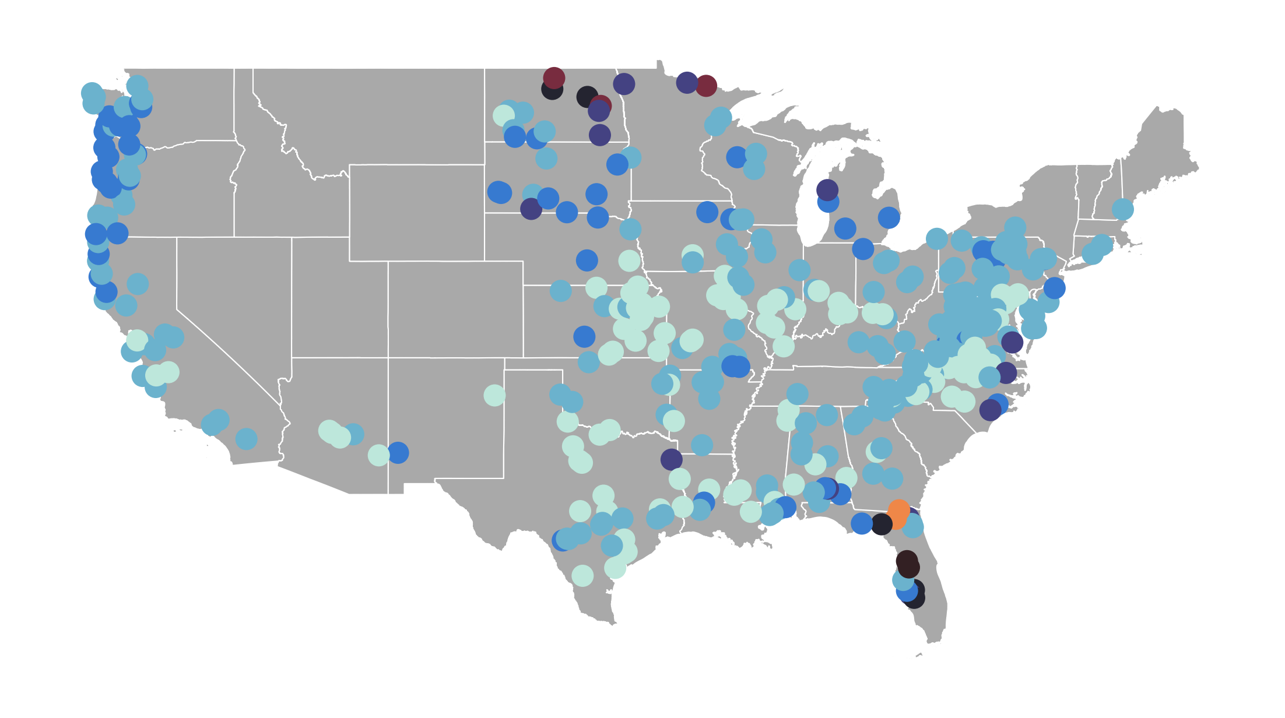
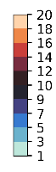
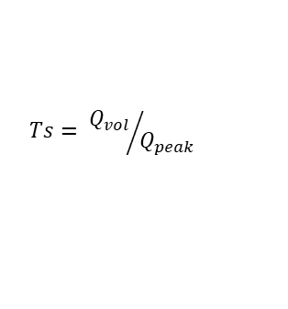
Event timescale Ts [days]
Which hydro-meteorological event conditions influence the runoff event timescale Ts at the catchment scale (temporal variability)?
Which physical and climate catchment attributes influence the catchment-scale median Ts (spatial variability)?
runoff
$$Ts= {Q_{vol}}/{Q_{peak}}$$
OSPP
time
Short, medium, and long Ts
Hydro-meteorological event conditions
Mean rainfall intensity
Rainfall duration
Maximum rainfall intensity
Antecedent soil moisture
Pre-event base flow
PICO spot A.7
Random forest feature importance and Spearman rank correlation
Temporal variability
Median Ts
Physical and climate catchment attributes
Topography
Vegetation
Soil
Geology
Climate
Spatial variability
“Wet” catchments: aridity ϕ < 1
“Dry” catchments: aridity ϕ ≥ 1

Slide 3
Identification of catchments with similar hydro-meteorological conditions during rainfall-runoff events: An event-based clustering approach for 378 catchments in the contiguous United States
OSPP
Research questions
Start
Methodology
Temporal variability
Summary
Results
Spatial variability
Rainfall-runoff events and event clusters
Temporal variability
I
II
Supporting Information
Spatial variability
I
II

Slide 4
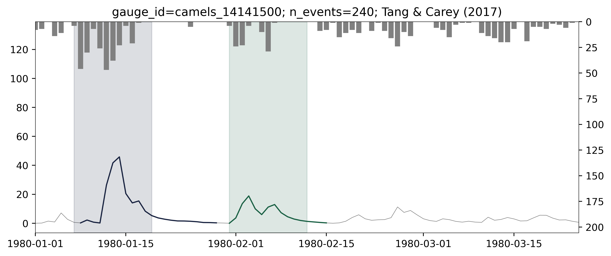
Methodology (I) – Temporal variability
OSPP
(1) Rainfall-runoff event identification
Toolbox by Tang & Carey (2017)
(2) Clustering of runoff event shapes
(3) Importance of hydro-meteorological event conditions for Ts clustering
Assumption: Ts in each catchment can be represented by three distinct shapes
Euclidean distance between each possible pair of Ts in a catchment, resulting in one distance matrix per catchment
Hierarchical, agglomerative clustering using Ward’s linkage method
Sort according to median Ts into short, medium, and long Ts
Random forest (RF) (Breiman, 2001) to quantify each event condition’s importance in the clustering of runoff events into the three shapes of short, medium, and long Ts
Quality control steps:
Exclude events with peaks falling below the long-term mean runoff
Exclude events without considerable peak
Exclude events with overlapping rainfall events
Exclude events with NaN
Exclude events with ERC > 1
Mean rainfall intensity
Rainfall duration
Maximum rainfall intensity
Antecedent soil moisture
Pre-event base flow
Menu

Slide 5
Methodology (II) – Spatial variability
Group | Attribute | Long name | Unit
Topography | Elevation | Median elevation | m.a.s.l.
 | Slope | Median slope | m km⁻¹
 | Area | Catchment area | km²
Vegetation | Forest cover | Fraction of forest cover extent | -
 | Maximum LAI | Maximum leaf area index (LAI) | -
 | LAI difference | Difference between maximum and minimum monthly mean LAI | -
Soil | Soil depth | Soil depth based on STATSGO (Miller & White, 1998) | m
 | Hydr. conductivity | Saturated hydraulic conductivity | cm hr⁻¹
 | Max. water content | Maximum water content | m
 | Sand fraction | Percentage of sand content | %
 | Silt fraction | Percentage of silt content | %
 | Clay fraction | Percentage of clay content | %
Geology | Carb. rock fraction | Fraction of carbonate sedimentary rock | -
 | Geol. porosity | Subsurface porosity | -
 | Geol. permeability | Subsurface permeability | (log10) m²
Climate | Seasonality | Seasonality and timing of precipitation (Woods, 2009) | -
 | Aridity | Ratio of PET/P | -
 | Freq. high P days | Frequency of high precipitation days | days yr⁻¹
 | Dur. high P events | Duration of high precipitation events | days
 | Freq. low P days | Frequency of low precipitation days | days yr⁻¹
 | Dur. low P events | Duration of low precipitation events | days
 | P mean | Mean daily precipitation | mm d⁻¹
 | PET mean | Mean daily potential evapotranspiration | mm d⁻¹
OSPP
(4) Influence of physical and climate catchment attributes on catchment median Ts
Random forest (RF) and Spearman rank correlation coefficient
Topography
Vegetation
Soil
Geology
Climate
Menu

Slide 6
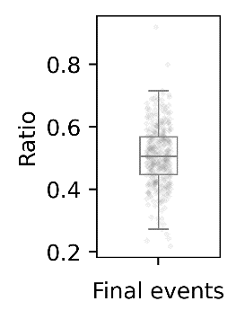
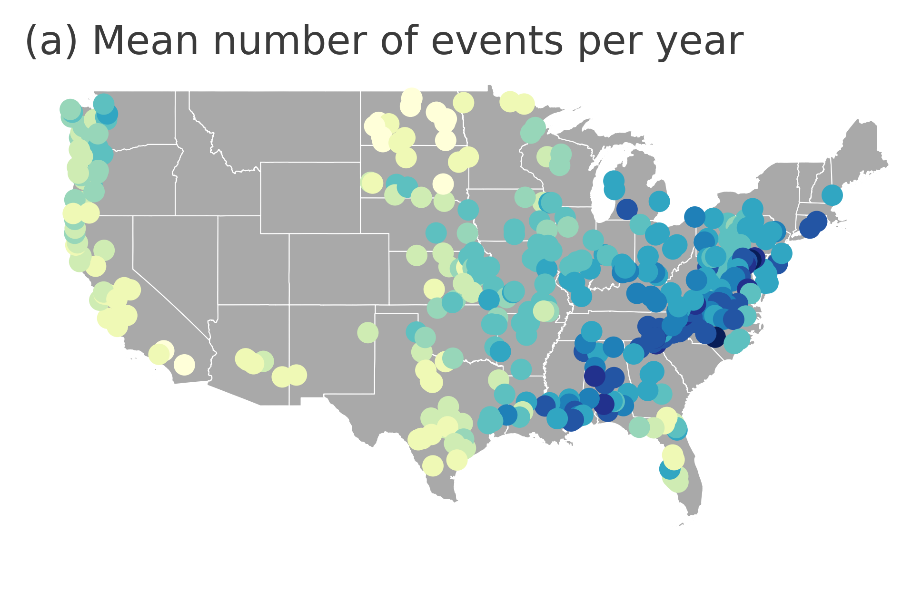
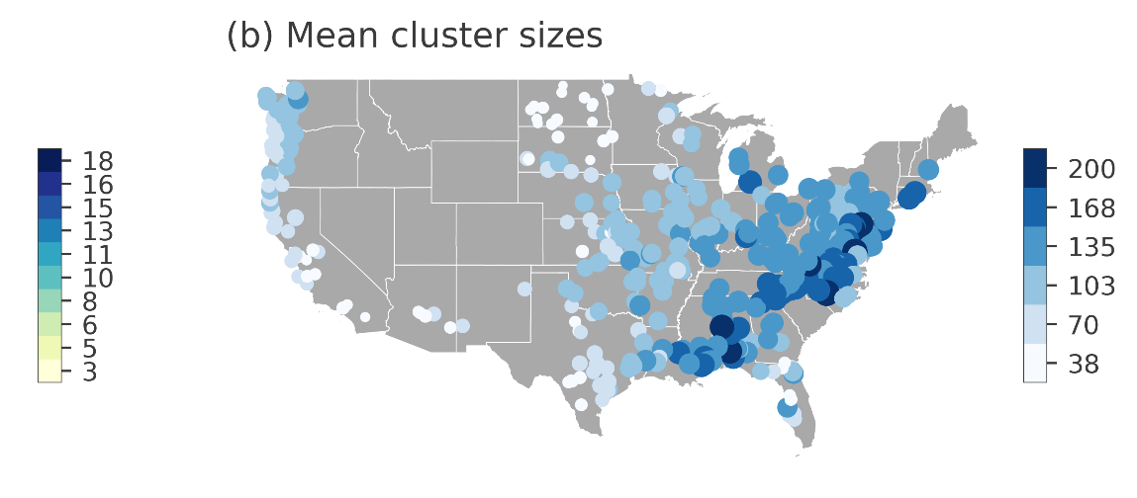
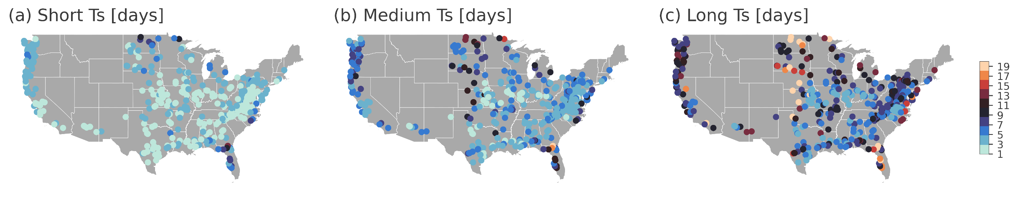
Results – Rainfall-runoff events and clusters of Ts
OSPP
Rainfall-runoff event identification
Fraction of snow ≤ 20 %
n = 388
Approx. 50 % of events (on average) passed the quality checks
Clusters of event runoff shapes (Ts)
Methodology (I)
Menu

Slide 7
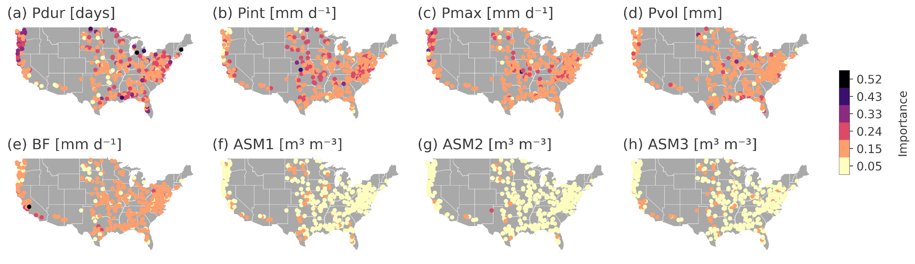
Results – Temporal variability (I)
OSPP
Importance of hydro-meteorological event conditions for the clustering of events into different shapes
Accuracy of the random forest classifier
Menu

Slide 8
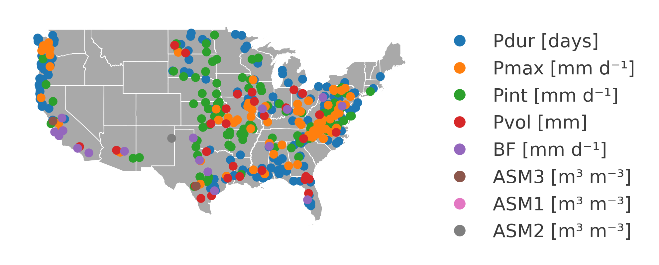
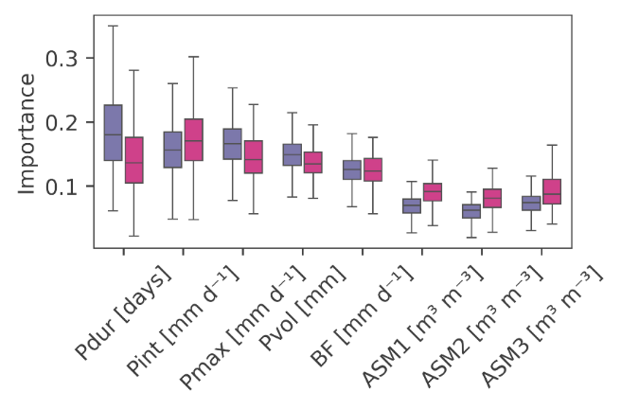
Results – Temporal variability (II)
OSPP
Most decisive hydro-meteorological event conditions for the clustering of events into different Ts
Importance of hydro-meteorological event conditions for “dry” and “wet” catchments
“Wet” catchments: aridity ϕ < 1
“Dry” catchments: aridity ϕ ≥ 1
Menu

Slide 9
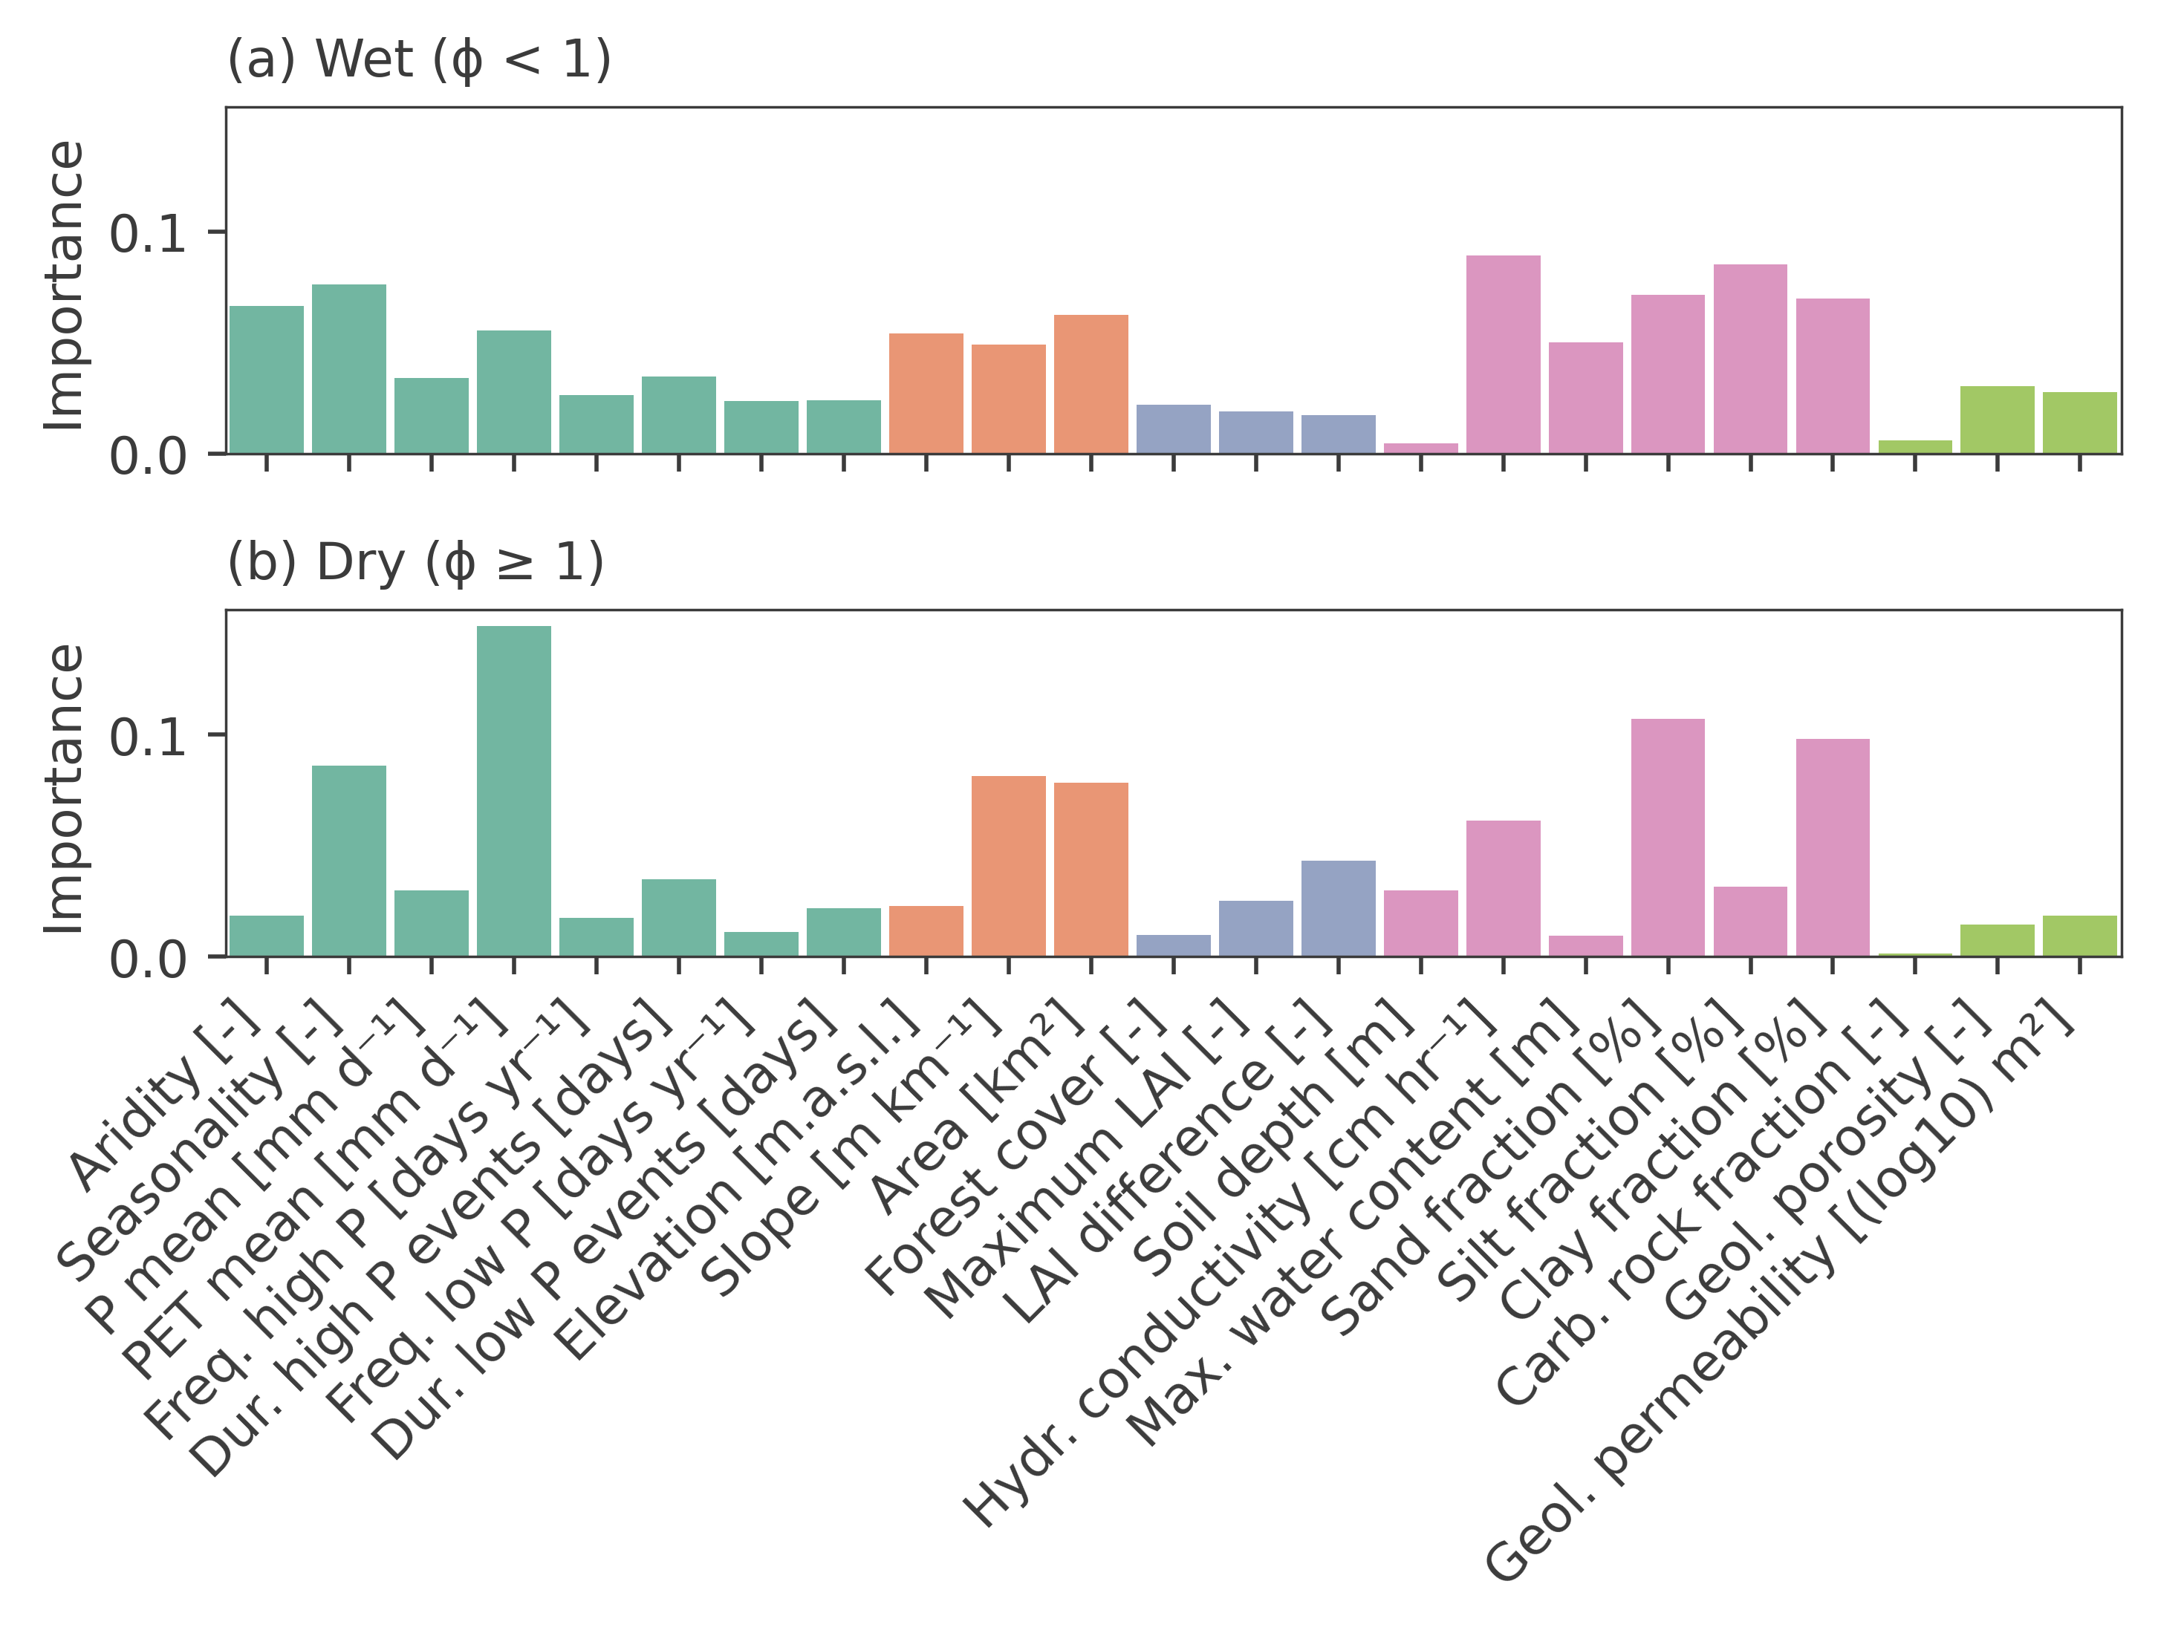
Results – Spatial variability (I)
OSPP
Physical and climate catchment attributes – Feature importance
R² = 0.56
Climate
Topography
Vegetation
Soil
Geology
R² = 0.82
Methodology (II)
Menu

Slide 10
Results – Spatial variability (II)
OSPP
Physical and climate catchment attributes – Spearman rank correlation with Ts
“Wet” catchments: aridity ϕ < 1
“Dry” catchments: aridity ϕ ≥ 1
Attribute | Spearman rank correlation
Clay fraction [%] | -0.42
Hydr. conductivity [cm hr⁻¹] | 0.39
Freq. high P [days yr⁻¹] | -0.38
Sand fraction [%] | 0.35
Freq. low P [days yr⁻¹] | -0.34
Attribute | Spearman rank correlation
Clay fraction [%] | -0.63
Hydr. conductivity [cm hr⁻¹] | 0.48
Seasonality [-] | 0.41
PET mean [mm d⁻¹] | -0.40
Sand fraction [%] | 0.36
Menu

Slide 11
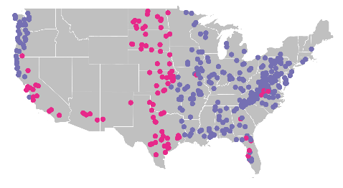
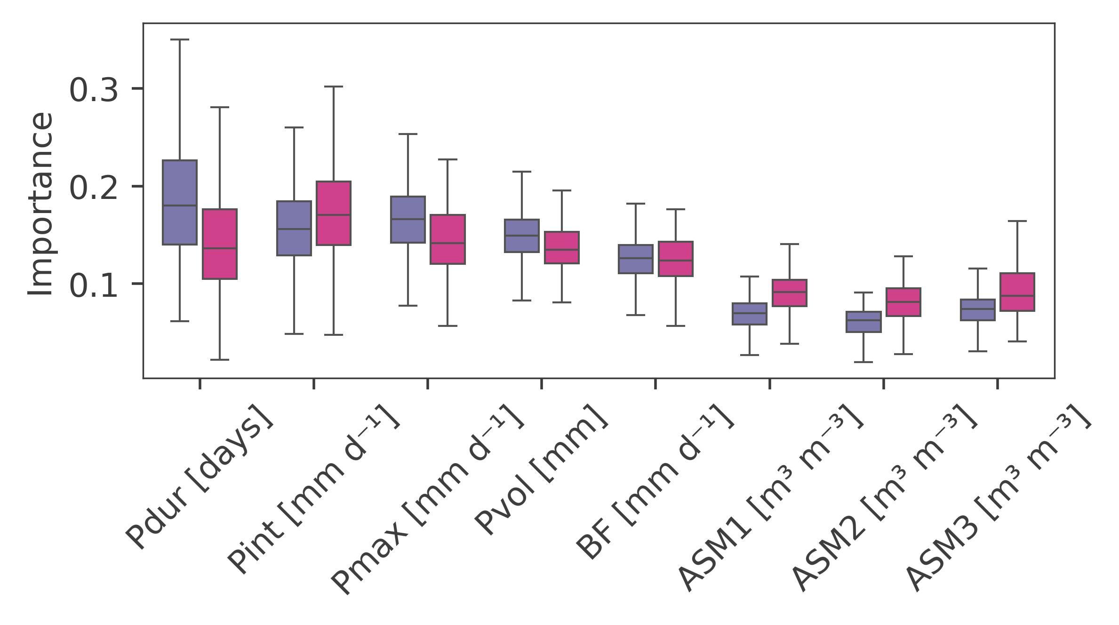
Results – Summary
Temporal variability of Ts
Spatial variability of Ts
OSPP
“Wet” catchments: aridity ϕ < 1
“Dry” catchments: aridity ϕ ≥ 1
On average, most important event conditions are event rainfall duration, maximum rainfall intensity, and mean rainfall intensity
Importance of antecedent soil moisture significantly higher in dry catchments (ϕ ≥ 1) compared to wet catchments (ϕ < 1)
Median catchment-scale Ts is mainly influenced by catchment soil characteristics and climate attributes
Menu

Slide 12
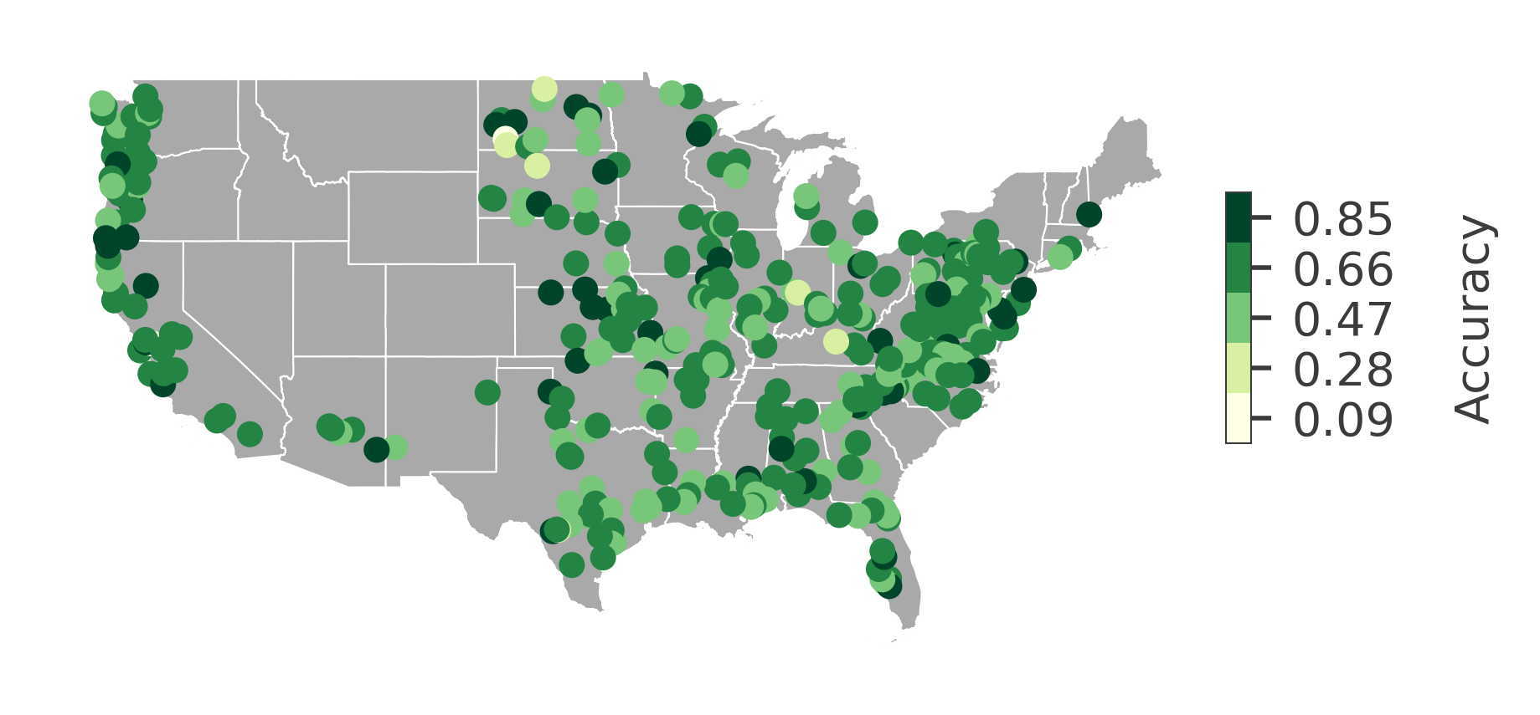
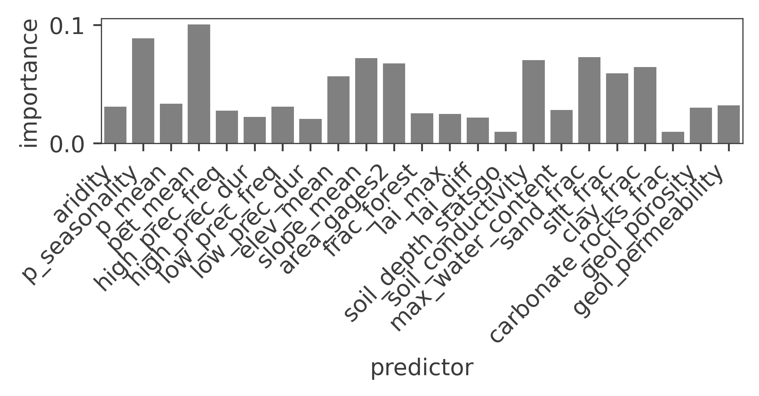
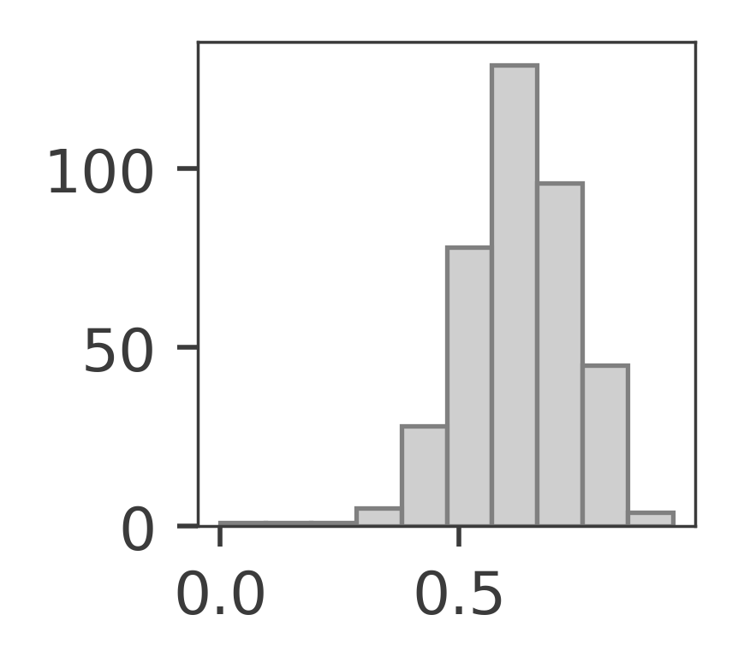
Supporting Information
OSPP
Accuracy of the random forest classifier
Feature importance of physical and climate catchment attributes: all catchments
Ranking
pet_mean
p_seasonality
sand_frac
slope_mean
soil_conductivity
R² = 0.51
Menu

