Slide 1
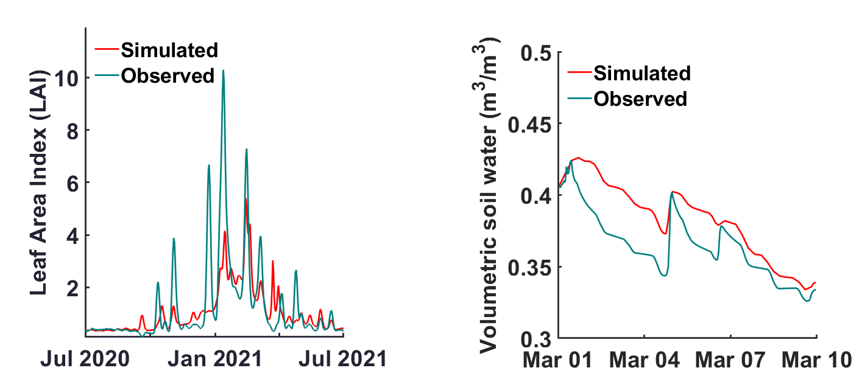
A symbolic regression approach to illuminate the water-energy-food-ecosystem interlinkages in a rainwater harvesting system
Dr. Kyriakos Kandris, k.kandris@imperial.ac.uk
Dr. Nikolas Markatos, n.markatos@imperial.ac.uk
Dr. Elisa Nika , e.nika@imperial.ac.uk
Prof. Evina Katsou, e.katsou@imperial.ac.uk
Background and aim
Nature-based solutions (NBS) are pivotal in tackling interconnected challenges across the water, energy, food, and ecosystem (WEFE) nexus, yet their inherent nonlinearity and high dimensionality often thwart traditional modeling approaches.
Aim
Can symbolic regression (SR) reveal a simple yet accurate dynamic system that captures the complexity of WEFE nexus approaches?
Case study
A sub-surface rainwater harvesting system in a remote agricultural area; collected rainwater irrigates a crop.
Generate synthetic data via process-based models and employ SR to detect the underlying functions only from the synthetic time-series data.
Synthetic data generation
4 sub-models, 14 variables, 34 parameters
One-year long dataset
“Injected” random noise (Gaussian, 10%) and missing data points
Concluding remarks
Major findings
Parsimony: Low-complexity equations captured key dynamics of soil, water, and crop yield.
Robustness: The dynamic system remained valid under diverse external forcings.
Impact of Noise: Elevated noise levels challenged our ability to accurately discern the underlying system dynamics.
Considerations for future work
Incorporate site-specific measurements to further validate symbolic expressions
Explore filtering techniques to improve model resilience to high noise levels
Mechanisms of the integrated modeling approach used to create the synthetic dataset
Symbolic Regression Approach
Approximate derivatives using splines
Explore analytic expressions to identify a dynamic system solely from data via evolutionary search
Test the system under diverse hydrometeorological, irrigation and fertilization scenarios.
Simulated versus observed data for (a) the Leaf Area Index, and (b) the soil water content under long- and short-term scenario testing

