Slide 1




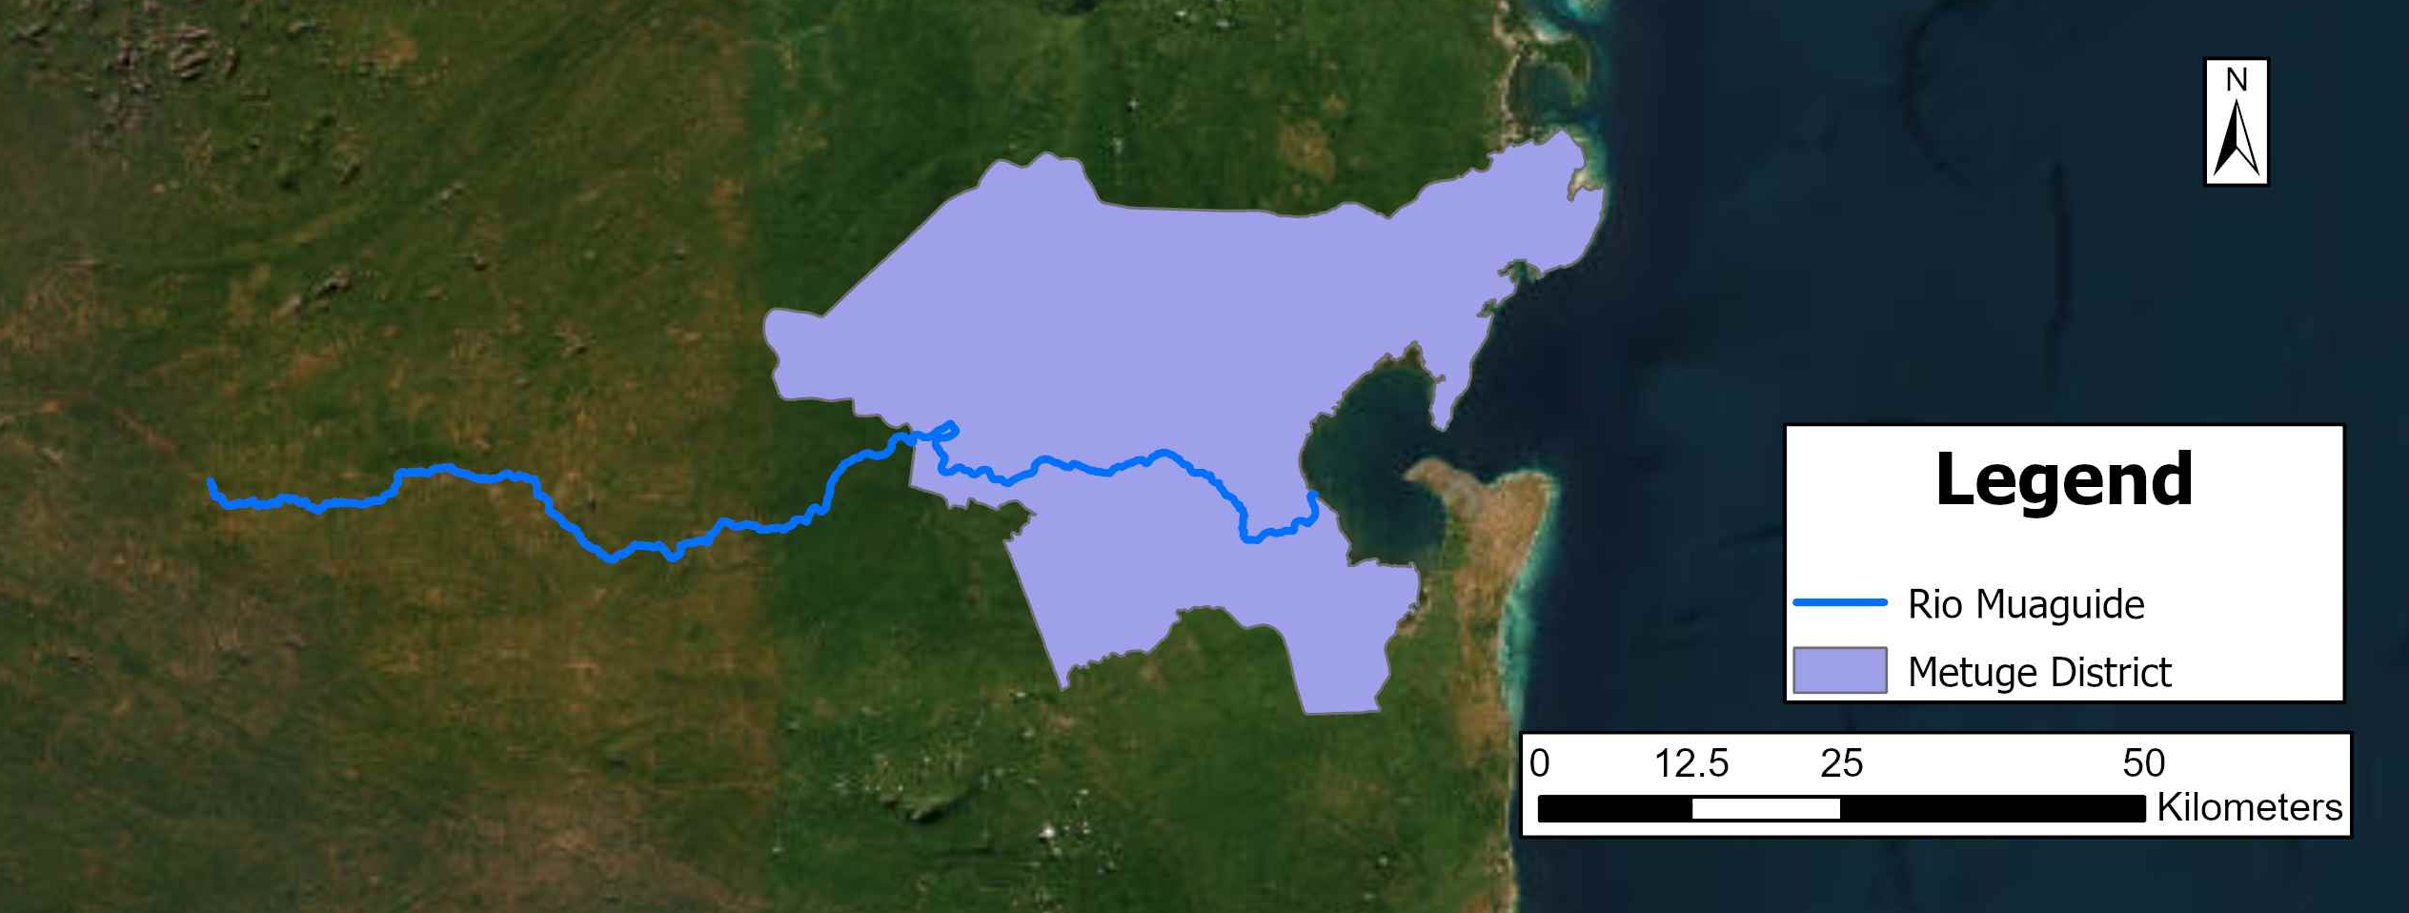
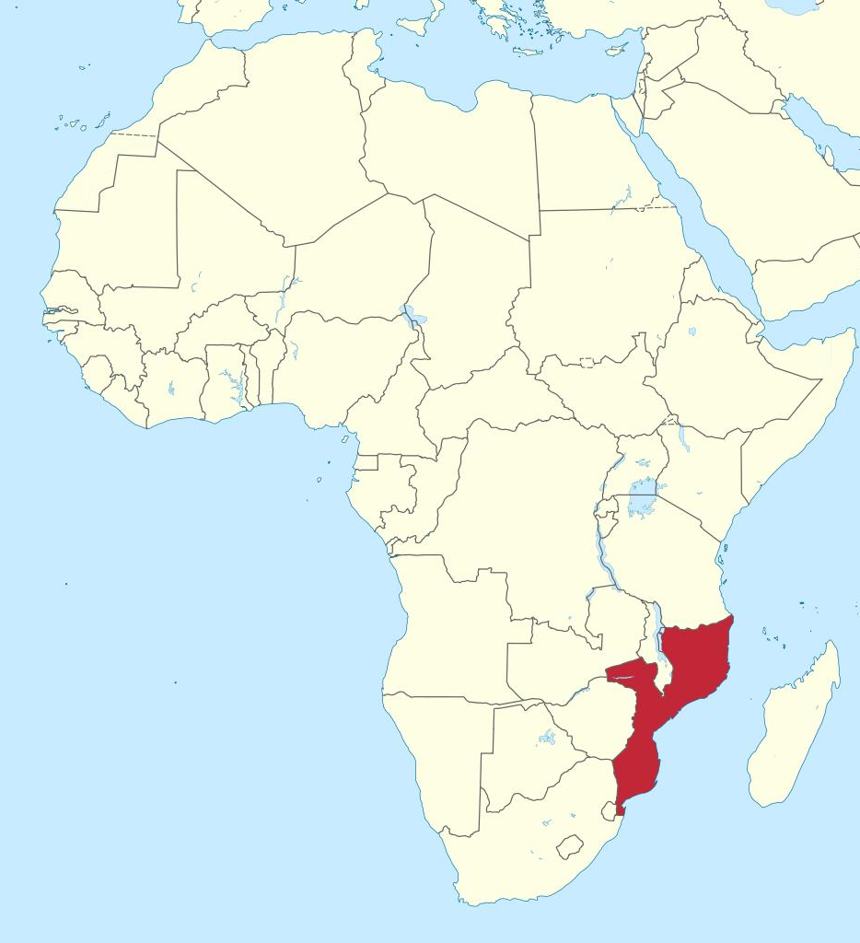
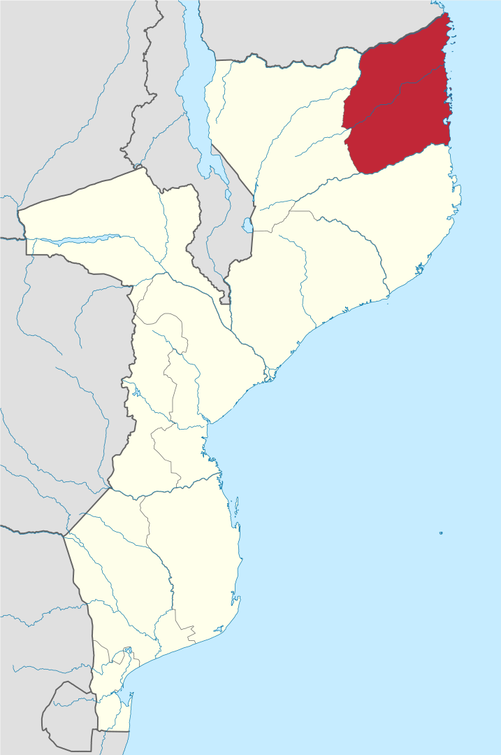

Integrating modelling and community engagement for flood risk management in data scarce contexts: insights from Metuge district in northern Mozambique.
Integrating modelling and community engagement for flood risk management in data scarce contexts: insights from Metuge district in northern Mozambique.
Daniela Molinari, Sara Rrokaj, Charlie Dayane Paz Idarraga, Ana Maria Rotaru, Zeynep Ergün, Abdul Anza, Margherita Porzio, Alice Costa, Alessio Radice
Vienna | Austria | 27April 20235– 2 May 2025

Slide 2
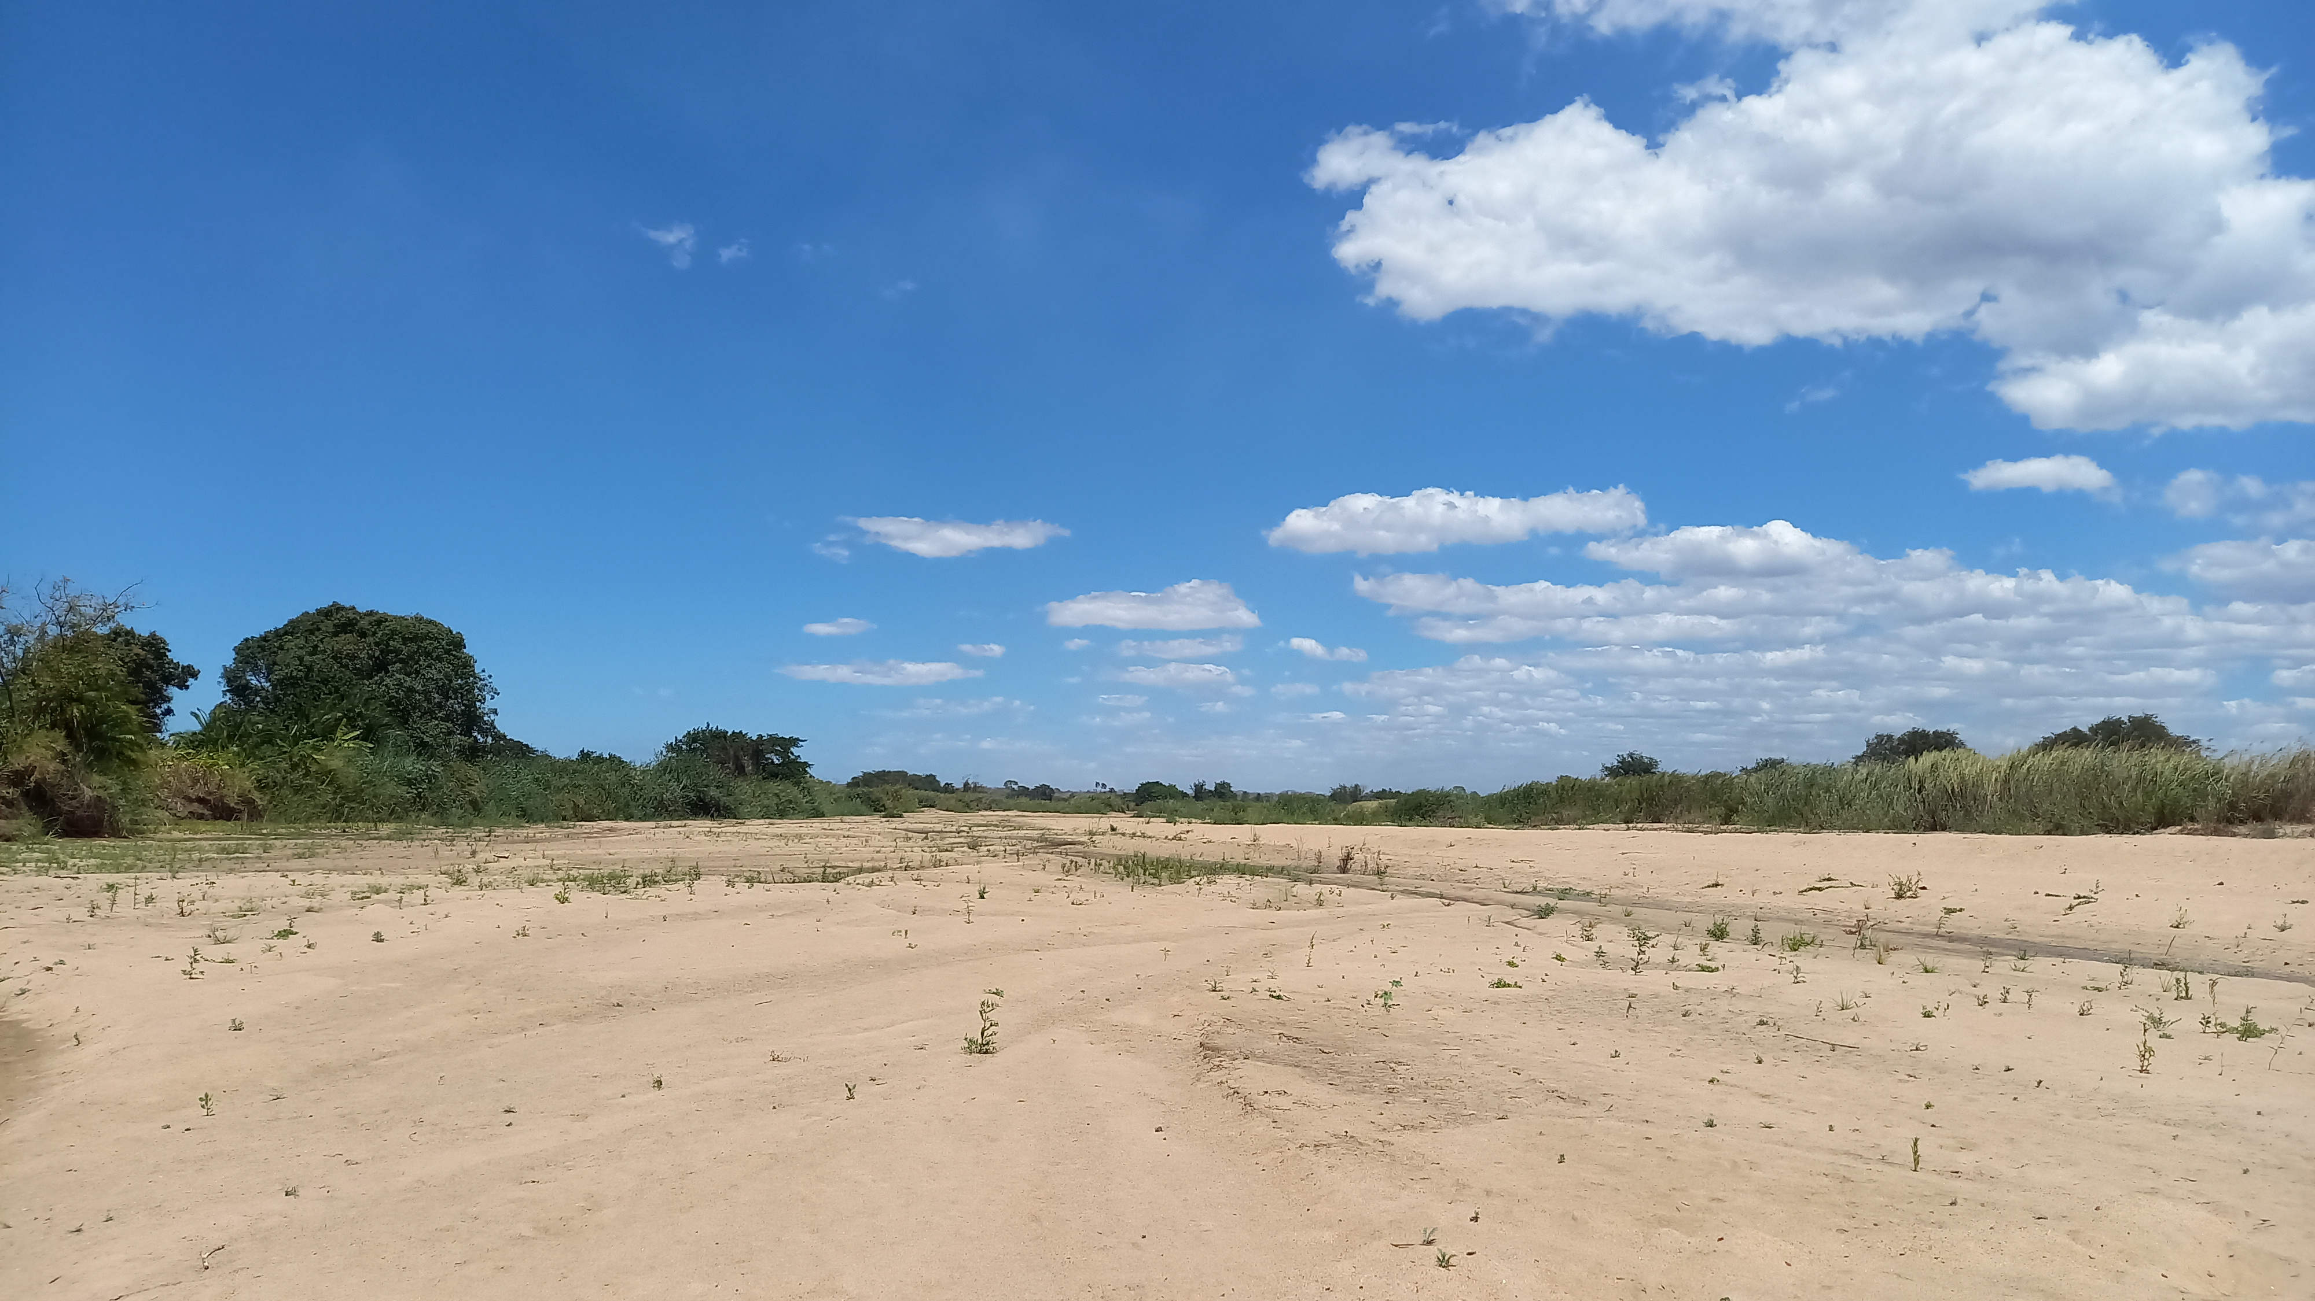
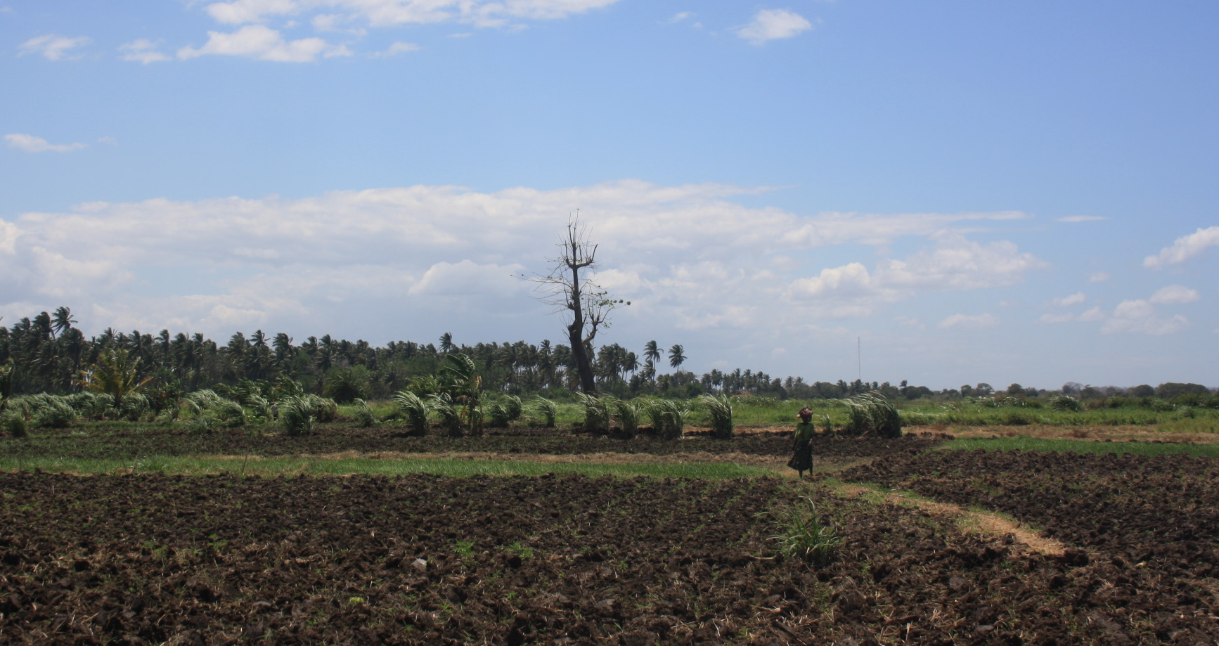
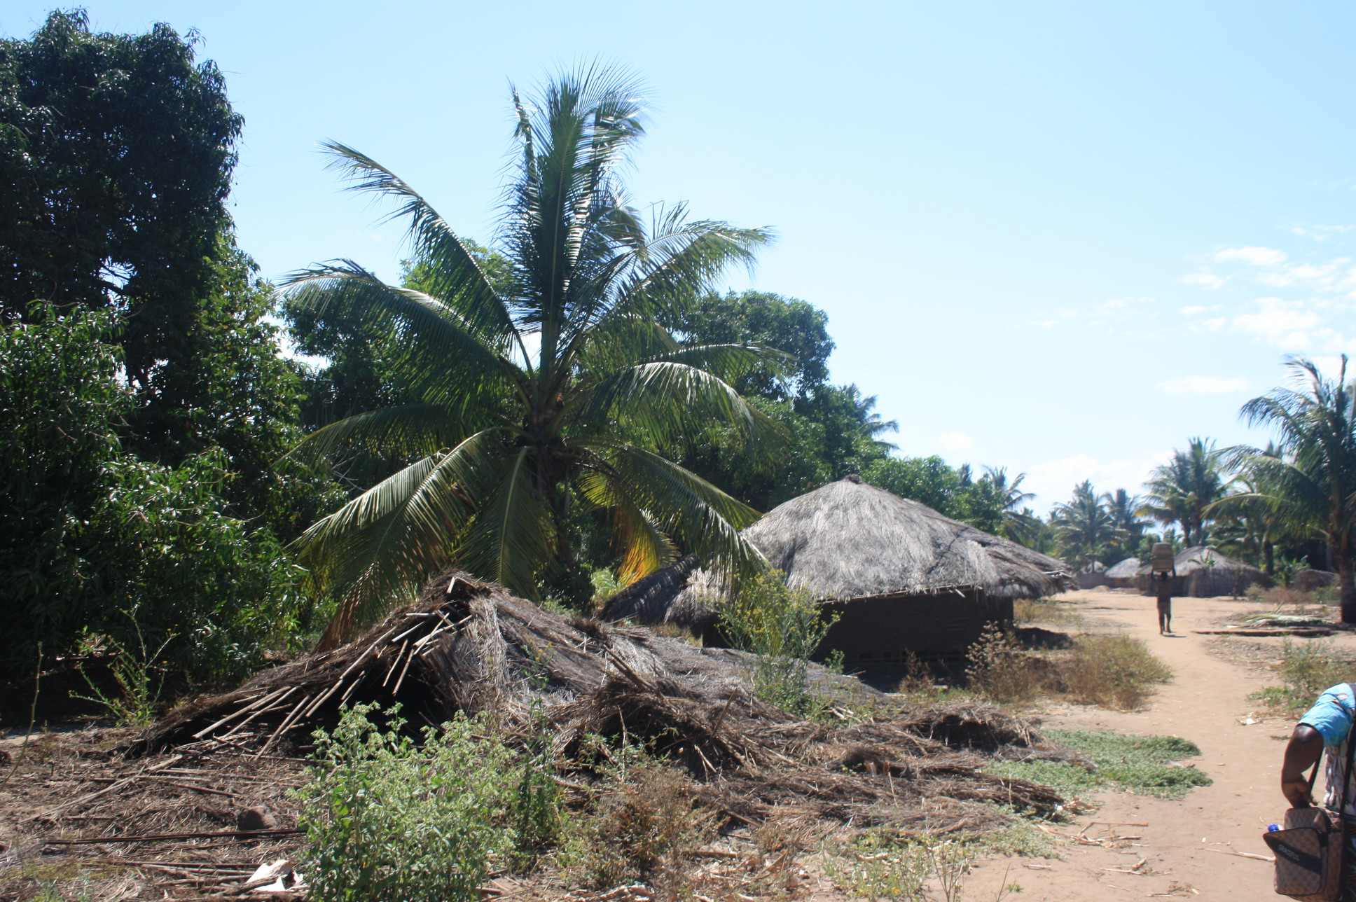
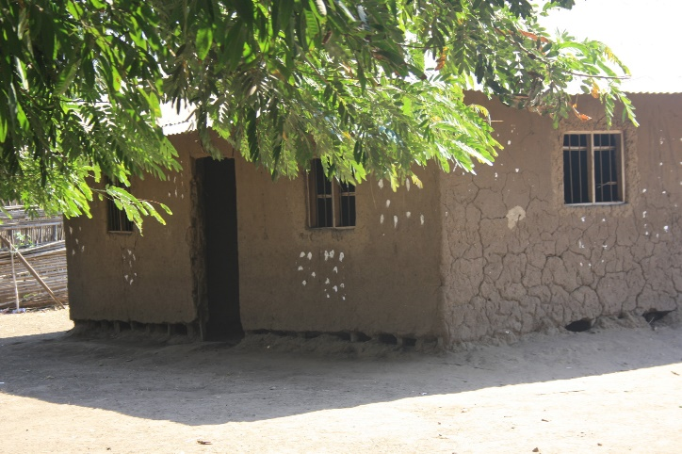
Study area
Agricultural area
Riverbed buried by sediment
Periodic floods
Damage to surrounding communities

Slide 3



Objective and methodology
Objective
Quantitative flood risk assessment to support mitigation measure
Challenge
Data scarsity, typical in low-income countries
Framework
Global data
Field survey
Participatory process
Challenge
Solution
Modelling phases
Global data
overcome
to perform
Hazard
Data
Scarsity
Field Survey
Damage
Risk
Participatory
process
Validation
feedback

Slide 4
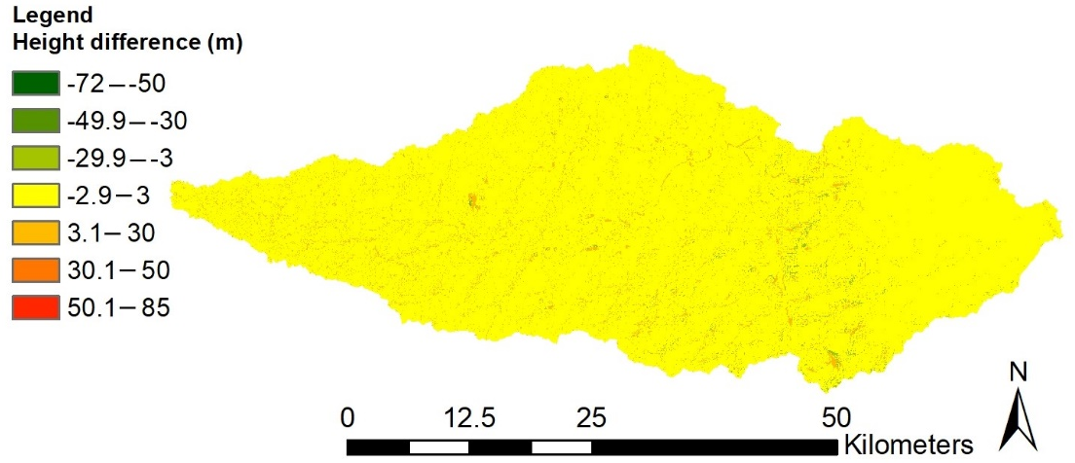
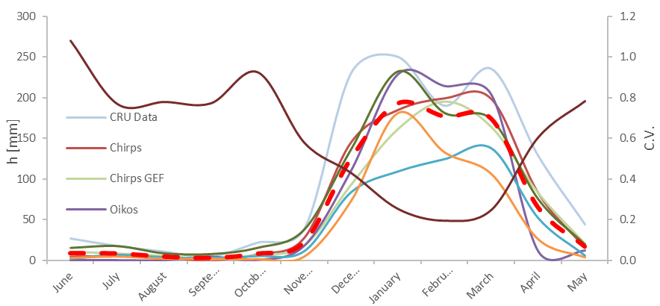
Global data
Differences between ALOS PALSAR and SRTM
Study area
DEM | Cell size [m]
SRTM 90 | 90
SRTM 30 | 30
ASTER | 30
ALOS PALSAR | 12.5
DEM
Rainfall
Land cover
River basin
Sources | Data availability
TuTiempo | From 1980
Chirps | From 1981
Chirps GEFS | From 1981
CRU data | From 1901
Meteonorm | 1961-2009
Meteoblue | From 1985
Oikos | 2014-2019
Comparison of average monthly rainfall depth
Sources
Fao
Copernicus
JRC
All the sources have been used to compute an average CN value
Dry season
Rainy season

Slide 5
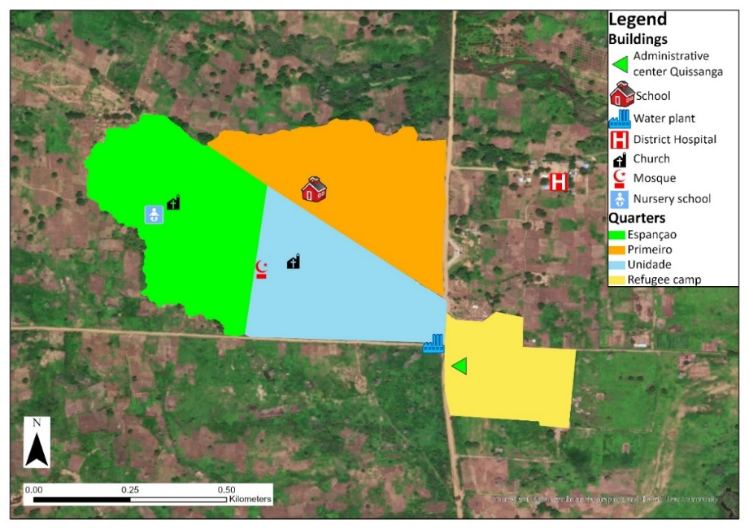
Field survey
Population
Strategic buildings
Residential buildings
Roads
Example of Namuapala village
Village
Guide of local chiefs
Perimeter of quarters ;
Cell phone application (GaiaGPS)
WHEN?
HOW
August-October 2021

Slide 6
Field survey
Population
Strategic buildings
Residential buildings
Roads
Example of Namuapala village
Quarter | N. Men | N. Women | N. Children
Unidade | 120 | 158 | 487
Primeiro | 162 | 147 | 329
Espançao | 165 | 222 | 578

Slide 7
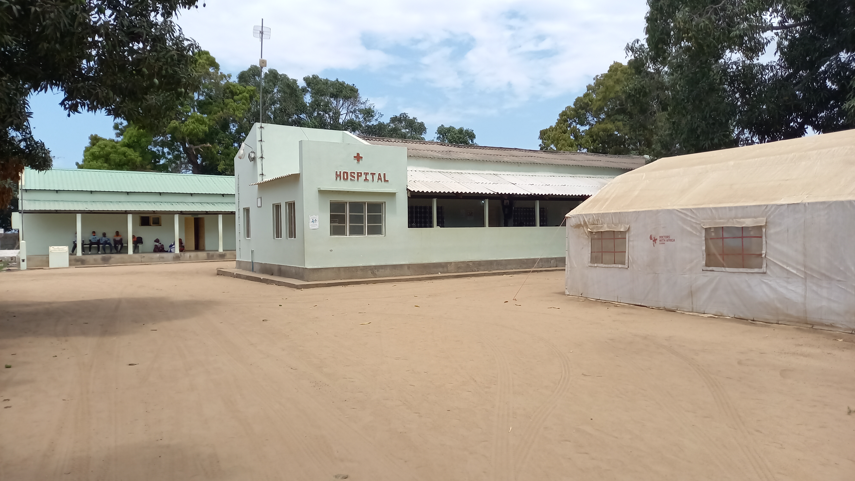
Field survey
Population
Strategic buildings
Residential buildings
Roads
Example of Namuapala village
Type of services
N. people/day
Target market
District hospital

Slide 8
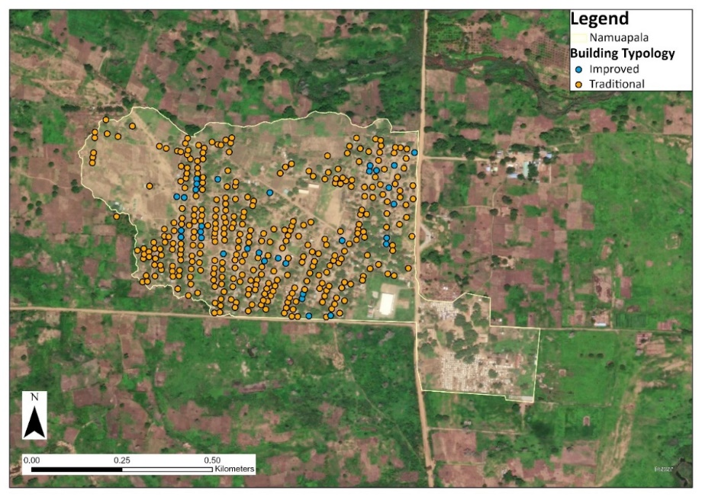
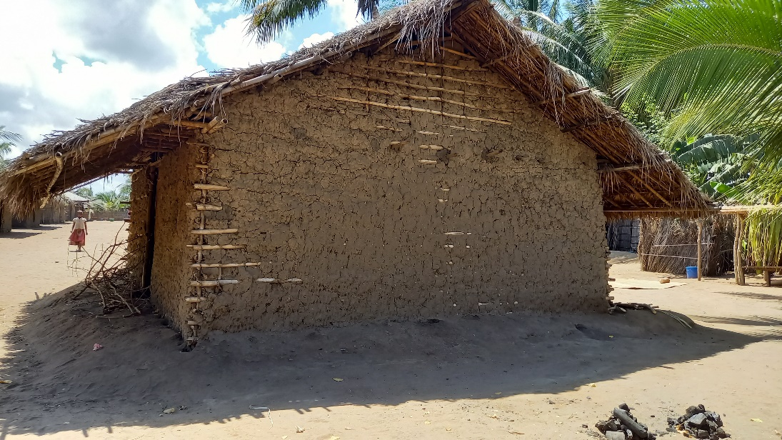
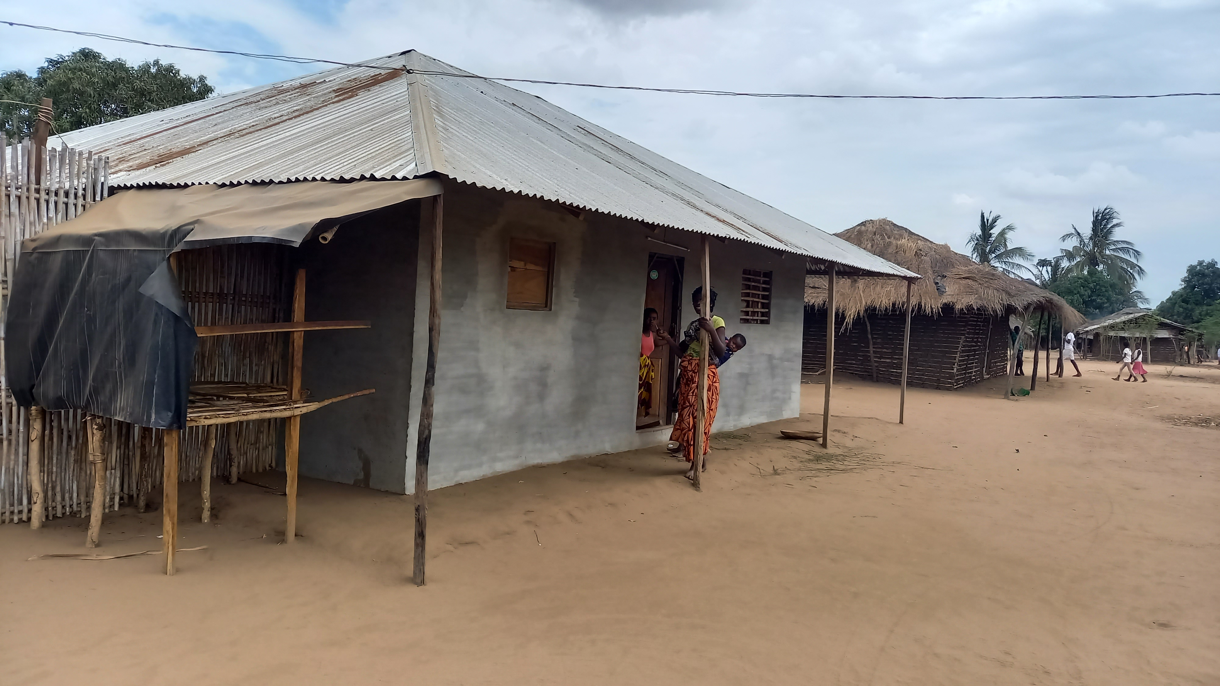
Field survey
Population
Strategic buildings
Residential buildings
Roads
Example of Namuapala village
Traditional house
Improved house

Slide 9
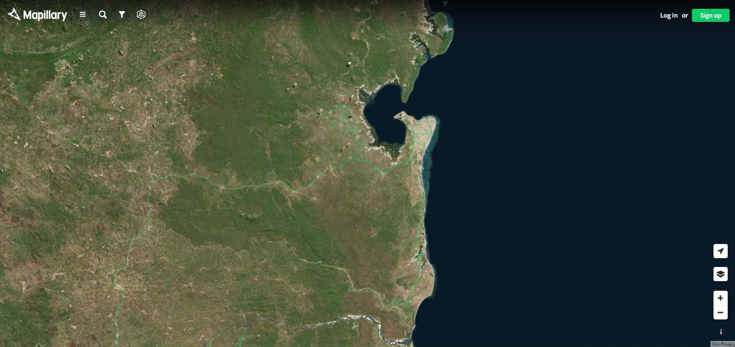
Field survey
Strategic buildings
Population
Residential buildings
Roads
Route recorded by telephone application
Travel time by car
Photographic documentation (Mapillary)

Slide 10

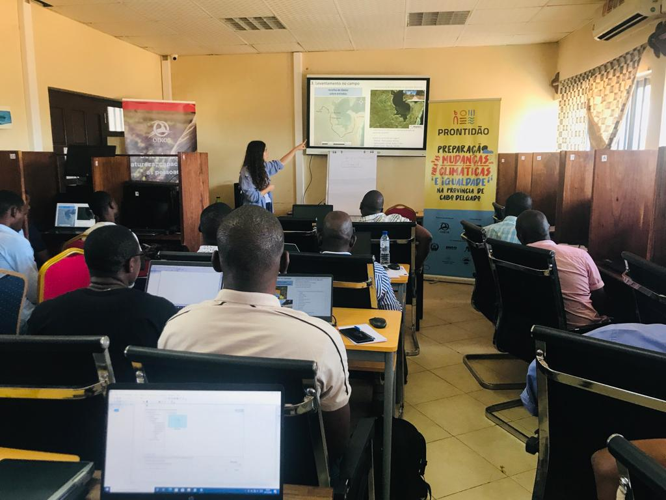
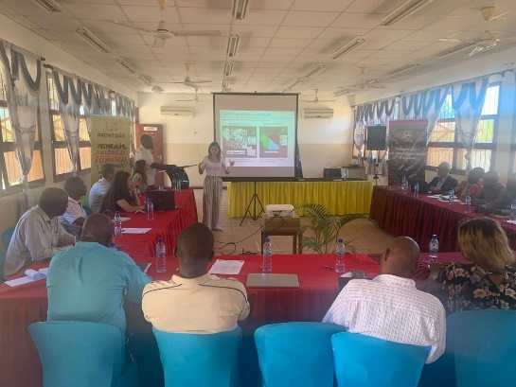
Participatory approach
EVENT OBJECTIVE DURATION PARTICIPANTS
Trainings
Round table (presentation of the results)
Co-mapping
Knowledge transfer
Validation
Validation and resilience enhancement
10 Days
2 days
2 days
Technicians of district and provincial institutions
Representatives
of district and provincial institutions
Volunteers of civil protection of Namuapala

Slide 11
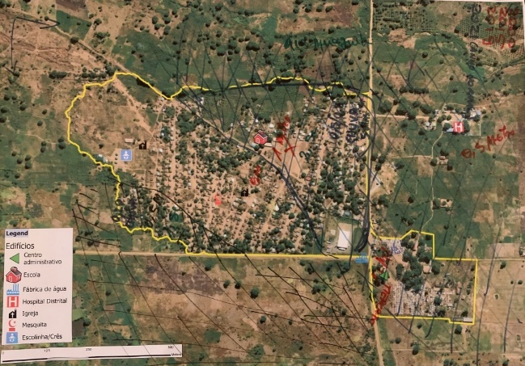
Co-mapping with volunteers of local civil protection of Namuapala
Volunteers drew frequently flooded areas on a printed map of the village
Reference to 2 events
    Kenneth cyclon (2019)
    2021 rainfall event
Definition of 6 zones according to hazard features
Zones | CLGRD: 2019 event |  | CLGRD: 2021 event
 | Max. Depth | Water permanence time | Max. Depth | Water permanence time
Old zone | 1.00 m | 2 weeks | 0.50/0.80 m | 5 days
Safe inhabited zone | 0.10 m | - | - | -
Safe expansion zone | - | - | - | -
Southern zone | 0.50 m | 1 week | 0.20 m | -
Hospital zone | 0.50 m | - | - | -
IDP Camp | 1.00 m | - | - | -
Modelled scenarios:
10 years return period
2 years return period

Slide 12
Co-mapping with volunteers of local civil protection of Namuapala
Volunteers drew frequently flooded areas on a printed map of the village
Reference to 2 events
    Kenneth cyclone (2019)
    2021 rainfall events
Definition of 6 zones according to hazard features
Confirmation of model findings:
School (p2) placed in hazardous area
Main roads inaccessible for a 10-years return period flood
Isolation of the hospital (p3)
Modelled scenarios:
10 years return period
2 years return period

Slide 13
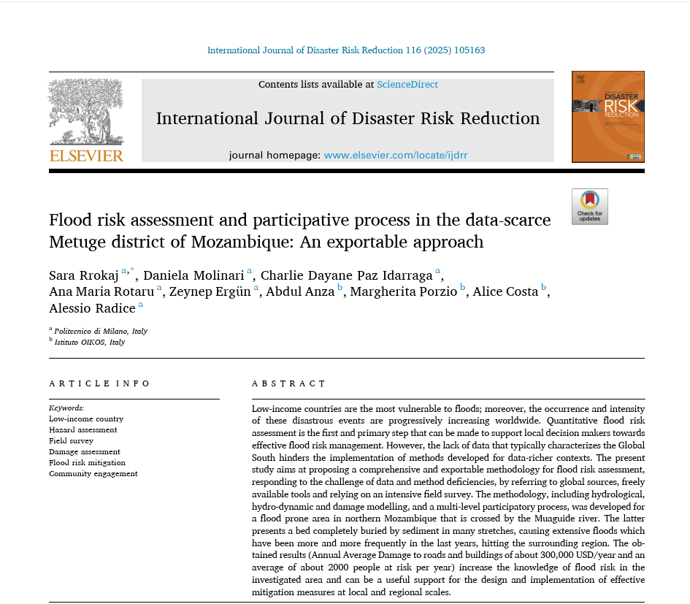
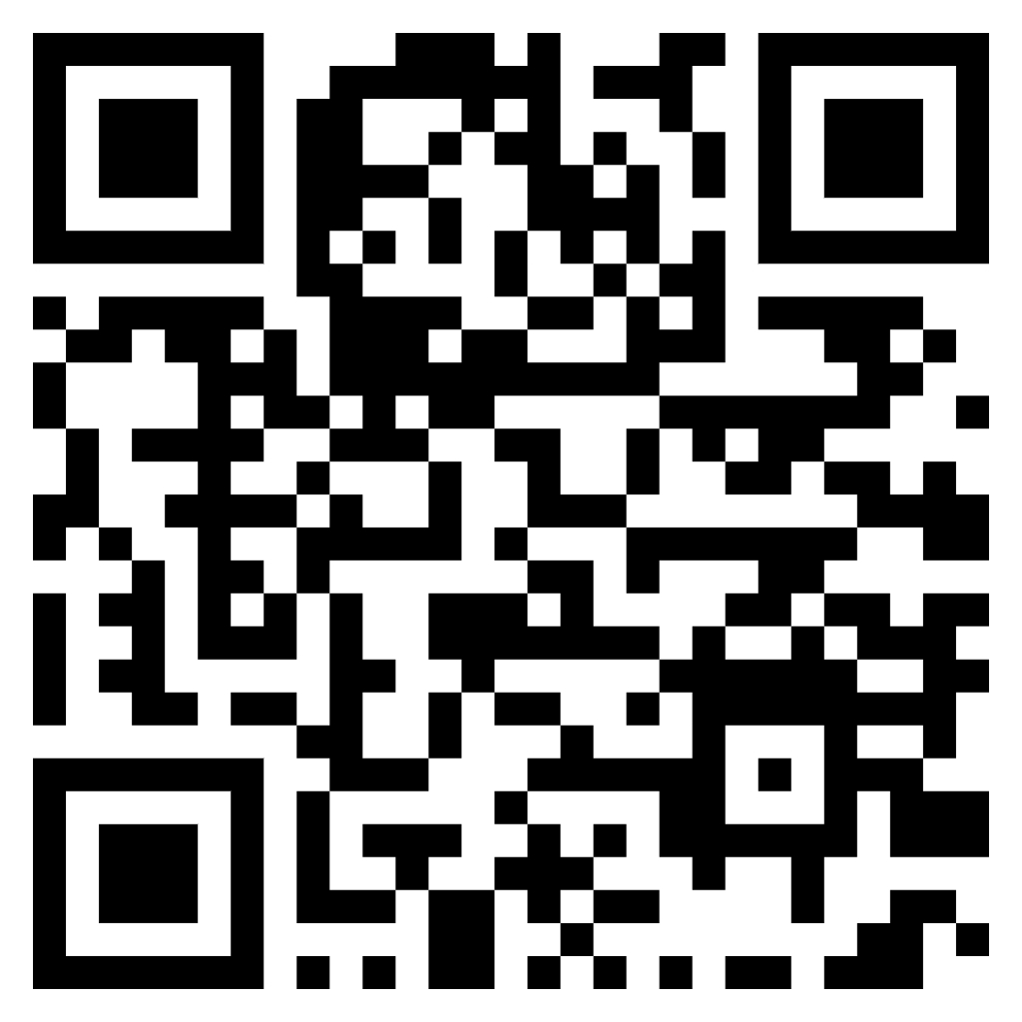
Conclusion
Framework for fully quantitative risk assessment
In low income countries the data are scarce
Global data can partially bridge this scarcity
A field survey is essential to perform a damage assessment
A multi-level participatory process is crucial to improve modelling assumptions and validate results
Flood risk assessment and participative process in the data-scarce Metuge district of Mozambique: An exportable approach,
International Journal of Disaster Risk Reduction,
https://doi.org/10.1016/j.ijdrr.2024.105163.

Slide 14
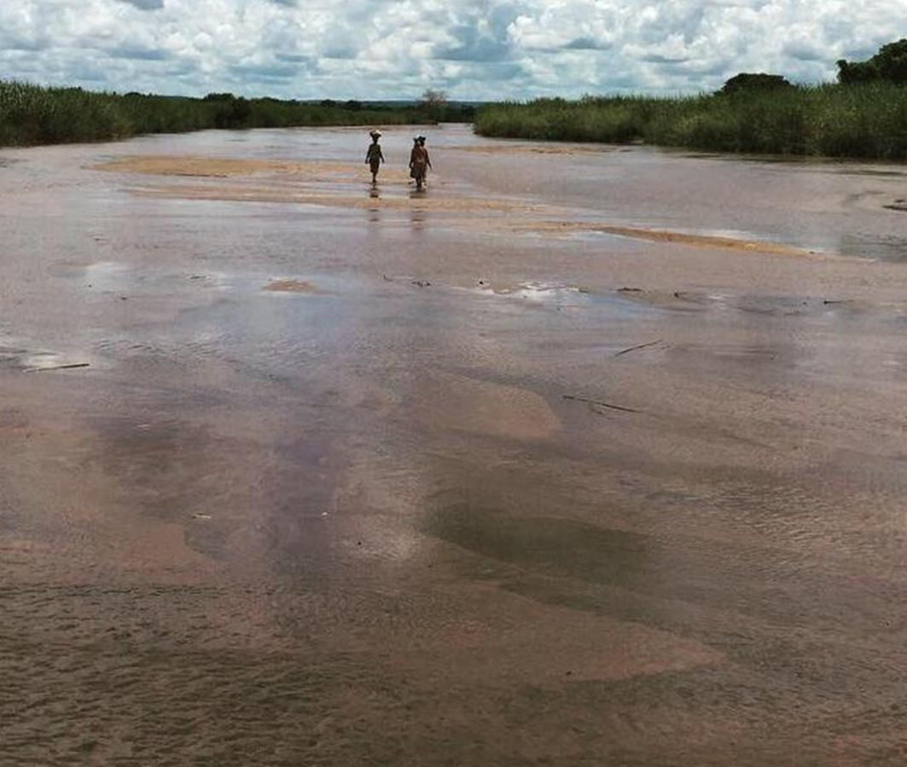
Thank you for the attention!
Flood risk assessment and participative process in the data-scarce Metuge district of Mozambique: An exportable approach,
International Journal of Disaster Risk Reduction,
https://doi.org/10.1016/j.ijdrr.2024.105163.

Slide 15
