Slide 1
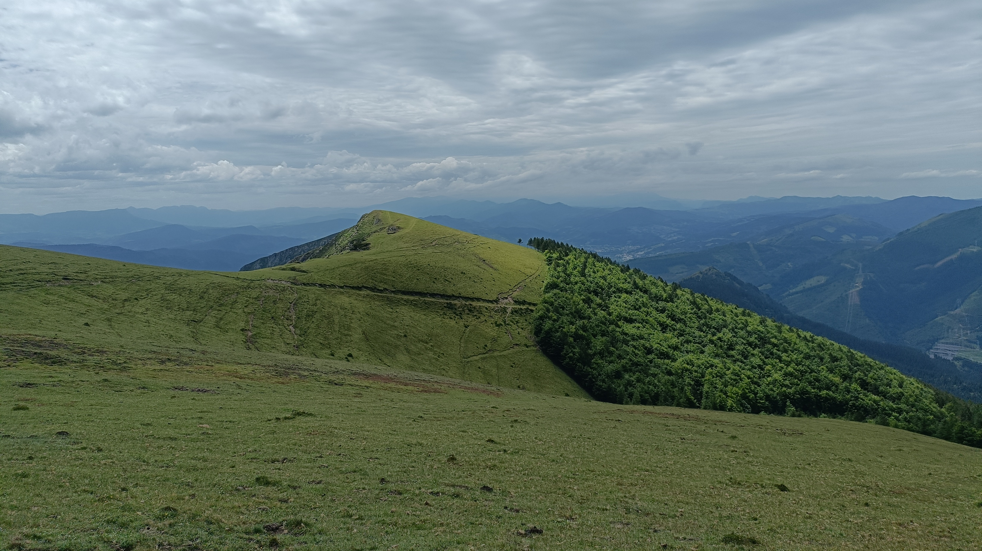


Assessing the condition of forest soils in the Basque Country (Spain) with site-specific thresholds for soil health indicators
Mercedes Román Dobarco (NEIKER, BC3), Sophie Cornu (INRAE, CEREGE), Alex B. McBratney (the University of Sydney), and Jorge Curiel Yuste (BC3)
EGU25 SSS8.1, Vienna 29 April 2025

Slide 2
Context
EU Soil strategy 2030: all soil ecosystems in healthy condition by 2050
Soil Monitoring Directive – Soil health indicators’ criteria:
  some have (SOC:clay), some don’t (pH)
Different approaches for setting thresholds (Matson et al. 2024)

Slide 3
Objectives
Delineation of soil monitoring units in the Basque Country
to assess the condition of managed forest soils (plantations)
  with the thresholds in the EU Soil Monitoring Directive
  using native forests as reference of good condition with unit-specific thresholds
to map soil condition and its uncertainty

Slide 4
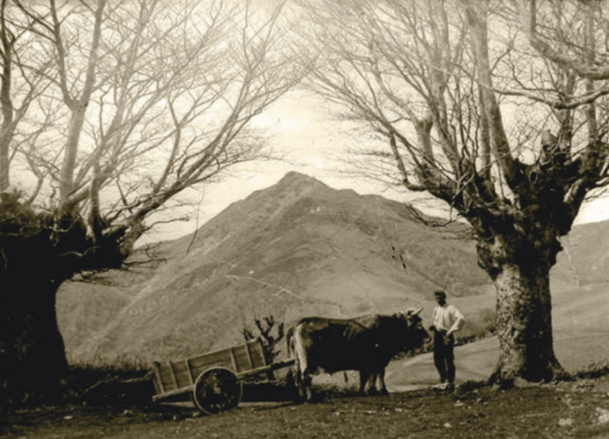
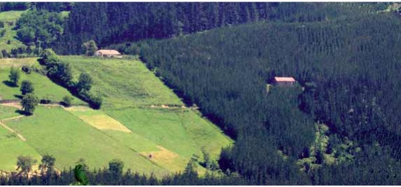
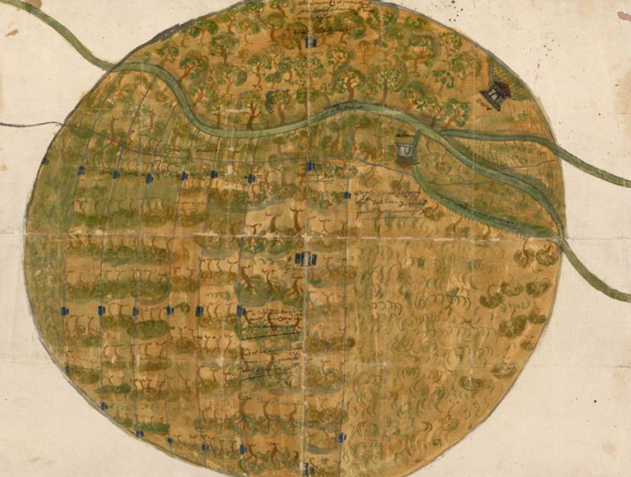
The ecosystems and soils of the Basque Country have been subject to intensive transformations for centuries…
Forest clearing and terracing
Agro-silvo-pastoral systems around family farmsteads
Introduction of Pinus radiata
Photo credit: Gipuzkoako Foru Aldundía-Diputación Foral de Gipuzkoa, 2014
Photo credit: Felipe Manterola
Middle Ages
Modern period
Late XIX c.
Mid XX c.
Oak, chestnut, and beech forests managed with coppicing and pollarding
Mountain pastures → commercial plantations of P. radiata
Bizkaiko Foru Aldundia-Diputación Foral de Bizkaia, 2018
Photo credit: Felipe Manterola
Michel Rodríguez (2003); Narbarte-Hernandez et al. (2021); Narbarte-Hernández et al. (2019); Ruano (2013)
Notes:
Beech with pollarding – shape like a chandelier results from cutting branches, that are used for charcoal, and the understory for feeding the livestock
Oak copicce for firewood and pastures for grazing

Slide 5
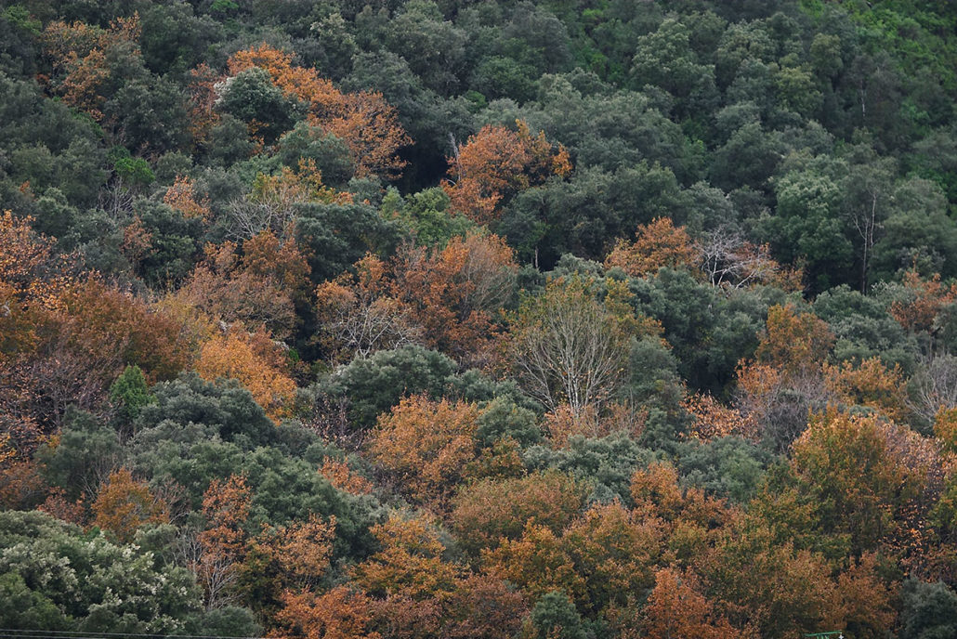
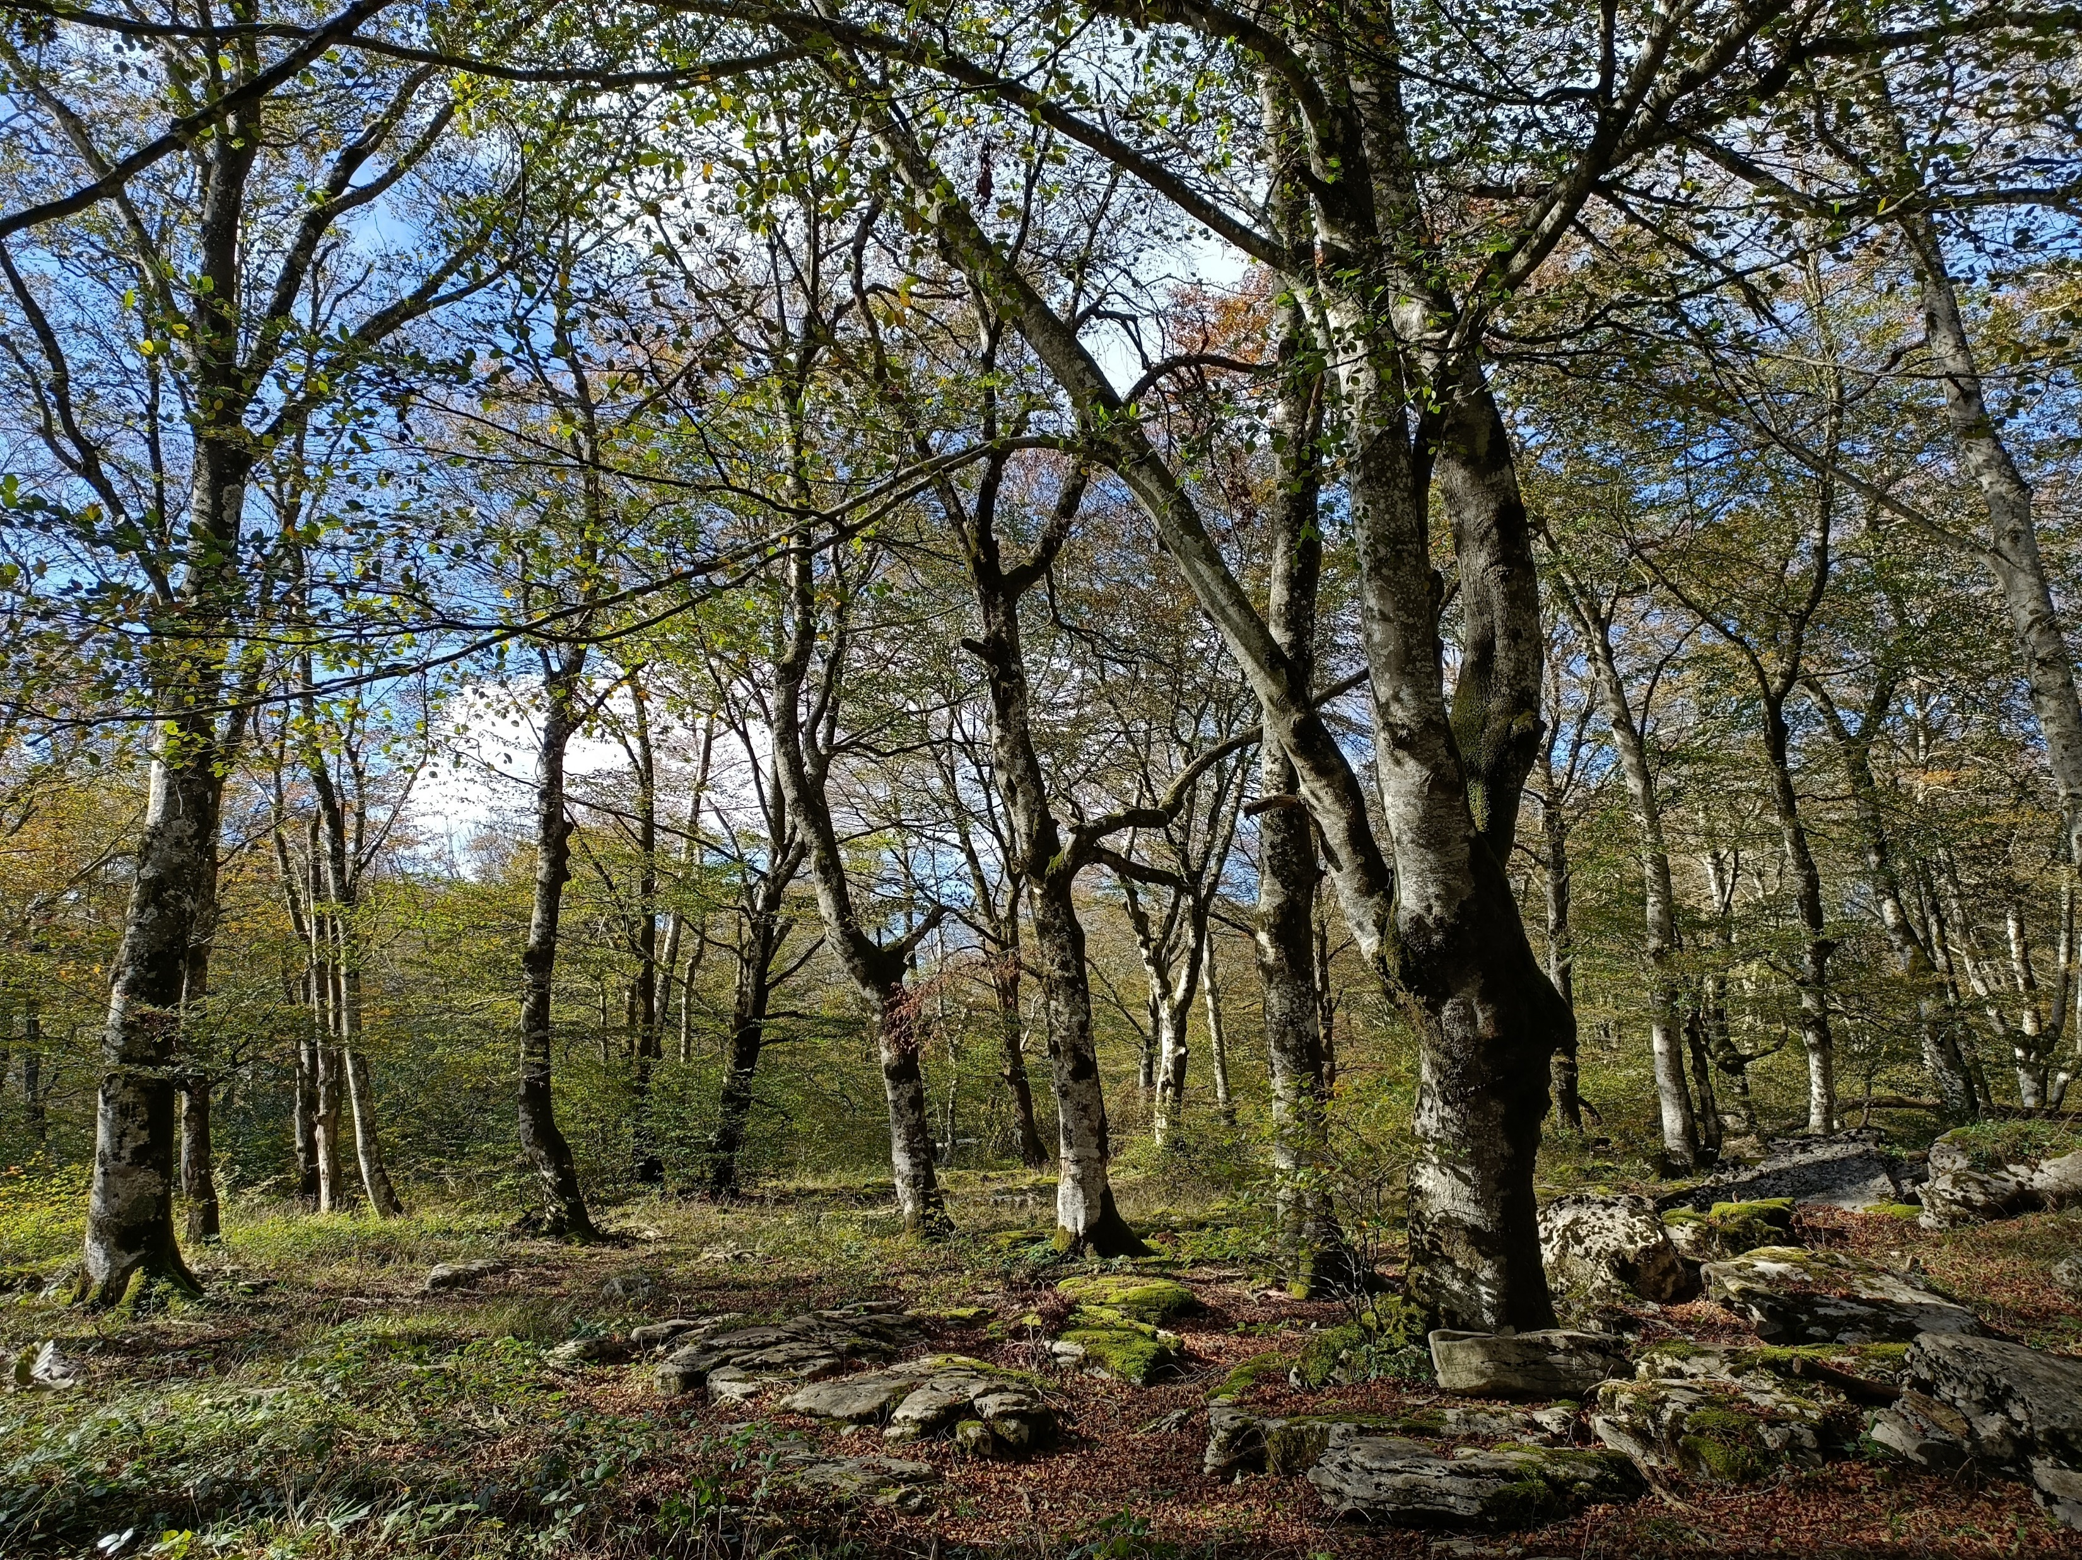
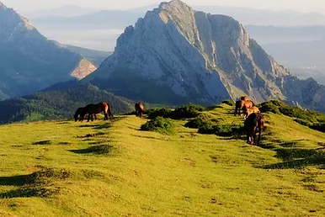
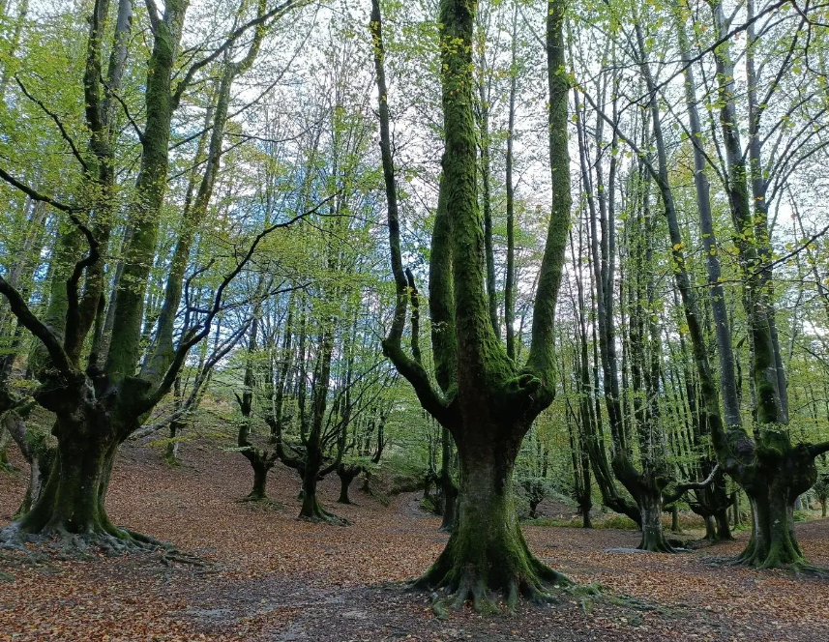
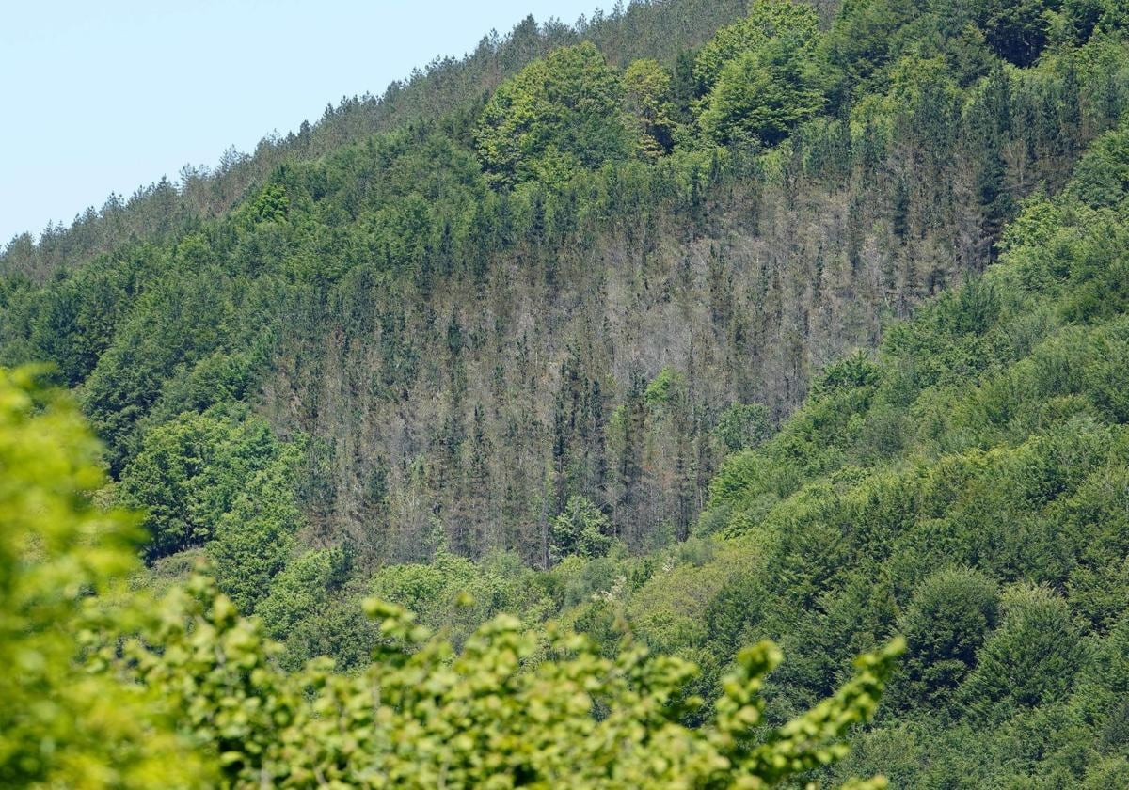
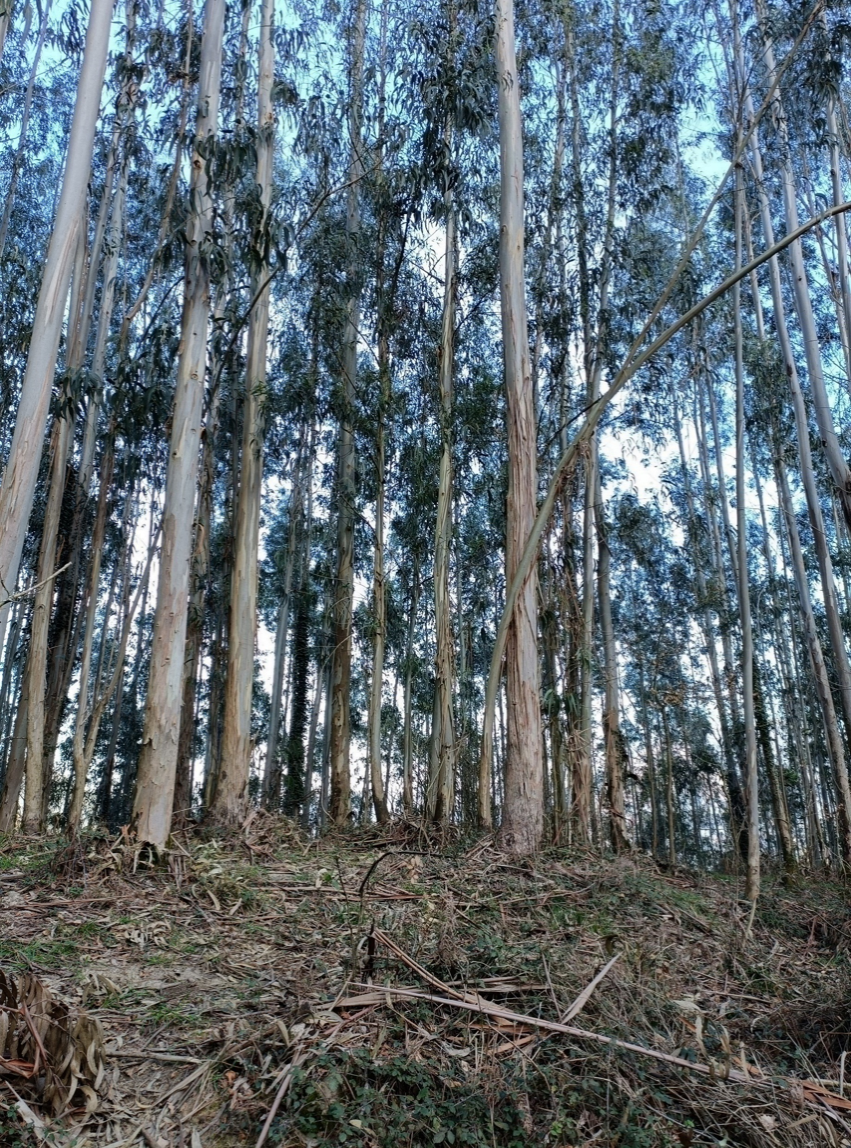
… making it difficult to identify reference soils
Reference soils
(genosoils or phenosoils)
Semi-natural forests
Assessed soils (phenosoils)
Commercial plantations
condition ↑
condition ↓
Soil condition
Anthropogenic pressure / soil management
Time
Pictures from: Mercedes Román, www.urdaibai.eus, www.gorbeiaeuskadi.com

Slide 6
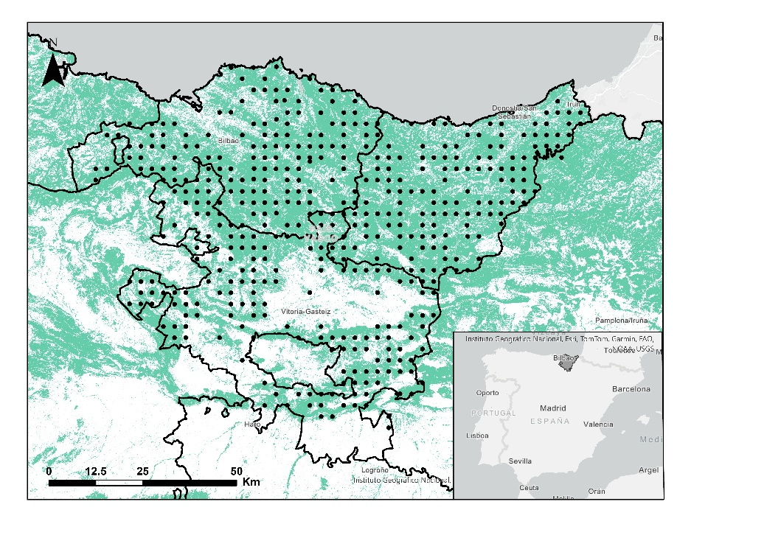
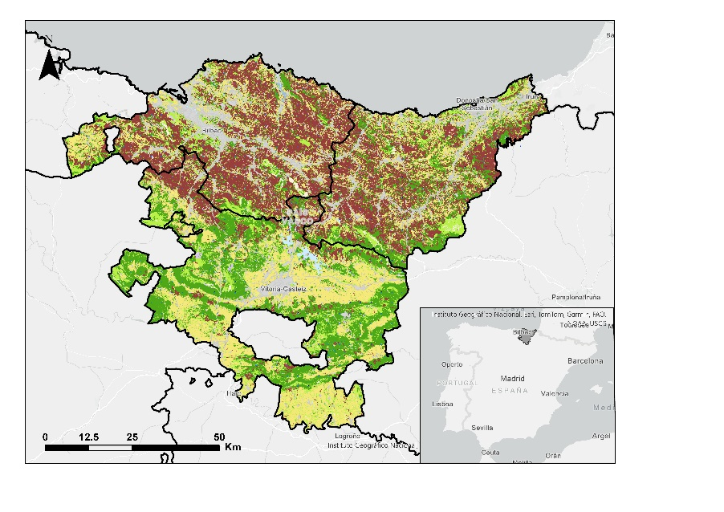
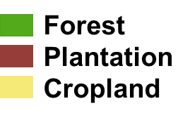
BASONET
Basque Country’s forest monitoring network
430 plots of 25 m diameter in a 3 km grid
Sampled in 2021
0-20 cm and 20-40 cm
Soil and stand data
Notes:
The land cover is mostly forest, occupying 68% of the territory, of which 41% are commercial plantations of conifers (mainly radiata pine, Pinus radiata D. Don) and Eucalyptus spp. Radiata pine covers more than 98,718 ha and eucalyptus 26,152 ha (Eusko Jaurlaritza / Gobierno Vasco, 2022). Croplands occupy 25% of the area, mainly in the Álava Plains and the Rioja alavesa.

Slide 7
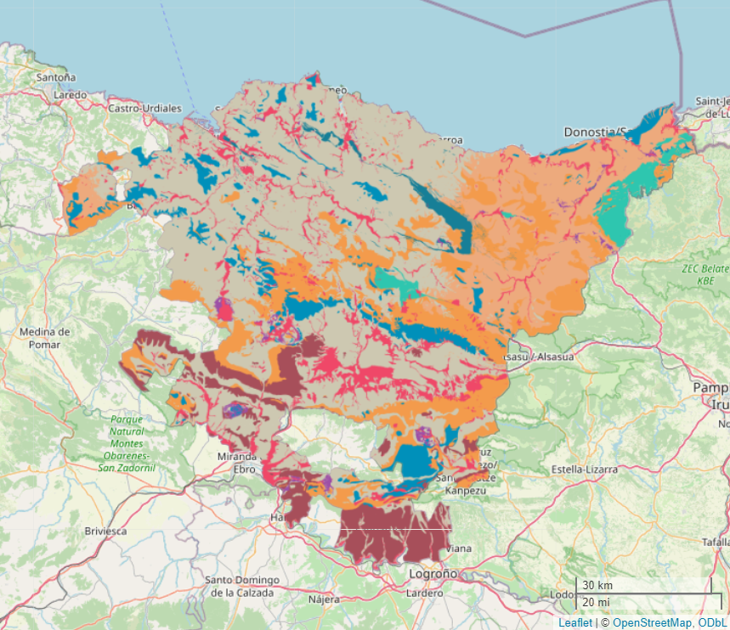
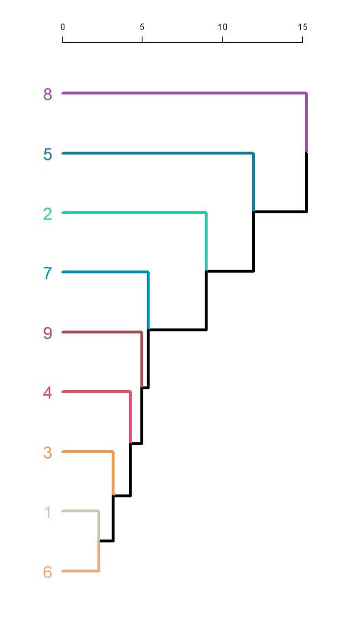
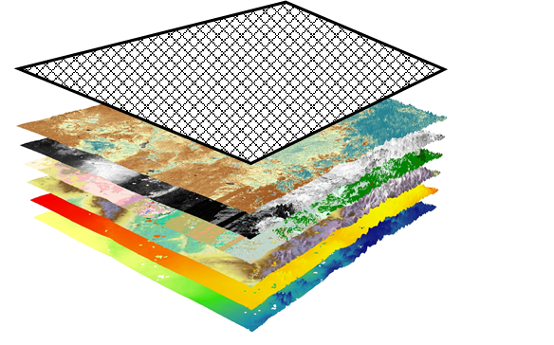
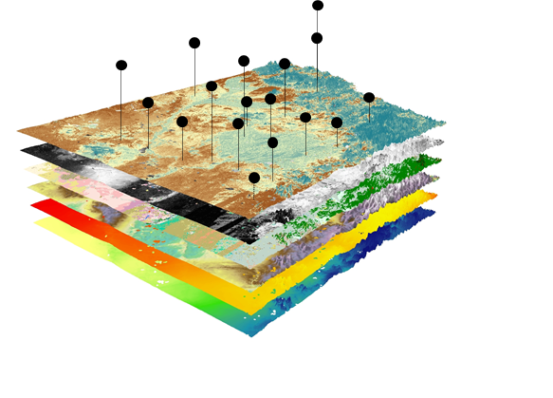
Digital soil assessment
SCORPAN
covariates
  Climate
  Organisms
  Relief
  Parent material
Soil monitoring units
Classes with homogeneous conditions on soil-forming factors
Unsupervised classification
Set indicator thresholds
Assess soil condition at Basonet plots
Basonet
Digital Soil Mapping of indicators
Quantile regression forest models
Maps of soil condition
and uncertainty

Slide 8
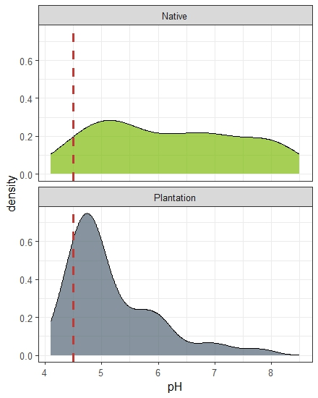
Reference soils
Threshold
5% or 25%
Specific for each soil monitoring unit
Plantations soils
Soil condition assessment
Healthy
Unhealthy
pH

Slide 9
Reference soils
Threshold
5% or 25%
Management target
(median)
Specific for each soil monitoring unit
Plantations soils
Target met
Soil condition assessment
Healthy
Unhealthy
pH

Slide 10
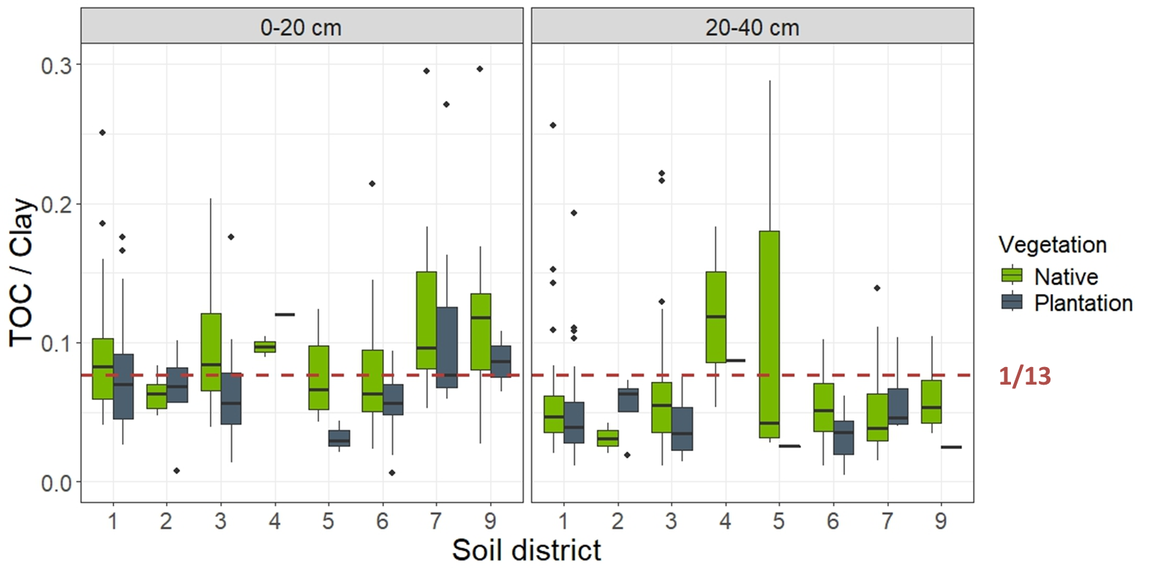
SOC:clay was generally lower under plantations
37% of topsoils and 79% of subsoils of native forests < 1/13 threshold
SOC:clay
SOC:Clay = 1/13
Soil monitoring unit

Slide 11
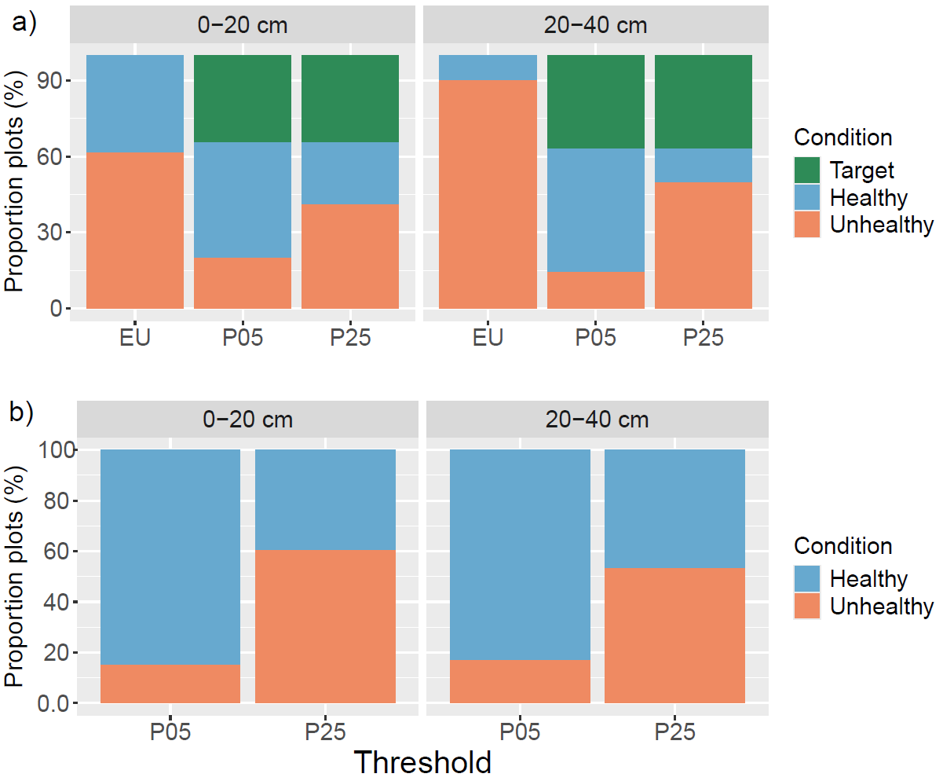
61 % of topsoils and 90% of subsoils of plantations < 1/13 threshold
14-50% plantations considered unhealthy depending on the percentile used with the reference approach
SOC:clay
pH
Román Dobarco et al. (under review)
Notes:
When considering the threshold suggested by the SMD for SOC:clay (<1/13), 61% of plots at 0-20 cm layer and 90% at 20-40 cm layer of plantations were in poor condition (unhealthy), while 37% of plots at 0-20 cm and 79% at 20-40 cm of semi-natural forests would be considered unhealthy. The proportion of plantation plots in poor condition for loss of SOC ranged between 14-50% depending on the percentile used to set thresholds (5th and 25th percentiles) when considering semi-natural forest as references.
Forest plantations acidified the soil compared to semi-natural forests, with 15-60% of plantation plots with pH lower than the thresholds. All plantation plots were in good condition (healthy) in terms of subsoil compaction with the EU criteria, but 9.6% of semi-natural plots suffered from compaction.

Slide 12
Forest plantations acidified the soil compared to semi-natural forests
15-60% plantations had pH below threshold
SOC:clay
pH
Román Dobarco et al. (under review)
Notes:
When considering the threshold suggested by the SMD for SOC:clay (<1/13), 61% of plots at 0-20 cm layer and 90% at 20-40 cm layer of plantations were in poor condition (unhealthy), while 37% of plots at 0-20 cm and 79% at 20-40 cm of semi-natural forests would be considered unhealthy. The proportion of plantation plots in poor condition for loss of SOC ranged between 14-50% depending on the percentile used to set thresholds (5th and 25th percentiles) when considering semi-natural forest as references.
Forest plantations acidified the soil compared to semi-natural forests, with 15-60% of plantation plots with pH lower than the thresholds.

Slide 13
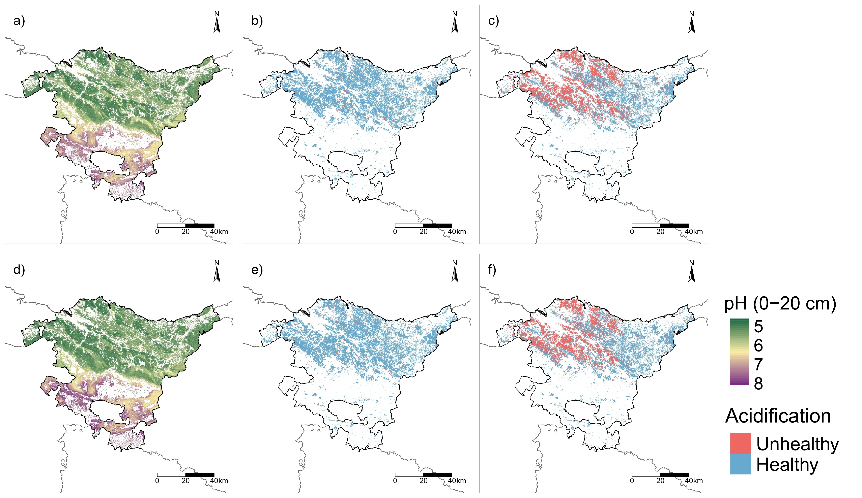
Maps of soil condition for the threat of acidification (pH)
pH
5th percentile
25th percentile
< 2%
~40%
0-20 cm
20-40 cm
Román Dobarco et al. (under review)
Notes:
The relative area of unhealthy topsoils with the 5th percentile was 1.4% and 42% for the 25th percentile (Figures 10.b-10.c). At 20-40 cm, only 1.6% of soils of forest plantations were below the 5th percentile threshold and increased to 39% for the 25th percentile (Figures 10.e- 10.f).

Slide 14
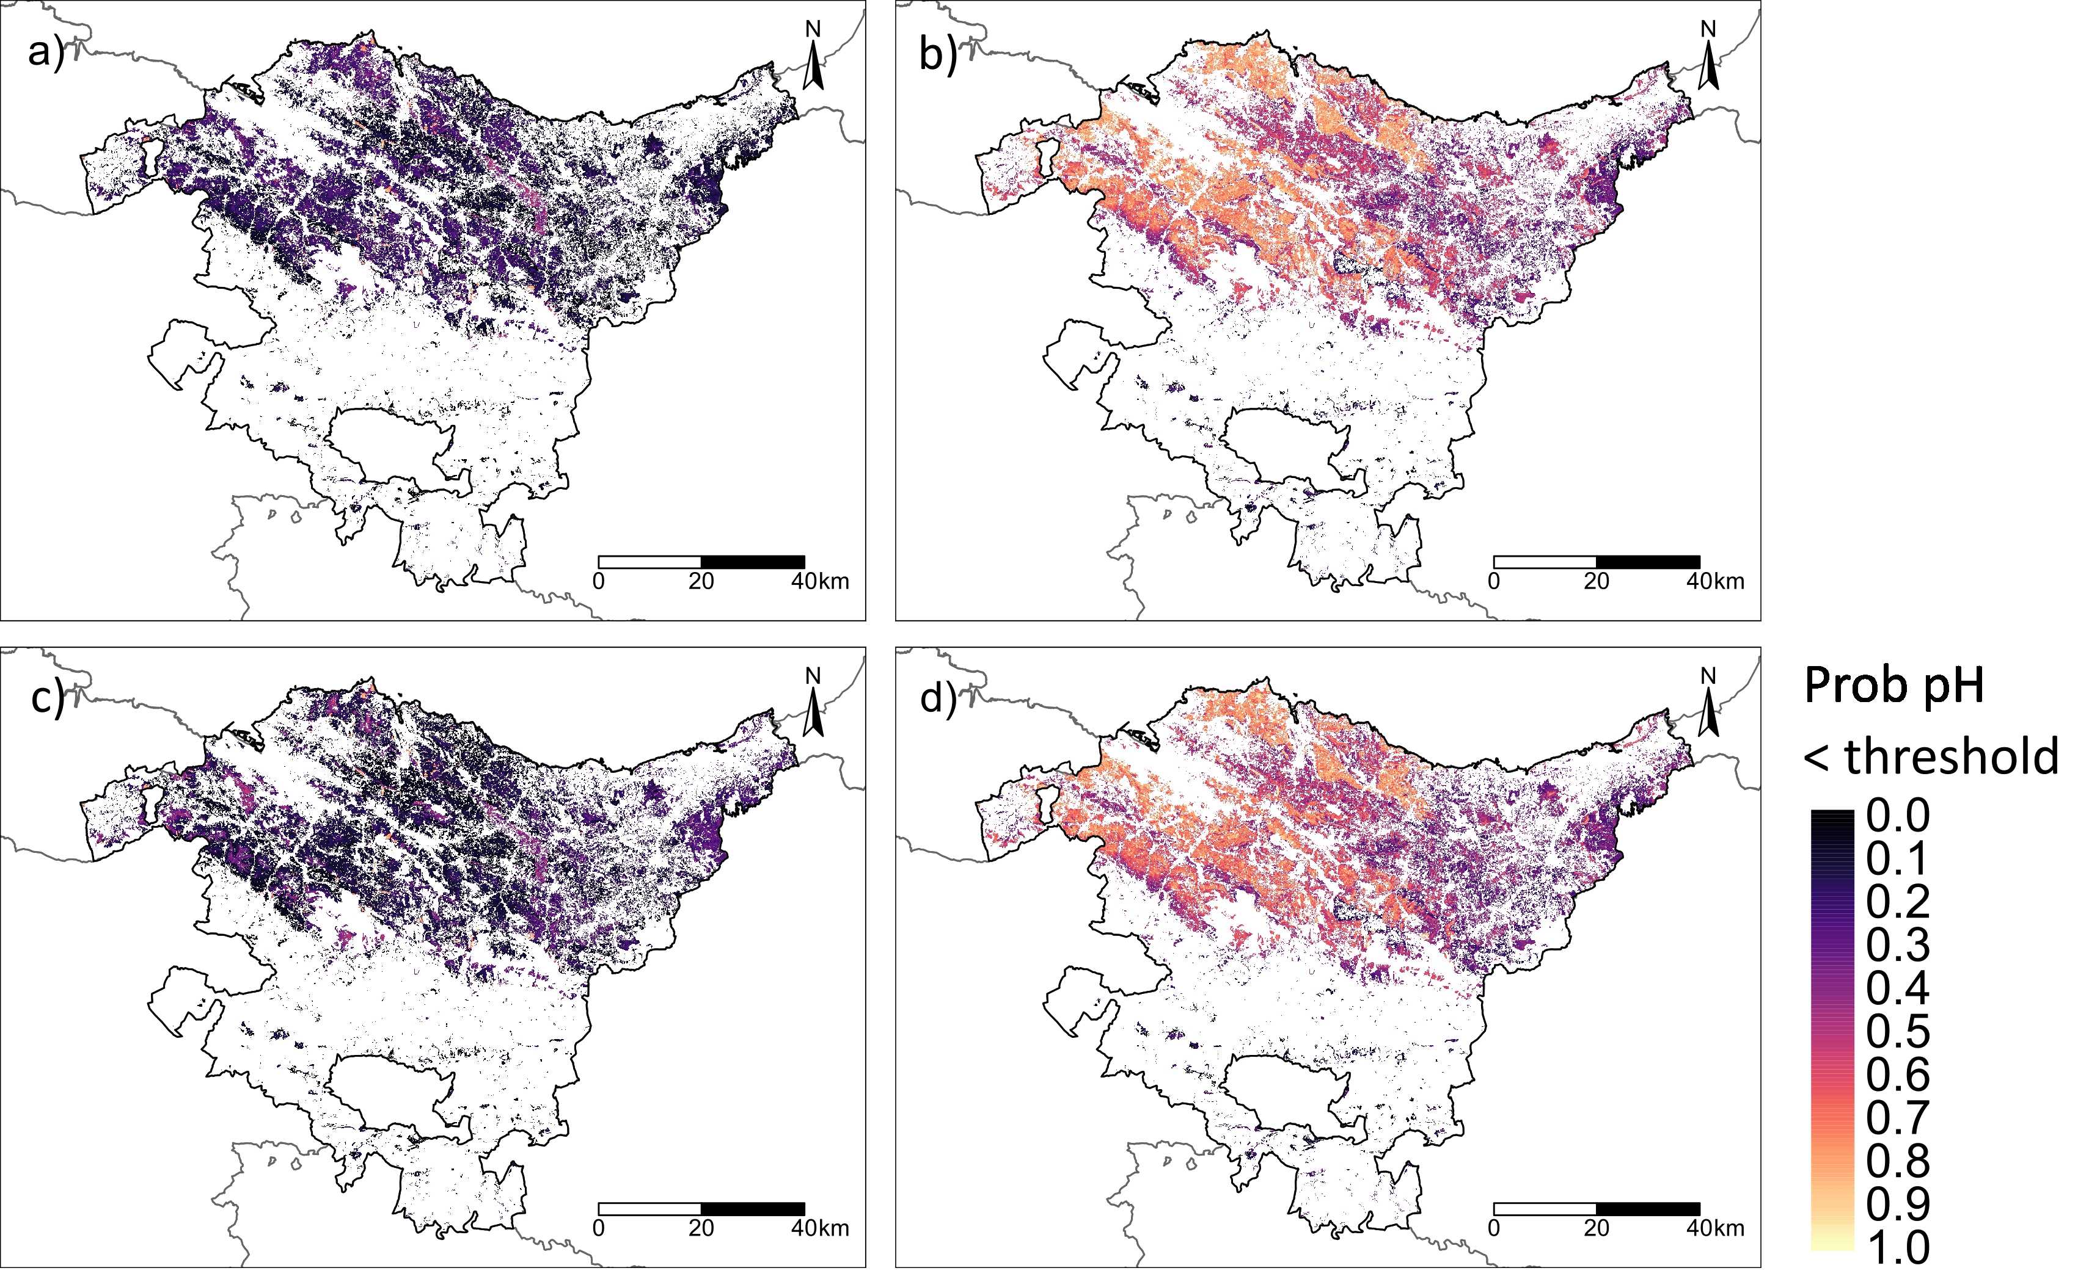
The uncertainty was estimated as the probability of pH < thresholds
5th percentile
25th percentile
0-20 cm
20-40 cm
Román Dobarco et al. (under review)
Notes:
, the area of hotspots with higher probability of having a more acidic pH than the thresholds (higher probability of being unhealthy) increased from the 5% to the 25% percentile (Figure 11), and were located in the northwest of the Basque Country, in the surroundings of the metropolitan area of Bilbao.

Slide 15
Take home messages
Thresholds for assessing soil condition should be specific to the pedoclimatic context
Current forest management in plantations leads to a loss of SOC and acidification compared to semi-natural forests
Semi-natural forests are affected y global change and the legacy of past land use. Can we assume their soils are healthy?

Slide 16
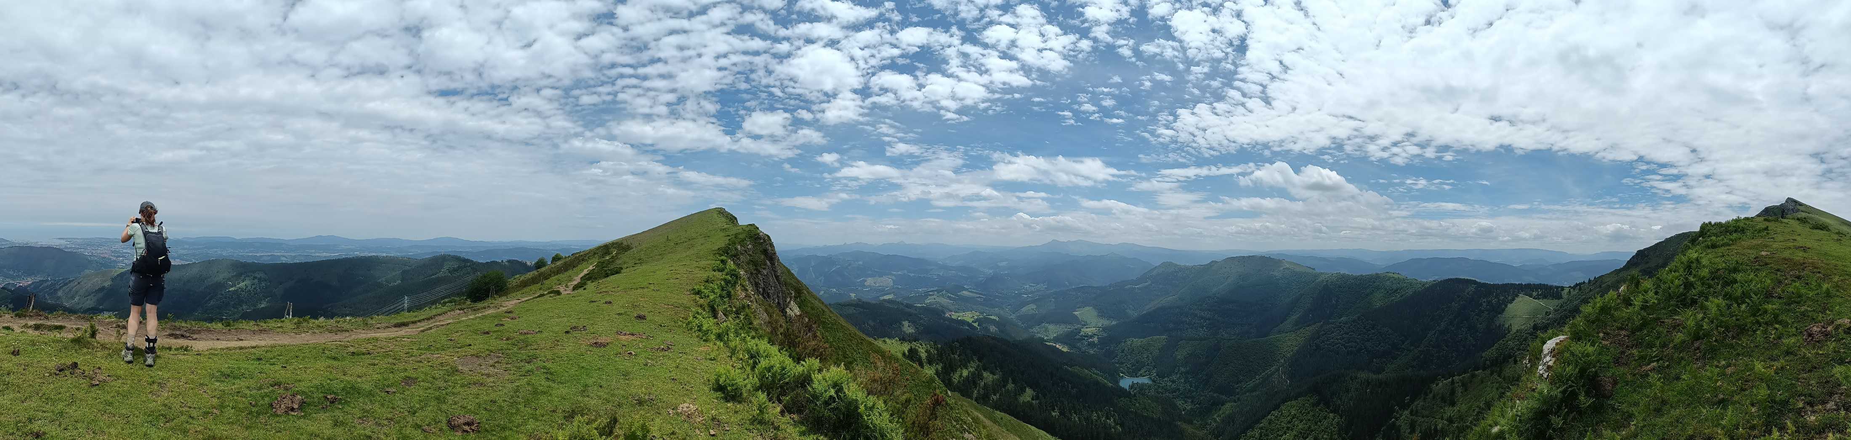





Thanks for your attention
SELVANS Soil condition and capability mapping for sustainable forest management. Project Number: 101063363
Funded by the European Union
Views and opinions expressed are however those of the authors only and do not necessarily reflect those of the European Union or BC3. Neither the European Union nor BC3 can be held responsible for them.

Slide 17
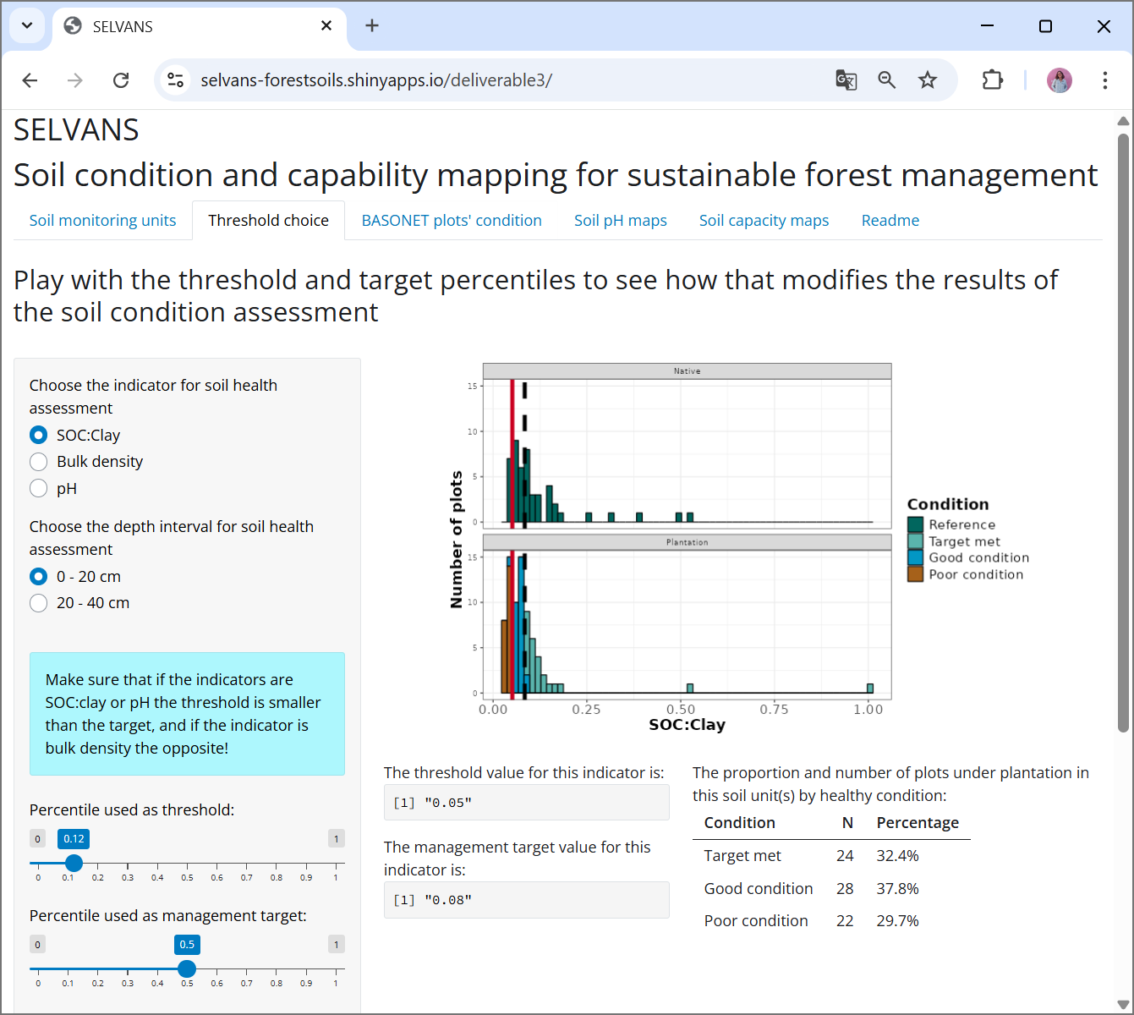
Notes:
Interactive web app to test the effect of percentile on the threshold values and the results of the soil condition assessment

Slide 18
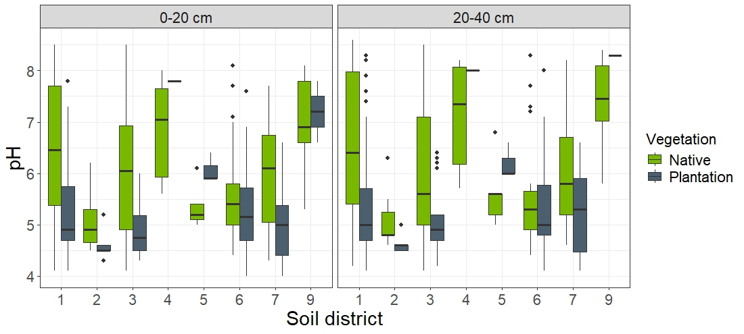
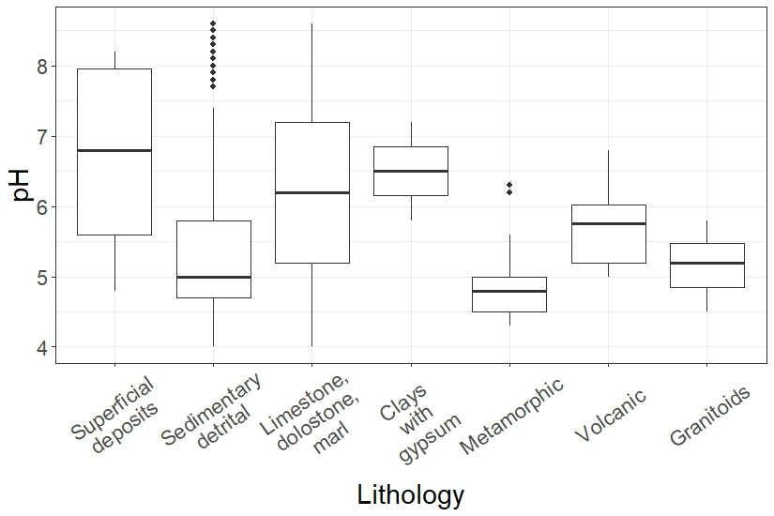
Acidification
Precipitation
Lithology
Tree species

Slide 19
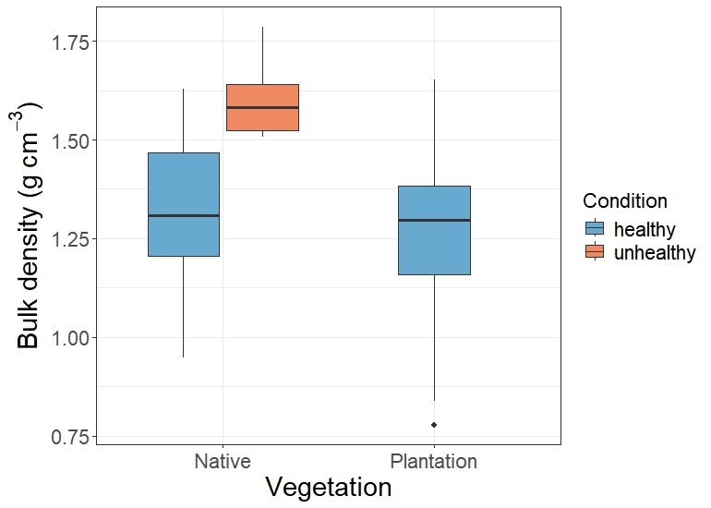
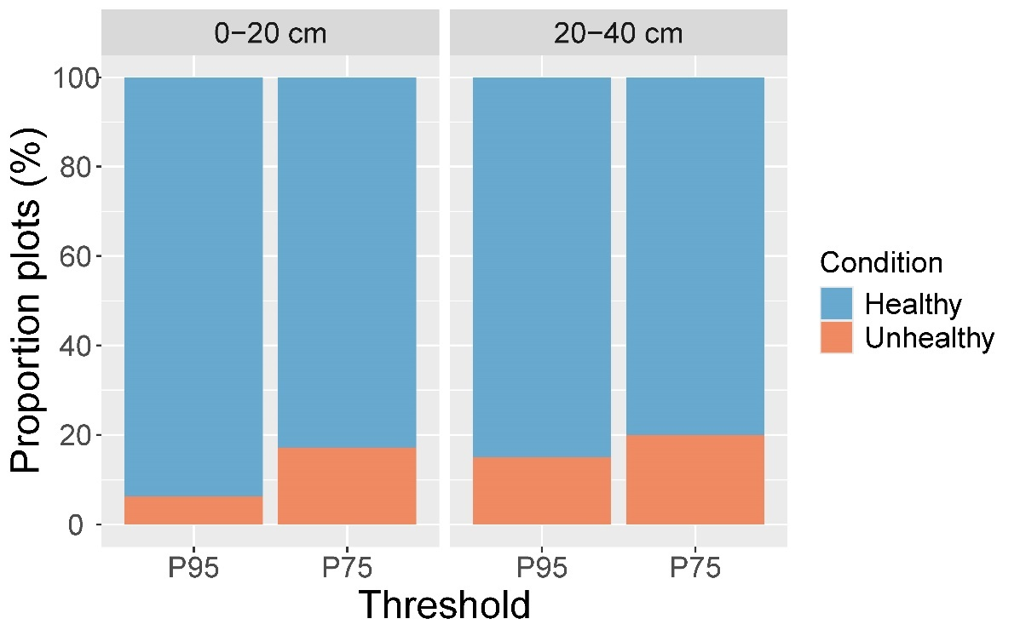
Compaction (bulk density)
Notes:
All plantation plots were in good condition (healthy) in terms of subsoil compaction with the EU criteria, but 9.6% of semi-natural plots suffered from compaction.
With the reference approach, 15% of subsoils in plantations had greater bulk density than the 95th percentile of the bulk density in native forests and hence could be considered unhealthy. The proportion of subsoils with condition affected by compaction increased to 20% with the 75th percentile.
The soil condition of topsoil bulk density has no set criteria and hence was assessed only with the reference approach. The bulk density of topsoils (0-20 cm) in plantations was generally smaller than the bulk density under native vegetation, resulting in 6% of the topsoils in poor condition with the 95th percentile but this proportion increased to 17% with the 75th percentile.

