Slide 1
Enhancing physically based and distributed hydrological model calibration through internal state variable constraints
Frédéric Talbot¹, Jean-Daniel Sylvain², Guillaume Drolet², Annie Poulin¹, Richard Arsenault¹
¹ Hydrology, Climate and Climate Change Laboratory, École de technologie supérieure, Université du Québec, Montréal, H3C 1K3, Canada
² Direction de la recherche forestière, Ministère des Ressources naturelles et des Forêts, Québec, G1P 3W8, Canada
Correspondence to: Frédéric Talbot (frederic.talbot.2@ens.etsmtl.ca)
April 29th, 2025, Vienna

Slide 2
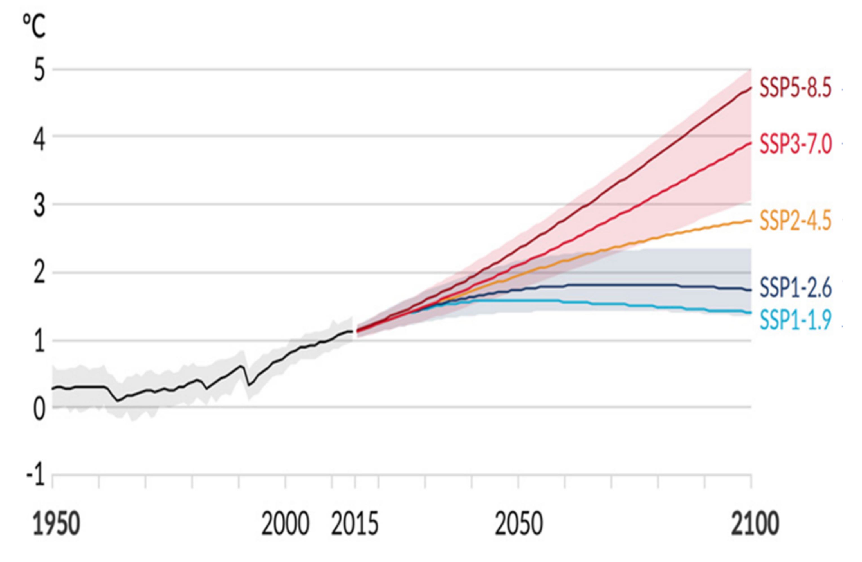
Introduction
Figure 1. Projected global temperature changes under the five SSP scenarios. Adapted from Ouranos (2024), based on IPCC, 2021. Summary for Policymakers.
Introduction
Methods
Results
Discussion

Slide 3
Introduction
Physically-based and distributed hydrological models can be used to generate hydrological variable estimations
Equifinality problem when calibrating using only streamflow (Mei et al., 2023)
Many recent studies included multiple variables in calibration (Mei et al., 2023; Schäfer et al., 2023; De Lima Ferreira and da Paz, 2024)
How do different calibration strategies and levels of model complexity influence the representation of hydrological processes?
Introduction
Methods
Results
Discussion

Slide 4
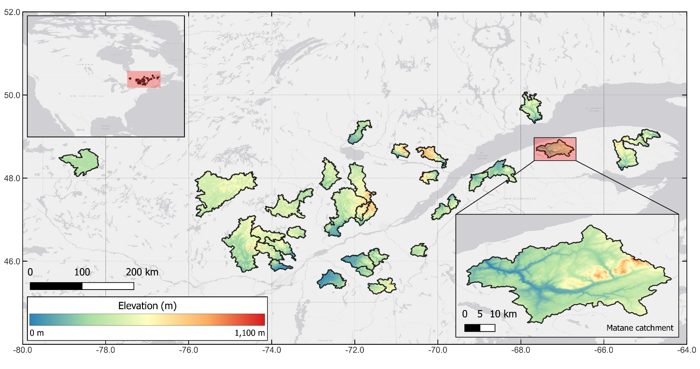
Methods
34 snowy catchments
Water Flow and Balance Simulation Model (WaSiM)
ERA5 datasets for meteorological data
Objective function: KGE
Calibration period: 2000-2009
Validation period: 1990-1999
Figure 2. Elevation map of study catchments in southern Quebec
Introduction
Methods
Results
Discussion

Slide 5
Methods
How do different calibration strategies and levels of model complexity influence the representation of hydrological processes?
BL: Baseline configuration
GW: Introduces groundwater flow sub-model
GW-RC: Includes groundwater flow sub-model and constraints on groundwater recharge during calibration
Introduction
Methods
Results
Discussion

Slide 6
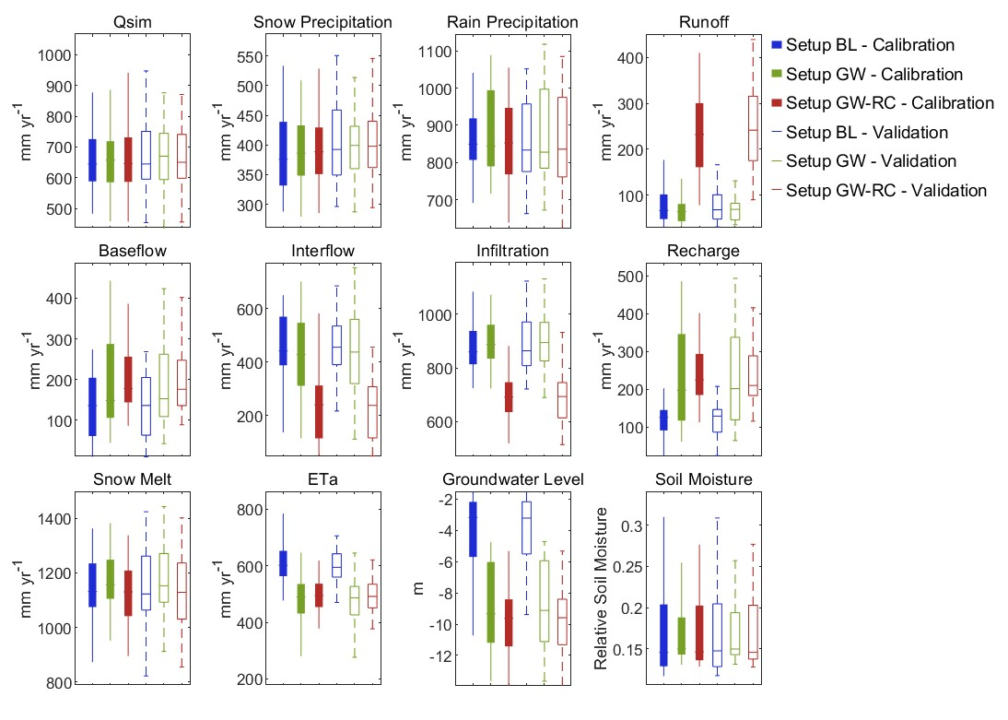
Results
Figure 3. Boxplots illustrating annual totals for all catchments
Introduction
Methods
Results
Discussion

Slide 7
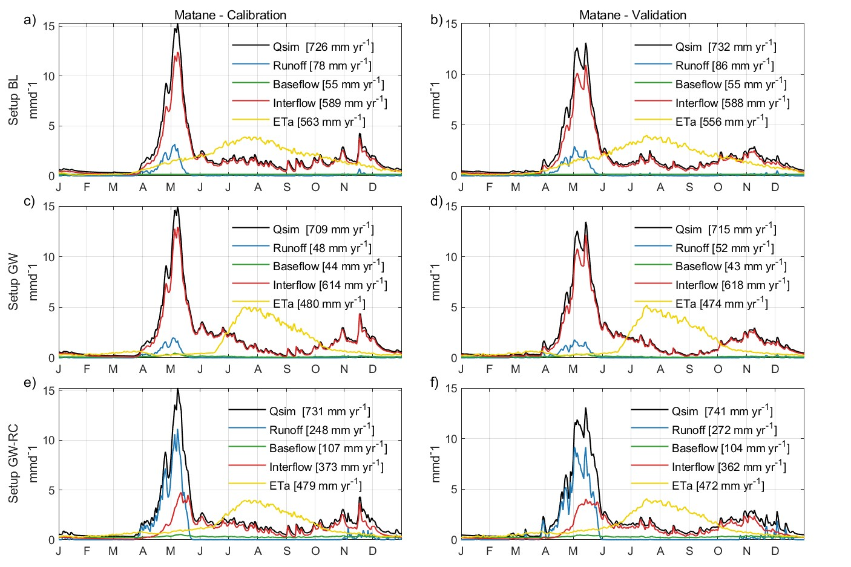
Results
Figure 4. Hydrological variable hydrograph for the “Matane” catchment
Introduction
Methods
Results
Discussion

Slide 8
Discussion
GW-RC shows slightly lower KGE (reduction of 0.05) but delivers more realistic estimates of hydrological processes.
Small changes in the objective function (incorporating recharge constraints) can improve the realism of simulated hydrological processes.
More realistic process estimations enhances the model’s credibility and supports climate change adaptation strategies.
Introduction
Methods
Results
Discussion

Slide 9
References
De Lima Ferreira, P. M. and da Paz, A. R.: Enhanced calibration of a distributed hydrological model in the Brazilian Semi-Arid: integrating spatiotemporal evapotranspiration and streamflow data, Environ. Earth Sci., 83, 345, https://doi.org/10.1007/s12665-024-11663-6, 2024.
IPCC: Summary for Policymakers, in: Climate Change 2021: The Physical Science Basis, Contribution of Working Group I to the Sixth Assessment Report of the Intergovernmental Panel on Climate Change, edited by: Masson-Delmotte, V., Zhai, P., Pirani, A., Connors, S.L., Péan, C., Berger, S., et al., Cambridge University Press, Cambridge, United Kingdom and New York, NY, USA, 3–32, https://www.ipcc.ch/report/ar6/wg1/downloads/report/IPCC_AR6_WGI_SPM_final.pdf, 2021.
Mei, Y., Mai, J., Do, H. X., Gronewold, A., Reeves, H., Eberts, S., Niswonger, R., Regan, R. S., and Hunt, R. J.: Can Hydrological Models Benefit From Using Global Soil Moisture, Evapotranspiration, and Runoff Products as Calibration Targets?, Water Resour. Res., 59, e2022WR032064, https://doi.org/10.1029/2022WR032064, 2023.
Ouranos: Modélisation climatique, available at: https://www.ouranos.ca/fr/science-du-climat-modelisation-climatique (last access: 16 April 2025).
Schäfer, C., Fäth, J., Kneisel, C., Baumhauer, R., and Ullmann, T.: Multidimensional hydrological modeling of a forested catchment in a German low mountain range using a modular runoff and water balance model, Front. For. Glob. Change, 6, https://doi.org/10.3389/ffgc.2023.1186304, 2023.
Talbot, F., Sylvain, J.-D., Drolet, G., Poulin, A., and Arsenault, R.: Enhancing physically based and distributed hydrological model calibration through internal state variable constraints, EGUsphere, 1–42, https://doi.org/10.5194/egusphere-2024-3353, 2024.

Slide 10
Supplementary Material
Configurations detailed
BL: Baseline configuration
GW: Introduces groundwater flow sub-model
GW-RC: Includes groundwater flow sub-model and constraints on groundwater recharge during calibration
Step 1: Narrow the parameter space for five key parameters using a preliminary objective function: 70% KGE, 20% standard deviation of recharge, and 10% mean annual recharge.
Step 2: Perform the final calibration using the reduced parameter space, with an objective function weighted at 96% KGE and 4% standard deviation of recharge.
Introduction
Methods
Results
Discussion

Slide 11
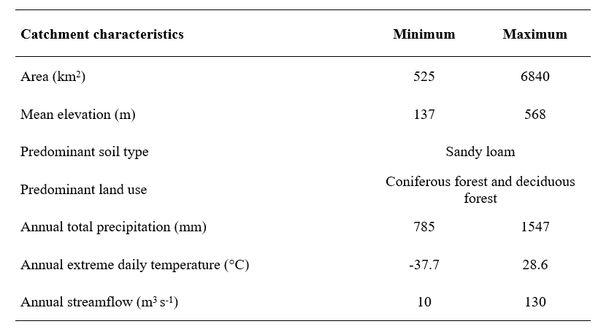
Supplementary Material
Table S1. Hydrological and geophysical characteristics of the study catchments

Slide 12
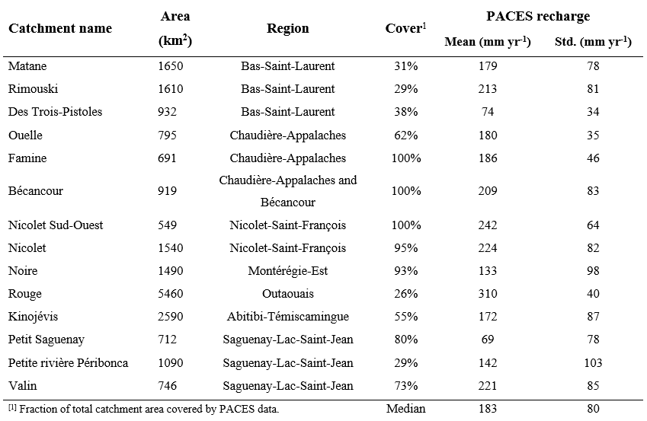
Supplementary Material
Table S2. PACES data coverage and groundwater recharge statistics for covered catchments

Slide 13
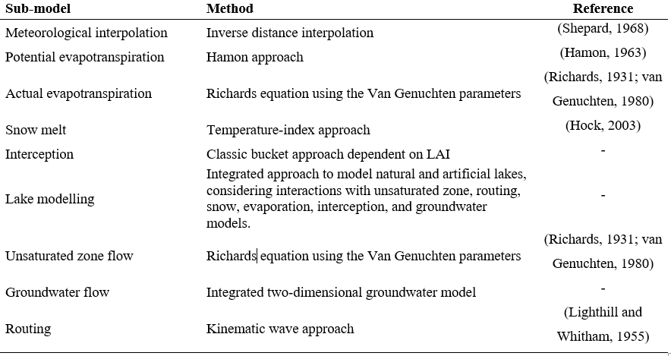
Supplementary Material
Table S3. Overview of WaSiM characteristics and sub-models used in this study

Slide 14
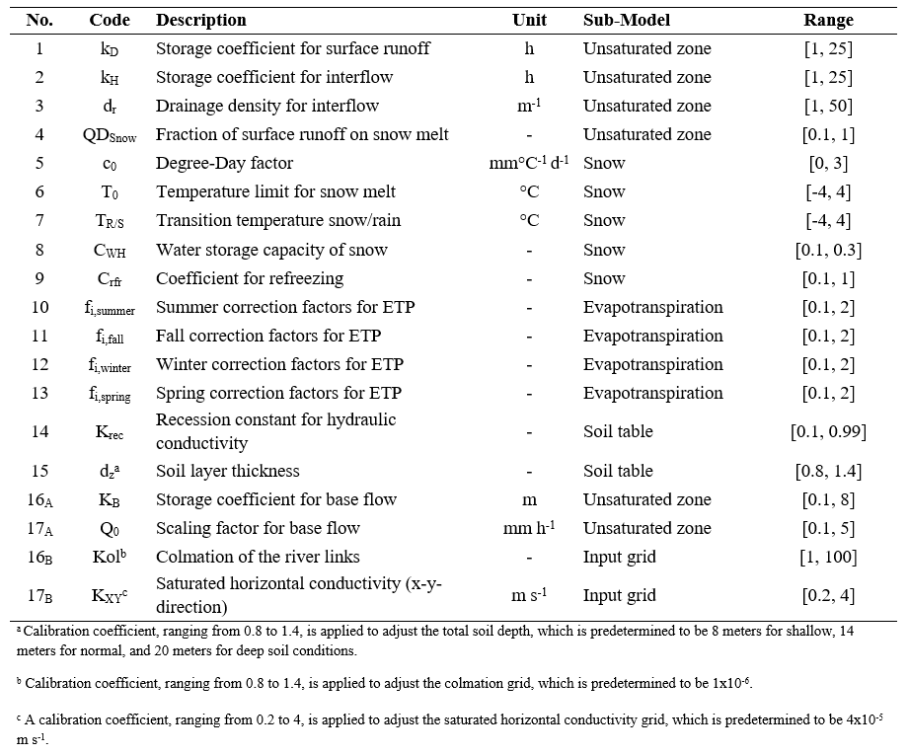
Supplementary Material
Table S4. Description of the parameters used for the calibration of WaSiM

Slide 15
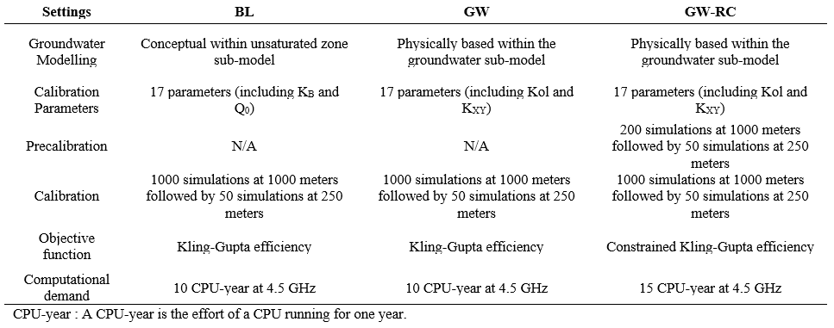
Supplementary Material
Table S5. Summary of configurations

Slide 16
Supplementary Material
Figure S1. Comparison of KGE values between calibration and validation periods for three configurations

Slide 17
Supplementary Material
Figure S2. Proportional distributions of key hydrological variables for the BL, GW and GW-RC hydrological model configurations for the validation period (1990-1999)

Slide 18
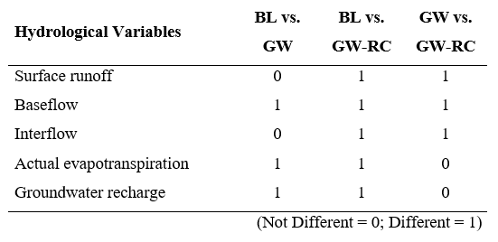
Supplementary Material
Table S6. Statistical analysis of the differences in estimated hydrological variables from the three configurations BL, GW and GW-RC

Slide 19
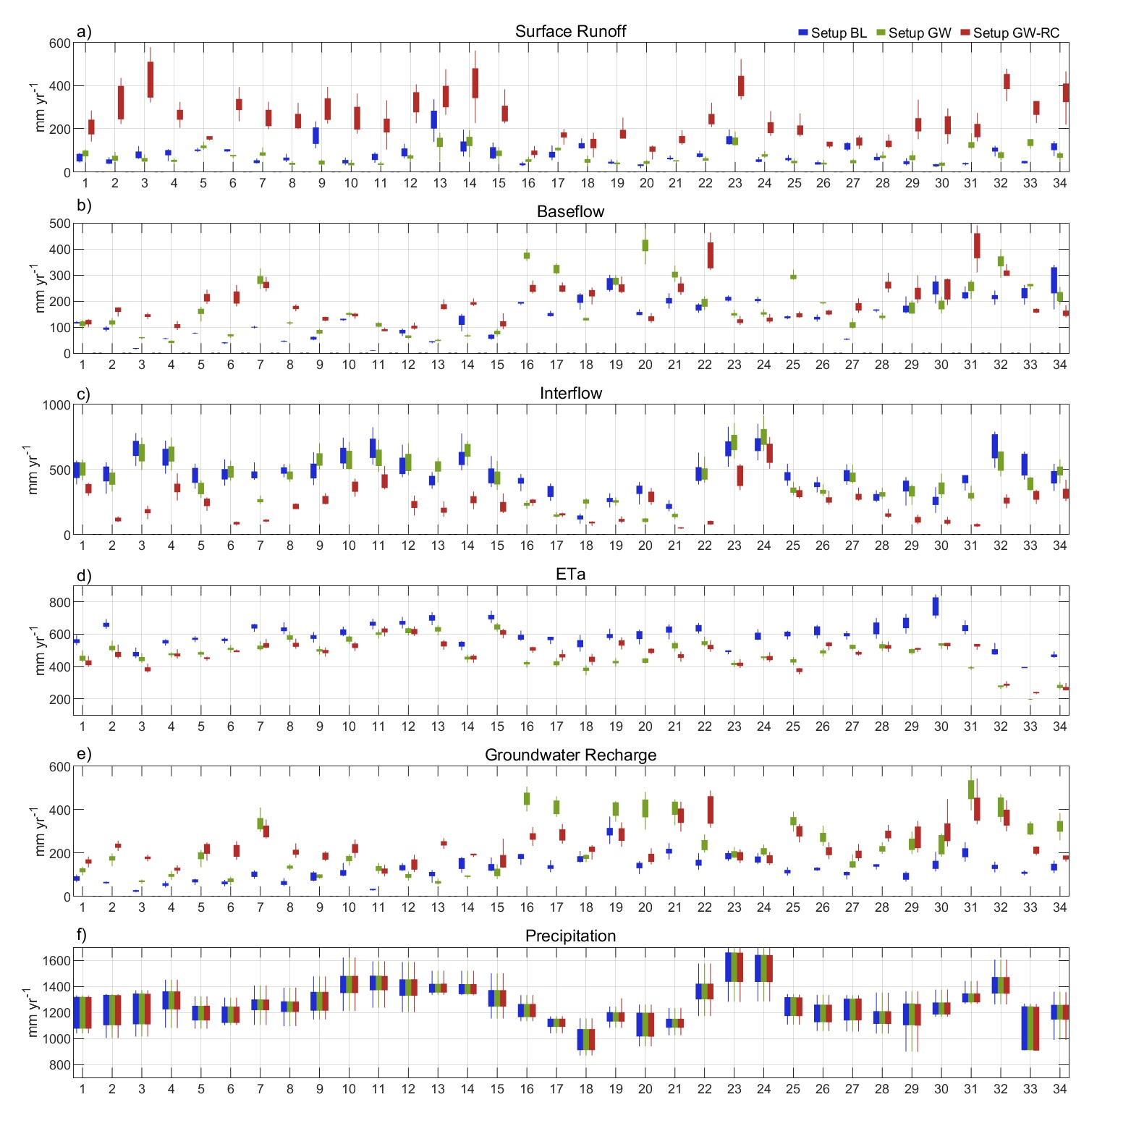
Supplementary Material
Figure S3. Boxplots of annual values for key hydrological variables for the validation period (1990-1999)

Slide 20
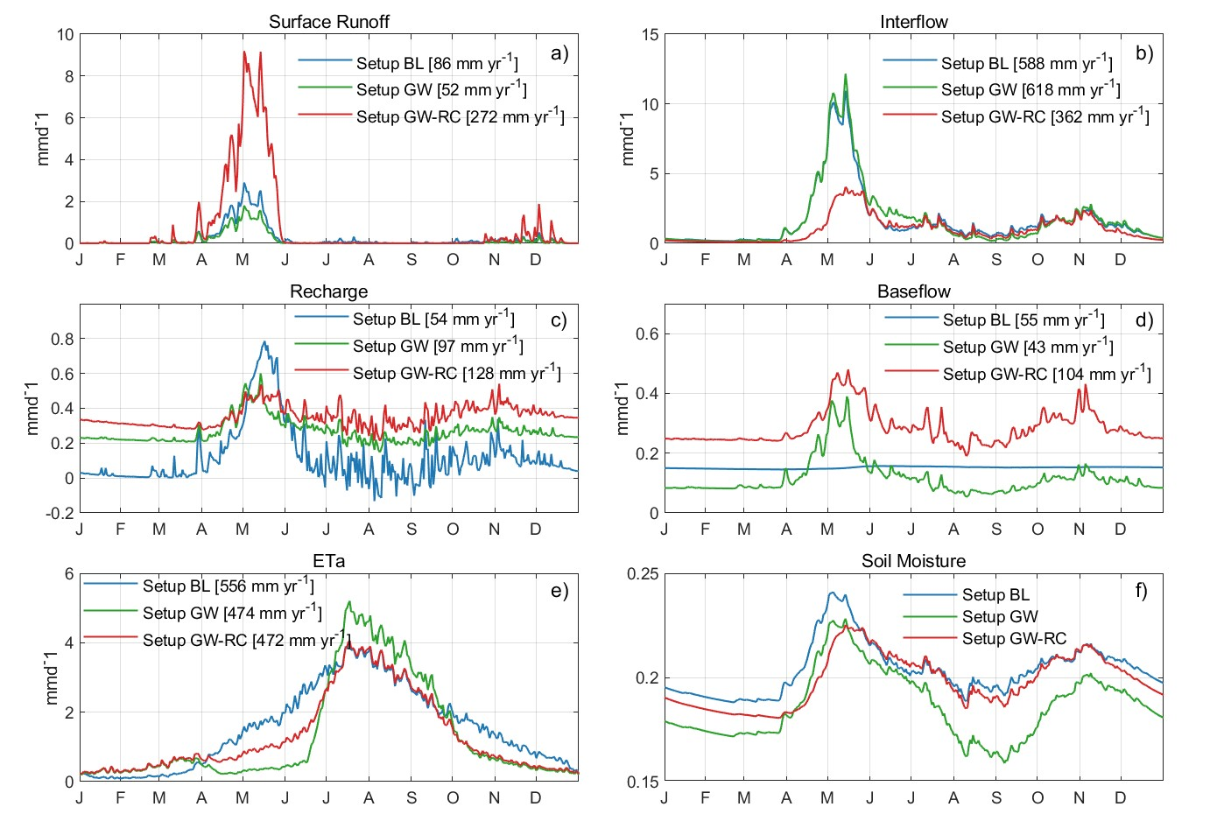
Supplementary Material
Figure S4. Seasonal distribution of hydrological variables in the Matane catchment for the validation period (1990-1999)

Slide 21
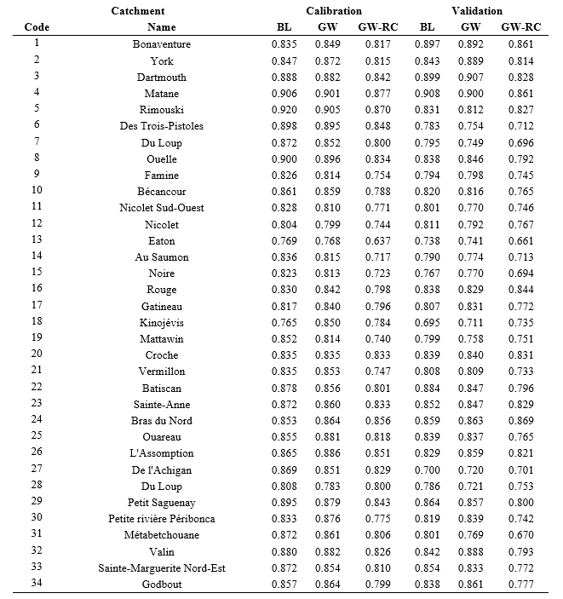
Supplementary Material
Table S7. KGE values across studied catchments

Slide 22
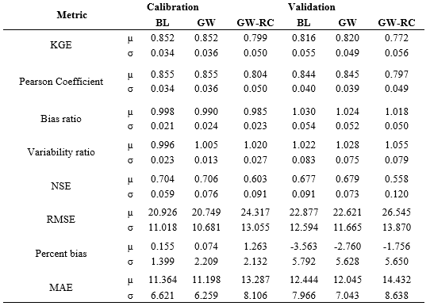
Supplementary Material
Table S8. Multiple streamflow metrics across studied catchments

Slide 23
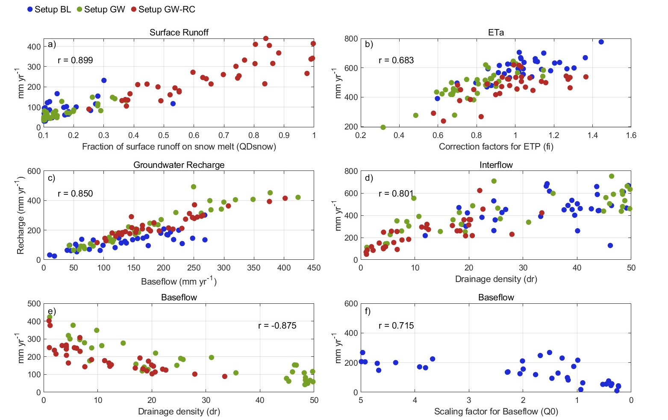
Supplementary Material
Figure S5. Correlations between key hydrological variables and calibration parameters for three model configurations

