Slide 1



Modulation of temporal evolution of black carbon aerosols at a rural location in the Western Ghats
by meteorology and boundary layer dynamics
Devika Sunil S. , N. Anand , K. Sunilkumar , S.K. Satheesh , K. Krishnamoorthy
*dsun25@iisertvm.ac.in

Slide 2
OVERVIEW OF STUDY
TERMINOLOGY
BC = Black Carbon , BC_{bb} = BC from biomass burning, BC_{ff} = BC from fossil fuel burning
M_{B} = BC Mass Concentration, M_{bb} = BC_{bb} mass concentration, M_{ff} = BC_{ff} mass concentration
BB% = Biomass burning percentage, ABL = Atmospheric Boundary Layer
Black carbon (BC) aerosols have been reported to influence the precipitation patterns over South-East Asia.
Lack of information on the historical concentrations of carbonaceous aerosols forms a major source of uncertainty in climate modelling. In-situ measurements of BC from distinct geographical locations, particularly the remote and background locations with minimal anthropogenic influence gain importance here.
We present near-surface observations of BC mass concentration (M_{B}) from a rural location in the Western Ghats.
The location exhibits characteristic varying mean diurnal variations in M_{B} levels, with patterns akin to those observed in tropical as well as high-altitude locations.
The subtle interplay between large scale land-sea breeze wind flows and local atmospheric boundary layer (ABL) modulates the aerosol presence for this remote region which is difficult to be modelled, warranting in-situ measurements from the location.

Slide 3
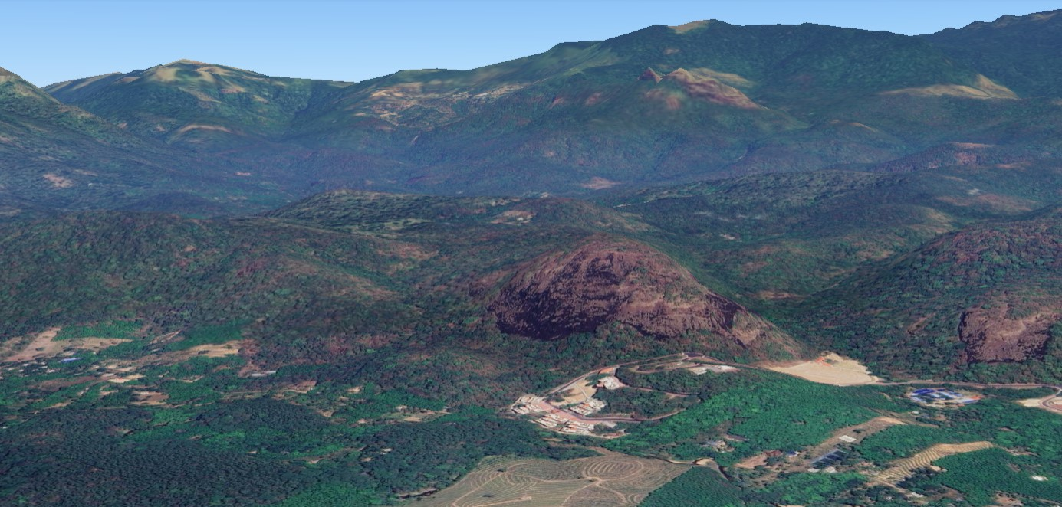
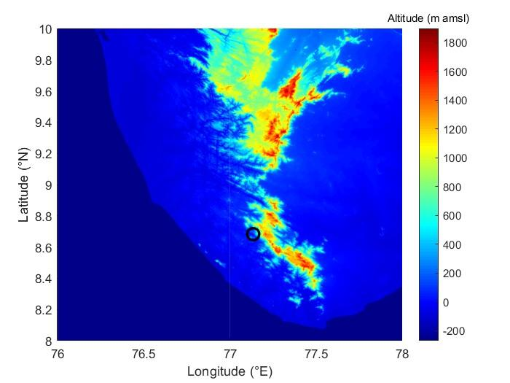
MEASUREMENT LOCATION
Image credit: Google Earth
Data credit: Bhuvan/ISRO
Lab: School of Earth, Environmental and Sustainability Sciences (SEESS),
Indian Institute of Science Education and Research Thiruvananthapuram (8.69 °N, 77.13 °E; elevation: 175 m amsl)
Town: Maruthamala, Thiruvananthapuram, Kerala (population: ~1456 ª)
Nearest : Vithura (population: 18437 ^{b}; aerial distance: ~ 4 km away)
semi-urban center
Situated ~ 30 km away from the Arabian Sea coast and metropolitan city of Thiruvananthapuram, all of which lies towards its west.
ª Govt. of Kerala (https://village.kerala.gov.in/Office_websites/about_village.php?nm=14Vithuravillageoffice ), 2024
^{b} State Election Commission Kerala (https://sec.kerala.gov.in/public/voters/list) , 2024

Slide 4
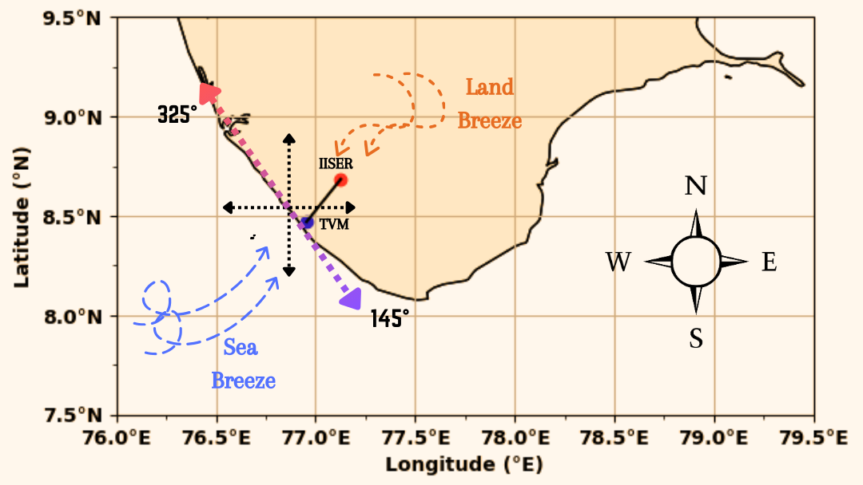
Schematic showing positions of measurement location (IISER) and primary source of pollutants (TVM city). The chief wind circulations, divided as sea and land breeze circulations are also depicted
Situated at the foothills of the Western Ghats, with the Agasthyamalai biosphere reserve to its West with the nearest hill (~ 300 m away) at an elevation of 309 m amsl.
Lies downind of the sea breeze regime (considered as winds between 145 and 325 °N) from the Arabian Sea.

Slide 5
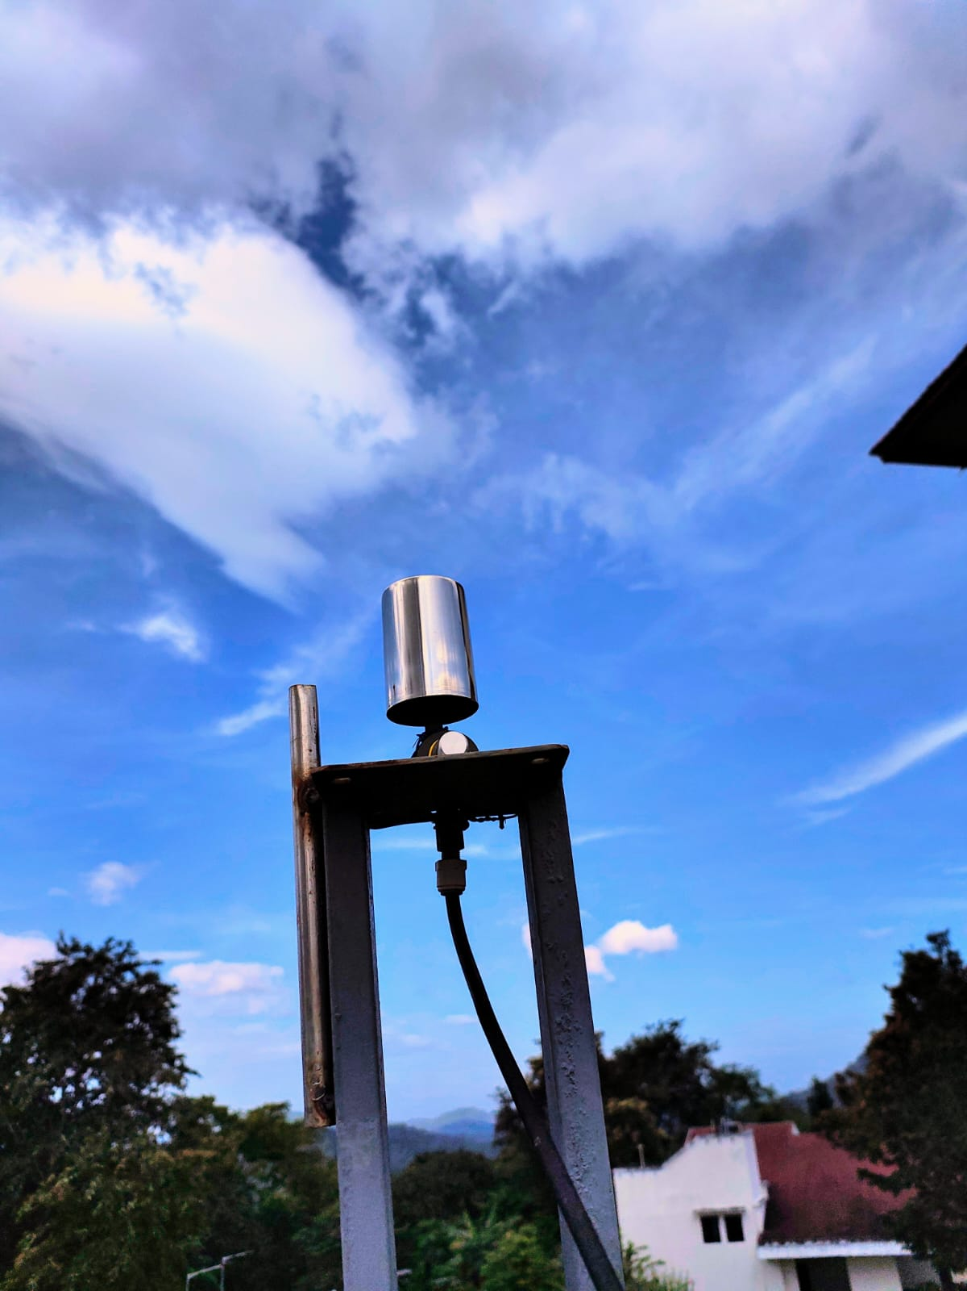
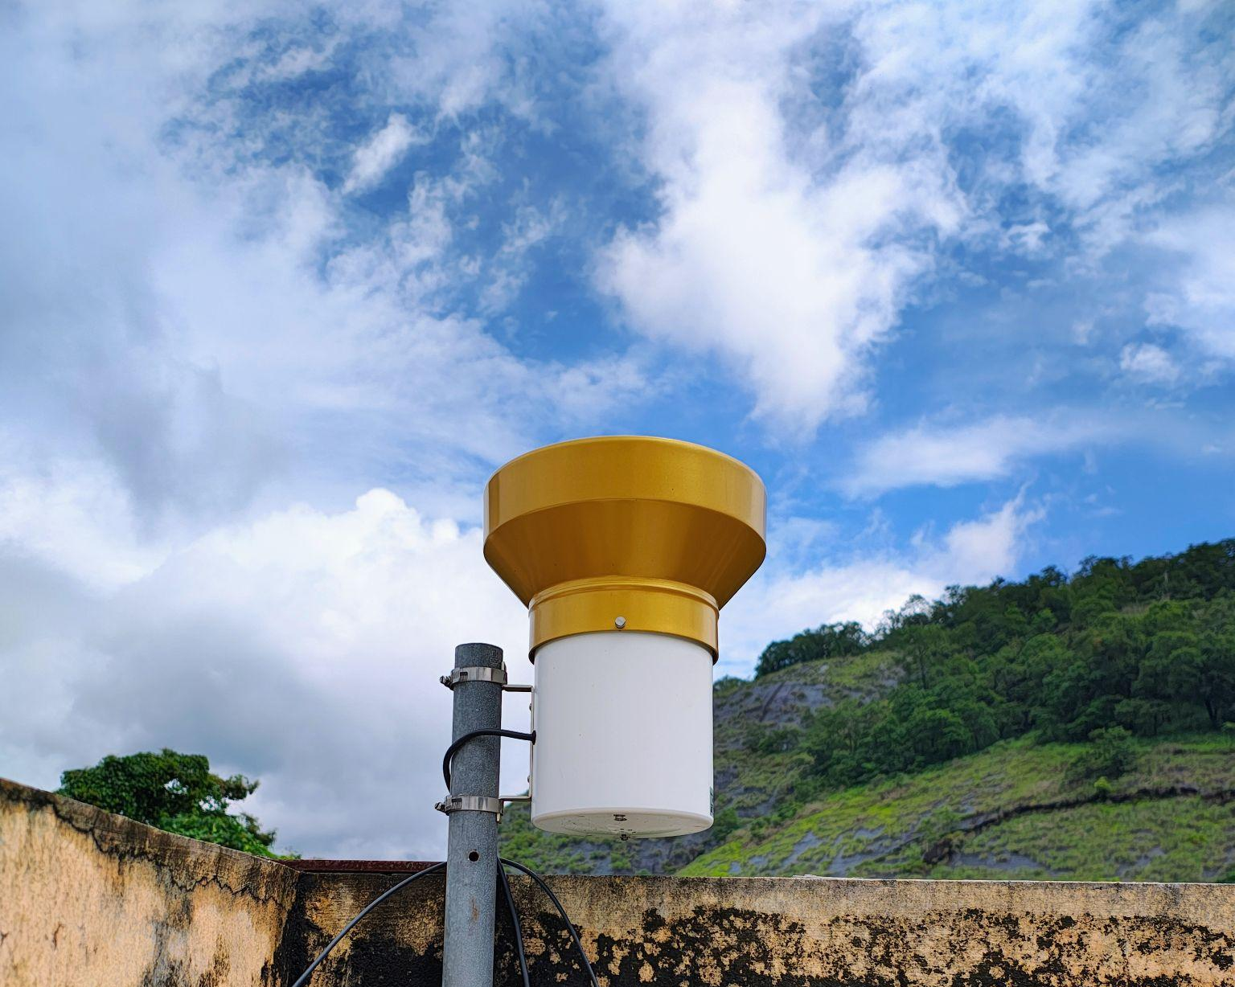
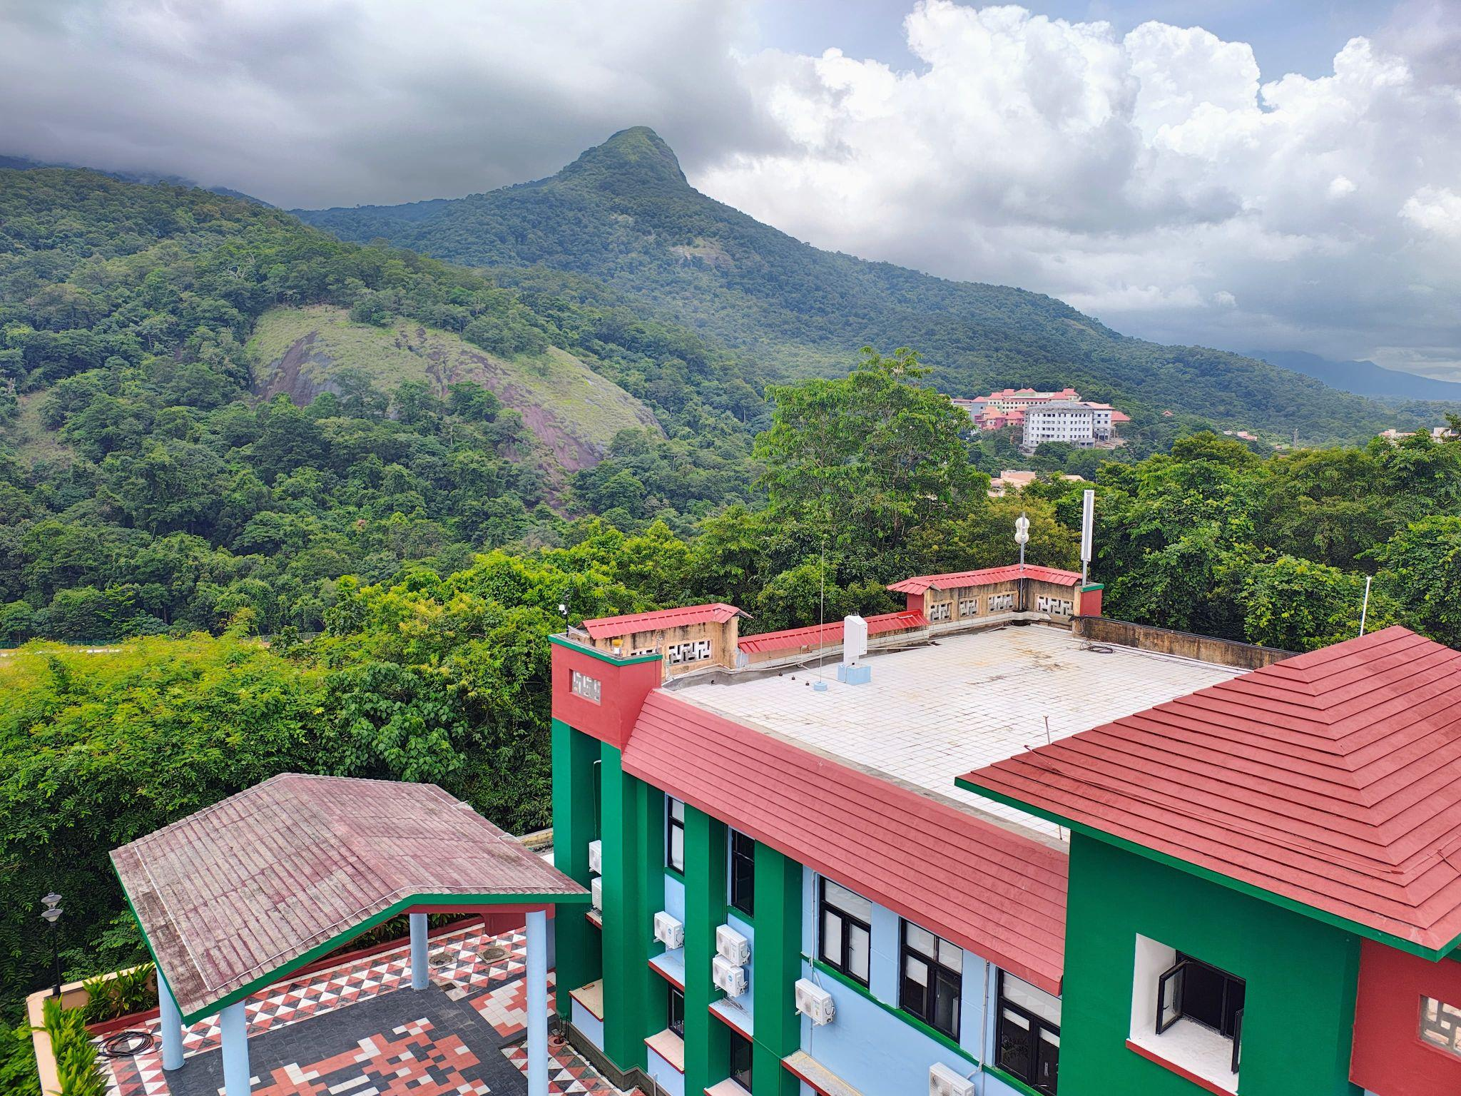
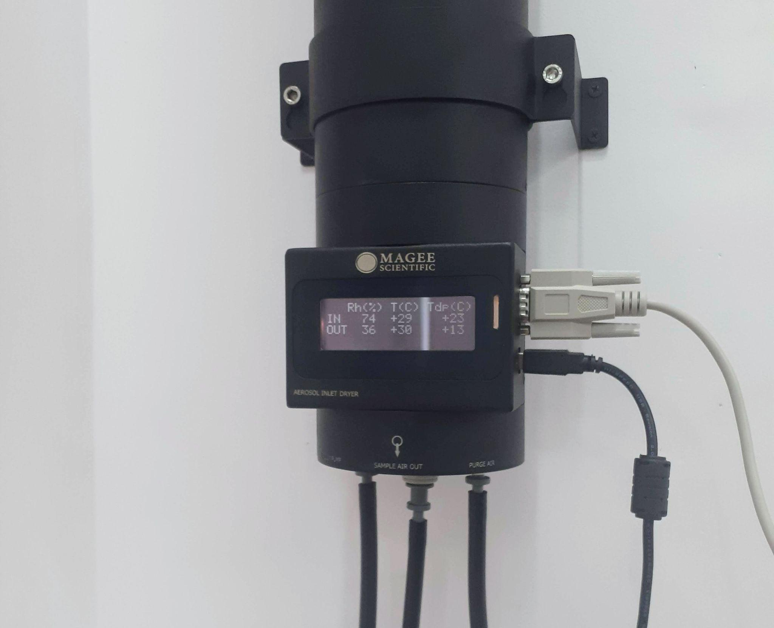
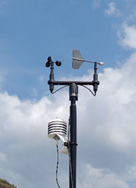
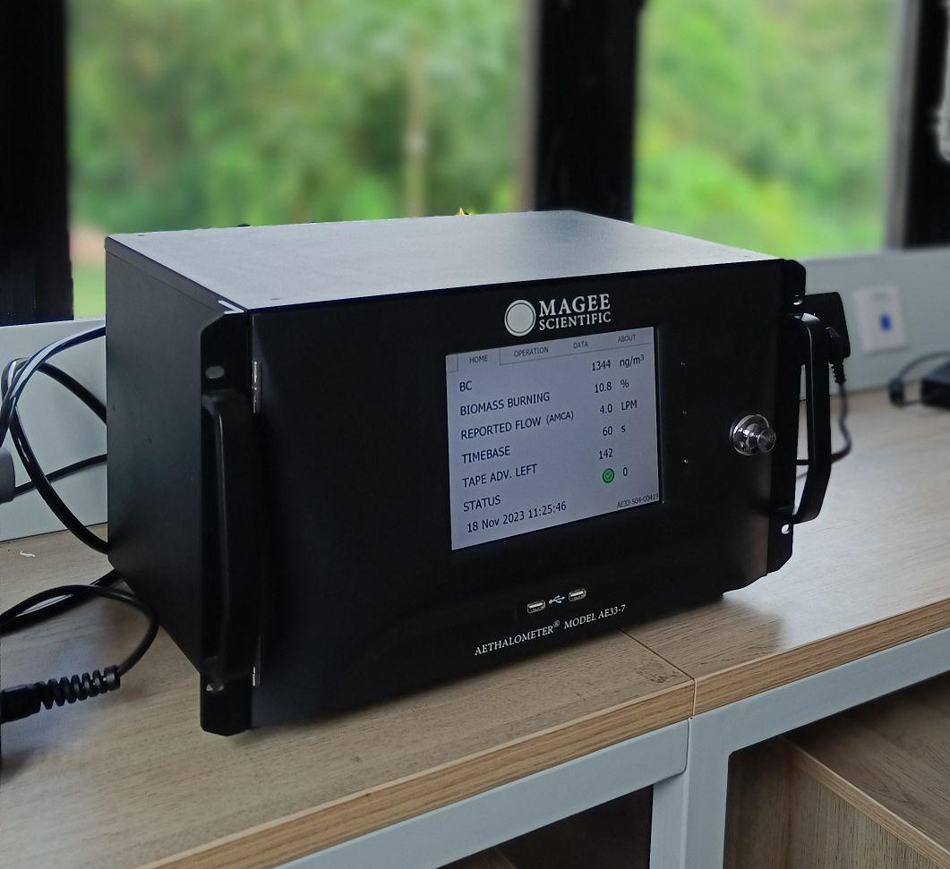
PM2.5 inlet
Tipping bucket raingauge
MEASUREMENT LOCATION
Dryer
Cup anemometer +
Wind vane
RT sensor
Automated Weather Station
from Campbell Scientific©
AE33 Dual Spot Aethalometer
from Magee Scientific©

Slide 6
Background Meteorology at Site
In this study, we’ve followed IMD’s classification of Indian seasons:
WINTER → December, January, February (DJF) SUMMER → March, April, May (MAM)
MONSOON → June, July, August, September (JJAS) POST-MONSOON → October, November (ON)
The atmosphere is mostly humid (which is why the sampled aerosols are dried using a Nafion membrane dryer to maintain a relative humidity of < 40 %). A subtropical highland climate is typically observed with moderate temperatures throughout.
The location experiences 2 kinds of winds:
  Sea Breeze - Blowing from the city (possible transport conduit for pollutants)
  Land Breeze - Blowing from the hills (From differential heating of land and katabatic flow from the hills)
The hottest months were JFM, during which strong gusts of wind blew from the hills. The differential heating and higher surface temperatures at measurement location might have caused colder air mass from the hills to descent).

Slide 7
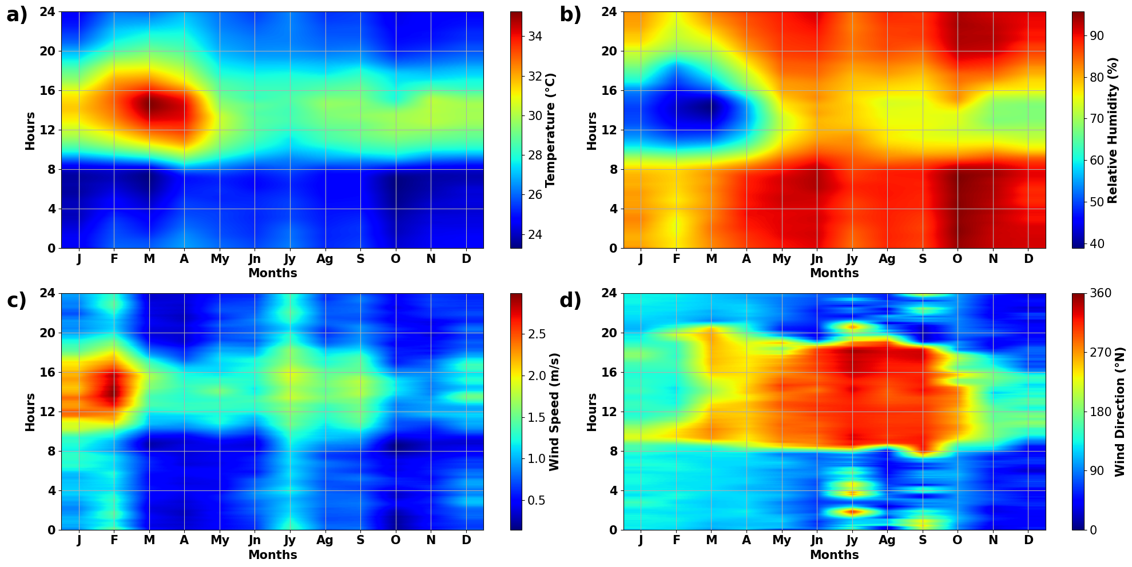
January, February, March (JFM) were the hottest months with T > 34℃.
RH is greatest between September and November (75 - 90 %).
JFM also recorded the highest wind speeds (reaching upto 7 m/s, not seen here after taking average).
Wind direction shifts to sea breeze regime around 0900 hrs and continues till 1800 hrs. The wind speeds also tend to be high during this timeframe.
Diurnal variation in meteorological parameters (a) Temperature (b) Relative humidity
(c) Wind speed and (d) Wind direction (Data has been smoothed for 30 minutes.)

Slide 8
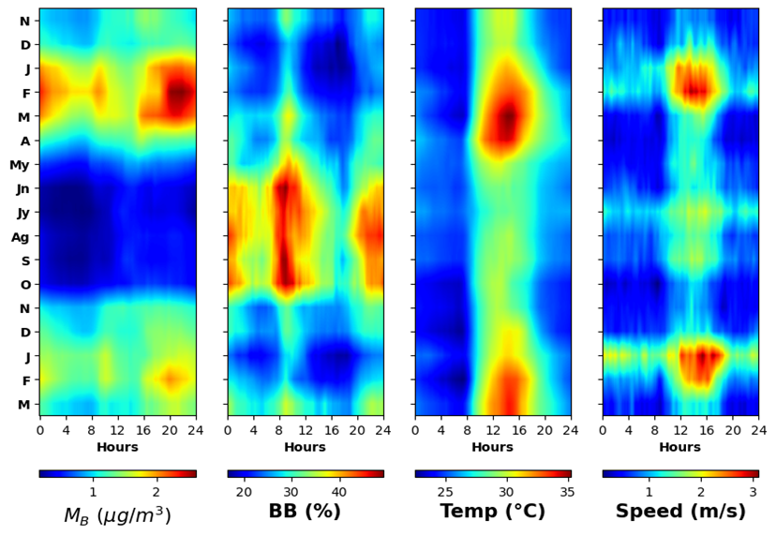
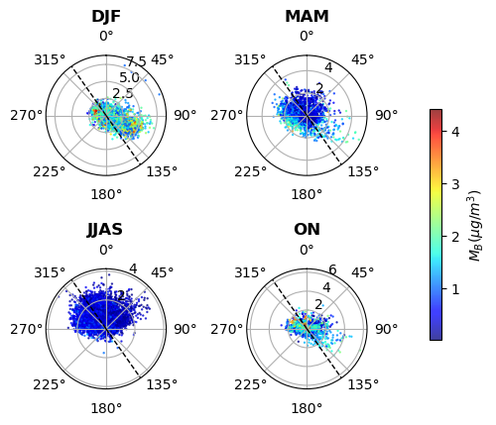
Aerosol presence in the location showed significant amenability to modulation through large-scale wind flows (the orography and proximity to the Arabian Sea aiding to some complex interactions) and local meteorology and ABL dynamics
Temporal Variation of M_{B}, biomass burning percentage (BB%), temperature and wind speed as observed from late November 2023 to early March 2025.
Wind Rose with wind speed represented through radius of spoke and M_{B} through color gradient

Slide 9
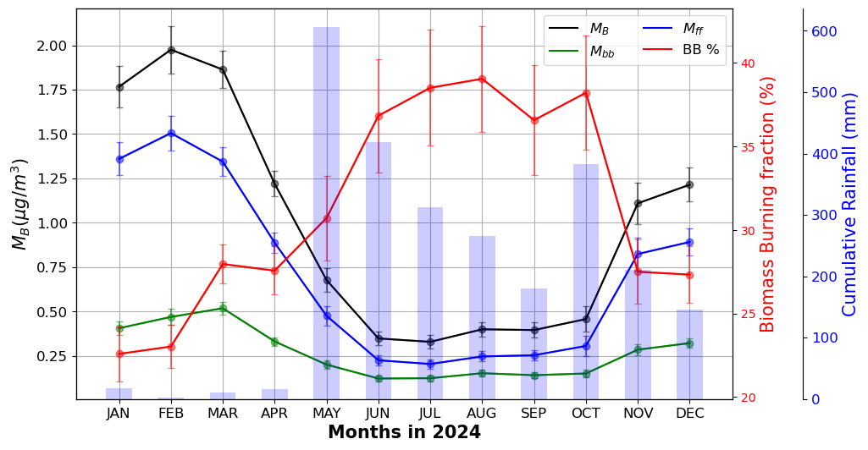
Monthly means of source apportioned BC mass concentrations and their biomass burning fractions (BB%).
Respective standard deviations have been shown as vertical bars.
Winter
(DJF)
1.497 ± 0.69 µg/m³
Summer
(MAM)
1.264 ± 0.67 µg/m³
Monsoon
(JJAS)
0.412 ± 0.27 µg/m³
Post-Monsoon
(ON)
0.872 ± 0.64 µg/m³
Seasonal M_{B} values:

Slide 10
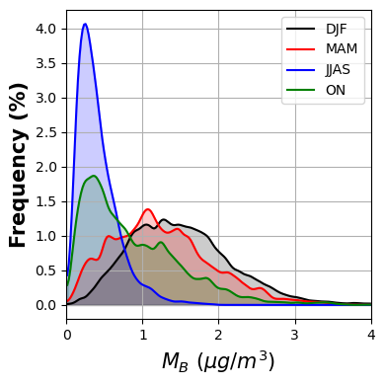
(M_{B})_{mean}:
0.96 ± 0.73 µg/m³
Despite this, the total M_{B} value was still significantly low compared to other near-pristine locations.
29.92%
from
biomass burning
70.08%
from
fossil fuel burning
Despite being a remote location, a high percentage of BC from fossil fuel combustion was measured, indicating long-range transport/advection from the nearest urban centre.

Slide 11
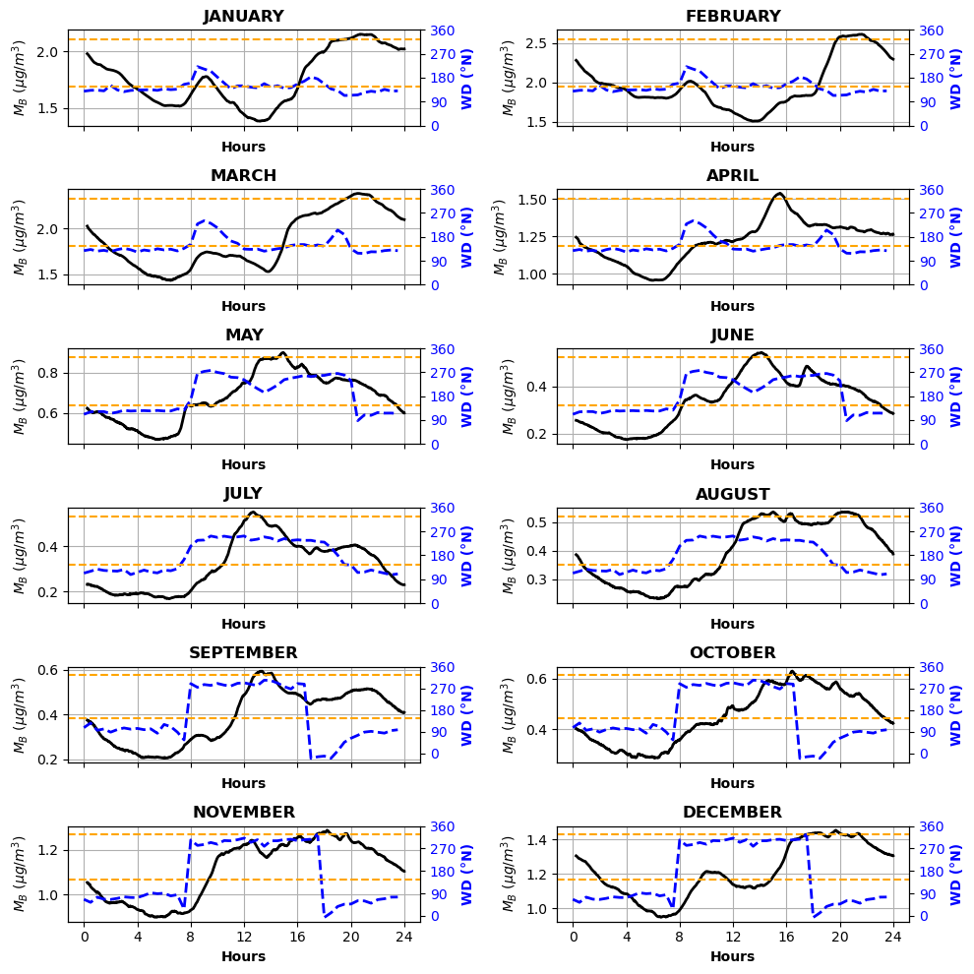
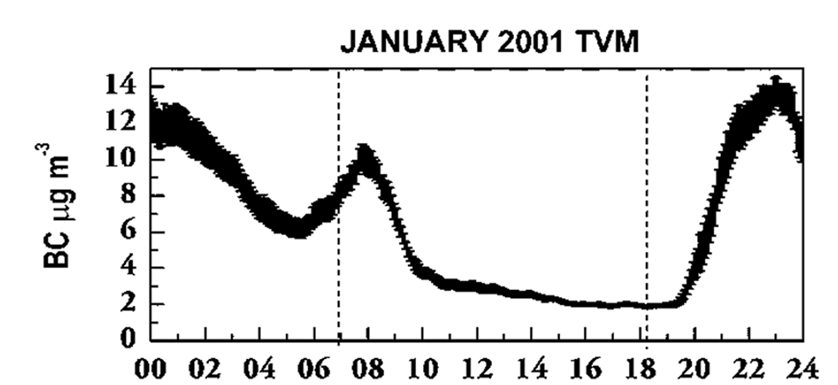
Diurnal Variation in M_{B}
Observed diurnal trends showing significant deviation from expected tropical mean diurnal trend in M_{B}
(Babu, Moorthy; 2001 measurements from Trivandrum)
Result of decoupled behaviour of BC from different sources, owing to their different origin and driving mechanisms
* orange dashed lines demarcates directions that constitute sea breeze regime

Slide 12
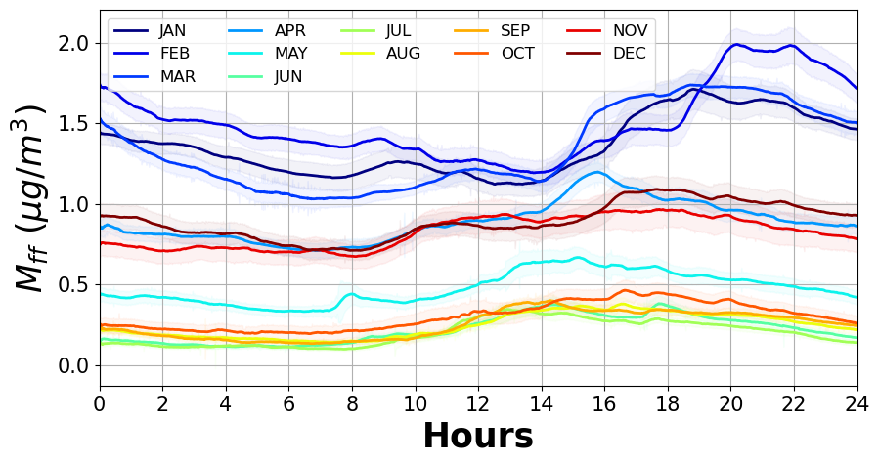
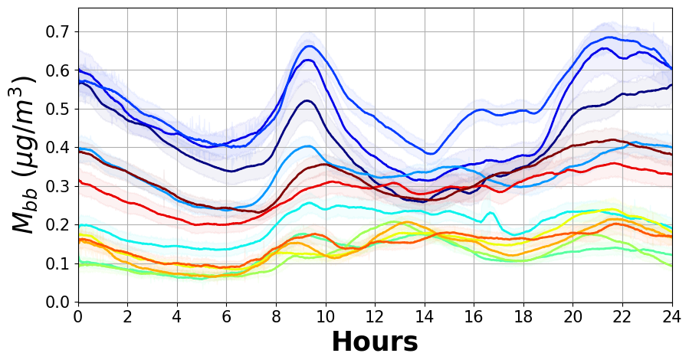
Source Apportionment
Result of advection from nearest urban centre
Modulated by large scale land-sea breeze circulations
Driver of afternoon peak seen in monsoon months.
Result of local emission and advection
Modulated by atmospheric boundary layer dynamics
Exhibits typical topical diurnal aerosol variation.
BC from Fossil fuel burning
BC from Biomass burning

Slide 13
M_{B} at location is chiefly modulated by its fossil fuel component (M_{ff}), which takes up almost 73.49% of total M_{B}.
As there are no direct sources for BC_{ff} in the vicinity, the BC_{ff} we see at our location is likely that transported from the nearest urban center. Our location lies downwind of the sea breeze regime, which can act as a conduit of transportation for the pollutants produced in the city.
BC_{bb} can be transported from the city, as well as have sources locally in the form of forest fires and domestic wood burning.
M_{B} is highest during JFM. Since the peak is contributed majorly by BC_{ff}, which is transported BC, the high values during the hottest months must be a result of increased boundary layer activity, which might have aided in more BC_{ff} being “uplifted” by ABL, which can then easily get advected to our measurement location. The values were lowest during monsoon due to wet deposition by the heavy rainfall received.
BB% shows the opposite behaviour by being lowest during winter (DJF) and highest during monsoon (JJAS). This might be a combined result of M_{bb} being higher due to burning of wet wood, which will create more smoke/BC than dry wood due to incomplete combustion, and a decrease in transported M_{ff} due to strong precipitation, which might be aiding in wet deposition of any transported BC, removing it from circulation before it can reach our location.

Slide 14
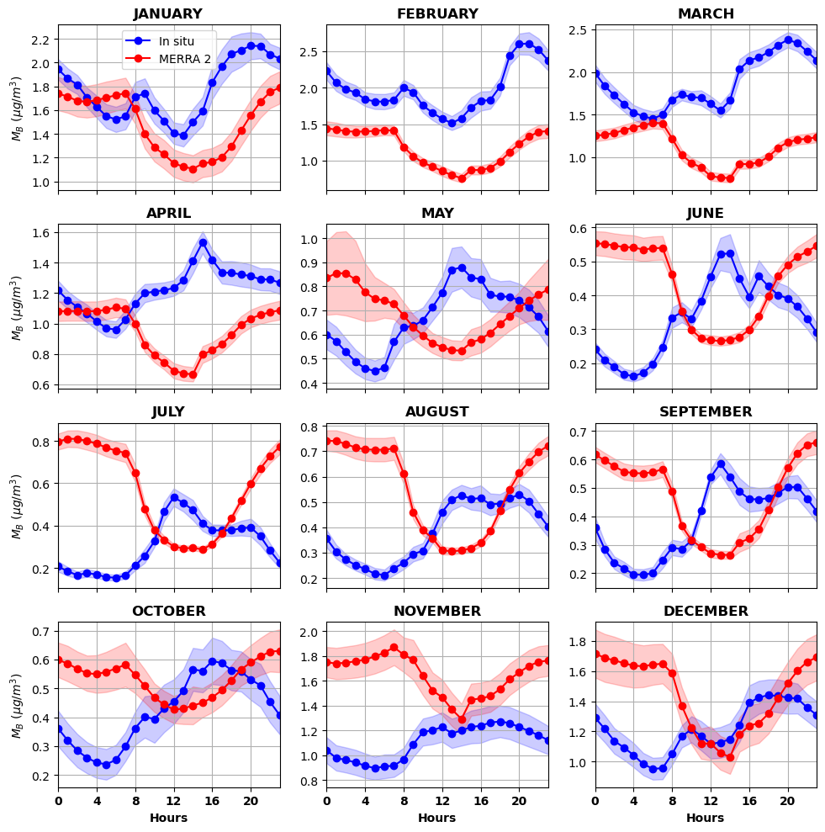
Comparison with Reanalysis Dataset
The varying patterns are a result of complex interaction between the land-sea breeze wind flows and local ABL dynamics, a characteristic specific to the location due to its geographical features.
This leads to modelled datasets not being able to capture the variations, as is visible in the figure.
This inability to generalise aerosol temporal evolution in the location warrants sufficient in-situ measurements.

Slide 15
SUMMARY
BC at a rural location like one mentioned in the current study, which is close to a forested area that presents pristine conditions and not far from an urban centre which represents anthropogenic influence and pollution, shows influence from both, the effect of which is primarily modulated by the impact of meteorological conditions expressed at site, and the influence of local boundary layer dynamics.
Despite being remote and having diurnal features similar to other high-altitude locations due to scarce local emissions, the location still falls within the inland fetch of the Arabian Sea causing the aerosol presence to be largely regulated by land-sea breeze dynamics.
It was observed that the major share of BC seen there is that from fossil fuel burning/traffic, though there are not any major sources for this near the location. This called to speculate that BC was getting transported from the urban center to our location.
On close inspection of the in-situ meteorological data, it could be surmised that BC_{ff} was getting transported through the sea breeze cell wind circulation, blowing from the urban center to our location, which has an inland fetch of ~40km, making our location fall in the regime. This could be clearly observed in the diurnal patterns of BC and WD, where BC_{ff} showed peaks following sea breeze.
BC_{bb} is a result of local domestic wood burning. Since there’s an elevation difference of only ~ 70 m amsl from the local village, BC_{bb} released can reach our location easily, facilitated by local boundary layer. We see peaks in BC_{bb} corresponding to increase in their production. During periods of strong local boundary layer activity, the increased convection leads to decreased levels (afternoon dip).
The inability to generalise aerosol temporal evolution in the location due to its unique geographical features warrants sufficient in-situ measurements.

Slide 16
ACKNOWLEDGEMENT
We acknowledge the Indian Space Research Organization (ISRO) for providing access to the Bhuvan data through the National Remote Sensing Centre (NRSC).
We acknowledge the National Aeronautics and Space Administration (NASA) for providing access to the Modern-Era Retrospective analysis for Research and Applications, Version 2 (MERRA-2) data through the NASA Goddard Earth Sciences (GES) Data and Information Services Center (DISC).
Anand acknowledges the Department of Science and Technology (DST), India for the INSPIRE Faculty Fellowship (faculty registration number: IFA20-EAS-83)

