Slide 1
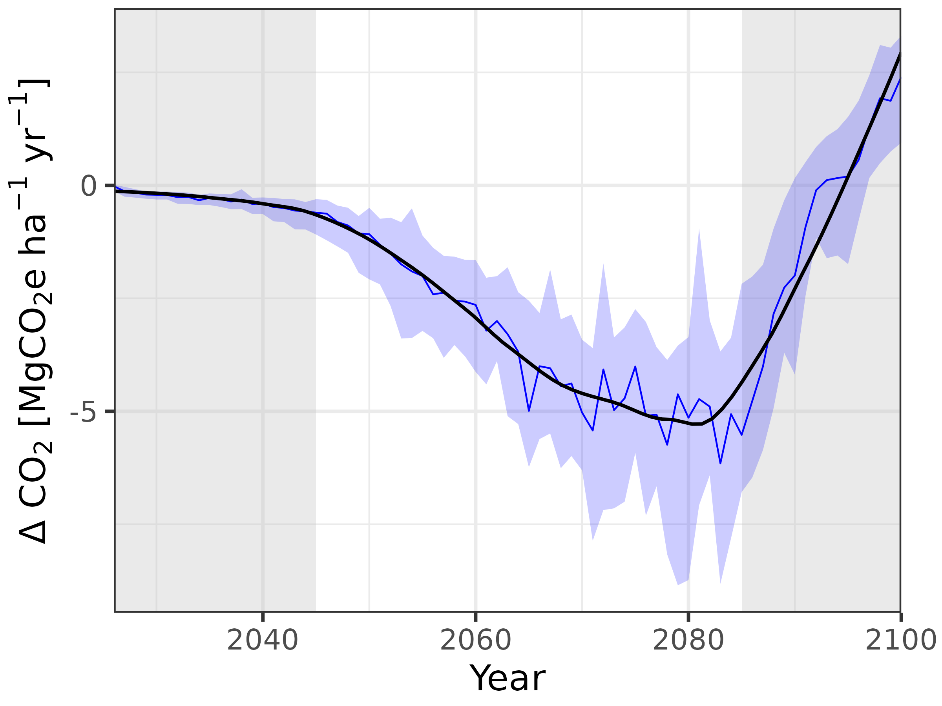
Total CDR per ha and year

Slide 2
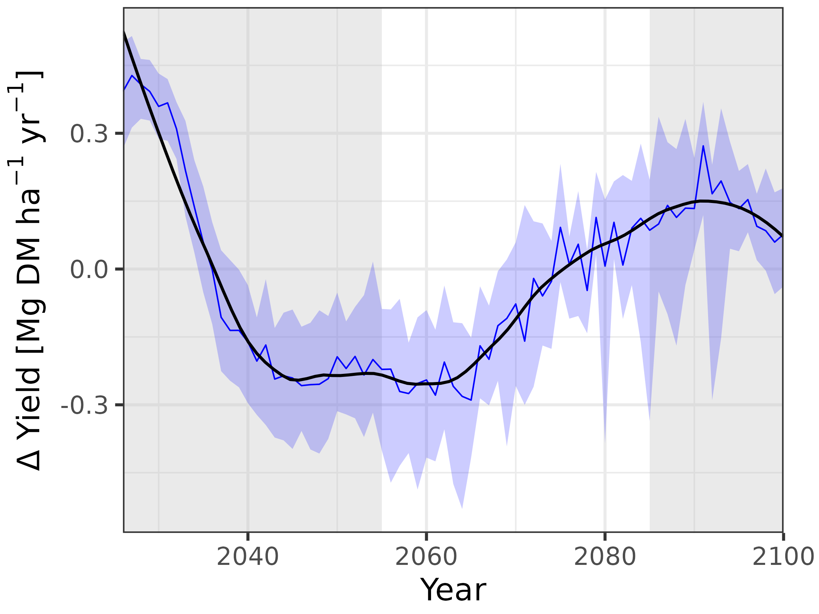
Yield loss per ha and year

Slide 3
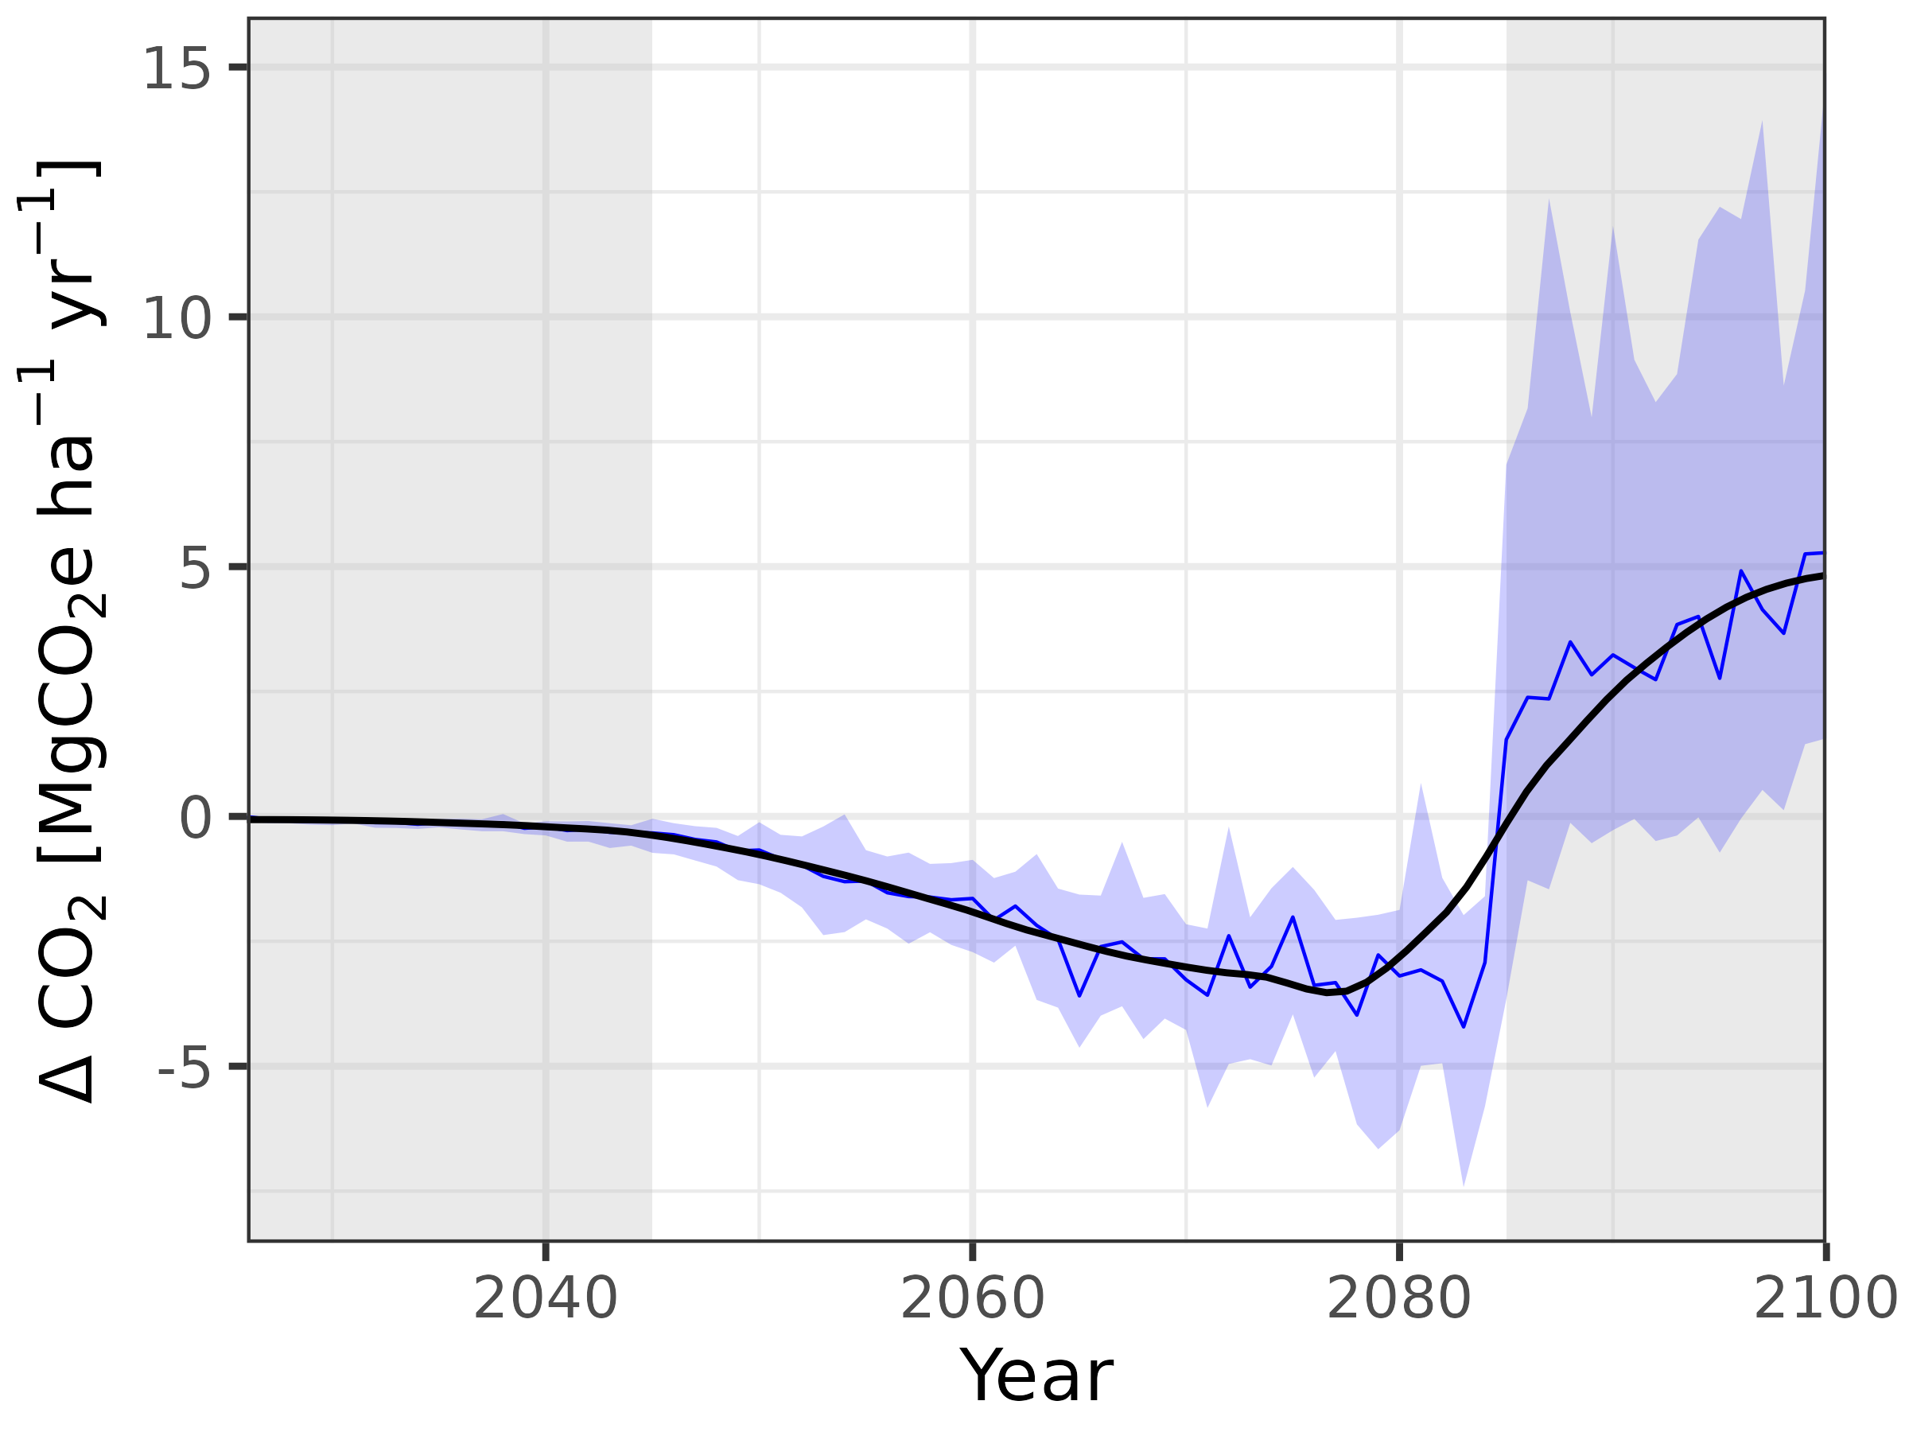
CDR of vegetation per ha and year

