Slide 1
Instabilities of the magnetotail current layer: hybrid-Vlasov simulations of the Earth’s magnetosphere
Ivan Zaitsev¹⁾, Giulia Cozzani²⁾, Markku Alho¹⁾, Konstantinos Horaites¹⁾, Hongyang Zhou³⁾, Sanni Hoilijoki¹⁾, Yann Pfau-Kempf¹⁾, Markus Battarbee¹⁾, Urs Ganse¹⁾, Konstantinos Papadakis¹⁾, Jonas Suni¹⁾, Venla Koikkalainen¹⁾, Lucile Turc¹⁾, and Minna Palmroth^{1),4)}
1) Department of Physics, University of Helsinki, Finland
2) LPC2E, CNRS, CNES, OSUC, University of Orléans, Orléans, France
3) Department of Astronomy, Boston University, MA, USA
4) Finnish Meteorological Institute, Helsinki, Finland
EGU General Assembly 30.04.2025

Slide 2
Outline:
Overview on tearing and kink instabilities
Magnetotail dynamic in global hybrid-Vlasov simulations
Conclusions

Slide 3
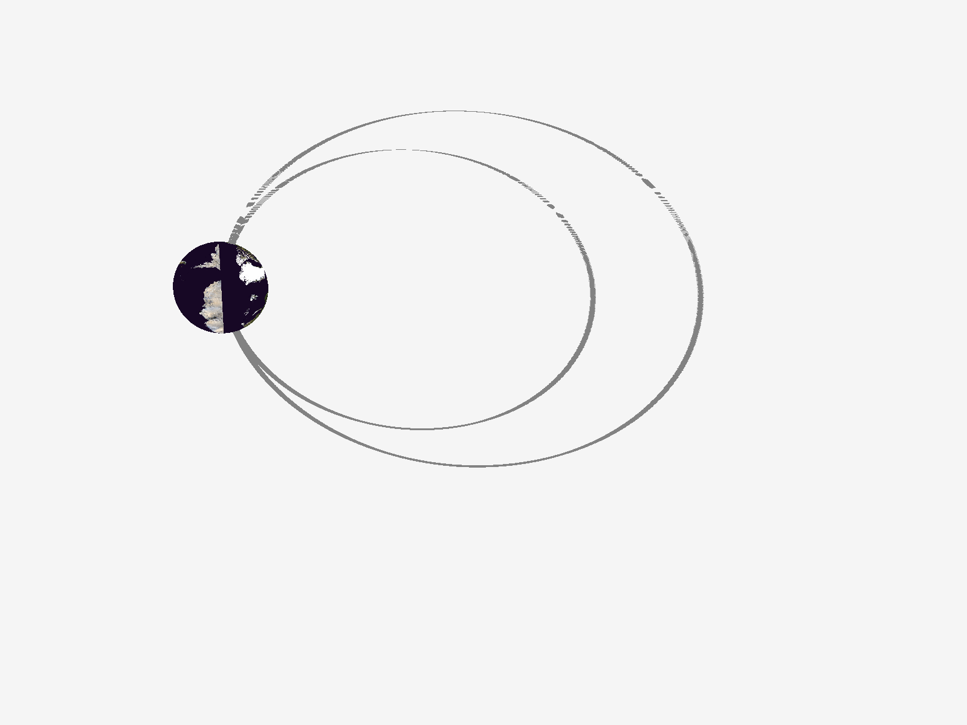
Magnetotail current is supported by Speiser orbits
Magnetic Flux Uploading:
Current layer thins due to external drivers
Ions become less magnetized, intensifying meandering motion in the neutral plane

Slide 4
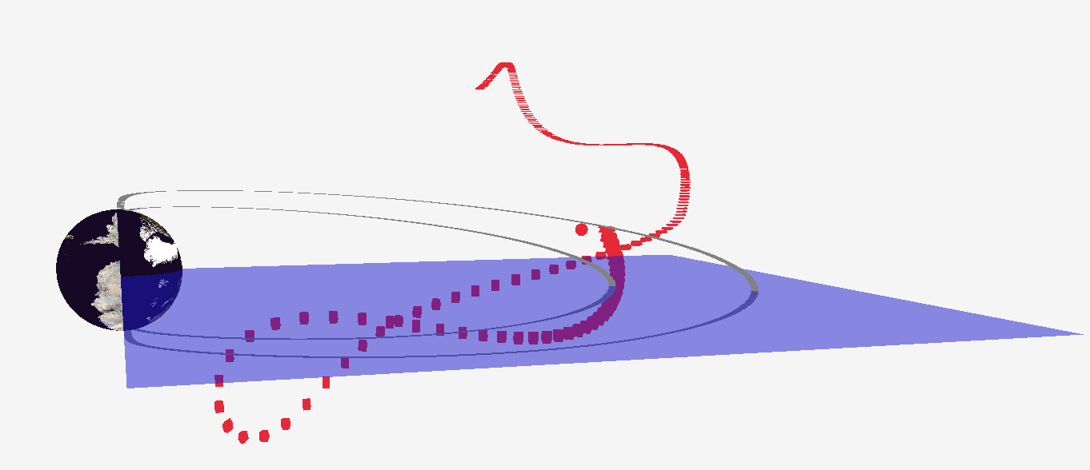
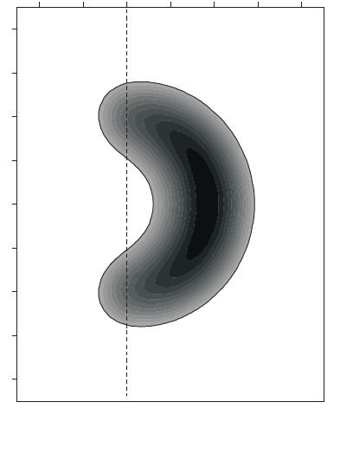
Inside the thin current layer particles are demagnetized
Z
X
Y
Meandering orbits drives unstable velocity distributions
Z
Adiabatic motion
Vy
+ L
Non-Adiabatic motion
(appears when current layer is thin)
i+
Vz
- L
Y
[Daughton 1999]
0

Slide 5
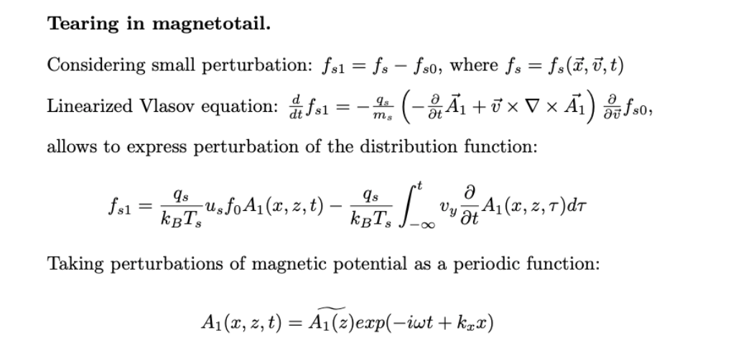
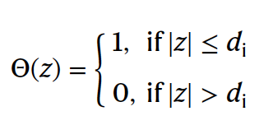
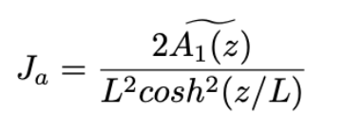
Jy
resonance term
kx
Tearing
[Coppi et. al 1966, Dobrowolny 1968, Pritchett et. al. 1991]

Slide 6
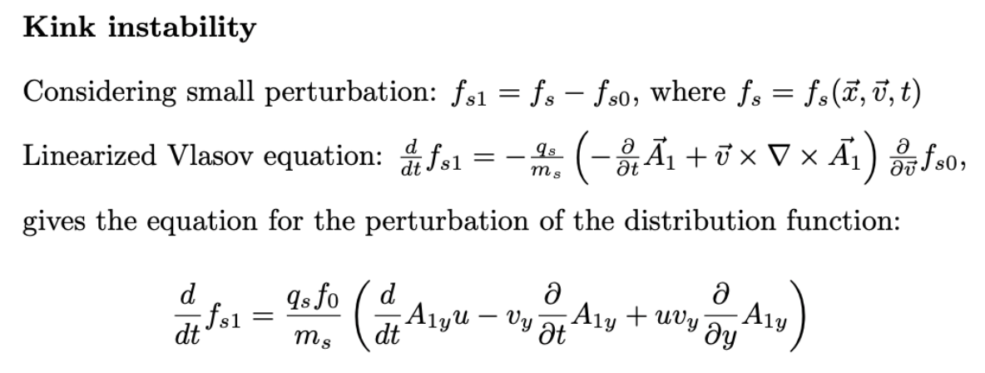
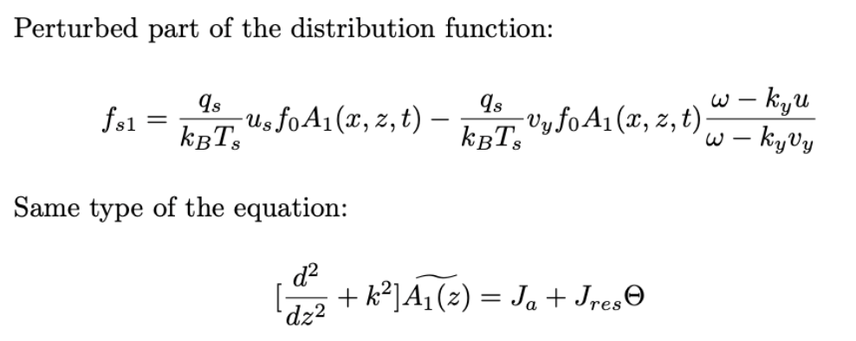
Jy
kx
ky
resonance term
Tearing
Kink
where
[Lapenta Brackbill 1997]

Slide 7
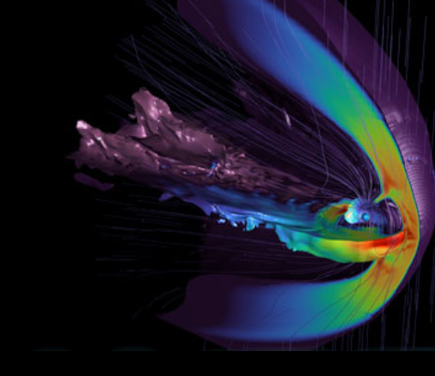
Simulations results:
Impressive Movie here

Slide 8
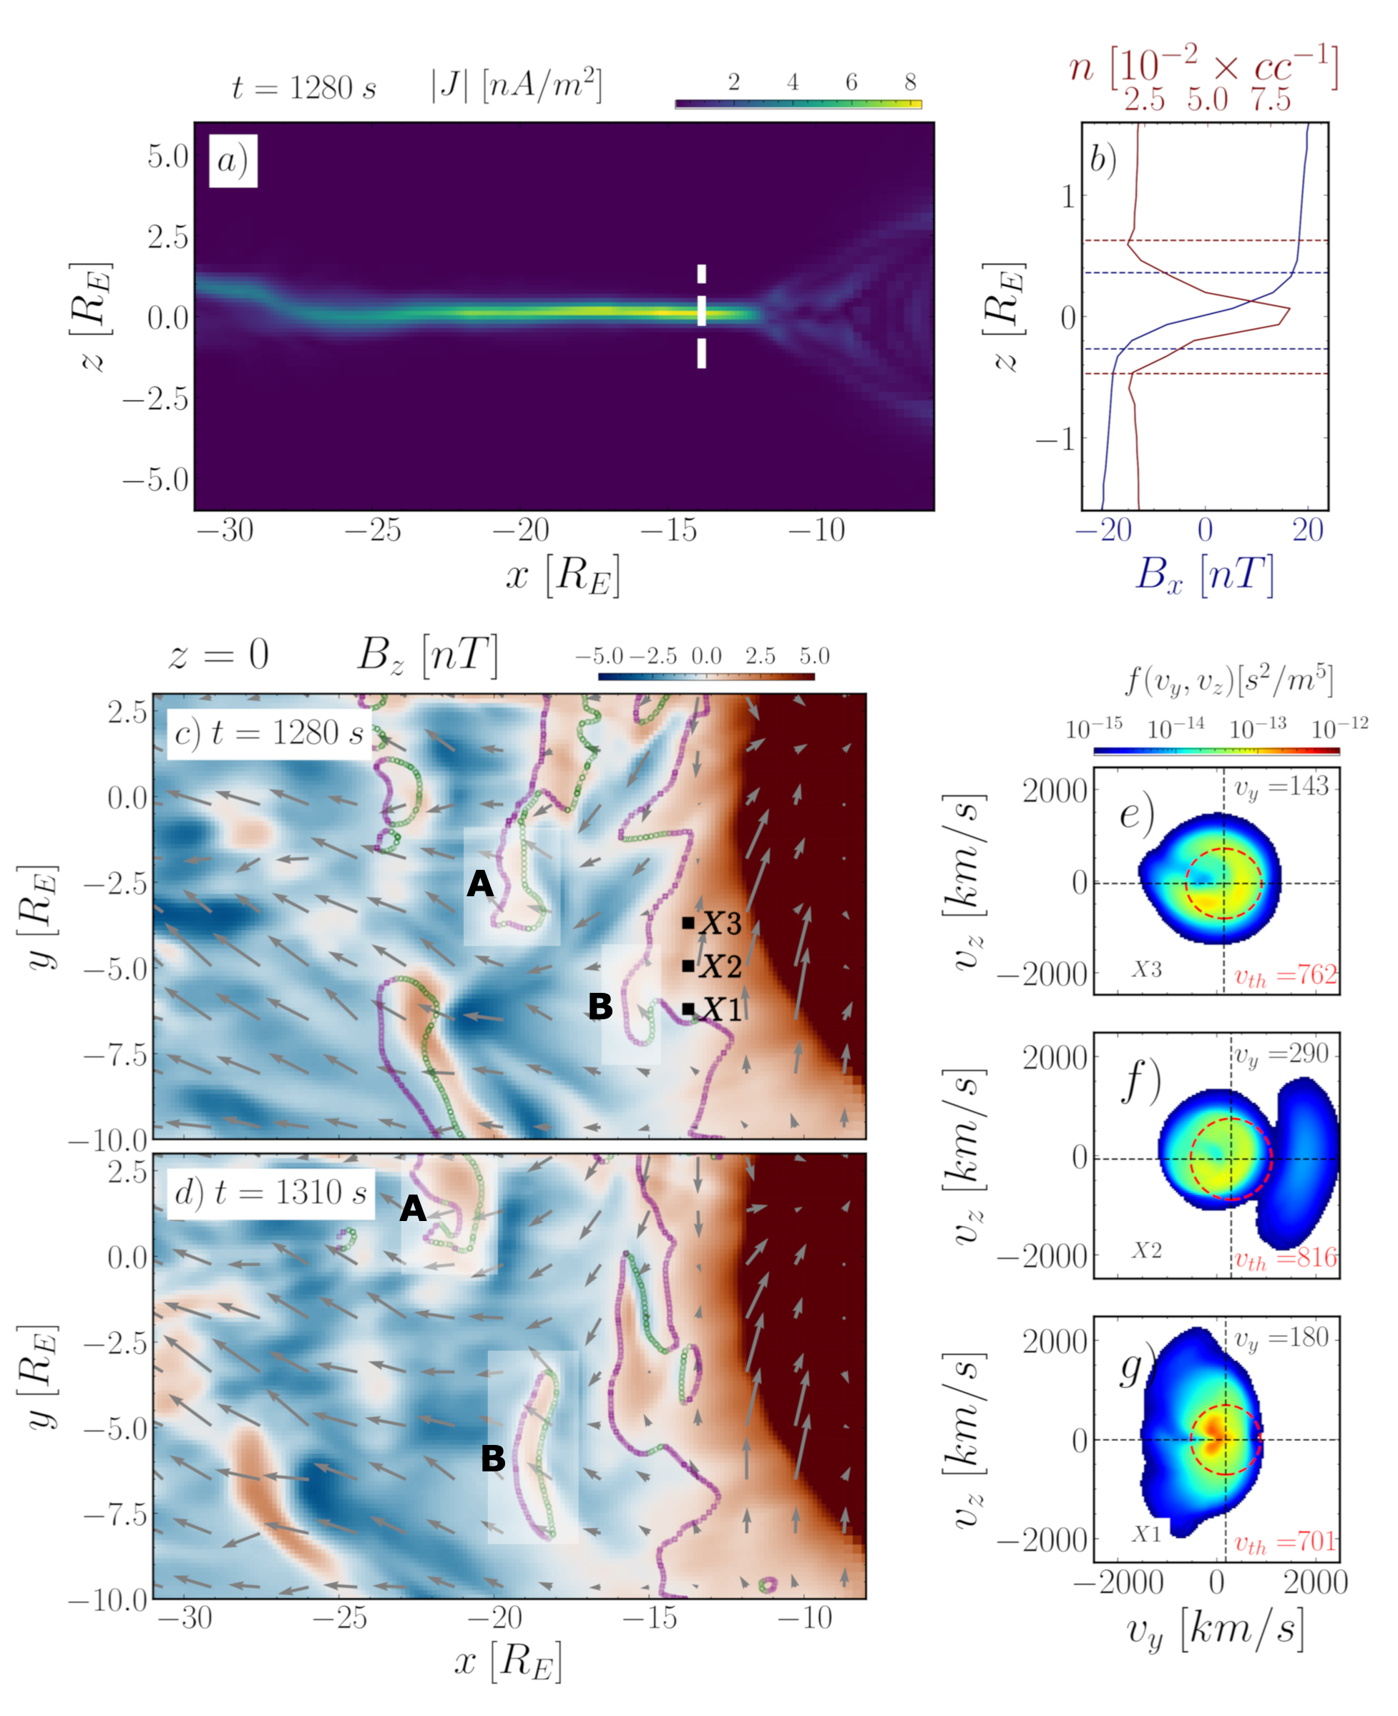
Formation of the thin current layer and development of the X-line
Peak density: n₀ ~ 0.08 cc⁻¹
=> ion skin depth: d_{i} ~ 800 km
B_{lobe} ~ 20 nT
=> ion cyclotron frequency ~ 1.9 Hz
Width of the current layer: L ~ 4000 km
Thermal velocity ~ 700 - 800 km/s
Drift velocity ~ 150 - 300 km/s
Resonance population (Crescents)
Deflection of inflowing ions by
magnetic forces
X-line
O-line

Slide 9
0
1
High-energy crescent distributions represent
demagnetisation / resonance:
2
3
4
5
6
7
t =1280 - 1320 s:
Resonance population travels from P4 to P0
before the X-line development

Slide 10
Tearing analysis
North
Current layer with small normal B-field
Formation of the magnetic islands
Current layer with small normal B-field
South
Tailward direction
Earthward direction

Slide 11
Tearing analysis

Slide 12
Tearing analysis
Examples of current profiles
for which we apply
spatial Fourier transformation:
Averaging over spatial domain Nz = Ny = 3 dx
(adaptation of the method proposed by [Hoshino 1987])
Select harmonics with amplitudes > 0.5 nA/m
m = 2,3 = >
Time evolution of the Fourier modes
Slope gives the estimations for the growth rate
Parametric scan over the CL width

Slide 13
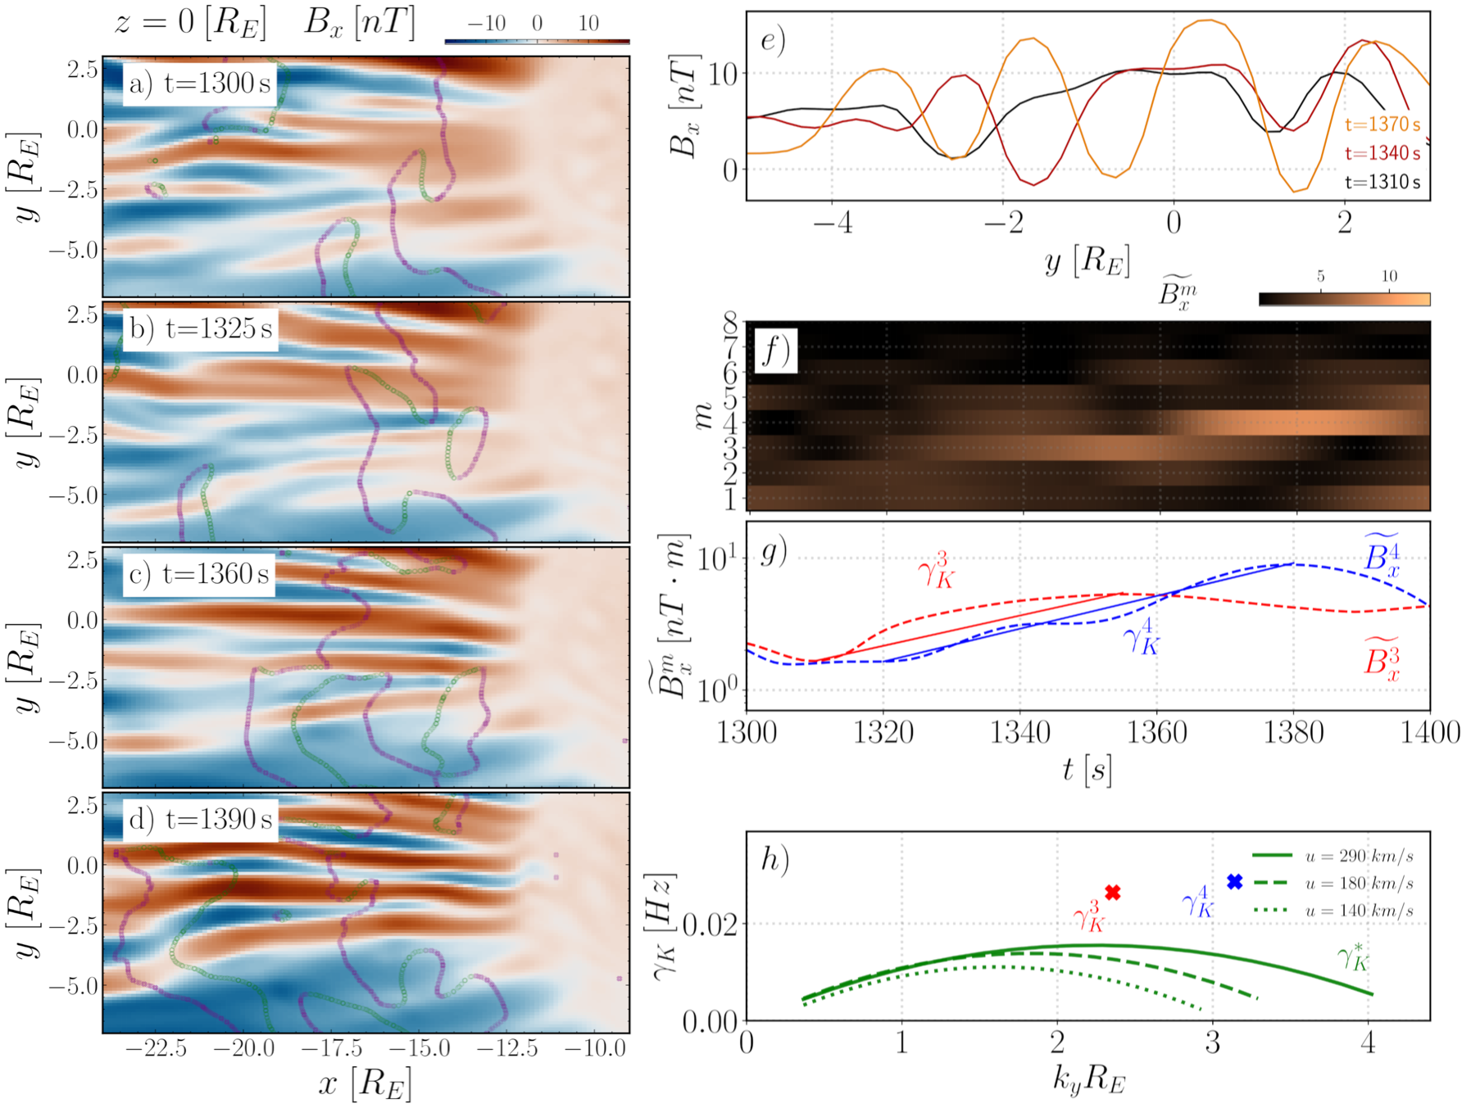
Kink analysis

Slide 14
Kink (Flapping) analysis
Dusk
Intensification of Bx (stripe pattern)
is due to vertical oscillations of the current layer
Formation of the X-O lines
X-O lines are removed by kink?
Dawn

Slide 15
0
1
After 1350s X-O lines disappears
in the near-Earth region (x> -15 Re)
2
3
4
5
6
7
With the development of the flapping (kinking)
- crescents are thermalized

Slide 16
Conclusions:
Tearing instability:
a) Develops along the Sun-Earth direction.
b) Drives the formation of reconnection X-lines.
c) Amplifies meandering, leading to the formation of crescents
Kink instability :
a) Develops along the dawn-dusk direction.
b) Causes flapping.
c) Thermalizes crescents.
Jy
kx
ky
Tearing
Kink
On instabilities - Zaitsev et. al. 2025 JGR
Kink impact on the reconnection rate - Cozzani et. al. 2025 GRL

Slide 17
Thank you for attention !

Slide 19
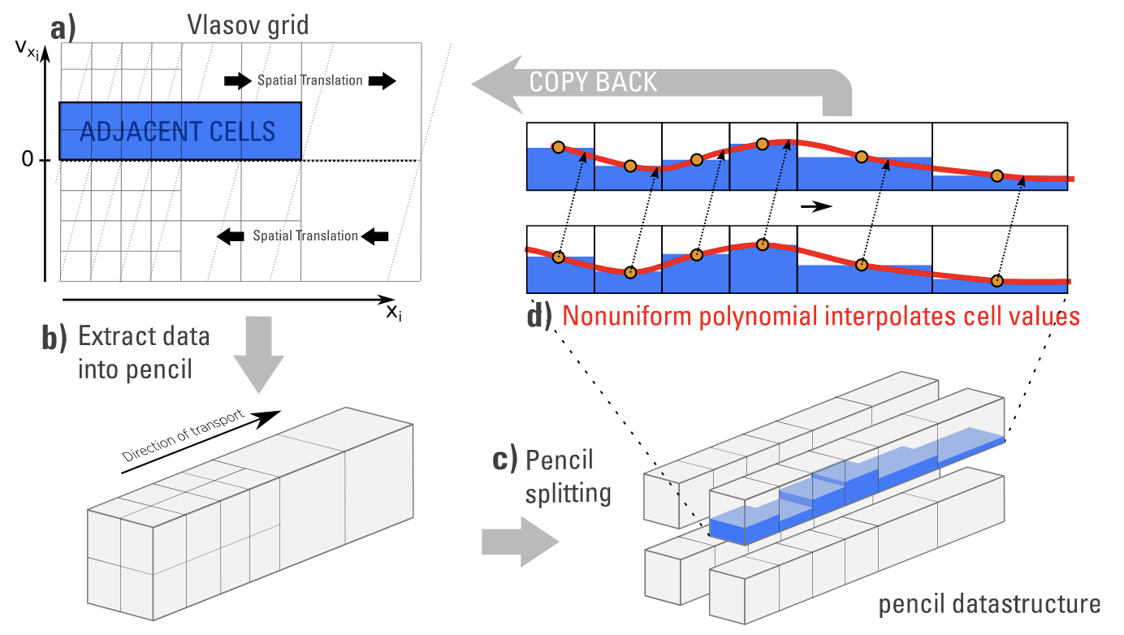
Vlasiator: Vlasov solver
Urs Ganse et. al [2023] : Enabling technology for global 3D+3V hybrid-Vlasov simulations
Translation step: Linear shear of f in the (x,v_{x}) space
Acceleration: Electric field cause linear shift of f in v-space and Lorenz force cause gyration
Acceleration step affects velocity space locally within each spatial cell.

Slide 20
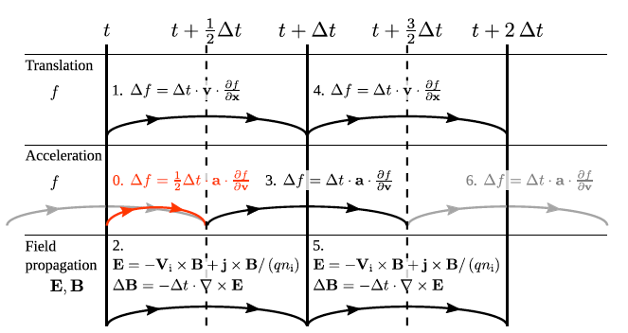
Vlasiator: computation scheme
Vlasov equation:
Acceleration
Translation
Strang Splitting (leapfrog scheme)
Vlasov Solver
Field Solver
Closure via the Ohm’s law
Darwin approximation for Maxwell’s equations
[Palmroth et. al. 2018 ]

Slide 21
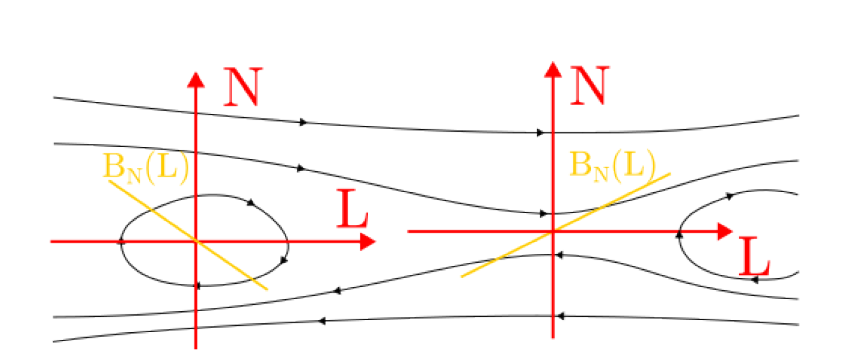
X-O detection
Find current layer (|J|>2 nA/m)
Determine local LMN coordinates (cellwise):
N ~ Z - Minimum Derivative Direction
L ~ X - Maximum Variance Component
Detect intersection of isosurfaces BN=0 and BL=0
Distinguishing X (dBN/dL >0) and O (dBN/dL <0)
[Alho et. al. 2024]

Slide 22
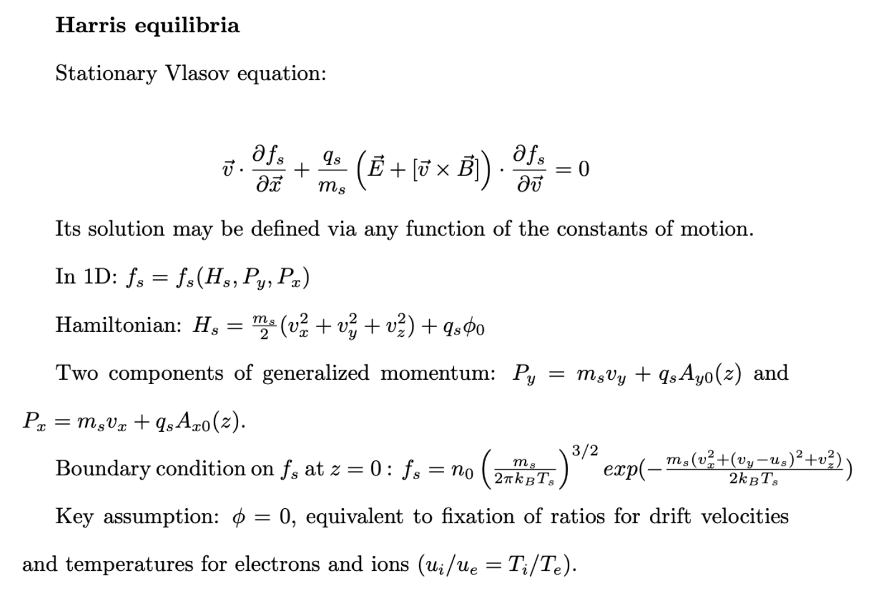
Z
Jy
Bx
[Harris 1962]

Slide 23
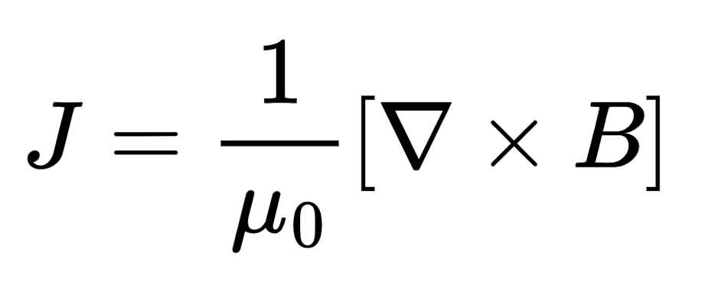
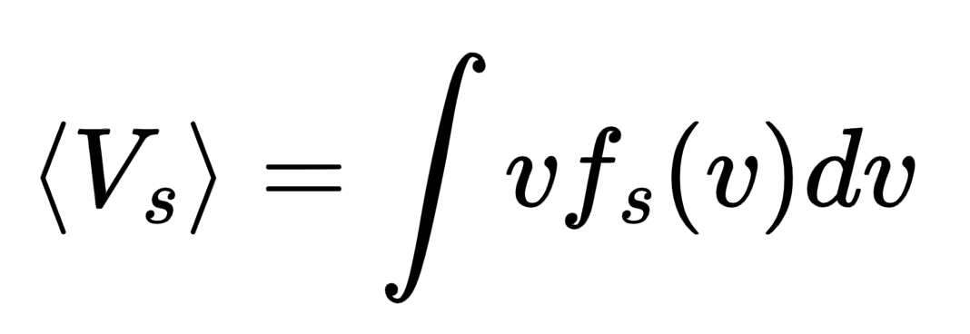
Boundary layers :: Current layers
- link macroscale magnetic field topology and microscale kinetic effects via reconnection
Magnetotail
Magnetopause
MHD description:
Kinetic current:
Coronal loops
Where

Slide 24
We will consider magnetotail current
X - Sun-Earth direction
Y - Direction of the current
Z - Normal
Magnetotail
Magnetopause
Coronal loops
Z
Jy
Bx

