Slide 1



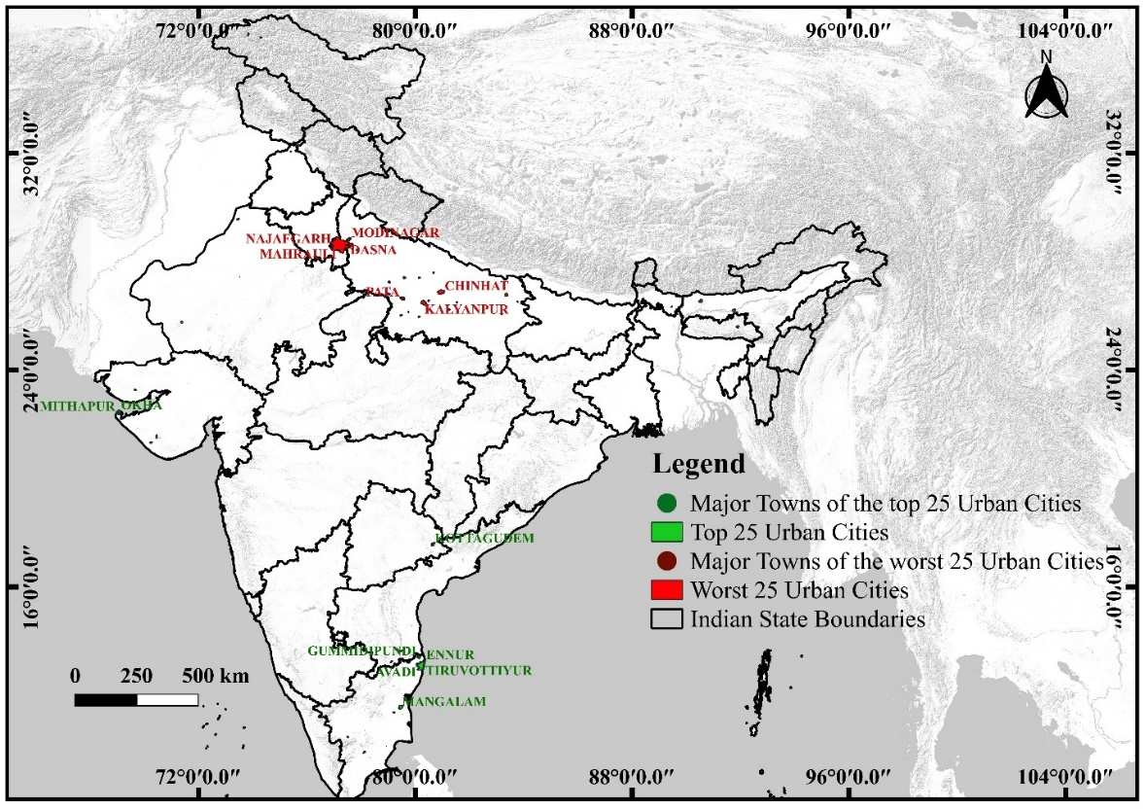
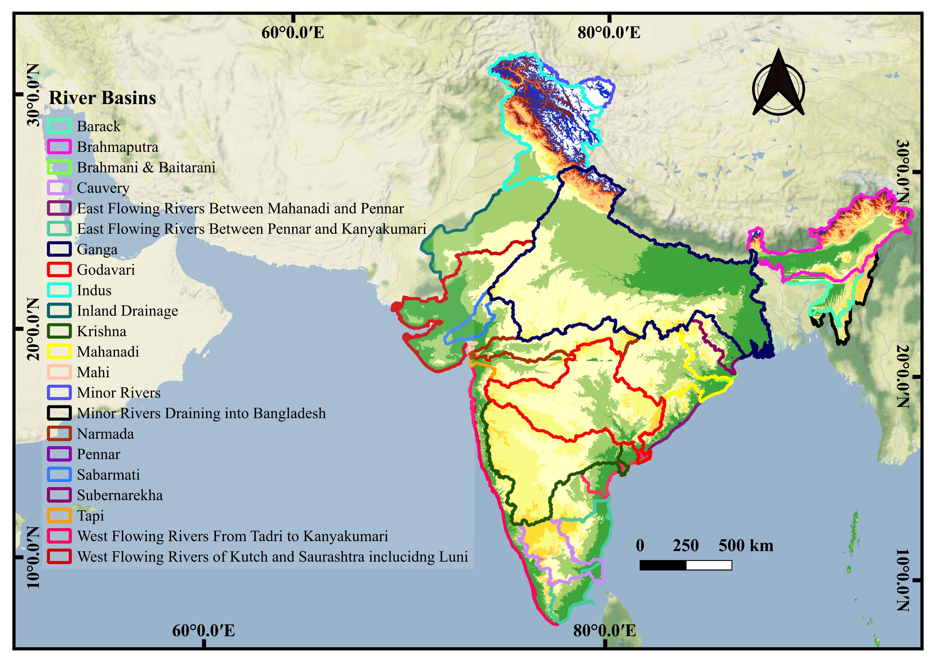
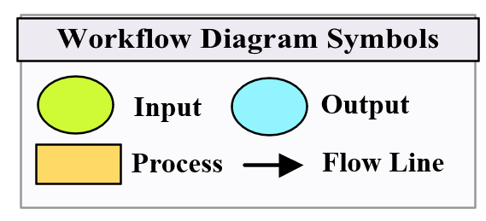
Climate Variability and Extremes in Indian River Basins: Trends, Regional Disparities, and Urban Risk Assessment
Date: 28/4/2025
Session: Advances in Estimation of Hydrometeorological Extremes and their Applications in Society
Presentation ID: EGU25-1114
Dr. Srija Roy and Prof. Manish Kumar Goyal

