Slide 1
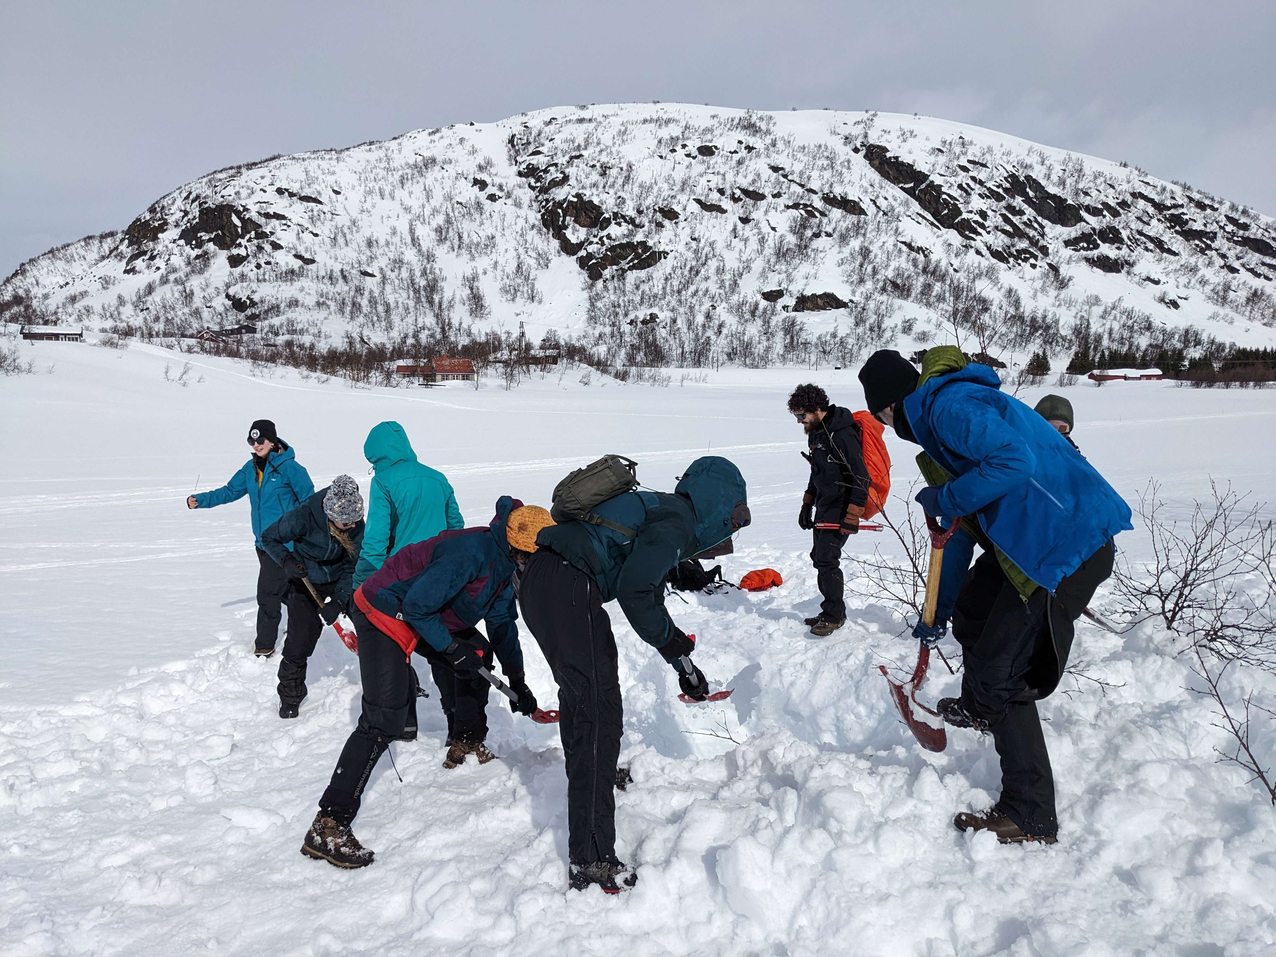
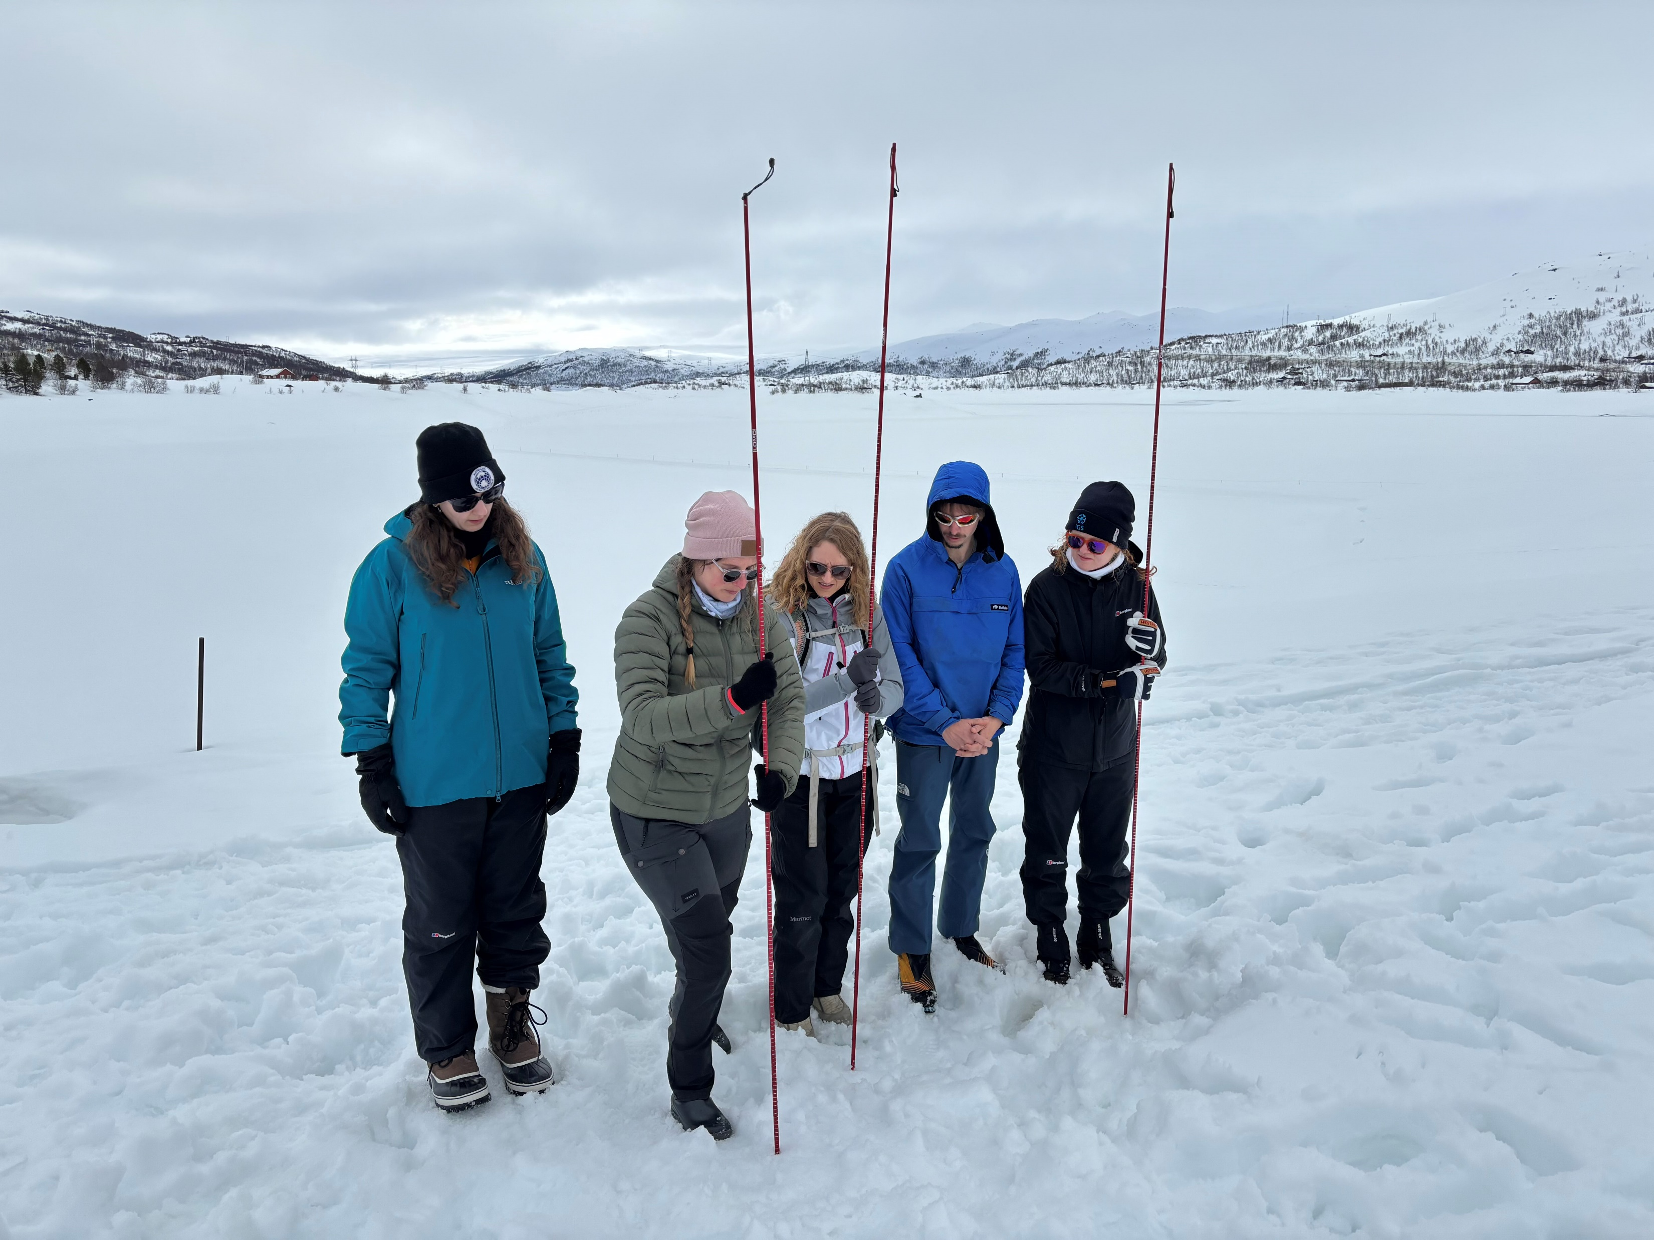
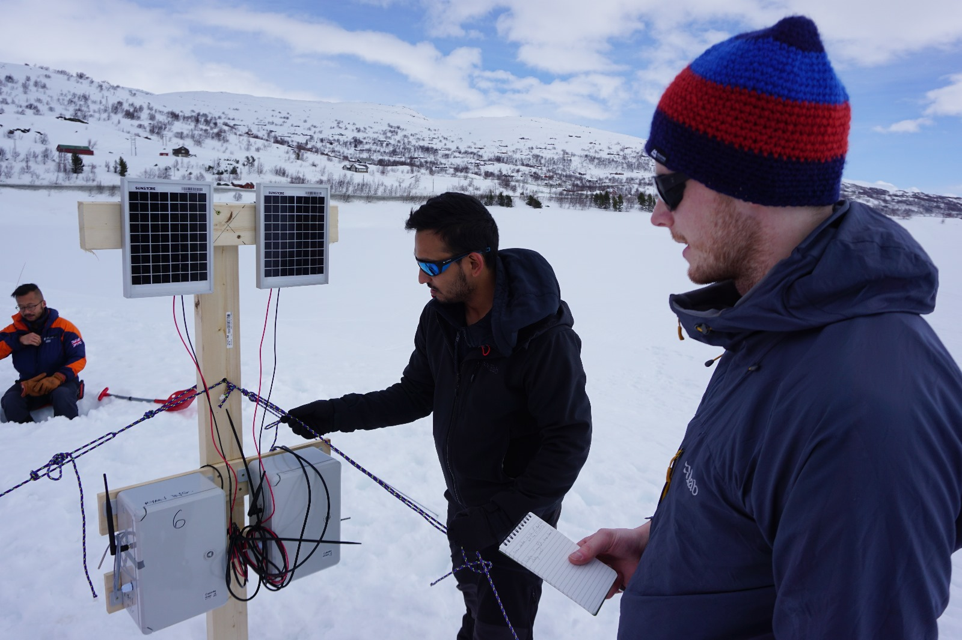
Sharing good cryospheric fieldwork practice with the next generation of scientists Mike Prior-Jones, Elizabeth Bagshaw, Lisa Craw, Samuel Doyle, Simon Filhol, Emma Fisher, Donna Frater, Jonathan Hawkins, Larissa van der Laan, Emma C Smith, and Tun Jan Young
PICO 3.1

Slide 2
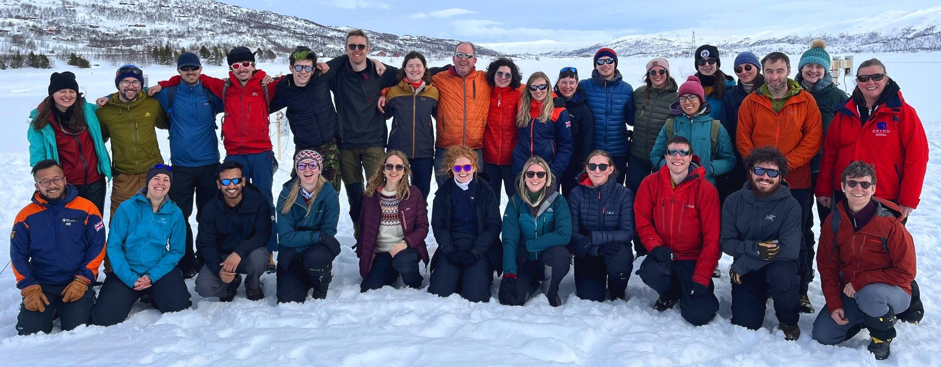
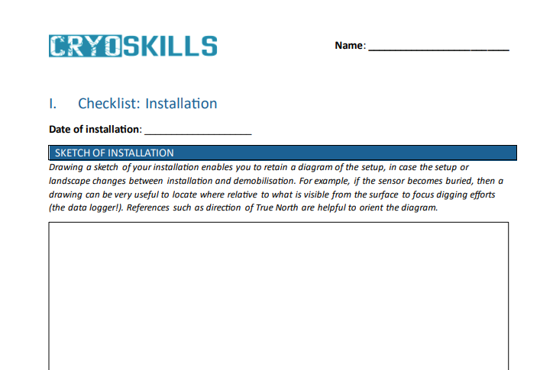
The Three Standard Objectives of scientific fieldwork are:
Everyone comes home safely
Everyone is still friends
Scientific objectives are achieved
in that order of priority!
Your body functions best when you are
well-rested, well-fed and comfortable.
You do not need to suffer to be a successful field scientist.
If one member of your team is too cold, then you need to solve that problem together.
Discomfort is a valid reason to stop work.
PICO 3.1

Slide 3
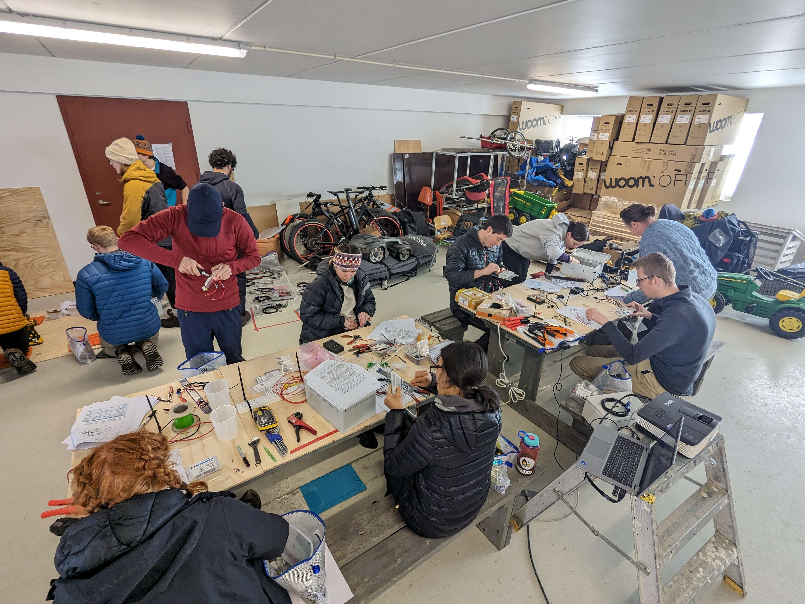
CryoSkills – a new field course
Held at Haugastøl, Norway in April 2024
Teaching teamwork, inclusivity and good practice
Learn more about the venue
Learn more about our approach to the course
Teaching engineering skills to cryospheric scientists
Teaching field skills for a snowy environment
Learn more about the technical content
Learn more about the field skills

Slide 4
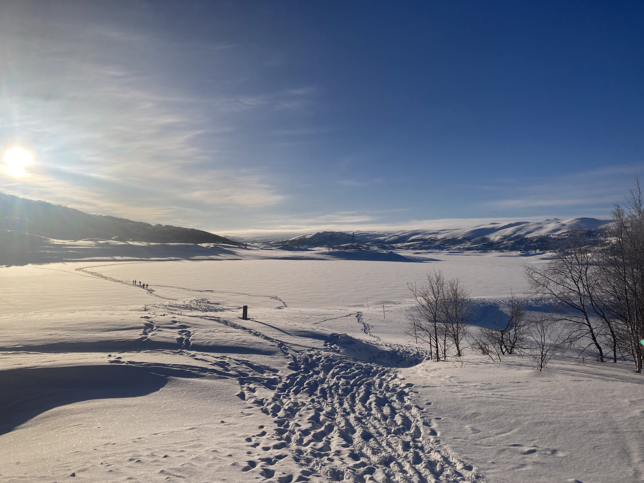
Haugastøl Turistcenter – a hotel and activity centre
on the edge of the Hardangervidda plateau

Slide 5
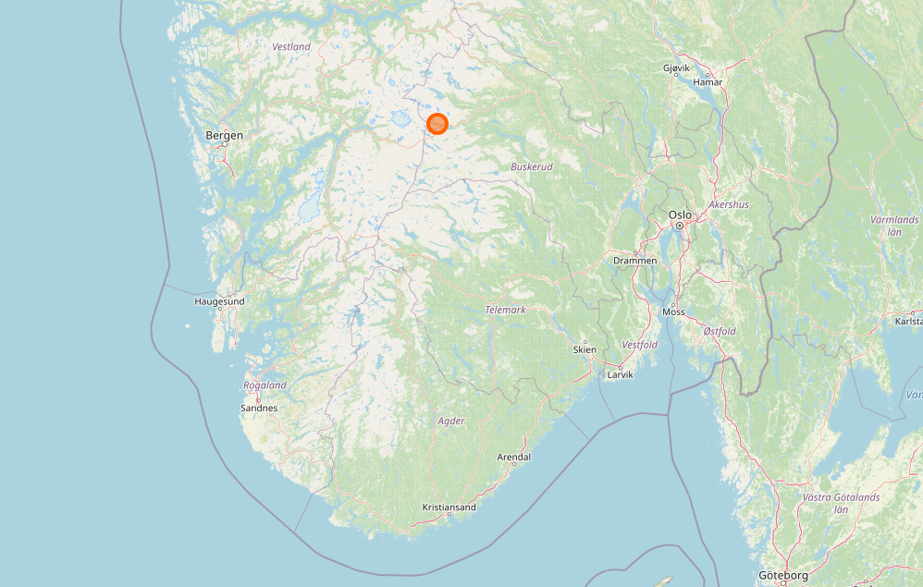
Half-way between Oslo and Bergen – on the main road and railway line

Slide 6
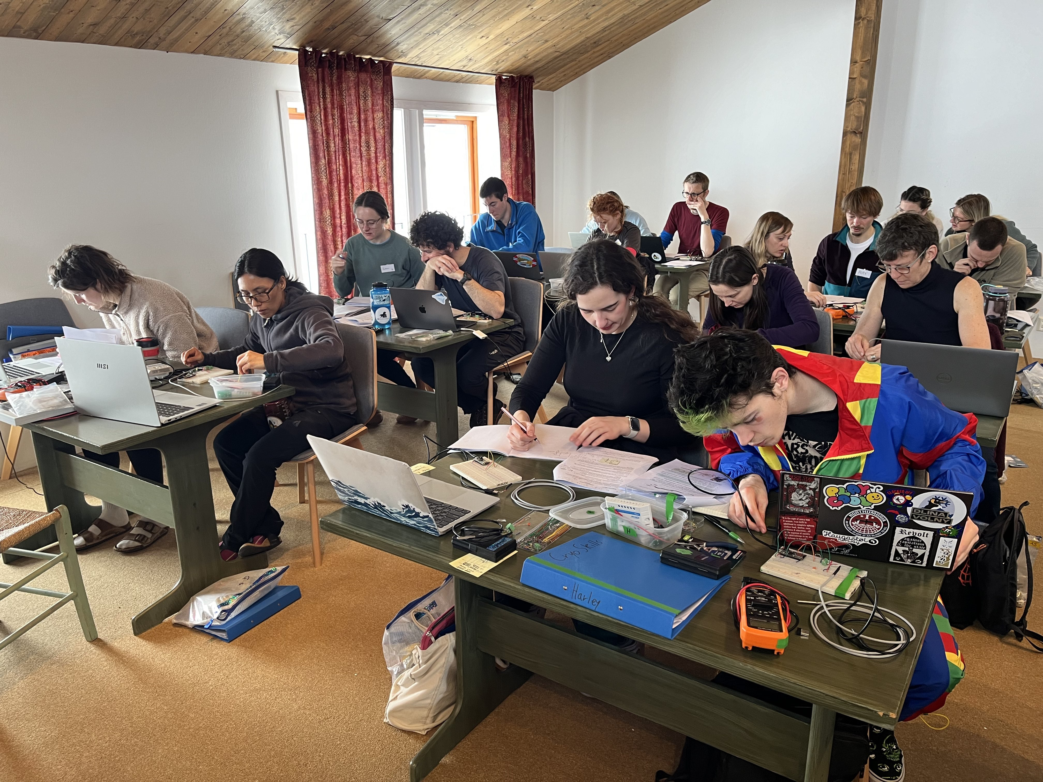
Why Haugastøl?
Location has ~1m snow cover in April
Excellent setup for teaching:
Indoor classroom with projector
Garage we could use as a lab / workshop
Outdoor teaching in the grounds – if anyone gets cold, they can go inside within minutes
More comfortable and less intimidating than a research station
Safe – accommodation in small apartments with card access
Incredibly good food and friendly staff team!

Slide 7
Challenges in cryospheric science fieldwork culture
These approaches are common on fieldwork, and they’re both unhelpful and exclusionary:
Machismo – “You’ve got to be tough enough!”
Unhealthy science focus – “We only have a limited time in the field so we can’t stop for lunch or comfort breaks – we have to keep working”
Martyrishness – “You’ve got to suffer for the science”
Penny-pinching – “We can’t afford the fuel to wash dishes in hot water”
Assuming skills and knowledge – “what do you mean, you can’t use a ratchet strap? Everyone knows how to do that!”
We aim to change that for the next generation of scientists!

Slide 8
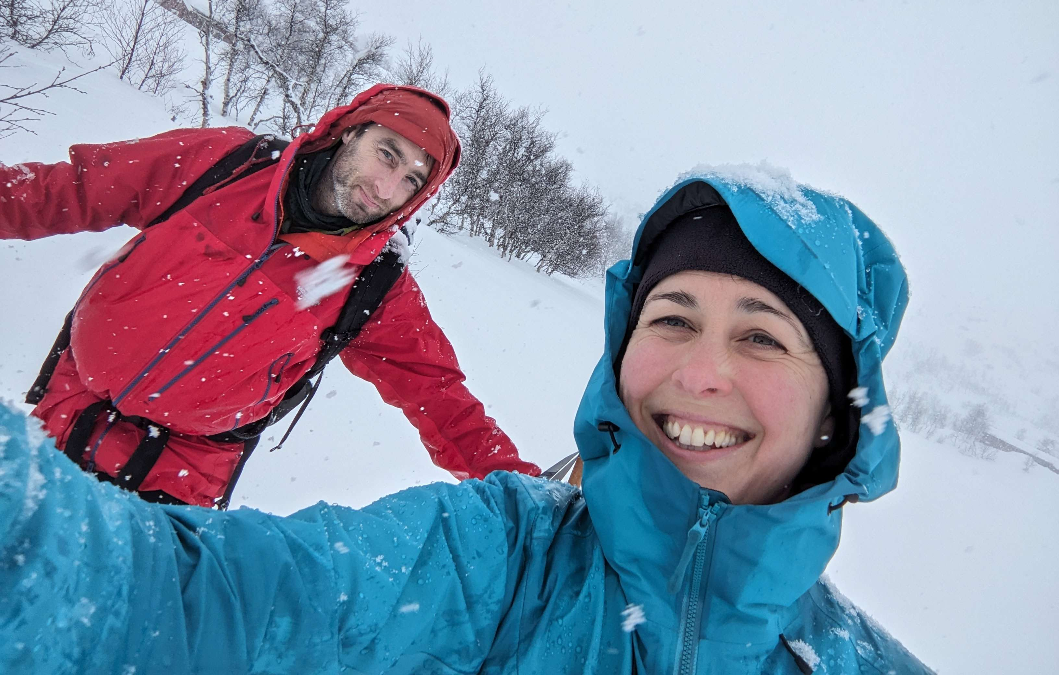
Our approach to fieldwork
These are all extracts from the course material
The Three Standard Objectives of scientific fieldwork:
Everyone comes home safely
Everyone is still friends
Scientific objectives are achieved
In that order!
Your body functions best when you are
well-rested, well-fed and comfortable.
You do not need to suffer to be a successful field scientist.
If one member of your team is too cold, then you need to solve that problem together.
Discomfort is a valid reason to stop work.

Slide 9
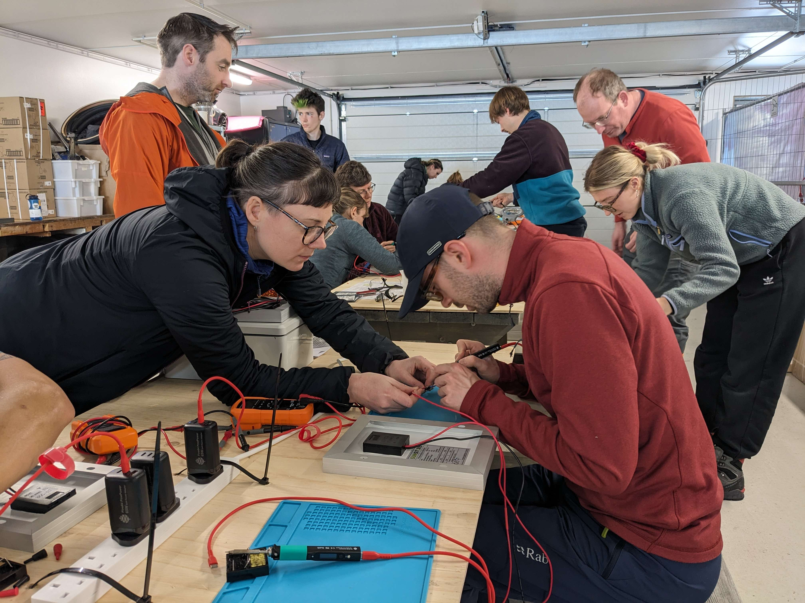
Trust
Trust is the foundation of all good teamwork!
Help build trust:
Be prepared - show that you care
Eat and drink together
Train together
Work together on simple tasks before attempting complex ones

Slide 10
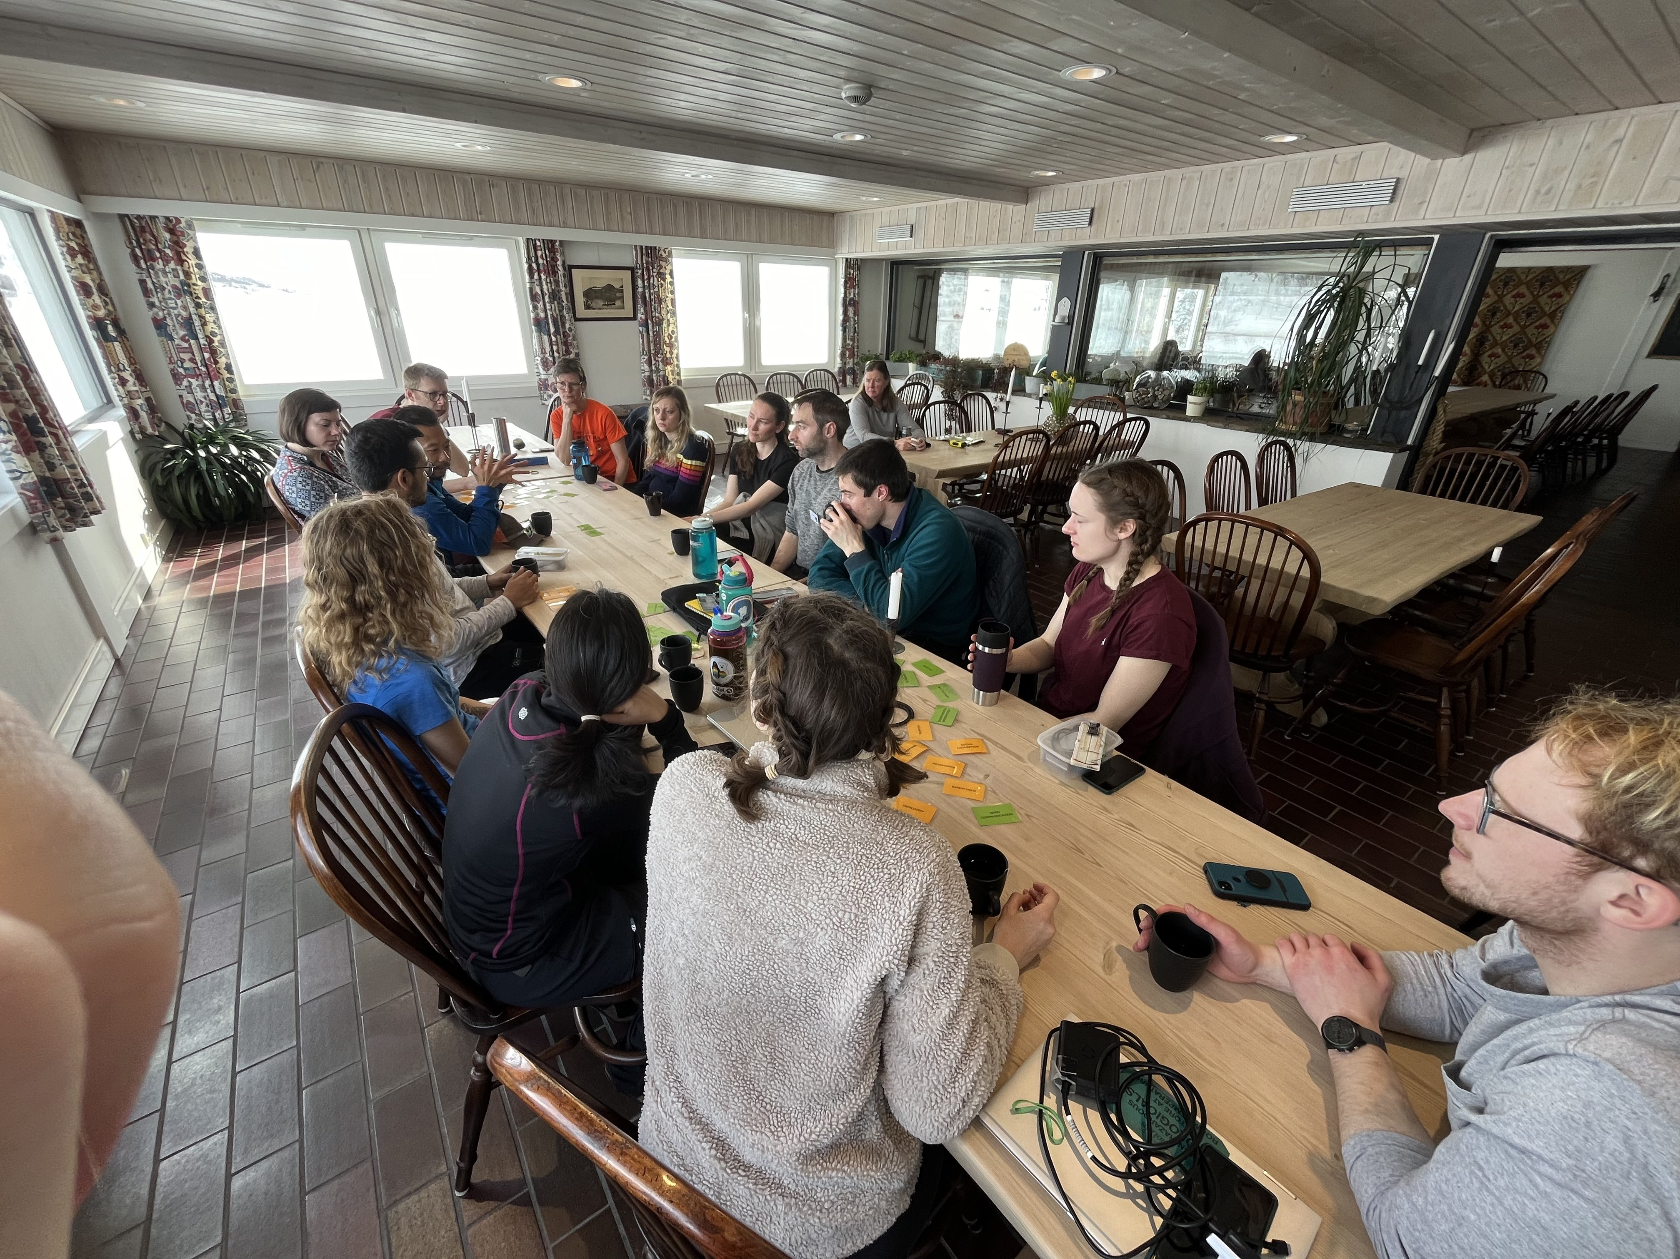
A trust cycle
Be welcoming
Set out clear expectations and consequences (e.g. code of conduct)
Trust is enhanced
Start by trusting
People respond positively
Follow through on consequences
“Your team’s culture is defined by the worst behaviour that you’ll tolerate”
Shannon Gabriel
https://www.forbes.com/councils/forbeshumanresourcescouncil/2024/02/21/your-culture-is-defined-by-the-worst-behavior-you-tolerate/
Team sees consequences happen

Slide 11
Planning for success in the field
If you fail to prepare, you prepare to fail!
We advocated for:
Good note-taking – if possible, dedicate one team member to it during a task
Photographing everything – again, ideally with a dedicated person
Prepare protocols, checklists and forms in advance – they help you remember all the crucial details whilst you’re working in the field
Backing up data, metadata and notes immediately!

Slide 12
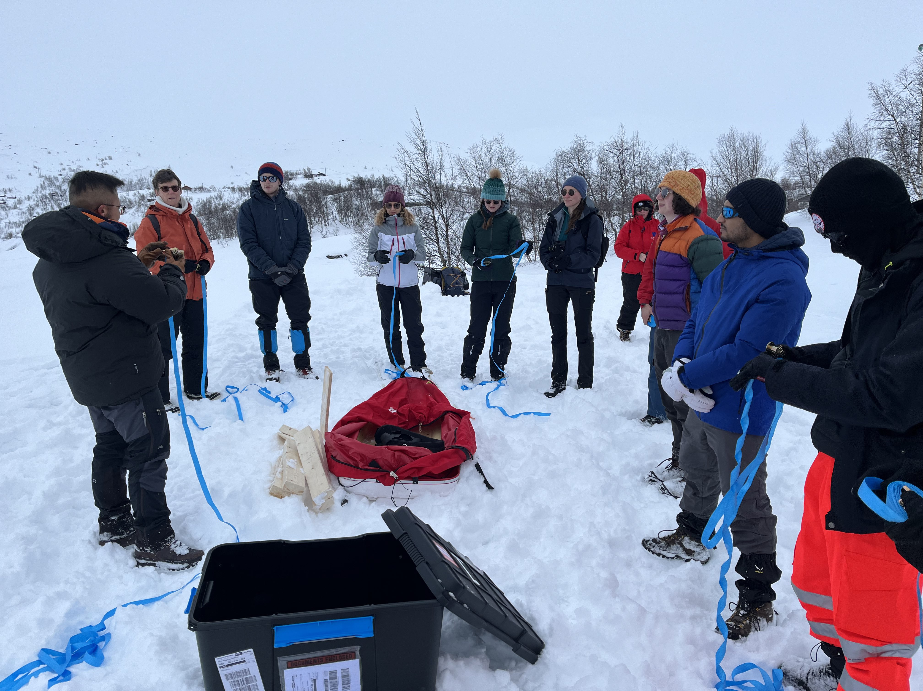
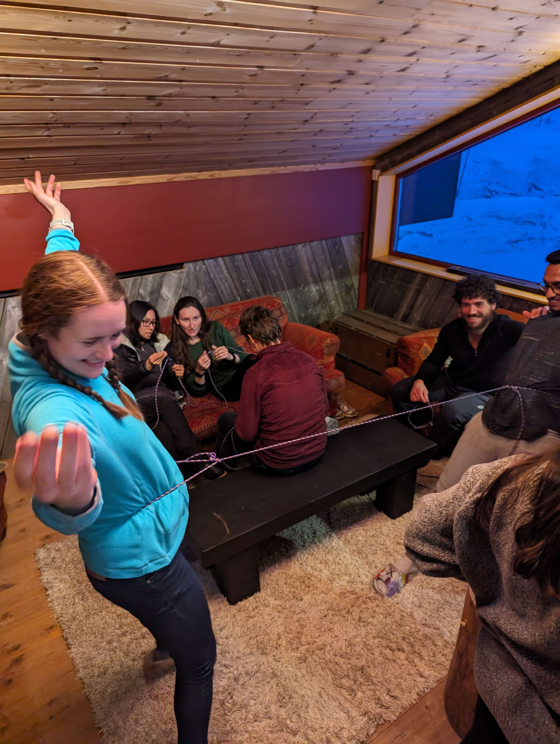
Practical skills
Small practical skills make fieldwork easier
Practicing beforehand in a low-stakes environment really helps!
Learning to use ratchet straps
Learning to dig snow efficiently
Learning to tie useful knots

Slide 13
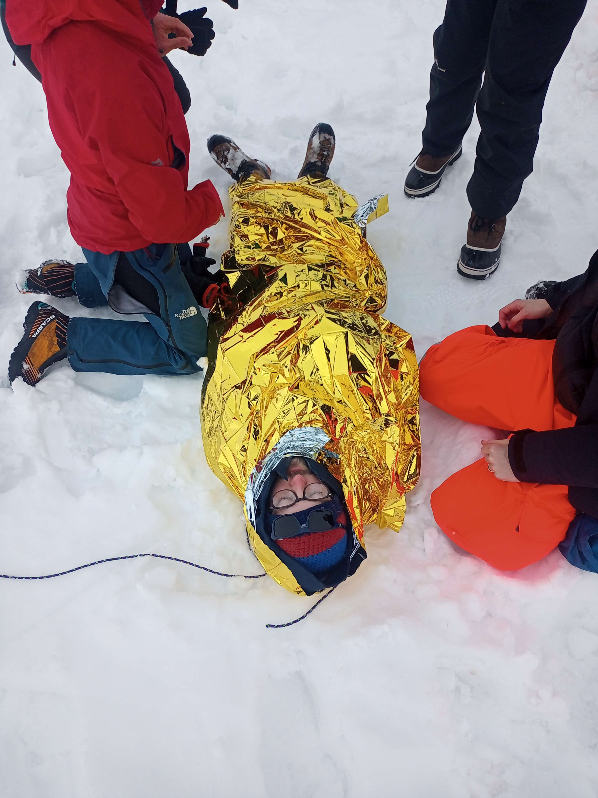
Emergencies
We set up an emergency scenario
Participants had to respond to a range of challenges including:
Being sent out with the wrong equipment
Single-minded scientists not recognising the seriousness of the situation
People becoming hypothermic
People with injuries
Bad communications
This was good practice – but it was also stressful and highlighted the role of the field leader

Slide 14
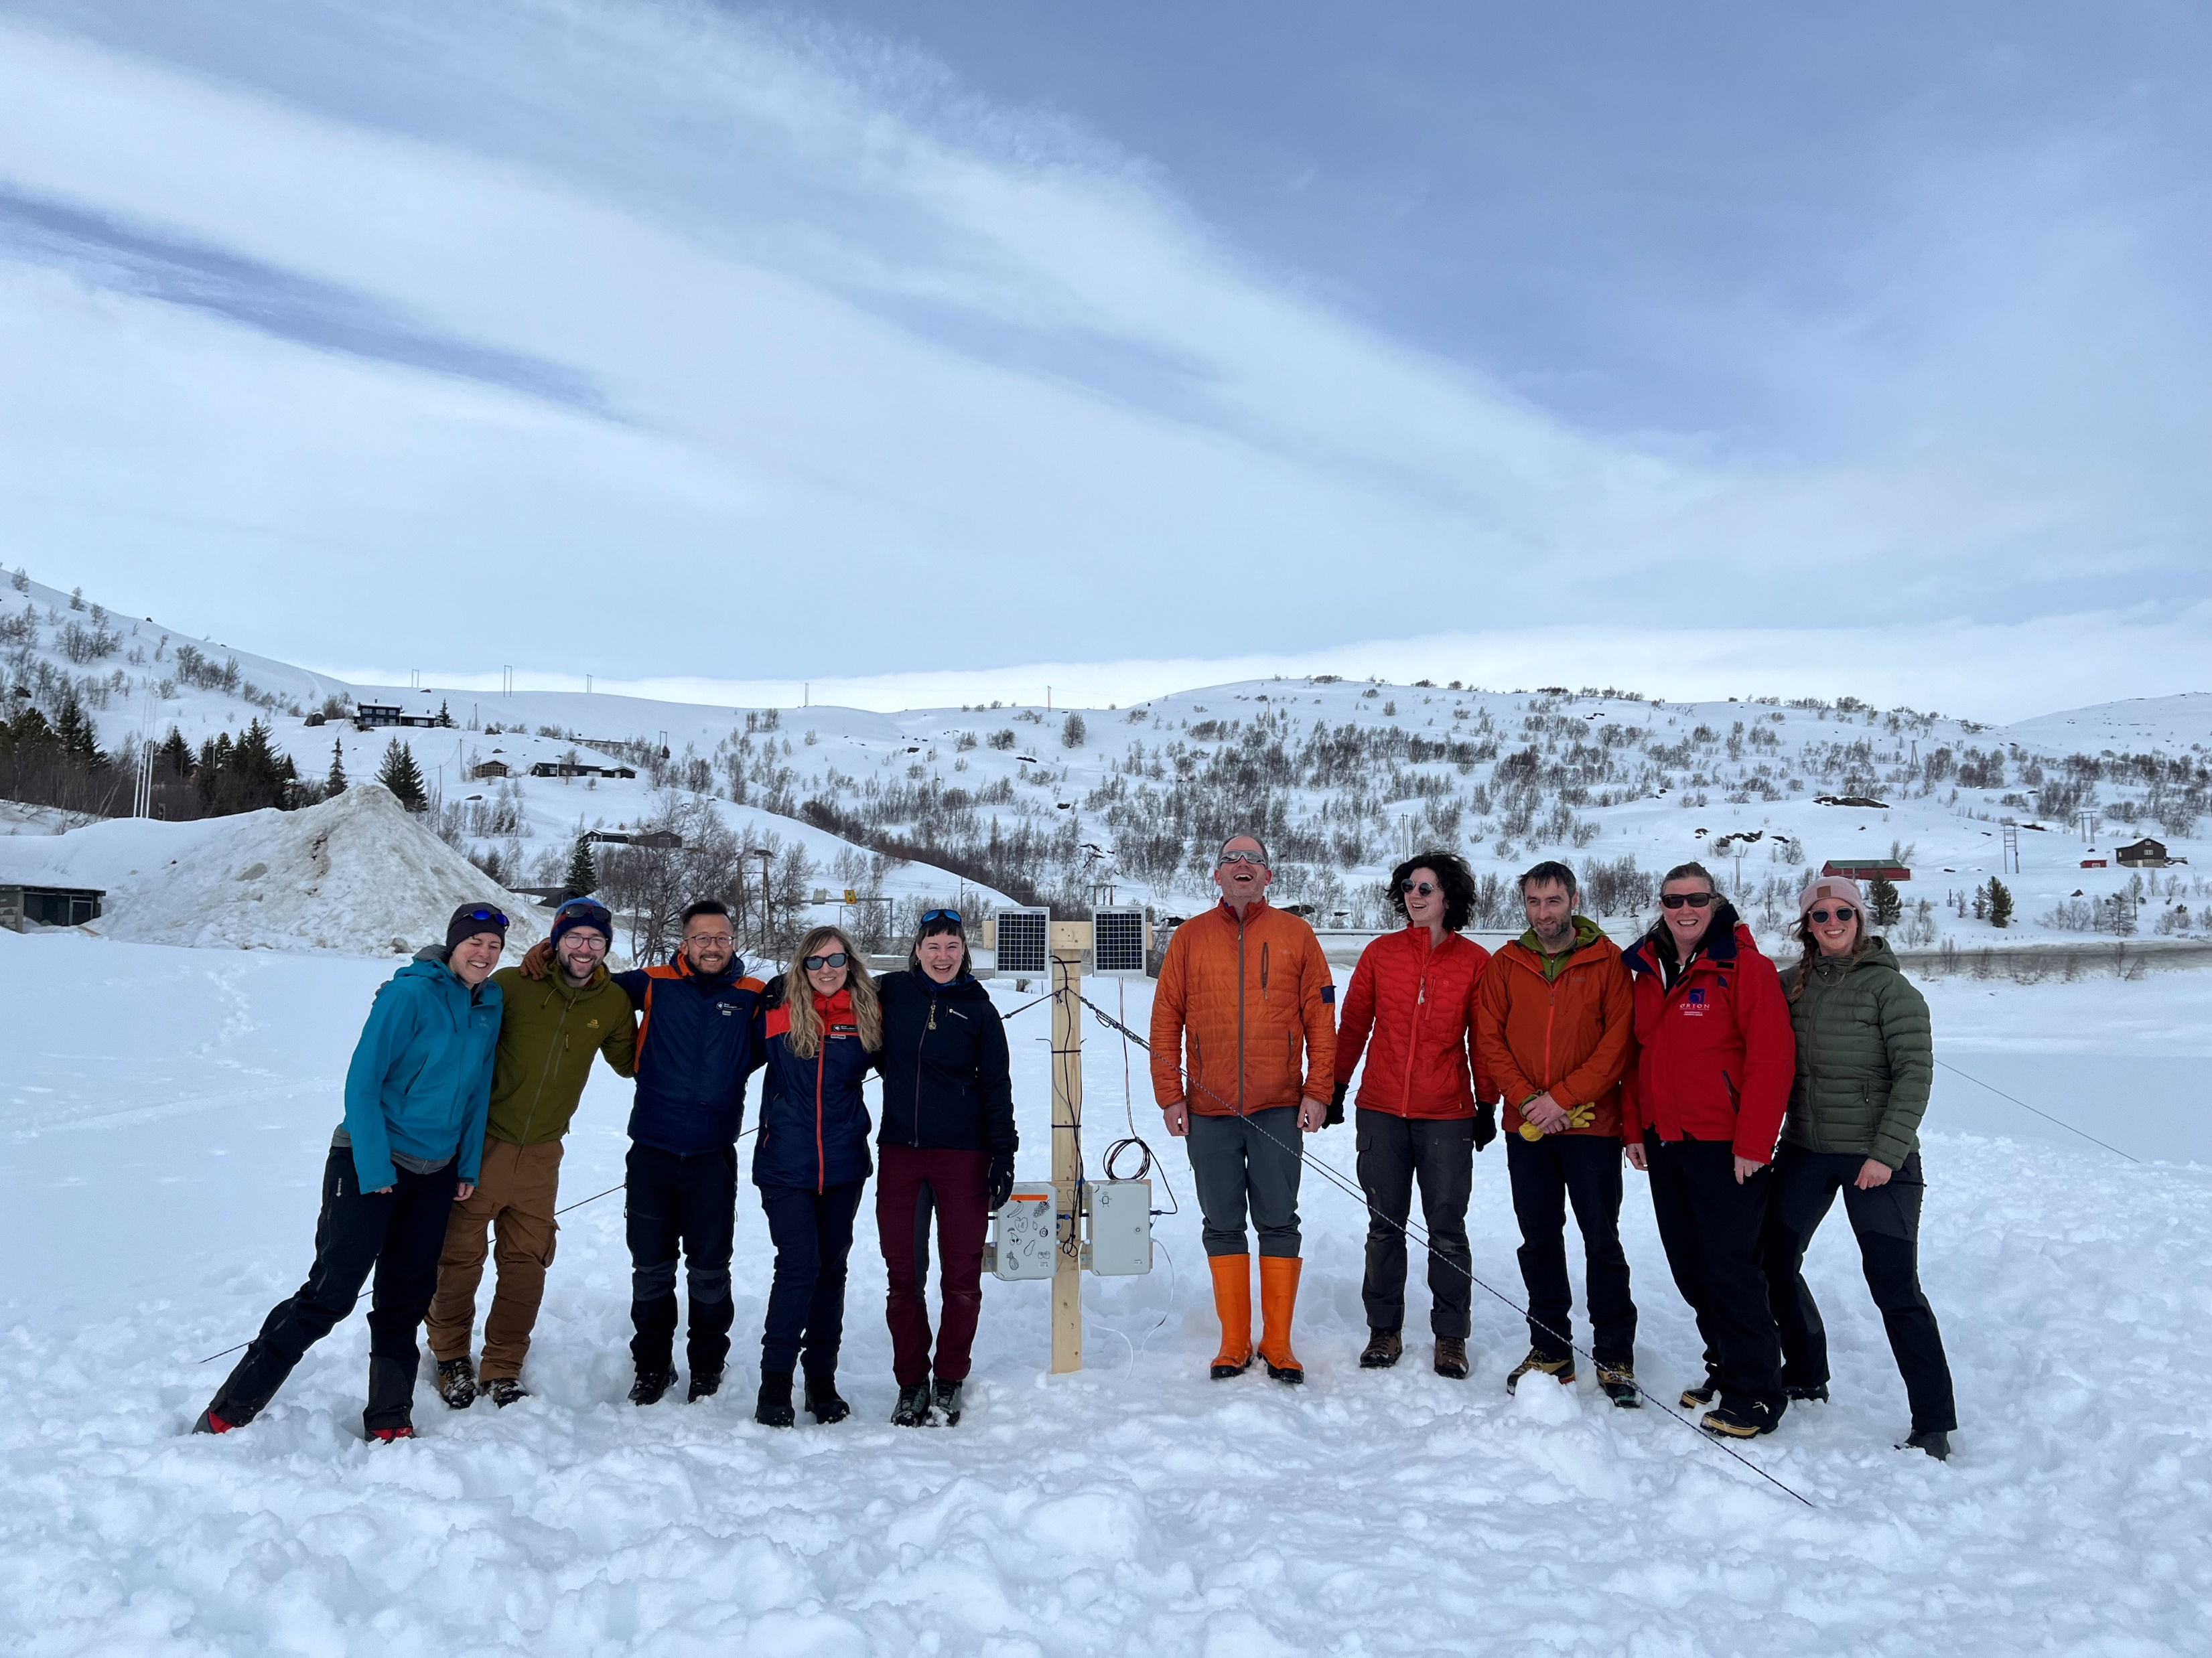
Modelling good behaviour
Participants commented positively on how the instructor team behaved:
“you all seem to genuinely like each other!”
“it was clear that you were working together”
We were changing our plans as we went along and discussing and negotiating – and the participants saw us do this
Showing how a good team works together turned out to be one of the biggest unexpected outcomes of the course!

Slide 15
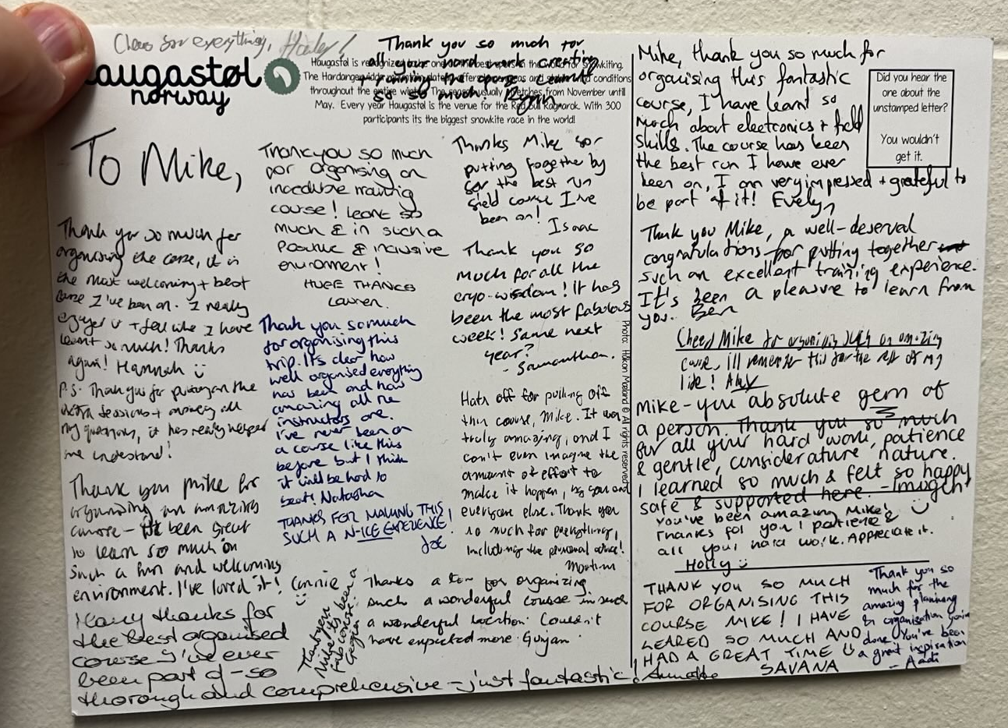
“I learned so much in a positive and inclusive environment”
“By far the best-run field course I’ve ever been on”
“The first time I’ve ever felt safe on a field course”

Slide 16
“I learned so much in a positive and inclusive environment”
“The first time I’ve ever felt safe on a field course”
“By far the best-run field course I’ve ever been on”

Slide 17
Some things we learned:
It’s much easier to be inclusive if you plan ahead
Provide clear, detailed information in advance of the course
A group-chat system (we used Discord) is really valuable
Communicate constantly – we had morning and evening briefings
Teach outdoors if you can!
Budget for extra inclusion costs – visa fees, single rooms, etc

Slide 18
Course aims
Learn some basic engineering skills
Build a simple datalogger and deploy it for 24 hours
Learn to work safely in a cold environment
Learn to work together with people that you don’t already know
20 participants and 10 instructors

Slide 19
Our approach to course design
Aim to be as inclusive as possible
Large instructor group (10 instructors to 20 participants)
50/50 gender balance in instructors
All instructors led on different activities
All had real-world field experiences to share
Provide detailed information and reassurance in the pre-application process to encourage people to apply.
We wanted to avoid people thinking “I can’t do that”, “that’s not for me”, “that’s not safe for me”, “that’s only for people with lots of experience”, “that’s going to be all boys”, “people like me won’t be welcome”
We wanted to emulate the experience of working on a research station – familiarising participants with common rules and processes (e.g. signing out when leaving the building)
Practice working as a team with people you haven’t previously met
Teach hands-on practical skills that are often overlooked: e.g. use of satellite phone; knots; pulling a loaded sledge; safe lifting and carrying;
Provide practical advice on organising your work in the field – e.g. checklists, notetaking, data backups

Slide 20
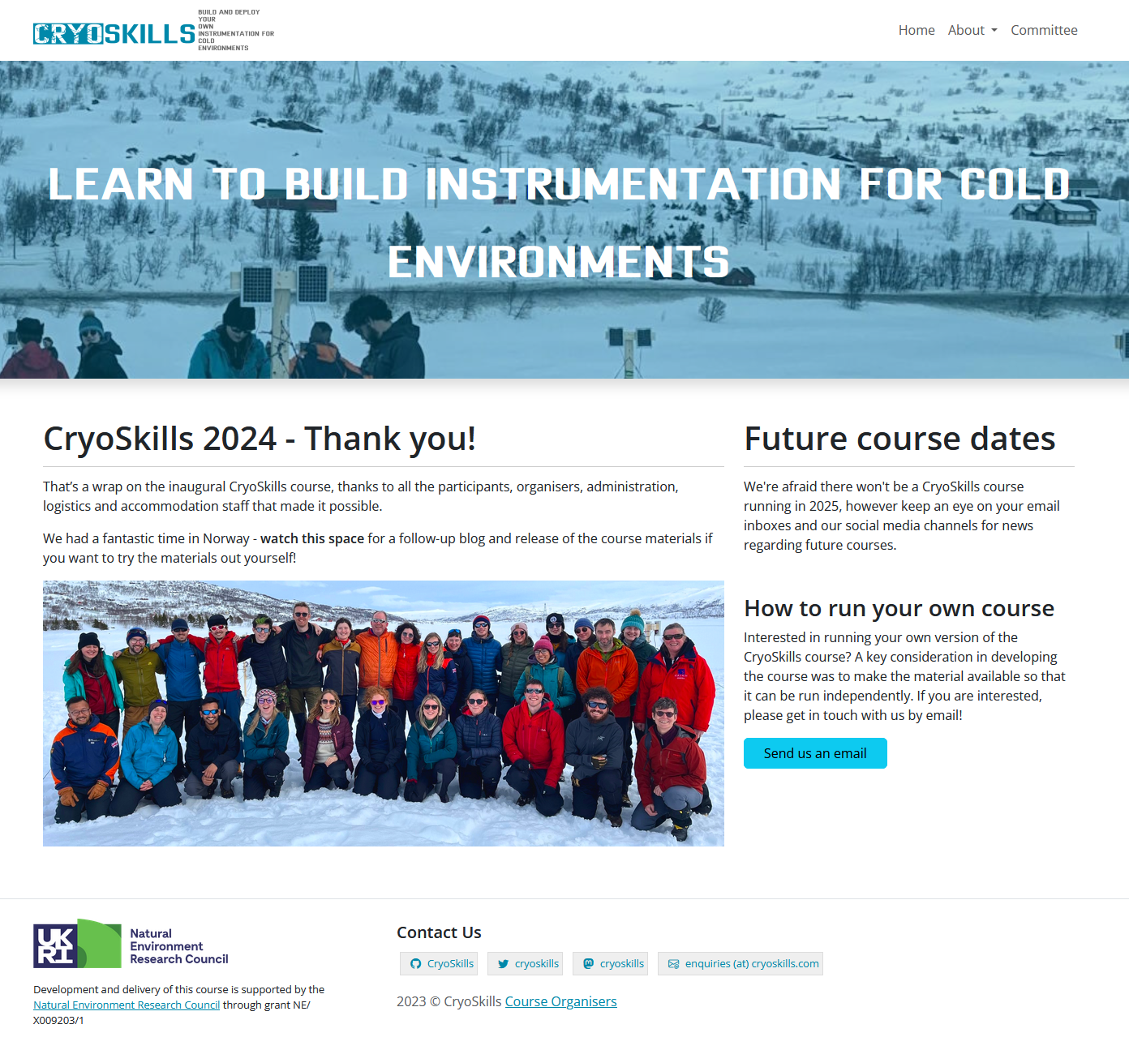
Adverts
Pre-course process
Website
Application form
Webinars
Selection process
Travel booking
Briefings
Online community
Pre-work

Slide 21
Core values
It’s okay to make mistakes
Get to know everyone and learn from their experience
Work together and help each other out
Be good to work with
Ask if you don’t understand or want something explained further
Nobody will be “left behind”
Be fully present – leave your day-to-day work at the office

Slide 22
Engineering skills
“In 5 days you can learn 80% of what you need to know, and the other 20% is why you go to medical engineering school!”
Inspired by a first aid course, we aimed to teach commonly-used engineering skills:
Electronics – DC theory, batteries, solar power, breadboarding, wiring, soldering, connectors, multimeter, analogue and digital sensors
Mechanical – modifying a plastic box to fit connectors and cable glands, building a support frame, rope and knotwork
Software – firmware programming using Arduino, interfacing to sensors

Slide 23
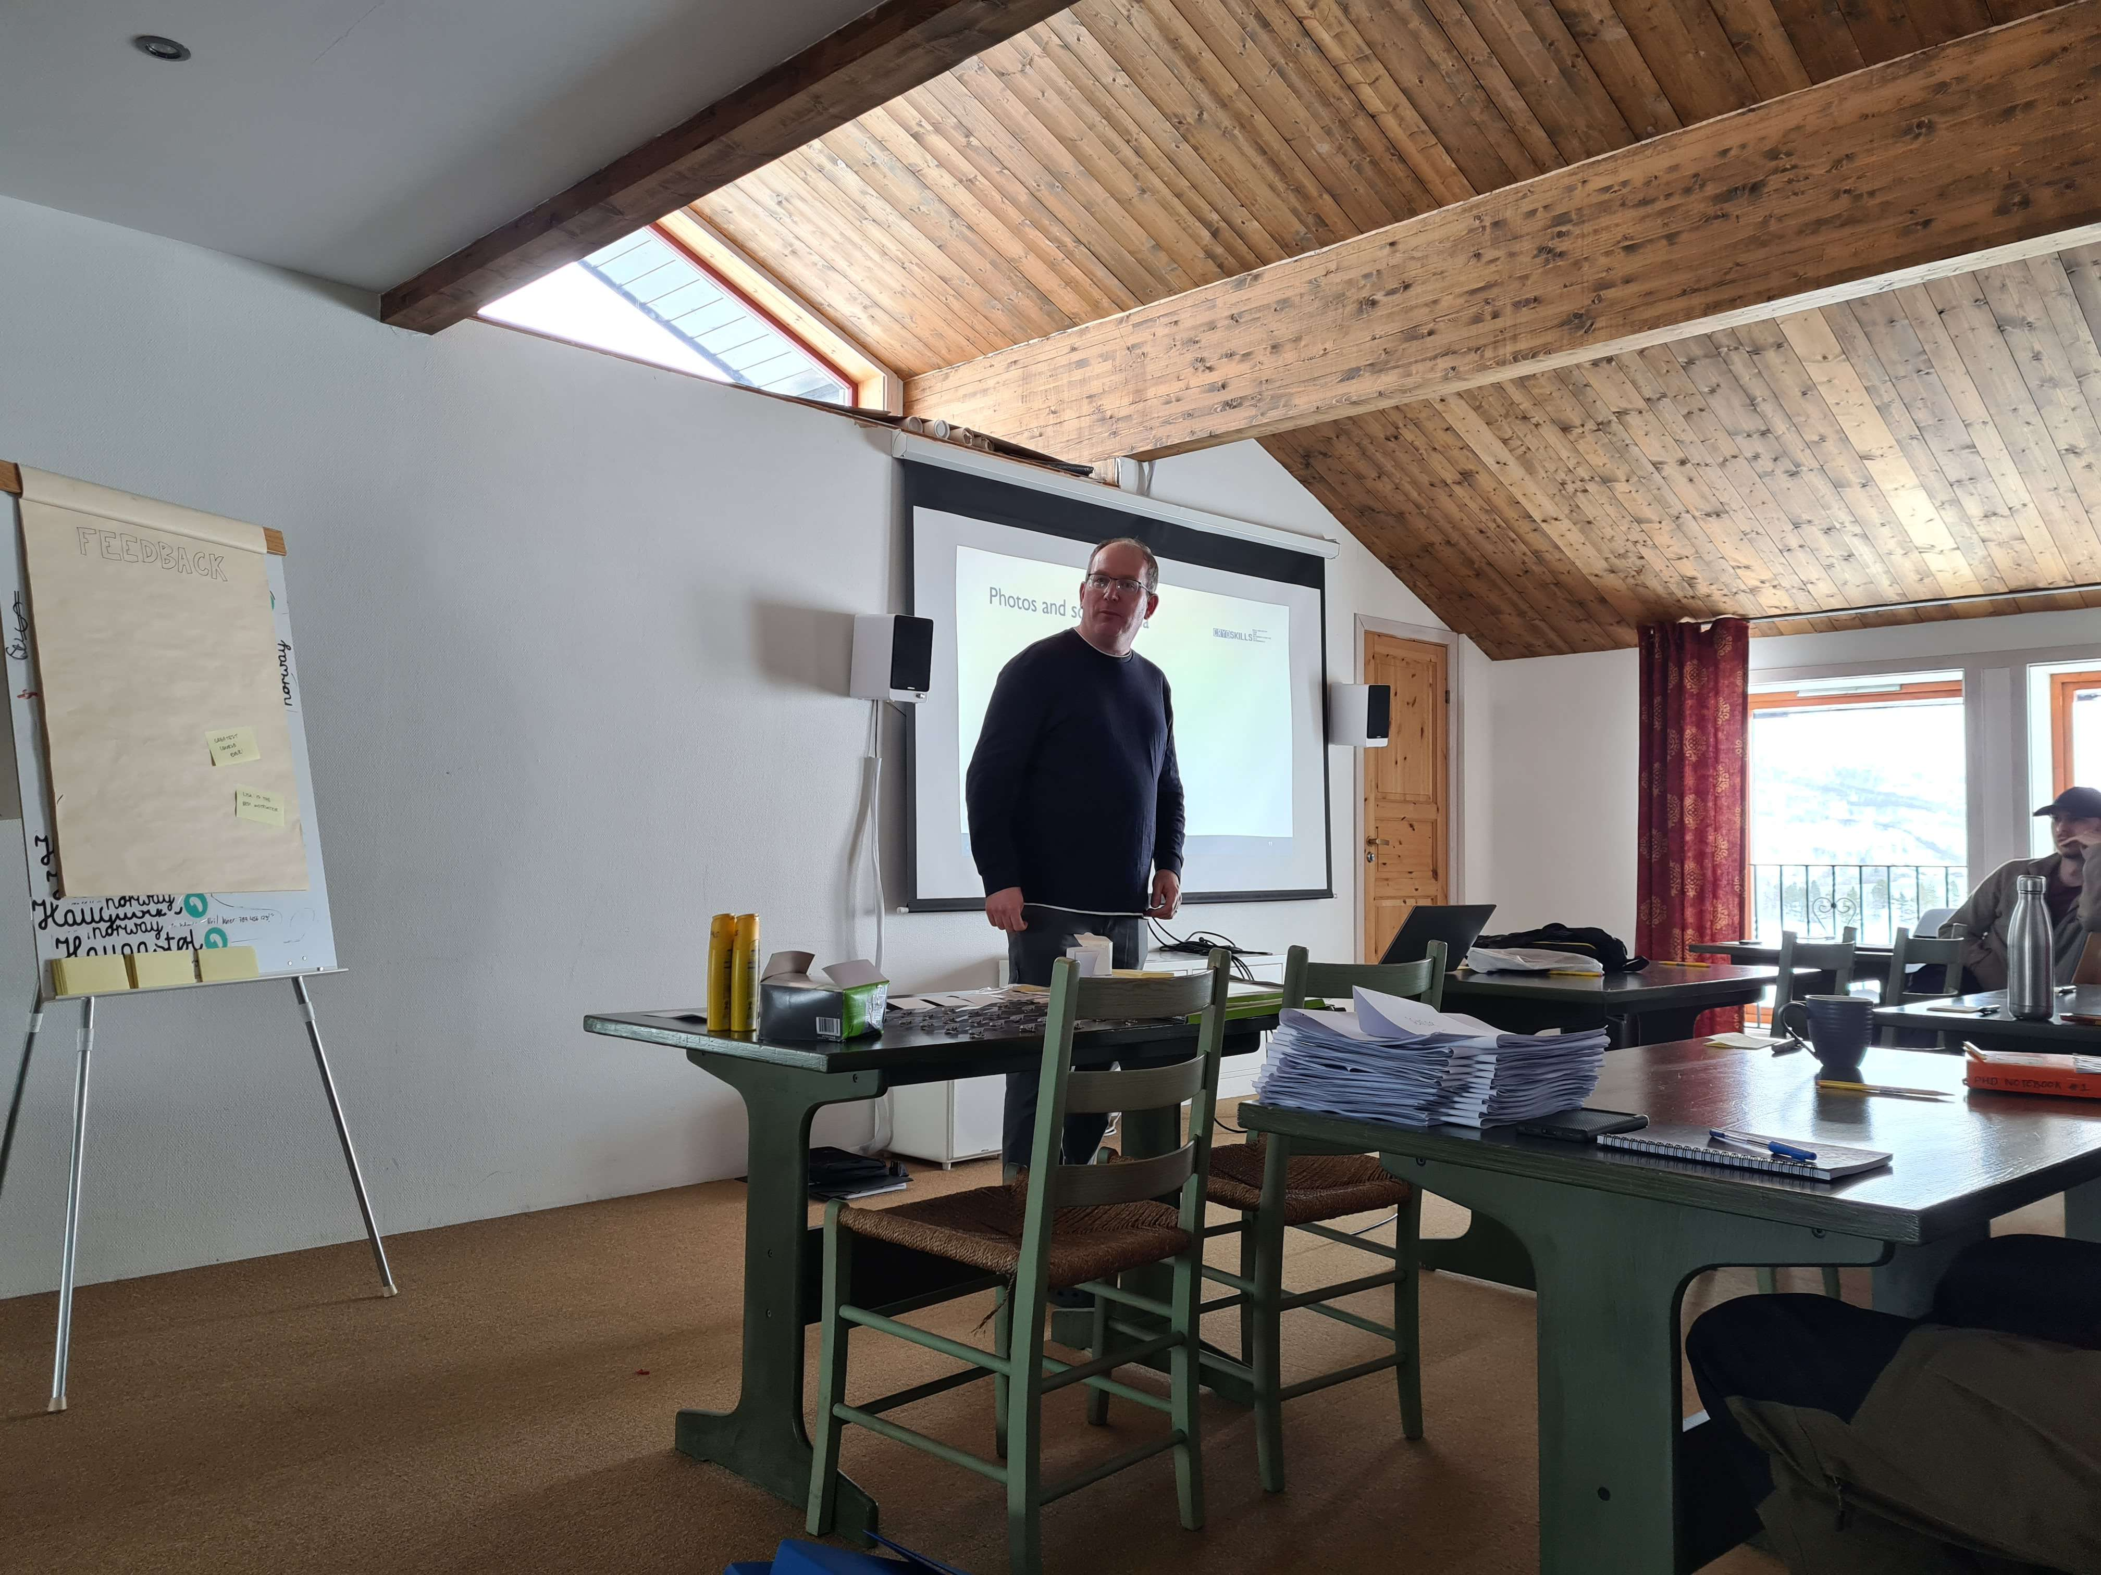
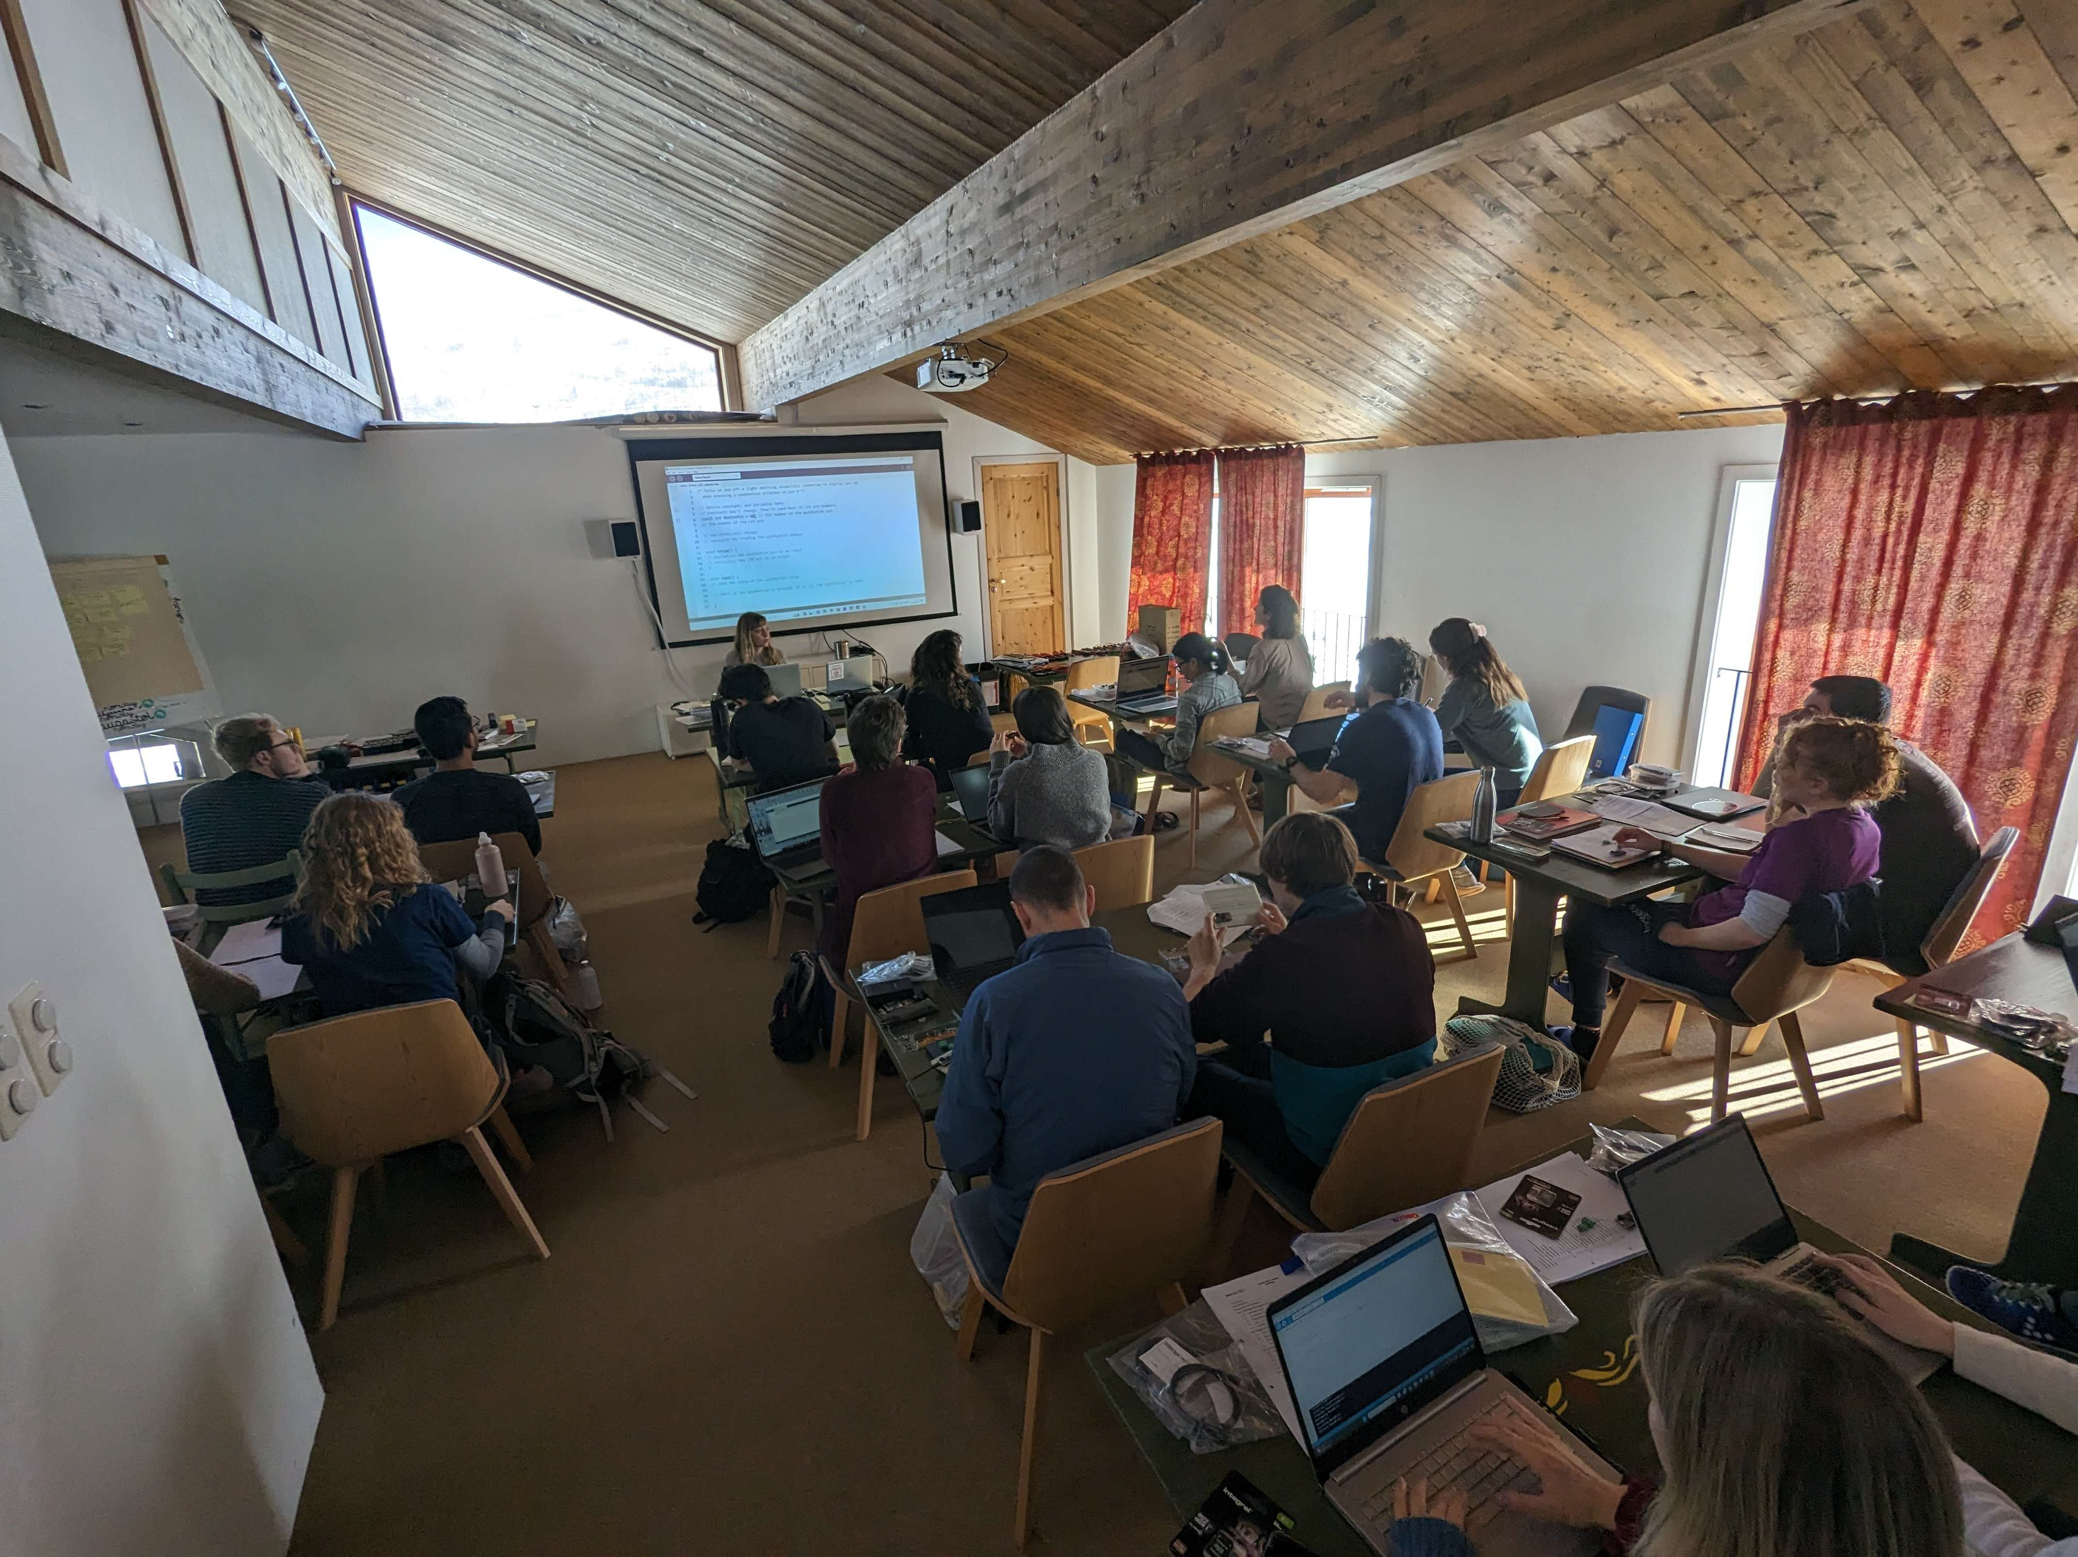
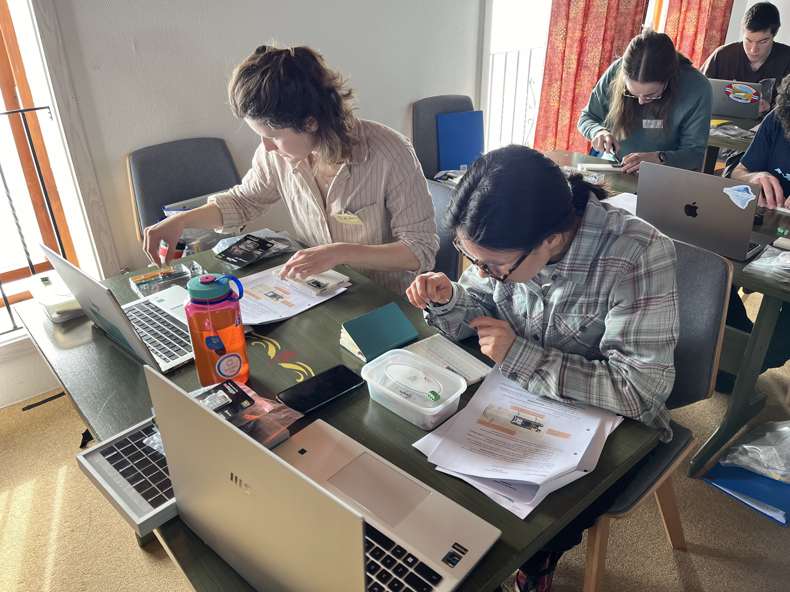
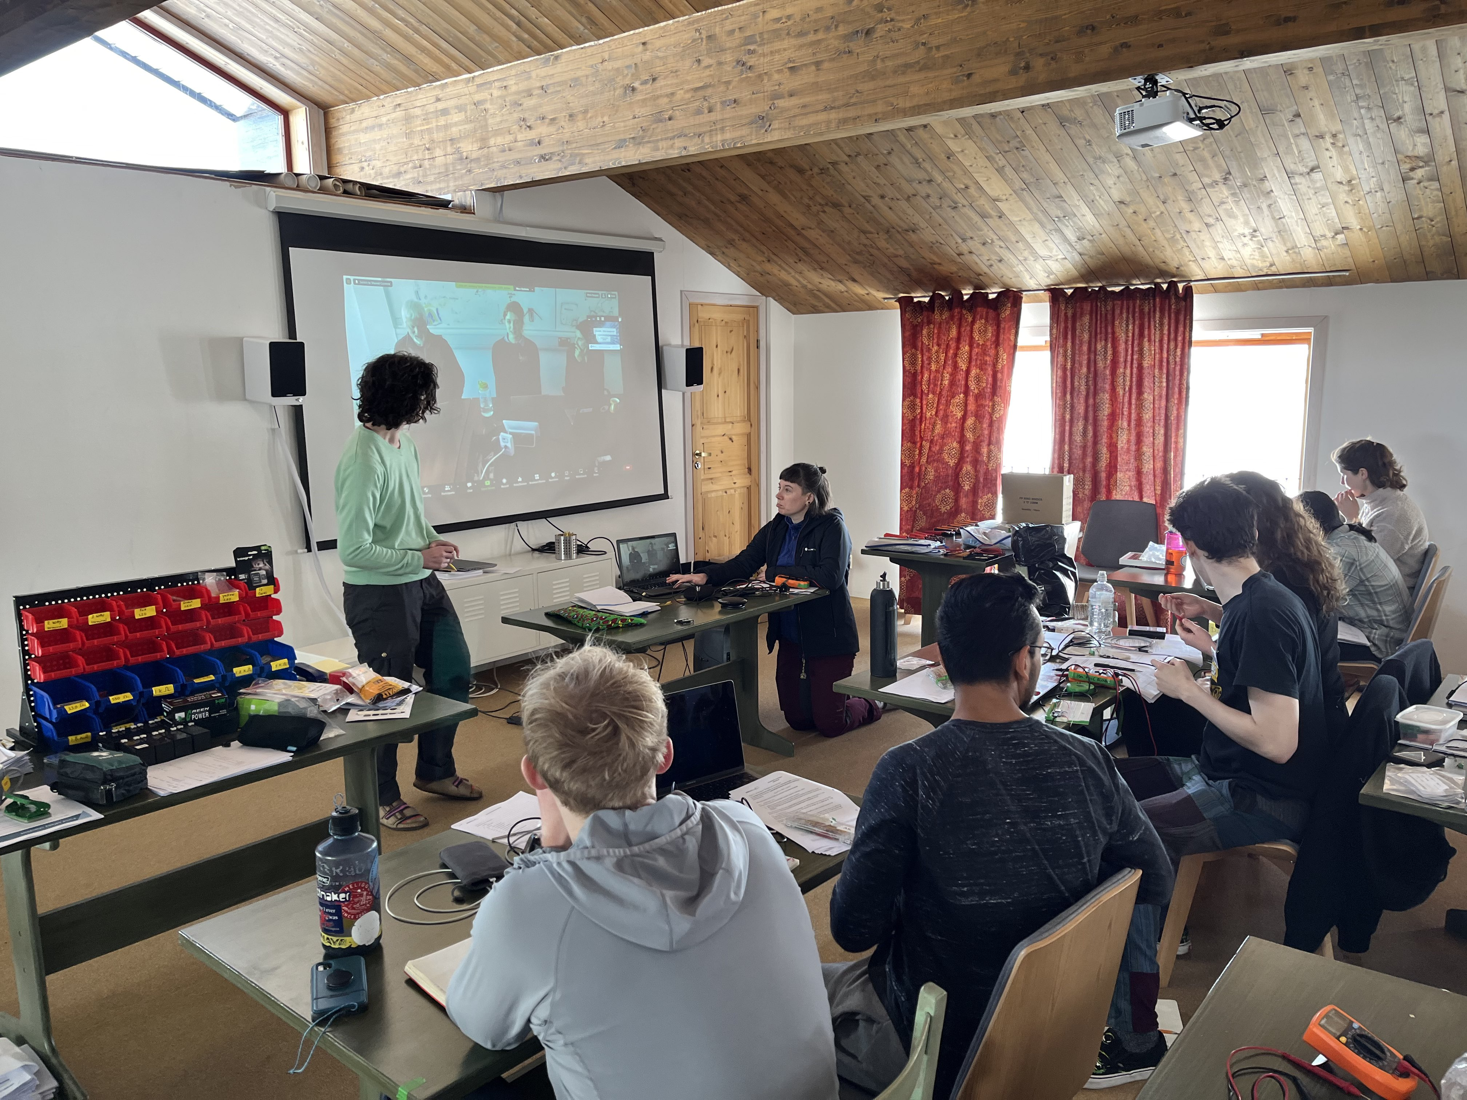

Slide 24
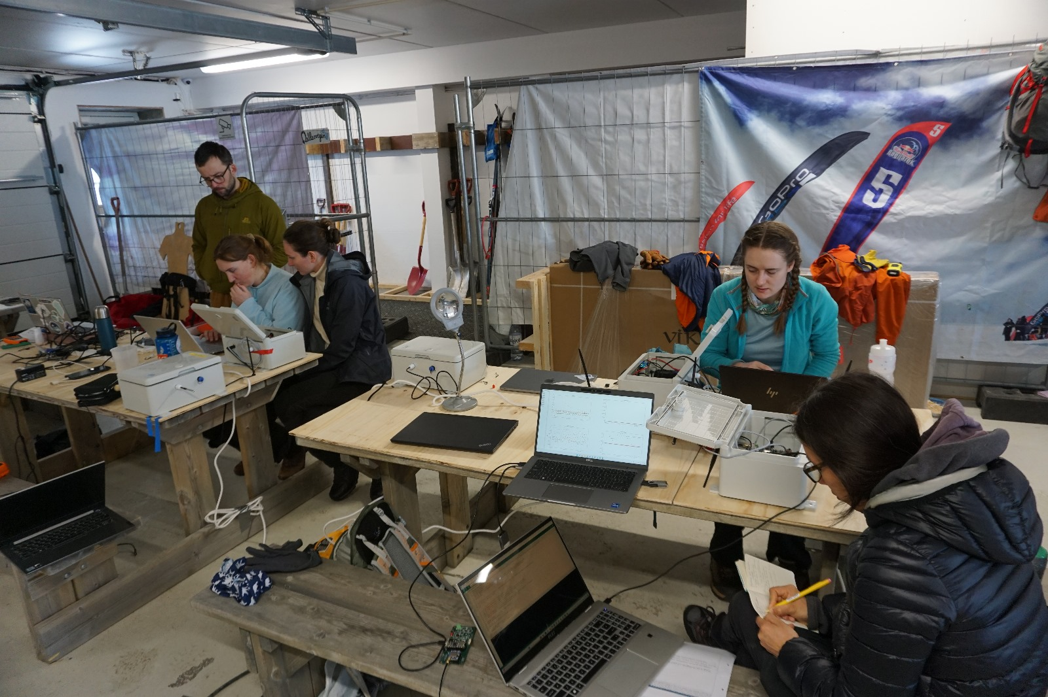

Slide 25
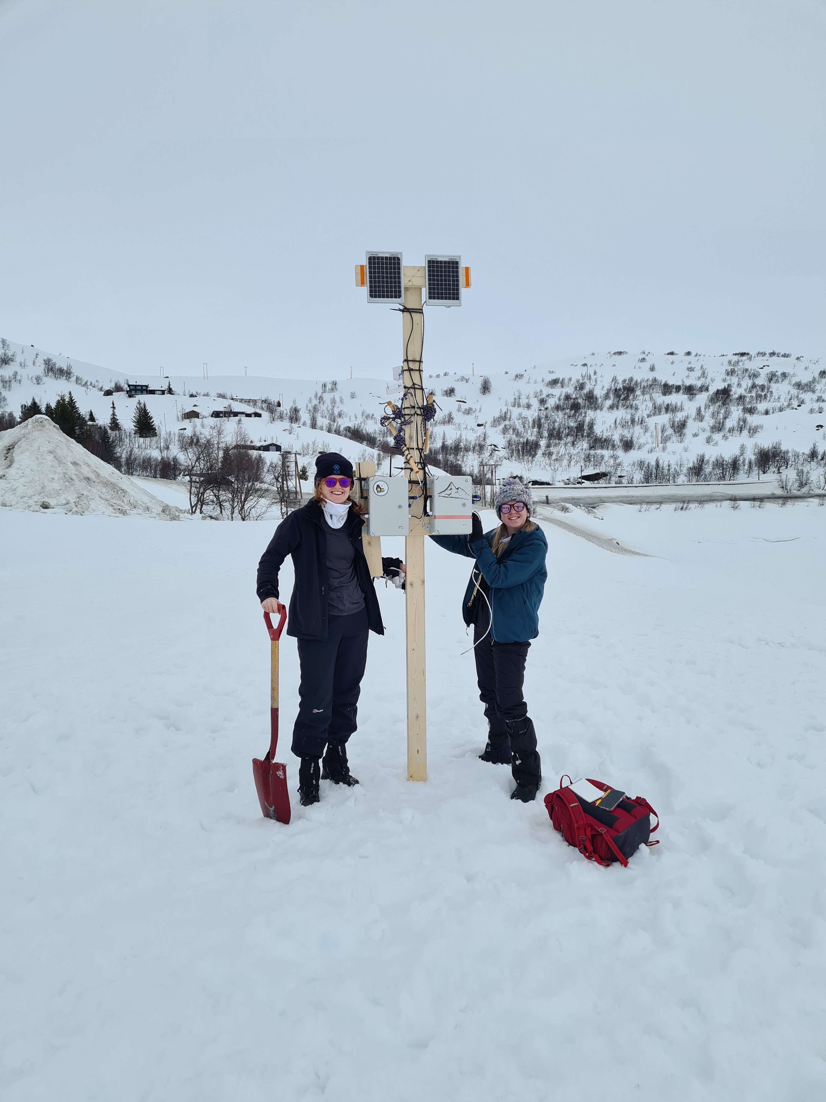
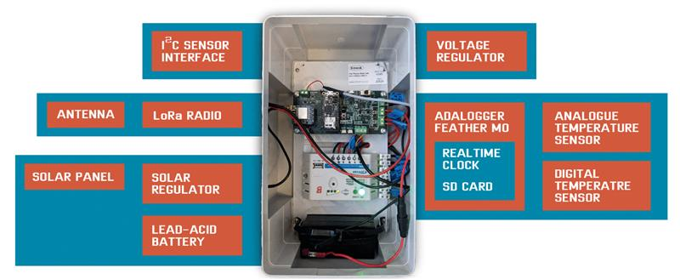
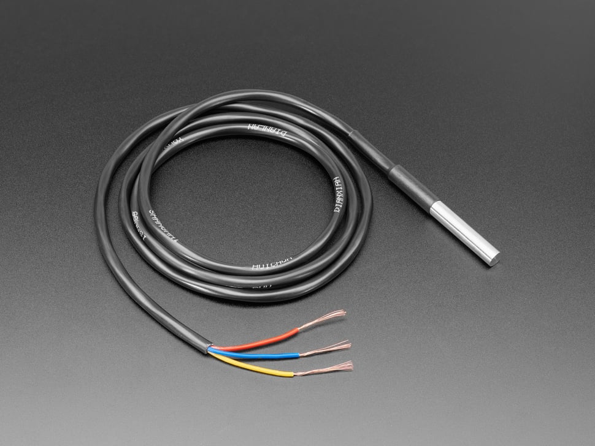
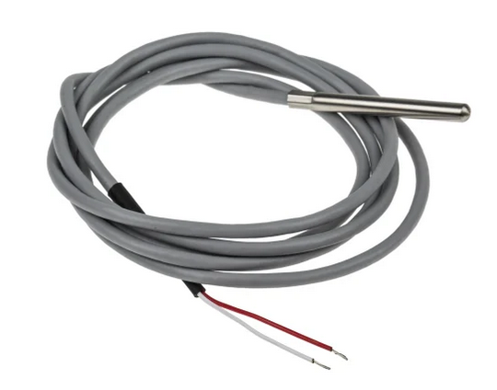
Solar panels
Temperature sensors
Logger boxes
Digital temperature sensor (DS18B20)
Analogue temperature sensor (PT1000)

Slide 26
Field skills
Practical field skills, taught outside:
Digging
Use of probes to look for a person or item buried in snow
Whiteout simulation
Use of two-way radios and satellite phone, including reading out GPS positions
Loading and pulling a sledge
Lifting and carrying safely
Knotwork (trucker’s hitch) and ratchet straps
Responding to an emergency

Slide 27
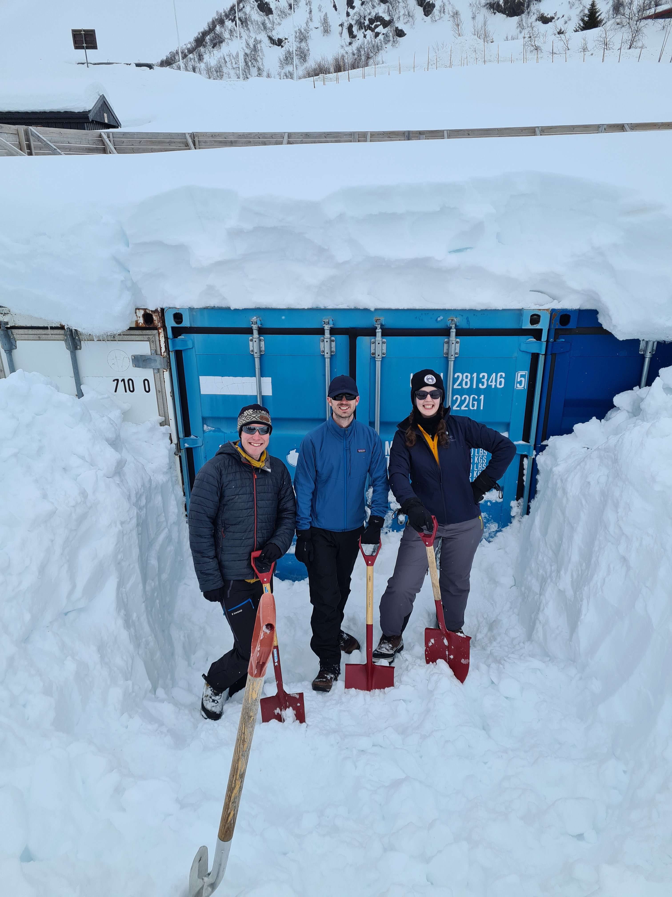
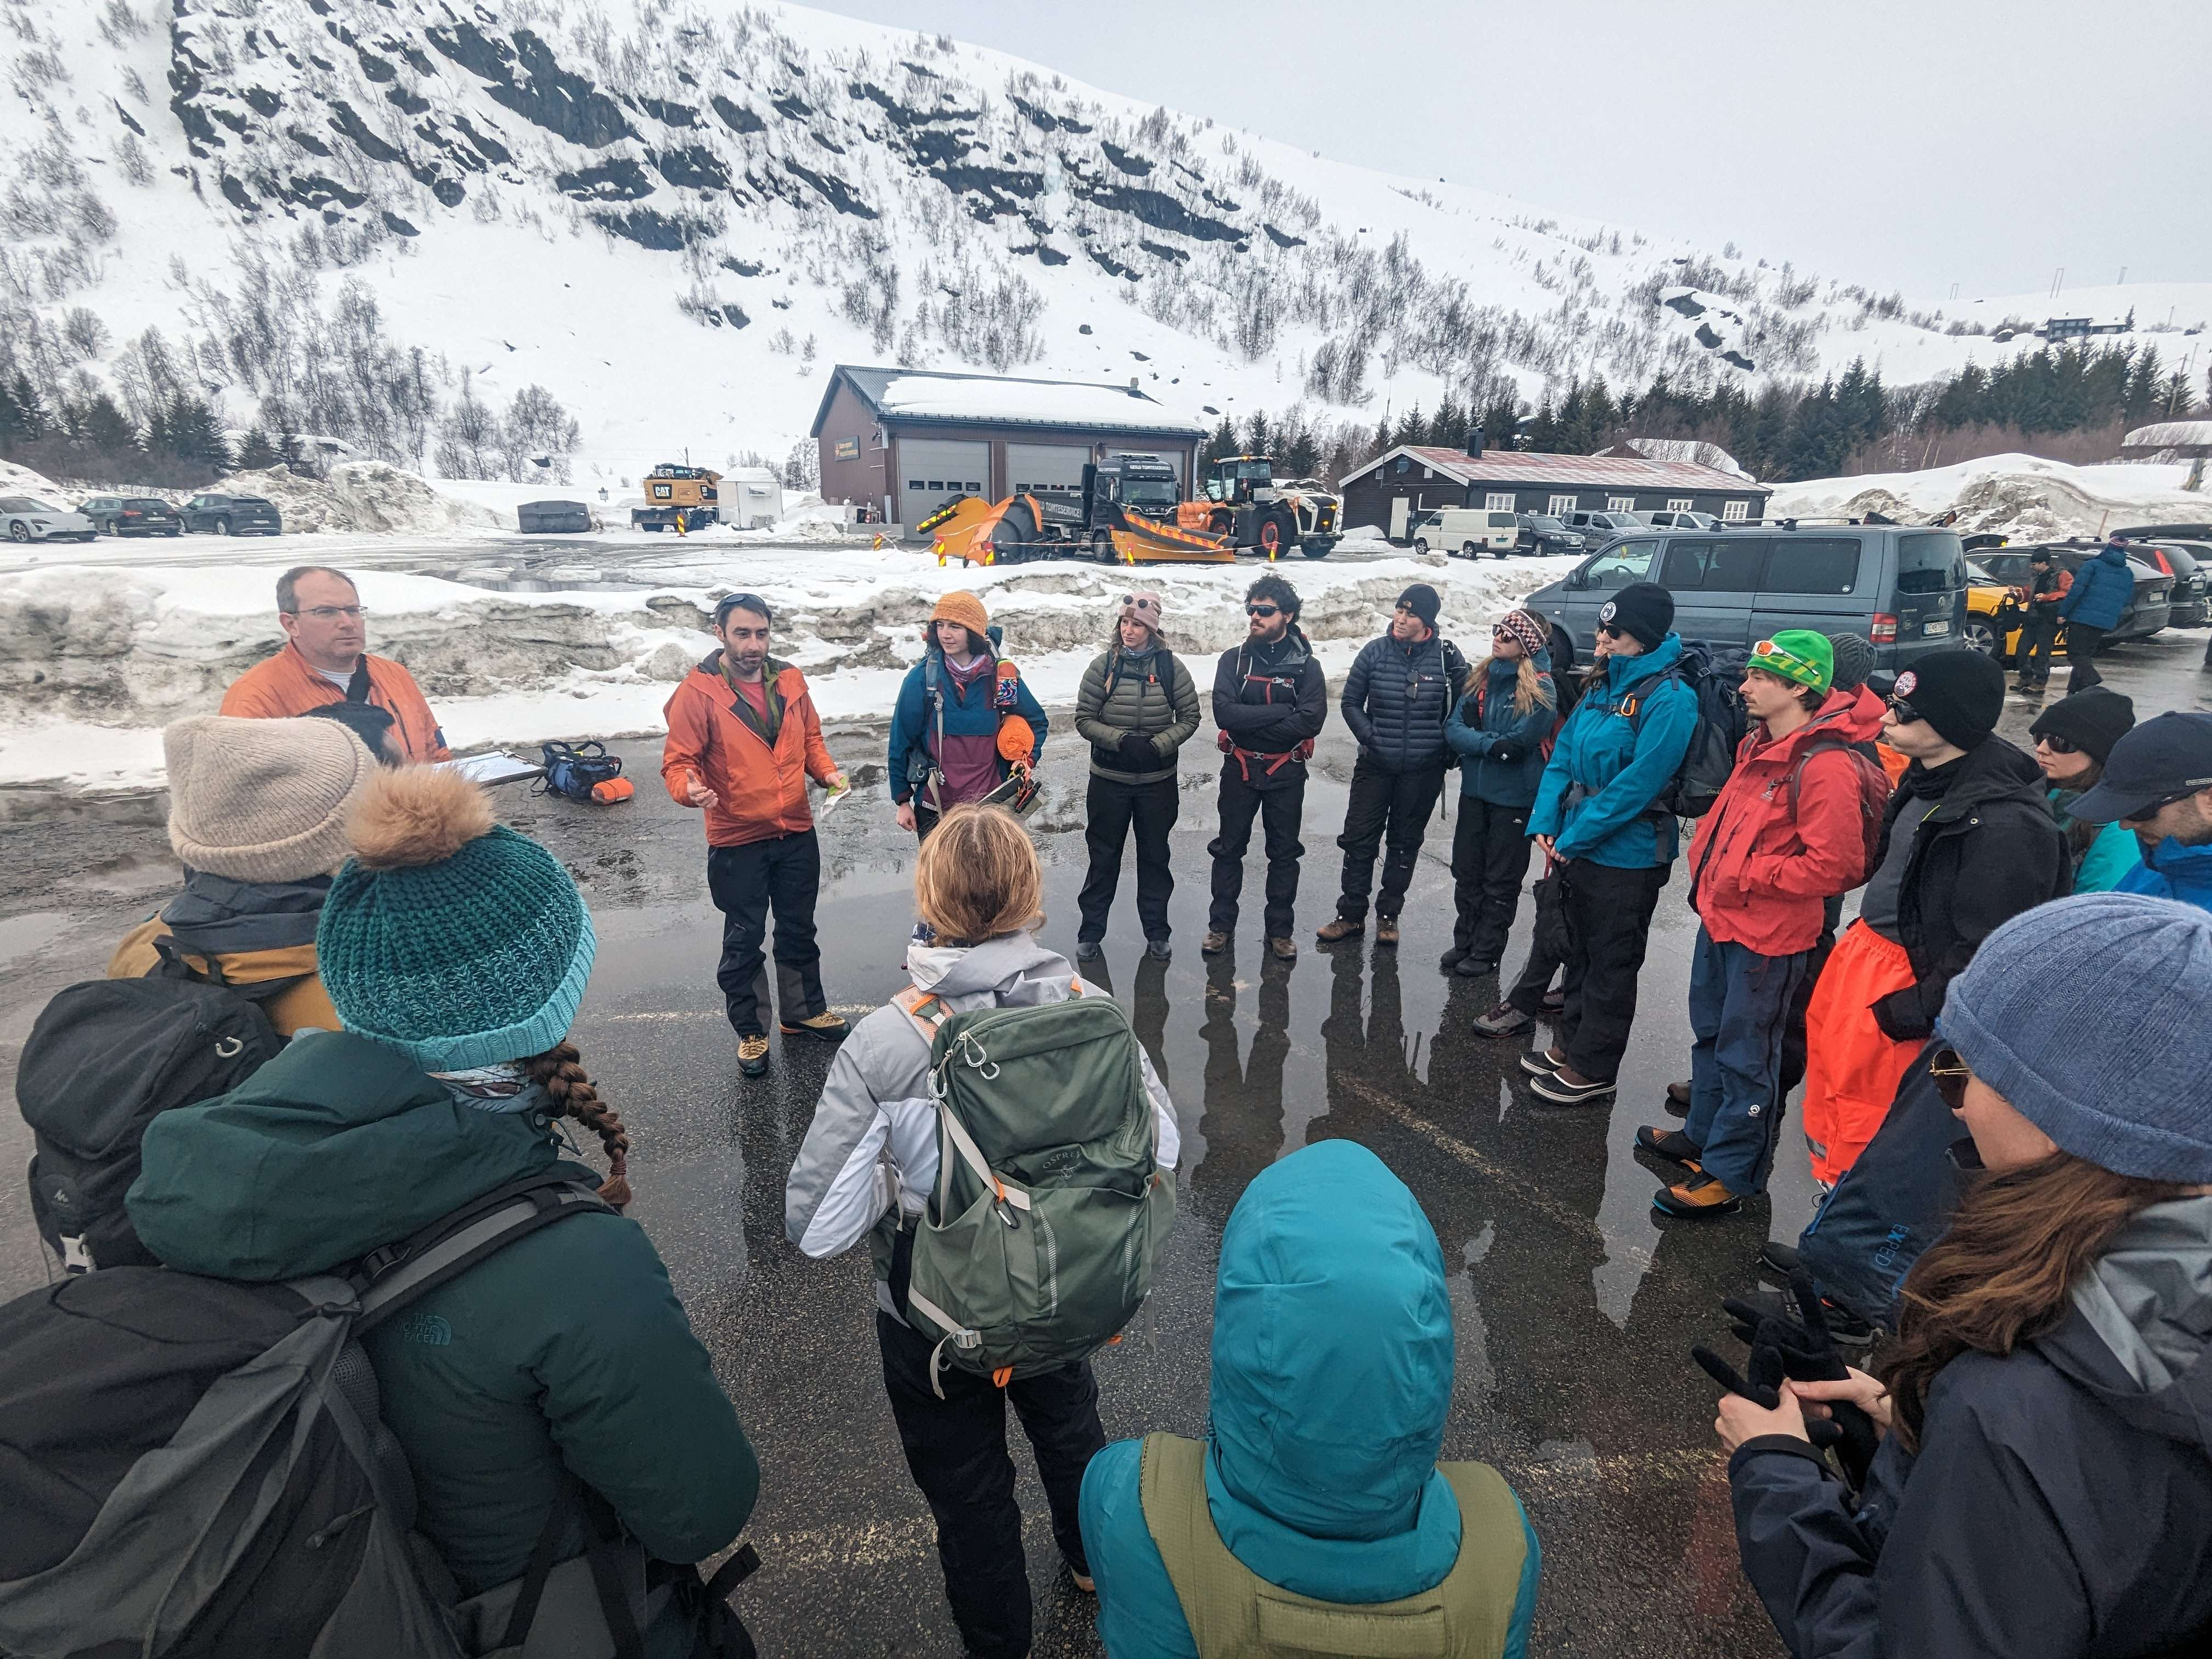

Slide 28
