Slide 1
Improved floodplain modelling with FABDEM and Sentinel-2 earth observations in the middle valley of the Senegal River
Issa Leye, Andrew Ogilvie, Soussou Sambou and Didier Martin
Vienna, Austria : HS6.9, Thu 01 May, 08:45-08:47 | PICO4.6 | EGU25-11344

Slide 2
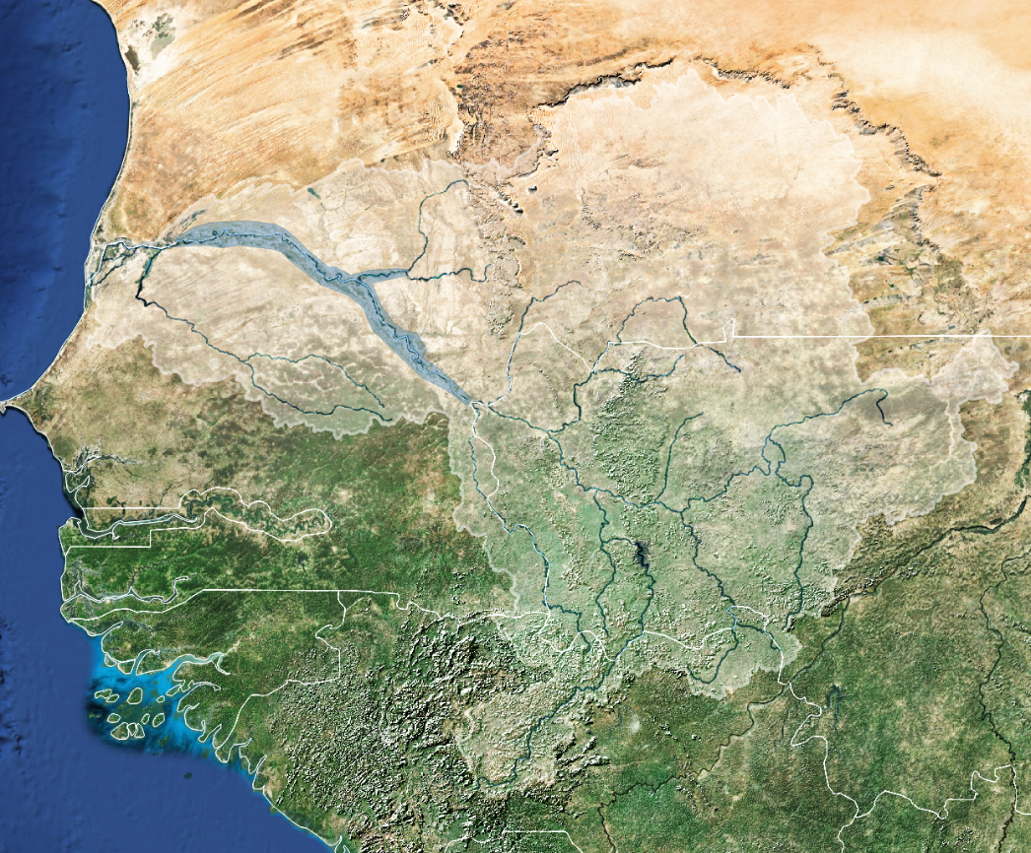
Study area and objectives
Floodplain of Senegal river basin
Annual inundation
Limited knowledge (sparse observations, flat topography)
Supports flood-recession agriculture & associated ecosystem services
1900 km² floodplain
Podor
Matam
Bakel
Map surface water dynamics through
- 2D hydraulic modelling (HEC-RAS)
Combining advances in remote sensing - DEM (Fabdem, Copdem),
Sentinel-2 inundation maps, and field data

Slide 3
Methods
HEC-RAS
SENTINEL-2
Ground control points
Simulation
( Flood area)
MNDWI (Water-Bodies)
DEM Accuracy
No
KGE,
F1-score
Yes
Elevation
(FABDEM, TanDEM, COPDEM…)
Calibration
(Input parameters)
Yes
Validation (model)
Flood mapping

Slide 4
Methods
HEC-RAS: 2D Models
The 2D diffusion wave equations
2D flow area mesh in RAS Mapper (500m x 500m)

Slide 5
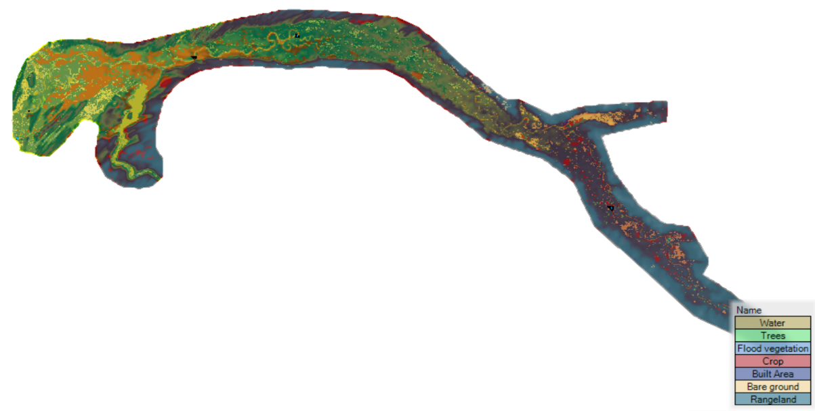
Methods
HEC-RAS: 2D Models
Land use/land cover and Manning's Roughness Coefficient (n)
Land use | n
water | 0.028
Trees | 0.137
Flooded Vegetation | 0.068
Crops | 0.035
Built Area | 0.103
Bare ground | 0.027
Rangeland | 0.038

Slide 6
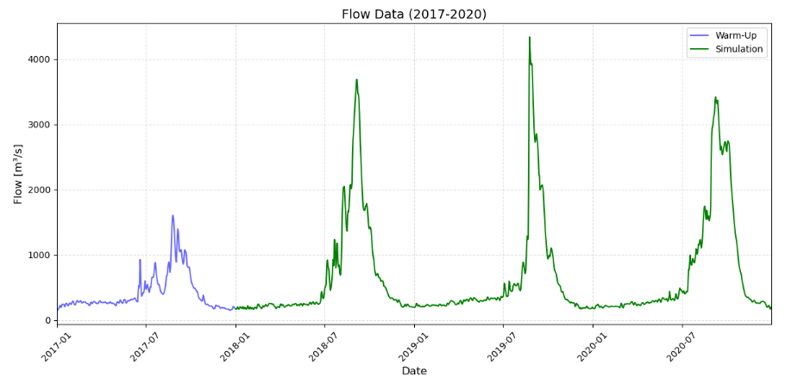
Methods
HEC-RAS: 2D Models
HEC-RAS: Boundary conditions
Upstream: Flow Hydrograph
Downstream: Normal Depth
HEC-RAS: Meteorological Data
Precipitation
Evapotranspiration

Slide 7
Methods
Remote Sensing: Sentinel-2 (Water-Bodies)
The Normalized Difference Water Index (NDWI).
Modified Normalized Difference Water Index (MNDWI).
Green: Band 3 ; NIR: Band 8 ; MIR: Band 11

Slide 8
Methods
HEC-RAS and Sentinel-2: Comparison (Flooded areas/ Water-Bodies)
The harmonic mean of precision and recall (F1-score).
Precision is the ratio of true positive (TP) to the sum of true positive and false positive (FP), while recall is the ratio of true positive to the sum of true positive and false negative (FN).
value ranges from 0 to 1

Slide 9
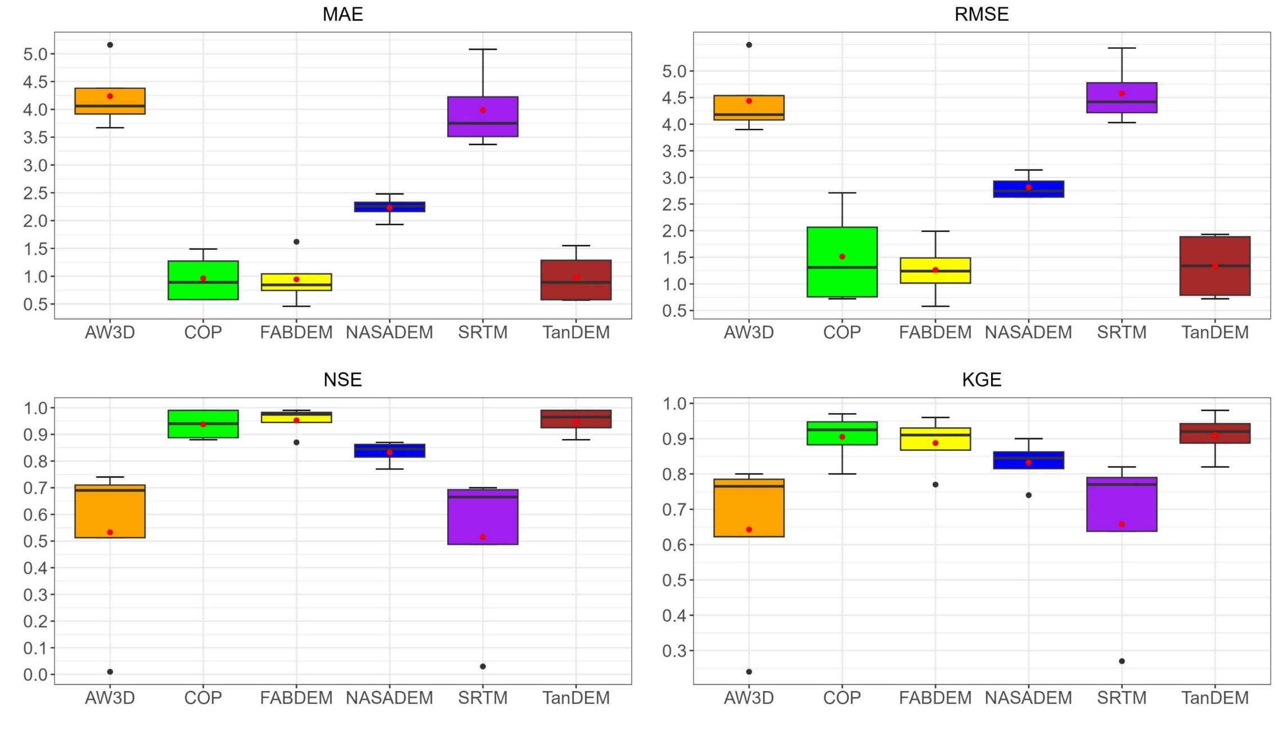
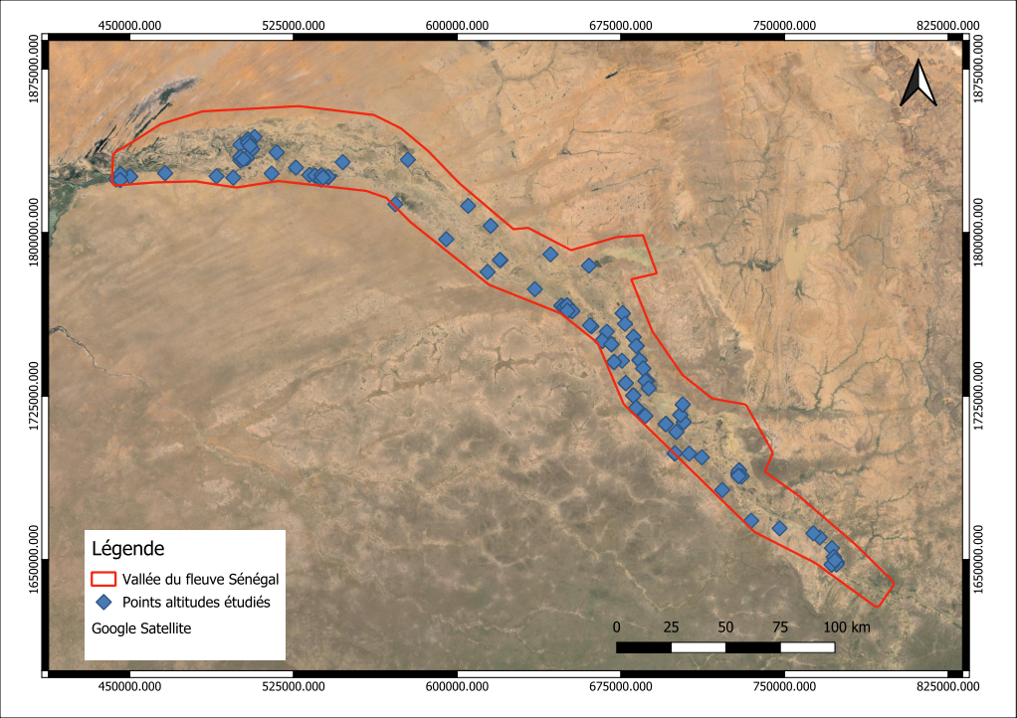
Results
Comparison of 6 DEMs with ground control points and river profiles
Best results with COPDEM, FABDEM and TANDEM
FABDEM has the lowest errors
126 ground control points
4 river profiles

Slide 10
Results
Best results with COPDEM, FABDEM and TANDEM
Parameters |  | AW3D | COP | FABDEM | NASADEM | SRTM | TanDEM
MAE | Min. | 3,67 | 0,58 | 0,46 | 1,93 | 3,37 | 0,57
 | Median | 4,64 | 1,35 | 1,24 | 2,38 | 4,51 | 1,38
 | Max. | 10,39 | 9,1 | 9,24 | 7,62 | 11,62 | 6,09
RMSE | Min. | 3,9 | 0,72 | 0,58 | 2,63 | 4,03 | 0,72
 | Median | 4,86 | 2,28 | 1,66 | 3 | 5 | 1,9
 | Max. | 10,81 | 10,01 | 10,15 | 9,52 | 13,11 | 7,24
NSE | Min. | -5,42 | -1,7 | -2,13 | -1,79 | -4,87 | -0,69
 | Median | 0,35 | 0,89 | 0,92 | 0,8 | 0,34 | 0,91
 | Max. | 0,74 | 0,99 | 0,99 | 0,87 | 0,7 | 0,99
KGE | Min. | -2,8 | -1,53 | -1,57 | -1,48 | -2,68 | -0,53
 | Median | 0,5 | 0,86 | 0,84 | 0,79 | 0,52 | 0,87
 | Max. | 0,8 | 0,97 | 0,96 | 0,9 | 0,82 | 0,98

Slide 11
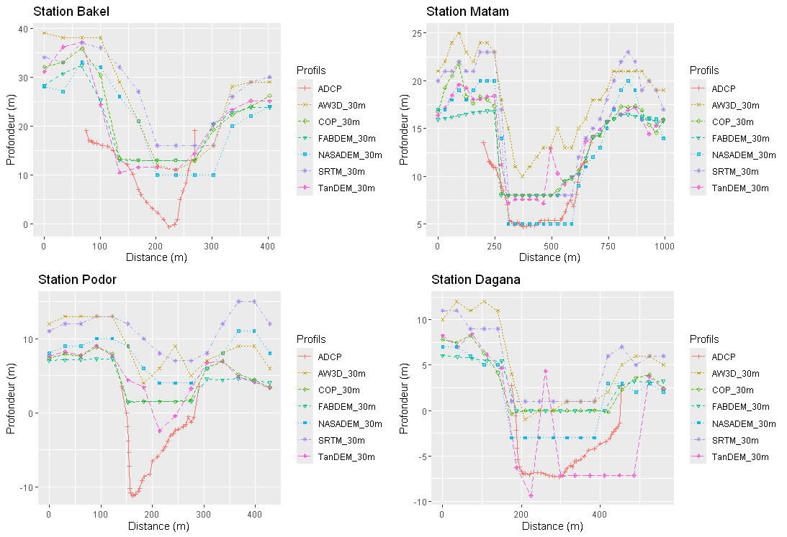
Results
HEC-RAS terrain reconditioning
Lowering the altitudes of the minor bed of the main channel

Slide 12
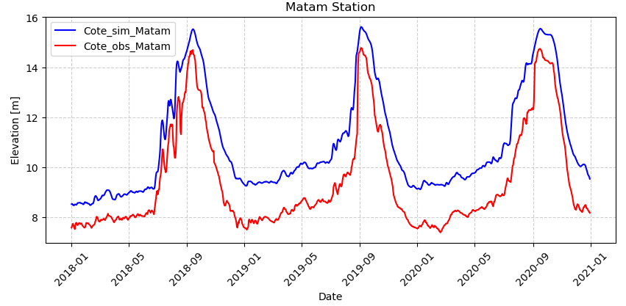
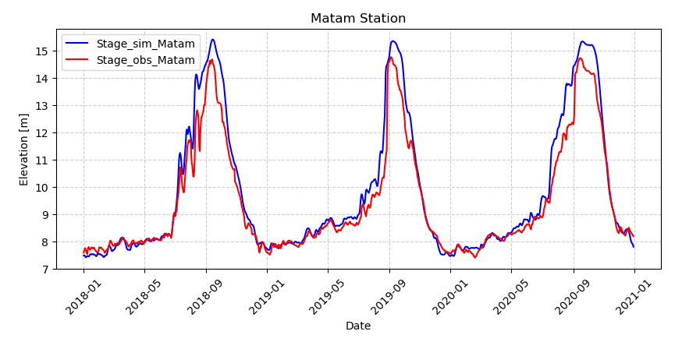
Results
Simulation (water level)
Calibration (water level)
Simulation: KGE (0.80) Overestimate water level
Calibration: KGE (0.84) Better representation of water level

Slide 13
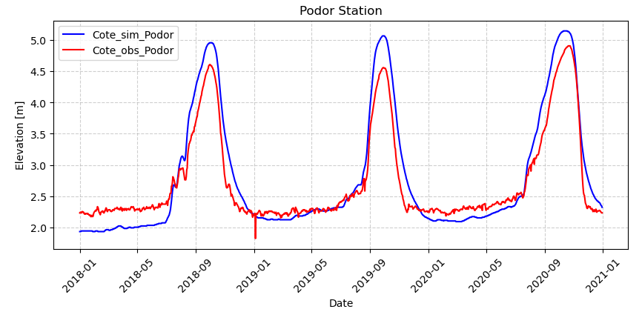
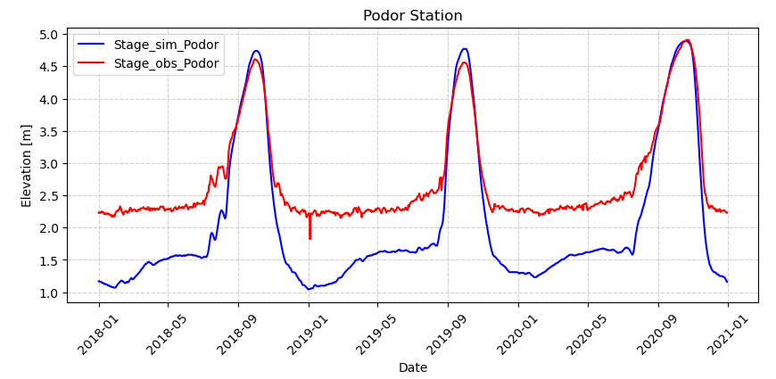
Results
Simulation (water level)
Calibration (water level)
Simulation: KGE (0.84) Overestimate peak
Calibration: KGE (0.47) Overestimate recession

Slide 14
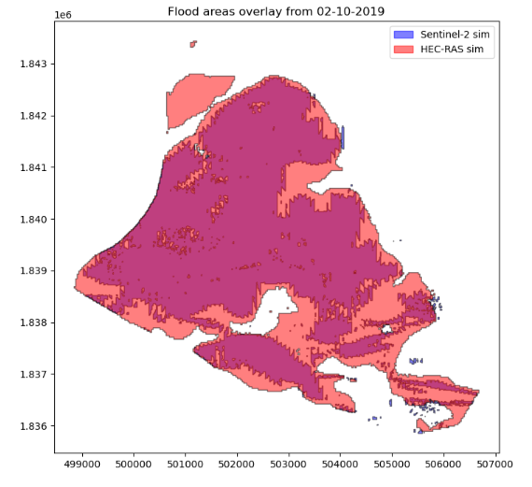
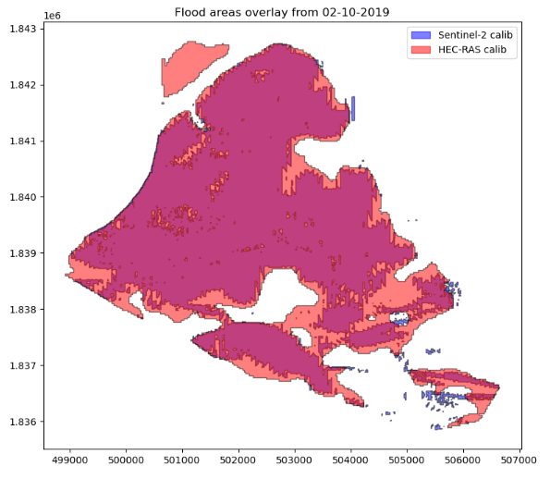
Results
Simulation (Flooded area)
Calibration (Flooded area)
Simulation: F1-Score (0.81), HEC-RAS overestimates flooded areas.
Calibration: F1-Score (0.86), Flooded area matches better SENTINEL-2.

Slide 15
Results
Simulation (Flooded area)
Calibration (Flooded area)
Simulation: F1-Score (0.88), HEC-RAS overestimates flooded areas.
Calibration: F1-Score (0.91), Flooded area matches better SENTINEL-2.

Slide 16
Results
Validation (Flooded area)
Podor: F1-Score (0.81), Flooded area matches better SENTINEL-2.
Ouoloum Néné: F1-Score (0.55), HEC-RAS overestimates flooded areas.

Slide 17
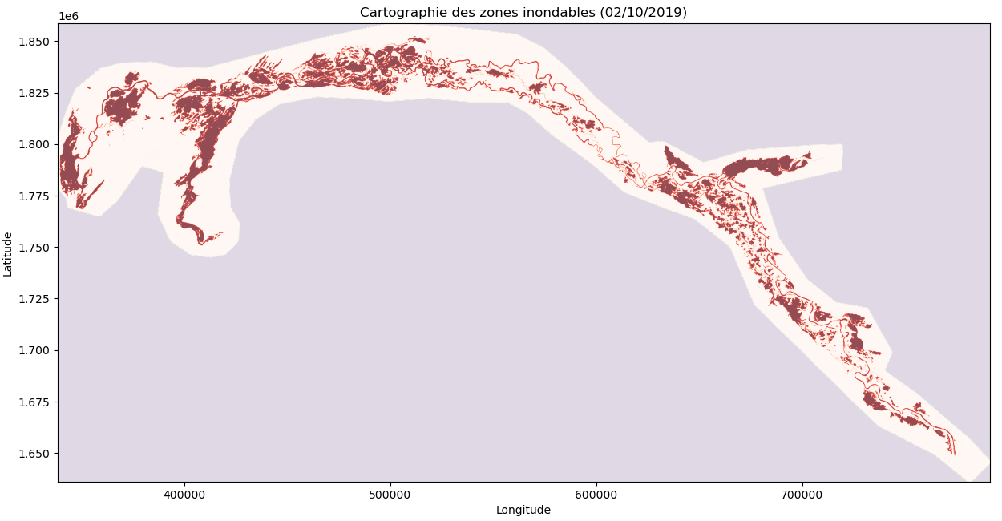
Results
Flood mapping
Results for mapping flooded areas are very encouraging.

Slide 18
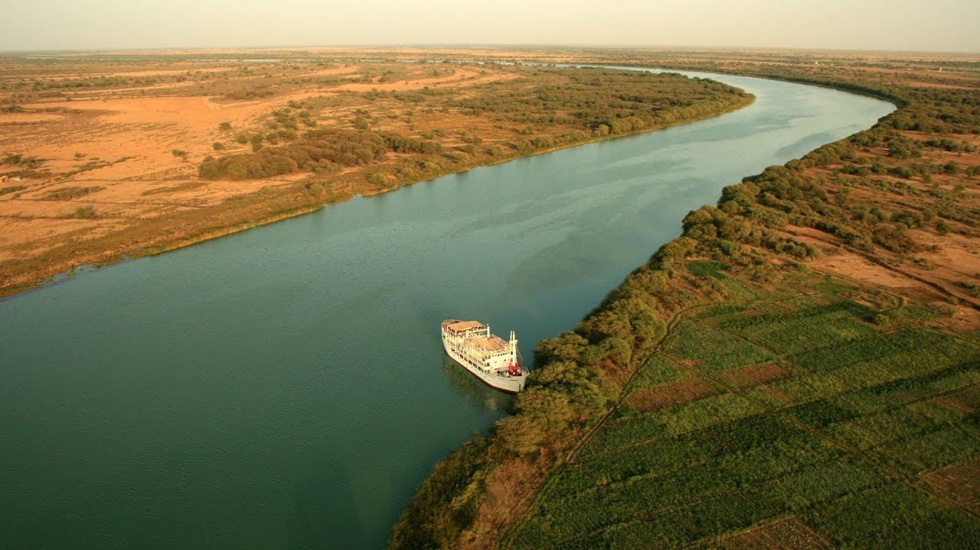
Thank you for your attention

