Slide 1
A data-driven framework for the temporal extrapolation of annual water withdrawals for hydrological modelling
?
ZARPAS Paul¹, RAMOS Maria-Helena¹, TALLEC Gaëlle¹, SARRAZIN Fanny¹, PENASSO Aldo², BARON Sébastien²
¹ Université Paris-Saclay, INRAE, UR HYCAR, Antony, France, ² EPTB Eaux & Vilaine, La Roche Bernard, France
paul.zarpas@inrae.fr

Slide 2
2’ pitch
?

Slide 3
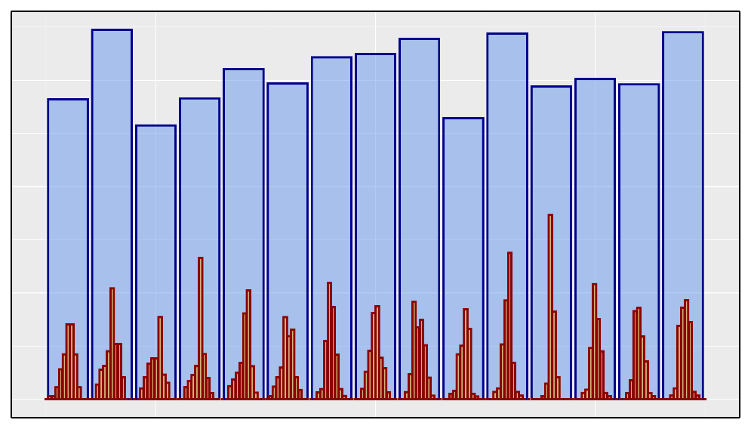
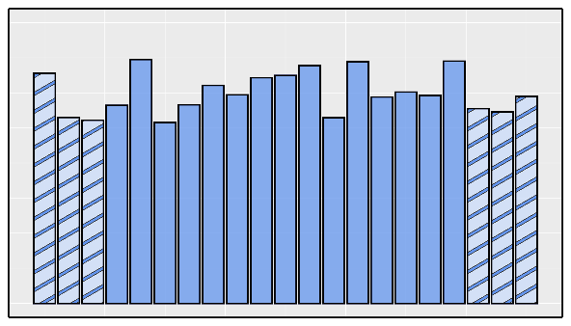
A data-driven framework for the temporal extrapolation of annual water withdrawals for hydrological modelling
?
PICO screen 4.14
Problematic
Method
Results
BNPE database
BNPE annual value
Not enough years available
Annual resolution too coarse
not suitable for hydrological modelling
Data-driven modelling
Extrapolation
Disaggregation
Disaggregated monthly value
BNPE: National database of quantitative water withdrawal
Enhanced BNPE database
→ French open source database BNPE not suitable for hydrological modelling
suitable for hydrological modelling
BNPE extrapolation
→ Adaptation of BNPE for hydrological modelling
→ BNPE extrapolation and temporal disaggregation

Slide 4
Overview
?
Context, problematic
Workflow
Study area
Method
Predictors
Performing extrapolation and disaggregation
Results for annual value
Synthesis
Results for monthly value

Slide 5
10’ presentation
?

Slide 6
Need for water withdrawal quantification
?
Climate change and increasing pressure on freshwater resource: need for prospective hydro-climatic studies to guide public policies
Resources ↓ Demand ↑
More
Need water withdrawal quantification for hydrological model that account for human influence
Water use
Hydrological model
Human society
Volume
More
In France, BNPE open source data-base: annual volume, availability 2008-2022, needs to be adapted for hydrological modelling
Not enough years available
Temporal resolution too coarse
More

Slide 7
Data-driven approach to estimate monthly irrigation water withdrawal at catchment scale
?

Slide 8
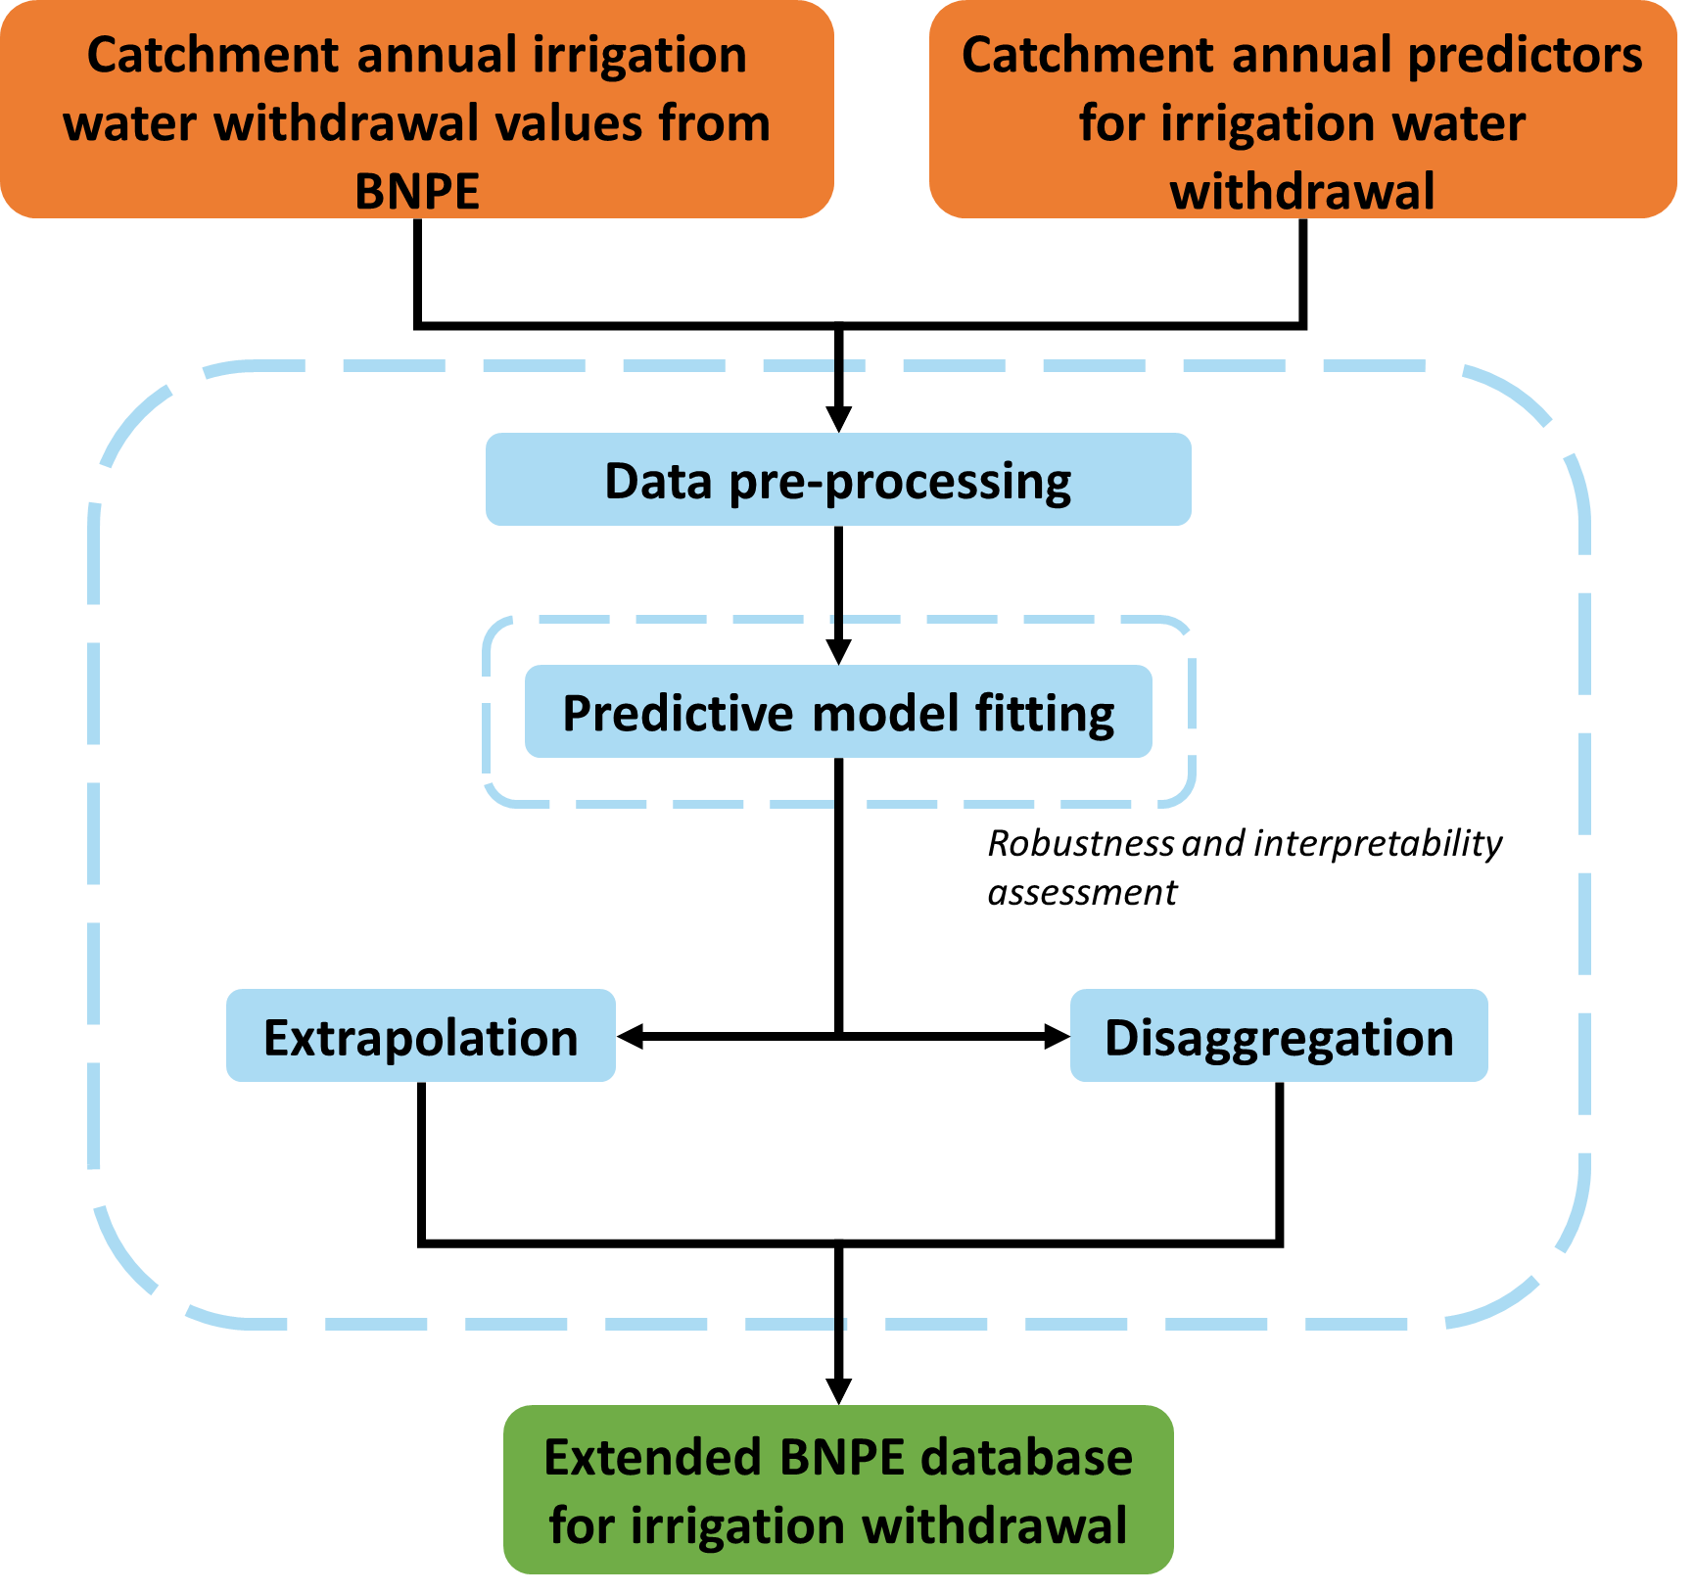
Data-driven approach : workflow
?
Idea: exploit the information contained in the BNPE and in explanatory variables (climate, area equipped for irrigation, etc.) to extrapolate and disaggregate the BNPE
More
Global information enhanced by local knowledge in limited data configuration
Global model tested and evaluated in several configurations
Monthly value compared with global irrigation models

Slide 9
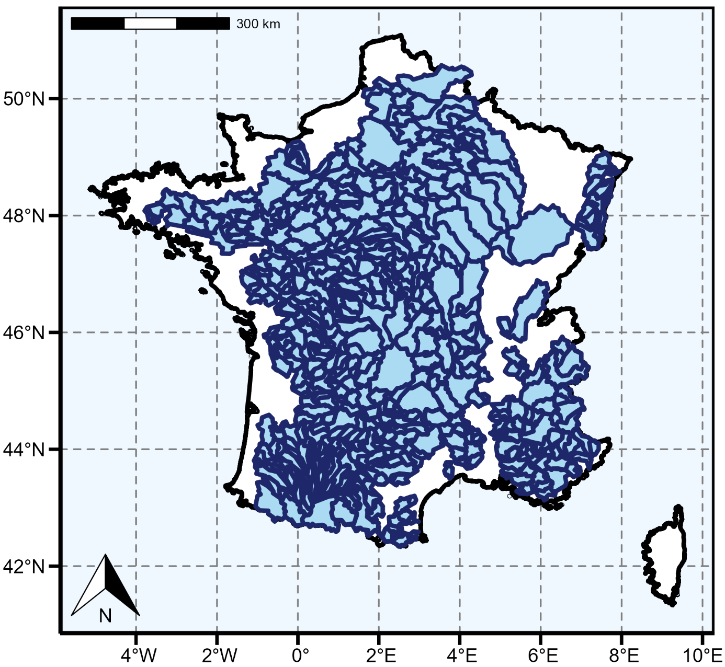
Data-driven approach : study area
?
Study is performed on 652 catchments in France :
Area> 350 km² : tradeoff between uncertainty on catchment aggregated value and number of catchments
BNPE data considered as valid on catchment
More
More
Map of the catchments used in this experiment. Note that they can be nested.

Slide 10
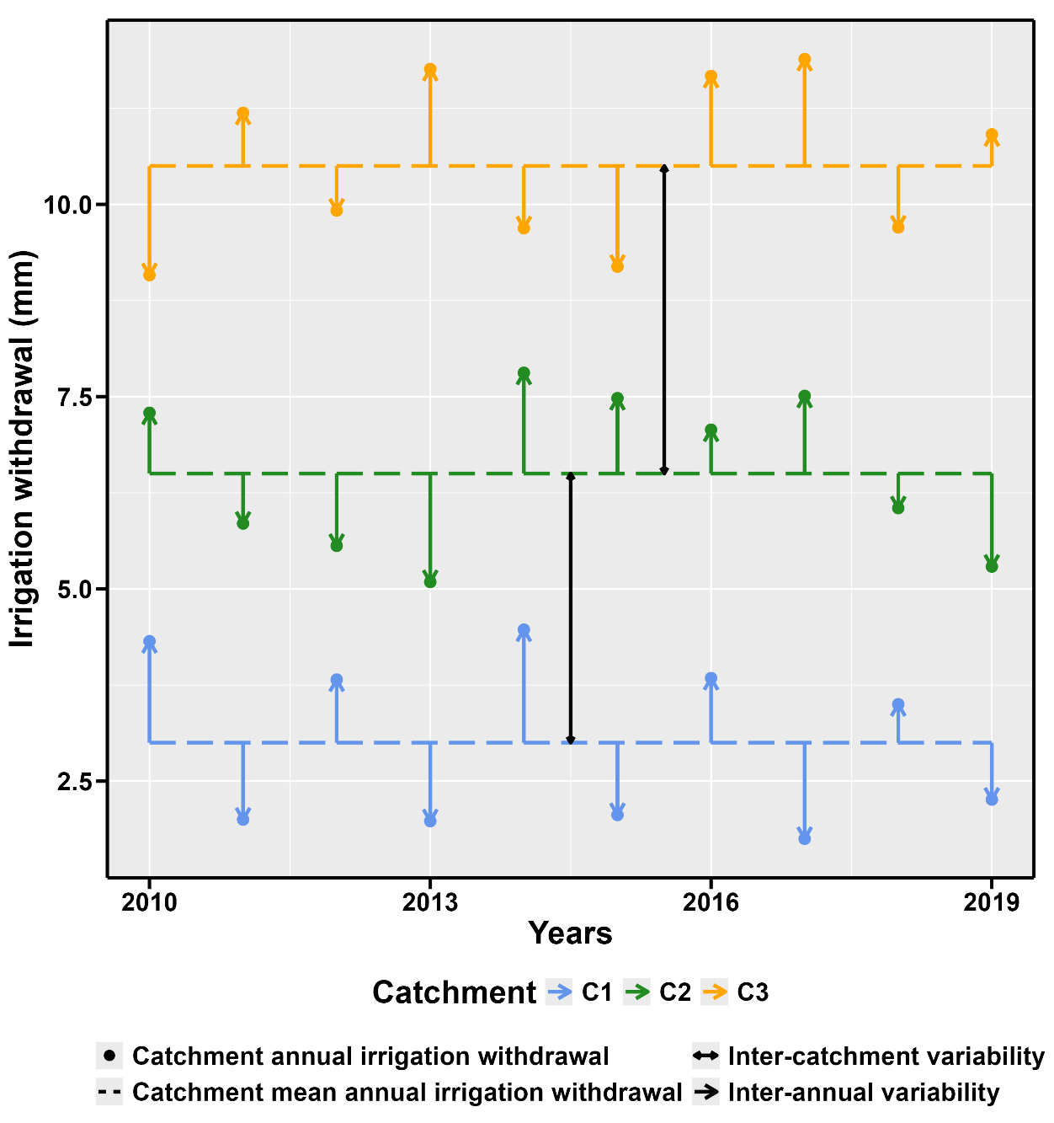
Data-driven approach : method
?
Several observations per catchment → two variabilities to capture :
(i) Inter-catchment variability (ii) Intra-catchment inter-annual variability
$𝓦_{y,c}$ = $𝓦_{y,c}^{0} ×\left(1+{δ𝓦}_{y,c} \right)$
Annual withdrawal
Base withdrawal
Relative deviation
Withdrawal total
Only available data
Structural effect term, account for inter-basin variability
Estimated by $\overline{𝓦_{c}}$
Accidental effect term, account for intra-basin inter-annual variability
$\overline{{δ𝓦}_{c}}=0$
$y$: year $c$: catchment
A model is fitted for each term
$\overline{𝓦_{c}}=f^{0}(X_{y,c}^{0})$
$\left(𝓦_{y,c}−\overline{𝓦_{c}}\right)\text{/}\overline{𝓦_{c}}=f^{δ}(X_{y,b}^{δ})$
$f^{0}$ and $f^{δ}$ : Random Tree Forest
More

Slide 11
Data-driven approach : predictors
?
Economical
Agricultural
3 variables
15 variables
GDP...
More
AEI...
More
Descriptor
Meteorological
22 variables
60 variables
More
Soil...
More
Precipitations...
$$X^{0}$$
$$X^{δ}$$
40 variables
71 variables

Slide 12
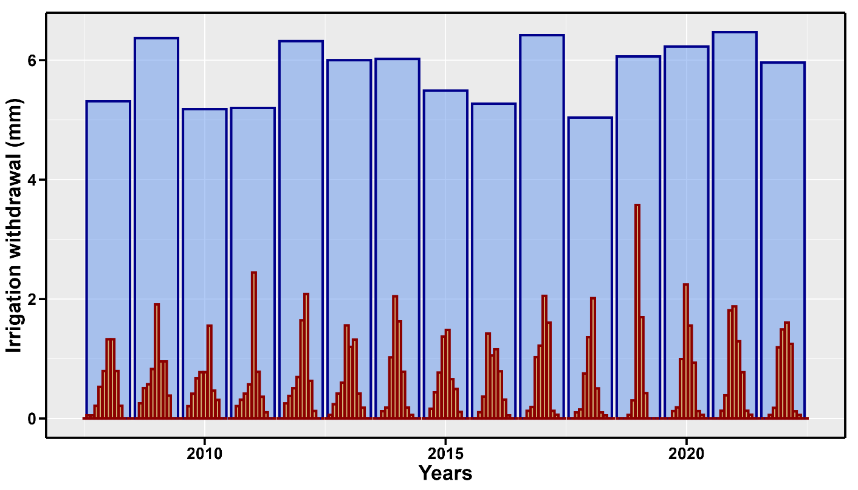
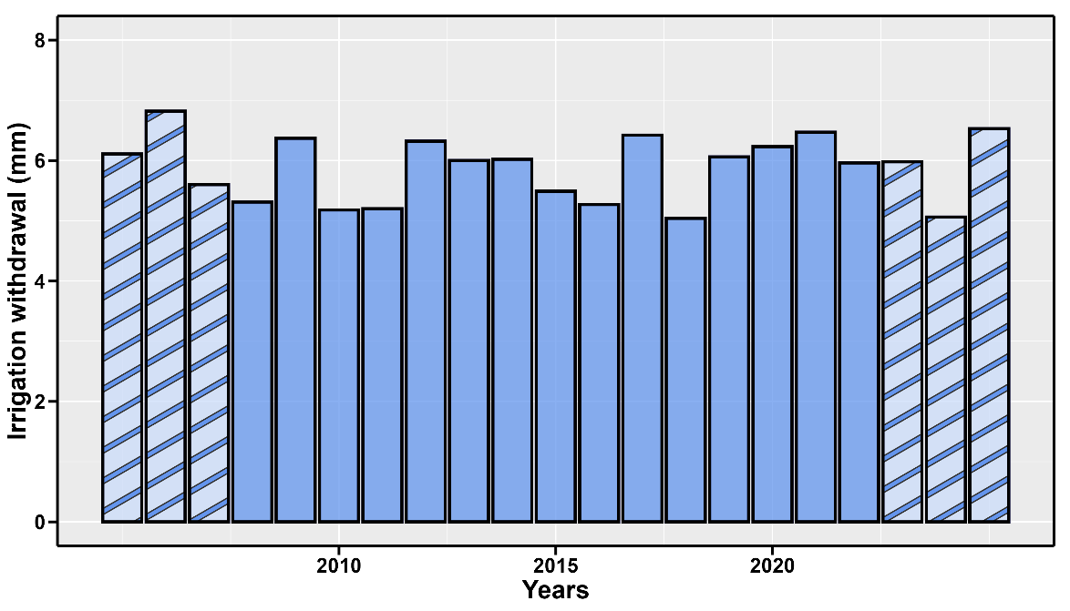
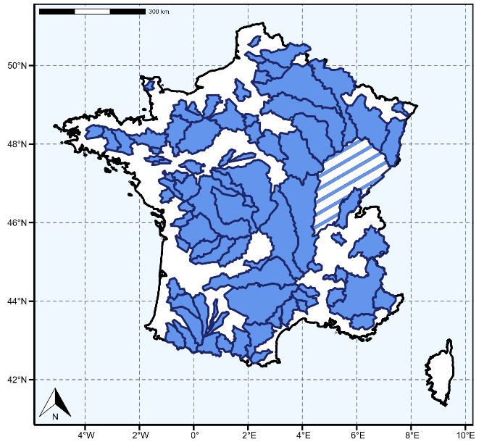
Data-driven approach : extrapolation and disaggregation
?
Annual value : apply function
$$𝓦_{y,c}=f^{0}(X_{y,c}^{0})\left(1+f^{δ}(X_{y,c}^{δ}) \right)$$
Results
Temporal extrapolation
Temporal disaggregation
Monthly value : no reference – more challenging
Objective: calculate monthly profile $r_{y,m,c}= \frac{𝓦_{y,m,c}^{monthly}}{𝓦_{y,c}^{annual}}$
Idea: month contribution to ${δ𝓦}_{y,c}$↔ monthly withdrawal
Computation: use Shapley value of $f^{δ}(X_{y,c}^{δ})$ values to estimate $r_{y,m,c}$
Results
Spatial extrapolation
More

Slide 13
Results
?
Annual value
Monthly value
Synthesis

Slide 14
Results on monthly value and temporal disaggregation
?

Slide 15
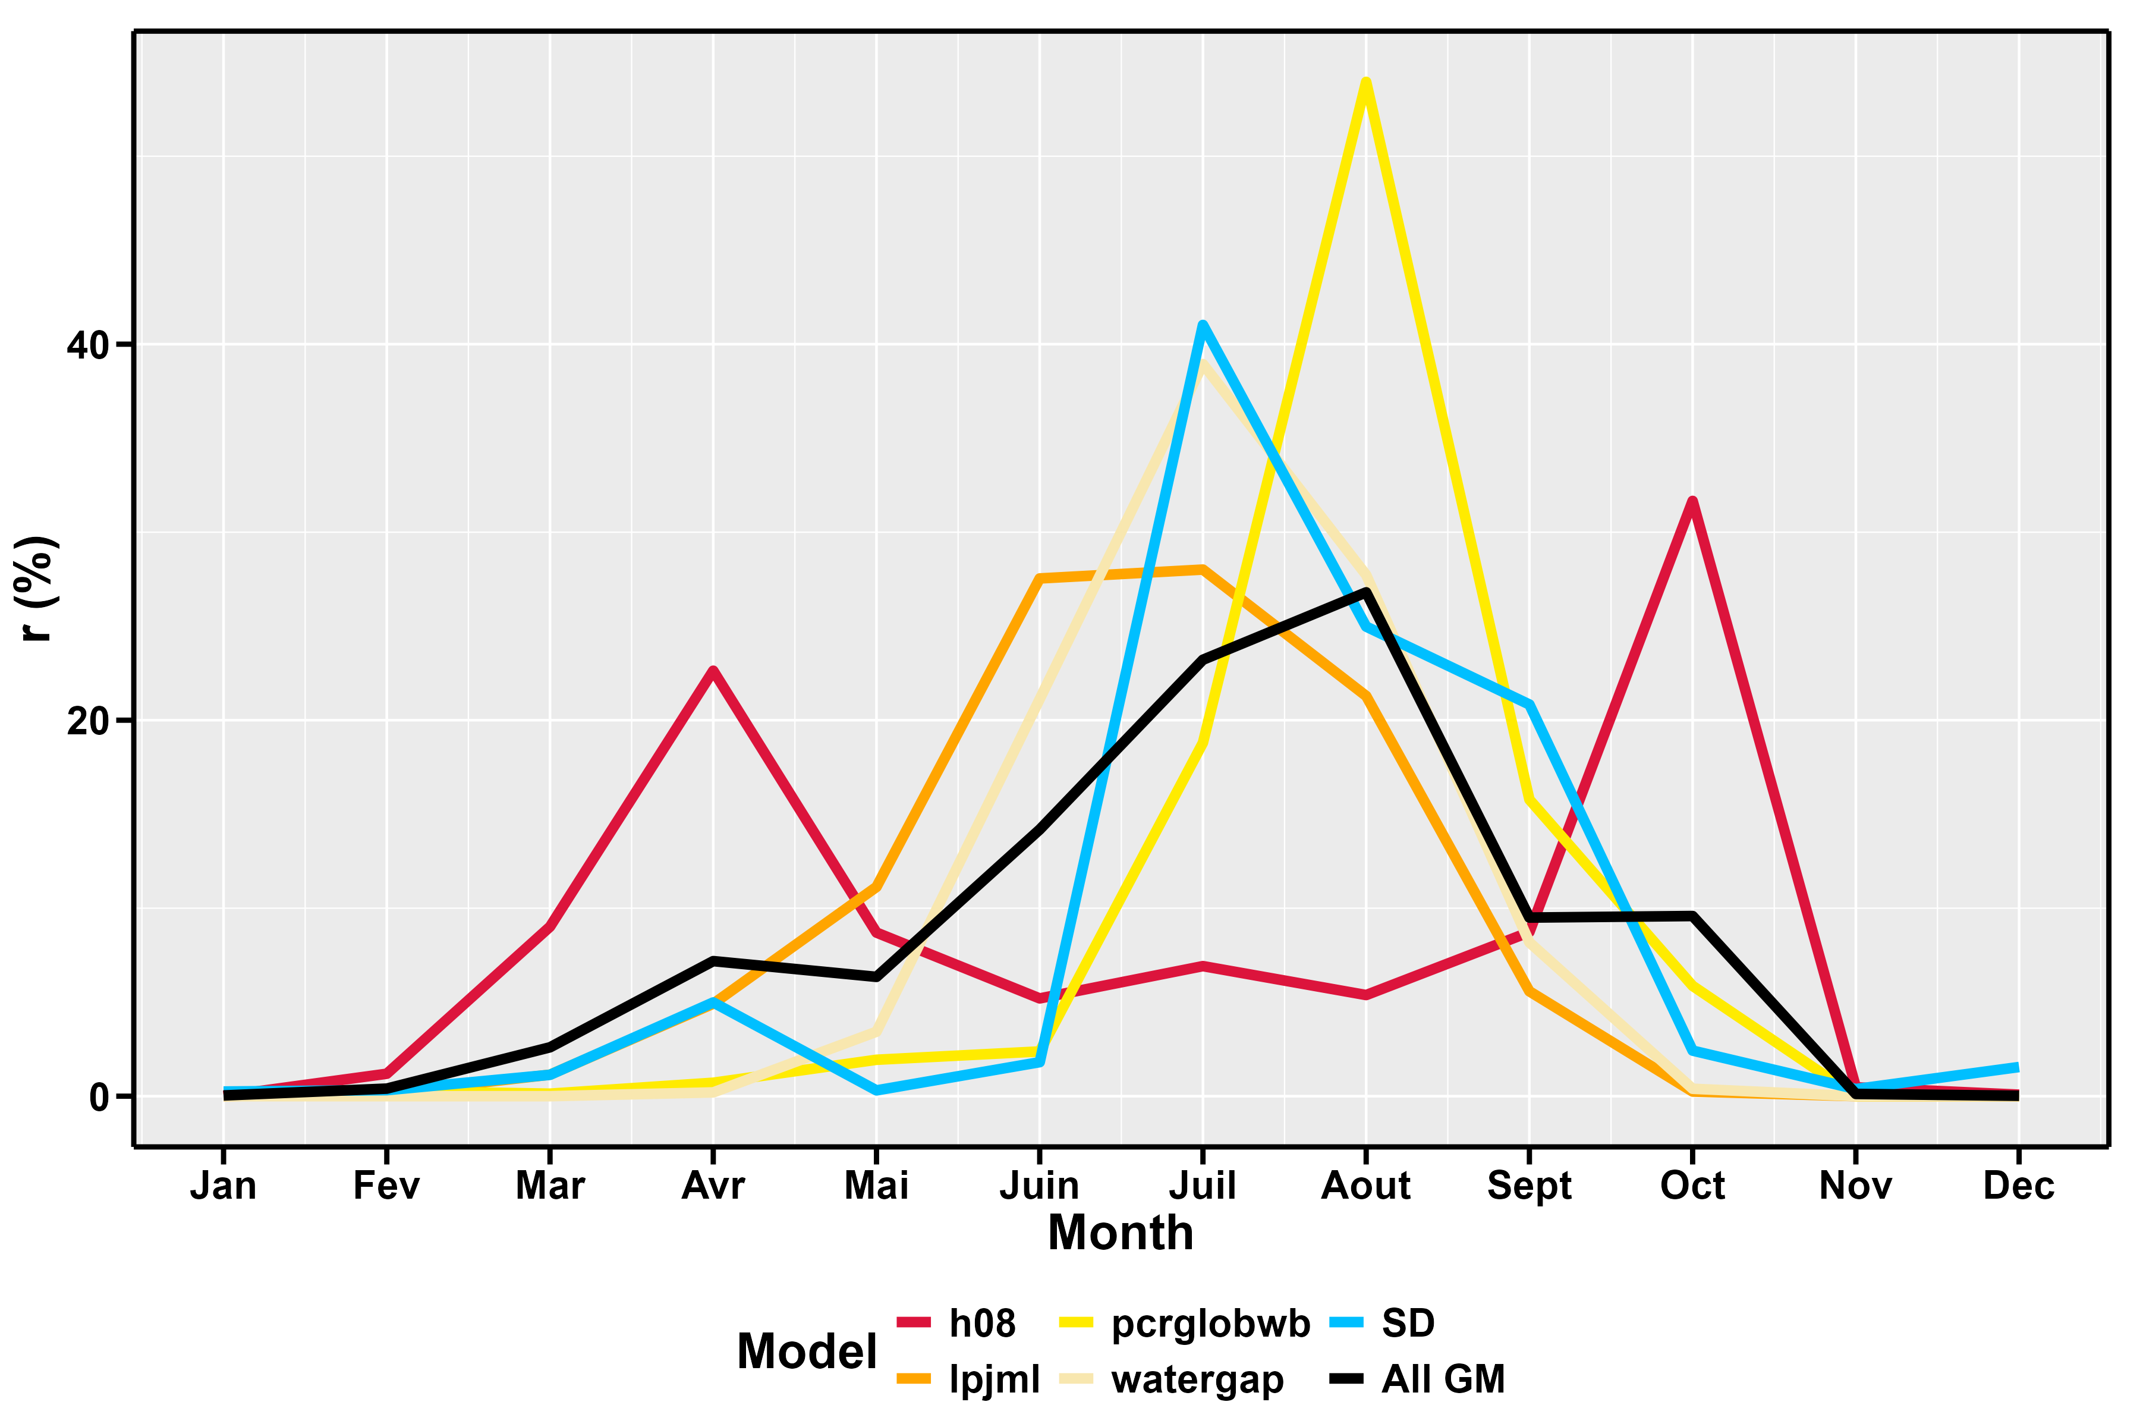
Results on temporal disaggregation
?
Comparison of mean monthly ratio
for each month for each model
Comparison of our model (SD) to 4 global models (GM) : h08, lpjml, pcrglowb, watergap; value from Huang et al., 2018
Mean monthly ratio, 2008-2010, some selected catchments
Ref.
Monthly ratio : $r_{y,m,c}= \frac{𝓦_{y,m,c}^{monthly}}{𝓦_{y,c}^{annual}}$
→ Our model exhibits the same temporality as the GMs

Slide 16
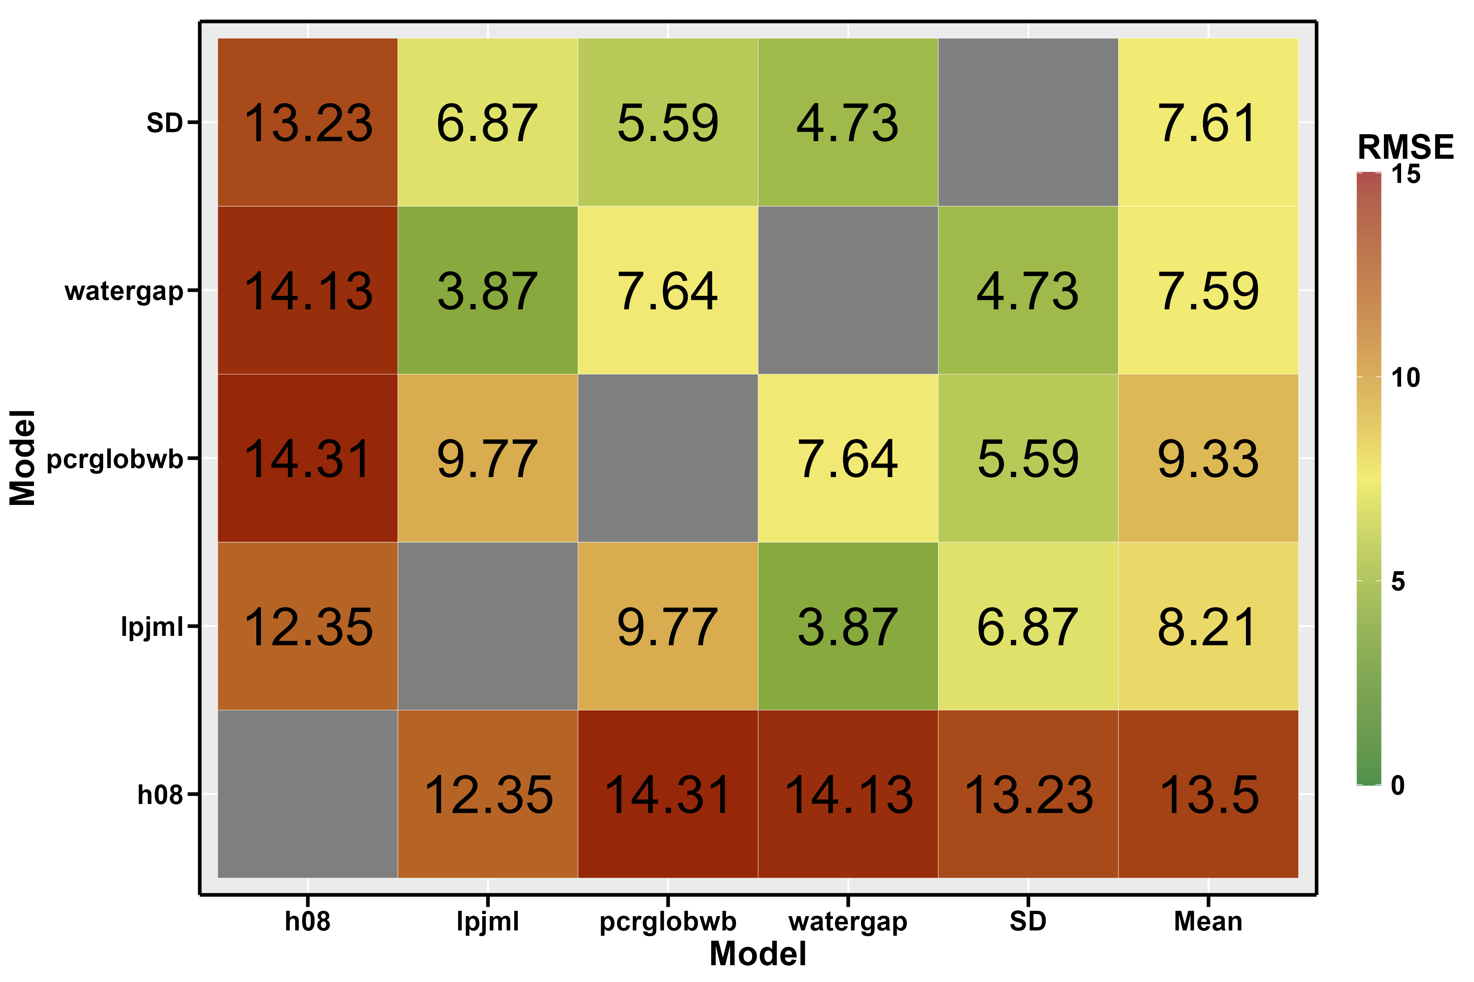
Results on temporal disaggregation
?
Comparison of distance to other model for each model
Comparison of our model (SD) to 4 global model (GM) : h08, lpjml, pcrglowb, watergap; value from Huang et al., 2018
Distance* of models to the others, 2008-2010, some selected catchments
Ref.
Monthly ratio : $r_{y,m,c}= \frac{𝓦_{y,m,c}^{monthly}}{𝓦_{y,c}^{annual}}$
*the distance is the mean of the per catchment per year RMSE. To catch the seasonality, we compute the RMSE on a 3 month moving average.
→ Our model in the same range as the GMs

Slide 17
Results on robustness
?

Slide 18
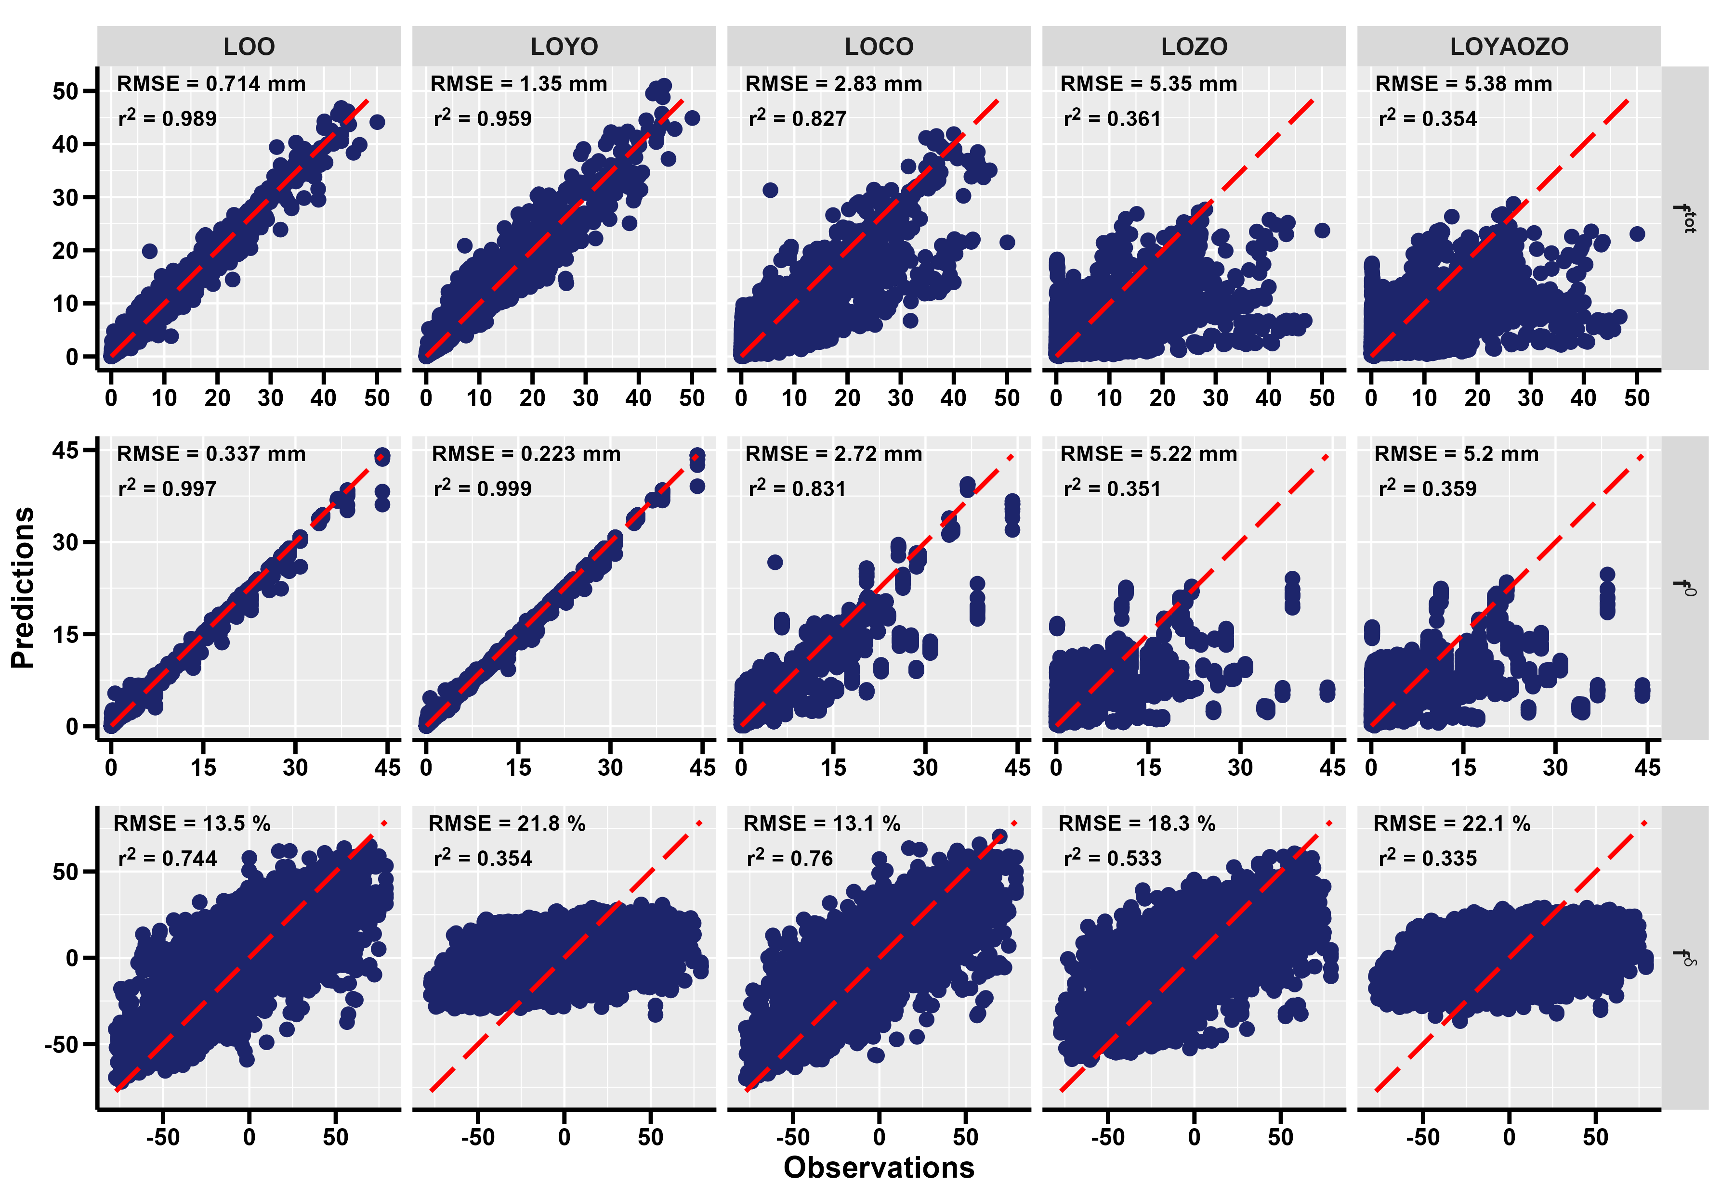
Results on robustness
?
Inter-catchment variability performance :
all catchments together in a global test
LOO: Leave One Out
LOYO: Leave One Year Out
LOCO: Leave One Catchment Out
LOZO: Leave One Zone Out
LOYAOZO: Leave One Year And One Zone Out

Slide 19
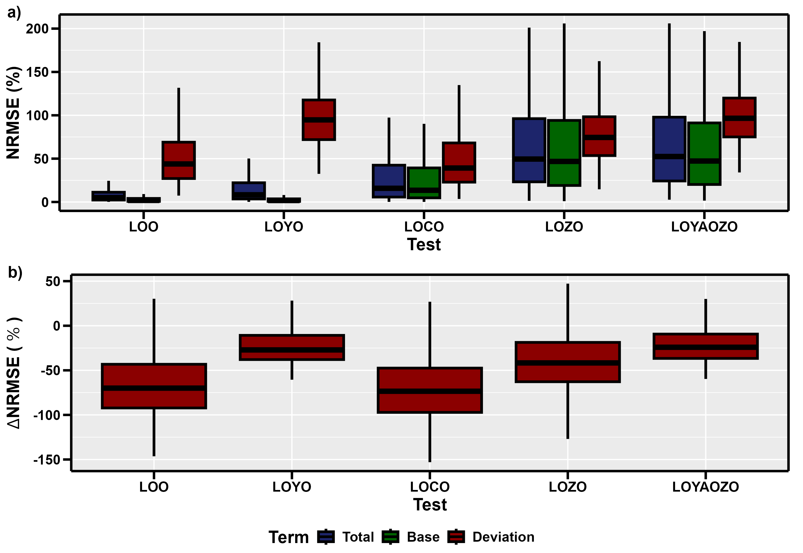
Results on robustness
?
Inter-annual variability performance : each catchment individually
LOO: Leave One Out
LOYO: Leave One Year Out
LOCO: Leave One Catchment Out
LOZO: Leave One Zone Out
LOYAOZO: Leave One Year And One Zone Out

Slide 20
Results on temporal extrapolation
?

Slide 21
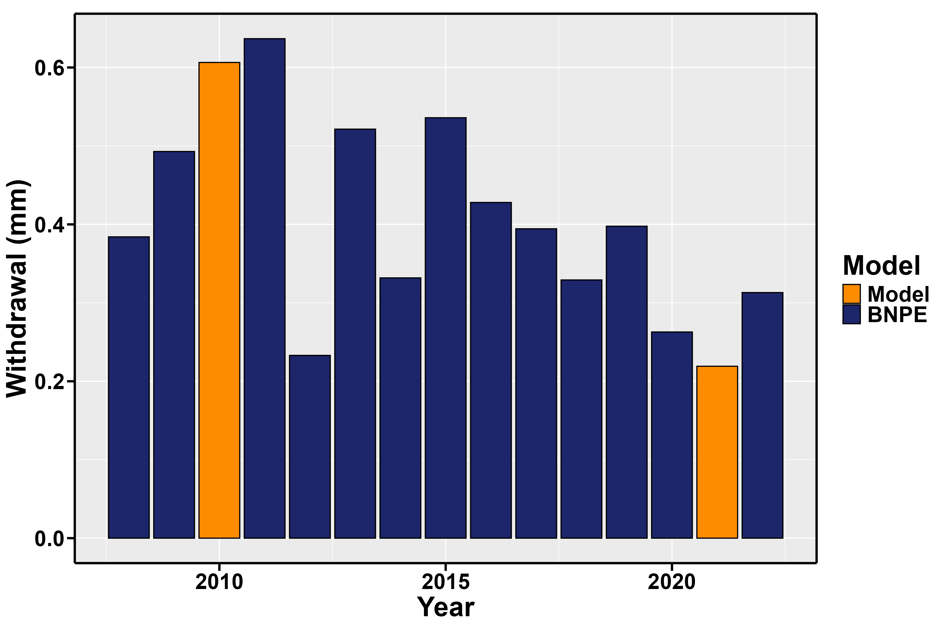
Missing year filling
?
Model allows fill missing years
Application case: France North West catchment (Le Semnon à Bain-de-Bretagne)

Slide 22
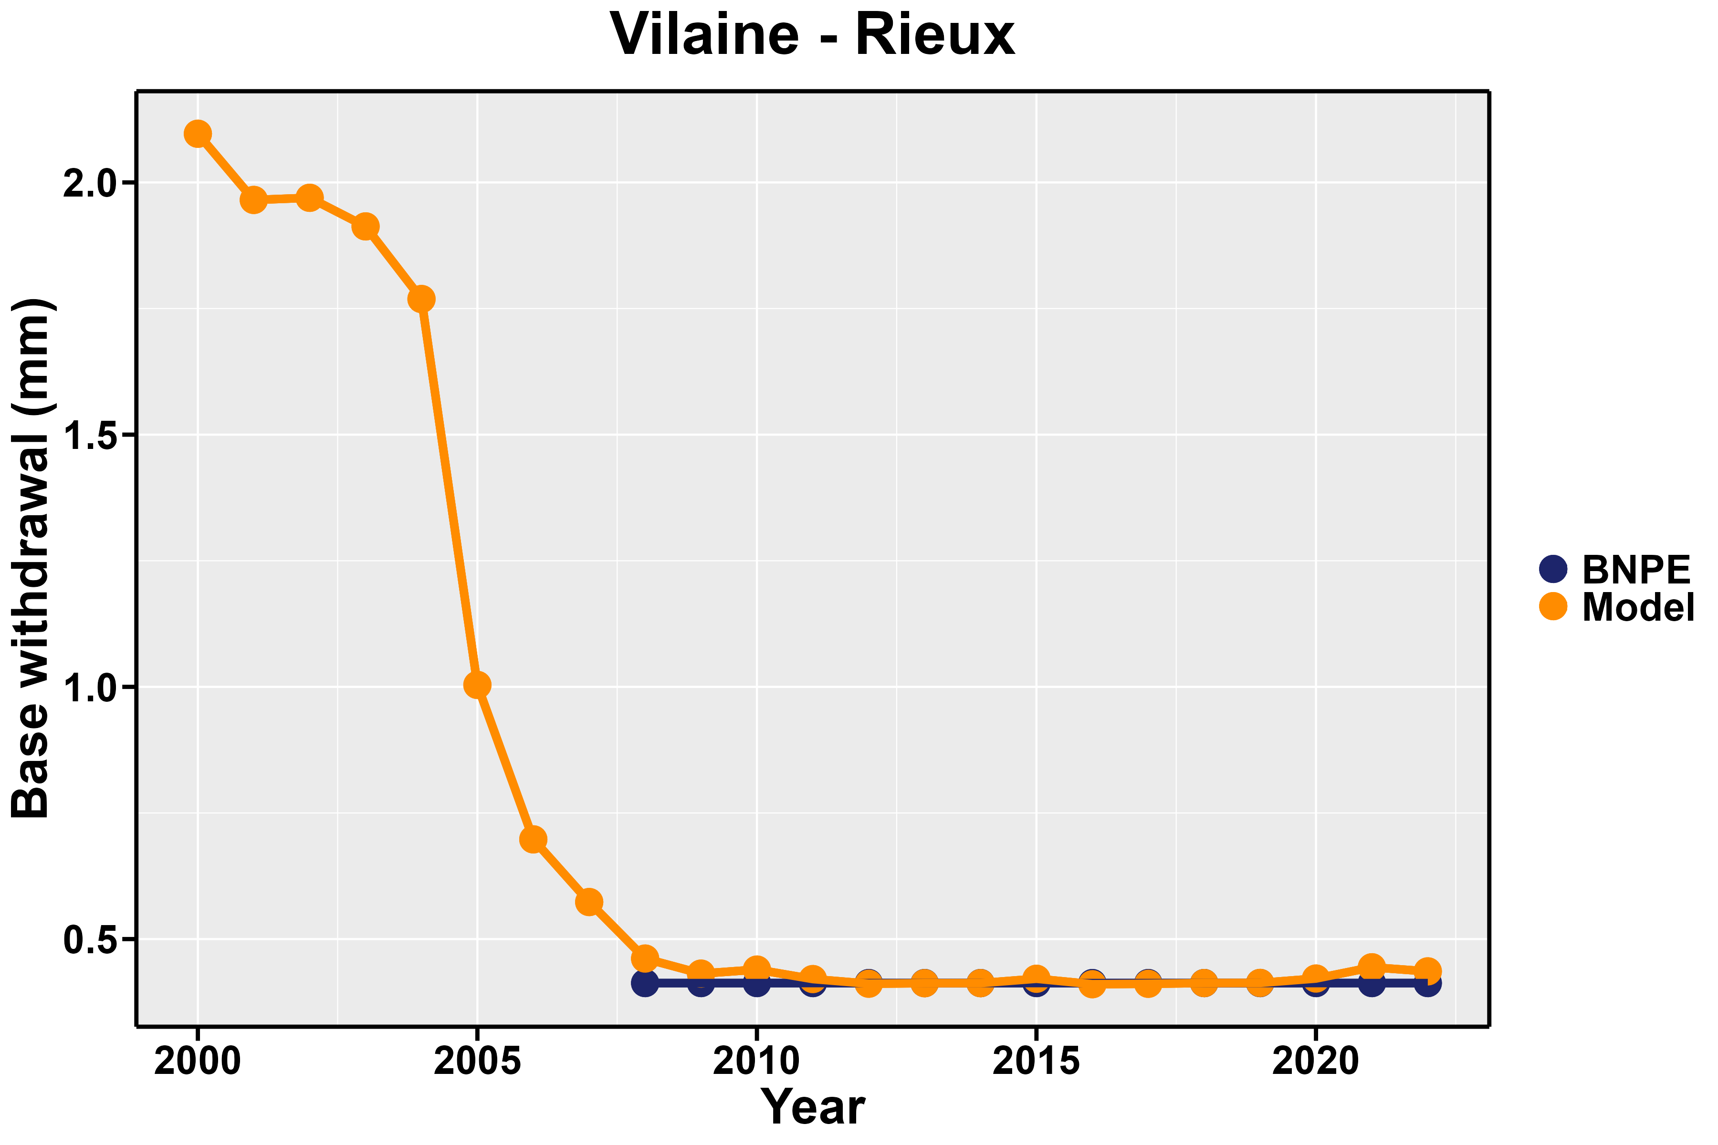
Unknown year prediction
?
Issue on base term:
the random forest fails to capture the structure of data
lack of temporal autocorrelation
on some catchments it results in a sudden jump
need for a new predictive model?

Slide 23
Results synthesis
?
BNPE original domain
BNPE domain boundaries
Our monthly prediction
GM inter-model variability
✓ :
Predict unknown point within BNPE boundaries
Our model is as close to other models as they are to each other
✓
✗
Our model is coherent with process-based GM
Space
Withdrawal
✗ :
Predict new point outside BNPE boundaries
Time
Month
Extrapolation
Disaggregation

Slide 24
Key take-away
?
We developed a data-driven framework to quantify irrigation water withdrawal for hydrological modeling
An enhancement of original database is performed, with more catchments, missing year completion with monthly resolution
Final results to be published soon

Slide 25
Appendices
?

Slide 26
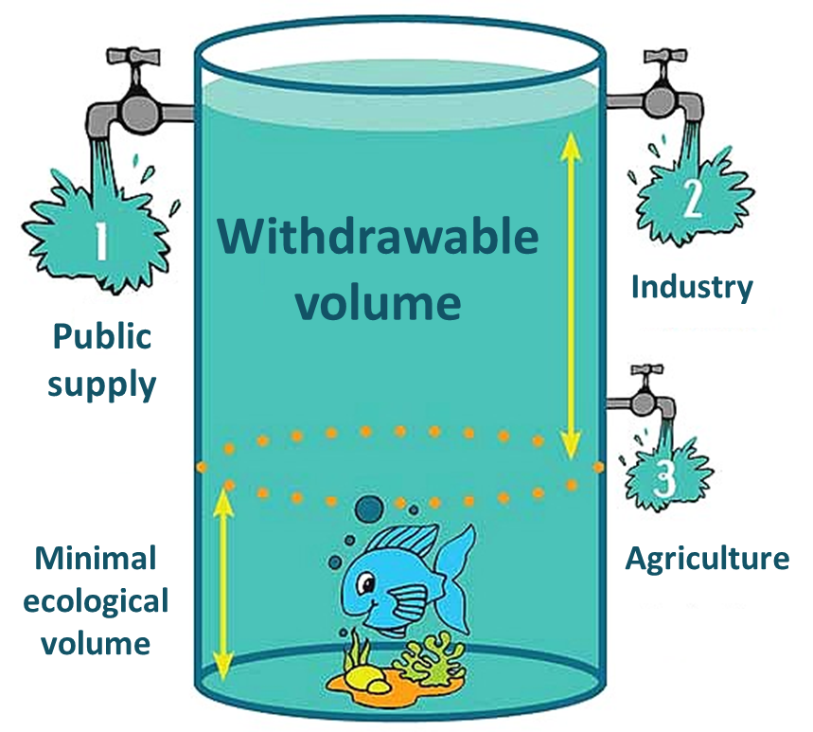
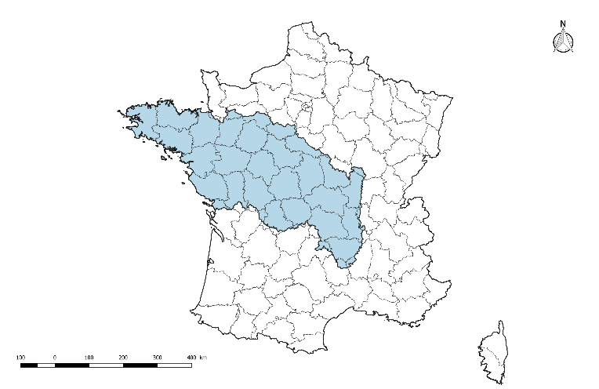
Prospective hydro-climatic studies in France
?
Explore 2: Nationally coordinated study that explored the hydrological futures of France for a large selection of climatic projection and 9 hydrological model
Key result: strong diminution of summer streamflow's
Ref.
Emission scenario
Climatic model (GCM)
Downscaling and bias correction
Hydrological modeling
Water use scenario
Hydro-climatic projection
HMUC (hydrology, environment, use, climate):
Local study (catchments in Loire-Bretagne, France), that link projection (hydro-climatic for different water use scenarios) to operational question (e.g withdrawable volume per sector) with a direct use of conclusions in public policy
https://fr.wikipedia.org/wiki/Bassin_Loire-Bretagne
Santos et al., 2022a,b, 2023
https://www.sage-authion.fr/nos-actions/preserver-ressource-eau/letude-h-m-u-c/
Ref.

Slide 27
Data for hydrological modeling of anthropized system
?
Sectorial water demand and water use rules
Key challenge for influenced hydrological model development:
What do we couple the hydrological model to ?
→ Quantification of human water uses
(ii) How do we represent this coupling ?
→ Accounting for water uses in the model
Climatic data
T, P, …
Hydrological model
Human society
Volumes
Naturel hydrological modeling
Influenced hydrological modeling
Ref.
Development of human influence accounting in daily parsimonious conceptual models (GR models):
Multiplication of local prospective studies in France
Groundwater abstraction representation remain untreated
Needs for a large amount a data (years and catchments) : large sample hydrology approach and climatic projection objective
Ref.

Slide 28
Sources for water withdrawal quantification in France
?
National database of quantitative water withdrawals (BNPE)
Data obtained through compulsory declarations for any legal entity withdrawing an annual volume exceeding 10 000 m3 (7 000 m3 in chronic water scarcity zone).
Data available from 2008 to 2022 at the annual scale
Localized in space through coordinates
For large areas, BNPE data considered representative
Ref.
Different possible sources:
Local studies: precise, but resources and time demanding, results rarely public
Global modeling: easy availability, but subject to large uncertainties and do not build on local knowledge
BNPE: open source and homogenous, but contains uncertainties, limited availability and resolution
Proposition: build an intermediary between local and global scale by enhancing the BNPE
Ref.

Slide 29
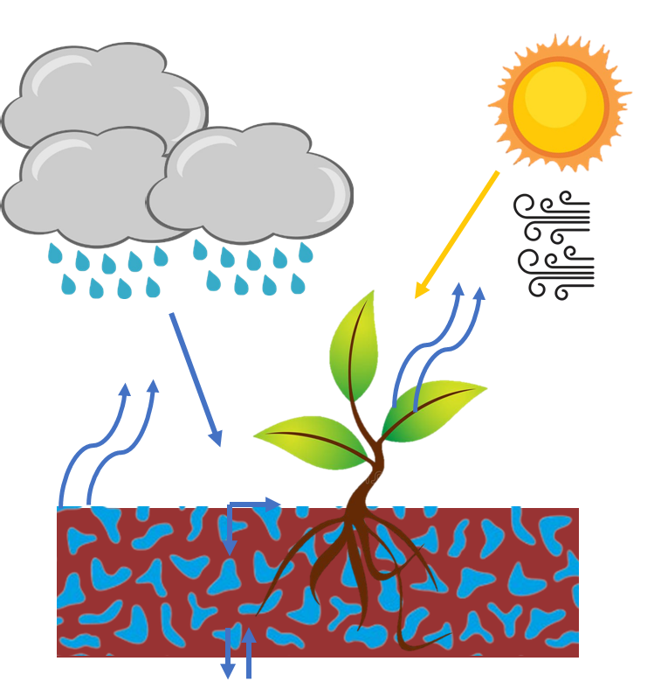
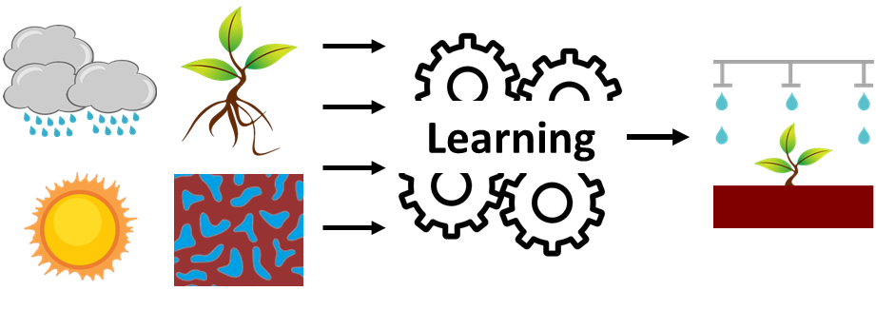
Irrigation water withdrawal quantification
?
Classic approach: process-based approach
Crop water demand : $k_{c}×ETP0$
Need for precise data, as the information they provide is set a priori
Ref.
Ref.
Recent developments of data driven approach for water withdrawal quantification
Regression and machine learning as tools for constructing a data-base
This approach lacks of interpretability, but allows to let the data speak for themselves

Slide 30
More about study area
?
a)
b)
Distribution of area in catchments selection
Zoom on < 10 000 km² section

Slide 31
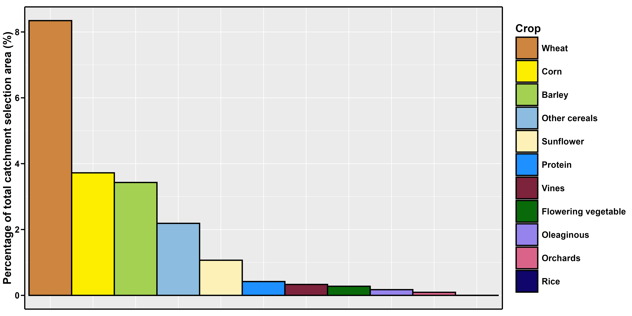
More about study area
?
Crop type importance on the catchment selection total area

Slide 32
More about study area
?
Distribution of area equipped for irrigation (as a percent of total catchment area) in catchments selection

Slide 33
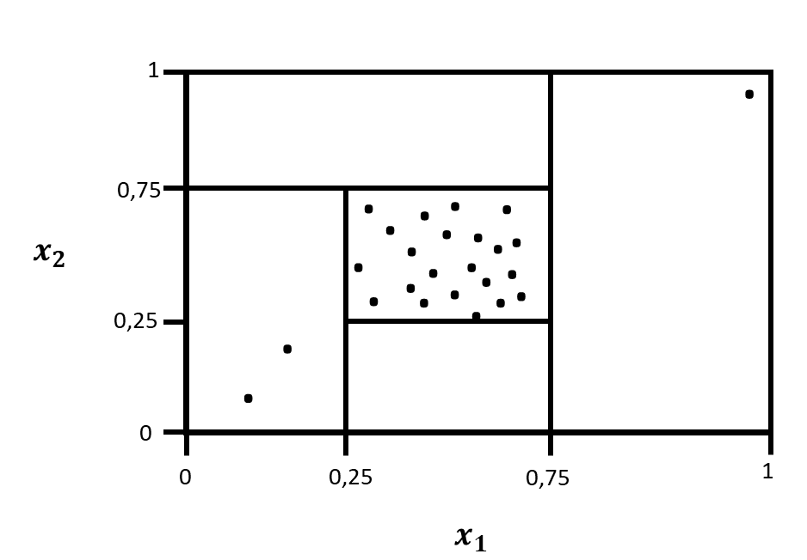
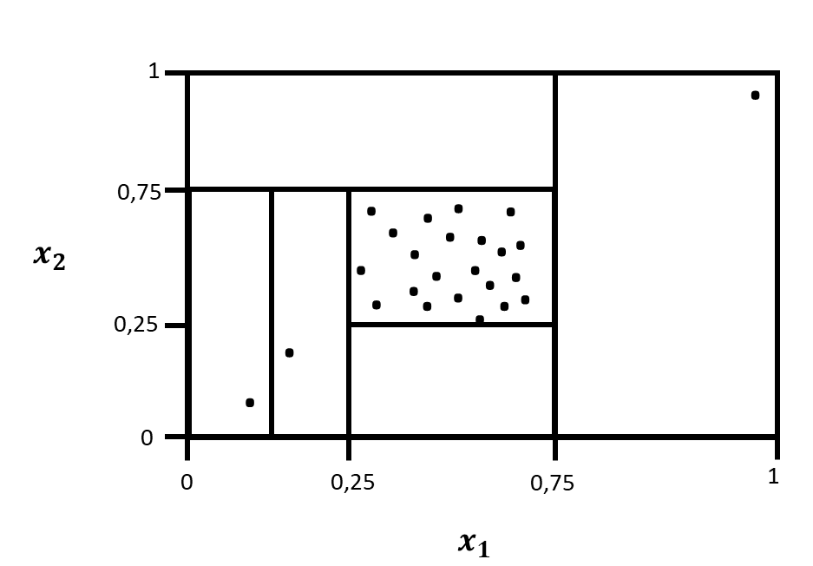
Data pre-processing
?
Rules to consider BNPE value valid
Years with variation of $±80\%$ from the catchment mean are discarded
Catchments with less than N-2 years of data are discarded, N being the maximum number of years of the BNPE record
Catchments with mean value considered as outliers are discarded
Years with deviation considered as outliers are discarded
Outliers detection
Compute isolation forest anomaly score
Outlier: top $1\%$ anomaly score in the dataset
Liu et al., 2001
Ref.
Illustration of the isolation forest algorithm. Idea: when performing random splitting of the dataset, how quickly a point is isolated ?

Slide 34
Decision tree
?
Mapping the predictors space by successive splitting
James et al., 2023
$$x_{1}≤0,75$$
$$x_{1}>0,75$$
Ref.
1
$$x_{2}≤0,75$$
$$x_{2}>0,75$$
$$y=1$$
0,75
$$x_{1}≤0,25$$
$$x_{1}>0,25$$
$$x_{2}$$
$$y=0$$
$$y=0,2$$
$$x_{2}≤0,25$$
$$x_{2}>0,25$$
0,25
$$y=0,4$$
$$y=0,8$$
$$y=0,4$$
$$y=0,8$$
$$y=0$$
$$y=1$$
$$y=0,2$$
0
0
0,25
0,75
1
Illustration of the partitioning process of the predictors space ($x_{1}$ and $x_{2}$) for the prediction of variable $y$.
The split selected is the one which minimizes the sum of the squared deviations from the mean in the two separate partitions.
$$x_{1}$$
Illustration of the partitioning of predictors space ($x_{1}$ and $x_{2}$) for the prediction of variable $y$

Slide 35
Random Tree Forest
?
Association of several trees to improve results
For each tree, random selection of a sub-sample of for training
High predictive capacity
Few observations and high dimension handling
Predictors correlation handling
Breiman, 2001
James et al., 2023
Ref.
$$y=1$$
$$y=1$$
$$y=1$$
$$y=1$$
$$y=0,2$$
$$y=0$$
$$y=0,23$$
$$y=0,2$$
$$y=0,4$$
$$y=0$$
$$y=0,2$$
$$\left\{x_{1} ;x_{2}\right\}$$
$$y=0,4$$
$$y=0$$
$$y=0,2$$
$$y=0,4$$
$$y=0,8$$
$$y=0$$
$$y=0,2$$
$$y_{RTF}= \overline{y_{A}}$$
$$y=1$$
$$y=0,4$$
$$y=0,8$$
$$y=0$$
$$y=0,8$$
$$y=1$$
$$y=0,56$$
$$y=0,8$$
$$y=1$$
$$y=0,8$$
$$y=0$$
$$y=0,2$$
$$y_{A3}$$
$$y=0$$
$$y=0,2$$
$$y_{A2}$$
$$y=0,4$$
$$y=0$$
$$y=0,2$$
$$y_{A1}$$
$$y=0,4$$
$$y=0,8$$
$$y=0,4$$
$$y=0,8$$
$$y=0,8$$
Illustration of the random tree forest algorithm

Slide 36
Agricultural predictors
?
Name | Source | Original available year | Original spatial resolution | Term
Area equipped for Irrigation (AEI) | ELIAD (Zhu et Siebert, 2022) | 1989-2020 | NUTS2 | $$X^{0}$$
Irrigation technic | RA2020¹ et Eurostat² | 2020¹ et 2010² | French regions¹ et NUTS2² | $$X^{0}$$
Crop type | Graphic parcel register (RPG) | 2007, 2011, 2016, 2021 | Land lot | $X^{0}$, $X^{δ}$
Ref.
Crop types: Wheat, Corn, Barley, Other cereals, Sunflower, Oleaginous, Protein, Rice, Orchards, Vines, Flowering vegetables
Irrigation technics: Surface irrigation, sprinkler irrigation, drop irrigation
More
about spatial scale and missing year

Slide 37
Economical predictors
?
Name | Source | Original available year | Original spatial resolution | Term
GDP | EUROSTAT | 2011-2022 | NUTS3 | $$X^{0}$$
Workforce | RICA (agrest) | 1988-2022 | French regions | $$X^{0}$$
Permanent capital | RICA (agrest) | 1988-2022 | French regions | $$X^{0}$$
More
about spatial scale and missing year

Slide 38
Descriptor
?
Name | Sources | Different variables | Term
Climate | BDD | Average (sum) of temperatures (precipitation) for two periods (spring-summer; autumn-winter); 30-years average | $$X^{0}$$
Reservoir | Topage | Proportion of catchment area covered by reservoirs (type 2.1, 2.1.1, 2.1.2) | $$X^{0}$$
Morphology | CamelsFR | Mean slope, altitude and form factor (Horton) | $$X^{0}$$
Hydrogeology | CamelsFR (BDLISA) | Catchment area proportion which is: karstic, alluvion, sediment, bedrock; mean permeability | $$X^{0}$$
Soils | CamelsFR | Total available water content (TAWC), depth to roots, catchment area proportion which is: clay, sand, silt, organic | $$X^{0}$$
Land cover | CAMELSFR (CorineLandCover) | Catchment area proportion which is type 1, 2, and 3 | $$X^{0}$$
Ref.
More
about spatial scale and missing year

Slide 39
Meteorological predictors
?
Name | Source | Content | Term
Monthly temperature mean | BDD HydroClim (Safran) | Average daily temperature ($T$) for one month in the catchment | $$X^{δ}$$
Monthly precipitation total | BDD HydroClim (Safran) | Total of daily precipitation ($P$) for a month in the catchment | $$X^{δ}$$
Monthly evapotranspiration total | BDD HydroClim (Safran) | Total of daily evapotranspiration ($ETP$) for a month in the catchment | $$X^{δ}$$
Monthly net precipitation total | BDD HydroClim (Safran) | Total of daily net precipitation ($P_{n}=max⁡(0,P −ETP)$for a month in the catchment | $$X^{δ}$$
Monthly humidity index mean | BDD HydroClim (Safran) | Average daily humidity index (SWI, extracted from SIM model) for one month in the catchment | $$X^{δ}$$
For a meteorological variable $X$, we define $X_{y,m}$ the sum (or average depending on the variable) of the variable over the month $m$ of the year $y$. We construct for each variable 12 predictors (one for each month), defined by $δX_{y,m}=\frac{X_{y,m}−\overline{X_{m}}}{\overline{X_{m}}}$.
More
about spatial scale and missing year

Slide 40
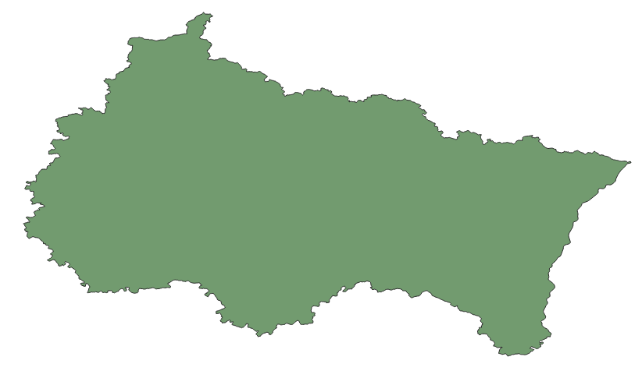
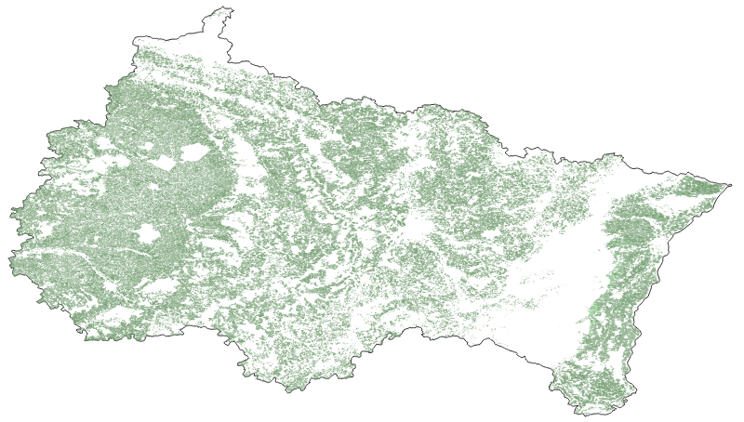
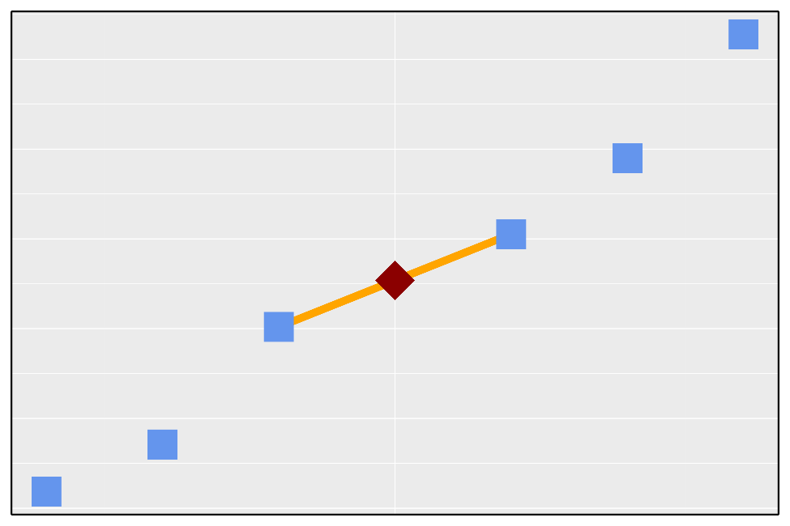
Data rescaling and missing year handling
?
a)
Basin descriptors and meteorological data: aggregated to catchment scale
GDP disaggregation: considered it constant in space (a)
Agricultural (and agriculture-linked economical) variables spatial disaggregation: considered constant over agricultural land (b)
Missing years are completed using linear interpolation using the two closest years (c)
b)
c)

Slide 41
Shapley Value
?
Let’s consider a function $f$ with predictors $X={\left\{x_{i}\right\}}_{i∈⟦1,4⟧}$
Shapley Value $φ_{i}$ : quantification of the contribution of the predictor $x_{i}$ to $f\left(X\right)$
Additive: $\sum_{i}{φ_{i}}=f\left(X\right)−\overline{f(X)}$
Ref.
$$f\left(X\right)−\overline{f(X)}$$
$$4$$
$$x_{1}$$
$$x_{2}$$
$$5$$
5
$$f$$
$$φ$$
$$x_{3}$$
-2
-2
$$x_{4}$$

Slide 42
References
?

Slide 43
Global Irrigation model
?
Huang, Z., Hejazi, M., Li, X., Tang, Q., Vernon, C., Leng, G., Liu, Y., Döll, P., Eisner, S., Gerten, D., Hanasaki, N., and Wada, Y.: Reconstruction of global gridded monthly sectoral water withdrawals for 1971–2010 and analysis of their spatiotemporal patterns, Hydrol. Earth Syst. Sci., 22, 2117–2133, https://doi.org/10.5194/hess-22-2117-2018, 2018.
Hanasaki, N., Kanae, S., Oki, T., Masuda, K., Motoya, K., Shirakawa, N., Shen, Y., and Tanaka, K.: An integrated model for the assessment of global water resources – Part 1: Model description and input meteorological forcing, Hydrol. Earth Syst. Sci., 12, 1007–1025, https://doi.org/10.5194/hess-12-1007-2008, 2008.
Wada, Y., Wisser, D., and Bierkens, M. F. P.: Global modeling of withdrawal, allocation and consumptive use of surface water and groundwater resources, Earth Syst. Dynam., 5, 15–40, https://doi.org/10.5194/esd-5-15-2014, 2014.
Rost, S., Gerten, D., Bondeau, A., Lucht, W., Rohwer, J., and Schaphoff, S.: Agricultural green and blue water consumption and its influence on the global water system, Water Resour. Res., 44, W09405, https://doi.org/10.1029/2007WR006331, 2008.
Müller Schmied, H., Eisner, S., Franz, D., Wattenbach, M., Portmann, F. T., Flörke, M., and Döll, P.: Sensitivity of simulated global-scale freshwater fluxes and storages to input data, hydrological model structure, human water use and calibration, Hydrol. Earth Syst. Sci., 18, 3511–3538, https://doi.org/10.5194/hess-18-3511-2014, 2014.

Slide 44
Random Forest, Shapley Value, R package
?
Breiman, L.: Random Forests, Machine Learning, 45, 5–32, https://doi.org/10.1023/A:1010933404324, 2001.
James, G.; Witten, D.; Hastie, T.; Tibshirani, R.; Taylor, J., 2023. An Introduction to Statistical Learning: with Applications in Python [en ligne]. Cham: Springer International Publishing. Springer Texts in Statistics. isbn 978-3-031-38746-3 978-3-031-38747-0. doi: 10.1007/978-3-031-38747-0.
Biau, G.; Scornet, E., 2016. A random forest guided tour. Vol. 25, no. 2, p. 197–227
issn 1133-0686, issn 1863-8260 doi: 10.1007/s11749-016-0481-7
F. T. Liu, K. M. Ting and Z. -H. Zhou, "Isolation Forest," 2008 Eighth IEEE International Conference on Data Mining, Pisa, Italy, 2008, pp. 413-422, doi: 10.1109/ICDM.2008.17.
Yang, Jilei. Fast treeshap: Accelerating shap value computation for trees. arXiv preprint arXiv:2109.09847, 2021.
Wright MN, Ziegler A (2017). “ranger: A Fast Implementation of Random Forests for High Dimensional Data in C++ and R.” Journal of Statistical Software, 77(1), 1–17. doi:10.18637/jss.v077.i01.
Komisarczyk K, Kozminski P, Maksymiuk S, Biecek P (2025). treeshap: Compute SHAP Values for Your Tree-Based Models Using the 'TreeSHAP' Algorithm. R package version 0.3.1.9000, https://github.com/modeloriented/treeshap.
Bischl B, Lang M, Kotthoff L, Schiffner J, Richter J, Studerus E, Casalicchio G, Jones Z (2016). “mlr: Machine Learning in R.” Journal of Machine Learning Research, 17(170), 1-5. https://jmlr.org/papers/v17/15-066.html.
Bischl B, Richter J, Bossek J, Horn D, Thomas J, Lang M (2017). “mlrMBO: A Modular Framework for Model-Based Optimization of Expensive Black-Box Functions.” arXiv preprint arXiv:1703.03373.

Slide 45
Climate change and hydroclimatic studies in France
?
Wanders, N. and Wada, Y.: Human and climate impacts on the 21st century hydrological drought, Journal of Hydrology, 526, 208–220,
https://doi.org/10.1016/j.jhydrol.2014.10.047, 2015
Sauquet, Éric; Caballero, Yvan; Vergnes, Jean-Pierre; Aissat, Ryma, 2024, "Points et supports de simulation des projections hydrologiques", https://doi.org/10.57745/RE6CDN, Recherche Data Gouv, V1
Sauquet, Éric; Strohmenger, Laurent; Thirel, Guillaume; Le Lay, Matthieu, 2024, "Quelles évolutions des régimes hydrologiques en France hexagonale ?", https://doi.org/10.57745/TLUTKF, Recherche Data Gouv, V3
Tramblay, Yves; Sauquet, Éric; Arnaud, Patrick; Rousset, Fabienne; Soubeyroux, Jean-Michel; Hingray, Benoit; Jaouen, Tristan; Jeantet, Alexis; Munier, Simon; Vergnes, Jean-Pierre, 2024, "Scénarios d’extrêmes hydrologiques", https://doi.org/10.57745/2XDJ5H, Recherche Data Gouv, V3
Santos, L., Thomas, A., Mounereau, L., and Thirel, G.: Etude HMUC : Rapport Phase 1 - Analyse des données et définition des besoins
complémentaires, Tech. rep., INRAE ; EPTB Sèvre Nantaise, https://hal.inrae.fr/hal-03962321, 2022.
Santos, L., Tales, E., Bluche, A., Thomas, A., Mounereau, L., and Thirel, G.: Etude HMUC : Rapport Phase 2 - État des lieux / Diagnostic /
Constitution de la modélisation, Tech. rep., INRAE ; EPTB Sèvre Nantaise, https://hal.inrae.fr/hal-04008873, 2023a.
Santos, L., Tallec, G., Tales, E., Bluche, A., You, B., Thomas, A., Mounereau, L., and Thirel, G.: Étude HMUC : Rapport Phase 3 - Définition
des débits biologiques - Analyses prospectives : besoins futurs et changement climatique, Tech. rep., INRAE ; EPTB Sèvre Nantaise,
https://hal.inrae.fr/hal-04355199, 2023b.

Slide 46
Influenced hydrological modelling
?
Nazemi, A. and Wheater, H. S.: On inclusion of water resource management in Earth system models – Part 1: Problem definition and
representation of water demand, Hydrology and Earth System Sciences, 19, 33–61, https://doi.org/10.5194/hess-19-33-2015, 2015a.
Nazemi, A. and Wheater, H. S.: On inclusion of water resource management in Earth system models – Part 2: Representation of water supply
and allocation and opportunities for improved modeling, Hydrology and Earth System Sciences, 19, 63–90, https://doi.org/10.5194/hess-315
19-63-2015, 2015b.
Wada, Y., Bierkens, M. F. P., De Roo, A., Dirmeyer, P. A., Famiglietti, J. S., Hanasaki, N., Konar, M., Liu, J., Müller Schmied, H., Oki, T.,
Pokhrel, Y., Sivapalan, M., Troy, T. J., Van Dijk, A. I. J. M., Van Emmerik, T., Van Huijgevoort, M. H. J., Van Lanen, H. A. J., Vörösmarty,
C. J., Wanders, N., and Wheater, H.: Human–water interface in hydrological modelling: current status and future directions, Hydrology
and Earth System Sciences, 21, 4169–4193, https://doi.org/10.5194/hess-21-4169-2017, 2017.
Payan, J., Perrin, C., Andréassian, V., and Michel, C.: How can man-made water reservoirs be accounted for in a lumped rainfall-runoff
model?, Water Resources Research, 44, 2007WR005 971, https://doi.org/10.1029/2007WR005971, 2008
Perrin, C., Michel, C., and Andréassian, V.: Improvement of a parsimonious model for streamflow simulation, Journal of Hydrology, 279,
275–289, https://doi.org/10.1016/S0022-1694(03)00225-7, 2003.
Dorchies, D., Delaigue, O., and Thirel, G.: airGRiwrm R package: an extension of the airGR R-package for handling Integrated Water
Resources Management modeling, 2021.

Slide 47
BNPE and water withdrawal data sources
?
Nowak, C.: Construction d’un dispositif de connaissance quantitative des usages de la ressource en eau fondé sur la BNPE, https://bnpe.
eaufrance.fr/presentation, 2014
Puy, A., Sheikholeslami, R., Gupta, H. V., Hall, J. W., Lankford, B., Lo Piano, S., Meier, J., Pappenberger, F., Porporato, A., Vico,
G., and Saltelli, A.: The delusive accuracy of global irrigation water withdrawal estimates, Nature Communications, 13, 3183,
https://doi.org/10.1038/s41467-022-30731-8, 2022.
Gaudou, B., Sibertin-Blanc, C., Therond, O., Amblard, F., Auda, Y., Arcangeli, J.-P., Balestrat, M., Charron-Moirez, M.-H., Gondet, E.,
Hong, Y., and others: The MAELIA multi-agent platform for integrated analysis of interactions between agricultural land-use and low
water management strategies, in: Multi-Agent-Based Simulation XIV: International Workshop, MABS 2013, Saint Paul, MN, USA, May
6-7, 2013, Revised Selected Papers, pp. 85–100, Springer, 2014.
Santos, L., Tales, E., Bluche, A., Thomas, A., Mounereau, L., and Thirel, G.: Etude HMUC : Rapport Phase 2 - État des lieux / Diagnostic /
Constitution de la modélisation, Tech. rep., INRAE ; EPTB Sèvre Nantaise, https://hal.inrae.fr/hal-04008873, 2023a.
Pinson, S., Rouxel, E., Surdyk, N., Ollagnier, S., and Mauroy, N.: Outils et services pour la gestion et l’amélioration des connaissances sur
les prélèvements en eau en Pays de la Loire- Etat des lieux sur les données, outils, besoins et recommandations, Tech. Rep. RP-71841-FR,
BRGM,http://ficheinfoterre.brgm.fr/document/RP-71841-FR, 2023
Surdyk, N.: Comparaison de méthodes d’acquisition de données pour l’amélioration des connaissances des prélèvements agricoles, Tech.
Rep. RP-72890-FR, BRGM, http://ficheinfoterre.brgm.fr/document/RP-72890-FR, 2023

Slide 48
Irrigation water withdrawal quantification
?
Smith, Martin. CROPWAT: A computer program for irrigation planning and management. No. 46. Food & Agriculture Org., 1992.
Soutif-Bellenger, Myriam, et al. "As simple as possible but not simpler?: the case of irrigation modeling at catchment scale in southwestern France." Irrigation science 41.5 (2023): 713-736.
Puy, A., Sheikholeslami, R., Gupta, H. V., Hall, J. W., Lankford, B., Lo Piano, S., Meier, J., Pappenberger, F., Porporato, A., Vico,
G., and Saltelli, A.: The delusive accuracy of global irrigation water withdrawal estimates, Nature Communications, 13, 3183,
https://doi.org/10.1038/s41467-022-30731-8, 2022.
Puy, A.; Beneventano, P.; Levin, S. A.; Lo Piano, S.; Portaluri, T.; Saltelli, A., 2022. Models with higher effective dimensions tend to produce more uncertain estimates. Science Advances. Vol. 8, no. 42, eabn9450. issn 2375-2548. doi : 10.1126/sciadv.abn9450
Lamb, S. E., Haacker, E. M. K., and Smidt, S. J.: Influence of Irrigation Drivers Using Boosted Regression Trees: Kansas High Plains, Water
Resources Research, 57, e2020WR028867, https://doi.org/10.1029/2020WR028867, 2021.
Alzraiee, Ayman, et al. "Next generation public supply water withdrawal estimation for the conterminous United States using machine learning and operational frameworks." Water Resources Research 60.7 (2024): e2023WR036632.
Liu, Kai, et al. "Uncovering current and future variations of irrigation water use across China using machine learning." Earth's Future 12.3 (2024): e2023EF003562.

Slide 49
Input data sources
?
Zhu, W. and Siebert, S.: Climate-driven interannual variability in subnational irrigation areas across Europe, Communications Earth &
Environment, 5, 554, https://doi.org/10.1038/s43247-024-01721-z, 2024
Delaigue, O., Guimarães, G. M., Brigode, P., Génot, B., Perrin, C., Soubeyroux, J.-M., Janet, B., Addor, N., and Andréassian, V.: CAMELS-FR dataset: a large-sample hydroclimatic dataset for France to explore hydrological diversity and support model benchmarking, Earth Syst. Sci. Data, 17, 1461–1479, https://doi.org/10.5194/essd-17-1461-2025, 2025.

Slide 50
Navigate through presentation
?
Go to Navigate through presentation
Go to 2min pitch
Go to 10 min presentation
Go to Title
Go to Overview
Go to Next slide
Go to Previous slide

