Slide 1
Supplementary
Improved projections of sea-level change and nuisance flooding in Atlantic Canada: The importance of GIA-induced land motion
Soran Parang, Makan A. Karegar, Glenn A. Milne

Slide 2
Supplementary – GIA modelling
Constraining GIA signal from our modelling (Parang et al., 2024)
Using broad parameter ranges for lithospheric thickness, mantle viscosity space, and ice history model
Based on 1D/3D GIA modelling and recent paleo regional sea-level observations
Model uncertainty bounds quantified using three different approaches
Present-day VLM rates from regionally optimized GIA models for two subregions in eastern Canada (GLAC1D-na9927_12021 and GLAC1D-na1259_120p830)
Session CL4.17. Understanding and assessing sea level changes: from global to local, from past to future

Slide 3
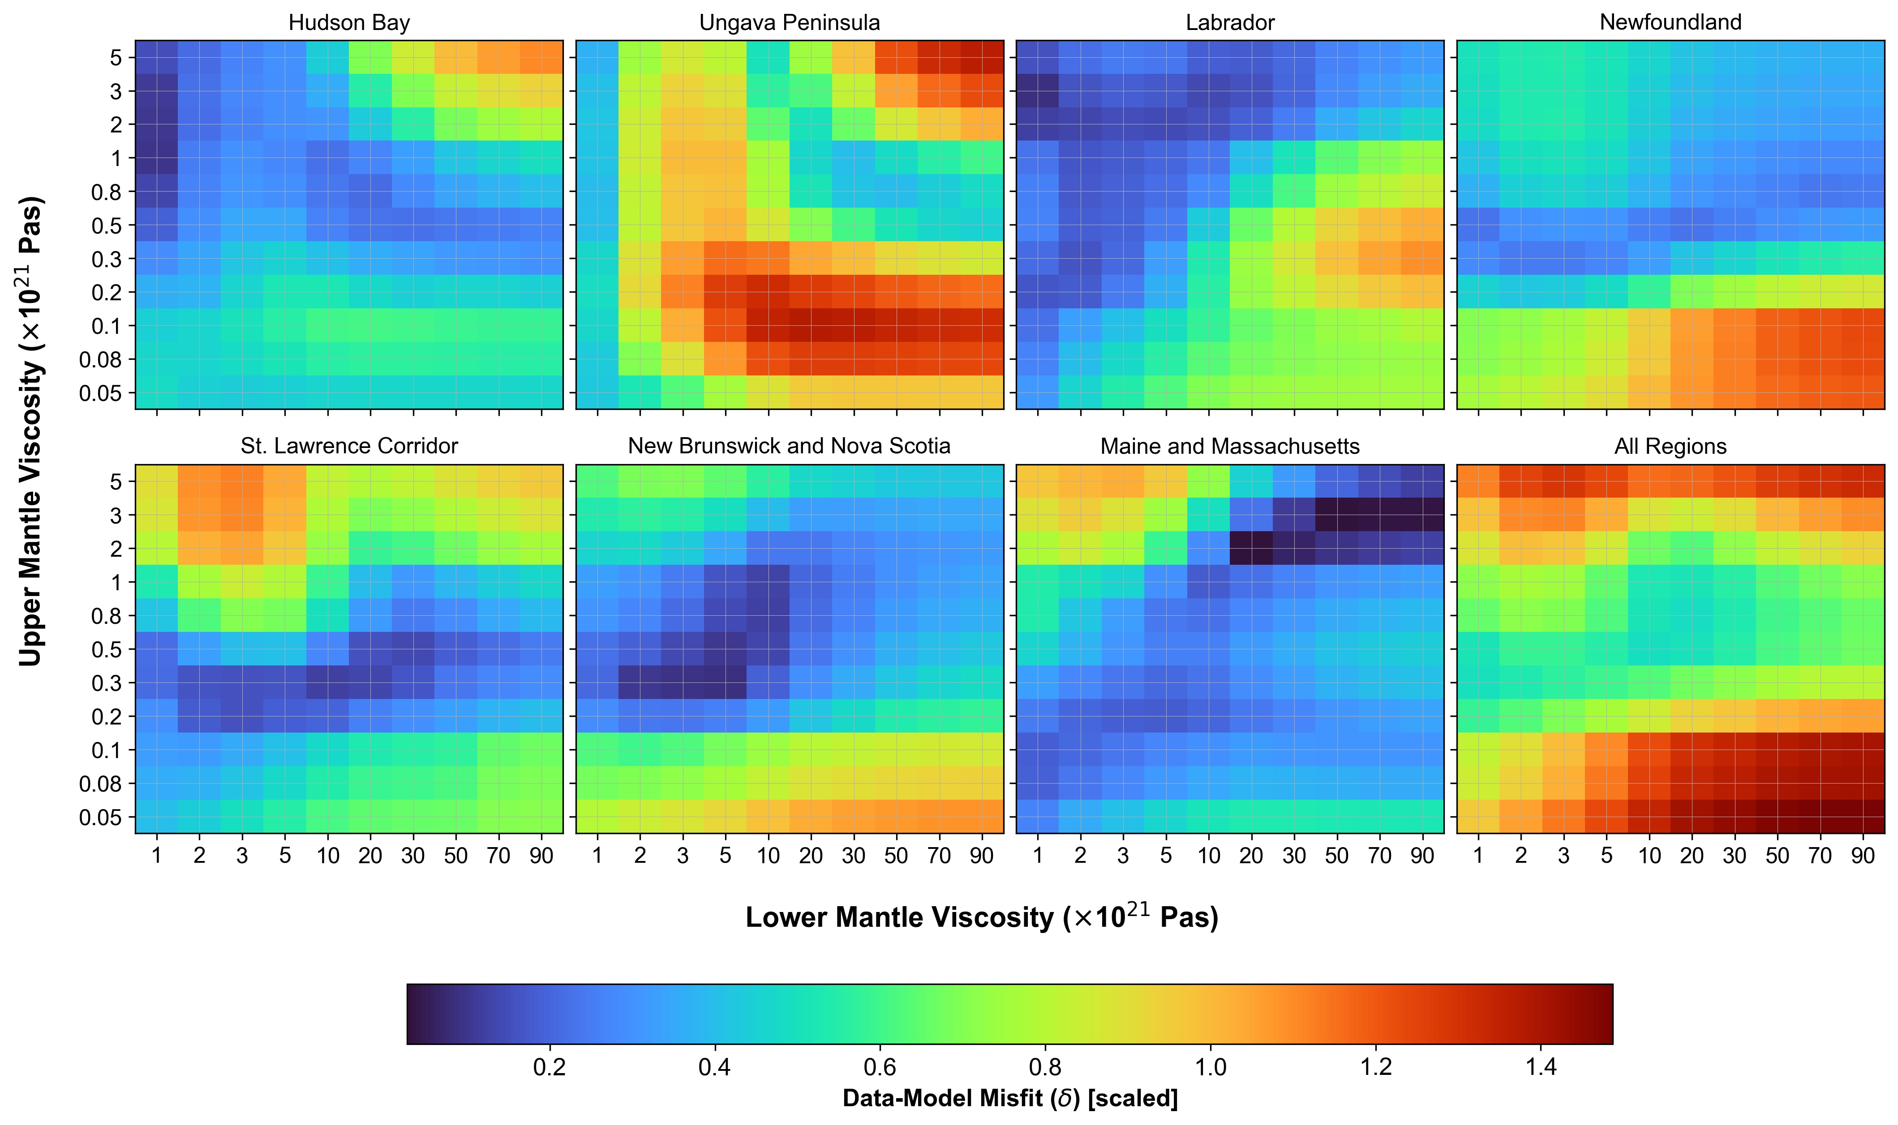
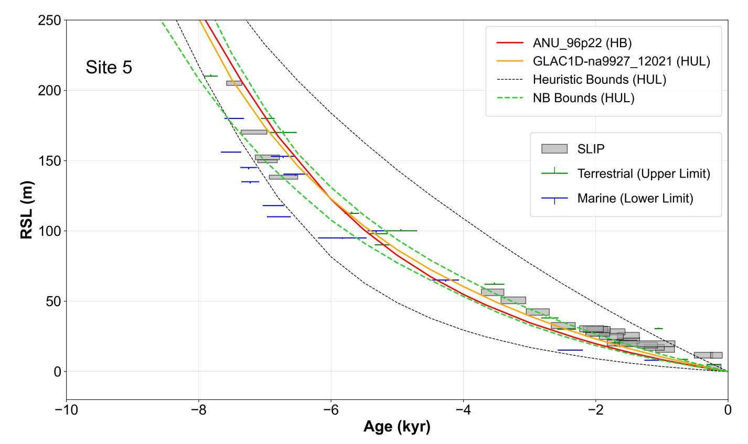
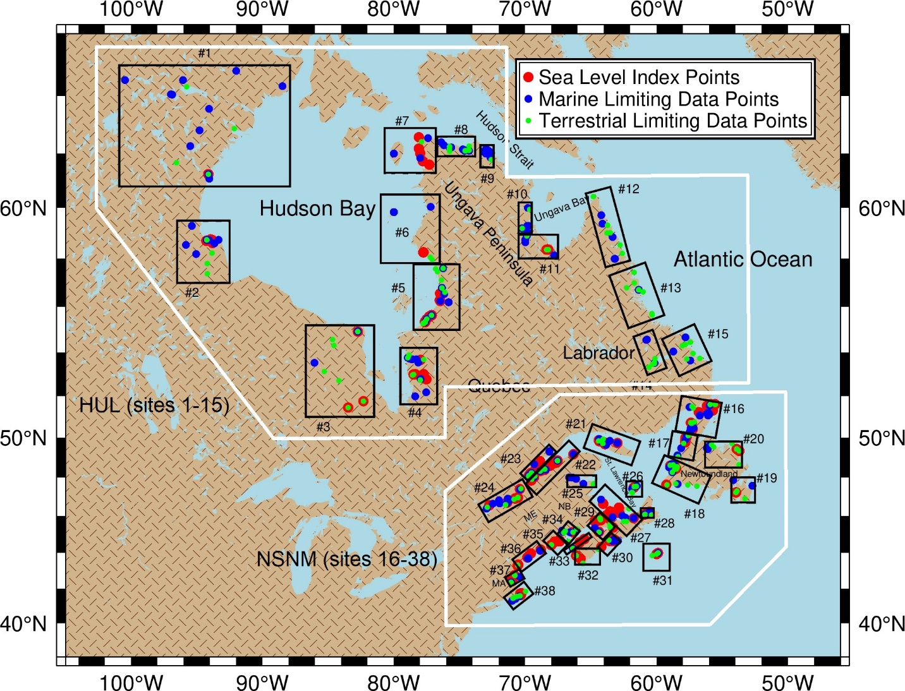
Supplementary – GIA modelling
Data-model misfit plots (δ) [GLAC1D-na9927, Lithospheric thickness = 96 km]
Partitioning into two larger sub-regions to account for the lateral viscosity structure (Parang et al., 2024)
Session CL4.17. Understanding and assessing sea level changes: from global to local, from past to future

Slide 4
Supplementary – Nuisance flooding
$$\hat{y}\left(t\right)=Z+ \sum_{n=1}^{N}{H_{n}f_{n}\left(t\right)cos⁡(\frac{π}{180}\left(ω_{n}t −g_{n}+ u_{n}\left(t\right)+V_{n}\right))}$$
(1) Harmonic analysis
On each year separately
For each year with at least 70% data completeness
(2) Least-squares fits of a linear trend plus a 18.6-year sinusoid
$$\hat{y}\left(t\right)=a+bt+csin\left(\frac{2π}{18.6}t\right)+dcos\left(\frac{2π}{18.6}t\right)$$
𝑦 ̂(𝑡)=𝑎+𝑏𝑡+𝑐𝑠𝑖𝑛(2𝜋/18.6 𝑡)+𝑑𝑐𝑜𝑠(2𝜋/18.6 𝑡)
Fitting performed separately for annual amplitude and phase lag
Applied separately for each tidal constituent (M2, N2, K1)
Estimation of secular rate of change (b)
Estimation of nodal modulations for amplitude (A_{m}) and phase lag (Pha_{m})
All with corresponding uncertainty
$A_{m}=\frac{\sqrt{c^{2}+d^{2}}}{a+bt_{mid}}×100$ (unitless, percent)
${Pha}_{m}=\sqrt{c^{2}+d^{2}}$ (in degrees)
$$t_{mid}= \frac{t_{min}+t_{max}}{2}$$
𝐴_𝑚=√(𝑐^2+𝑑^2 )/(𝑎+𝑏𝑡_𝑚𝑖𝑑 )×100 (unitless, percent)
〖𝑃ℎ𝑎〗_𝑚=√(𝑐^2+𝑑^2 ) (in degrees)
𝑡_𝑚𝑖𝑑= (𝑡_𝑚𝑖𝑛+𝑡_𝑚𝑎𝑥)/2
Based on M2, N2, and K1
Without nodal corrections
Estimation of annual amplitude and Greenwich phase lag with associated uncertainty
Final outputs
Session CL4.17. Understanding and assessing sea level changes: from global to local, from past to future

Slide 5
Supplementary – Nuisance flooding
Projections of nuisance flooding frequency for 2050, 2100, and 2150 CE
Estimation of the impact-based flood thresholds
Using the approach of Sweet et al. (2018) and results from the harmonic analysis
Regression relationship with the local tidal range
Minor (nuisance flooding) threshold ≈ 1.04 ⨯ GT + 0.50 + MLLW (in meters)
Temporal baseline from IPCC = 20 years (1995 – 2014)
Prediction of hourly tide levels from harmonic analysis results
Projected regional mean sea-level changes as input to the analysis
Accounting for secular changes in amplitude and phase lag for M2, N2, and K1
Minimizing the climate seasonality effects in SA and SSA using the FES2014 global tide model
Residuals between observed water levels and predicted tide levels (from all constituents, excluding SA and SSA)
Predicted tide levels based on SA and SSA from FES2014
Session CL4.17. Understanding and assessing sea level changes: from global to local, from past to future

Slide 6
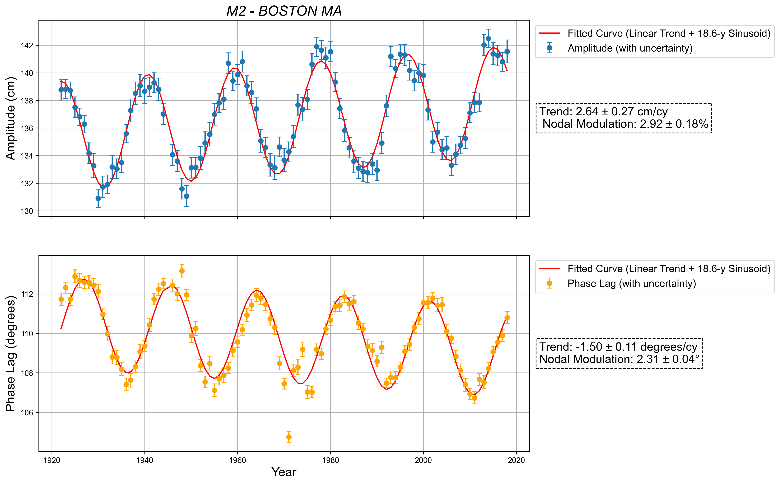
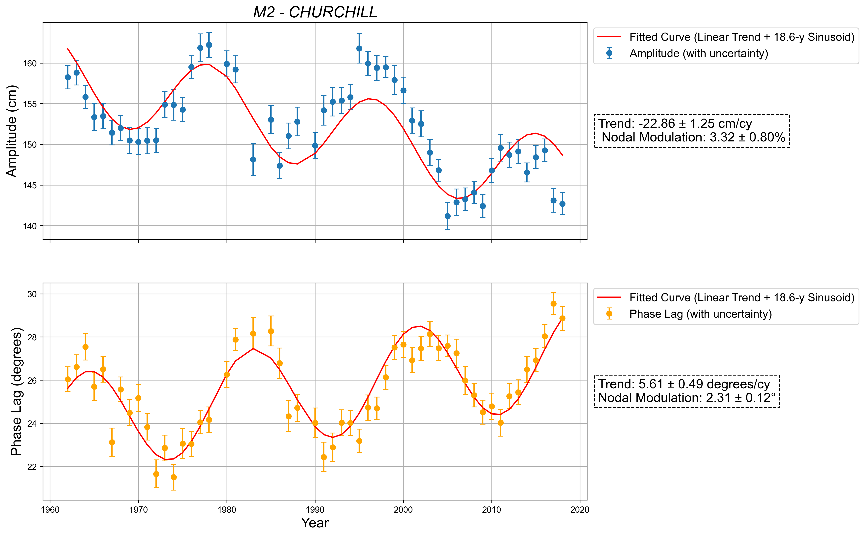
Supplementary – Nuisance flooding
Secular changes and local nodal modulations for M2 at two tide gauges (Boston and Churchill)
Larger secular changes at Churchill can be mainly associated with a higher rate of GIA-induced sea-level fall
Session CL4.17. Understanding and assessing sea level changes: from global to local, from past to future

Slide 7
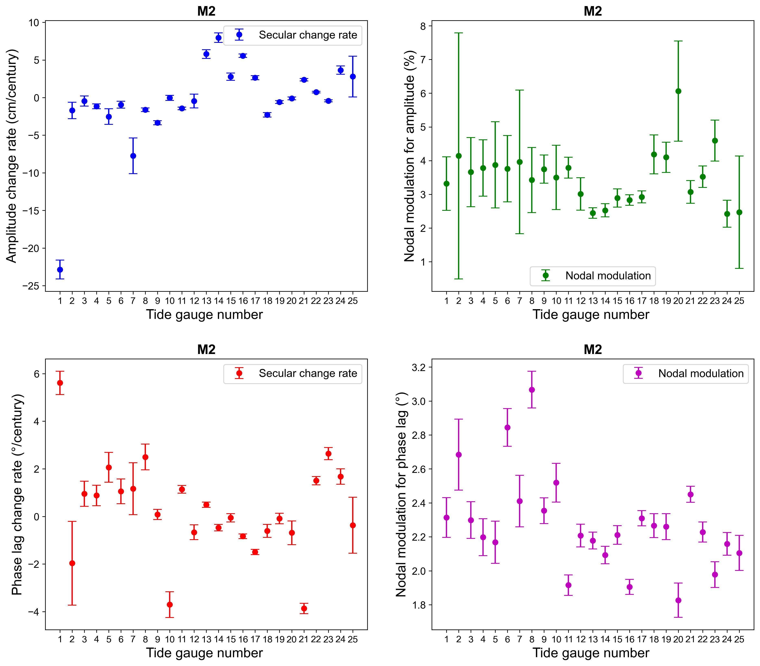
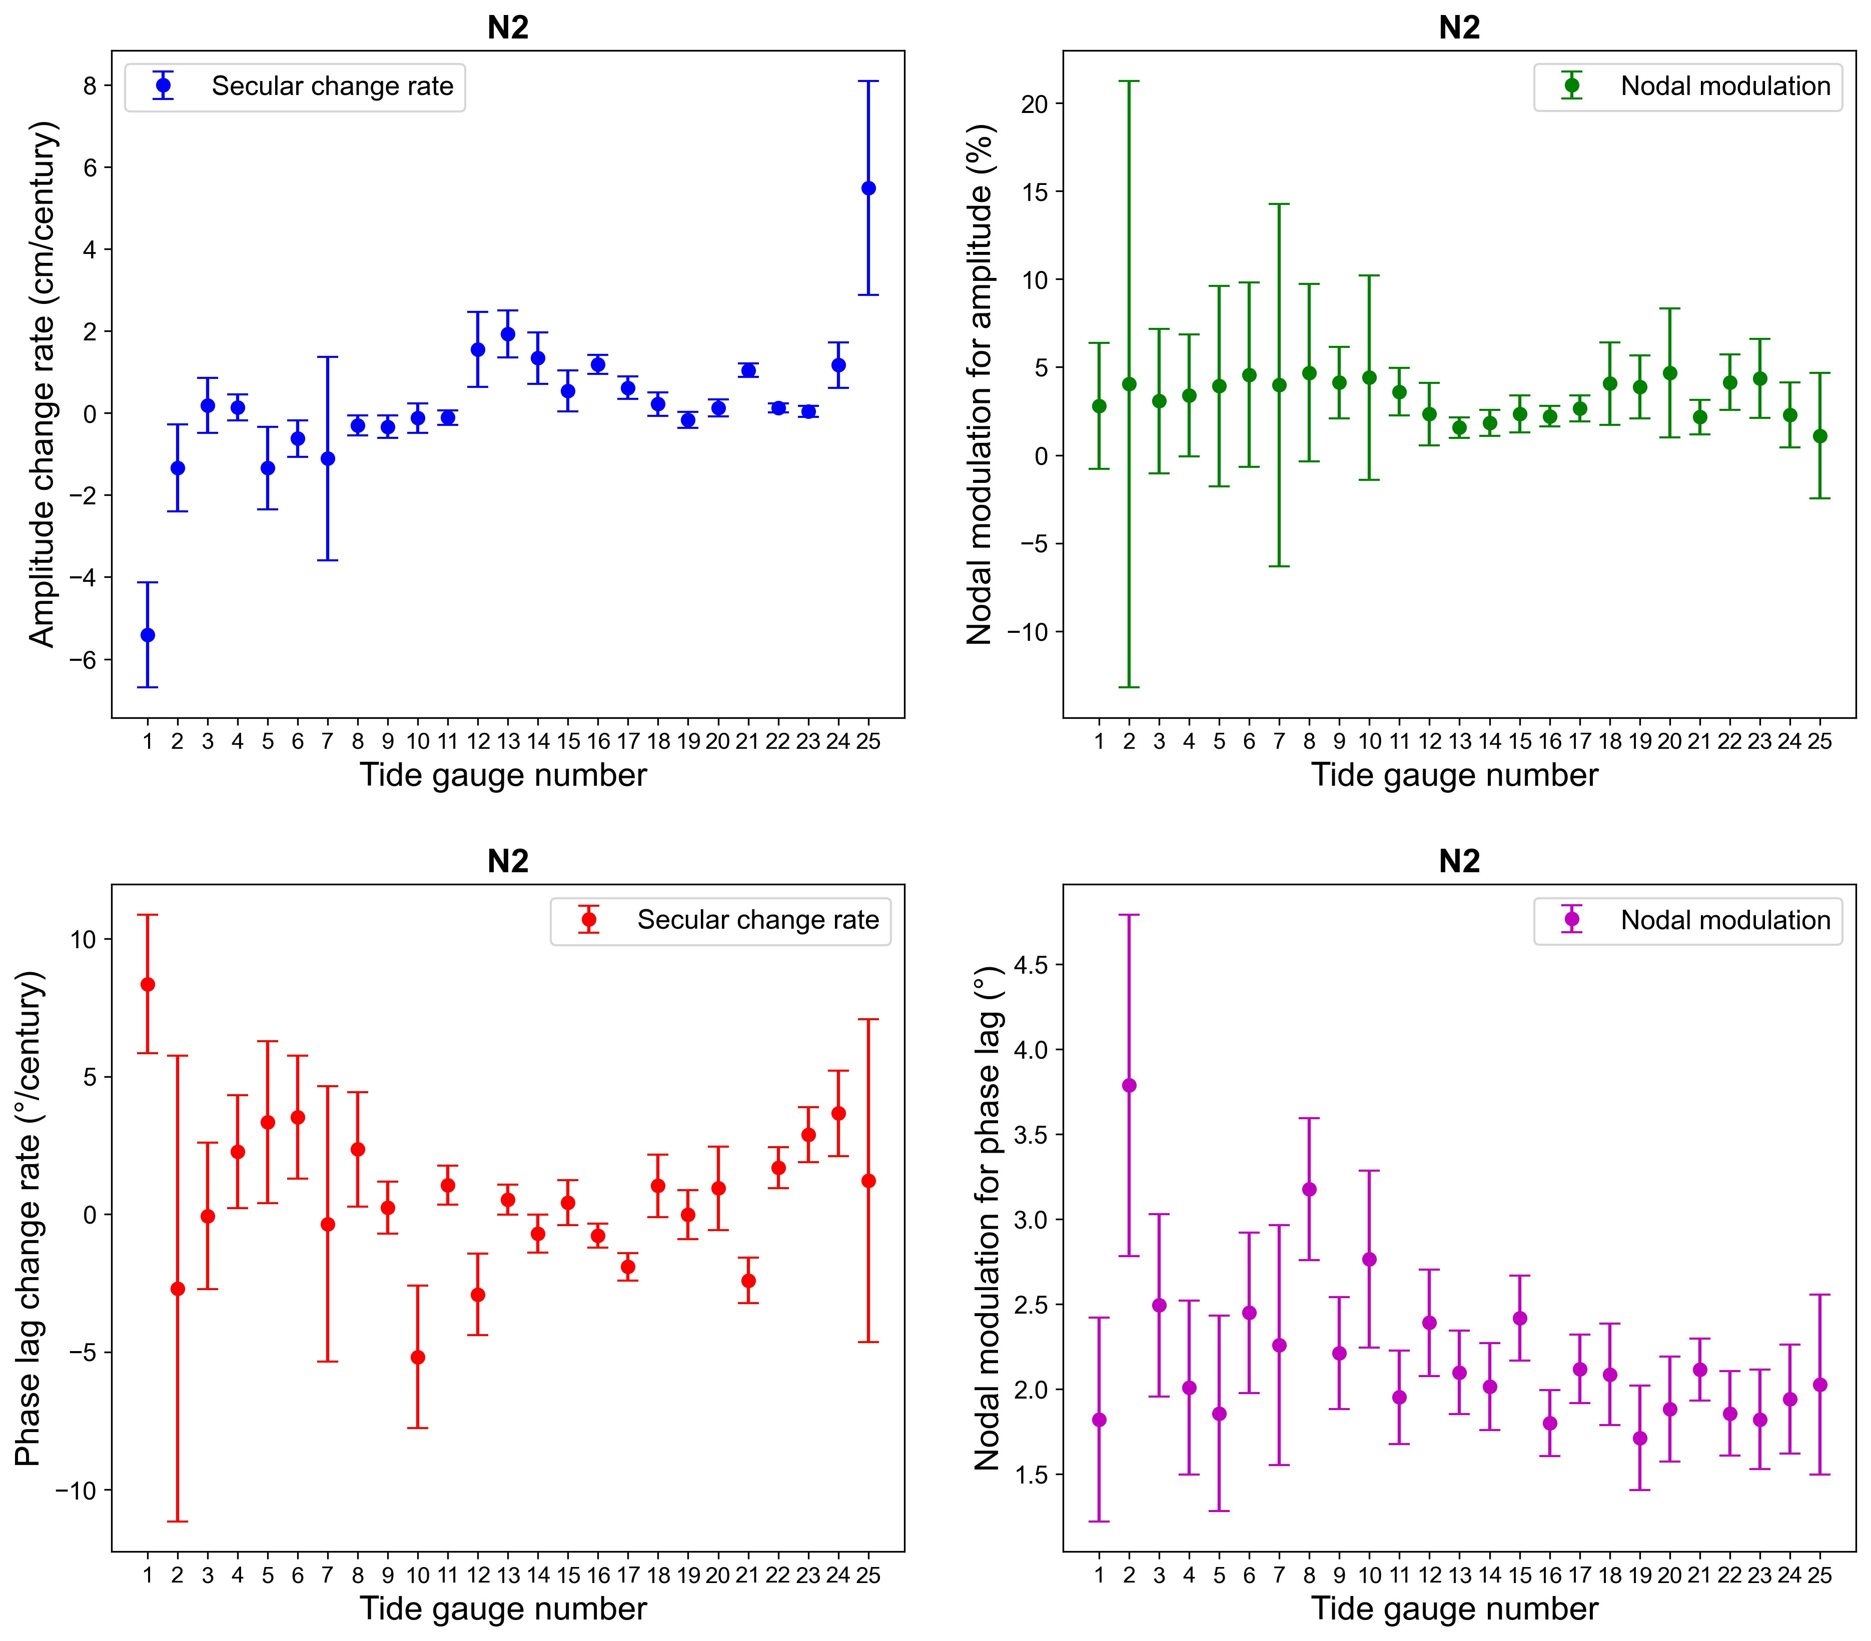
Supplementary – Nuisance flooding
Session CL4.17. Understanding and assessing sea level changes: from global to local, from past to future

Slide 8
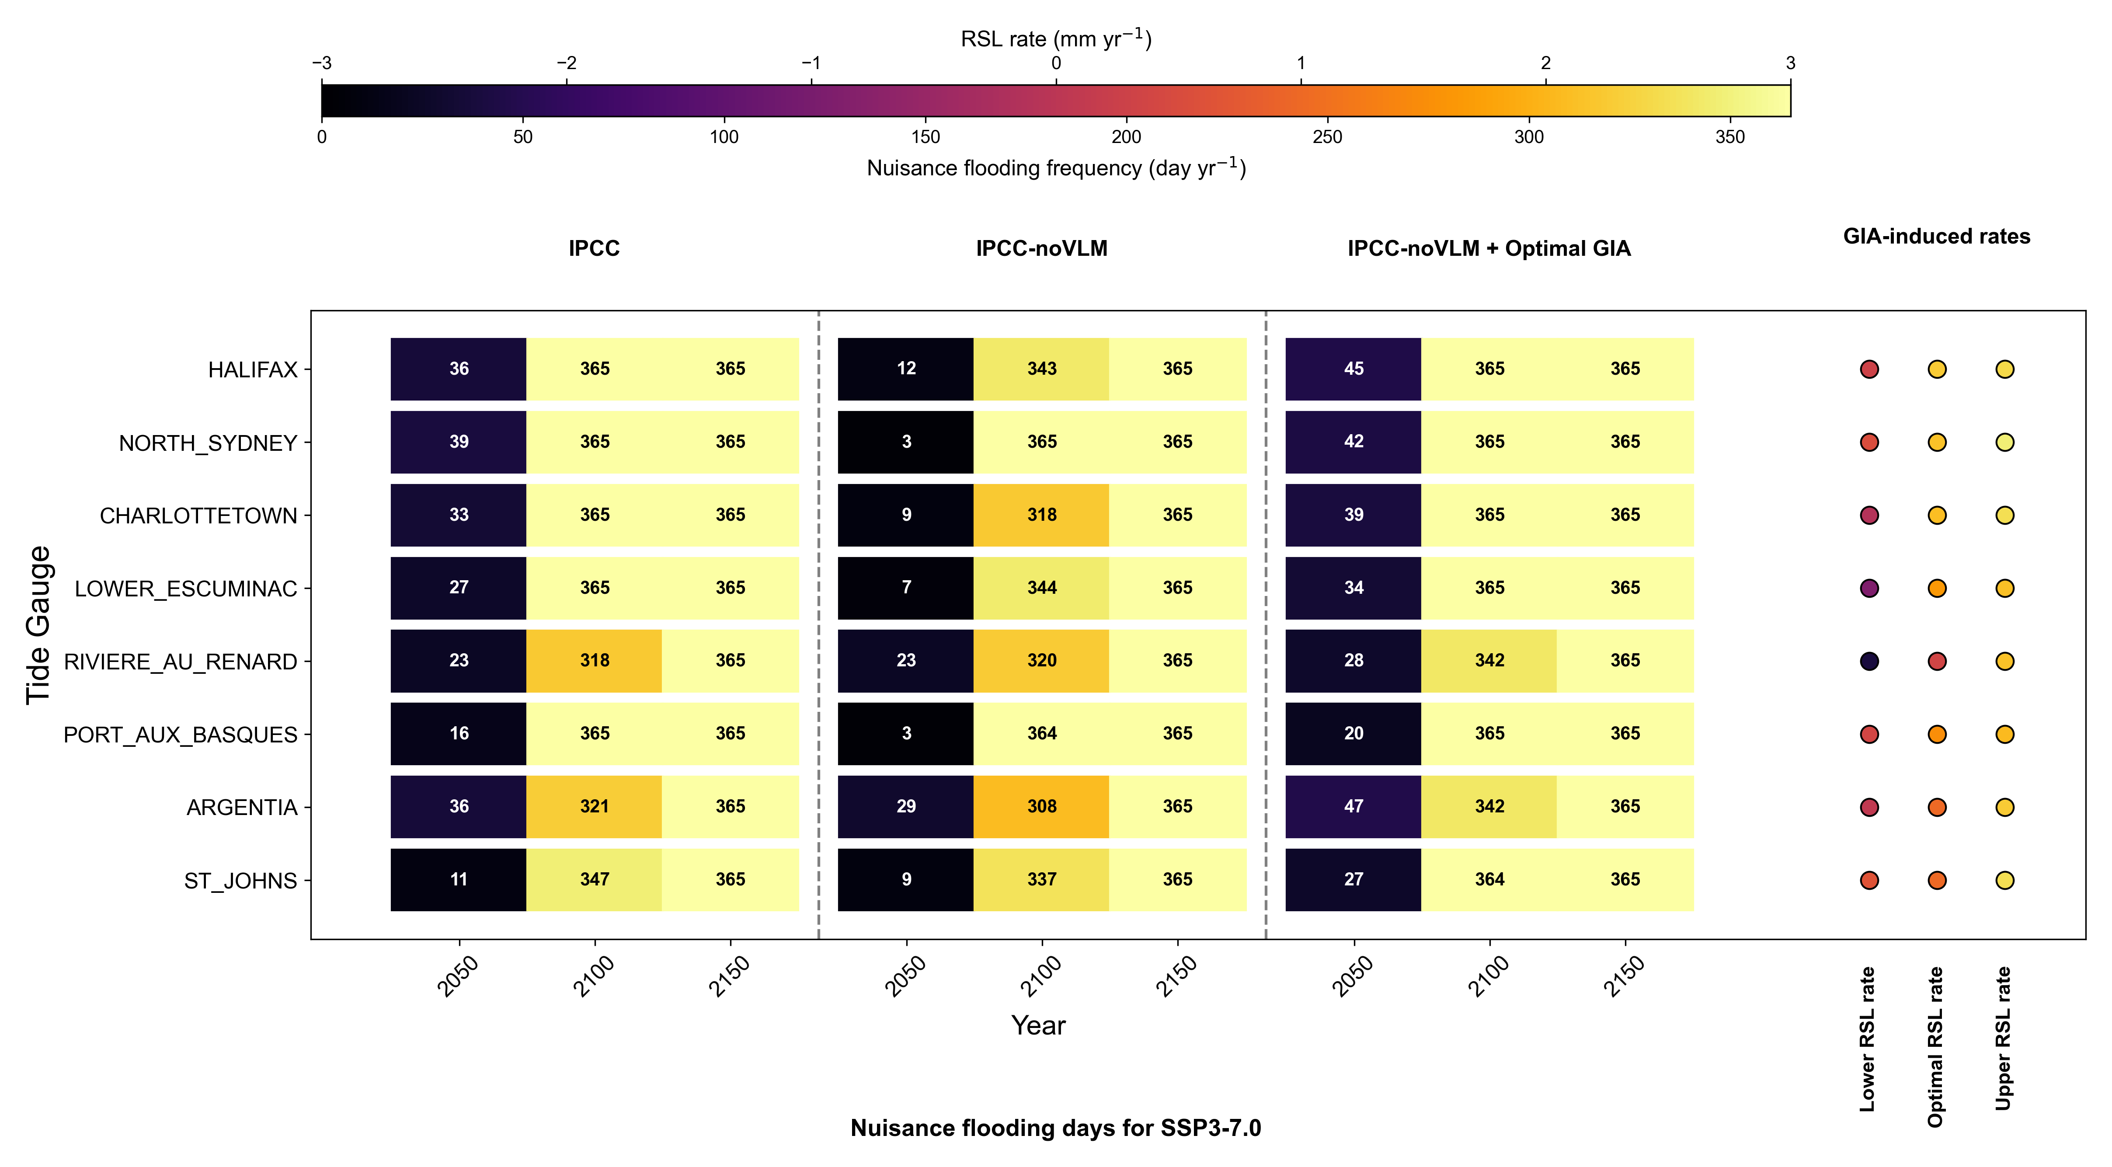
Supplementary – Results (other Canadian tide gauges)
Session CL4.17. Understanding and assessing sea level changes: from global to local, from past to future

Slide 9
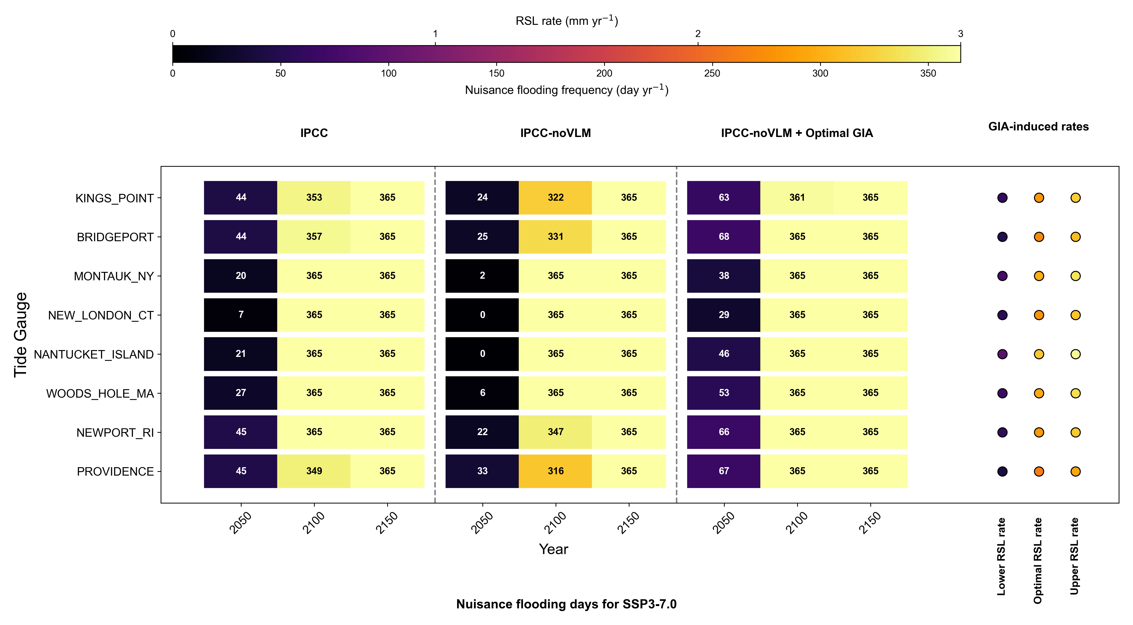
Supplementary – Results (other USA tide gauges)
Session CL4.17. Understanding and assessing sea level changes: from global to local, from past to future

